Slide 1
Use of CMAQ Model Output in Trace Gas Retrievals from Satellite and Airborne UV-Vis Spectrometers
Kenneth Pickering (NASA GSFC), Lok Lamsal (USRA, NASA GSFC), Christopher Loughner (UMD, NASA GSFC), Scott Janz (NASA GSFC), Nick Krotkov (NASA GSFC), Andy Weinheimer (NCAR), Alan Fried (University of Colorado)
14th Annual CMAS Conference
UNC Chapel Hill, North Carolina
October 5-7, 2015

Slide 2
Introduction
Spaceborne UV-Vis spectrometer observations of NO2 and HCHO to date have all been from polar-orbiting satellites (e.g., GOME, GOME-2, SCIAMACHY, OMI) once per day at relatively coarse resolution.
Global model profiles have been typically used in retrievals
Geostationary hourly fine-resolution (4-8 km) observations of trace gases will begin late in this decade.
Profiles used in geostationary retrievals will need to come from regional models and diurnal evolution of profile shape will become an important consideration.
Notes:
The main point that I am trying to make here is that TO DATE we have predominantly used remote sensing (RS) data in addition to air quality (AQ) data for exposure assessment. The AQ data have been our trusted friends, while the RS data have been kind of whacky and novel. I think we are NOW transitioning to a point where the RS data will be our trusted friends for this type of exposure assessment, and where the AQ data will be used to supplement/evaluate if/when available. Aerosol specific platforms will accelerate us in this direction.
Top left: RS data used to interpolate air quality measurements between zip codes. Among the first to take advantage of improved spatial coverage.
Bottom left: RS data used to evaluate a dispersion model designed to fill in data between 6 available monitors. Maybe note that Charles Ichoku was a collaborator on this project and that there is a lot of ongoing work in BC/Canada on this issue?
Top right: RS data used to estimate PM in the relative absence of air quality data. Required relaxation of cloud algorithm.
Bottom right: Extension and downscaling of Van Donkelaar approach to an area with dense AQ data.

Slide 3
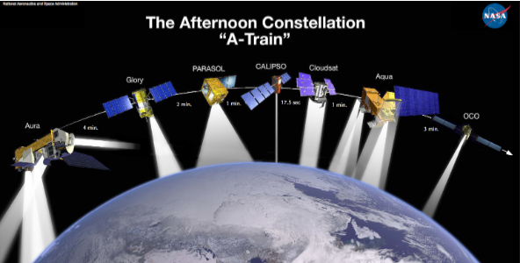
Aura/OMI
Ozone Monitoring
Instrument
Aura
2-dimensional CCD
Wavelength range: 270 – 500 nm
Sun-synchronous polar orbit;
Equator crossing at 1:30 PM LT
2600-km wide swath; horiz. res.
13 x 24 km at nadir
Global coverage every day
O₃, NO₂, SO₂, HCHO, aerosol,
BrO, OClO
wavelength
~ 580 pixels
~ 780 pixels
viewing angle
± 57 deg
flight direction
» 7 km/sec
13 km
(~2 sec flight))
2600 km
13 km x 24 km (binned & co-added)
Notes:
The main point that I am trying to make here is that TO DATE we have predominantly used remote sensing (RS) data in addition to air quality (AQ) data for exposure assessment. The AQ data have been our trusted friends, while the RS data have been kind of whacky and novel. I think we are NOW transitioning to a point where the RS data will be our trusted friends for this type of exposure assessment, and where the AQ data will be used to supplement/evaluate if/when available. Aerosol specific platforms will accelerate us in this direction.
Top left: RS data used to interpolate air quality measurements between zip codes. Among the first to take advantage of improved spatial coverage.
Bottom left: RS data used to evaluate a dispersion model designed to fill in data between 6 available monitors. Maybe note that Charles Ichoku was a collaborator on this project and that there is a lot of ongoing work in BC/Canada on this issue?
Top right: RS data used to estimate PM in the relative absence of air quality data. Required relaxation of cloud algorithm.
Bottom right: Extension and downscaling of Van Donkelaar approach to an area with dense AQ data.

Slide 4
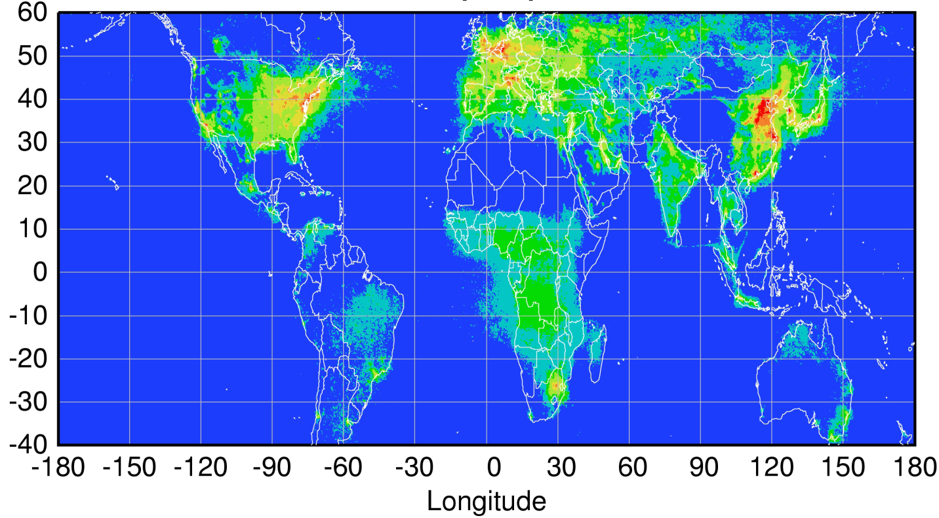
Upcoming Geostationary Missions
Sentinel-4
TEMPO
GEMS
Courtesy Jhoon Kim,
Andreas Richter
Notes:
The main point that I am trying to make here is that TO DATE we have predominantly used remote sensing (RS) data in addition to air quality (AQ) data for exposure assessment. The AQ data have been our trusted friends, while the RS data have been kind of whacky and novel. I think we are NOW transitioning to a point where the RS data will be our trusted friends for this type of exposure assessment, and where the AQ data will be used to supplement/evaluate if/when available. Aerosol specific platforms will accelerate us in this direction.
Top left: RS data used to interpolate air quality measurements between zip codes. Among the first to take advantage of improved spatial coverage.
Bottom left: RS data used to evaluate a dispersion model designed to fill in data between 6 available monitors. Maybe note that Charles Ichoku was a collaborator on this project and that there is a lot of ongoing work in BC/Canada on this issue?
Top right: RS data used to estimate PM in the relative absence of air quality data. Required relaxation of cloud algorithm.
Bottom right: Extension and downscaling of Van Donkelaar approach to an area with dense AQ data.

Slide 5
Retrieval Scheme for Tropospheric NO₂
1)Spectral fit
( e.g. DOAS)
NO₂ and T profiles
NO₂ SCD
Reflectivity
3)Strat-trop separation
AMF
Cloud fraction/pressure
2)RTM
Aerosols
Surface pressure
NO₂ tropospheric VCD
NO₂ stratospheric VCD
Viewing geometry
VCD = SCD/AMF

Slide 6
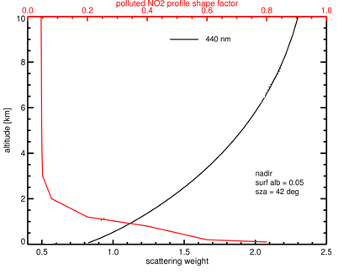
Relationship Between A-Priori NO₂ Profiles and NO₂ Retrievals
AMF: Air mass factor
Sw: Scattering weights
P_{i}: Partial column over model layers
S: slant columns
V: vertical columns

Slide 7
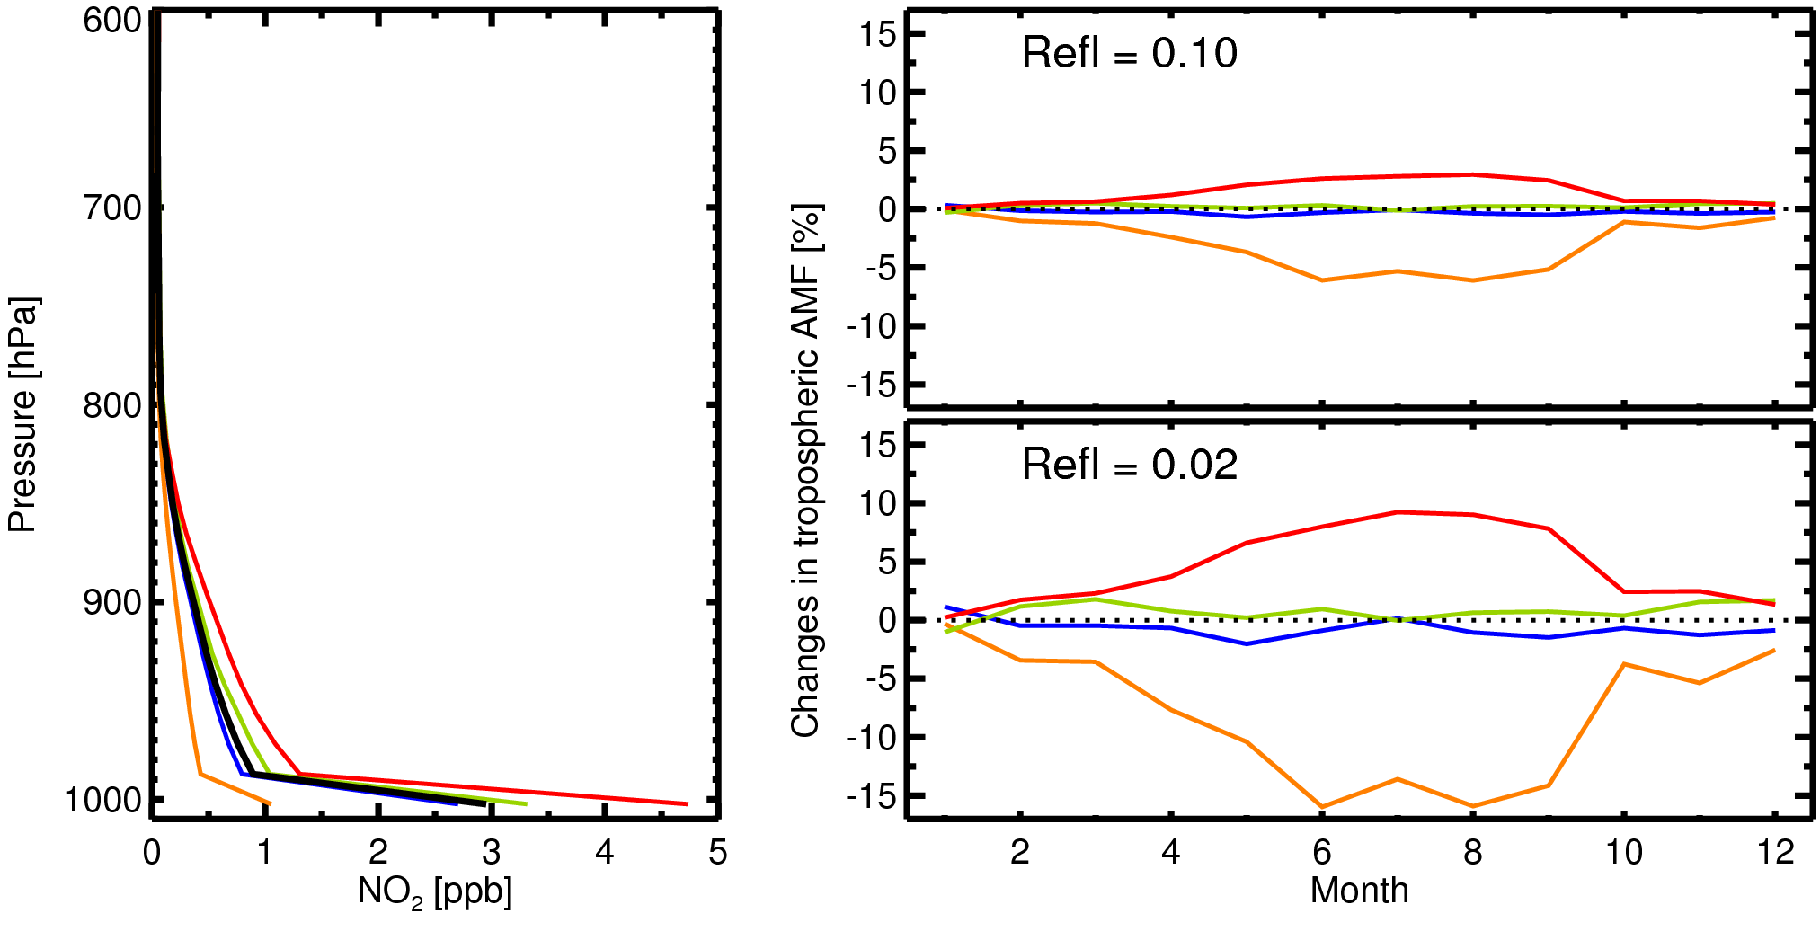
Sensitivity of AMF to A-Priori NO₂ Profiles: Spatial Resolution
A factor of 4 increase in resolution changes retrievals by up to 15% in some locations.
GMI, June, 2005
2.0°
sza=45, vza=30, raz=45
1x1.25°
2x2.5°
(AMF_{2x2.5} – AMF_{1x1.25})/AMF_{1x1.25}
Note: OMI operational algorithm will use monthly NO₂ profiles for each year from a high resolution (1°×1.25°) GMI global simulation with year-specific emissions.

Slide 8
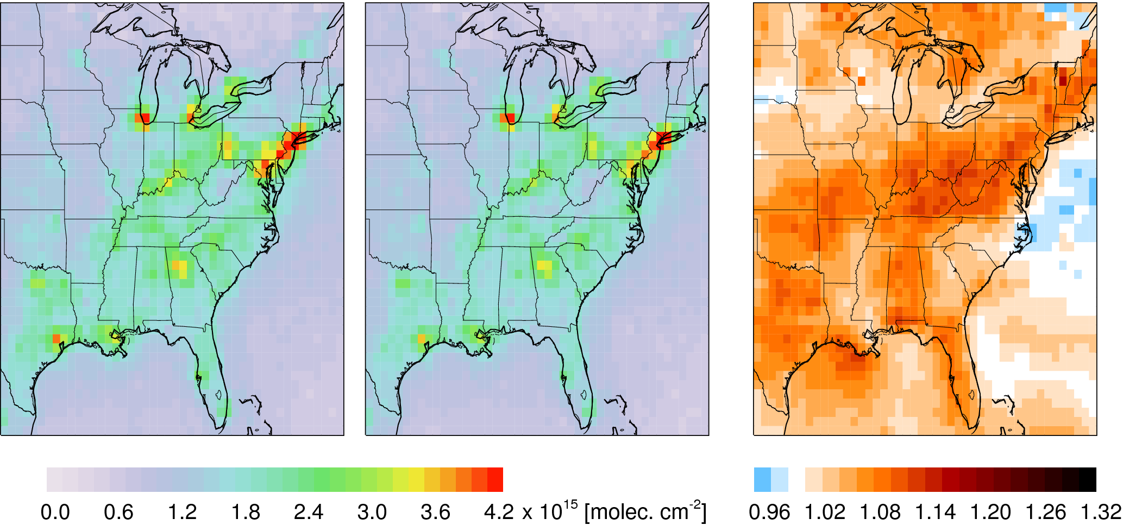
Sensitivity of AMF to A-Priori NO₂ Profiles:
Emission Inventory
A
B
A / B
OMI NO₂ (2010 July)
OMI NO₂ (2010 July)
Retrievals w/ 2005 profiles
Retrievals w/ 2010 profiles
Profiles based on outdated emissions can introduce significant retrieval errors – overestimation where emissions have reduced and underestimation where emissions have increased.

Slide 9
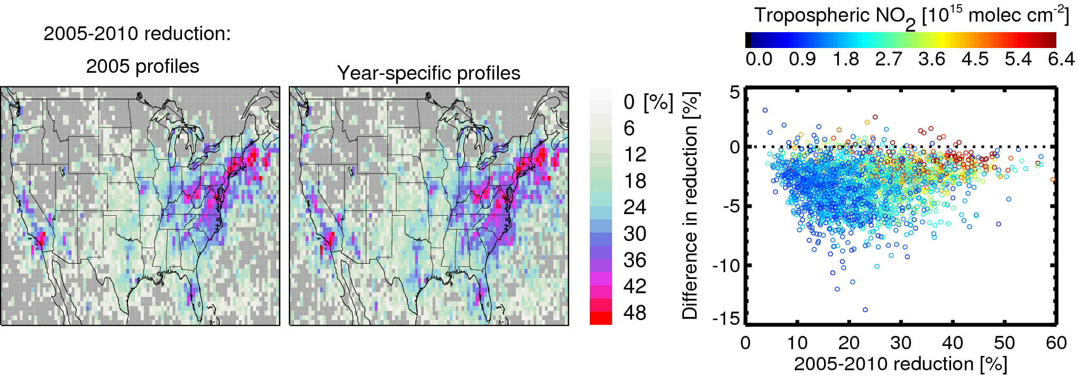
Sensitivity of AMF to A-Priori NO₂ Profiles:
Improvement in Accuracy of Estimated Trends
If profiles used in retrievals are based on outdated emissions, they could affect trends by 1-2%/year (e.g. over USA).
Lamsal et al., 2015 (Atmos. Env)

Slide 10
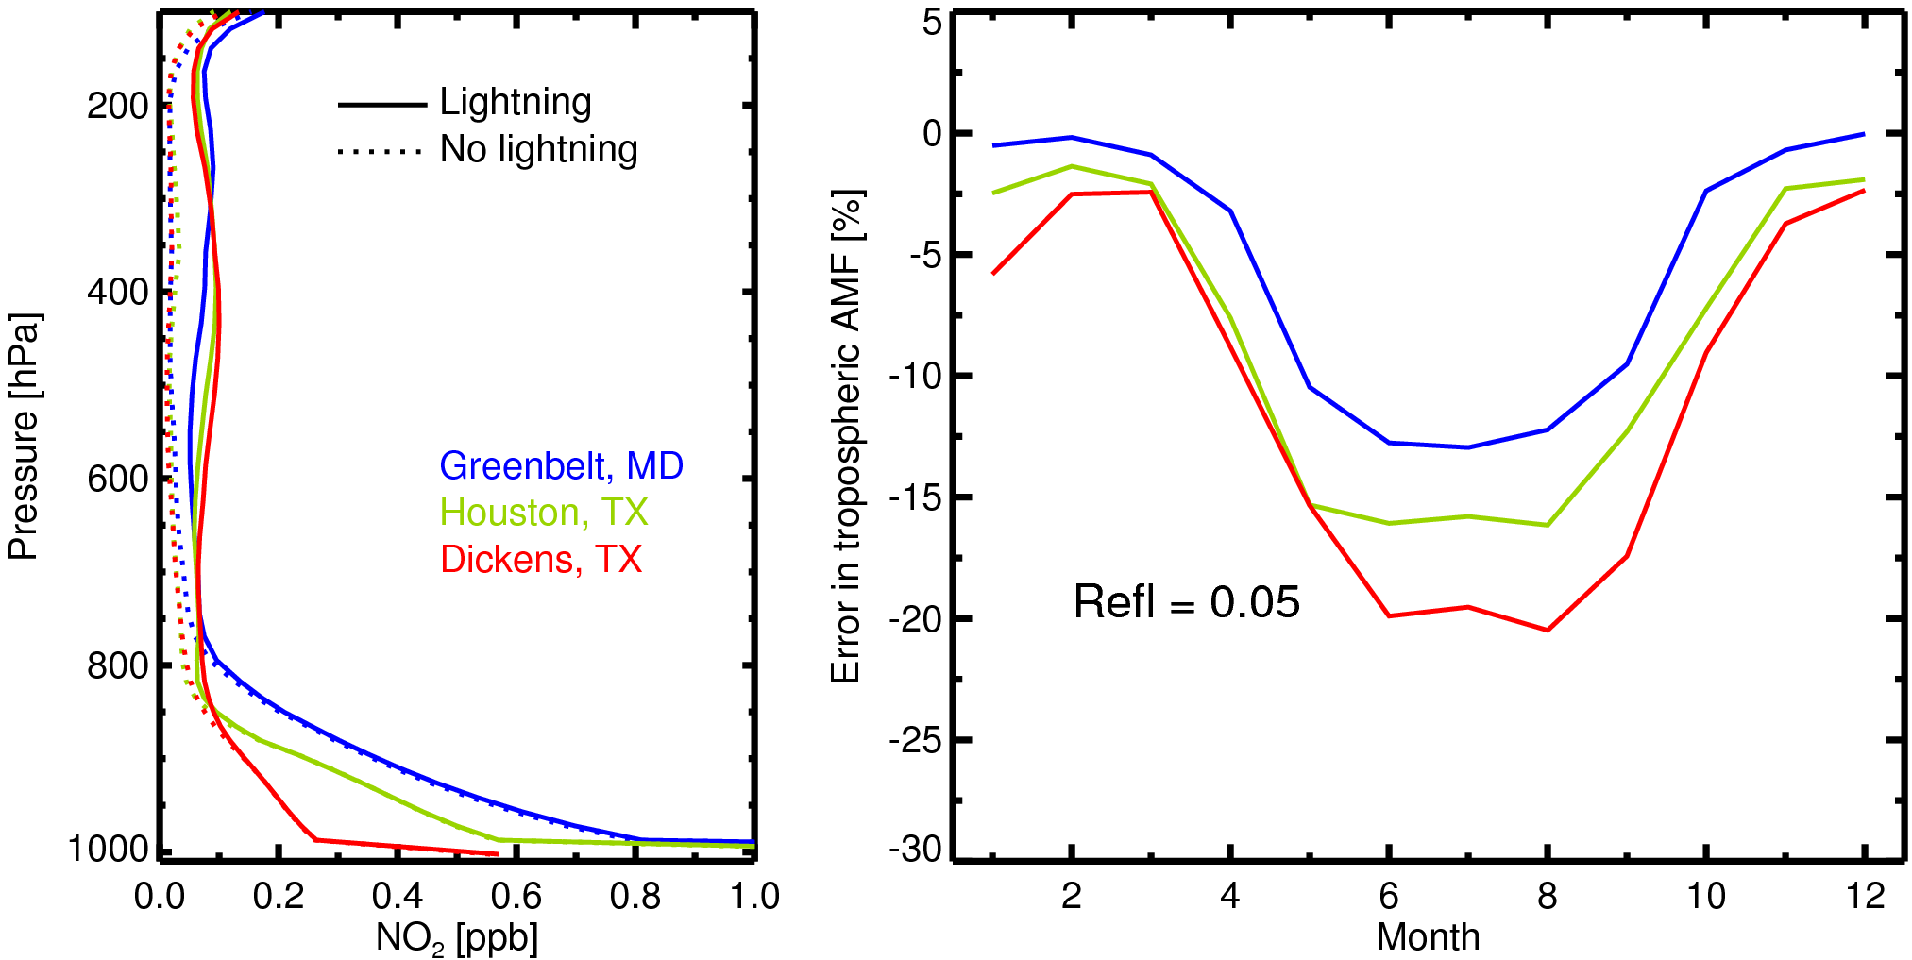
Sensitivity of AMF to A-Priori NO₂ Profiles: Lightning NO_{x}
Some users recalculate AMF using high-resolution regional model profiles that may not include lightning NO_{x} emissions.What errors might they introduce in the data they generate?
sza=45, vza=30, raz=45
GMI simulation for June, 2005
(AMF_{NoL}– AMF_{L})/AMF_{L}
Neglecting lightning NO_{x} changes profiles, AMFs, and therefore VCDs

Slide 11
High Resolution CMAQ Simulations to Study Retrieval Sensitivity to Diurnal Changes in NO₂ Profiles
Three CMAQ simulations: Model set up
Horizontal resolution | 4 km x 4 km
Vertical levels | 45 (surface-100 hPa)
Chemical mechanism | CB05
Aerosols | AE5
Dry deposition | M3DRY
Vertical diffusion | ACM2
Boundary condition | CMAQ; 12 km x 12 km
Biogenic emissions | Calculated within CMAQ with BEIS
Biomass burn. emissions | FINNv1
Lightning emissions | Calculated within CMAQ (Allen et al., 2012)
Anthropogenic emissions | NEI-2005 projected to 2012
 | Simulation 1 | Simulation 2 | Simulation 3
Mobile sources | Base | 50% reduction | 50% reduction
WRF PBL scheme | ACM2 | ACM2 | YSU

Slide 12
Evaluation of Modeled NO₂ Profiles: Methods
Location: Padonia, Maryland (DISCOVER-AQ)
Observation period: 3-4 spirals/day for 14 days in July 2011 (Hours covered 6 AM – 5 PM, local time)
NO₂ observations:
Aircraft (P3B) measurements (300 m - ~4 km) NCAR data
Surface measurements by photolytic converter instrument
Spatial resolution comparable between model (4x4km) and spiral (radius ~5km)
Observed PBL heights: Estimation based on temperature, water vapor, O₃ mixing ratios, and RH (Donald Lenschow)
Collocation and sampling:
Model and surface measurements sampled for the days and time of aircraft spirals
Spiral data sampled to model vertical grids

Slide 13
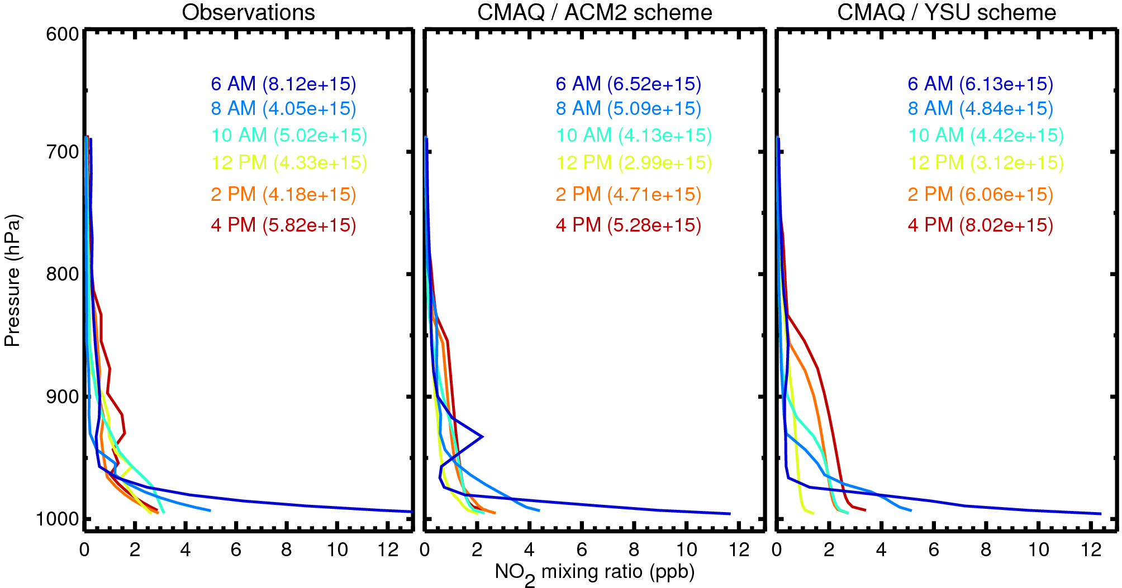
Diurnal Changes in NO₂ Vertical Distribution
Padonia, MD (July)
Models capture overall diurnal variation, but some differences related to emissions, PBL height, vertical mixing are evident.

Slide 14
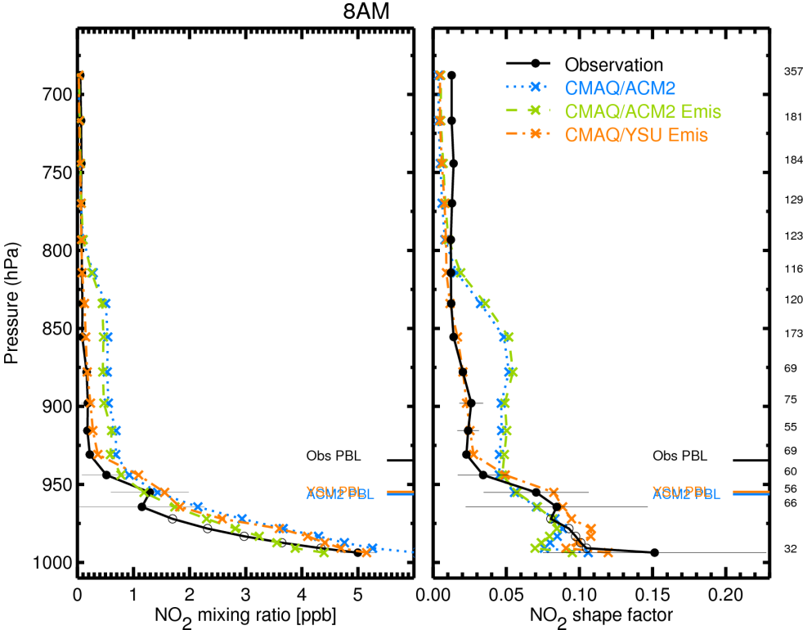
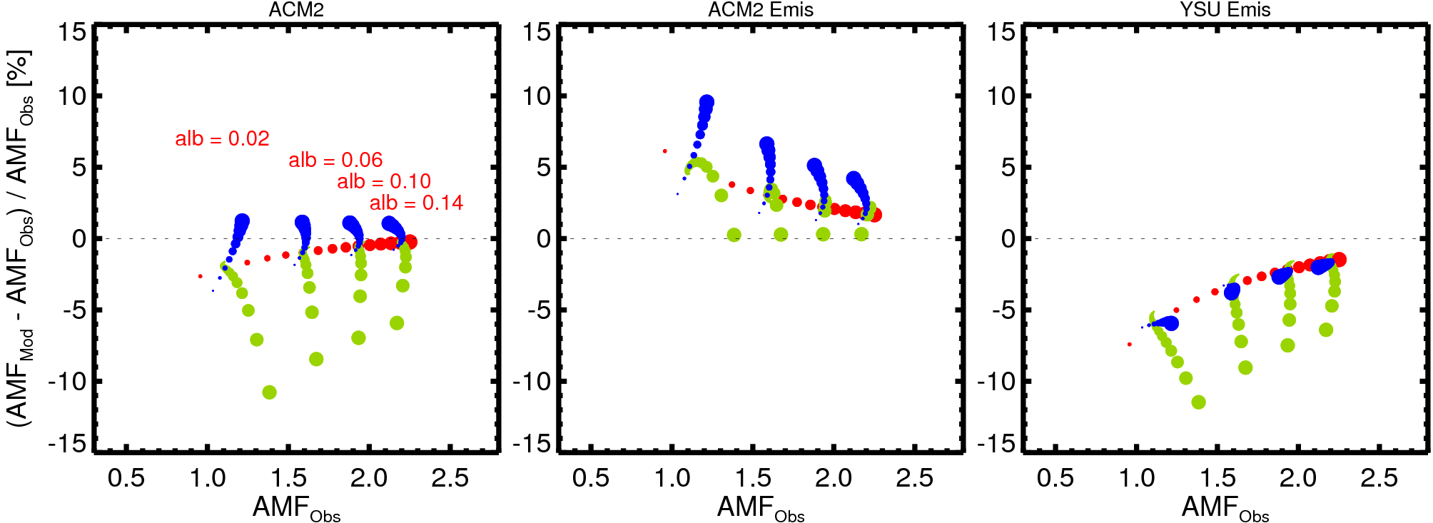
NO2 Profiles and Retrieval Errors (8 AM)
Surface reflectivities: 0.1 to 0.15 at 0.01 steps
Solar zenith angles: 10° to 85° at 5° steps
Aerosol optical depths: 0.1 to 0.9 at 0.1 steps

Slide 15
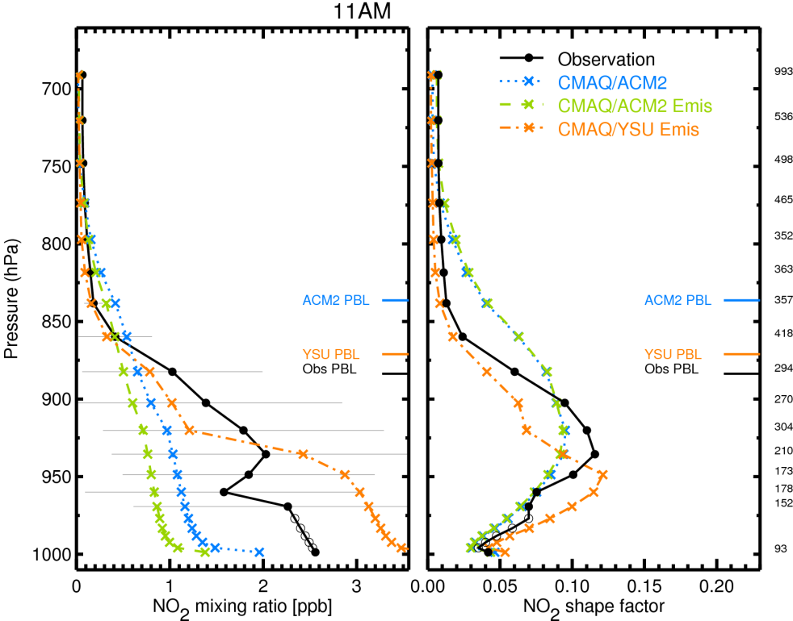
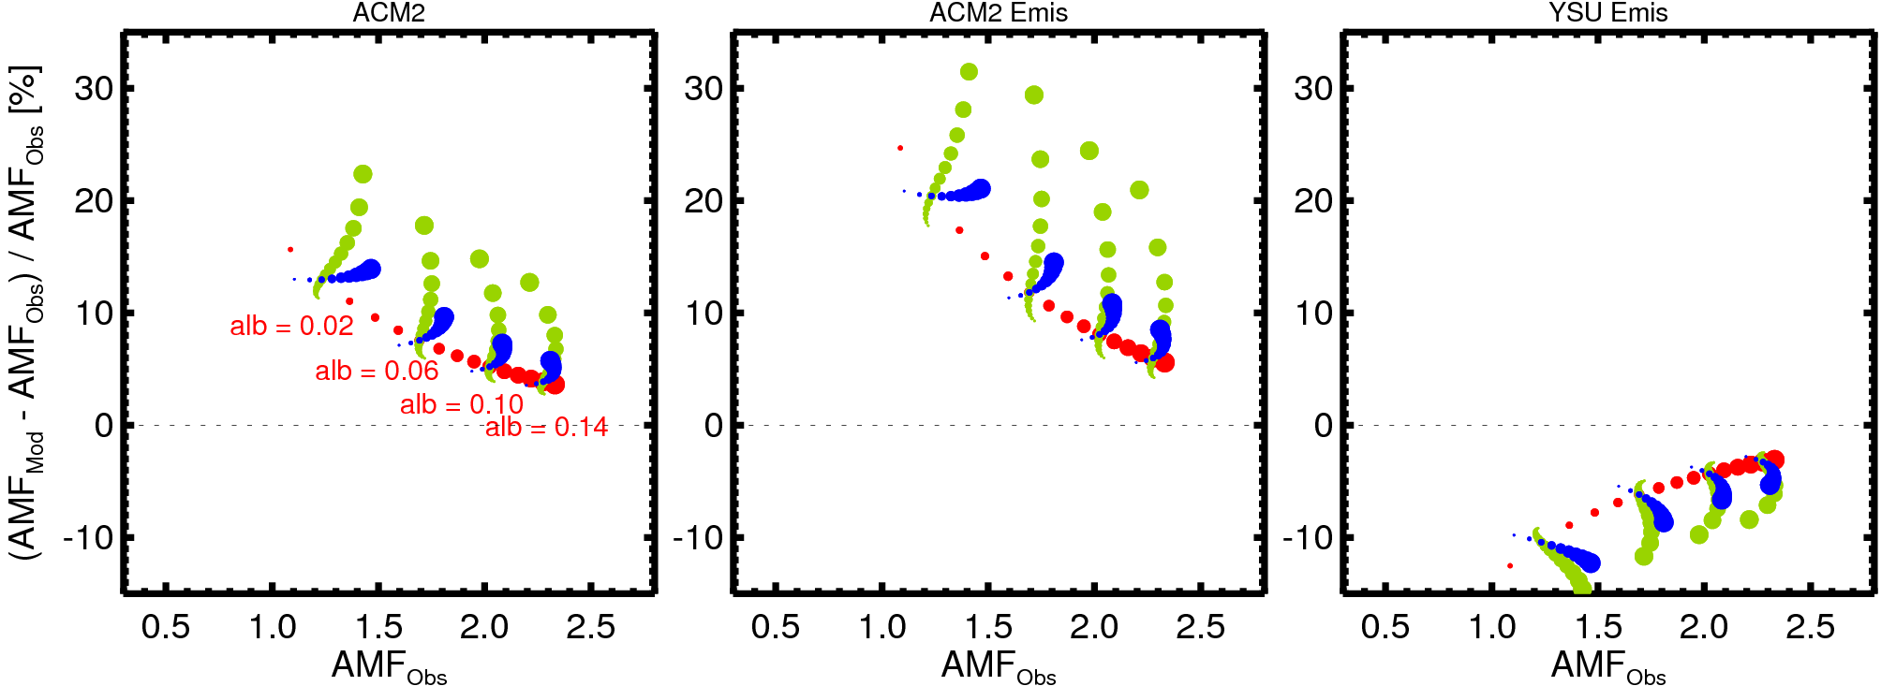
NO2 Profiles and Retrieval Errors (11 AM)

Slide 16
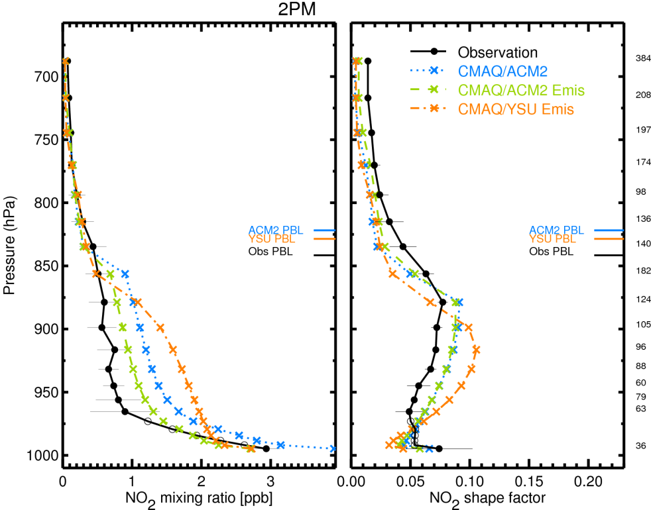
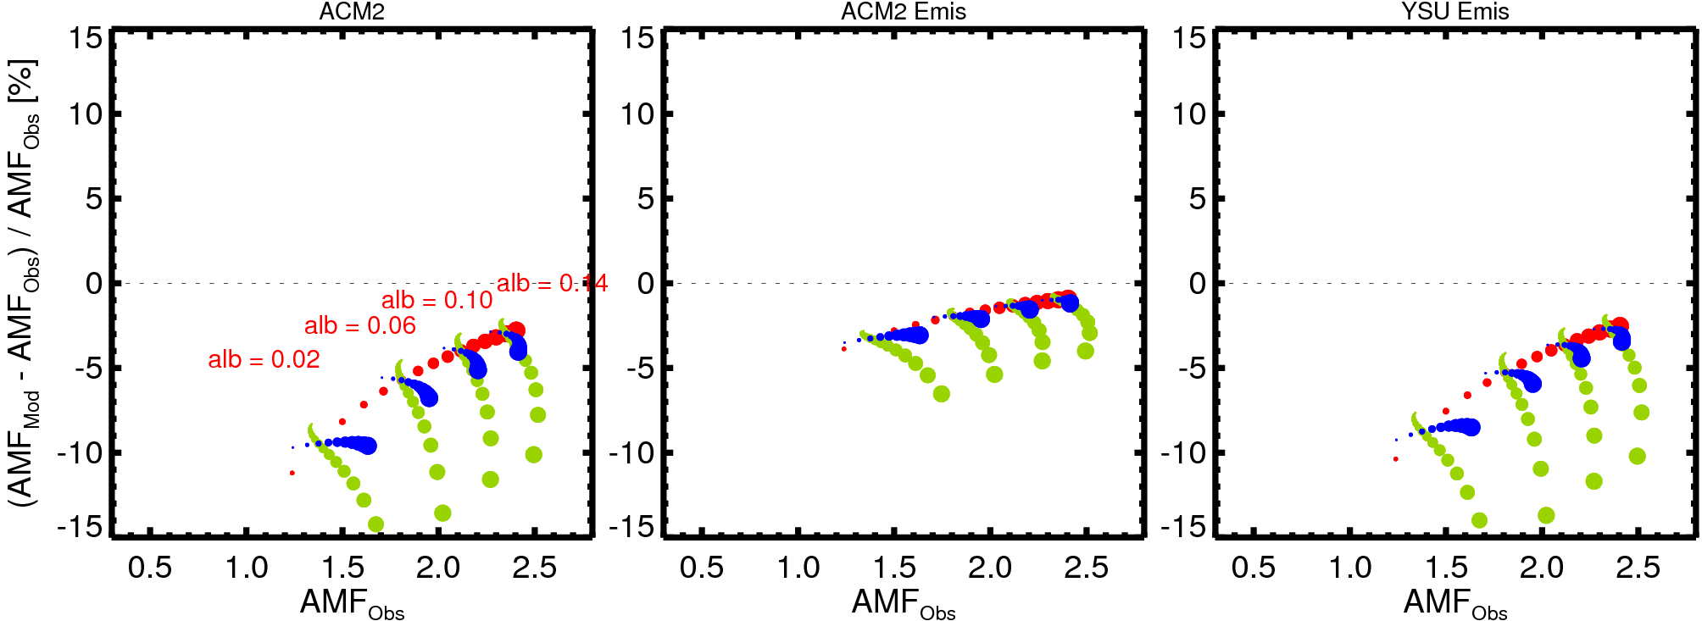
NO2 Profiles and Retrieval Errors (2 PM)

Slide 17
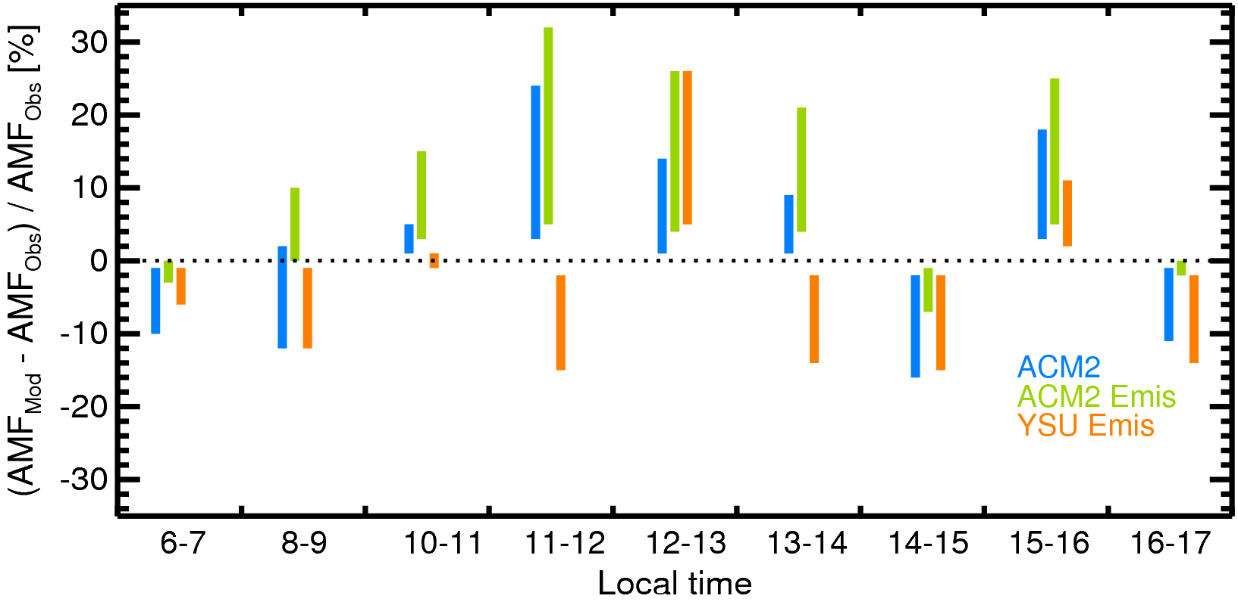
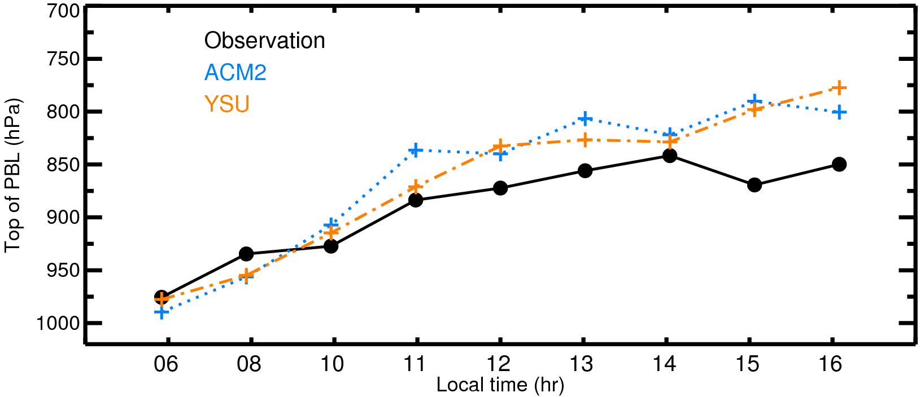
Model Need to Well Represent PBL Mixing to Minimize Errors from NO₂ Profiles
PBL scheme alone can cause different AMF errors
Better performance for certain hours for both ACM2 and YSU
Diurnal pattern in AMF errors for ACM2
We need model that well represents PBL mixing and emissions to minimize errors in retrievals

Slide 18
Summary
1. Model-derived NO₂ profiles assumed in satellite retrievals can be significant sources of retrievals errors.
2. Spatial resolution of model NO₂ profiles used in retrievals is important.
3. Emission errors can have a significant impact on NO₂ profile shapes and consequently on NO₂ retrievals.
3. Systematic errors in diurnal variation of PBL heights and vertical mixing can introduce diurnally varying retrieval errors – especially for geostationary satellite and aircraft remote sensing observations
Notes:
The main point that I am trying to make here is that TO DATE we have predominantly used remote sensing (RS) data in addition to air quality (AQ) data for exposure assessment. The AQ data have been our trusted friends, while the RS data have been kind of whacky and novel. I think we are NOW transitioning to a point where the RS data will be our trusted friends for this type of exposure assessment, and where the AQ data will be used to supplement/evaluate if/when available. Aerosol specific platforms will accelerate us in this direction.
Top left: RS data used to interpolate air quality measurements between zip codes. Among the first to take advantage of improved spatial coverage.
Bottom left: RS data used to evaluate a dispersion model designed to fill in data between 6 available monitors. Maybe note that Charles Ichoku was a collaborator on this project and that there is a lot of ongoing work in BC/Canada on this issue?
Top right: RS data used to estimate PM in the relative absence of air quality data. Required relaxation of cloud algorithm.
Bottom right: Extension and downscaling of Van Donkelaar approach to an area with dense AQ data.

