Slide 1



Expected Ozone Benefits from EGU NOx Reductions
Tim Vinciguerra,
Emily Bull, Timothy Canty, Hao He, Eric Zalewsky,
Michael Woodman, Sheryl Ehrman, Russell Dickerson

Slide 2
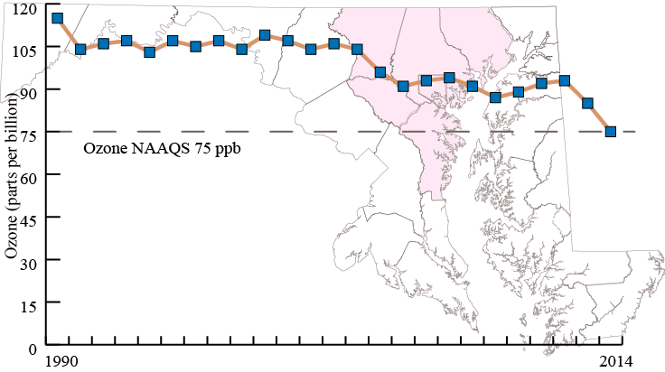
Maryland Ozone
75ppb 8-hour ozone NAAQS
Baltimore - Moderate non-attainment area
  Moderate NAA on east coast, submitting SIP
  Also DC and Philadelphia marginal NAAs
Image courtesy of Tad Aburn, MDE

Slide 3
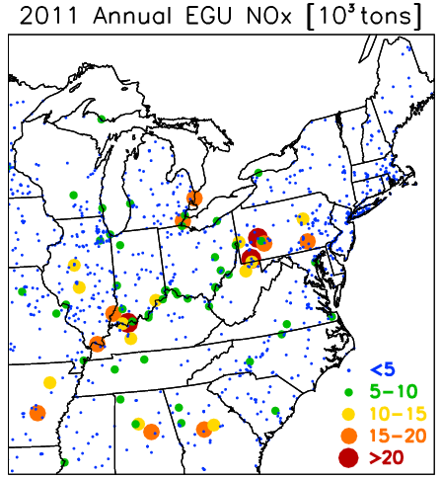
EGU Controls
Potential for high ozone on hot summer days
Electric Generating Units (EGUs) heavily run
  More NOx emitted,
  risk of ozone formation
Maryland affected by
local and upwind units

Slide 4
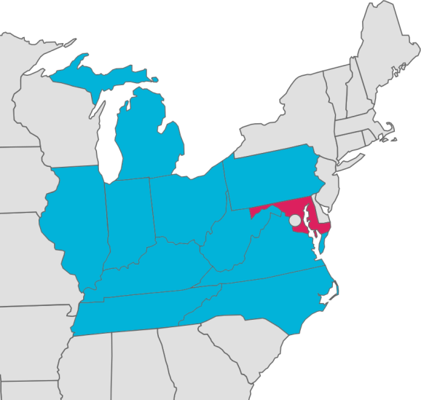
July EGU NOx Reductions
2011 Baseline, 2018 Future Year
July 2018 Sensitivity Runs
  Representative of ozone season
Evaluate ozone season CAMD data from 2005-2012
Adjust 2018 EGU NOx from IPM 5.13 results for SCR/SNCR units in MD and surrounding states

Slide 5
July EGU NOx Reduction Scenarios
Scenario 3A
  Reduce 2018 EGUs to match best NOx rates seen in 2005-2012
Scenario 3B
  Increase EGU NOx to 2005-2012 worst NOx rates
Scenario 3C
  Increase EGU NOx to 2011 NOx rates
Scenario 3D
  3A EGU and model uncontrolled units in neighboring states with SCR
Scenario A4
  3A EGU and NOx emissions capped at MD EGUs

Slide 6
Emissions and Models Used
2011/2018 Emissions
  Surface 2011 EPA version 1 (ec platform)
  Surface 2018 EPA version 1 future case (ed platform)
  Added point sources to EPA surface emissions
SMOKE v3.1 at 12km resolution for Eastern US
CMAQ v5.0.2 with CB05 mechanism

Slide 7
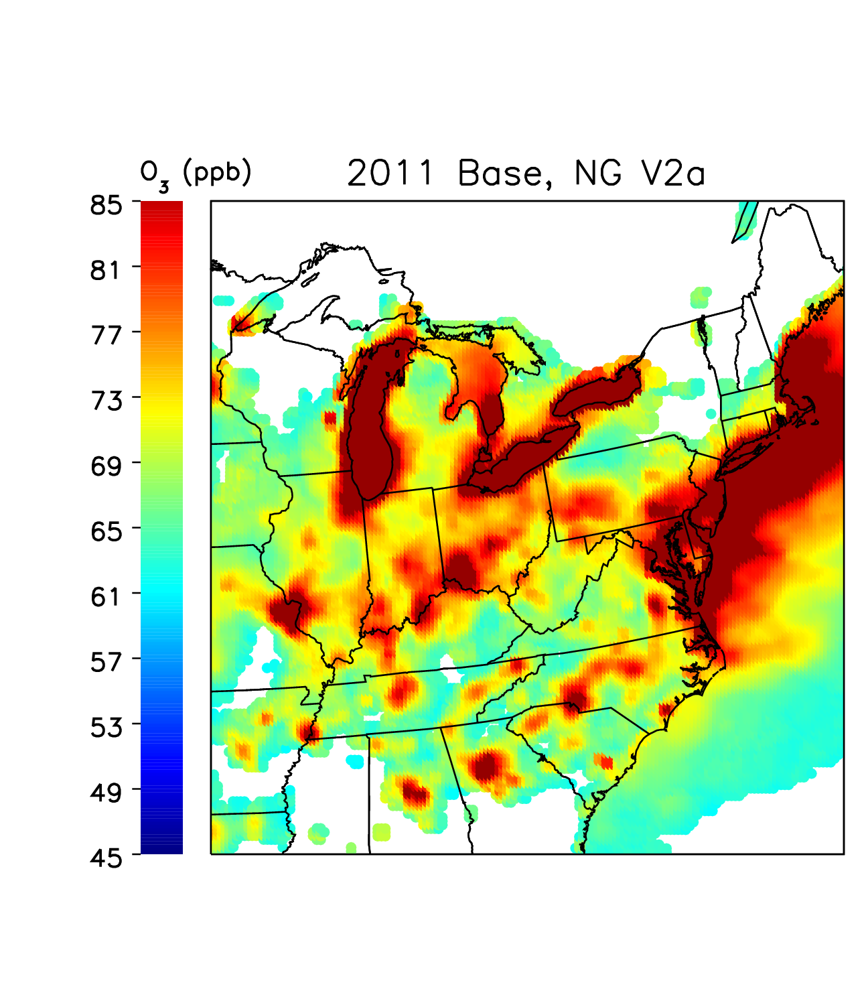
2011 Base
2011 Baseline
July 2011
Average of 8-hour max ozone from top six days over 60 ppb
  Minimum criteria
  White if not met

Slide 8
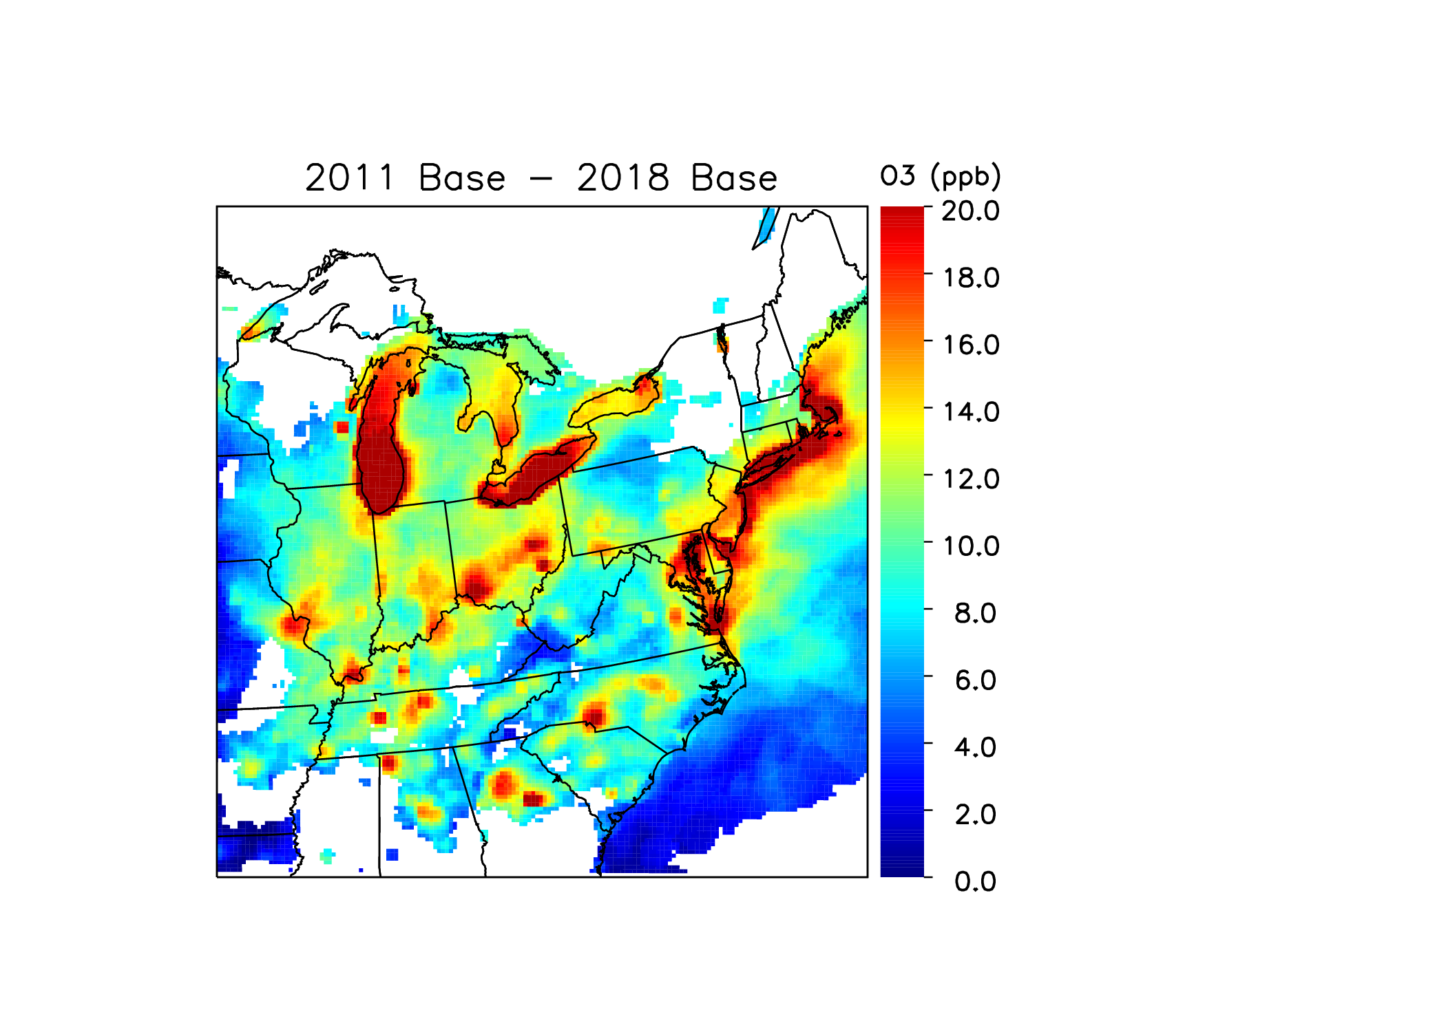
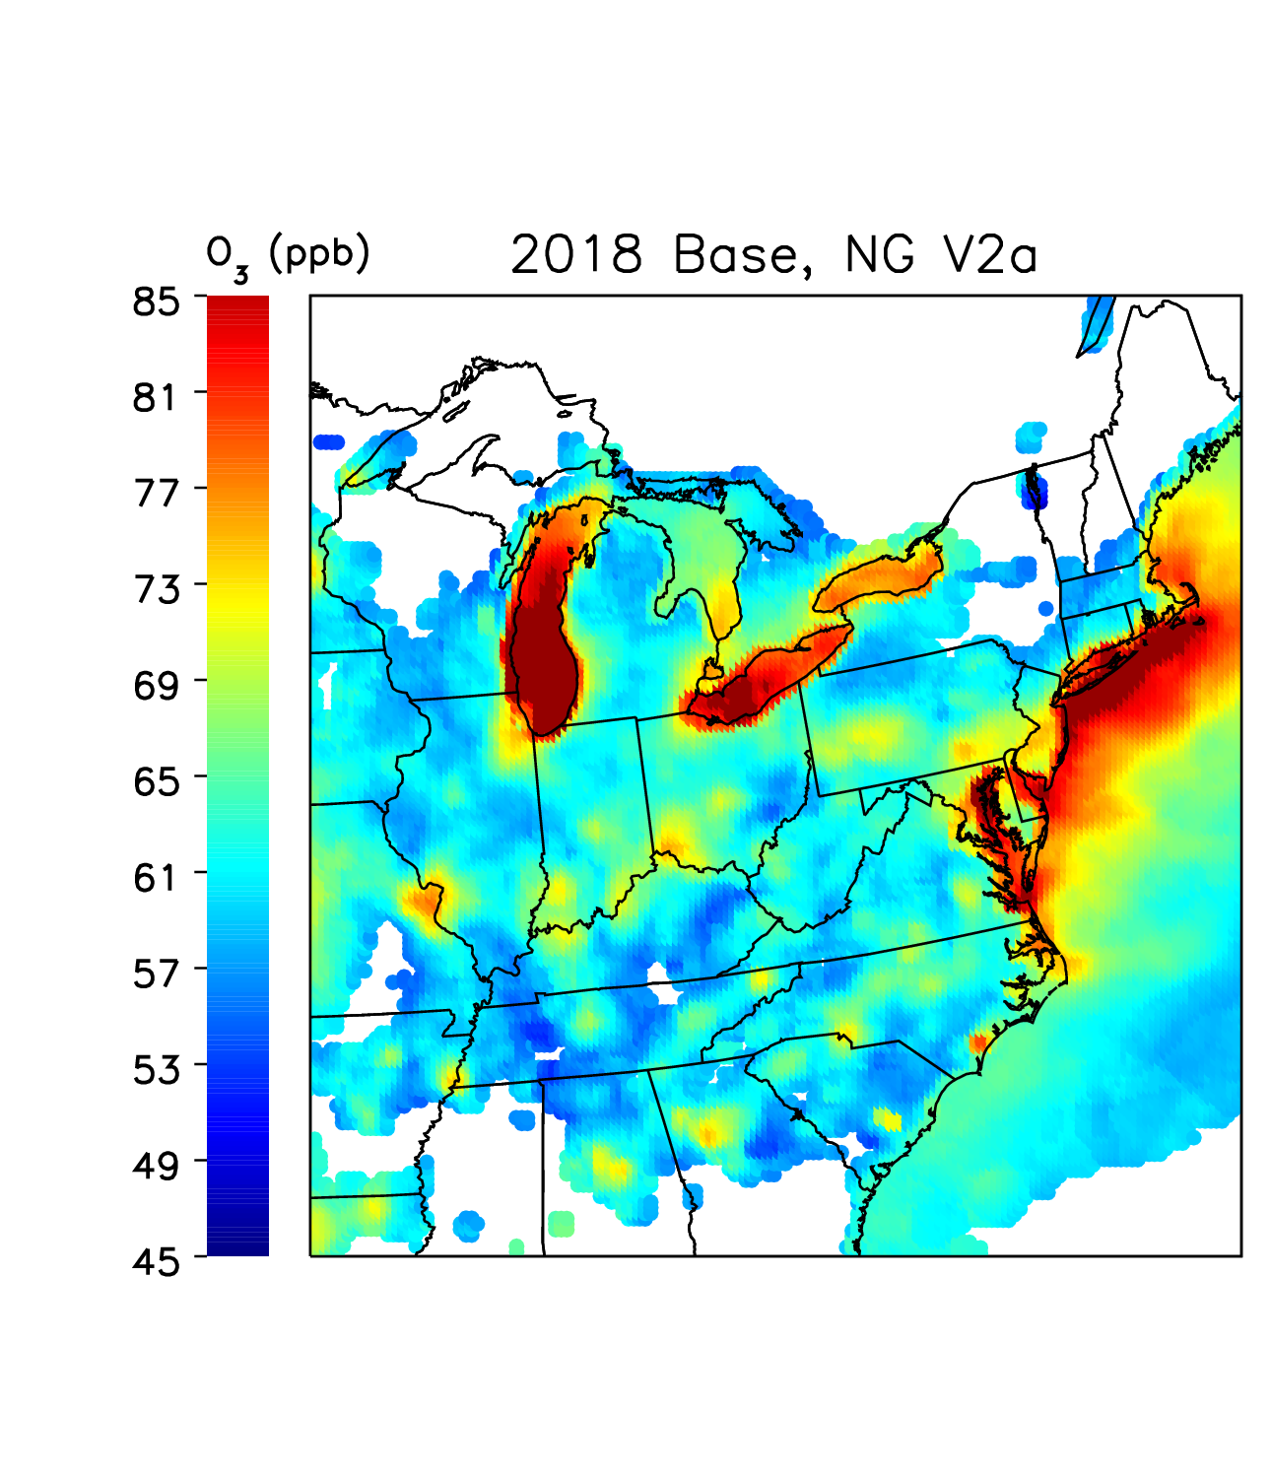
2018 Base
2018 Baseline
From 2011, large reductions from improvements across various sectors

Slide 9
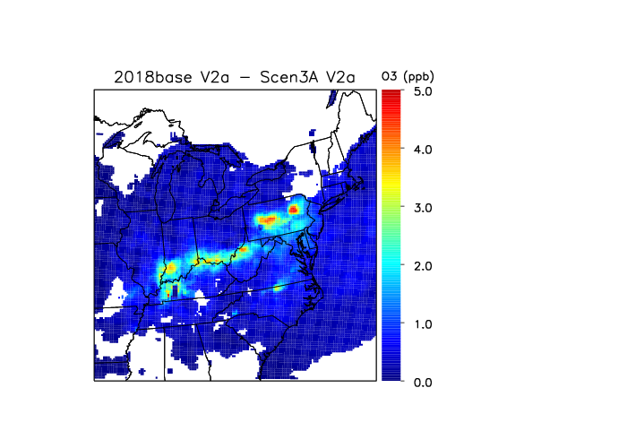
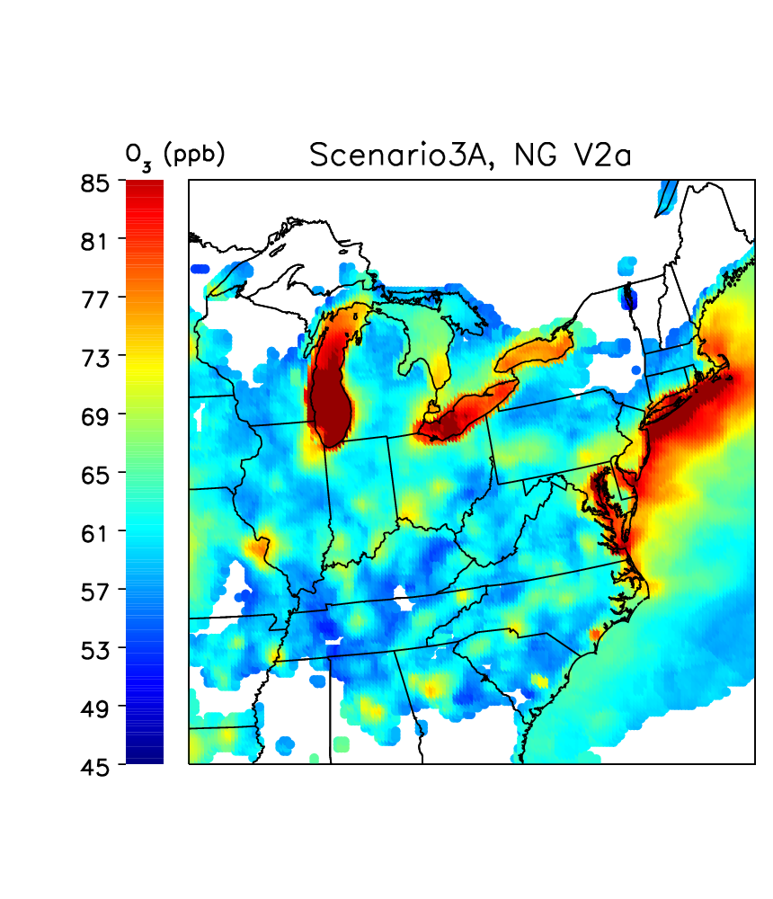
2018 3A – Best Rates
2018 Base – Scenario 3A
Scenario 3A
Running 2018 EGUs at observed best rates can provide 3-5ppb improvement

Slide 10
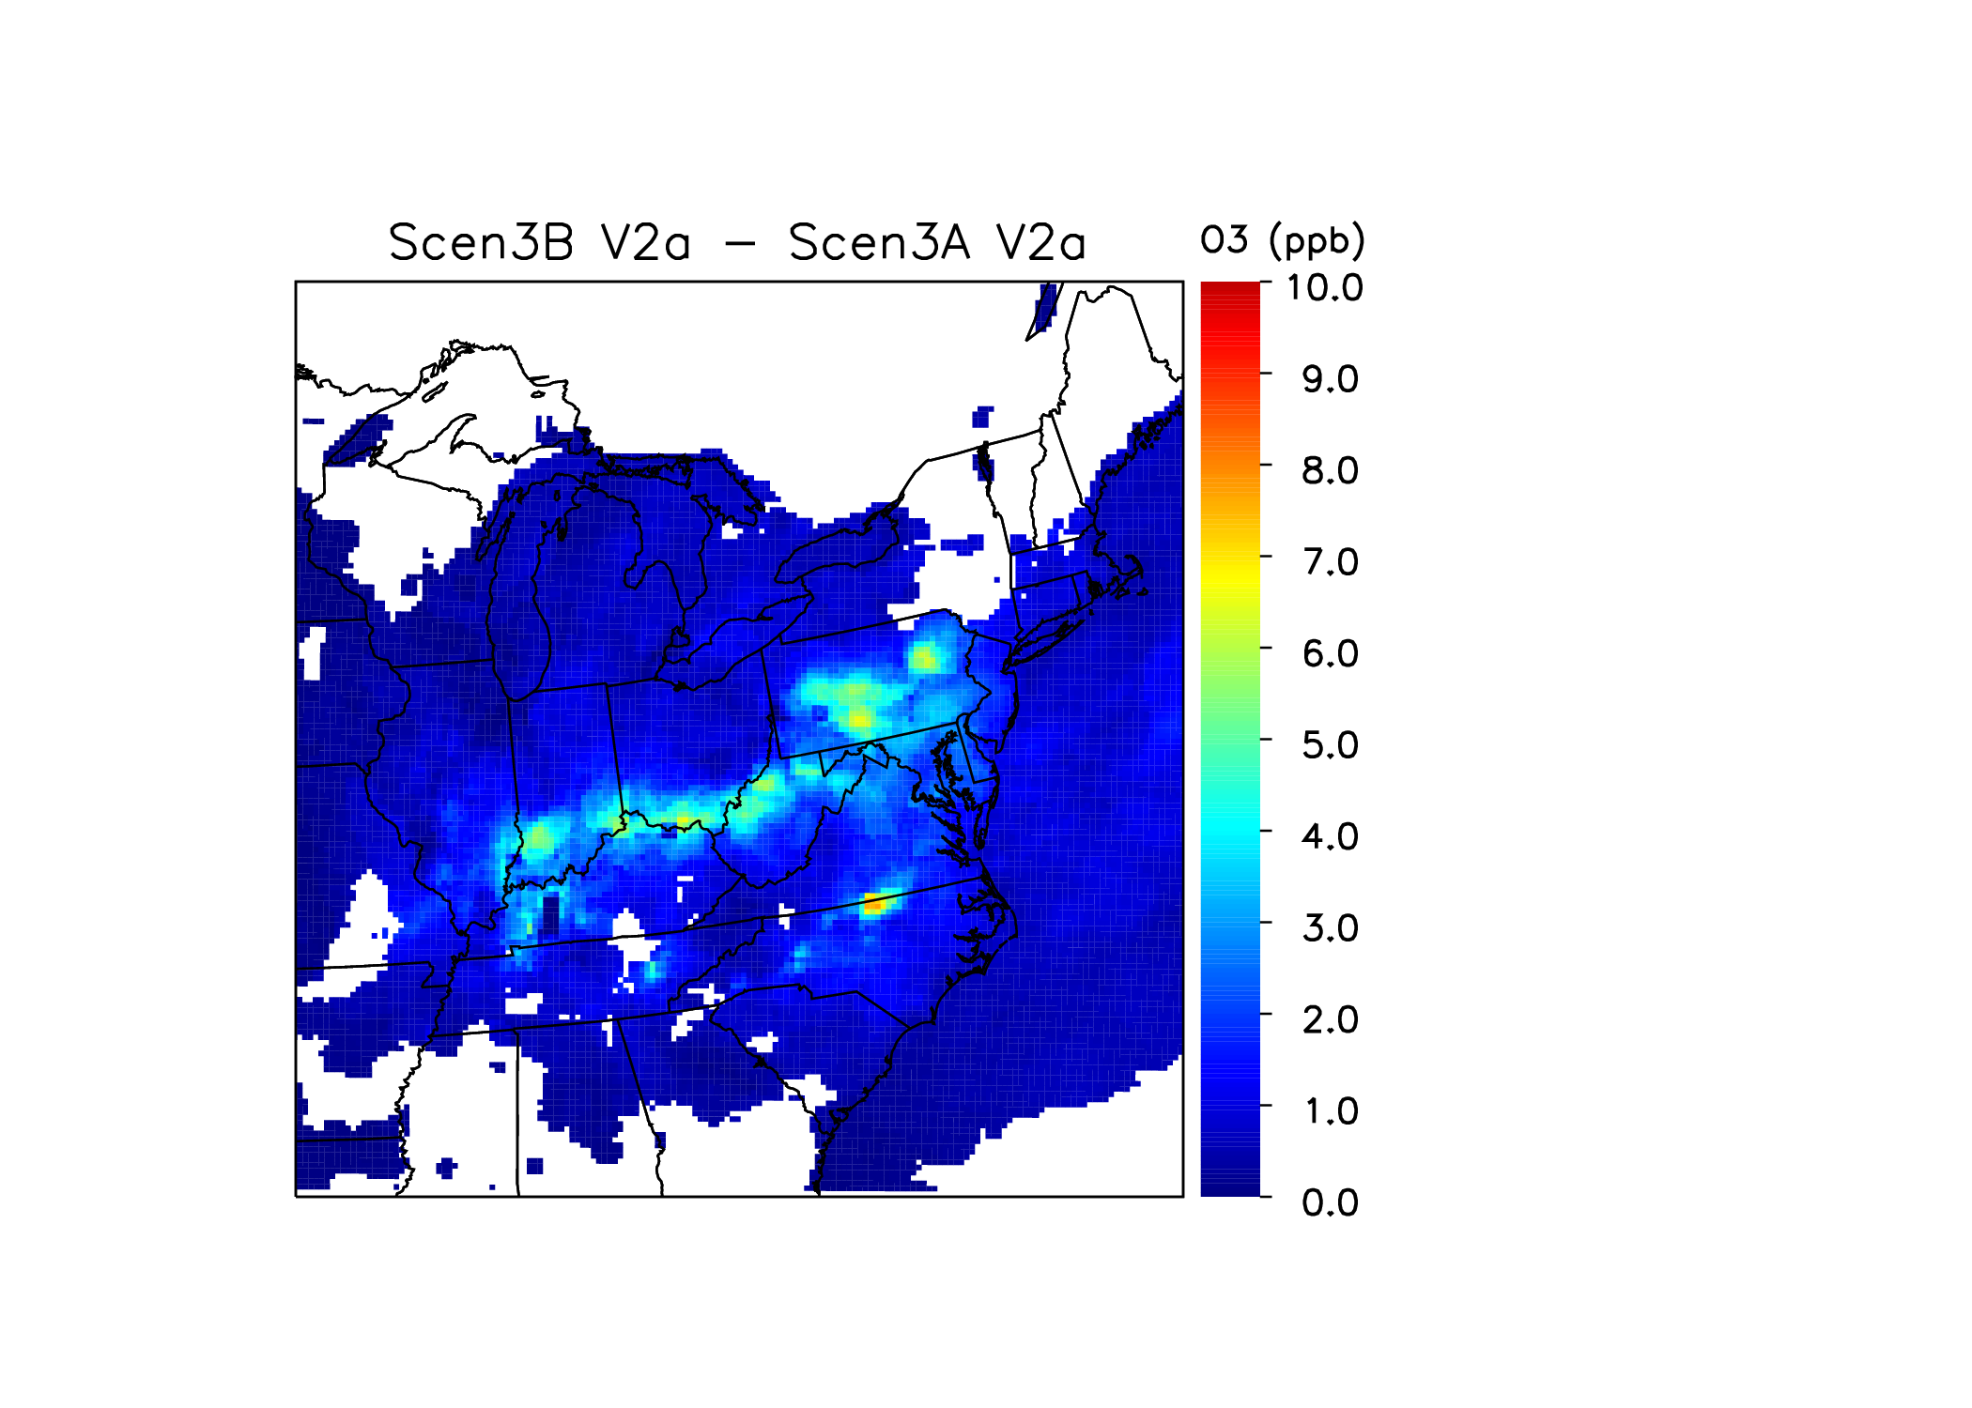
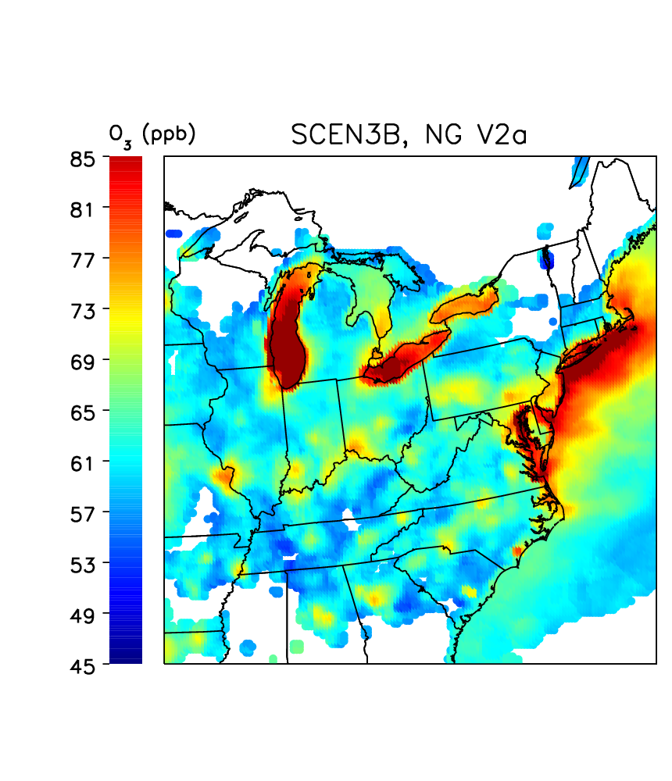
2018 3B – Worst Rates
Scenario 3B – Scenario 3A
Scenario 3B
Regions see 4-7 ppb difference between best and worst EGU rates

Slide 11
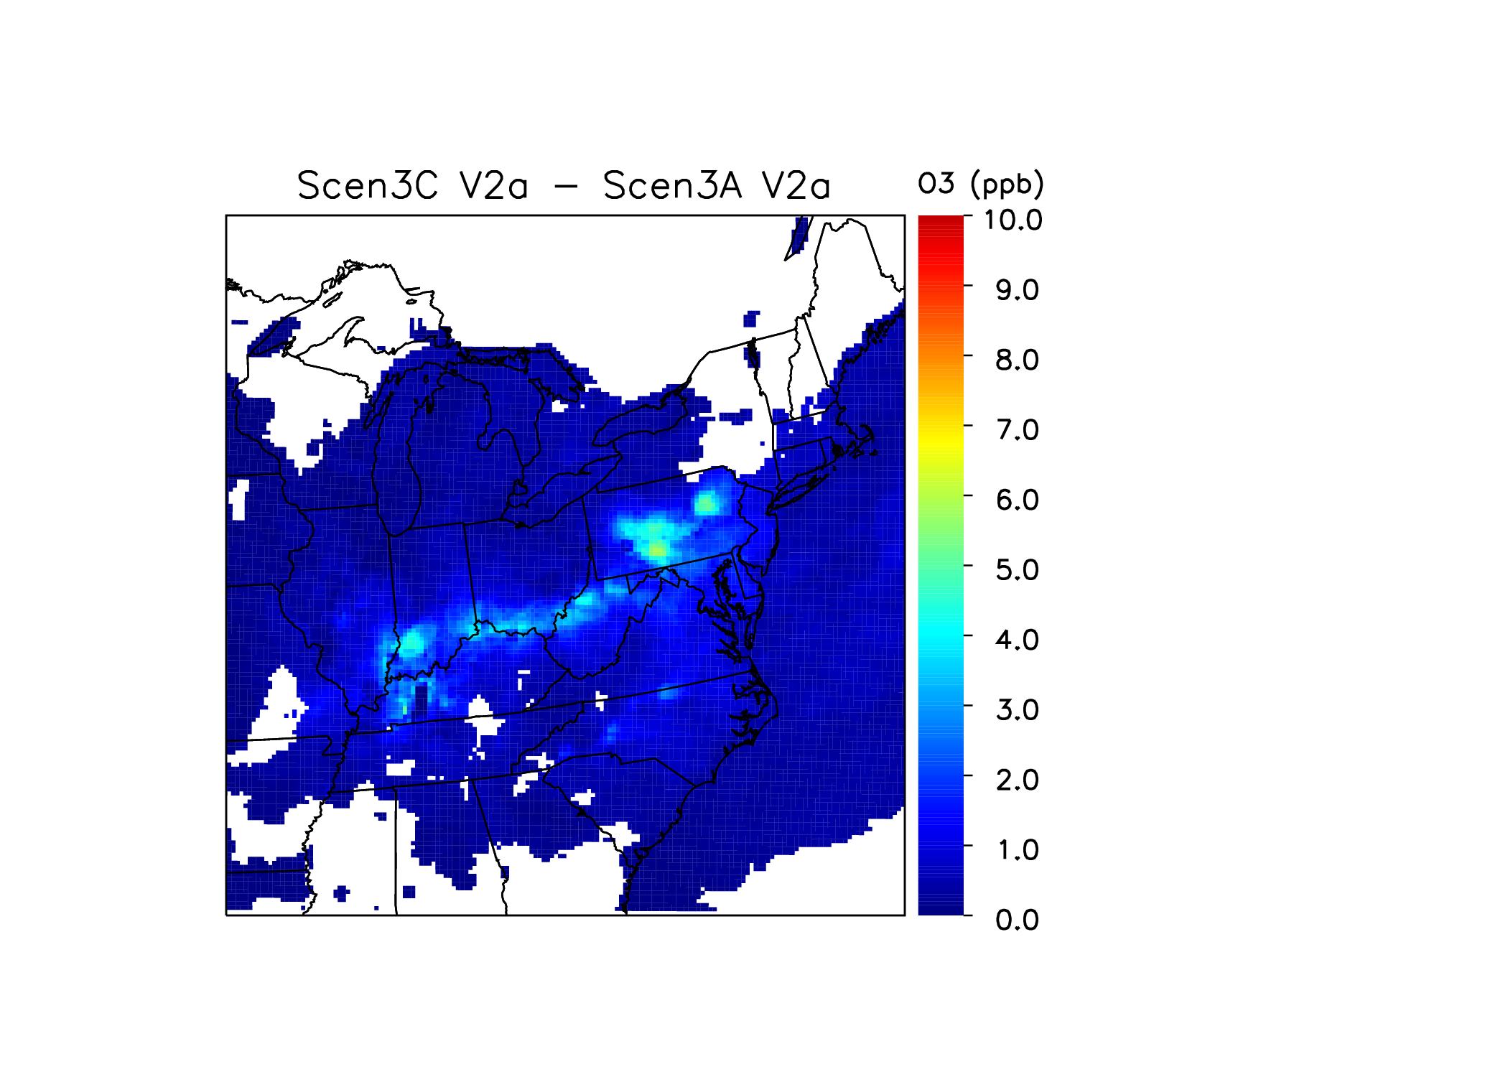

2018 3C – 2011 Rates
Scenario 3C – Scenario 3A
Scenario 3C
Smaller regions see 4-5 ppb difference between best and 2011 EGU rates

Slide 12
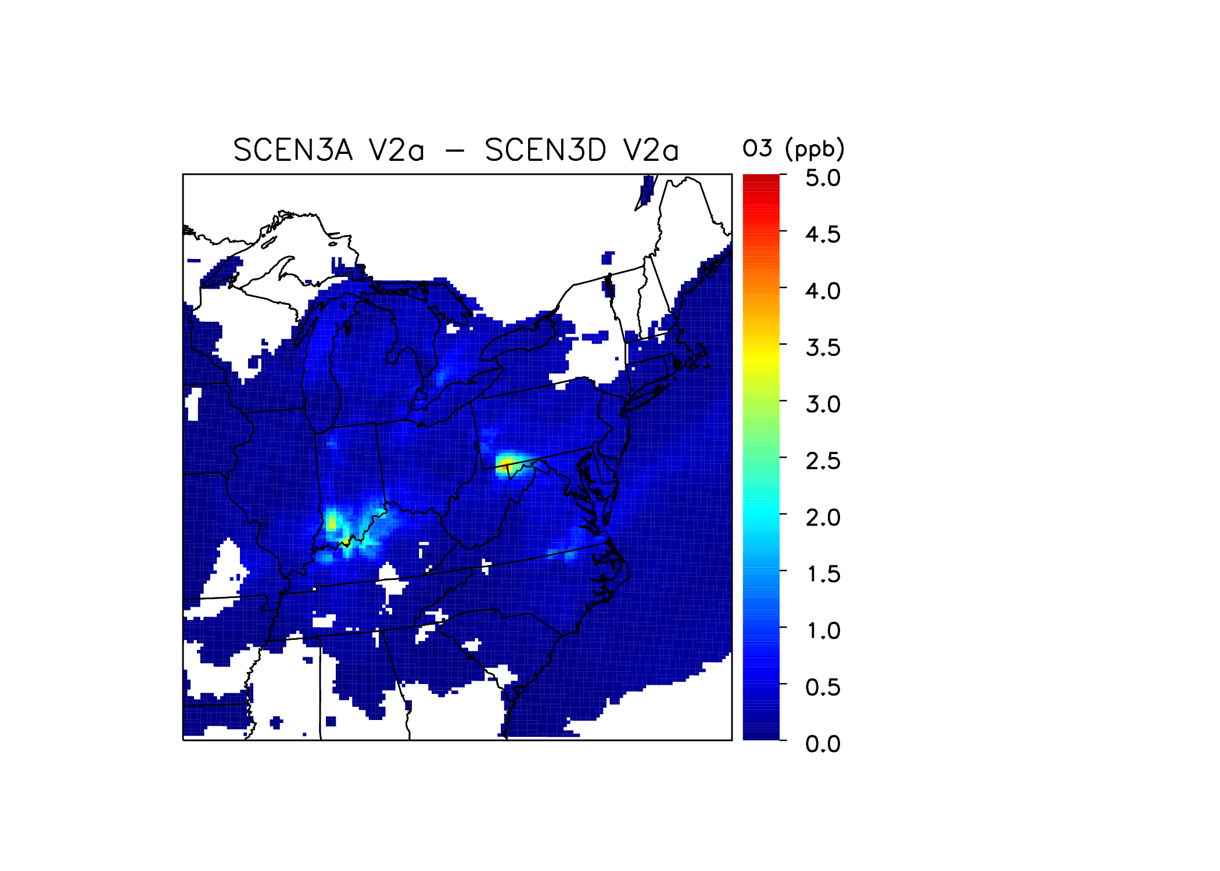
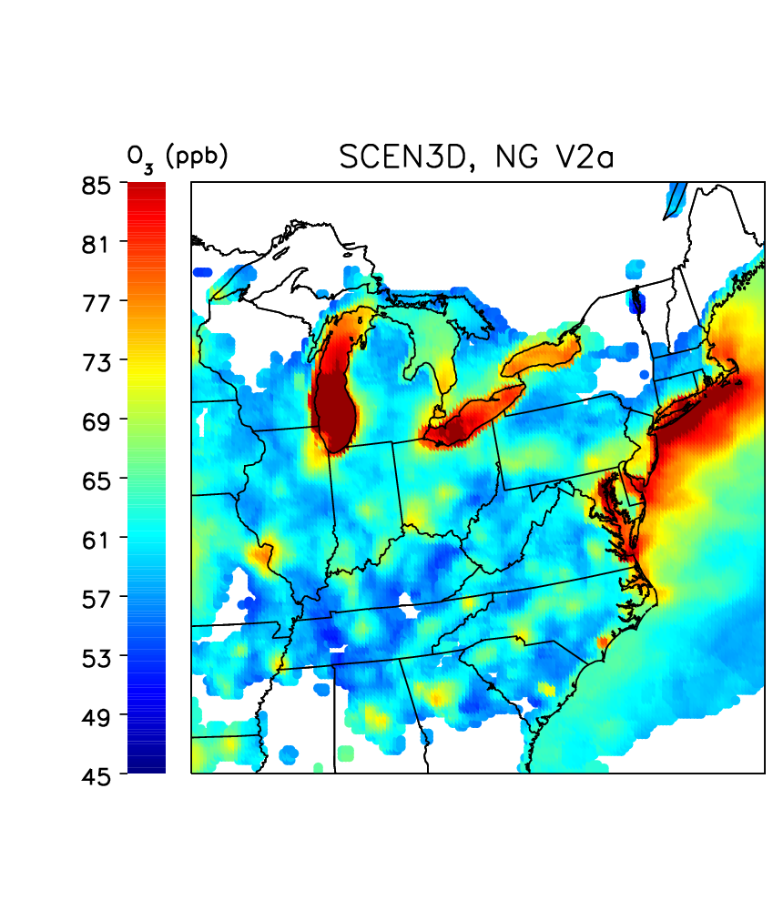
2018 3D – Added SCR Rates
Scenario 3A – Scenario 3D
Scenario 3D
Can improve up to 2-4 ppb more with SCR on uncontrolled units

Slide 13
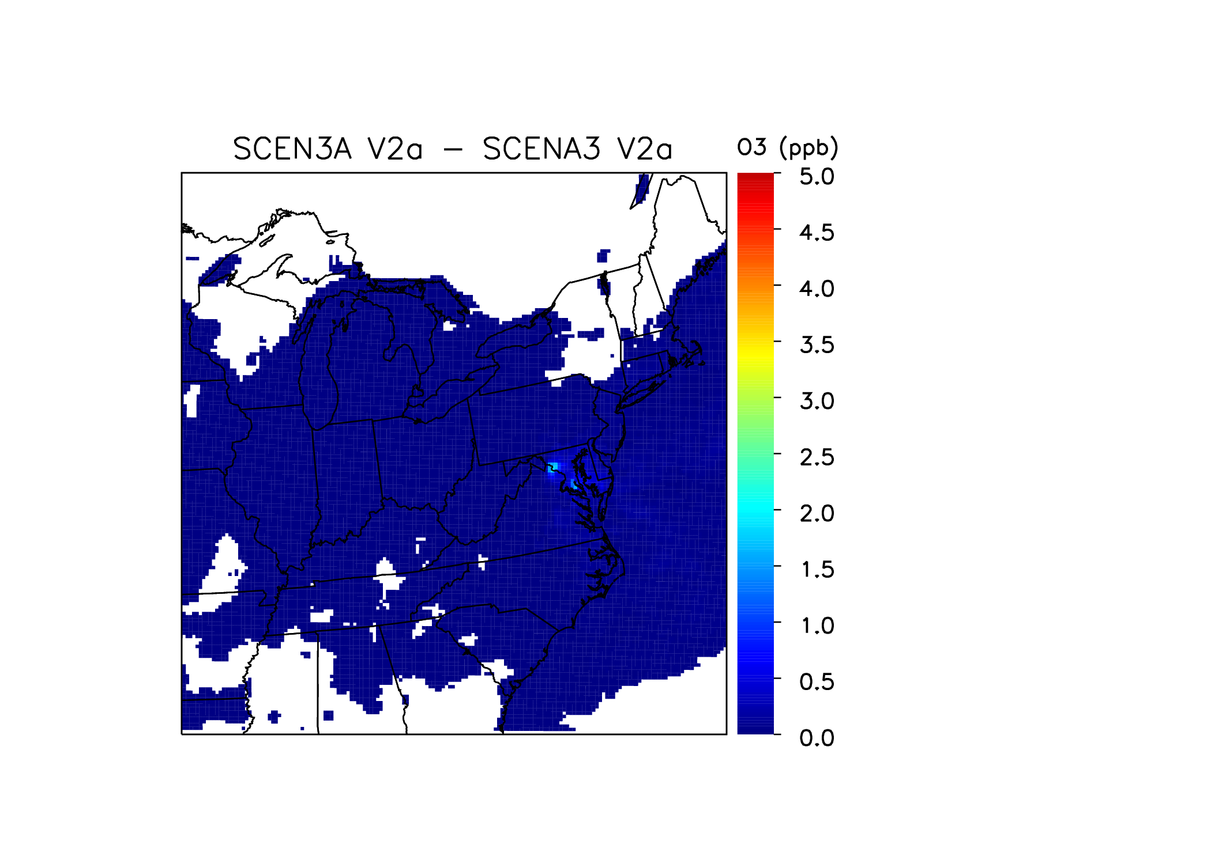

2018 A4 – MD Capped Rates
Scenario 3A – Scenario A4
Scenario A4
MD local improvement

Slide 14
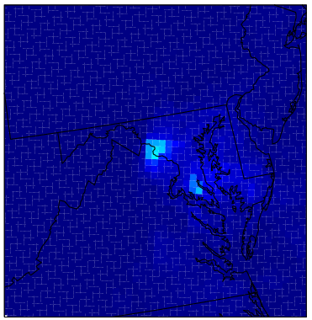
2018 A4 – MD Capped Rates
Scenario 3A – Scenario A4
Scenario A4
Improve MD up to 1-2 ppb more

Slide 15
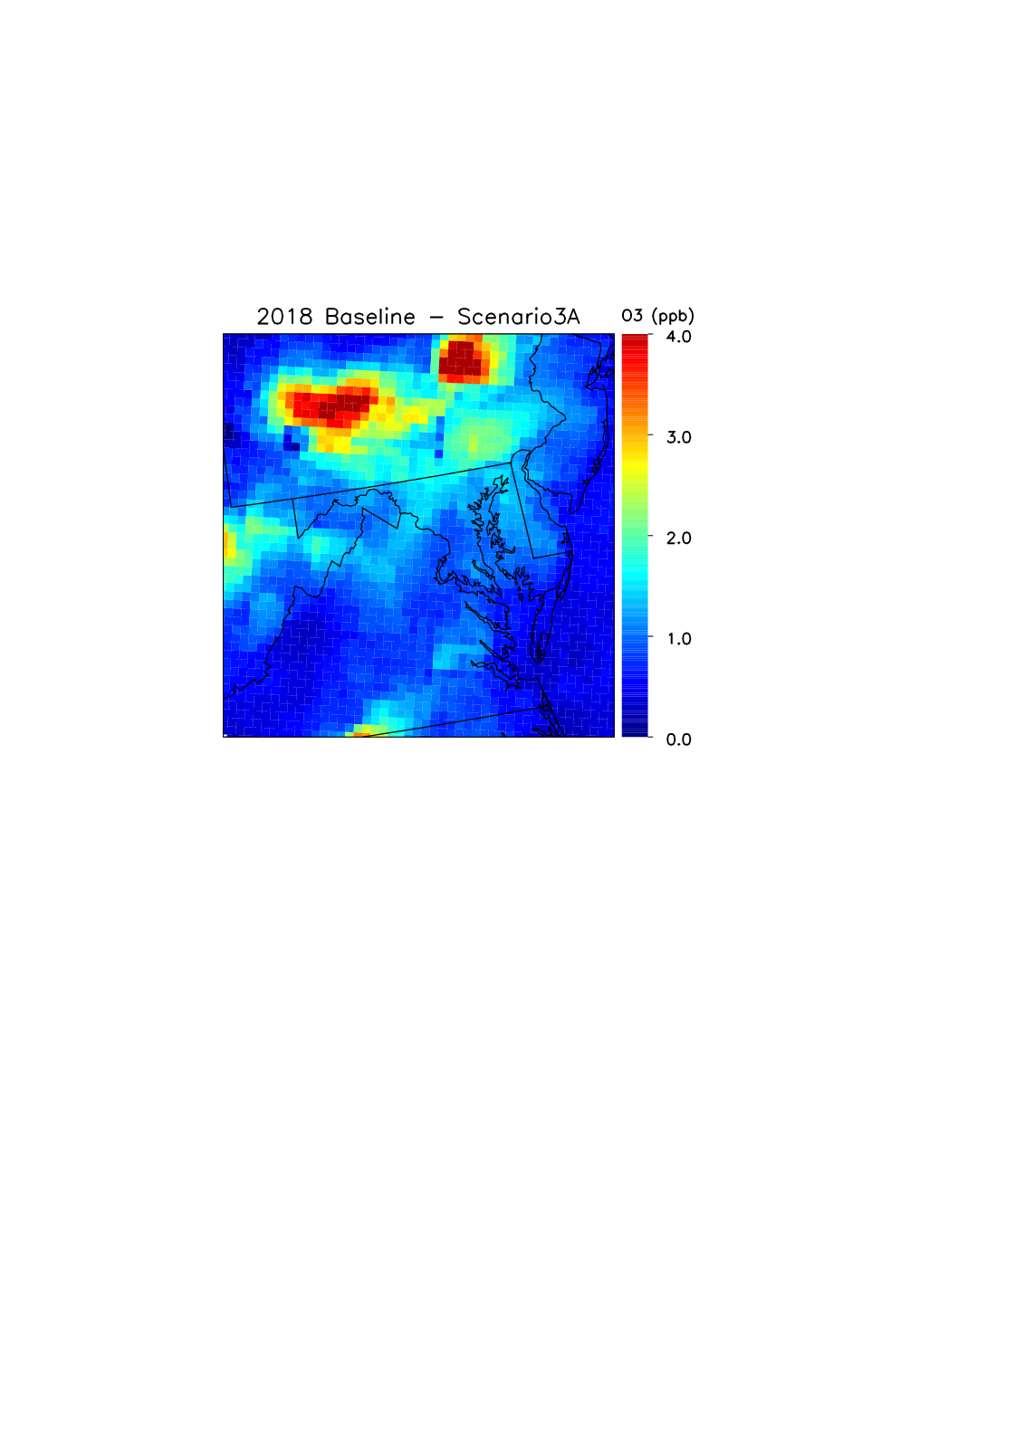
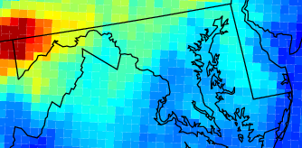
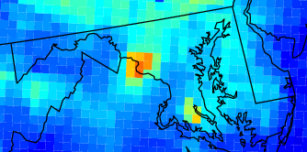
2018 Ozone Improvements in MD
2018 Baseline – Scenario 3D
2018 Baseline – Scenario A4
MD has 1-1.5ppb decrease with EGUs at best rates
Additional benefits from SCRs on uncontrolled units and local caps

Slide 16
New Ozone Standard
New NAAQS announced October 1
  Limit lowered to 70 ppb
More areas at risk for non-attainment

Slide 17
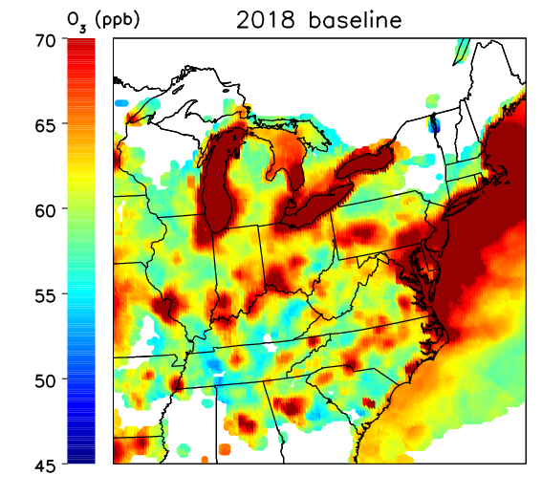
2018 Base
Several regions could exceed a 70ppb standard in 2018

Slide 18
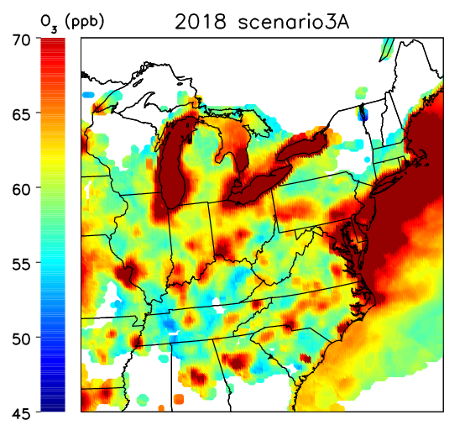
2018 3A – Best Rates
Many regions move into attainment

Slide 19
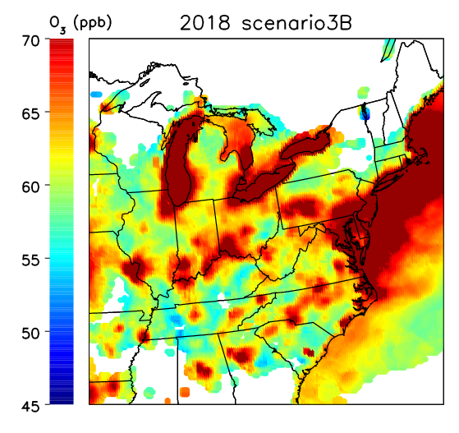
2018 3B – Worst Rates
Widespread regions exceed 70ppb standard

Slide 20

2018 3C – 2011 Rates
Several regions exceed 70ppb standard

Slide 21

2018 3D – Added SCR Rates
Many areas now well within new standard

Slide 22

2018 A4 – MD Capped Rates
MD improved slightly, more work needed for much of the east coast

Slide 23
Conclusions
Removing EGU NOx at best observed rates could reduce 2018 ozone ~5 ppb in areas
Additional controls could cut extra 2-4 ppb
Lower standard could put areas at risk of non-attainment in 2018
  Running SCRs would be beneficial

Slide 24
Acknowledgements
Thank you to:
EPA for providing model-ready, surface SMOKE outputs and MCIP files
NYSDEC for helping add elevated sources and CMAQ configurations

Slide 26
Extra Slides
Side-by-side comparisons

Slide 27
2018 Base
2018 Baseline
2011 Baseline

Slide 28
2018 3A – Best Rates
Scenario 3A
2018 Baseline

Slide 29
2018 3B – Worst Rates
Scenario 3B
Scenario 3A

Slide 30
2018 3C – 2011 Rates
Scenario 3C
Scenario 3A

Slide 31
2018 3D – Added SCR Rates
Scenario 3D
Scenario 3A

Slide 32
2018 A4 – MD Capped Rates
Scenario A4
Scenario 3A

