Slide 1
Using Dynamical Downscaling to Project Changes in Climate and Air Quality
Chris Nolte¹, Tanya Spero¹, and Jared Bowden²
¹U.S. Environmental Protection Agency, Research Triangle Park, North Carolina
²Institute for the Environment, University of North Carolina, Chapel Hill, North Carolina
14th Annual CMAS Conference
7 October 2015

Slide 2
Introduction
EPA Strategic Goal 1: Addressing Climate Change and Improving Air Quality
General approach:
  Use WRF to dynamically downscale global climate models (GCMs) to create regional climate for North America
  Use these as meteorological inputs to CMAQ to simulate changes in air quality for some future period
We have developed and tested dynamical downscaling methods on historical meteorological fields, and applied these methods to downscale three U.S.-based GCMs:
  NASA Goddard Institute for Space Studies ModelE2
  NCAR/DOE Community Earth System Model (CESM)
  NOAA Geophysical Fluid Dynamics Laboratory CM3

Slide 3
Global Climate Scenarios and the Representative Concentration Pathways (RCPs)
Coupled Model Intercomparison Project phase 5 (CMIP5): coordinated set of modeling experiments by participating models in IPCC Fifth Assessment Report
Moss et al., Nature 2010

Slide 4
Dynamical Downscaling
CESM CMIP5 data (0.9° × 1.25°) acquired from Earth System Grid
  “historical” run: 1995–2005
  2025–2055 from each of RCP4.5, RCP6.0, and RCP8.5
  Input data used at 6-h intervals
  Lake surface temperature data from CLM (CESM land component) used to prescribe lake temperatures in WRF (Spero et al., J. Climate, in press)
WRFv3.4.1
  36-km domain over most of North America (199 × 127 grid points)
  34 layers up to 50 hPa
  Continuous runs (no reinitialization)
  Spectral nudging of wavelengths >1500 km toward CESM fields, applied above PBL only

Slide 5
Air Quality Modeling
CMAQ 5.0.2 with CB05TUMP chemical mechanism, AERO6, online computation of LNOx and photolysis; not using bidi or windblown dust options
Used meteorology downscaled from “historical” CESM simulation (1995-2005) and 2025-2035 from RCP4.5, RCP6.0, and RCP8.5
EPA OTAQ 2030 emissions incorporating existing regulations used for both historical and future CMAQ simulations
  Emissions of NO_{x} and SO₂ have declined dramatically in recent years and are projected to continue to decline
  Focus of this effort is on the effect of climate change on AQ at 2030
  Changes are relative to what conditions would be if climate did not change rather than to present day
  Year 2007 wildfire emissions

Slide 6
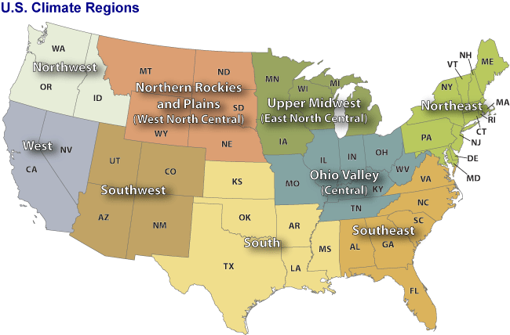
Analysis Across NCDC Climate Regions
Courtesy NOAA NCDC
Climatological evaluation in comparison to CFSR and NARR reanalyses

Slide 7
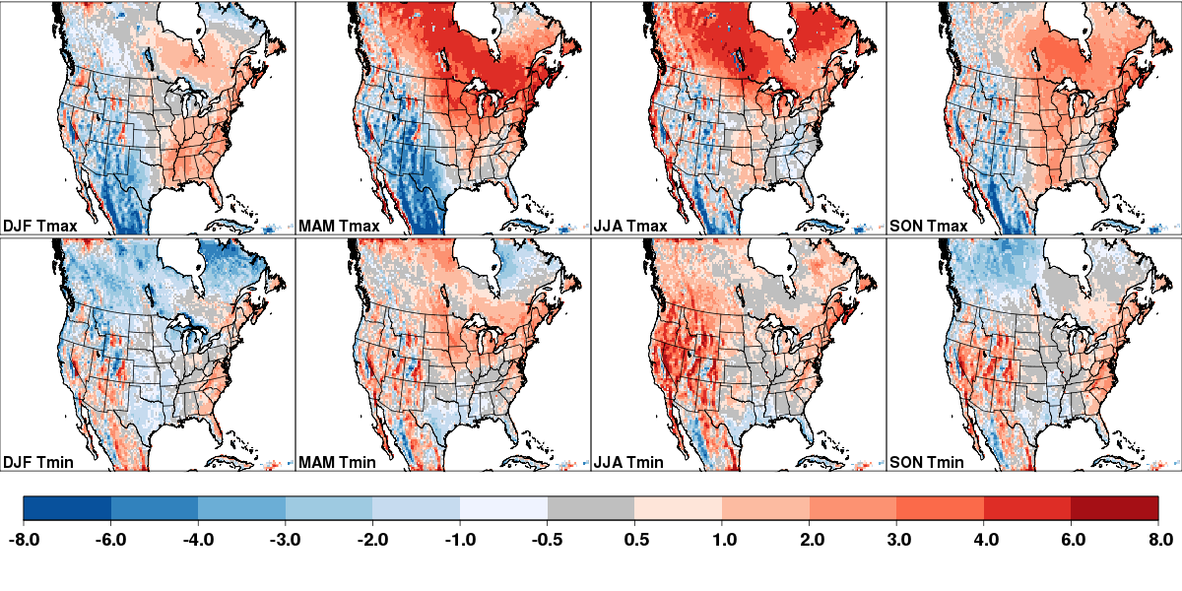

CESM-WRF 2-m Temperature Bias 1995–2005
K

Slide 8
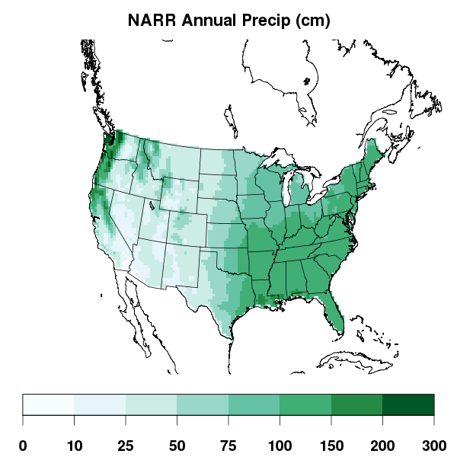
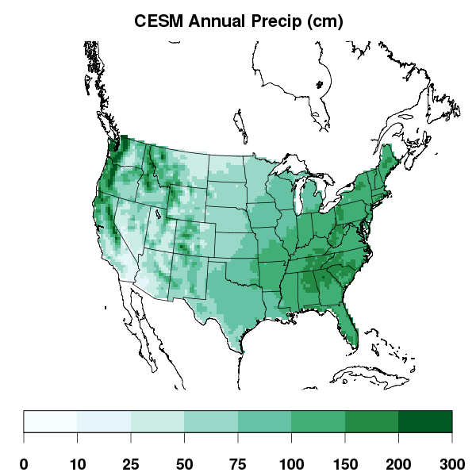
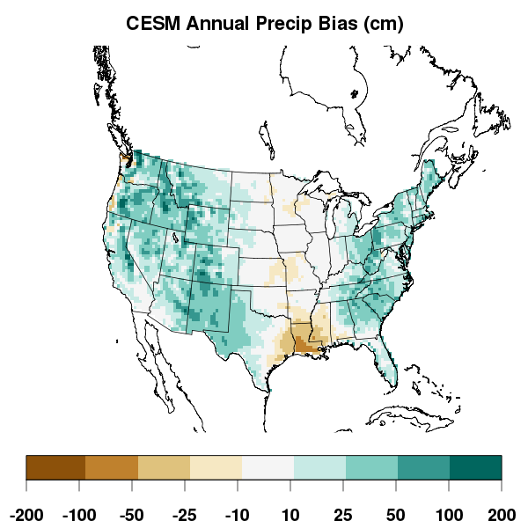
CESM-WRF Average Annual Precipitation 1995–2005
NARR
CESM
CESM –NARR
cm
WRF generally reproduces broad spatial pattern of precipitation across the U.S., with a wet bias relative to NARR.

Slide 9
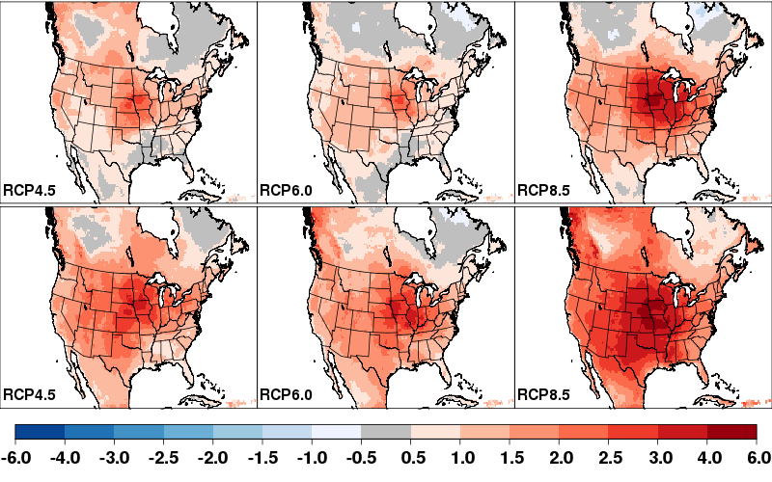
Change in Summer (JJA) Average Daily Maximum Temperatures circa 2030 and 2050 by RCP
RCP4.5
RCP6.0
RCP8.5
2025–2035
2045–2055
K

Slide 10
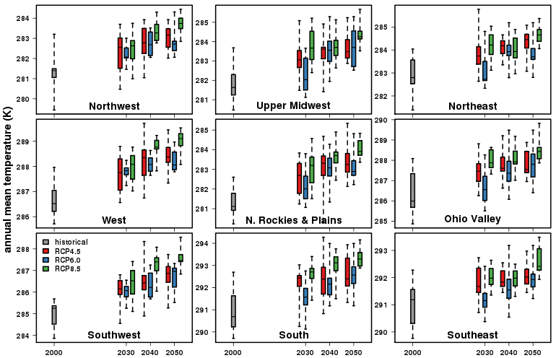
CESM: Decadal Variability in Annual Average
2-m Temperature
2000
2030
2040
2050
2000
2030
2040
2050
2000
2030
2040
2050

Slide 11
Decadal Variability in Projected Global Mean Temperatures
IPCC AR5 WG1, Ch. 11

Slide 12
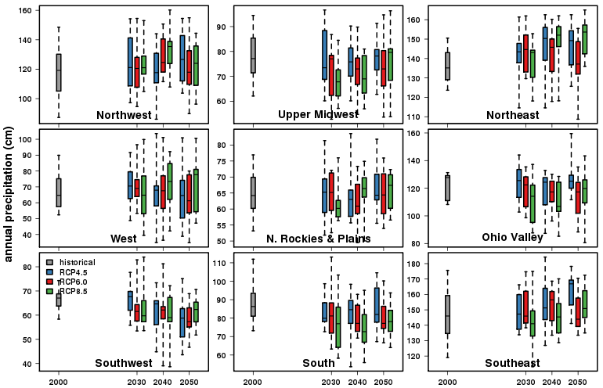
CESM: Decadal Variability in Precipitation
2000
2030
2040
2050
2000
2030
2040
2050
2000
2030
2040
2050

Slide 13
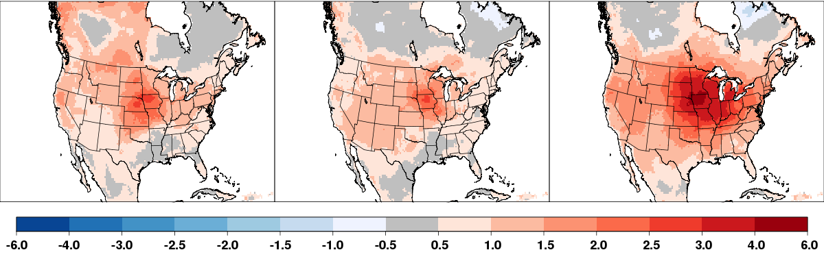
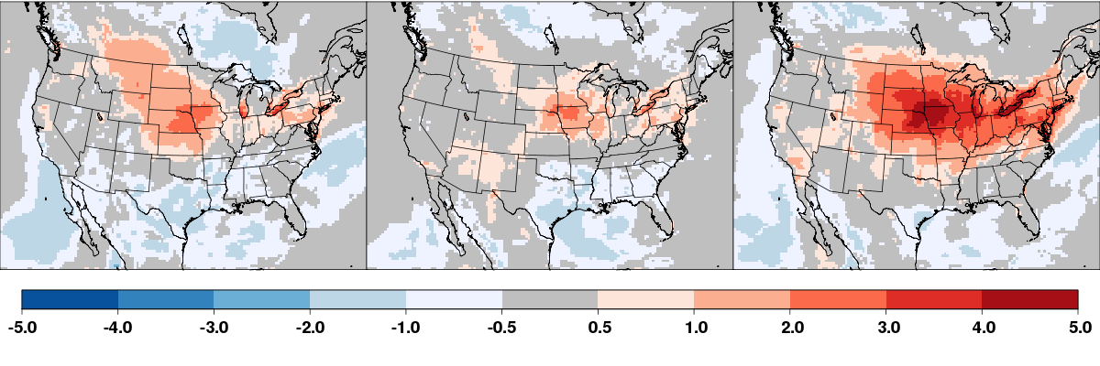
Projected Changes by RCP at 2030 (JJA)
RCP4.5
RCP6.0
RCP8.5
Daily max T
K
MDA8 O₃
ppb

Slide 14
Summary (1)
Regional climate obtained by downscaling CESM for 1995-2005 is in reasonable agreement with CFSR and NARR reanalysis products
  Biases in seasonally averaged daily maximum and daily minimum temperature generally less than 1 K averaged across the U.S.
  Regionally averaged biases less than 2 K for most regions and seasons, although locally higher biases occur throughout the U.S.
  Overall precipitation pattern well represented, with wet bias.
Warming is projected throughout the U.S. for all scenarios
  Substantial interannual variability in regional temperature trends
  Near-term warming in RCP6.0 generally less than RCP4.5
  Some regions have decadal cooling periods
No evident trend in near-term precipitation for any of these scenarios

Slide 15
Summary (2)
Keeping emissions constant at 2030 levels, projected climate change leads to “climate penalty” of 0.5–4.5 ppb in MDA8 O₃.
Areas of ozone increases generally collocated with increases in daily maximum temperatures, though small MDA8 decreases are simulated in some areas at 2030.
No significant change in PM_{2.5} concentrations
  Did not model climate change impacts on wildfire or dust emissions

