Slide 1
Evaluation of modeled surface ozone biases as a function of cloud cover fraction
Hyun Cheol Kim^{1,2}, Pius Lee¹, Fong Ngan^{1,2}, Youhua Tang^{1,2}, Hye Lim Yoo^{1,2}, Li Pan^{1,2} and Ivanka Stajner³
¹ NOAA Air Resources Laboratory, College Park, MD
² University of Maryland, Cooperative Institute for Climate and Satellites, College Park, MD
³ NOAA National Weather Service, Silver Spring, MD

Slide 2
Outline
Motivation
  Photolysis rate
  Cloud fractions in observations, models and satellites
Data & Methodology
Comparison with model
  NAQFC (N. America)
  IMAQS-K (East Asia)
Summary

Slide 3
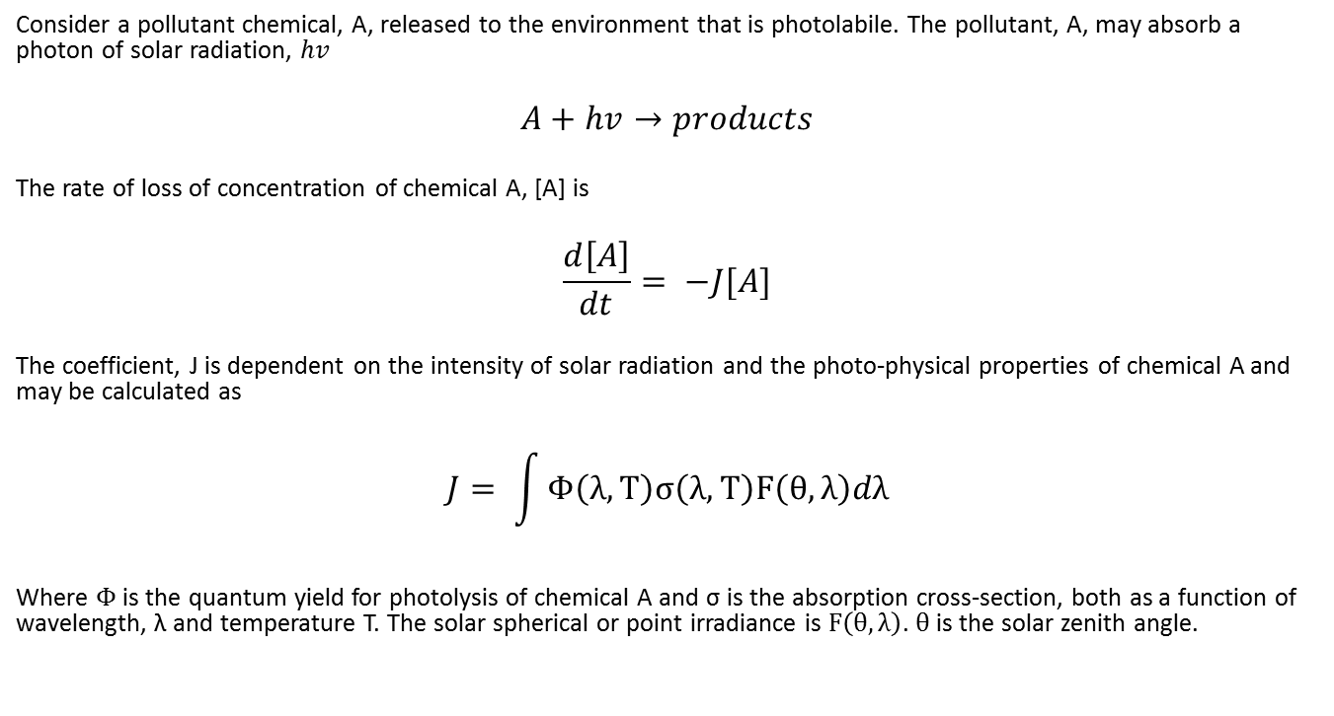
Photolysis rate
Consider a pollutant chemical, A, released to the environment that is photolabile. The pollutant, A, may absorb a photon of solar radiation, $hv$
$$A+hv→products$$
The rate of loss of concentration of chemical A, [A] is
$$\frac{d\left[A\right]}{dt}= −J[A]$$
The coefficient, J is dependent on the intensity of solar radiation and the photo-physical properties of chemical A and may be calculated as
$$J= \int{Φ\left(λ,T\right)σ\left(λ,T\right)F\left(θ,λ\right)dλ}$$
Where $Φ$ is the quantum yield for photolysis of chemical A and σ is the absorption cross-section, both as a function of wavelength, λ and temperature T. The solar spherical or point irradiance is $F\left(θ,λ\right)$. $θ$ is the solar zenith angle.

Slide 4
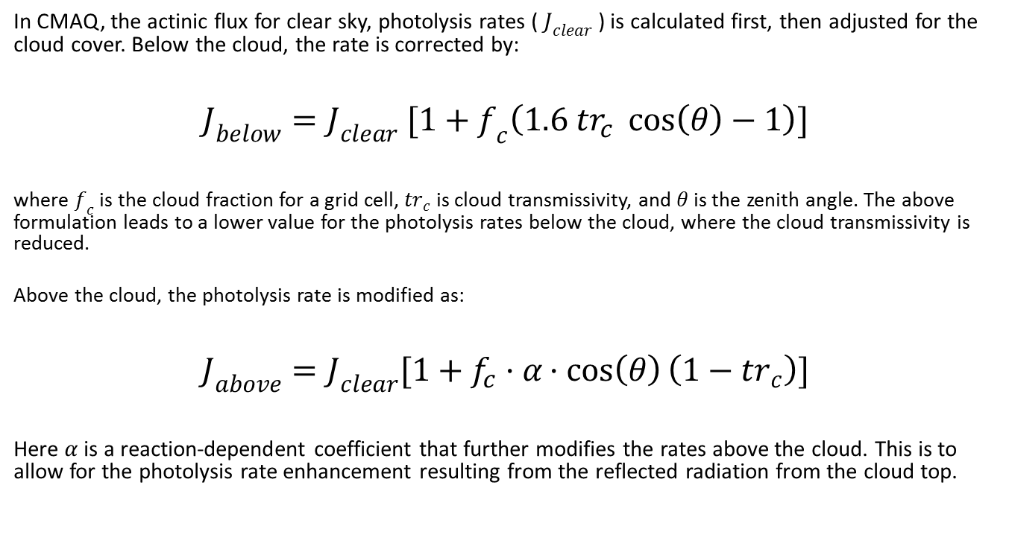
Adjustment of photolysis rate
In CMAQ, the actinic flux for clear sky, photolysis rates ( $J_{clear}$ ) is calculated first, then adjusted for the cloud cover. Below the cloud, the rate is corrected by:
$$J_{below}=J_{clear} [1+f_{c}\left(1.6 {tr}_{c} \cos\left(θ\right)−1\right)]$$
where $f_{c}$ is the cloud fraction for a grid cell, ${tr}_{c}$ is cloud transmissivity, and $θ$ is the zenith angle. The above formulation leads to a lower value for the photolysis rates below the cloud, where the cloud transmissivity is reduced.
Above the cloud, the photolysis rate is modified as:
$$J_{above}=J_{clear}[1+f_{c}·α·cos\left(θ\right)\left(1−{tr}_{c}\right)]$$
Here $α$ is a reaction-dependent coefficient that further modifies the rates above the cloud. This is to allow for the photolysis rate enhancement resulting from the reflected radiation from the cloud top.
Photolysis rate adjustment is proportional to the cloud fraction

Slide 5

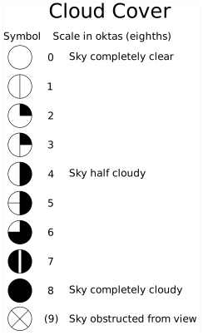
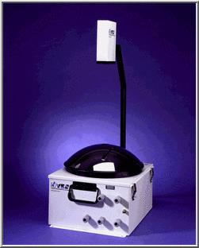
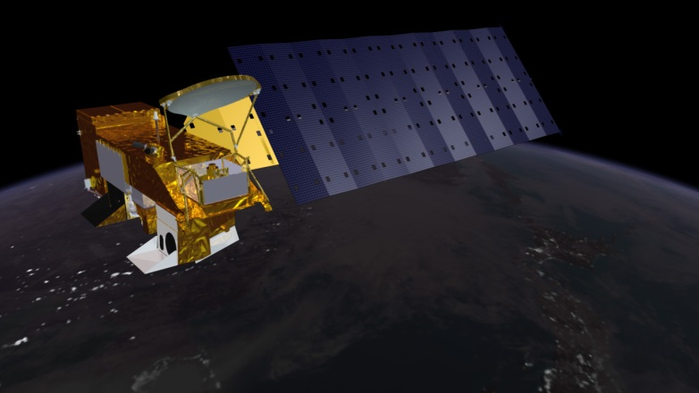
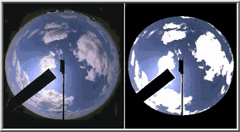
Defining “Cloud Fraction”
In model:
  relative humidity (w/ critical RH)
In satellite:
  radiance (BT & BTD)
In surface site :
  visual inspection, sky imager
Aqua satellite
TSI-880 AUTOMATIC TOTAL SKY IMAGER

Slide 6
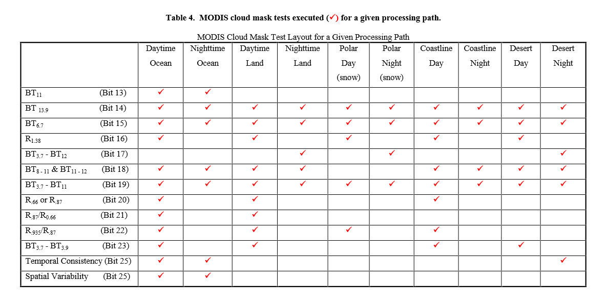
MODIS Cloud Mask (MOD35)
http://modis-atmos.gsfc.nasa.gov/_docs/CMUSERSGUIDE.pdf

Slide 7

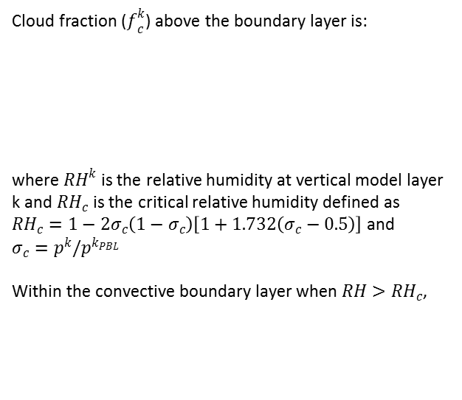

CF calculation in MCIP
Cloud fraction ($f_{c}^{k}$) above the boundary layer is:
where ${RH}^{k}$ is the relative humidity at vertical model layer k and ${RH}_{c}$ is the critical relative humidity defined as ${RH}_{c}=1−2σ_{c}\left(1−σ_{c}\right)\left[1+1.732\left(σ_{c}−0.5\right)\right]$ and $σ_{c}=p^{k}/p^{k_{PBL}}$
Within the convective boundary layer when $RH>{RH}_{c}$,
DO k = 1, metlay
! Define RH and critical RH of all layers.
rh = xwvapor(c,r,k) / &
qsat( e_aerk( xtempm(c,r,k)-stdtemp ), xpresm(c,r,k) )
rh = MIN(rh,1.0)
! Set RHC to at least 98% in PBL - JEP 5/91
IF ( x3htf(c,r,k-1) < xpbl(c,r) ) THEN
rhc = 0.98
kmx = k
IF ( rh > rhc ) THEN
! CBL mixing induced clouds should not exceed the frac area of
! the updrafts at top of cbl, les estimates are ~34%
! (Schumann 89, and Wyngaard and Brost 84)
ccov(k) = 0.34 * ( rh - rhc ) / ( 1.0 - rhc )
ELSE
ccov(k) = 0.0
ENDIF
ELSE
sg1 = xpresm(c,r,k) / xpresm(c,r,kmx)
rhc = 1.0 - ( 2.0 * sg1 * (1.0-sg1) * (1.0 + 1.732*(sg1-0.5)) )
IF ( rh > rhc ) THEN
ccov(k) = ( (rh - rhc)/(1.0 - rhc) )**2 ! Geleyn et al., 1982
ELSE
ccov(k) = 0.0
ENDIF
ENDIF
ccov(k) = MAX( MIN( ccov(k), 1.0 ), 0.0 )
ENDDO
$$f_{c}^{k}={\left[\frac{{RH}^{k}−{RH}_{c}}{1−{RH}_{c}}\right]}^{2}$$
$$f_{c}^{k}=0.34\frac{{RH}^{k}−{RH}_{c}}{1−{RH}_{c}}$$
Cloud cover is estimated based on the relative humidity using critical relative humidity threshold

Slide 8
Problems may happen due to …
Wrong displacement of cloud fields in space and/or time
Model’s capability to produce appropriate amount of cloud field

Slide 9
Data & Methodology
National Air Quality Forecast Capability (NOAA)
  WRF-NMMB / CMAQ
IMAQS-K (Ajou. University)
  WRF-ARW/CMAQ
MODIS cloud product (MOD06)
KMA observations & synoptic weather chart (Georeferencing)

Slide 10
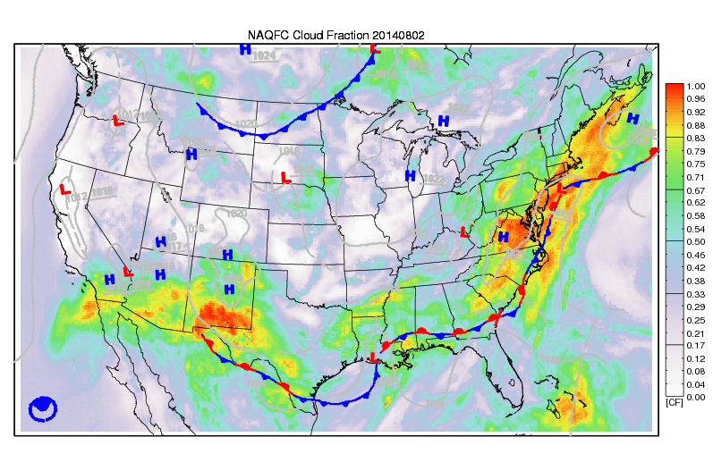
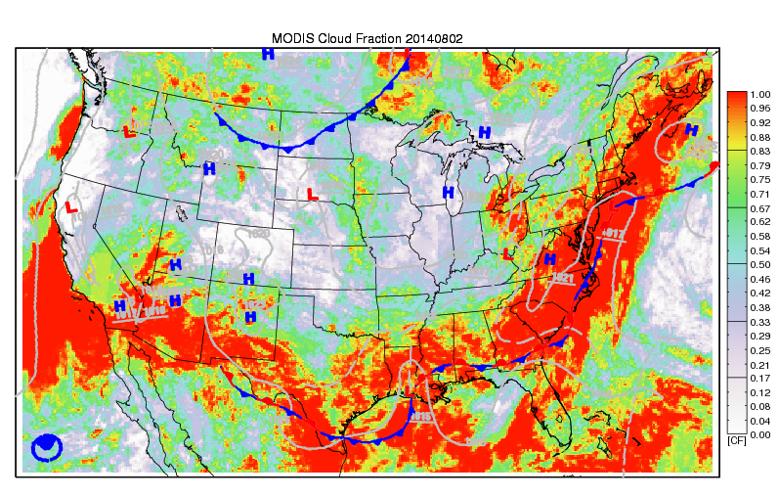
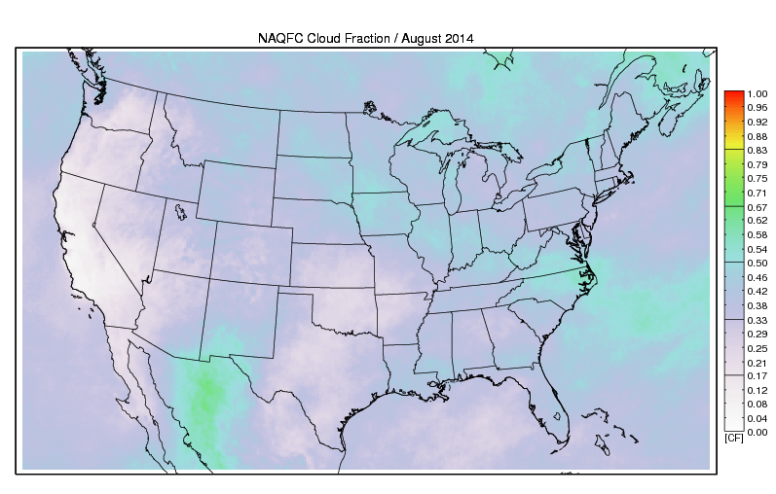
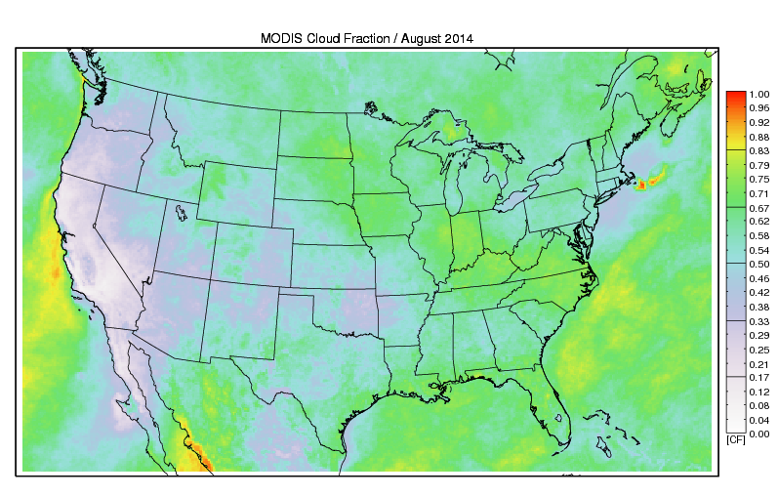
Model CF (snapshot)
MODIS CF (snapshot)
Model CF (monthly mean)
MODIS CF (monthly mean)

Slide 11
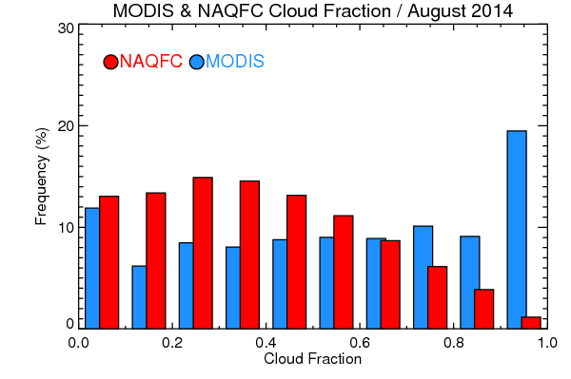
Cloud Fraction distribution (land only)

Slide 12
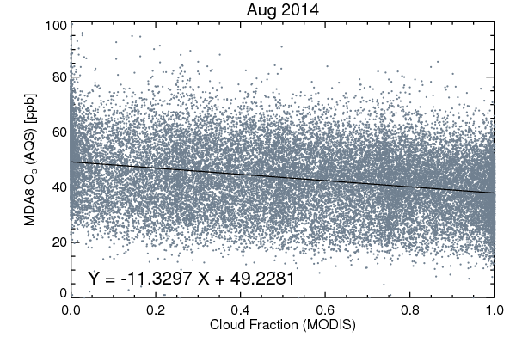
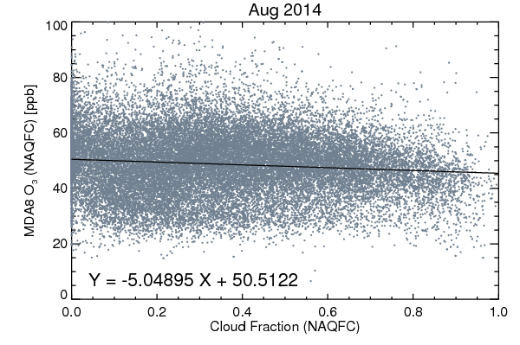
Cloud Fraction & Surface Ozone
EPA AQS MDA8 ozone (daily max 8h moving average ozone, 1024 sites)

Slide 13
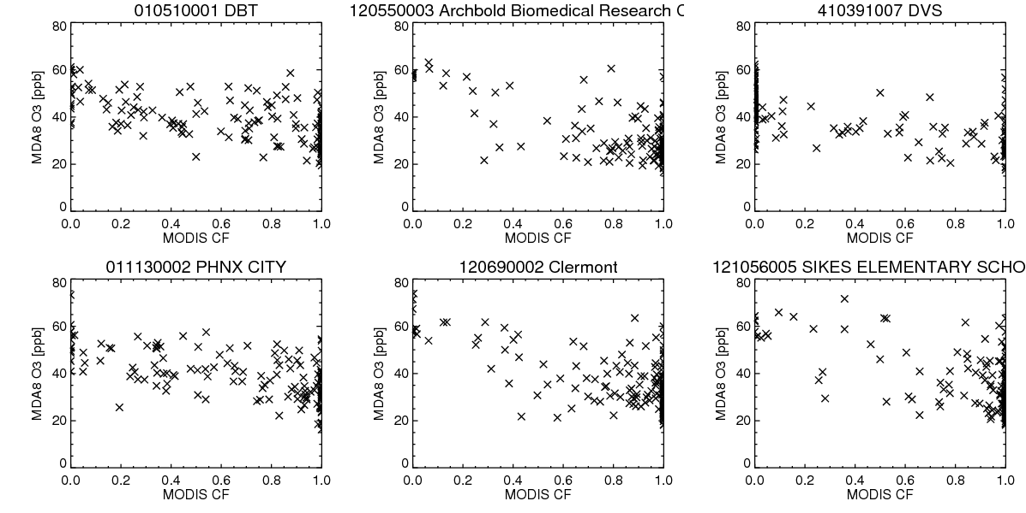
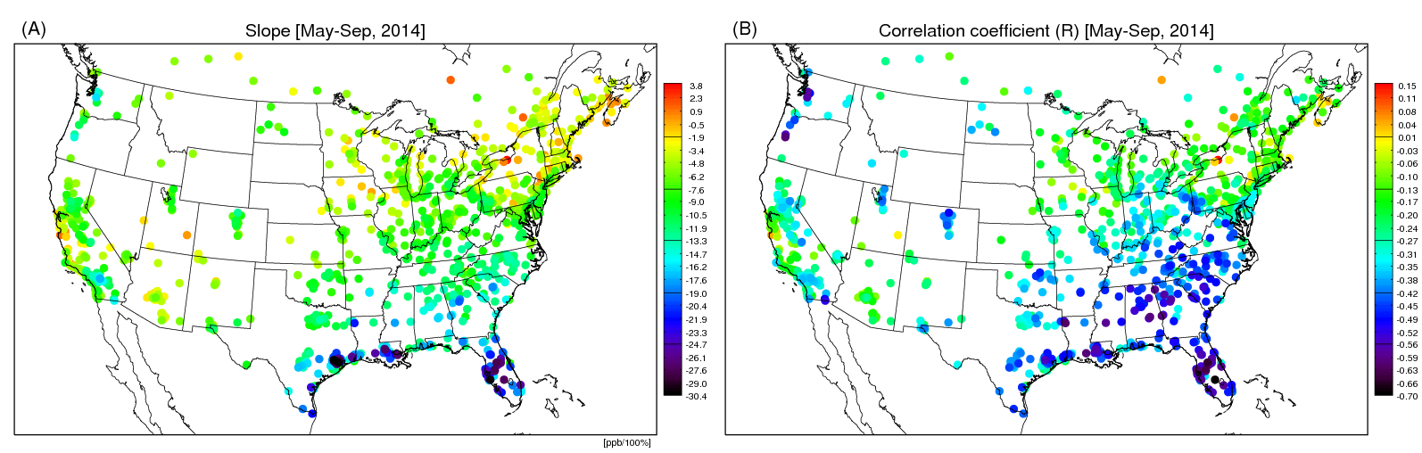

Slide 14
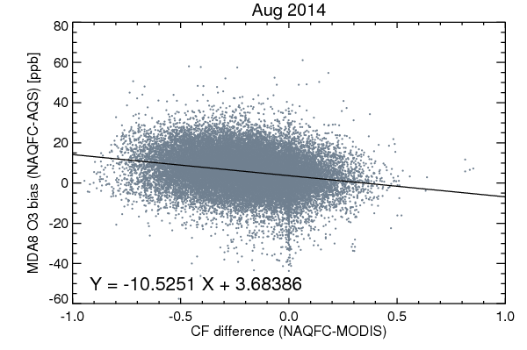
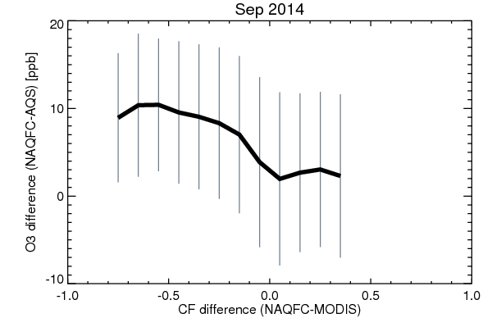
CF difference & ozone bias
Slope = -10.5 ppb/100%
Mean AQS O3 = 42.92 ppb
Mean NAQFC O3 = 48.71 ppb
Mean CF (MODIS) = 0.56
Mean CF (NAQFC) = 0.36
0.2 CF means 2.1 ppb
(36% of O₃ overestimation, 5.79 ppb)

Slide 15
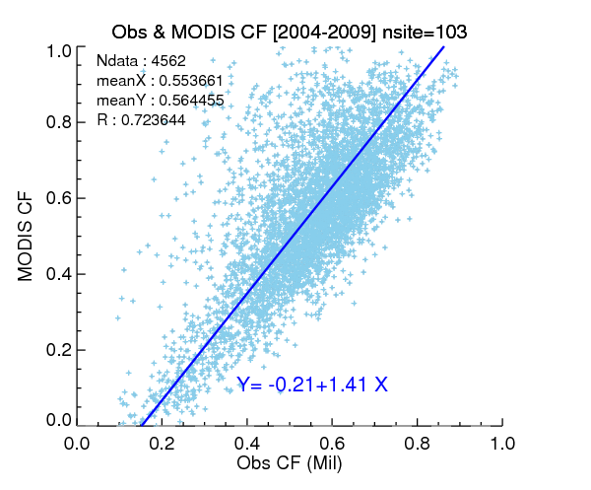
Cloud fraction comparison
(2004-2009, 103 military sites, monthly mean)

Slide 16
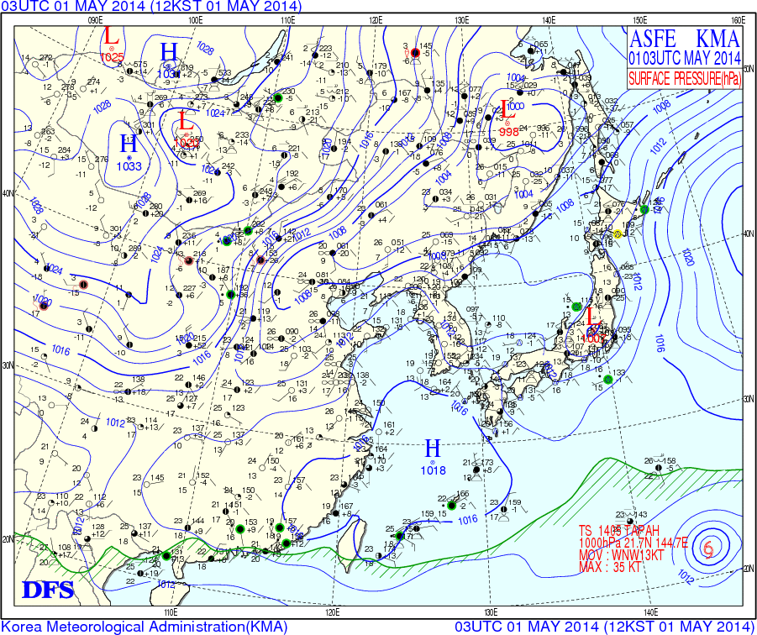
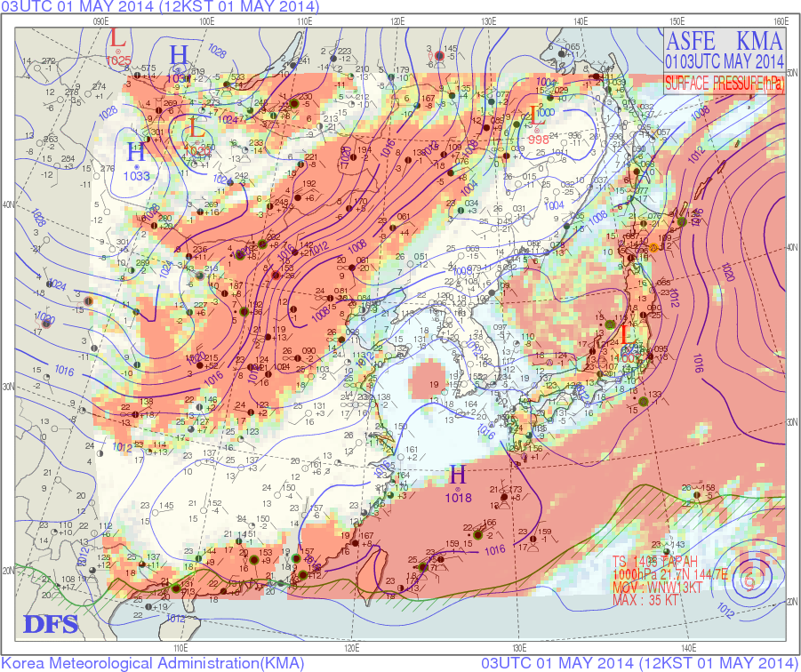
MODIS cloud fraction & weather chart
(East Asia)
Georeferencing & Alpha channel blending

Slide 17
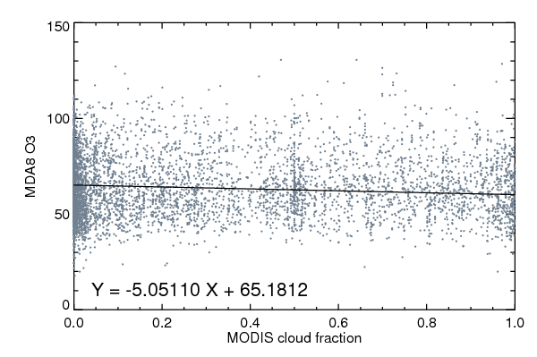
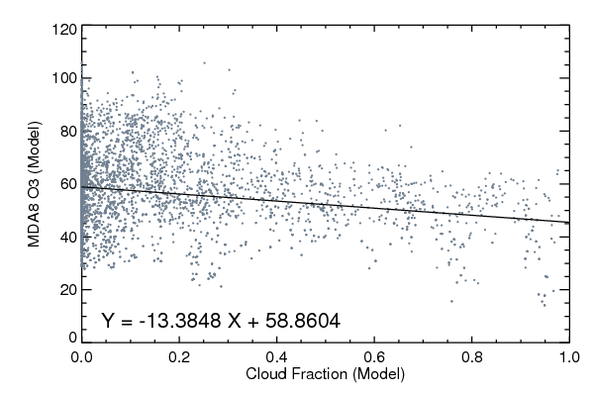
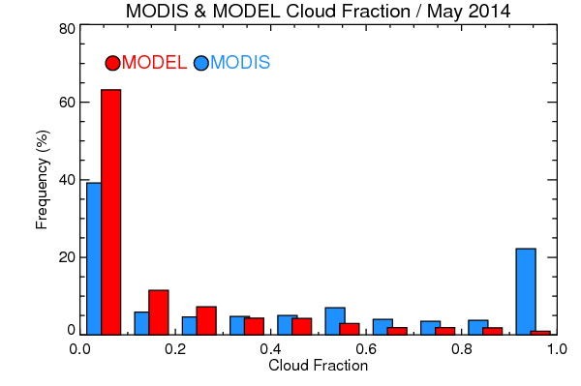
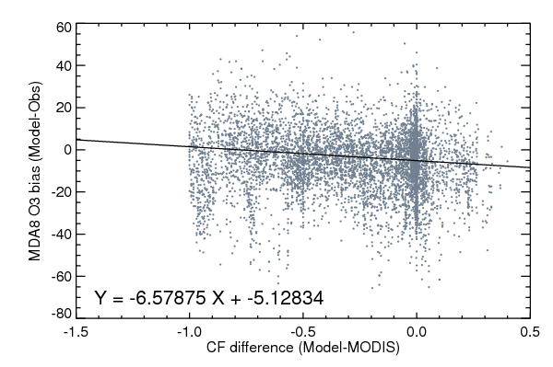
Cloud Fraction & Surface Ozone
(May 2014)

Slide 18
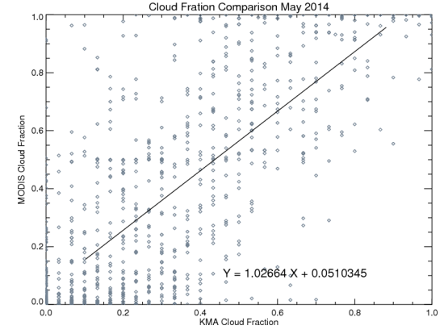
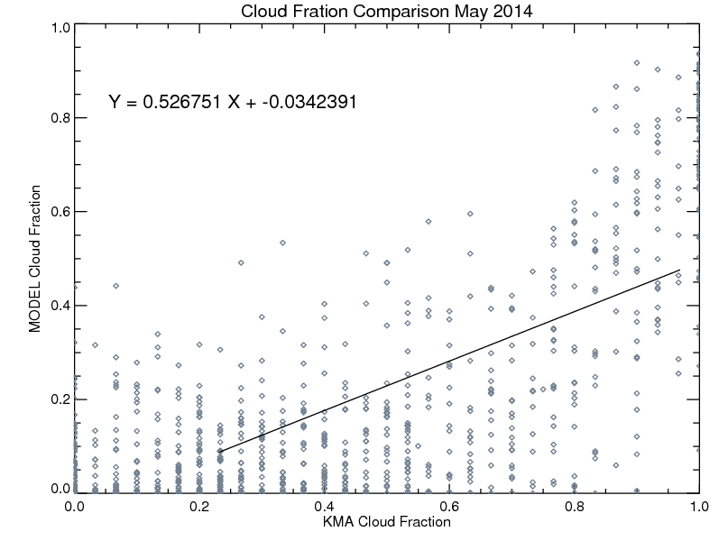
Cloud fraction comparison
(May 2014, KMA)
MODIS
Model
OBS
OBS
MODIS CF is slightly higher than KMA CF while CMAQ CF shows considerable underestimation.

Slide 19
Long-term cloud fraction comparison
(Observation & Global Models)
723910: US Point Mugu NAS latitude: 34.117, longitude: -119.117
CFSR_18Z monthly mean
JRA-55 monthly mean
ECMWF_18Z monthly mean
MERRA_18Z monthly mean
(Courtesy by Hye-Lim Yoo)

Slide 20
Who cares cloud fraction….?
If radiation is OK
Climate model doesn’t care cloud fraction ….
Weather model doesn’t care cloud fraction ….
Air quality model doesn’t care…
If precipitation is OK
and blame emission

Slide 21
Future works
Radiation-based photolysis adjustment
  Correlation of cloud fraction & radiation
  Cloud type (Low-, Middle-, High- cloud types)
More satellite cloud products
  GOES (temporal resolution)
  MODIS (cloud type)
  VIIRS (spatial resolution)

Slide 22
Take Home Messages
The photolysis rate is crucial in photochemistry. It can be calculated using RTM, and is adjusted using the cloud coverage (e.g. cloud fraction).
The definition of cloud fraction is ambiguous, and not physically consistent in model, in satellite, and in situ observation.
Cloud fraction differences are associated with surface ozone biases.
Current modeled cloud fields are too bright (less cloud fraction), having a possibility to cause overestimation of surface ozone production.

