Slide 1
Reactive plume modeling of HRVOC emissions from the Houston Ship Channel
Prakash Karamchandani¹, David Parrish², Lynsey Parker¹, Thomas Ryerson³, Paul O. Wennberg⁴, Alex Teng⁴ , John D. Crounse⁴,
Greg Yarwood¹
¹Ramboll Environ, Novato, CA
²David.D.Parrish, LLC, Boulder, CO
³NOAA ESRL Chemical Sciences Division, Boulder, CO
⁴California Institute of Technology, Pasadena, CA
14th Annual CMAS Conference
Chapel Hill, North Carolina, October 5-7, 2015

Slide 2
AcknowleDgementS
This research was supported by the State of Texas through the Air Quality Research Program (AQRP) administered by The University of Texas at Austin by means of a grant from the Texas Commission on Environmental Quality (TCEQ), AQRP Project 14-026
The TCEQ has not yet fully reviewed the findings presented here

Slide 3
Background & Objectives
Enhanced O₃ in Houston associated with HRVOC (ethene, propene, butenes, 1,3-butadiene) emissions from the Houston Ship Channel (HSC)
Objective of study: improve and quantify understanding of O₃ and HCHO from HRVOC emissions from the HSC
Quantifying relative contributions of HRVOCs has been difficult
Recent aircraft (NASA DC-8) measurements in Houston during the 2013 SEAC⁴RS study provide unique data to quantify contributions:
Caltech measurements of β-hydroxynitrates (βHNs), formed when HRVOCs react in the atmosphere when NOx is present, downwind of the HSC
Measurements of O₃ and aldehyde enhancements in the HSC plumes
Combination of observational data analysis and reactive plume modeling to accomplish study objectives
Notes:
SEAC4RS: Studies of Emissions and Atmospheric Composition, Clouds and Climate Coupling by Regional Surveys

Slide 4
HSC Plume Modeling with SCICHEM 3.0*
Lagrangian 3-D puff model
Puff dispersion based on SCIPUFF (Second Order Closure Integrated Puff Model)
Full chemistry treatment, comparable to CAMx and CMAQ
Chemistry updates to SCICHEM 3.0 for HRVOC modeling:
CB6r2 chemistry mechanism
HRVOC tracer mechanism to estimate direct O₃ and aldehyde formation from individual alkenes
Oxidation of individual alkenes in the presence of NOx
Formation of βHNs, O₃, and aldehydes
_________________________________________________________
*See SCICHEM 3.0 poster on October 6, 2015

Slide 5
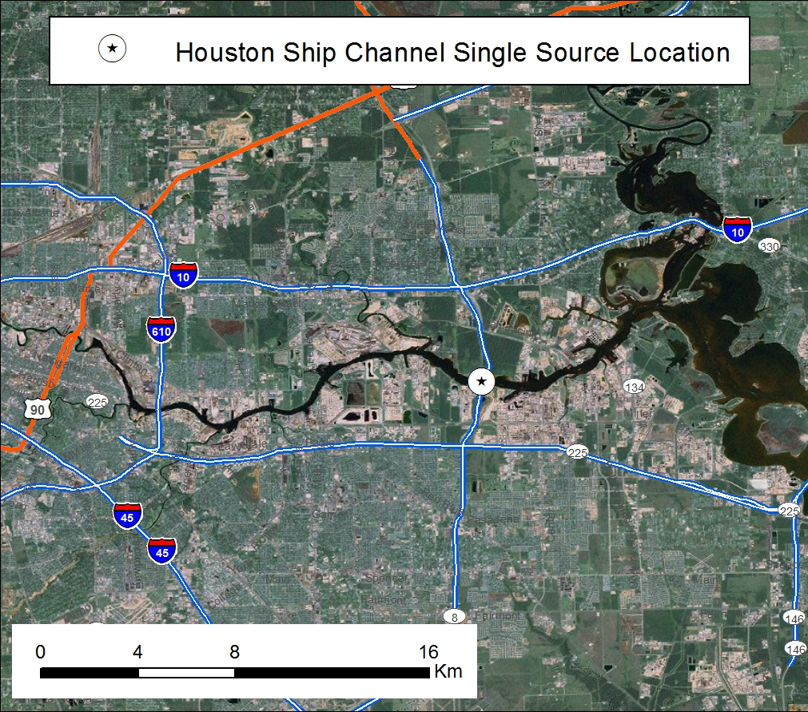
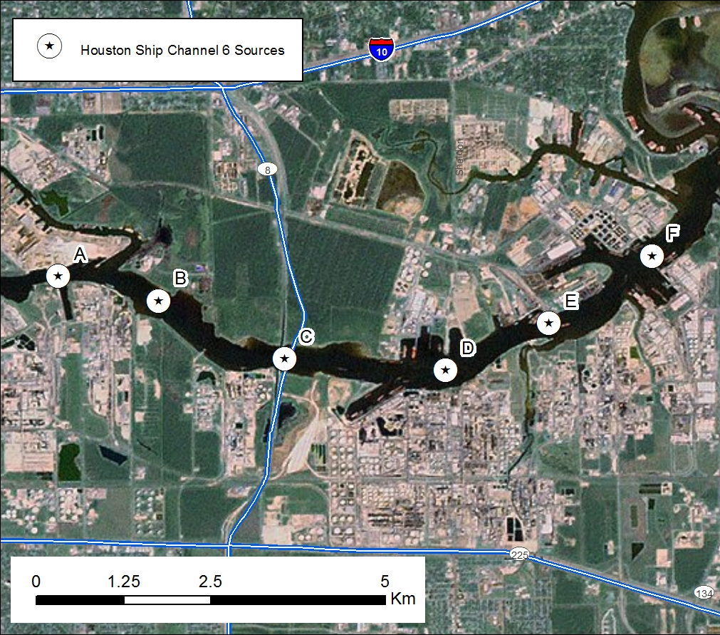
HSC Source Configurations FOR SCICHEM
Base Case – 1 source
Sensitivity Studies – 6 sources
HSC emissions of ethene, propene, HCHO and NOx based on 2011 Solar Occultation Flux (SOF) and mobile DOAS measurements of Johansson et al. (2014a; 2014b)
Notes:
Measurements over the HSC provide near-source ratios of individual alkenes
Specification of background: surface emissions for large regions (60 km by 60 km) using CAMx gridded emissions
SOF: utilizing the absorption of direct solar infrared radiation. The SOF method utilizes the sun as the light source and gas species that absorb
in the infrared portion of the solar spectrum are measured.
DOAS: differential optical absorption spectroscopy

Slide 6
Specification of Background Chemistry
Typically specified as fixed or diurnally varying concentrations
Different approach adopted in this study:
Simultaneous simulation of transport and chemistry of background surface emissions and HSC emissions
Regionally averaged (60 km by 60 km boxes) surface background emissions to the west, south and northeast of the HSC
Based on CAMx inputs for the Houston-Galveston-Brazoria (HGB) 4 km modeling domain
Allows more accurate interaction of regional background with the Ship Channel plume since background evolves along with the plume
Notes:
SEAC4RS: Studies of Emissions and Atmospheric Composition, Clouds and Climate Coupling by Regional Surveys

Slide 7
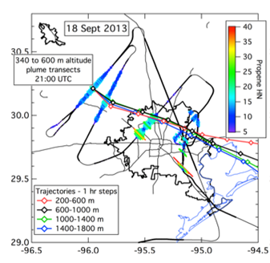
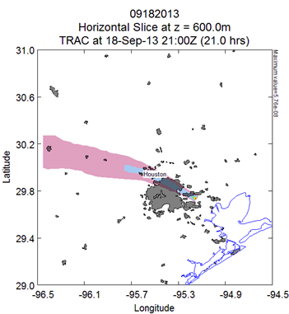
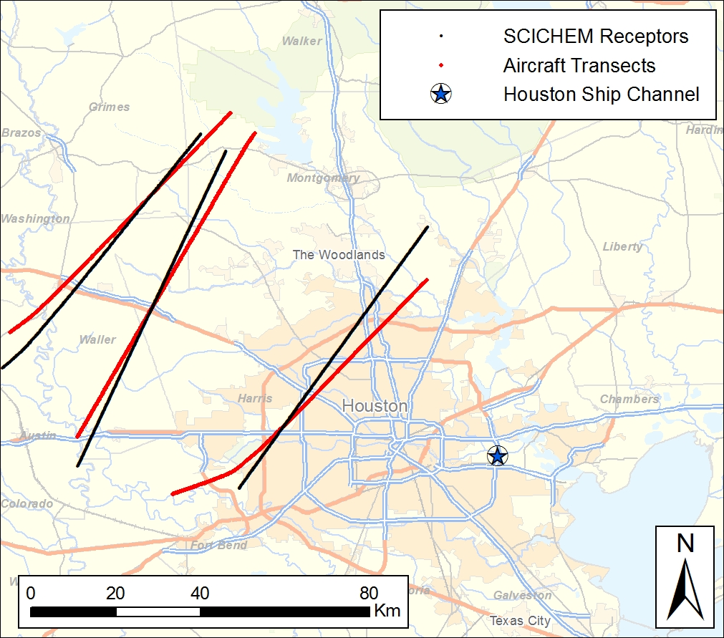
Plume TRANSPORT On September 18, 2013
T100
T80
T40
Aircraft Measurements
Modeled Plume
Aircraft and Model Transects
Notes:
Plume transported to the WNW of HSC
Downwind transects between 20:30 to 21:00 UTC at distances of 40 km, 80 km and 100 km from the HSC

Slide 8
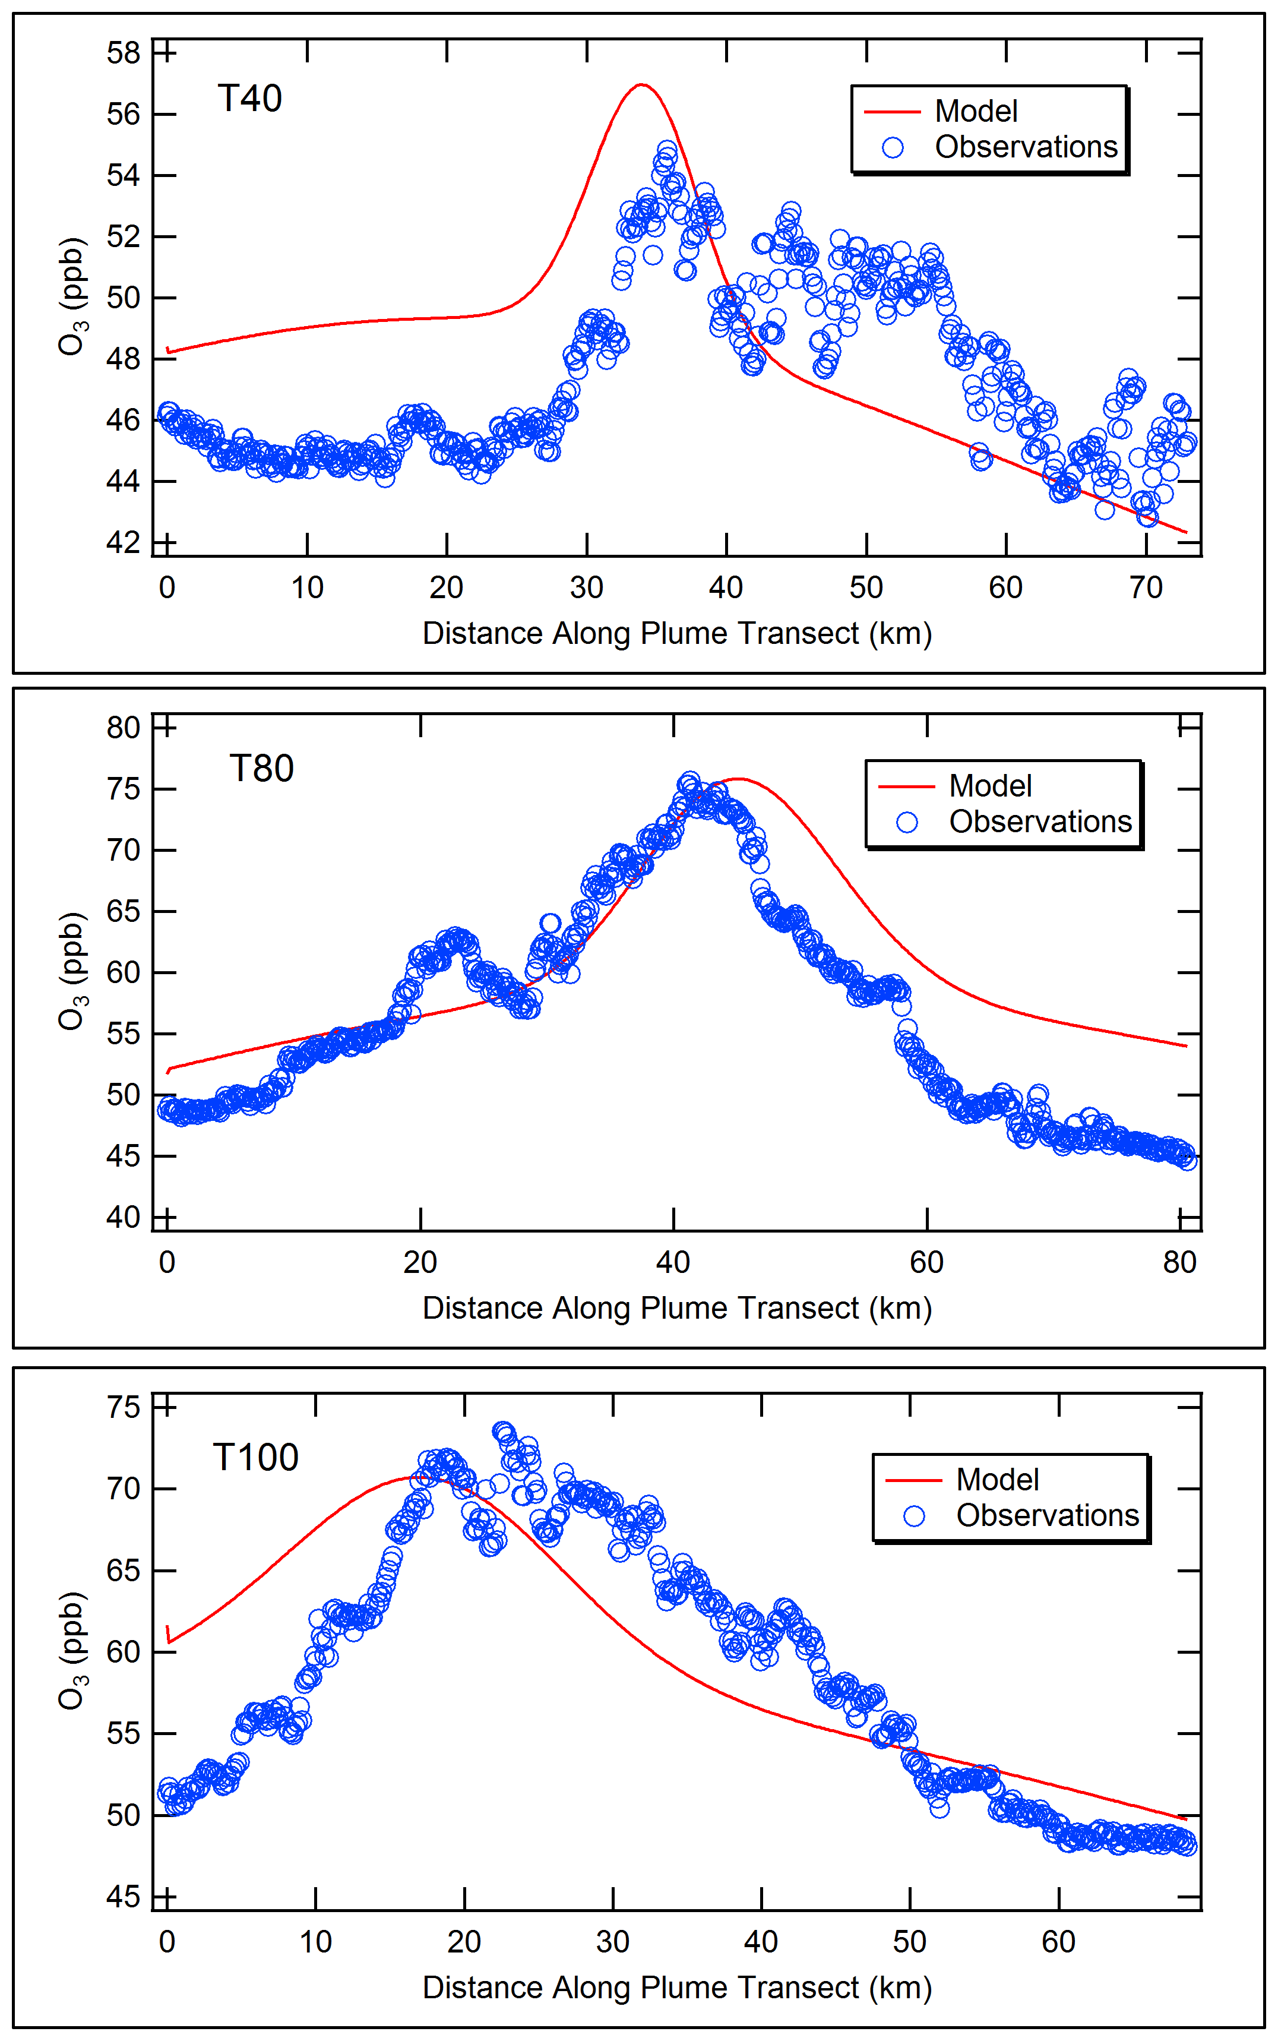
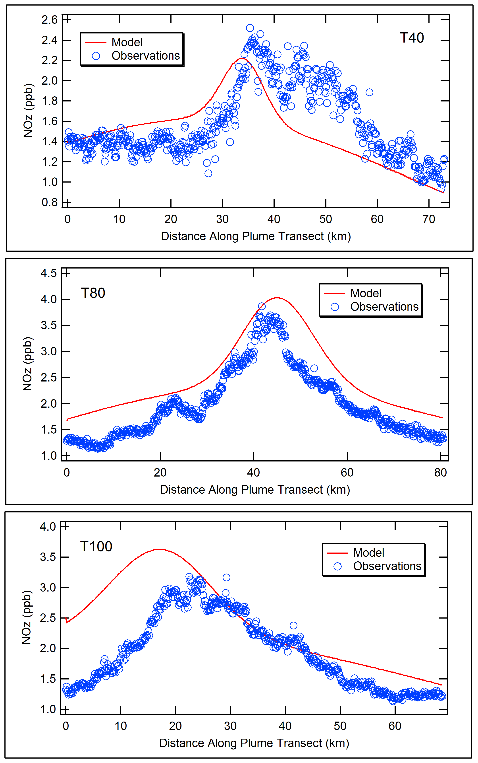
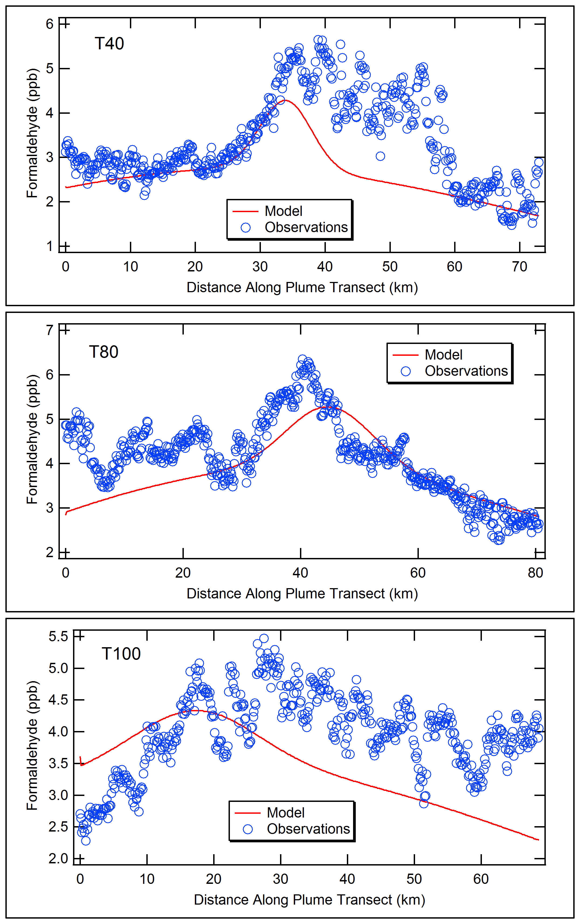
Model vs Measurements-Single HSC Source
O₃
HCHO
40 km
NOz
80 km
100 km

Slide 9
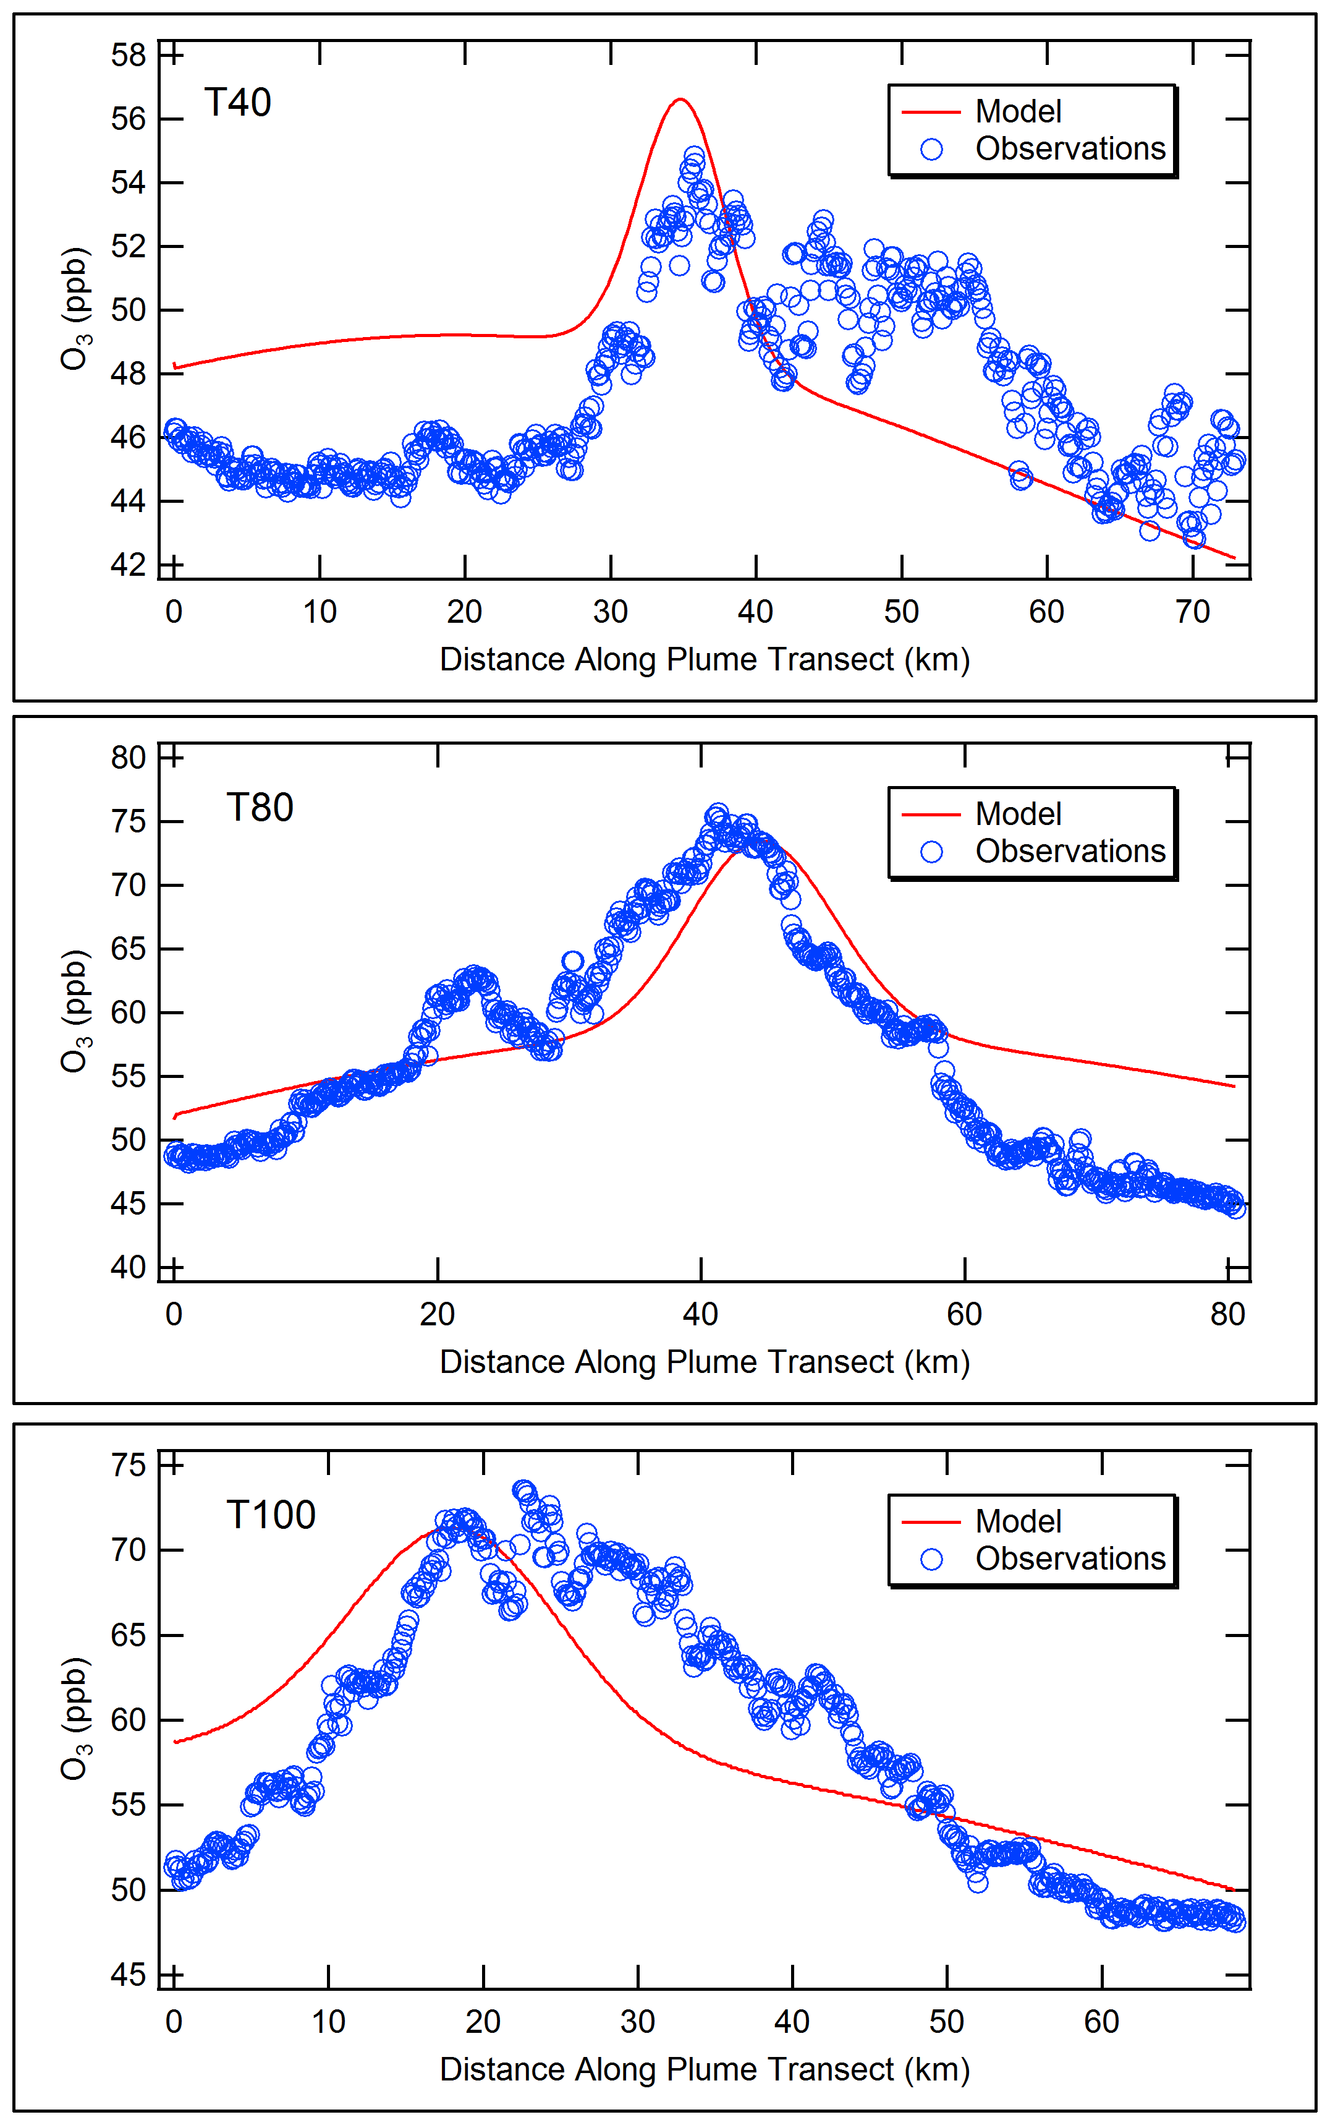
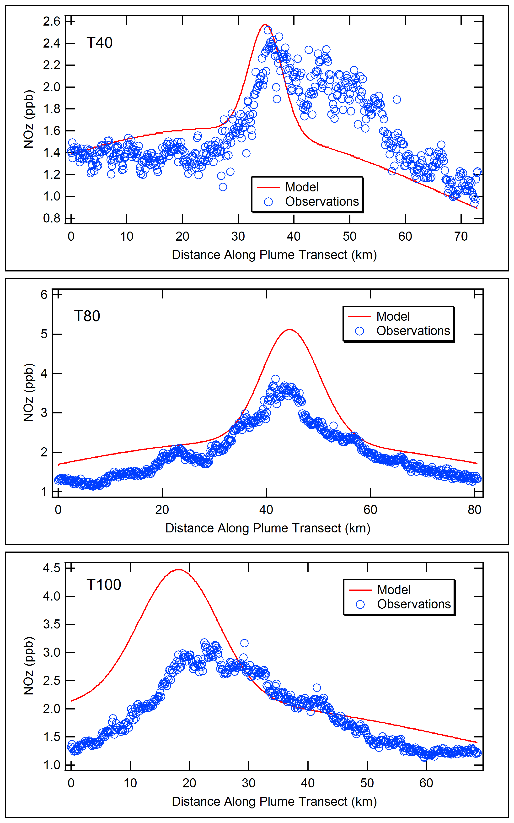
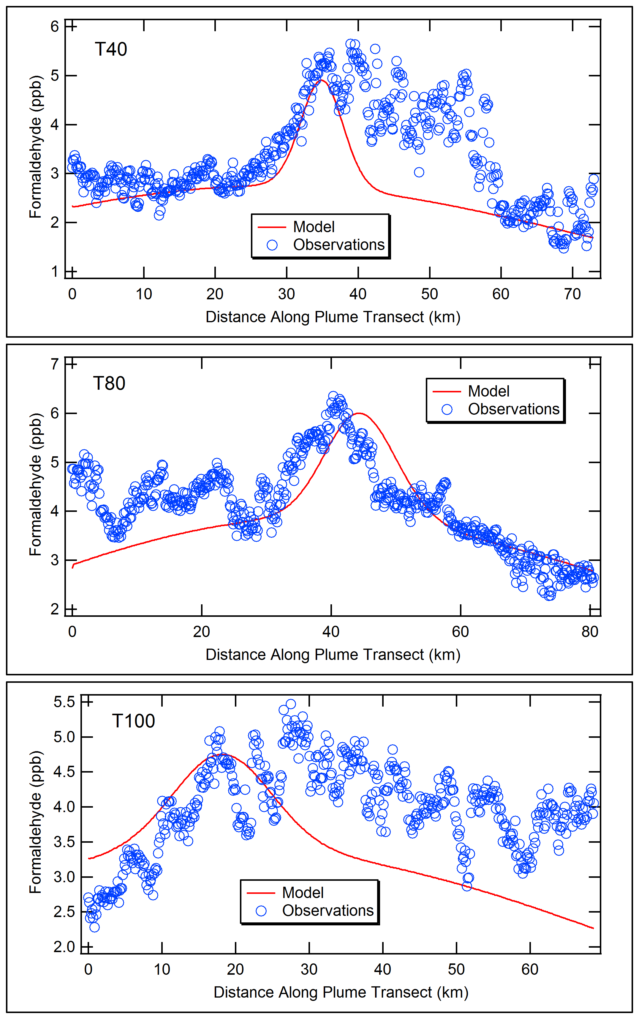
Model vs Measurements-MULTIPLE HSC Sources
O₃
NOz
HCHO
40 km
80 km
100 km

Slide 10
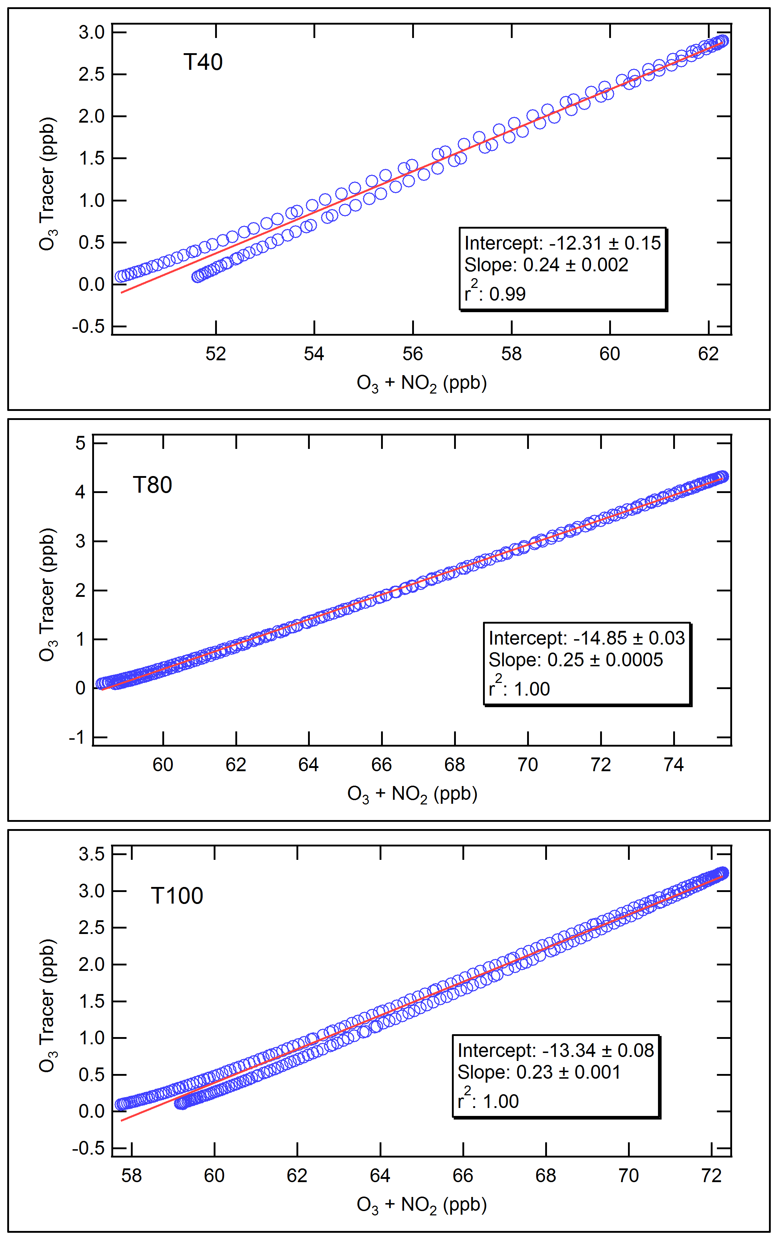
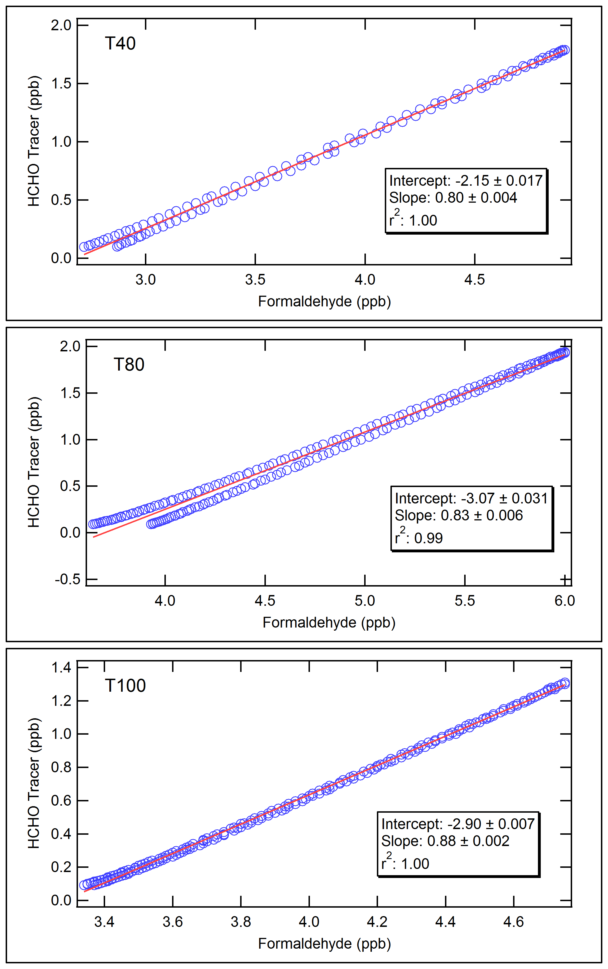
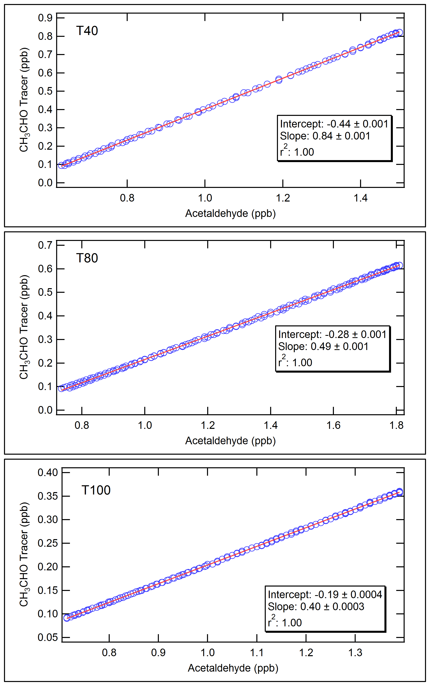
DIRECT (AND indirect) contributions
O₃ 24%
HCHO 80%
CH₃CHO 84%
40 km
25%
83%
49%
80 km
23%
88%
40%
100 km

Slide 11
INDIVIDUAL HRVOC Contributions to downwind O₃ FORMED DIRECTLY FROM HRVOCS
From Plume Model
HRVOC | 40 km downwind ΔO₃ = 2.3 ppb | 80 km downwind ΔO₃ = 2.7 ppb | 100 km downwind ΔO₃ = 2.1 ppb
Ethene | 24% | 32% | 34%
Propene | 36% | 36% | 35%
Butenes | 37% | 30% | 29%
1,3-Butadiene | 3% | 2% | 2%
From Observational Analysis of βHN Measurements
HRVOC | 40 km downwind ΔO₃ = 2.7 ppb | 80 km downwind ΔO₃ = 3.0 ppb | 100 km downwind ΔO₃ = 2.6 ppb
Ethene | 37% | 53% | 53%
Propene | 39% | 26% | 27%
Butenes | 19% | 15% | 14%
1,3-Butadiene | 6% | 6% | 6%

Slide 12
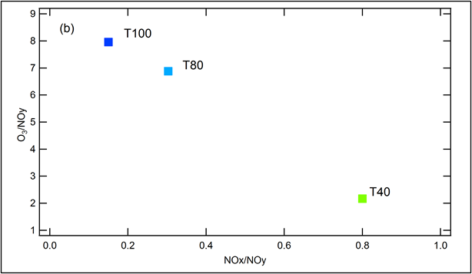
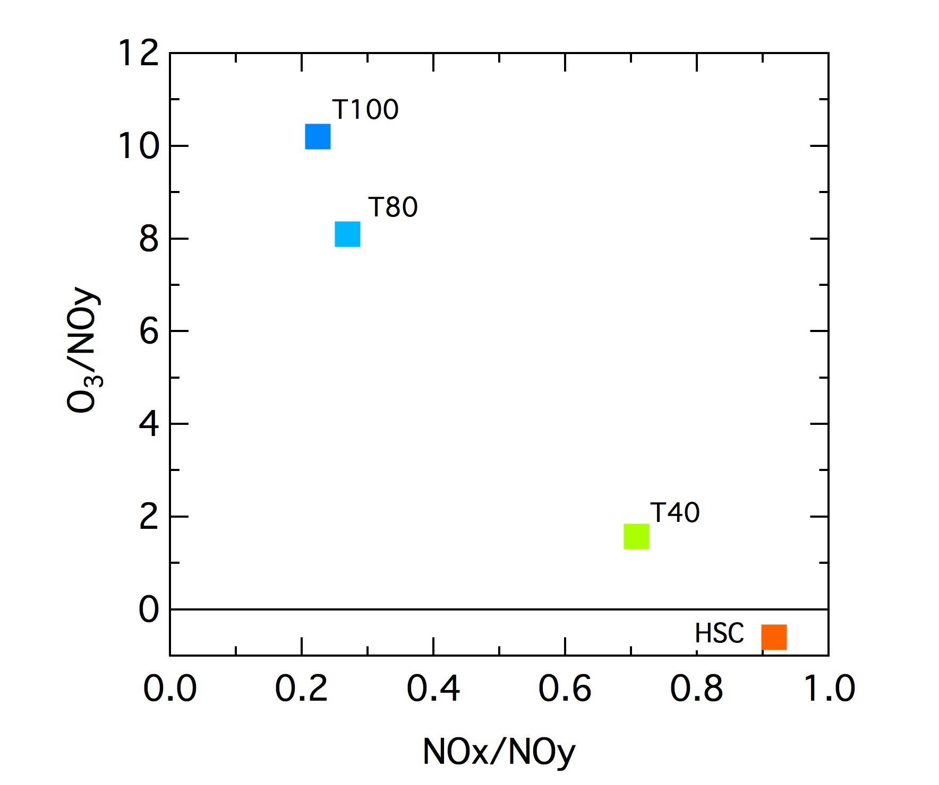
O₃ Production Efficiency vs. Plume Photochemical AGE
From Plume Model
From Measurements

Slide 13
SENSITIVITY STUDIES: SEGREGATING Nox and VOC
No Segregation
Divide HSC VOC and NOx emissions equally among 6 sources
Total Segregation
Sources A, C, E: NOx only
Sources B, D, F: VOC only
Partial Segregation
Sources A, C, E: 90% of total NOx, 10% of total VOC
Sources B, D, F: 90% of total VOC, 10% of total NOx

Slide 14
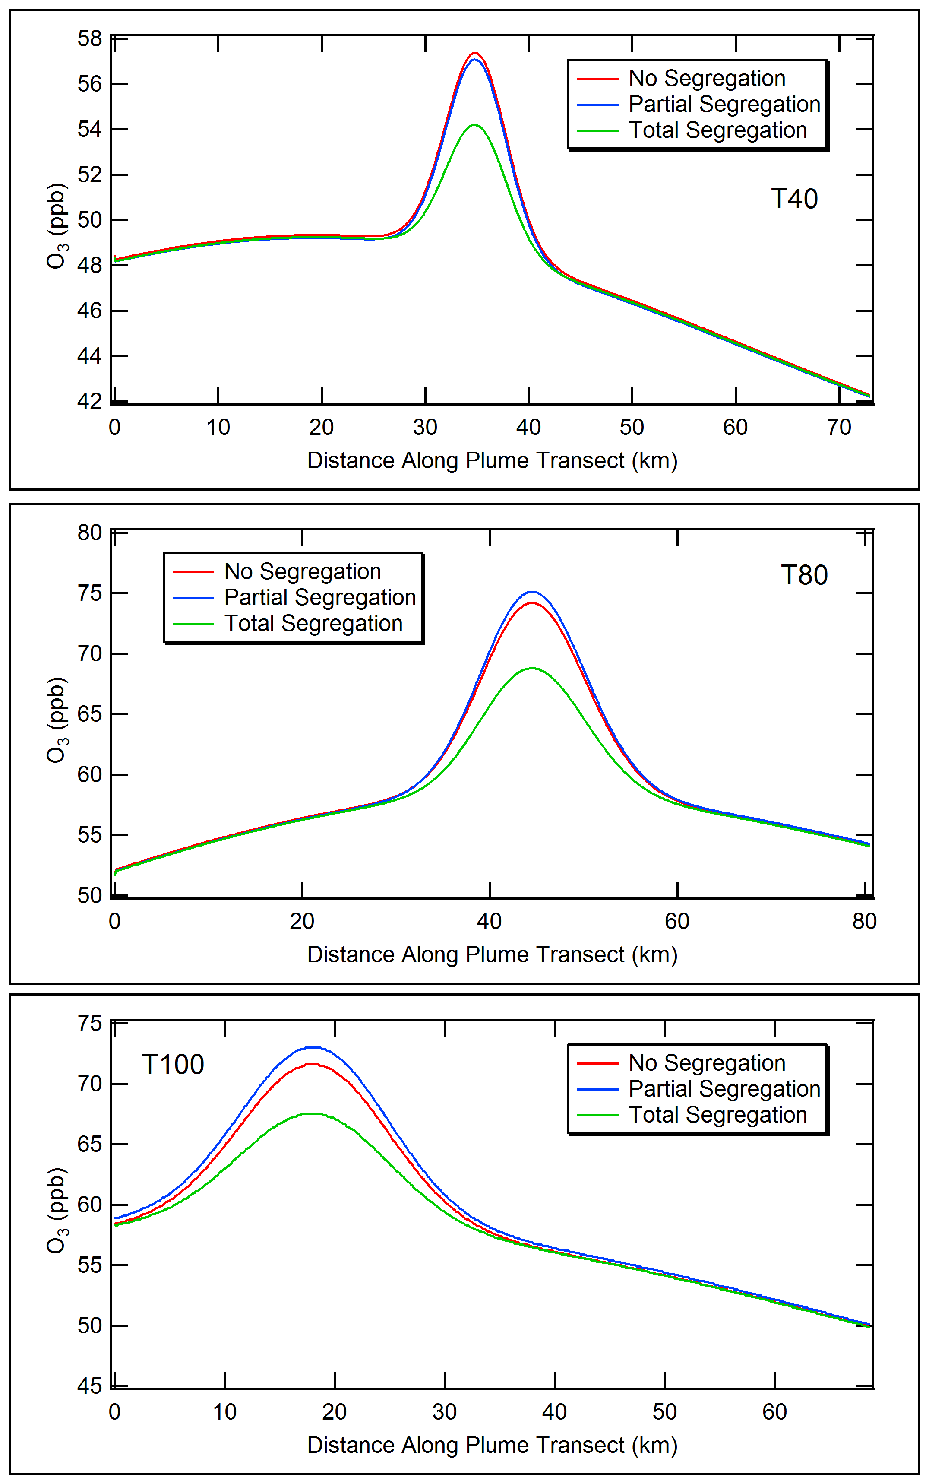
Effect of Nox and VOC segregation
SCICHEM allows overlapping plumes to interact chemically
Total segregation slows down chemistry as NOx and VOC plumes are separated initially
Partial segregation has small impact
Implications for fine-scale modeling

Slide 15
Conclusions
O₃ in modeled plume downwind of HSC is in good agreement with observations
NOz and aldehyde results show that chemistry proceeds more slowly in the modeled plume than observed during early plume stages when one large source represents HSC emissions
Overall effect of using multiple narrower source plumes is more rapid chemistry and better model performance at 40 km downwind
Direct formation of O₃ from the HSC HRVOC emissions explains about 20% of the plume O₃ increments: remaining O₃ formed indirectly by the interaction of HSC emissions with emissions of other species (e.g., isoprene)
Plume chemistry is sensitive to whether HRVOC and NOx are released together or segregated in separate plumes that interact as they disperse and overlap each other

Slide 16
Limitations of Study
Actual HSC emissions for 18 September 2013 are not known (but estimates from 2011 SOF measurements work quite well in the model)
18 September 2013 had moderate ozone enhancements; higher direct contributions are expected for days with higher HRVOC emissions
The modeled HSC source locations are conceptual scenarios

Slide 17
Recommendations for Future Studies
Understand direct versus indirect O₃ formation from HRVOC emissions
Interaction of HRVOC plumes with background emissions; role of isoprene
Investigation of the role of initial plume width and emissions segregation on O₃ production from industrial sources
Plume modeling
Fine-scale grid modeling

