Slide 1
Evaluation of CMAQ prediction of carbon monoxide vertical profiles against SENEX
Nina Randazzo*, Daniel Tong¥, Pius Lee¥, Li Pan¥, Min Huang¥
* =CICS/UMD, ¥ = NOAA/ARL

Slide 2
Purpose
To evaluate CMAQ CO in the upper and lower troposphere in the SE US
To determine whether biomass burning may have influenced the accuracy of predictions even in areas dominated by anthropogenic emissions
Importance of CO
  Used to determine emissions of other trace gases through ratios of gas concentrations; combustion tracer
  Ozone precursor
  Criteria pollutant
Notes:
CMAQ is an atmospheric chemistry model that is used by NOAA’s Air Resources Laboratory for air quality forecasting.
This project was an evaluation of CMAQ carbon monoxide predictions aloft. The Southeast United States was chosen as the region of focus because the Southeast Nexus (SENEX) aircraft campaign of 2013 provided a large amount of aloft in situ data for comparison.
The SENEX flights were planned to capture anthropogenic emissions: power plant emissions, shale leakage, and agricultural emissions. I thought it would be interesting to use this opportunity to determine whether biomass burning may significantly affect the accuracy of carbon monoxide predictions even in areas where other emissions dominate.
Carbon monoxide prediction is important for several reasons. Carbon monoxide can be used to determine allocation of emissions of other trace gases through the ratios of gas concentrations. Also, due to its atmospheric lifespan of several months, carbon monoxide is useful to detect pollution plumes, since the lifespan is not so long that the gas becomes too well-mixed to detect a plume, but also is not so short that transportation cannot be traced.
Carbon monoxide is also an ozone precursor, with important implications for human health, and is a criteria pollutant. Understanding how this compound is distributed in the atmosphere may be relevant to public health.

Slide 3
Methods
Determination of biomass burning influence on different flights and different altitudes through acetonitrile (C2H3N) concentrations and C2H3N-CO correlations
Production of CMAQ output using version 4.7.1 with the following inputs:
  Anthropogenic emissions: NEI 05 with projections to 2013
  Biogenic emissions: BEIS 3.13
  Wild fire: HMS and BLUE SYS
Matching of CMAQ output to SENEX observations by time, altitude, and horizontal coordinates
Statistical analysis
Notes:
I split the data at 2km altitude as an estimate for the cutoff between the lower and free troposphere. I determined biomass burning influence on carbon monoxide concentrations for these data sets by calculating the correlation between acetonitrile and carbon monoxide. Although carbon monoxide can be generated by many sources, many of them anthropogenic, acetonitrile is primarily put into the atmosphere through biomass burning. So, if carbon monoxide concentrations rise consistently and linearly with acetonitrile concentrations, it may be assumed that much of the increase in carbon monoxide can be attributed to a source that also produces acetonitrile, such as biomass burning.
Once I determined a mix of data sets with different acetonitrile-carbon monoxide correlations and concentrations, our lab produced 3-dimensional CMAQ output for CO using version 4.7.1. The anthropogenic emission input was the National Emissions Inventory 2005 extrapolated to 2013. For biogenic emissions, we used the Biogenic Emissions Inventory System 3.13 run inline. For wild fire emissions, we used the Hazard Mapping System predictions and BlueSys.
We then matched CMAQ output to SENEX observations by matching UTC time to the model 12Z time, GPS altitude to model layer, and GPS coordinates to the model grid, and we ran a statistical analysis and compared the model performance for the case studies.

Slide 4
Possible Causes of High Acetonitrile
Biomass burning (Holzinger et al. 1999)
  Plume in lower troposphere indicates that the fire would probably have occurred nearby
  Plume in upper troposphere indicates transport
Fireworks (Drewnick et al. 2006)
  No evidence of high acetonitrile or a high acetonitrile-carbon monoxide correlation in a nearby sampled area from the SENEX 7/05 flight
Notes:
Biomass burning is a well-documented source of acetonitrile, and it appears to be the dominant source of acetonitrile in the atmosphere. High acetonitrile in the lower troposphere may indicate nearby biomass burning, whereas high acetonitrile in the upper troposphere is more likely to be the result of a plume transported from further away.
Fireworks have also been documented to produce acetonitrile. There was no flight on July 4th to see a strong fireworks plume, though. July 5th did not display obviously elevated acetonitrile. July 3rd did display high acetonitrile, so it may be plausible that some of this may have been influenced by early Independence day festivities.

Slide 5
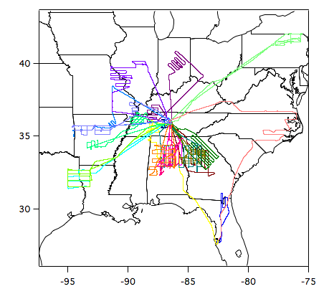

SENEX Campaign Region
A series of 19 aircraft flights in the SE US in 2013
Focused on anthropogenic emissions
CO measured using UV resonance fluorescence
VOCs measured using chemical ionization mass spectrometer
I will focus on 3 case studies
Image from: http://www.esrl.noaa.gov/csd/groups/csd7/measurements/2013senex/P3/flighttrack/
Notes:
SENEX was a series of 19 flights. Again, the campaign took place in the Southeast United States in 2013 and focused on anthropogenic emissions. The data I’m using is the carbon monoxide measurements, which were taken using UV resonance fluorescence, and acetonitrile, which was measured simultaneously using a chemical ionization mass spectrometer that was used for volatile organic compounds. For this presentation, I’m going to focus on three case studies.

Slide 6
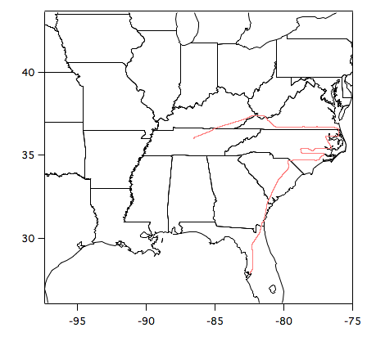
7/10/2013 SENEX Flight Path
Passed over hog CAFOs (concentrated animal feeding operations), coal mines
Notes:
On July 10th, the flight passed over hog CAFOs and coal mines. For this reason, you might expect elevated methane or particulates for parts of the flight, but carbon monoxide would not be affected by these locations to the same level as if the flight passed over a power plant.

Slide 7
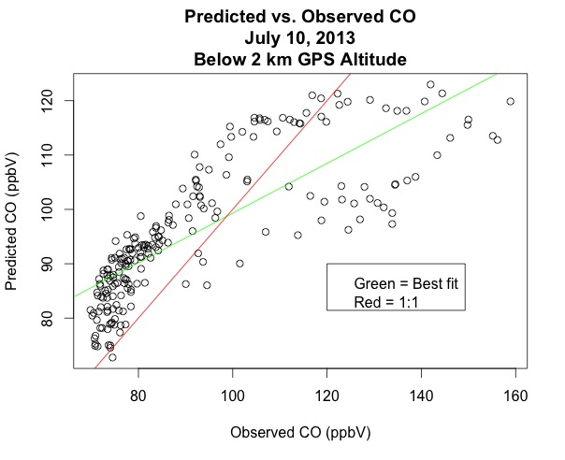
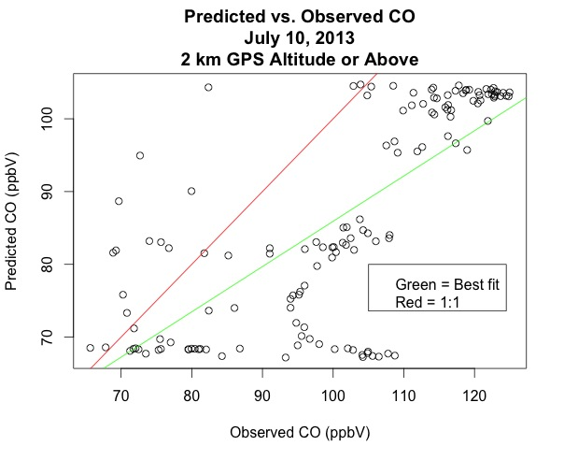
CO Evaluation 7/10
Mean bias = 3.54 ppbV
Mean error = 12.23 ppbV
N = 217
Mean bias = -14.61 ppbV
Mean error = 16.26 ppbV
N = 137
In both the lower and upper troposphere, CMAQ tends to underpredict high CO concentrations; in the upper troposphere, there was an overall underprediction.
Notes:
Here I have scatter plots for both above and below 2km altitude. The x axis is the observation of carbon monoxide from SENEX, and the y axis is the corresponding CMAQ prediction. The red line is the 1:1 line, and the green line is the line of best fit. As you can see, the slope of the line of best fit is less than one, indicating that predictions are higher for lower observational values and lower for higher observational values relative to the observation. At under 2km, the mean bias is fairly low because the overpredictions somewhat cancel out the uderpredictions. At higher altitudes, there is a more significant negative bias and also a greater spread.

Slide 8
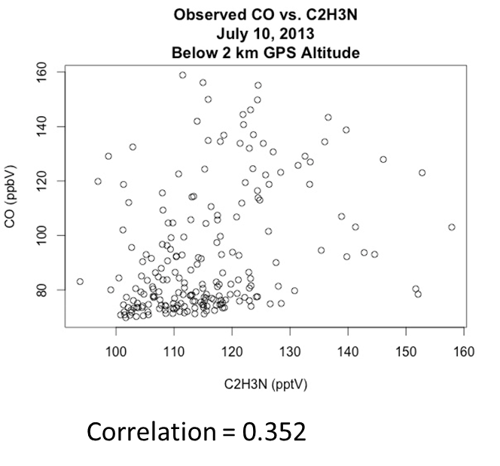
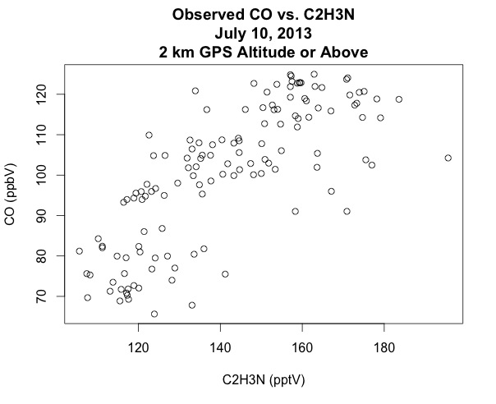
CO-C2H3N Correlation 7/10
Correlation = 0.758
The correlation is fairly high in the upper troposphere, but there is no obvious plume.
Notes:
There is fairly high correlation between acetonitrile and carbon monoxide at a higher altitude, but a low correlation at a lower altitude. Concentrations are a little bit high for the upper troposphere, but there’s no obvious plume. The high correlation between CO and our biomass burning marker compound could simply have occurred because of the absence of a major anthropogenic plume drowning out the background, which could include biomass burning emissions.

Slide 9
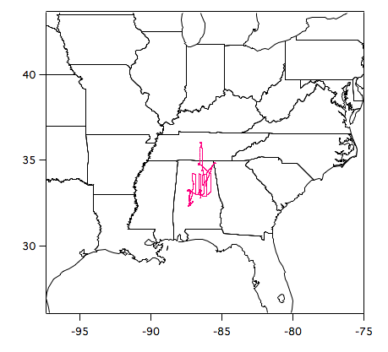
6/29/2013 SENEX Flight Path
Passed over Birmingham, several paper mills
Notes:
The June 29th flight passed over Birmingham, a major urban center, which one would expect to be a major source of carbon monoxide for this region.

Slide 10
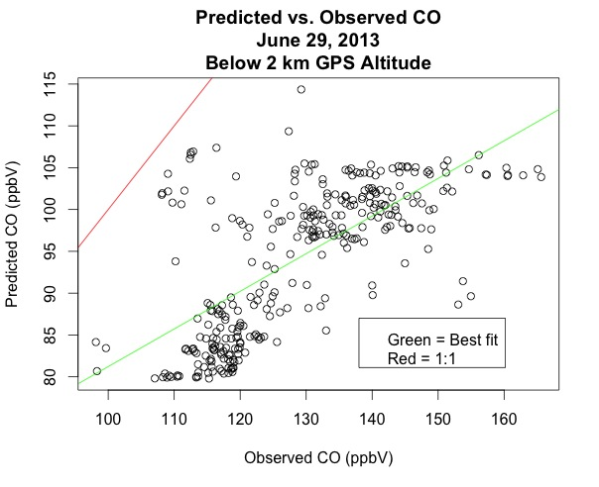
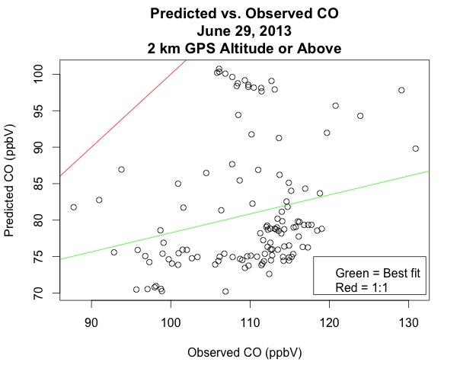
CO Evaluation 6/29
Mean bias = -34.72 ppbV
Mean error = 34.72 ppbV
N = 310
Mean bias = -28.56 ppbV
Mean error = 28.56 ppbV
N = 121
For both the upper and lower troposphere, CMAQ underestimated every data point, and the negative bias is large.
Notes:
For both the higher and lower altitudes, CMAQ had a very large negative bias, with every data point underpredicted.

Slide 11
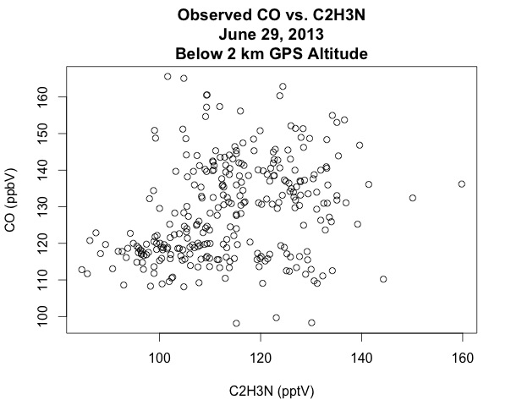
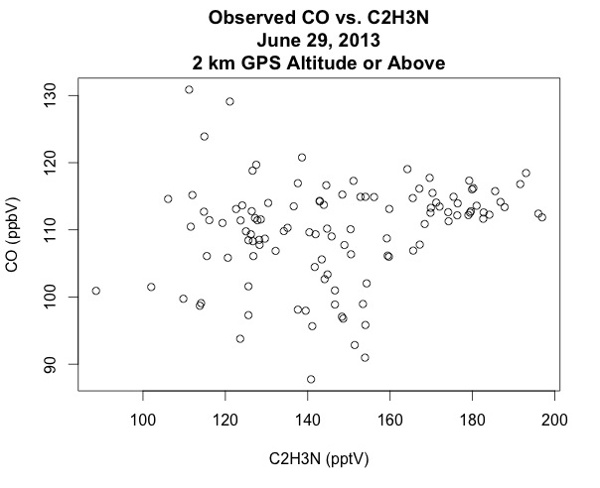
CO-C2H3N Correlation 6/29
Correlation = 0.303
Correlation = 0.303
Correlation = 0.208
The correlation is low in both the upper and lower troposphere.
Notes:
For both high and low altitudes, the correlation between carbon monoxide and acetonitrile is very low. This indicates that the carbon monoxide concentrations for this data set were probably not heavily influenced by biomass burning. There are some fairly high acetonitrile concentrations in the upper troposphere, but the relative influence of biomass burning compared to other sources seems insignificant.

Slide 12
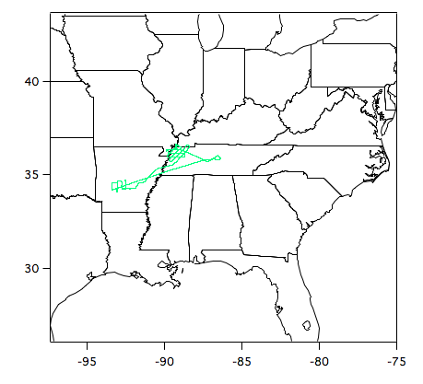
7/3/2013 SENEX Flight Path
Passed over power plants and through power plant plumes
According to PI, picked up an agricultural fire
Notes:
For July 3rd, the flight path passed over the Mississippi River and was designed to capture power plant plumes. According to the principal investigator of the SENEX campaign, this flight also picked up a plume from an agricultural fire, even though this was not the intention and was not listed on the flight plan documentation.

Slide 13
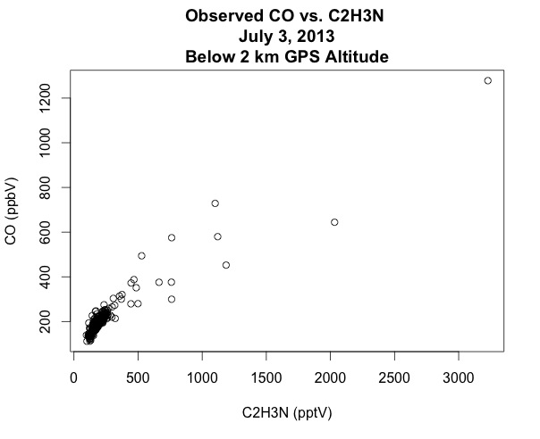
CO-C2H3N Low Altitude Correlation 7/3
Correlation = 0.935
The correlation is very high; this is the only date for which CO and C2H3N were more highly correlated in the lower troposphere than in the upper troposphere.
Notes:
I’d like to focus on this case study because even though this flight was designed to measure power plant plumes, which tend to be high in carbon monoxide but not in acetonitrile, there is a very strong correlation between carbon monoxide and acetonitrile at low altitudes, and the concentrations of acetonitrile and of carbon monoxide are very high. This was also the only flight for which the correlation between acetonitrile and carbon monoxide was higher for the lower troposphere, which tends to be more heavily influenced by local anthropogenic emissions.

Slide 14
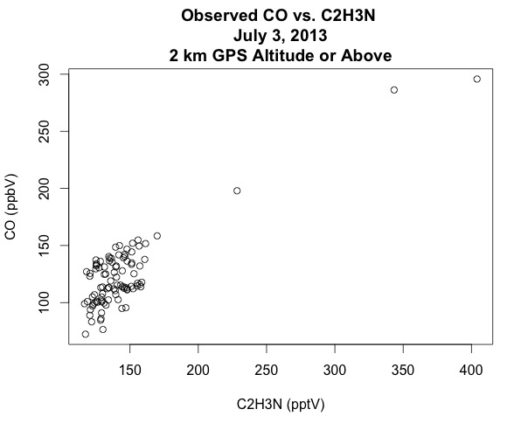
CO-C2H3N High Altitude Correlation 7/3
Correlation = 0.853
Very high correlation in the upper troposphere as well.
Notes:
The correlation was also high in the upper troposphere.

Slide 15
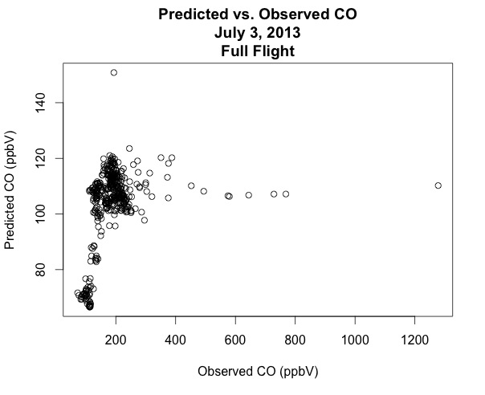
CO Evaluation 7/3
High observational values do not have correspondingly increased model values.
Notes:
Here is a scatterplot for predicted carbon monoxide versus observed carbon monoxide for the entire July 3rd flight. Again, the observed values are on the x axis, and the corresponding predicted values are on the y axis. You can see a group of very high observational values for which the model did not at all predict correspondingly higher values.

Slide 16
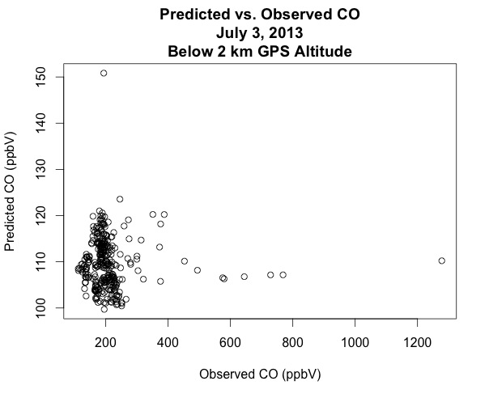
Plume 7/3
Mean bias = -98.63
Mean error = 98.63
These very high values that are not accounted for in the model are co-located with high concentrations of C2H3N, indicating a possible biomass burning plume.
Notes:
Here is the scatterplot for low altitude predicted versus observed carbon monoxide side by side with the plot showing the correlation between carbon monoxide and acetonitrile at this altitude. The mean bias is extremely large at this altitude, and the most underpredicted data points correspond with very high acetonitrile. Again, the model didn’t predict any increase in CO for these data points, indicating that perhaps the model overlooked a biomass burning plume for this day. Since the PI says that an agricultural fire occurred nearby, it’s safe to assume that this biomass burning plume was a result of the agricultural fire, which seems to have not been included in the HMS system.

Slide 17
Conclusion
CMAQ tended to underpredict aloft CO both in the lower and upper troposphere for several days in July 2013
Underpredictions tended to be more significant for higher observed values
SENEX seems to have picked up a biomass burning plume during a power plant flight
CMAQ did not catch this plume (perhaps an oversight in the HMS/BLUE SYS), resulting in extremely large underpredictions for this day
Notes:
For last bullet point: add that CMAQ also greatly underpredicted a data set that seemed to not be significantly influenced by biomass burning.

Slide 18
Acknowledgements
Funding from NOAA/CPO/AC4
SENEX PI: Joost de Gouw (NOAA/ESRL)
SENEX CO PI: John Holloway (NOAA/ESRL)
SENEX VOC PIs: Martin Graus , Carsten Warneke (NOAA/ESRL)

