Slide 1
14th Annual CMAS Conference
October 5-7, 2015
Development and Evaluation of an
Interactive Sub-Grid Cloud Framework for the
CAMx Photochemical Model
Chris Emery, Jeremiah Johnson, DJ Rasmussen, Wei Chun Hsieh,
Greg Yarwood (Ramboll Environ)
John Nielsen-Gammon, Ken Bowman, Renyi Zhang,
Yun Lin, Leong Siu (Texas A&M University)
Notes:
15 minutes total

Slide 2
Development and Evaluation of an
Interactive Sub-Grid Cloud Framework for the
CAMx Photochemical Model
Acknowledgments:
Khalid Al-Wali, Texas Commission on Environmental Quality
Gary McGaughey, University of Texas
Kiran Alapaty and Jerry Herwehe, US EPA/NERL
The DISCOVER-AQ program
The START08 program

Slide 3
Development and Evaluation of an
Interactive Sub-Grid Cloud Framework for the
CAMx Photochemical Model
Topics:
Summarize convective processes and model limitations
Project objectives
Introduce EPA’s convection updates in the Weather Research and Forecasting (WRF) meteorological model
Summarize the new CAMx convective model framework – Cloud in Grid (CiG)
Summarize evaluation of WRF + CAMx/CiG

Slide 4
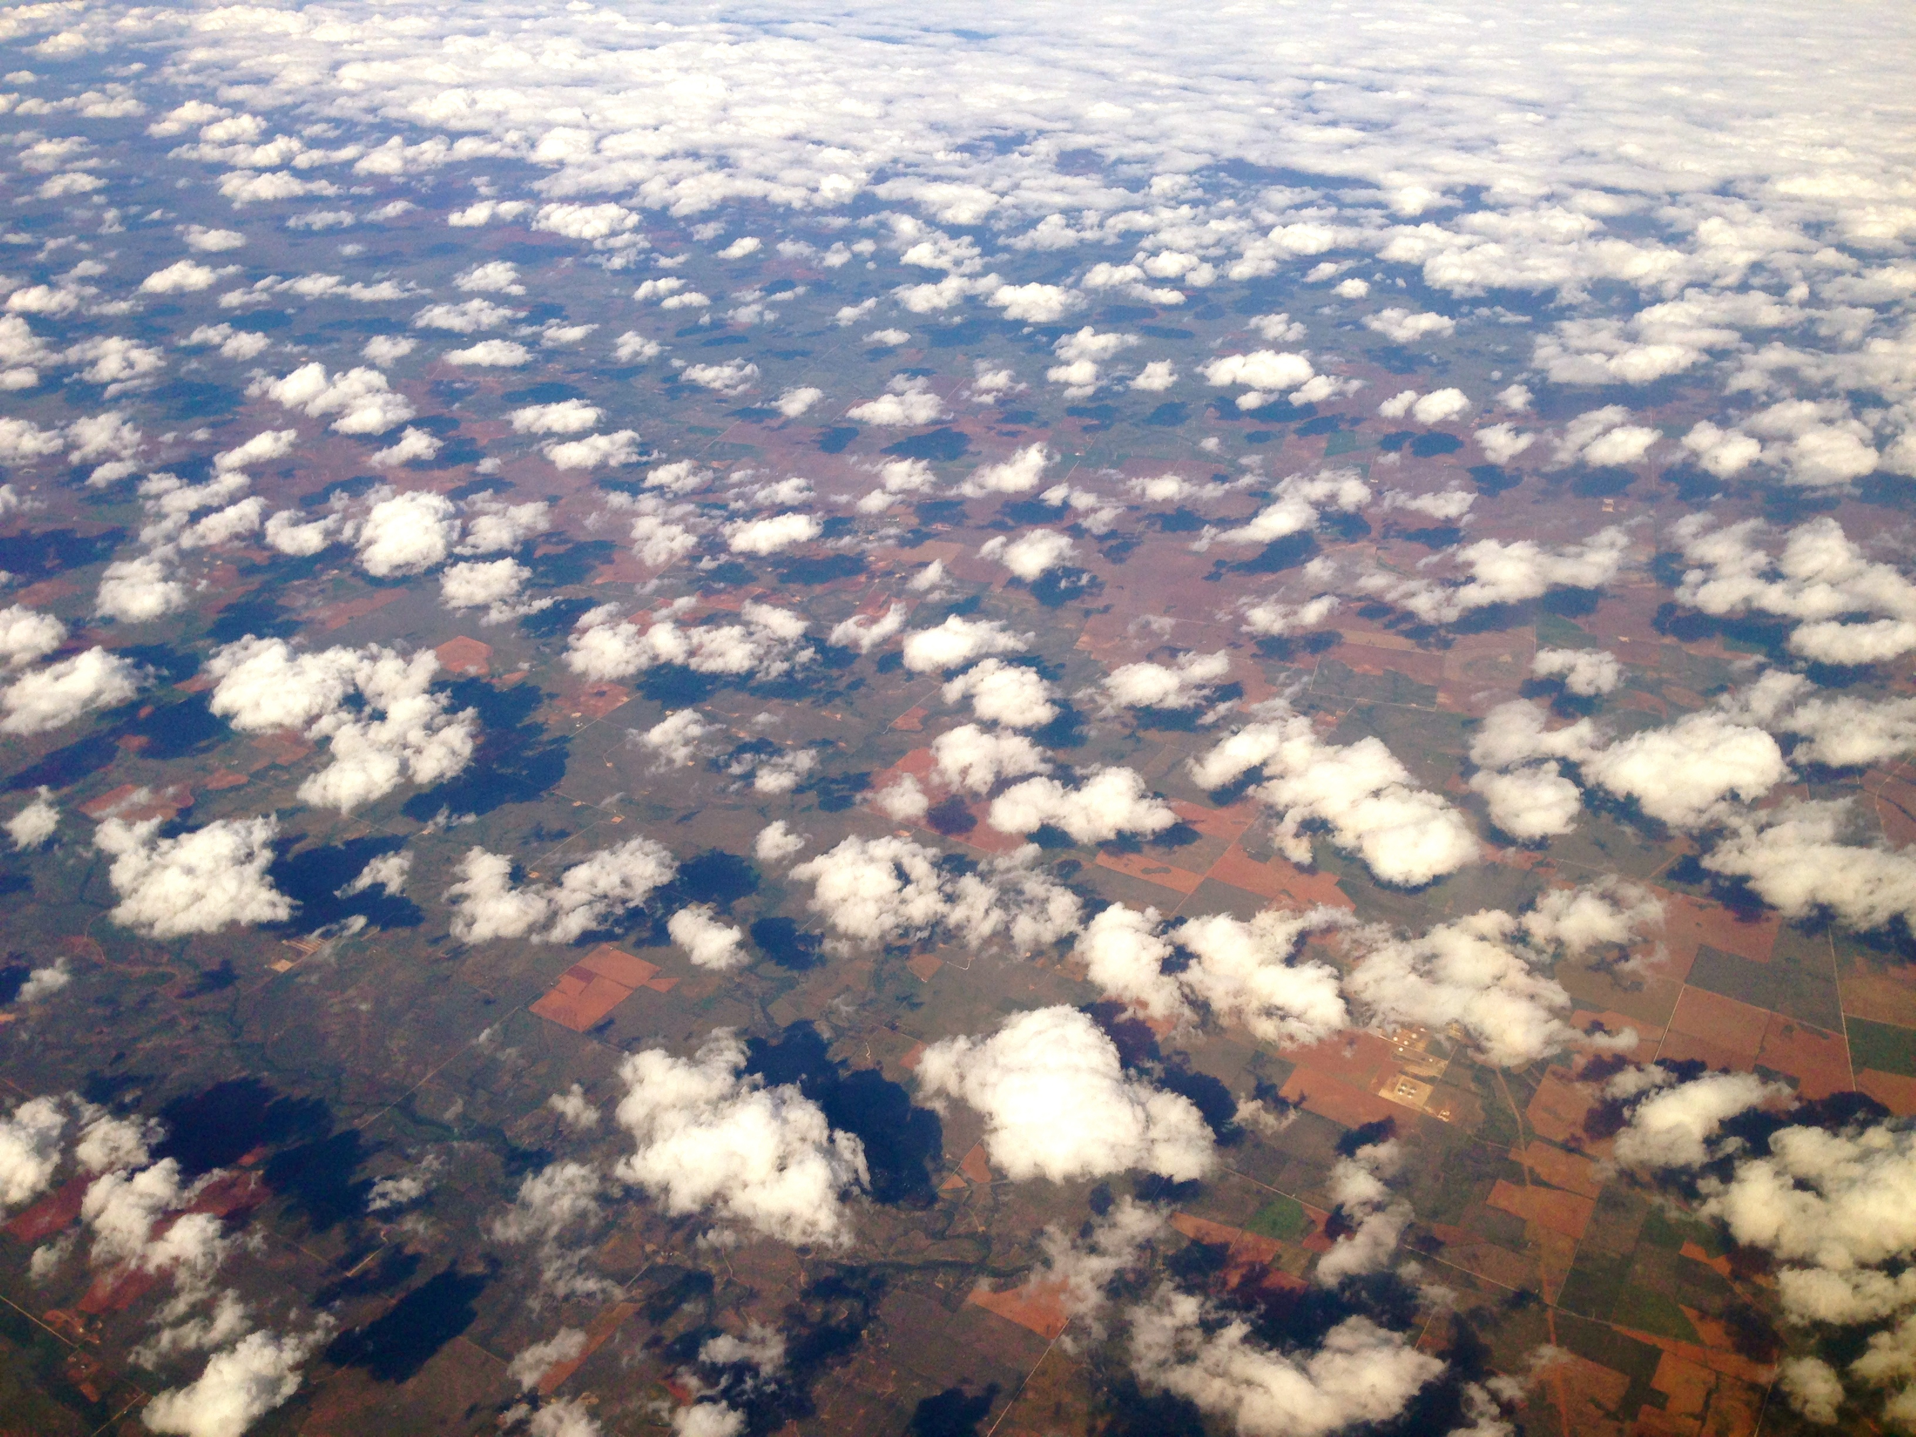

Importance of convection for atmospheric processes
Daily convective clouds/rainfall are common during the ozone season
Clouds are often small, but ubiquity and abundance are important:
  Boundary layer mixing and ventilation
  Deep tropospheric transport
  Radiative transfer, energy budgets, photolysis
  Precipitation, aqueous chemistry, wet scavenging/deposition
  Environmentally-sensitive emission sectors (e.g., biogenics)

Slide 5
Modeling limitations
Most clouds are not explicitly resolved by model grid scales
  “Sub-grid” clouds /convection (SGC)
  Develop and propagate via stochastic processes
  Physical effects are difficult to characterize accurately
Meteorological models do not export SGC data to PGMs
  SGC must be re-diagnosed
  SGC effects are addressed to varying degrees among PGMs
  Potentially large inconsistencies between models
CAMx implicitly treats effects of diagnosed SGC at grid scale
  Adjusts resolved cloud fields for SGC properties
  Impacts photolysis, aqueous chemistry, wet scavenging
  No cloud convective mixing treatment

Slide 6
Project Objectives
Add sub-grid convective module to CAMx
  Vertical transport
  Aqueous chemistry
  Wet deposition
Tie into recent EPA/NERL updates to WRF convection (MSKF)
  Add KF cloud information to WRF output files
  Consistent cloud systems among WRF and CAMx
Test for two aircraft field study episodes:
  September 2013 Houston DISCOVER-AQ
  Spring 2008 START08 over central US

Slide 7
CAMx Cloud-in-Grid (CiG) framework
CiG defines a multi-layer cloud volume per grid column according to WRF KF output
Stationary steady-state SGC environment between met updates (e.g., 1 hour)
  Grid-scale pollutant profiles are split to cloud and ambient volumes
Convective transport designed for quick solution
  Solves transport for a matrix of air mass tracer per grid column
  Tracer matrix is algebraically applied to pollutant profiles
  Rigorously checked to ensure mass conservation
Aqueous chemistry and wet scavenging (fast) separately processed on in-cloud and ambient profiles
Cloud/ambient profiles are linearly combined to yield final profiles
Ozone chemistry (slow) is applied on the final profiles

Slide 8
Schematic of CAMx CiG
Up/downdrafts (Fc) balanced by lateral en/detrainment (E,D) by layer (dz)
Compensating vertical motion (Fa) in ambient air is a function of –(E,D) and cloud fractional area (fc)

Slide 9
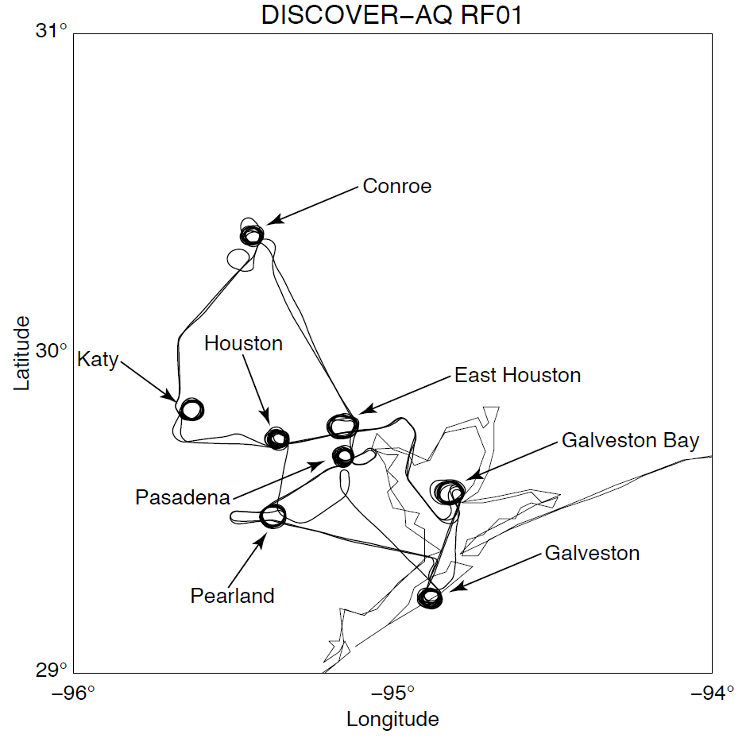
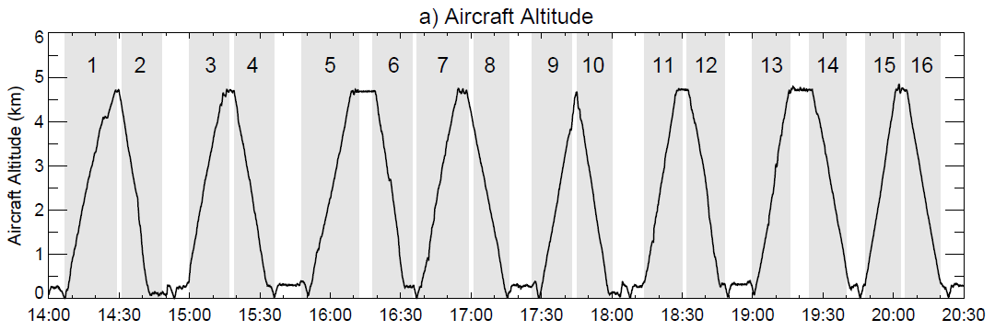
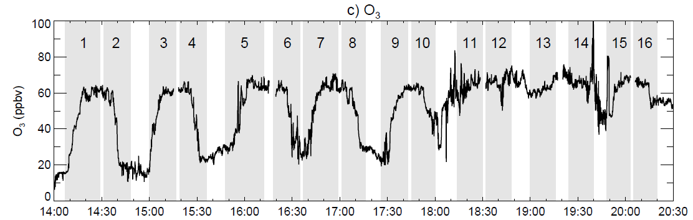
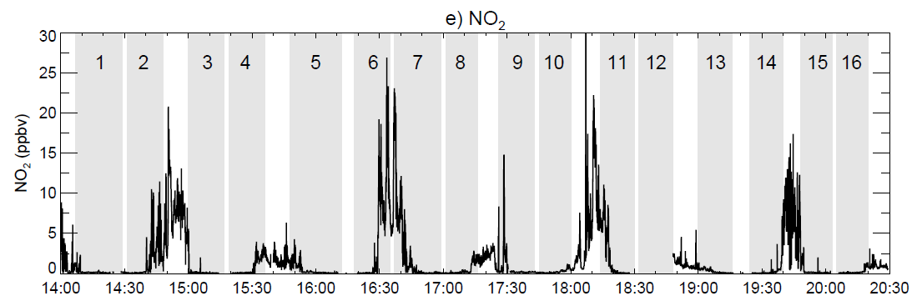
DISCOVER-AQ: September 4, 2013
O₃: 20-70 ppb at sfc
60-70 ppb at 4 km
NOy: 1-20+ ppb

Slide 10
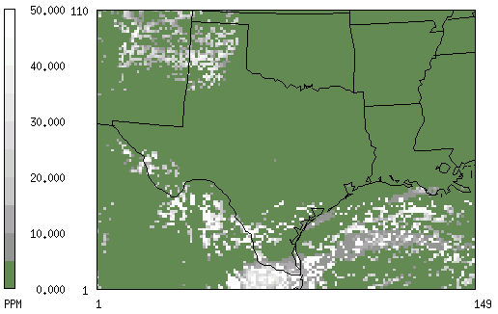
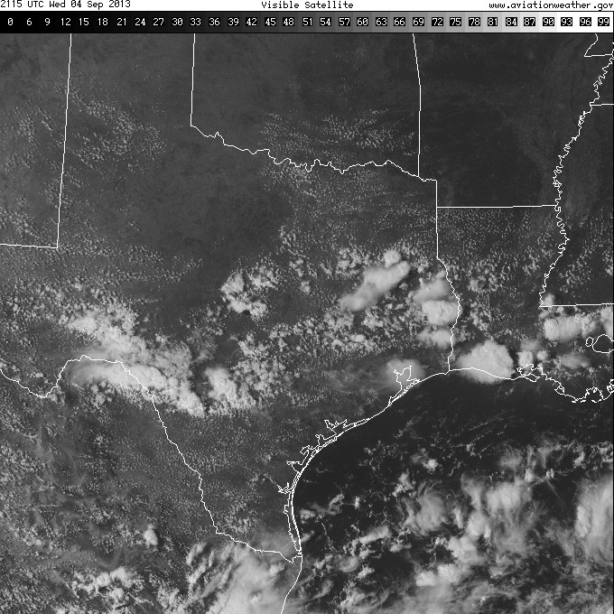
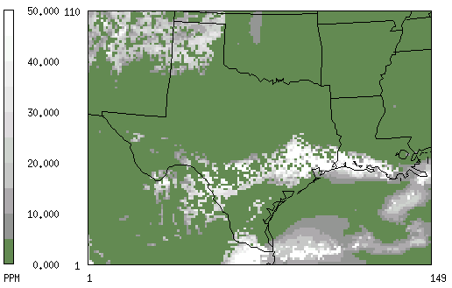
DISCOVER-AQ: September 4, 2013
RadKF (WRF v3.6.1) and MSKF (WRF v3.7) lead to very different cloud patterns
  And different wind, temperature, humidity patterns
  Purely a result of MSKF? Or other changes in WRF v3.7?
MSKF is a better cloud simulation
12 km CAMx grid
Resolved + RadKF Clouds
Resolved + MSKF Clouds

Slide 11
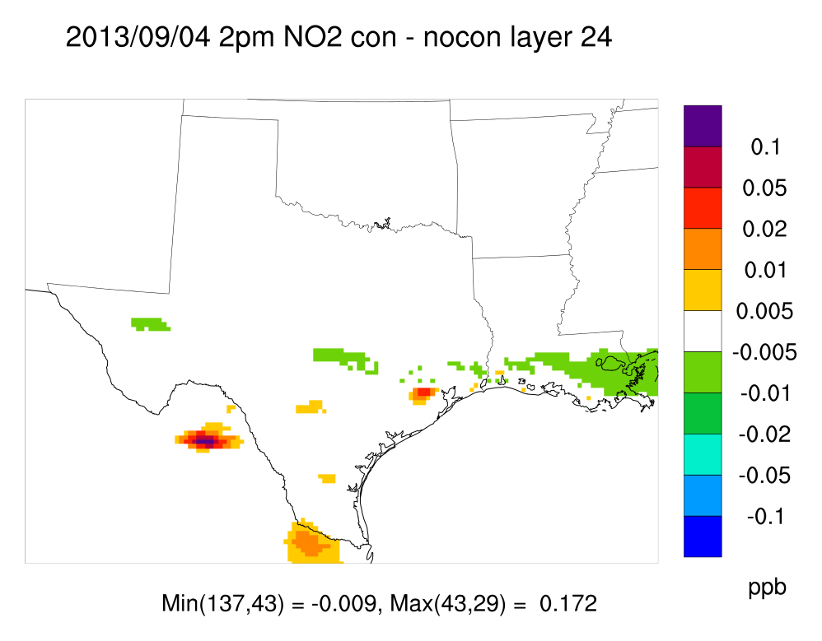
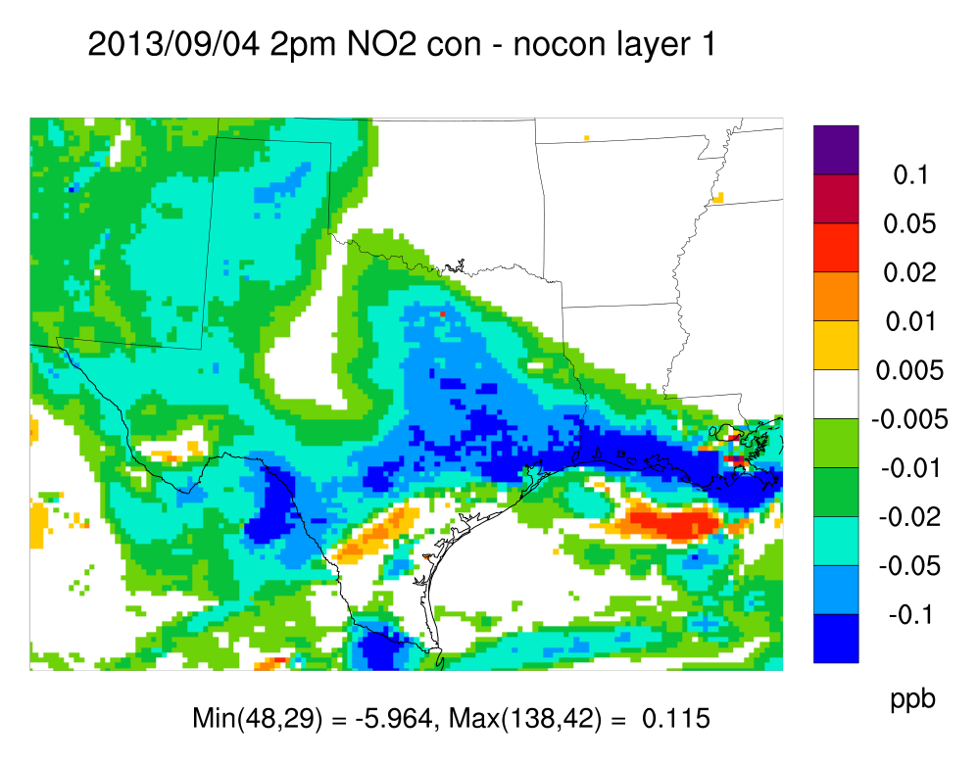
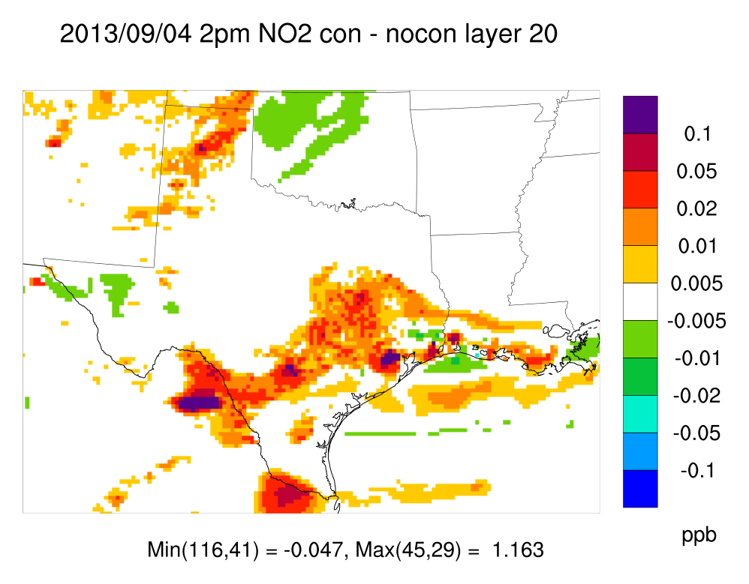
DISCOVER-AQ: September 4, 2013
NOx ventilation from surface to free troposphere
Reductions near surface, increases aloft
  Agrees with conceptual model for upward ventilation of surface sources
  Patterns reflect local net influence of up/downdrafts among clouds and ambient volumes
5.4 km
Surface
2.8 km

Slide 12
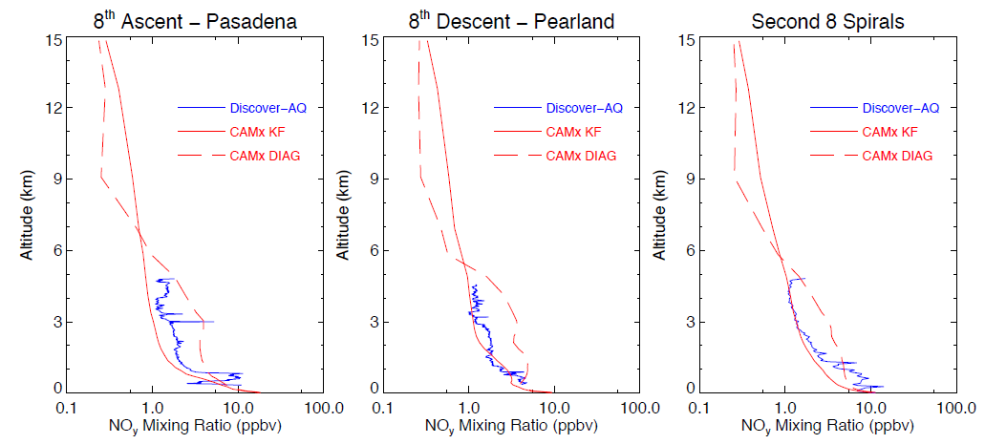
DISCOVER-AQ: September 4, 2013

Slide 13
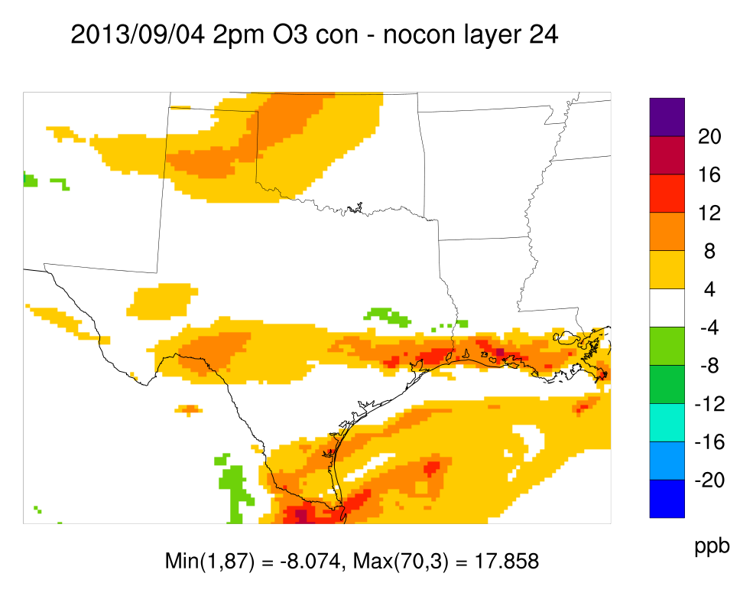
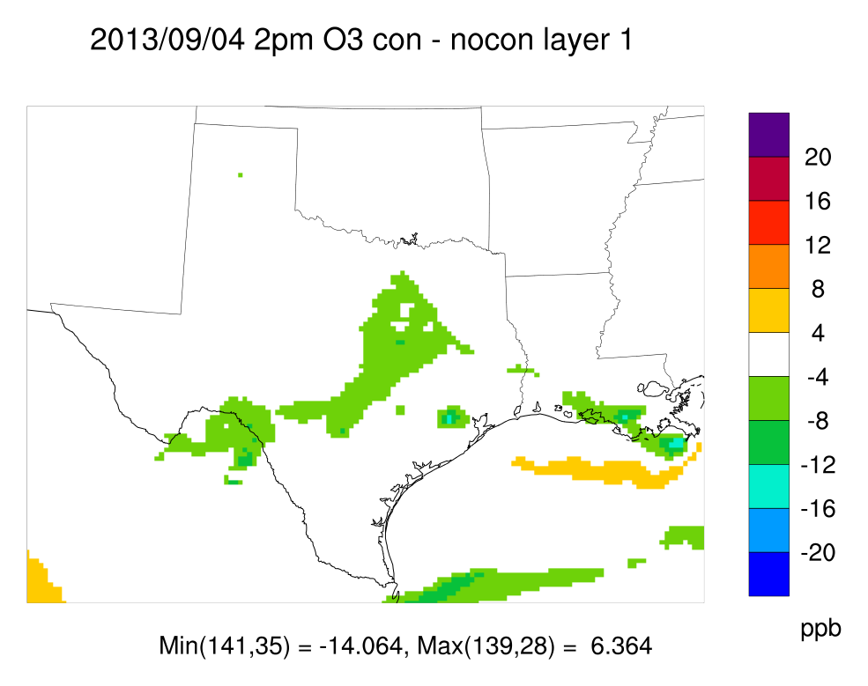
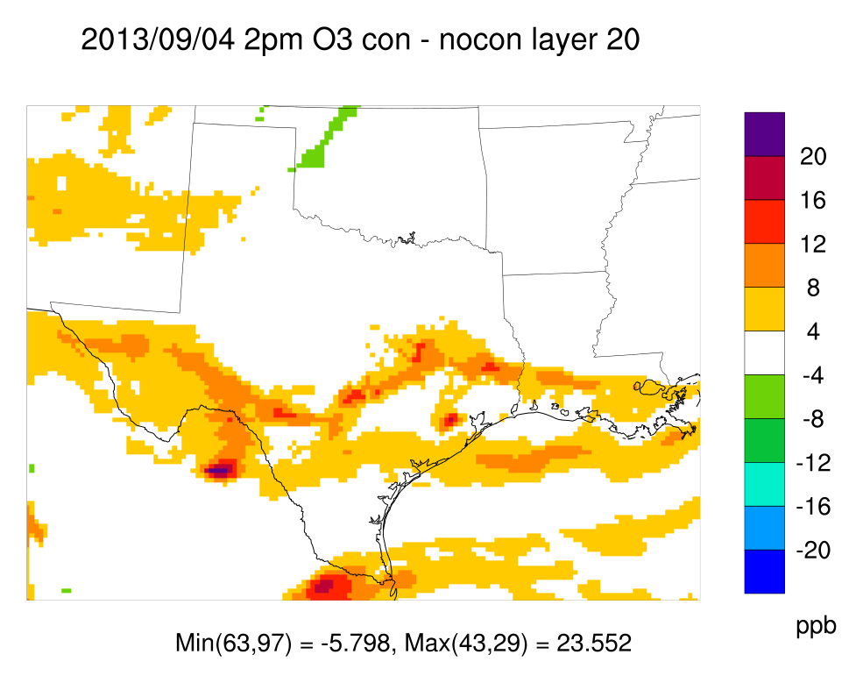
DISCOVER-AQ: September 4, 2013
O₃ is effects are similar
Net ventilation from surface to free troposphere
  But mitigated somewhat by inverted boundary layer gradient
5.4 km
Surface
2.8 km

Slide 14
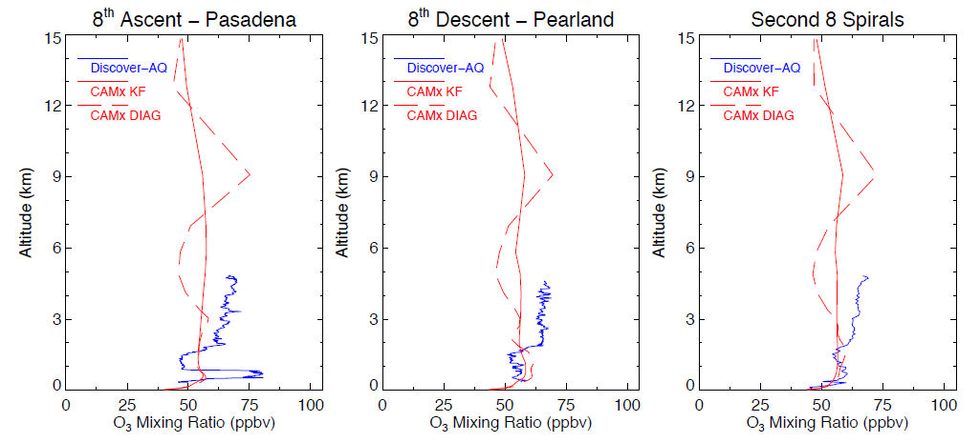
DISCOVER-AQ: September 4, 2013

Slide 15
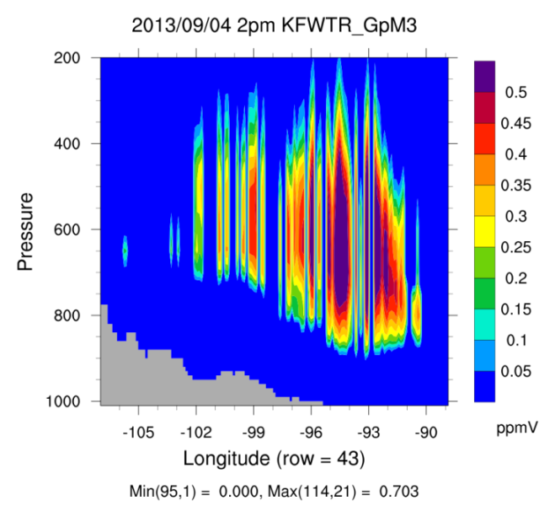
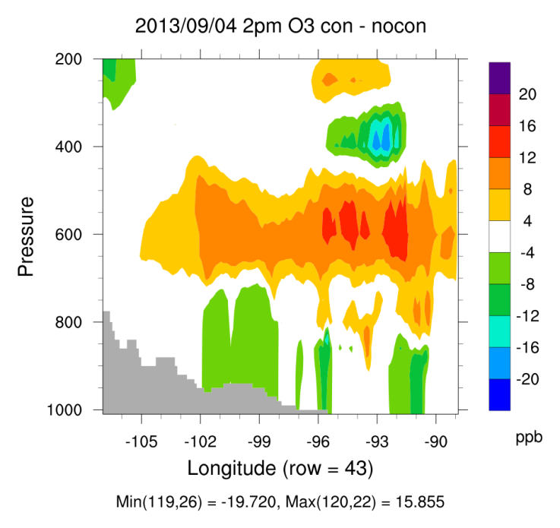
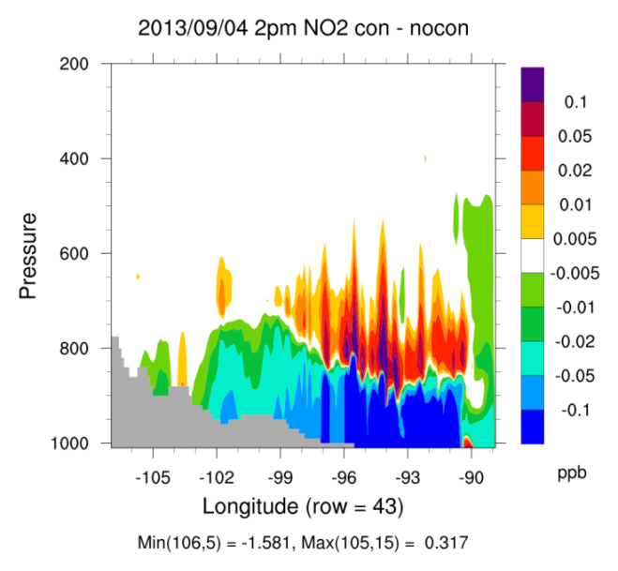
DISCOVER-AQ: September 4, 2013
Some convective columns extend to 200 mb (~12 km)
Clear ventilation of PBL NOx and O₃
Free/mid-tropospheric buildup of pollutants
Some deep convective influences on upper tropospheric O₃

Slide 16
14th Annual CMAS Conference
October 5-7, 2015
Development and Evaluation of an
Interactive Sub-Grid Cloud Framework for the
CAMx Photochemical Model
Summary:
Convection is locally/regionally important for pollutant ventilation, transport and removal, but is difficult to model
New CAMx/CiG framework includes sub-scale vertical transport and wet removal of gases & PM, plus in-cloud PM chemistry
CiG is operating as designed, but model-measurement comparisons are hindered by WRF’s SGC predictions

Slide 17
14th Annual CMAS Conference
October 5-7, 2015
Development and Evaluation of an
Interactive Sub-Grid Cloud Framework for the
CAMx Photochemical Model
Future work:
Evaluate impacts to PM, deposition
Tie in Probing Tools (SA, DDM, RTRAC)
Tie in lightning NOx
Available in future public release (2016?)
Thank you – Questions?

Slide 18
Extra Slides

Slide 19
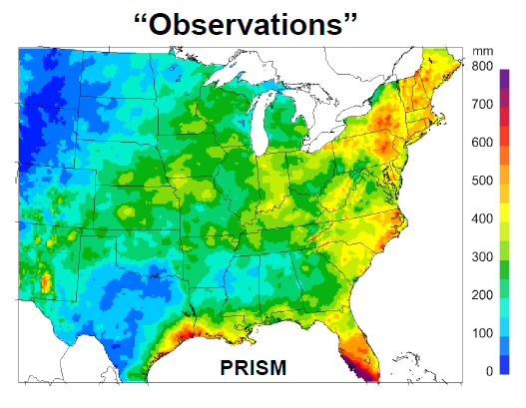
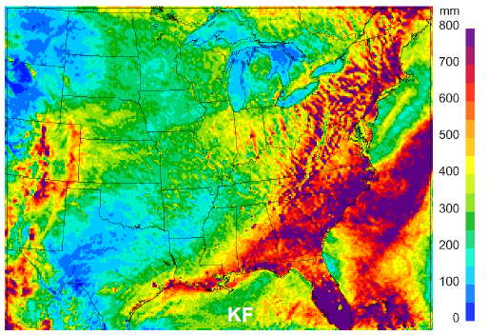
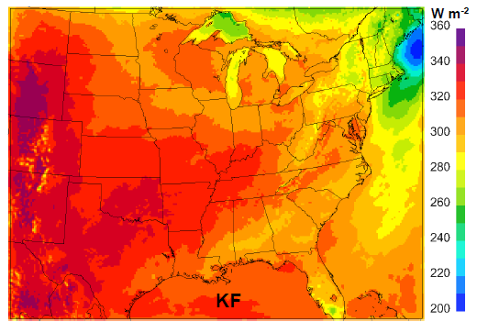
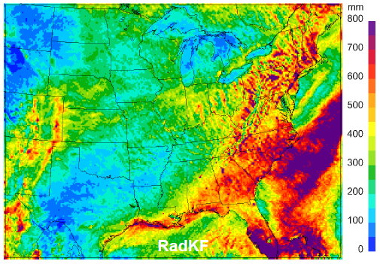
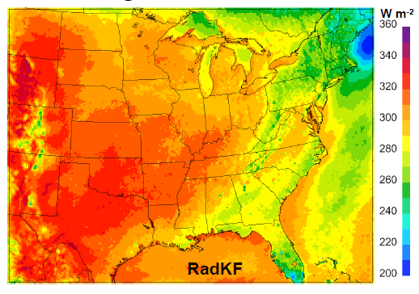
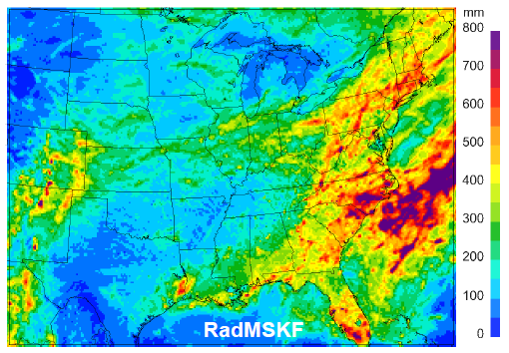
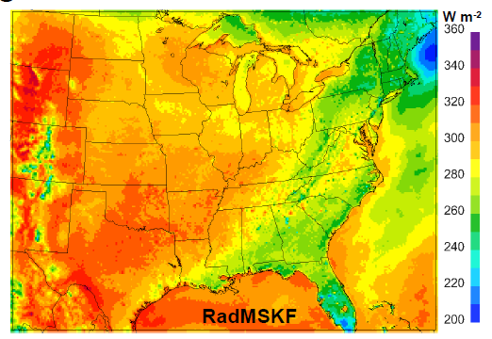
EPA’s WRF updates to convection (Alapaty et al, 2012; 2014)
JJA 2006 WRF Precip
JJA 2006 Solar Rad
2012: Link WRF KF cumulus scheme to WRF radiation scheme (RadKF)
  RadKF shades ground: reduces convective PE and rain
2014: Generalize RadKF to multi-scale (MSKF)
  MSKF generates more SGC: more shading, less rain

Slide 20
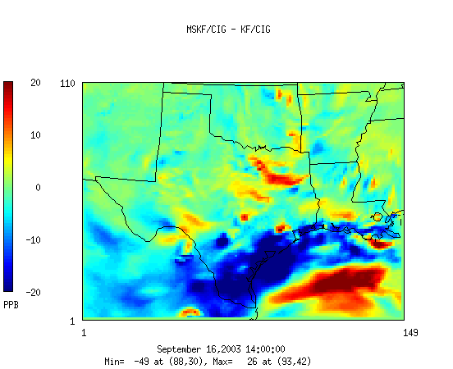
DISCOVER-AQ
Ozone difference (MSKF – RadKF)
2 PM September 4, 2013 (same as slide 10)

Slide 21
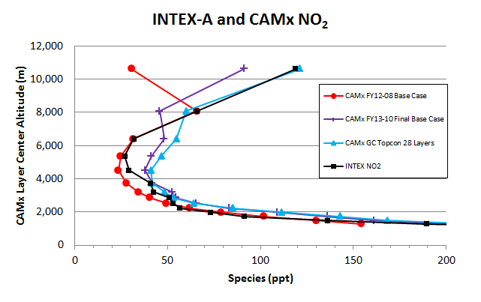
Modeling limitations
Comparing CAMx NOy profiles against aircraft and satellite data (Kemball-Cook et al., 2012; 2013, 2014):
Large underestimates above 8 km
Add NOx sources aloft (aircraft, lightning) and set top BC’s
Add explicit top BC’s from a global model
These improve average profiles over large areas
Convective mixing is important at local scales

