Slide 1

Improving the Nocturnal Wind Speed Bias and Daytime Ozone Prediction using a Dynamic Bulk Critical Richardson Number
Barry Baker¹, Rick Saylor^{1,} Pius Lee²
¹ National Oceanic and Atmospheric Administration
Air Resources Laboratory
Atmospheric Turbulence and Diffusion Division
Oak Ridge, TN 37830
² National Oceanic and Atmospheric Administration
Air Resources Laboratory
College Park, MD 20740
October 5-7, 2015
17th Community Modeling & Analysis System Annual Meeting
Chapel Hill, NC

Slide 2
On using the Richardson Number
The standard method uses a constant critical Ri number
Critical Ri numbers have been reported from 0 -> 1 in atmospheric flows (Richardson and Holtslag, 2013; Vickers and Mahrt, 2004)
Many have tried to create a dynamic bulk critical Richardson number (Melgarejo and Deardorff, 1974; Nieuwstadt, 1985; Vickers and Mahrt, 2004)
Other methods have their own problems
  TKE threshold is only useful when there is strong wind gradients
  Surface inversions routinely exist and cause problems finding a the NBL inversion

Slide 3


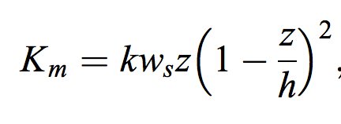

Method to improve the NBL Height Prediction
Ricr scales with the Monin-Obhukov length (L)
h is the boundary layer height
L is a characteristic length scale from the surface where the bouyant and shear energy is equal
Taken from Richardson and Holtslag 2013

Slide 4
Constant Ri_{cr} vs. Dynamic Ri_{cr}
Collapse and during the night
Dynamic Ri_{cr} BL Height
Just before sunrise
Constant Ri_{cr} BL Height

Slide 5
Dynamic Ri Effect on the Diurnal Cycle
Dynamic Ri_{cr} number
Constant Ri_{cr} number

Slide 6
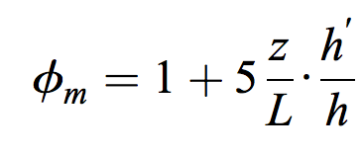

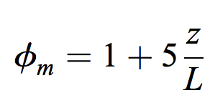
10m Wind Speed
Dependence on BL height
Adding Dependence back in
Independent of BL height

Slide 7
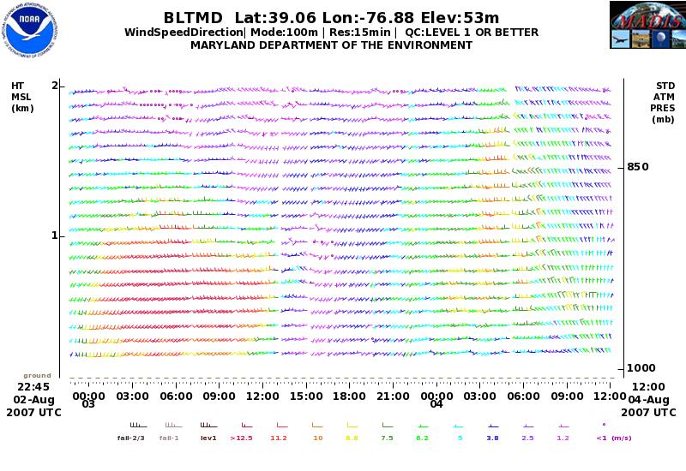
August 3rd LLJ event
Maximum Wind Speed Level ~500m

Slide 8
August 3rd LLJ event
RI2013 Algorithm predicts a NBL depth closer to maximum wind speed of the jet

Slide 9
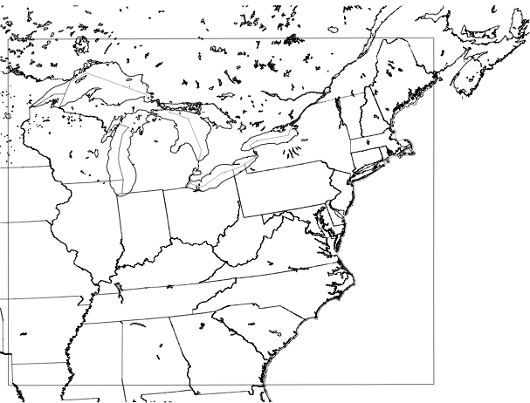
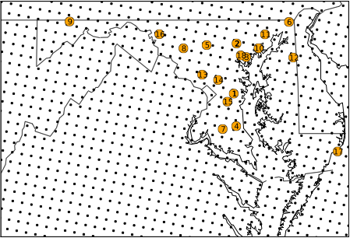
2007 (August 1st– 22nd) CAMx STUDY Overview
model domain
WRF Settings
WRF 3.2.1 and WRF 3.4.1
Blackadar & YSU BL scheme
Kain Fritsch Convection
Dudhia/RRTM (SW/LW)
WRF SM 6 Class Microphysics
32 Unequally spaced layers (17 below 3 km)
12 km horizontal Resolution
CAMx Settings
ACM2 BL scheme
Zhang Dry Deposition
CBO5
12km horizontal Resolution
32 Unequally spaced layers (17 below 3 km)
Observations
18 EPA AQS Surface Monitors (~1000) measurements at each site)
MPLNET/ELF BL heights
Ozonesondes (2007 WAVES CAMPAIGN)
surface ozone monitoring stations
Notes:
study was sponsored by the state of MD (MD Dept of the Environment). compared model to obs for the 2007 ozone season (summer).

Slide 10
Probability of Large Changes in O₃ Throughout the Day

Slide 11
Frequency Distribution of Large Changes in O₃ Throughout the Day Conditioned on the PBL Depth
PBL < 200m
200m < PBL < 500m
PBL > 800m

Slide 12
No NBL vs. constant NBL
Frequency Distribution of peak 8HR Ozone Model Bias
Using a constant NBL height decreased median model bias by 5 ppbv (~6%)
Constant NBL
No NBL

Slide 13
Constant Ri_{cr} vs. No NBL
Frequency Distribution of peak 8HR Ozone Model Bias
Using a constant Ri_{cr} =0.25 lowers median model bias by 10 ppbv ppbv (~13%)
Constant Ri_{cr} NBL
No NBL

Slide 14
Dynamic Ri_{cr} vs. No NBL
Frequency Distribution of peak 8HR Ozone Model Bias
Using the RI2013 method lowers median model bias by 11 ppbv ppbv (~15%)
This is a marked improvement of ~10% compared to a constant Ri_{cr}
Dynamic Ri_{cr} NBL
No NBL

Slide 15
Summary
RI2013 algorithm can be used to predict NBL depth in a NWP model
  NBL depth ~300m higher during stable regimes
  NBL depth ~100m lower during weakly stable regimes
  Does not improve 10m wind speed predictions
Nighttime mixing processes can alter the next days O₃ levels (~15%)
Application of a new BL height model showed:
  Improvement in the representation of the nocturnal boundary layer height during LLJ events
  Improvement of ~10% in the 8hr max surface ozone compared to constant Ri_{cr} number

