Slide 1


Evidence for an increasing geographic region of influence on ozone air pollution in the eastern United States
Evidence for an increase in the photochemical lifetime of ozone in the eastern United States
Presentation by:
Dan Goldberg, Ph.D. Candidate
Co-authors: Tim Vinciguerra, Tim Canty, Chris Loughner, Ross Salawitch & Russ Dickerson
Presented at the 14th CMAS Meeting
Wednesday October 7th, 2015

Slide 2
Motivation for this study…
The state of Maryland is very interested in the role of the interstate transport of ozone.
Science objectives:
How much ozone is generated locally vs. transported from upwind regions?
What are the future trends in surface ozone?
Is ozone being simulated for the right reasons?

Slide 3
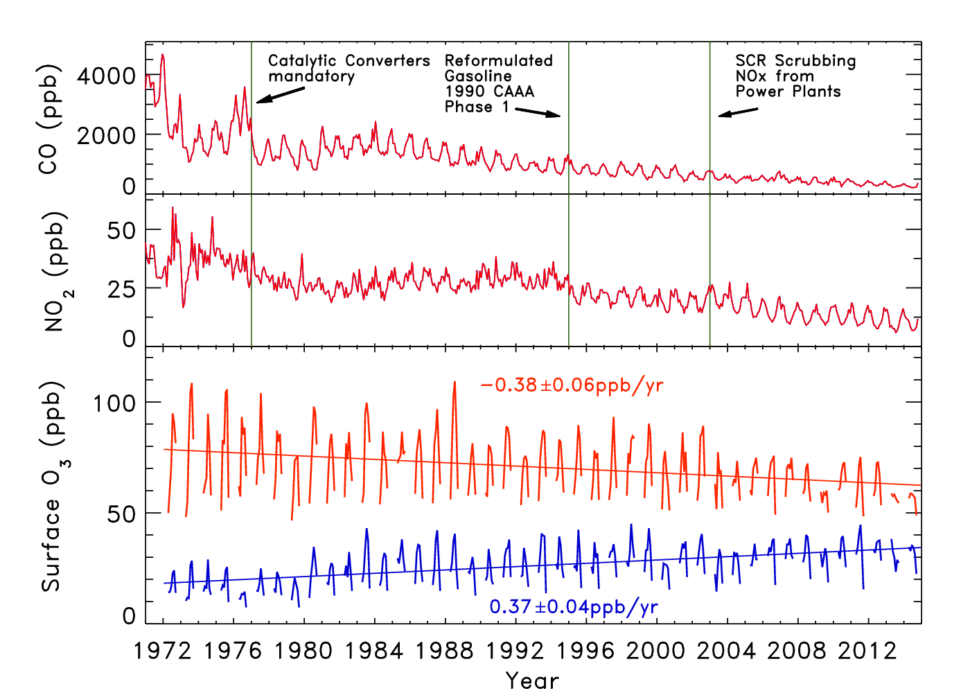
Motivation for this study…
Is it due to:
An increase in the global ozone background?
A decrease in chemical processes that remove ozone?
Perhaps a combination of both, but for this presentation I will focus on the second option.
Why is the bottom-third rising?
Red – Top third of the O₃ distribution
Blue – Bottom third of the O₃ distribution
Surface data taken from AQS sites in the Baltimore-Washington area

Slide 4
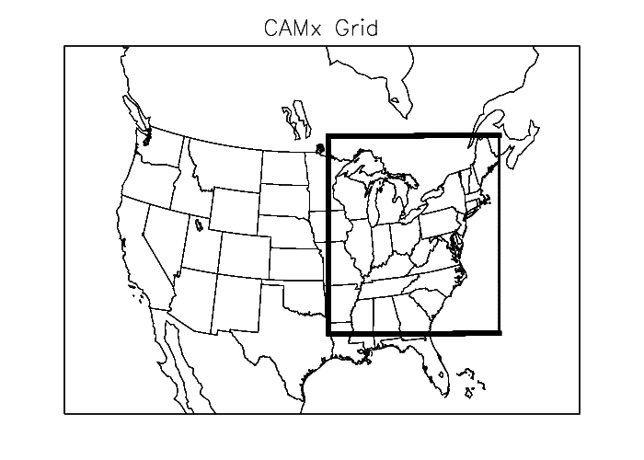
CAMx v6.10 with Ozone Source Apportionment

Slide 5
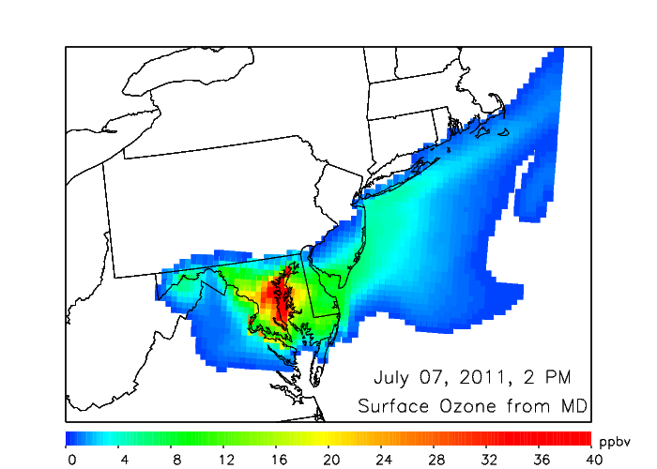
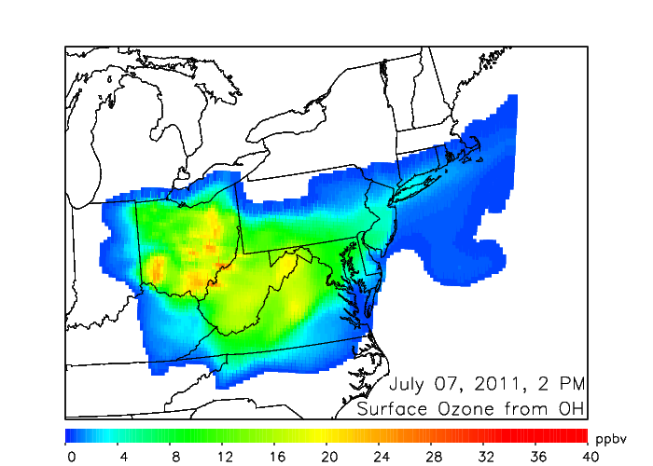
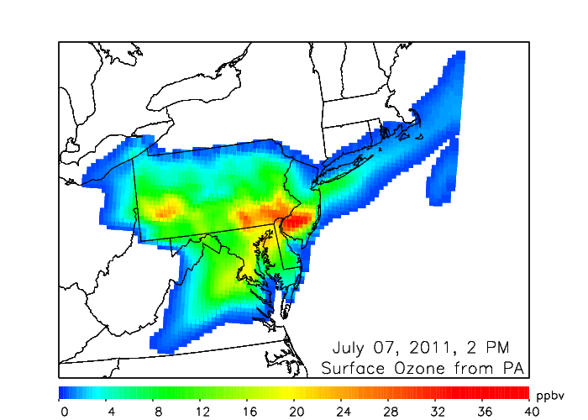
Ozone Source Apportionment Examples
The CAMx software can attribute ozone to different source regions.
Surface ozone, once formed, can be transported 100’s km downwind from the original source.
MD
OH
PA

Slide 6
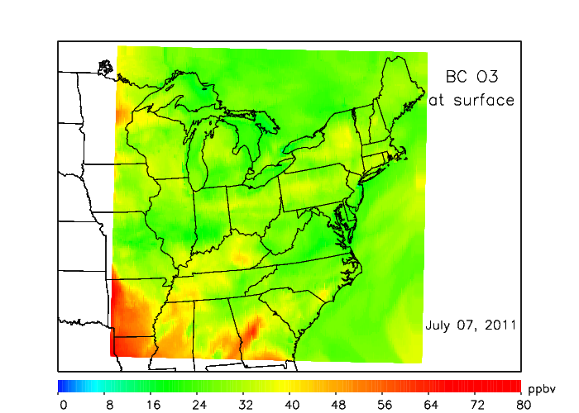
Ozone from the model boundary
Ozone attributed to areas beyond the model domain, i.e., Texas, Cal, Asia
Ozone from the boundary is uniformly greater than 15 ppbv.
Some locations, especially close to the boundaries, are higher.

Slide 7
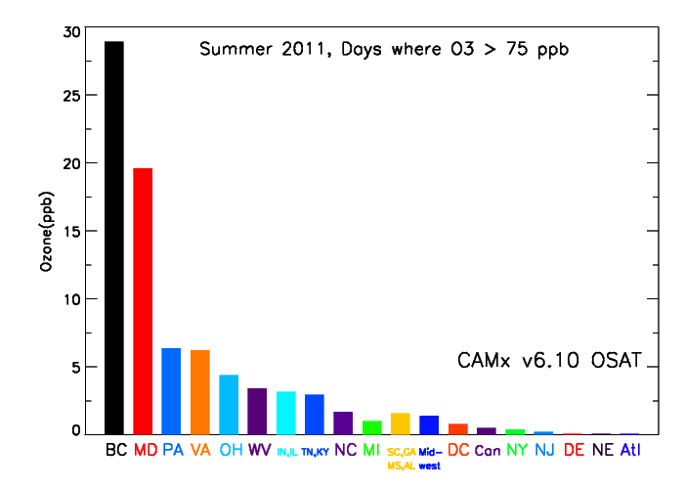
Summer 2011: Ozone Source Attribution
Baltimore, MD
BC=boundary conditions

Slide 8
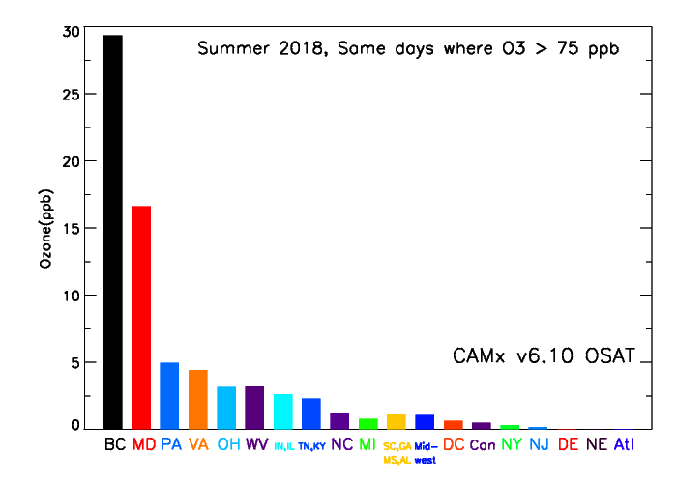
Summer 2018: Ozone Source Attribution
The attribution of ozone in all states decreases 10 – 25 % over 7 years.
The only portion to increase is the ozone attributed to the model boundary.
Baltimore, MD
BC=boundary conditions

Slide 9
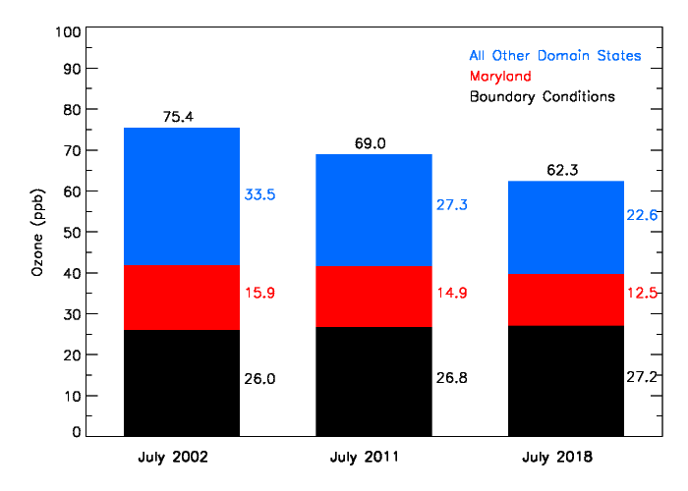
Trends in the Apportionment of Surface Ozone
Mean 8-hr max in Baltimore, MD
Boundary and meteorology are initialized identically in each simulation.
Total surface ozone has decreased and is projected to further decrease.
  Sources inside the model domain will decrease.
  If the sources outside the model domain remain the same, ozone attributed to these sources will increase.

Slide 10
Trends in the Apportionment of Surface Ozone
Mean July concentration of ozone (ppbv) attributed to the boundary
What is causing this increase???
Ironically, we think it’s related to reductions in NO_{x} and VOCs
An increasing role of the boundary is seen in all metropolitan areas in the eastern United States.

Slide 11
How is O₃ chemically produced?
NO + HO₂ → NO₂ + OH
NO₂ + hν → NO + O
O₂ + O → O₃
As NO_{x} and VOC emissions decrease, ozone production rates will also decrease.

Slide 12
How is O₃ chemically destroyed?
O₃ + HO₂ → 2 O₂ + OH
O₃ + OH → O₂ + HO₂ (minor)
How is NO₂ chemically destroyed?
NO₂ + OH → HNO₃
NO₂ + NO₃ → N₂O₅ + H₂O → 2 HNO₃ (minor)
As NO_{x} and VOC emissions decrease, ozone loss rates will also decrease.

Slide 13
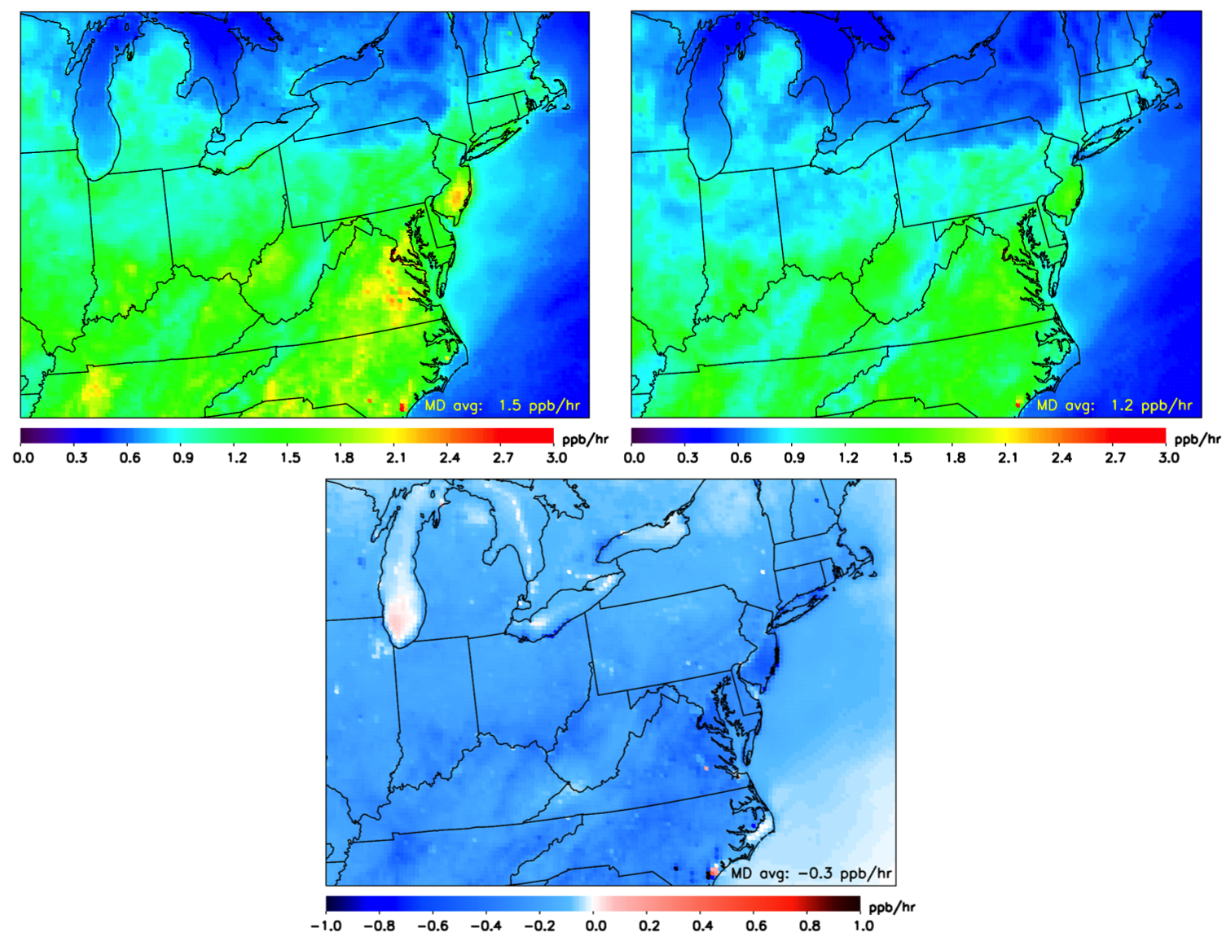
Change in O_{x} (O₃+NO_{y}–NO) Loss Rates
2002
2018
MD Avg: 1.5 ppb/hr
MD Avg: 1.2 ppb/hr
2018 – 2002
O_{x} is lasting longer in the troposphere
MD Avg: −0.3 ppb/hr

Slide 14
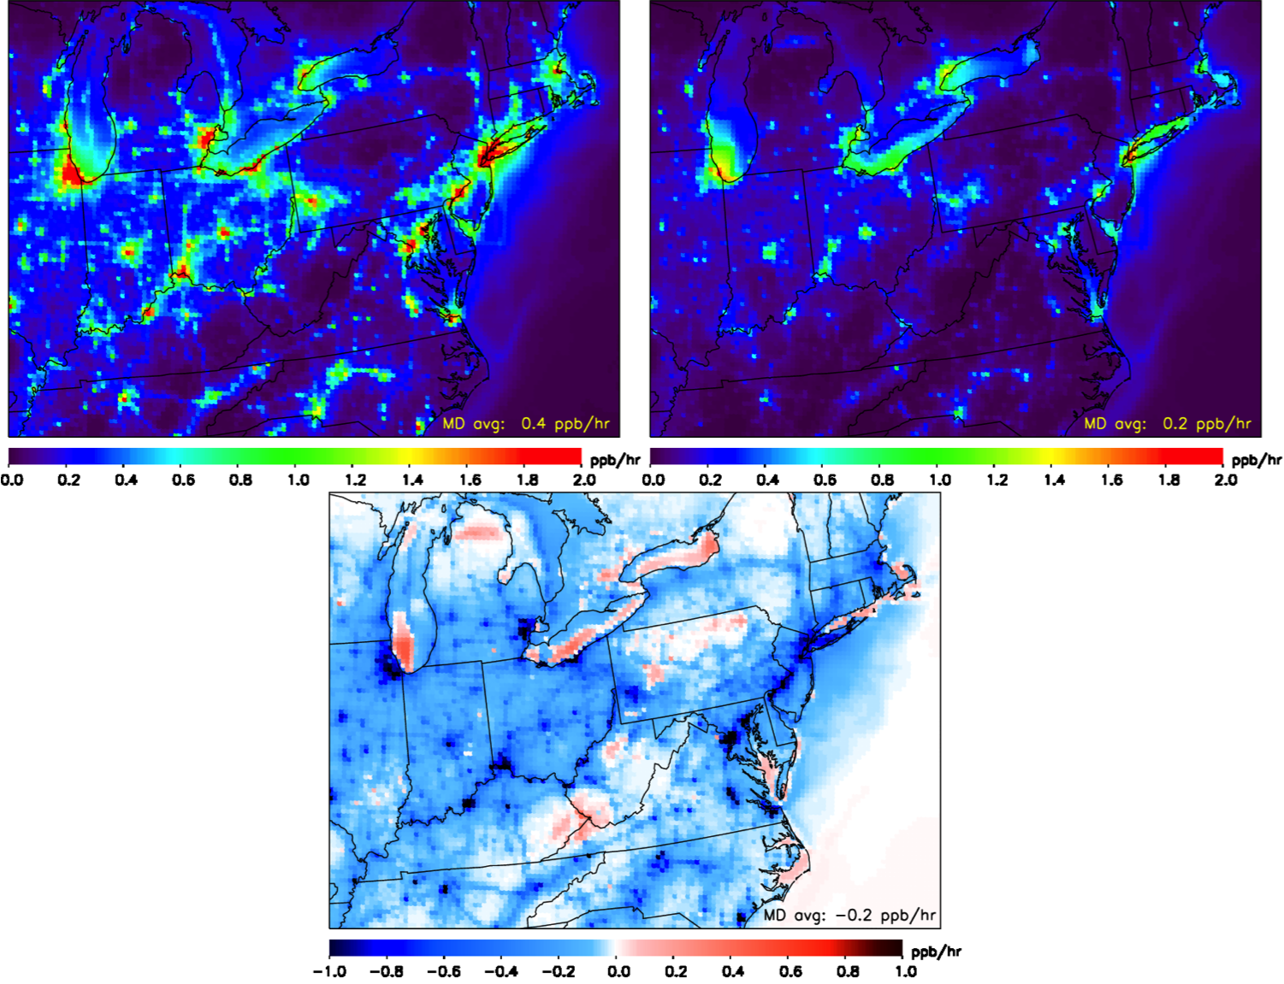
Change in the NO₂+OH reaction rates
2002
2018
MD Avg: 0.4 ppb/hr
MD Avg: 0.2 ppb/hr
2018 – 2002
NO₂ is lasting longer especially in urban areas
MD Avg: −0.2 ppb/hr

Slide 15
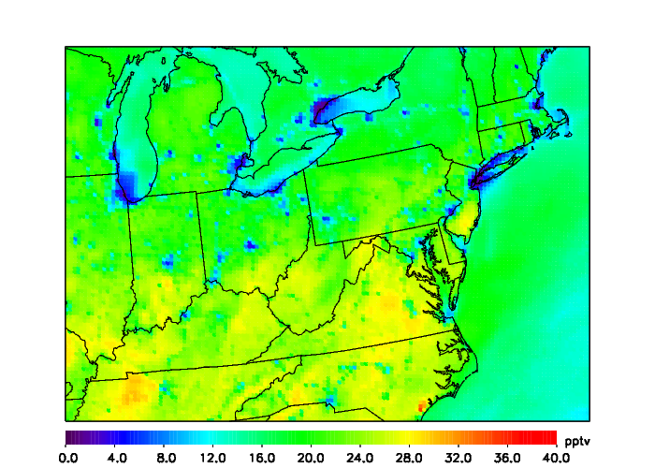
HO₂ Chemistry in the eastern United States
Mean July 2011 daytime (7 AM – 7 PM EDT) HO₂ concentrations
The HO₂ + O₃ reaction can be an important sink of O_{x} (O₃+NO₂+…) when HO₂ >15 pptv.

Slide 16
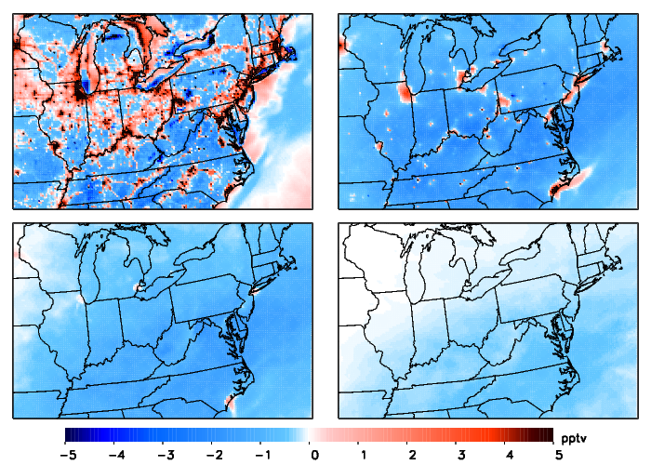
Change in daytime HO₂ concentrations between July 2002 and 2018
Surface
1 km
2 km
5 km
Daytime HO₂ concentrations are decreasing in most areas.
This is increasing the lifetime of ozone when reaction with HO₂ is important.
Ozone lifetime with respect to reaction with HO₂ increases from 9.0 to 9.5 days.
15

Slide 17
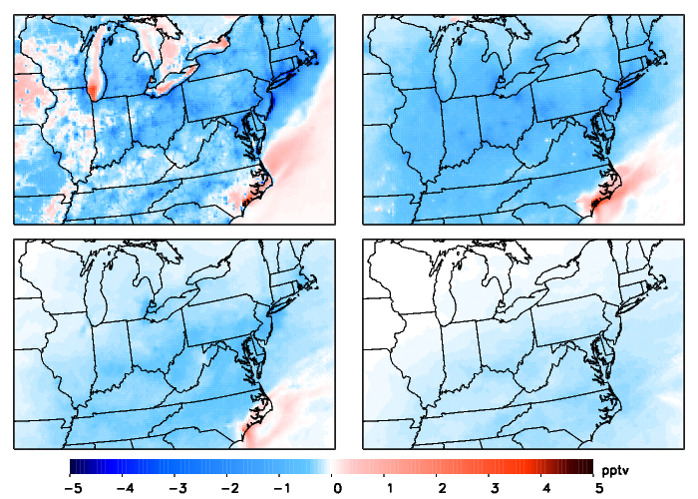
Change in daytime HO₂ concentrations between July 2002 and
July 2018 (with VOC reductions ONLY)
Surface
1 km
2 km
5 km
Anthropogenic VOC reductions are partially (but not fully) responsible for the decrease in HO₂ concentrations.

Slide 18
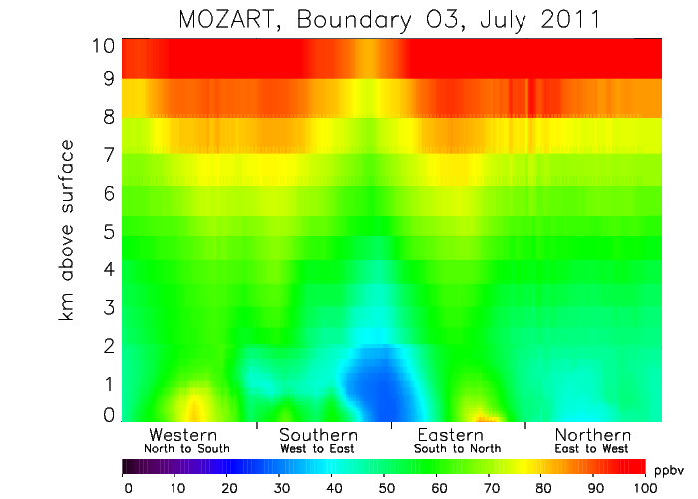
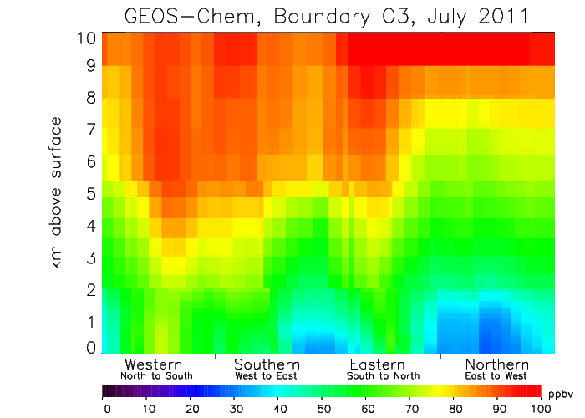
Curtain plots of Ozone at the Boundary during July 2011
Modeling domain
MOZART is marginally higher in the lower layers at all boundaries, except the Southeast.
GEOS–Chem has higher ozone in the mid–troposphere, especially at the western boundary (which is the boundary that most often influences ozone in the eastern United States).

Slide 19
Conclusions
  We use boundary condition ozone as a reactive tracer to discover that:
  Nonlinearities associated with NO_{x} and VOC emission reductions are responsible for an increase in the photochemical lifetime of ozone.
  Ozone produced from distant sources will remain in the atmosphere for a longer time.
  This is an unintended consequence of the policies to reduce these emissions.

Slide 20
Future Work
Implement a better representation of current year boundary conditions using satellites and ozonesondes.
  Henderson et al., 2014; Fiore et al., 2014
Use future year boundary conditions for future year regional model scenarios.

Slide 21
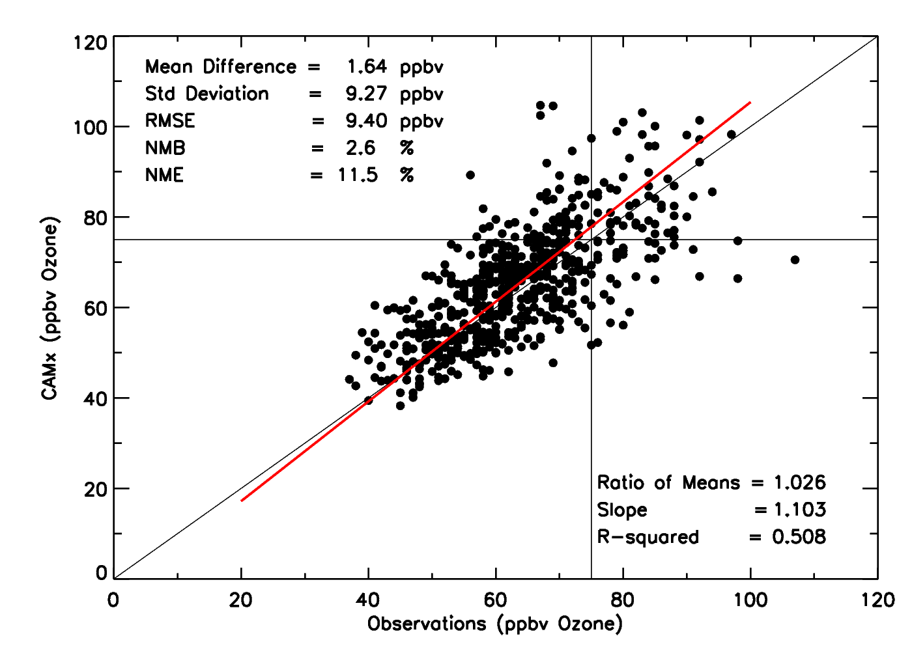
Model Verification: Surface O₃ at Maryland sites

Slide 22
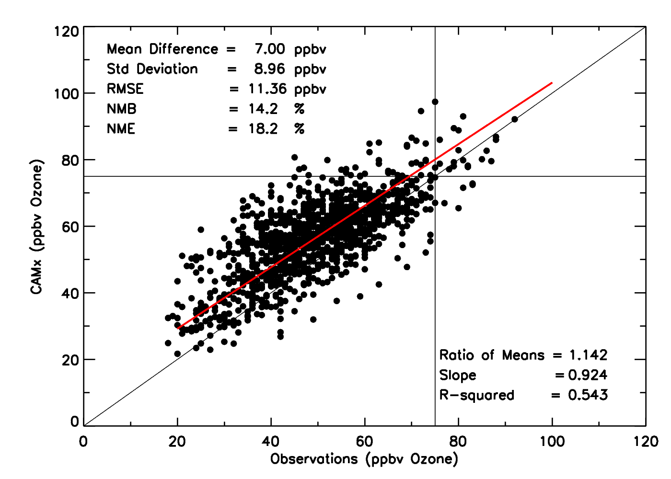
Model Verification: Surface O₃ at CASTNET sites

