Slide 1
Evaluation and Intercomparison of 2010 Hemispheric CMAQ Simulations Performed in the Context of AQMEII and HTAP
C. Hogrefe¹, J. Xing¹, J. Flemming², M.-Y. Lin³, R. Park⁴, G. Pouliot¹, S. Roselle¹, R. Bianconi⁵, E. Solazzo⁶, S. Galmarini⁶, and R. Mathur¹
¹Atmospheric Modeling and Analysis Division, National Exposure Research Laboratory, U.S. Environmental Protection Agency, RTP, NC, USA
²European Centre for Medium-Range Weather Forecasts, Reading, U.K
³Princeton University and NOAA GFDL, Princeton, NJ, USA
⁴Seoul National University, Seoul, South Korea
⁵Enviroware, Concorezzo, Milano, Italy
⁶European Commission Joint Research Centre, Ispra, Italy
CMAS Conference
Chapel Hill, NC, October 5 - 7, 2015

Slide 2
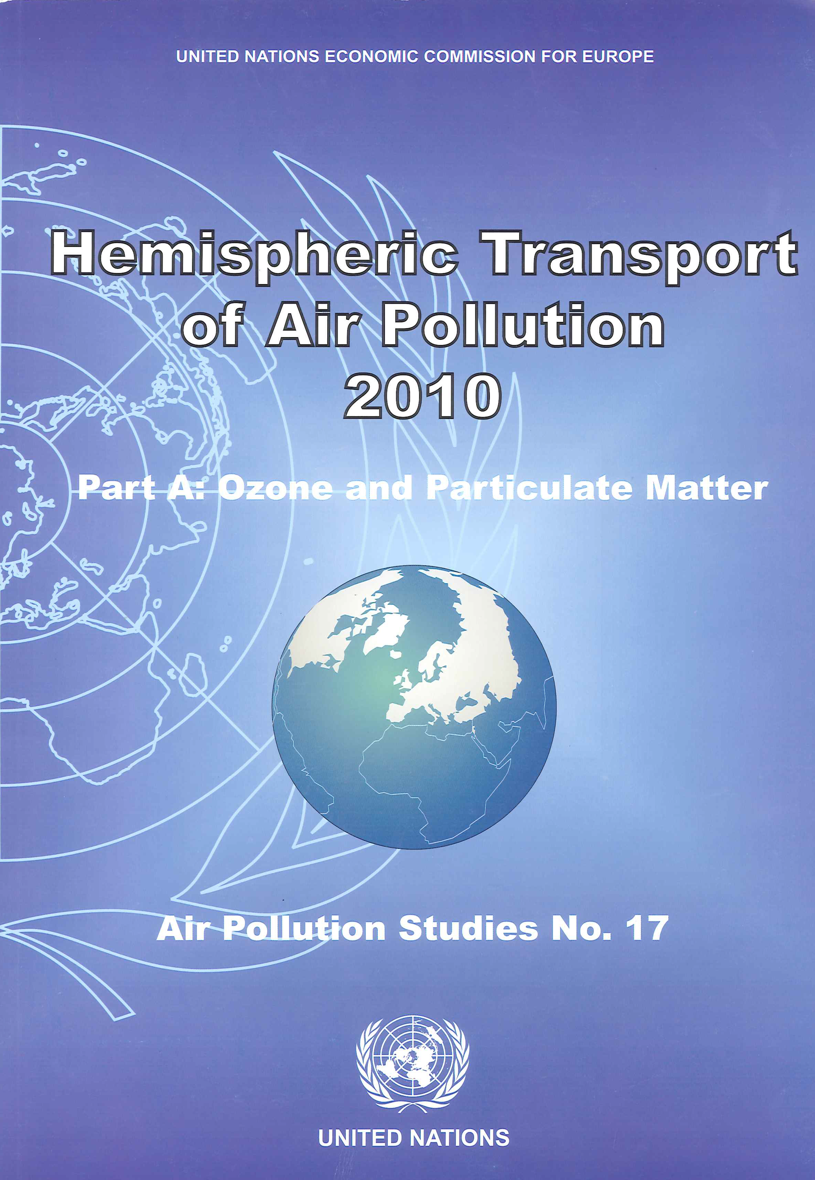




Introduction
Revised ozone standards increase the need for properly characterizing background ozone in regional-scale air quality modeling applications
Phase 3 of the Air Quality Model Evaluation International Initiative (AQMEII3) is collaborating with the Task Force on Hemispheric Transport of Air Pollution (TF-HTAP) on coordinating global/hemispheric/regional modeling experiments to address this need
Objectives of this study:
  Compare hemispheric CMAQ (H-CMAQ) against global model simulations performed as part of HTAP for 2010
  Evaluate against ground-based and upper air observations over North America and Europe
  Focus mostly on ozone, some PM comparisons

Slide 3
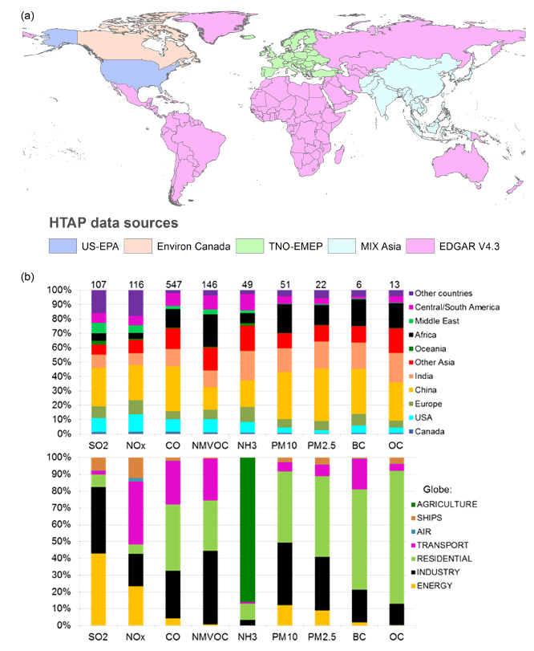
Emissions Overview
The 2010 global emissions used by all models in this study are described in Janssens-Maenhout et al., 2015, ACPD
Compiled from
  AQMEII 2010 (Europe/North America)
  MICS-Asia (Asia)
  EDGARv4.3 (Rest of World)
Sectors
  Energy, industry, residential, transport, shipping, agriculture, aviation (landing/take-off, climb and descent, cruise)
Temporal / spatial resolution
  Monthly except shipping, agriculture and aircraft which are annual
  0.1 x 0.1 degree global coverage grid maps
Fig. 1, Janssens-Maenhout et al., ACPD, 15, 12867-12909

Slide 4
Global/Hemispheric Model Overview
H-CMAQ (U.S. EPA, Atmospheric Modeling and Analysis Division)
  WRF3.5/CMAQv5.0.2 with CB05-TU gas phase chemistry, AERO6 aerosol scheme; stratospheric ozone scaled to potential vorticity (Xing et al., 2014), modified organic nitrate deposition and scavenging
  1990-2010 H-CMAQ application evaluated for trends in air quality and direct radiative forcing in Xing et al. (2015a,b ACP)
  C-IFS (“Composition – Integrated Forecasting System”, European Centre for Medium Range Weather Forecasts)
  CB05/TM5 gas phase chemistry for troposphere (Flemming et al., 2015); MACC aerosol scheme; stratospheric ozone relaxed towards MACC reanalysis
AM3 (NOAA GFDL)
  Coupled stratosphere-troposphere chemistry (Donner et al., 2011), with pressure-dependent nudging to reanalysis winds (Lin et al., 2012; 2014-Nature Geoscience)
GEOS-CHEM (Seoul National University)
  GEOS-Chem v9-01-03, full tropospheric chemistry, climatological representation of stratospheric sources/sinks (Murray et al., 2012)

Slide 5
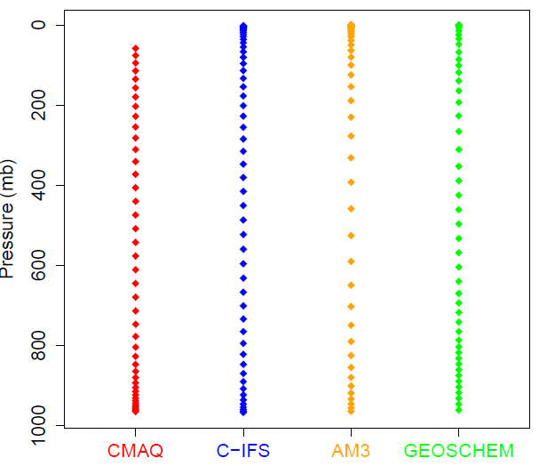
Horizontal and Vertical Model Structure
H-CMAQ:
  Northern hemisphere at 108 km x 108 km, 44 layers surface to 50 mb
C-IFS:
  Original run: 60 layers to 0.1 mb, T255 grid (~80 km); Provided to AQMEII3 for boundary conditions: 54 layers, top pressure 2 mb, 1.125 x 1.125 lat/lon grid, results provided for North America and Europe
AM3:
  48 layers surface to 0.01 mb, original run on C90 cubed-sphere grid (~100km), interpolated to horizontal grid 1.25 x 1 lat/lon, results provided for entire globe
GEOS-CHEM:
  47 layers surface to 0.04 mb, horizontal grid 2.5 x 2 lat/lon, results provided for North America only
Vertical Structure

Slide 6
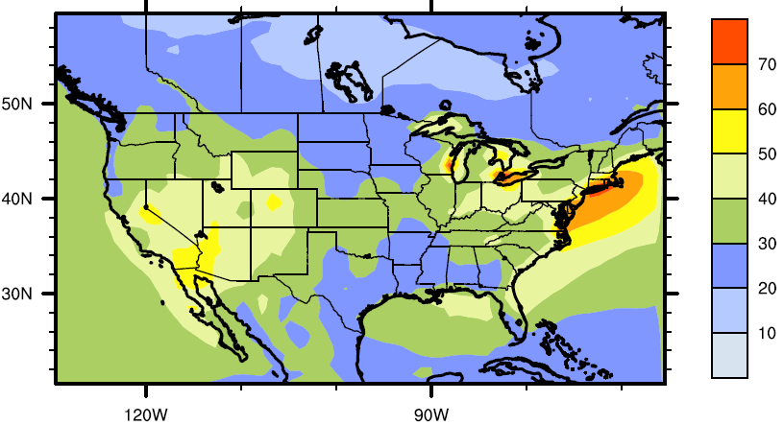
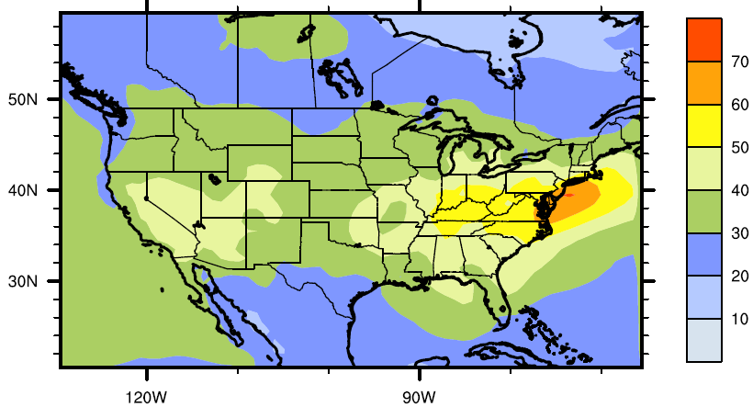
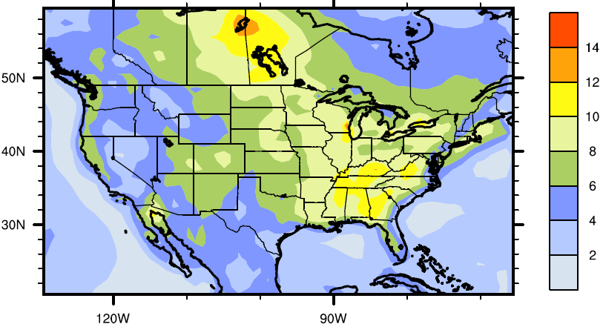
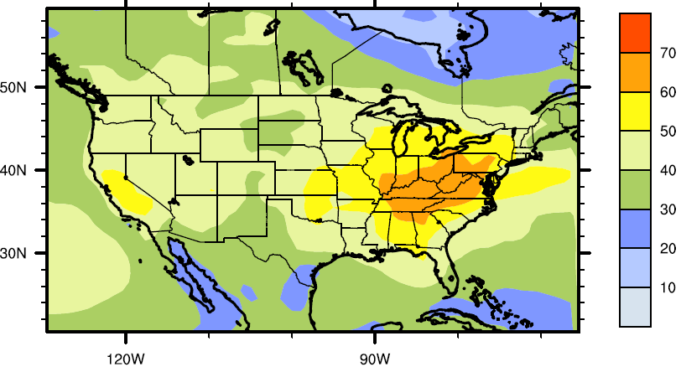
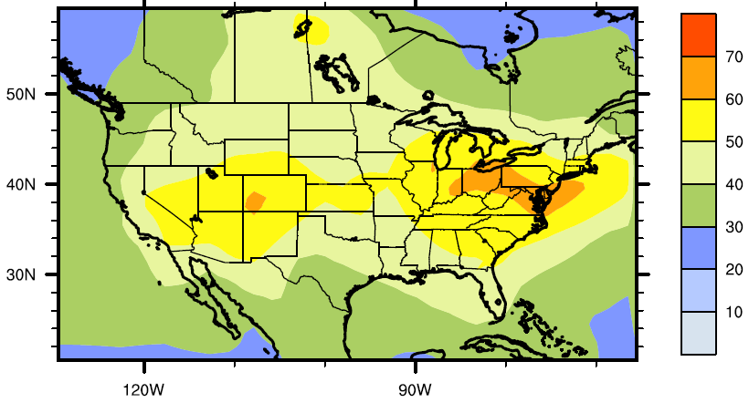
July Average Surface Ozone, North America
4-Model Standard Deviation
H-CMAQ
C-IFS
AM3
GEOS-CHEM
Large model-to-model differences in July surface ozone, exceeding 20 ppb in portions of the domain

Slide 7
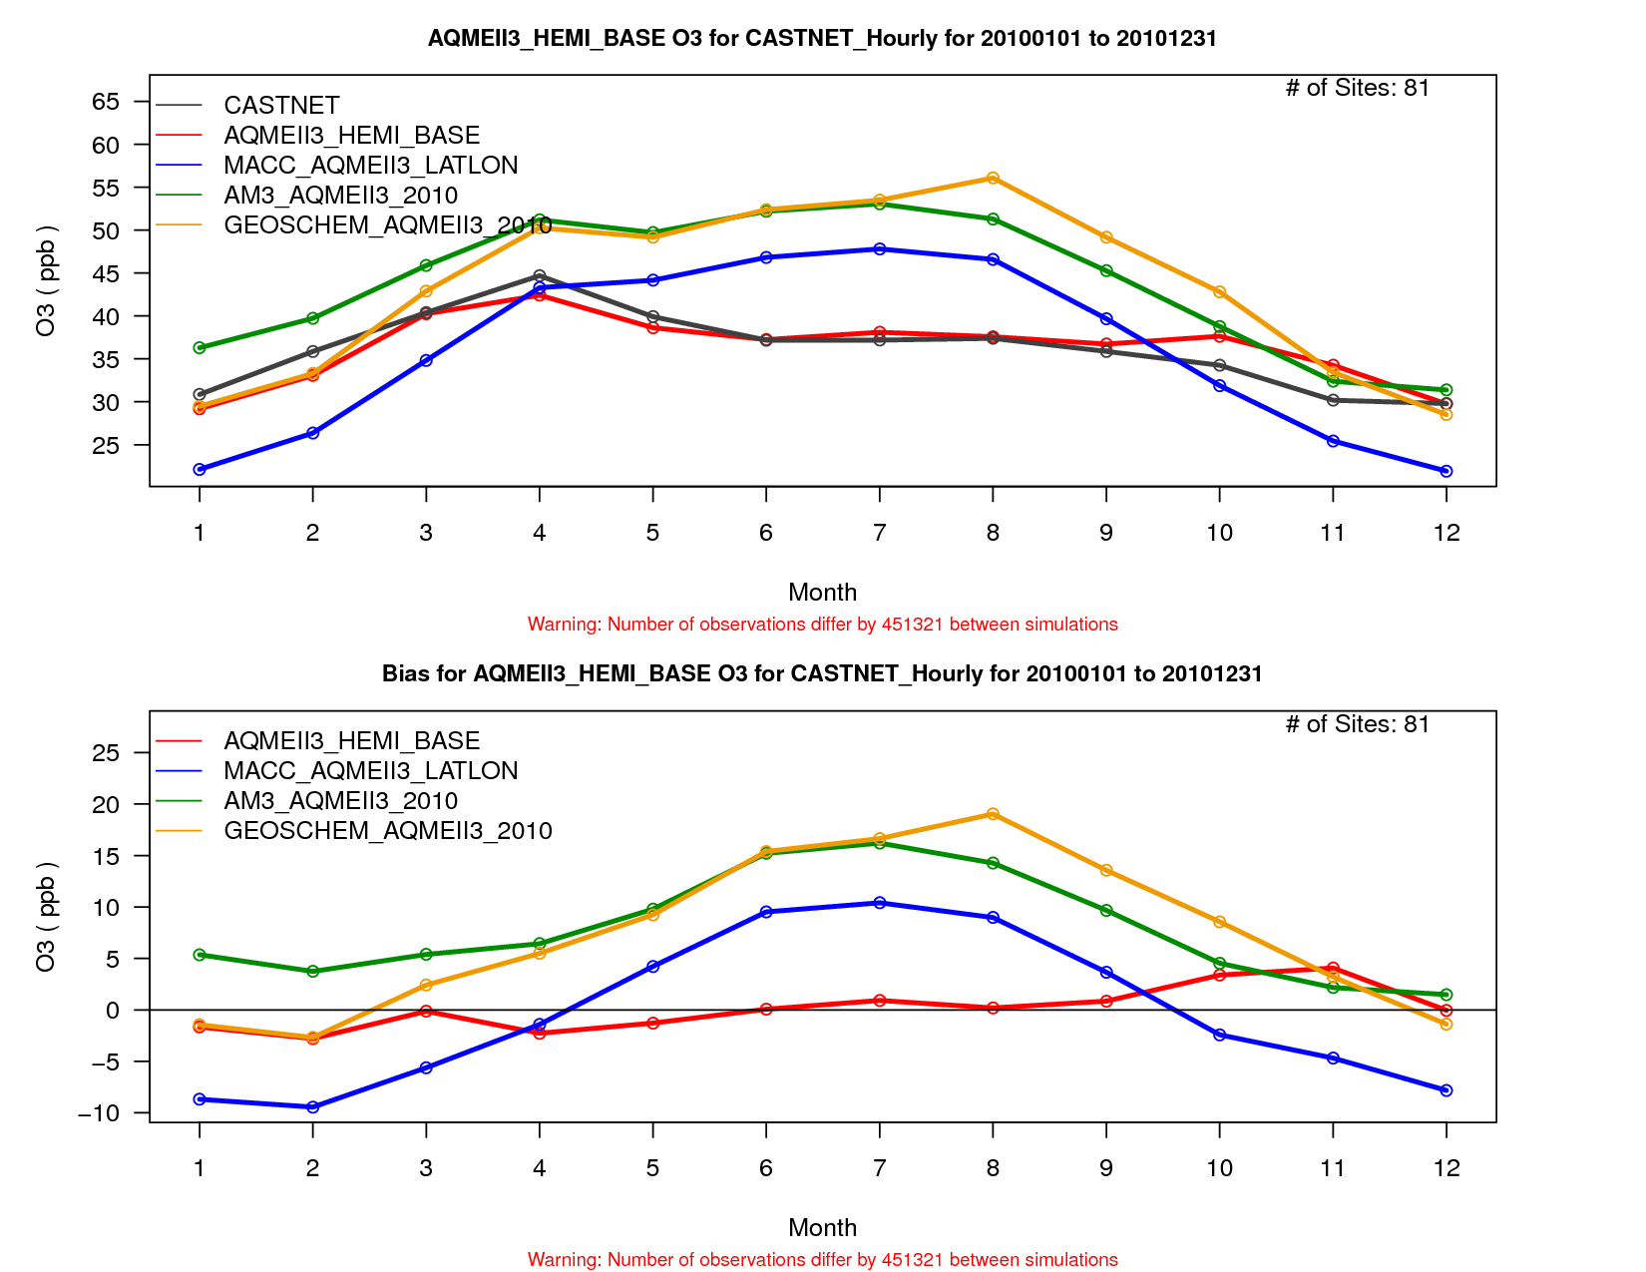
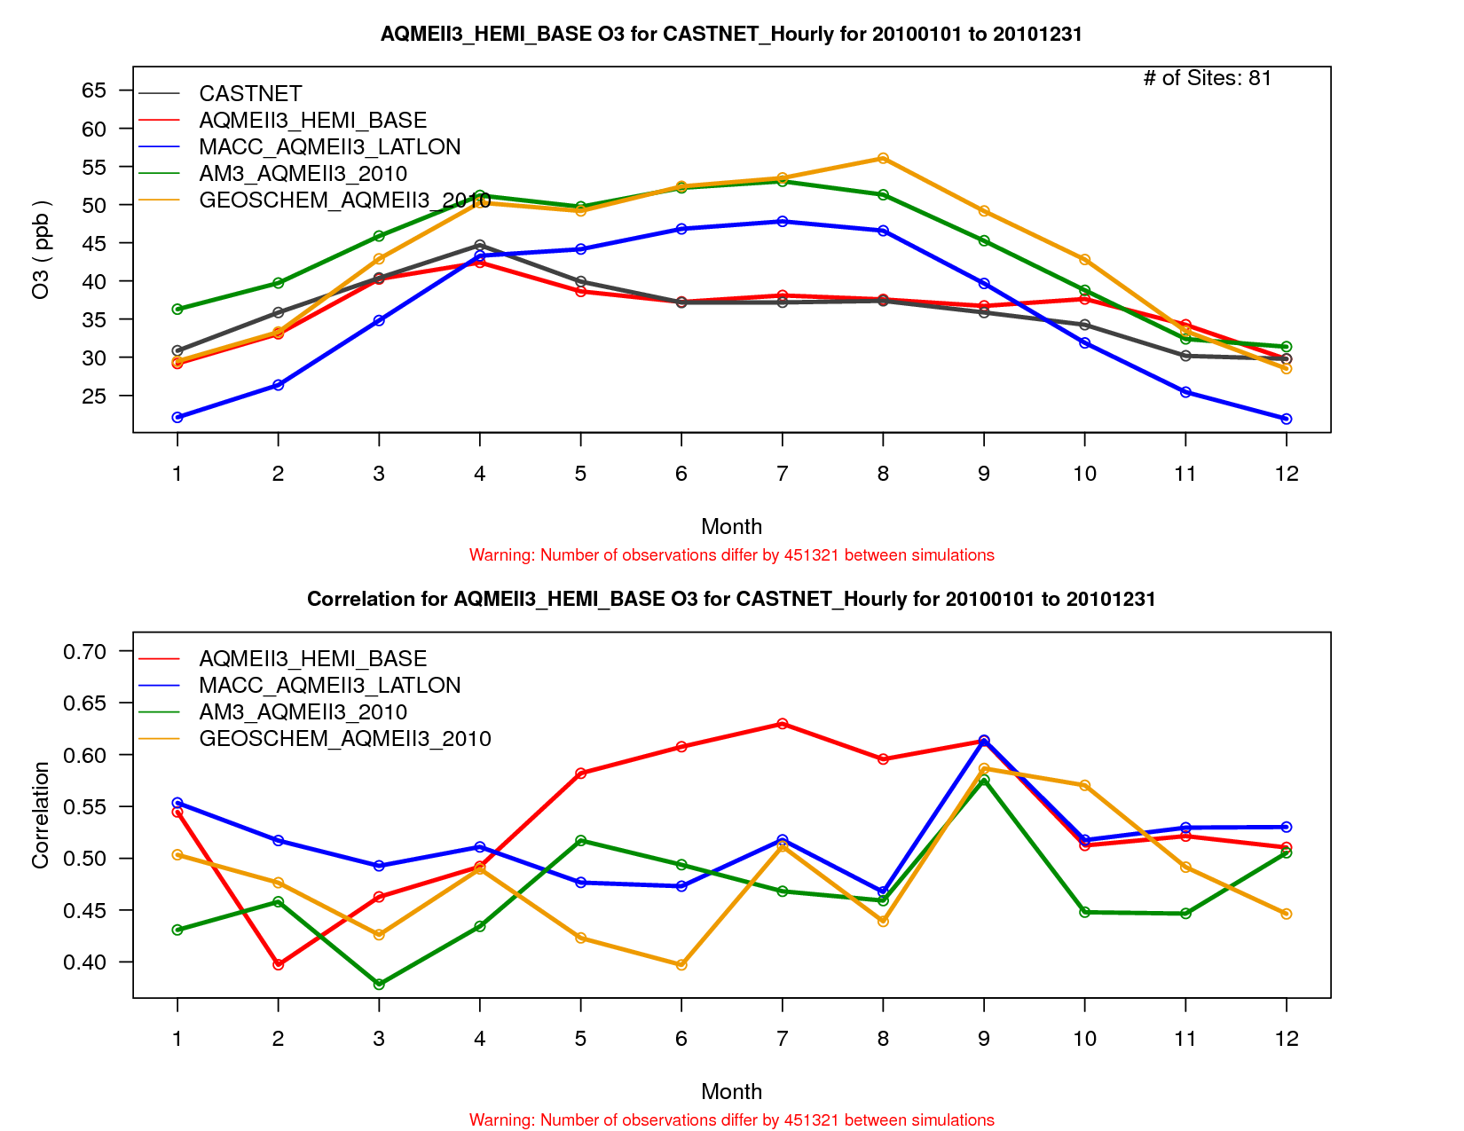
Monthly Average Ozone at CASTNet Sites, U.S.
Observed and Modeled Concentrations
All models except H-CMAQ exhibit high ozone biases during summer
From a regional model perspective, surface ozone biases of global models may not be directly relevant, but performing such surface comparisons can nevertheless be useful in investigating process representations in global models with the goal of moving towards more consistency between global and regional models
Observations
H-CMAQ
C-IFS
AM3
GEOS-CHEM
Model – Observation Differences
Model – Observation Correlations
H-CMAQ
C-IFS
AM3
GEOS-CHEM
H-CMAQ
C-IFS
AM3
GEOS-CHEM

Slide 8
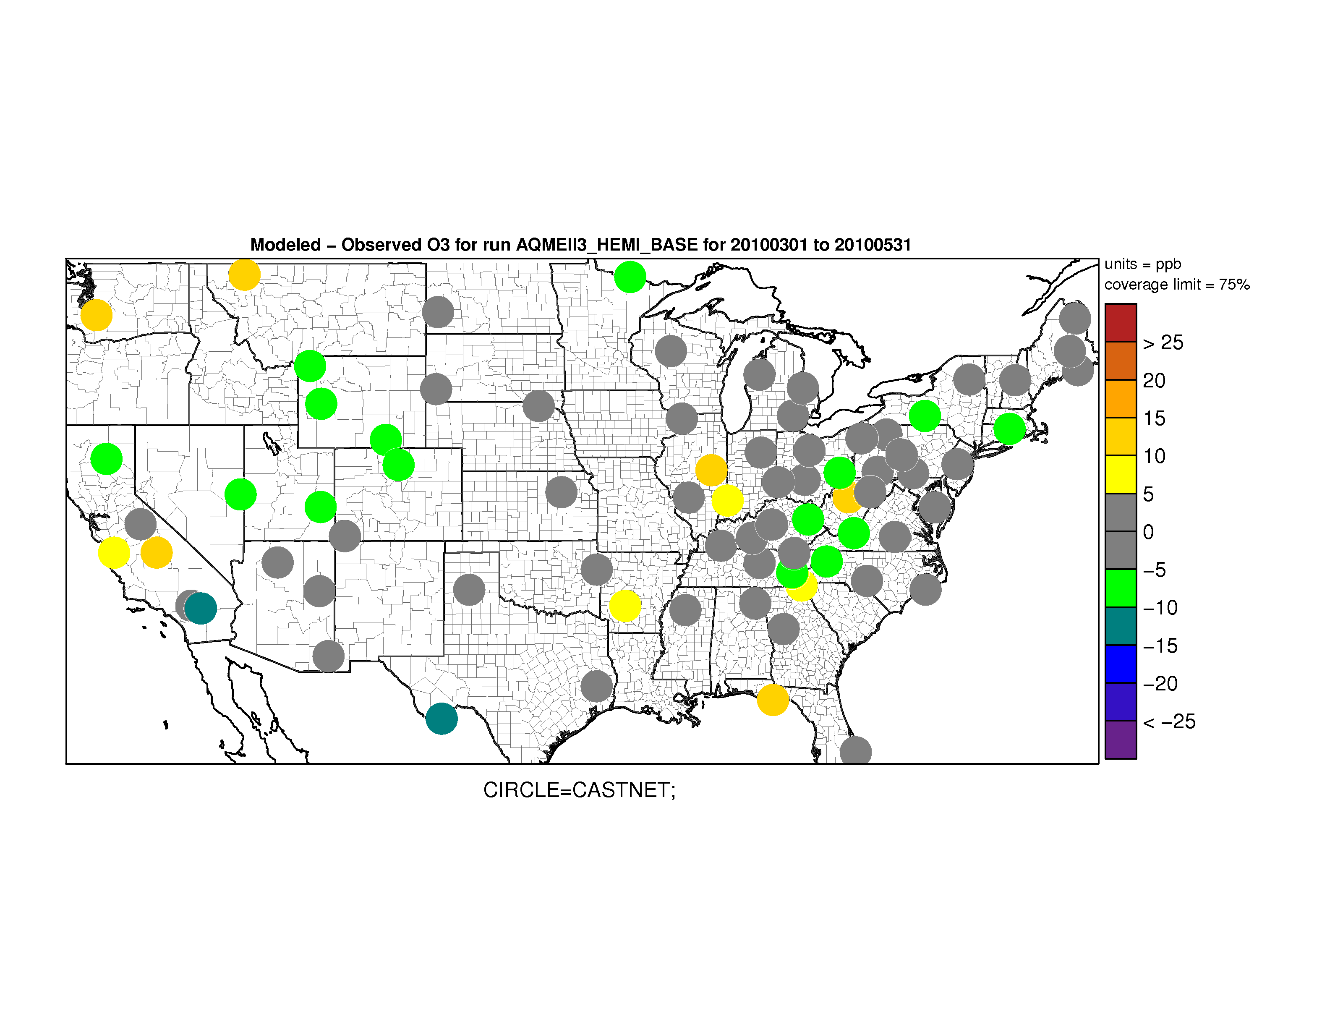
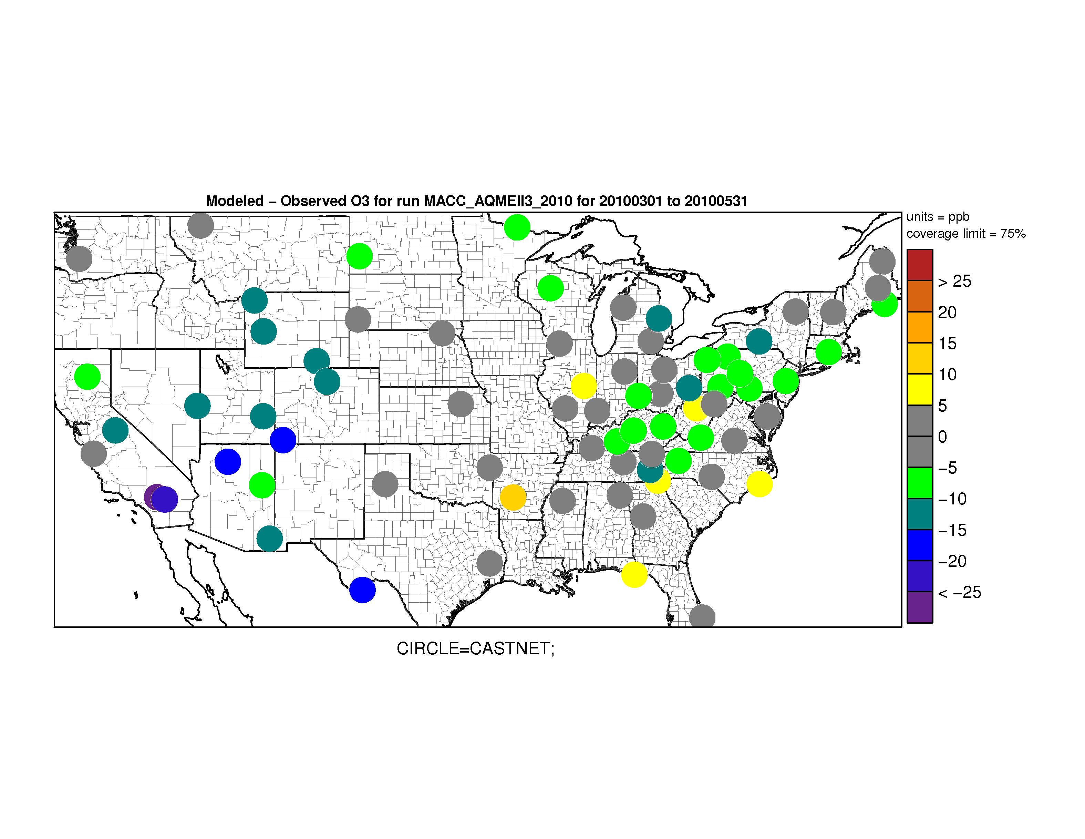
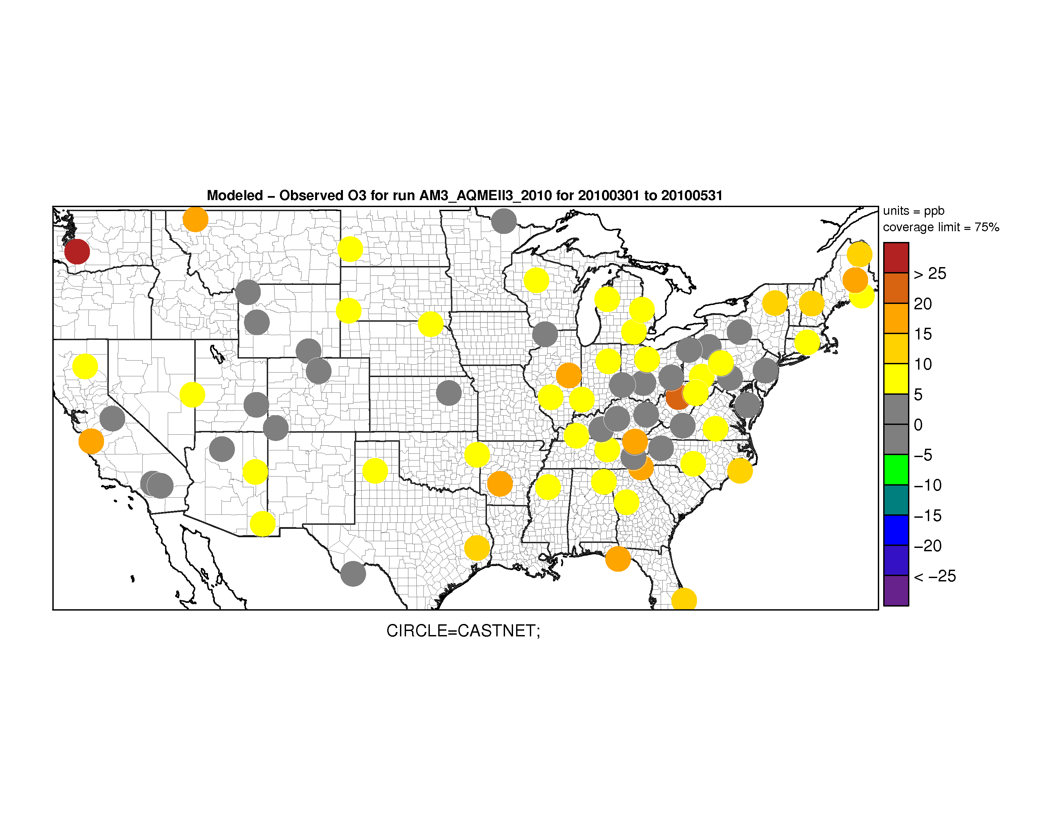
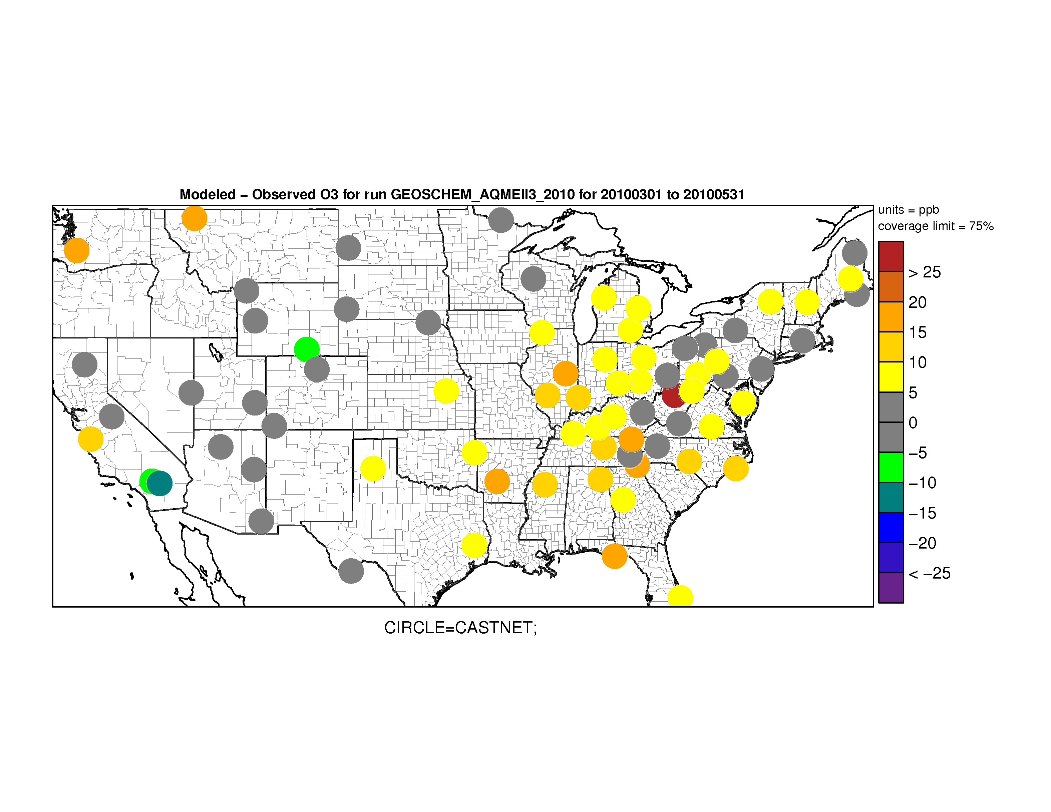
Modeled Minus Observed Ozone at CASTNet Sites, U.S.
March - May
H-CMAQ
C-IFS
Springtime ozone in the intermountain west tends to be underestimated by H-CMAQ and C-IFS while AM3 and GEOS-CHEM are close to observations
AM3 and GEOS-CHEM tend to have positive biases in the eastern U.S.
AM3
GEOS-CHEM

Slide 9
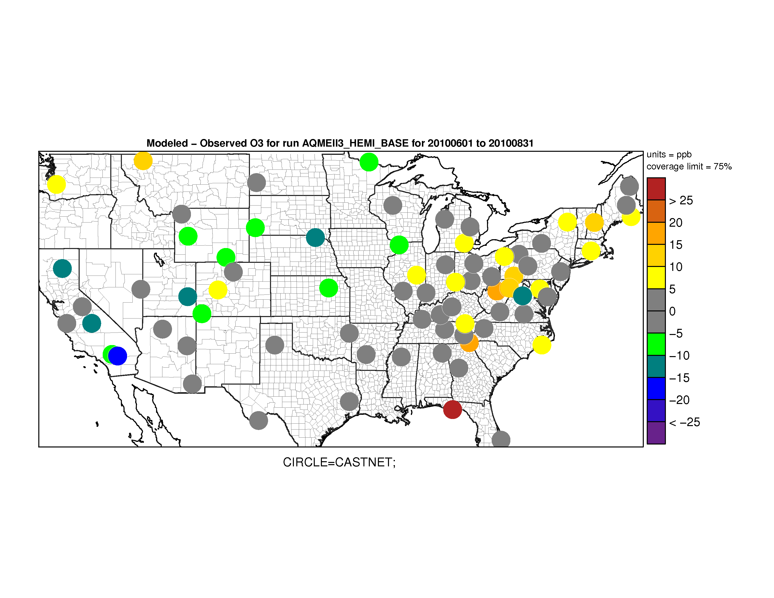
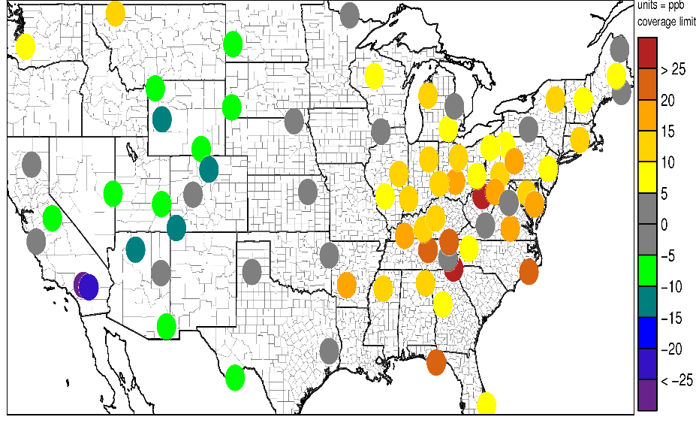
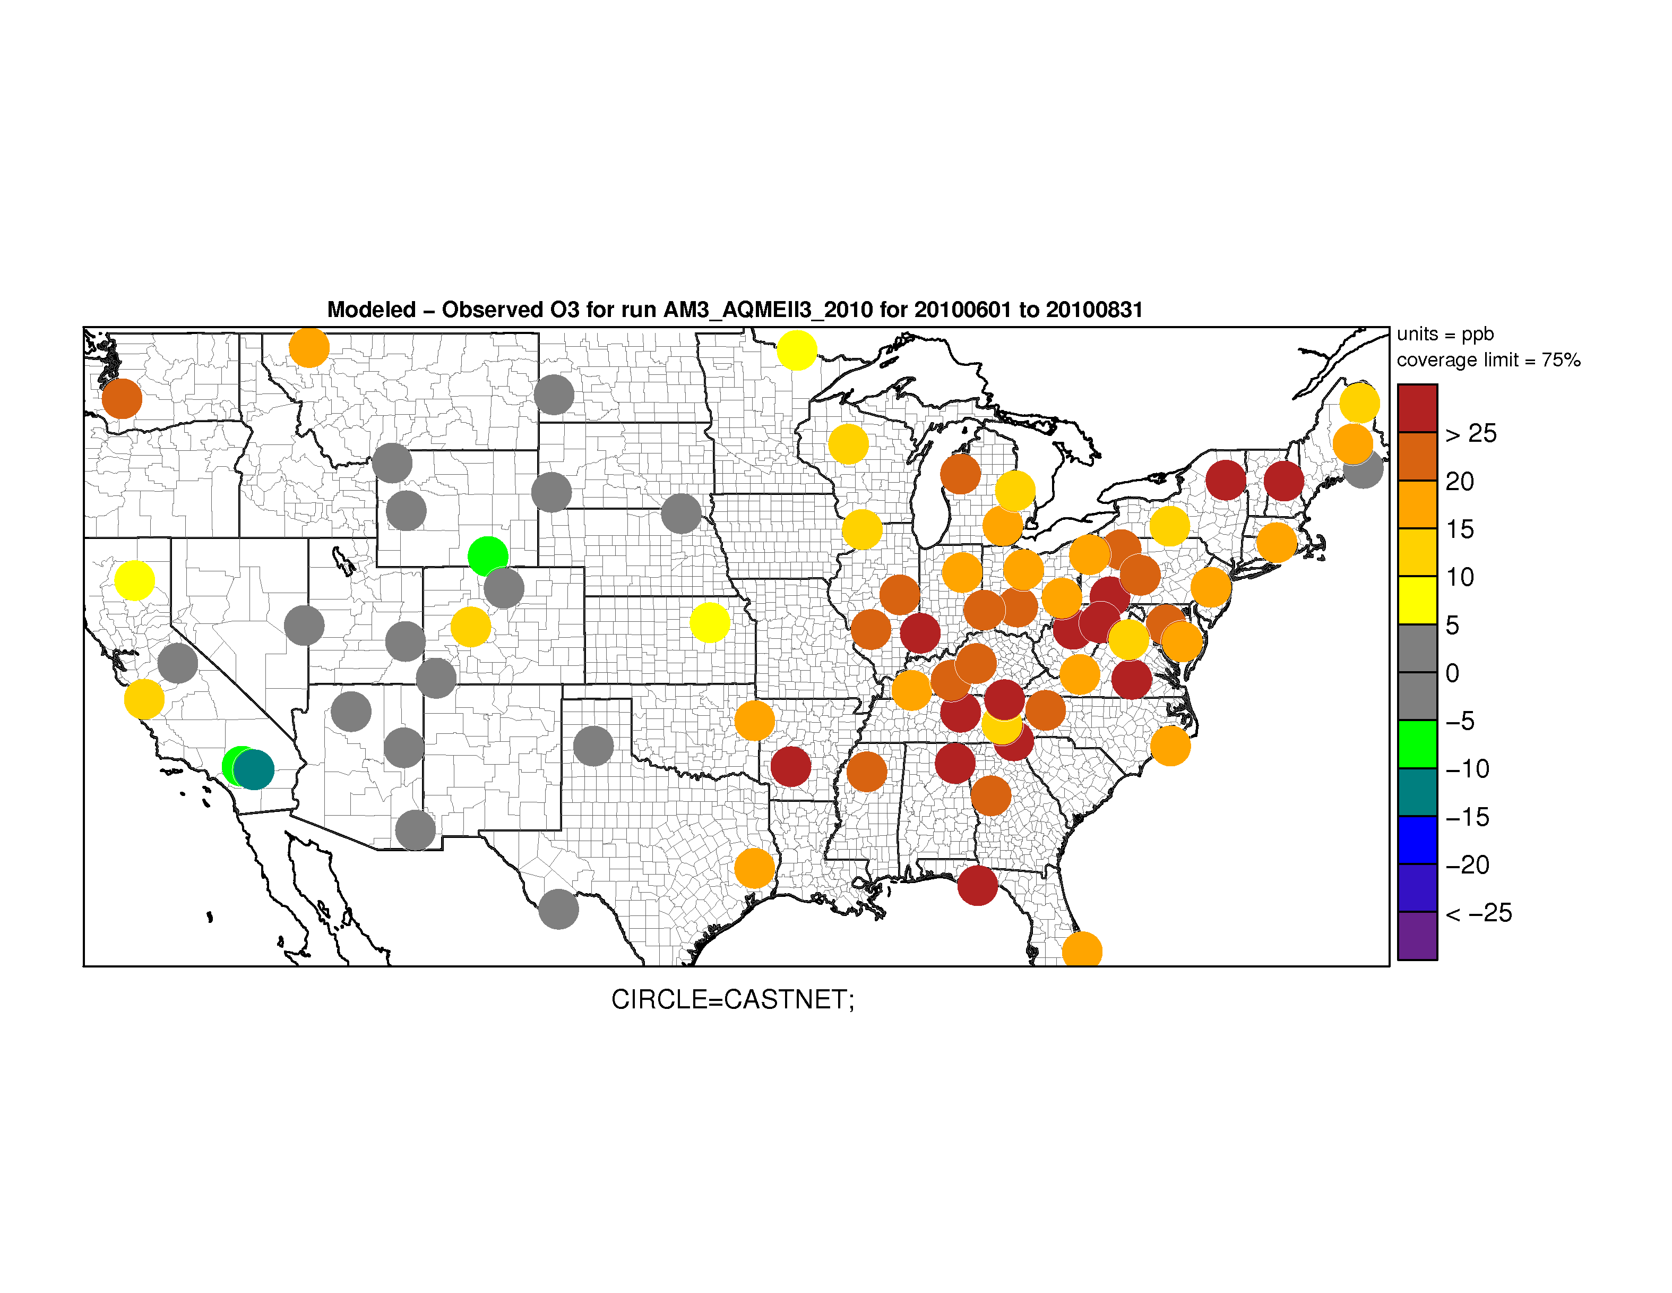
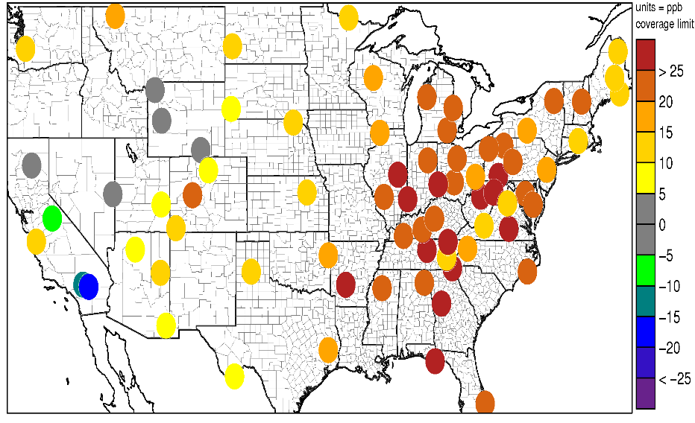
Modeled Minus Observed Ozone at CASTNet Sites, U.S.
June - August
H-CMAQ
C-IFS
Model-to-model differences and model biases tend to be largest over the eastern U.S., potentially due to differences in biogenic emissions and chemistry (Fiore et al., 2009; 2014)
AM3
GEOS-CHEM

Slide 10
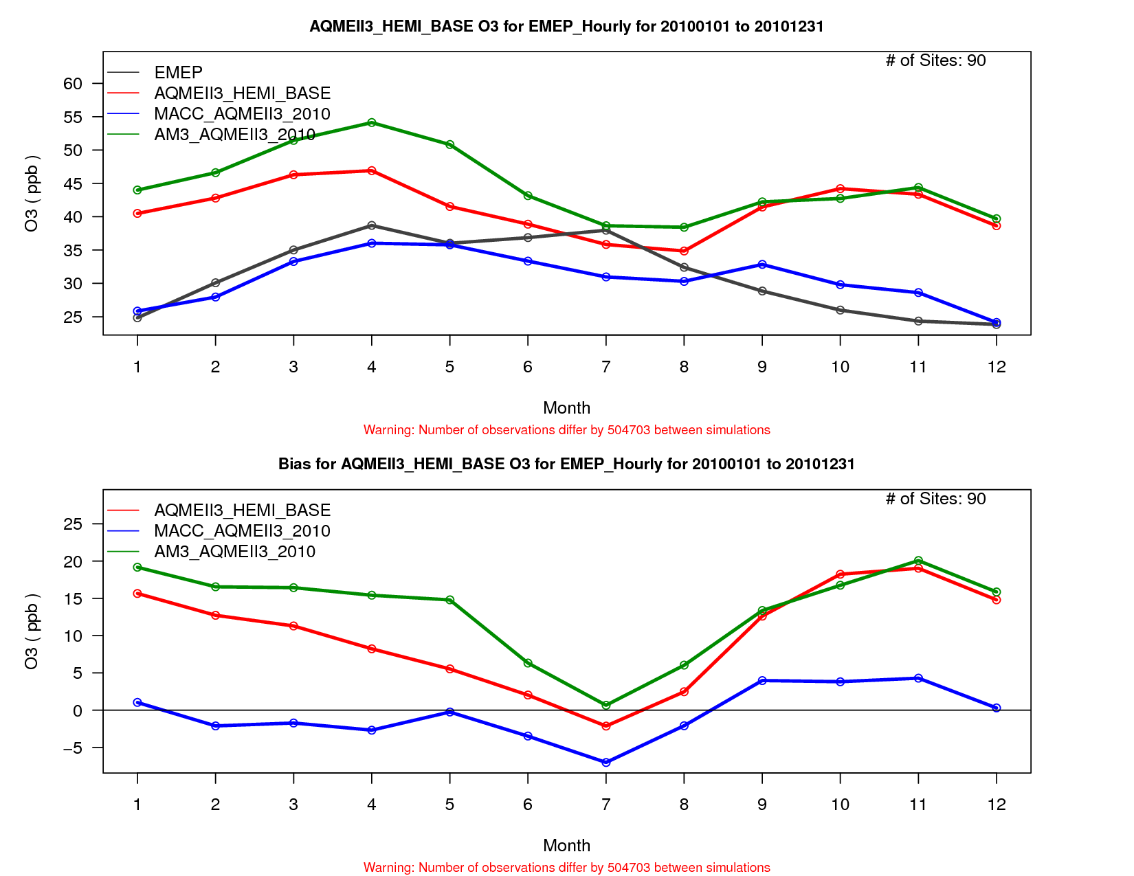
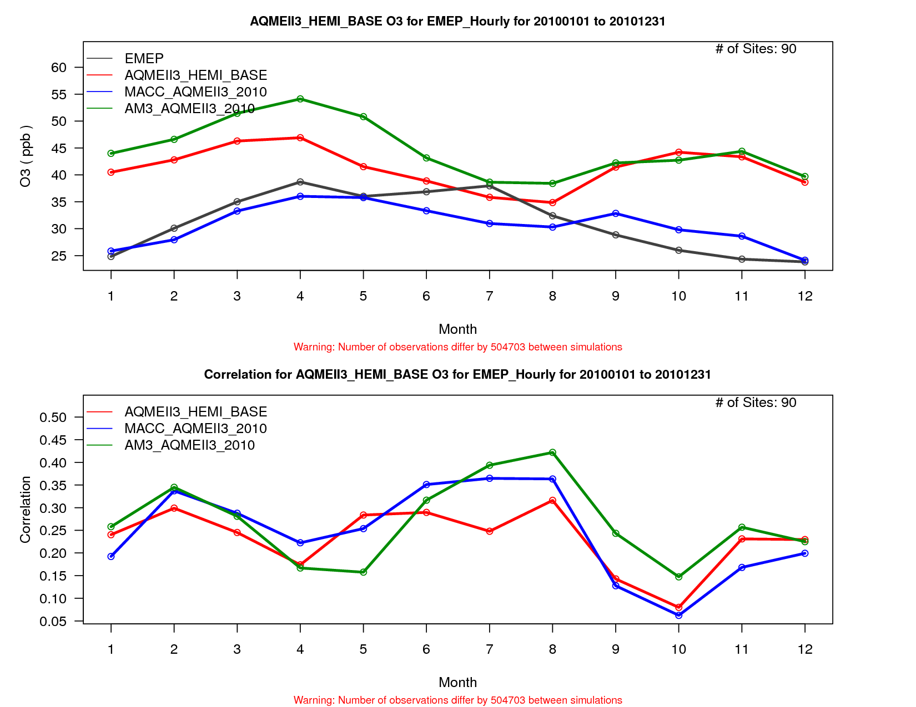
Monthly Average Ozone at EMEP Sites, Europe
Observed and Modeled Concentrations
Observations
H-CMAQ
C-IFS
AM3
Over Europe, both H-CMAQ and AM3 have positive biases for most of the year while C-IFS is largely unbiased
Further work is needed to determine potential reasons for the differences in model behavior over North America and Europe (e.g. siting of monitors, emission differences, etc.)
Model – Observation Differences
Model – Observation Correlations
H-CMAQ
C-IFS
AM3
H-CMAQ
C-IFS
AM3

Slide 11
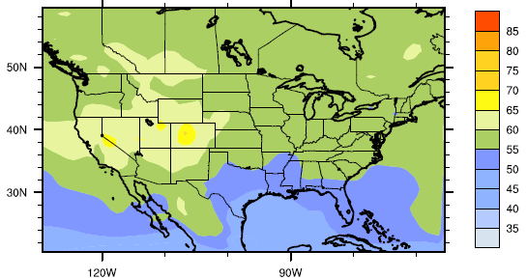
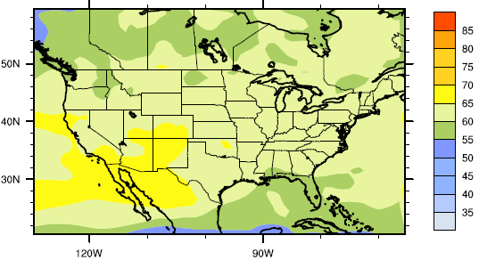
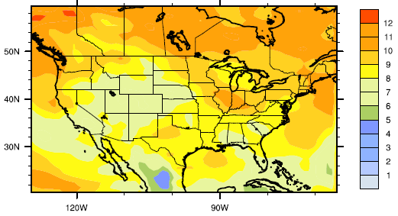
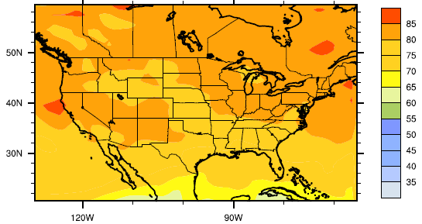
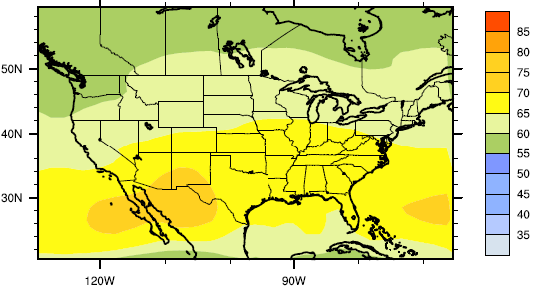
April Average 500 mb Ozone, North America
H-CMAQ
C-IFS
4-Model Standard Deviation
Large model-to-model variations in mid-tropospheric ozone
“Background” ozone modeled by regional models is sensitive to these differences along the western and northern edges of the analysis domain
AM3
GEOS-CHEM

Slide 12
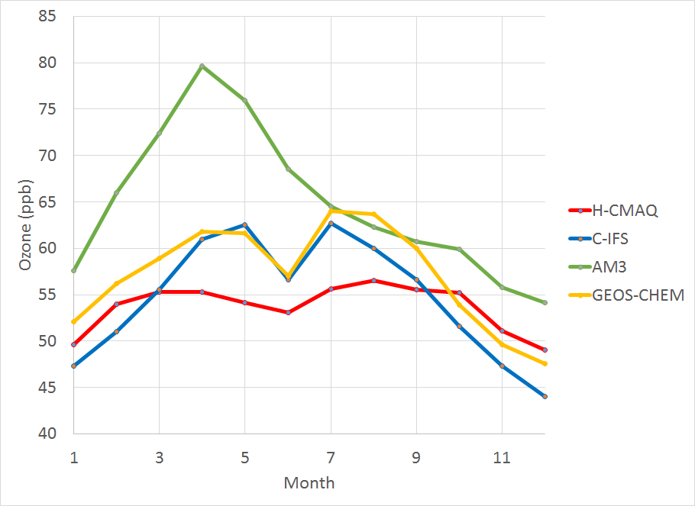
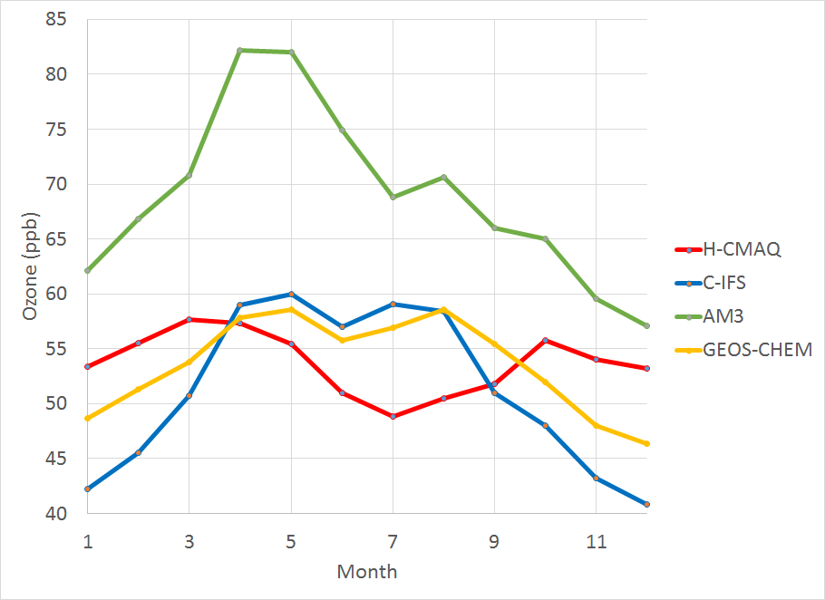
Monthly Average Ozone Time Series at 500 mb
Averaged Along Western and Northern Edges of NA Domain
Western Edge (-130W, 20N to 60N)
Northern Edge (-130W to -65W, 60N)
Large model-to-model variations in mid-tropospheric ozone over North American inflow regions, particularly during spring
Seasonal fluctuations also differ between models, with H-CMAQ showing the smallest seasonal variability

Slide 13
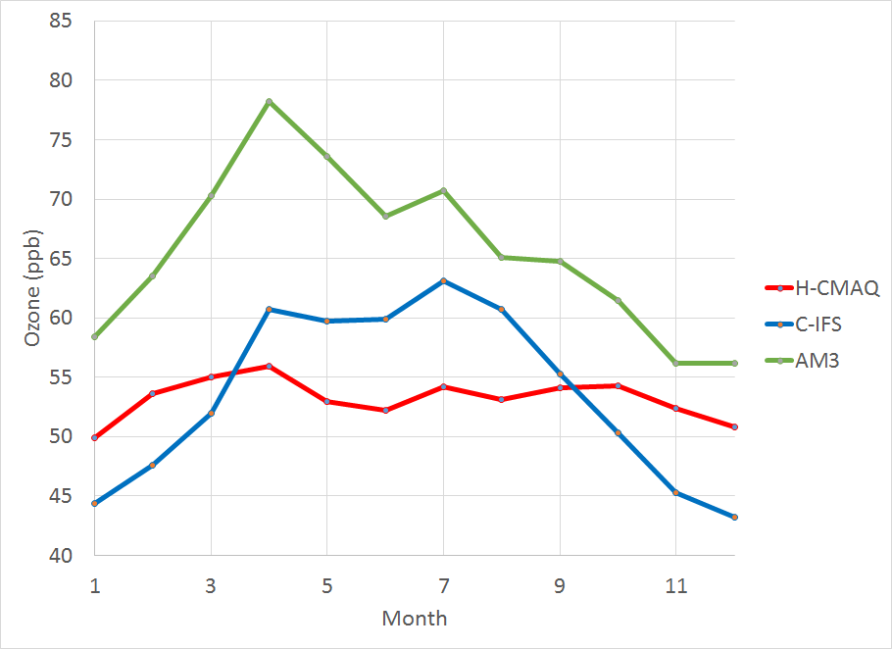
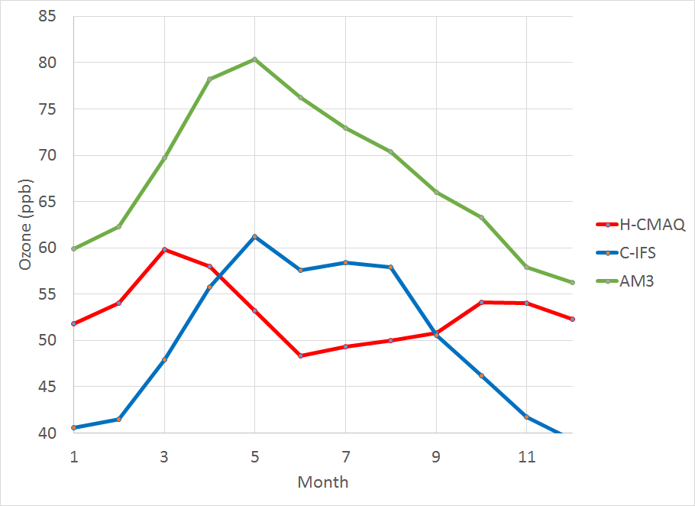
Monthly Average Ozone Time Series at 500 mb
Averaged Along Western and Northern Edges of EU Domain
Western Edge (-25W, 30N to 70N)
Northern Edge (-25W to 40E, 70N)
Model behavior over the EU inflow regions is similar to that over the NA inflow regions

Slide 14
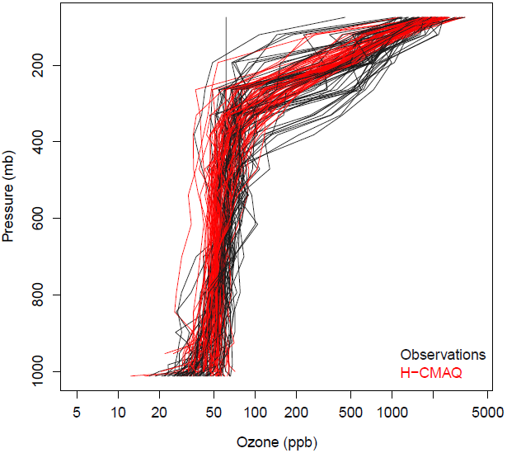
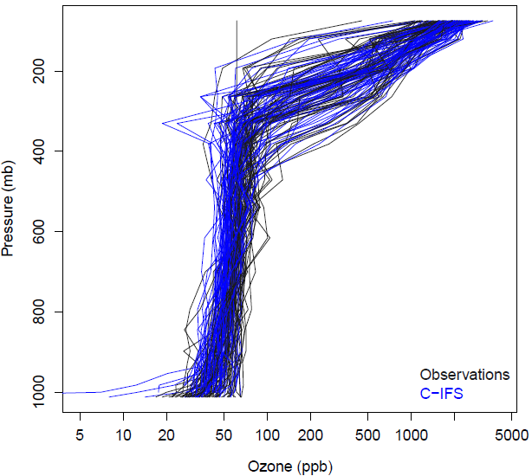
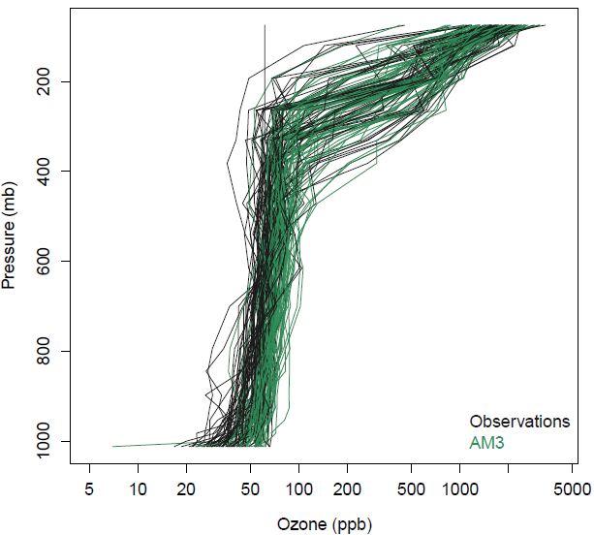
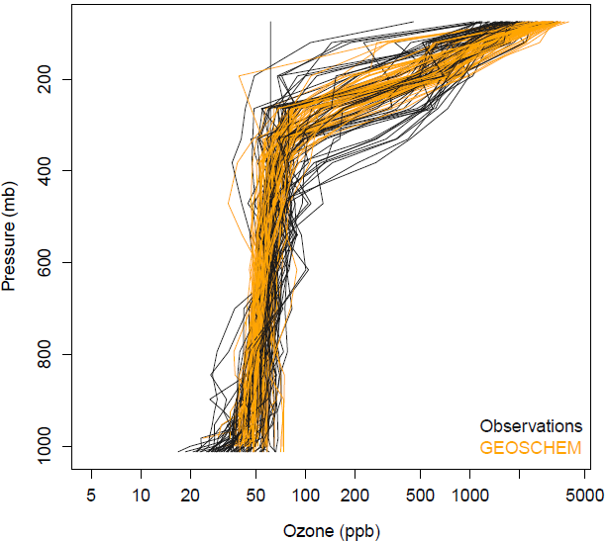
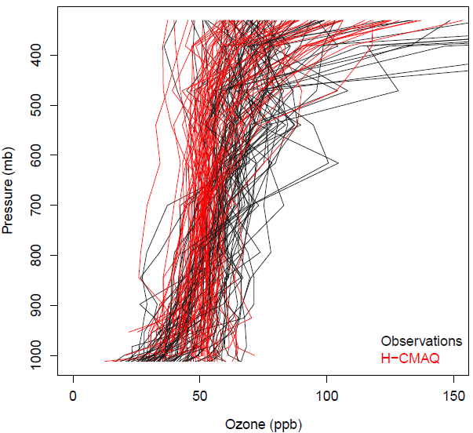
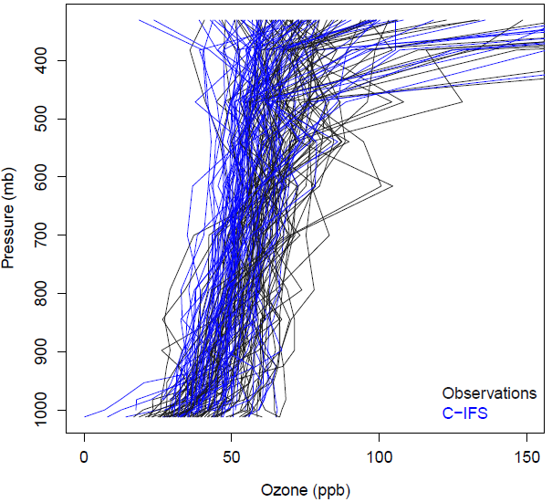
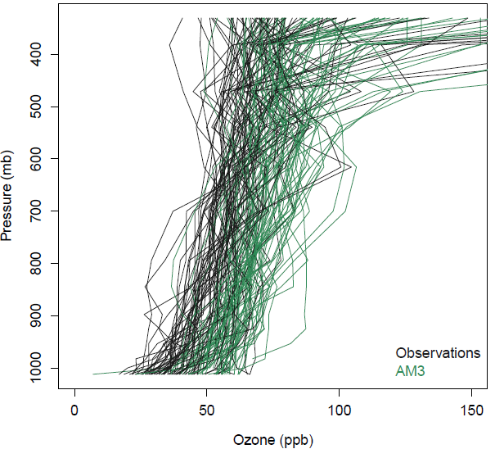
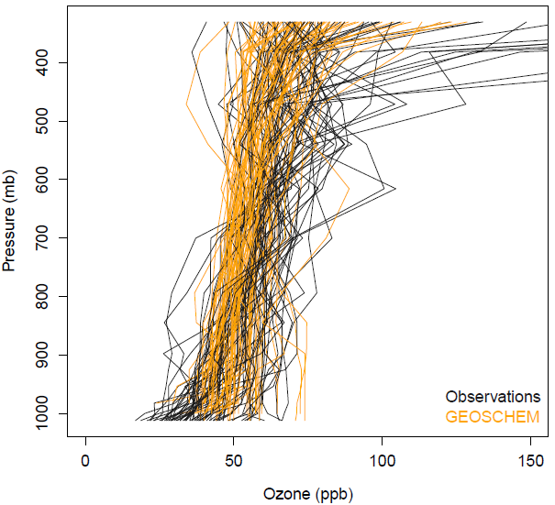
Spring Ozonesonde Profiles, North America
All Layers (top row), Surface to 8.5 km (Bottom Row)
H-CMAQ, All Layers
C-IFS, All Layers
AM3, All Layers
GEOS-CHEM, All Layers
H-CMAQ, To 8.5km
C-IFS, To 8.5km
AM3, To 8.5km
GEOS-CHEM, To 8.5km

Slide 15
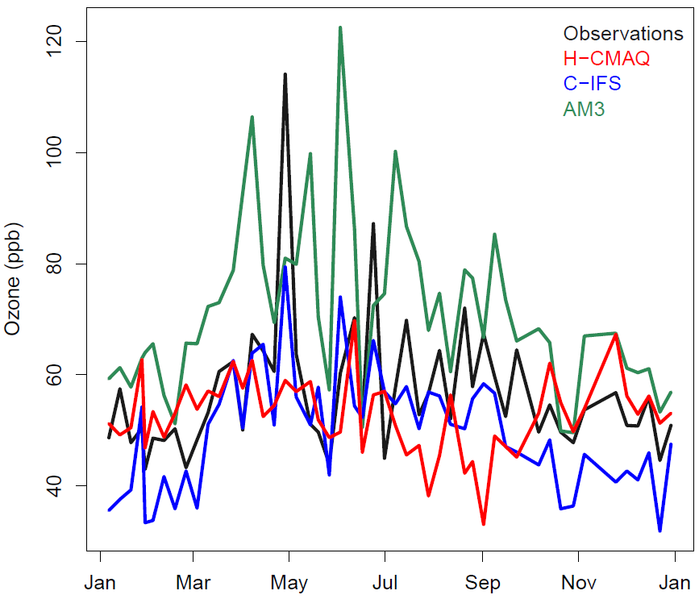
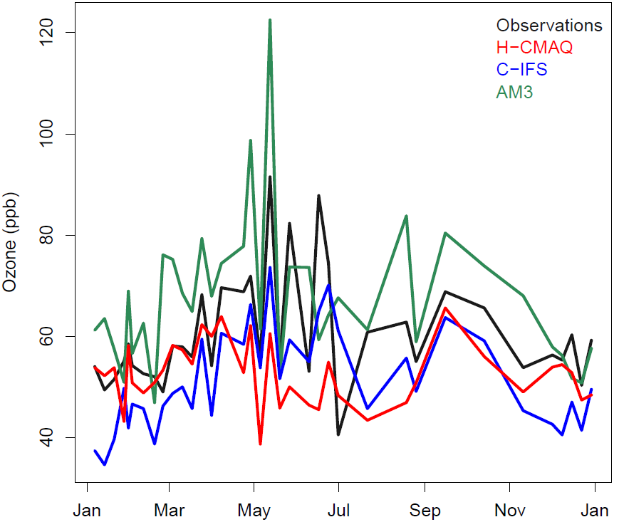
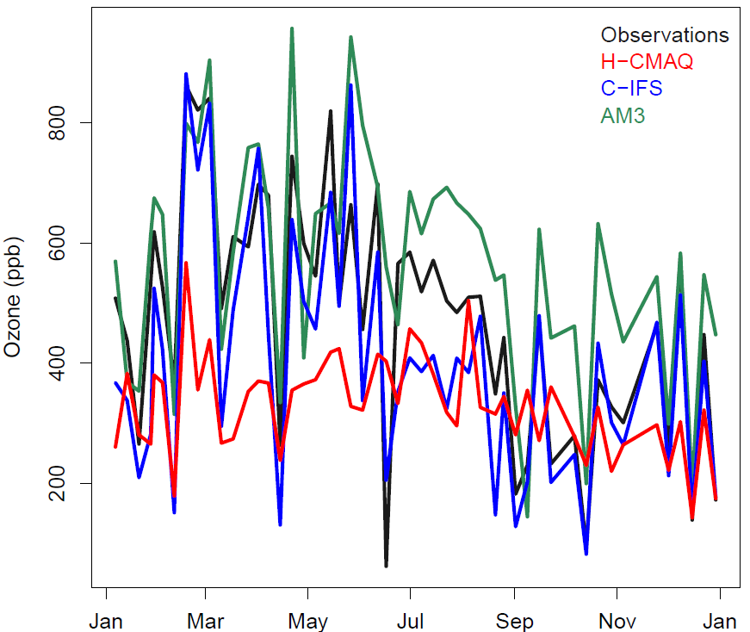
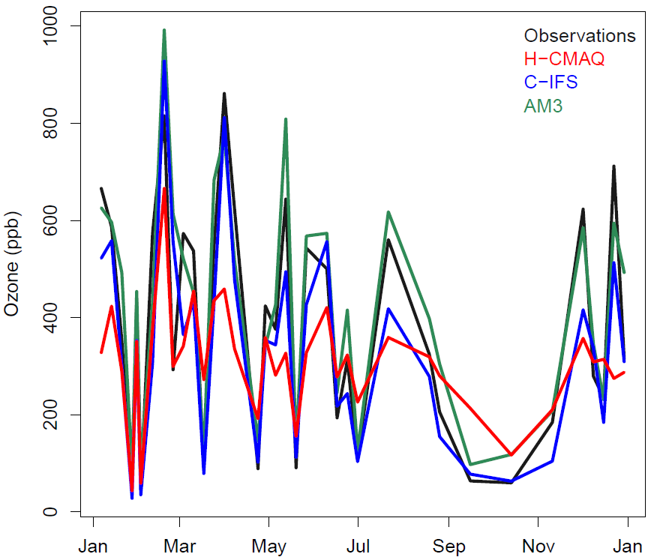
5km and 12km Ozone Time Series at Lerwick (Shetland Islands, U.K.) and Valentia Observatory (Ireland)
Lerwick, 5km, All Launches
Valentia, 5km, All Launches
Agreement between observations and models varies with altitude and over time
AM3 tends to be higher and C-IFS and H-CMAQ tend to be lower than observed mid-tropospheric ozone
H-CMAQ tends to underestimate the seasonality in mid-tropospheric and lower stratospheric ozone while AM3 and C-IFS tend to capture the observed variability
Lerwick, 12km, All Launches
Valentia, 12km, All Launches

Slide 16
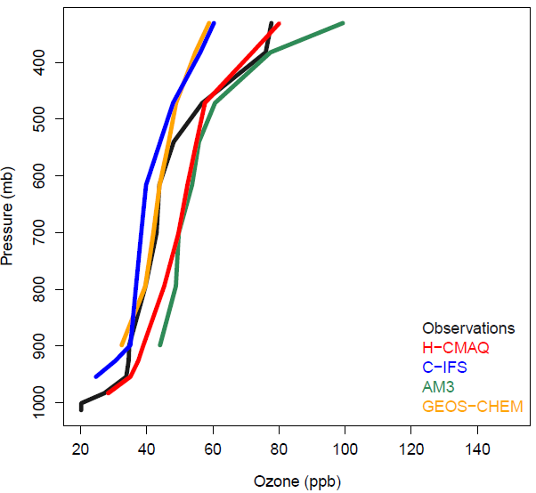
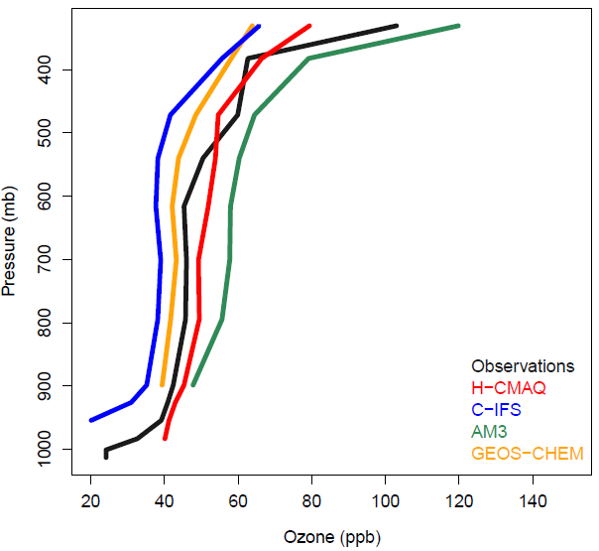
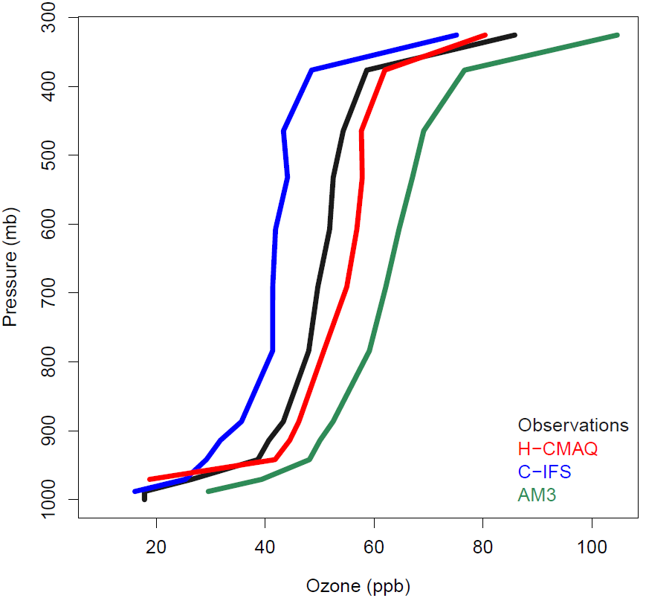
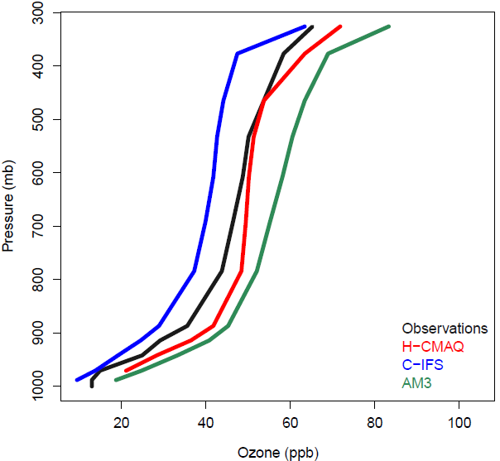
Seasonal Average MOZAIC Aircraft Ozone Profiles, Vancouver (top) and Frankfurt (bottom)
Vancouver, Fall
Vancouver, Winter
Model spread ~20 ppb throughout much of the troposphere
H-CMAQ profiles generally are between C-IFS and AM3 profiles at these locations
Frankfurt, Spring
Frankfurt, Fall
Frankfurt, Winter

Slide 17
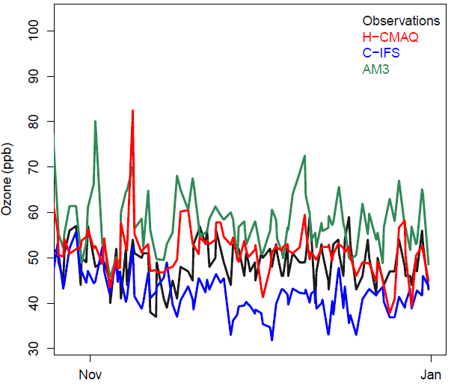
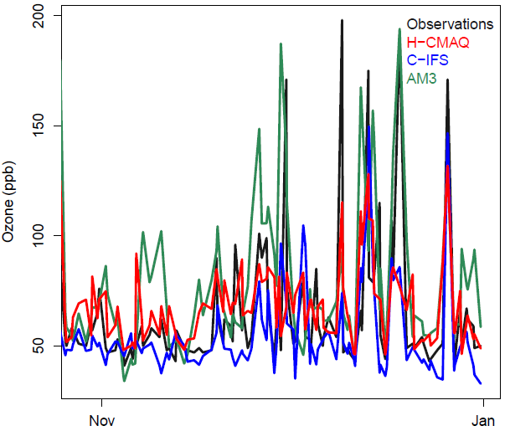
MOZAIC Time Series, Frankfurt Airport, November/December 2010
Altitude 5 km
Altitude 8.5 km
Large number of take-off/landing profiles over Frankfurt provide a good observational dataset for model evaluation
All models tend to capture elevated ozone events at 8.5 km but show variations in magnitude
H-CMAQ ozone concentrations generally fall between C-IFS and AM3 ozone concentrations

Slide 18
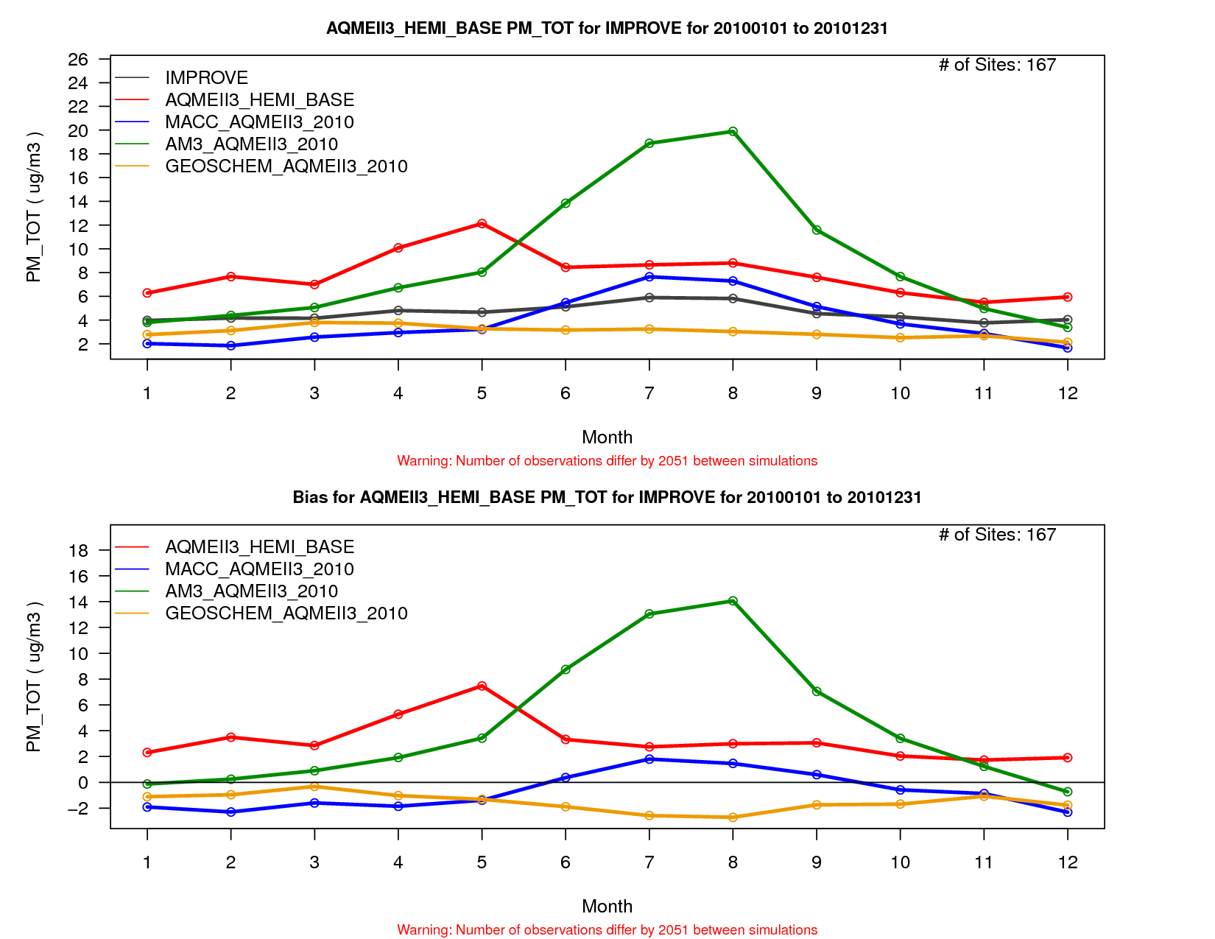
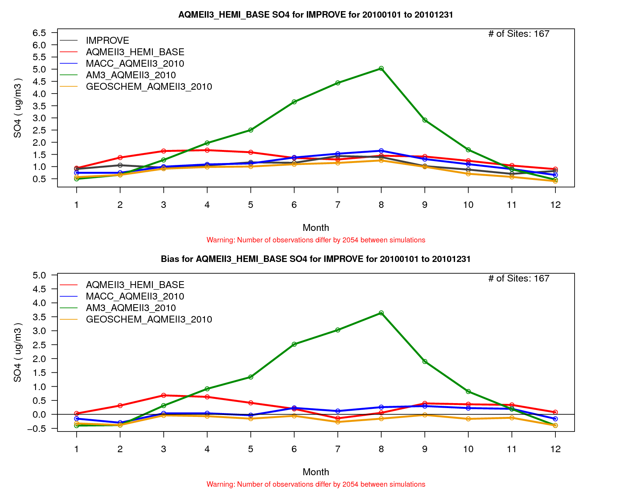
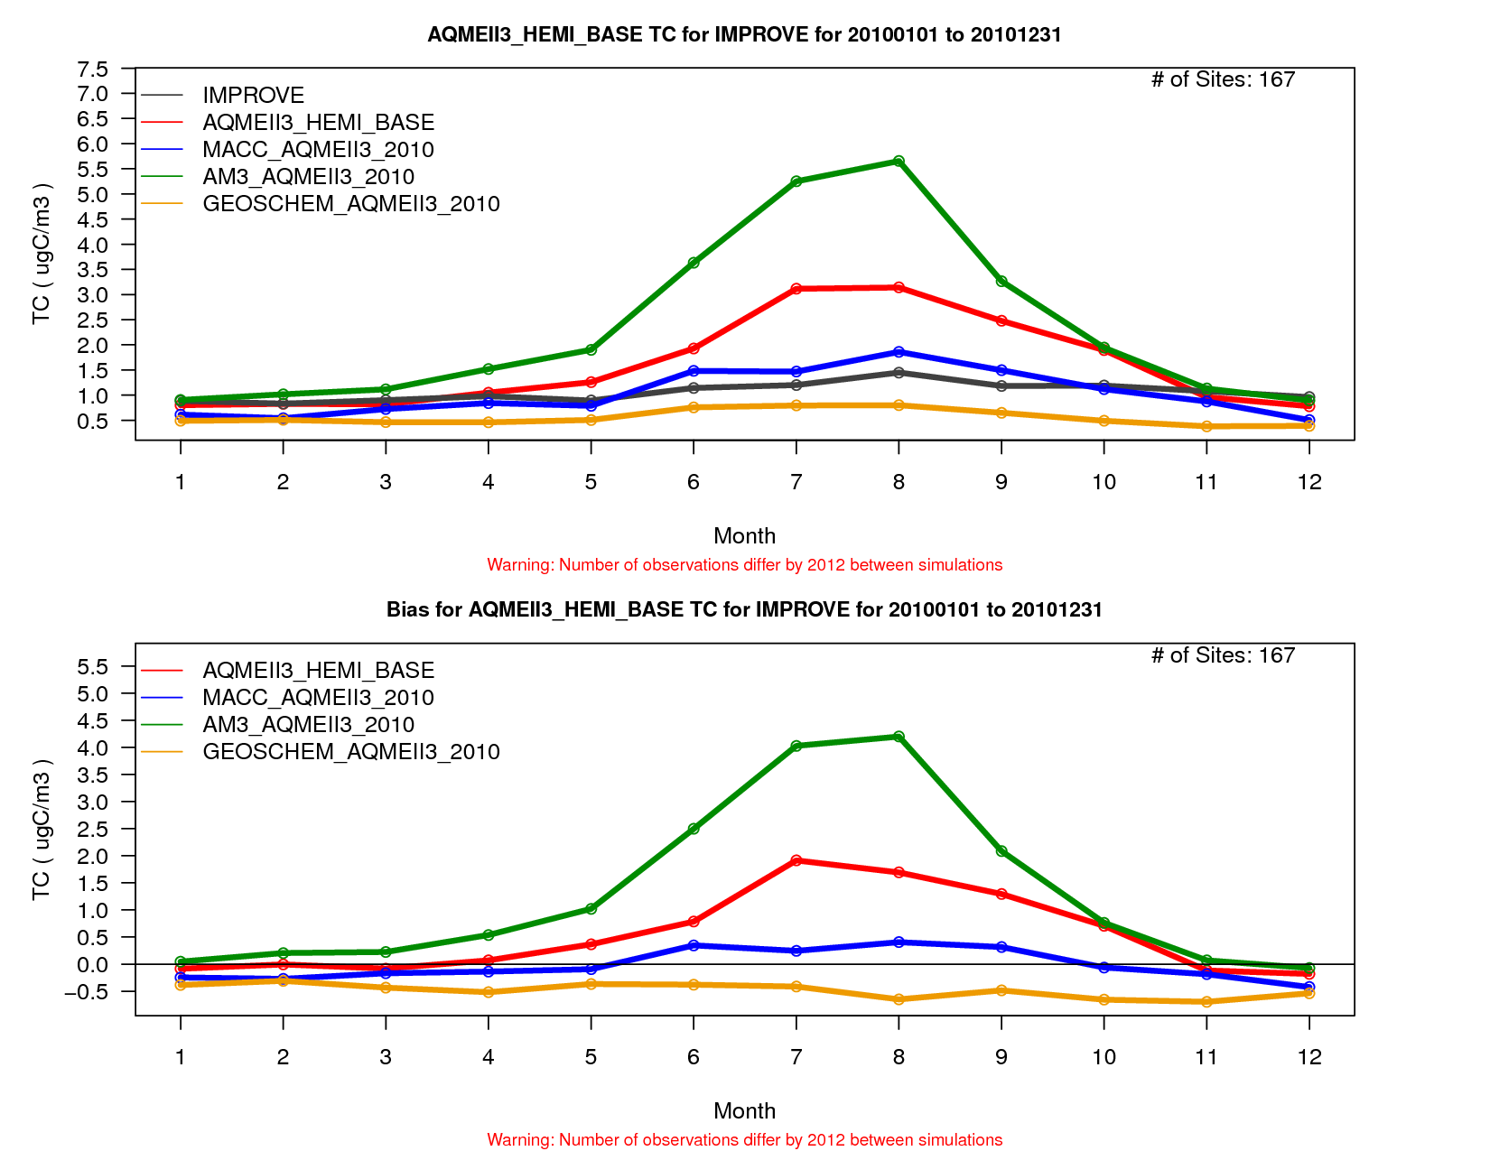
Modeled Minus Observed Monthly Average PM_{2.5}, SO₄ and Total Carbon at IMPROVE Sites, U.S.
PM_{2.5}, IMPROVE
H-CMAQ
C-IFS
AM3
GEOS-CHEM
Substantial model-to-model differences in agreement with observed IMPROVE PM_{2.5} mass and species
AM3 summertime concentrations show a large positive bias → Paulot et al. (2015 ACPD)
SO₄, IMPROVE
TC, IMPROVE
H-CMAQ
C-IFS
AM3
GEOS-CHEM
H-CMAQ
C-IFS
AM3
GEOS-CHEM

Slide 19



Modeled Minus Observed Monthly Average PM_{2.5}, SO₄, and NO₃ at rural EMEP Sites, Europe
PM_{2.5}, EMEP
At these European sites, all models substantially underestimate wintertime PM_{2.5}, NO₃, and SO₄
As for the U.S. IMPROVE sites, AM3 also has the largest SO₄ concentrations, but tends to agree well with EMEP observations during the non-winter months
H-CMAQ
C-IFS
AM3
NO₃, EMEP
SO₄, EMEP
H-CMAQ
AM3
H-CMAQ
C-IFS
AM3

Slide 20


Monthly Average SO₄ Time Series at 500 mb
Averaged Along Western Edges of NA and EU Domains
Western Edge NA Domain
Western Edge EU Domain
Model-to-model variations in mid-tropospheric SO₄ concentrations over NA and EU inflow regions
Seasonal fluctuations also differ between models

Slide 21
Summary and Future Work
Performance of hemispheric CMAQ for O₃ and PM_{2.5} is comparable to other global models participating in HTAP over North America and Europe based on a comparison against both ground-based and upper air observations
There is substantial model-to-model variability in free tropospheric ozone mixing ratios which can have a significant impact on regional model performance
There is a need for diagnostic analyses to identify and constrain the processes causing the model-to-model variability, especially the representation of stratospheric chemistry and stratosphere/troposphere exchange
Future work:
  Expand the analysis to perform regional CMAQ simulations with boundary conditions derived from all of these global model simulations performed as part of HTAP
  Continue to develop, apply, and evaluate hemispheric CMAQ

Slide 22
Acknowledgments and Disclaimer
We gratefully acknowledge the contribution of various groups: the WMO World Ozone and Ultraviolet Data Centre (WOUDC) and its data-contributing agencies provided North American and European ozonesonde profiles; the MOZAIC Data Centre and its contributing airlines provided North American and European aircraft takeoff and landing vertical profiles; for European air quality data the following data centers were used: EMEP European Environment Agency/European Topic Center on Air and Climate Change/AirBase provided European air chemistry data. Joint Research Center Ispra/Institute for Environment and Sustainability provided its ENSEMBLE system for model output harmonization and analyses and evaluation.
Although this work has been reviewed and approved for presentation by the U.S. Environmental Protection Agency (EPA), it does not necessarily reflect the views and policies of the agency.

