Slide 1
Air Quality
Climate Change
& Energy
CMAS 2015

Slide 2
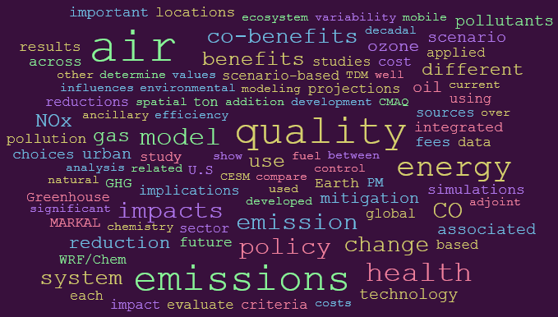
Is it a jumble of topics?

Slide 3
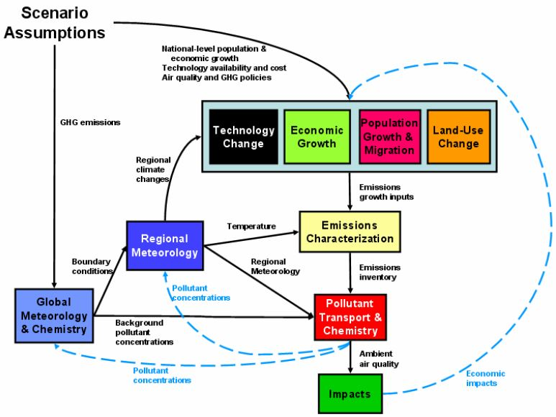
Modeling to support decision making
Exercise in integrated modeling
Multiple scales
  Geographic
  Time
Multiple media
  Air
  Water (quality & supply)
Multiple sectors/systems
  Electricity production
  Industry
  Buildings
  Transportation
  Agriculture
Consideration of a wide range
of management measures:
  Controls
  Renewables
  Energy efficiency & conservation
Many uncertainties

Slide 4
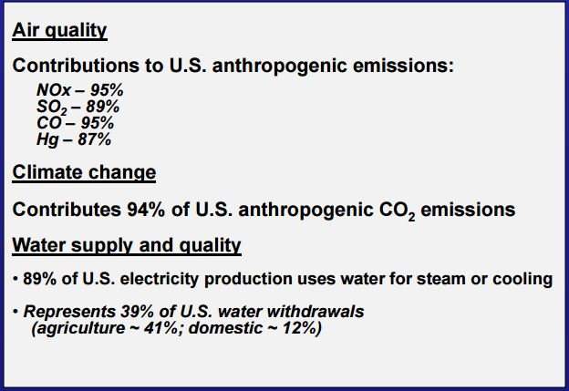
Why the focus on energy?….

Slide 5
Modeling to support decision making
Presentations & posters
Recognition of need for integrated air-
climate-energy modeling
Bottom-up models are being linked
More detailed resolution is being
added to top-down models to
characterize impacts

