Slide 1
Improving an Emissions Inventory for Bogotá, Colombia via a Top-Down Approach
Robert Nedbor-Gross¹, Barron H. Henderson.¹,
Jorge E. Pachon. ², Maria P. Perez Penà ²
¹ University of Florida, Department of Environmental Engineering Sciences
² Universidad de la Salle, School of Engineering

Slide 2
Introduction
Project Goal: Evaluate emission reduction strategies in Bogotá, Colombia using an air quality model (CMAQ)
Methods:
Develop and evaluate an air quality hindcast
Incorporate feedback from model performance evaluation
Simulate projections with and without reduction strategies

Slide 3
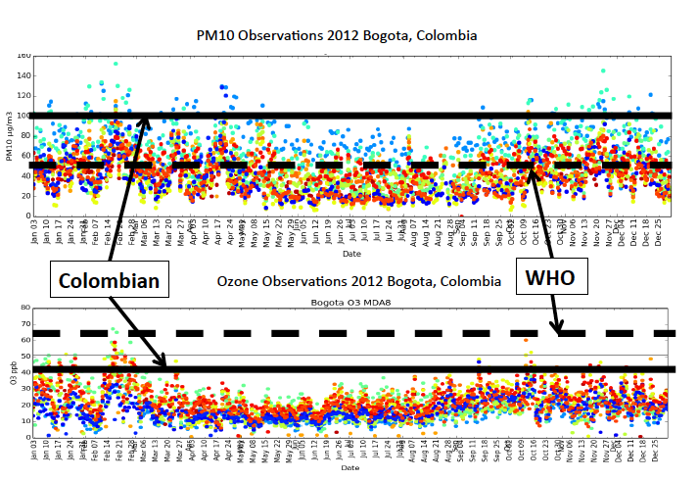
Introduction to Bogotá Air Quality
Main issues are PM10 and ozone
PM10 frequently exceeds standards for WHO and Colombia
Ozone frequently exceeds Colombian standard but not the WHO

Slide 4
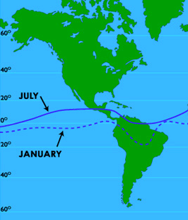
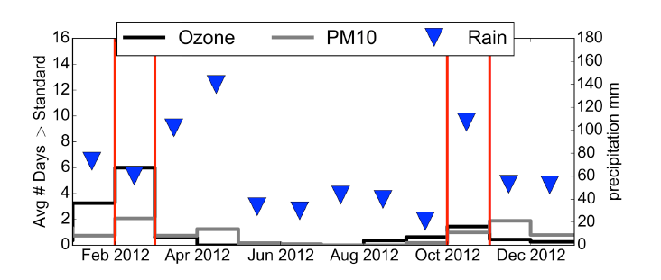
Episode Selection
https://courseware.e-education.psu.edu/courses/earth105new/content/lesson07/03.html
Bogotá has 2 dry seasons and 2 wet seasons because of the ITCZ
Temperatures are consistent throughout the year
Selected pollution episodes for a wet and dry period in 2012

Slide 5
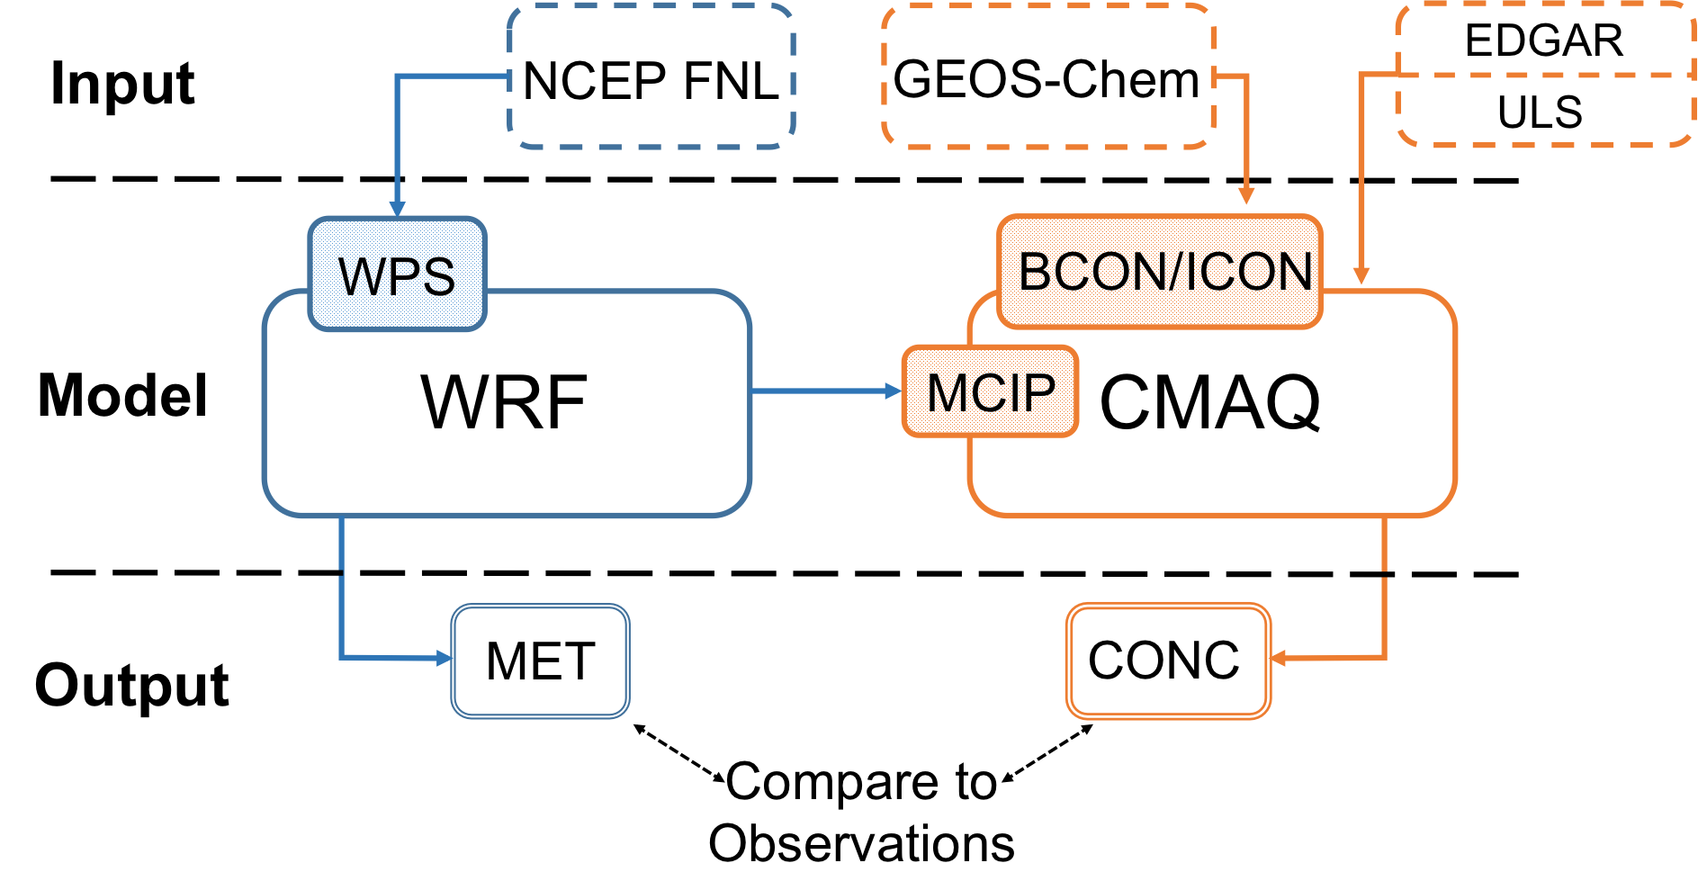
Modeling Methods

Slide 6
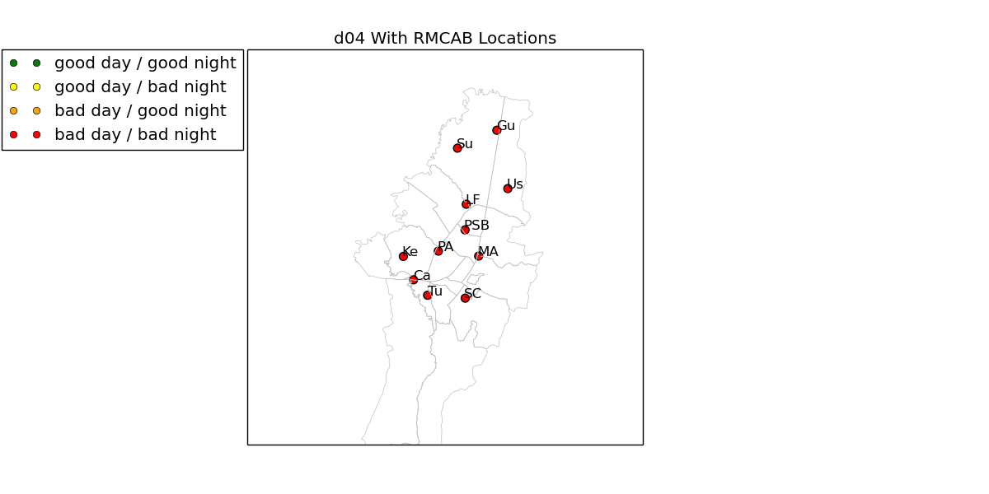
Meteorological Modeling
WRF was run for two 25 day periods in 2012
Each period consisted of 5, 5.5 day segments with half-day spin-up
4 domains, 3:1 nesting ratio
5 physics configurations tested
Improved surface characterizations
  See poster “Improving Inputs for Meteorological Modeling in Bogota Colombia”
Nedbor-Gross, R., B.H. Henderson, J. R. Davis, J.E. Pachón, A. Rincón, O.J. Guerrero, F. Grajales, 2015: Developing Meteorology for Air Quality Modeling in Bogotá, Colombia. Appl. Meteor. Climatol., Under Review.

Slide 7
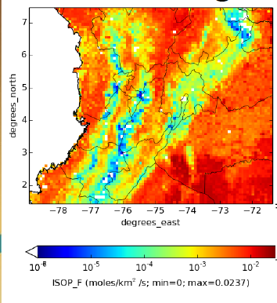
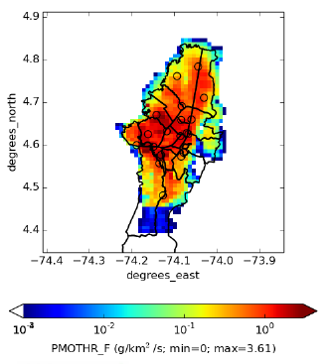
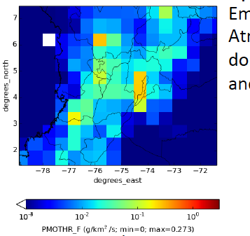
Emissions
Biogenic emissions from Model of Emissions and Gaseous Aerosols from Nature (MEGAN)
Coarse domain anthropogenic emissions from the Emissions Database for Global Atmospheric Research (EDGAR)
Innermost domain anthropogenic emissions inventory developed by Universidad de la Salle from records on industries, vehicles and resuspended dust
Local Emissions

Slide 8
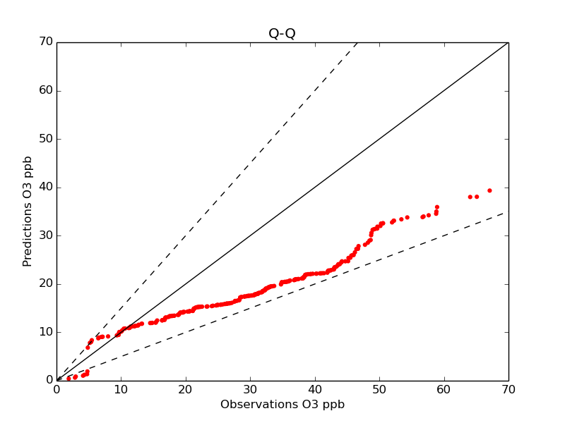
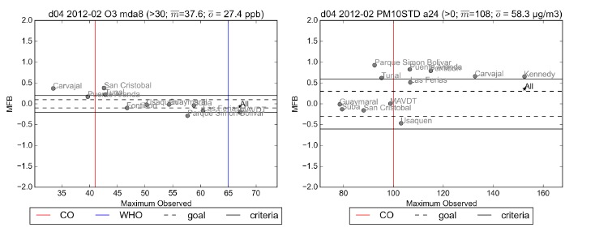
Base Case Results O3
Ozone MFB
Studying February because of rain in October
Strong Ozone performance for most stations
Performance benchmarks from Simon et al., 2012
Simon, H., K. R. Baker, and S. Phillips. 2012. “Compilation and Interpretation of Photochemical Model Performance Statistics Published between 2006 and 2012.” Atmospheric Environment 61 (December): 124–39

Slide 9
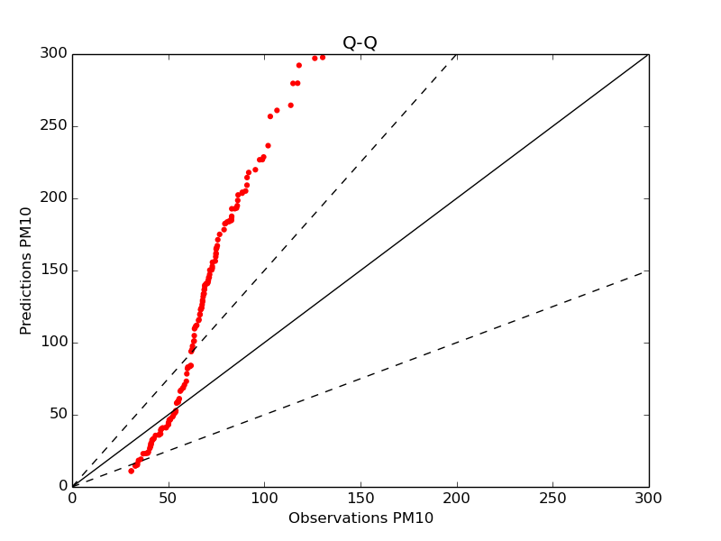
Base Case Results PM10
PM10 MFB
PM is dominated by resuspended dust, about 90%
Dust emissions are a large source of uncertainty
Performance benchmarks from Simon et al., 2012
Simon, H., K. R. Baker, and S. Phillips. 2012. “Compilation and Interpretation of Photochemical Model Performance Statistics Published between 2006 and 2012.” Atmospheric Environment 61 (December): 124–39

Slide 10
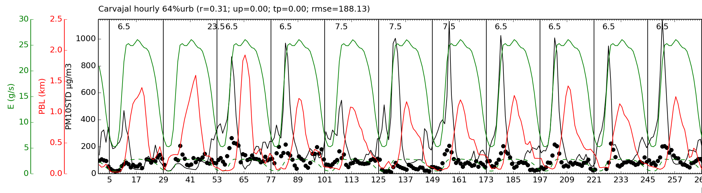
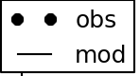
PM10 Hourly High Bias
Carvajal Monitor hourly PM10 STD
CMAQ overpredicts PM10 peaks (500 – 700 µg/m³)
PBL rise or emissions?
  Largest uncertainty is emissions inventory
  Dust is 90% of PM10 and PM25 emissions
  Dust emissions are typically reduced

Slide 11
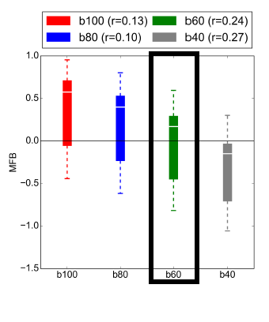
Top-Down (empirical) Emission Scaling
Base model is a function of meteorology (M) and emissions from dust (E_{d}) and everything else (E_{i})
  B=f(M,E_{d}+Σ_{i}E_{i})
Emissions optimized for model performance
  Dust scaling factor d=100%,80%,60%,40%
  MFB is the cost function
Lowest MFB is for d=60%

Slide 12
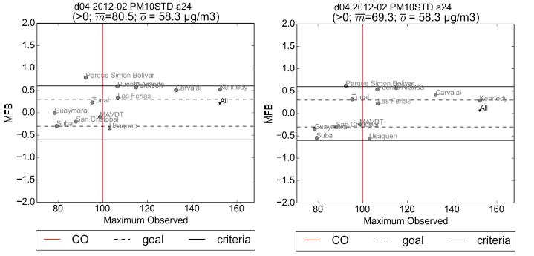
Scaling Factor Improvements
5 stations are brought into attainment with SF=60%
Overall is less biased

Slide 13
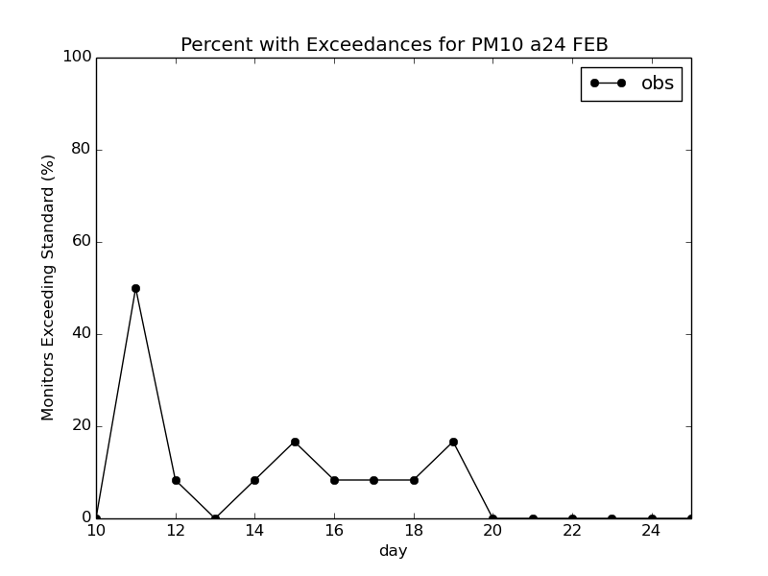
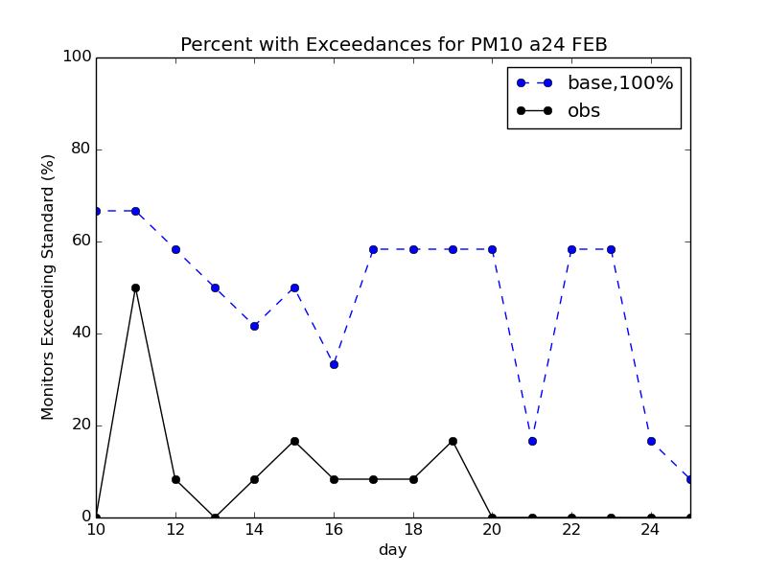
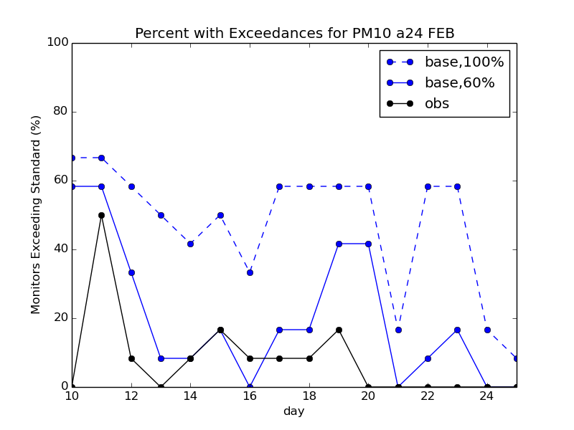
Percent Excceedances Improvement
Significantly more realistic percent exceedence for all stations with SF=60% (r=.24) for the base case year than SF=100%(r=.13)

Slide 14
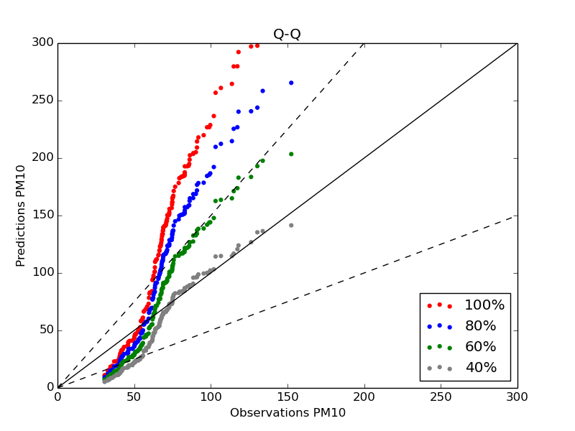
Scaling Factor Improvements

Slide 15
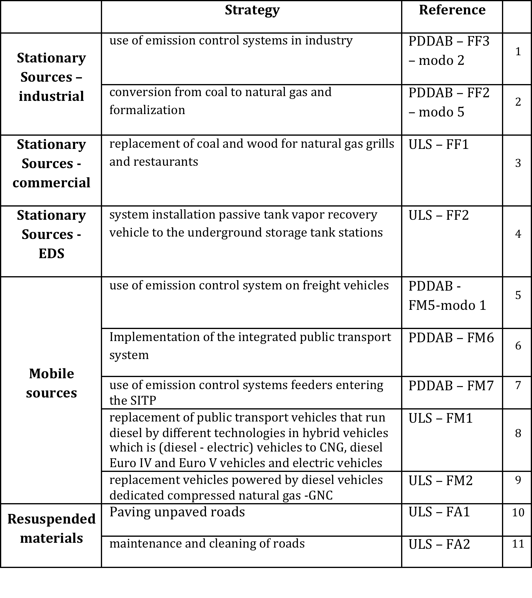
Application to 2020 Modeling

Slide 16
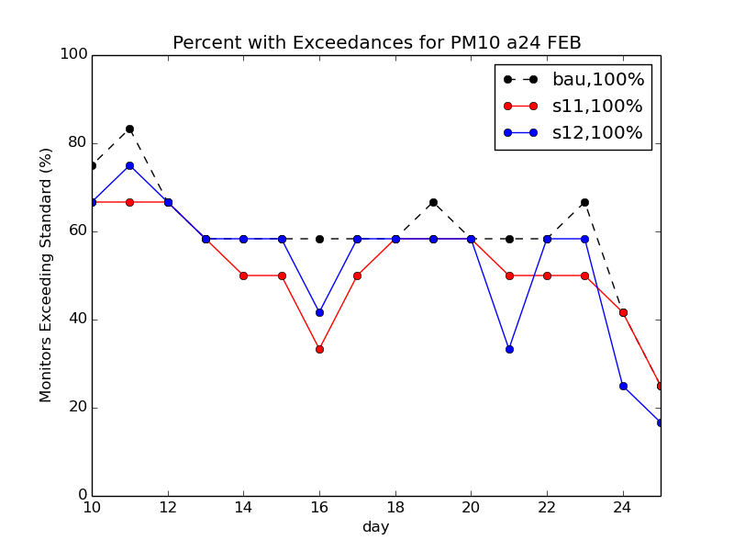
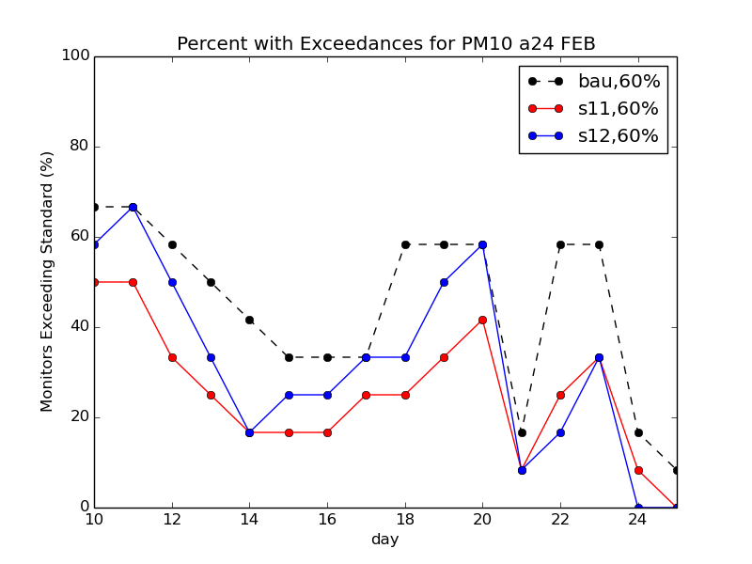
Effect on Future Case
2020 Percent Exceedances
bau vs s12. unscaled
2020 Percent Exceedances,
bau vs s11,s12. Corrected
Less significance for s12
Dependent on reduction strategy

Slide 17
Conclusions
Developed an air quality model for Bogotá that is suitable for regulatory modeling
Unscaled CMAQ performs well for ozone and overpredicts PM10
High bias can be corrected empirically (d=60%)
  Frequency of exceedences is much more realistic.
  With scaling, emissions reduction strategies have more effect.
More realistic basecase exceedances suggests more realistic future.
    Some stations under-predict with and without scaling. Missing sources include mining and construction. Enough?
Notes:
In the future: PM10 PRIMARY emissions is made up of about 96% for bau, 94% in s11, 96% emission
when in the past it was about 95%
Main point is that we have this huge knob to decrease the bia. But is it right? We don’t’ know because we don’t know the source aportionment. Are the new emissions from mobile sources more than dust?

Slide 18
Next Steps
Empirical scaling to mass is uncertain
  Need speciated measurements.
  Need process based dust emission mitigation
  Not accounting for construction and mining
Compared to US: E_{ext}= E[(365-P)365]
    E_{ext}=annual extrapolated emissions, E=emissions factor, P=annual precipitation
    [USEPA. AP 42, Fifth Edition, Volume I Chapter 13: Miscellaneous Sources. Sections 13.2.1 Paved roads and 13.2.2 Unpaved roads]
A “Dynamic Dust” inventory may improve performance further.
  Currently overestimating spatial variance of concentrations.
  Not accounting for high variable precipitation
For more information see poster by Maria Paula Perez Pena (Poster Session 1)
  “Application of a Natural Mitigation Factor and Transportable fraction to the re-suspended particulate matter emissions inventory from paved and unpaved roads in Bogotá, Colombia”

Slide 19
Take Home Message
Able to improve model bias using a top-down scaling factor, however speciation and source apportionment is uncertain.
To find out if the scaling method is appropriate we need to do another study!

Slide 20
Questions?

