Slide 1
Improving NOAA NAQFC PM2.5 predictions with bias correction approach
Jianping Huang^{1,2}, Jeff McQueen², Perry Shafran^{1,2},
Irina Djalalova^{3,4}, James Wilczak⁴, Ho-Chun Huang^{1,2}, Pius Lee⁵,
Li Pan^{5,6}, Daniel Tong^{5,6}, Youhua Tang^{5,6} , Geoff DiMego²,
Sikchya Upadhayay^{7,8}, Ivanka Stajner⁸
1: IMSG; 2: NOAA/NCEP; 3: CIRES/UCB; 4: NOAA/ESRL; 5: NOAA/ARL; 6: UMD;
7: Syn Tech; 8: NOAA/OSTI
Presented to the 14th Annual CMAS Conference
October 7, 2015, UNC-Chapel Hill, NC

Slide 2
Motivation and Objectives
NAQFC has been providing O₃ operational forecast for the US since 2004. However, PM_{2.5} forecast is still on experimental status
To incorporate a bias correction approach into the NAQFC for improving PM_{2.5} predictions
To determine an optimal configuration for real-time forecast application

Slide 3
Outline
Update of NAQFC
Current issue of NAQFC PM_{2.5} predictions
Bias correction method: Analog Ensemble
Evaluation of PM_{2.5} bias correction
Summary

Slide 4
NMM-B
NGAC(dust)
+ GEOS/Chem
2005 NEI
+ 2011 NEI
PRDGEN
(met interpolator)
PREMAQ
BlueSky
(smoke)
CMAQ
(v4.6)
Post
AirNow Obs
Bias Correction
G2O FVS
verification
A flow-chart of the NAQFC
(new changes as indicated by the red dashed boxes)

Slide 5
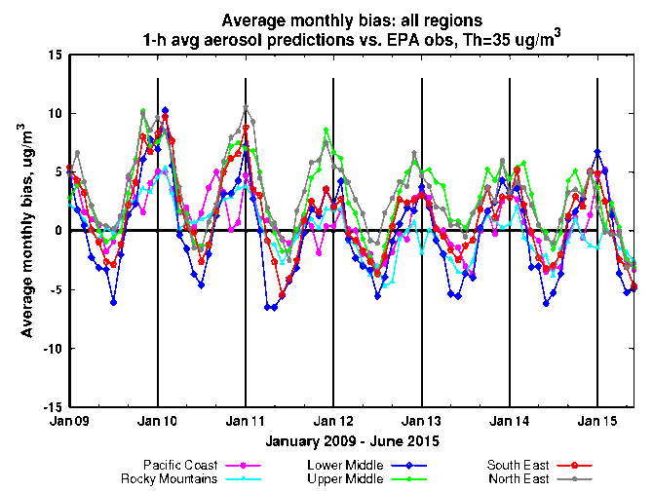
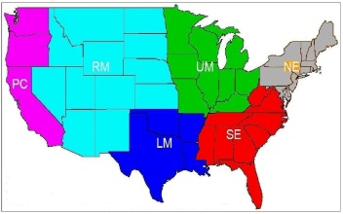
Current issues of PM_{2.5} predictions
Significant seasonal biases
over-prediction in winter
under-prediction in summer
Sources of biases
emissions ?
Met inputs like PBLH ?
CMAQ itself?
LBCs?
Over-prediction in winter is getting improvement and Under-prediction in summer is unchanged

Slide 6
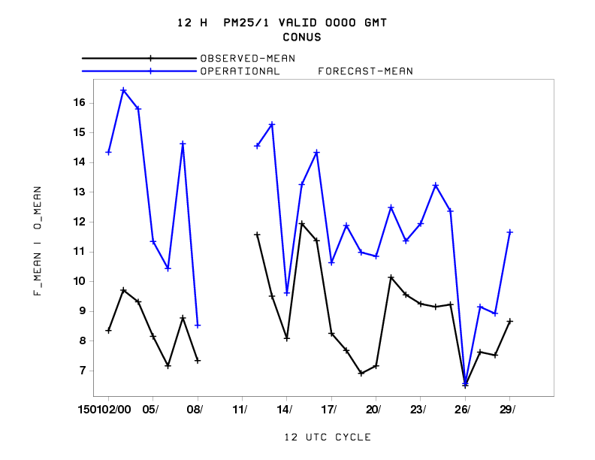
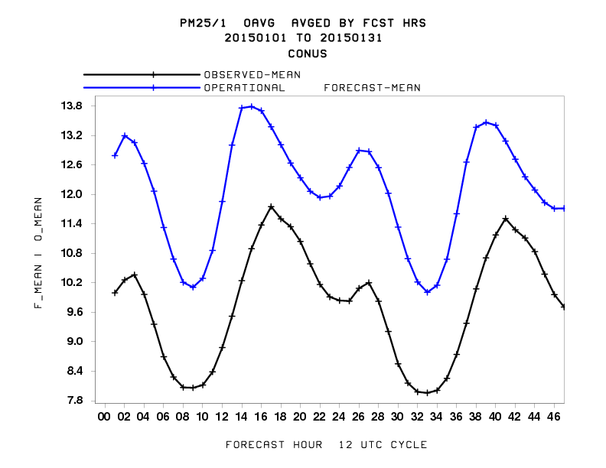
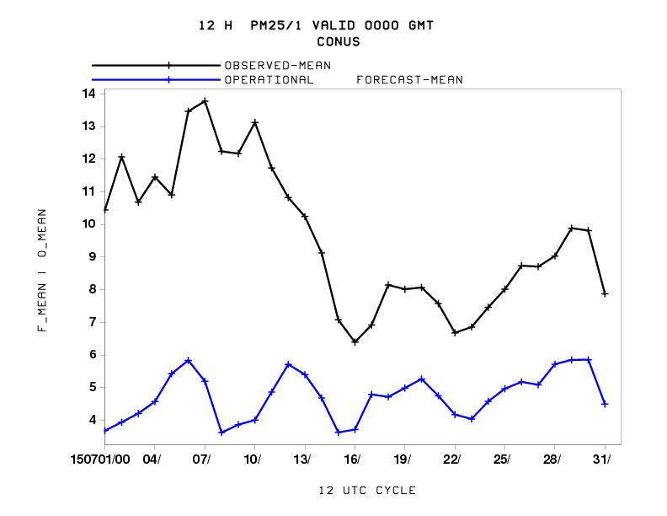
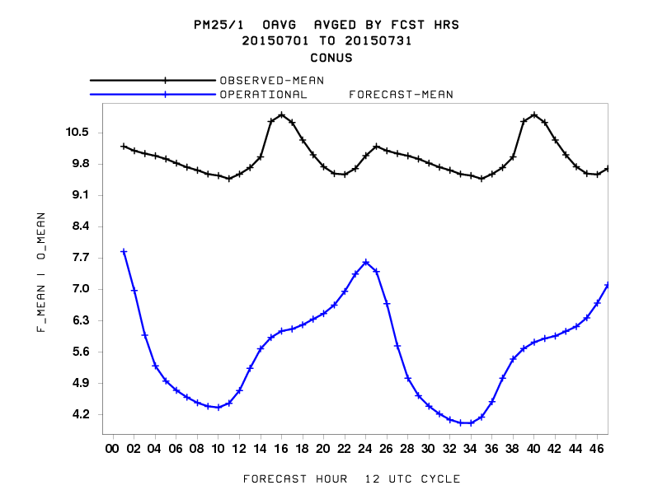
Current issue of PM_{2.5} predictions
Jan/2015
Jan/2015
Jul/2015
Jul/2015

Slide 7
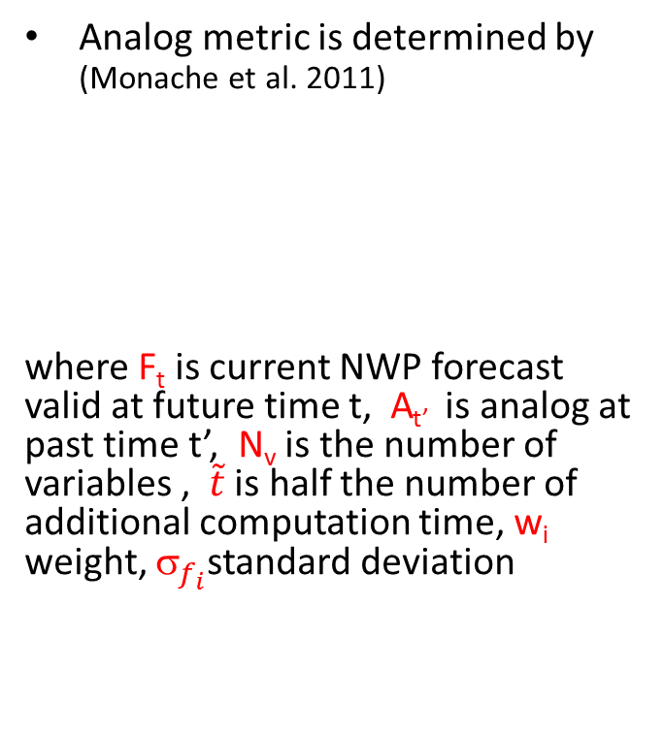
Analog Ensemble for PM_{2.5} Bias Correction
Analog metric is determined by (Monache et al. 2011)
where F_{t} is current NWP forecast valid at future time t, A_{t’} is analog at past time t’, N_{v} is the number of variables , $\tilde{t}$ is half the number of additional computation time, w_{i} weight, $_{f_{i}}$standard deviation
(Source: Djalalova et al., 2015)

Slide 8
Configurations of NAQFC runs
Met inputs: NMMB 12-km (bgrd3d files)
Emissions: 2005 NEI + part of 2011 NEI (without mobile sources) + Blue Sky fire/smoke emissions (no gas)
CMAQ: CB05 gas-phase mechanism + Aero 4 module + 35 vertical levels
Lateral Boundary Conditions: NGAC dust + 2006 GEOS/Chem simulations (for gas + others of PM_{2.5})
Bias Correction for PM_{2.5}:
- Analog Ensemble
- Analog search variables: PM_{2.5} + T+WS/WD

Slide 9
Configurations of NAQFC runs (cont.)
Runs | Raw PM_{2.5} | Bias corrected PM_{2.5}
Operational | √
Parallel | √
CMAQBIACOR1 |  | 3 members + 8 weeks
CMAQBIACOR2 |  | 10 members+ 8 weeks
CMAQBIACOR3 |  | 3 members + 5 months
Testing periods:
- January 2015 (winter)
- July 2015 (summer)

Slide 10
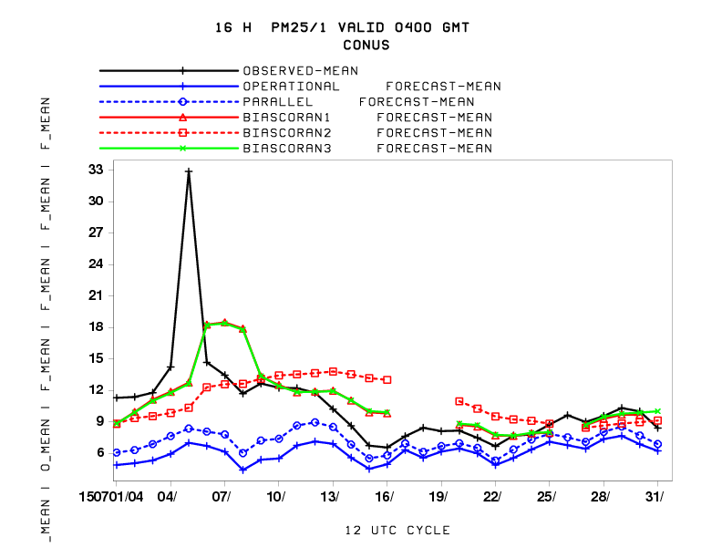
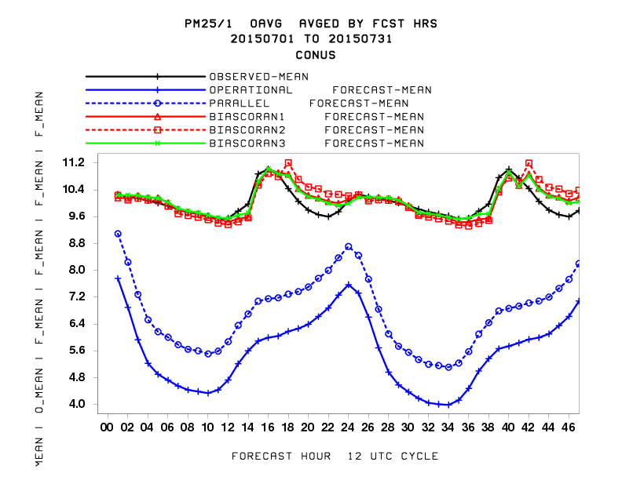
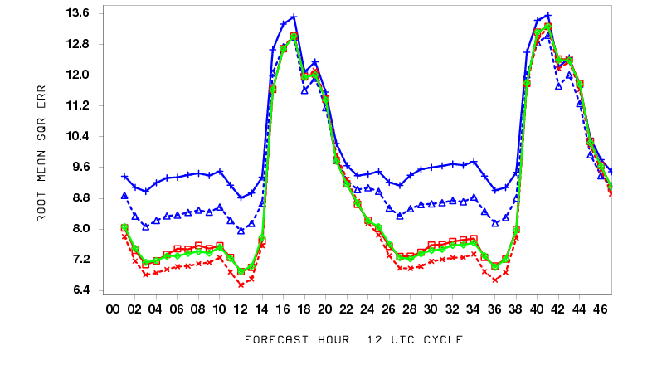
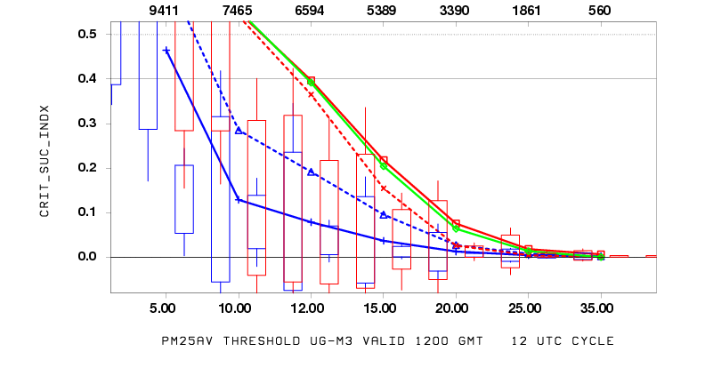
Comparison of five runs for July 2015
at 16th fcst hour
RMSE
Crit_Suc_Indx
For the 2-months training period, the 10-member scenario does not help
For the 3-members scenario, 2 months and 5 months training period have similar performance

Slide 11
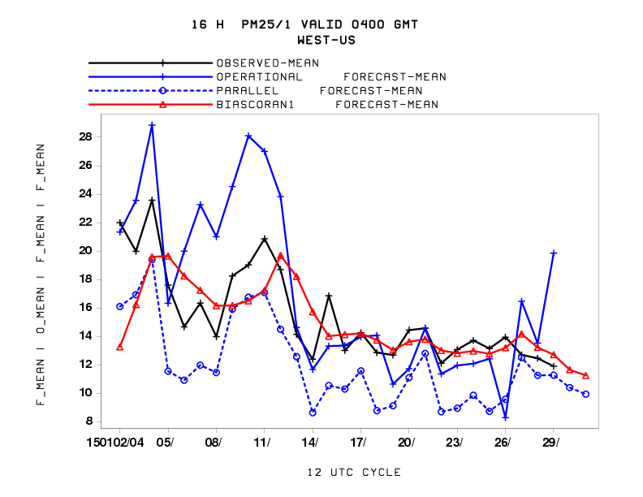
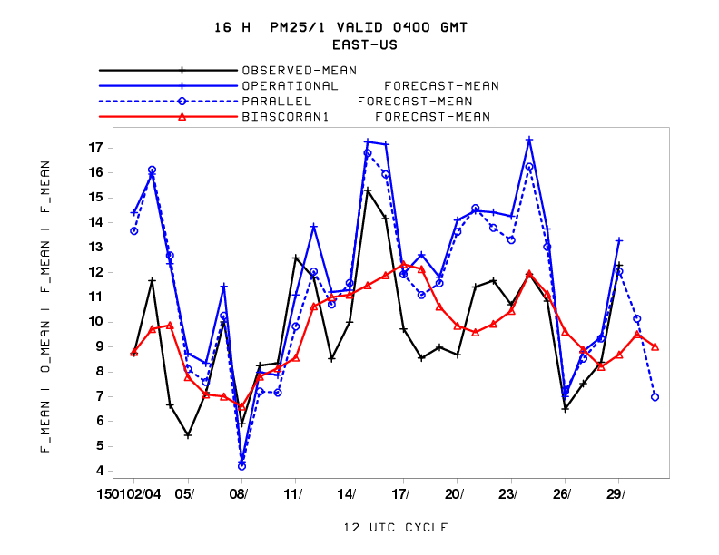
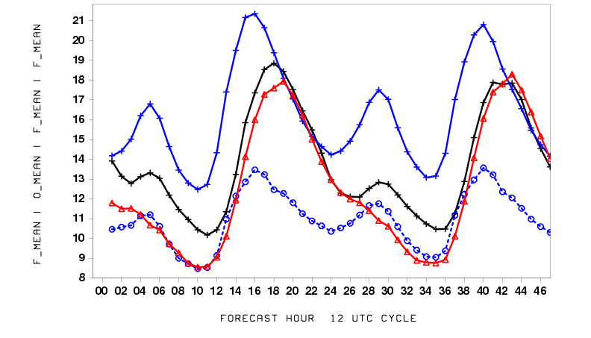
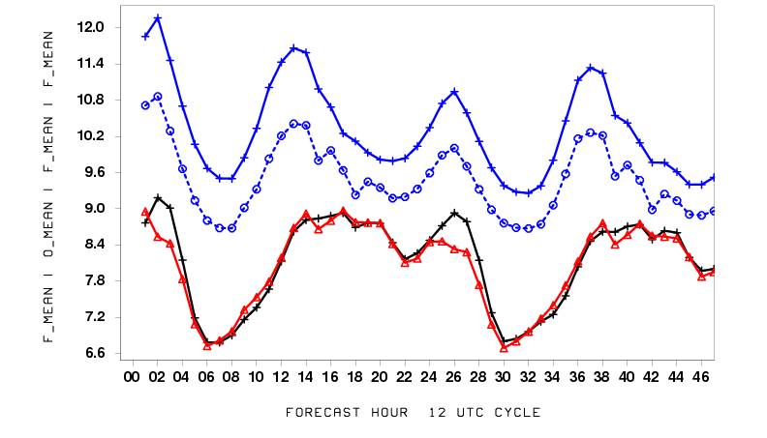
Testing for winter month (Jan/2015)
WUS
EUS
WUS
EUS
Diurnal pattern was improved;
Day to day variability was lost on some days

Slide 12
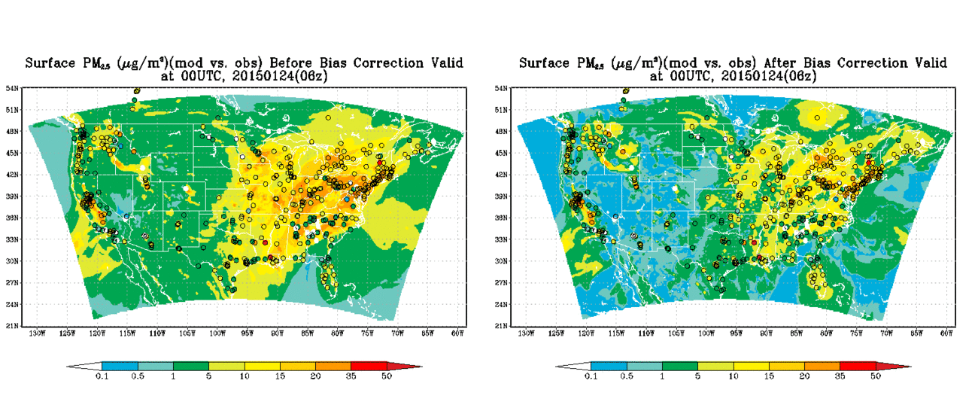
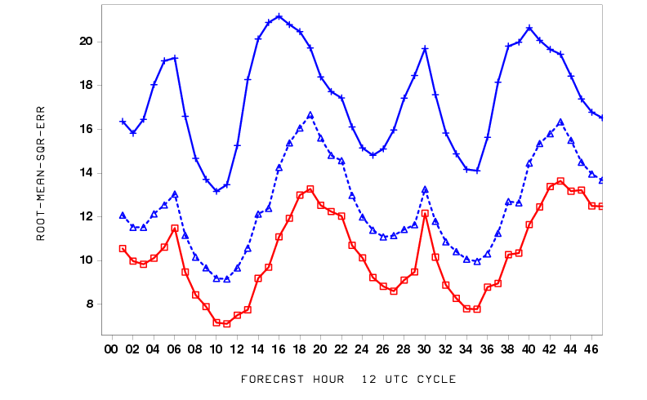
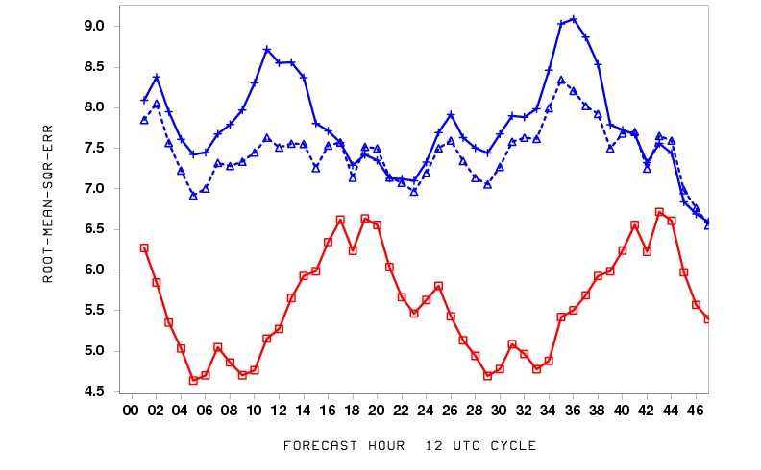
Testing for winter month (cont.)
Before Bias Correction
After Bias Correction
WUS
EUS
RSME
Over-prediction reduced over EUS
RMSE was still high during night time

Slide 13
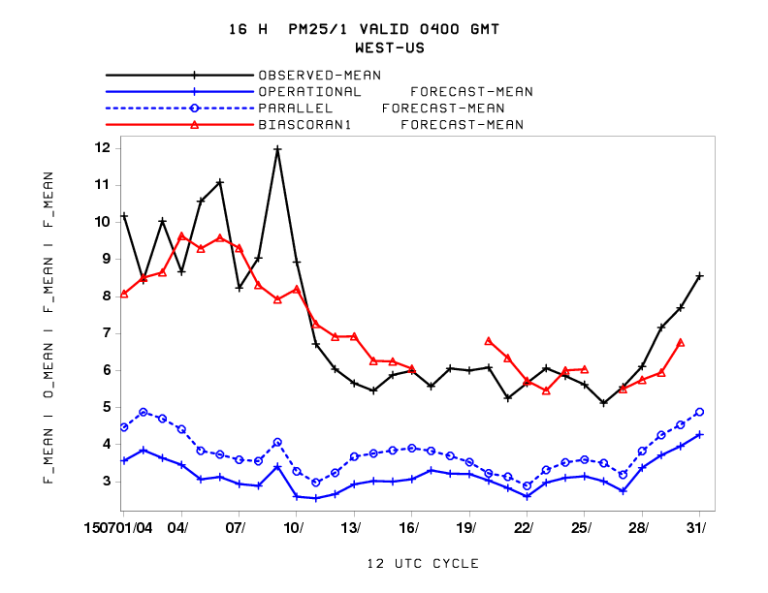
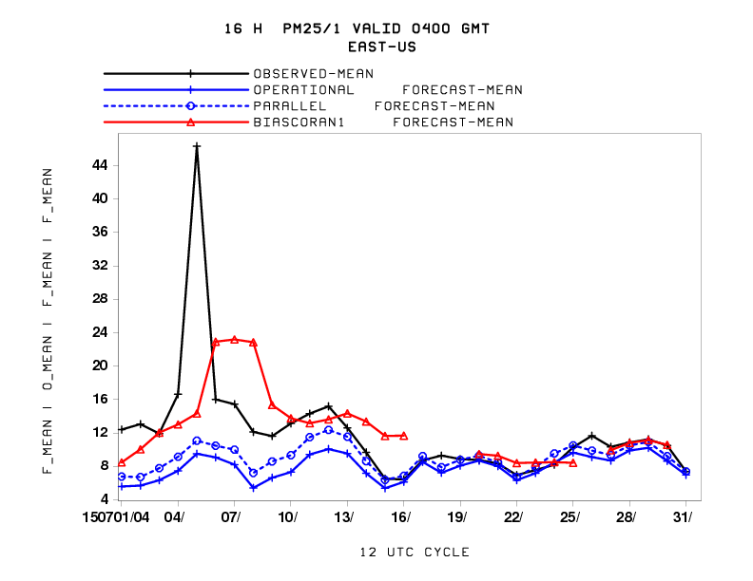
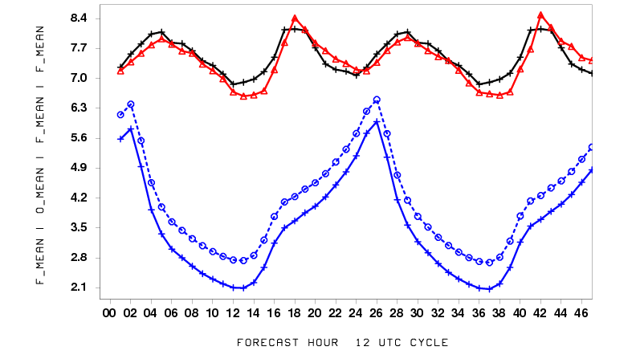
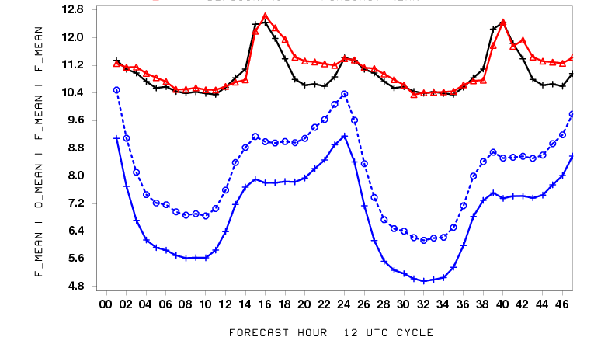
Testing for summer month(July 2015)
WUS
EUS
WUS
EUS
EUS
Diurnal variation was captured very well but the July 4th case was not captured.

Slide 14
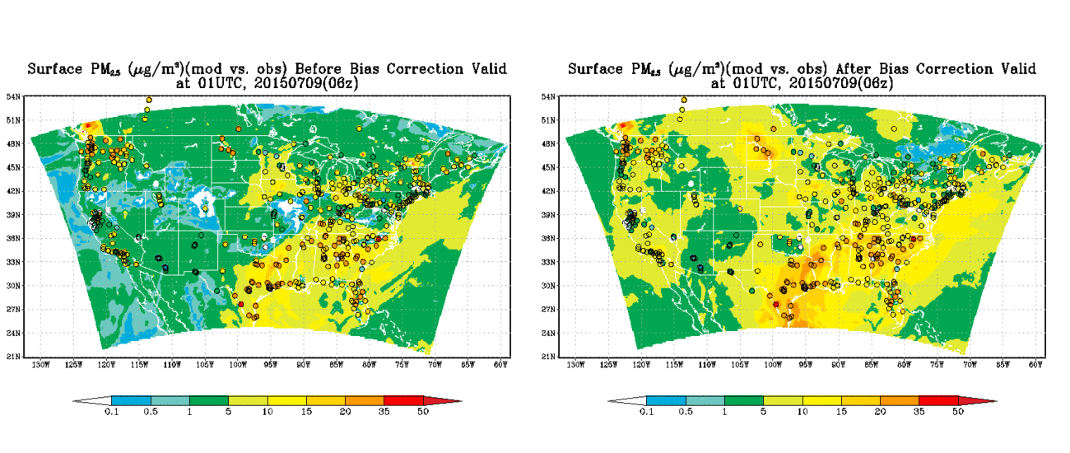
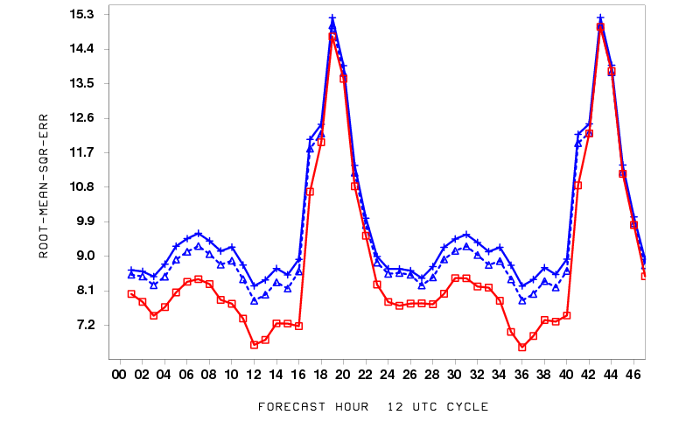
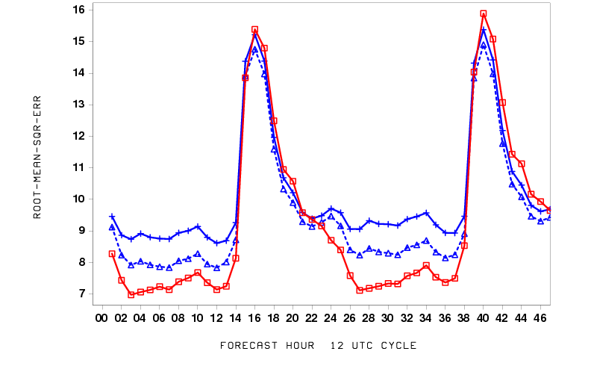
Testing for summer month(cont.)
Before Bias Correction
After Bias Correction
WUS
EUS
RSME
Under-prediction was improved in summer and
RSME was not changed during nighttime.

Slide 15
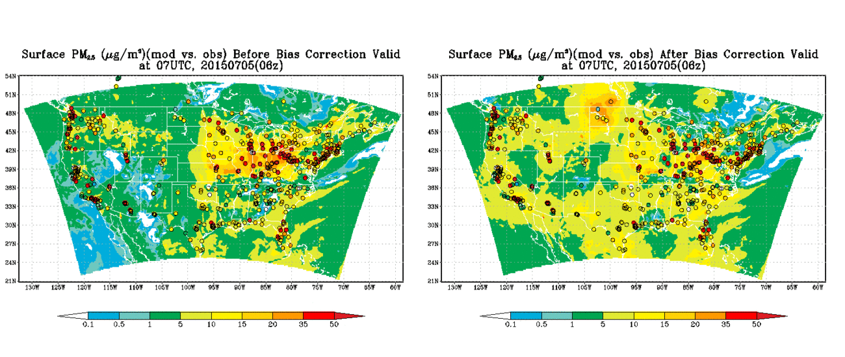
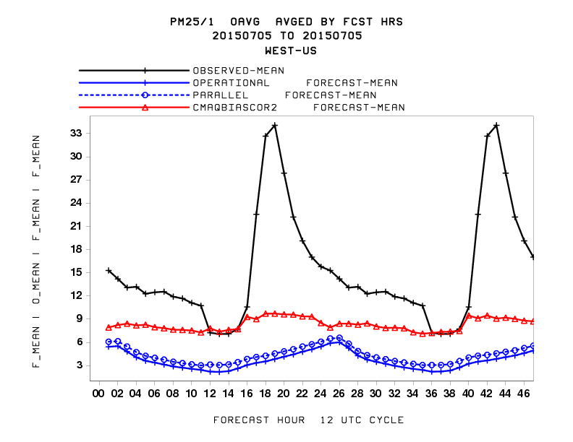
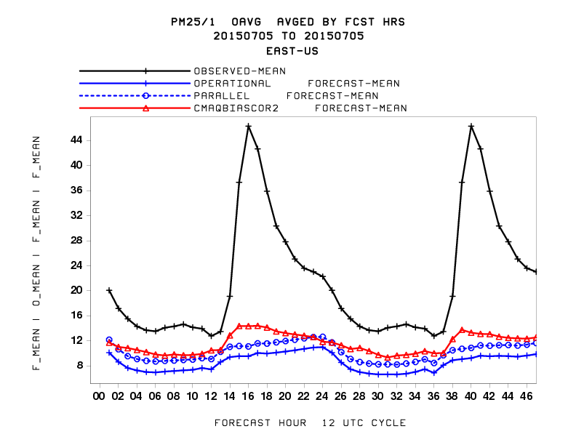
A case study on July 4th
Before Bias Correction
After Bias Correction
WUS
EUS

Slide 16
Summary and conclusions
Analog Ensemble bias corrections has been tested by NOAA/NAQFC for improving PM_{2.5} predictions.
Training period and number of ensemble members are the key for the bias correction. With configuration of 8-week training period and 3 ensemble members, the Analog bias correction may capture the diurnal pattern quite well. But daily variability needs further improvement.
RMSE was reduced significantly during daytime but little improvement during nighttime.
High PM_{2.5} cases like July 4th, dust, and smoke episodes are still a challenge.
Notes:
Smoke and dust, ozone, anthropogenic PM now in one unified system with CMAQ Unified
Now using a version of CMAQ supported by EPA CMAS community Supported
First time in 7 years we’ve seen consistent improvement in ozone predictions Updated
Inclusion of PM in operational model provides refliable PM product for all of U.S. Reliable

