Slide 1
EPA's 2011v6.2 Platform Future Year Emissions Inventory Projections
October 6, 2015
Alison Eyth, Rich Mason (EPA OAQPS EIAG*) Alexis Zubrow (Volpe, DOT)
* Emission Inventory and Analysis Group

Slide 2
Base Year NEI is the Basis for Projections
NEI data submitted by states, locals, tribes (S/L/T) and EPA into the Emissions Inventory System (EIS)
Five categories
Point/Facility Inventory (point locations)
Nonpoint (county-based) – includes biogenics
Onroad mobile sources from MOVES model (except CA)
Nonroad mobile sources from NONROAD / NMIM
Events (day-specific fires from SMARTFIRE)
EPA and S/L/T data are blended to create the NEI
http://www.epa.gov/ttn/chief/net/2011inventory.html
EIS outputs a “flat file” in a format input to SMOKE
2011 NEI Version 2 was released in March, 2015
Included many improvements over 2011 NEI Version 1
Notes:
Give a quick introduction to emissions modeling
Specifics about 2011v6.2 platform

Slide 3
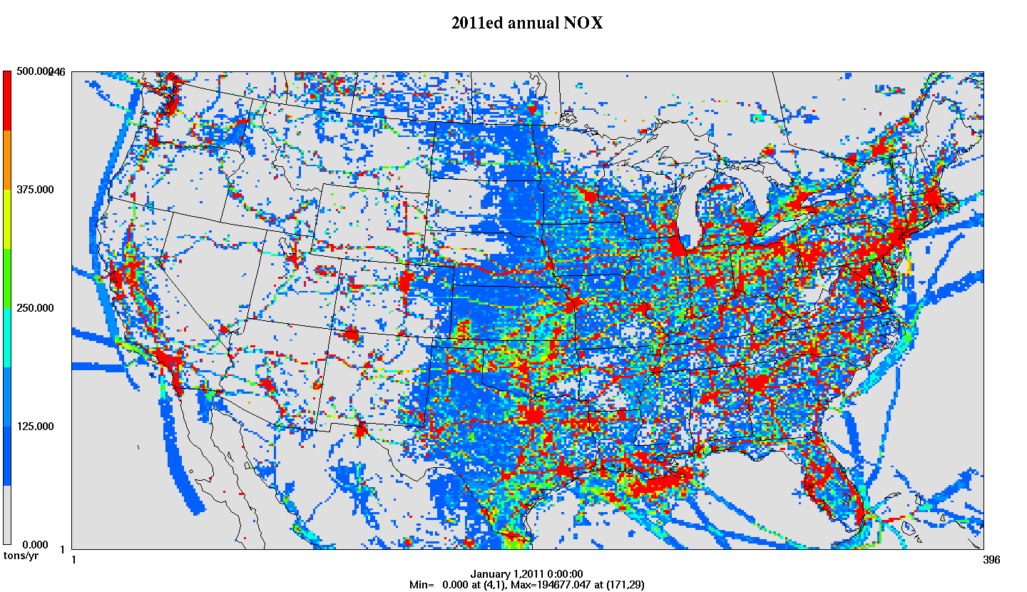
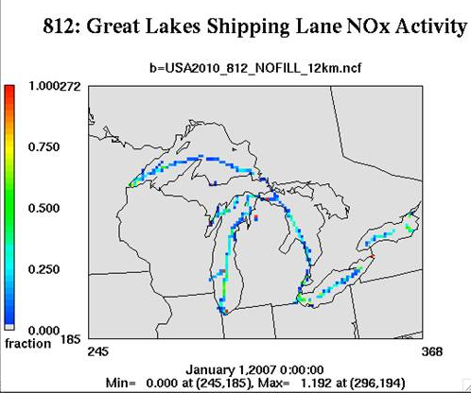
Emissions Modeling Process
Ancillary Data: profiles and cross references
SMOKE
SMOKE software performs temporal allocation, spatial allocation, and speciation to create…
Temporal Profiles
Inventories (annual, monthly, daily, hourly)
Met. Data
Speciation Profiles
Gridded, hourly, speciated emissions in a format for an air quality model
Spatial Surrogates
Notes:
Go quickly: Ancillary data = temporal profiles, speciation profiles, spatial surrogates

Slide 4
Emissions Models Used for 2011v6.2 Base Year and Projections
Biogenic Emission Inventory System (BEIS): creates air quality model-ready biogenic emissions (new: v3.61 is embedded in SMOKE)
Motor Vehicle Emission Simulator (MOVES): generates emission factors for onroad mobile sources that can be combined with activity data within SMOKE (new: MOVES2014)
National Mobile Inventory Model (NMIM): generates inventories for nonroad mobile sources (being replaced by MOVES)
Integrated Planning Model (IPM) new v5.14: generates EGU emissions for future years

Slide 5
Future Year Projections
Estimate changes between base and future years
Changes in activity levels (e.g., VMT, # wood stoves)
Rules / technology changes in intervening years
New units, closures, consent decrees
Interpolation / extrapolation often difficult or technically not defensible
Projection techniques vary by sector
Use models for future emissions (EGUs-IPM, onroad-MOVES)
Apply factors - both for activity changes and controls
Stand-alone inventories: new kilns, ethanol, biodiesel plants
Hold constant: biogenics, fires (only anthro. change)
Each platform uses consistent methods for a set of future years (2017 and 2025 for 2011v6.2)

Slide 6
Future Year Ancillary Data
Most ancillary data is the same in base and future year modeling
Meteorology is held constant
Spatial surrogates are constant
Temporal profiles are constant for most sectors (except for EGUs)
Speciation profiles are constant for many sources
Updated for mobile sources to account for changes in fuels in future years
Notes:
Go quickly

Slide 7
EGU Projections based on IPM
IPM is a multi-regional, dynamic, deterministic linear programming model of the U.S. electric power sector
Provides forecasts of least-cost capacity expansion, electricity dispatch, and emission control strategies that meet constraints
IPM 5.14 reflects impacts of federal and state laws and regulations through 12/2014 in the intervening years
Produces winter, summer, and annual emissions
Pollutants: CAPs, Hg, HCl, CO₂
Output years: 2016, 2018, 2020, 2025, 2030, 2040, 2050
Years not directly produced by IPM mapped to others
EGUs for which emissions are predicted by IPM are identified in the NEI point inventory and substituted with IPM output data in future years
IPM postprocessor creates a flat file that can be read by SMOKE

Slide 8
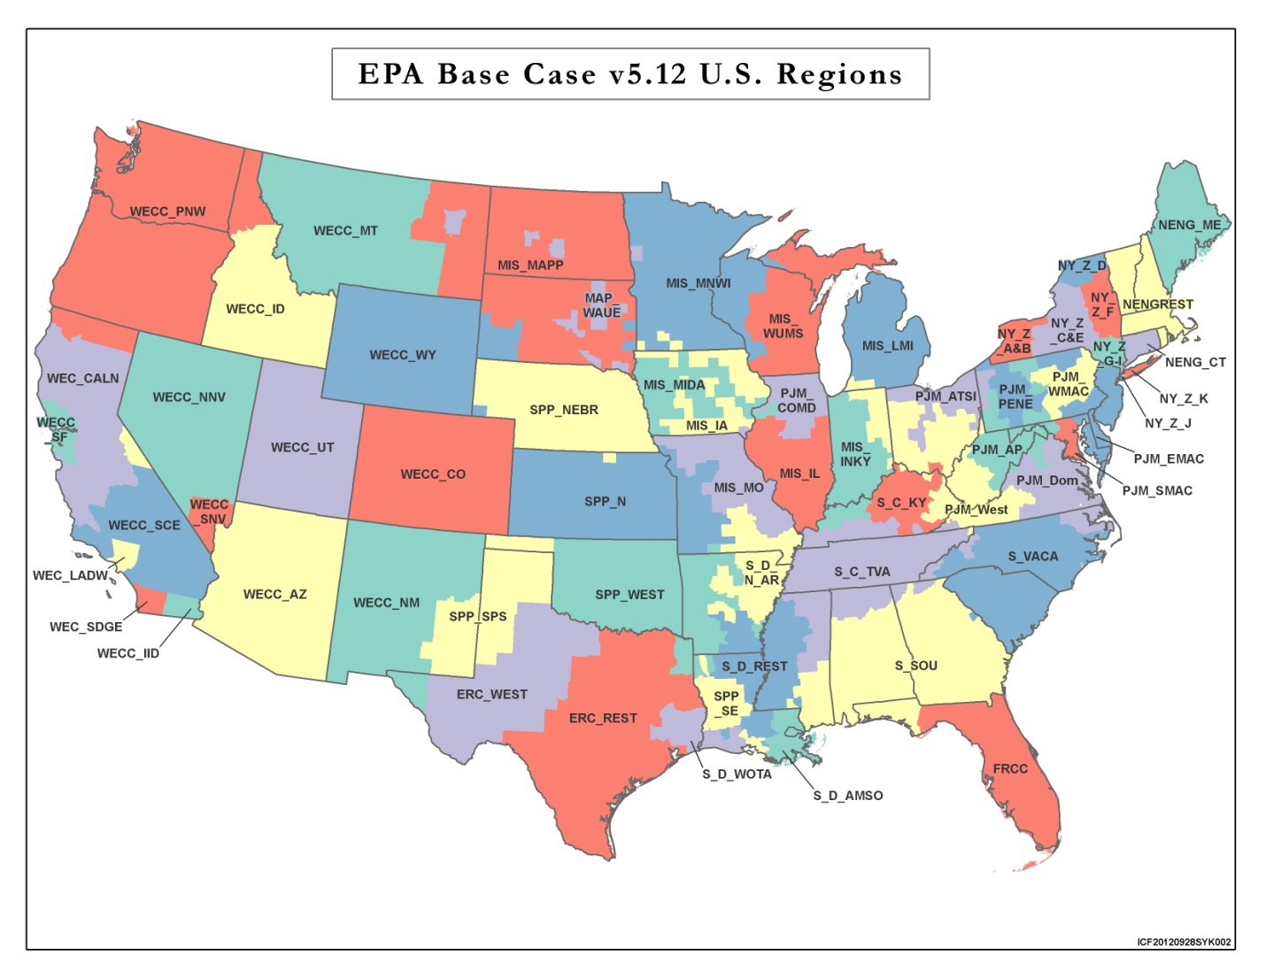
Map of IPM regions
Notes:
Detail in northeast, Mississippi valley, CA

Slide 9
EGU Temporal Allocation for Future Years
Allocate IPM winter and summer emissions to unit-specific 2011 hourly temporal pattern of the CEMS data for that season, when possible
Otherwise, sources are temporalized using regional average profiles to allocate emissions to month, then day, then hour
Used for units that are new, have no 2011 emissions, change fuels from base to future, or have large predicted emission increases
Profiles are region-, fuel-, and pollutant-specific

Slide 10
Example of Unit-specific EGU Temporal Profiles
Summer emissions at this unit going down in future
Note: Average profiles do not include gaps in service

Slide 11
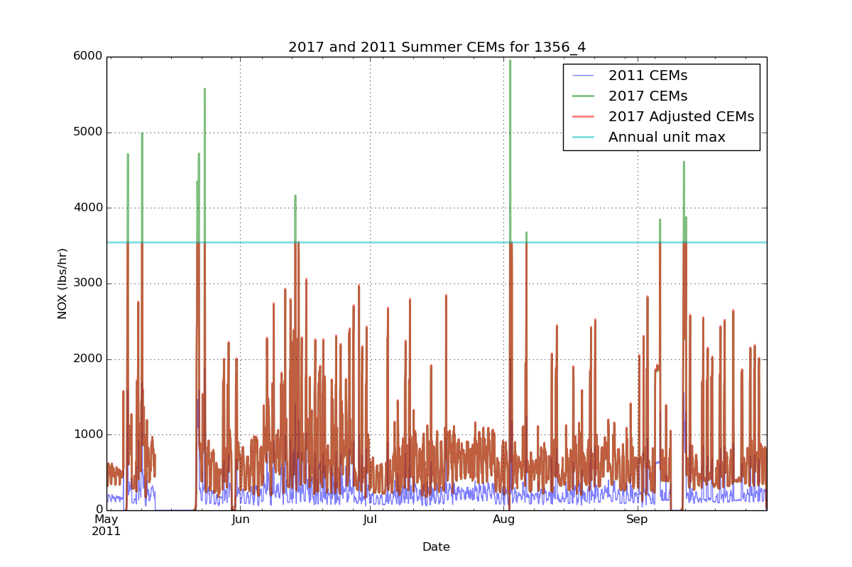
Emissions Capped at Historic Annual Max Levels

Slide 12
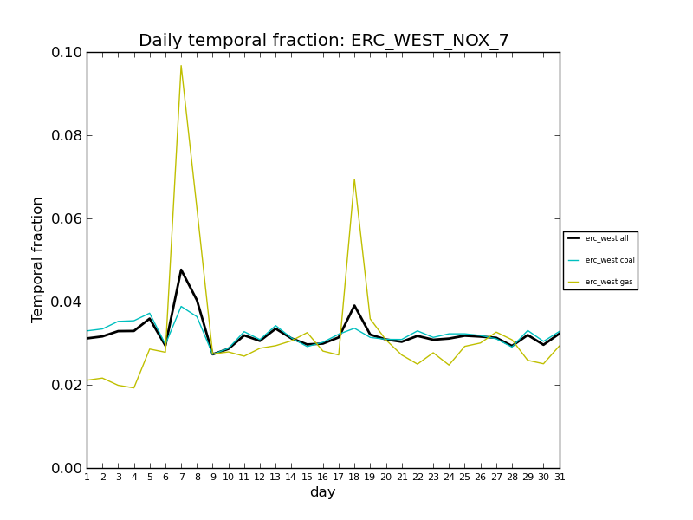
Regional Average Profiles
Use for unmatched units, new units, fuel switches, 0 base year
Profiles now vary by fuel (coal, gas, composite) and region
Diurnal profiles now vary by winter, summer, and composite
Previous platforms only used composite

Slide 13
Onroad Projections Overview
Reflect some changes in MOVES input databases:
Regulatory impacts (also incorporated into MOVES code)
Inspection and Maintenance programs
Vehicle age distributions
Fuel changes
Speciation changes due to fuel changes
SMOKE: Future year VMT and other activity data
Constant between base year and future year:
Counties for which emission factors are computed (i.e., “representative counties”)
Meteorology
Temporal profiles and spatial surrogates
Updated for 2011v6.2 (see Technical Support Document)
Notes:
CDB is where you update age distribution/fleet mix, I/M program. MOVES databases for LEV standards and regional fuel changes by year. Regulations are controlled by MOVES

Slide 14
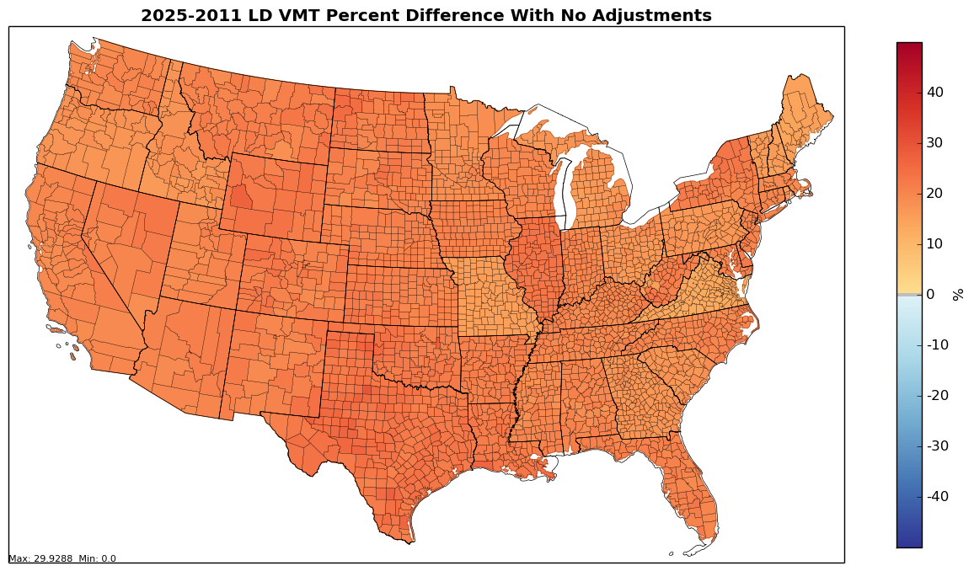
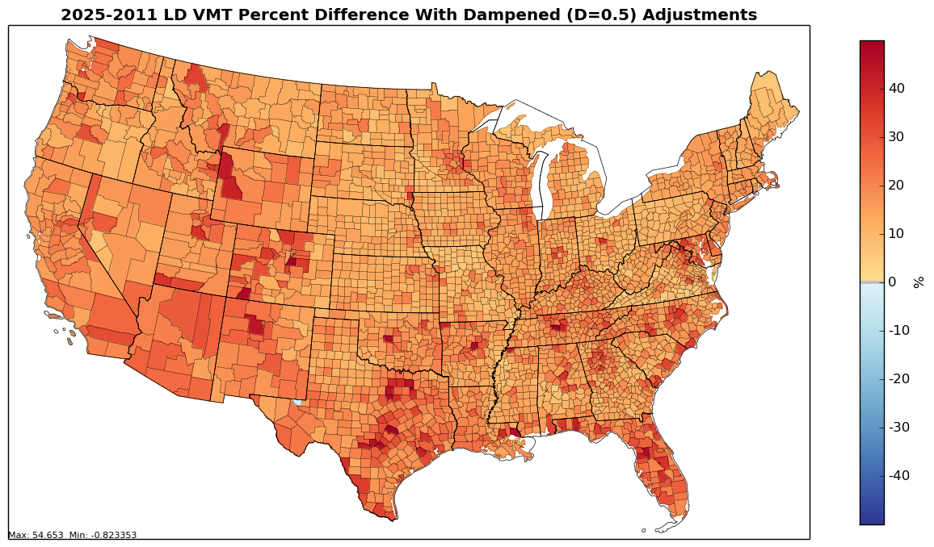
Vehicle Miles Traveled Projections
Use Annual Energy Outlook (AEO) 2014 to get overall magnitude (varies slightly due to vehicle / fuel mix)
2011v6.2 adjusts light duty (LD) VMT projections geographically based on human population projections
AEO projection
County adjustments
Notes:
Point out that there is variation even in the national projection b/c of difference mix of vehicle/fuels by state/county

Slide 15
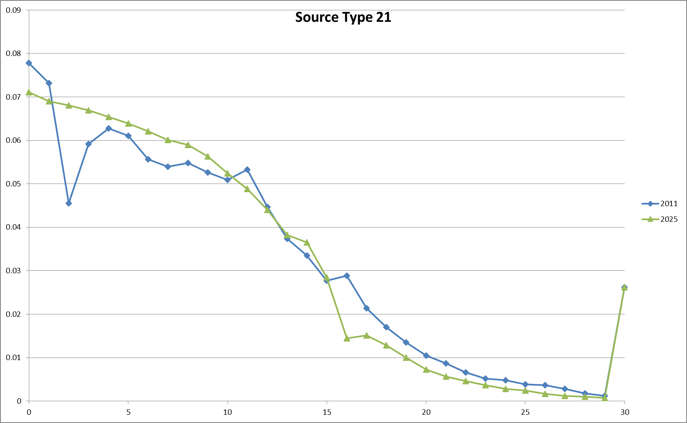
Projecting Vehicle Age Distribution
2018
2025
Recession
Recession
Years before modeled year
Years before modeled year
Each plot shows fraction of vehicles
Shift in recession to older section of age distribution to maintain model year impacts
Dampening of spikes/troughs occurs over time due to scrappage

Slide 16
Non-EGU Point and Nonpoint
Control Strategy Tool within Emissions Modeling Framework is used to project most NEI non-EGU point and nonpoint inventories
Exceptions include stand-alone future year inventories (e.g., biodiesel and cellulosic plants, new cement kilns)
Input data “packets” created from many data sources
Packet Types: Closures, projections, control percentage
Data from: AEO, EPA offices (e.g., rules), state / local / regional organizations, consent decrees, NEI submissions
Very complex to integrate data from all sources together
2011v6.2 updates
Growth for non-EGU industrial sources
Updates to oil and gas, residential wood combustion, commercial marine vessels, boilers, fugitive dust

Slide 17
Impact of Projections
Annual tons
NH₃
NO_{x}
PM₁₀
PM_{2.5}
SO₂
VOC
Notes:
NH3 slight increase; Onroad NOx going down a lot and point some, nonpoint PM10 going up, Point SO2 going down, Nonpoint VOC going up, but Nonroad going down

Slide 18
Challenges for projections
Placement of new sources
Quantifying impacts of rules
Incorporating state rules
Meteorological changes
Keeping up with data changes (e.g., AEO 2015)
International emissions and projections
Only have 2010 for Canada
EPA developed 2008-based projections for Mexico
Projecting fires and their impact on biogenics
Projections of changes in land use/population
Spatial surrogates could be updated for future years

Slide 19
2011v6.2 Emissions Modeling Platform Data Availability
Data and documentation is available from http://www.epa.gov/ttn/chief/emch/index.html#2011
TSD (Final Ozone NAAQS, Proposed ozone transport)
2011NEIv2-based inventories, scripts, ancillary data
Speciation profiles for CB05, CB6, SAPRC07
Spatial surrogates for 4km, 12km, 36km
Temporal profiles
2015 EIC training class on modeling / projections
IPM 5.14 base case data available at new URL:
http://www.epa.gov/airmarkets/powersectormodeling.html
Other EPA web page locations will be changing 10/1
Ongoing NODA for 2011/2017: comments due 10/23
EPA-HQ-OAR-2015-0500 - Contact eyth.alison@epa.gov

