Slide 1
A Mixed Integer Programming Model for National Ambient Air Quality Standards (NAAQS) Attainment Strategy Analysis
Alexander Macpherson
Heather Simon
Charles Fulcher
David Misenheimer
Bryan Hubbell
Robin Langdon
[All authors are with U.S EPA’s Office of Air and Radiation]
Community Modeling and Analysis Conference
Chapel Hill, NC, October 7, 2015
Disclaimer: Although this work was reviewed by the United States Environmental Protection Agency and approved for publication, it does not reflect official Agency policy.

Slide 2
Overview
States with areas designated as nonattainment for the National Ambient Air Quality Standards (NAAQS) are required to develop State Implementation Plans (SIPs)
  SIPs demonstrate how pollution levels will be reduced to meet the standard
  While historically most states have developed SIPs independently, some states developed regional agreements to control ozone-forming emissions
Because ozone can be transported regionally, air quality improvement strategies that account for transport may have lower costs

Slide 3
Overview
We present a mathematical programming model that, conditional on the model parameters and input data, can help identify potential minimum-cost emissions control strategies that recognize varying degrees of interstate transport of ozone
A series of national-level model applications are presented drawing on:
  Future year forecasts of nationwide ozone levels
  Air quality source-receptor relationships drawn from a series of air quality model simulations
  Technologically and spatially-detailed emissions abatement supply
The model:
  Quickly evaluates alternative attainment scenarios
  Quickly identifies monitors that are difficult to bring into attainment
  Approximates the nonlinearity of ozone response to NOx
  Tests the role of transport in compliance strategies

Slide 4
Literature Review
The model builds from a tradition of mathematical programming applications in environmental management and planning
  Kohn modelled least cost air quality management in the St. Louis area (Kohn, 1971)
  Atkinson and Lewis compared strategies to reduce emissions at least cost and achieve ambient targets at least cost with strategies where reductions were applied uniformly across point sources until federal standards were met (Atkinson and Lewis, 1974, 1976)
  Ellis et al. (1985a; 1985b, 1986) applied programming approaches to develop optimal plans for acid rain abatement across eastern parts of North America
More recent applications have focused on ozone planning at city and multi-county scales (Shih et al., 1998; Cohan et al., 2006; Hsu et al., 2014; Liao and Hou, 2015)

Slide 5
Our Model
Conditional on model parameters and input data, the model minimizes total cost of:
  Choices to apply specified emissions controls to sources across regions and states (binary)
  Choices of level of unspecified controls across regions and states (continuous and non-negative)
Subject to:
  NOx and VOC emissions reductions sufficient to bring monitors into attainment
  Emissions reductions cannot exceed specified levels
  User-defined constraints about locations from which emissions reductions may come
Additional characteristics
  If multiple controls available for a given source, the model makes optimal choice of control
  Model tracks reductions of multiple pollutants from a given control application

Slide 6
Scenarios Analyzed
Identify potential cost-minimizing attainment strategies in achieving national standards of:
  75 ppb (2008 NAAQS standard)
  70 ppb
  65 ppb
For each alternative standard we vary how the model accounts for interstate ozone transport:
  State: each state goes it alone (but Northeast states collaborate in each scenario)
  Regional: hypothetical transport regions collaborate and account for intra-regional transport
  National: hypothetical single nationwide transport region

Slide 7
Air Quality Data and Parameters
We investigate predicted ozone levels and responses to emissions reductions in the year 2025
We project future ozone levels based on a combination of recently observed ozone and relative changes in modeled ozone between recent and future years
We conduct a series of emissions sensitivity air quality model simulations in combination with state-level source apportionment modeling to determine air quality transfer coefficients for NOx and VOC emissions from regions on following slides
  Air quality transfer coefficients = incremental response in 2025 ozone values per ton of emissions reduction (ppb/ton)
  Separate air quality transfer coefficients developed for each pairing of monitor location and NOx or VOC emissions region

Slide 8
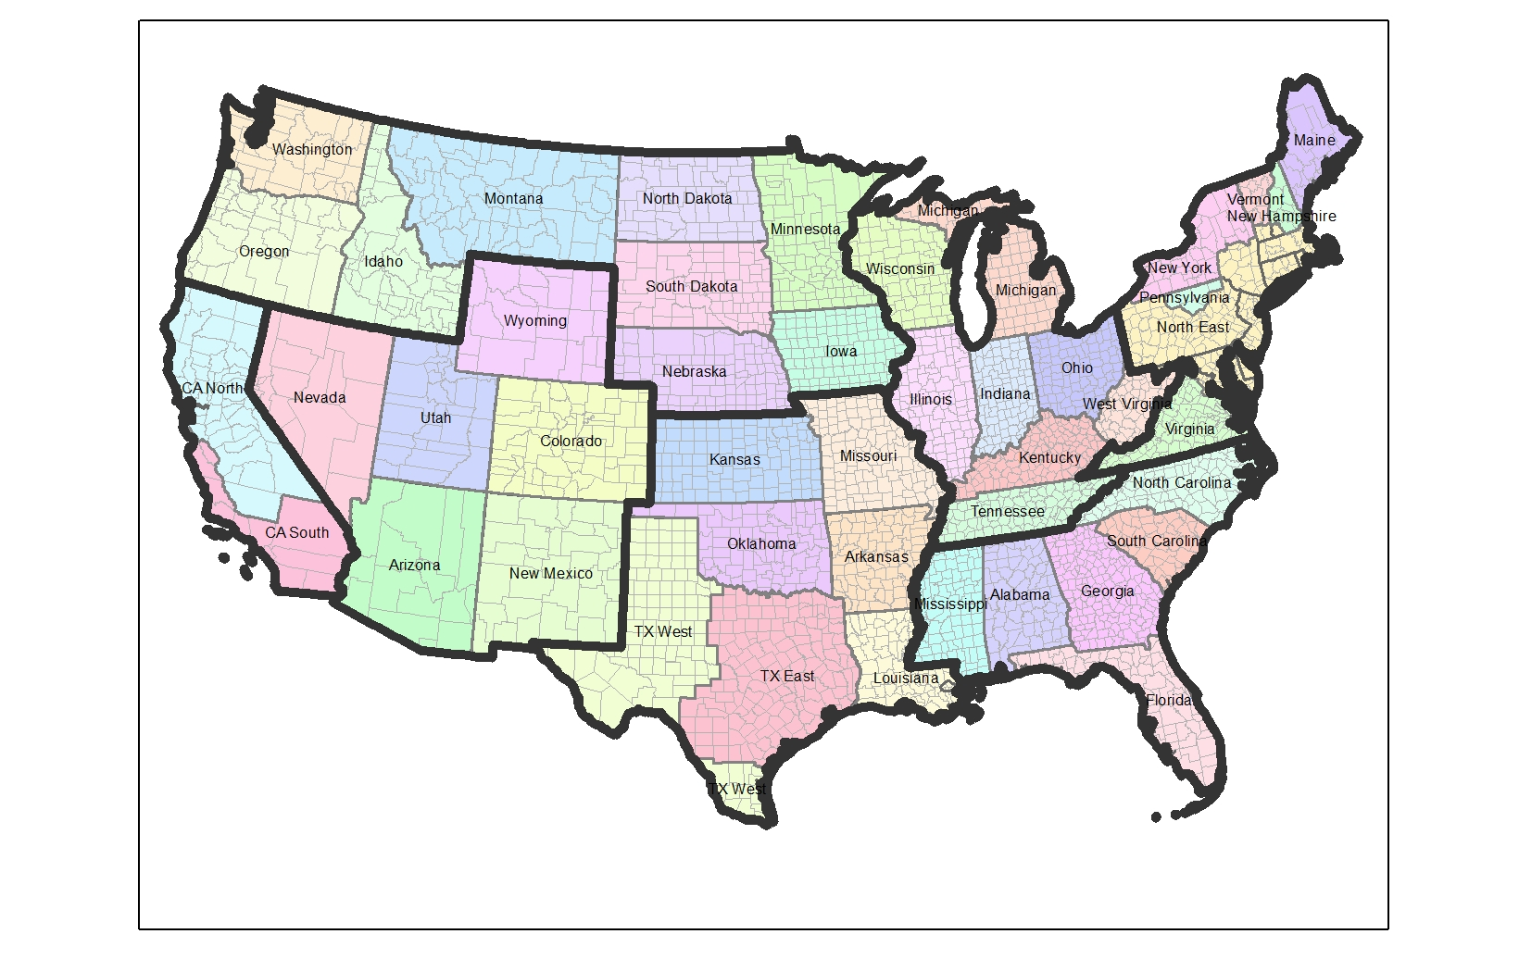
NOx Regions

Slide 9
VOC Regions

Slide 10
Emissions Control Data and Parameters
The emissions control measures and costs were primarily drawn from the U.S. EPA’s Control Strategy Tool (CoST)
  Applied to point, area, and mobile sources of NOx and VOC emissions
  Supplementary data on NOx reductions from coal-fired power plants and diesel engine retrofits and rebuilding were drawn from other EPA databases
  CoST does not does not include measures that reduce NOx through fuel switching, energy efficiency, or other non-traditional control measures
  Nationwide, we specified about 73,000 possible control choices for about 26,000 emissions sources
Cost of unspecified controls were assumed to be $15,000 per ton of NOx or VOC reduction consistent with U.S. EPA’s 2014 Ozone NAAQS Proposal RIA

Slide 11
Basecase Conditions
Coal

Slide 12
Results: Total Reductions
National
Regional
State
Coal

Slide 13
Results: NOx Reductions by Region
National
Regional
State
Coal

Slide 14
Results: Total Cost
National
Regional
State
Coal

Slide 15
Controlling Sites
The marginal value at the air quality constraint represents the reduction in cost to the system of a 1 ppb increase in the alternative standard applying to the given site
For example, for the 65 ppb alternative standard
  National scenario
    12 controlling sites ($46 million to $720 million)
  Regional scenario
    12 controlling sites ($50 million to $720 million)
  State scenario
    15 controlling sites ($50 million to $720 million)
Coal

Slide 16
Key Caveats
Spatial resolution of air quality transfer coefficients
  Estimated as an average of region-to-monitor relationships, not emissions source-to-monitor relationships
Emissions controls
  Future year emissions in baseline uncertain
  Incomplete characterization of specified emissions controls
Optimization sensitive to solver parameters and initial values

Slide 17
Insights
Accounting for ozone transport in developing regional control strategies can result in significantly lower costs
Small number of sites exert leverage on system
Decreases reliance on unspecified reductions and therefore reduces costs
VOC controls potentially more important than expected

Slide 18
Appendix
Works Cited
Atkinson, S.E., Lewis, D.H., 1974. A cost-effectiveness analysis of alternative air quality control strategies. J. Environ. Econ. Manage. 1, 237-250.
Atkinson, S.E., Lewis, D.H., 1976. Determination and implementation of optimal air quality standards. J. Environ. Econ. Manage. 3, 363-380.
Cohan, D., Tian, D., Hu, Y., Russell, A., 2006. Control Strategy Optimization for Attainment and Exposure Mitigation: Case Study for Ozone in Macon, Georgia. Environmental Management 38, 451-462.
Ellis, J., McBean, E., Farquhar, G., 1985a. Deterministic Linear Programming Model for Acid Rain Abatement. J. Environ. Eng. 111, 119-139.
Ellis, J.H., McBean, E.A., Farquhar, G.J., 1985b. Chance-constrained/stochastic linear programming model for acid rain abatement—I. Complete colinearity and noncolinearity. Atmos. Environ. 19, 925-937.
Ellis, J.H., McBean, E.A., Farquhar, G.J., 1986. Chance-constrained/stochastic linear programming model for acid rain abatement—II. Limited colinearity. Atmos. Environ. 20, 501-511.
Hsu, W.-C., Rosenberger, J., Sule, N., Sattler, M., Chen, V.P., 2014. Mixed Integer Linear Programming Models for Selecting Ground-Level Ozone Control Strategies. Environ. Model. Assess. 19, 503-514.
Kohn, R.E., 1971. Application of Linear Programming to a Controversy on Air Pollution Control. Manage. Sci. 17, B-609-B-621.
Liao K.J, and X. Hou X., 2015. Optimization of Multipollutant Air Quality Management Strategies: a Case Study for Five Cities in the United States. J. of Air & Waste Mgmt. Assoc. 65, 732-742.
Shih, J.-S., Russell, A.G., McRae, G.J., 1998. An optimization model for photochemical air pollution control. Eur. J. Oper. Res. 106, 1-14.

