Slide 1
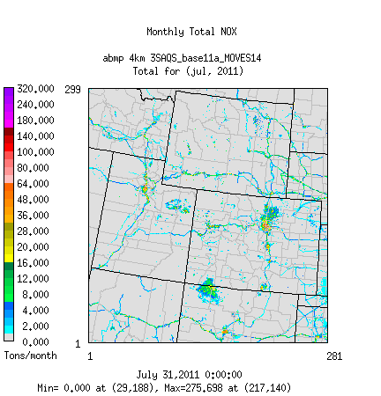
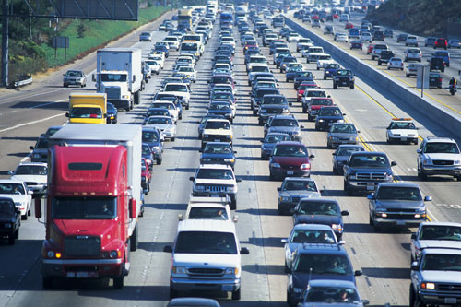


Impacts of MOVES2014 On-Road Mobile Emissions on Air Quality Simulations of the Western U.S.
Z. Adelman, M. Omary, D. Yang
UNC – Institute for the Environment
R. Morris
Ramboll-Environ Corp.
T. Moore
Western States Air Resources Council
14th Annual CMAS Conference
October 5-7, 2015 – Chapel Hill, NC

Slide 2
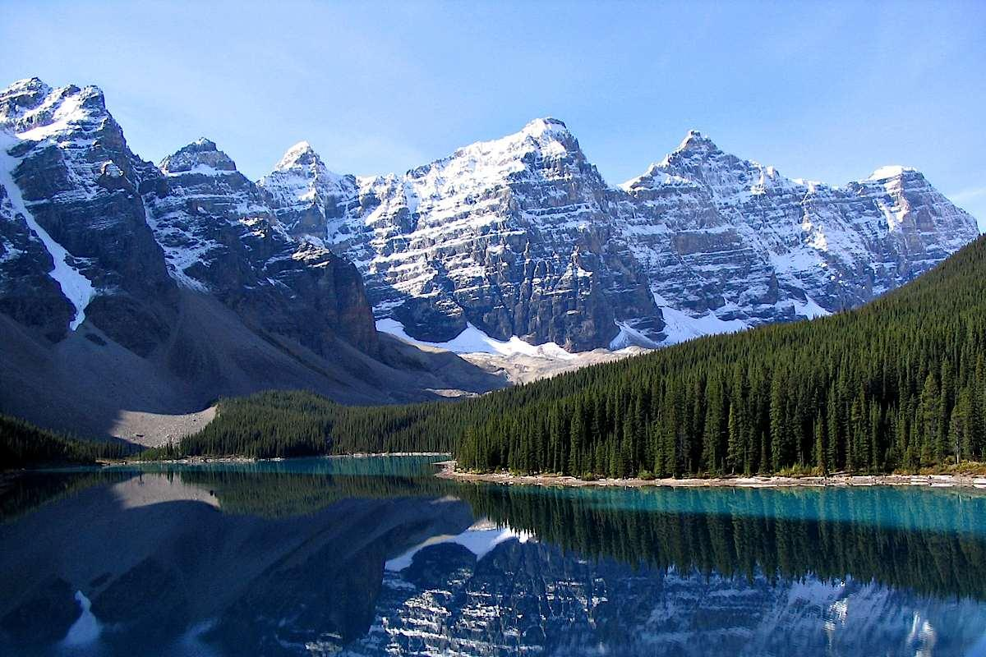
Study Objective
Understand the impacts of changing from MOVE2010b to MOVES2014 on air quality simulations of the Intermountain West.

Slide 3
Outline
What is MOVES?
The context for this research under the Intermountain West Data Warehouse (IWDW) - Western States Air Quality Study (WAQS)
Summary of the MOVES sensitivity emissions
Air quality modeling sensitivity design and results
What did we learn?

Slide 4
MOVES
The Motor Vehicle Emissions Simulator is the current EPA mobile source emissions model
  Current version MOVES2014 released October 2014
  Previous version, MOVES2010b last updated October 2012
MOVES2014 is a major update over MOVES2010b
  Different representation of mobile source processes for on-network and off-network sources
  Latest control programs
  Updates to vehicle activities and populations
  Updated VOC speciation profiles and spatial surrogates
  New User Interface

Slide 5
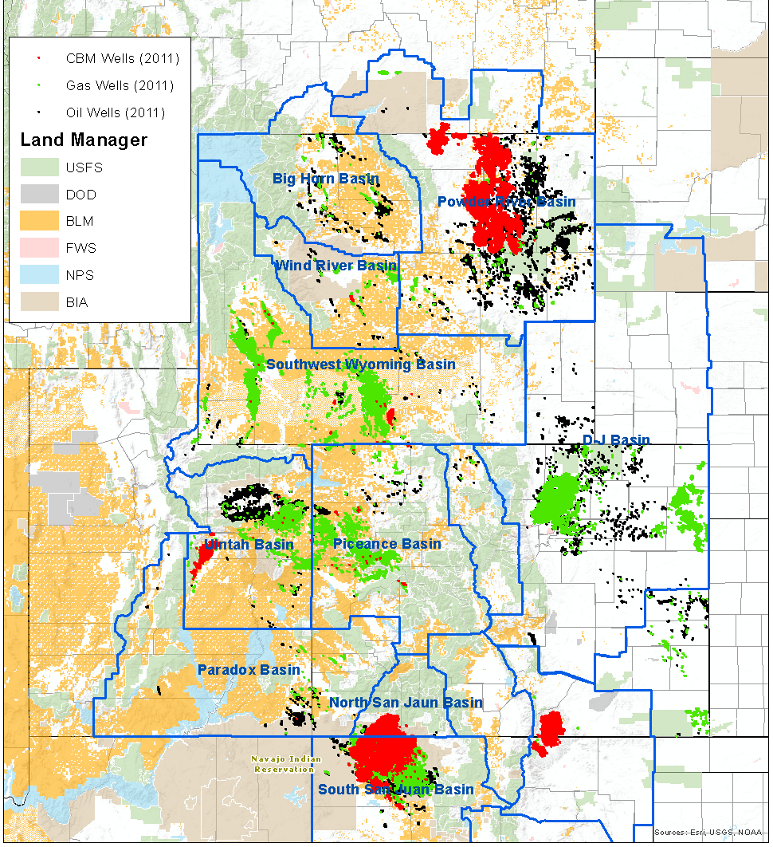
Intermountain West Data Warehouse (IWDW) -Western Air Quality Study (WAQS) http://views.cira.colostate.edu/tsdw/
Facilitate air resource analyses for federal and state agencies in the Intermountain West
Support regional modeling studies, including those pursuant to the National Environmental Policy Act (NEPA)
WSAQS 2011 O&G Wells

Slide 6
MOVES Modeling and the IWDW-WAQS
IWDW-WAQS is developing regional modeling frameworks for the Western U.S.
  Cooperators include Federal and State agencies
  Collaborators include universities, public, and private organizations
Need to understand how changes to the representation of major emissions sources will impact simulated Western U.S. air quality
Scope: Summarize what, not necessarily why

Slide 7
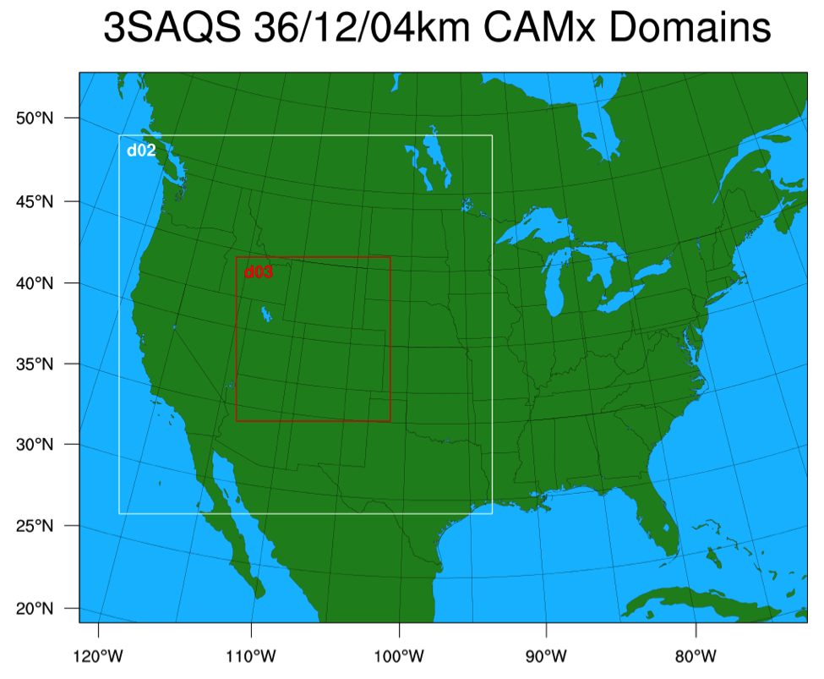
WAQS 2011 Modeling
WRF/SMOKE/CAMx and CMAQ modeling
Annual 2011 simulations on 36/12/4 km nested domains
Base and future year modeling
Focus on air impacts from oil and gas projects

Slide 8
MOVES Sensitivity Modeling
WAQS emissions simulations based on the U.S. EPA OAQPS Emissions Modeling Platforms (EMPs)
  WAQS Simulation Base11a used 2011v1 EMP
  WAQS Simulation Base11b used 2011v2 EMP
EMPs include MOVES emissions factor lookup tables, all activity inputs, and SMOKE-MOVES scripts
  2011v1 used MOVES2010b
  2011v2 used MOVES2014

Slide 9
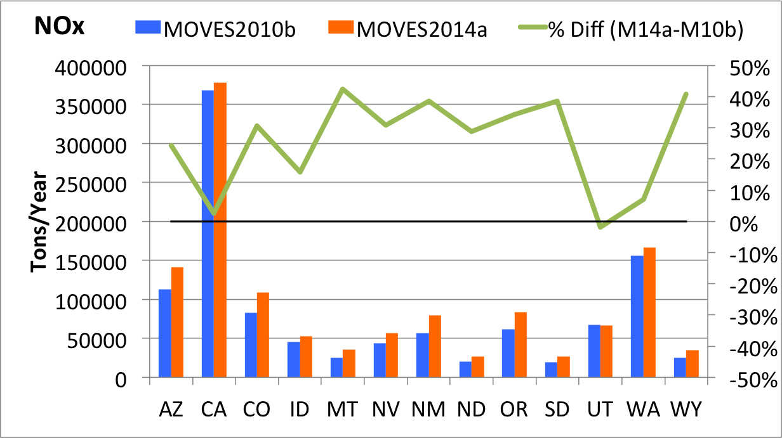
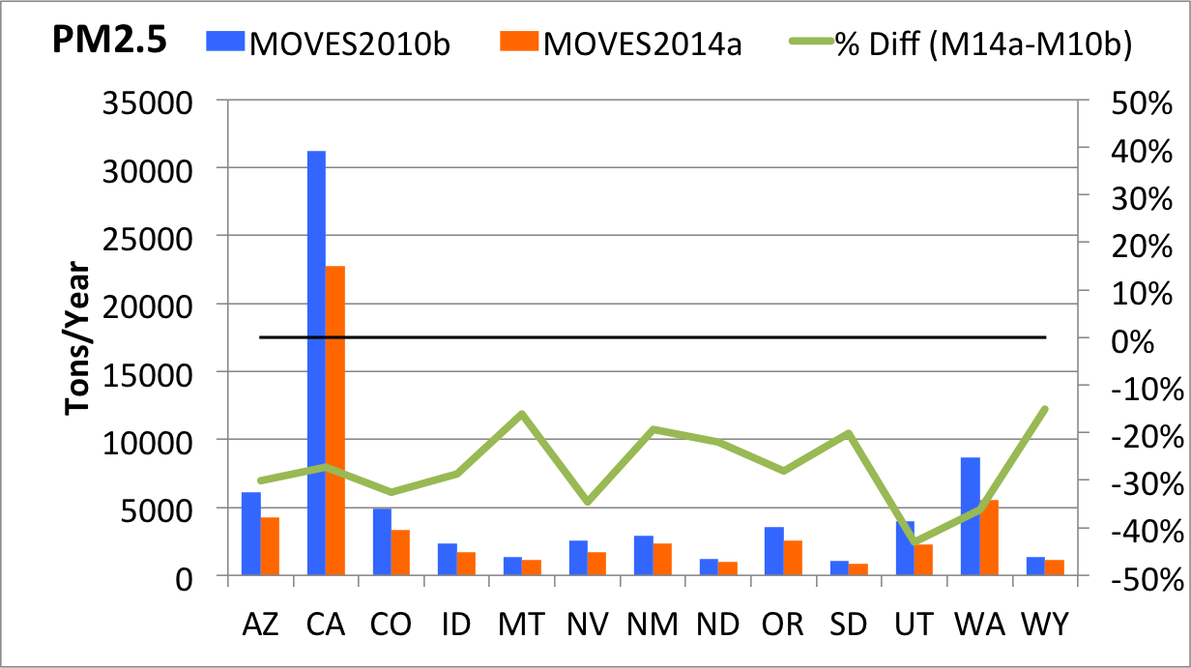
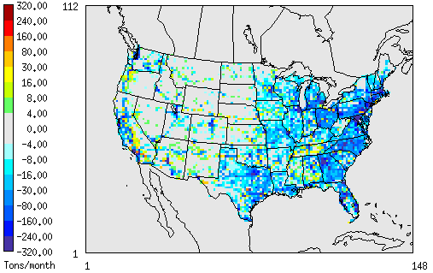
MOVES Emissions Comparison
4-km Domain Total
Annual domain and state total emissions summaries miss the fine scale differences between the models

Slide 10
MOVES CAMx Sensitivity
IWDW-WAQS simulation Base11a
  CMAQ and CAMx modeling based on EPA 2011v1 EMP (with MOVES2010b)
Sensitivity Base11a_MOVES
  Substituted the MOVES2010b emissions with MOVE2014 emissions based on EPA 2011v2 EMP
  Simulated January and July 2011
Base11a_MOVES vs Base11a isolates the simulated air quality impacts of the two versions of MOVES

Slide 11
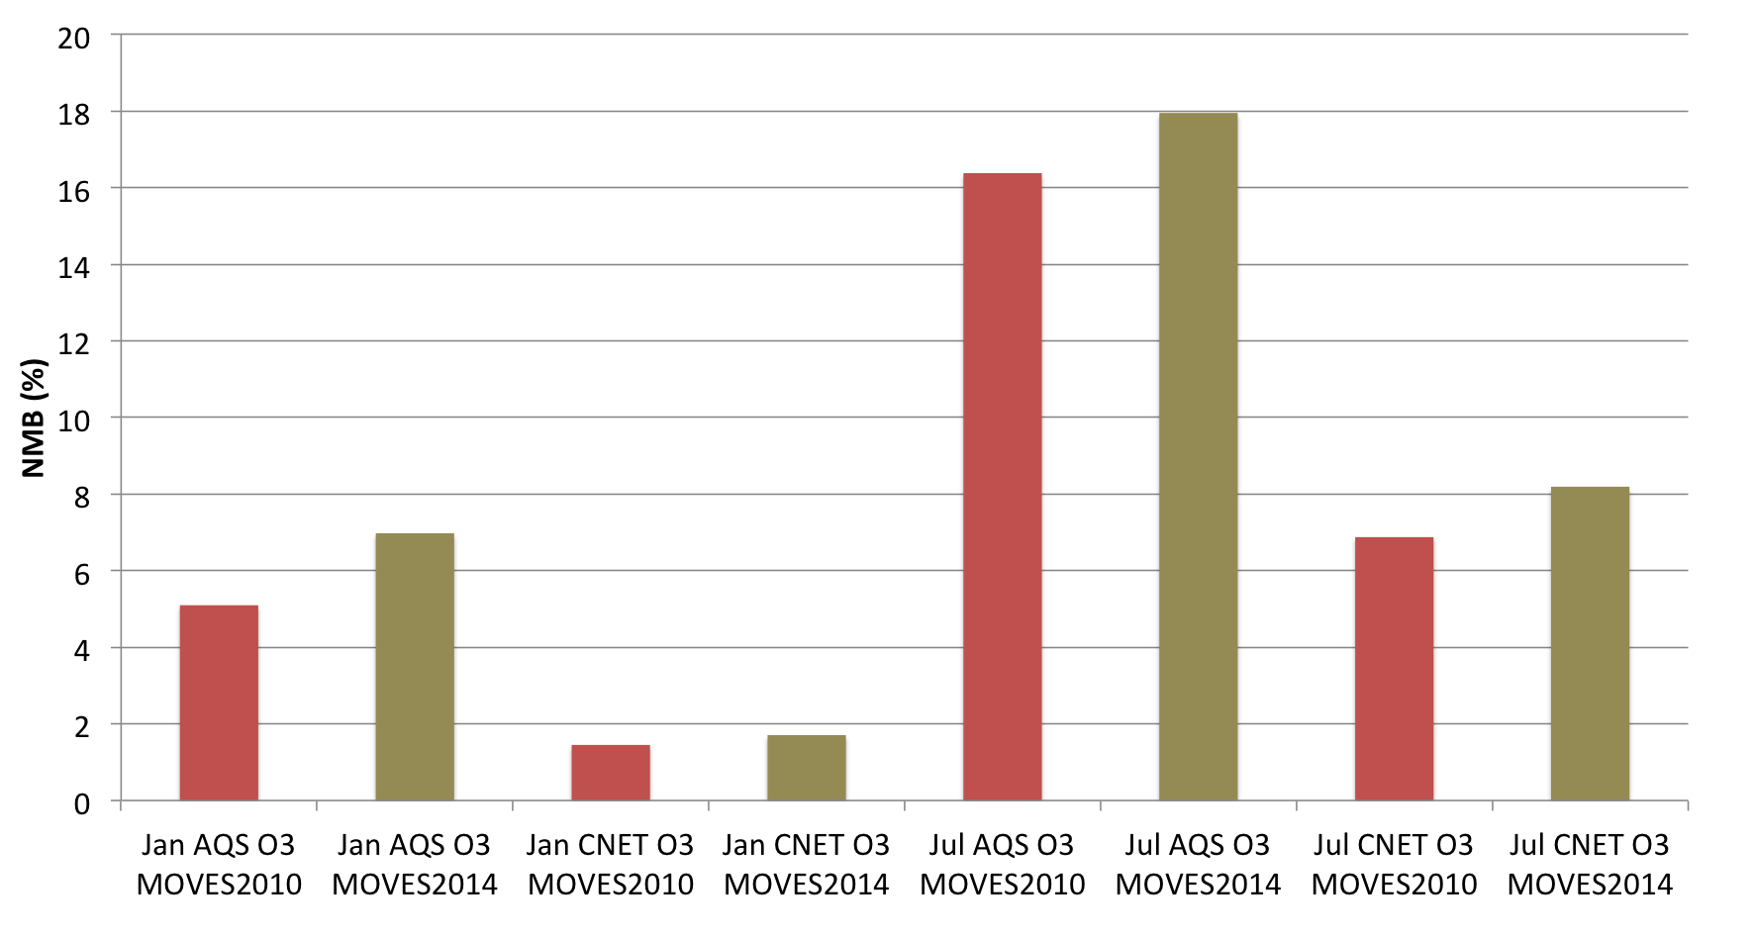
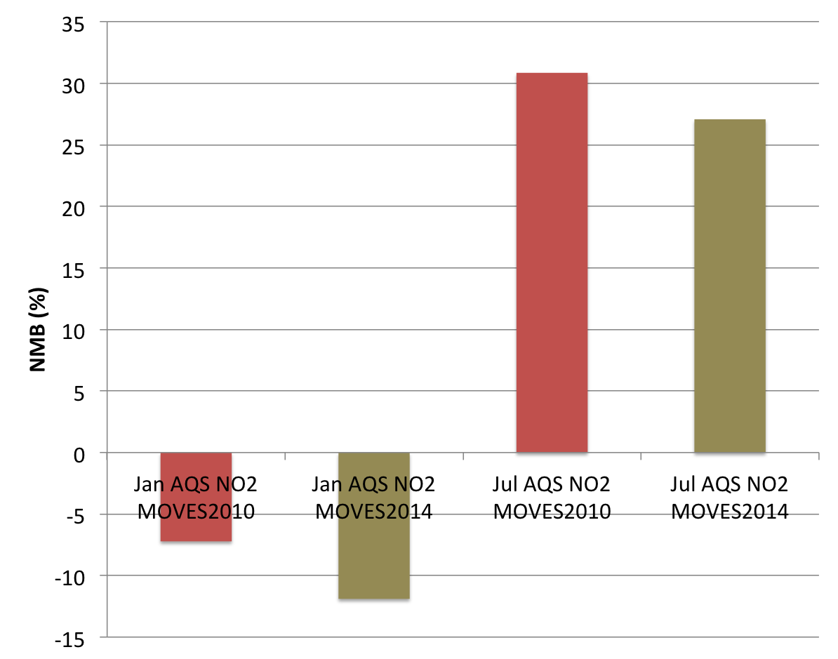
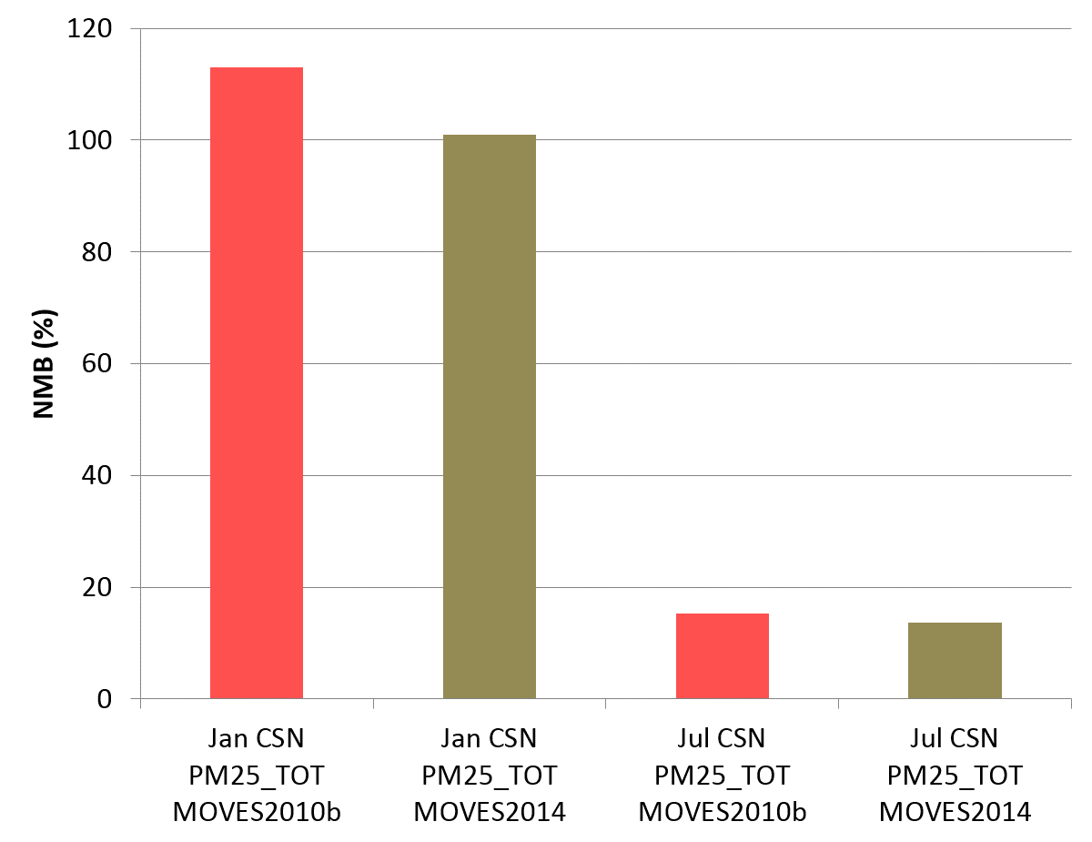
MOVES CAMx Sensitivity
4-km domain averaged normalized mean bias (NMB)
O₃ is overestimated in all periods/networks
NMB slightly higher with MOVES2014
NO₂ underestimated in January; overestimated in July
MOVES2014 has a higher NO₂ bias in January and lower bias in July
Slightly lower PM_{2.5} bias with MOVES2014
O₃
MOVES 2010b
MOVES2014
NO₂
PM_{2.5}

Slide 12
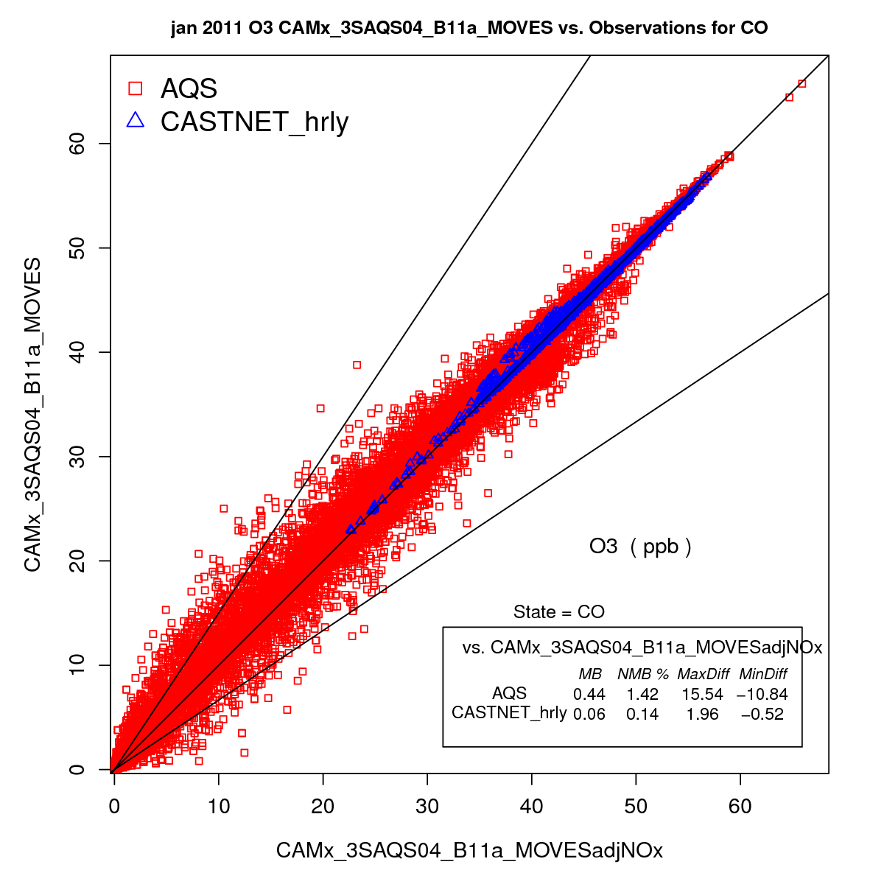
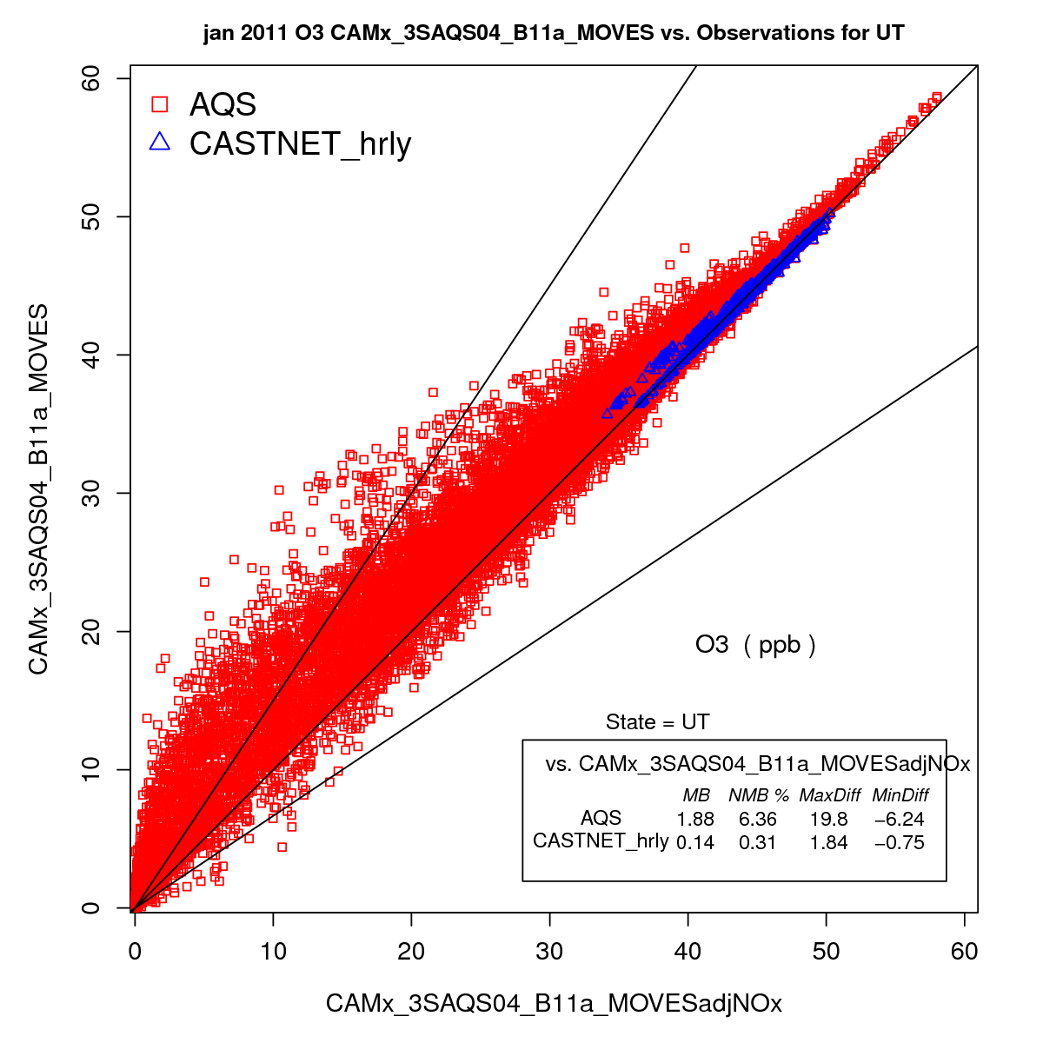
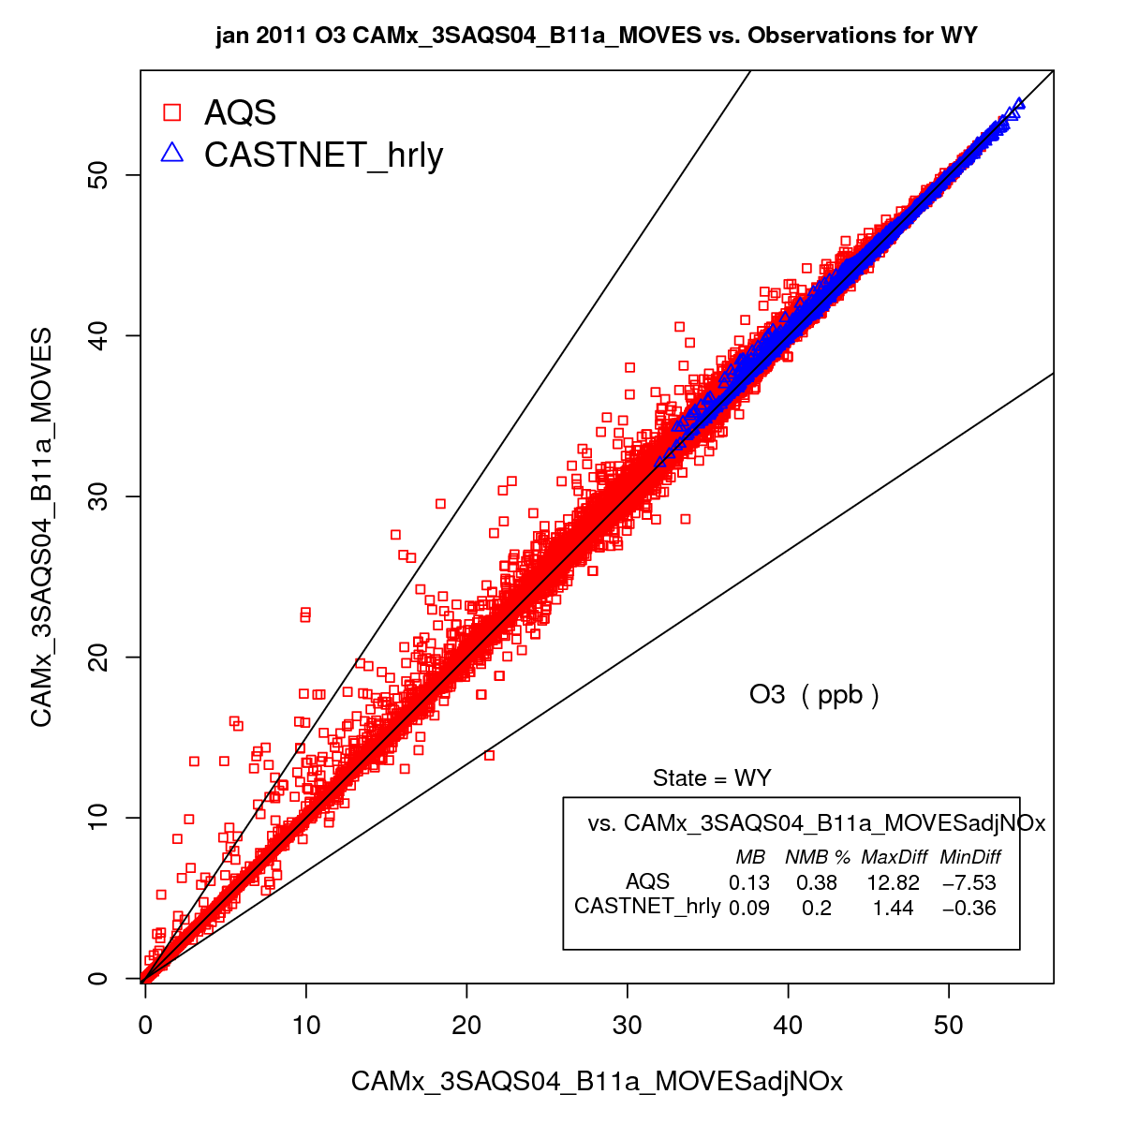
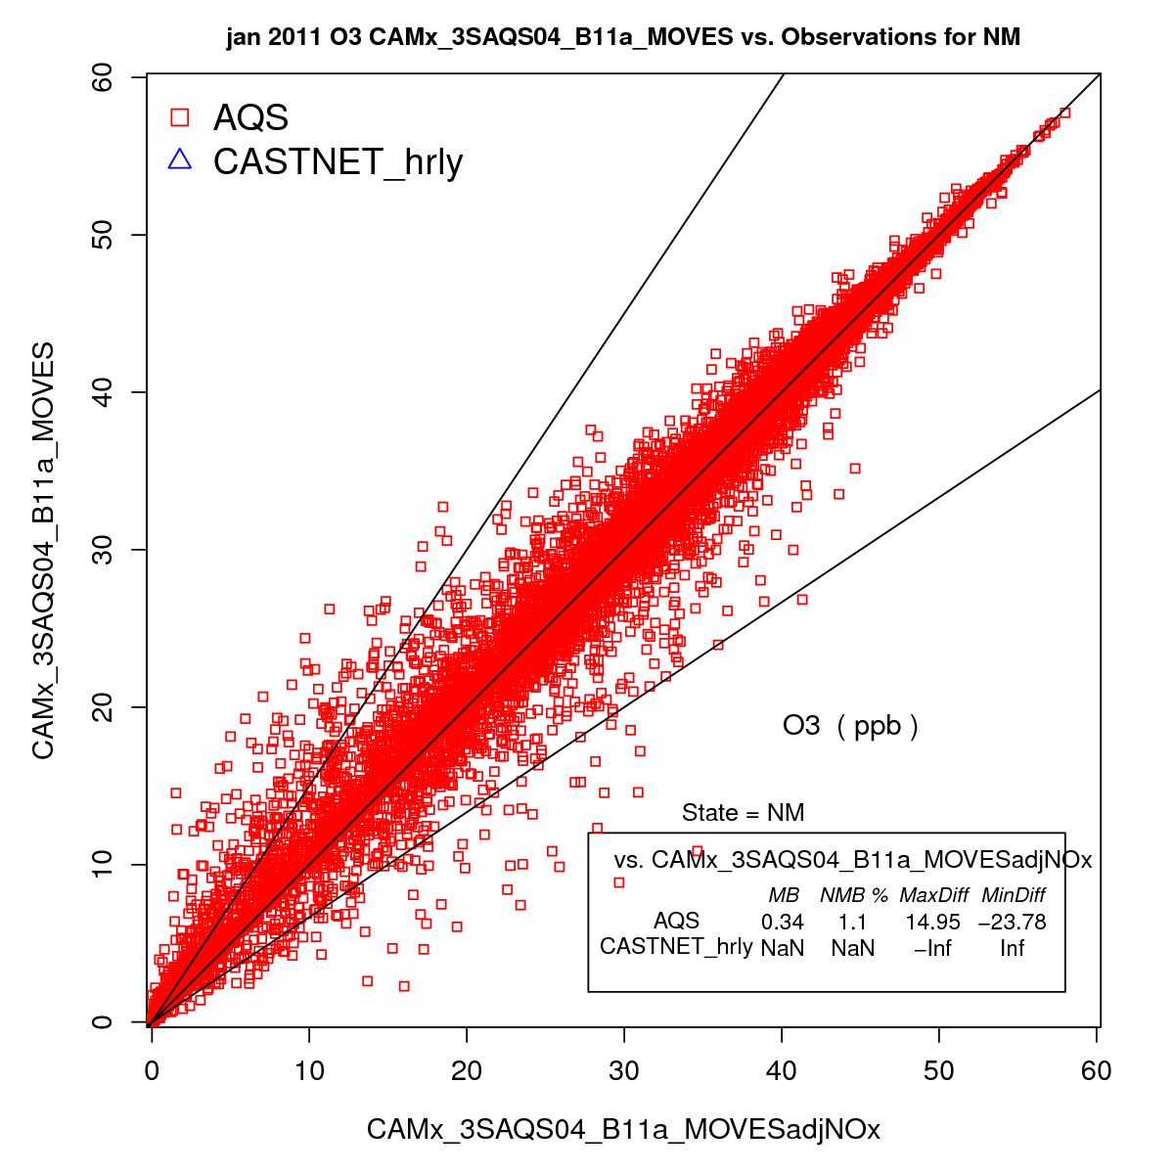
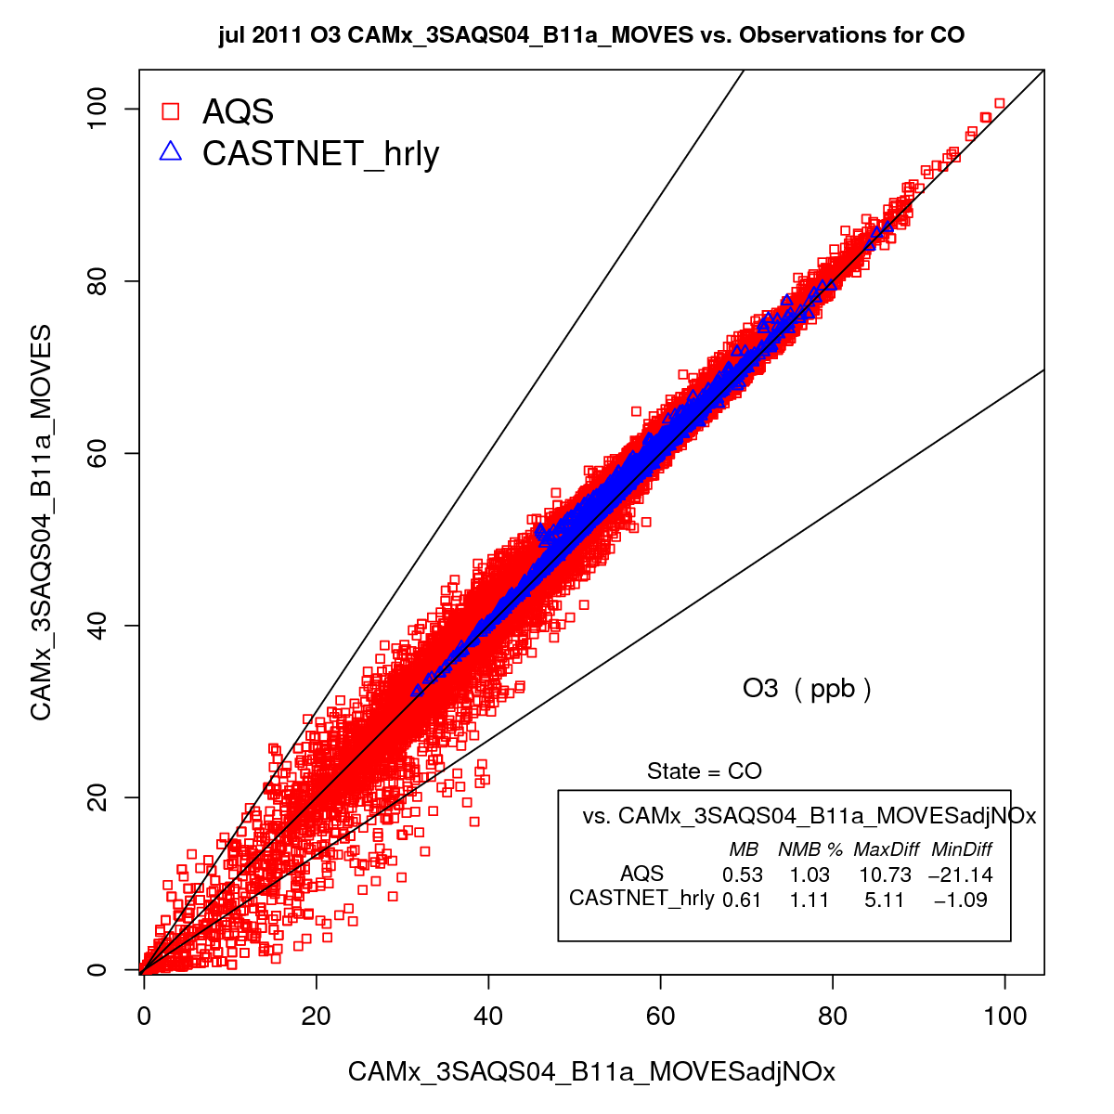
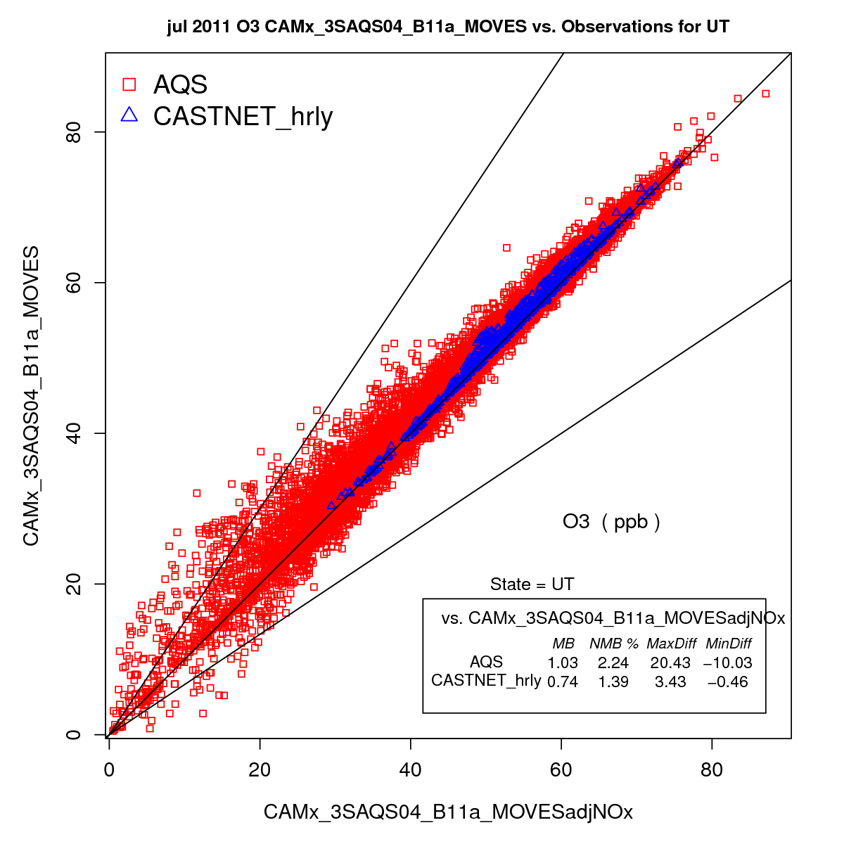
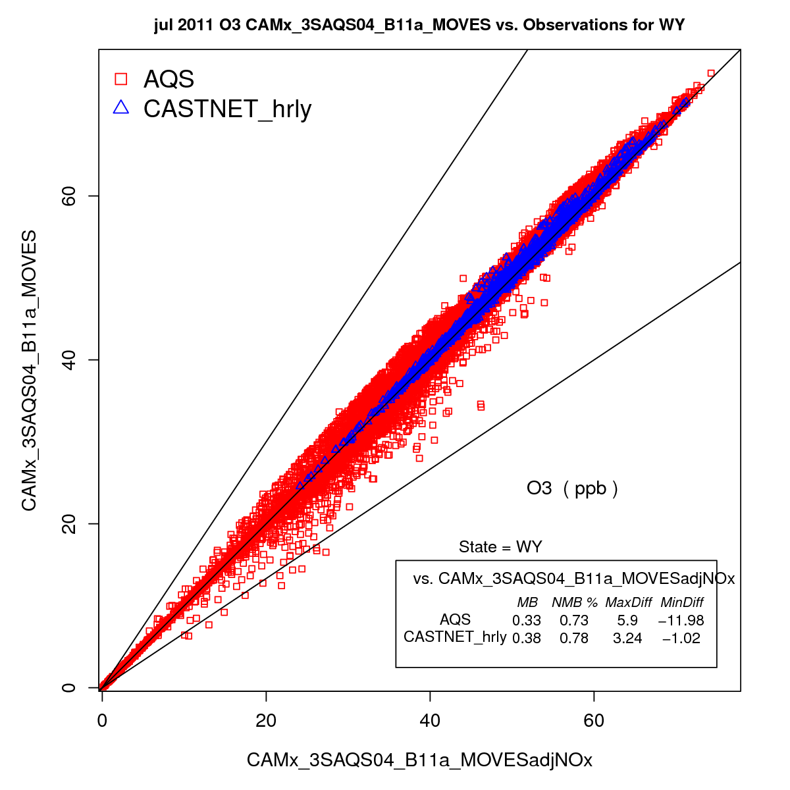
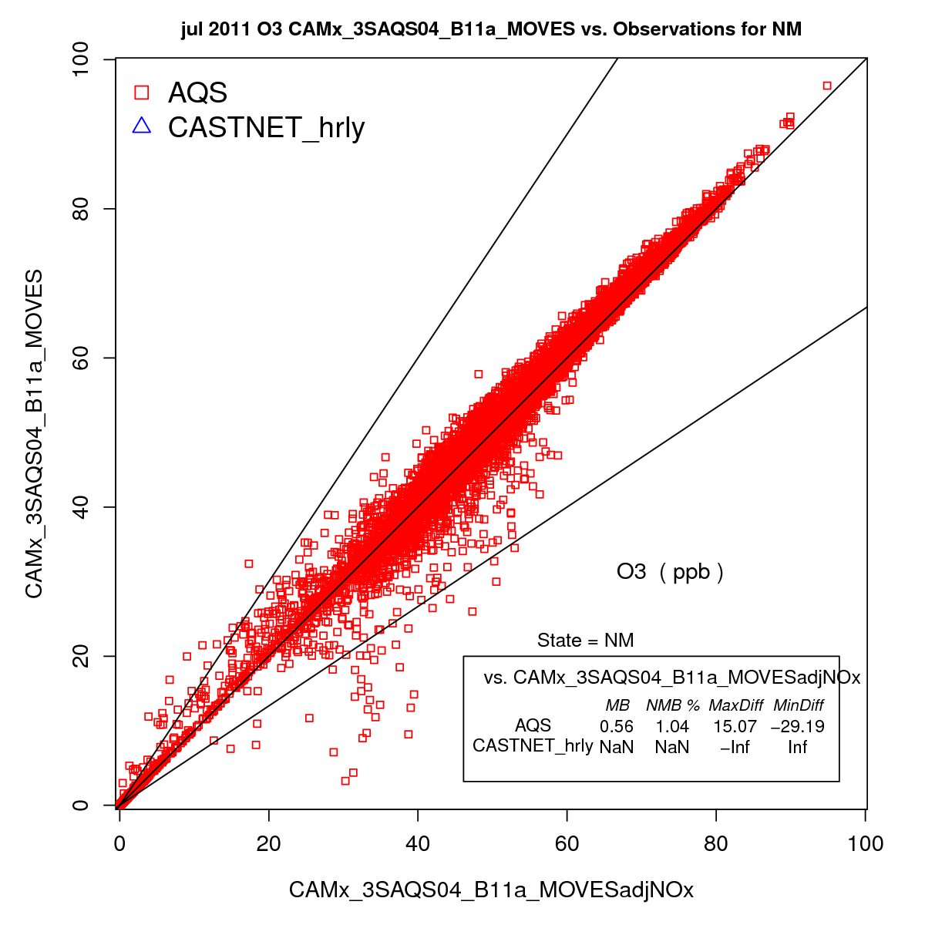
Hourly O3: All sites 4-km Domain
MOVES2014 vs MOVES2010b
MOVES2014
MOVES2010
January
July
Colorado
Utah
Wyoming
New Mexico

Slide 13
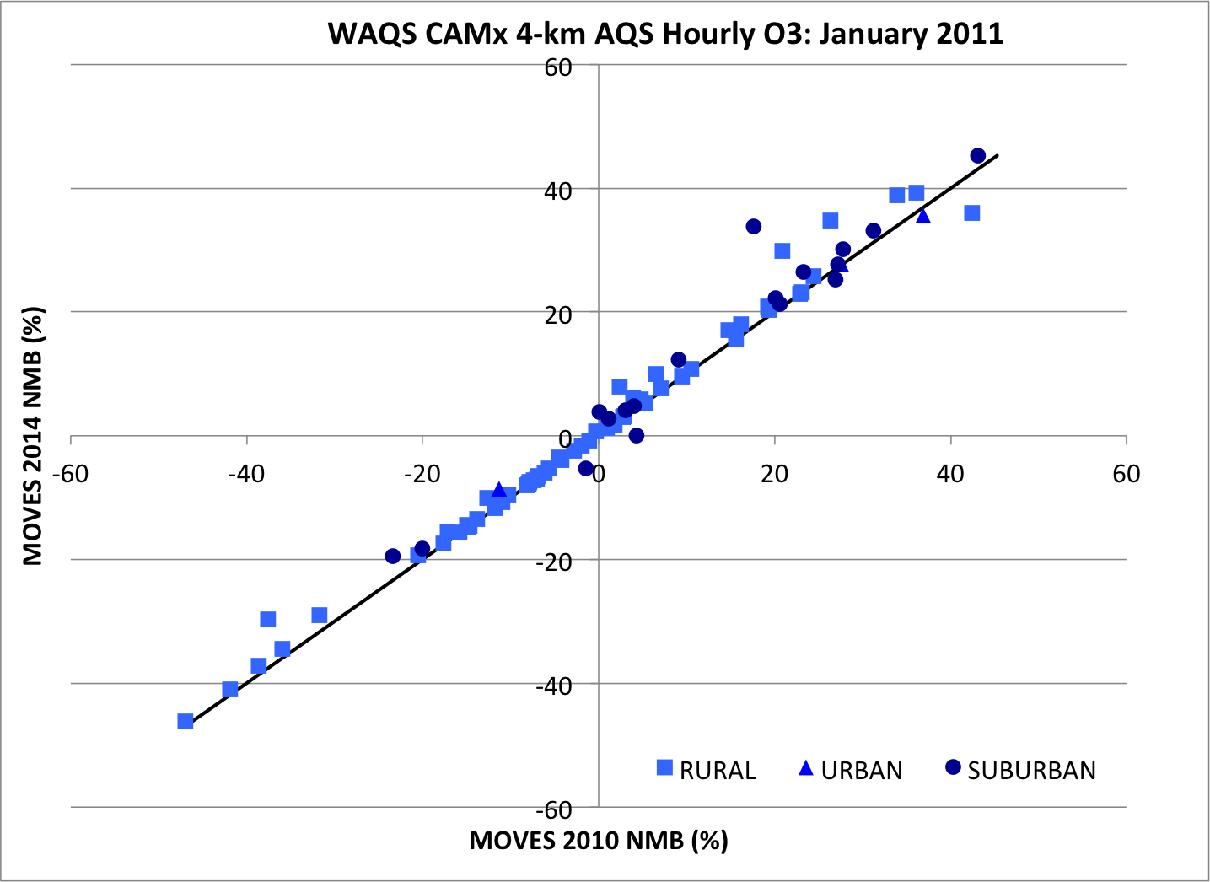
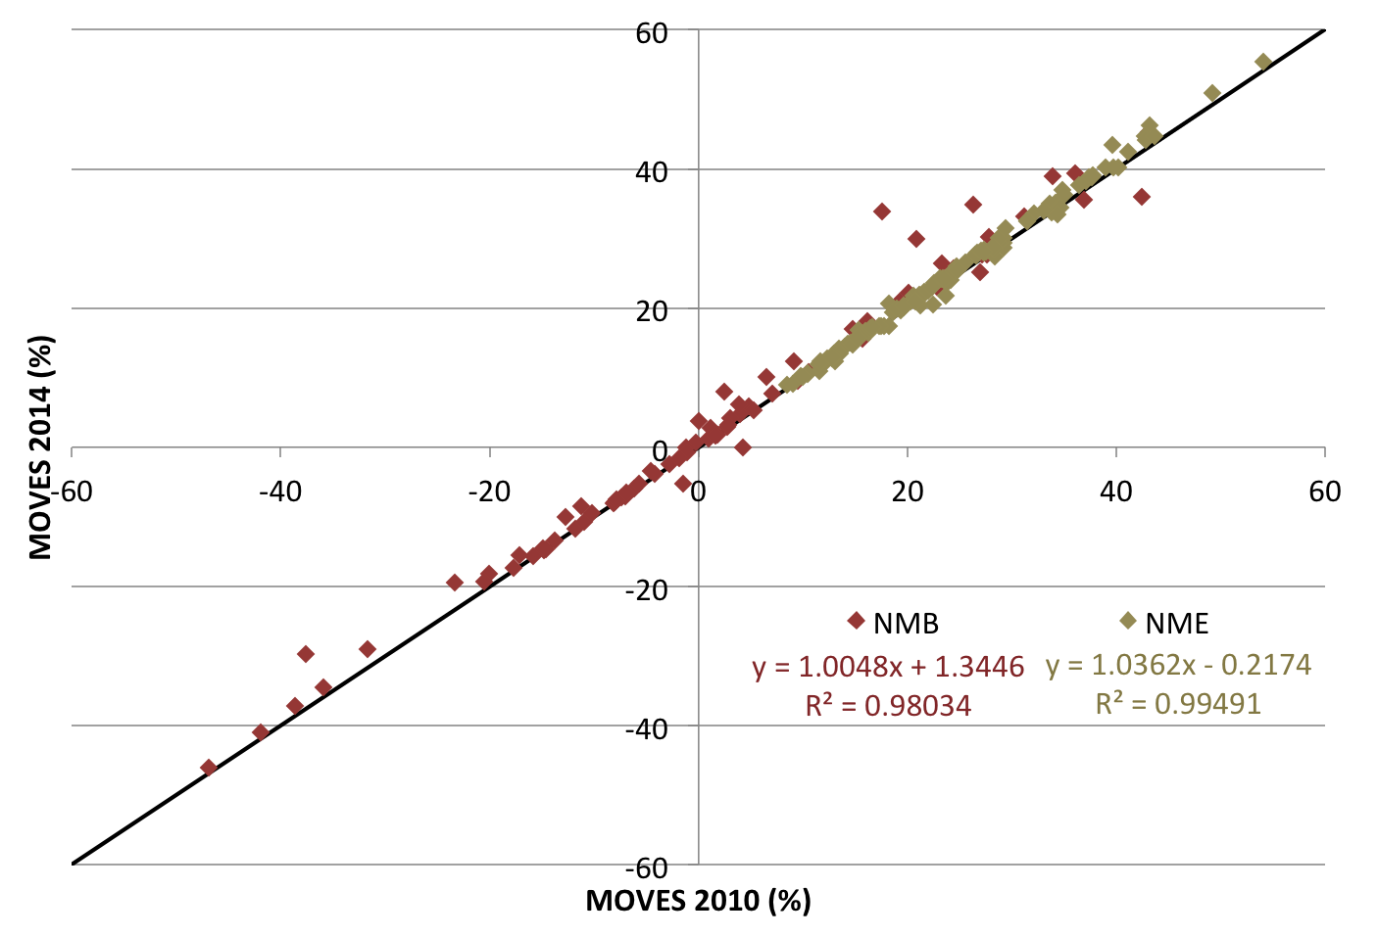
AQS Hourly O3: January 2011
Monthly NMB and NME: MOVES2014 vs MOVES2010b
MOVES2014 vs MOVES2010b NMB and NME
Each point is an AQS site in the 4-km domain
Points above the 1:1 line highlight sites where the monthly NMB/NME is higher in MOVES2014 than MOVES2010b
NMB by rural, urban, and suburban sites (left plot) shows changes in model performance across all classes of sites

Slide 14
AQS Hourly O3: January 2011
Monthly NMB and NME: MOVES2014 vs MOVES2010b
Hawthorn, UT
MOVES2014 vs MOVES2010b NMB and NME
Each point is an AQS site in the 4-km domain
Points above the 1:1 line highlight sites where the monthly NMB/NME is higher in MOVES2014 than MOVES2010b
NMB by rural, urban, and suburban sites (left plot) shows changes in model performance across all classes of sites

Slide 15
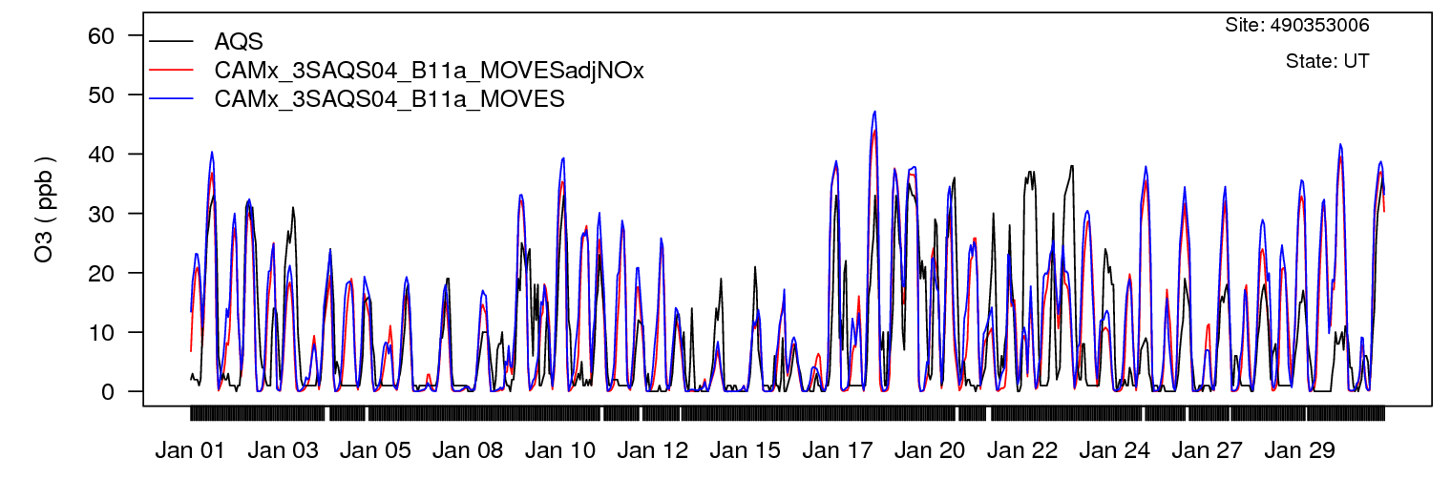
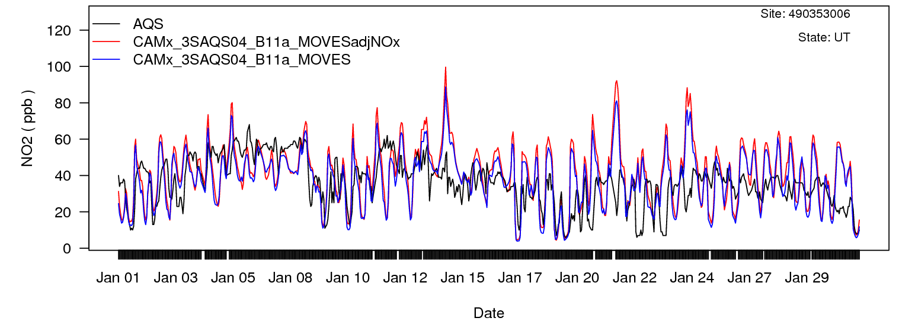
AQS Hawthorne, UT January 2011
Hourly O3 and NO₂ Timeseries
Suburban site in a neighborhood near a 6-lane secondary road and many local roads
Lower NOx in MOVES2014 results in higher daytime O₃ concentrations
AQS
MOVES2010b
MOVES2014

Slide 16
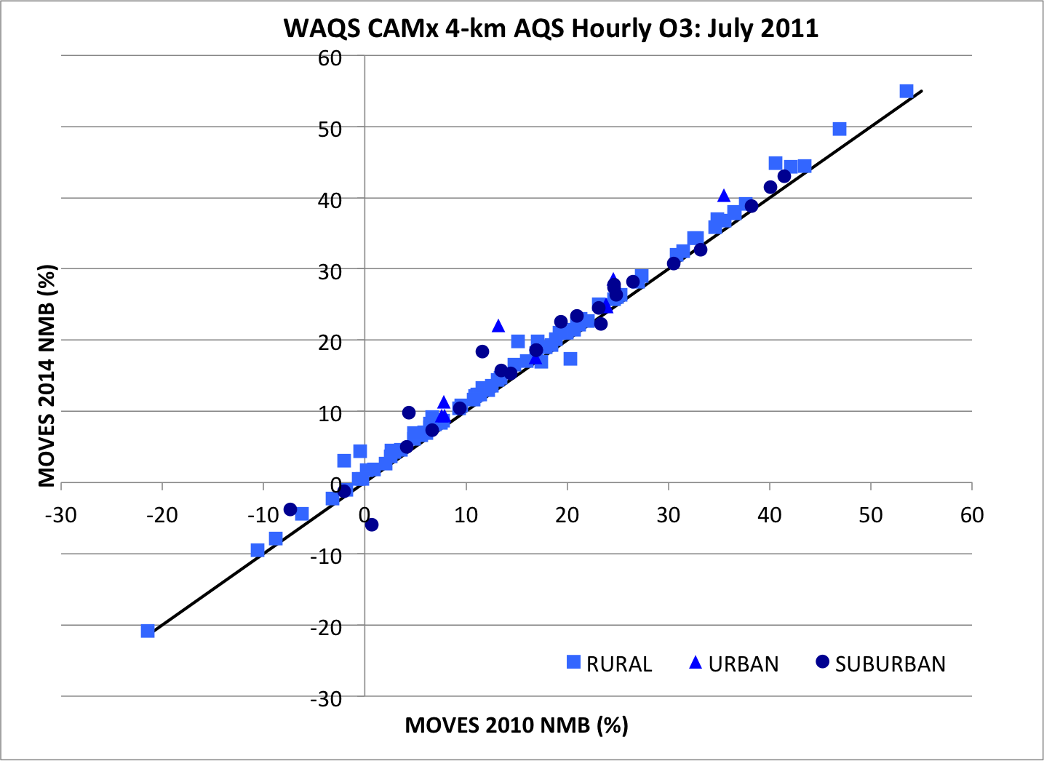
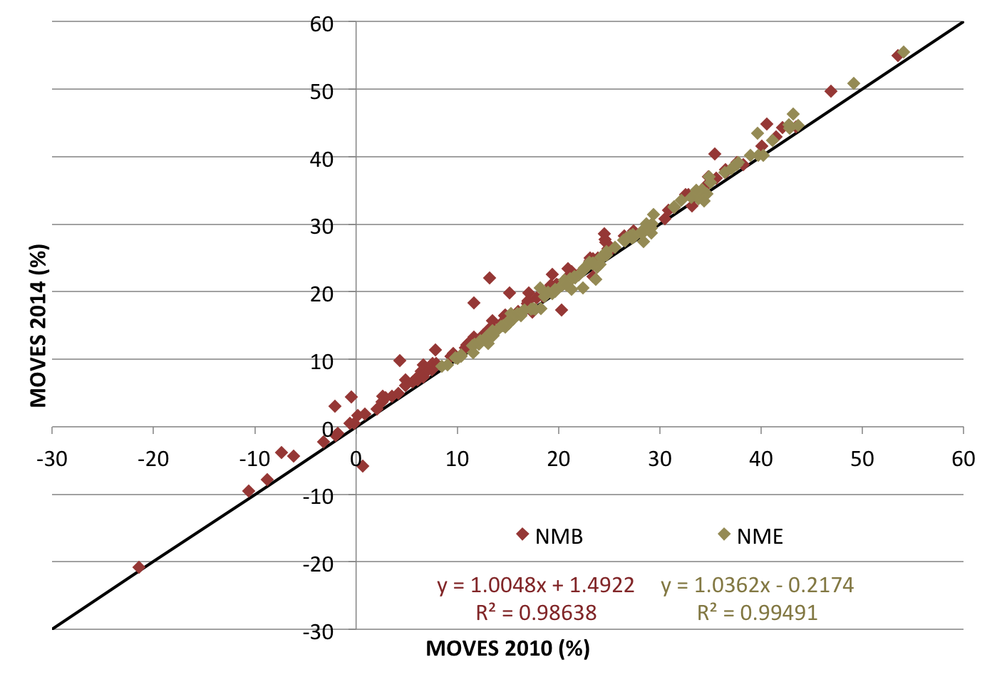
AQS Hourly O3: July 2011
Monthly NMB and NME: MOVES2014 vs MOVES2010b
The MOVES2014 and MOVES2010b CAMx simulations exhibit very similar model performance
No discernable differences in model performance between rural-suburban-urban sites in the Intermountain West

Slide 17
AQS Hourly O3: July 2011
Monthly NMB and NME: MOVES2014 vs MOVES2010b
Greeley, CO
The MOVES2014 and MOVES2010b CAMx simulations exhibit very similar model performance
No discernable differences in model performance between rural-suburban-urban sites in the Intermountain West
CAMx performance at the Greeley, CO monitor cell showed one of the largest changes: MOVES2010b NMB = 0.67 vs MOVES2014 NMB = -5.87

Slide 18
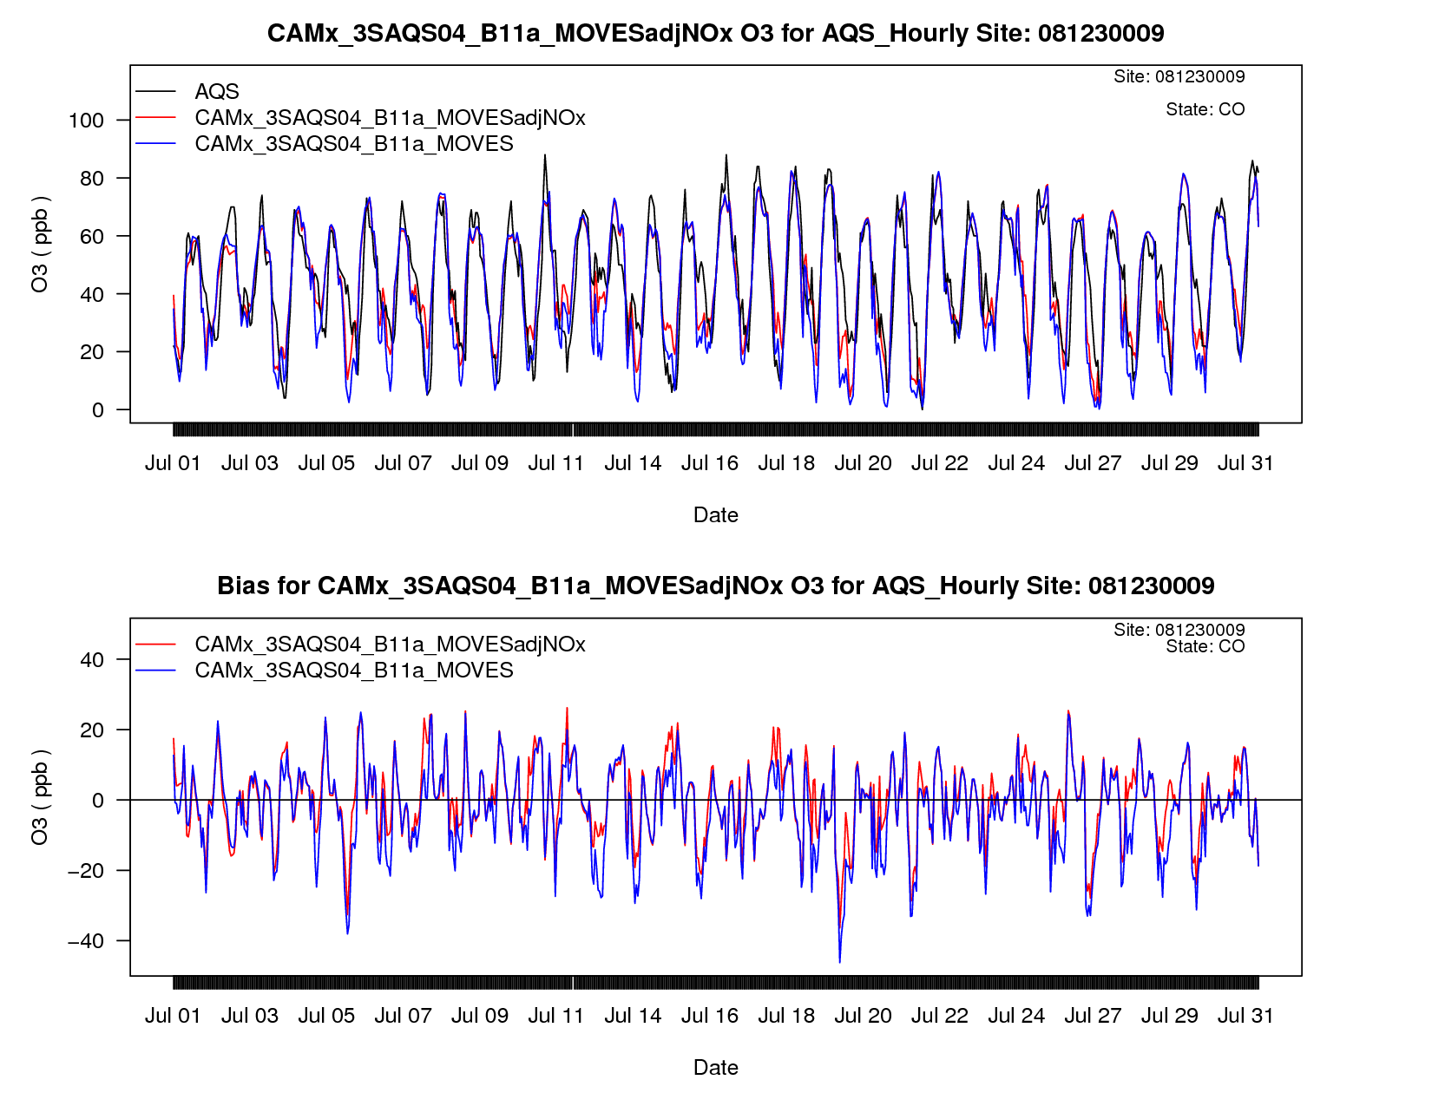
AQS Greeley, CO July 2011
Hourly O₃ Timeseries
AQS
MOVES2010b
MOVES2014
Greeley is a suburban site north of Denver.
MOVES2014 results in lower nighttime O3 (worse underestimates than MOVES2010b).

Slide 19
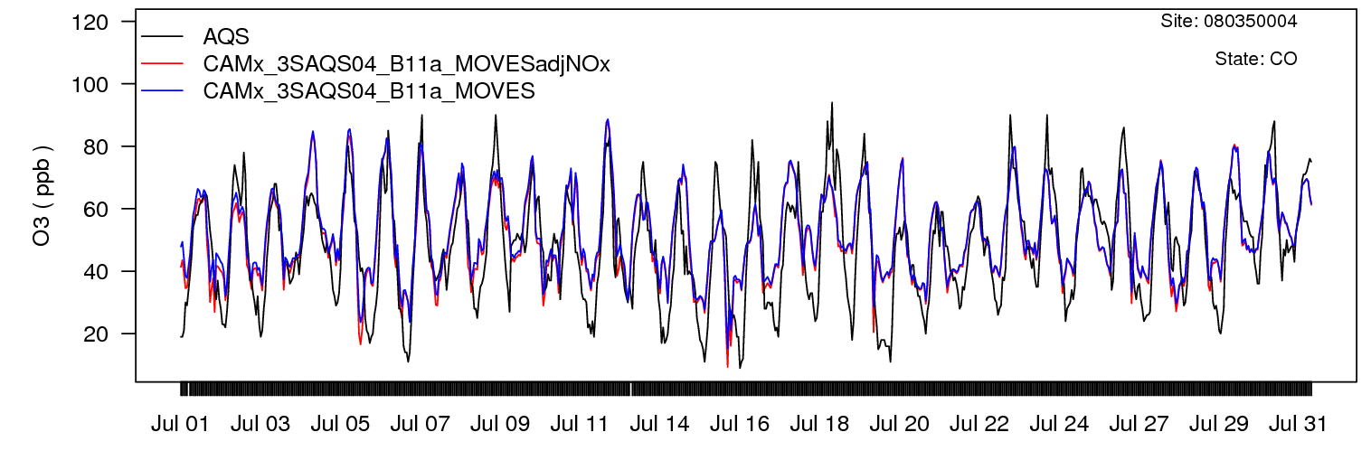
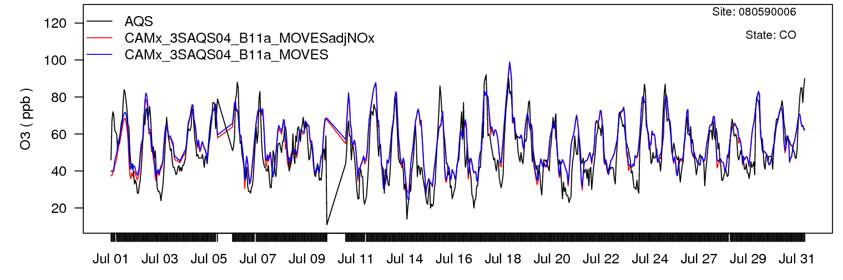
AQS Colorado High Ozone Sites
July 2011 Hourly O₃ Timeseries
Rocky Flats-N is a rural site NW of Denver.
Chatfield is a rural site south of Denver.
Both sites experience high measured summertime ozone.
AQS
MOVES2010b
MOVES2014
Chatfield State Park, CO
Rocky Flats North, CO
The on-road mobile emissions model does not impact the model performance at these sites during this study period

Slide 20
What Did We Learn?
MOVES2014 vs MOVES2010b
Emissions
  The MOVES2010 vs. 2014 emissions differences are localized
  Annual, statewide average: CO, NOx, SO2, and NH3 increase; PM2.5 and VOC decrease across much of the west
Air Quality
  Model performance for averaged or aggregated species (i.e. daily max O3 or MDA8) is very similar
  Biggest differences are seen at the hourly level
  Urban/suburban/rural site classification not as important as…proximity of monitor to roads
  Expect to see large differences when looking projection years

Slide 21

Acknowledgements
Co-authors
IWDW-WAQS Cooperators: NPS, USFS, BLM, EPA R8, states of Colorado, Utah, Wyoming, and New Mexico
The Cubs

