Slide 1
Impact of dimethylsulfide chemistry on sulfate
Golam Sarwar, Kathleen Fahey, Kristen Foley, Brett Gantt, Deborah Luecken, Rohit Mathur
October 7, 2015

Slide 2
Sources
• DMS is emitted from natural sources (Seinfeld and Pandis, 1998)
  Oceans: 15-25 Tg/yr (these estimates have been revised in recent years)
  Wetlands: 0.003-0.68 Tg/yr
  Plants and soil: 0.05-0.16 Tg/yr
  The largest emissions source is the ocean; therefore we focus on oceanic DMS
• Oceanic DMS emissions
  Marine organisms (phytoplankton) emit DMS
  Phytoplankton contains dimethylsulfoniopropionate (DMSP) which is broken down by microbes to eventually produce DMS. A small fraction of DMS escapes into atmosphere
• The existence of DMS in ocean water was first suggested by Lovelock et al. (1972)
  Since then DMS levels in seawater have been measured in many campaigns
  A global database of DMS in seawater was developed using measured data and by applying interpolation, extrapolation, and objective analysis
Notes:
2

Slide 3
Global database of DMS concentration in seawater
• Kettle et al. (1999) prepared the first global database of DMS concentrations in seawater
  Included measurements from individual scientists
  Number of measurements > 15,000
  They developed monthly climatology of DMS for oceans (1⁰ x 1⁰ )
• Kettle and Andrea (2000) updated the global database
  Additional ~1,500 measurements performed during 1996-1998 were incorporated
  Number of measurements > 17,000
• Lana et al. further updated the DMS global database in 2011
  Number of measurements > 47,000 (covers data measured from 1972 – 2010)
  64% of the data were collected in Northern Hemisphere; 36% in Southern Hemisphere
  DMS levels in monthly climatology generally range between 1-7 nM
  Dataset can be freely obtained from Pacific Marine Environmental Lab (NOAA) website
  Most extensive and the latest database which we use for our modeling effort
Notes:
3

Slide 4
DMS emissions estimates
DMS flux: F = k_{T} ( C_{w} – C_{g} H ) = k_{T} C_{w}
Different k_{T} parameterizations are available which yield different estimates
  Lana et al. (2011) reported global DMS estimates using Kettle/Andrea & Lana et al. C_{W}:
    Here, we choose the Nightingale et al. (2000) parameterization
Global annual anthropogenic SO₂ estimate for 2005 (Smith et al., 2011): ~60 TgS
DMS to anthropogenic SO₂ emissions ratio: ~25-60%
  As anthropogenic sulfur emissions are lowered, the ratio increases
• Our DMS emission estimate for Northern Hemisphere
  Annual estimate ~14.0 TgS compared to 10.8 TgS reported by Lana et al. (2011)
    Our estimate is ~30% greater primarily due to meteorological difference
  Sulfur emission from DMS is ~30% of anthropogenic SO₂
K_{T} Parameterization | Kettle/Andrea C_{W} | Lana et al. C_{W}
Liss and Merlivat (1986) | 15.0 | 17.6
Nightingale et al. (2000) | 24.0 | 28.1
Wanninkhof (1992) | 29.4 | 34.4
Notes:
4

Slide 5
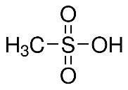
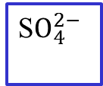
Gas-phase DMS chemistry
No | Reaction | Reference
1 | DMS + OH = SO₂ + …. (abstraction channel) | Sander et al. (2011)
2 | DMS + OH = 0.75*SO₂ + 0.25*MSA + .. (addition channel) | Sander et al. (2011)
3 | DMS + NO₃ = SO₂ + … | Sander et al. (2011)
4 | DMS + BrO = 0.75*SO₂ + 0.25*MSA + .. | Atkinson (2006)
5 | DMS + IO = 0.75*SO₂ + 0.25*MSA + ….. | Atkinson (2006)
6 | DMS + Cl = 0.86*SO₂ + …. | Atkinson (2006)
7 | DMS + ClO = 0.75*SO₂ + 0.25*MSA + …. | Atkinson (2006)
DMS
OH, NO₃, BrO, IO, Cl, ClO (gas)
SO₂
OH (gas)
H₂SO₄
S$O_{4}^{2−}$
H₂O₂ O₃, O₂, MEPX, PAA (aq)
MSA
aerosol
Ocean
Not included in the model
Notes:
5

Slide 6
Modeling details
• Hemispheric CMAQv5.0 using 108-km grids (two-way model)
• Meteorology – WRF, 44 layers, 20-meter surface layer height
• Emissions Database for Global Atmospheric Research (EDGAR)
• Two model runs were completed
  Case A : CB05 mechanism
  Case B : Case A + DMS chemistry + detailed halogen chemistry
  Modeling period – 4 months (May – August, 2006)
  May is the spin-up period and the results are analyzed for summer months (Jun-Aug)
Notes:
6

Slide 7
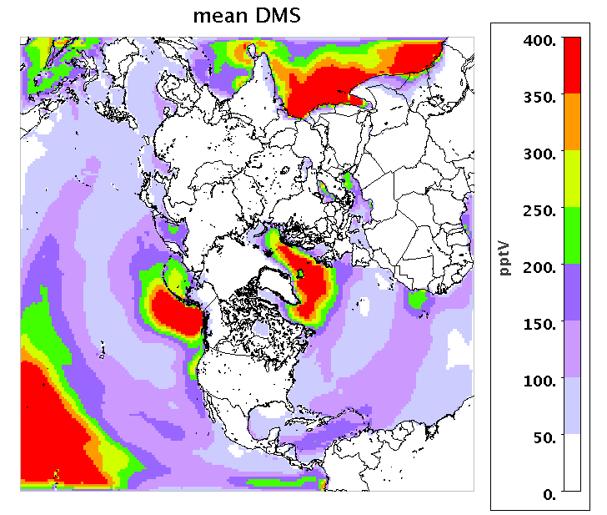
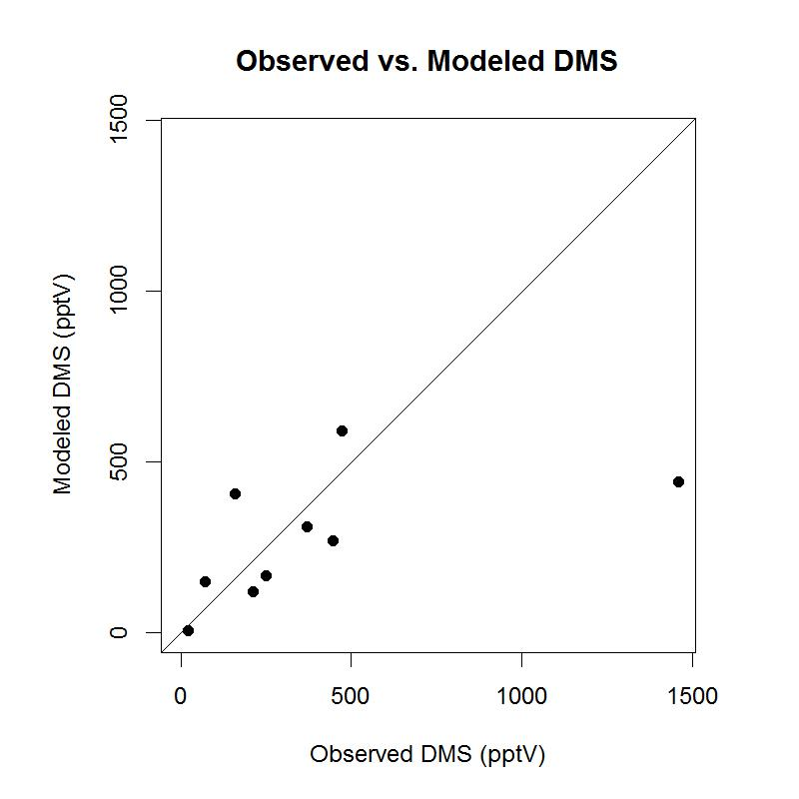
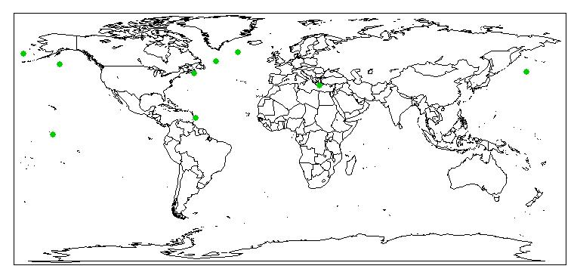
Predicted surface level DMS
● Observed and model data are not paired in time
● Observed data are from different years
● Measurements were taken over a few days while model results are averaged over summer
● Comparison is done for first order check
Notes:
7

Slide 8
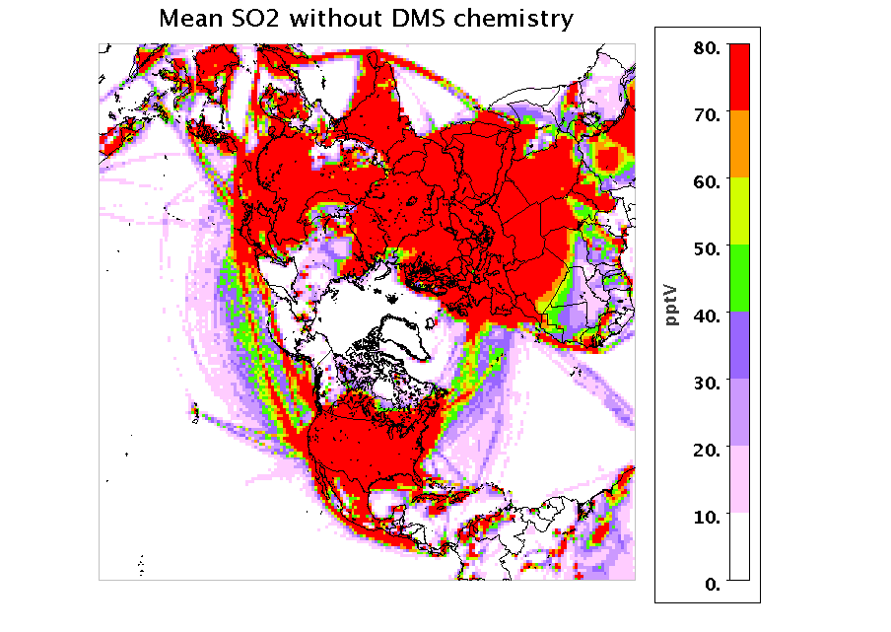
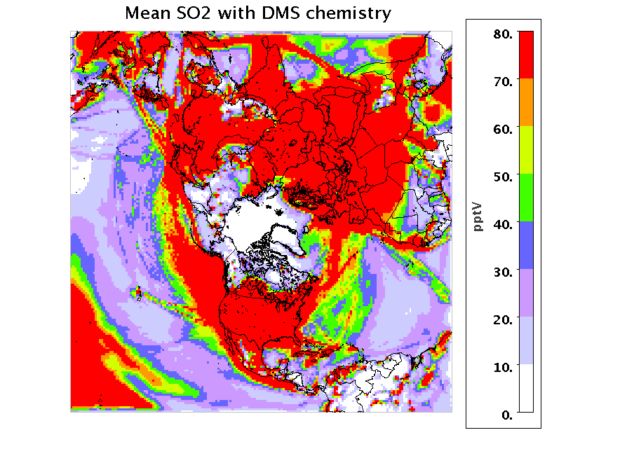
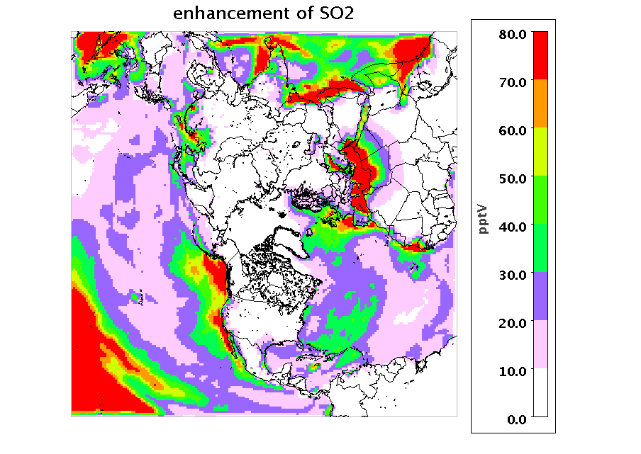
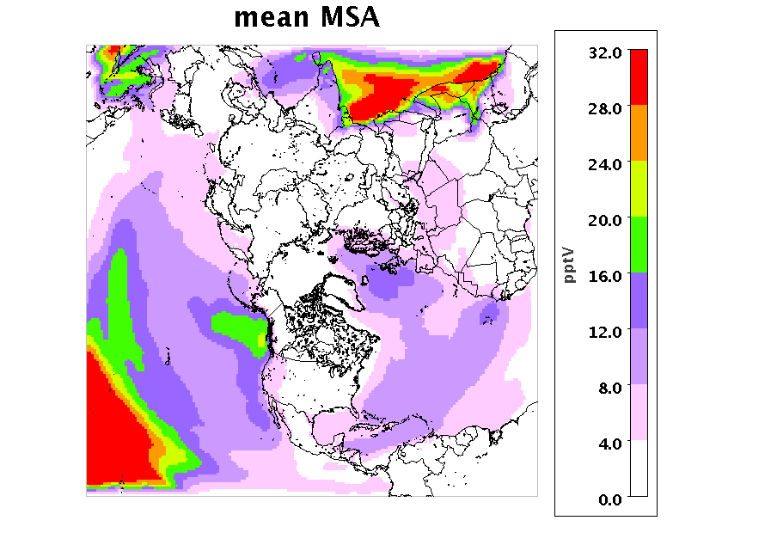
Impact on surface level SO₂ and MSA
Notes:
8

Slide 9
Importance of chemical pathways for DMS oxidation
The majority of the DMS is oxidized via the OH pathway; however, the NO₃ and BrO pathways are also important in DMS oxidation
Kloster et al. reported 77% of DMS is oxidized by OH and 23% by NO₃ in NH
Notes:
9

Slide 10
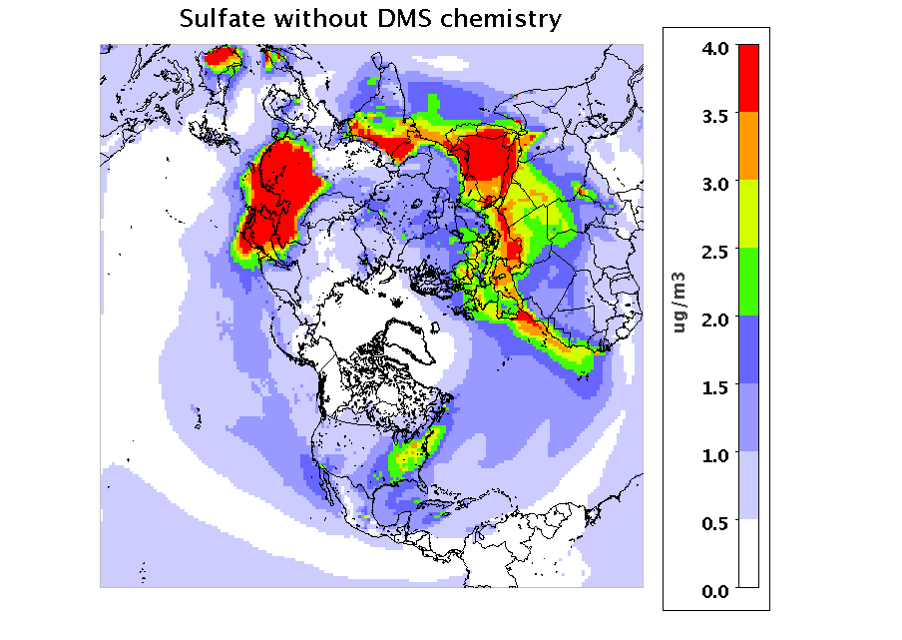
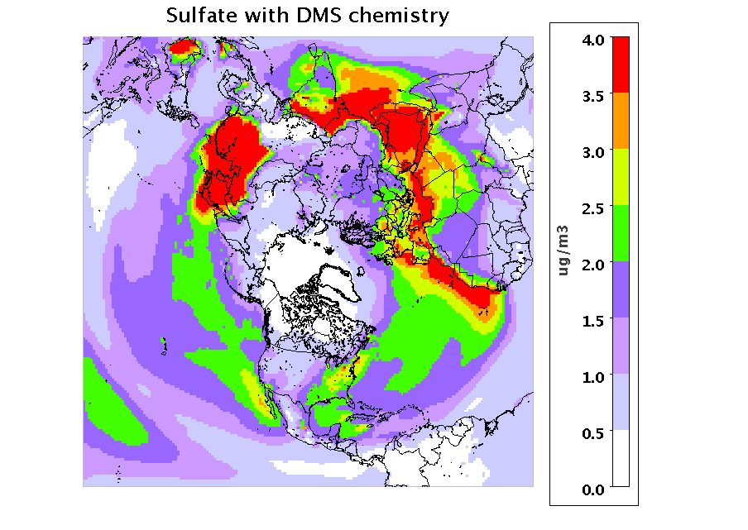
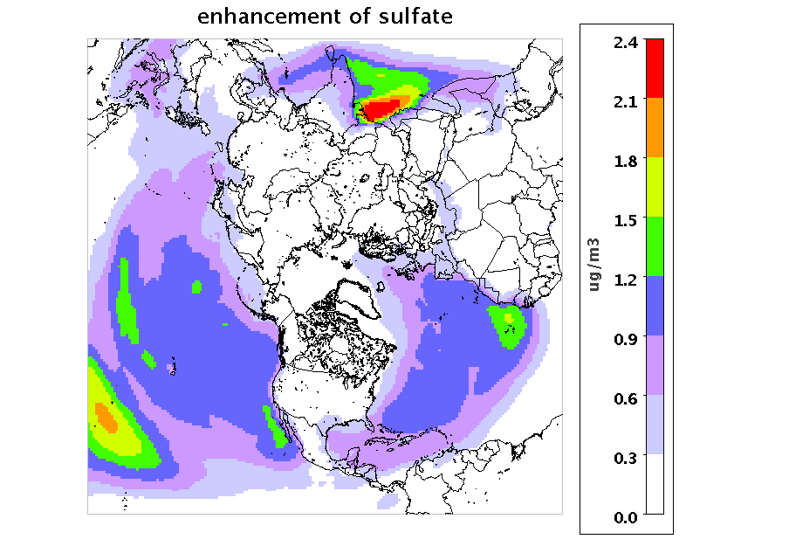
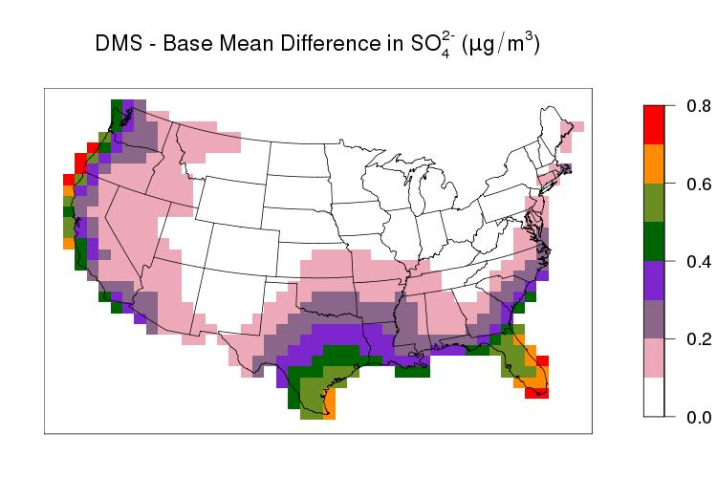
Impact on surface level S$O_{4}^{2−}$
Enhancement of sulfate over US
Notes:
10

Slide 11
Comparison of predicted S$O_{4}^{2−}$with observed data
deterioration
improvement
Notes:
11

Slide 12
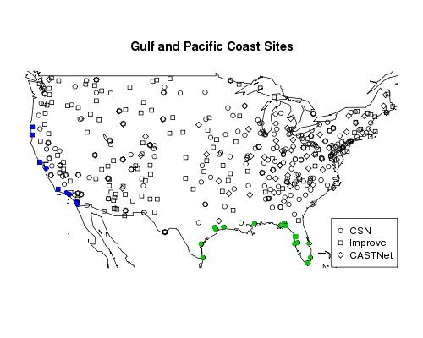
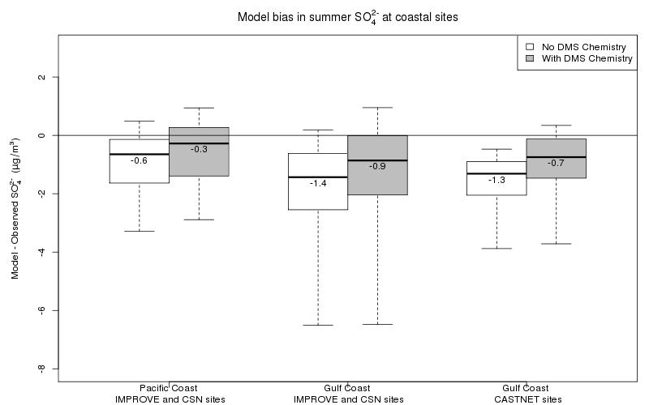
Model performance at coastal sites
5 CSN &
4 IMPROVE sites
2 CASTNET, 10 CSN, 3 IMPROVE sites
Notes:
12

Slide 13
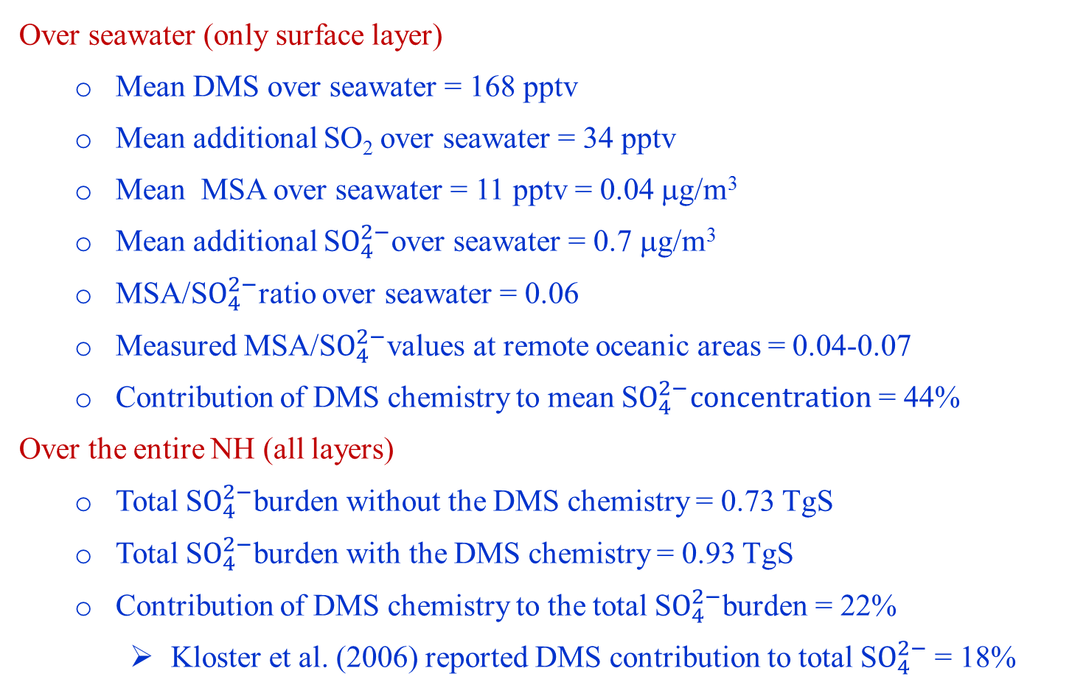
Overall contribution of the DMS chemistry
Over seawater (only surface layer)
  Mean DMS over seawater = 168 pptv
  Mean additional SO₂ over seawater = 34 pptv
  Mean MSA over seawater = 11 pptv = 0.04 μg/m³
  Mean additional S$O_{4}^{2−}$over seawater = 0.7 μg/m³
  MSA/S$O_{4}^{2−}$ratio over seawater = 0.06
  Measured MSA/S$O_{4}^{2−}$values at remote oceanic areas = 0.04-0.07
  Contribution of DMS chemistry to mean S$O_{4}^{2−}concentration$= 44%
Over the entire NH (all layers)
  Total S$O_{4}^{2−}$burden without the DMS chemistry = 0.73 TgS
  Total S$O_{4}^{2−}$burden with the DMS chemistry = 0.93 TgS
  Contribution of DMS chemistry to the total S$O_{4}^{2−}$burden = 22%
    Kloster et al. (2006) reported DMS contribution to total S$O_{4}^{2−}$= 18%
Notes:
13

Slide 14
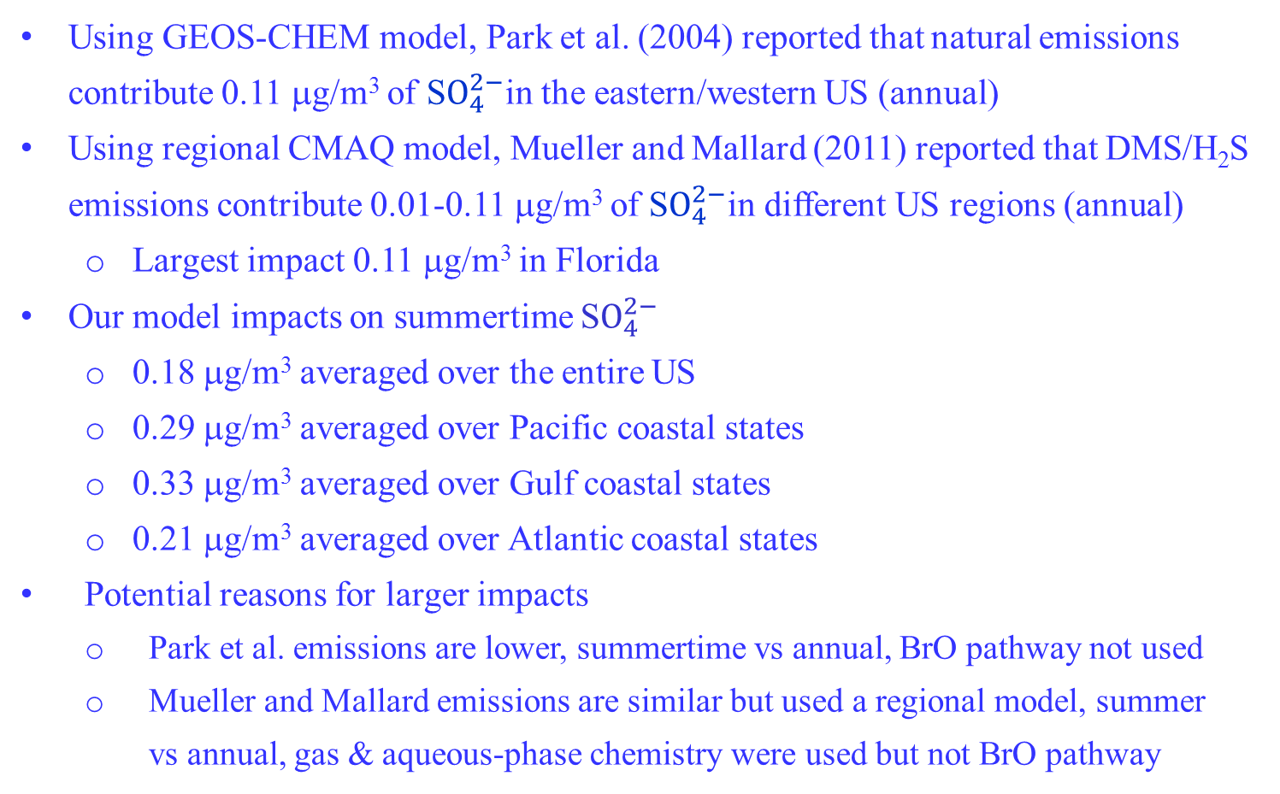
Comparison with previous DMS modeling work
Using GEOS-CHEM model, Park et al. (2004) reported that natural emissions contribute 0.11 μg/m³ of S$O_{4}^{2−}$in the eastern/western US (annual)
Using regional CMAQ model, Mueller and Mallard (2011) reported that DMS/H₂S emissions contribute 0.01-0.11 μg/m³ of S$O_{4}^{2−}$in different US regions (annual)
  Largest impact 0.11 μg/m³ in Florida
Our model impacts on summertime S$O_{4}^{2−}$
    0.18 μg/m³ averaged over the entire US
    0.29 μg/m³ averaged over Pacific coastal states
    0.33 μg/m³ averaged over Gulf coastal states
    0.21 μg/m³ averaged over Atlantic coastal states
Potential reasons for larger impacts
    Park et al. emissions are lower, summertime vs annual, BrO pathway not used
    Mueller and Mallard emissions are similar but used a regional model, summer
    vs annual, gas & aqueous-phase chemistry were used but not BrO pathway
Notes:
14

Slide 15
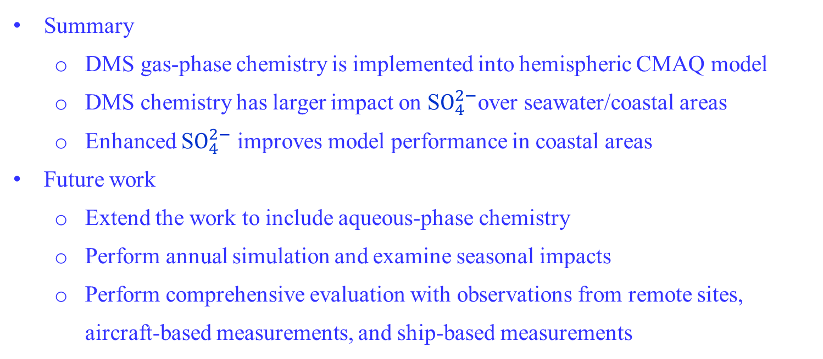
Summary and future plan
Summary
  DMS gas-phase chemistry is implemented into hemispheric CMAQ model
  DMS chemistry has larger impact on S$O_{4}^{2−}$over seawater/coastal areas
  Enhanced S$O_{4}^{2−}$ improves model performance in coastal areas
Future work
  Extend the work to include aqueous-phase chemistry
  Perform annual simulation and examine seasonal impacts
  Perform comprehensive evaluation with observations from remote sites, aircraft-based measurements, and ship-based measurements
Notes:
15

