Slide 1



Regional Model Evaluation During the Houston, TX NASA DISCOVER-AQ Campaign
Melanie Follette-Cook (MSU/GESTAR)
Christopher Loughner (ESSIC, UMD)
Kenneth Pickering (NASA GSFC)
Rob Gilliam (EPA)
Jim MacKay (TCEQ)
Funded by DISCOVER-AQ and Texas AQRP
CMAS Oct 5-7, 2015

Slide 2
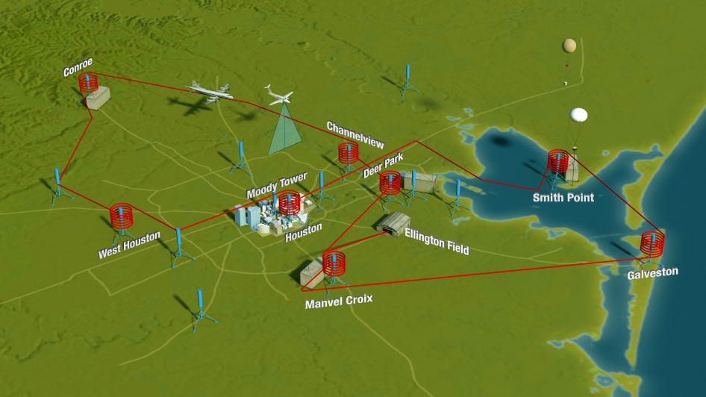
Deriving Information on Surface conditions from Column and Vertically Resolved Observations Relevant to Air Quality (DISCOVER-AQ)
Four deployments
  MD – Jul 2011
  CA – Jan/Feb 2013
  TX – Sep 2013
  CO – Jul/Aug 2014
Houston, TX campaign
  9 flight days
  99 missed approaches at four airports
  195 in-situ aircraft profiles
    ~24 per ground site
  Other measurements
    14 Pandoras
    16 Aeronet
    3 EPA NO₂ sites
    Ship in Galveston Bay
    3 mobile vans
    TX AQRP ground sites
A NASA Earth Venture campaign intended to improve the interpretation of satellite observations to diagnose near-surface conditions related to air quality

Slide 3
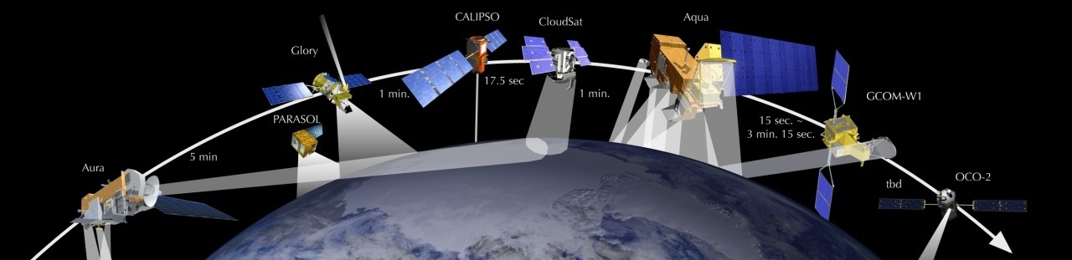
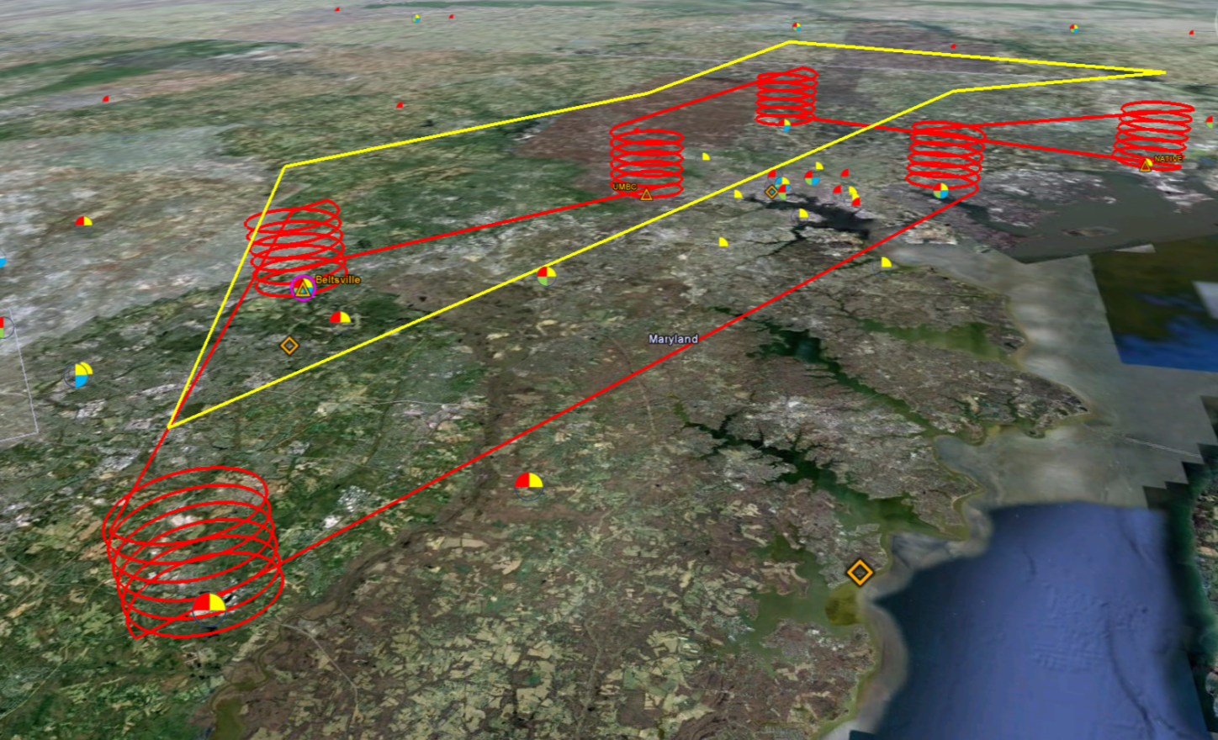
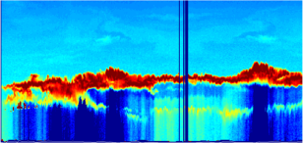

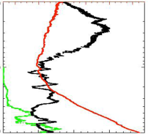
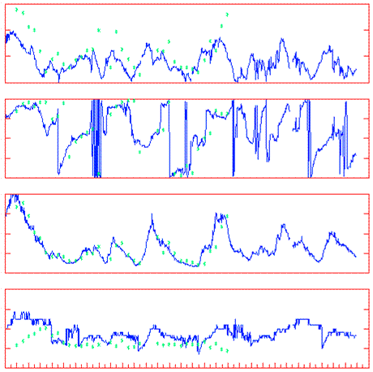
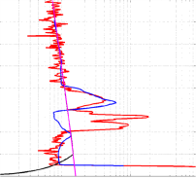
DISCOVER-AQ Deployment Strategy
Systematic and concurrent observation of column-integrated, surface, and vertically-resolved distributions of aerosols and trace gases relevant to air quality as they evolve throughout the day.
Continuous lidar mapping of aerosols with HSRL on board B-200
Continuous mapping of trace gas columns with ACAM on board B-200
In situ profiling over surface measurement sites with P-3B
Continuous monitoring of trace gases and aerosols at surface sites to include both in situ and column-integrated quantities
Surface lidar and balloon soundings

Slide 4
Deriving Information on Surface conditions from Column and Vertically Resolved Observations Relevant to Air Quality (DISCOVER-AQ)
Four deployments
  MD – Jul 2011
  CA – Jan/Feb 2013
  TX – Sep 2013
  CO – Jul/Aug 2014
Houston, TX campaign
  9 flight days
  99 missed approaches at four airports
  195 in-situ aircraft profiles
    ~24 per ground site
  Other measurements
    14 Pandoras
    16 Aeronet
    3 EPA NO₂ sites
    Ship in Galveston Bay
    3 mobile vans
    TX AQRP ground sites
A NASA Earth Venture campaign intended to improve the interpretation of satellite observations to diagnose near-surface conditions related to air quality

Slide 5
Daily 1-Hour Max Ozone (ppbv) – All Stations
September 1st – 30th
bay, sea breezes
following cold front
#8
#9
#1
#4
#5
#6
clouds, heavy
rains, marine air
#3
#7
#2
Relatively clean 3 flight days
Moderate pollution 4
Strongly polluted 2

Slide 6
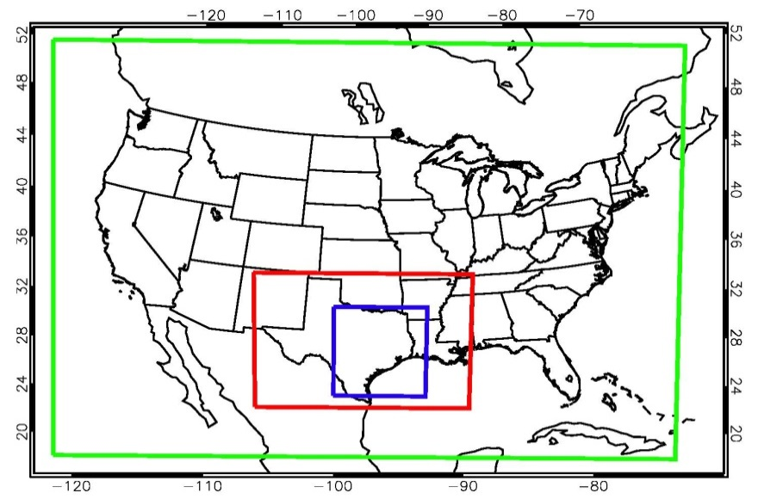
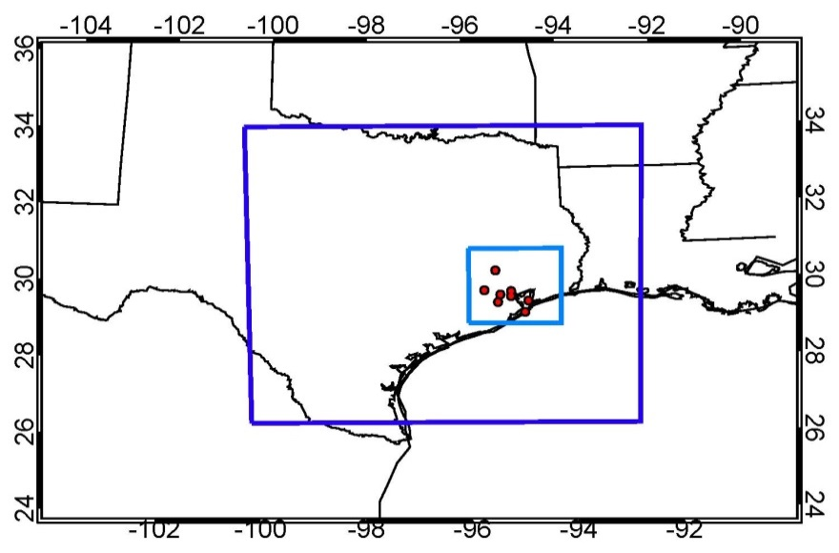
WRF-CMAQ evaluation
  DISCOVER-AQ dataset - Ideal for in-depth model evaluation
    Multiple instrument platforms (aircraft in-situ and remote sensing, profiling instruments, and ground based in-situ and remote sensing instruments)
    Variety of meteorological and air quality conditions during the course of each month-long campaign
    Consistent flight patterns result in large sample size
  The observations have been collocated in space and time with the CMAQ output
12 km
4 km
36 km
4 km
1 km

Slide 7
WRF simulations
Time period:
  28 August – 2 October, 2013
Original simulation (4 km domain only)
  Initial and boundary conditions – 40 km NARR
  WRF reinitialized every three days
    Run in 3.5 day increments, with the first 12 hours discarded
  Observational and analysis nudging on 36 km domain only
Iterative runs (EPA iterative nudging) (4 km and 1 km domains)
  Initial and boundary conditions – 12 km NAM
  Observational nudging of all domains
  1 km nonpoint emissions interpolated from 4 km emissions
  Output saved every 20 minutes (4 km) and 5 minutes (1 km)
  Iteration #1
    Analysis nudging on all domains based on 12 km NAM
  Iteration #2
    Analysis nudging (all domains) of 2 m temperature and humidity from previous WRF run, everything else from 12 km NAM
    CMAQ run using this WRF simulation

Slide 8
Weather Research and Forecasting (WRF) Version 3.6.1 Model Options
Radiation | LW: RRTM; SW: Goddard
Surface Layer | Pleim-Xiu
Land Surface Model | Pleim-Xiu
Boundary Layer | ACM2
Cumulus | Kain-Fritsch
Microphysics | WSM-6
Nudging | Observational and analysis nudging
Damping | Vertical velocity and gravity waves damped at top of modeling domain
SSTs | Multi-scale Ultra-high Resolution (MUR) SST analysis (~1 km resolution)
CMAQ Version 5.0.2 Model Options
Chemical Mechanism | CB05
Aerosols | AE5
Dry deposition | M3DRY
Vertical diffusion | ACM2
Emissions | 2012 TCEQ anthropogenic emissions BEIS calculated within CMAQ Lightning emissions scheme:Allen et al. (2012)
Initial and Boundary conditions | MOZART CTM

Slide 9
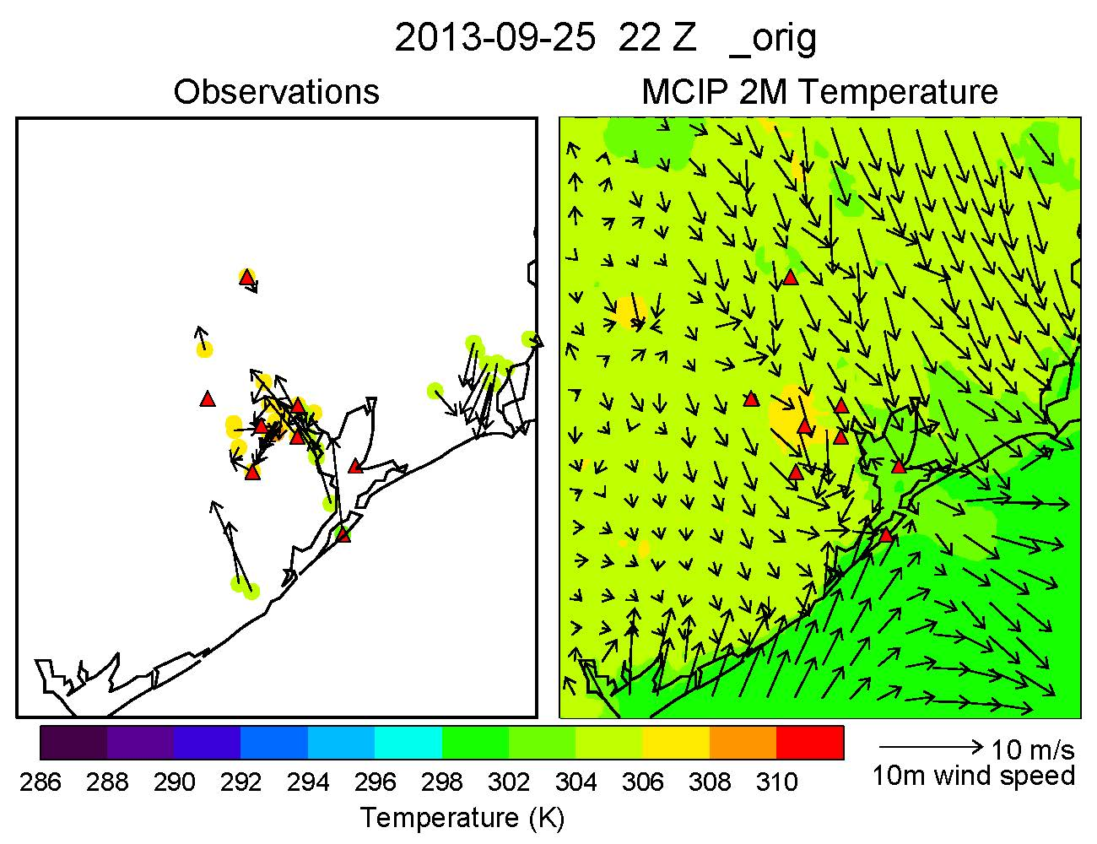
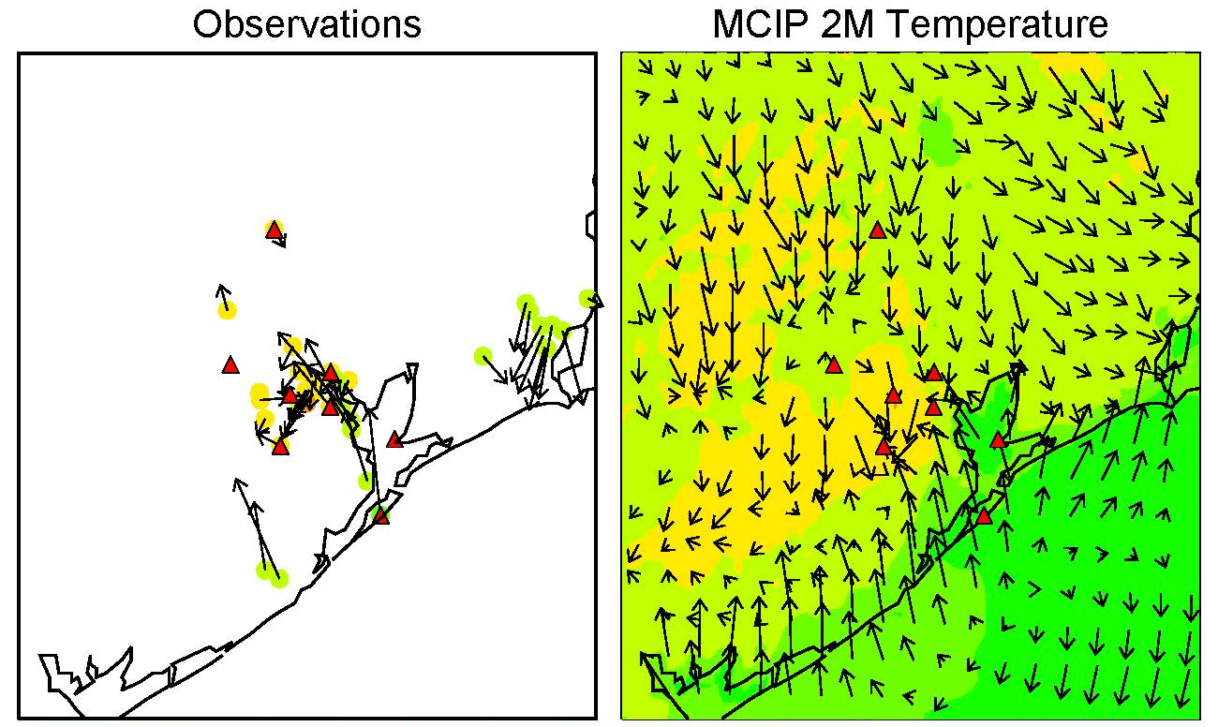
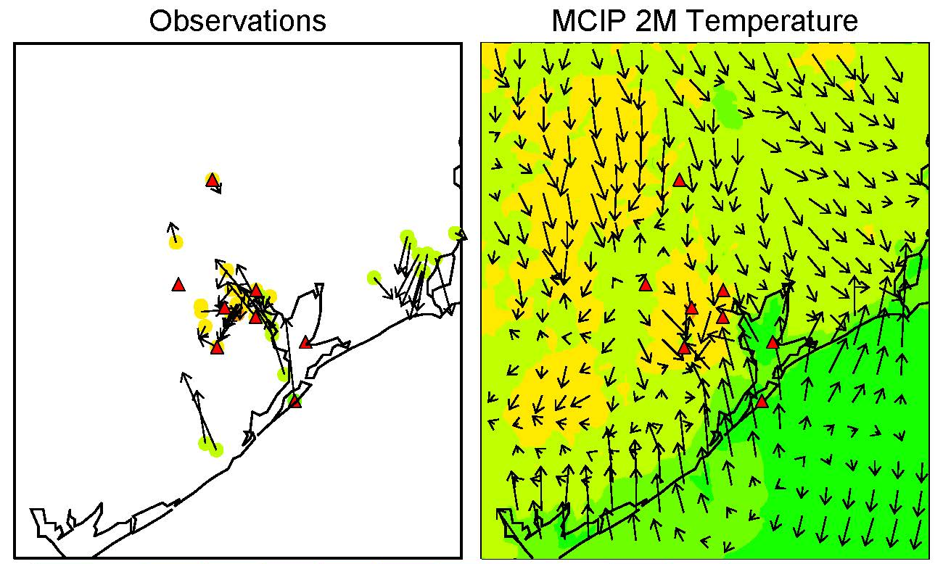
Sea Breeze Representation in each model simulation
September 25, 2013 22Z (5 pm CDT)
Observations
Original
Iteration 1
Iteration 2
MCIP 2 m Temperature (K)
All model results shown are 4 km
Bay breeze much better represented after using 12 km NAM and high resolution SST dataset

Slide 10
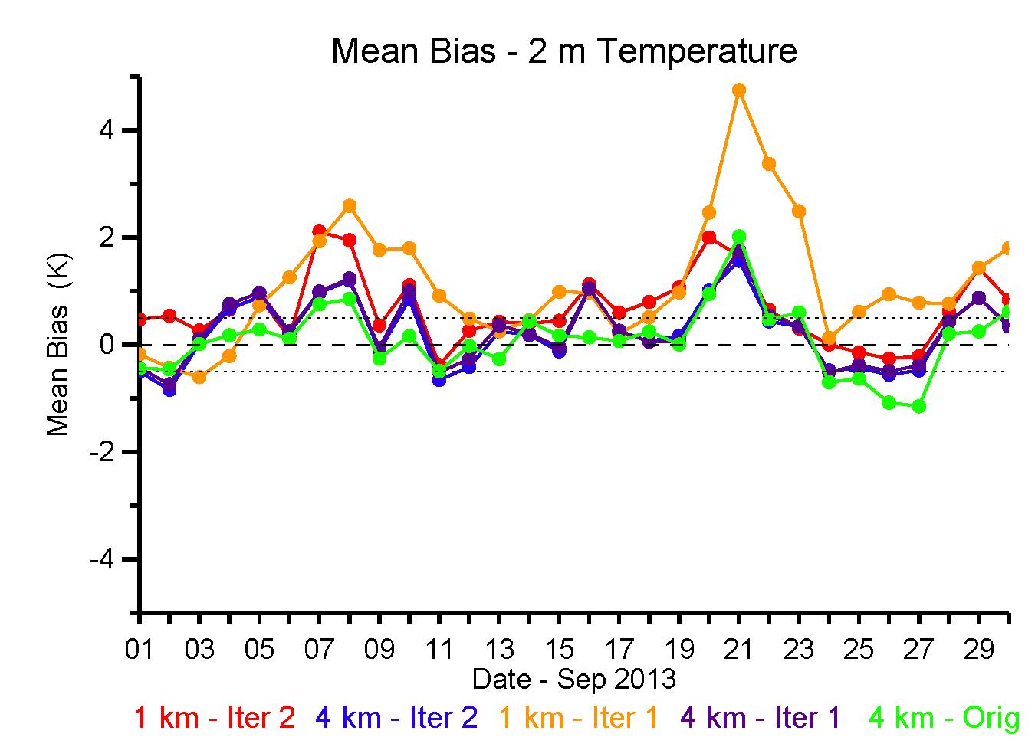
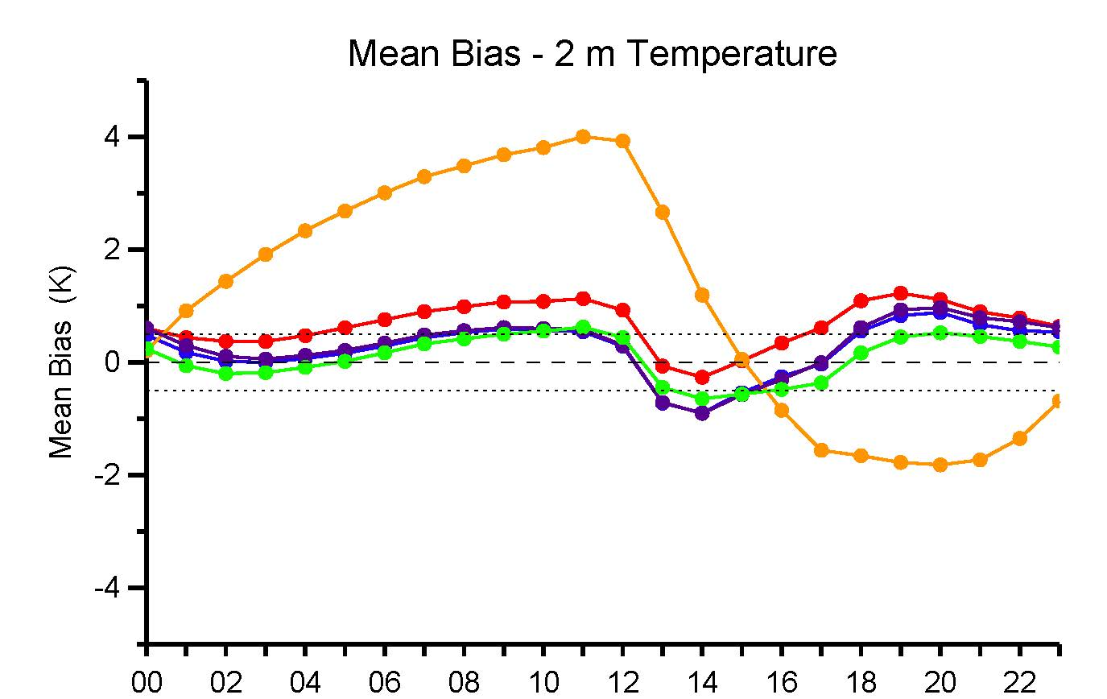
Surface
Temperature
Daily Mean Bias – 2 m Temperature
The 4 km iter 1, 4 km iter 2, and 1 km iter 2 yield very similar results overall
All model runs perform similarly with respect to mean bias and RMSE with the exception of the 1st iteration 1 km simulation
Evidence that the 12 km NAM used for analysis nudging degrades the high resolution 1 km WRF fields
There is considerable improvement in the 1km simulation after nudging using the previous iteration WRF temperature and RH output
MB: 0.2 K / RMSE: 1.6 K
MB: 0.3 K / RMSE: 1.6 K
MB: 0.7 K / RMSE: 1.7 K
MB: 1.1 K / RMSE: 3.1 K
MB: 0.1 K / RMSE: 1.5 K
Diurnal Mean Bias – 2 m Temperature
6 am – 6 pm CDT
Hour (Z)

Slide 11
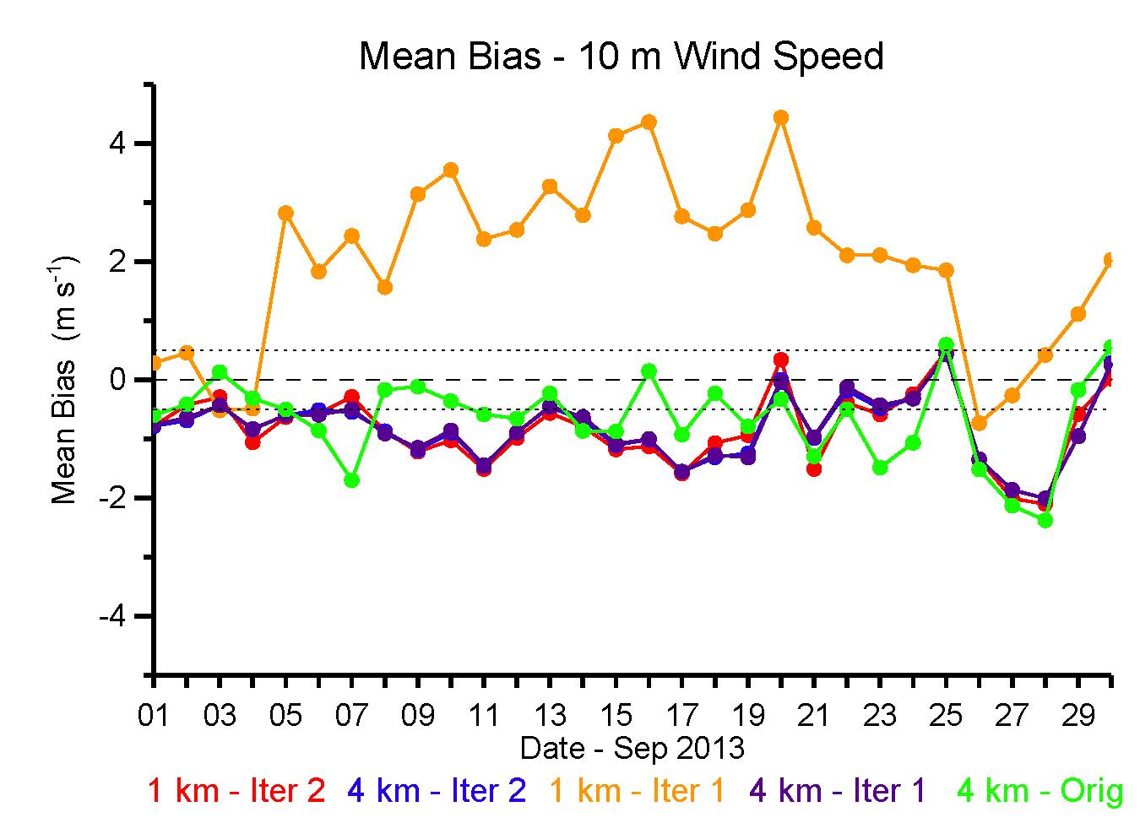
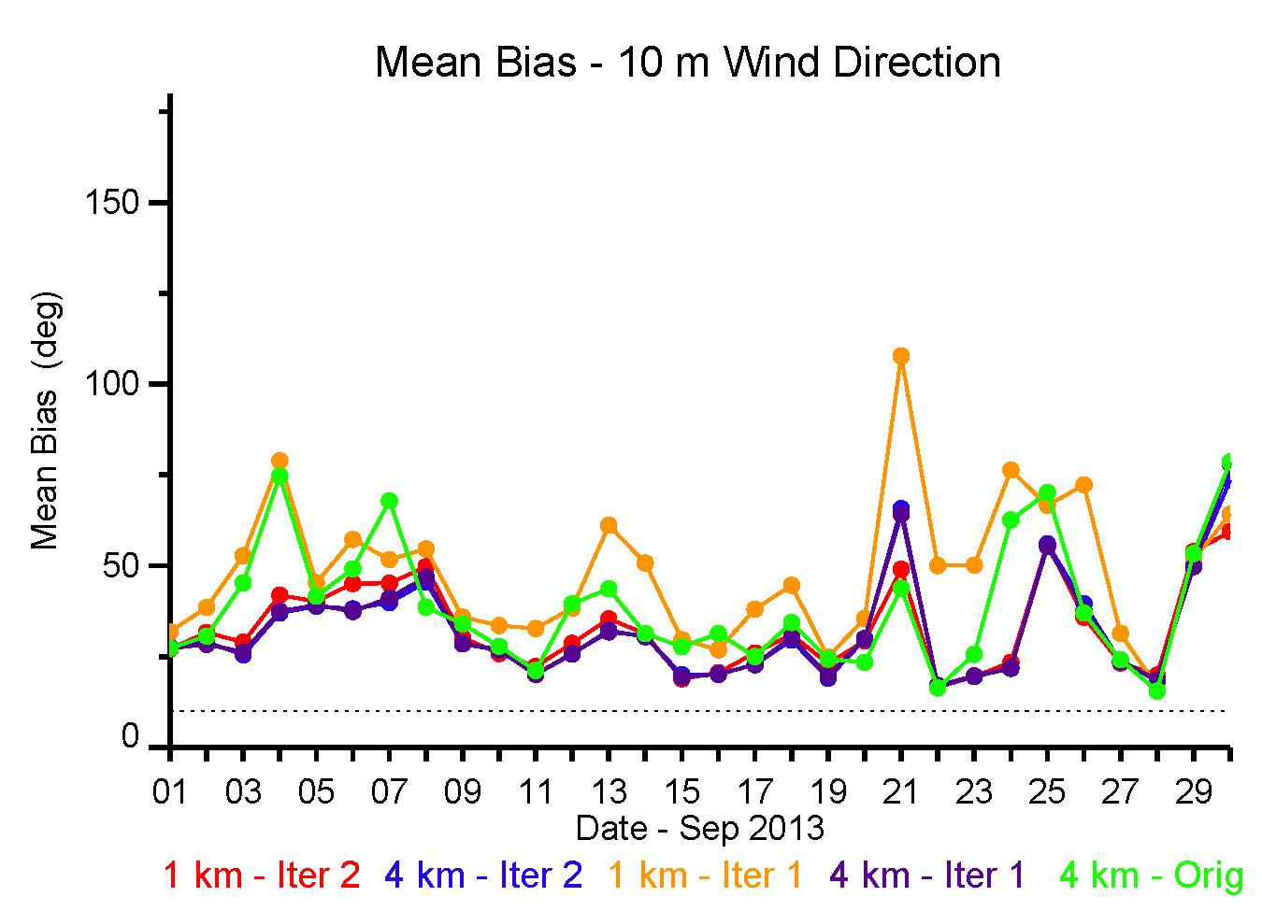
10 m Wind Speed & Direction
32 deg / 51 deg
32 deg / 51 deg
33 deg / 51 deg
48 deg / 65 deg
39 deg / 58 deg
-0.8 m/s / 2.3 m/s
-0.8 m/s / 2.3 m/s
-0.8 m/s / 2.4 m/s
2.0 m/s / 4.0 m/s
-0.7 m/s / 2.5 m/s
Again, considerable improvement in the 1km simulation after nudging using the previous iteration WRF temperature and RH output
The 4 km iter 1, 4 km iter 2, and 1 km iter 2 yield very similar results overall

Slide 12
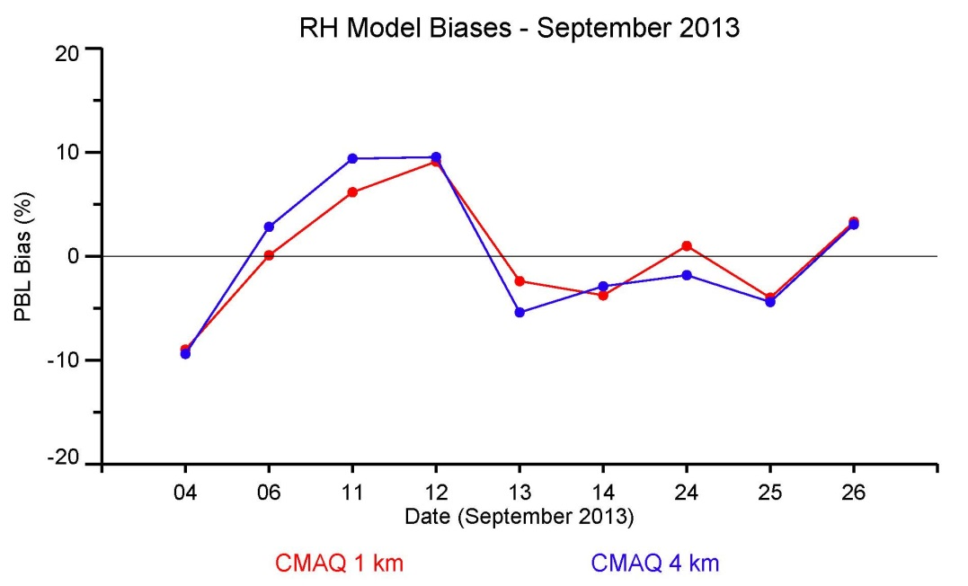
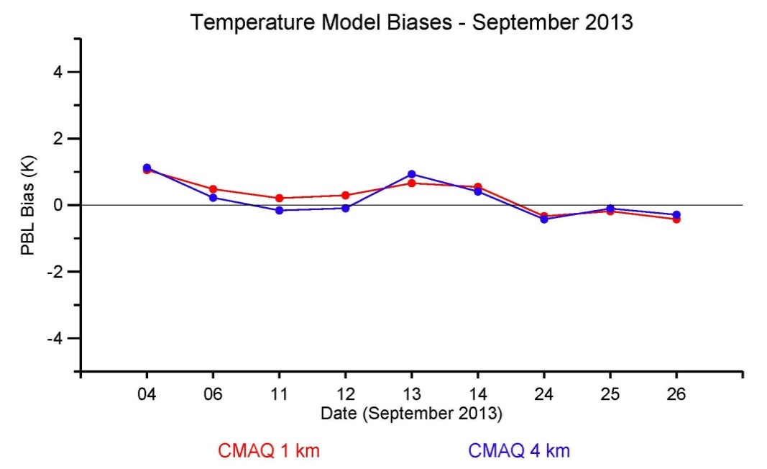
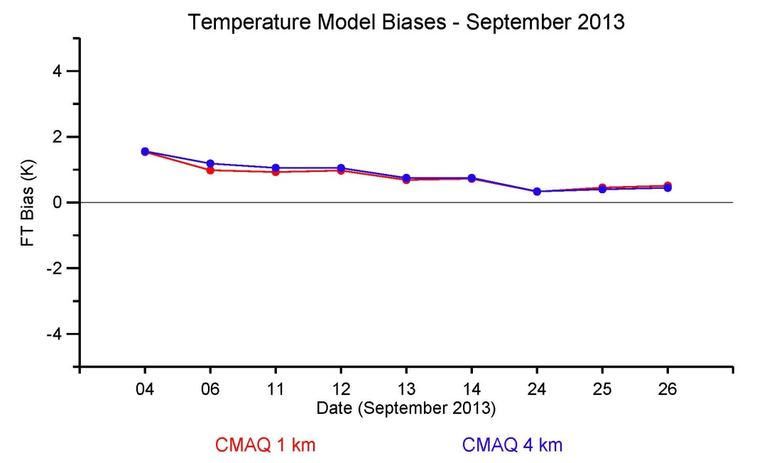
Aircraft Comparisons
Relative Humidity
PBL Mean Bias – P-3B
Temperature
PBL Mean Bias – P-3B
0.5 % / 12%
0.2 K / 1 K
0.4 % / 11%
0.3 K / 1 K
Temperature
FT Mean Bias – P-3B
No systematic bias seen in PBL RH or temperature
High bias in FT temperature
* PBL height from WRF

Slide 13
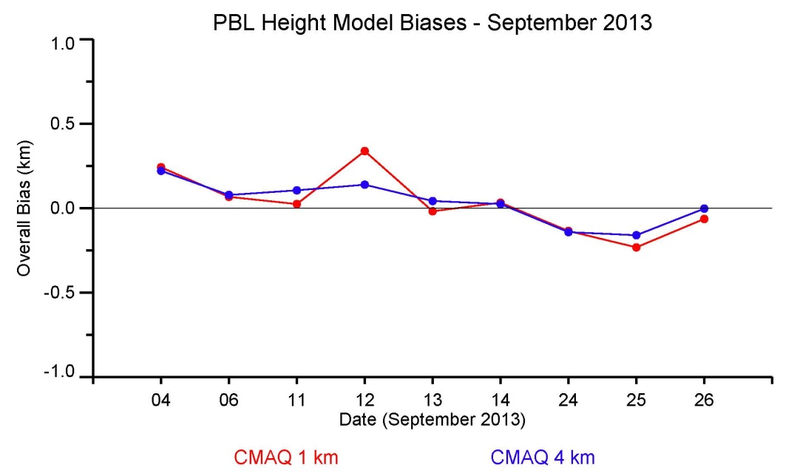
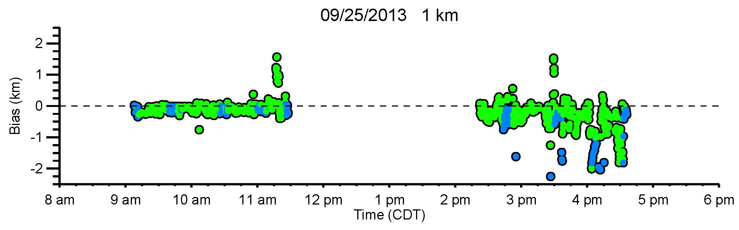
WRF PBL height vs ML heights from HSRL
Mean Bias
Mean bias over the campaign is minimal, but the RMSE is quite large
MB: 30 m / RMSE: 500 m
MB: 30 m / RMSE: 500 m
Land
Water
Most of the larger biases seen
are over or near the water

Slide 14
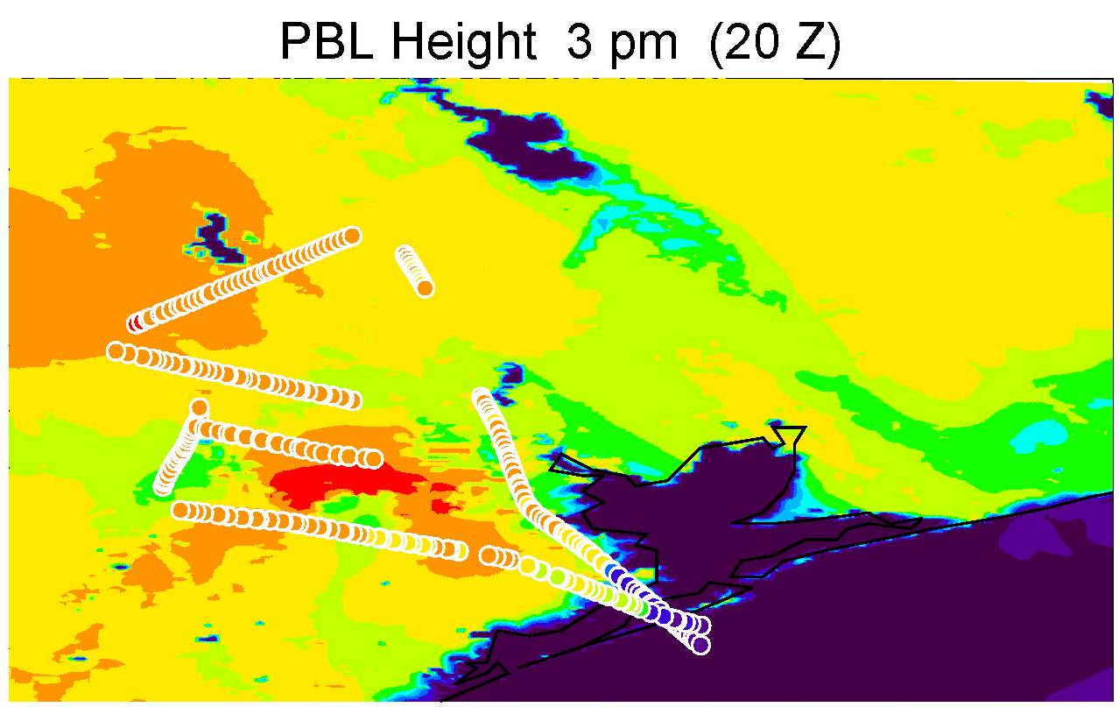
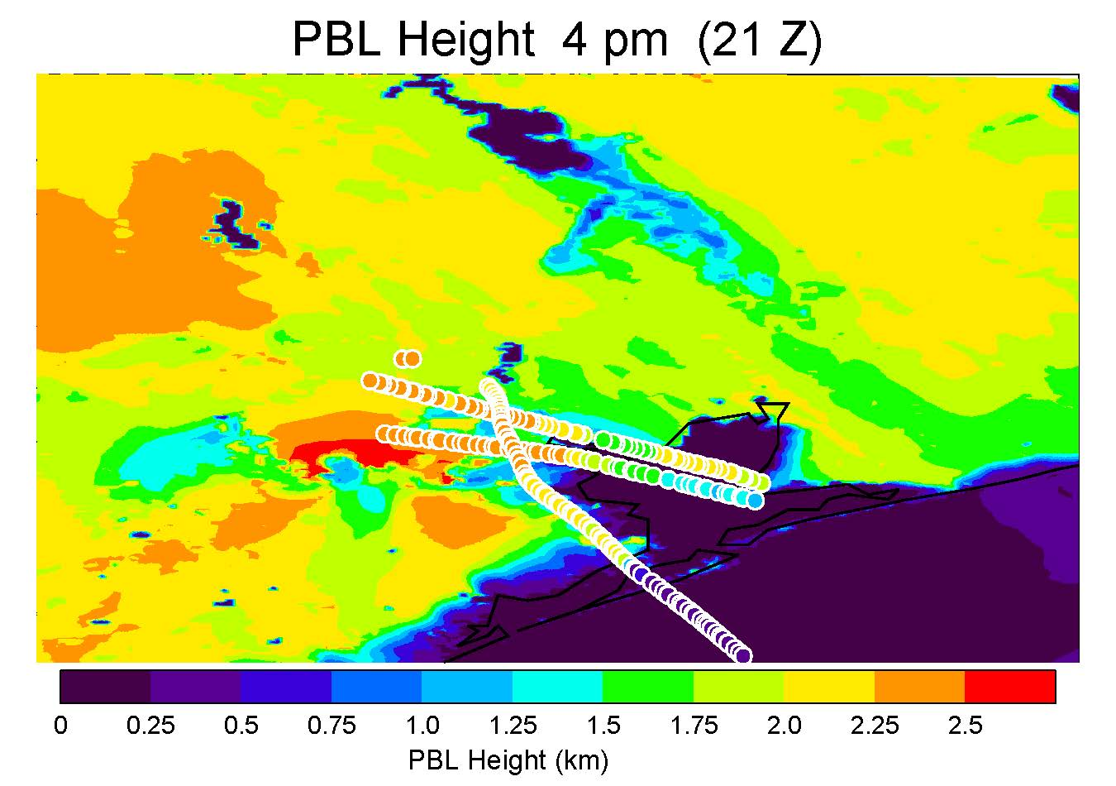
WRF PBL height vs ML heights from HSRL
Large underestimations seen over Galveston Bay

Slide 15
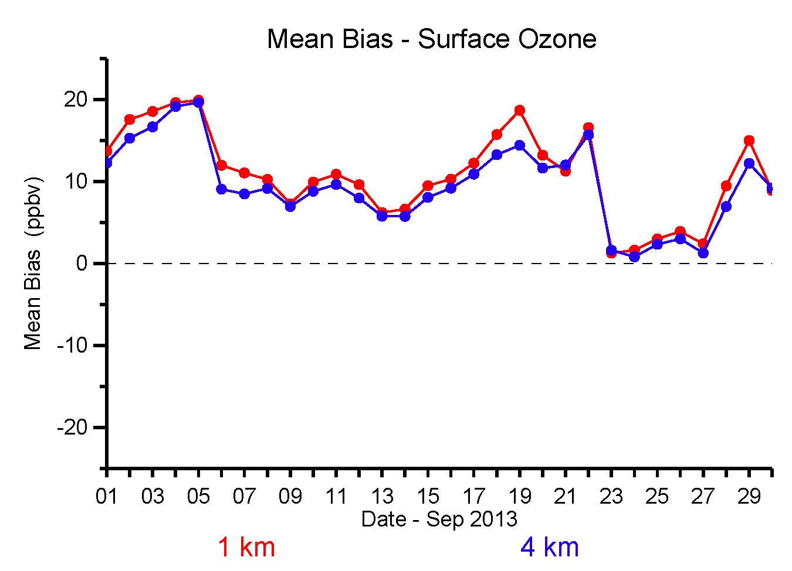
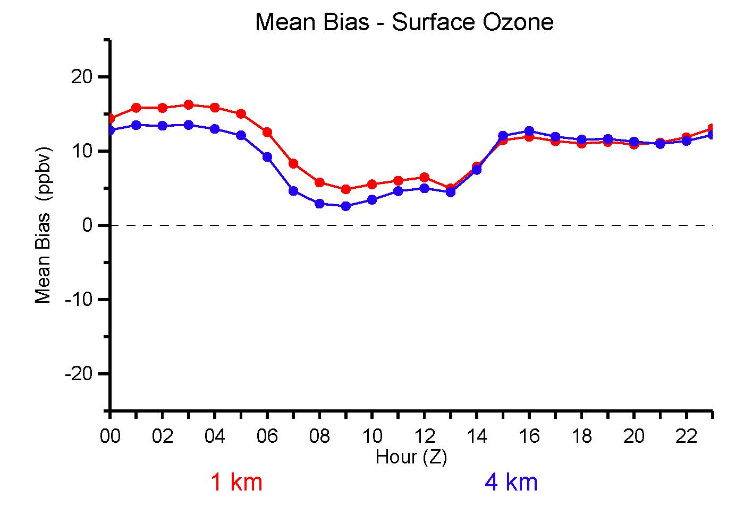
Surface Ozone
Daily Mean Bias
MB: 10.8 ppbv / RMSE: 16 ppbv
MB: 9.5 ppbv / RMSE: 15 ppbv
22 stations
The 4 km and 1 km output yields similar mean biases and RMSE
High bias in surface ozone at all hours
Diurnal Mean Bias
6 am – 6 pm CDT

Slide 16
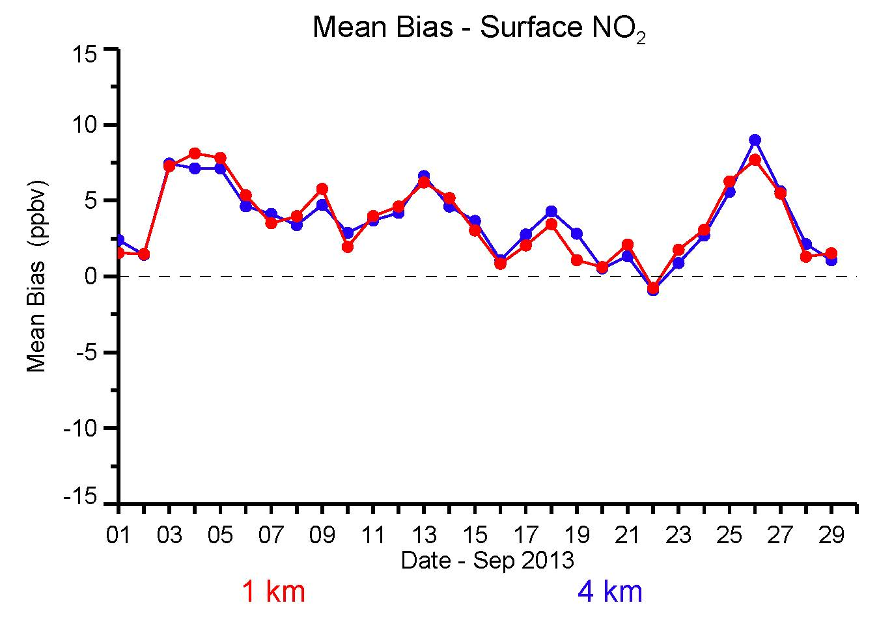
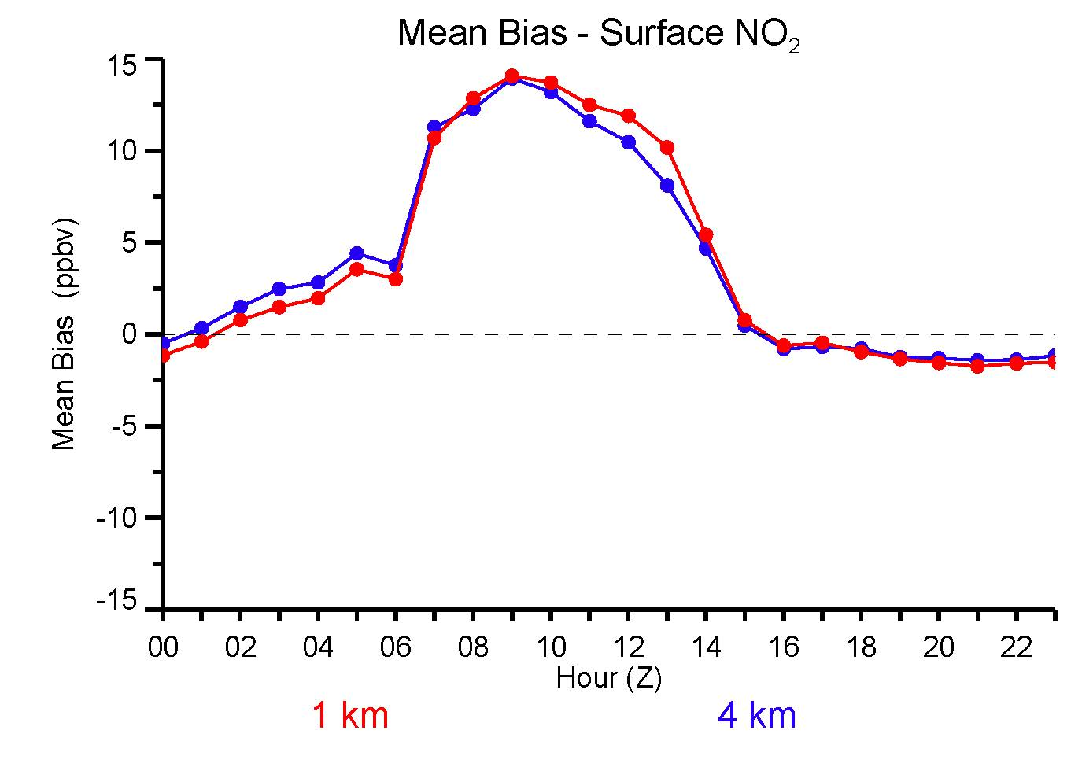
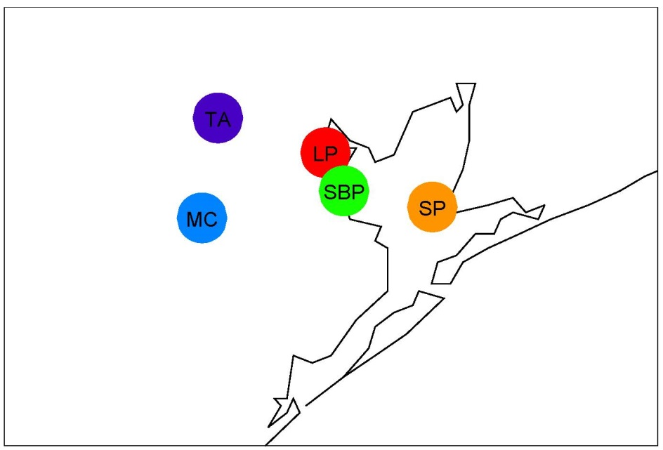
Surface NO₂
Daily Mean Bias
5 stations
The 4 km and 1 km output yields similar mean biases and RMSE
Very high bias in NO₂ during nighttime and early morning
MB: 3.8 ppbv / RMSE: 11 ppbv
MB: 3.8 ppbv / RMSE: 11 ppbv
Diurnal Mean Bias
6 am – 6 pm CDT

Slide 17
Summary
WRF was run iteratively using the EPA iterative nudging method
Overall, results for the 4 km iteration 1 and iteration 2 comparisons were similar with respect to mean bias and RMSE for 2 m temperature, and 10 m winds
The 1 km results improve considerably after nudging using the previous iteration high resolution WRF output
Comparison with ML heights derived from HSRL show over Galveston Bay, WRF is overestimating PBL heights by ~1-2.5 km
For surface O₃ and NO₂ the 4 km and 1 km results yield similar mean biases and RMSE
  The 4 km would have been sufficient for simulating this time period
  However, the 1 km CMAQ simulation used 4 km nonpoint emissions

Slide 20
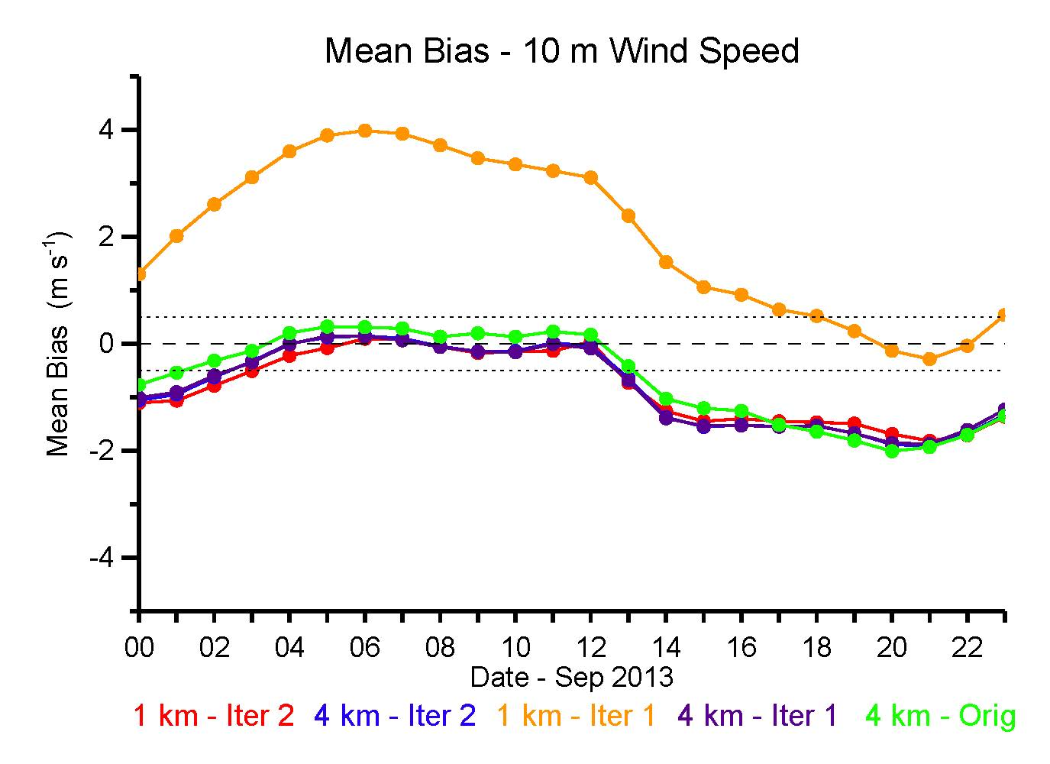
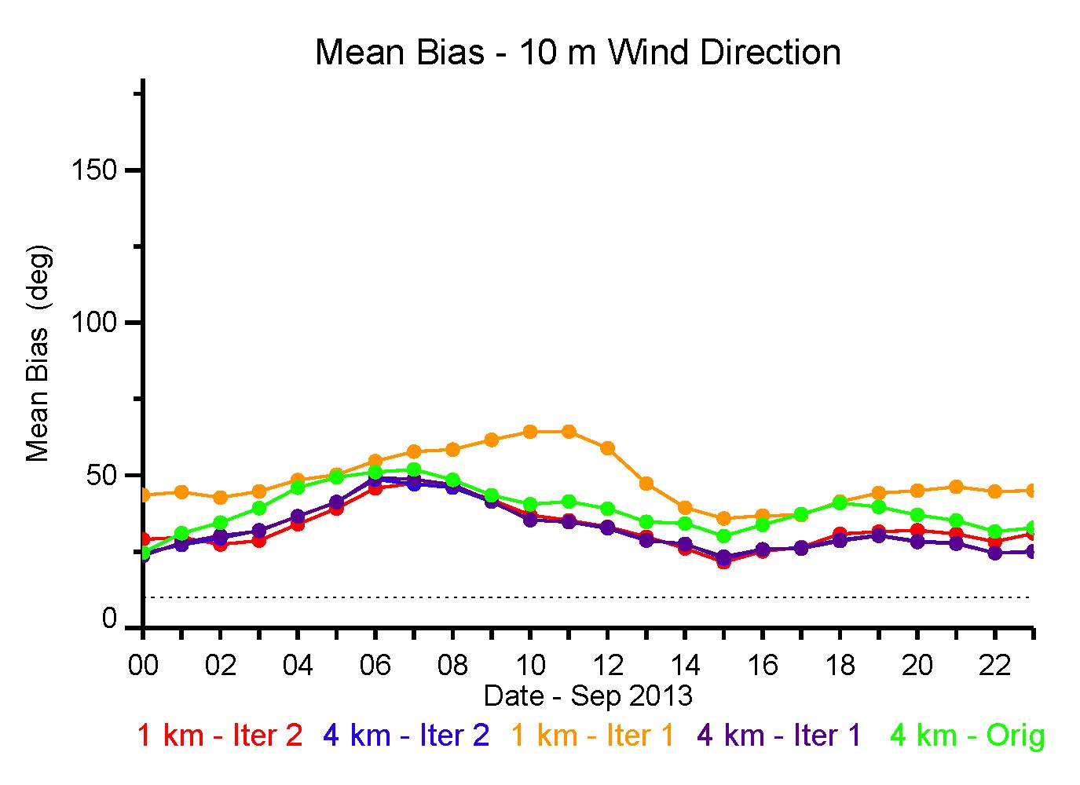
Diurnal Bias of 10 m wind speed and direction

