Slide 1


Comparison of CMAQ Lightning NOx Schemes and Their Impacts
Youhua Tang^{1,2}, Li Pan^{1,2}, Pius Lee¹, Jeffery T. McQueen⁴, Jianping Huang^{4,5}, Daniel Tong^{1,2,3}, Hyun-Cheol Kim^{1,2}, Min Huang^{1,3}, Dale Allen⁶, and Ken Pickering⁷
1. NOAA Air Resources Laboratory, 5830 University Research Court, College Park, MD 20740
2. Cooperative Institute for Climate and Satellites, University of Maryland, College Park, MD 20740
3. Center for Spatial Information Science and Systems, George Mason University, Fairfax, VA 22030
4. NCEP Environmental Modeling Centers, 5830 University Research Court, College Park, MD 20740
5. I.M Systems Group Inc., Rockville, MD 20852
6. Department of Atmospheric and Oceanic Science, University of Maryland, College Park, MD 20740
7. NASA Goddard Space Flight Center, Greenbelt, MD 20771

Slide 2
Lightning Emission Process used in CMAQ 5.0.2
NLDN (National Lightning Detection Network) data
Model’s Convective Precipitation (CP) Rate
Map to CMAQ grid
1 mm/hr => 147 flashs
Model’s flash count (monthly total)
Calculate Total monthly Lightning flash Count over each grid
1 flash => 500 moles NO
over land
Mean LTratio used in CMAQ
NLDN/Model
Inline Lightning NOx emission

Slide 3
WRF-ARW Setting
(12km CONUS, 42 layers up to 50hPa)
 | Schemes | Remarks and Reference
Advection | Runge-Kutta 3 advection scheme | Wicker and Skamarock (2002)
Shortwave radiation | Dudhia | Dudhia (1989)
Longwave radiation | RRTM | Mlawer et al. (1997)
PBL turbulent mixing | Yonsei University Scheme | Hong et al. (2006)
Cloud Micro Physics | WRF single-moment, 6-class scheme | Hong and Lim (2006)
Cumulus Parameterization | Kain-Fritsch scheme | Kain (2004)
Surface layer heat/momentum exchange | MM5 Similarity Scheme | Zhang and Anthes (1982)
Land surface exchange | Unified Noah Land Surface Model | Tewari et al. (2004)

Slide 4
CMAQ 5.0.2 Setting
(12km CONUS, 42 layers up to 50hPa)
CB05tucl-Aero6 Chemical mechanism
NEI2011 area emission
Mobile emission: 2005 mobile 6 project to year 2011
Point sources: 2010 CEM + DOE Annual Energy Outlook (DOE, 2012)
Biogenic Emission: BEIS 3 inline (CMAQ 5.0.2)

Slide 5
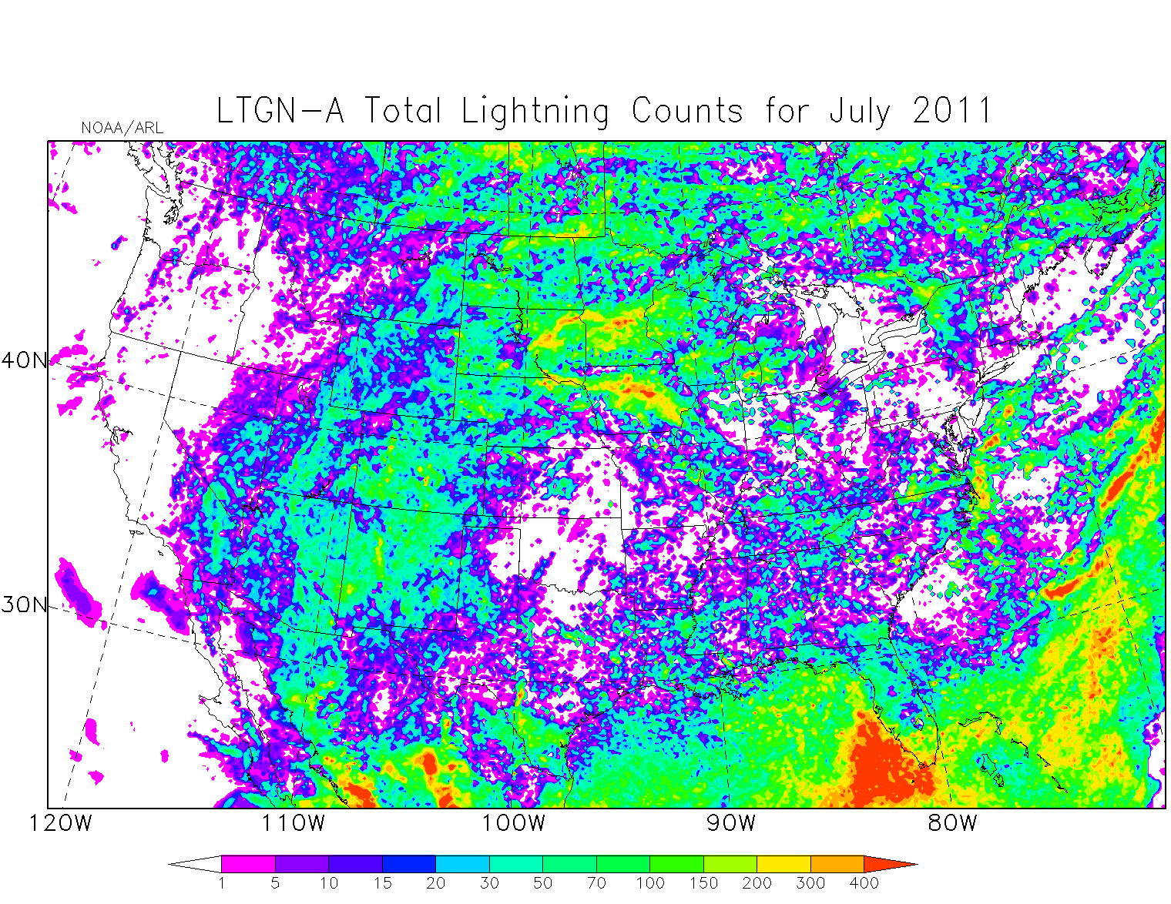
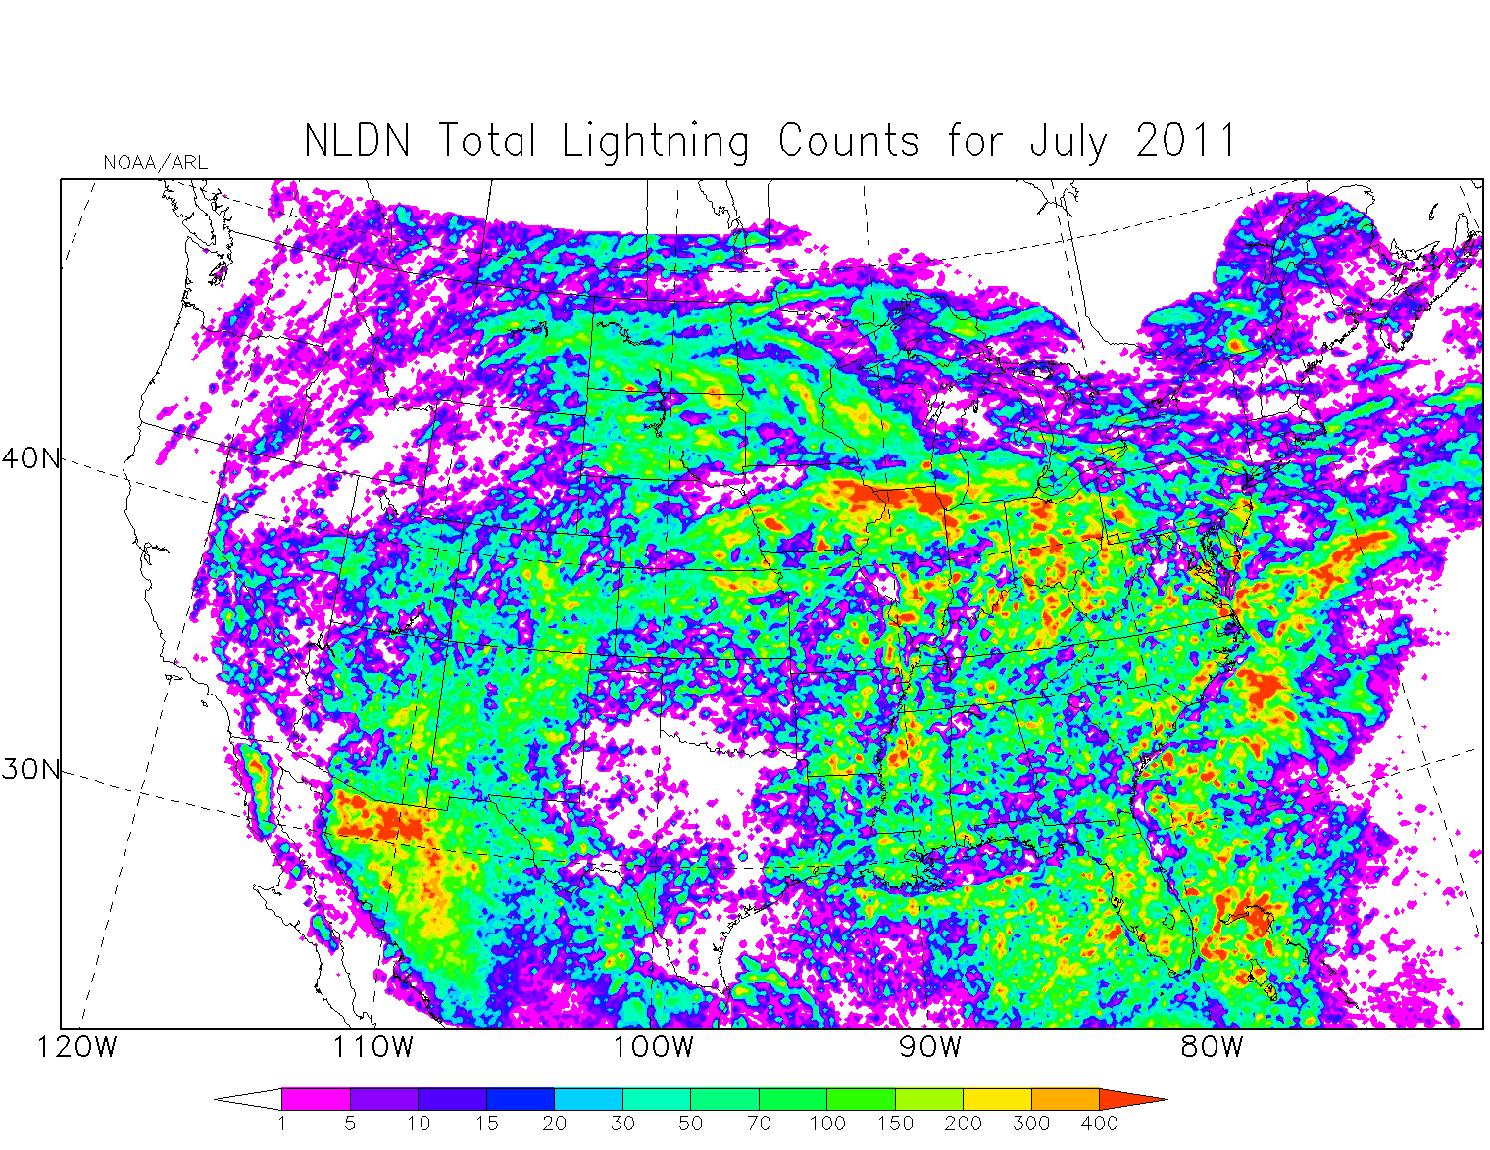
CP rate derived flash counts (July 2011) before being scaled to NLDN monthly totals
CMAQ Lightning counts (flash numbers) derived from modeled CP rate show location and time shifting compared to NLDN lightning data.

Slide 6
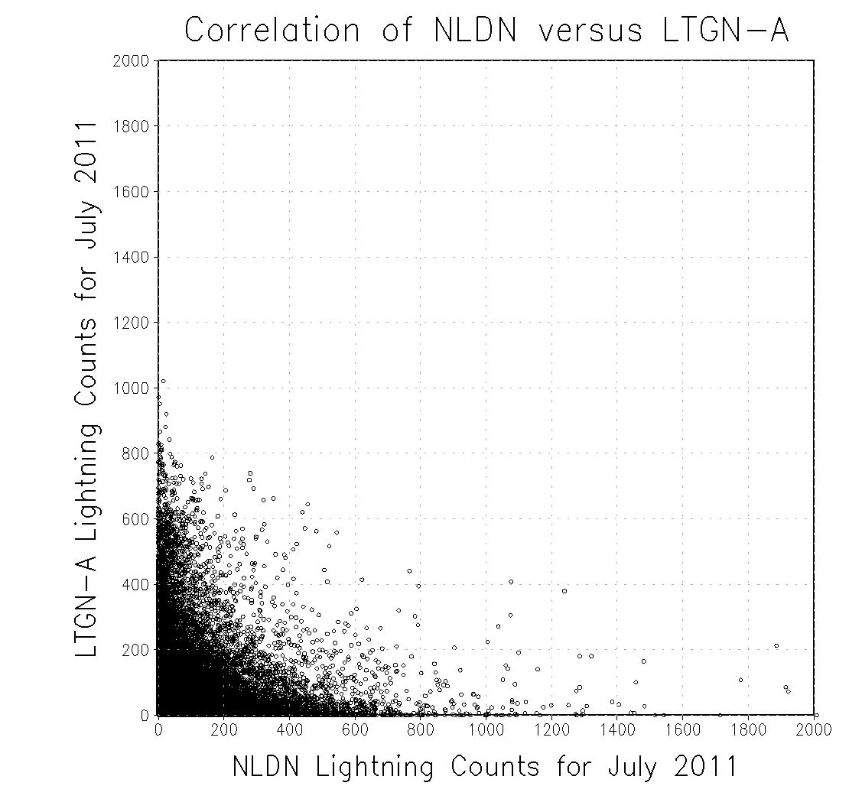
Their Correlation is poor

Slide 7
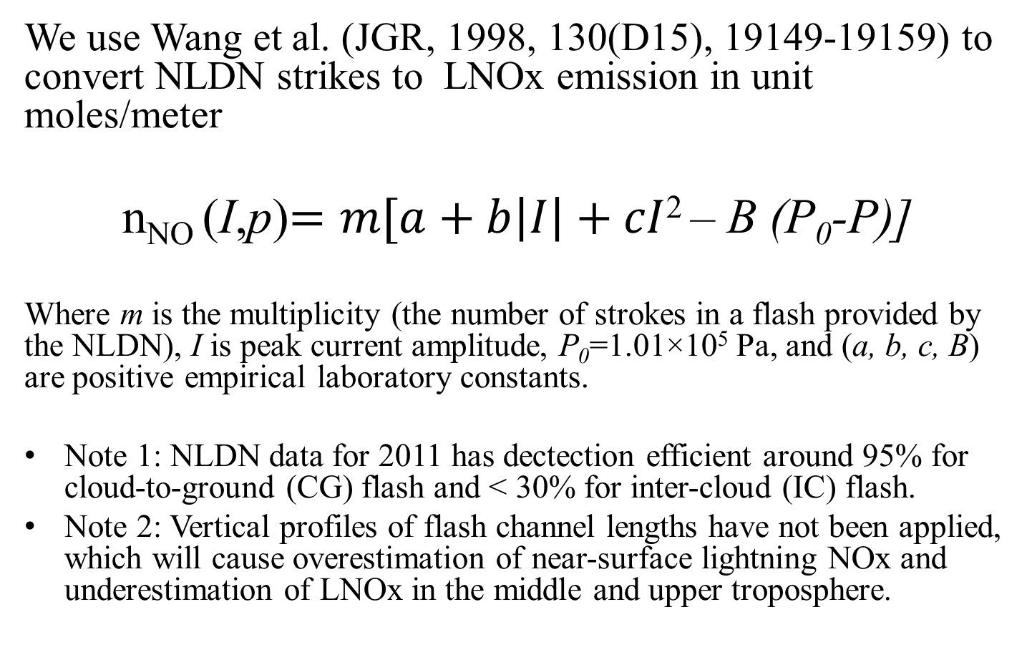
NLDN derived LNOx emission (NLDN1)
We use Wang et al. (JGR, 1998, 130(D15), 19149-19159) to convert NLDN strikes to LNOx emission in unit moles/meter
n_{NO} (I,p)$=m[a+b\left|I\right|+cI$² – B (P₀-P)]
Where m is the multiplicity (the number of strokes in a flash provided by the NLDN), I is peak current amplitude, P₀=1.01×10⁵ Pa, and (a, b, c, B) are positive empirical laboratory constants.
Note 1: NLDN data for 2011 has dectection efficient around 95% for cloud-to-ground (CG) flash and < 30% for inter-cloud (IC) flash.
Note 2: Vertical profiles of flash channel lengths have not been applied, which will cause overestimation of near-surface lightning NOx and underestimation of LNOx in the middle and upper troposphere.

Slide 8
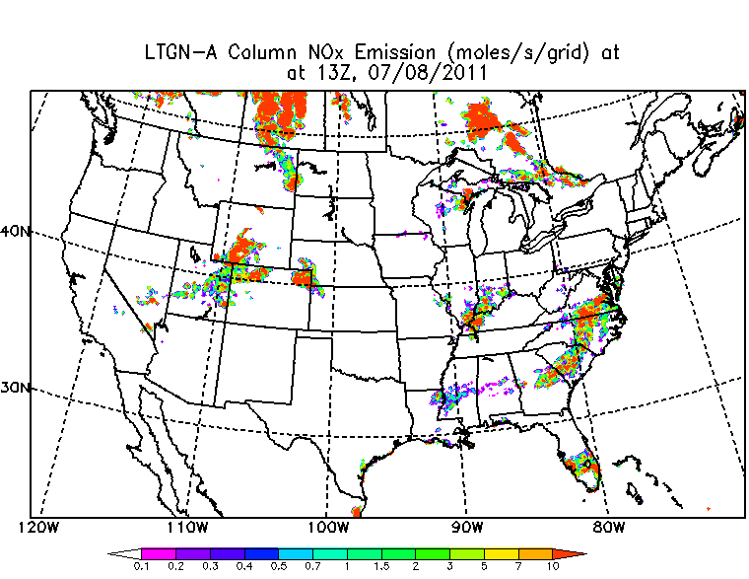
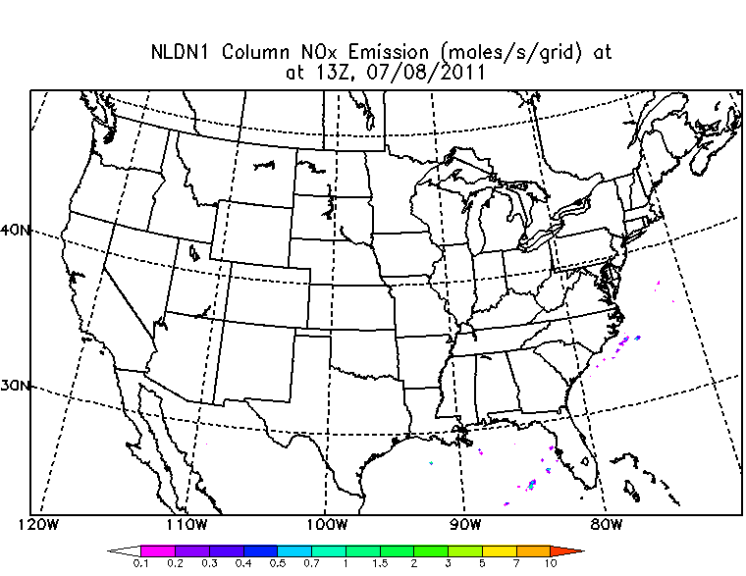
CMAQ Default LNOx (from modeled convective Precipitation rate, LTGN-A) versus NLDN-derived LNOx (NLDN1)

Slide 9
Issues in current Lightning NOx scheme
Highly depends on meteorological model’s convective precipitation rate for its time , location and strength, even with monthly NLDN data constrains.
Lightning NOx emission over ocean is set to zero.
Lightning NOx emission rate (500 moles NO/ stroke) is too high
Lightning stroke rate over ocean change to 1 mm/hr (CP) => 9 strokes according to Pessi and Businger (2009)
Lightning NOx emission rate changes to 43.2 moles/flash (Skamarock et al., 2003) (LTGN-B)

Slide 10
Comparison with Discover-AQ 2011
P-3B aircraft data

Slide 12
The default CMAQ LNOx emission rate was too high, and degraded the model performance.

Slide 13
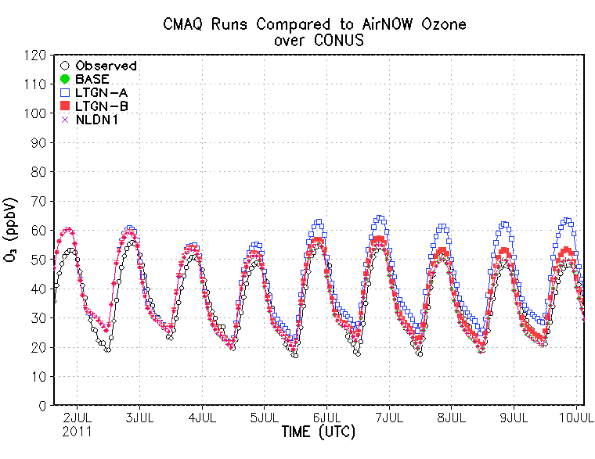
Similar Thing can also been for surface AIRNow ozone comparison

Slide 14
Summary
We tested the CMAQ 5.0.2’s lightning NOx emission module using hourly WRF-ARW convective precipitation rate and with constraint of monthly NLDN data. Its lightning counts show offsets in locations and timing, compared with NLDN lightning data. Its emission rate per flash may be too high. The LNOx’s wet scavenging and deposition needs further examination.
Reducing the LNOx emission rate can significantly reduce that high NOx bias, though its overestimation is still evident in some cases.
Using original NLDN data to derive LNOx emission for retrospective simulations looks more trustable, but it cannot be used in forecast. The current NLDN1 method needs significant improvements: application of NLDN detection efficiencies and inclusion of appropriate vertical distributions of flash channels
Lightning data derived from modeled convective precipitation rate is still quite uncertain for its location, time and strength.

