Slide 1
Implementation of
Linear Sensitivity Approximate Method
for Sensitivity Advection in CMAQ
Pedram Falsafi, Amir Hakami
Carleton University, Canada
CMAS 2015, Chapel Hill

Slide 2
Overview
Horizontal advection in CTMs
Issues with current advection schemes – CMAQ and PPM
Linear Sensitivity Approximate Method
Preliminary results
Future steps and conclusions

Slide 3
Horizontal advection in CTMs
Main transport process
Inherently linear process
suppressed peak
diffused signal
Negative values

Slide 4
Horizontal advection in CMAQ
Solves continuity equation for each species in two separate directions
Piecewise Parabolic Method (PPM) (with Yamo)
  Monotonic and Mass conservative
  Therefore, Nonlinear scheme

Slide 5
Sensitivity in Advection
Perturbation at a single grid cell
Impact at a few cells downwind
(finite-difference sensitivity)
?

Slide 6
Sensitivity in Advection
Negative values , physically meaningless
Depend on profile (species)
There is no “nonlinear term” in PPM
  discontinuous operations
Notes:
In general, agreement between TLM and NLM results
will depend on:
Amplitude of perturbations
Stability properties of the reference state
Structure of perturbations
Physics involved
Time period over which perturbation evolves
Measure of agreement

Slide 7
Sensitivity in Advection

Slide 8
Does artificial nonlinearity matter?
Can we trust advection process when …
  There are large gradients in concentration field?
  Sensitivity analysis?
    Derivative of an advection is not the same for nonlinear scheme (DDM and adjoint analysis)
  Taking differences in concentrations?
    We often calculate sensitivities (differences) even if we don’t call it sensitivity!

Slide 9
Linear Sensitivity Approximate Method
Why do we solve the continuity equation for each species?
After all, it is air that is advected; everything else is advected within the air.

Slide 10
Linear Sensitivity Approximate Method
1-D advection of air density field
Apply same coefficients (Jacobian) to other species
i
j

Slide 11
Linear Sensitivity Approximate Method
Trace air mass of only 1 cell at a time
  Independent of concentration profile (only wind field)
  No negative coefficients
  Approximate solution
Is it computationally efficient ?
PPM advection scheme: only 5 cells contribute
0
0
0
1
0
0
0
0
Ji-2
Ji-1
Ji
Ji+1
Ji+2
0
Notes:
Since air density profile in relatively smooth, this approximation works well

Slide 12
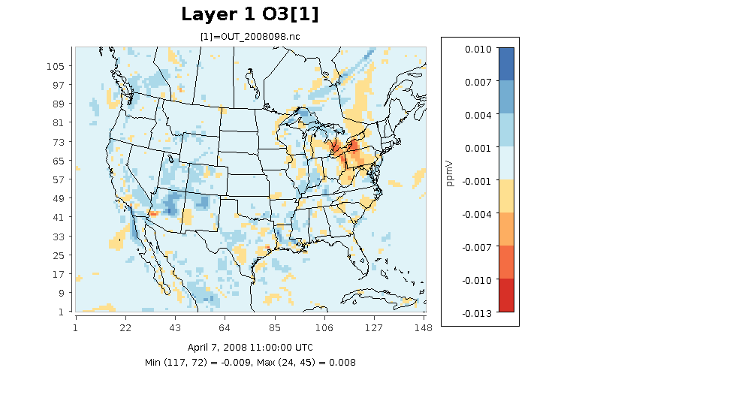
How good is the approximation?
Ozone: LSAM – PPM (8-day simulations)
Using LSAM [ppmv]
Notes:
We compared the results of forward simulation after 8 days, this is the special plot of difference between ozen concentration for a c ase with ppm (which is native cmaq advection schem)and another case which used LSAM for advection. The difference is very small for most locations

Slide 13
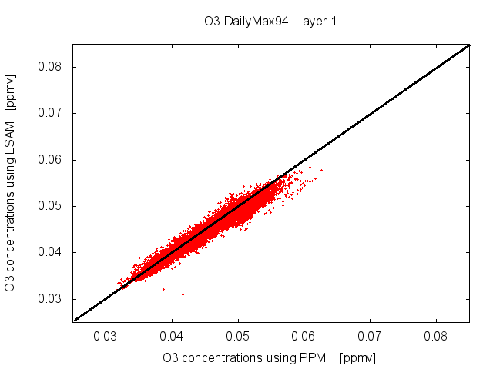
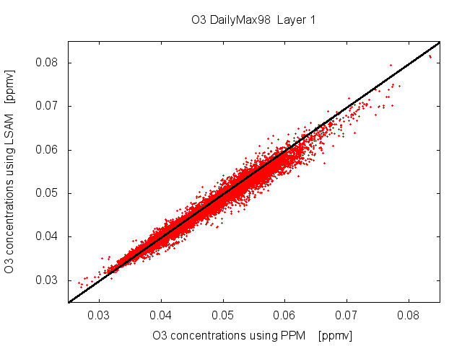
Daily Maximum O₃
How good is the approximation?
4-day simulation
8-day simulation
R-squared = 0.946
R-squared = 0.965
Using LSAM [ppmv]
Using PPM [ppmv]

Slide 14
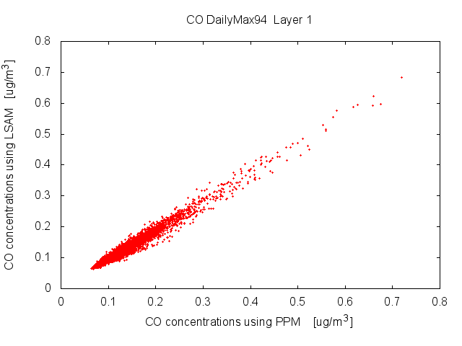
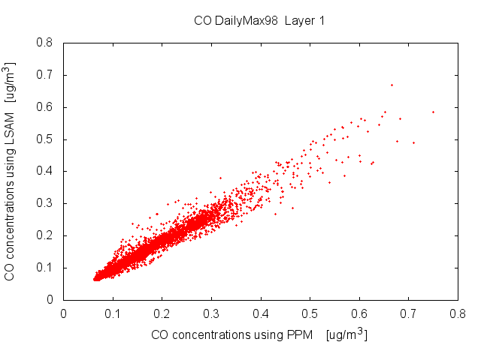
How good is the approximation?
Daily Maximum CO
4-day simulation
8-day simulation
R-squared = 0.969
R-squared = 0.948
Using LSAM [ppmv]
Using PPM [ppmv]

Slide 15
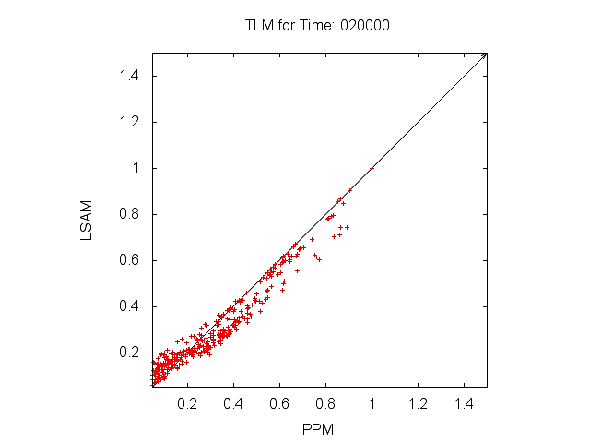
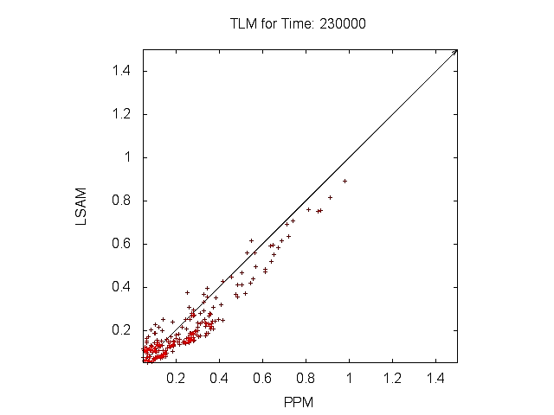
Sensitivity Tests - DDM
10 Time steps
120 Time steps (1 day)
DDM Using LSAM
DDM Using PPM

Slide 16
Linear Sensitivity Approximate Method
Cons
  Approximate
Pros
  positive definite and mass conservative
  Truly linear method, independent of profile
    Sensitivities will be “exact”
  Computationally less expensive
    Use of more expensive but more accurate scheme is feasible

Slide 17
Where to use LSAM
Intended for sensitivity calculations
Not for using instead of PPM (for now!)

Slide 18
Conclusions
Modeling linear advection process with a nonlinear/discontinuous scheme can entail problems
  With sensitivity calculations
  With concentration calculations used to estimate differences
Advected air densities provide an approximate operator to apply on all species
  More efficient
  More accurate/expensive schemes are feasible

Slide 19
Future steps
Propose a reliable benchmark for validation
Try less diffusive and more accurate schemes
Find a smoother base profiles for estimations of the contribution matrix

Slide 20
Acknowledgement
Thanks to
Talat Odman and Ted Russell
(Georgia Tech)
for insightful discussions

Slide 21
Thank You!

Slide 23
0
0
0
1
0
0
0
0
1
0
0
0
0
1
0
0
0

