Slide 1


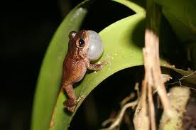
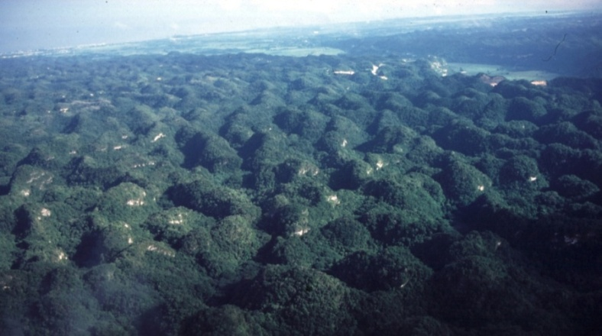
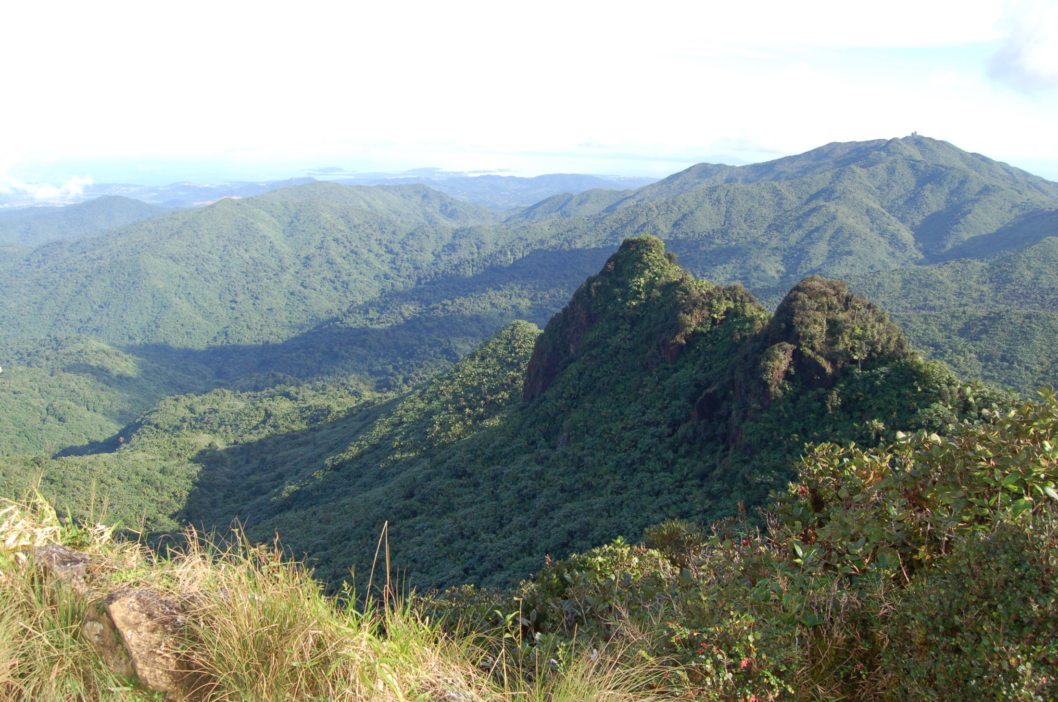
The Sensitivity of WRF downscaled precipitation in Puerto Rico to Cumulus Parameterization and Interior Grid Nudging
Jared H. Bowden
Adrienne Wootten
Ryan Boyles
Adam Terando
CMAS Conference
Oct. 7, 2015
Notes:
Review adaptation strategies paying particular attention to avian species, but applicable to other taxa.

Slide 2

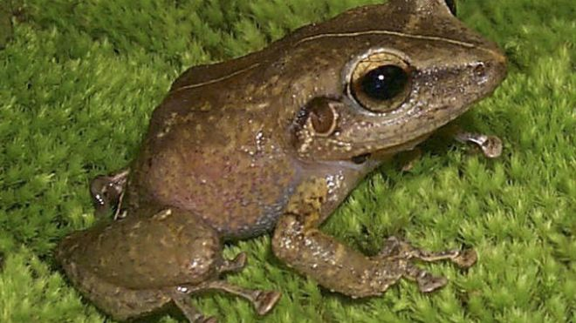
Motivation
The Puerto Rico Department of Natural and Environmental Resources and the U.S. Fish and Wildlife Service need to implement a strategic habitat conservation strategy that ensures the long-term persistence of amphibians and reptiles in Puerto Rico in the advent of climate change.
  Recover 11 species of terrestrial amphibians and reptiles, but also to prevent listing additional species that might become at risk.
Puerto Rican crested toad
Puerto Rican coqui

Slide 3
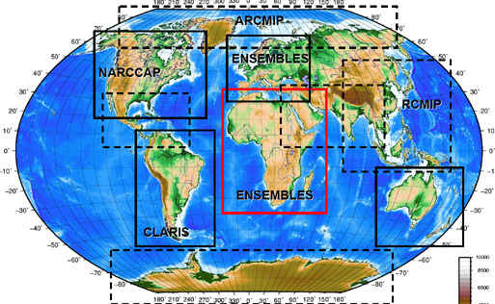
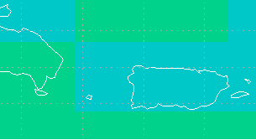
Climate change Projections for Puerto Rico
Coordinated Downscaling Experiments
CESM
Project Goal: Downscale multiple CMIP5 Global Models for RCP8.5 (extreme emission scenario) using multiple Regional Climate Models (RCMS).
  WRF
  RSM / Non-hydrostatic Model (Japan)

Slide 4

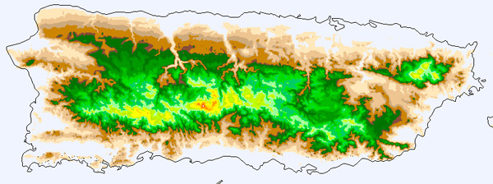
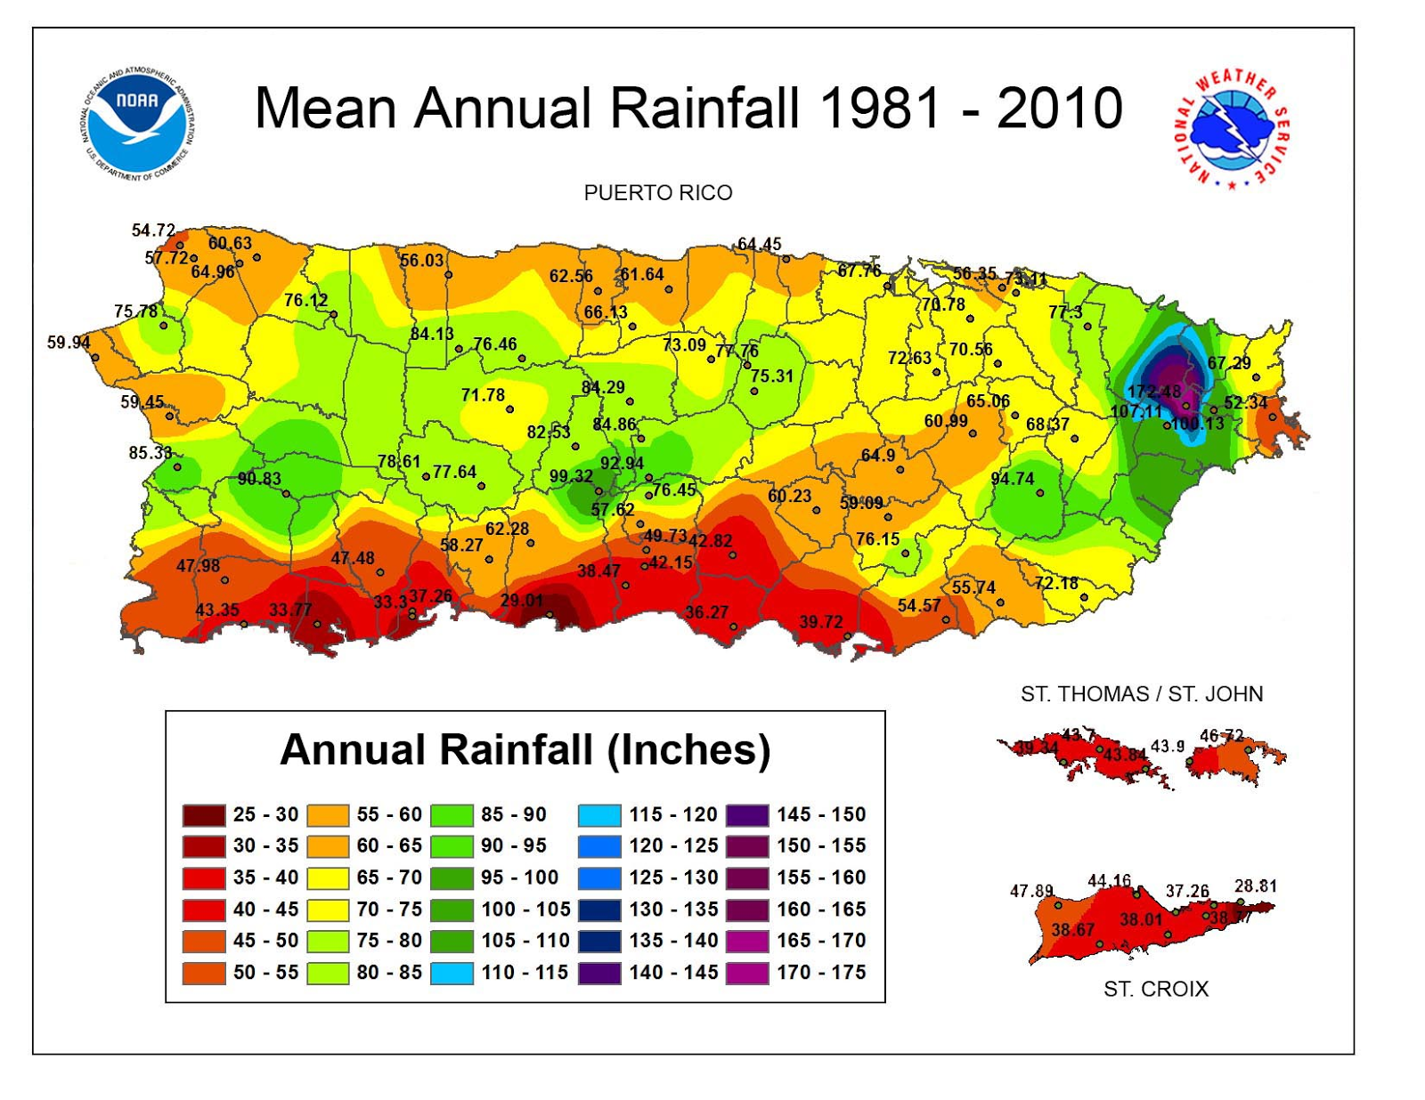
TOPOGRAPHY
Annual Precipitation
~60 miles apart

Slide 5
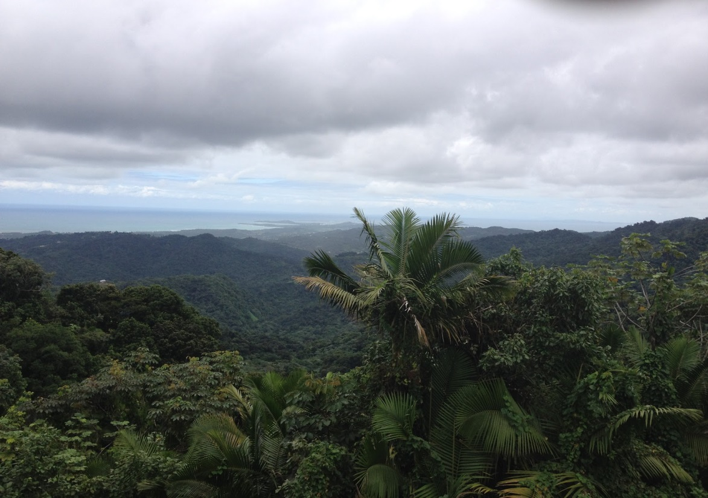

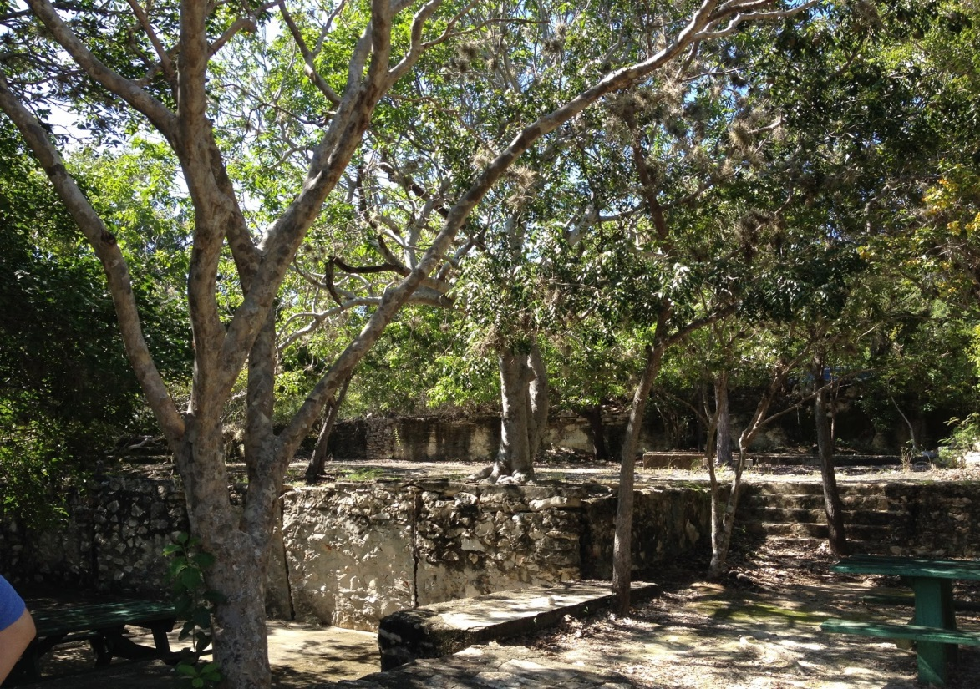
El Yunque
Mean Annual Rainfall > 170 in.
Rain Forest
Guanica
Mean Annual Rainfall = 33 in.
Dry Forest
Notes:
El Yunque National Forest is home to only tropical rainforest in the U.S. Forest System

Slide 6
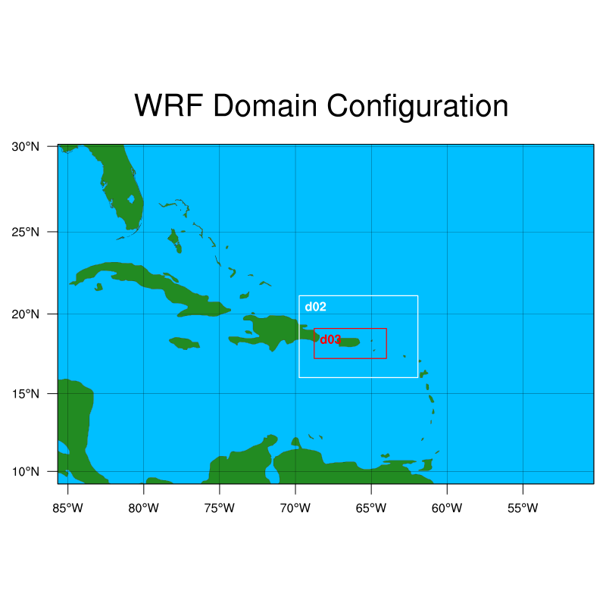
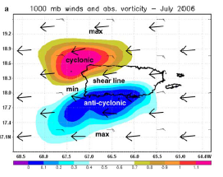
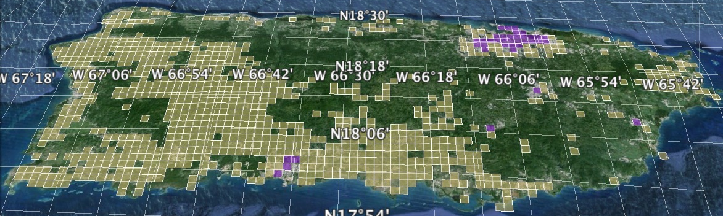
Dynamical Downscaling for Puerto Rico
WRFv3.6.1 to 2-km
30km - 10km - 2km

Slide 7
Convective Permitting Simulations (Explicit) vs. Convective Parameterization (CP) at convective permitting scales
Deep convection is a large source of uncertainty for climate modeling, even at explicit scales (Sherwood et al, 2014; Brisson et al. 2015; Prein et al. 2015)
Convective permitting simulations (explicitly resolving convection) are shown to improve precipitation errors such as diurnal cycle, extreme precipitation on hourly time scales, and wet-day frequency (Done et al., 2004; Prein et al. 2015).
However, there are a few issues with convective permitting simulations
  CP scheme in the outer domain is important for convective permitting domain precipitation (Perez et al., 2014).
  Some locations may still warrant the use of a CP scheme to represent the sub-grid scale convective processes in a high resolution domain (Warner and Hsu, 2000; Lee et al., 2011; Sun and Barros, 2014).
  For instance, Lee et al. (2011) demonstrated that activating the CP scheme at high resolutions improved the representation of heavy rain events in the high resolution domain.

Slide 8
WRF Precipitation
Sensitivity of CP schemes at explicit resolving scales
All simulations have the following in common
  Downscale NCEP-DOE Reanalysis for annual simulation - 2010
  RRTMG LW/SW, WSM6, YSU PBL, Noah LSM
  Analysis Nudging in D01 (30-km) and D02 (10-km)
Test two different CP schemes (mass-flux)
  Modified Kain-Fritsch (Kfmods) (Alapaty et al., 2012)
  Tiedtke (Zhang et al., 2011)
  on and off at convective permitting scale (2-km)
Evaluate against Multisensor Precipitation Estimates (MPE)
  MPE has a tendency to over-estimate light rain events and underestimate heavy rain events on a daily timescale (Wootten and Boyles, 2014)

Slide 9
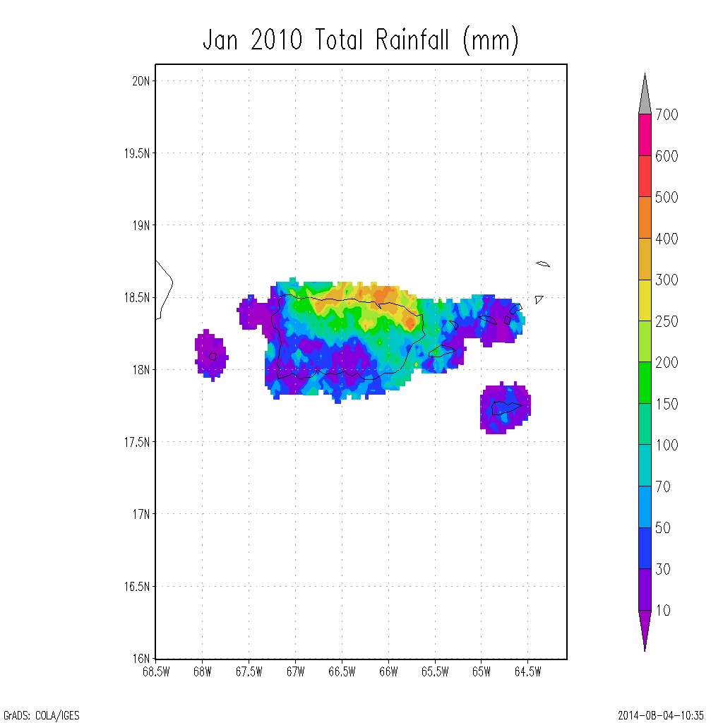
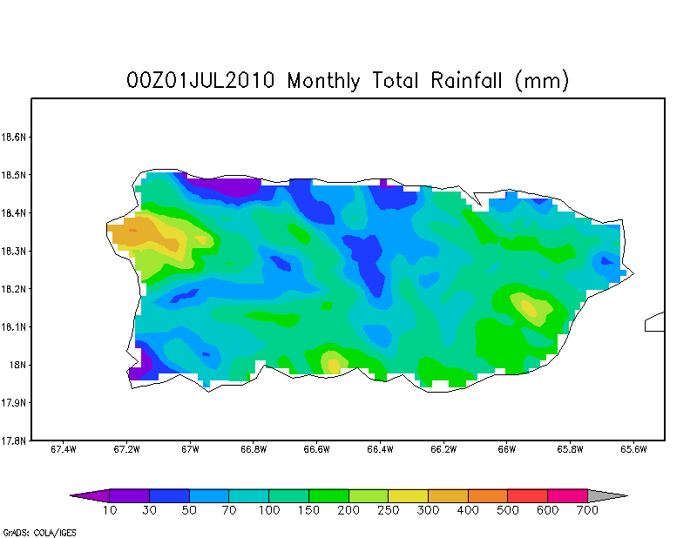
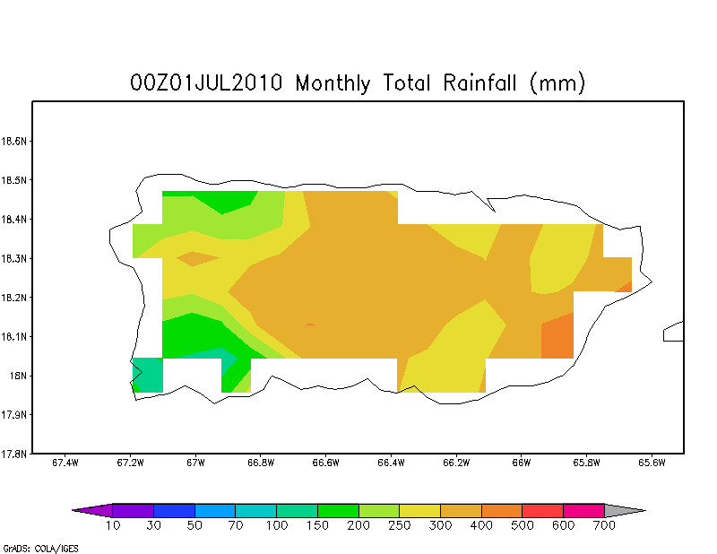
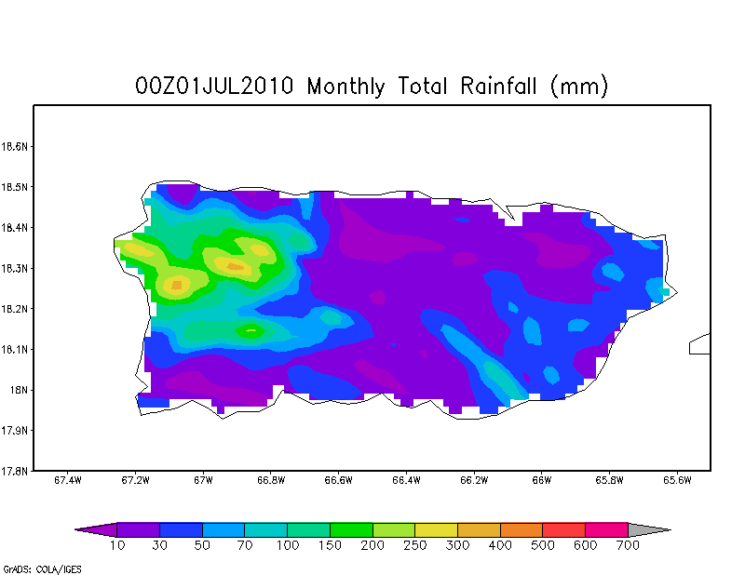
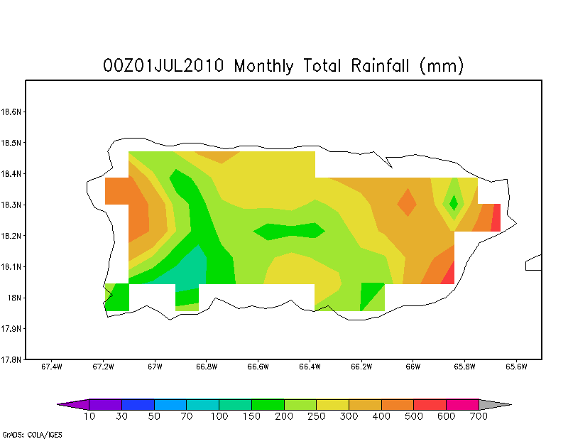
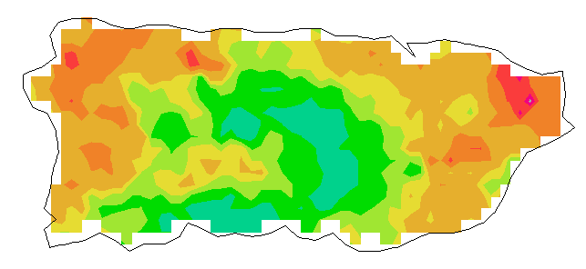
July Precipitation (mm)
2-km WRF
10-km WRF
Tiedtke (Explicit)
Tiedtke (CP Scheme Outer)
Kfmods (Explicit)
KFmods (CP Scheme Outer)
MPE (Observations)

Slide 10
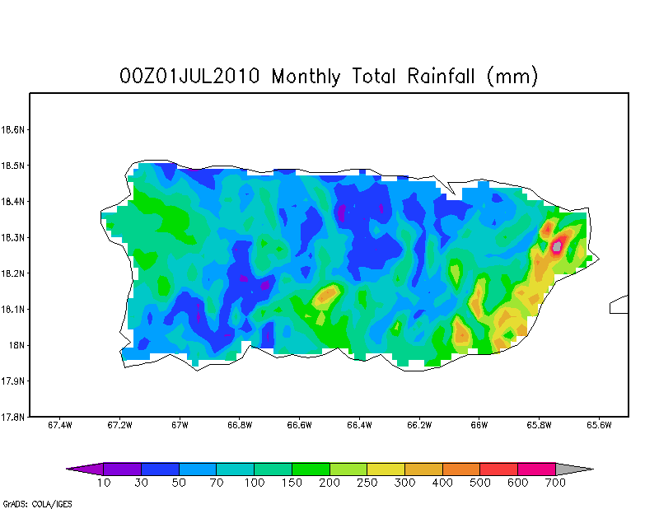
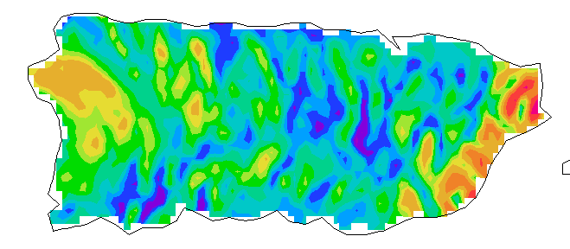
July Precipitation (mm)
Tiedtke (Explicit)
KFmods (Explicit)
Tiedtke (CP Scheme Inner)
KFmods (CP Scheme Inner)
MPE (Observations)
Notes:
Figure 4 - July 2010 total precipitation (mm), WRF inner domain vs. MPE. Tiedtke, KFmods, Tiedtke_inner, KFmods_inner, MPE

Slide 11
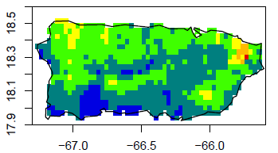
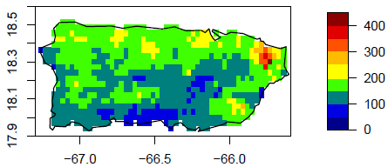
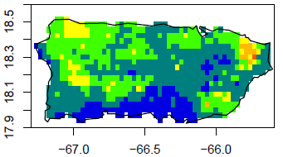
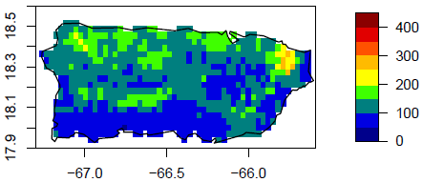
RMSE (mm) monthly total precipitation
Tiedtke (Explicit)
KFmods (Explicit)
148 mm
154 mm
Tiedtke (CP Scheme Inner)_
KFmods (CP Scheme Inner)
143 mm
117 mm
Notes:
Figure 13- RMSE (mm) for total precipitation for all WRF simulations across Puerto Rico for 2010. Numbers included for each are the average values for the domain.

Slide 12
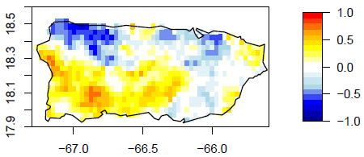
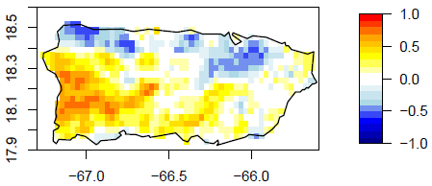
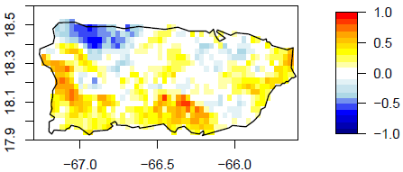
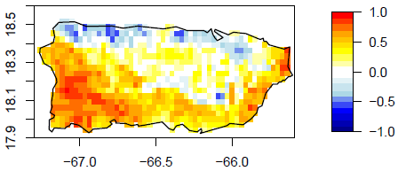
Correlation – Monthly Total Precipitation
Tiedtke (Explicit)
Kfmods (Explicit)
0.053
0.108
Tiedtke (CP Scheme Inner)
KFmods (CP Scheme Inner)
0.118
0.303
Notes:
Figure 14 - Correlation of total precipitation for all WRF simulations across Puerto Rico for 2010. Numbers included for each are the average values for the domain.

Slide 13
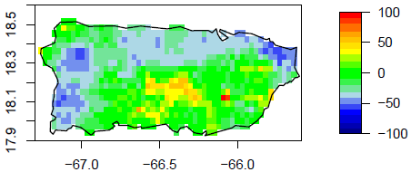
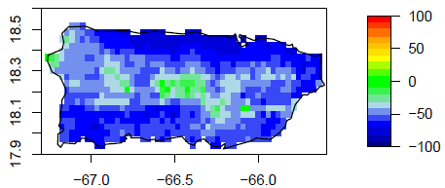
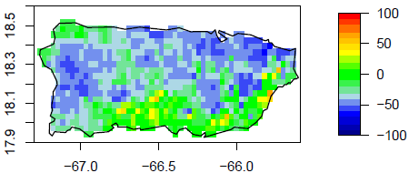
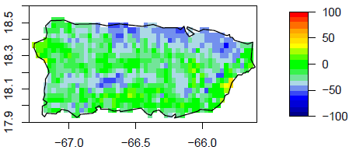
Percent Bias for Monthly Total Precipitation
Tiedtke (Explicit)
Kfmods (Explicit)
-12.7%
-52.4%
Tiedtke (CP Scheme Inner)
KFmods (CP Scheme Inner)
-28.3%
-23.0%
Notes:
Figure 15 - Percent Bias (%) for total precipitation for all simulations across Puerto Rico for 2010. Numbers included for each are the average values for the domain.

Slide 14
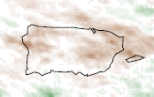
Dynamical Downscaling Uncertainty
CMIP5-CESM Projections
RCP8.5 – (2041-2043) – (1986-1988)
KFmods (Explicit)
Tiedtke (Explicit)
KFmods (CP Scheme Inner)
Significant Differences

Slide 15
Summary
2-km domain is drier than observations for all configurations
10-km domain provides better estimates with respect to the magnitude of precipitation but does not properly represent the large precipitation gradient across the island.
Activating the CP scheme in the inner most domain (2-km) improved monthly bias, correlation, RSME - particularly for KFmod
Persistent precipitation errors occur for the north coast of the island for all simulations.
In a climate change context, the different CP configurations result in statistically different change in the summer precipitation.

