Slide 1
Fine-scale characterization of mortality associated with exposure to traffic emission-related PM_{2.5}
Shih Ying Chang (Changsy)
Sarav Arunachalam
Marc Serre
Vlad Isakov
William Vizuete
Notes:
Prelinmory work. PLEASE don’t cite this!!!!!

Slide 2
Outline
Introduction
Objectives
Study design
Methodology
Results
Conclusions
Notes:
>25,000: heavy traffic I40: AADT: 74,000 Many people live close to heavy traffic roads and roads are harmful

Slide 3
Introduction
Introduction Objectives Study Design Methodology Results Summary
The importance of on-road emission source
Traffic-related Air Pollutants (TRAPs)
19% of the U.S. population lives close to roads
Source: EPA National Emission Inventory
Source: Rowangould, Transport Research Part D, 2013
Notes:
>25,000: heavy traffic I40: AADT: 74,000 Many people live close to heavy traffic roads and roads are harmful
Add another slide roadway and grid

Slide 4
Impact of on-road PM_{2.5}
PM_{2.5} from road transportation causes 53,000 premature death per year (Caiazzo et al. Atmos. Environ. 2013)
  Largest contributor to premature mortality
PM_{2.5} from mobile source causes 29,000 premature death per year (Fann et al. ES&T 2013)
  Second largest contributor to premature mortality
Chemical transport air quality model was used

Slide 5
TRAPs is a localized problem
Introduction Objectives Study Design Methodology Results Summary
Caiazzo et al. Atmos. Env. 2013
Karner et al. ES&T. 2010
Concentration varies within a short distance, grid based model can’t capture this spatial variation
Notes:
From previous discussions we see first: many people live close to roads so large scale exposure/risk assessment is required and second: TRAP is a localized problem so the exposure metric has to capture this pattern.

Slide 6
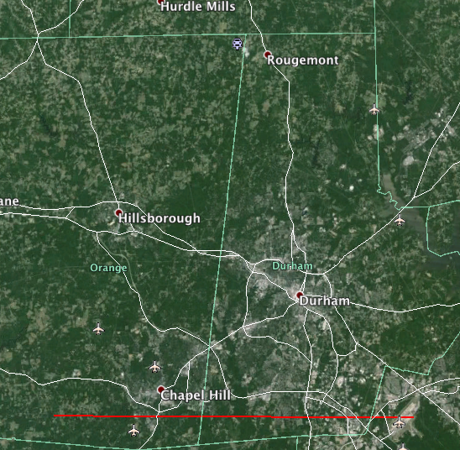
Example in Chapel Hill region
36
36

Slide 7
Objectives
Introduction Objectives Study Design Methodology Results Summary
Estimate mortality due to traffic-related emissions at fine scales in Central NC
  Use dispersion modeling at Census-block scales to estimate primary PM_{2.5}
  Use CMAQ at 36 x 36-km resolution to estimate primary PM_{2.5}
  Use CMAQ to estimate secondary PM_{2.5} at coarse resolution
Compare with prior studies that used only coarse resolution grid-based modeling
Notes:
Explain how big is Census block. Size. Map showing 36 km and block

Slide 8
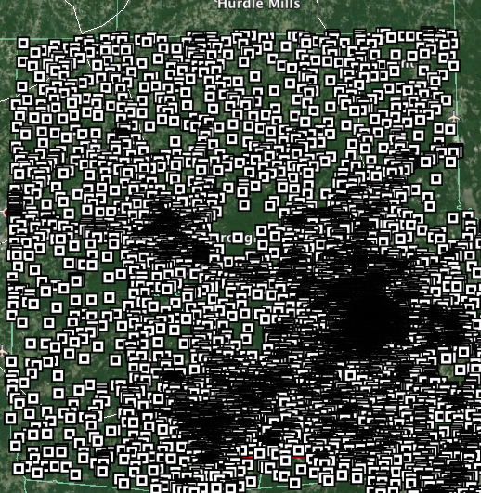
Example in Chapel Hill region
36
36

Slide 9
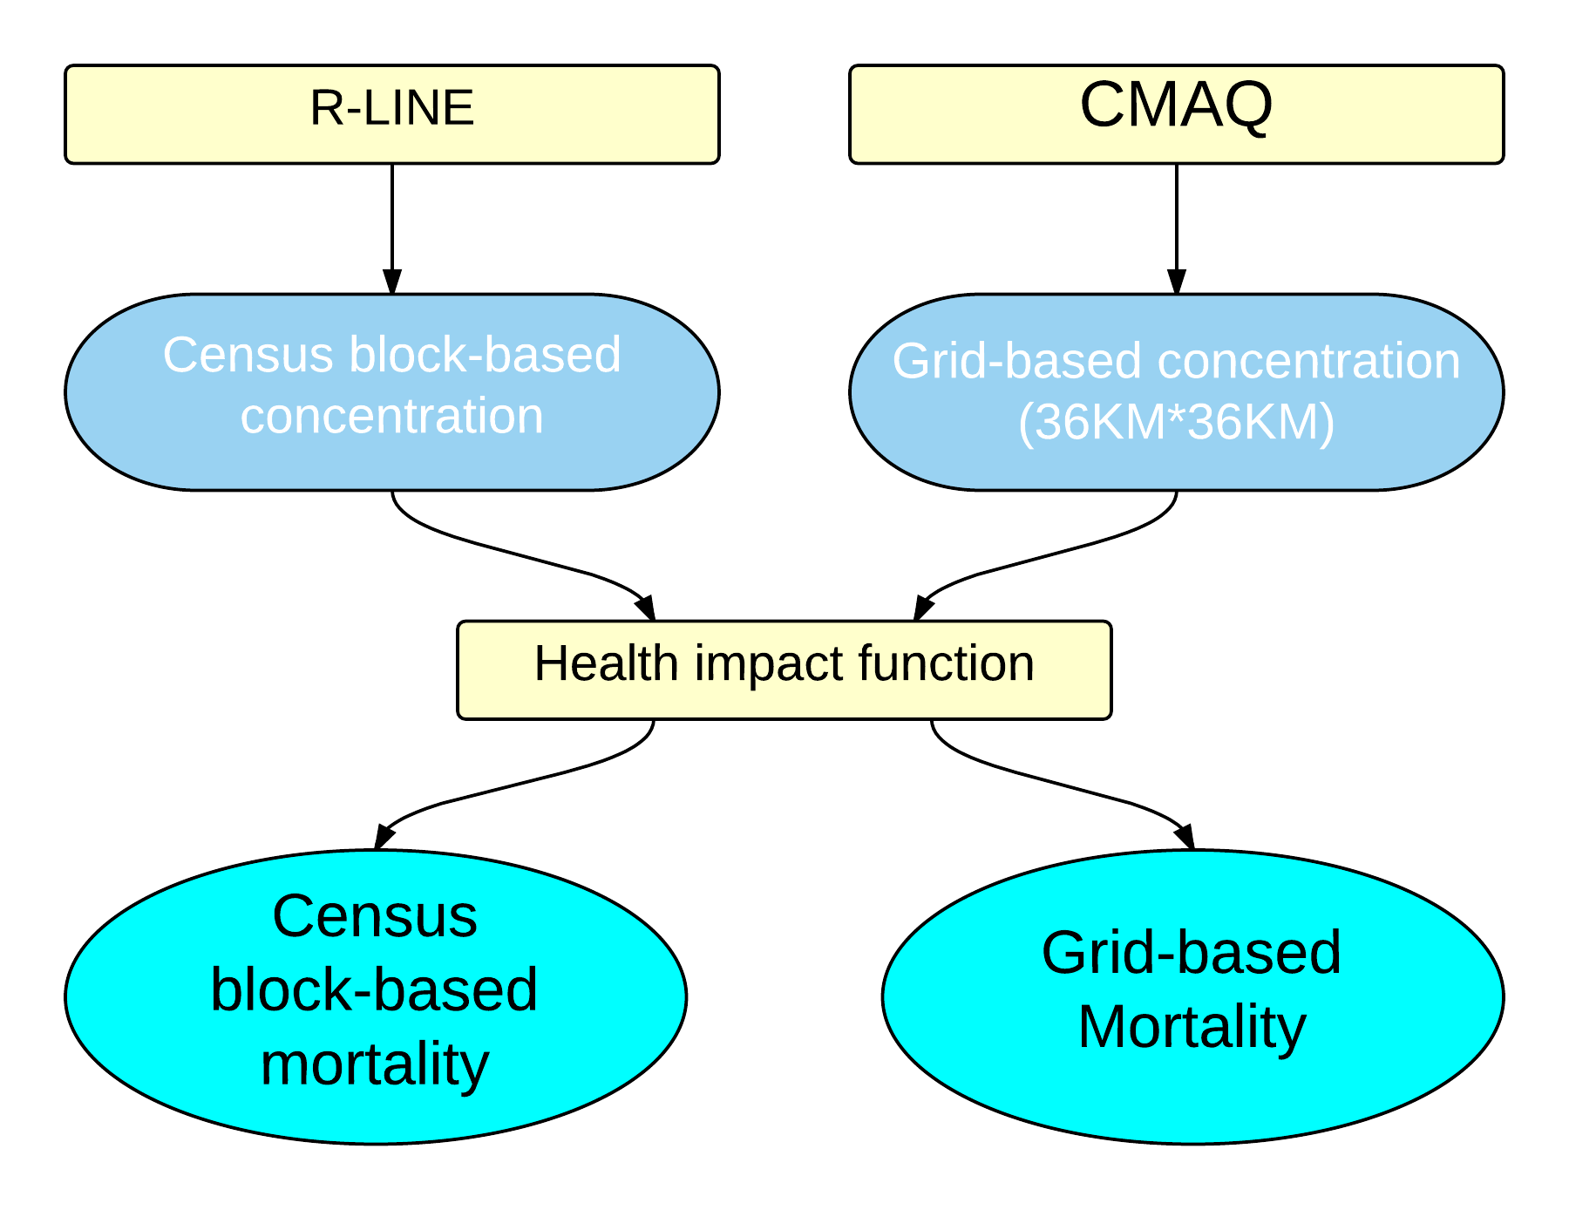
Study design flowchart
Introduction Objectives Study Design Methodology Results Summary

Slide 10
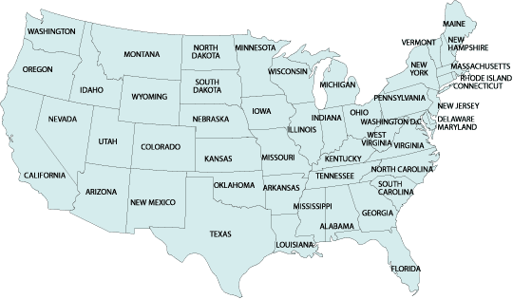
Modeling Domain
Introduction Objectives Study Design Methodology Results Summary
Study period: 2010

Slide 11
Introduction Objectives Study Design Methodology Results Summary
Develop emission inputs for R-LINE
MOVES: MOtor Vehicle Emission Simulator 2010b
MOVES emission factor
Vehicle type
Speed
Temperature
Road type
FHWA
Statistic series
National Emission Inventory
National Weather Service sites
FHWA
Freight Analysis Framework 3
Notes:
Take out small diagram

Slide 12
METeorologically Averaging for Risk and Exposure (METARE)
Introduction Objectives Study Design Methodology Results Summary
Use representative hours instead of actual hourly meteorological data
Scale model output to annual average concentration using weights
1 year: 8760 hours
Monin-Obukhov length: 5 categories
Unstable, Slightly Unstable, Neutral, Slightly Stable, Stable
Wind Direction: 4 categories
North, East, South, West
Wind Speed: 5 categories
0~1, 1~2, 2~4, 4~7, >7
Chang et. al., STOTEN 2015
1 year: 100 hours
Notes:
Small diagram

Slide 13
CMAQ
Introduction Objectives Study Design Methodology Results Summary
CAM-Chem
(initial/boundary conditions)
NEI
(other emissions)
MOVES
(on-road emission)
SMOKE
WRF
CMAQ
Base case: with all emission
Sensitivity case: without roadway emission
JAN and JUL, 2010
CONUS 36x36-km
Notes:
Emphasize MOVES mobile info. Simplify this!!!!

Slide 14

Health impact function
Introduction Objectives Study Design Methodology Results Summary
Mort: mortality
Y₀: baseline mortality rate
PAF: population attributable factor
pop: population
RR: relative risk
Log-linear function
RR=exp(β⋅Δx)
Δx: concentration change
PM2.5 ⬆ 10 μg/m³ (Krewski et al., 2009)
Cardiopulmonary disease | RR = 1.128
Lung Cancer | RR = 1.142
Integrated exposure-response (IER)
Chronic obstructive pulmonary disease (COPD)
Lung Cancer, Stroke, Ischemic heart disease
(Burnett et al., 2014)

Slide 15
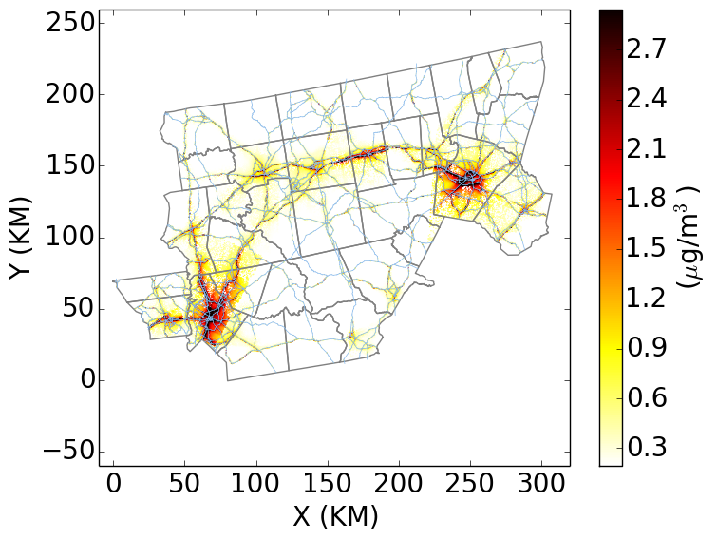
Primary PM_{2.5} from on-road emission
Introduction Objectives Study Design Methodology Results Summary
CMAQ
RLINE
Notes:
Put both conc. Map here

Slide 16
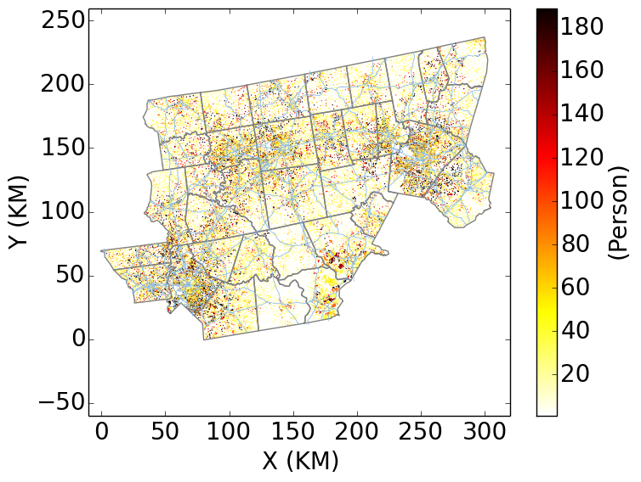
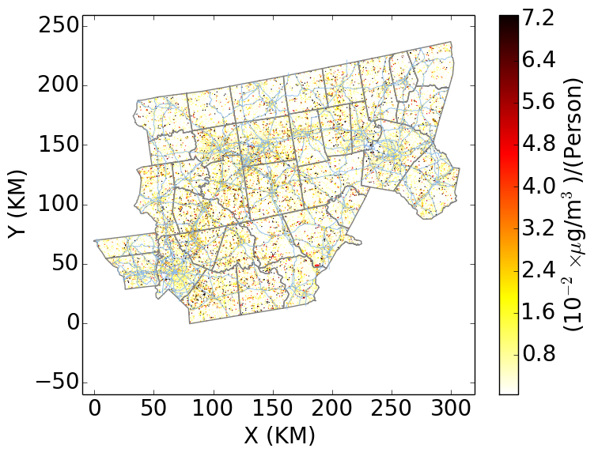
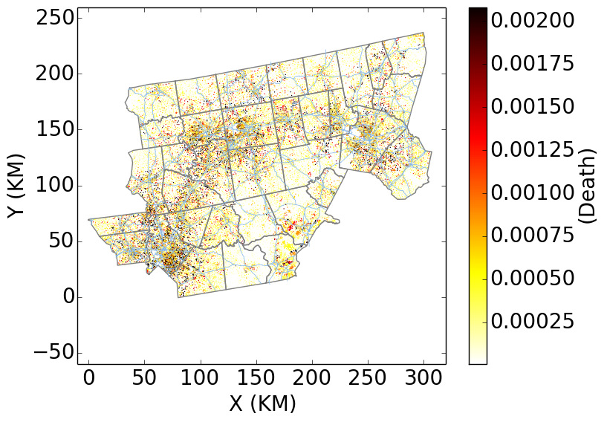
Estimation from CMAQ (On-road emitted primary PM_{2.5})
Introduction Objectives Study Design Methodology Results Summary
concentration
population
Population weighted concentration
Mortality

Slide 17
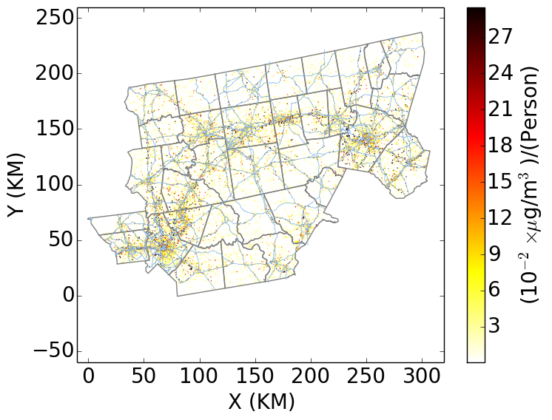
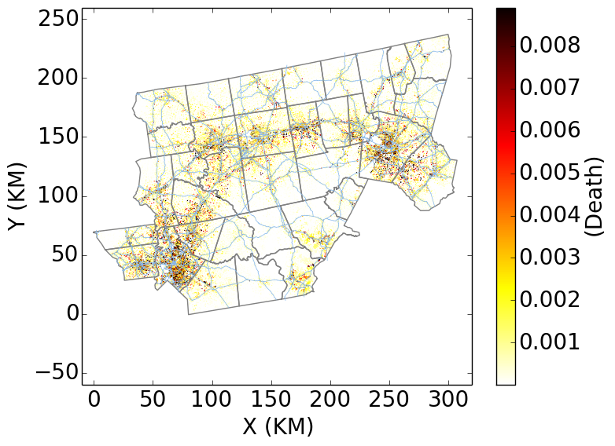
Estimation from R-LINE (On-road emitted primary PM_{2.5})
Introduction Objectives Study Design Methodology Results Summary
concentration
population
Population weighted concentration
Mortality

Slide 18
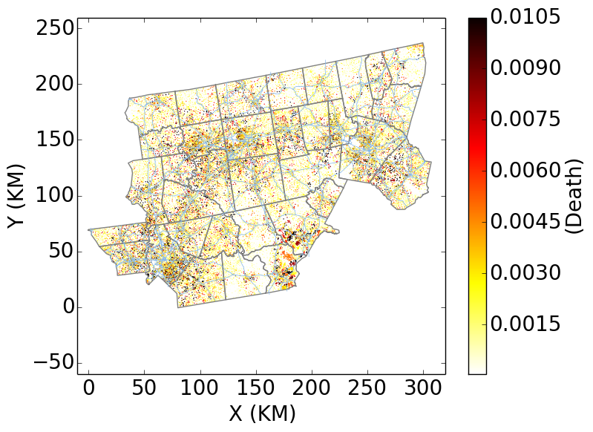
Introduction Objectives Study Design Methodology Results Summary
Estimation from CMAQ (On-road Secondary PM_{2.5})
concentration
Mortality

Slide 19
Introduction Objectives Study Design Methodology Results Summary
Total traffic emission-related mortality
Current work (2010)
 | Premature mortality (Primary only) |  | Premature mortality (Primary and Secondary)
Health impact function | R-LINE 1° (block-level) | CMAQ 1° (grid-based) | R-LINE 1°+ CMAQ 2° | CMAQ traffic (1° + 2°)
Krewski et al. 2009 | 225 | 52 | 485 | 312
IER function | 121 | 23 | 239 | 141
R-LINE predicts higher premature mortality than CMAQ
Notes:
2005 vs. 2010 emission for NC
We did only primary
Fann looked at all cause, Caiazzo look at LC and COPD but with a linear function
Take out 2nd table

Slide 20
The lower estimate from CMAQ compared to the previous studies
Introduction Objectives Study Design Methodology Results Summary
Results from Chemical Transport models, both primary and secondary PM_{2.5}
Study | Health impact function | Estimated premature mortality in NC Piedmont*
Caiazzo et. al | Linear, EPA 2011 | 1,125
Fann et. al | Krewski et al. 2009 | 581
This study | Krewski et al. 2009 | 312
* Estimated from State total (Caiazzo et. al) and national total (Fann et. al) based on population
Numbers from previous studies are scaled based on population
Caiazzo et al. used linear function
Fann et al. considered all mobile source
  On-road, non-road, aircraft, and marine vessels

Slide 21
Conclusions
Introduction Objectives Study Design Methodology Results Summary
Improved fine-scale characterization of Primary PM_{2.5} by R-LINE led to higher premature mortality counts than using CMAQ @ 36x36-km
While direct comparison not possible due to several confounding issues, method developed here indicates potential underestimation of health risk due to coarser-scale grid resolution used in prior studies
Notes:
Compare with Fann and Caiazzo

Slide 22
Acknowledgement
UNC ESE
Raquel Silva
Yuqiang Zhang
EPA
Neal Fann
UNC IE
Matt Woody
Pradeepa Vennam
Jiao-Yan Huang
Michelle Snyder
Mohammad Omary
NC DHHS
Samuel Tchwenko
Lauren Thie
Kathleen Jones-Vessey
The U.S. EPA partially funded this work under EPD12044 to UNC-CH. This work has been subjected to Agency review and approved. Approval does not signify that the contents reflect the views of the Agency nor does mention of trade names or commercial products constitute endorsement or recommendation for use.

Slide 23
References
Rowangould, G.M., 2013. A census of the US near-roadway population: Public health and environmental justice considerations. Transp. Res. Part D Transp. Environ. 25, 59–67. doi:10.1016/j.trd.2013.08.003
Caiazzo, F., Ashok, A., Waitz, I.A., Yim, S.H.L., Barrett, S.R.H., 2013. Air pollution and early deaths in the United States. Part I: Quantifying the impact of major sectors in 2005. Atmos. Environ. 79, 198–208. doi:10.1016/j.atmosenv.2013.05.081
Fann, N., Lamson, A.D., Anenberg, S.C., Wesson, K., Risley, D., Hubbell, B.J., 2012. Estimating the national public health burden associated with exposure to ambient PM2.5 and ozone. Risk Anal. 32, 81–95. doi:10.1111/j.1539-6924.2011.01630.x
U.S. Environmental Protection Agency, 2011. An Overview of Methods for EPA’s National-Scale Air Toxics Assessment [WWW Document]. URL http://www.epa.gov/ttn/atw/nata2005/05pdf/nata_tmd.pdf (accessed 2.20.14).
Gauderman, W.J., Vora, H., McConnell, R., Berhane, K., Gilliland, F., Thomas, D., Lurmann, F., Avol, E., Kunzli, N., Jerrett, M., Peters, J., 2007. Effect of exposure to traffic on lung development from 10 to 18 years of age: a cohort study. Lancet 369, 571–7. doi:10.1016/S0140-6736(07)60037-3
Karner, A.A., Eisinger, D.S., Niemeier, D.A., 2010. Near-roadway air quality: synthesizing the findings from real-world data. Environ. Sci. Technol. 44, 5334–44. doi:10.1021/es100008x
Krewski, D., Jerrett, M., Burnett, R.T., Ma, R., Hughes, E., Shi, Y., Turner, M.C., Pope, C.I., Thurston, G., Calle, E.E., Thun, M.J., 2009. Extended Follow-Up and Spatial Analysis of the American Cancer Society Study Linking Particulate Air Pollution and Mortality.
Burnett RT, Pope CA, Ezzati M, Olives C, Lim SS, Mehta S et al. An integrated risk function for estimating the global burden of disease attributable to ambient fine particulate matter exposure. Environ Health Perspect 2014; 122: 397–403.

Slide 24
Thank you

Slide 25
Extra slides

Slide 26
Introduction Objectives Study Design Methodology Results Summary
Develop emission inputs for R-LINE
MOVES: MOtor Vehicle Emission Simulator 2010b
MOVES emission factor
Speed
  MOVES input data
Vehicle Type
  8 types:
    LDGV, LDGT 1, LDGT 2, HDGV, LDDV, LDDT, HDDV, MC
    Table VM-4 from the FHWA Statistics Series convert with EPA Emission Inventory Improvement Program
*Road Type
  12 national function class (NFC) types:
    Rural Interstate, Rural Principal Arterial, Rural Minor Arterial, Rural Major Collector, Rural Minor Collector, Rural Local, Urban Interstate, Urban Freeway, Urban Principal Arterial, Urban Minor Arterial, Urban Collector, Urban Local
*Traffic Count
  Annual Average Daily Traffic (AADT)
Temperature
  Temperature bins in Summer and Winter
  Map with AERMET output from 824 National Weather Service (NWS) sites in the U.S.
Vehicle type
Speed
Temperature
NFC

Slide 27
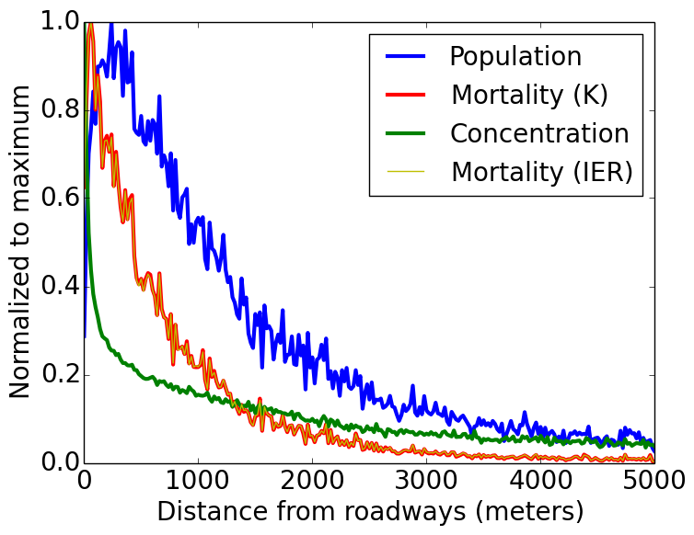
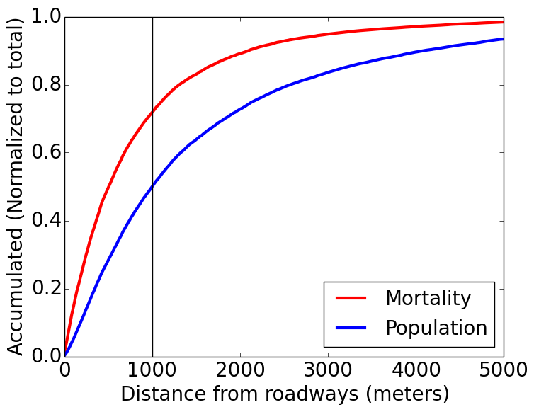
Mortality by distance from roadways
Introduction Objectives Study Design Methodology Results Summary
72%
50%
Mortality (K): log-linear function with Krewski et al.
Mortality (IER): IER function with Burnett et al.

Slide 28
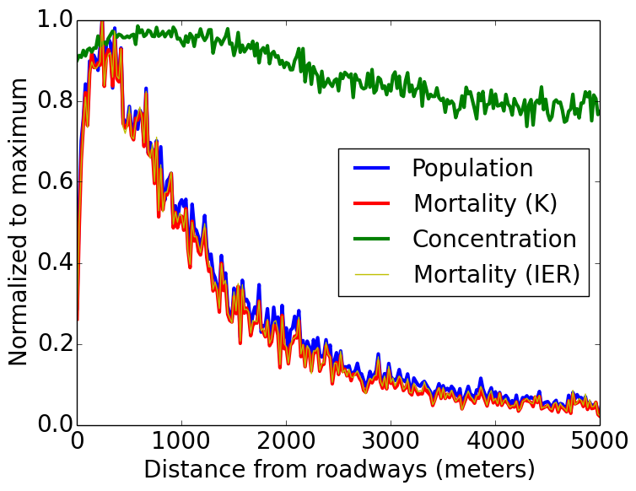
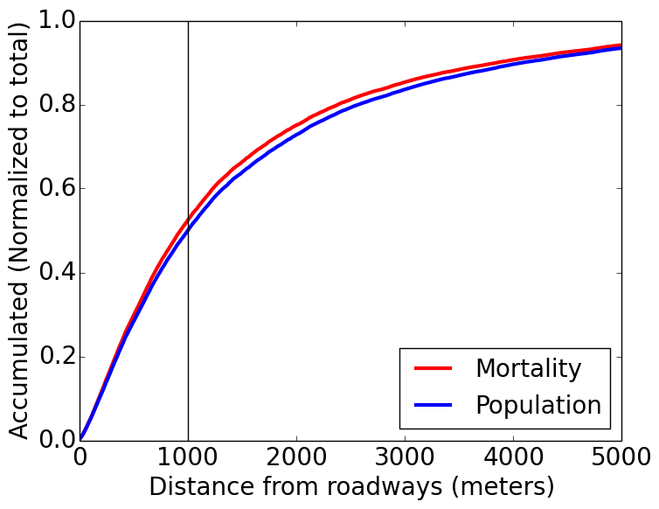
Mortality vs. DIST. CMAQ

Slide 29
Emission in NEI2008 vs. 2005

Slide 30
Limitations and Future work
Perform uncertainty assessment of current estimates
Additional spatial analyses in 3 metro areas of NC
Expand the work to entire nation
NO₂ was not considered
  New version of R-LINE that converts NO_{X} to NO₂
Notes:
Talk to Alex for option 2

Slide 31
Conclusions
Introduction Objectives Study Design Methodology Results Summary
Improved fine-scale characterization of Primary PM_{2.5} by R-LINE led to higher premature mortality counts than using CMAQ @ 36x36-km
While direct comparison not possible due to several confounding issues, method developed here indicates potential underestimation of health risk due to coarser-scale grid resolution used in prior studies
IER vs. log-linear
  IER is more conservative
  IER considered only 4 diseases
70% of the traffic-related mortality happened within 1,000 meters from the roadway, emphasizing importance of fine-scale characterization
Notes:
Compare with Fann and Caiazzo

