Slide 1
Contribution of Improved Spatial Allocation of Emissions to Reducing Urban Overpredictions of NO₂ and PM_{2.5} Concentrations
Michael Moran¹, Qiong Zheng¹, Junhua Zhang¹, Radenko Pavlovic², and David Niemi³
¹Air Quality Research Division, Environment Canada, Toronto, Ontario, Canada
²Air Quality Modeling Applications Section, Environment Canada, Montreal, Quebec, Canada
³Pollution Inventory and Reporting Division, Environment Canada, Gatineau, Quebec, Canada
2015 CMAS Conference Chapel Hill, North Carolina 5-7 Oct. 2015

Slide 2
Motivation
The primary concern of air quality forecasting is episodes of poor air quality
AQ forecasters want to minimize “false alarms”, that is, forecasts of poor air quality that do not actually happen
Environment Canada (EC) runs an in-line meteorology/chemistry model (GEM-MACH) operationally to produce twice-daily, continental-scale, 48-hour forecasts of O₃, NO₂, PM_{2.5}, and Air Quality Health Index.
Until recently, one weakness of GEM-MACH forecasts has been a tendency to episodic overpredictions of NO₂ and PM_{2.5} concentrations over some Canadian cities, especially in the wintertime.

Slide 3
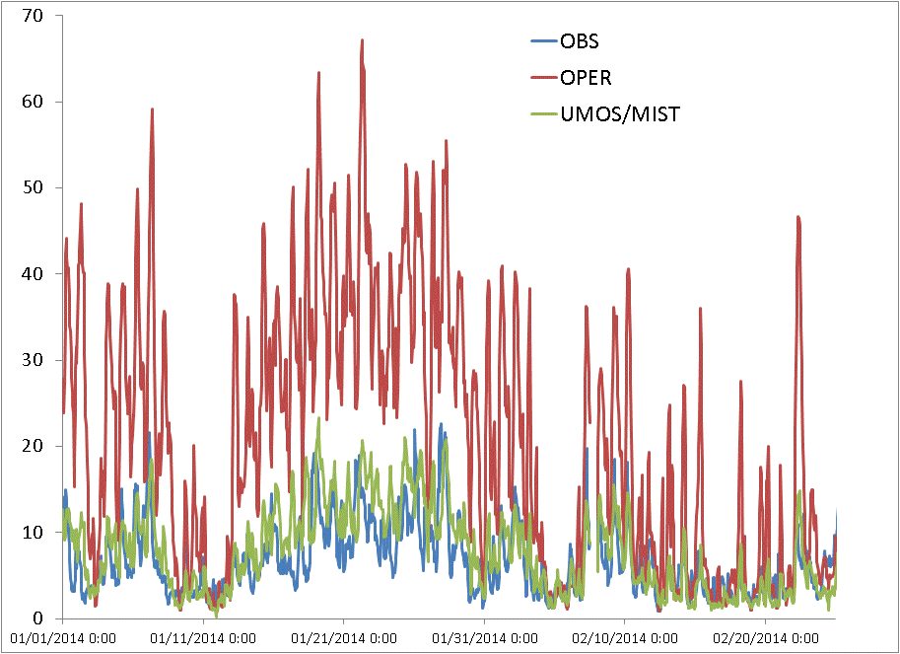
Vancouver PM_{2.5} Concentrations (ug m⁻³), Jan.-Feb. 2014: Observed, Forecast, and Adjusted (UMOS-AQ/MIST)
WINTER

Slide 4
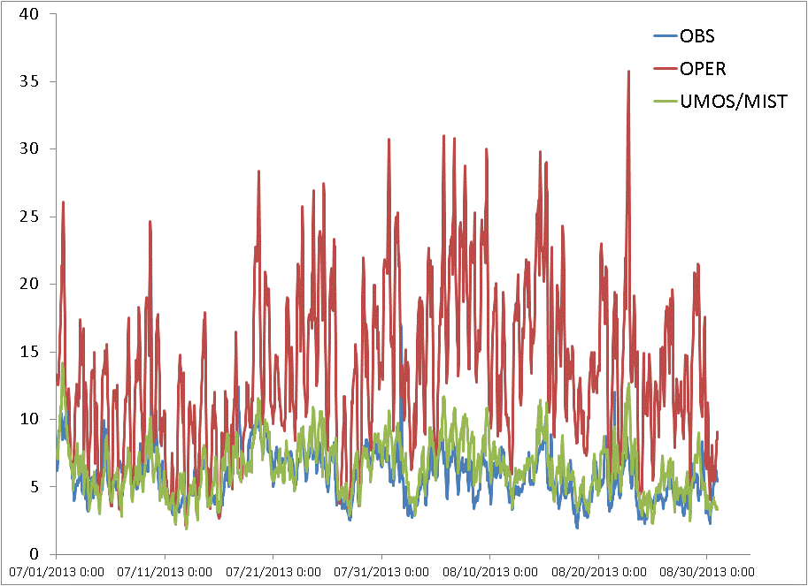
Vancouver PM_{2.5} Concentrations (ug m⁻³), July-Aug. 2014: Observed, Forecast, and Adjusted (UMOS-AQ/MIST)
SUMMER

Slide 5
Approach (1)
Overpredictions of primary pollutant concentrations may be caused by multiple factors, including :
Underestimation of vertical mixing or ventilation (e.g., neglect of urban heat island effects);
Underestimation of subgrid-scale removal (e.g., near-source impaction);
Overestimation of emissions
Recurring overpredictions associated with urban areas might be due to the spatial overallocation of some emissions categories to those areas associated with the use of unsuitable spatial surrogate fields

Slide 6
Approach (2)
Possible problematic emissions categories and hence problematic spatial surrogates can be identified by several approaches, including:
Identifying the major contributing source categories for selected urban areas (e.g., using SMKREPORT);
Plotting emissions spatial distributions for primary source sectors;
Examining predicted PM chemical composition and, where possible, comparing with measured PM chemical composition.

Slide 7
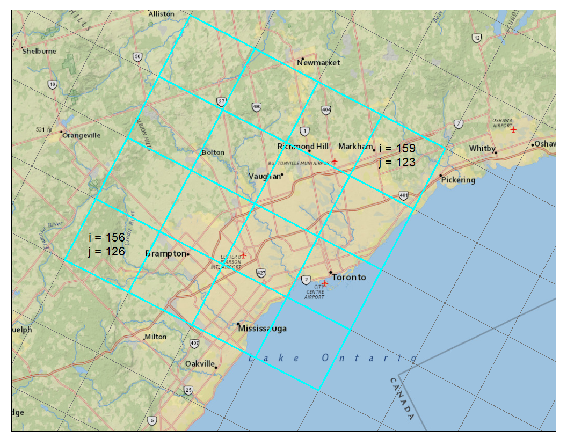
Example: Use SMKREPORT to Analyze GEM-MACH15 Emissions for a 4x4 Toronto Subdomain to Identify the Top NOx and PM2.5 Source Categories
Notes:
This slide shows a grid subdomain located over the Toronto area for which a detailed analysis was performed of emissions source types contributing to the input emissions.

Slide 8
Top 10 PM_{2.5} Surface Source Sectors in
Toronto GEM-MACH15 4x4 Subdomain from SMKREPORT for SET1 Emissions
(total 7,133 tons/y)
Source | SCC | Primary Surrogate | SCC Description | PM2.5 [tons/year] | PM2.5 percent (%)
oarea | 2810025000 | 101 | Miscellaneous Area Sources;Other Combustion;Charcoal Grilling - Residential (see 23-02-002-xxx for Commercial);Total | 1,031 | 14.5
oarea | 2305070000 | 327 | Industrial Processes;Mineral Processes: SIC 32;Concrete- Gypsum- Plaster Products;Total | 785 | 11.0
oarea | 2303020000 | 331 | Industrial Processes;Primary Metal Production: SIC 33;Iron and Steel Foundries;Total | 507 | 7.1
oarea | 2104008051 | 950 | Stationary Source Fuel Combustion;Residential;Wood;Non-catalytic Woodstoves: Conventional | 473 | 6.6
offroad | 2270005015 | 115 | Mobile Sources;Off-highway Vehicle Diesel;Agricultural Equipment;Agricultural Tractors | 419 | 5.9
adust | 2294000000 | 994 | Mobile Sources;Paved Roads;All Paved Roads;Total: Fugitives | 416 | 5.8
oarea | 2104006000 | 101 | Stationary Source Fuel Combustion;Residential;Natural Gas;Total: All Combustor Types | 355 | 5.0
oarea | 2103006000 | 921 | Stationary Source Fuel Combustion;Commercial/Institutional;Natural Gas;Total: Boilers and IC Engines | 336 | 4.7
onroad | 2230070000 | 992 | Mobile Sources;Highway Vehicles - Diesel;All HDDV including Buses (use subdivisions -071 thru -075 if possible);Total: All Road Types | 292 | 4.1
oarea | 2306010000 | 324 | Industrial Processes;Petroleum Refining: SIC 29;Asphalt Paving/Roofing Materials;Total | 250 | 3.5
Notes:
This table shows the top 10 source types contributing to PM2.5 emissions over this Toronto subdomain in the input emissions files. The first and fourth highest contributors are residential meat-cooking (i.e., BBQing) and residential wood combustion, both of which are largely composed of primary organic matter. Since the simulation period was January and February, when we would expect RWC emissions to be highest and BBQing emissions to be lowest for the year, this analysis suggests that problems with the specification of RWC emissions could be a significant source of the overpredictions. Two possible problems are (1) that the 2006 Canadian inventory that was used has too high RWC emissions values for Ontario or (2) that the spatial surrogate used to allocate these emission to the model grid assigned too large a fraction of these emissions to the Toronto region.

Slide 9
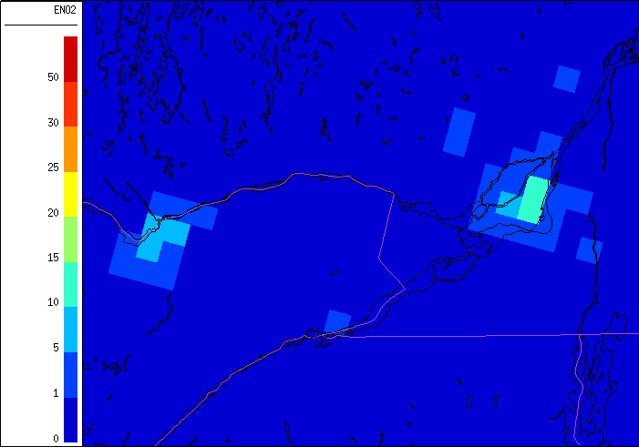
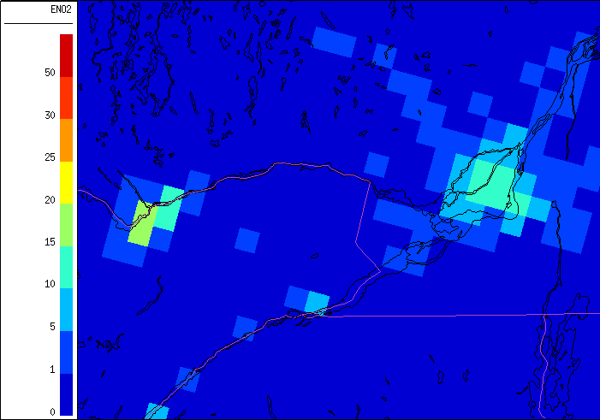
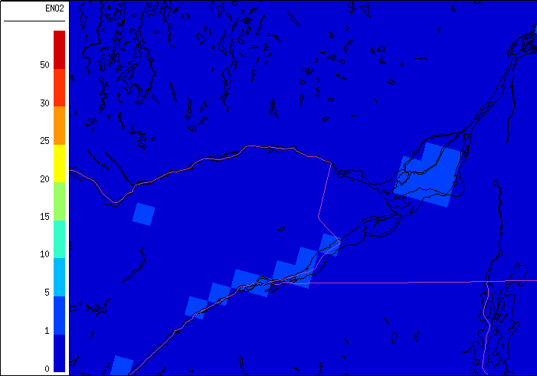
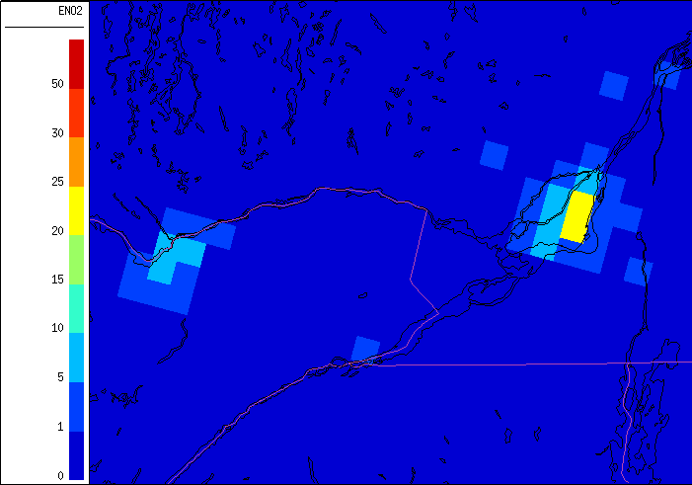
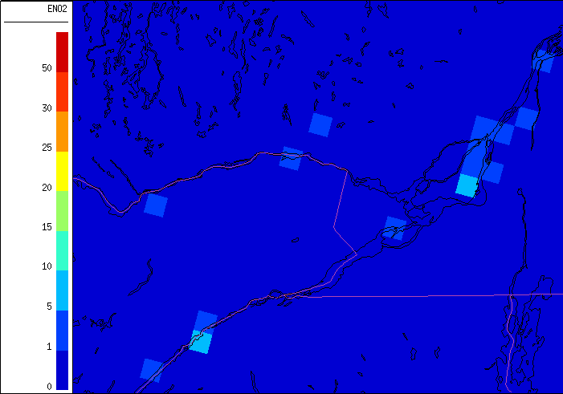
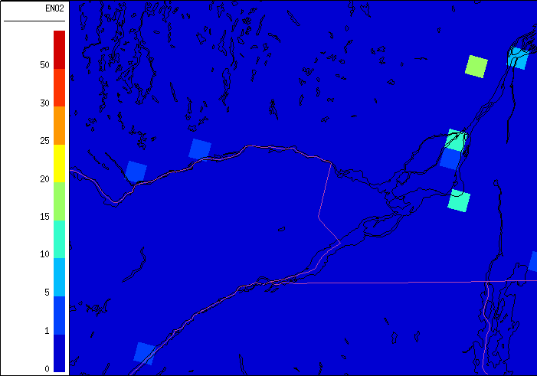
Zoom Over Montreal and Ottawa (SET2.1.1):
NO₂ January Emissions By Source Sector
oarea
onroad
offroad
offroad_T4
minor
major

Slide 10
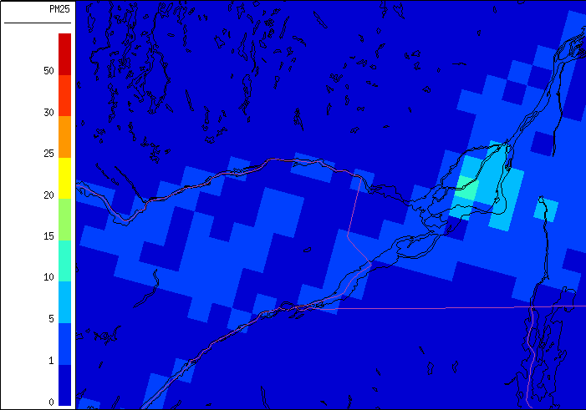
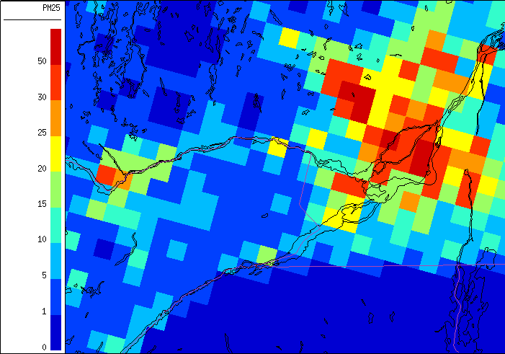
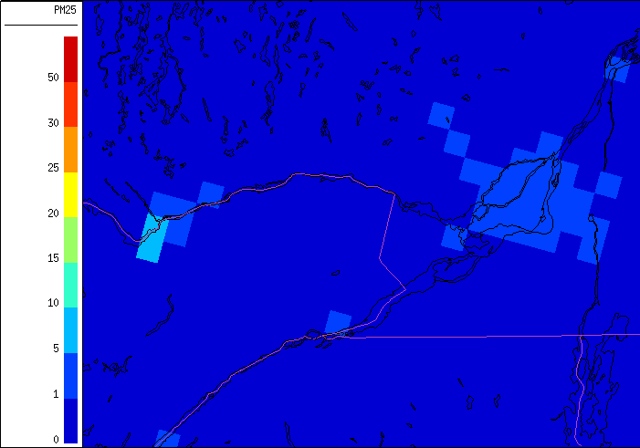
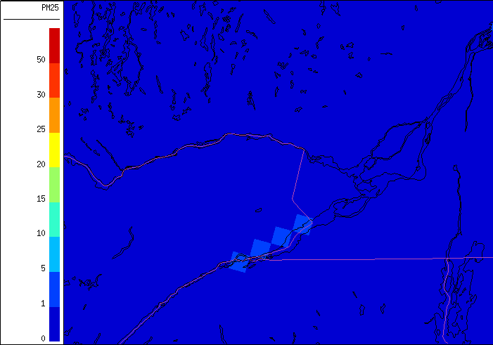
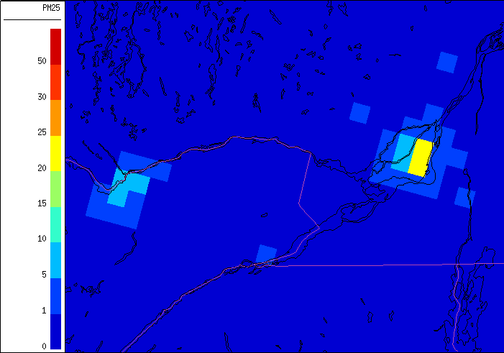
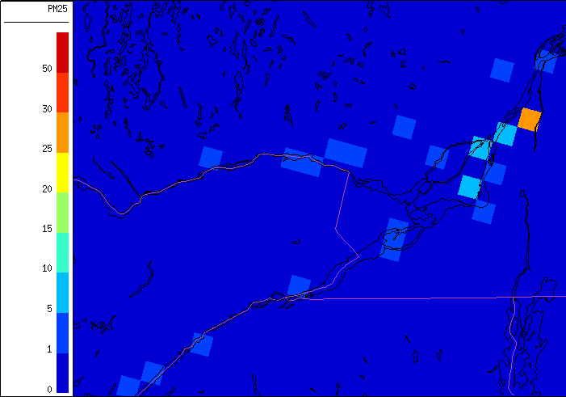
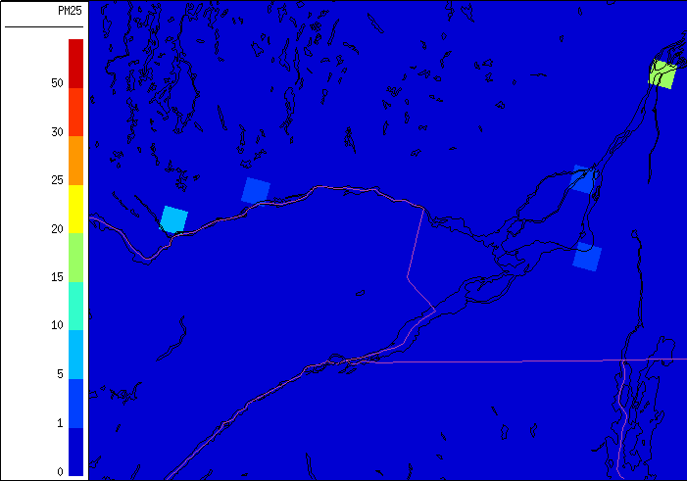
Zoom Over Montreal and Ottawa:
PM_{2.5} January Emissions By Source Sector (SET2.1.1)
adust
oarea
onroad
offroad
offroad_T4
minor
major

Slide 11
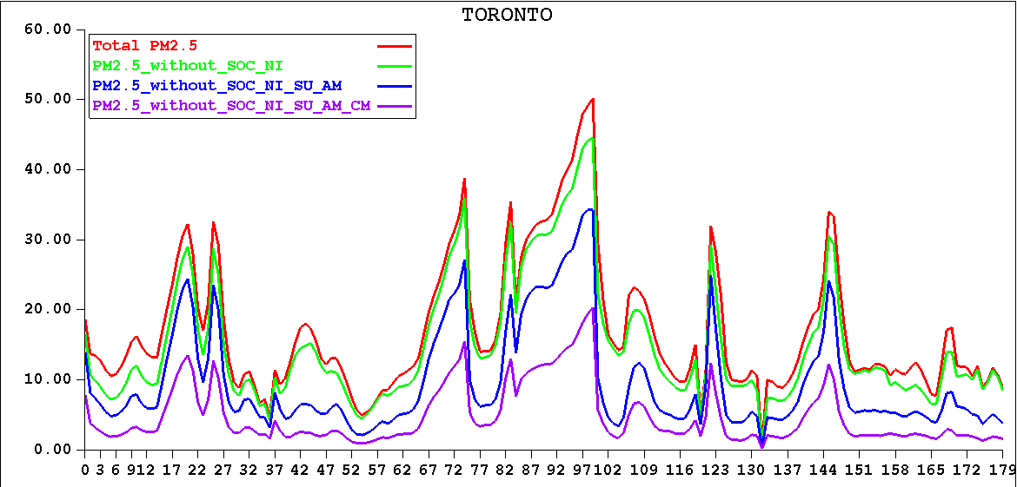
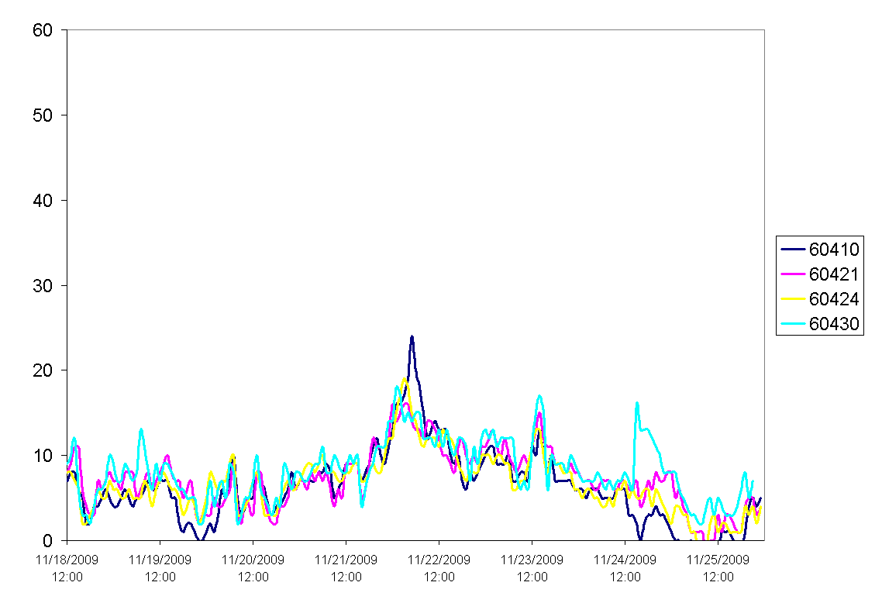
Time Series Of Bulk PM_{2.5} Mass (µg M⁻³) And Chemical Components: Toronto, Nov. 18-25, 2009
GEM-MACH
NI, SOM
SU, AM
CM
BC, POM
Measurements

Slide 12
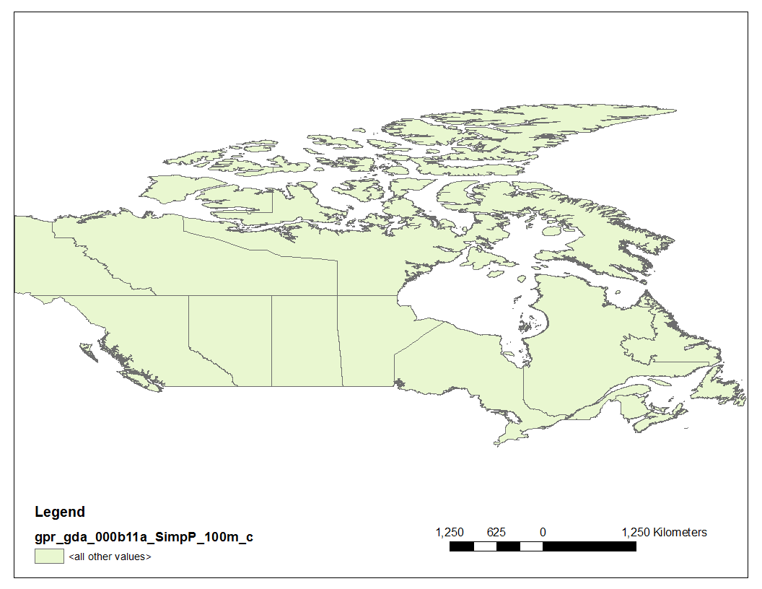
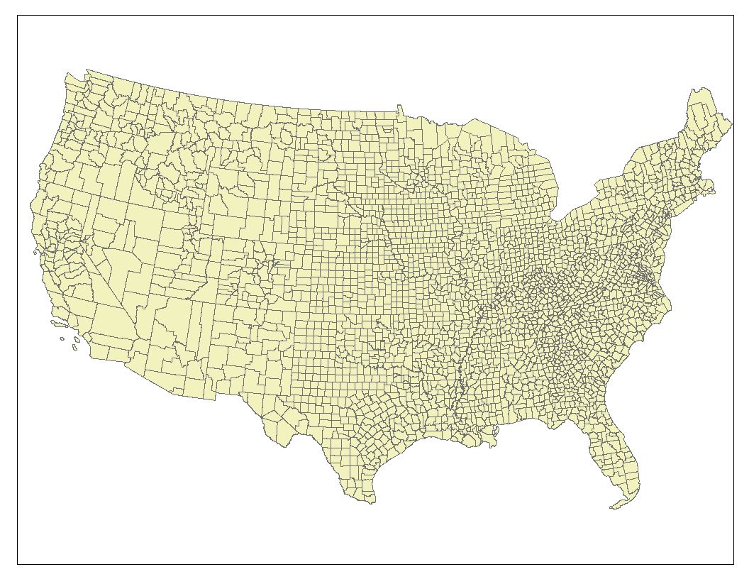
Unavoidable fact of life: Canadian emissions are only available by province or territory whereas U.S. emissions are available by county
(a)
(b)
10 provinces,
3 territories
3,143 counties
& equivalents
Unavoidable implication: the spatial allocation of Canadian emissions is more challenging than of U.S. emissions and spatial surrogates must play a more important role

Slide 13
Approach (3)
Urban-centred analyses of emissions identified the following emissions categories as top emitters of NO_{x} and/or PM_{2.5} in Canadian urban areas:
On-road sources;
Residential wood combustion;
Residential meat cooking;
Offroad T4;
Paved road dust
Spatial surrogates for Canada for each of these source categories were reviewed and new surrogates were developed for four of them as well as other source types based on the 2011 Canadian census and other data sets (note: 2011 census considers 56,204 neighbourhoods)

Slide 14
Scale Dependence of Spatial Surrogates for Higher-Resolution Model Grids
Issue: The use of some common spatial surrogates such as population or dwelling density may not be appropriate in high-density urban centres for many source types such as local traffic, residential wood combustion (RWC), residential meat-cooking (BBQs), and lawnmowers that have other constraints such as road geometry or the absence of fireplaces, patios, or lawns, respectively. At the same time, horizontal grid sizes of 4, 2, and even 1 km are now being employed that can resolve such centres.
One Solution: Impose either an upper limit (“cap”) or a “zero out” on high population density or dwelling density as part of calculation of selected spatial surrogate fields.
Notes:
The scale dependence of spatial surrogates is particularly important for urban-scale modelling, say for Toronto or Montreal. The basic idea is that it is not reasonable to apply the same spatial surrogate “recipe” indefinitely to finer and finer grids. This is an area that we have been investigating in the past year in support of the high-resolution AQ forecasting that will be carried out during the 2015 Pan Am and Para PanAm Games in the Toronto-Hamilton region.

Slide 15
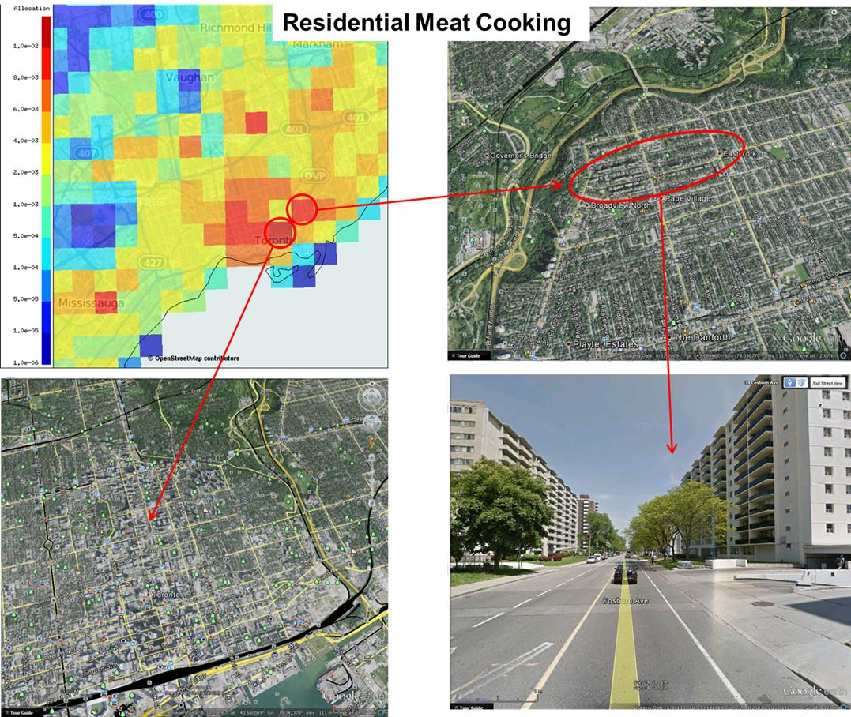
Example 1: Total Dwelling Density Is Used As Spatial
Surrogate to Allocate Emissions from Residential Meat
Cooking (BBQ’ing) in Toronto, Ontario
Find the BBQs

Slide 16
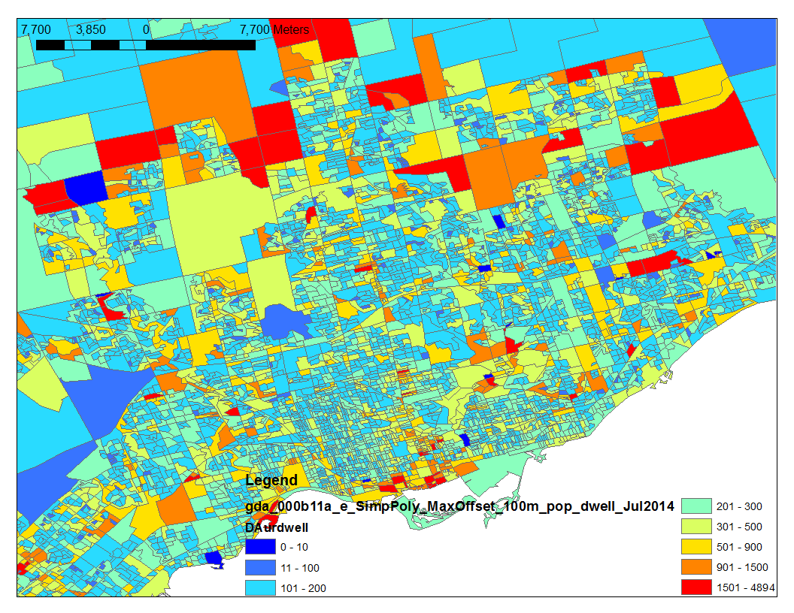
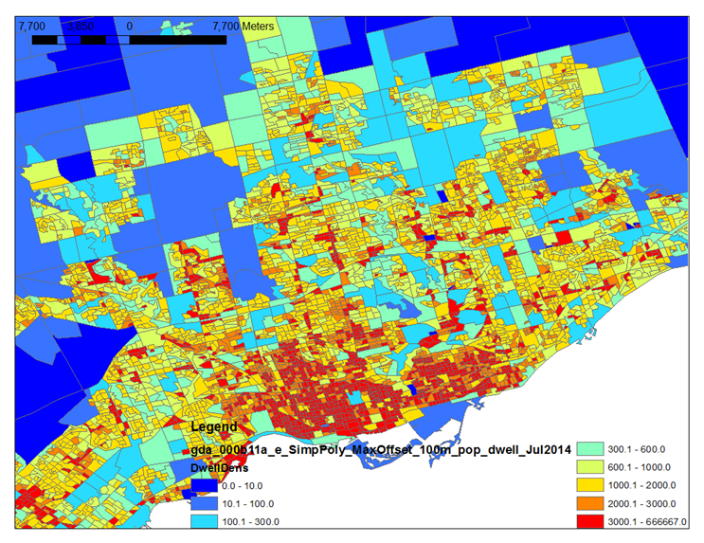
(Left) Usual-resident-occupied dwelling counts at neighbourhood level (i.e., dissemination area [DA]) for Toronto from 2011 Canadian census
(Right) Usual-resident-occupied dwelling density (number of dwellings km⁻²) by DA for Toronto from 2011 Canadian census
A
C
B
D

Slide 17
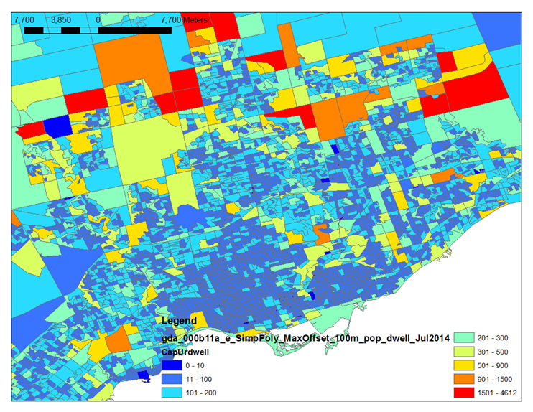
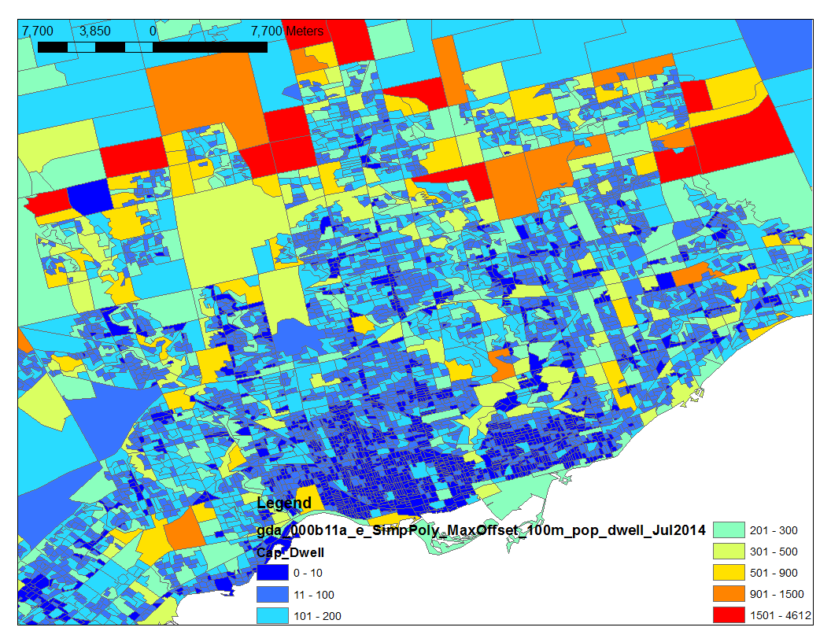
(Left) Version 1 of capped 2011 occupied dwelling counts by DA for Toronto. For those DAs with dwelling density > 600 dwellings km⁻², cap the density at 600, and then recalculate the DA dwelling counts.
(Right) Version 2 of capped 2011 occupied dwelling counts by DA for Toronto. For those DAs with dwelling density > 3000 dwellings km⁻², set the dwelling counts to zero, for those DAs with dwelling density between 600 and 3000, cap the density at 600, and then recalculate the DA dwelling counts.
A
C
B
D
Notes:
This slide shows 2 possible modifications to the dwelling-count shapefile. These types of modifications should be appropriate for selected source types, such as local traffic, residential meat-cooking, and residential wood combustion, which would not be expected to increase linearly in proportion to increasing population density.

Slide 18
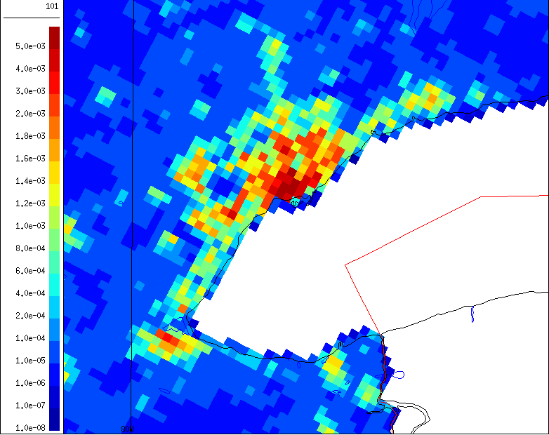
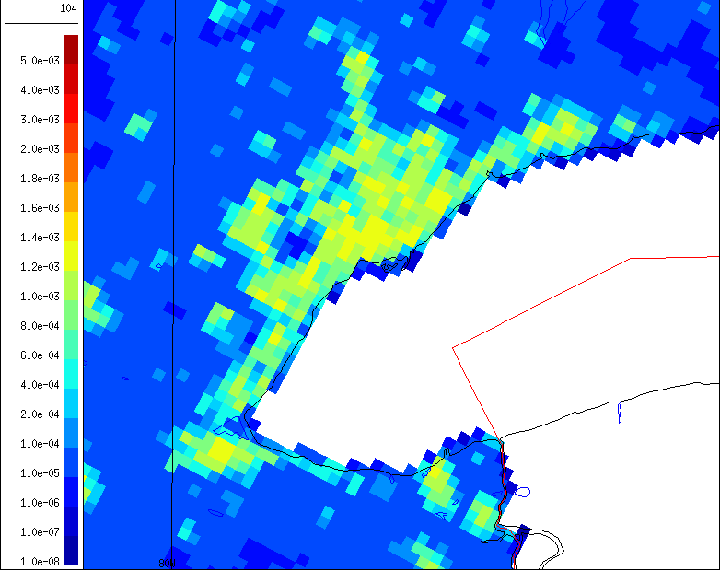

3 Versions of Surrogate (@ 2.5 km) Based on Total Dwelling Density in Toronto Region: Uncapped, V1 Capped, V2 Capped
SRG_101_total_dwelling
SRG_104_capped_total_dwelling
SRG_105_capped_total_dwelling_meat_cooking

Slide 19
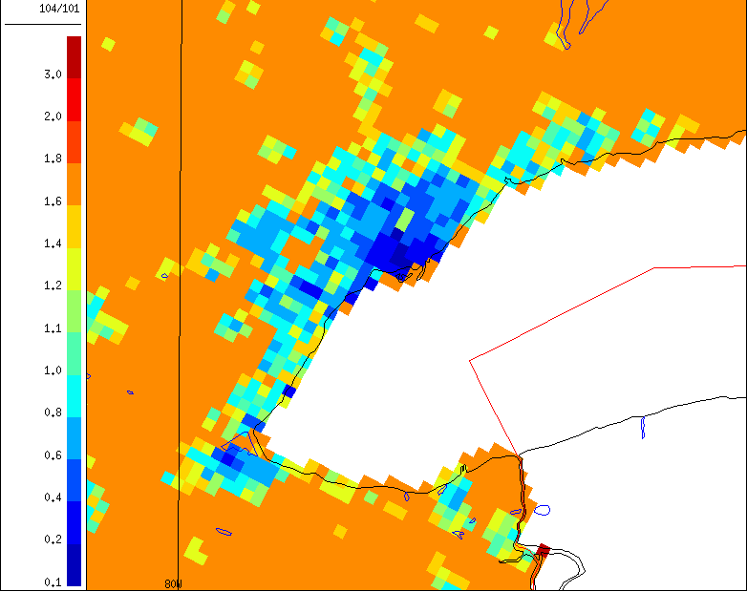
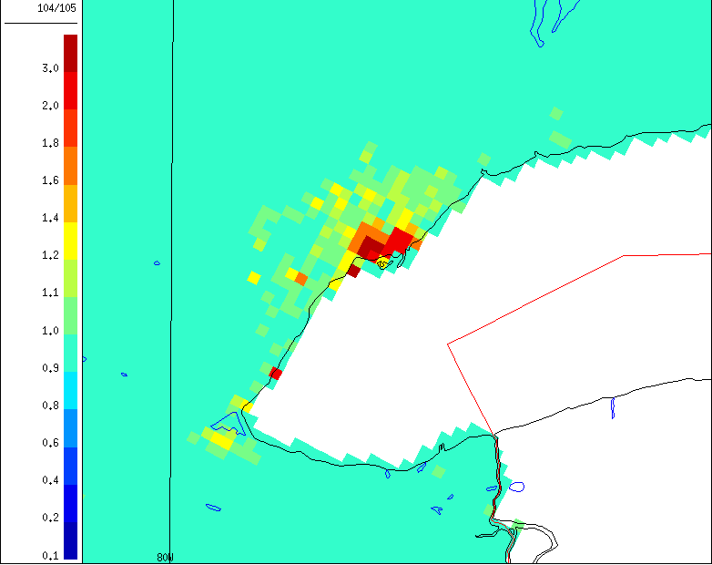
Ratios of (left) V1 Capped Total Dwelling Density Surrogate to Uncapped Total Dwelling Density Surrogate and (right) V1 Capped Total Dwelling Density Surrogate to V2 Capped Total Dwelling Density Surrogate over the Toronto Region
SRG_104-101_ratio
SRG_104-105_ratio

Slide 20
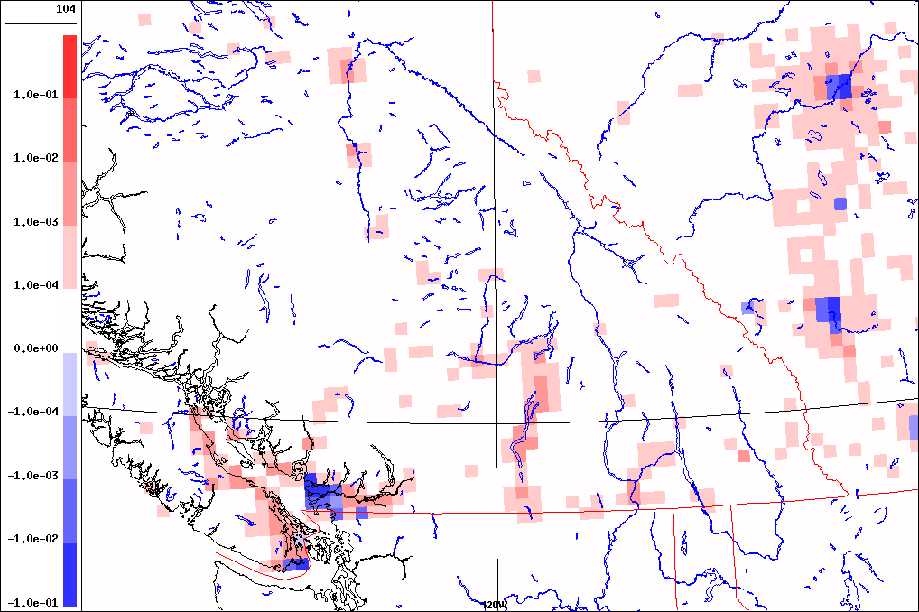
Differences between surrogate 104 (capped occupied total dwellings) and surrogate 101
(occupied total dwellings) over southern B.C. and Alberta on GEM-MACH15 grid.

Slide 21
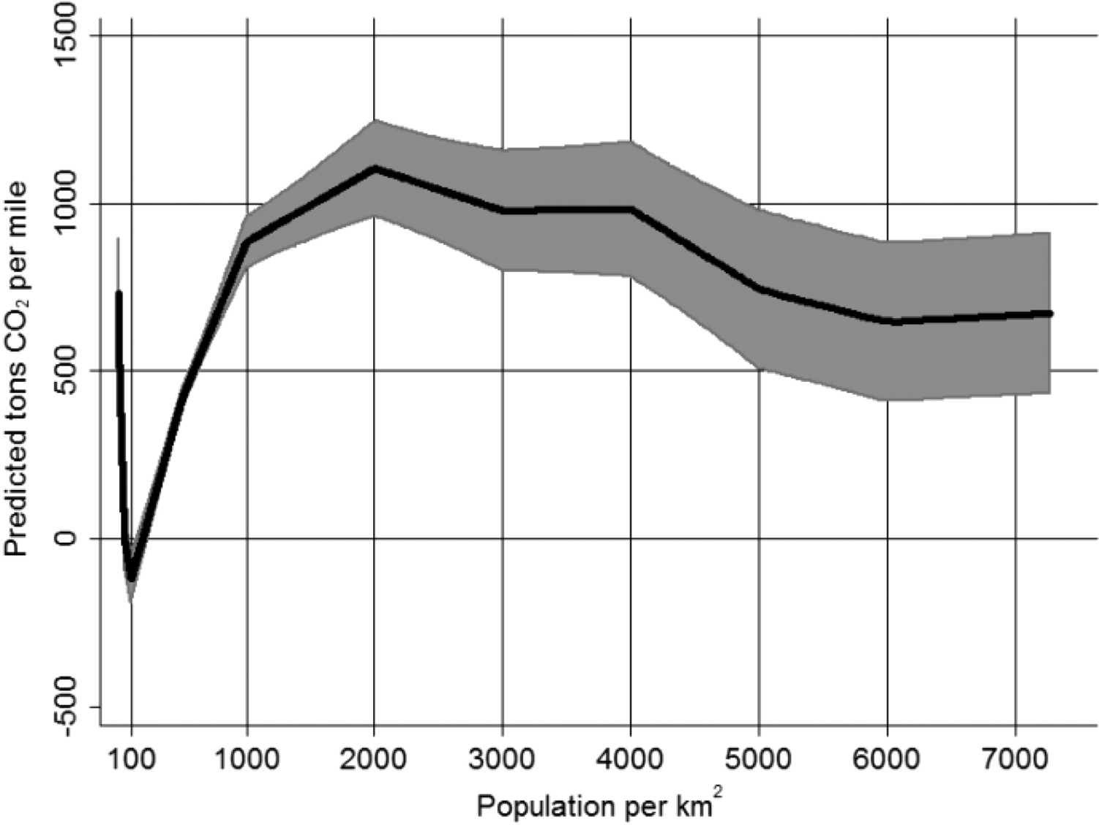
Issue Example 2: Population density is used as spatial surrogate to allocate emissions from local traffic, but traffic emissions are inversely related to population density above 2000 person km⁻² (Gately et al., 2013, ES&T, 47, 2423-2430) → Can apply cap and/or zero-out to population density field

Slide 22
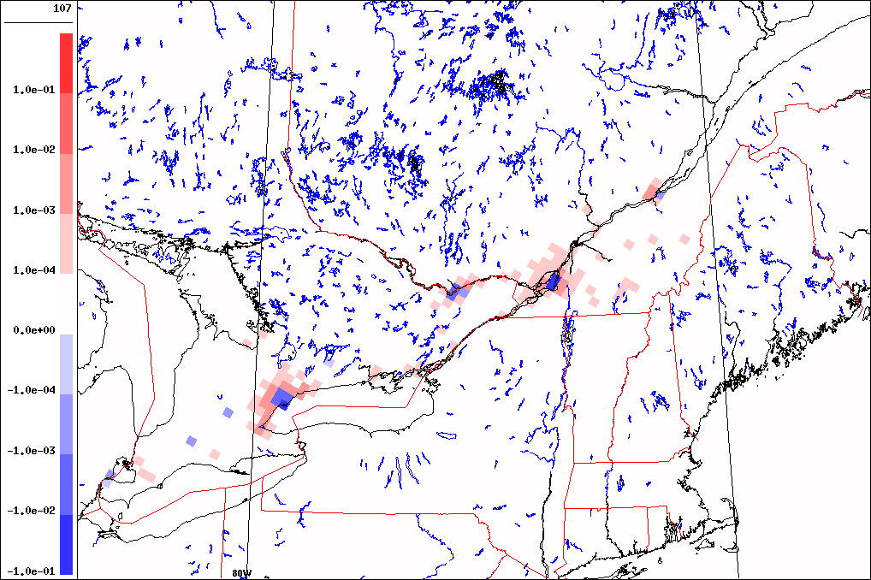
Differences between surrogate 107 for urban local mobile emissions after and before the population density cap was applied over southern Ontario and
Quebec on the GEM-MACH15 model grid.

Slide 23
Old Residential Wood Combustion Surrogate
Residential wood combustion (RWC) is a very important source of PM_{2.5} in Canada in the wintertime but the spatial allocation of RWC emissions has been problematic. In particular the allocation of RWC emissions to urban areas has seemed too high,
The old spatial surrogate used to grid province-level RWC emissions was an “intersection” surrogate based on the product of a forest-cover surrogate and a dwelling density surrogate.
This surrogate assumes implicitly that urban and rural households burn the same amount of wood, which is contradicted by many surveys of fuel use. As well, this surrogate is not directly related to wood consumption statistics.

Slide 24
“Recipe” for New RWC Spatial Surrogate (1)
The 2011 Statistics Canada Households and the Environment Survey (HES) and its accompanying Energy Use Supplement (EUS) provide data on household wood consumption at the provincial level but also for 28 Census Metropolitan Areas (CMAs) across Canada (11 located in Ontario, 6 in Quebec, 3 in B.C., 2 in Alberta, 2 in Saskatchewan, and one in each of Newfoundland, Nova Scotia, New Brunswick, and Manitoba).
These new data about sub-provincial wood consumption give a coarse spatial distribution of provincial RWC emissions between individual CMAs and “the rest of their province”. To build a province-level spatial surrogate a second step is then performed to determine a finer distribution of wood consumption at the DA level within each CMA and across “the rest of their province”

Slide 25
“Recipe” for New RWC Spatial Surrogate (2)
The new provincial RWC surrogates are calculated based on the following assumptions:
(1) Rural households (as represented by dwellings) will burn more wood on average than urban households (→ rural DAs have higher weighting);
(2) RWC is unlikely to occur in high-density, multi-storey, multiple-unit buildings (→ use capped and zeroed-out dwelling density);
(3) Households located within or close to forests are more likely to burn wood than households located in prairie or agricultural locations (→ higher weighting based on proximity to forests);
Use of RWC for space heating will be higher in colder locations (→ accounted for using a simple latitude dependence)
Households in small population centres (PCs: population < 30,000) are more likely to burn wood than those located in medium or large PCs
Simple weighting factors are used to account for each of the above assumptions.

Slide 26
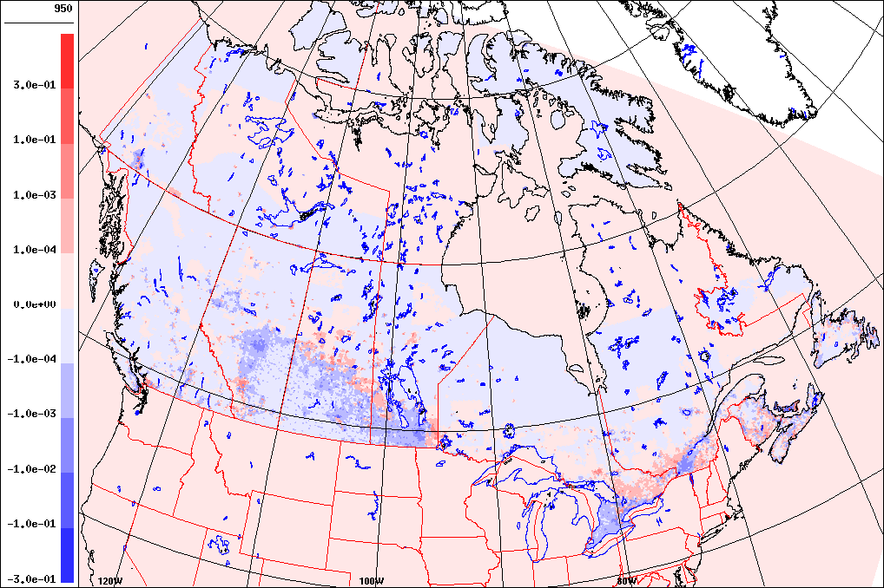
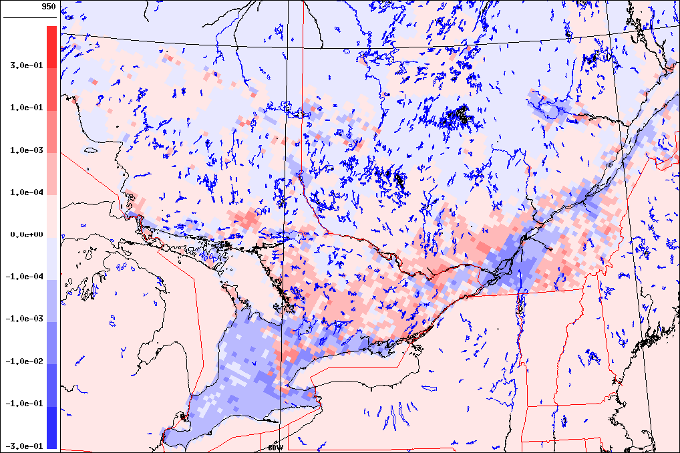
Differences Between New And Old RWC
Provincial Surrogates: (left) National View;
(right) Zoom over Ontario and Quebec

Slide 27
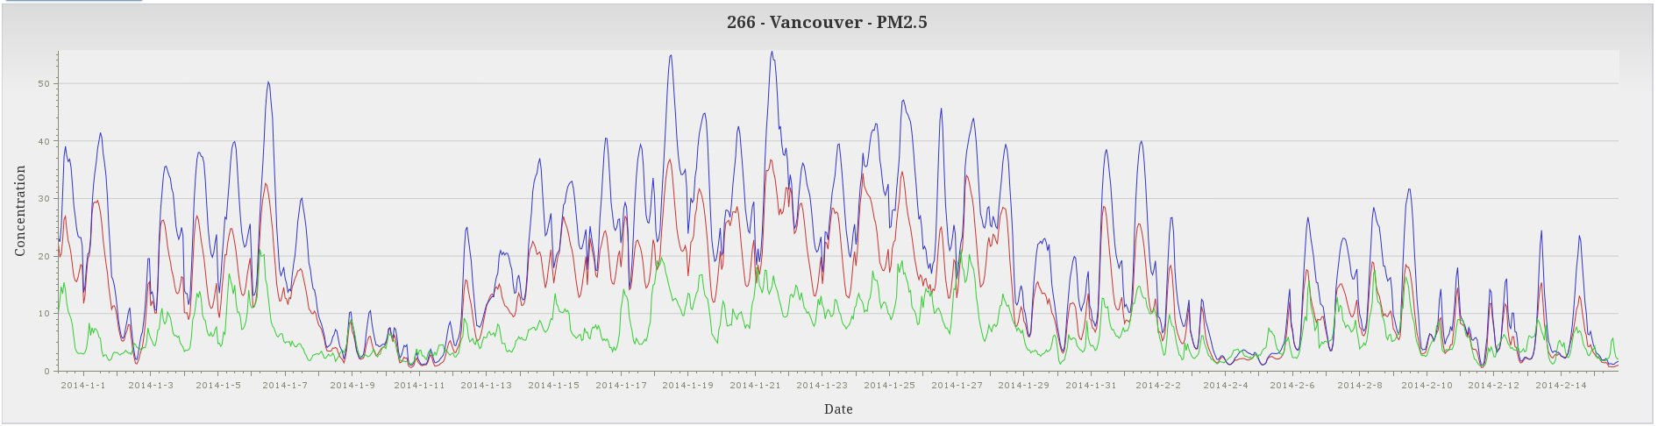
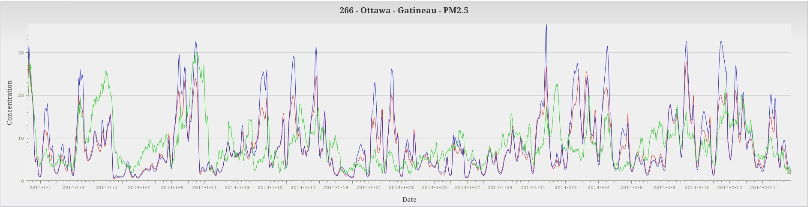
Time Series of Observed and GEM-MACH Predicted PM_{2.5} Concentrations for Jan.-Feb. 2014 for Vancouver and Ottawa Using Original (OPS) and Upgraded (SET2.1.1) Emissions
VANCOUVER
Observed
GM-OPS
GM avec SET2.1.1
OTTAWA
Observed
GM-OPS
GM avec SET2.1.1

Slide 28
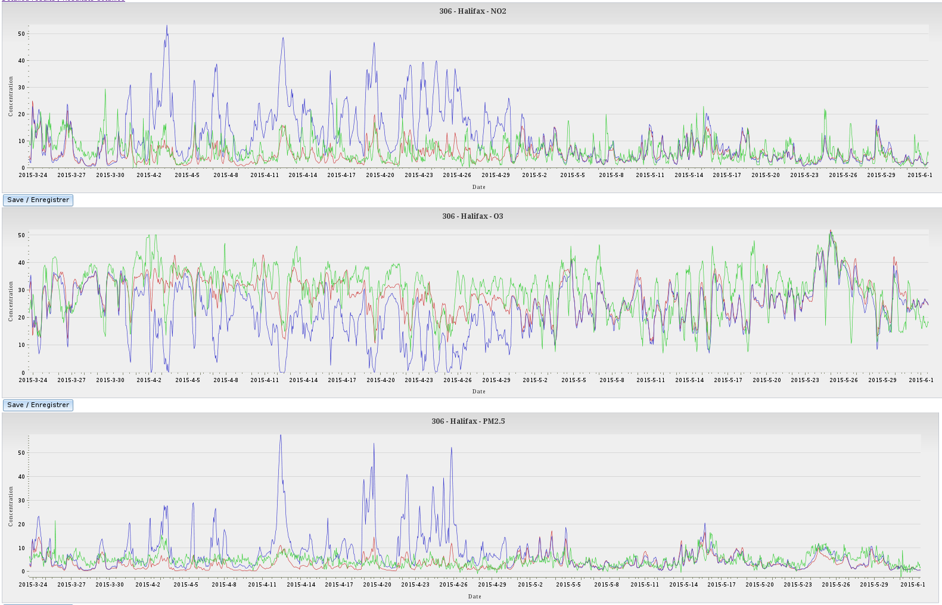
Time Series of Observed and Predicted NO₂, O₃, and PM_{2.5}
Concentrations for Halifax, Nova Scotia for Spring 2015
NO₂
Observed
OPS
PAR
O₃
PM_{2.5}

Slide 29
Conclusions
Analysis of gridded model emissions in Canadian urban areas suggested that primary pollutants such as NO₂ and PM_{2.5} were being overallocated to these areas.
Some new Canadian spatial surrogates have been developed for important source categories such as local traffic and RWC that reduce the allocation of emissions to urban areas.
GEM-MACH model runs using emissions based on the new Canadian spatial surrogates have shown improved performance.

Slide 30
Thank you for your attention

