Slide 1
The Canadian Air Quality Modelling Platform for Policy Emission Reduction Scenarios: Year 2010 Configuration
Presented by Sophie Cousineau on behalf of the REQA team
Air Quality Policy-Issue Response Unit,
Air Quality Modelling Application Section, National Operation Division
Canadian Centre for Meteorological and Environmental Prediction
Environment Canada, Dorval, QC, H9P 1J3, Canada.
14th Annual CMAS Conference, October 7, 2015, Chapel Hill, North Carolina

Slide 2
Talk outline
  EC’s air quality modelling platform for policy applications
  Migration to base year 2010
  2010 platform evaluation
  Summary & Future Work

Slide 3
Production of AQ modelling
  Multi-sector Air Pollutants Regulations (BLIERs Phase 1),
    targeting cement, Boilers & Heaters, Reciprocating Engines
    published in June 2014 in the Canada Gazette – Part I
    publication in Part II
  CAAQS development for SO2 and NO2
  TIER3 scenario project (transport regulations)
    to amend the « On-Road Vehicle and Engine Emission Regulations» and the «Sulphur in Gasoline Regulations».
    publication in the Canada Gazette Part I in September 2014,
Health Canada Fuel assessment project
    Asses on-road and off-road diesel and retrofit analysis for diesel.
    Assess on-road and off-road gasoline impact on health (+toxics)
Energy sectors projects (oil and gas, coal)

Slide 4
EC Air Quality Modelling Platform
GEM
(meteorological fields)
SMOKE
(gridded and temporally allocated emissions)
AURAMS
(particle and gas ambient levels)
O3, NO, NO2, PM (total and speciated), other species, deposition (dry and wet)
Health Canada and other EC branches: cost-benefit analysis (health & environment)

Slide 5
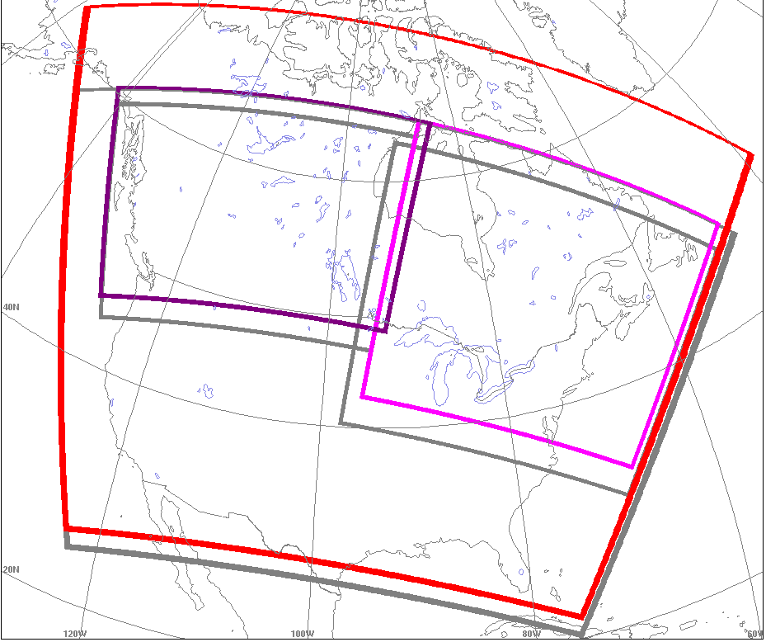
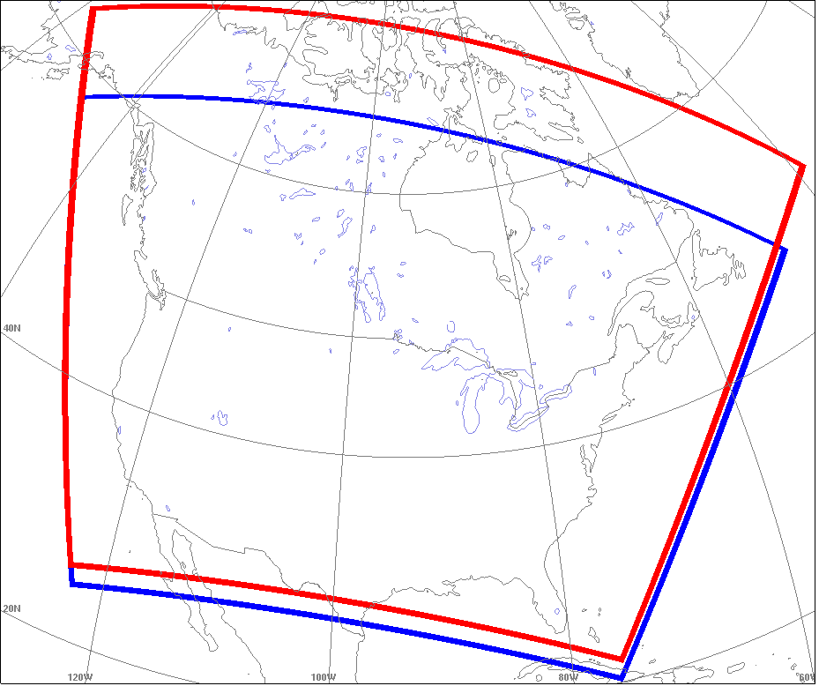
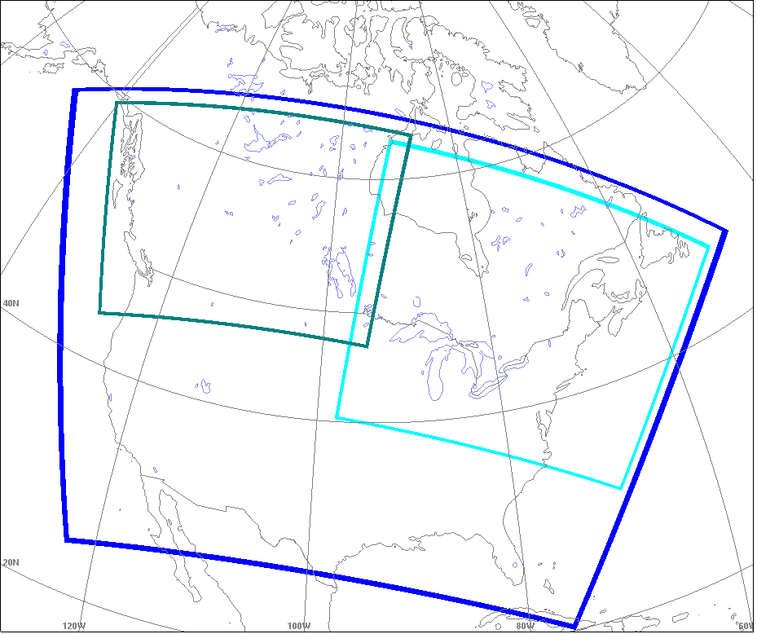
Grids : 2006 vs 2010
Grids : 2006 vs 2010
Cont. 2010
45 km (141x120)
Cont. 2006
45 km (143x107)
West
2006 : 22.5km (124x93)
2010 : 15km (193x135)
Cont. 2006
45 km (143x107)
West
2006 : 22.5km (124x93)
East
2006 : 22.5km (145x123)
2010 : 15km (201x180)
East
2006 : 22.5km (145x123)
Notes:
E-W Merge zone 10 grids points for both
Les bordures de chaque domaine sont à l’intérieur de de celui-ci.

Slide 6
EC Air Quality Modelling Platform
2006 vs 2010
 | 2006 | 2010
Meteorology Model Vertical levels: Horizontal resolution: | GEM 3.3.2 56 eta levels 33 km | GEM 3.3.8 80 hybrid levels 15 km
Chemistry CTM (off-line) - Horizontal resolution | AURAMS 1.5.0 (ADOM-II) 45 km and 22.5 km | AURAMS 2.0.3 (ADOM-II) 45 km and 15 km
Emissions - Anthropogenic Biogenic | SMOKE 2.6 2006 Can 2005 US 1999 Mex BEIS 3.09 with 2006 met files | SMOKE 3.5 2010 Can 2007/2008/2010 US 2008 Mex BEIS 3.09 with 2010 met files

Slide 7
Emissions Inventories for 2010
Source types | Canada | USA | Mexico
All | 2010 inventories | 2010/2008 inventories/data | 2008 inventories
Point | NPRI | 2008 electric and non electric power plants generation (PTIPM and PTNONIPM) | 2008 power generation plants
Area | DUST (grid-point based TF*), AG, etc. | 2008/2007 RWC with 2010 temporal profiles, AG, AGFIRE, C1C2RAIL, AFDUST (grid-point based TF*), etc. | 2008 residential and commercial combustion, agriculture, etc.
Transportation | on-road (MOVES & MOBILE6.2c), off-road (NONROAD) | 2010 gridded on-road & off-road emissions at 12-km resolution | 2008 on-road & off-road
* TF = Transportable fraction

Slide 8
2010 Canadian inventory comparison
Source types | 2006 | 2010
On-road sources | MOBILE6.2C | MOVES for HDDV and HDGV emissions MOBILE6.2C for the rest
Point sources Stack information Individual VOC speciation temporal profiles Oil Sands fleet emissions | Mean characteristics Based on SCC Allocation over the whole province | Detailed facility-characteristics Facility-specific Allocation using facilities’ geographic location
Area sources: Agriculture : spatial allocation of NAESI emissions Fugitive dust emissions | 4 surrogates Average sector-based TF | 54 detailed surrogates Improved estimates based on gridded land use TF
Notes:
2006 : certains points sources n’avaient pas de caracteristiques par conséquent SMOKE alloue caracteristique manquantes en assignant valeur par defaut
2010 : ces caractéristiques manquantes ont été fourni pour quelque point sources
Exemple de caracteristiques : hauteur cheminee et diametre cheminee

Slide 9
Observation Network
Type | Country | Network | Species
Continuous (hourly) (* Near real-time observations) | Canada | NAPS (National Air Pollution Surveillance)* | O3, PM2.5, CO, NO, NO2, and SO2
 | USA | AirNow* | O3, PM2.5 and PM10
 |  | AIRS | PM2.5, PM10, CO, NO2, SO2
Non-continuous | Canada | CAPMoN (Canadian Air and Precipitation Monitoring Network) | HNO3, NH4+, NO3-, SO4=, etc.
 | USA | AIRS | PM2.5, PM10, EC, HNO3, NH4+, NO3-, SO4=, etc
 |  | CASTNet | HNO3, NH4, NO3, SO2, SO4, etc.
 |  | IMPROVE | PM2.5, PM10 and other PM components

Slide 10
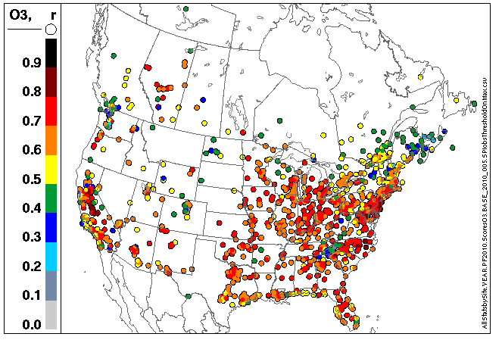

Platform Performance Evaluation: O3
YEAR | COUNTRY | NMB | NME
2010 | Canada | -5% | 37%
 | USA | 3% | 34%
2010* | Canada | -5% | 37%
 | USA | 3% | 34%
2006 | Canada | 5% | 38%
 | USA | 11% | 35%
by region
by station
Notes:
Pas de réseau pour Ozone en 2006 pour ile-prince-edouard

Slide 11
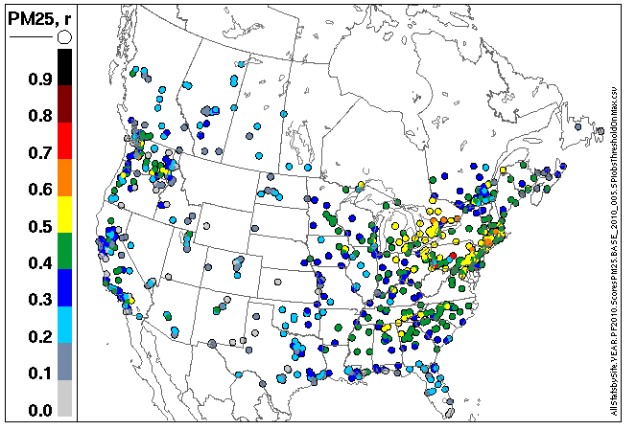
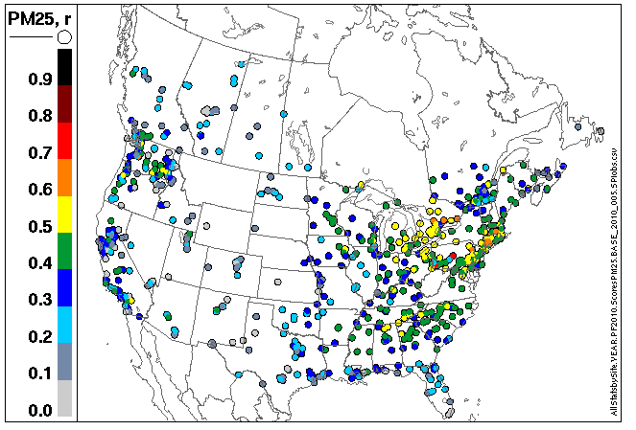
Platform Performance Evaluation : PM2.5
YEAR | COUNTRY | NMB | NME
2010 | Canada | -32% | 77%
 | USA | -43% | 67%
2010* | Canada | -31% | 77%
 | USA | -43% | 67%
2006 | Canada | -18% | 69%
 | USA | -37% | 61%
by region
by station
Notes:
Regarde Alberta et Saskatchewan des points change de couleur en animant

Slide 12
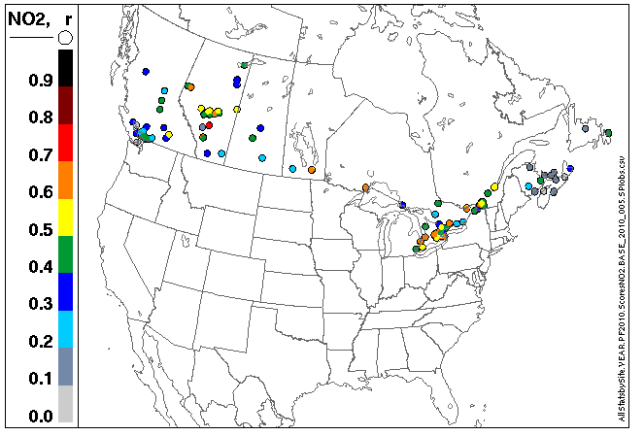
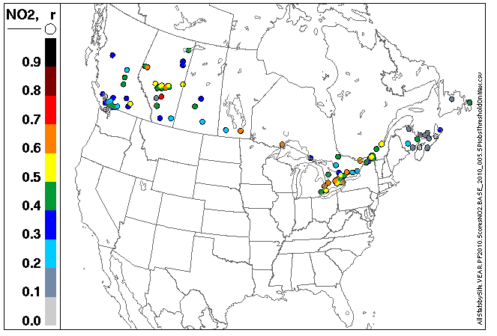
Platform Performance Evaluation : NO2
by region
YEAR | COUNTRY | NMB | NME
2010 | Canada | -40% | 72%
 | USA | NA | NA
2010* | Canada | -40% | 72%
 | USA | NA | NA
2006 | Canada | -42% | 70%
 | USA | -35% | 66%
by station
Notes:
Data not available for USA

Slide 13
Platform Performance Evaluation : monthly O3 analysis
USA
Canada
USA
Canada

Slide 14
Platform Performance Evaluation :
monthly PM2.5 analysis
USA
Canada
BC
USA
Canada

Slide 15
Platform Performance Evaluation :
O3 and PM2.5 daily time series
O3
PM2.5
Canada
USA

Slide 16
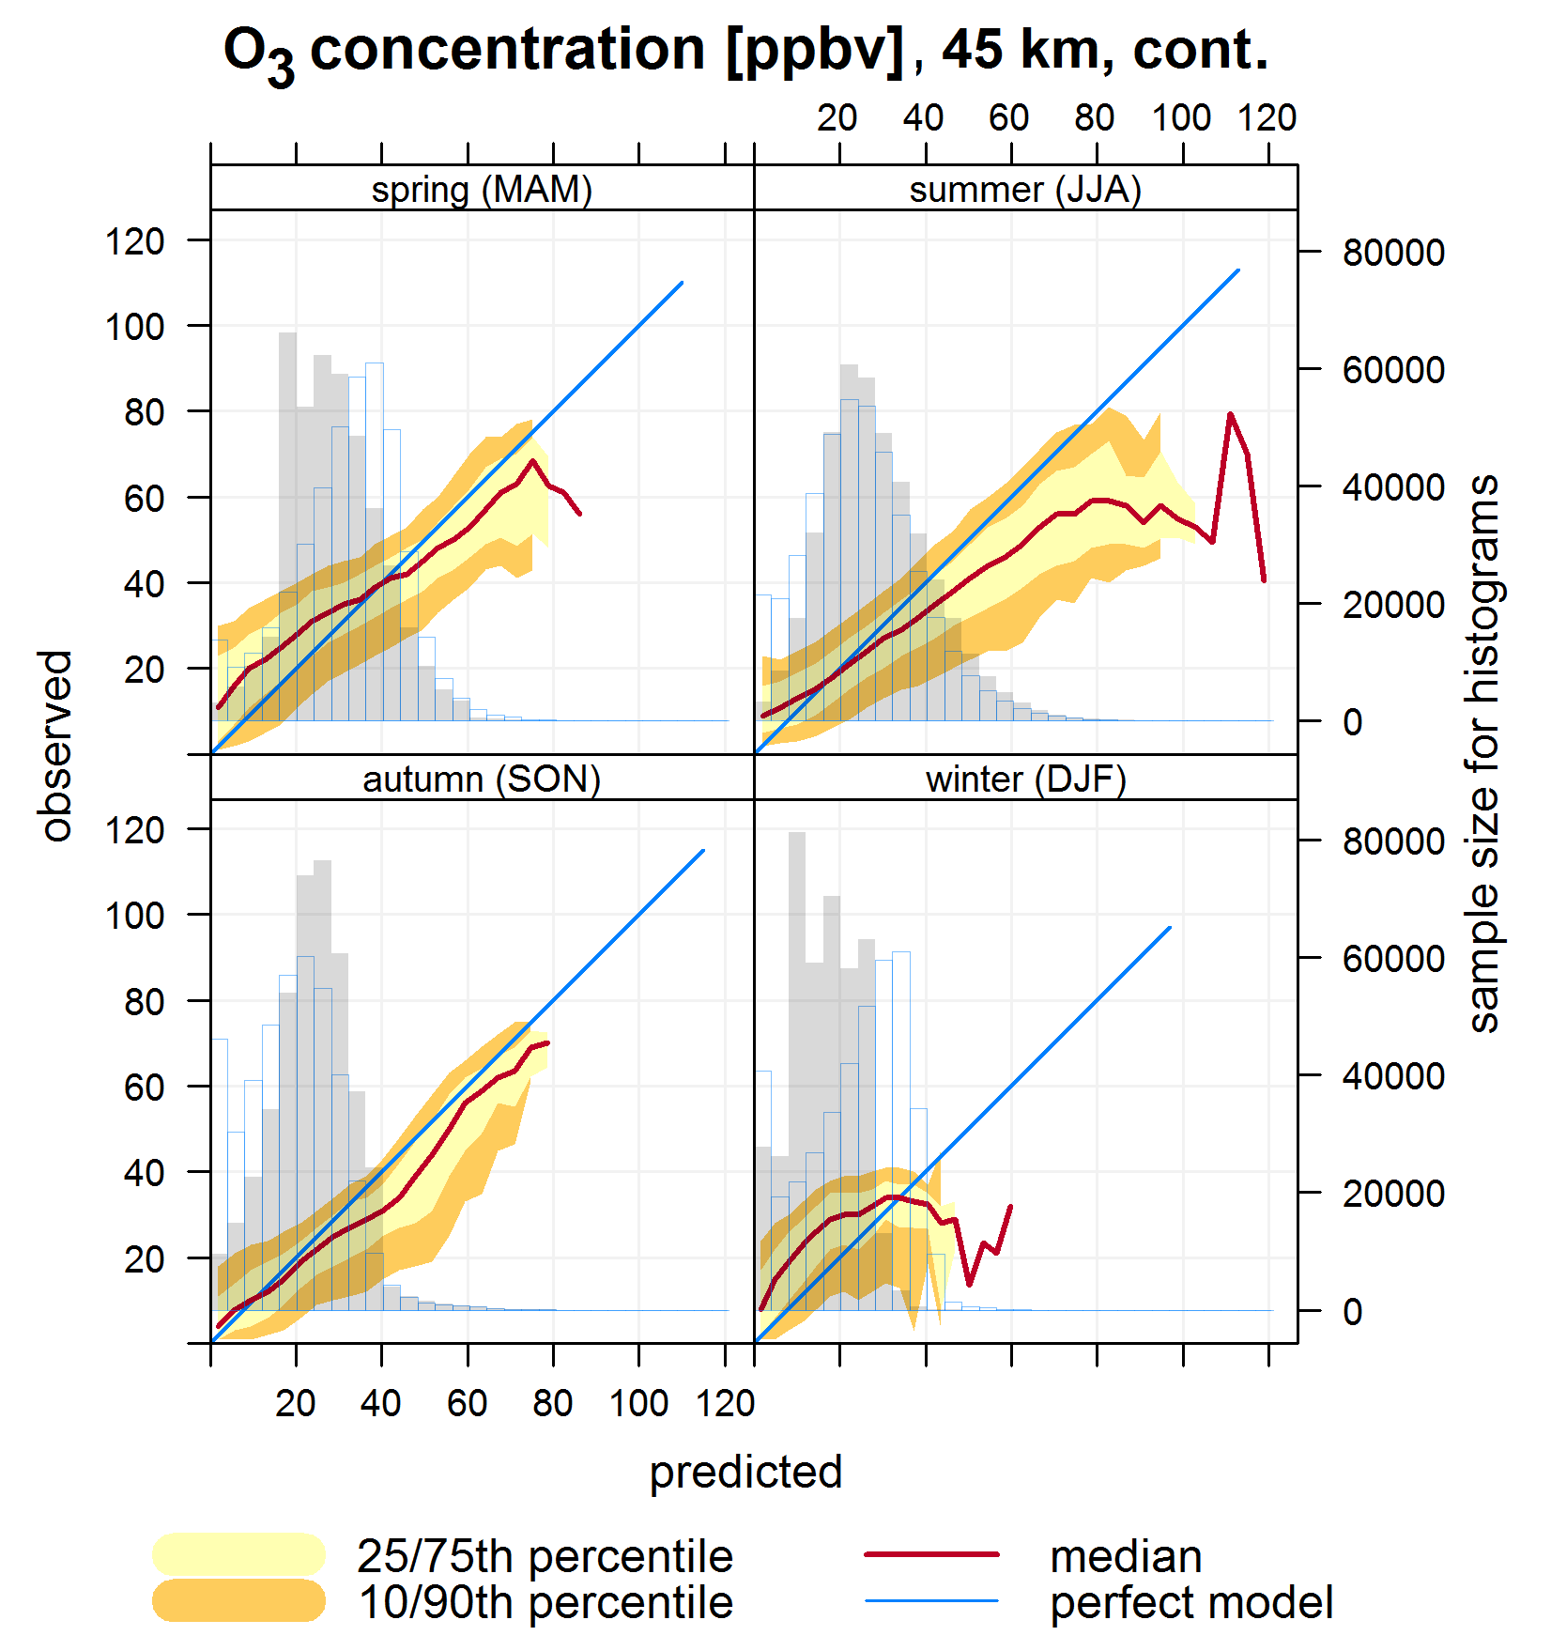
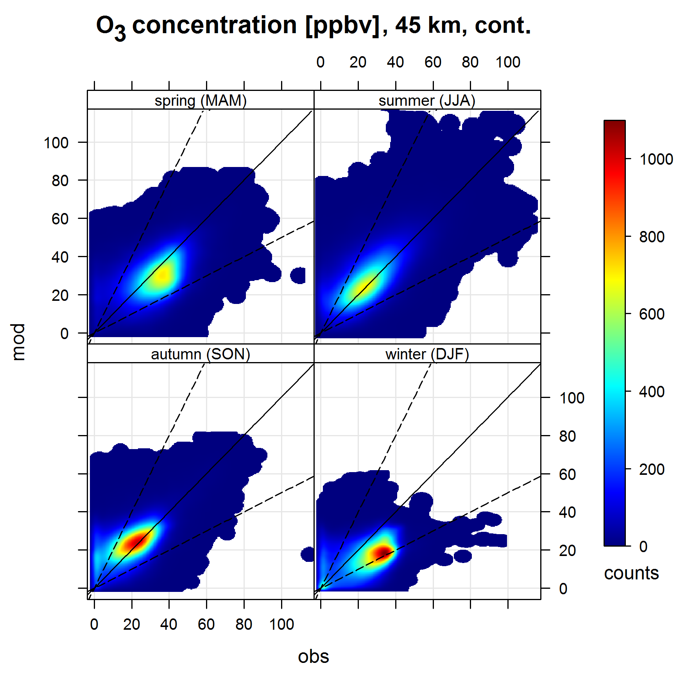
Platform Performance Evaluation : O3
Notes:
Gris = modèle
Blanc contour turquoise = obs

Slide 17
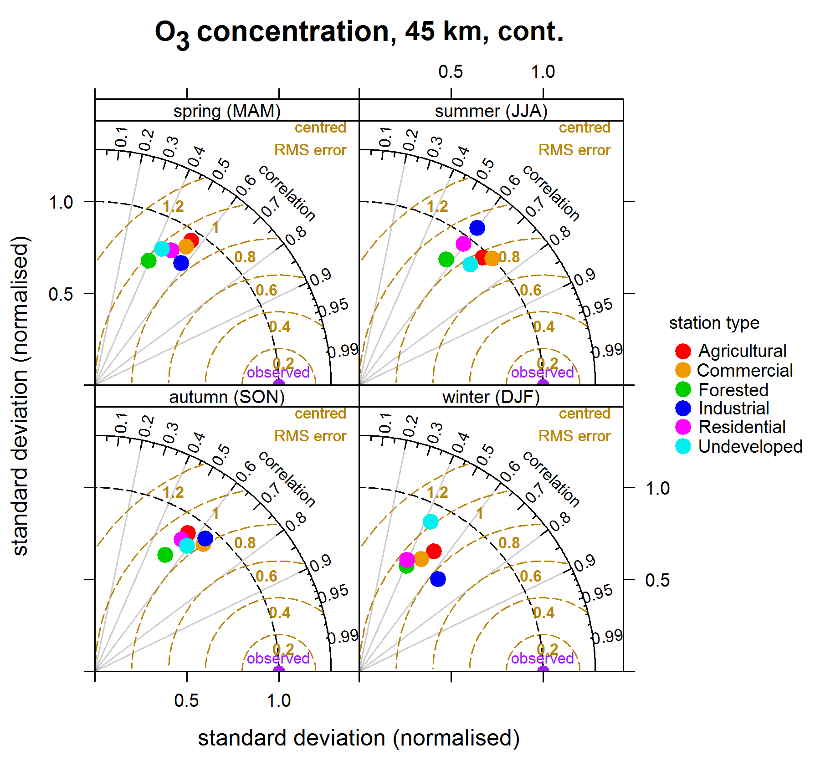
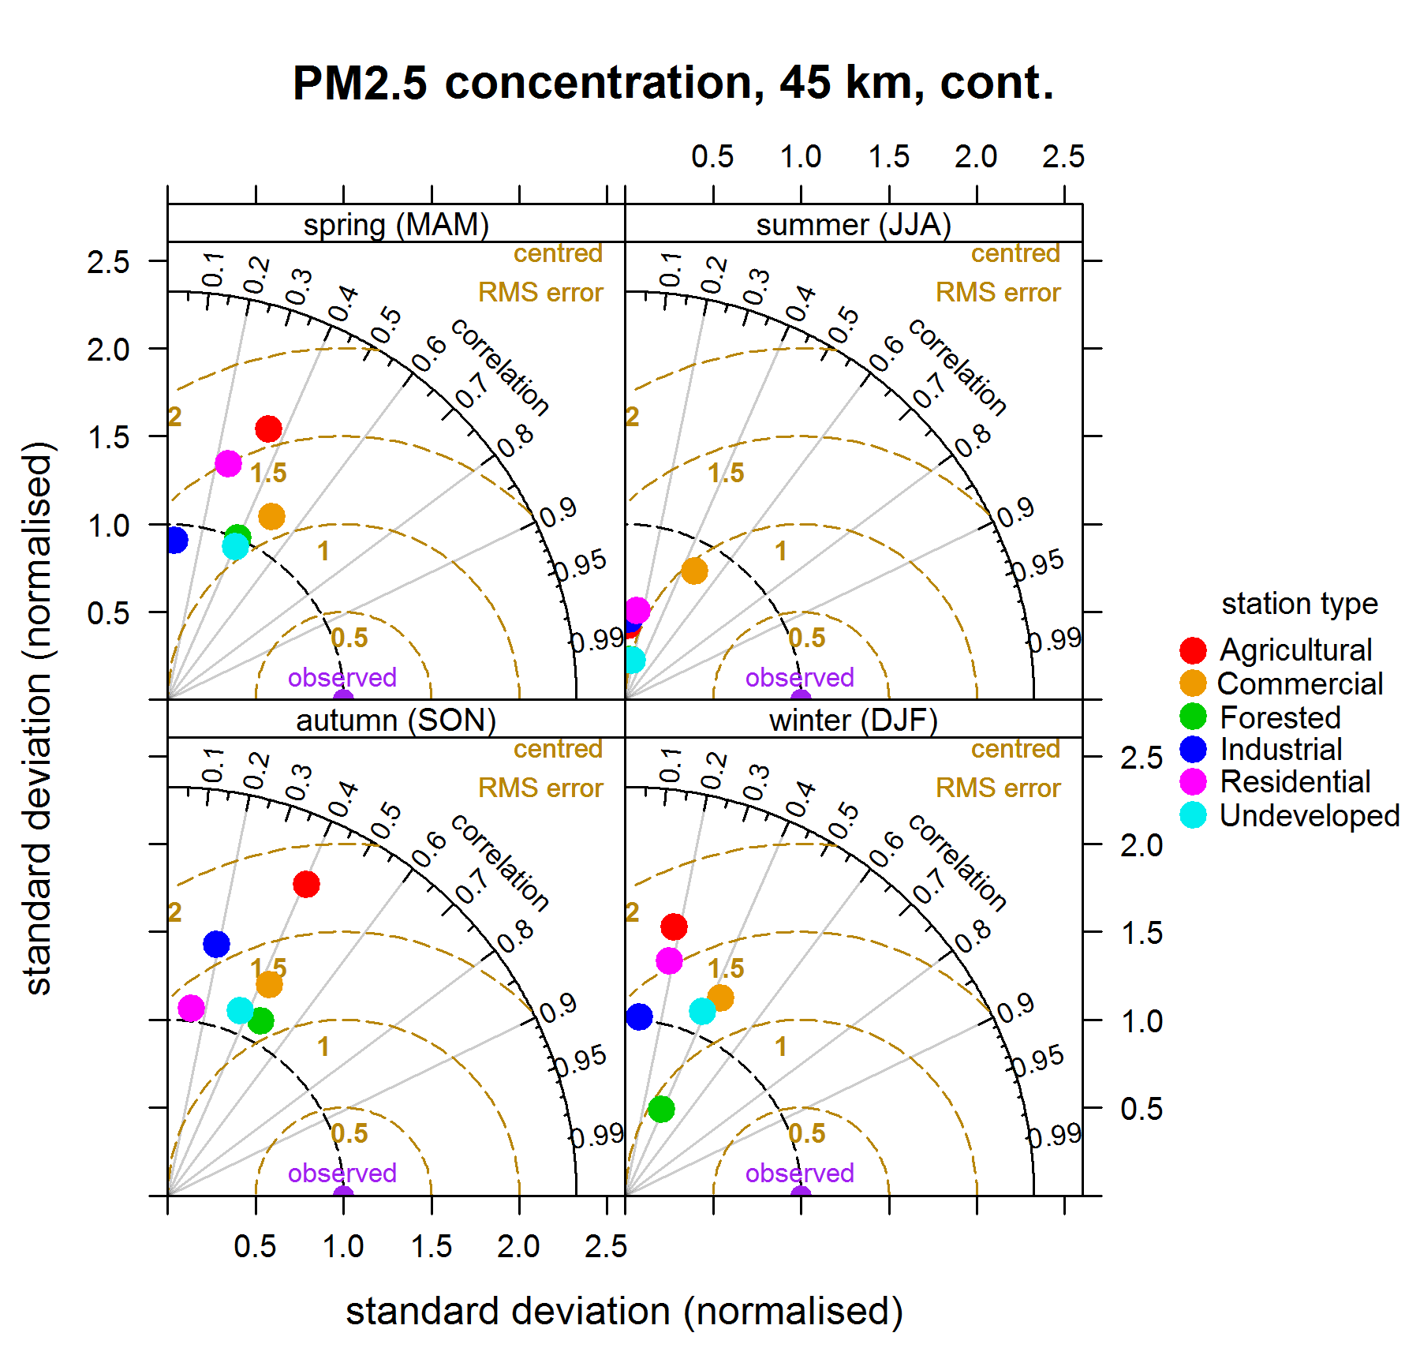
Platform Performance Evaluation:
O3 and PM2.5

Slide 18
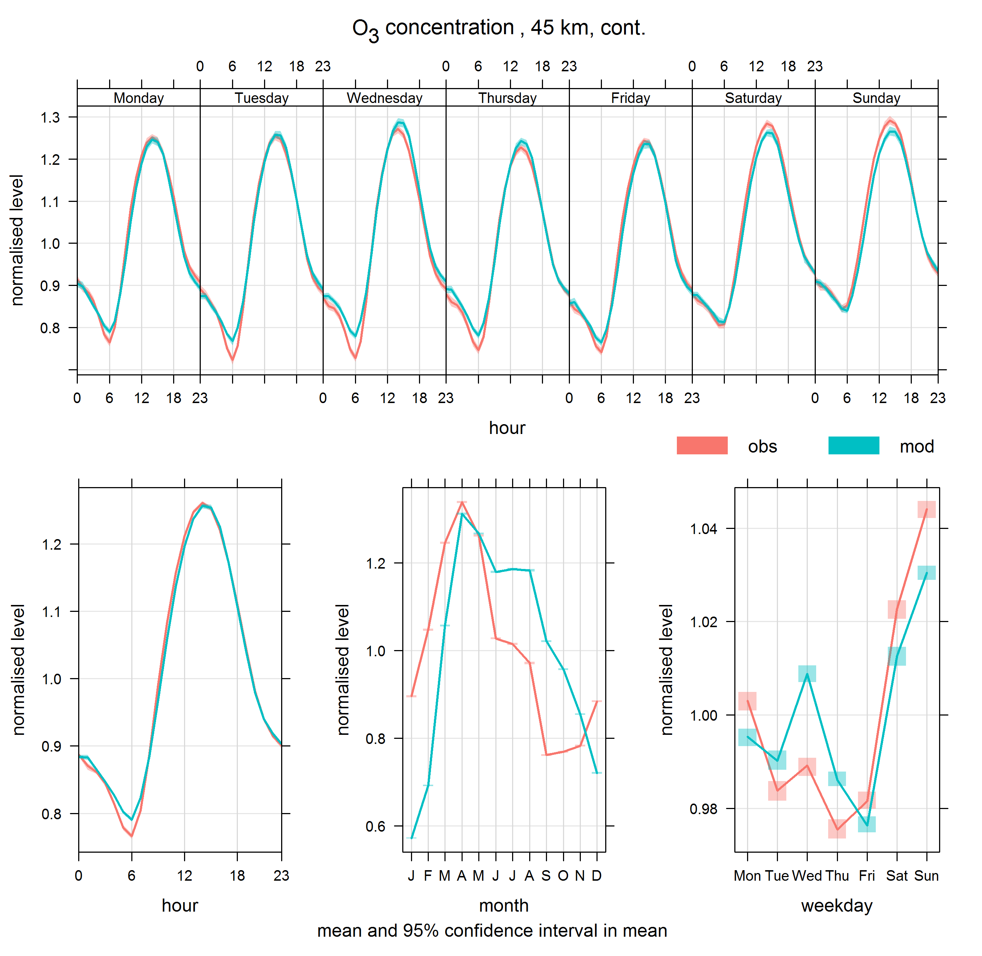
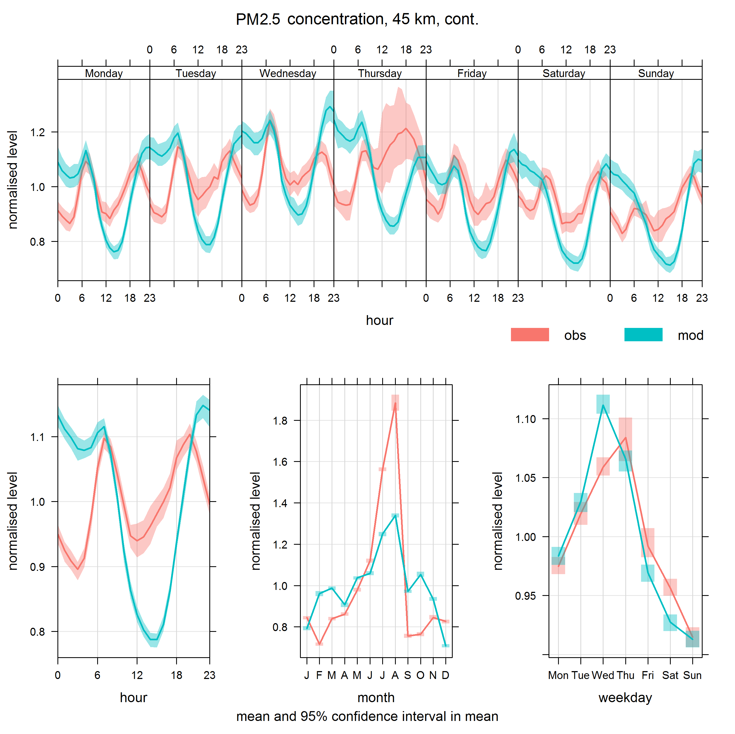
Platform Performance Evaluation :
O3 and PM2.5

Slide 19
Conclusion
  Preliminary results indicate that for O₃ and NO₂ results are comparable to 2006
  Changes done seems to have impacted more PM_{2.5}
  New tools will help us dig more to understand better our model behavior.
Notes:
Commentaires de Mourad:
Voici quelques limitations ou choses à améliorer :
For each month, we have one representative week for the anthropogenic emissions
Passage aux émissions journalières permet de mieux modéliser des épisodes non récurrents : forets fires, holidays, fugitives dust, fertilizers
No forest fires emissions and agricultural burns (necessite le passage aux émissions journalières)
Migration à MOVES pour les onroad canadiens pas completée
Modélisation à 45km, refaire les analyses avec 15km
Utilisation des statistiques socio-economiques de 2006 pour le génération des surrogates. Statistiques 2011 non disponibles.

Slide 20
Future Work
  Evaluate 15-km resolution base case runs using near real time observations
  Evaluate 45 km continental run and the 15 km run using QA/QC datasets
  Compare model performance at different grid resolution: 45km vs 22.5 km vs 15 km
  Evaluate intermediate steps to isolate the main source of change (meteorology, emissions, model updates)
Notes:
Commentaires de Mourad:
Voici quelques limitations ou choses à améliorer :
For each month, we have one representative week for the anthropogenic emissions
Passage aux émissions journalières permet de mieux modéliser des épisodes non récurrents : forets fires, holidays, fugitives dust, fertilizers
No forest fires emissions and agricultural burns (necessite le passage aux émissions journalières)
Migration à MOVES pour les onroad canadiens pas completée
Modélisation à 45km, refaire les analyses avec 15km
Utilisation des statistiques socio-economiques de 2006 pour le génération des surrogates. Statistiques 2011 non disponibles.

Slide 21

Calin Zaganescu, Jacinthe Racine, Nedka Pentcheva, (me), Annie Duhamel, Mourad Sassi, Mehrez Samaali, Rodrigo Munoz-Alpizar. Not in picture Sylvain Ménard.
Ackowlegment to the REQA team
Thank you for your attention!

Slide 22
NAPS station type | PM25 | O3
Residential | 42 | 96
Commercial | 16 | 42
Industrial | 5 | 6
Agricultural | 4 | 23
Forest | 5 | 23
Undeveloped | 4 | 18

Slide 23
Number of stations and ‘’obs-mod’’ pairs: O3
 | 2006 |  | 2010 | 2010 | 2010* | 2010*-2010
Prov./country | nstatn | npnt | nstatn | npnt | npnt* | diff | diff (%)
BC | 28 | 221404 | 29 | 199805 | 199803 | 2 | 0.0010010
AB | 23 | 185096 | 25 | 181528 | 181523 | 5 | 0.0027544
SK | 3 | 24750 | 3 | 24466 | 24461 | 5 | 0.0204365
MB | 3 | 24368 | 3 | 24317 | 24316 | 1 | 0.0041123
ON | 36 | 302879 | 41 | 350802 | 350802 | 0 | 0.0000000
QC | 46 | 376100 | 47 | 373173 | 373172 | 1 | 0.0002680
NB | 14 | 114444 | 14 | 114477 | 114474 | 3 | 0.0026206
PE | 0 | 0 | 3 | 24953 | 24953 | 0 | 0.0000000
NS | 9 | 70525 | 10 | 77555 | 77539 | 16 | 0.0206305
NL | 1 | 8677 | 4 | 30683 | 30683 | 0 | 0.0000000
NT | 2 | 15762 | 1 | 6358 | 6358 | 0 | 0.0000000
CAN | 165 | 1344005 | 180 | 1408117 | 1408084 | 33 | 0.0023436
USA | 961 | 6195989 | 1109 | 6731142 | 6731136 | 6 | 0.0000891
* Values above 150 ppbv were eliminated

Slide 24
Number of stations and ‘’obs-mod’’ pairs: PM2.5
 | 2006 |  | 2010 | 2010 | 2010* | 2010*-2010
Prov./country | nstatn | npnt | nstatn | npnt | npnt* | diff | diff (%)
BC | 30 | 201235 | 37 | 242464 | 242291 | 173 | 0.0713508
AB | 22 | 156661 | 24 | 157827 | 157677 | 150 | 0.0950408
SK | 0 | 0 | 3 | 23212 | 23208 | 4 | 0.0172325
MB | 4 | 31703 | 4 | 32889 | 32886 | 3 | 0.0091216
ON | 31 | 244757 | 36 | 271507 | 271507 | 0 | 0.0000000
QC | 39 | 327525 | 42 | 313306 | 313296 | 10 | 0.0031918
NB | 7 | 52246 | 8 | 56141 | 56139 | 2 | 0.0035625
PE | 0 | 0 | 3 | 23317 | 23317 | 0 | 0.0000000
NS | 5 | 35761 | 6 | 37979 | 37979 | 0 | 0.0000000
NL | 0 | 0 | 3 | 15756 | 15756 | 0 | 0.0000000
NT | 1 | 3870 | 0 | 0 | 0 | N/A | N/A
CAN | 139 | 1053758 | 166 | 1174398 | 1174056 | 342 | 0.0291213
USA | 403 | 3256918 | 612 | 4203188 | 4203143 | 45 | 0.0010706
* Values above 200 µg/m³ were eliminated

Slide 25
Number of stations and ‘’obs-mod’’ pairs: NO2
 | 2006 |  | 2010 | 2010 | 2010* | 2010*-2010
Prov./country | npnt | nstatn | nstatn | npnt | npnt* | diff | diff (%)
BC | 213924 | 27 | 32 | 210208 | 210208 | 0 | 0.0000000
AB | 195908 | 27 | 29 | 189865 | 189865 | 0 | 0.0000000
SK | 24857 | 3 | 3 | 24532 | 24532 | 0 | 0.0000000
MB | 24499 | 3 | 3 | 21289 | 21289 | 0 | 0.0000000
ON | 199554 | 24 | 33 | 268328 | 268328 | 0 | 0.0000000
QC | 111728 | 14 | 20 | 139050 | 139050 | 0 | 0.0000000
NB | 21274 | 4 | 6 | 38440 | 38440 | 0 | 0.0000000
PE | 0 | 0 | 3 | 10601 | 10601 | 0 | 0.0000000
NS | 14295 | 4 | 6 | 32844 | 32844 | 0 | 0.0000000
NL | 0 | 0 | 3 | 16110 | 16110 | 0 | 0.0000000
NT | 8530 | 1 | 0 | 0 | 0 | N/A | N/A
CAN | 814569 | 107 | 138 | 951267 | 951267 | 0 | 0.0000000
USA | 2371367 | 311 | 0 | 0 | 0 | N/A | N/A
* Values above 150 ppbv were eliminated

