Slide 1

Fine Scale Modeling of Ozone Exposure Estimates using a Source Sensitivity Approach
Cesunica E. Ivey, Lucas Henneman, Cong Liu, Yongtao T. Hu, Armistead G. Russell
Tuesday October 6, 2015
Fine Scale Modeling and Applications, 9:10 AM
14th Annual CMAS Conference
Chapel Hill, NC

Slide 2
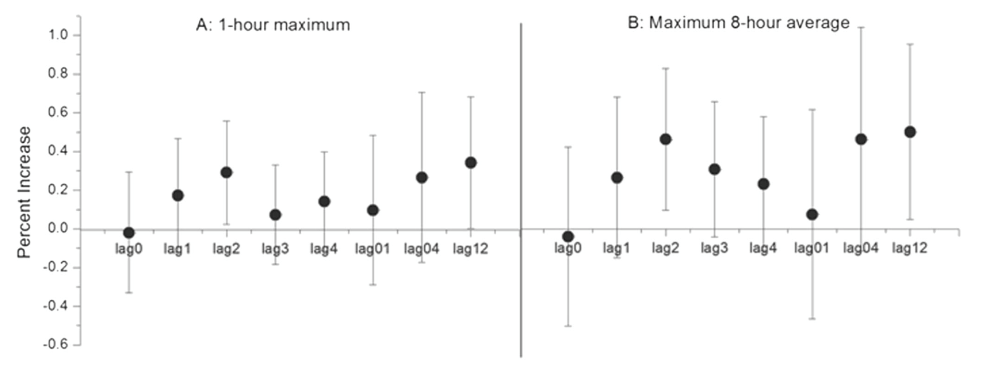
Motivation
Ozone exposure is associated with respiratory irritation and increased daily mortality.
Figure: Percent increase in daily mortality with 10 ug/m3 increase of ozone in Guangzhou, China
Source: Li et al., Environmental Science and Pollution Research, 22(11), June 2015

Slide 3
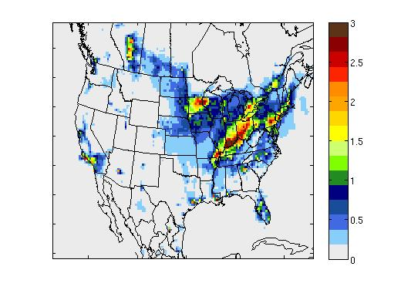
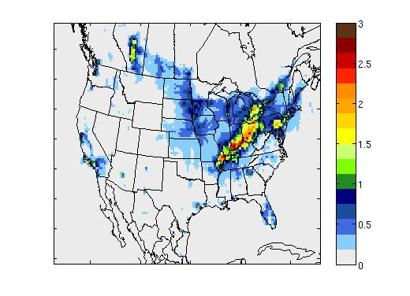
Related Work
We have optimized multi-year 36-km PM_{2.5} source impact fields for health studies: 2005-2007, up to 2014
Provides insight on spatial and temporal characteristics of source impacts
Optimized Non-Road Diesel Impacts on PM_{2.5}
July 25, 2006
CMAQ
Spatial Hybrid
Ivey et al. (2015), Geophys. Mod. Dev., 8, 2153-2165.
Notes:
Really emphasize that we have 10 years of pm2.5 data. Show the hybrid improvements.

Slide 4
Objectives
PM_{2.5} Source Impacts
(36 km)
1st Order Source Impacts on Ozone
(36 km)
1st Order Source Impacts on Ozone
(4 km)
1. Develop for health studies at the county-level and other local scales. ✓
2. Analyze to understand relationships between ozone and highly stratified source categories.
3. Develop to increase the spatial resolution of ozone data for health studies and mitigation.
With the new ozone standard, source interactions become more important for mitigation.
Notes:
Assess first-order source impacts on ozone using CMAQ-DDM sensitivity approach
Generate high-resolution spatial fields of first-order source impacts impacts for health analyses

Slide 5
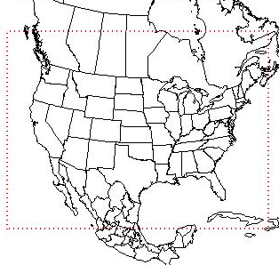
Study 1: Modeling
Episode
January 1, 2007 to December 31, 2007 over CONUS
Meteorology
Emissions
WRF ARW v3.3.1 | Kain-Fritsch cumulus parameterization
ACM2 PBL scheme | RRTM longwave radiation
Pleim-Xiu LSM | Dudhia shortwave radiation
36-km | Morrison 2-moment microphysics
Figure: 36 km Domain
CMAQ-DDM
SMOKE v3.1 | NEI 2008 Platform
SAPRC99 speciation | 16 source categories
v5.0.2 | Aerosol module 6
1st order DDM | SAPRC07tc mechanism

Slide 6
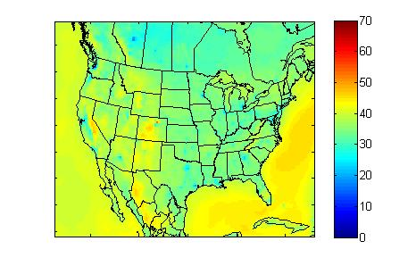
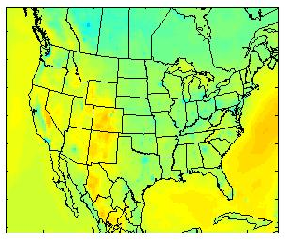
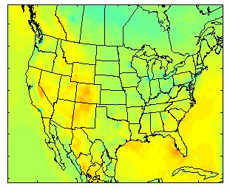
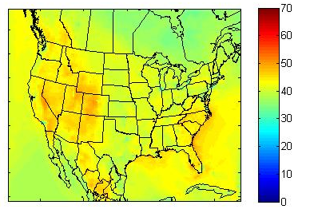
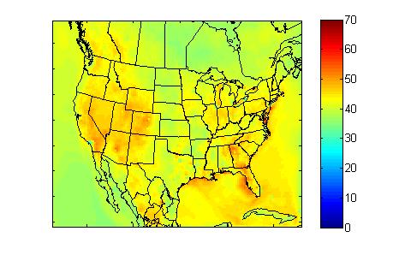
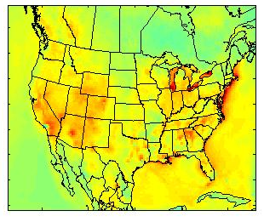
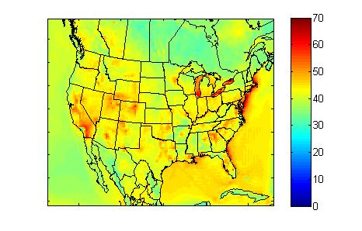
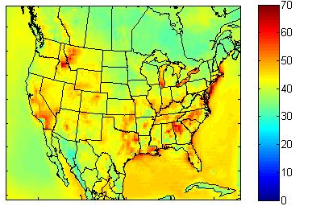
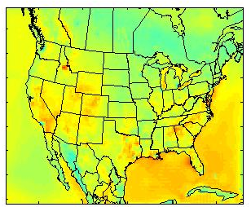
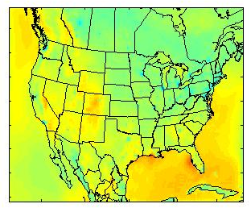
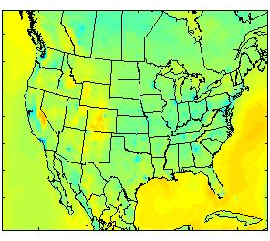
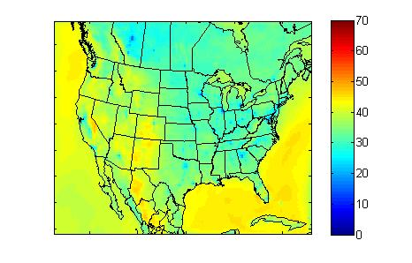
Study 1: Results
2007 Monthly-Averaged 8-hr Max Ozone (ppb)
Jan
Feb
Mar
Apr
May
Jun
Jul
Aug
Sep
Oct
Nov
Dec

Slide 7
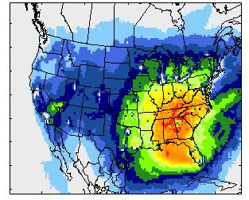
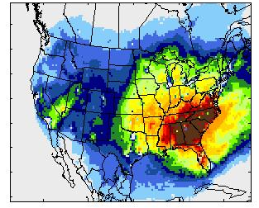
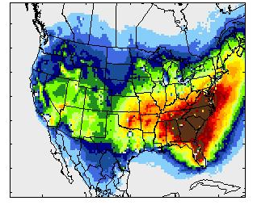
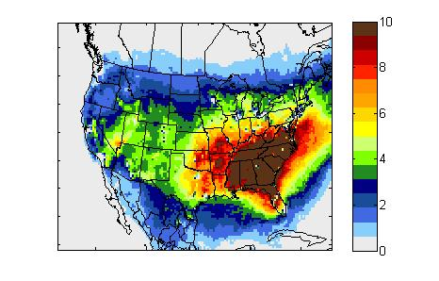
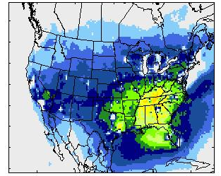
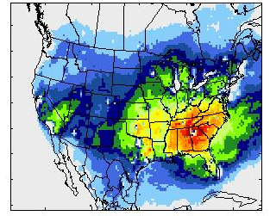
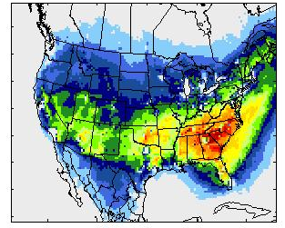
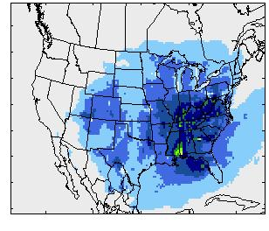
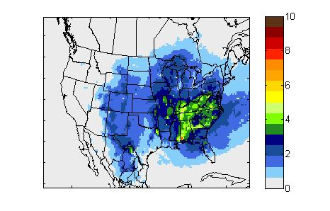
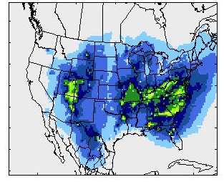
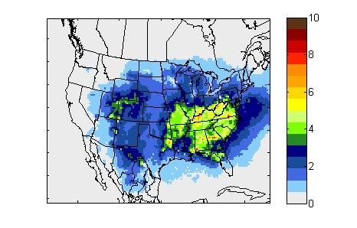
Study 1: Results
2007 Monthly-Averaged 8-hr Max 1st-order Ozone Sensitivities (ppb)
May
Jun
Jul
Aug
On-road
Gas
On-road
Diesel
Coal

Slide 8
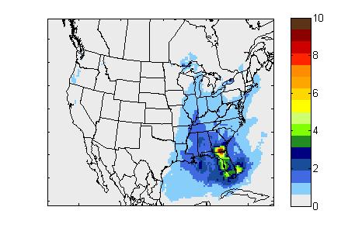
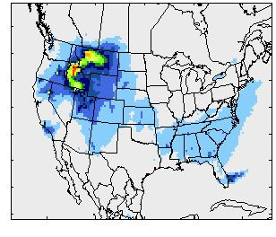
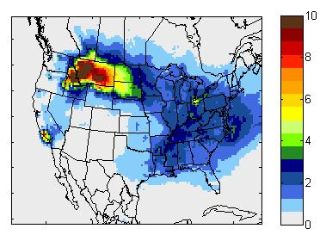
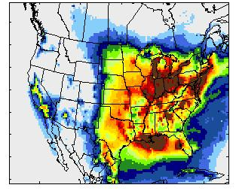
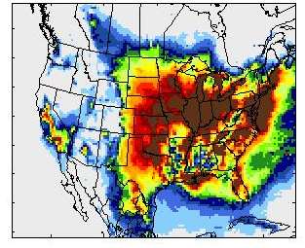
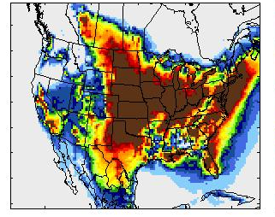
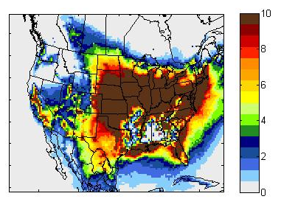
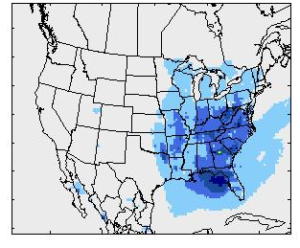
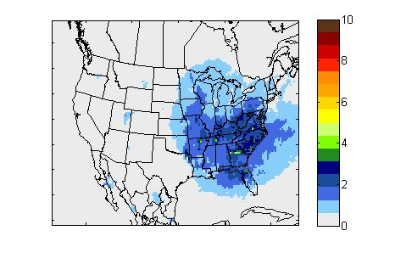
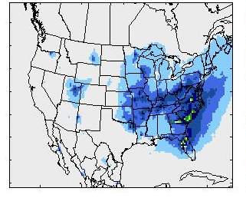
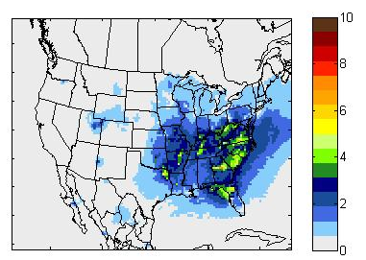
Study 1: Results
2007 Monthly-Averaged 8-hr Max 1st-order Ozone Sensitivities (ppb)
May
Jun
Jul
Aug
Biomass
Burning
Biogenics
Fuel Oil

Slide 9
Study 1: Results
July 2007 Monthly-Averaged Diurnal Profiles for 8hr-Max Ozone (ppb) Local Time
Atlanta (GA), Salt Lake City (UT), and Los Angeles (CA)
Total
Coal Burning
Fuel Oil Burning
Biogenics
Biomass Burning
Notes:
Where is all the LA ozone coming from? Possibly the “others” category

Slide 10
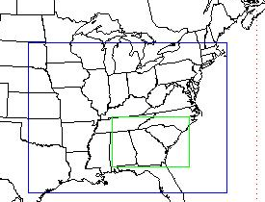
Study 2: Modeling
Episode
May 1, 2007 to June 30, 2007 over Southeast
Meteorology
Emissions
WRF ARW v3.3.1 | Kain-Fritsch cumulus parameterization
ACM2 PBL scheme | RRTM longwave radiation
Pleim-Xiu LSM | Dudhia shortwave radiation
4-km | Morrison 2-moment microphysics
Figure: 4 km Domain (green)
CMAQ-DDM
SMOKE v3.1 | NEI 2008 Platform
SAPRC99 speciation | 16 source categories
v5.0.2 | Aerosol module 6
1st order DDM | SAPRC07tc mechanism

Slide 11
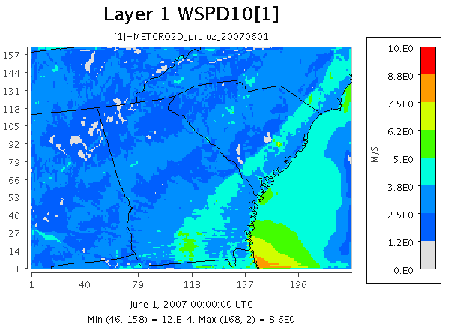
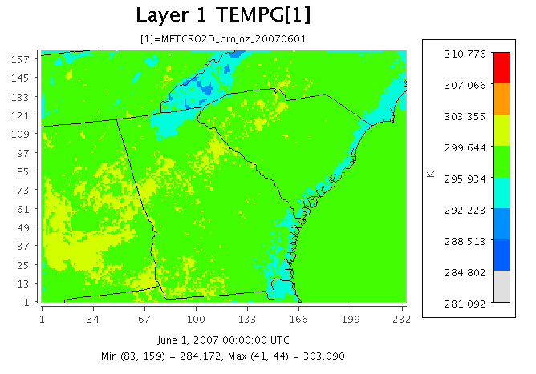
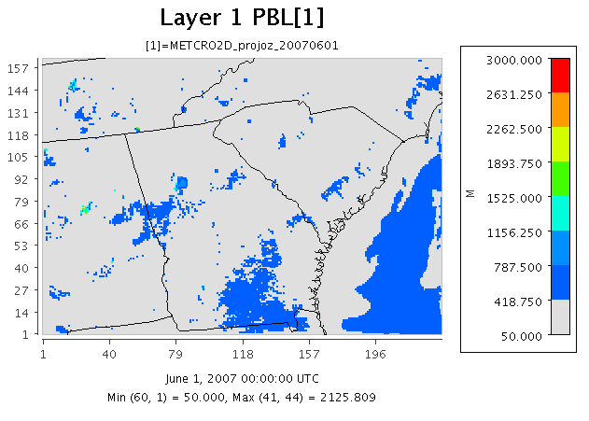



Study 2: Preliminary Results
Meteorology for June 1, 2007
Top-left | Wind speed at 10 m (m/s)
Bottom-left | Skin temperature (K)
Bottom-right | PBL height (m)
Noon EST | 17:00 UTC

Slide 12
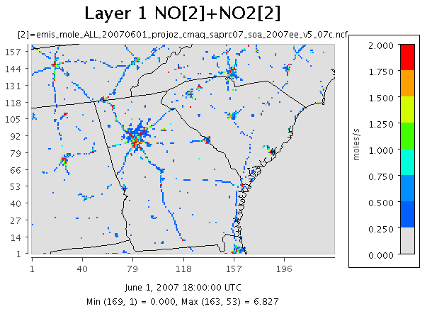
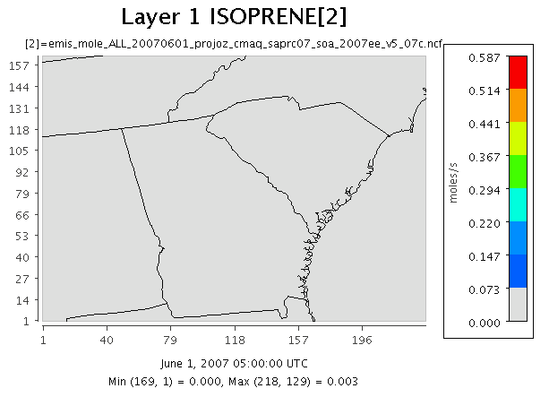
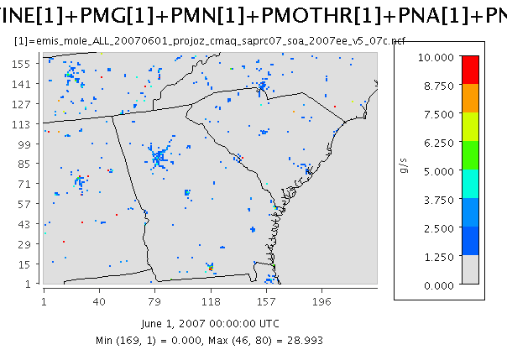
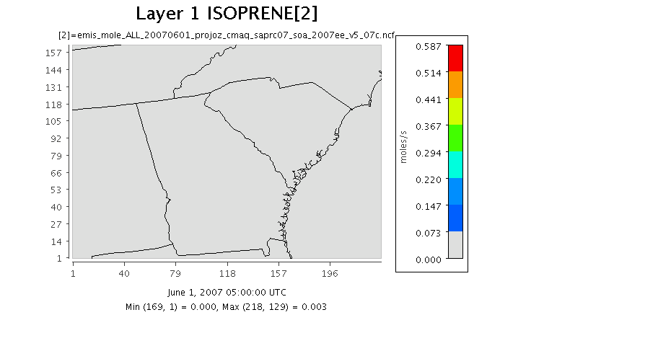

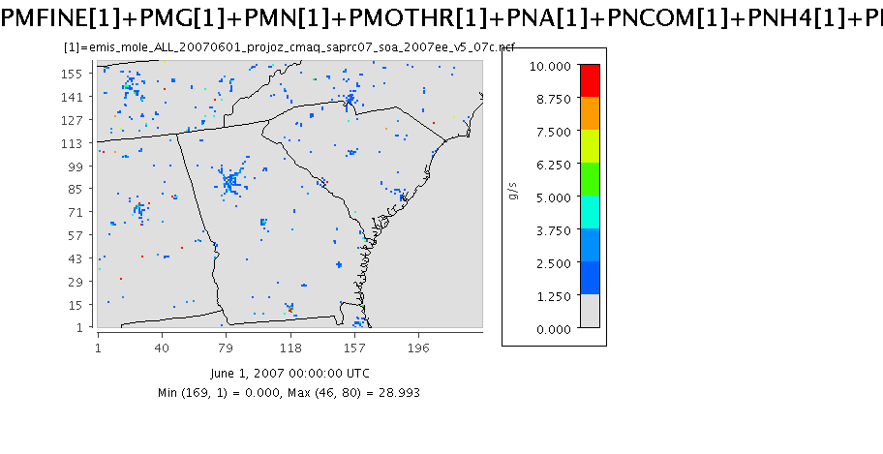
Study 2: Preliminary Results
Emissions for June 1, 2007
Top-left | NOx (moles/s)
Bottom-left | Isoprene (moles/s)
Bottom-right | Particulate matter (g/s)
Noon EST | 17:00 UTC

Slide 13
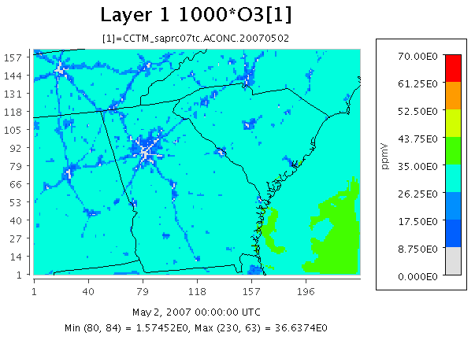
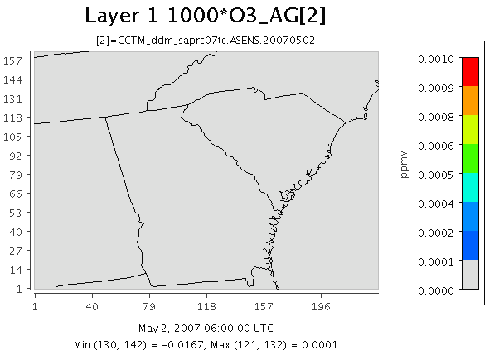
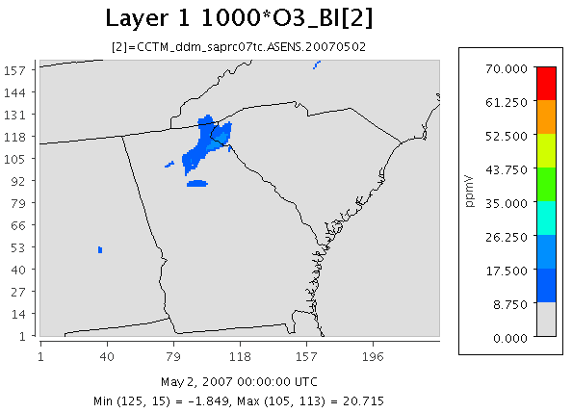



Study 2: Preliminary Results
CMAQ Results for May 2, 2007
Top-left | O3 concentration (ppb)
Bottom-left | O3 sensitivity to agriculture (ppb)
Bottom-right | O3 sensitivity to biogenics (ppb)
Noon EST | 17:00 UTC

Slide 14
Study 2: Preliminary Results
36 km vs 4km 8-hr Averaged Ozone Concentration (ppb)
Atlanta, GA May 1-8, 2007

Slide 15
Implications
Fine-scale ozone data are beneficial for health analyses
Ozone sensitivity analysis with highly stratified emissions may be beneficial for mitigation efforts
Future work:
  Complete 2007 4-km simulations
  Further explore ozone/PM_{2.5}-source relationships over the intermountain west, with an emphasis on wildfires (University of Nevada, Reno)
Poster: Lucas Henneman, Evaluation of air pollution sensitivities…
Session: Model Evaluation and Analysis

Slide 16



Acknowledgements
Southeastern Center for Air Pollution and Epidemiology (SCAPE)
EPA STAR Graduate Fellowship Program
Alfred P. Sloan Foundation
14th Annual CMAS
SCAPE Center Organization
This presentation was made possible in part by USEPA, NASA, and STAR Fellowship Assistance Agreement no. FP-91761401-0. It has not been formally reviewed by EPA. Its contents are solely the responsibility of the grantee and do not necessarily represent the official views of the funding sources and those sources do not endorse the purchase of any commercial products or services mentioned in the publication.

