Slide 1
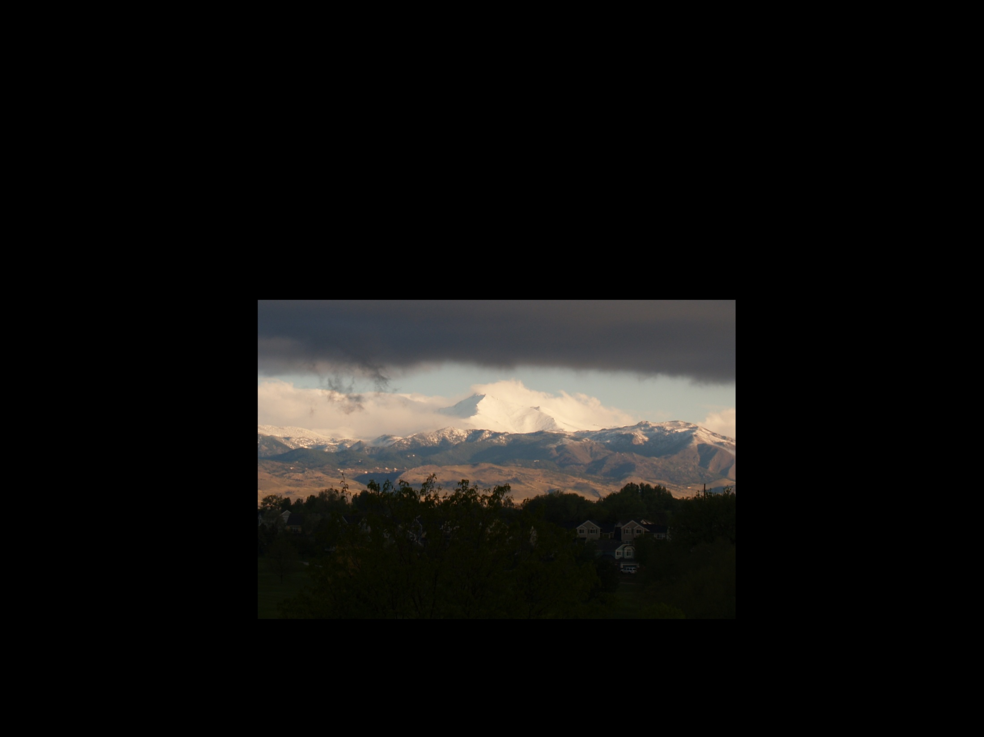
Source Attribution Modeling to Identify Sources of Regional Haze in Western U.S. Class I Areas
Gail Tonnesen, EPA Region 8
Pat Brewer, National Park Service
Tom Moore, WESTAR/WRAP
CMAS, Chapel Hill, NC, October 6, 2015

Slide 2
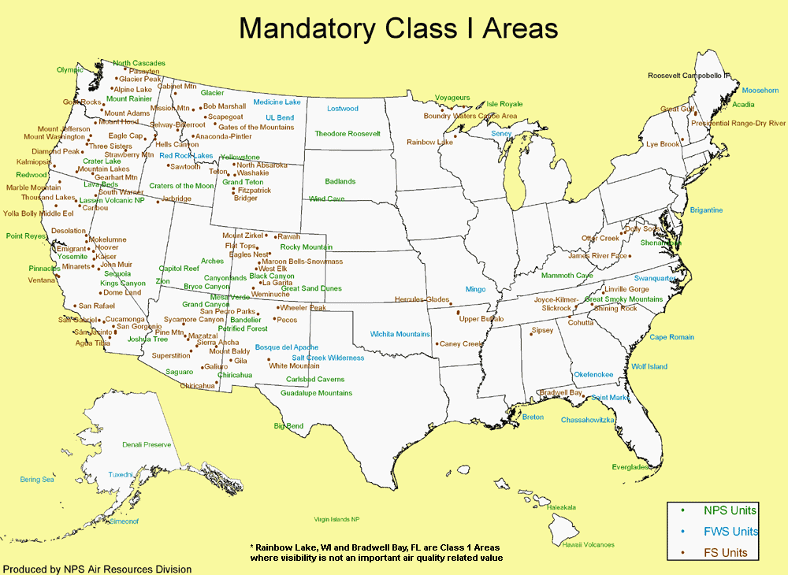
Regional Haze
Clean Air Act goal is to achieve natural visibility at Class I areas by 2064.
Regional haze metrics rely on IMPROVE monitoring data:
light extinction: b_{ext} (Mm⁻¹)
visual range = 3.91/b_{ext}
deciviews = 10 ln(b_{ext}/10 Mm⁻¹)
20 Mm⁻¹ = 200 km = 11 dv
100 Mm⁻¹ = 40 km = 24 dv
States submit SIPs every 10 years showing progress on improving visibility.
Regional Haze goal is linear progress in reducing haze (in deciviews) on the worst 20% days and no degradation on the best 20% days.
Uniform rate of progress (aka Glidepath) is defined as the slope of the line from baseline worst 20% deciviews to the natural deciviews.
Model simulations did not show progress below the glidepath at some western Class I areas, but modeled progress was evaluated on the 20% worst days that included wildfires.

Slide 3
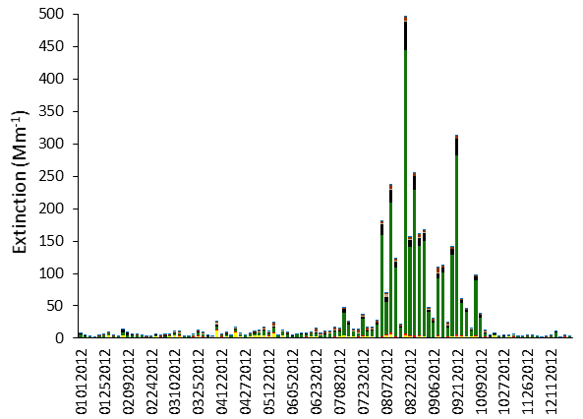
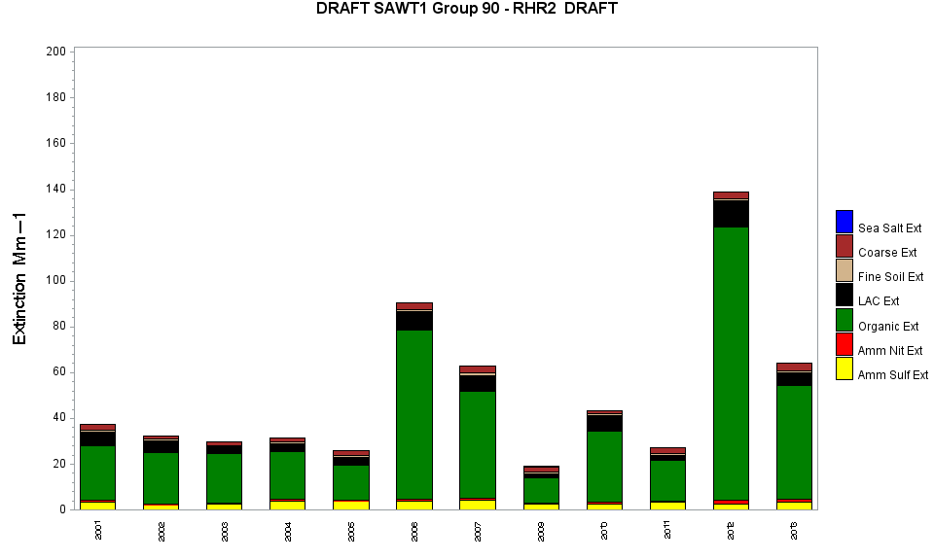
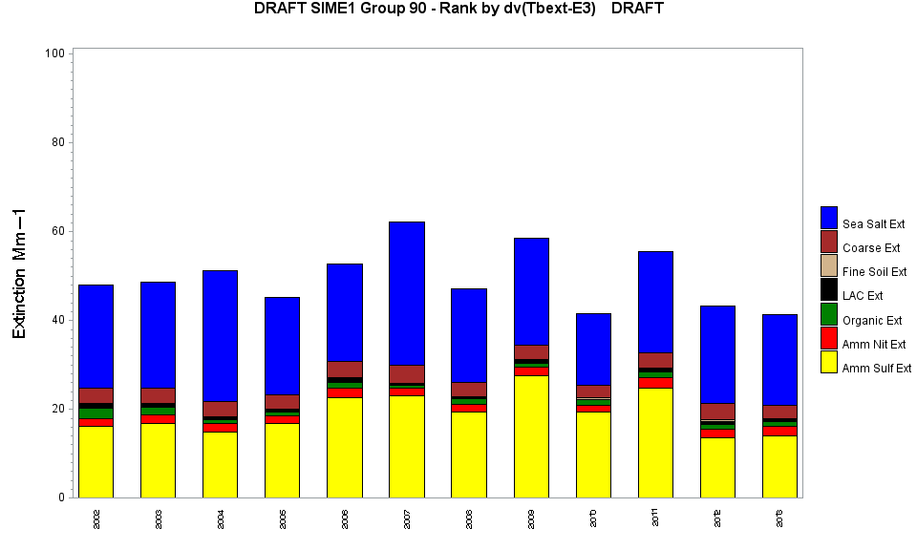
Sawtooth Wilderness Area, ID
Example of tracking progress:
  At Sawtooth Wilderness Area episodic natural events (e.g. wildfires), not anthropogenic emissions, dominate the 20% worst visibility days.
2012 IMPROVE daily data (bext)

Slide 4
Regional Haze Research Topics
Improved estimates of natural visibility conditions:
  Need site specific and seasonally varying estimates of natural haze.
  Can we quantify contributions from wildfires and other extreme episodic events?
  How well can models estimate natural visibility conditions?
  Can we use source apportionment modeling to distinguish domestic versus international contributions to natural haze?
Model evaluation – how accurately do models predict:
  The species composition of PM2.5
  Seasonal variations in speciated PM2.5
  Ammonia limited chemical regimes
  Source attribution and model response to emissions reductions
International transport:
  How reliable are model estimates for international transport?
  Need evaluation of global scale chemistry-transport models.

Slide 5
WestJumpAQMS 2008 Modeling
Annual CAMx simulation with a 12 km grid over the western US.:
  Model performance evaluation completed for ozone and speciated PM2.5.
  CAMx APCA used for ozone source apportionment and CAMx PSAT used for PM2.5 source apportionment.
PSAT source regions treat each of the western states, Eastern US, MX, CA, off-shore shipping and boundary conditions.
Source Sector Categories:
  Total anthropogenic emissions
  Biogenic Emissions
  3 classes of fire emissions: Wild fires, Prescribed fires and agricultural burning

Slide 6
Nested 36/12/4-km CAMx Domains
Lateral BC from MOZART Global Model
25 CAMx layers from the surface to the lower stratosphere.

Slide 7
CAMx 2008 Monthly average fractional bias
36 &12 km grids compared to IMPROVE data, averaged for all sites. More detailed results at: http://www.wrapair2.org/WestJumpAQMS.aspx
SO4
NO3
OC
EC

Slide 8
Summary of Aggregate Model Performance
Model performance (using monthly averages) is similar for the 36, 12 and 4 km grids.
Model is biased high for nitrate and EC, biased low for OC, and biased low for sulfate in spring & summer.
However, we should also evaluate model performance at individual Class I areas and for individual days.

Slide 9
MPE and PSAT results for Example class I Areas
Rocky Mt National Park (ROMO)
Lassen Volcanic National Park
For each site, compare IMPROVE data and model performance.
Show PSAT model estimate of U.S. anthropogenic contribution.
Focus on the 20% worst visibility days:
  How does the seasonal distribution of the worst days compare for the model and the IMPROVE data?
  Does the seasonal distribution change for worst US contribution to have versus the total haze?

Slide 10
MPE and PSAT results for Example class I Area: Rocky Mtn National Park

Slide 11
CAMx performance for sulfate and nitrate:
Rocky Mtn National Park
Biased high in winter
Biased low in spring & summer
Biased high in winter
Biased low in summer

Slide 12
CAMx PSAT anthropogenic extinction: ROMO

Slide 13
ROMO: contributions to sulfate

Slide 14
Lassen Volcanic National Park

Slide 15
CAMx performance for sulfate and nitrate:
Lassen Volcanic National Park
Biased high in winter
Biased low in spring
Biased high for wildfire
Biased high in winter and spring
Biased high for wildfire

Slide 16
CAMx PSAT anthropogenic extinction: Lassen

Slide 17
Lassen: source contributions to sulfate
How much confidence do we have in global model estimates of boundary conditions?

Slide 18
Next Steps
Global CTM evaluation and improvements:
  How well do global CTMs perform for natural, anthropogenic and fire emissions?
  Include source apportionment info in global models and pass through to nested regional models.
  Estimates of future trends in international transport.
  Need funding for global modeling improvements.
Updated CAMx and CMAQ source apportionment simulations for more recent years: 2011, 2014:
  Need improved treatment of NH3 emissions and fate.
  Improved model seasonal performance for sulfate and nitrate
  Improved treatment of episodic events: wild fires, wind blown dust.
  Assessment of seasonal variability in natural visibility conditions.
  Assessments of international transport (natural and anthropogenic contributions).
  Need funding to support regional modeling studies.
More research is needed to improve estimates of international transport:
  Same global/regional modeling platforms that would be useful for regional haze analysis can also be used to study background ozone in the western U.S.

Slide 19
Acknowledgments
ENVIRON performed CAMx PSAT simulations
Air Resource Specialists helped with data analysis

