Slide 1

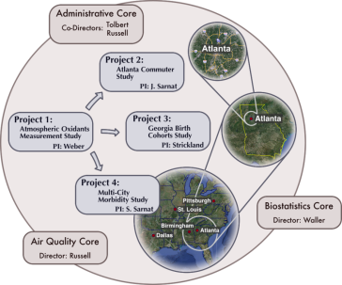

Going from 12-km to 250-m resolution
R834799
SCAPE
Comparison of Two Downscaling Techniques
Josephine Bates¹, Audrey Flak², Howard Chang², Heather Holmes³, David Lavoue¹, Mitchel Klein², Matthew Strickland², Lyndsey Darrow², James Mulholland¹, Armistead Russell¹
¹Georgia Institute of Technology ² Emory University ³ University of Nevada, Reno

Slide 2
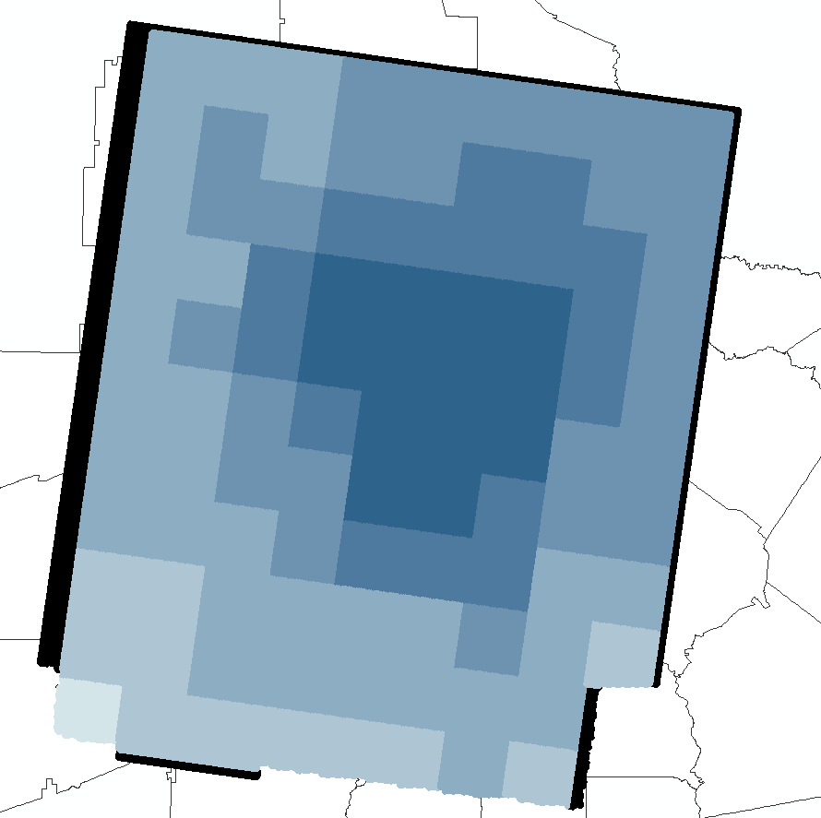
Motivation
Epidemiologic data for population-based studies available at a finer spatial resolution than air quality data
Health Data (~25,000 points)
12-km Average (99 cells)
Sites of homes for health study
<0.35
0.35 – 0.6
0.6 – 0.8
0.8 – 1.0
1.0 – 1.3
1.3 – 1.6

Slide 3
Goal
Goal: Develop a method for estimating daily exposure estimates at 250-m grid resolution using 12-km CMAQ data for a birth cohort study
Two approaches:
  Bayesian Statistical Downscaler
  CTM - Dispersion Model Fusion

Slide 4
Approach 1
Bayesian Statistical Downscaler

Slide 5
Inputs
SPATIAL AND TEMPORAL PREDICTORS
  Daily CMAQ PM_{2.5} for 2005
    CDC National Environmental Public Health Tracking Network, v4.7, CB05, 24 vertical layers, 2002 NEI, MM5, 12-km Eastern United States
  Daily or every 3-day monitor data PM_{2.5} for 2005
LAND USE AND METEOROLOGICAL VARIABLES
  Daily average temperature & wind speed for 2005
    WRF v3.3.1, 13 vertical layers, Pleim-Xiu land surface model
  2011 annually-averaged Atlanta Regional Commission (ARC) roadway emissions or Research Line (R-LINE) dispersion model concentration estimates (assume 2011 data apply to each year)

Slide 6
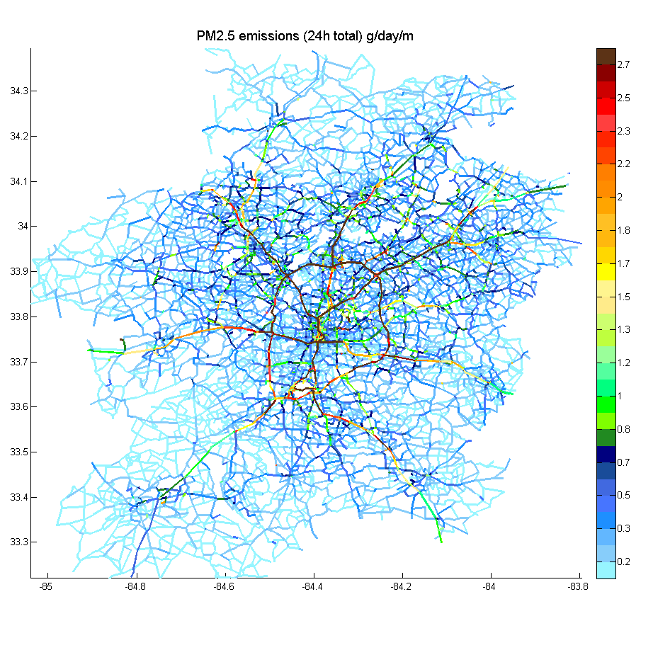
Inputs
2011 ARC Emissions
Link-based emissions
in g/day/m provided by the
Atlanta Regional Commission

Slide 7
Inputs
R-LINE is a line-source dispersion model for near-surface releases developed by the EPA
ΔPM_{2.5} = 10 ^{[0.32*log(RLINE_PM2.5) -} ^{0.05)}
We adjusted the R-LINE estimates using a three-step process
1. Fit R-LINE estimates to Chemical Mass Balance (CMB) vehicle source estimates
2. Fit R-LINE estimates to monitor values (after subtracting out background PM_{2.5})
3. Average the coefficients from each fit
Xinxin Zhai, et al. “Comparison and calibration of Research-Line (RLINE) model results with measurement-based and CMAQ-based source impacts” , 14th Annual CMAS Conference. Chapel Hill, NC. 2015

Slide 8
Method (Bayesian Statistical Downscaler)
PM (s,t) = α_{o}(s,t) + α₁(s,t)*AQ(s,t) + ε(s,t)
Additive bias: α_{o}(s,t) = β_{o}(s) + β_{o}(t) + 𝛾_{o}Z_{o}
Multiplicative bias: α₁(s,t) = β₁(s) + β₁(t) + 𝛾₁Z₁
PM = point-level measurements (PM_{2.5} observations)
AQ = gridded air quality data (CMAQ replaced aerosol optical depth (AOD)
Z = land use and meteorology (Temp, WS, ARC or R-LINE)
ε = residual errors
Chang et al. (2013), Calibrating MODIS aerosol optical depth for predicting daily PM2.5 concentrations via statistical downscaling, Journal of Exposure Science and Environmental Epidemiology, 24, 398-404.

Slide 9
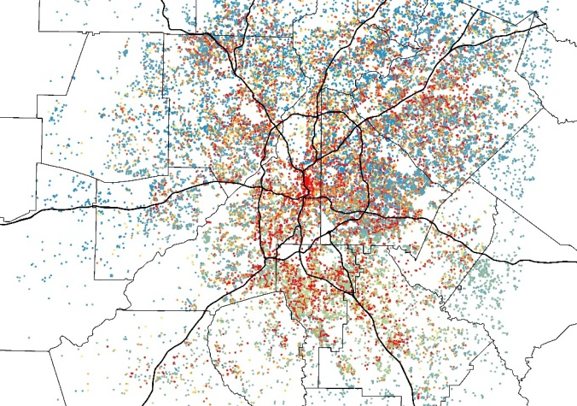
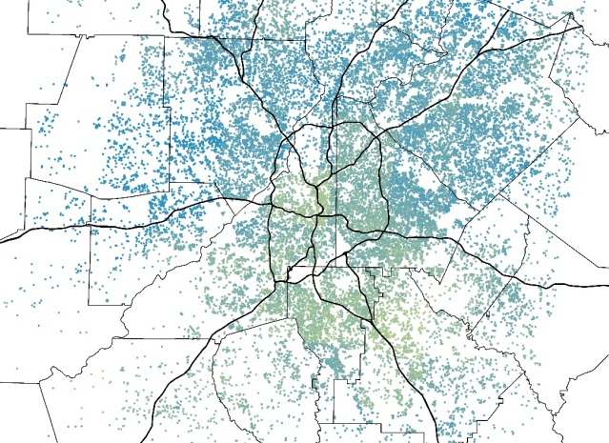
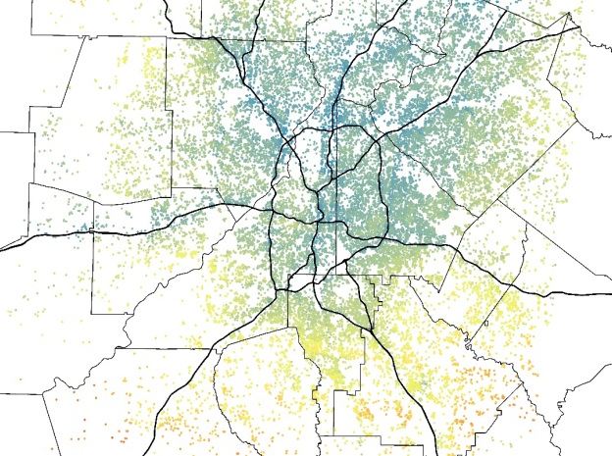
2005 Annually-Averaged Estimates
*only health study sites
ARC Emissions
ARC + Obs
R-LINE concentrations
< 16.0
16.0 - 18.0
18.0 - 20.0
> 20.0
μg/m³
Mean (SD) = 17.7 (3.0)
Mean (SD) = 15.7 (0.6)
Mean (SD) = 16.8 (0.9)
μg/m³
μg/m³
μg/m³

Slide 10
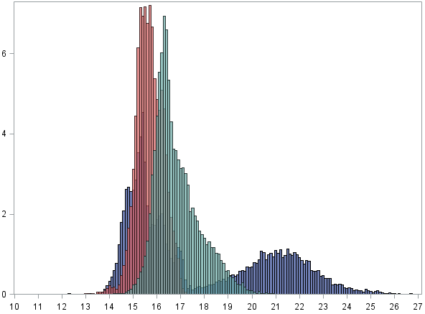
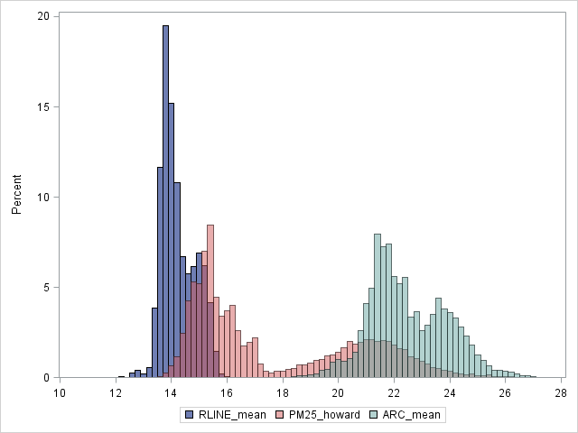
2005 Annually-Averaged Estimates
*only health study sites
ARC Emissions
ARC + Obs
R-LINE concentrations
< 16.0
16.0 - 18.0
18.0 - 20.0
> 20.0
μg/m³
Mean (SD) = 17.7 (3.0)
Mean (SD) = 15.7 (0.6)
Mean (SD) = 16.8 (0.9)
μg/m³
μg/m³
μg/m³
Monitors not capturing full spatial distribution of Atlanta (adding 12% more data at a rural site changes results)
High temporal correlations (0.8-0.9) and low spatial correlations (0-0.3) imply issues with ARC/R-LINE input
Different results for ARC and R-LINE inputs
Percent of grid cells
ARC
ARC + obs
RLINE
PM2.5 Annual Average Estimates

Slide 11
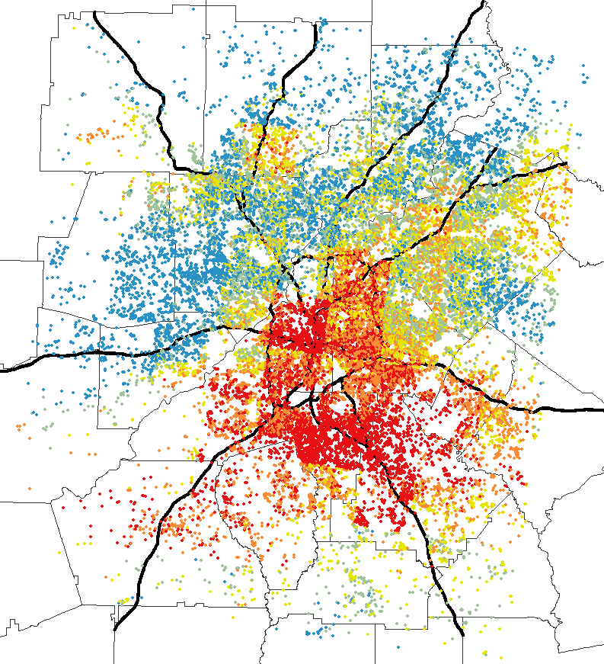
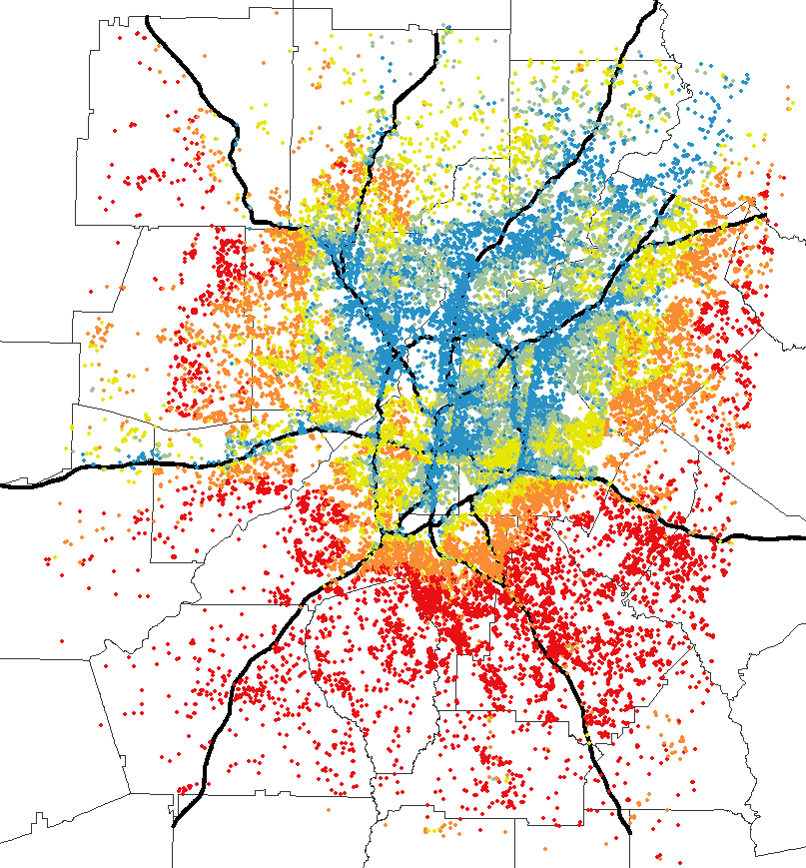
Issues with Spatial Gradients
ARC + obs
RLINE
13.0 – 15.2
13.5 – 16.1
15.2 – 15.5
16.1 – 16.4
15.5 – 15.8
16.4 – 16.9
15.8 – 16.2
16.9 – 17.6
16.2 – 17.4
17.6 – 21.3
Model | RMSE
CMAQ | 6.40
DS-ARC+obs | 2.68
 | 2.32
Unphysical results due to negative RLINE coefficient
Must check spatial map, not just RMSE
DS-RLINE

Slide 12
Conclusions (Bayesian Statistical Downscaler)
Results very dependent on number of monitor values it is trained on (CO, NO₂)
Results very dependent on land-use variables (ARC vs. R-LINE)
Downscaler not yet ready to be used with CMAQ and
R-LINE

Slide 13
Approach 2
CTM – Dispersion Model Fusion

Slide 14
Inputs
Dispersion Model
  2011 RLINE estimations adjusted using observations
  Assume 2011 RLINE estimations apply to each year
  250-m resolution
Chemical Transport Model
  CMAQ-OBS : must adjust CMAQ values using observations before inputting into CTM-Dispersion model
  12-km resolution
Scale 12-km CMAQ using fine-scale dispersion model
vehicle source impact estimates from R-LINE

Slide 15
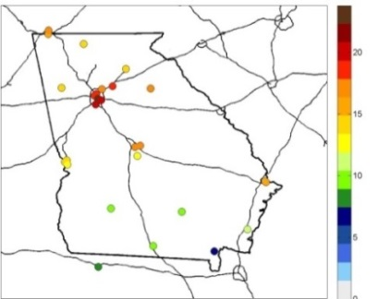
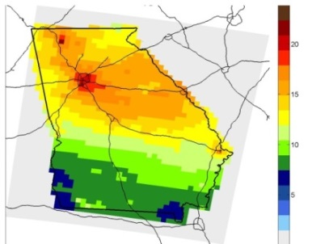
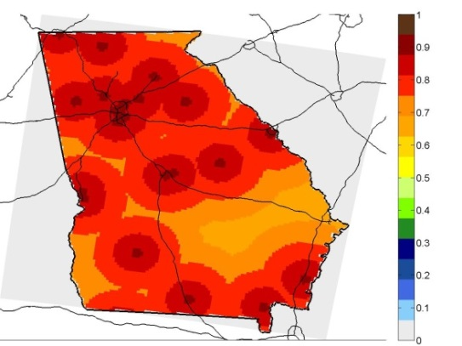
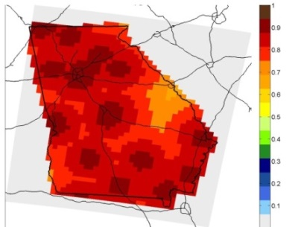
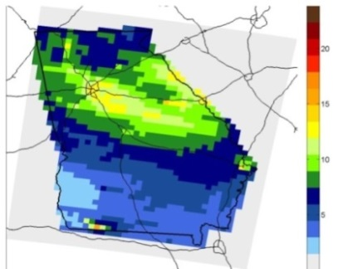
Data-Fused CMAQ-OBS
Observations
temporal variation from OBS;
spatial structure from mean CMAQ
PM_{2.5} (μg/m³), 7/23/08
optimized for temporal variation
C*
Fused Field and
Temporal Correlation Estimation
25
0
1
0
CMAQ
temporal variation & spatial structure from CMAQ; scaled to mean OBS
Zhai, et al. “Spatiotemporal error assessment for ambient air pollution estimates obtained using an observation-CMAQ data fusion technique”, 13th annual CMAS Conference

Slide 16
Method (CTM-Dispersion Model Fusion)
Spatially average R-LINE values to grid scale of CMAQ-OBS (12-km)
Subtract averaged R-LINE concentrations from CMAQ-OBS values to remove mobile impacts on PM_{2.5}
Spatially interpolate this result using bilinear interpolation to obtain spatially smooth estimates at the grid scale of R-LINE concentrations (250-m)
Add R-LINE estimated PM_{2.5} to results of step 3 to add mobile PM_{2.5} back into model

Slide 17
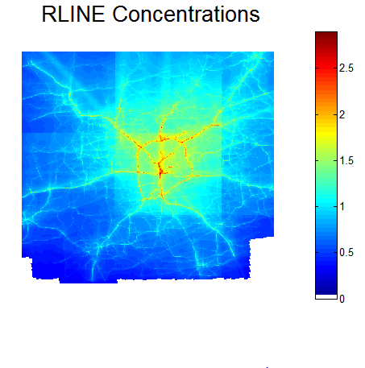
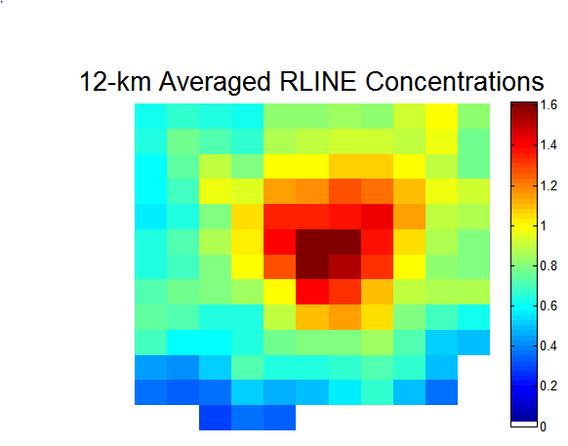
1. Average R-LINE Concentrations
2011 R-LINE Concentrations
2011 R-LINE_{12km_av}

Slide 18
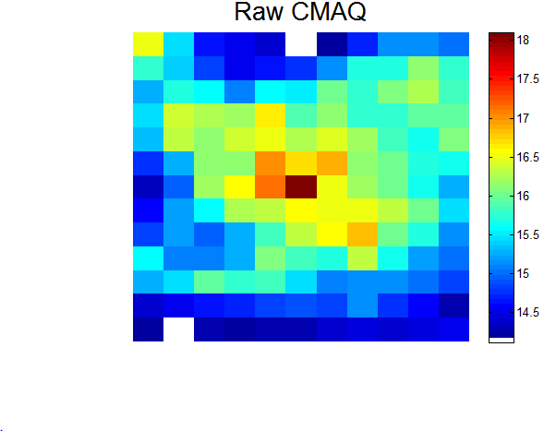
2. Subtract R-LINE (12-km) from
CMAQ-OBS
2005 Annually Averaged CMAQ-OBS
2011 R-LINE_{12km_av}

Slide 19
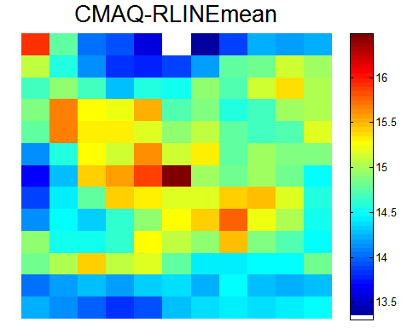
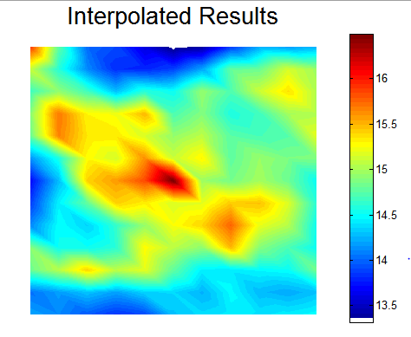
3. Spatial Bilinear Interpolation
CMAQ-OBS – R-LINE_{12km_av}
Interpolated Results

Slide 20
4. Add R-LINE (250-m) back into model
Interpolated Results
2011 R-LINE Concentrations

Slide 21
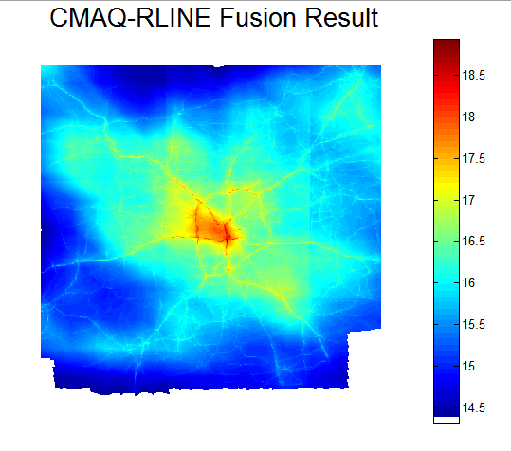
2005 Annual Average PM_{2.5} Results
μg/m³

Slide 22
Model Comparisons
Model | RMSE (µg/m³) | Computation Time
CMAQ | 6.40 | --
DS – RLINE | 2.32 | Data prep: 8.5 min Run: 16.7 hours
DS – ARC+obs | 2.68 | Data prep: 8.5 min Run: 16.7 hours
CTM-Dispersion | 1.64 | Data prep: 34 min Run: 2.5 min
*Run time for daily estimates of 329,472
grid cells over 1 year
*Data prep time does not include running
or adjusting CMAQ or R-LINE
Evaluations paired in time and space
  number of pairs = 1616 for DS; 1618 for CTM-Dispersion
CTM-Dispersion Fusion 97.5% faster to run
Notes:
Table: inputs, RMSE, computation time/grid cell,

Slide 23
Conclusions (CTM-Dispersion Model Fusion )
Data fusion of CMAQ and R-LINE successfully created spatially resolved exposure estimates. Daily estimates will be used for a spatially-resolved birth cohort study in Atlanta from 2002-2010
This approach can be applied to any pollutant with CMAQ and R-LINE estimates and any CMAQ grid size ≤ 12km
Evaluation statistics depend heavily on performance of input estimates (better at roadways)
This approach is much faster than the statistical downscaler

Slide 24
Acknowledgments
Collaborators at Georgia Tech and Emory University
*This publication was made possible by US EPA grant R834799. This publication’s contents are solely the responsibility of the grantee and do not necessarily represent the official views of the US EPA. Further, US EPA does not endorse the purchase of any commercial products or services mentioned in the publication.
Southeastern Center for Air Pollution & Epidemiology (SCAPE)
www.scape.gatech.edu
Josephine Bates
jbates2019@gatech.edu

Slide 25
Thanks!

