Slide 1
Improvement of PM Forecast using PSAT-based Customized Emission Inventory over Northeast Asia
Chang Han Bae ¹, Soon Tae Kim ¹,
Hyun Cheol Kim ^{2,3} and Byeong-Uk Kim ⁴
¹Ajou University, Dept. of Environmental Engineering, Suwon, Korea
² NOAA/Air Resources Laboratory, College Park, MD
³ UMD/Cooperative Institute for Climate and Satellites, College Park, MD
⁴ Georgia Environmental Protection Division, Atlanta, GA
October 7, 2015
CMAS meeting, Chapel Hill, NC
Air Quality Research Laboratory
Notes:
Good morning everyone, nice to meet you my name is Changhan Bae.
My topic is improvement of PM Forecast using PSAT-based Customized Emission Inventory over Northeast Asia.
Briefly Today I want to discuss about air quality forecasting and emission adjustment.

Slide 2
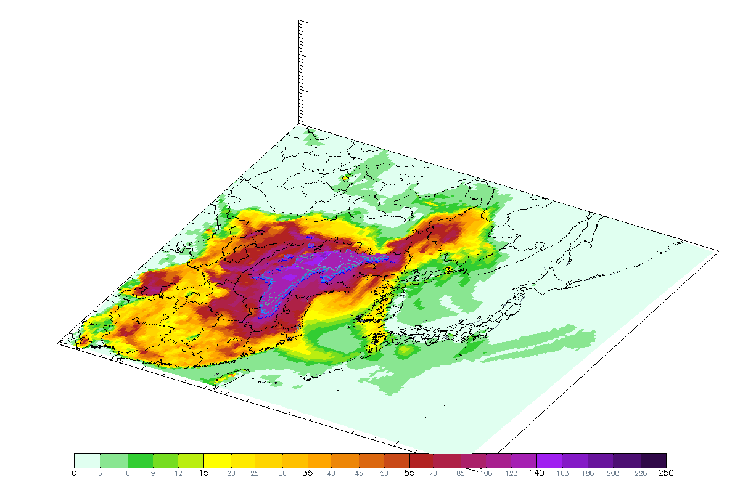
Background – PM₁₀ Transport
(㎍/㎥)
High PM event is a big public health concern in South Korea.
Air quality forecasting system is developed to protect public health.
Ajou University
Environmental Engineering
Notes:
High PM event is a big public health concern in South Korea.
It shows end of February case. Long range transported PM from China contributed high concentrations of PM to South Korea.
These pattern can be observed frequently during spring season.
So Korea government and many researchers have developed and have been operating air quality forecasting system to protect public health from the air pollutants.

Slide 3
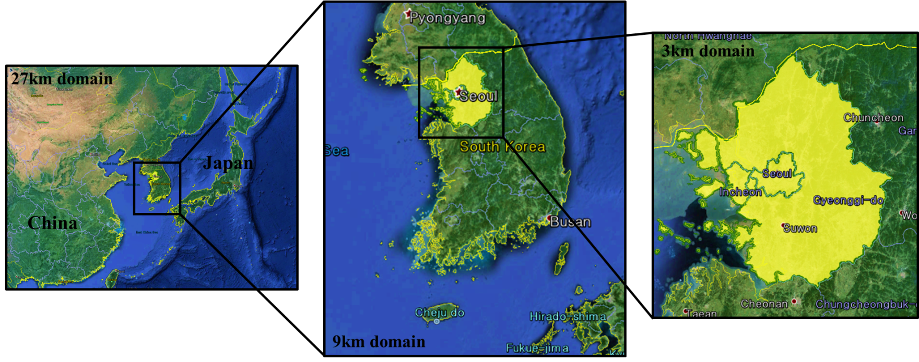
Background
The IMAQS/K(Integrated Multidimensional Air Quality System for Korea ) has been operated since May 2012, to provide regional air quality forecast over Northeast Asia (27-km), South Korea (9-km), and over the Seoul Metropolitan Area (SMA, 3-km).
Targeted pollutants : PM₁₀, PM_{2.5} (daily mean), O₃ (daily max).
The forecasting accuracy is about 70%
Ajou University
Environmental Engineering
Notes:
In our group's forecasting system The IMAQS/K(Integrated Multidimensional Air Quality System for Korea) has been operated since May 2012, to provide regional air quality forecast over Northeast Asia (27-km), South Korea (9-km), and over the Seoul Metropolitan Area (SMA, 3-km).
Area of SMA is similar while populations of SMA are 2 times compared with LA
The targeted pollutants are daily mean PM10, PM2.5 concentration, and daily maximum ozone concentration.
Typically, the forecasting accuracy is around 70%, however that include human forecasts.
I mean With the forecasting system, forecasters can use real time surface observation data, 세틀라잇 데이터, and their experience to improve the accuracy of the forecast.

Slide 4
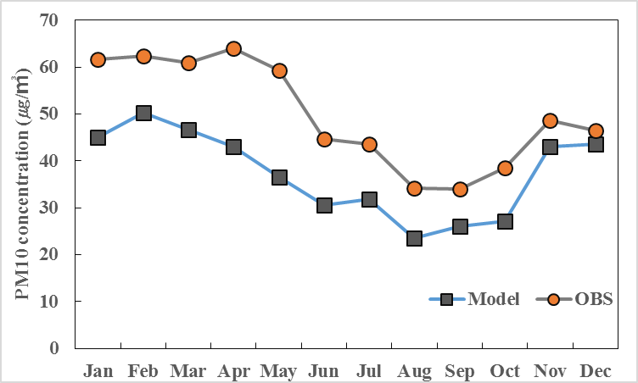
Base Run Performance Evaluation
SMA(2014)
PM10 (SMA) | R² | BIAS | FB (Fractional Bias)
Jan-Mar | 0.6290 | -13.71 | -22%
Apr-Jun | 0.6848 | -18.81 | -35%
Jul-Sep | 0.6285 | -10.12 | -23%
Oct-Dec | 0.5634 | -6.29 | -14%
Long-term comparisons of simulated PM10 and PM2.5 concentrations to the observed concentrations show consistent under-predictions.
Especially, the under-prediction tendency during first half year is more apparent than second half year
Ajou University
Environmental Engineering
Notes:
This graph is a comparison of observations and simulated PM10 concentrations over an SMA.
Black line is simulated PM10 and orange circle is observation data.
Sometimes simulated PM is similar with observations in high concentrations of PM10 event.
Overall, the simulated PM10 time series shows similar daily variation compared to the observations. However, the total mass is under-predicted about 25% annually
Especially, the under-prediction tendency during first half year is more apparent than second half year
The photo chemical Model has systematic under-prediction

Slide 5
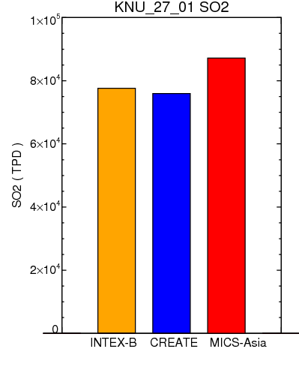
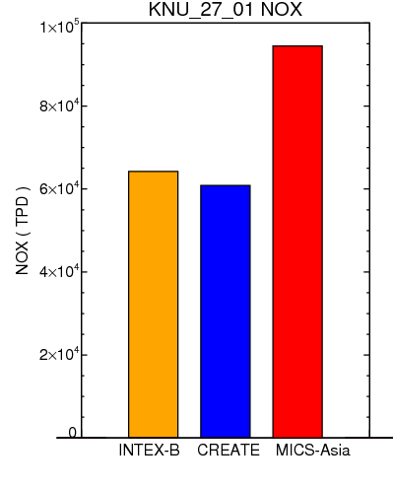
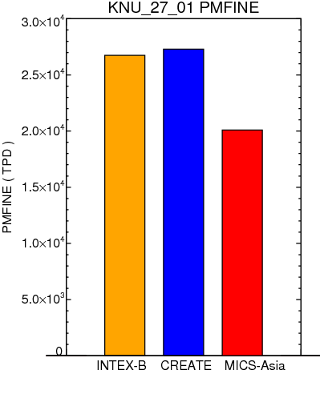
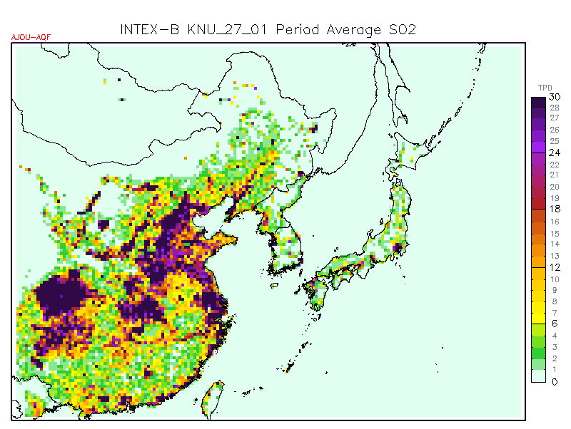
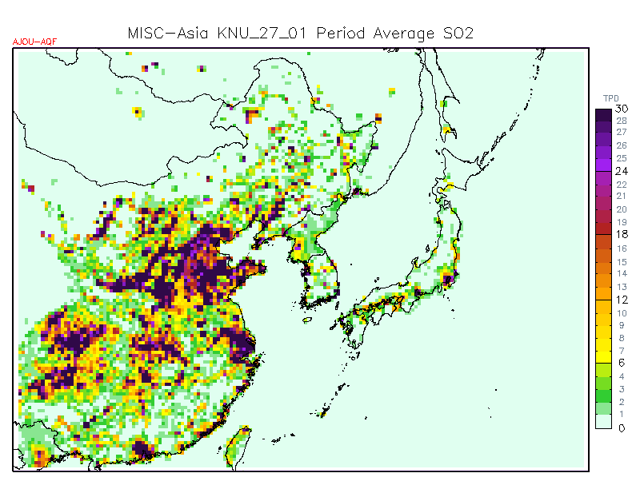
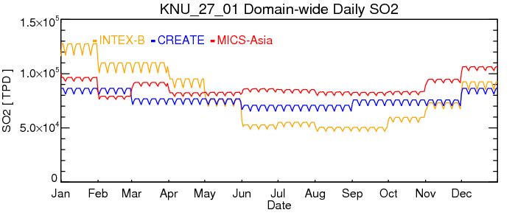
Emission Inventories in Northeast Asia
Daily Emission Rate
■ INTEX–B 2006
■ CREATE-KNU 2010
■ MICS-Asia 2010
SO₂
NOx
PM fine
Spatial Variation (Jan.)
Temporal Variation
SO₂(INTEX-B)
SO₂(MICS-Asia)
Theses are three most commonly used emissions inventories for AQF systems in South Korea
There are various differences among these emissions inventories (e.g. emission rate).
Ajou University
Environmental Engineering
Notes:
Theses are three most commonly used emissions inventories for AQF systems in South Korea
There are various differences among these emissions inventories
For example, SO2 emissions from MICS-Asia are higher than that from INTEX-B when annual data but from INTEX-B is higher when January data
Spatial distribution also somewhat difference in this area

Slide 6
Goal
Among various uncertainties in current air quality forecasting systems, emission inventory is one of the biggest components to improve the accuracy of PM10 forecast
Therefore we attempted to revise our base inventory using source contribution analysis results
Ajou University
Environmental Engineering

Slide 7
Air Quality Forecasting System
Forecasting date & Starting time setup
Initiation
09 KST
GFS data (NOAA)
Meteorology data
Data downloading
WRF
MCIP
WRF2CAMx
Emission data
SMOKE/
MEGAN
Two-way nesting
One-way nesting
Chemical Transport
Model
CAMx
(27/9/3-km)
CAMQ
(27/9/3-km)
Ajou University
Environmental Engineering
Notes:
Air quality forecasting system are operated using WRF-SMOKE-CMAQ/CAMx.
WRF is used to simulate regional meteorology using GFS from NCEP
SMOKE and MEGAN are used to estimate anthropogenic and biogenic emissions.
Photochemical model are performed to forecast air quality using meteorological and emissions inputs.

Slide 8
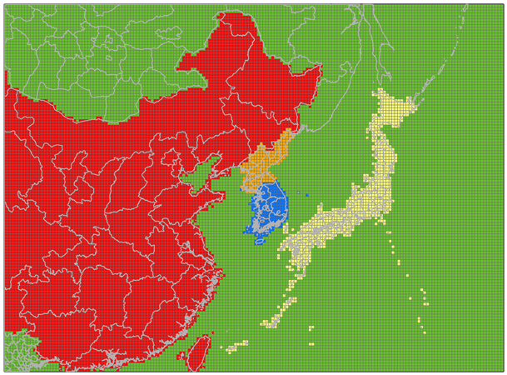
Source Contribution Analysis - PSAT
Particulate Source Apportionment Technology (Yarwood et al., 2004)
PSAT has been developed for CAMx(Comprehensive Air quality Model with eXtensions) to estimate PM source contribution by specific geographic regions and source categories (2011, Environ).
For this study five emissions source regions are tracked for contribution to particulate matter : South Korea, North Korea, China, Japan, and Others
Sources
Bulgwang
supersite
■ South Korea
■ North Korea
■ China
■ Japan
■ Others
Ajou University
Environmental Engineering
Notes:
PM source apportionment Technology(PSAT) is a tagged species method that apportions concentrations of PM components to their respective primary precursors
In this study, five emissions source regions are tracked for contribution to particulate matter
South Korea, North Korea, China, Japan and Others
Individual PM2.5 speciese concentrations are evaluated with over super observation site (Bulgwang)

Slide 9
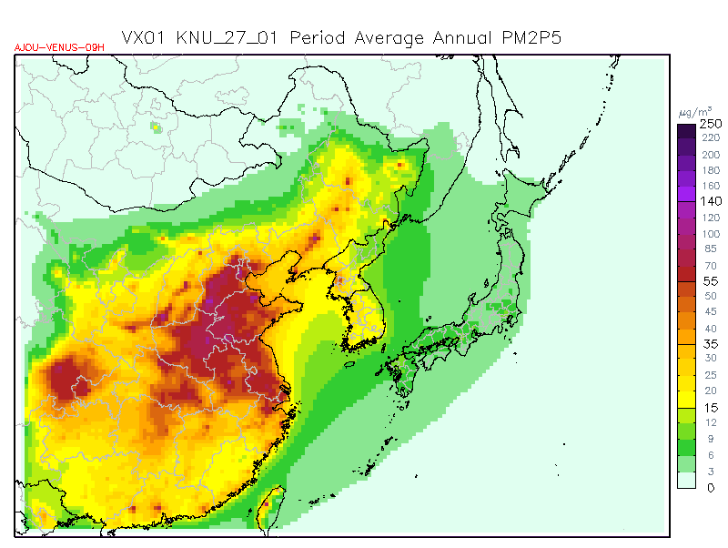
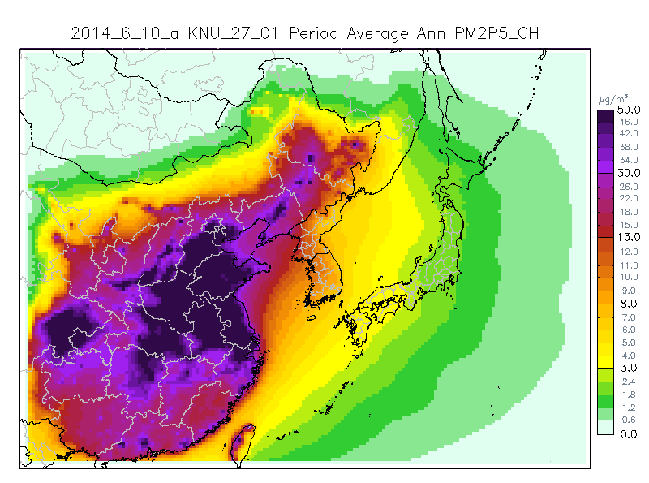
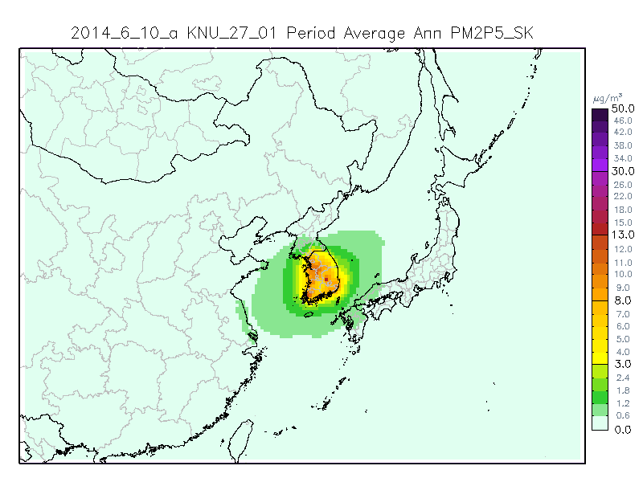
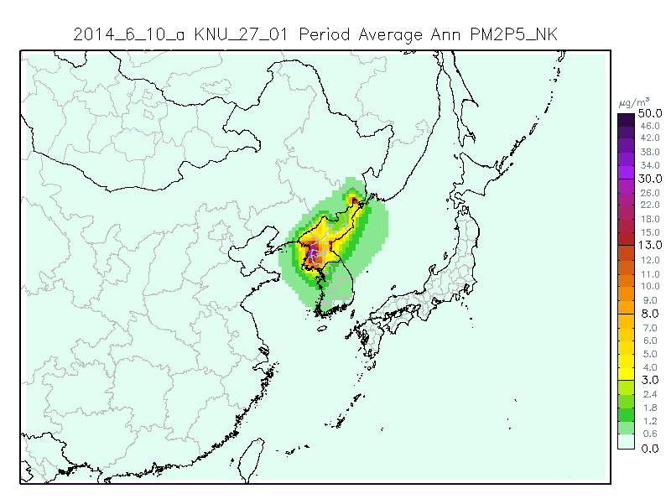
CAMx/PSAT Results – Annual PM_{2.5}
PM_{2.5}
China Contribution
~ 25 ㎍/㎥
~ 12 ㎍/㎥
South Korea
Contribution
North Korea
Contribution
~ 10 ㎍/㎥
~ 2 ㎍/㎥
Ajou University
Environmental Engineering
Notes:
These spatial plots show PM2.5 annual concentration and contribution.
Basically, simulated PM2.5 concentration is around 25 ug/m3 over the SMA.
South Korea contribute 10 ug/m3, North Korea contribute around 2 ug/m3 and China contribute around 12 ug/m3. Around half of PM2.5 concentration is contributed form sources in China.

Slide 10
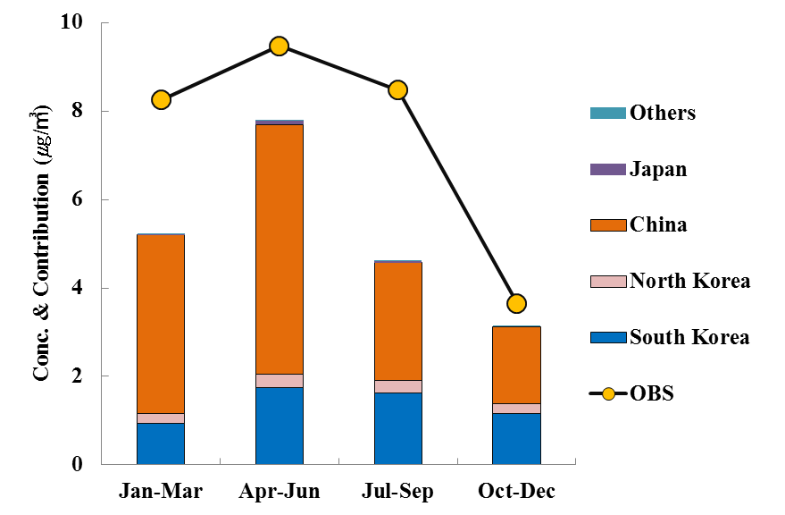
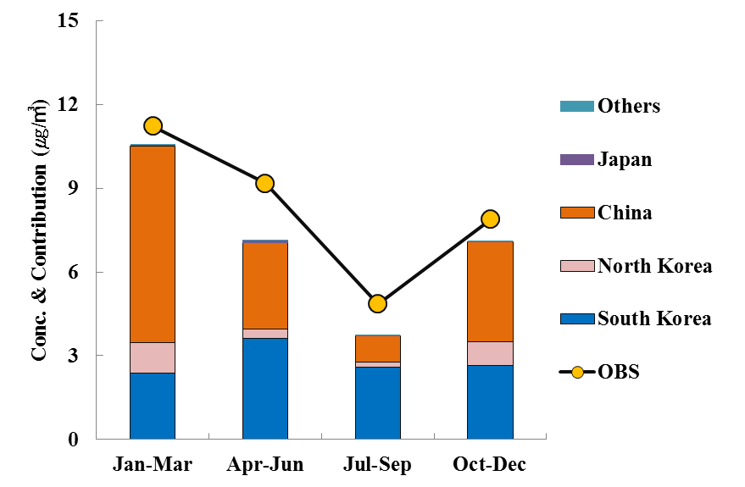
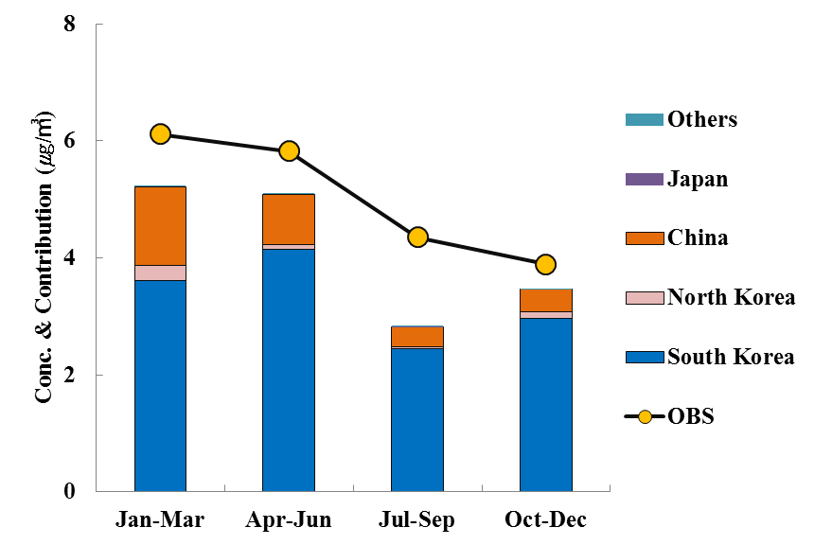
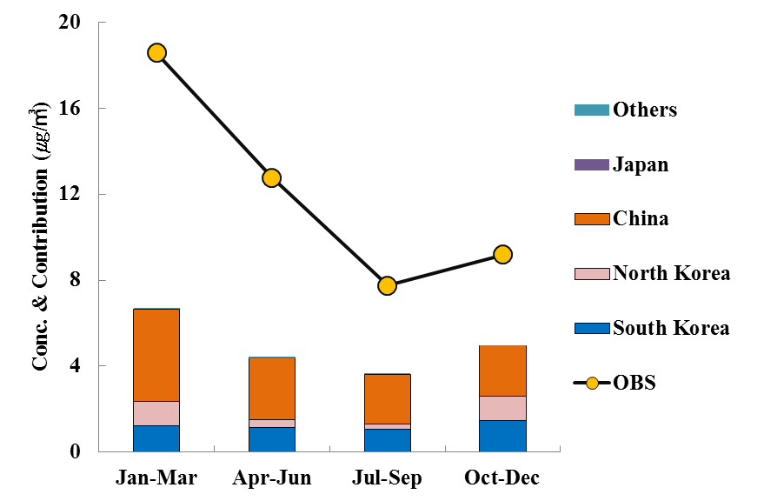
CAMx/PSAT Results – PM_{2.5} Species
Sulfate
Nitrate
China ~50%
China ~70%
Ammonium
Unknown
Model/OBS
= ~ 0.4
China ~60%
South Korea ~80%
Ajou University
Environmental Engineering
Notes:
CAMx/PSAT Results about each PM2.5Species
CAMx/PSAT simulations explain that most of sulfate, unknown concentration is contributed form sources in China during 2014.
Contributions of Sulfate from China is relatively higher during 1st half period than 2nd half period. The differences between simulations and observations is large and high contributions from china is simulated for unknown species.
In case of simulated Nitrate, small scale underprediction is presented and south korea contribution is increased between APR-SEP (period).
For Ammonium, South Korea contribution is dominant.
I

Slide 11
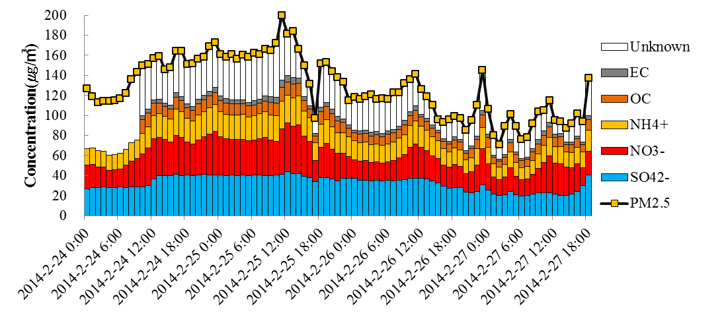
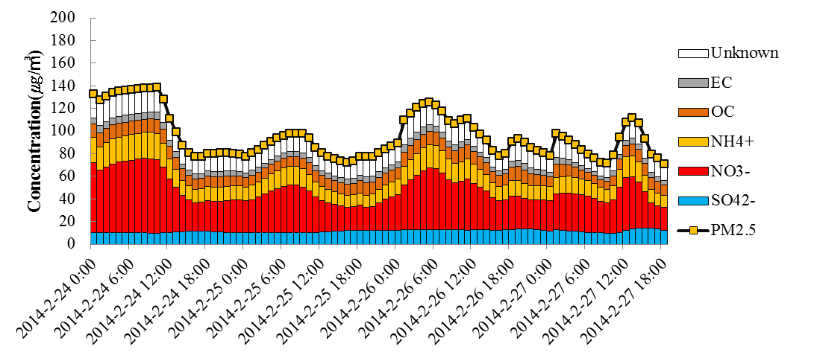
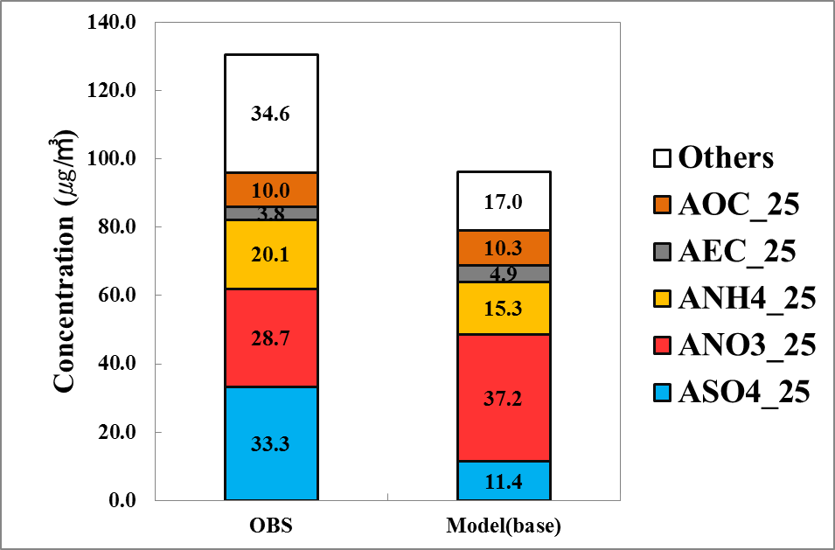
Sensitivity Test – High PM_{2.5} Case
PM_{2.5} (OBS)
PM_{2.5} (Model)
To adjust emission inventory, we need to know emission to concentration relationship
We chose this episode (2014. 02. 24 ~02. 28), because it shows high concentration due to regional transport
Sulfate, ammonium, and unknown species are under predicted.
Ajou University
Environmental Engineering
Notes:
To adjust emission inventory, we need to know emission to concentration relationship
We chose this episode (2014. 02. 24 ~02. 28), because it shows high concentration due to regional transport
Sulfate, ammonium, and unknown species are under predicted.
February case especially has underprediction, but high concentration is simulated in model. . It is decided result from PSAT is relatively reliable because moving pattern from China presents clearly.

Slide 12
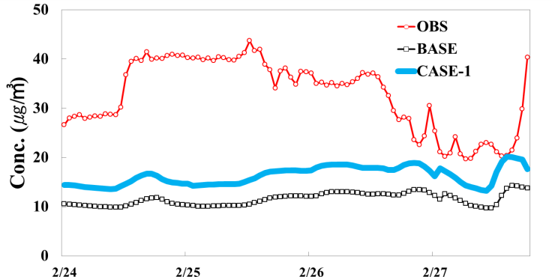
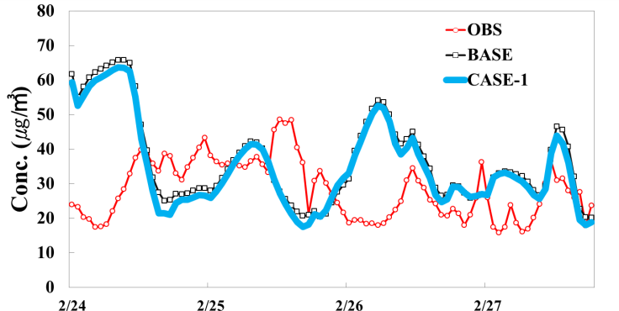
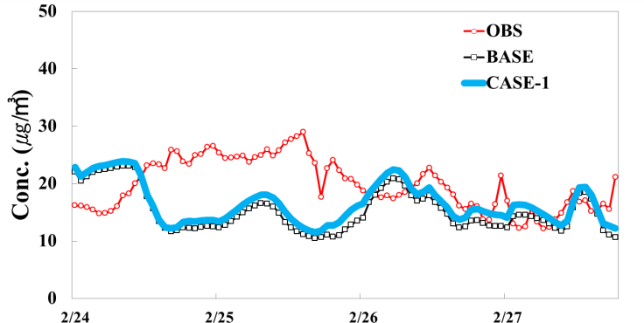
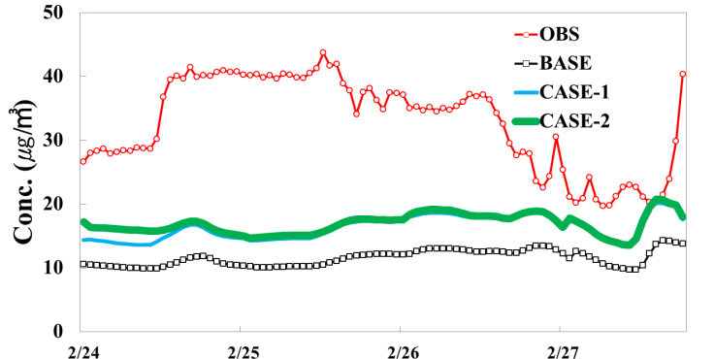
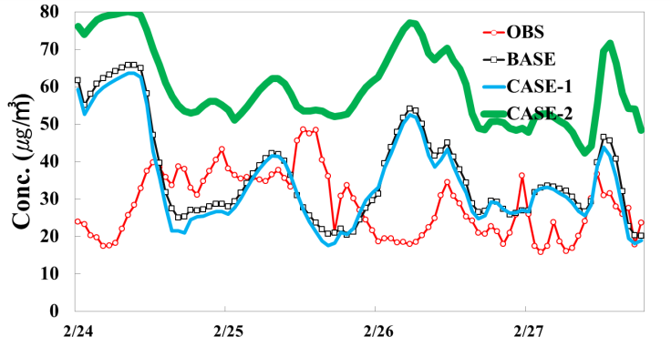
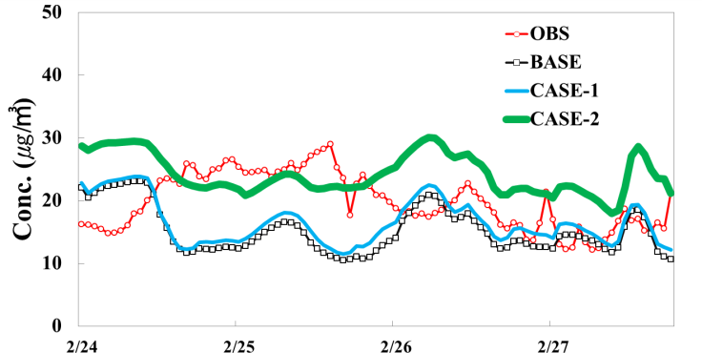
Sensitivity Test Results
Case 1. SO₂ revision : 50% increase of china SO₂
Sulfate
Nitrate
Ammonium
Case2. SO₂ & NH₃ revision : 50% increase of china SO₂ and 100% increase of china NH₃
Sulfate
Nitrate
Ammonium
China SO₂ and NH₃ emission adjustment increases sulfate concentrations, however increase of china NH3 emissions result in additional high bias nitrate concentration.
Notes:
Because SO2, NOx and NH3 basically have an interactional effect on them in the air, we analyzed the concentration together when we compare emission concentration
Case 1 is 50% increse of china so2 emissions to increase sulfate concentration.
As a result sulfate concentration is increase around 5 ug/m3,
Case 2 is China SO₂ and NH₃ emission adjustment increases sulfate concentrations, however increase of china NH3 emissions result in additional high bias nitrate concentration.
Unfortunately, we could not carry out more detailed analysis. However, it is estimated that the effects are thought to occur due to the lack of an ammonia concentration of the atmosphere in the China region.

Slide 13
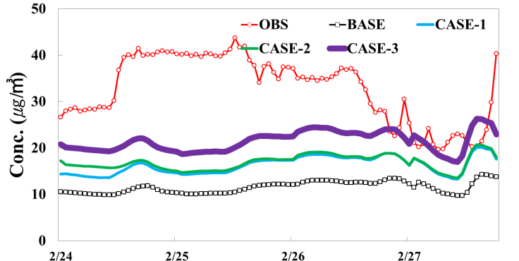
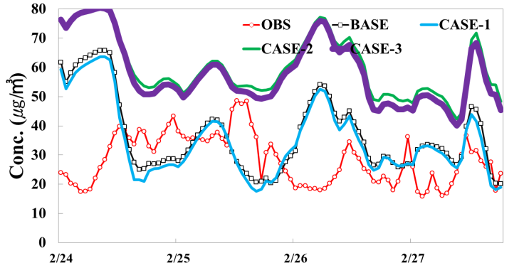
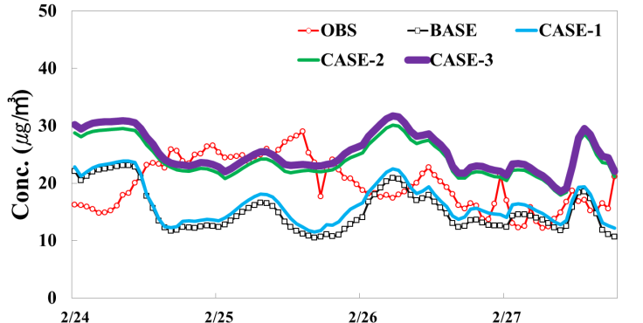
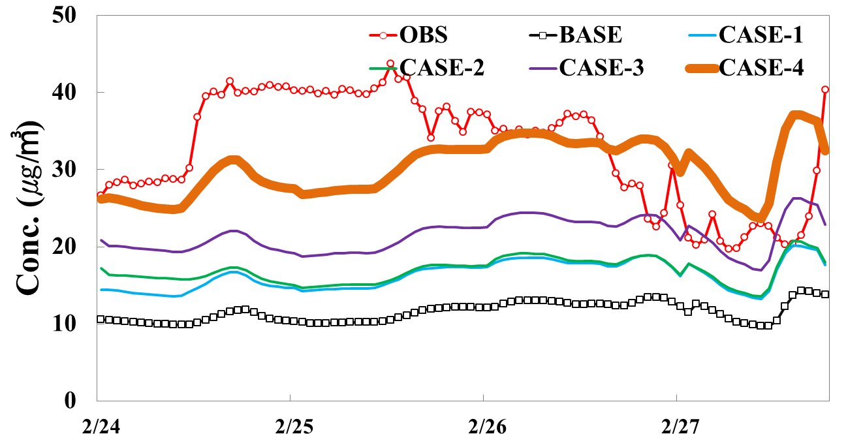
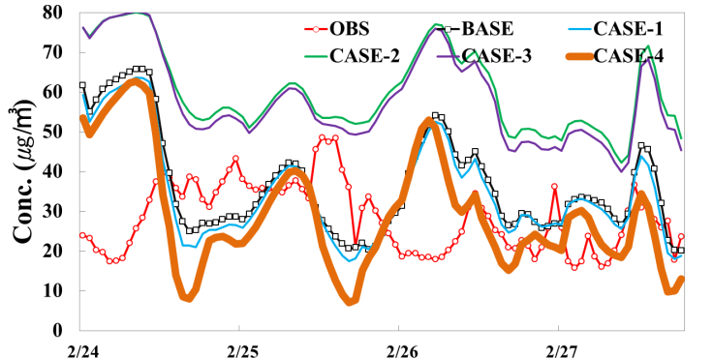
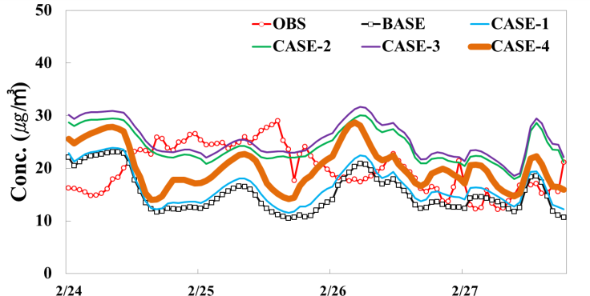
Sensitivity Test Results
Case 3. SO₂ & NOx revision : 100% increase of china SO₂ ,100% increase of china NH_{3,}
, and 50% decrease of South Korea NOx
Sulfate
Nitrate
Ammonium
Case 4. SO₂ & NOx revision : 200% increase of china SO₂,
and 50% decrease of South Korea NOx
Sulfate
Nitrate
Ammonium
Korea sulfate concentration show linear relationship to China SO2 emission changes
Based on these analysis result we derived emissions scaling factor and apply those factor to an annual simulation.
Notes:
For case 3, South Korea NOx emission is decreased to improve overestimaion of nitrate but it doesn't have any effect
Because the Ammonia emission increase occurred overestimation of nitrate, we decided not to correct. Thus it is not modified.
Case 4 200% increase of china SO_{2,} emssions,Sulfate concentration is close to observed concentraion level. Ammonium is also increased and it has similar level with the observed concentration.

Slide 14
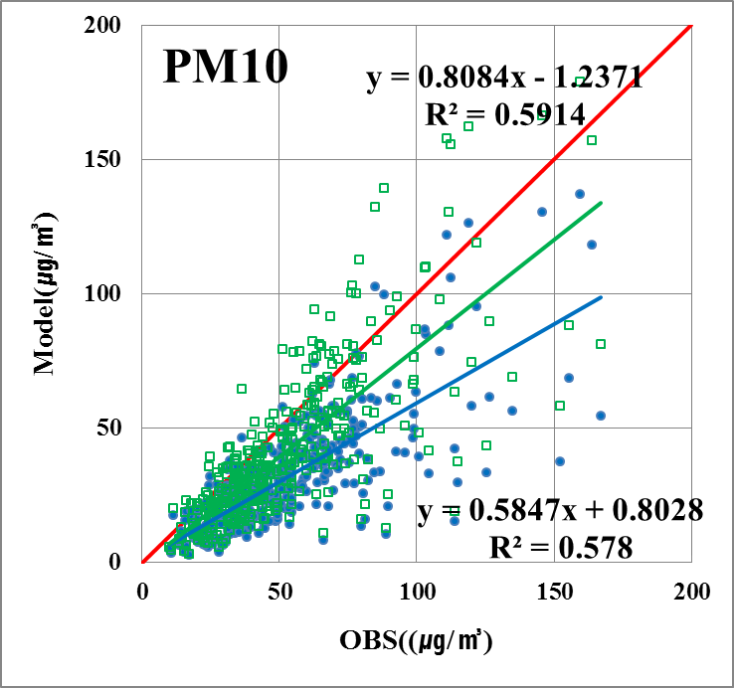
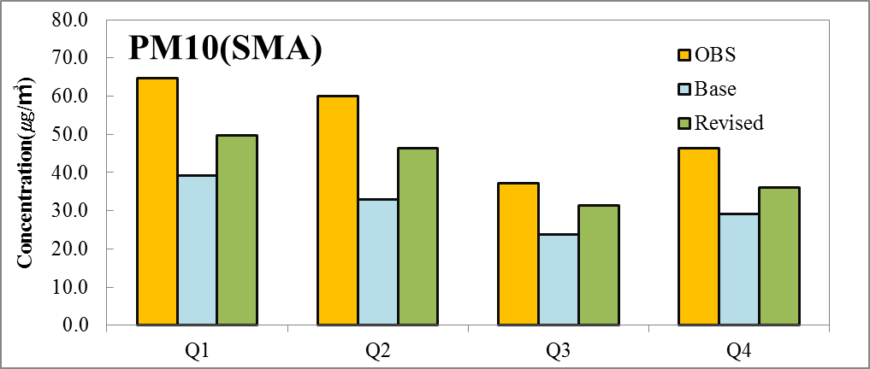
Preliminary Results – Annual PM₁₀
PM10 bias is improved from -20.8 ㎍/㎥ to -11.2 ㎍/㎥
Ajou University
Environmental Engineering
Notes:
For many cases, simulated PM10 concentration shows improvement effects increasing to similar level with the analysis.
When we examine them quarterly, concentration improvement between ARP-JUN (period) is remarkable.

Slide 15
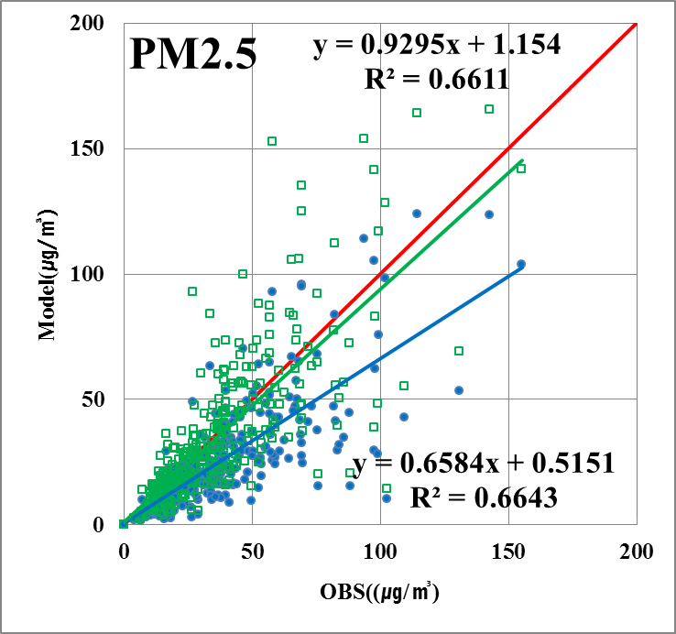
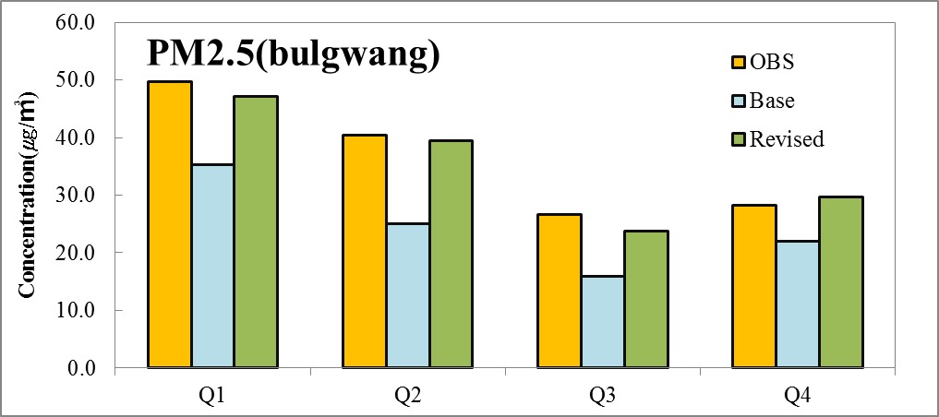
Preliminary Results – PM_{2.5}
PM_{2.5} bias is improved from -11.4 ㎍/㎥ to -1.9 ㎍/㎥
Ajou University
Environmental Engineering
Notes:
거의 관측과 유사한 수준으로 농도가 증가, 오히려 어떤 경우 과대 모의 하는 경우가 발생

Slide 16
Conclusions
IMAQS K using the unadjusted 2006 INTEX-B emission inventory underestimates PM10 concentrations about 20 ㎍/㎥ compared to observations over SMA in 2014.
The model underestimates sulfate about 6 ㎍/㎥ and unknown species underestimates about 11 ㎍/㎥
CAMx/PSAT results show that the half of PM_{2.5} concentrations are contributed by China during 2014.
We derived emission scaling factors based on CAMx/PSAT results from high PM event case and applied to the annual simulation.
We showed emission revision for China SO₂ can improve PM forecasting accuracy in SMA.
Ajou University
Environmental Engineering
Notes:
~할 것으로 판단됨. 사료됨 표현..

Slide 17
Future Direction
Extended model performance evaluation for areas outside of SMA, South Korea
Statistical approach to derive emission scaling factor such as least square method
Scaling factors reflecting spatial and temporal variability
Thank you
Email : again1210@ajou.ac.kr
Ajou University
Environmental Engineering
Notes:
기준, 왜 했는가?.. 팩트만 있다..

