Slide 1
Nitrogen Oxide Emissions Constrained by Space-based Observations of NO₂ Columns
University of Houston
Amir Souri, Yunsoo Choi, Lijun Diao & Xiangshang Li

Slide 2
Introduction
NO_{x} Sources
  Fuel combustion (mobile, power plants and etc.)
  Biomass burning
  Lightening
  Microbial processes in soil amplified by fertilizers, rain and burning
NO_{x} Roles
  Ozone production
  Effect on the global climate indirectly by perturbing greenhouse gases
  Adverse health effects
  A precursor for ammonium nitrate
  Acidification and eutrophication of soils and surface waters
Introduction
Data
Methodology
Results
Conclusion

Slide 3
Introduction
‘Bottom-up’’ inventories
  Fuel
  Land use statistics
  In-tunnel measurements of NO_{x} emission
  Agricultural data
  Estimates of burned areas
Labor-intensive and expensive
Done every 3 years in U.S.
Have high uncertainty (e.g., ~50% for NEI-2005)
Very soon become obsolete
Introduction
Data
Methodology
Results
Conclusion

Slide 4
Long-term NO₂ trends
A large and continuous decline in CAMS NO₂ levels during 2000-2014.
Trend analysis
NO2
HCHO
HCHO/NO2
Ozone
Model Analysis
Conclusion

Slide 5
Long-term NO₂ trends
A continuous decline in OMI NO₂ levels during 2005-2014.
Trend analysis
NO2
HCHO
HCHO/NO2
Ozone
Model Analysis
Conclusion

Slide 6

Introduction
“Top-down” approach
  Satellite observations (y)
  Emissions (x)
  A Jacobian matrix (K) from a forward model
When a physical quantity is not directly accessible for measurement, it is common to proceed by observing other quantities that are connected with it by physical laws.
The notion of an inverse problem corresponds to the idea of inverting these physical laws to gain indirect access to the quantity.
Introduction
Data
Methodology
Results
Conclusion

Slide 7
Research objective
Quantify the posteriori NO_{x} emissions from a priori emissions (e.g., point, area, mobile, and soil sources) using an inverse method with tropospheric OMI NO₂ columns.
  Use high spatial resolution of OMI NO₂
  Improve WRF-CMAQ simulation using objective analysis
  Utilize the Bayesian framework for inverse modeling
  Evaluate the adjusted emissions with aircraft and ground-based observations.
Introduction
Data
Methodology
Results
Conclusion

Slide 8
Data: in-situ surface
CAMS for surface ozone and NO_{x} data
Surface ozone NO_{x}
Introduction
Data
Methodology
Results
Conclusion

Slide 9
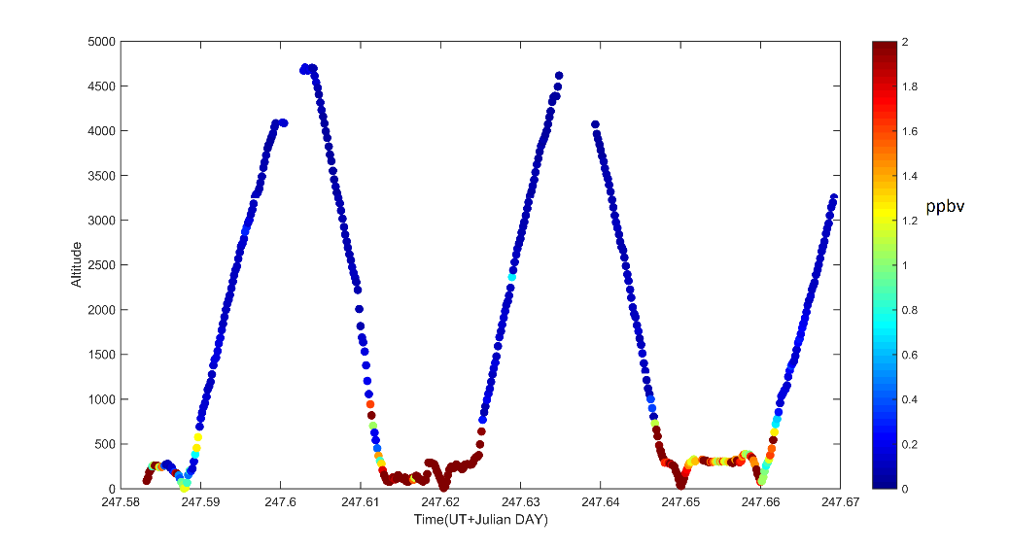
Data: Aircraft and emission
Aircraft measurements (various gases including ozone and NO_{x}) (10 flights in September 2013)
NO_{x} emission inventories from four different sources (area, mobile, biogenic and point) based on NEI-2011
Introduction
Data
Methodology
Results
Conclusion

Slide 10
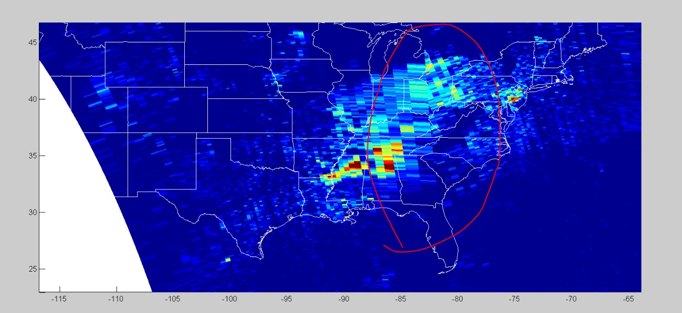
Data: remote sensing
Satellite tropospheric OMI NO₂ column.
  Noisy pixels filtered out based on cloud fraction, RMSE in the retrieval, VCD quality and etc.
  OMI footprint is larger in pixels far from nadir. A remedy is to use splines to correct geometric distortions based on Kuhlmann et al. (2014)
Introduction
Data
Methodology
Results
Conclusion

Slide 11
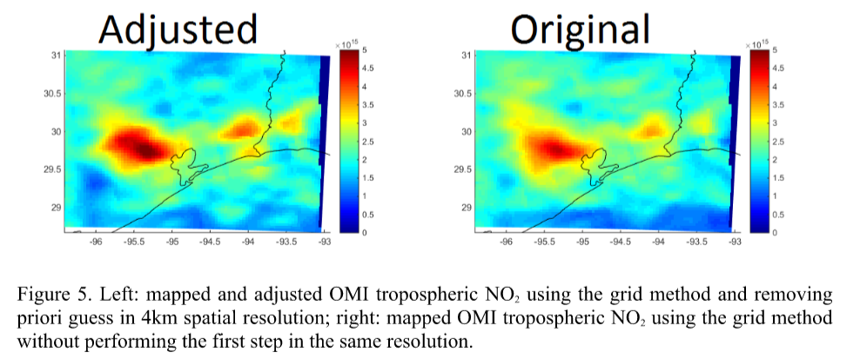
Data: remote sensing
  The influences of priori NO₂ profiles removed by using Air Mass Factor in each granule and model simulation (e.g., Palmer et al., 2001; Choi et al., 2008; Duncan et al., 2014).
  Without this adjustment, OMI shows underprediction and overprediction in urban and rural areas respectively.
Introduction
Data
Methodology
Results
Conclusion

Slide 12
Method: Inverse modeling
Inverse modeling:
For well-conditioned linear problems, under the assumption of independent and normally distributed data errors, least-squares (maximum likelihood principle) can be used.
The Bayesian approach
  Random variables
  The approach can naturally use a priori
Introduction
Data
Methodology
Results
Conclusion

Slide 13

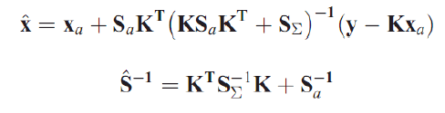
Bayesian method
Model (CMAQ or CAMx) determines, K = dNO₂/dE_NO_{x}
A posteriori emission, x is determined at last
Introduction
Data
Methodology
Results
Conclusion

Slide 14
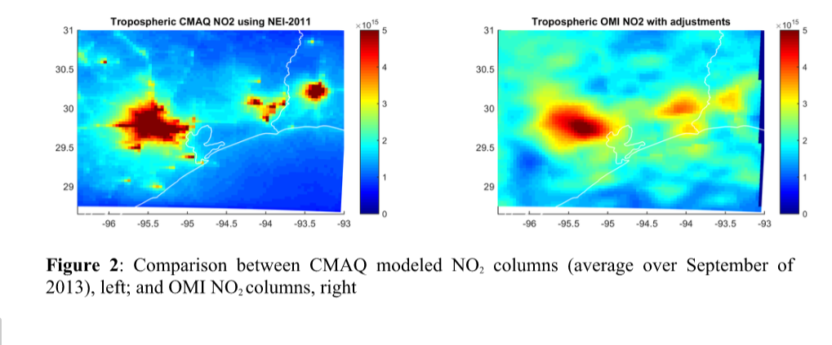
Results
CMAQ overpredicted NO₂ in urban regions and underpredicted in rural ones, which is similar to those by Choi et al. (2012) and Choi (2014)
Data
Methodology
Results
Conclusion

Slide 15
Results
Overall, all the anthropogenic NO_{x} emissions reduced, while biogenic emissions increased. Both reduction and enhancement not occurred evenly over the domain.
Results
Conclusion

Slide 16
Results
A priori & posteriori point source comparison to TCEQ 2013 emission
Results
Conclusion

Slide 17
Results
Total NO_{x} emission overview:
Methodology
Results
Conclusion

Slide 18
Results
Comparison to OMI NO₂ columns
Results
Conclusion

Slide 19
Results
Comparison to CAMS NO_{x} values in morning time (06-12 LT) of Sep 2013 (before and after inverse modeling)
Results
Conclusion

Slide 20
Results
Time series of CAMS NO_{x} before (upper) and after (lower) adjusting emissions:
Results
Conclusion

Slide 21
Results
RMSE and bias between aircraft NO_{x} and simulated ones are 2.4 and 6.0ppbv for NEI2011 (left) and 1.9 and 4.1ppbv for adjusted NEI-2011 (right).
A snapshot for Sep. 24th

Slide 22
Conclusion
Model simulation based on NEI-2011 showed overprediciton and underprediction in NO₂ over urban region and rural region, respectively
Tropospheric OMI NO₂ can be successfully used to constrain the emission
Anthropogenic emissions decreased after the adjustment, but biogenic emission increased
Future works:
  Inverse modeling for biomass burning and HCHO
  Similar approach to US using 12km CMAQ & PM2.5 study
Introduction
Data
Methodology
Results
Conclusion

Slide 23
Acknowledgements
Air Quality Research Program – The University of Texas at Austin & Texas Commission on Environmental Quality (TCEQ)
BH Baek University of North Carolina
TCEQ CAMS monitoring site team
DISCOVER-AQ aircraft campaign team
OMI NO₂ column retrieval team
Introduction
Data
Methodology
Results
Conclusion

Slide 24
Thanks for your attention

