Slide 1
Evaluation of the Community Multiscale Air Quality (CMAQ) Model Version 5.1
K. Wyat Appel, Sergey Napelenok, Christian Hogrefe, Kristen M. Foley, George Pouliot, Shawn J. Roselle, Jonathan E. Pleim and the CMAQ development team
U.S. EPA, National Exposure Research Laboratory,
Atmospheric Modeling and Analysis Division, RTP, NC
CMAS Annual Conference – October 7, Chapel Hill, NC

Slide 2
CMAQ Simulations Details
Model Version | CMAQ v5.0.2 | CMAQ v5.1
Domain | CONUS 12km | CONUS 12km
Meteorological Model | WRF v3.4 | WRF v3.7
MCIP Version | MCIPv4.1.3 | MCIPv4.2 (w/ other updates)
Emissions | 2011 NEI v1 (Inline) | 2011 NEI v2 (inline)
BELD Version | BELD Version 3 | BELD Version 4
Lightning NO Emissions | Yes | Yes
OMI Data | Yes | Yes
Photolysis | Inline | Inline (updated)
AERO Version | AERO6 | AERO6
Chemical Mechanism | CB05CLTU | CB05e51
Boundary Conditions | GEOS-Chem | GEOS-Chem
Multi-pollutant Version | No | No
Gravitational Settling | No | Yes
Wind-blown Dust | Yes | Updated
Halogen Chemistry | No | Yes

Slide 3
Major Updates Affecting Ozone
Revised in-line calculation of photolysis rates
  aerosol optical properties based on the Mixing Model and Mie Theory
  cloud effects are now more consistent with the cloud model in meteorological model
Revised ozone deposition to wet vegetation
  set wet cuticular resistance to 385 s/m (Altimir et al. 2006)
  scale cuticular resistance at physisorbed H₂O at RH > 70% linearly between the dry and wet values
  set dry cuticular resistance to that of Wesley (1989)
Updates to chemistry
  added halogen chemistry-derived ozone decay
  updated photolysis rates to IUPAC 2010
  more recycling of NO₂ from nitrates and OH from peroxy radicals
Update to ACM2 in WRFv3.7
  Improvements in land surface and atmospheric boundary layer processes (PX LSM, ACM2)
  Consistent changes in ACM2 in CMAQ
    more accurate representation of surface meteorology and pollutant concentrations day and night
Re-calculation of Monin-Obukhov length in CMAQ to be consistent with ACM2 in WRF
  Tends to reduce stability in CMAQ, particularly during the evening transitions hours
  Increases ozone mixing ratios through reduced titration by NO_{X}

Slide 4
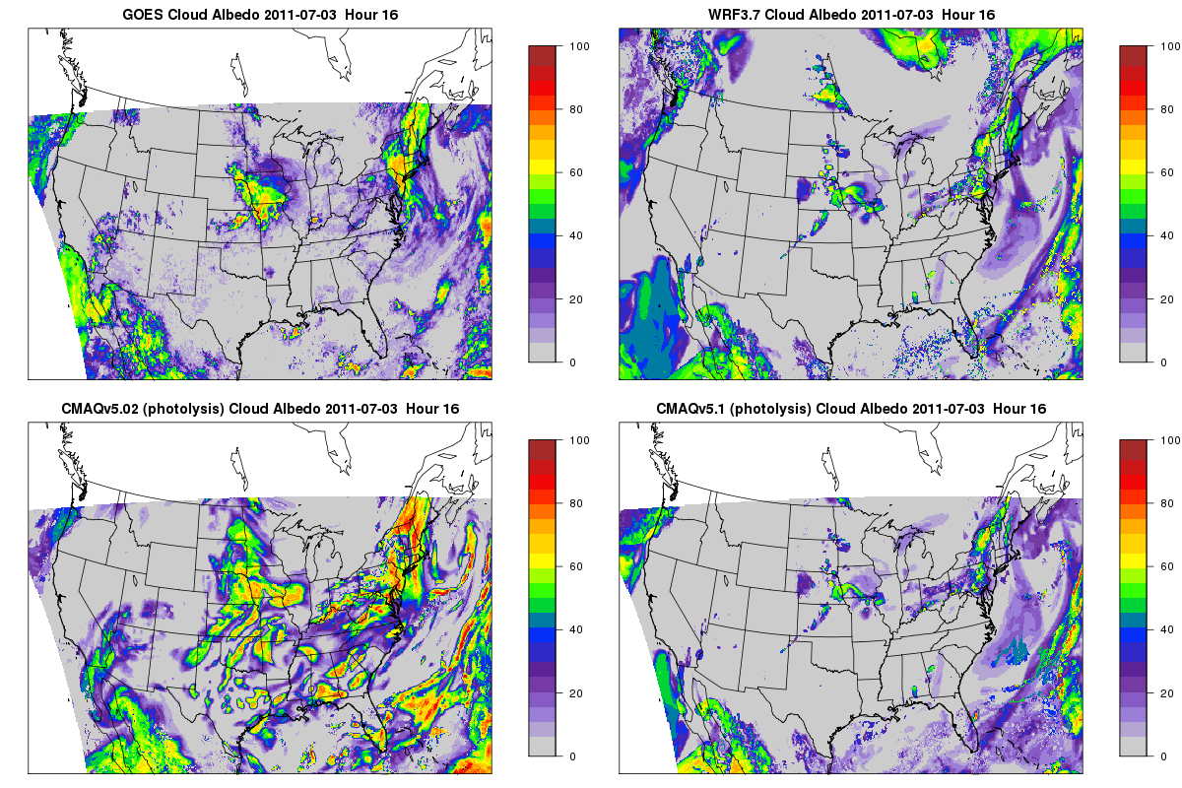
July 3, 2011 1600 UTC: GOES vs Photolysis Model Cloud Albedo (%)
Differences in cloud albedo at this single hour are representative of what we see across the entire month:
CMAQv5.0.2 is too cloudy
CMAQv5.1 corrects this bias but is now too clear
Result is considerably more ozone in CMAQv5.1 than CMAQv5.0.2
Only pertains to photolysis attenuation

Slide 5
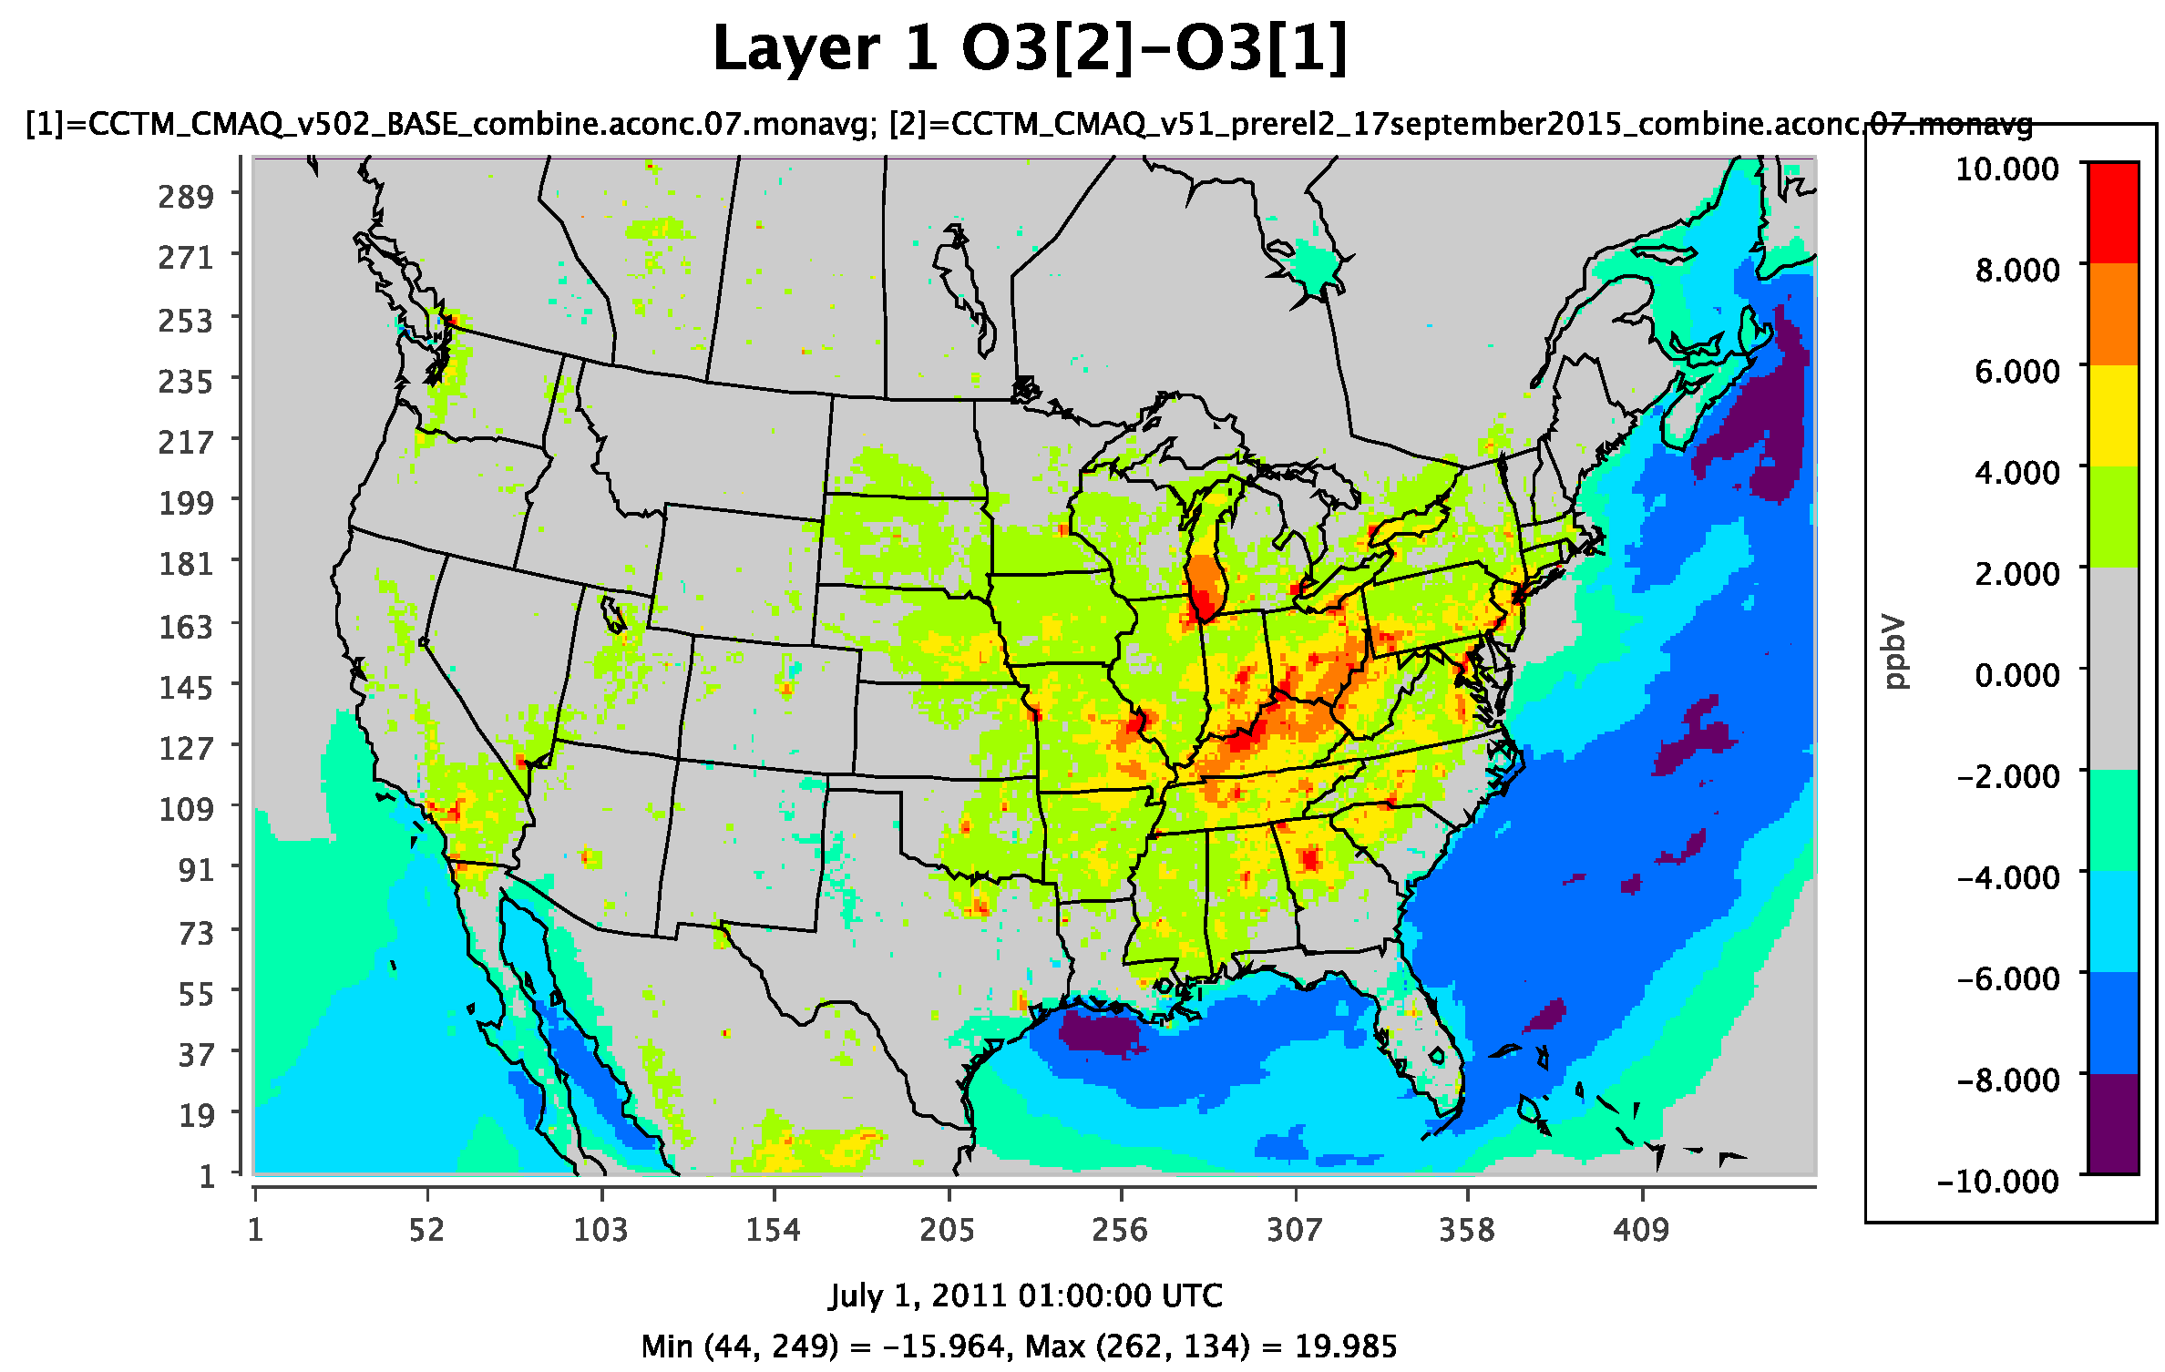
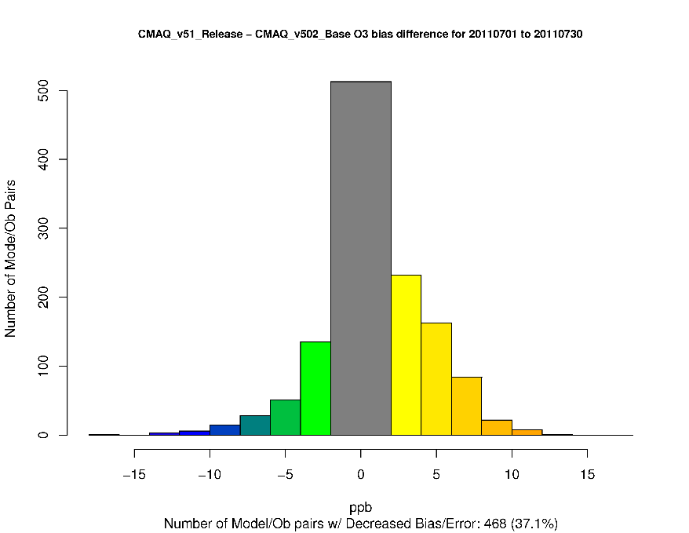
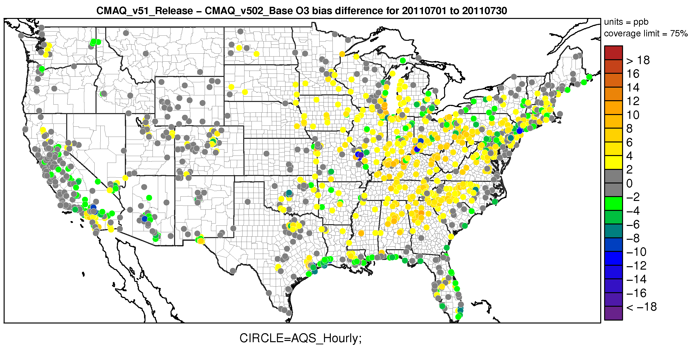
July Monthly Average Ozone (all hours)
Ozone increases by approximately 2-10 ppb on average for July in the eastern United States, while large decrease in ozone are observed over the Gulf of Mexico and along the east and west coasts.
The increase in ozone results in generally higher biases at sites in the eastern U.S., but slightly lower biases in California and the Northeast, while the decreases in ozone result in lower biases for most coastal sites (e.g. Gulf of Mexico and eastern U.S.)
Increase in Bias
Decrease in Bias
Warm colors represent an increase in hourly ozone bias in CMAQv5.1
Cool colors represent a decrease in hourly ozone bias in CMAQv5.1

Slide 6
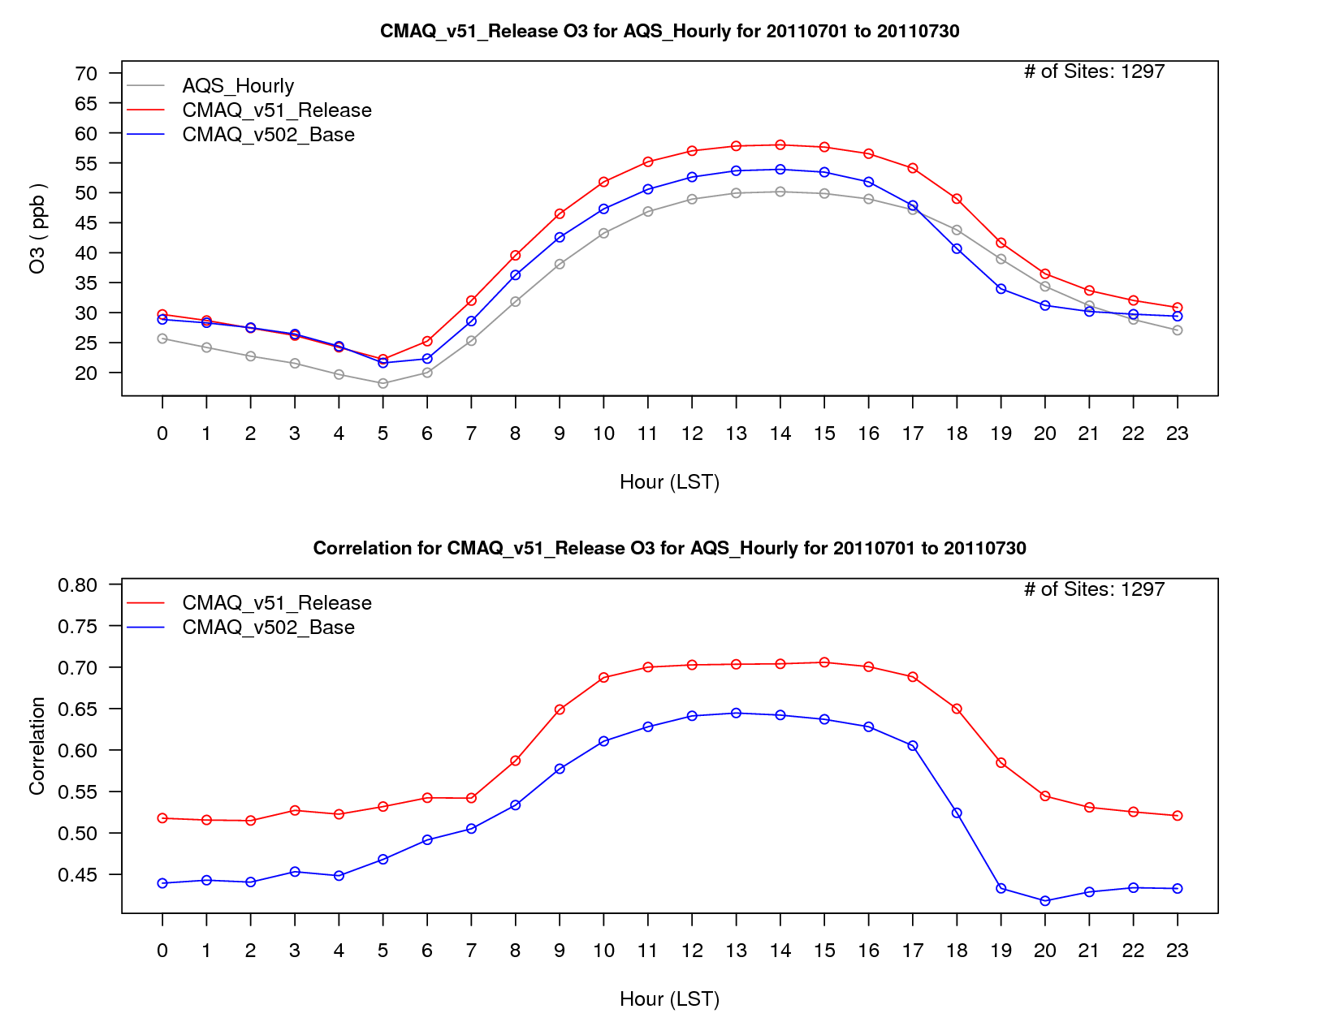
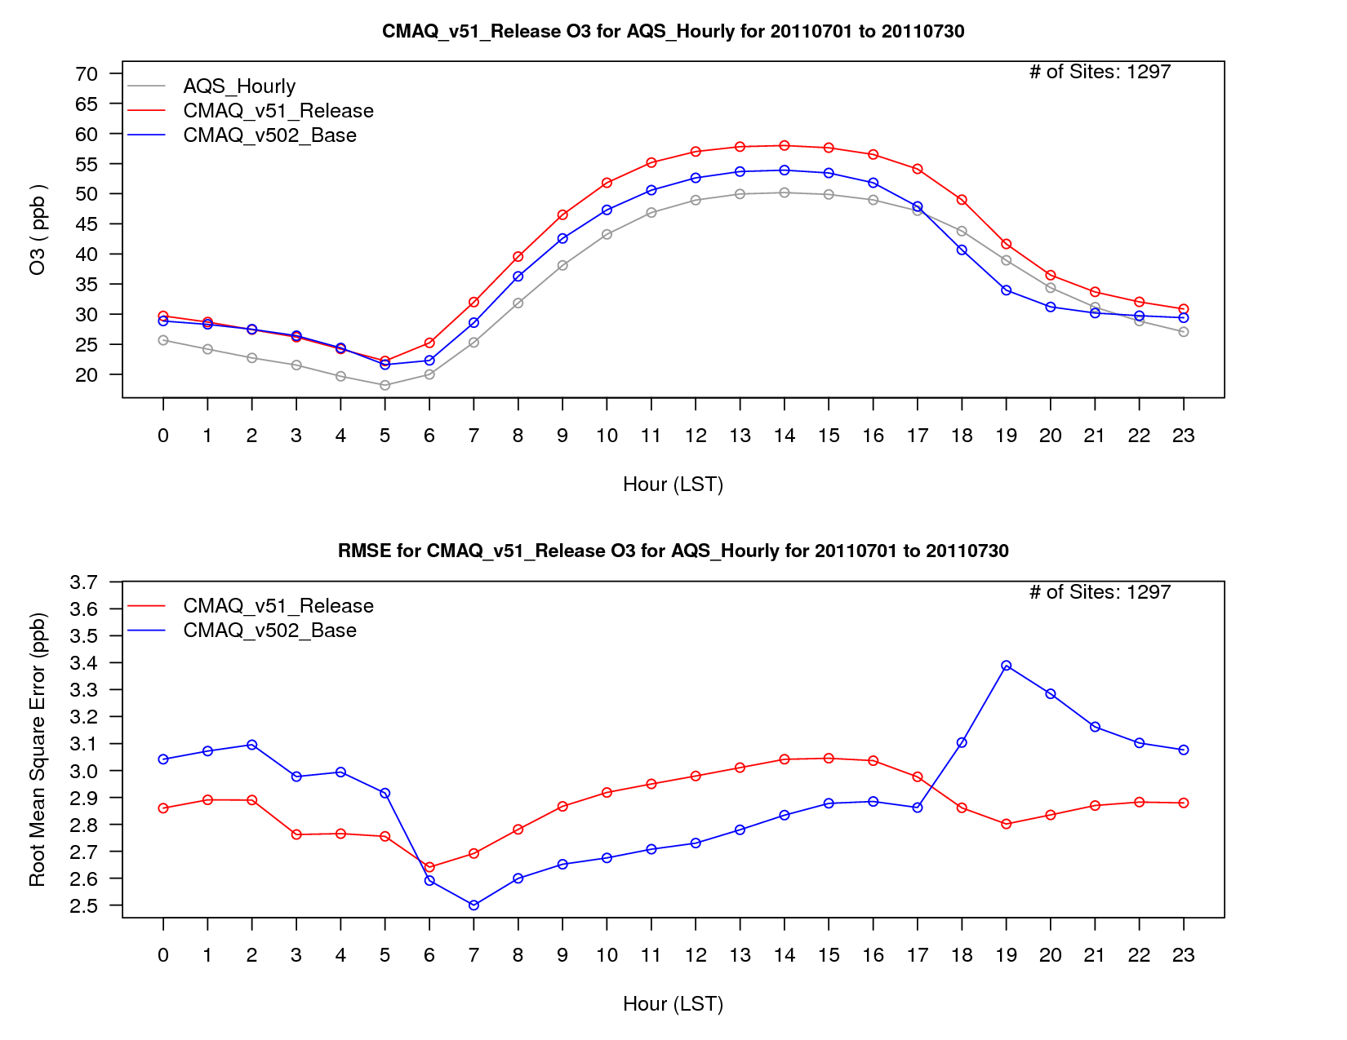
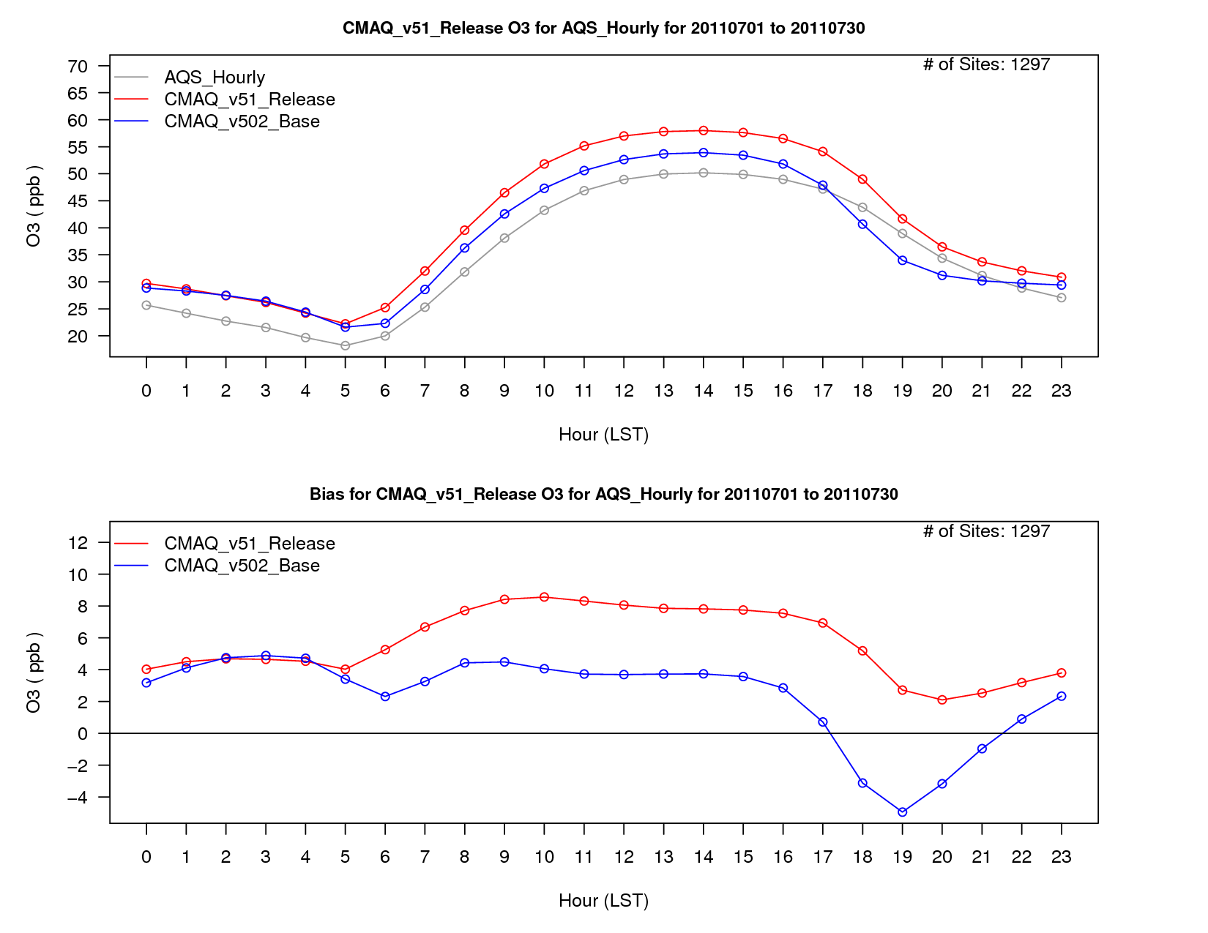
Ozone Diurnal Performance -
all sites; July average
While ozone bias increases during most of the day, the evening transition is better represented in CMAQv5.1, which may result is a better model response to control strategies.
RMSE is lower during the nighttime, while the correlation is higher for all hours in CMAQv5.1 vs. v5.0.2, which should improve the model’s usefulness in health study applications.

Slide 7
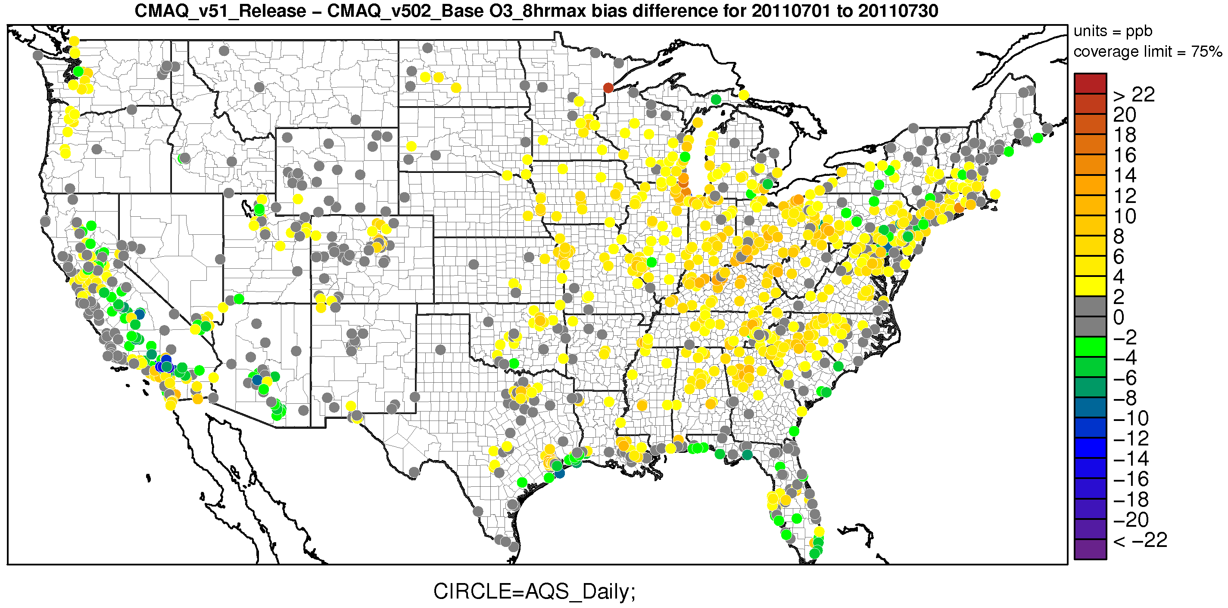
July 2011 Monthly Average MDA8 Ozone Bias Change from CMAQv5.0.2 to CMAQv5.1
Warm colors represent an increase in MDA8 ozone bias in CMAQv5.1
Cool colors represent a decrease in MDA8 ozone bias in CMAQv5.1

Slide 8
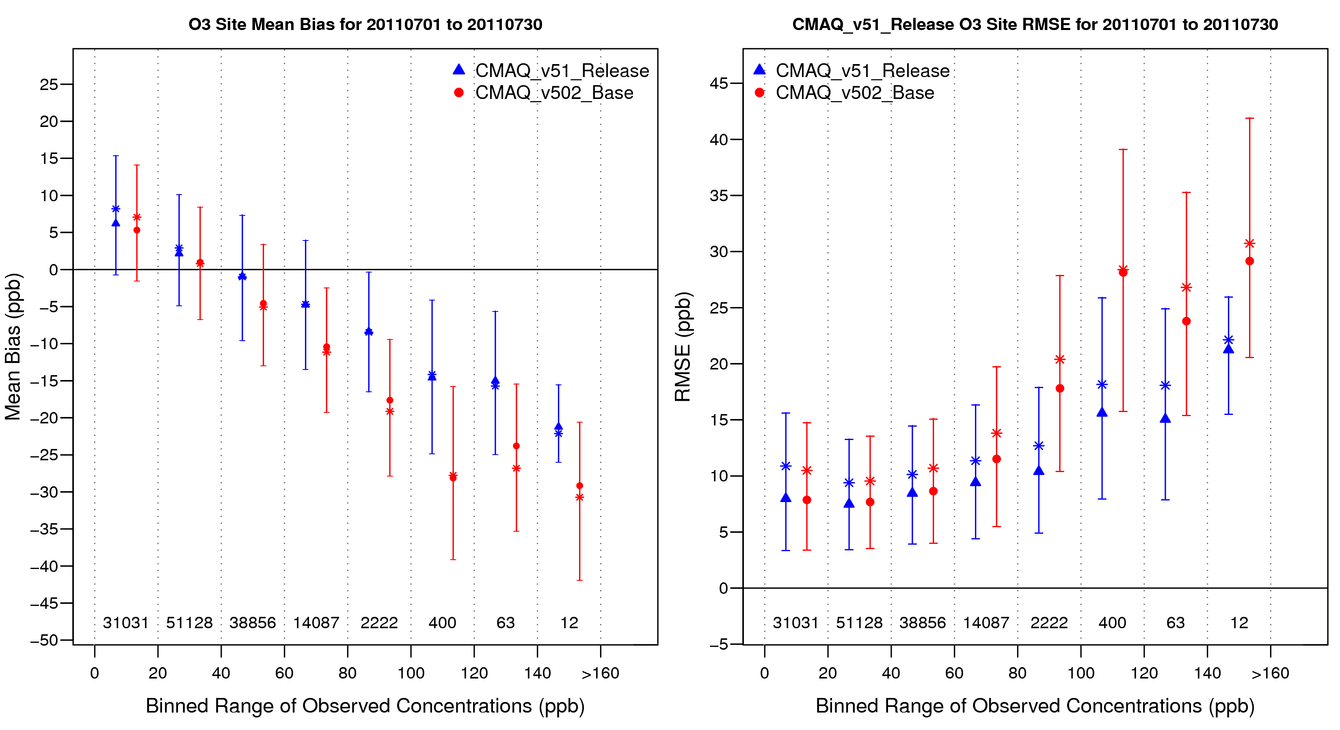
Hourly Ozone Binned Bias and
RMSE for July 2011
Improvement in bias and RMSE at ozone mixing ratios > 40 ppb.

Slide 9
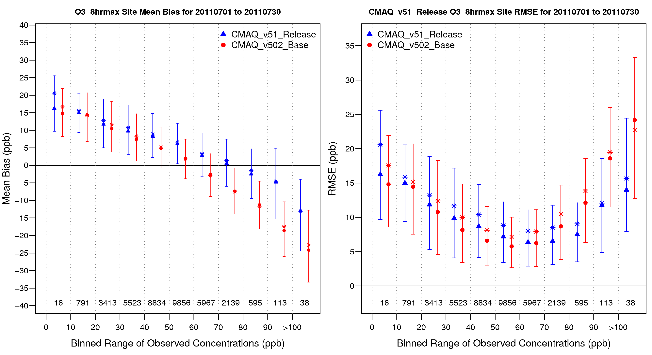
MDA8 Ozone Binned Bias and
RMSE for July 2011
Improvement in MDA8 bias and RMSE at moderate to high (>70 ppb) ozone mixing ratios.

Slide 10
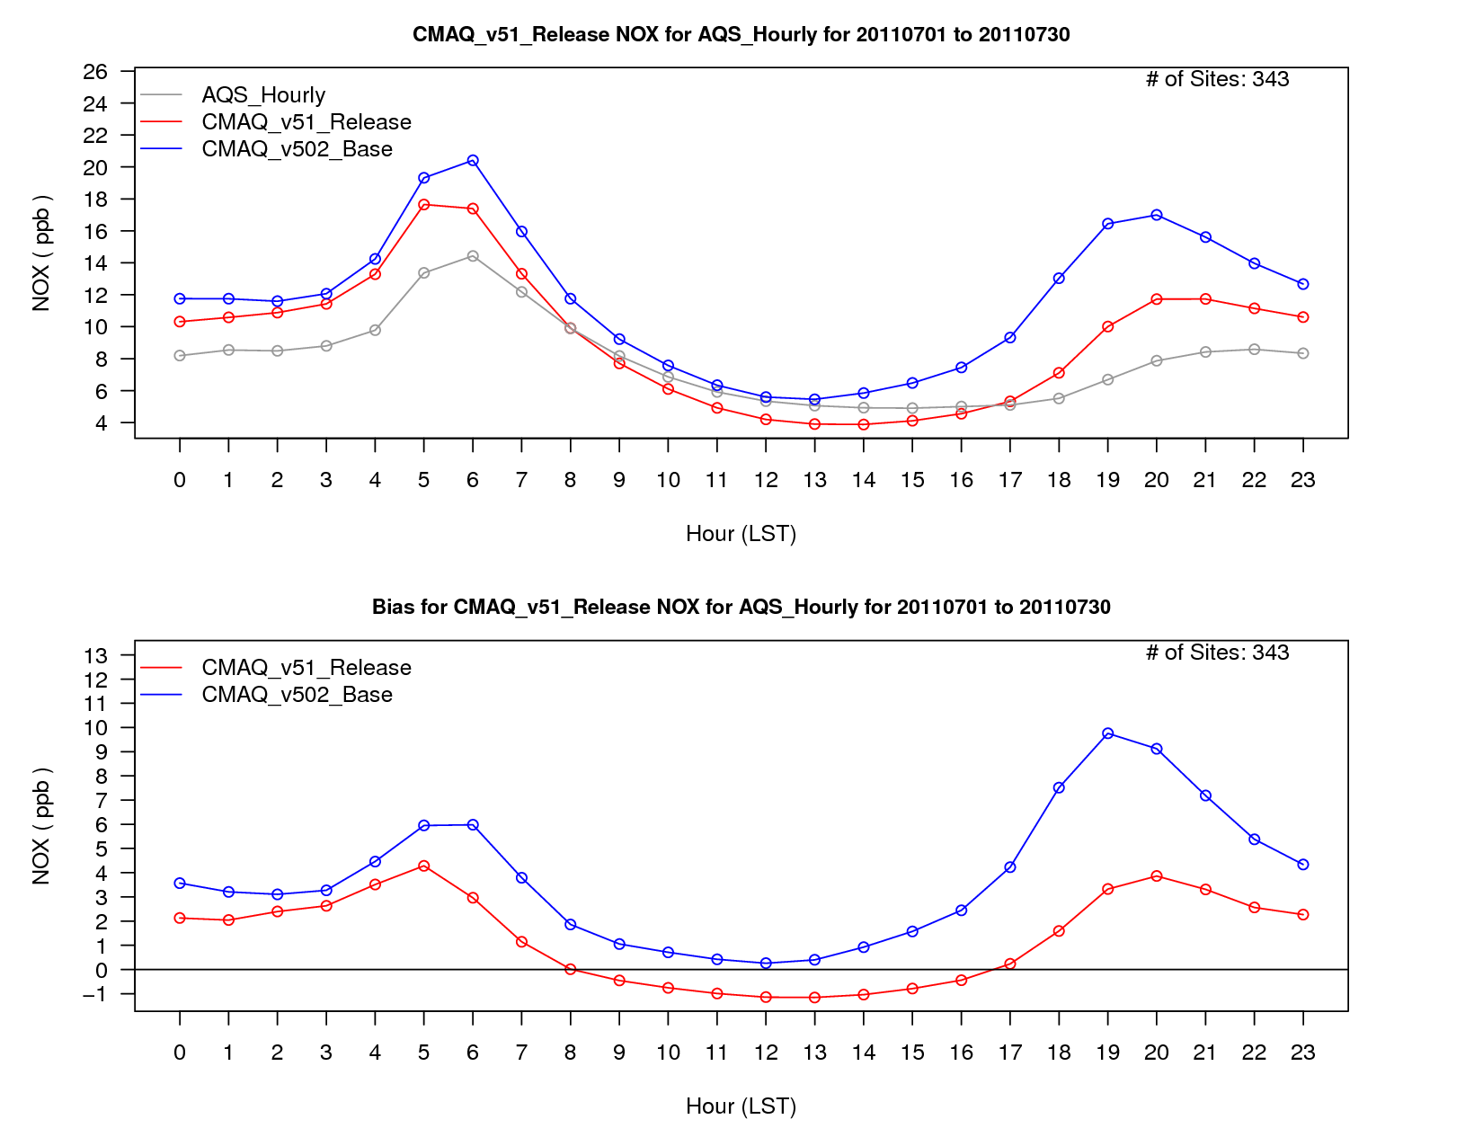
NO_{X} Diurnal Performance -
all sites; July average
Large improvement in the NO_{X} mixing ratios biases during the morning and evening transitions, with a slight under-prediction in NO_{X} mixing ratios during the middle of the day.

Slide 11
Major Updates Affecting PM
Added SOA from isoprene epoxydiols (IEPOX)
  adds approximately 1.0 µgm⁻³ of IEPOX SOA in the Southeast
Added SOA from isoprene + NO₃
  increases AlSO1J and AlSO2J by less than 0.5 µgm⁻³ in the Southeast
Added gravitational settling from upper layers
  results in additional fine and coarse (mostly coarse) mass in the surface layer
  should also result in small increase in coarse PM dry deposition
Update to ACM2 in WRFv3.7
  Improvements in land surface and atmospheric boundary layer processes (PX LSM, ACM2)
  Consistent changes in ACM2 in CMAQ
    more accurate representation of surface meteorology and pollutant concentrations day and night
Re-calculation of Monin-Obukhov length in CMAQ to be consistent with ACM2 in WRF
  Tends to reduce stability in CMAQ (particularly during evening transition hours)
  Results in decreased concentrations of most primary emitted pollutants (through greater dilution)

Slide 12
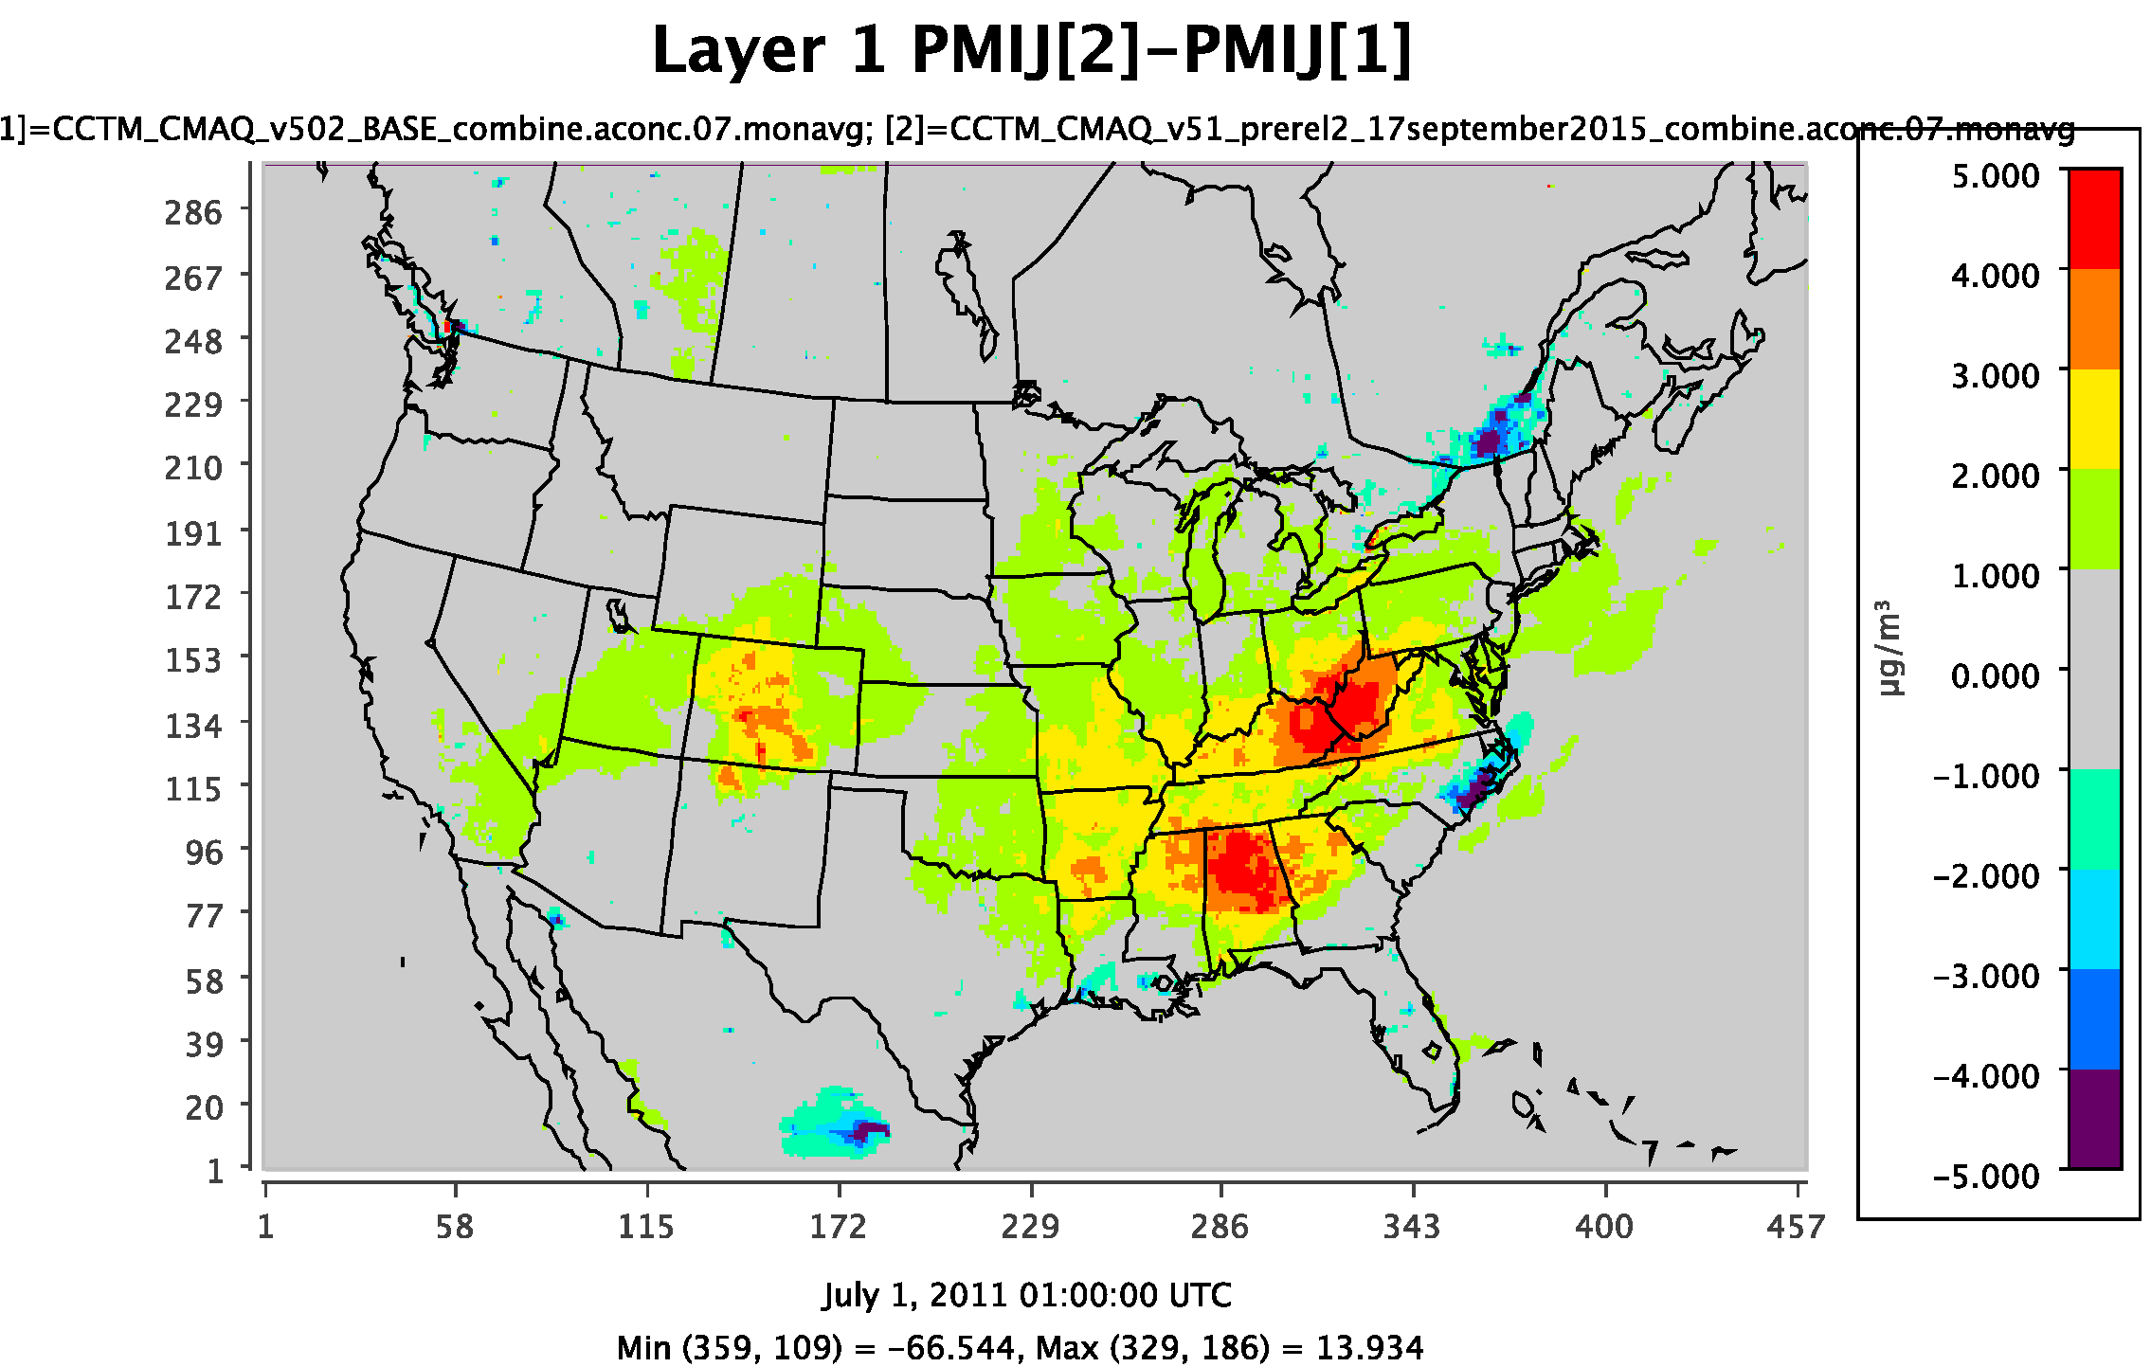
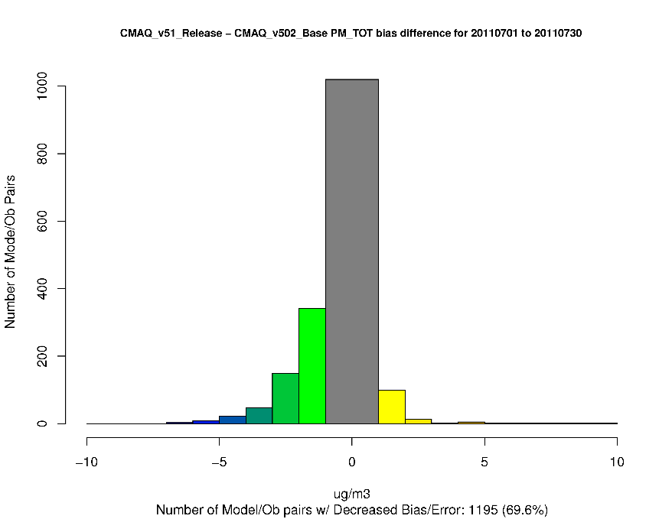
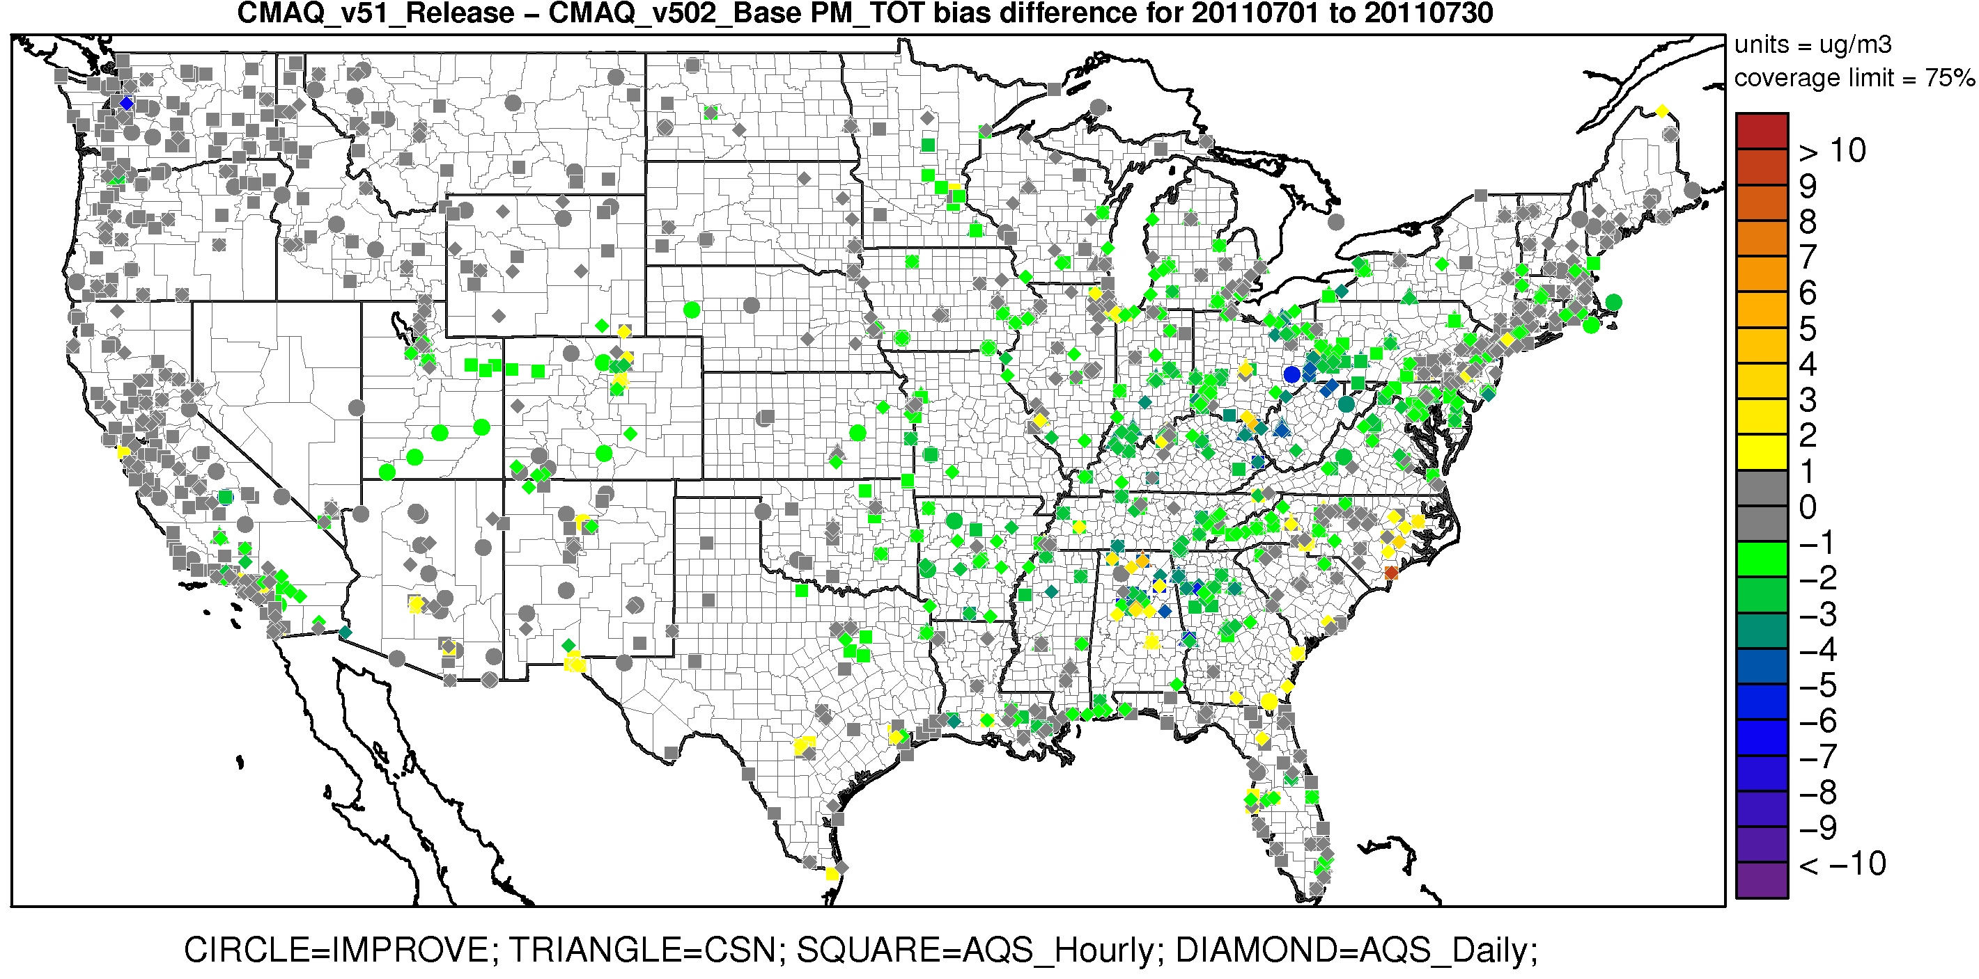
July Monthly Average PM_{2.5} (all hours)
PM_{2.5} increases by approximately 0.5-3 µgm⁻³ on average for July, predominantly in the eastern United States. The increase in PM_{2.5} in CMAQv5.1 is primarily due to increased SO₄²⁻ (from greater OH⁻ concentrations) and additional secondary organic aerosol (SOA) from IEPOX, and changes affecting WRF (ACM2 and MOL).
As a result, PM_{2.5} biases decrease at most sites (since PM_{2.5} is predominately underestimated during the summer)
Increase in Bias
Decrease in Bias
Warm colors represent an increase in PM_{2.5} bias in CMAQv5.1
Cool colors represent a decrease in PM_{2.5} bias in CMAQv5.1

Slide 13
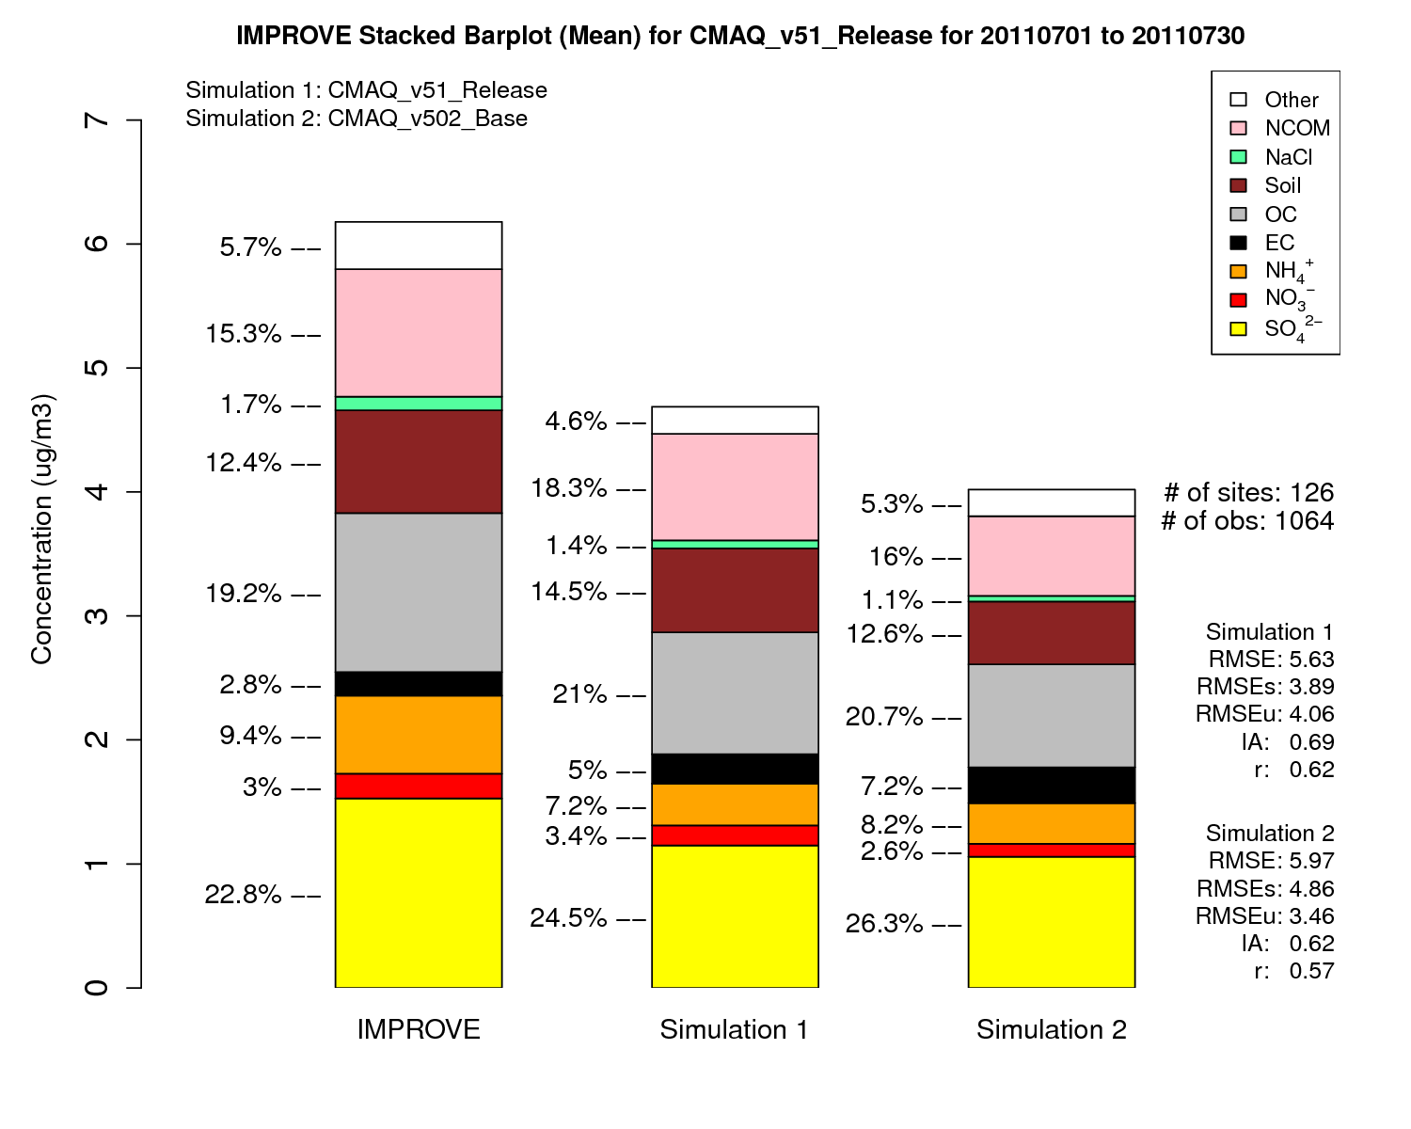
IMPROVE
CMAQv5.1
CMAQv5.0.2
PM_{2.5} increases in CMAQv5.1 primarily due to increases in SO₄²⁻, OC, Soil and NCOM

Slide 14
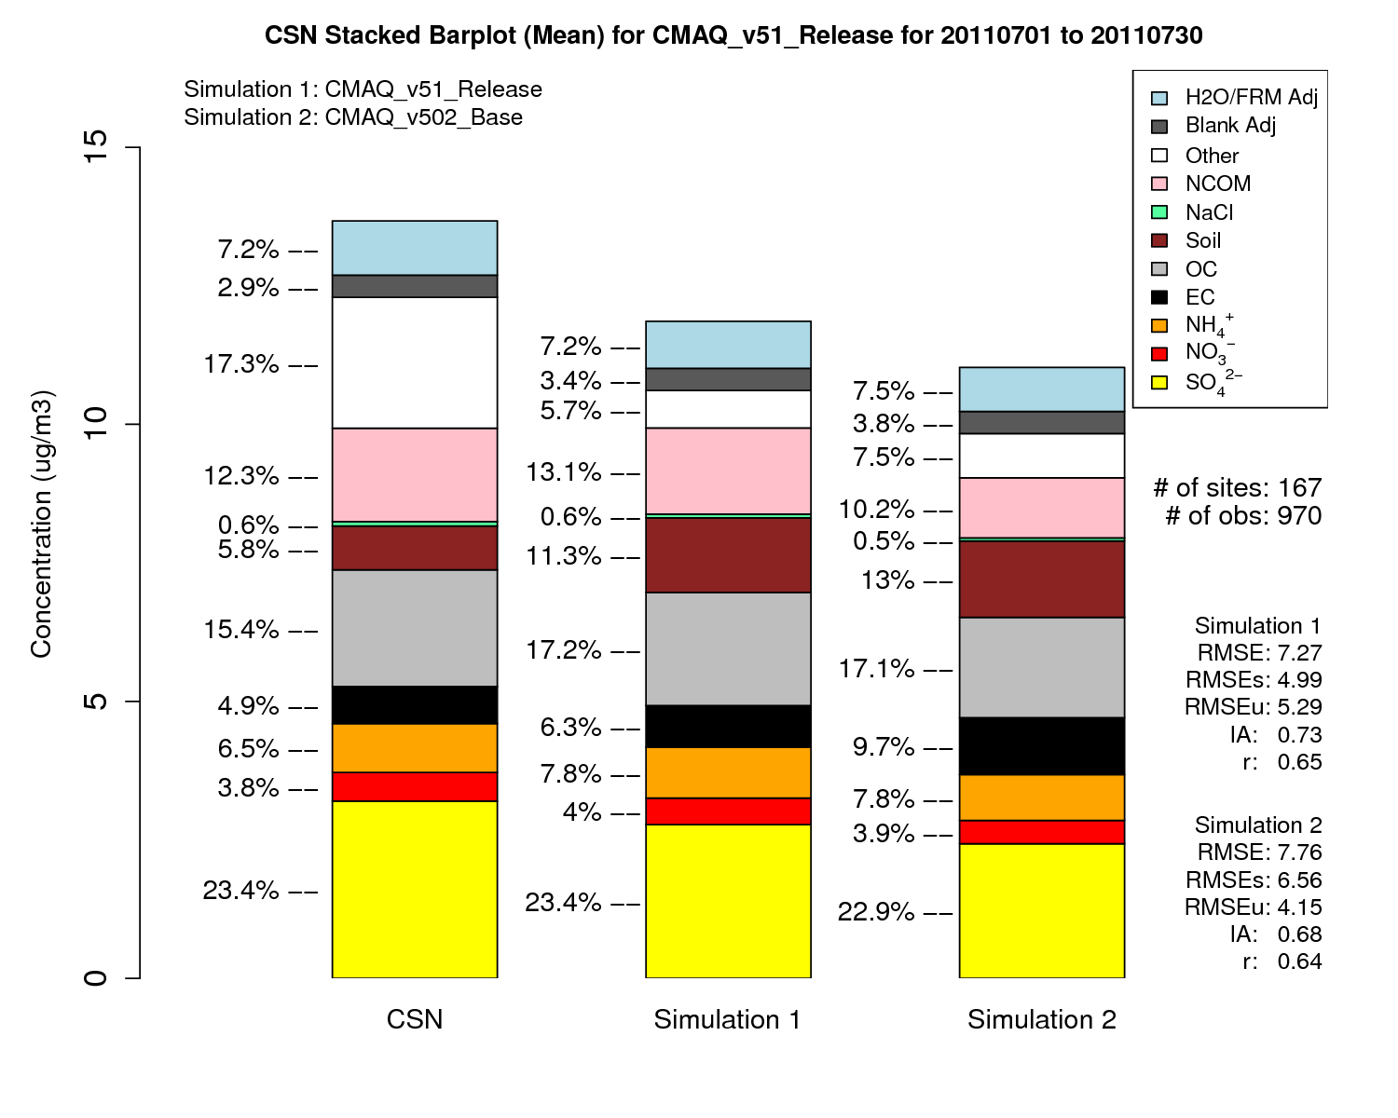
CSN
CMAQv5.1
CMAQv5.0.2
PM_{2.5} increases in CMAQv5.1 primarily due to increases in SO₄²⁻, OC and NCOM

Slide 15
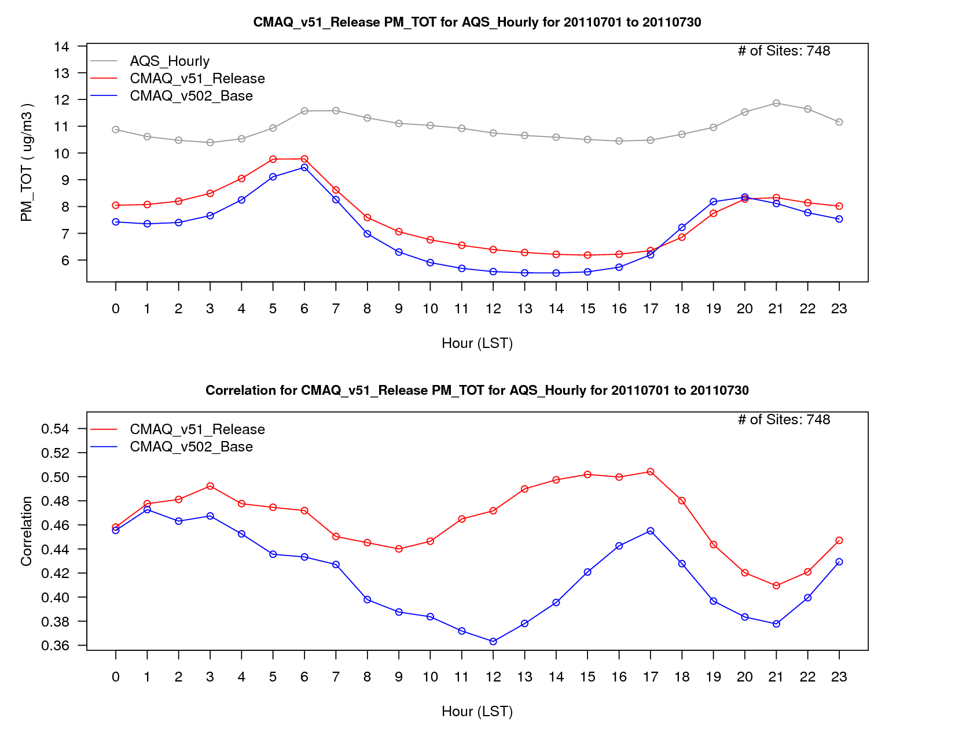
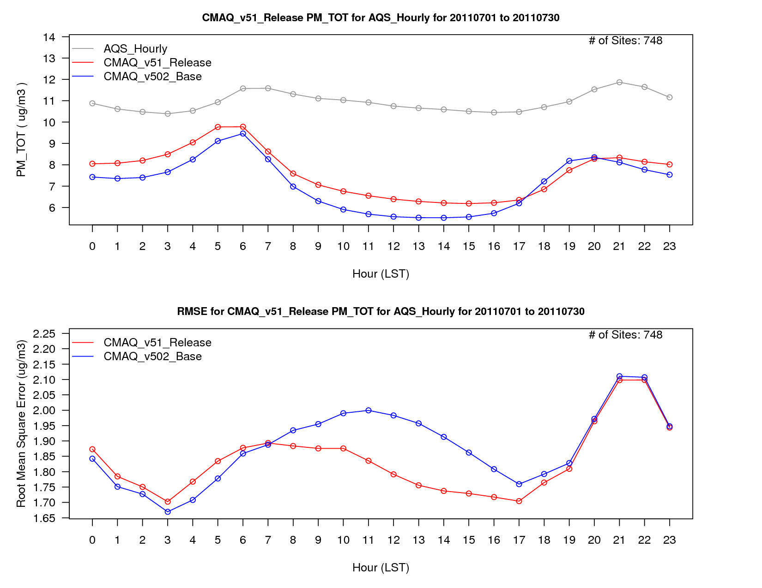
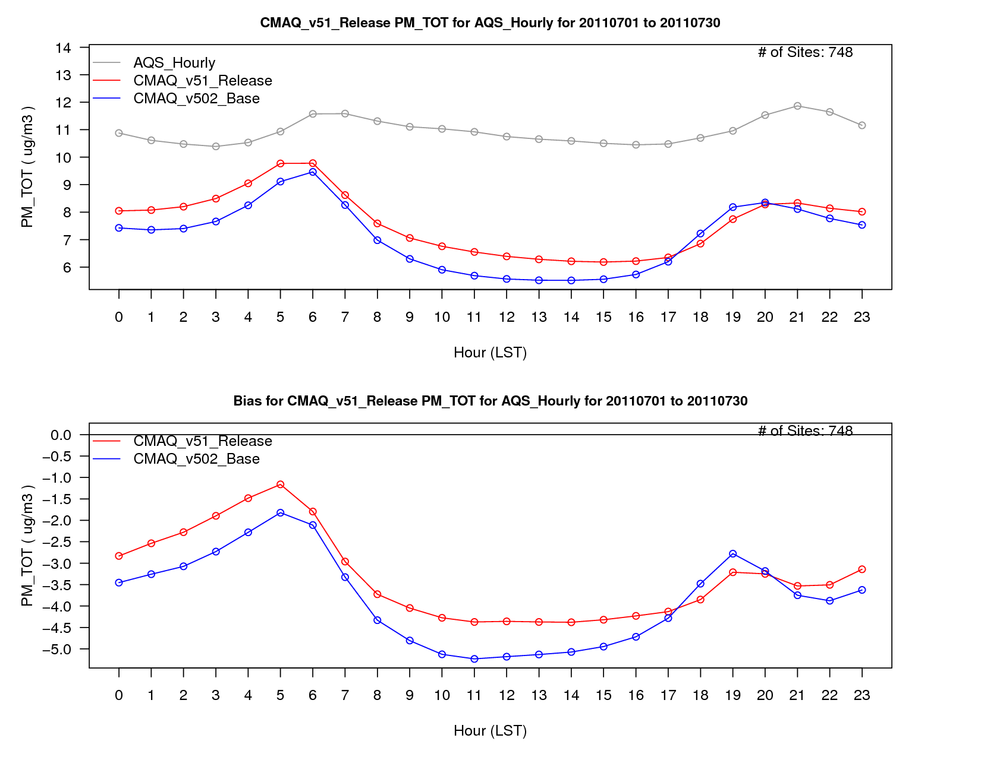
PM_{2.5} Diurnal Performance -
all sites; July average
PM_{2.5} concentrations are higher in v5.1 than v5.0.2 throughout most of the day, which results in improved bias as PM_{2.5} is largely underestimated by the model in July 2011.
RMSE and correlation are also improved for v5.1 over v5.0.2, with lower RMSE values during the daytime and greater correlation for the entire day.

Slide 16
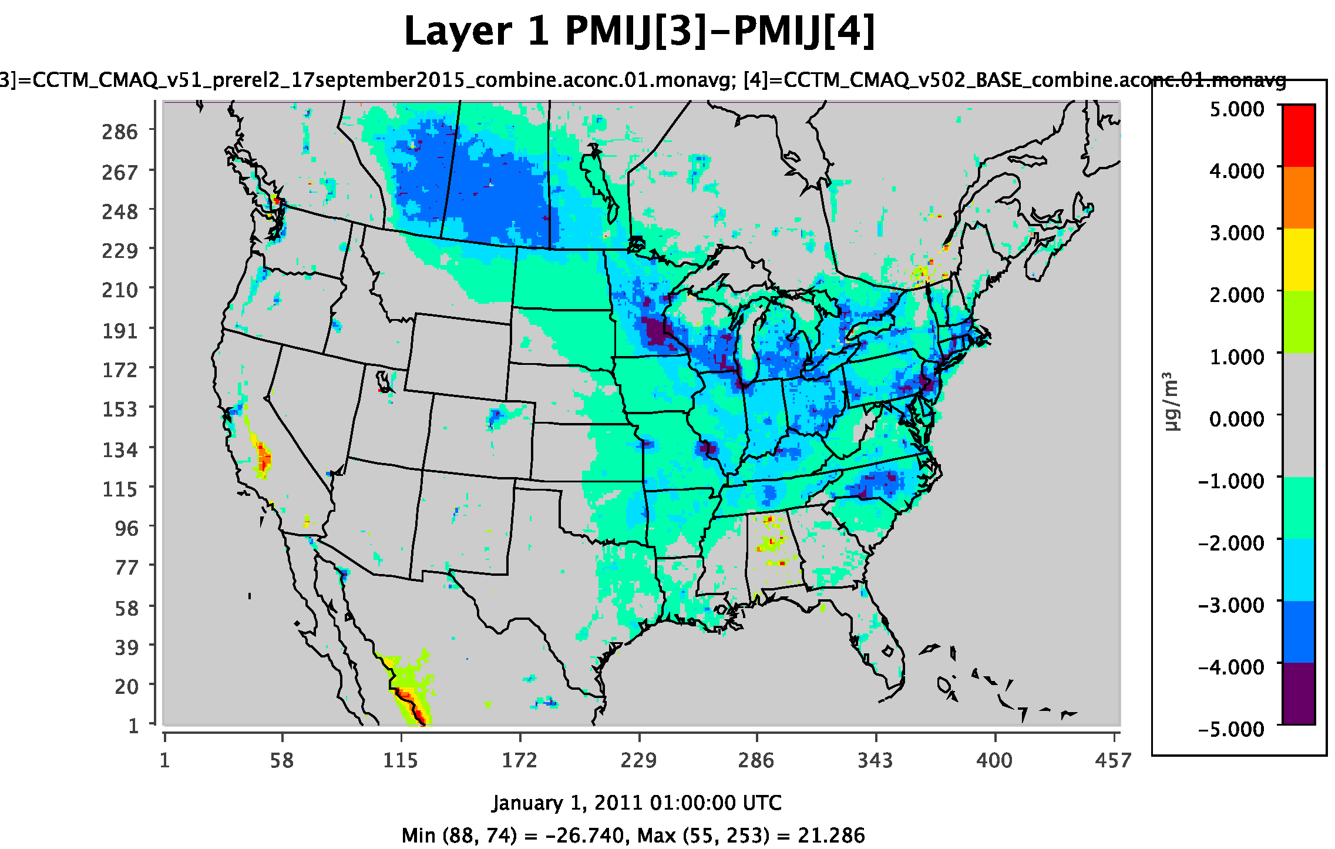
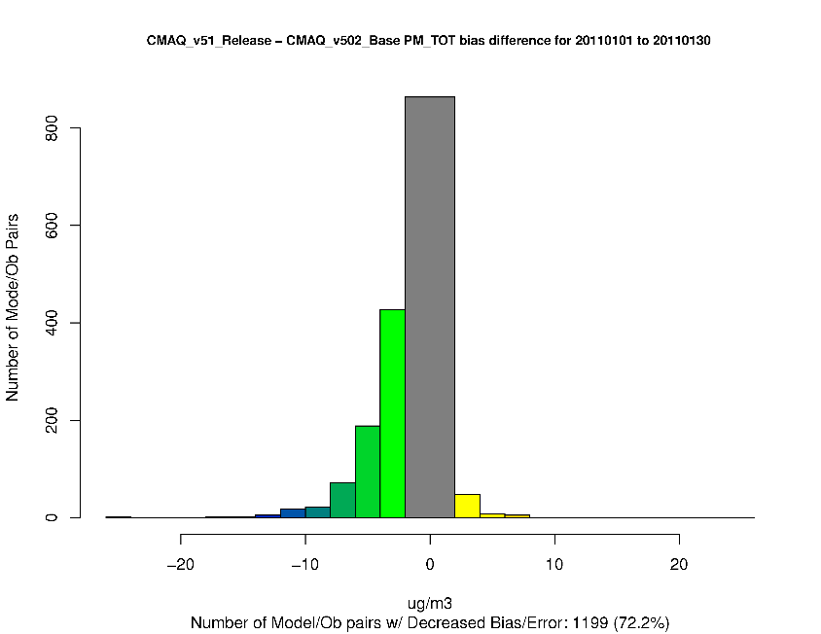
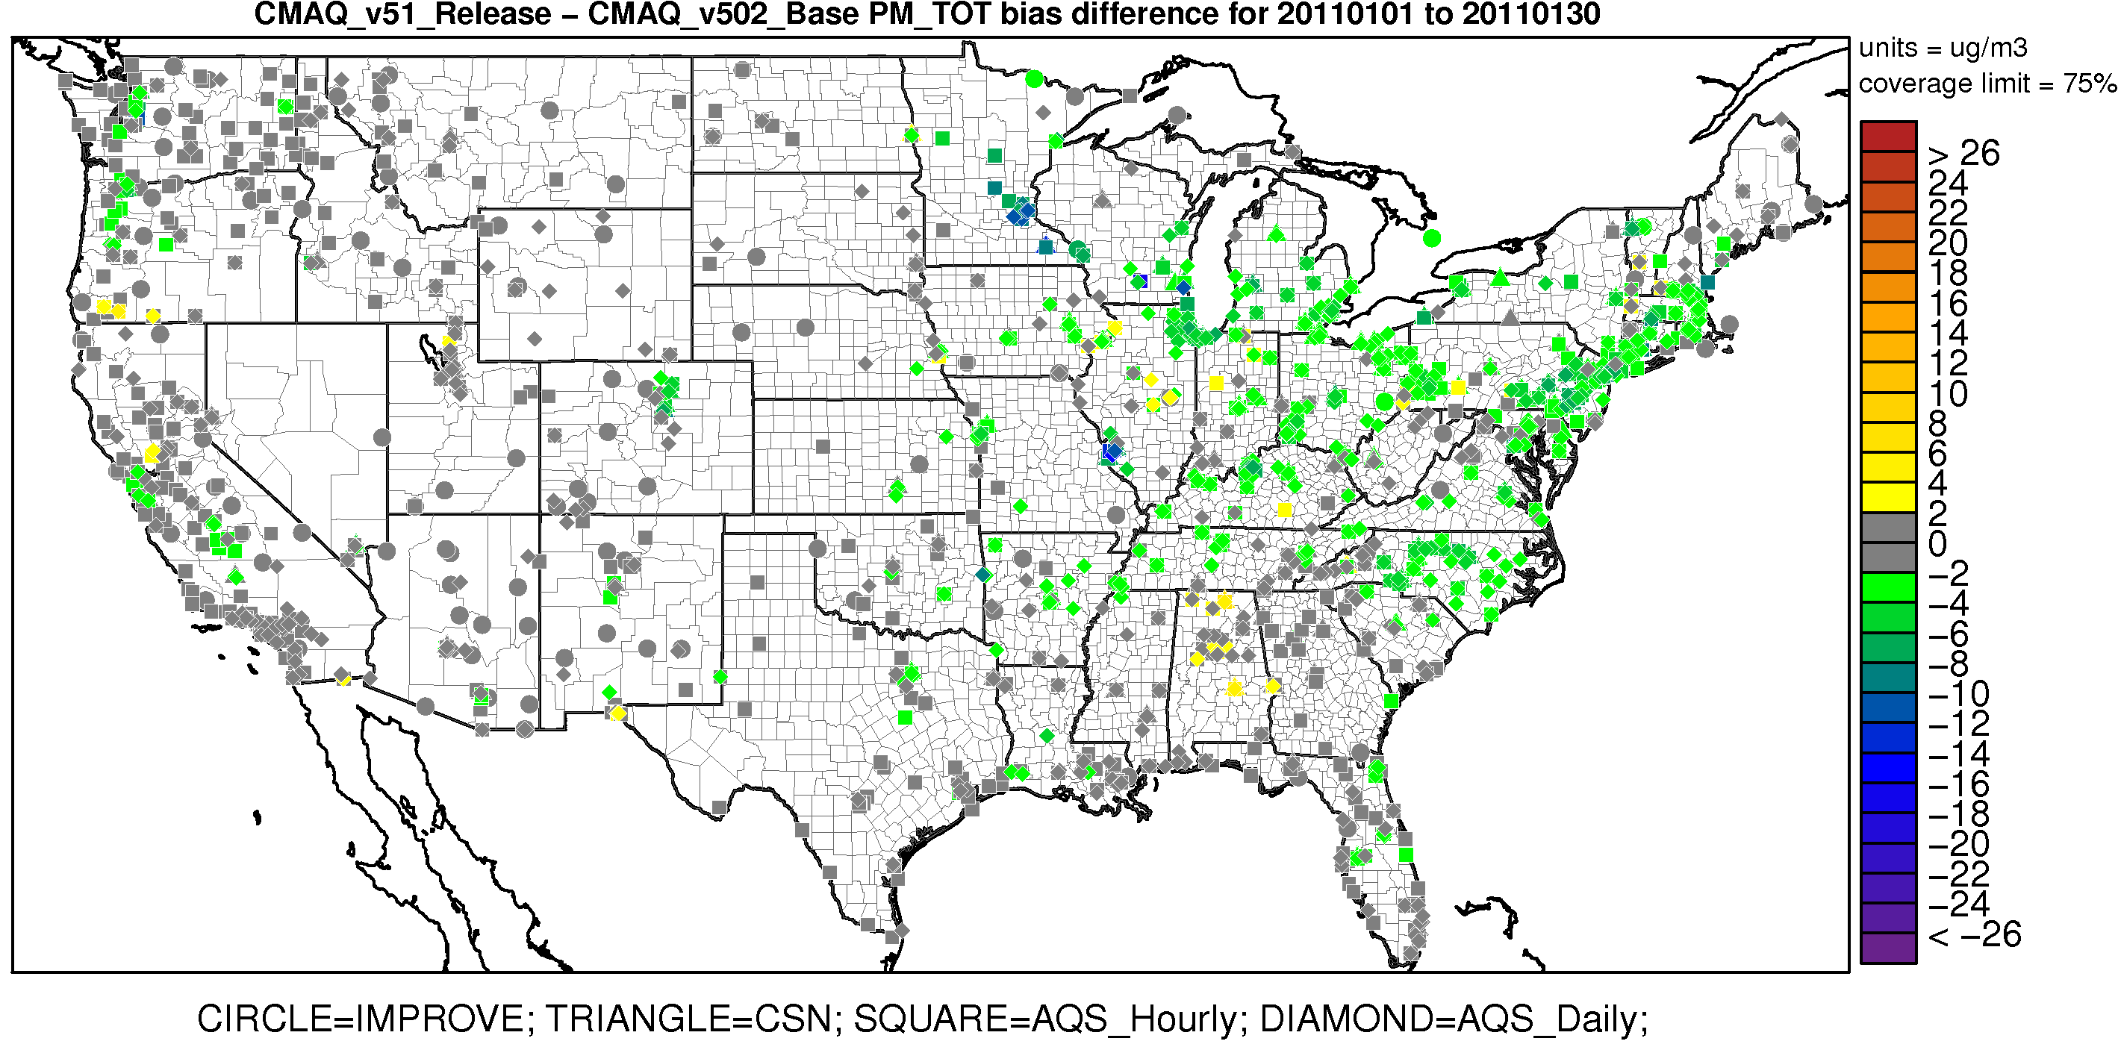
January Monthly Average PM_{2.5} (all hours)
PM_{2.5} generally decreases in January in CMAQv5.1 (exception being the SJV of California) by about 1-5 µgm⁻³, resulting in a broad improvement in model performance, particularly in the eastern U.S.
The decrease in PM_{2.5} is driven primarily by a decrease in particulate NO₃⁻ from a net decrease in HNO₃ due to ClNO₂ and NTR chemistry changes, as well as decreases in primary PM pollutants from changes in WRF (i.e. ACM2 updates).
Increase in Bias
Decrease in Bias
Warm colors represent an increase in PM_{2.5} bias in CMAQv5.1
Cool colors represent a decrease in PM_{2.5} bias in CMAQv5.1

Slide 17
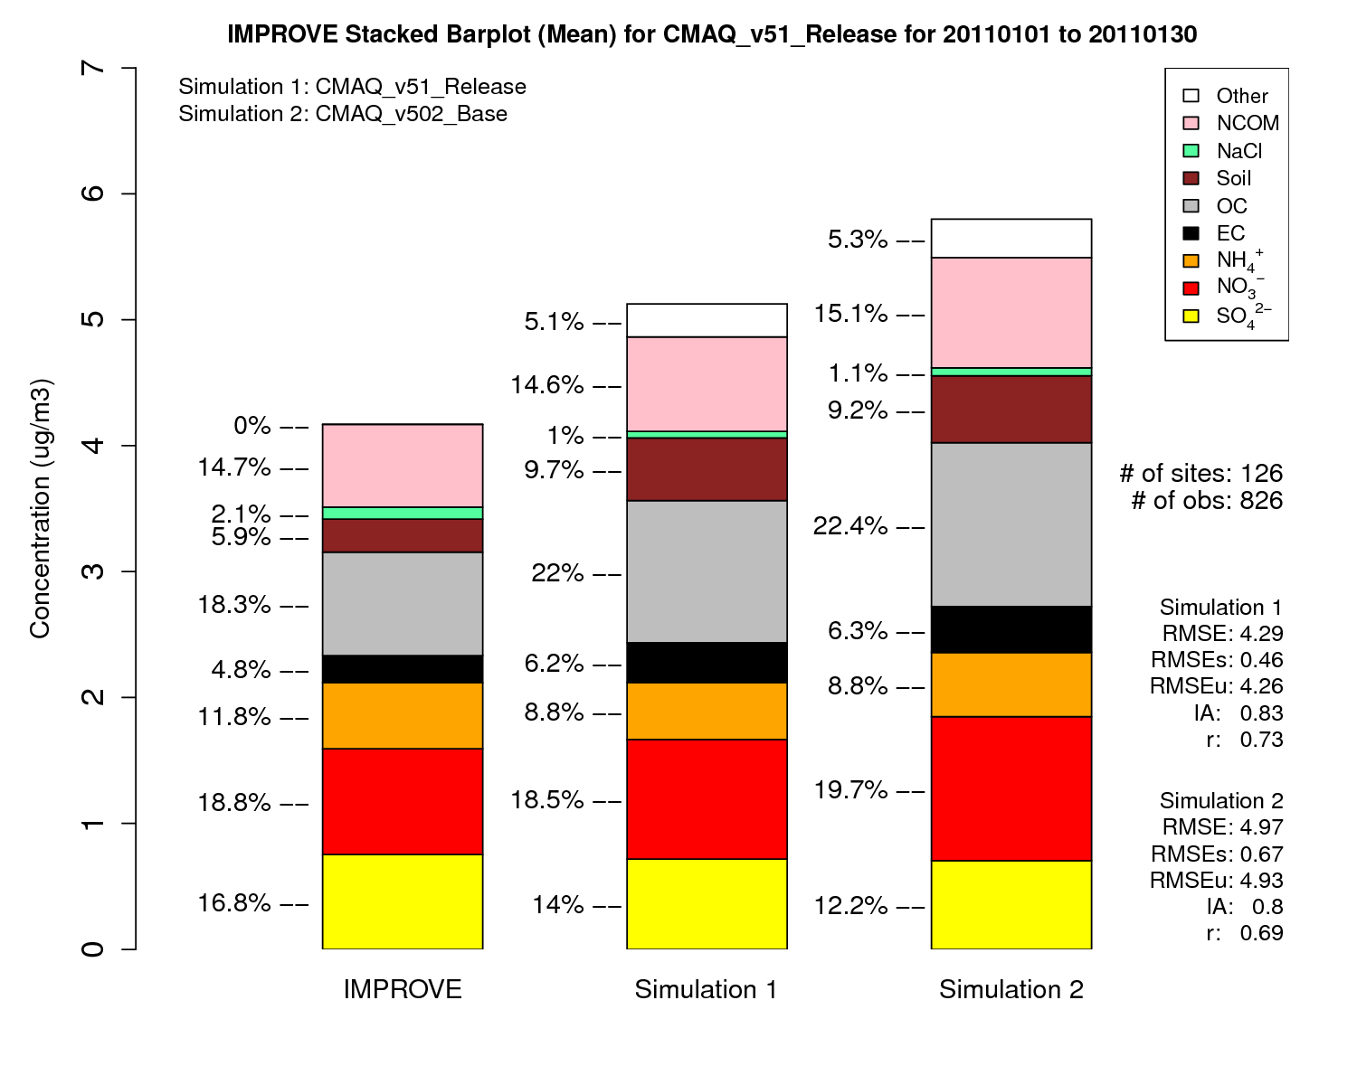
IMPROVE
CMAQv5.1
CMAQv5.0.2
PM_{2.5} decreases in CMAQv5.1 due to decreases in NO₃⁻ and primary species (e.g. EC, OC)

Slide 18
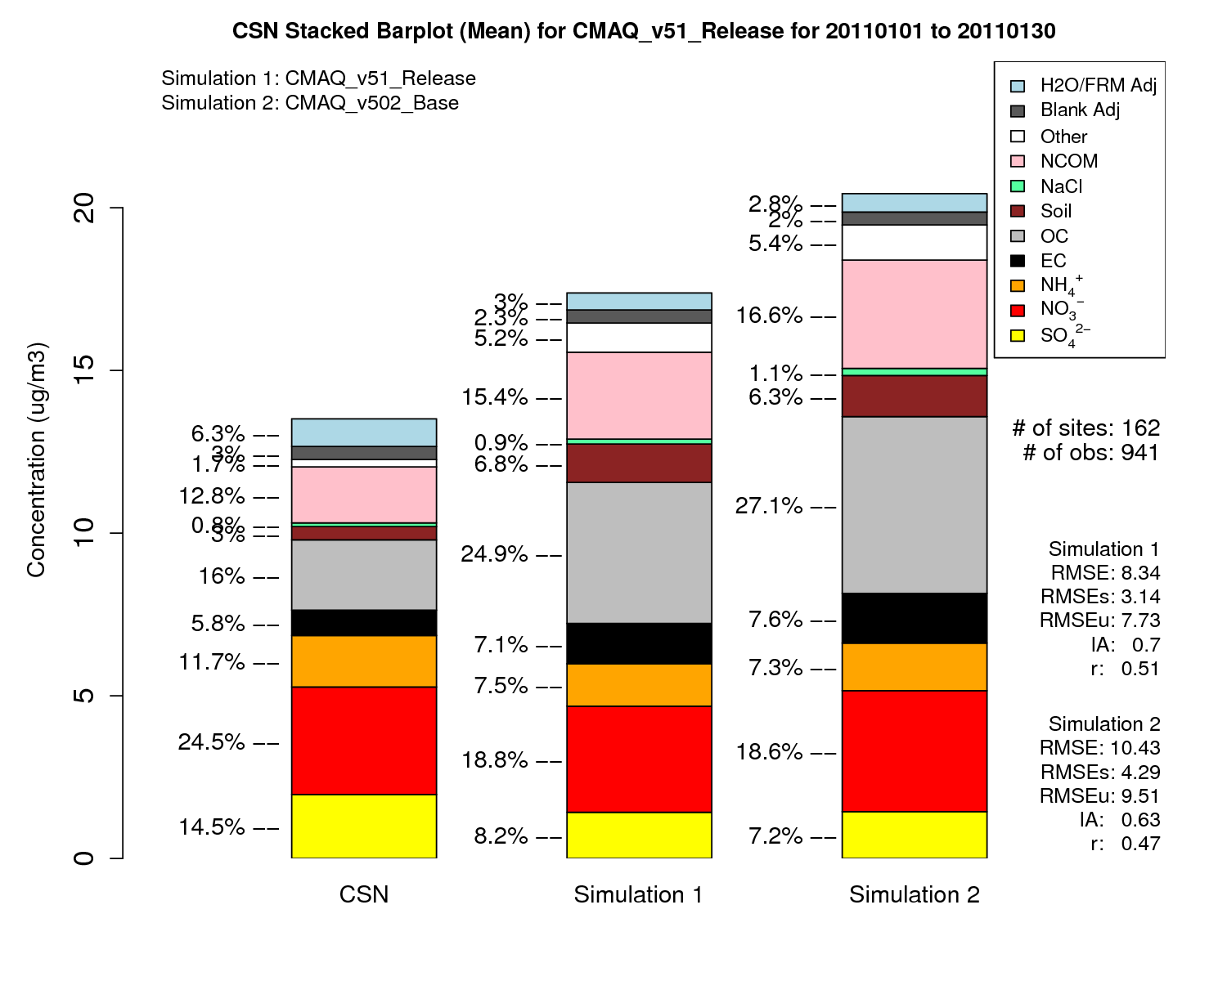
CSN
CMAQv5.1
CMAQv5.0.2
PM_{2.5} decreases in CMAQv5.1 due to decreases in NO₃⁻ and primary species (e.g. EC, OC)

Slide 19
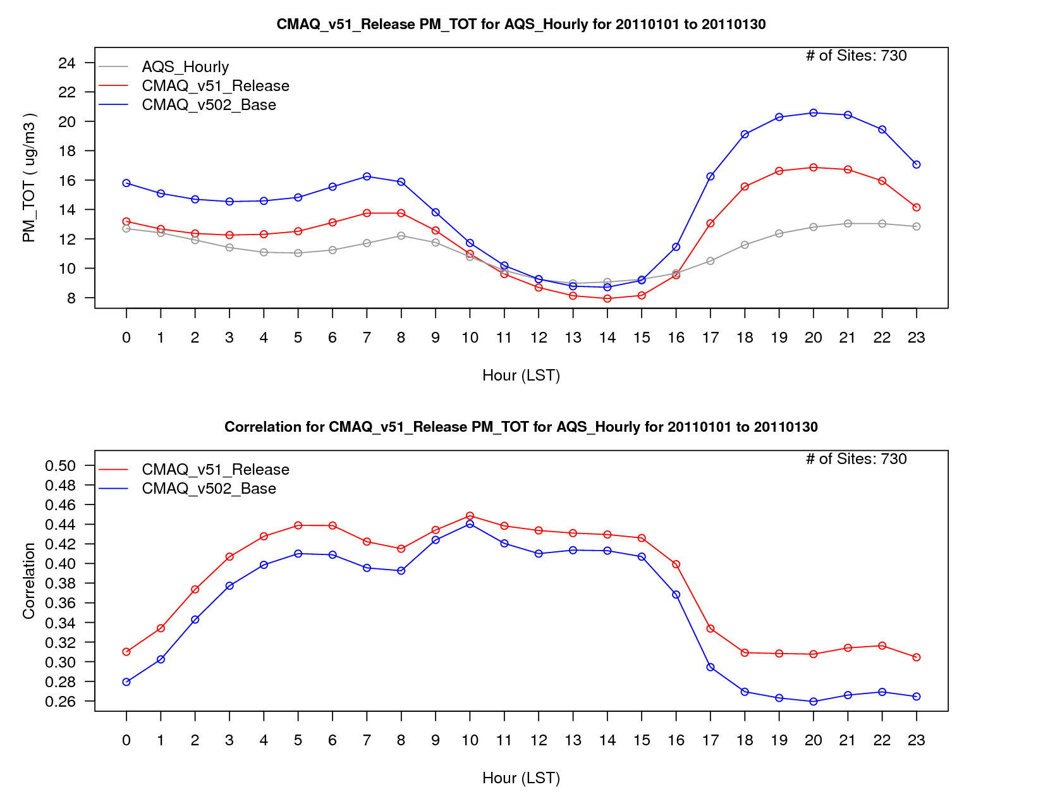
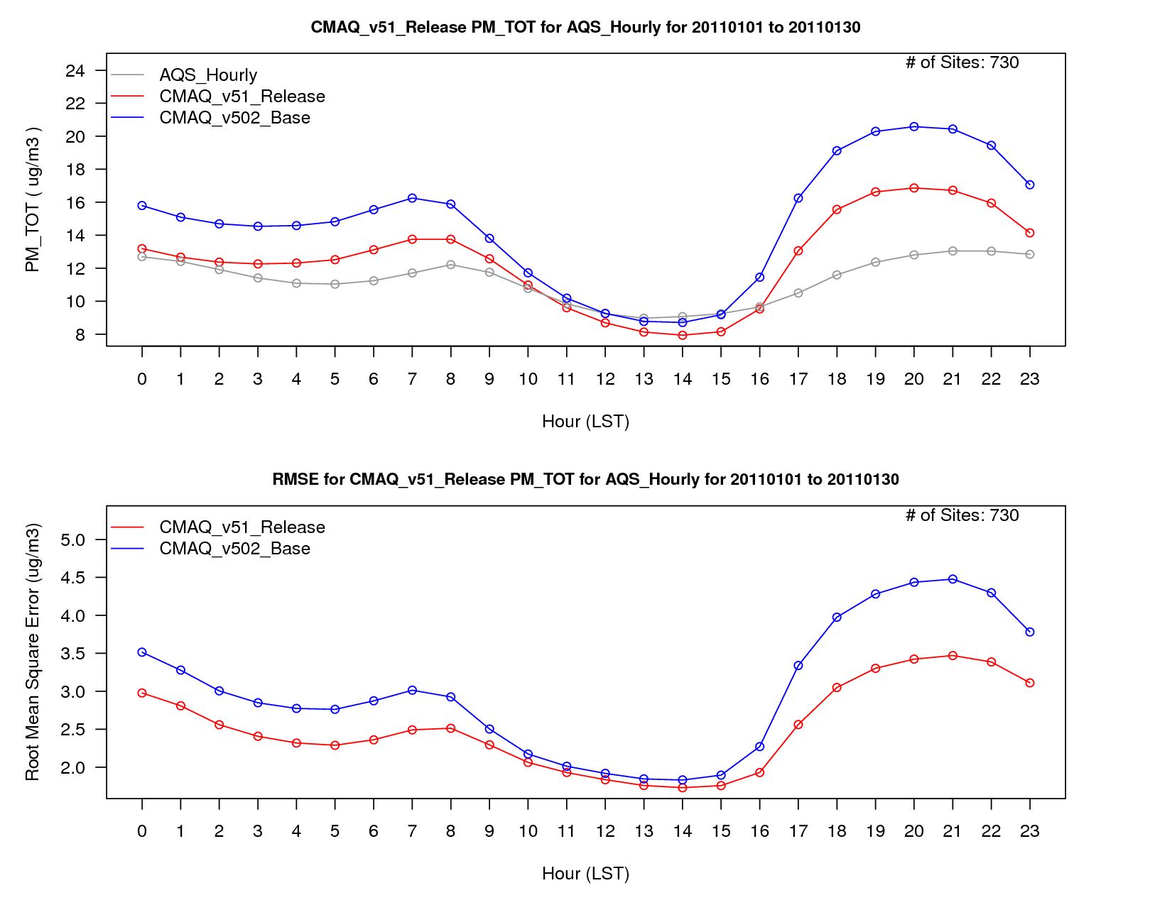
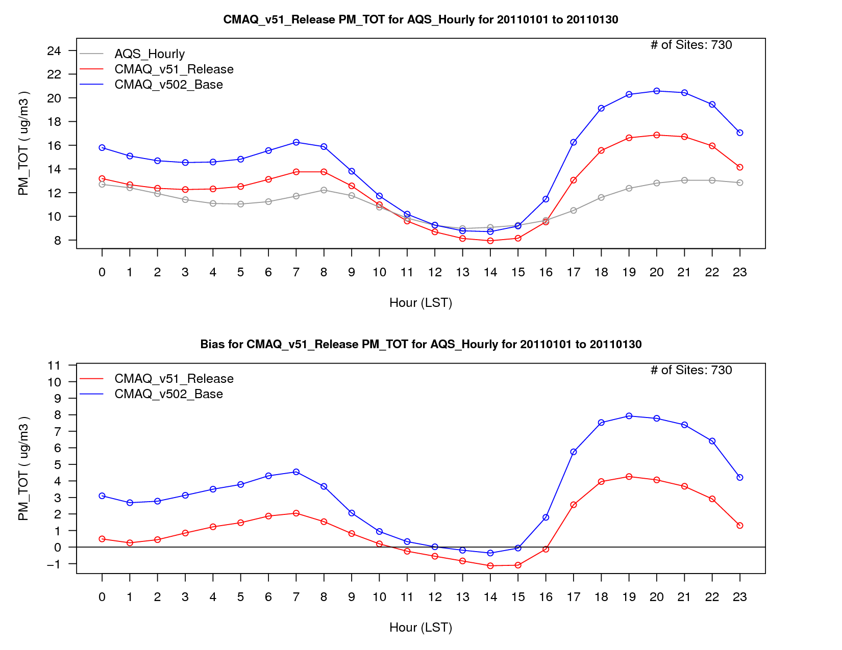
PM_{2.5} Diurnal Performance -
all sites; January average
PM_{2.5} concentrations decrease throughout the day, particularly during the overnight hours and during the transition periods.
Bias with CMAQv5.1 is lower throughout most of the day, while RMSE is lower throughout the entire day, and correlation is greater throughout the entire day as well.

Slide 20
CMAQ Model Sensitivity to
Emission Reductions
Air Quality models are often used as tools to test emission control strategies
Previous research has shown that CMAQ tends to underestimate the response to emission reductions
  i.e. ozone reduction is greater in the real world than simulated by the model
Test CMAQ response to large cuts in input emissions
  50% Anthropogenic NOX Cut
  50% Anthropogenic VOC Cut
  50% Anthropogenic SOX Cut
Performed Base and Sensitivity (emission cut) simulations using CMAQv5.0.2 and CMAQv5.1
  Calculated the RRF for ozone at all non-water sites between the base/sensitivity runs for each version of the model to determine model responsiveness
  Then compared the RRFs for ozone between each simulation
  Difference values > 1 indicate CMAQv5.1 is more responsive than v5.0.2 (and vice versa)

Slide 21
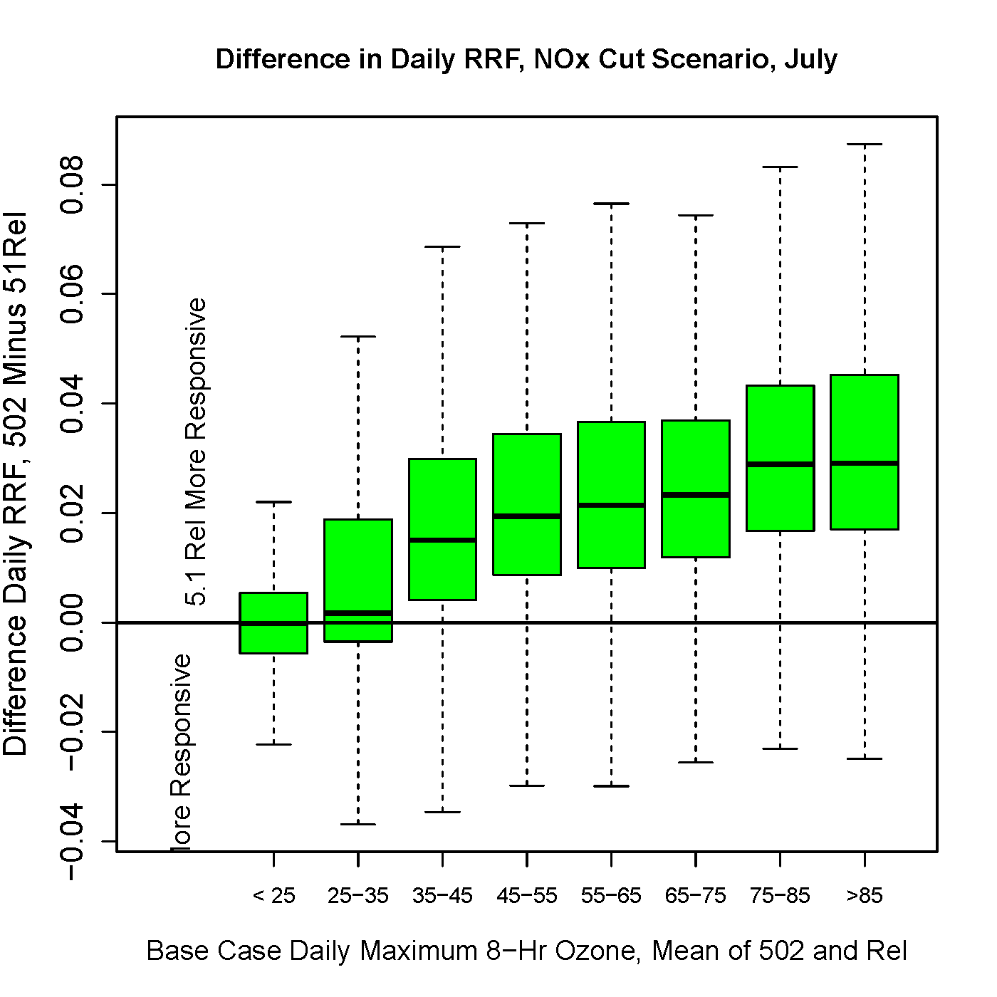
Model MDA8 Response to 50% Anthropogenic NO_{X} Cut
  Boxplots of differences in “daily RRF” between CMAQv5.0.2 and CMAQv5.1, grouped by average concentration range from the base emission simulations (for a given day and grid cell, use the average of the CMAQ5.0.2 and CMAQv5.1 base emissions simulations to group both the CMAQv5.0.2 and CMAQv5.1 daily RRF)
  The median differences are generally positive, indicating that CMAQv5.1 is more responsive than CMAQv5.0.2 in terms of daily RRF for this NOx cut scenario
  CMAQ has generally been criticized as being under-responsive to emission reductions (compared to the real-world), so a more responsive model is good
CMAQv5.1
more responsive
Difference in Daily RRF, CMAQv5.0.2 – CMAQv5.1
CMAQv5.0.2
more responsive
Base Case MDA8 Ozone, Mean of CMAQv5.0.2 and v5.1

Slide 22
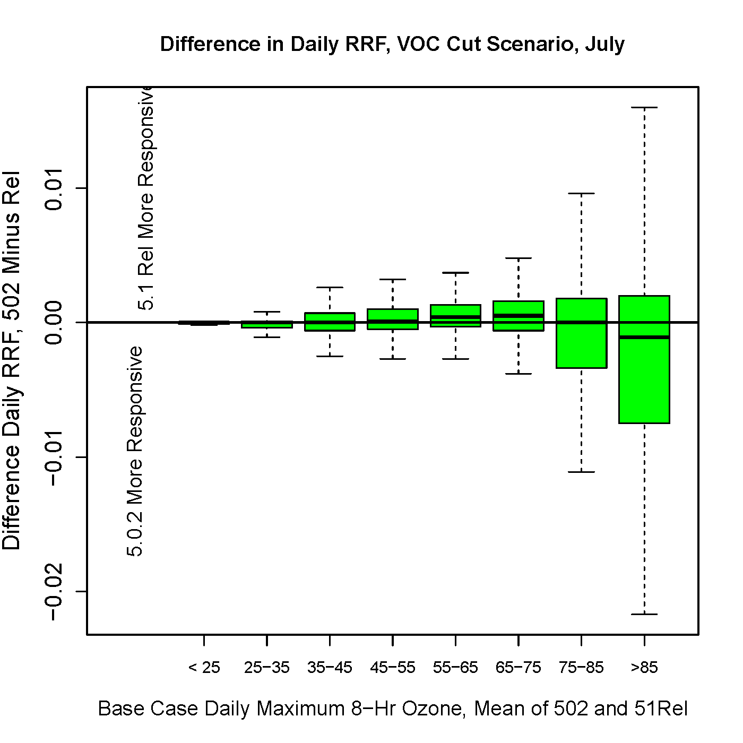
Model MDA8 Response to 50% Anthropogenic VOC Cut
  Boxplots of differences in “daily RRF” between CMAQv5.0.2 and CMAQv5.1, grouped by average concentration range from the base emission simulations (for a given day and grid cell, use the average of the CMAQv5.0.2 and CMAQv5.1 base emissions simulations to group both the CMAQv5.0.2 and CMAQv5.1 daily RRF)
  For concentrations between 45 ppb and 75 ppb, the median differences are positive for this VOC cut scenario, indicating that CMAQv5.1 is slightly more responsive in terms of daily RRF
  The opposite holds true for the highest concentrations
CMAQv5.1
more responsive
Difference in Daily RRF, CMAQv5.0.2 – CMAQv5.1
CMAQv5.0.2
more responsive
Base Case MDA8 Ozone, Mean of CMAQv5.0.2 and v5.1

Slide 23
Summary
Increase in summertime ozone (~2-10 ppb) mixing ratios in CMAQv5.1
  Largest increase in the eastern United States
  Result of increased photolysis due to fewer clouds in the model and updates to ACM2 and MOL calc
  Results in a moderate increase in bias overall
    bias for mixing ratios above 70 ppb are reduced
    Consistent may help improve model response to emission control scenarios
  RMSE and correlation are both improved for ozone in CMAQv5.1 over CMAQv5.0.2
    may improve usefulness of model in health related studies
Moderate increase in summertime PM_{2.5} (~0.5-3 µgm⁻³)
  Largest increase occurs in the eastern United States
  Result of increased OH⁻ radical concentrations and increased SOA from IEPOX and ACM2/MOL updates
  Results in a moderate decrease in PM_{2.5} bias overall, RMSE and correlation both improve as well
Moderate decrease in wintertime PM_{2.5} (1-5 µgm⁻³)
  Largest decrease in the eastern United States
  Driven by lower NO₃⁻ concentrations
    ClNO₂ chemistry (lower HNO₃ concentrations at night)
  Lower primary species concentrations
    ACM2 updates and MOL fix
  Results in a lower PM_{2.5} bias and RMSE values, and improved correlation values
Model response to changes in emissions
  increased model response to emission control strategies (studies show CMAQ typically underestimates the response)
  RRF values to NOX and VOC emissions cuts are larger (more responsive) w/ CMAQv5.1 than CMAQv5.0.211

Slide 24
Future Work
Complete annual CMAQv5.1 simulation
  fully test model for all seasons
Test the performance of CMAQv5.1 at fine scales (e.g. 4-km, 2-km and 1-km)
  DISCOVER-AQ Baltimore campaign in July 2011
  DISCOVER-AQ San Joaquin Valley campaign in January/February 2013
Perform hemispheric CMAQ simulation using v5.1
  use results from that simulation as BCs for 12-km CMAQv5.1 simulation
Re-do 2002/2005 CMAQ Dynamic Evaluation Test Case
  Examine CMAQv5.1 response to “real-world” emission reductions
Thanks to the AMAD development and evaluation teams!

Slide 25
Extra Slides

Slide 26
Major Emission Differences between emission platforms (CMAQ 5.0.2 vs CMAQ 5.1)
Revisions from States/locals/Tribes for NEI2011 v2
Oil and Gas Emissions updated using new Oil/Gas Tool
Residential Wood Combustion Updates (urban areas)
Ag Burning Reduced in the Midwest per state input
Redistribution of Commercial Marine Vessel emissions with new surrogates
Updates to emissions in Gulf Of Mexico
Mobile Sources:
  MOVES2014 includes:
    on-network, off-network(fuel venting, extended idling, non-vented/non extended idle (parking) (rate per vehicle)
    additional representative counties(284 vs 163)
    built-in speciation in MOVES
    re-mapping of SCC codes to match MOVES
    vehicle profiles updated based on 2012 VTRIS data
Canada 2010 emissions with updated spatial surrogates
Mexico 2008 emission inventory (not 1999 inventory projected as previous emission platform)

Slide 27
CMAQv5.1 Major Updates
Cloud and Aerosol Microphysics
Nucleation parameterization
  updated nucleation to correct errors in Kulmala et al.⁵ and to be consistent with Vehkamaki et al.⁶
    should increase nucleation, but impact is generally small
  updated modal size fractions for PM emissions based on Elleman and Covert⁶
    generally results in a small increase in PM_{2.5} mass on average
Added gravitational settling from upper layers
  results in additional fine and coarse (mostly coarse) mass in the surface layer
  should also result in small increase in coarse PM dry deposition
Emissions/Land Surface
Updated the sea spray aerosol emissions
  updated emission algorithms to be based on sea surface temperature dependence
  changed aerosol size distribution
  revised the surf zone emissions
    Collectively these changes increase coarse mode sea salt concentrations near tropical waters, reduce concentrations near polar waters and the surf zone, and increase accumulation mode sea salt for all open ocean and coastal regions
Updated the in-line and off-line Biogenic Emissions Inventory System (BEIS)
  added two-layer canopy model
  updated leaf temperature algorithms
  included dynamic leaf area index (LAI) calculation
  temperature and solar radiation history now based on emissions
    cumulative impact of all these changes is lower isoprene emissions during morning/evening hours and higher emissions during the day (net increase in isoprene of approximately 7%)
  updated the Biogenic Emissions Land-cover Database (BELD) and emission factors
    reduced biogenic VOC emissions resulting in more spatial heterogeneity
Revisions to bidirectional exchange
  bidirectional Soil NO option - connects the Yienger and Levy algorithms to the Environmental Policy Integrated Climate (EPIC) soil nitrogen and deposition
Revisions to dry deposition
More explicit treatment of organic nitrogen deposition species and revisions to the Henry's Law constant

Slide 28
CMAQv5.1 Major Updates (Cont.)
Chemistry
Updated the Carbon Bond 05 (CB05) chemical mechanism (included as CB05v51; CB6 not available at this time)
  improved representation of organic nitrogen reaction rates, solubility, and products
  updated PAN-type compound rates
  added explicit acrolein and naphthalene species
Added secondary organic aerosols (SOA) from Polycyclic Aromatic Hydrocarbons (PAHs) and alkanes
  adds additional SOA of less than 0.1 µgm⁻³
Added SOA from isoprene epoxydiols (IEPOX)
  adds approximately 1 µgm⁻³ of IEPOX SOA in the Southeast
Added SOA from isoprene+NO₃
  increases AlSO1J and AlSO2J by less than 0.5 µgm⁻³ in the Southeast
Corrected photolysis
Other miscellaneous updates to NO_{Y} reactions
Updated the SAPRC07 chemical mechanism based off California Air Resource Board (CARB) updates (included as SAPRC14T)
  updated isoprene chemistry
  updated NO₂+OH reaction
  improves temperature and pressure dependency against observations
  updated HO₂+RO₂ production of OH
    introduces new sources of OH and formaldehyde
  SOA from PAHs, alkanes, IEPOX, and isoprene+NO₃ (as in CB05)
Added ClNO₂ chemistry
  reduces aerosol and TNO₃⁻ concentrations and increases ozone concentrations, particularly in the winter (small impact in the summer)
Added halogen chemistry
  results in reduced ozone mixing ratios over marine environments
Revised in-line calculation of photolysis rates
  alternative methods for determining aerosol optical properties based on the Mixing Model and Mie Theory
  cloud effects are now more consistent with the cloud model in meteorological model
  added an alternative method for calculating actinic fluxes based on a regression model
Updated data and code representing mechanisms
  replacement of include files with Fortran modules
  reaction type representing heterogeneous reactions
Reactions now possible between gas-phase concentrations (GC), aerosol (AE) and non-reactive (NR) species groups

Slide 29
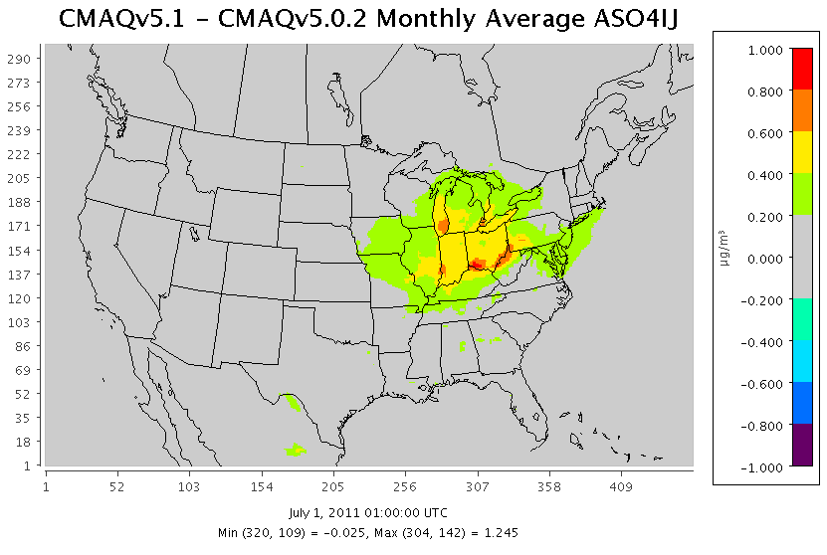
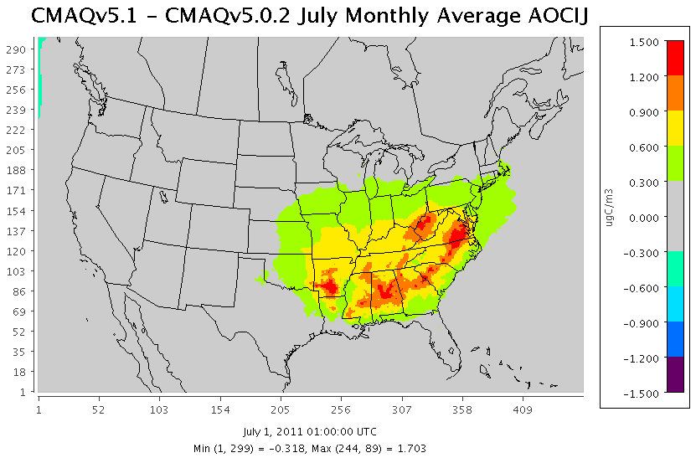
Particulate Sulfate
Organic Carbon

Slide 30
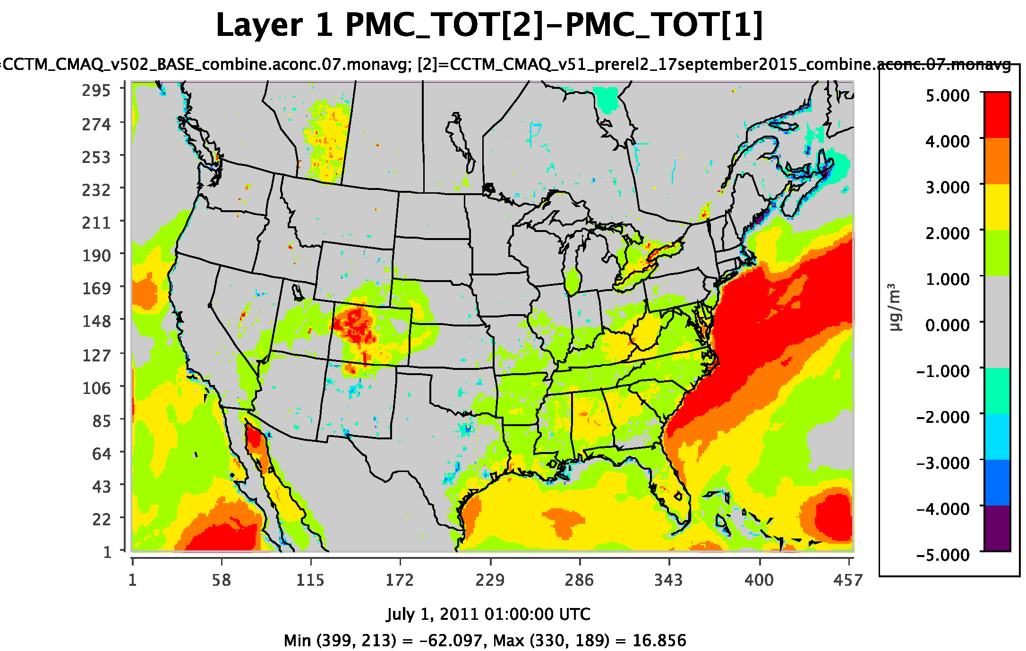
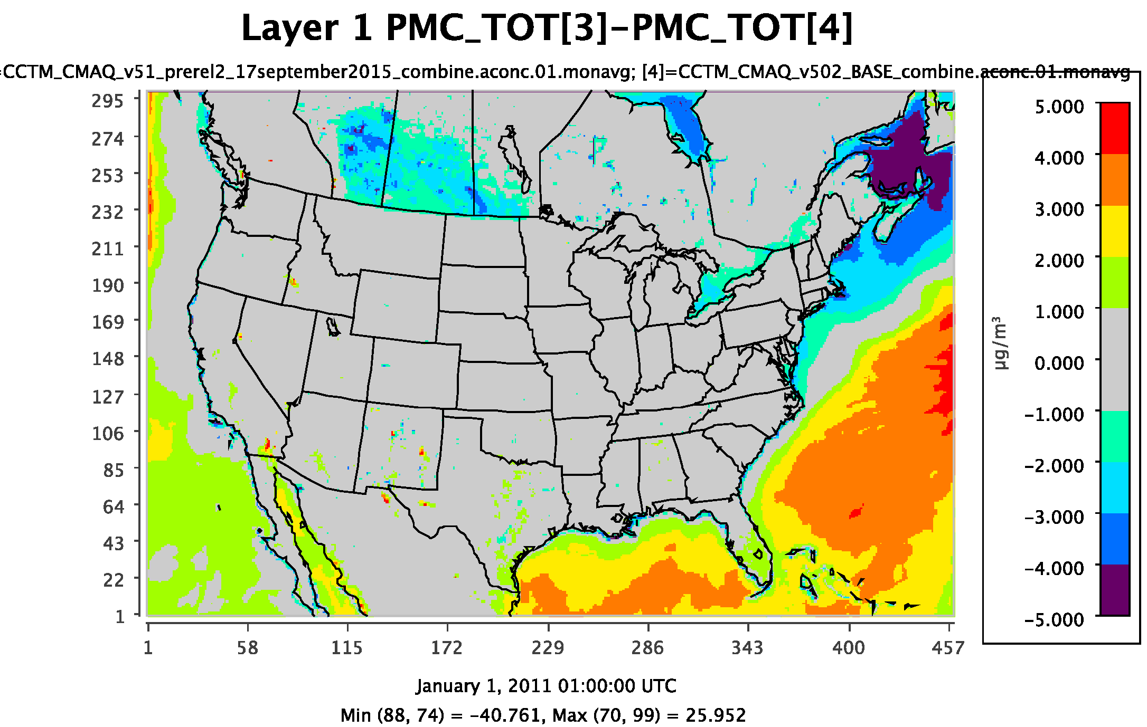
PM Coarse Diurnal Performance -
all sites; July and January average

Slide 31
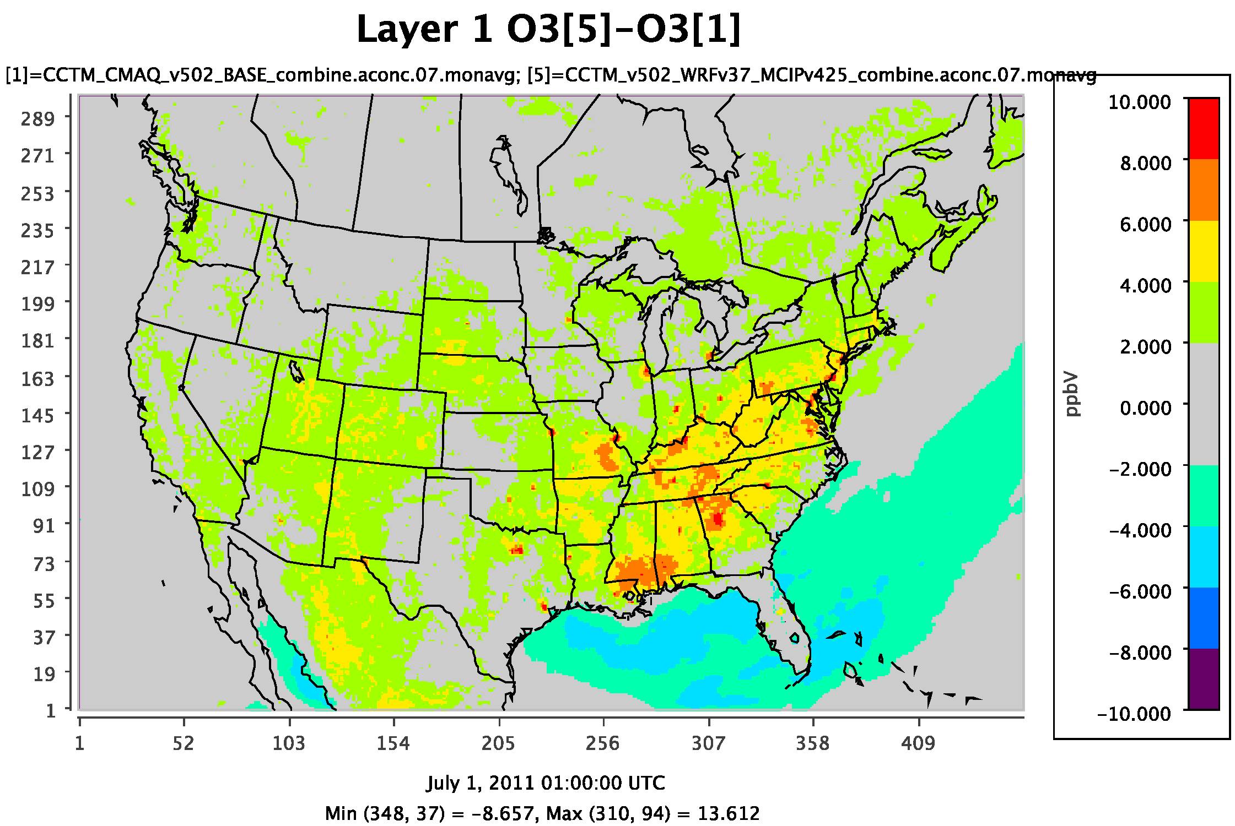
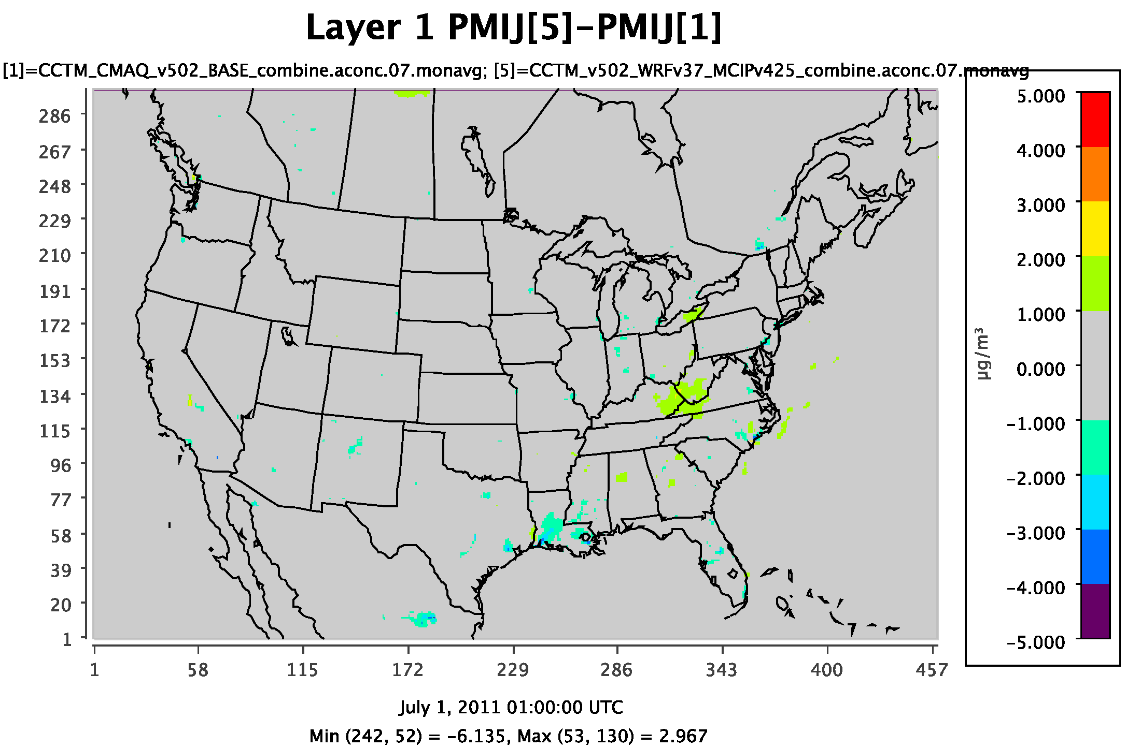
v5.0.2_MCIPv425 vs. v5.0.2_Base –
July ozone and PM_{2.5}

Slide 32
Transition from CMAQv502_WRFv3.4 to CMAQv5.1_WRFv3.7
Base CMAQv5.0.2 simulation using WRFv3.4
Base CMAQv5.0.2 simulation using WRFv3.7
CMAQv5.0.2 simulation using WRFv3.7 and MCIPv4.2.5
CMAQv5.1 simulation using WRFv3.7 with MCIPv4.2.5 equivalent

Slide 33
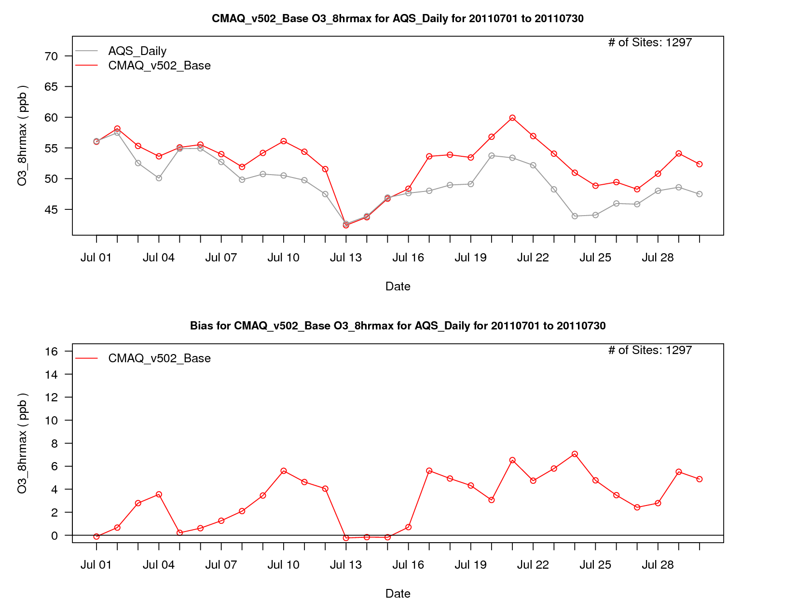

Slide 34
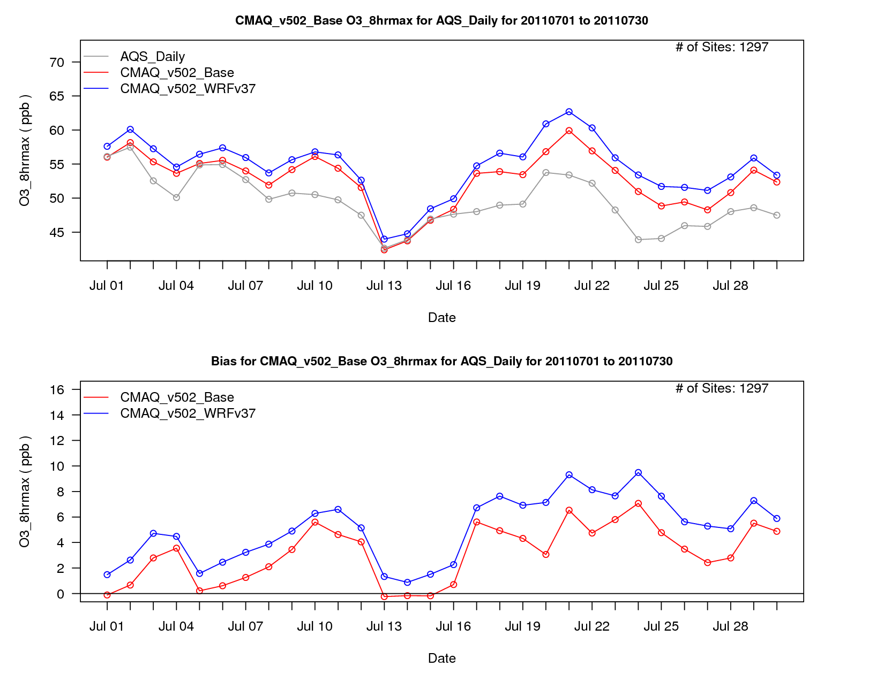

Slide 35
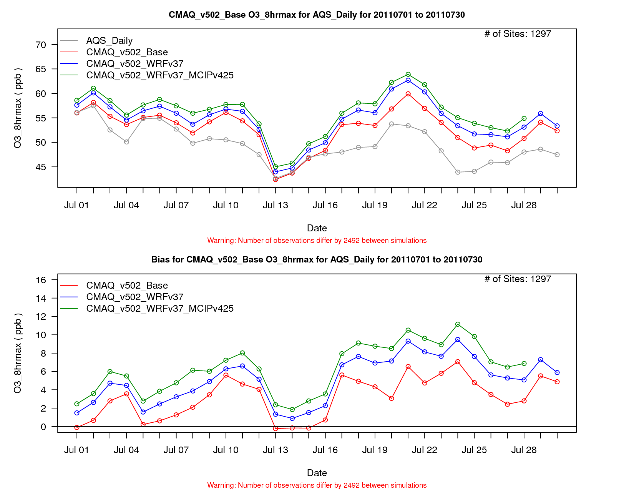

Slide 36
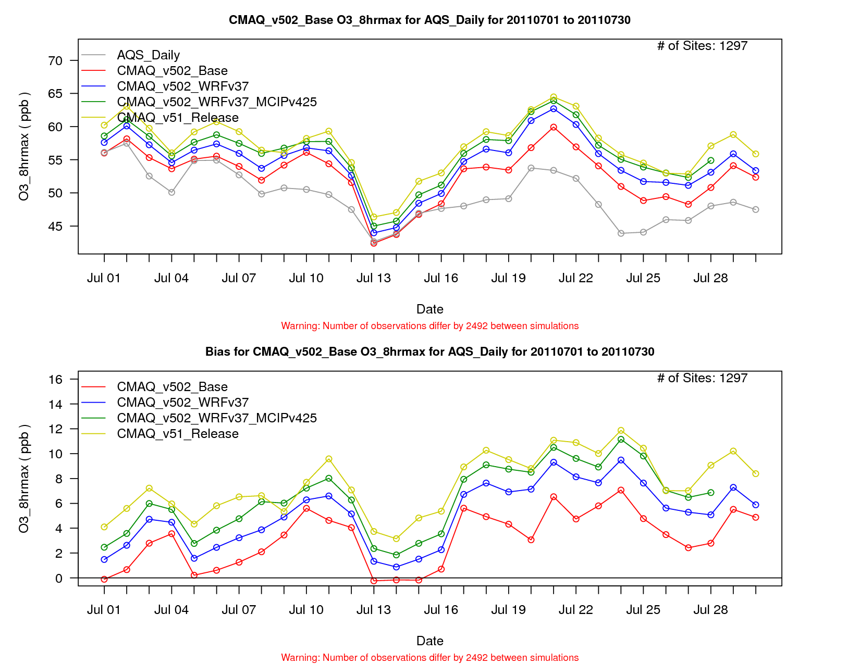

Slide 37
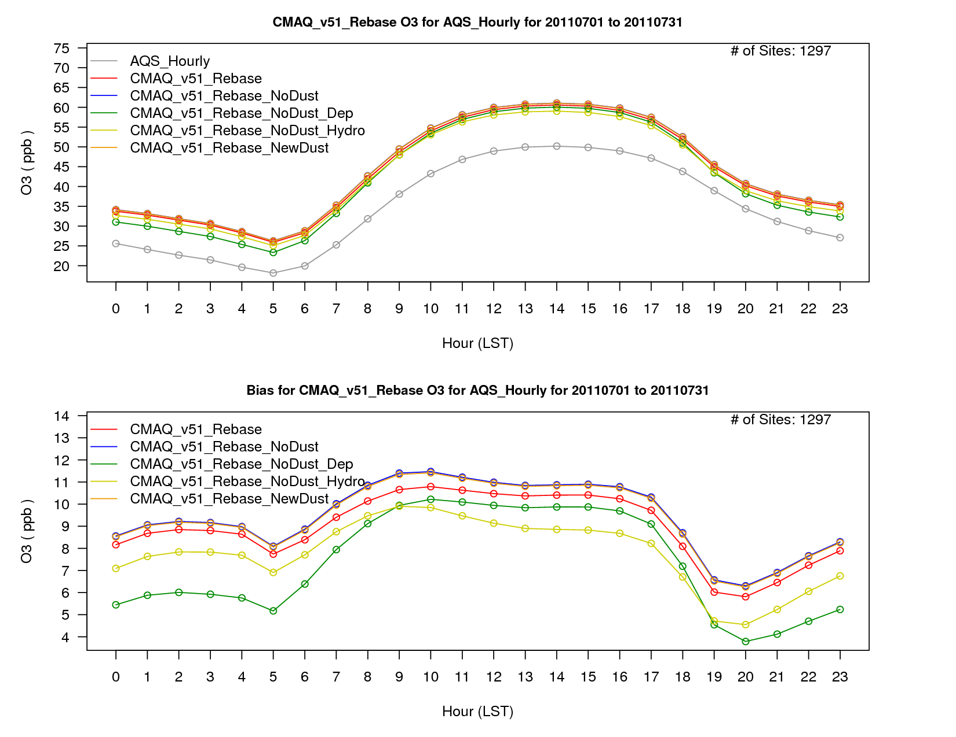

Slide 38
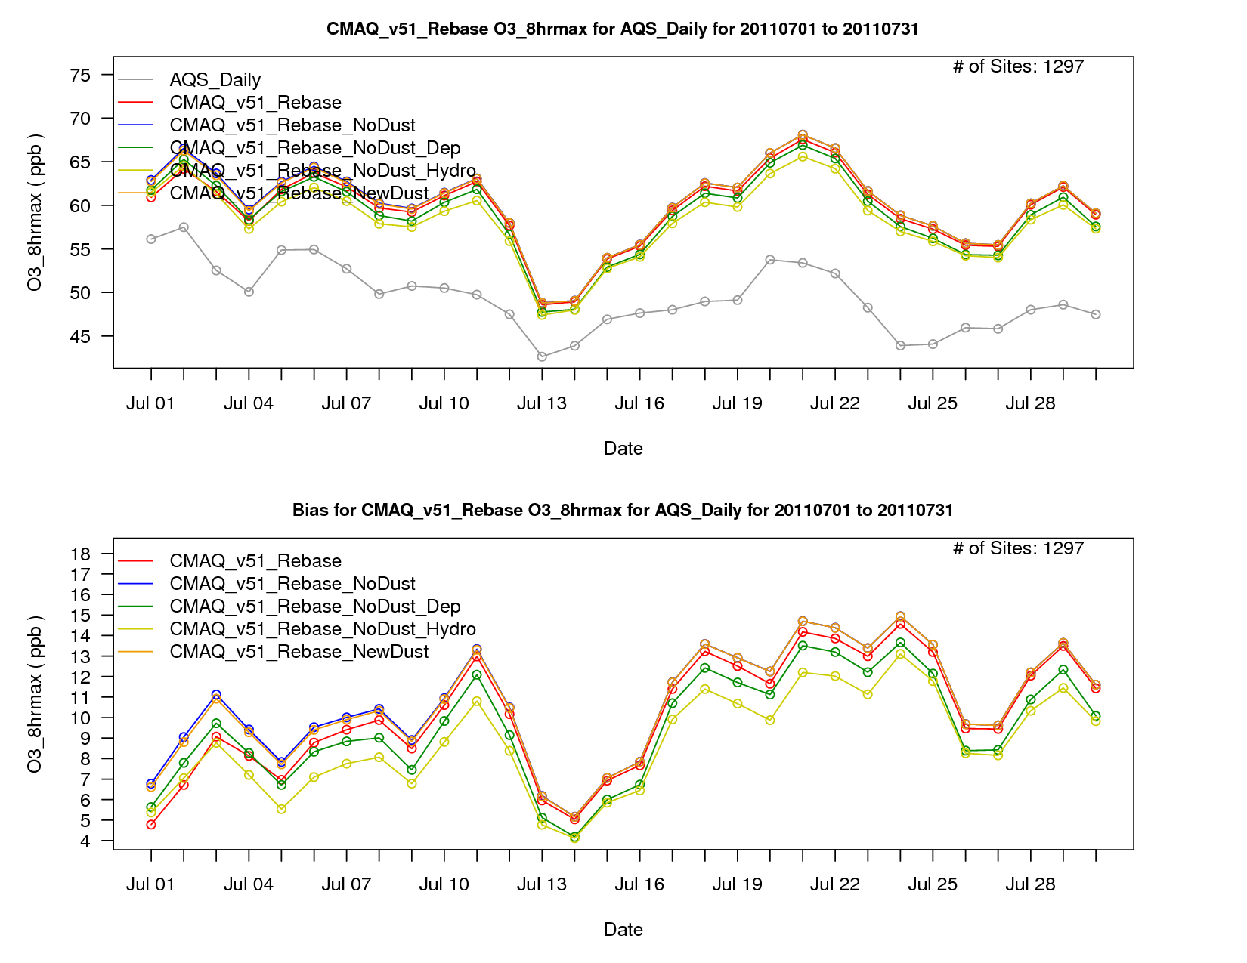

Slide 39
