Slide 1
10/28/2014
The impact of the observational meteorological nudging and nesting on the simulated meteorology and ozone concentrations from WRF-SMOKE-CMAQ during DISCOVER-AQ 2013 Texas campaign
Xiangshang Li, Yunsoo Choi, Beata Czader
Earth and Atmospheric Sciences
University of Houston

Slide 2
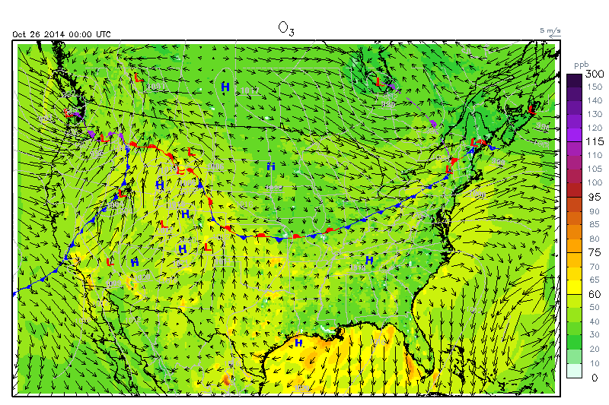
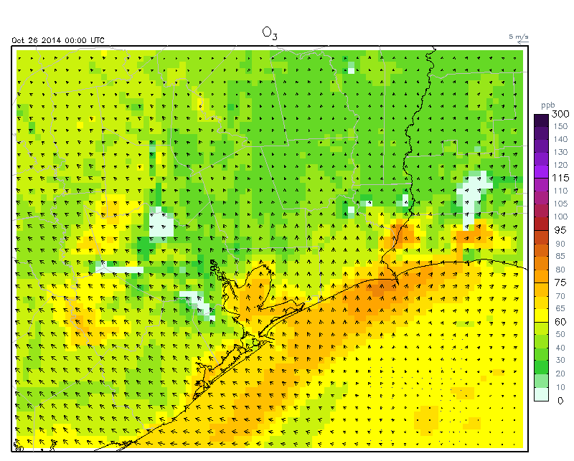
UH Air Quality Forecasting (12km & 4km)
http://spock.geosc.uh.edu
University of Houston

Slide 3
DISCOVER-AQ Simulation
September 2013
Four complete set of WRF-SMOKE-CMAQ simulations; new model version and 2008 inventory
12km Chemical boundary condition is used
Detailed analyses
  Variables
    Meteorology: T/U/V/CFRAC/CLDT/TEMP2/PBL
    Chemistry: Ozone/NO/NO₂/NOx/Isoprene etc
University of Houston

Slide 4
DISCOVER-AQ Simulation
Analyses
  Various satellite cloud, radar images and weather charts
  Hourly precipitation data
  Full statistics (CORR, IOA, MB, MAE etc) for major variables (T/U/V/O₃/NO/NO₂/NOx)
    Daily
    By site
    Day-time
    Night-time
  Spatial and time-series plots
  High ozone episode due to front passage (09/25-09/26)
  Inland and coastal sites
  Background ozone
  Bogus thunderstorms
University of Houston

Slide 5
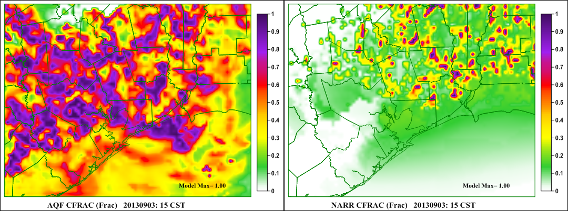
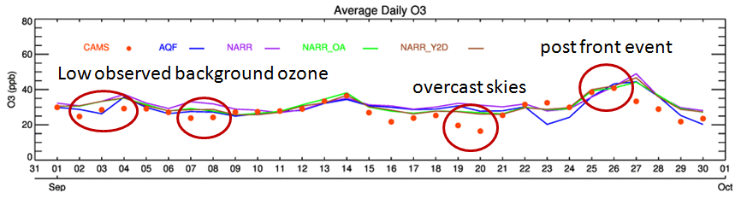
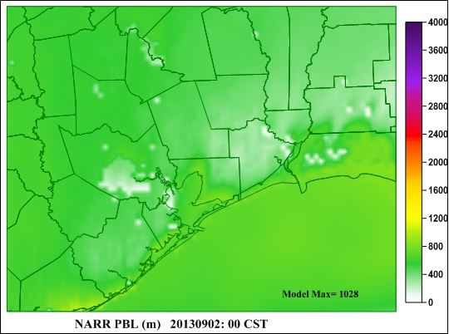
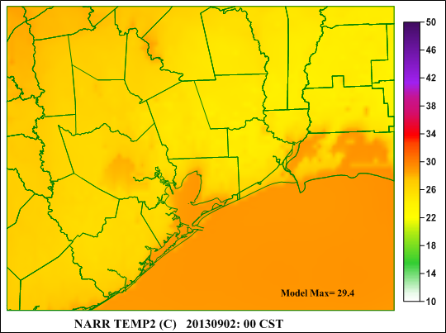
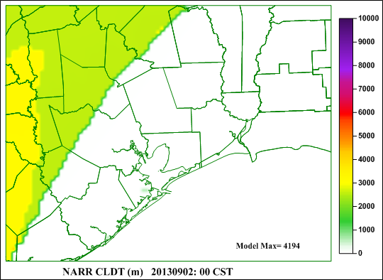

Slide 6
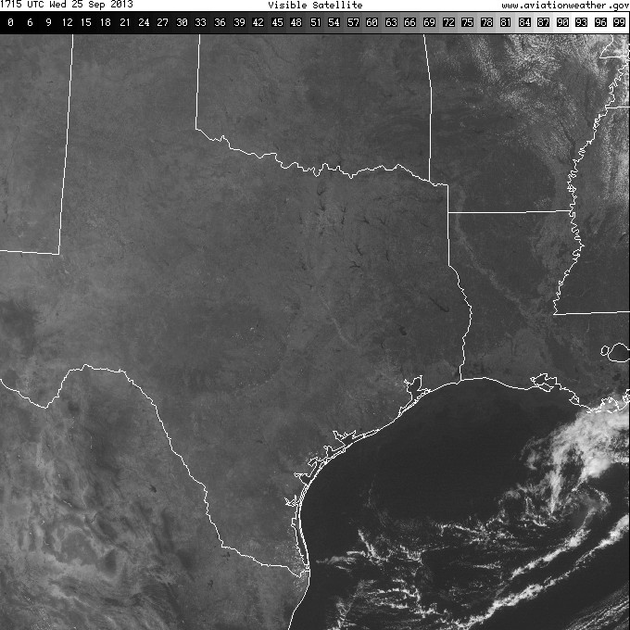
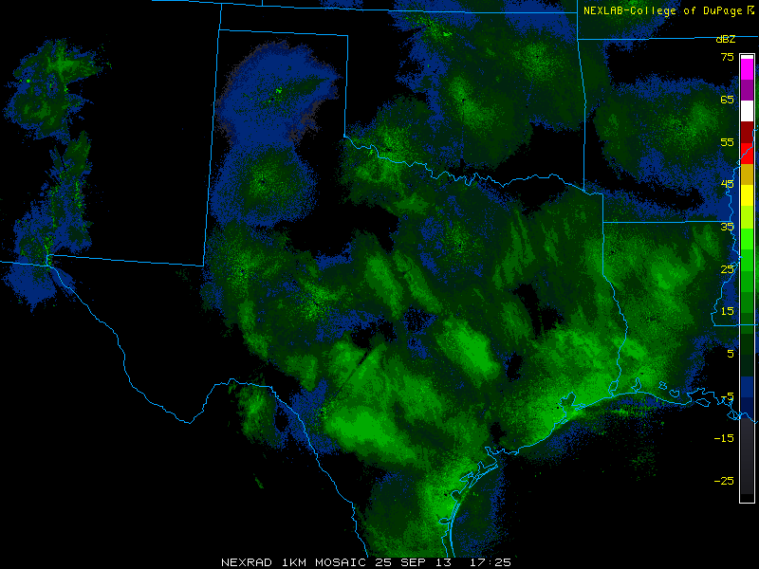
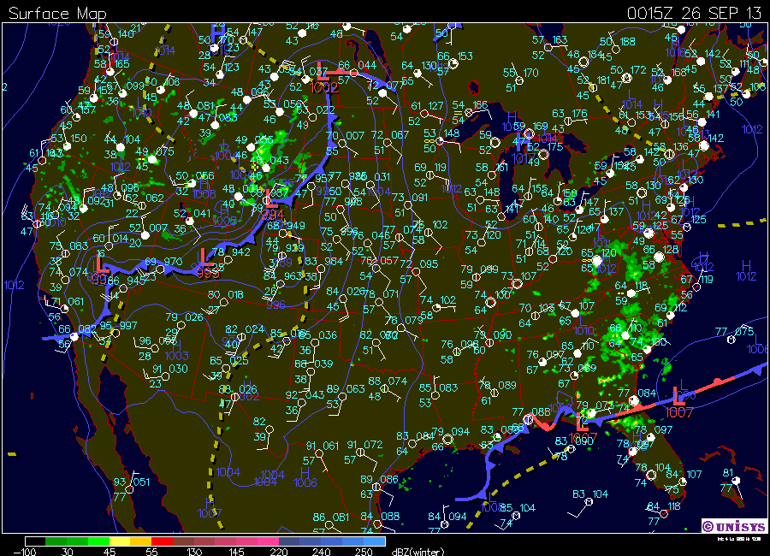
Radar – 20130925_11 CST
Satellite Visible – 20130925_11 CST

Slide 7
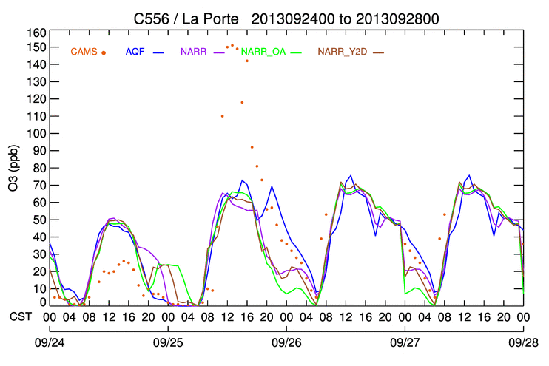
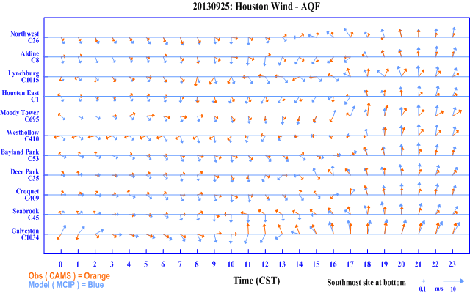
Ozone at La Porte
Wind progression on 20130925
11 sites at Houston

Slide 8
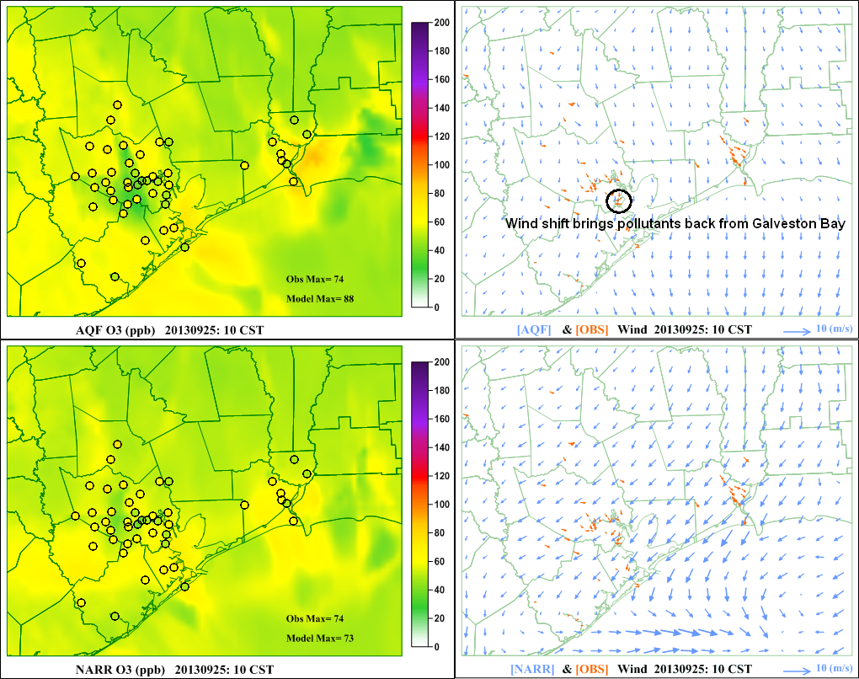
09/25 high ozone day: 10 CST
University of Houston

Slide 9
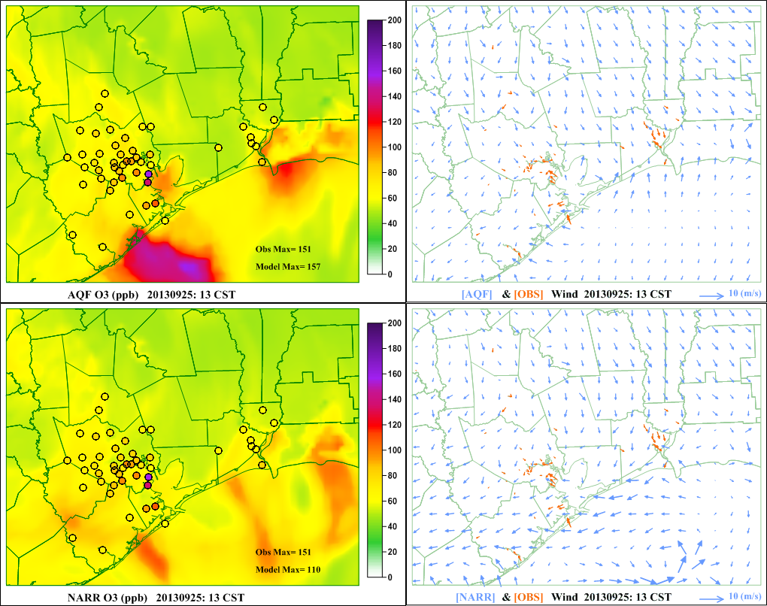
Model missed the high ozone around La Porte: 13 CST
High ozone
Bay breeze fully developed
University of Houston

Slide 10
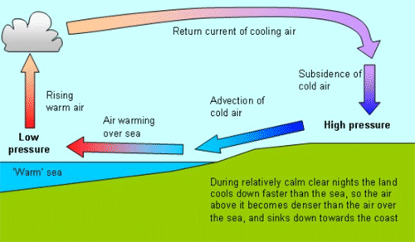
Land/Sea/Bay breeze etc
Land breeze and sea/bay breeze
Local wind reversal, convergence
Small-scale phenomenon, short life time, a few hours
Occurs when large scale forcing is absent -> prone to high ozone
Extremely important for simulating high ozone episode
Hard for WRF to replicate
University of Houston

Slide 11
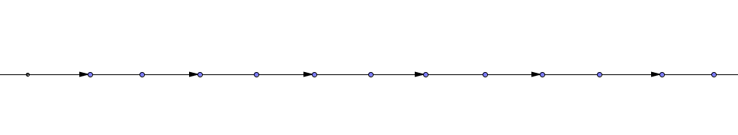
Observation nudging
FDDA is one of the most important components in modern NWP models
Model performance gain is substantial while cost is relatively low
Nudging is a FDDA method to push (or nudge) model values toward observation.
  Grid nudging uses analysis input (‘met_em’ files from WPS)
  Obs-nudging uses observation data (OBS_DOMAIN files from WRF-OBSGRID)
Obs-nudging is performed every 3 hours, just like the grid nudging
Nudging
Nudging
Nudging
Nudging
Nudging
Nudging
Time
3
6
9
12
15
18
Improvement of IOA: Wind (U and V) 10-14%; Temperature 9%
University of Houston

Slide 12
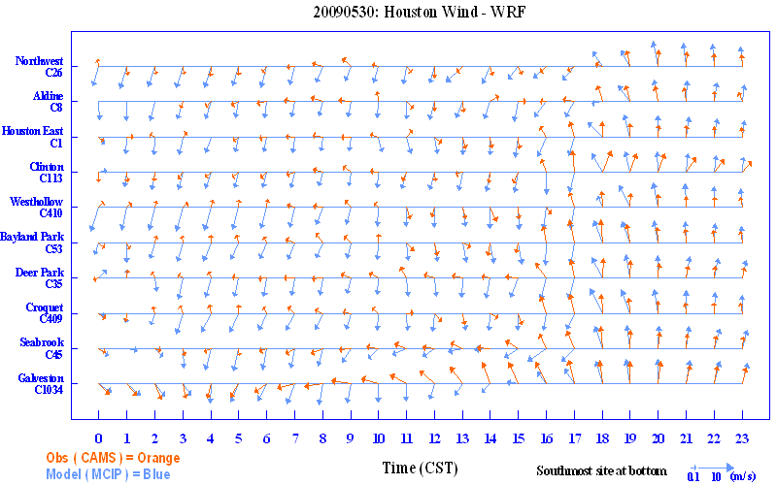
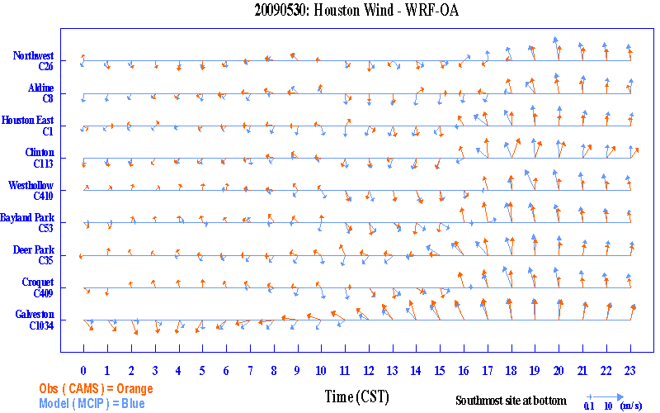
Improvement
significant

Slide 13
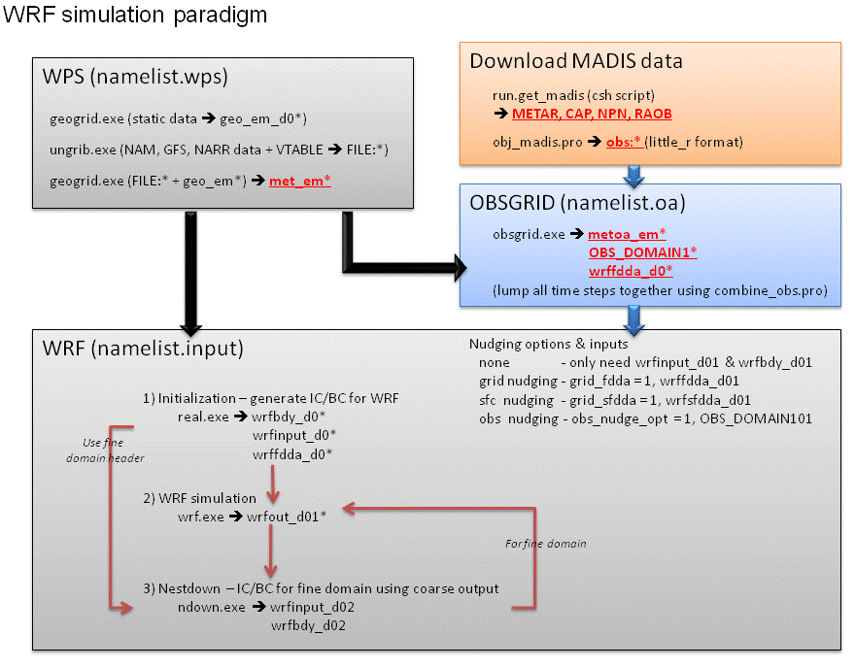
WRF Obs nudging – op. flow chart

Slide 14
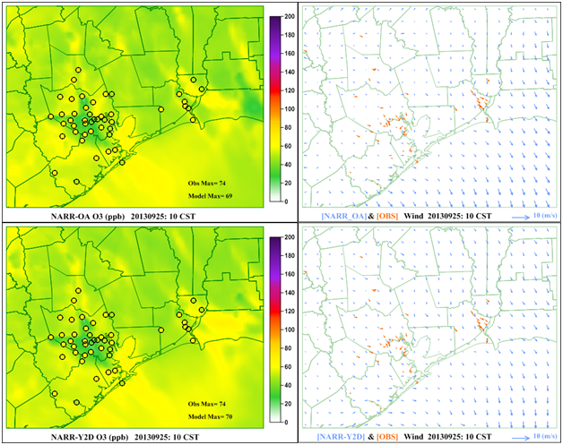
OA did not solve the problem for 09/25
No bay breeze
No bay breeze
University of Houston

Slide 15
Current work: Enhanced obs nudging
In 09-25, last nudging is performed at 9 CST, yet baybreeze onset is at 10 CST
  From 10 to 13 CST, there is only one nudging done at 12 CST -> Not enough push to ‘bend’ model!
Possible solution
  Increase the obs nudging frequency to hourly!
    Data available, already preprocessed
    WRF does not support it
  Implementation
      First task (modifying OBSGRID code) done!
      On 2nd task (modifying WRF)
University of Houston

Slide 16
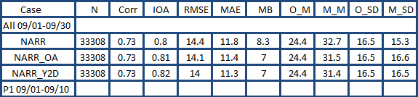
High CMAQ background Ozone
High ozone bias ~ 7-8 ppb
Possible Cause
  Coastal sites such as Galveston (C1034) have higher biases, the most inland site (C78 Conroe) has very small bias
  Production is typically low at C1034
  Suggesting model background ozone may be a factor since prevailing winds are from southeast
University of Houston

Slide 17
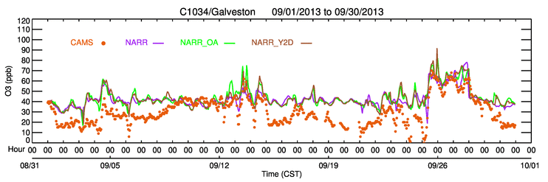
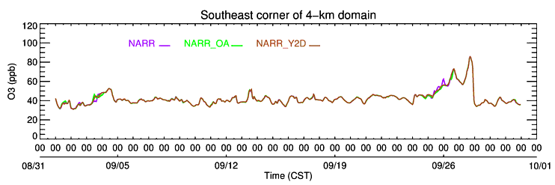
CMAQ Background Ozone
Galveston ozone time series – high bias for many days
Model southeast corner time series – pattern similar to C1034
Reducing CMAQ boundary ozone values may help bias reduction
University of Houston

Slide 18
Conclusions
Different met data produces ozone differences
Objective Analysis makes better met data (not all the times)
Incapability to capture sea-breeze on Sep 25, 2013 may cause low simulated high ozone
3-hour observation update frequency is not good enough to capture sea-/land-breeze
  1-hour observation update tool needs
Ozone is overestimated in the model particularly in Galveston and high overestimated chemical boundary condition may contribute overpredictions
University of Houston

