Slide 1
Ozone Sensitivities to NO_{x} and VOC Emissions in Southeastern US: Projections for 2018 and a Look Back at 2009
Talat Odman and Yongtao Hu, Georgia Tech
Zac Adelman, Mohammad Omary and Uma Shankar, UNC
James Boylan and Byeong-Uk Kim, Georgia DNR

Slide 2
SEMAP Project
SouthEastern Modeling, Analysis and Planning (SEMAP) Project
Managed through SESARM (2009-2014)
Help Southeastern states with potential O₃ and PM_{2.5} SIPs and demonstration of reasonable progress for regional haze rule
10 states were involved
AL, FL, GA, KY, MS, NC, SC, TN, VA, WV
2007 and 2018 annual modeling
36 km CONUS and 12 km SEMAP grids
2007 performance evaluation (performance was acceptable)
2018 future year projections with MATS
2018 NO_{x} and VOC reduction scenarios

Slide 3
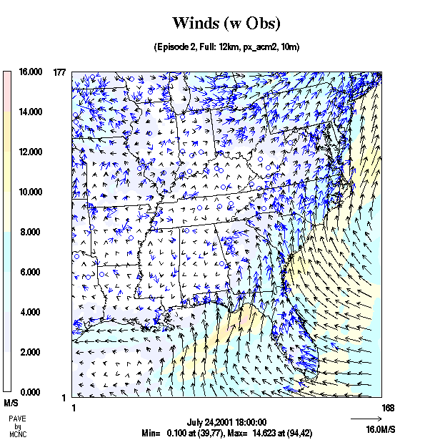
Air Quality Modeling System
Meteorology (WRF)
Air Quality (CMAQ)
Emissions (SMOKE)
Emissions
Inventory
(NIF)
MOVES
Rates

Slide 4
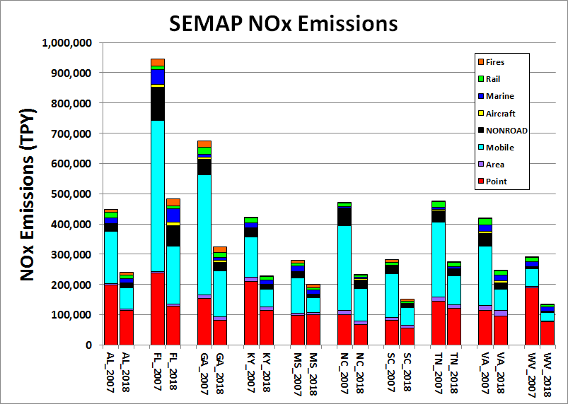
SEMAP Anthropogenic NO_{x} Emissions

Slide 5
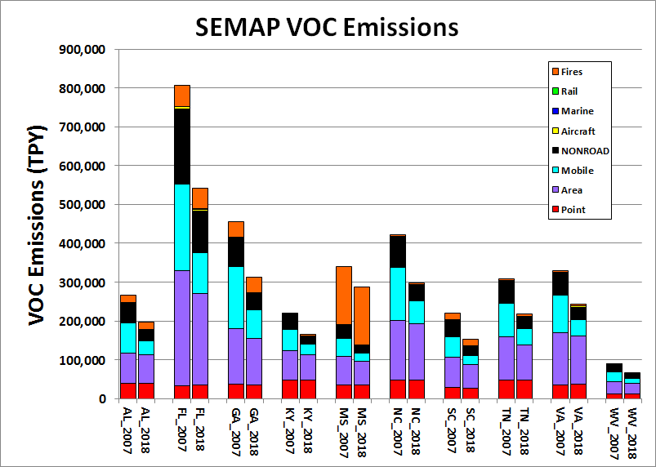
SEMAP Anthropogenic VOC Emissions

Slide 6
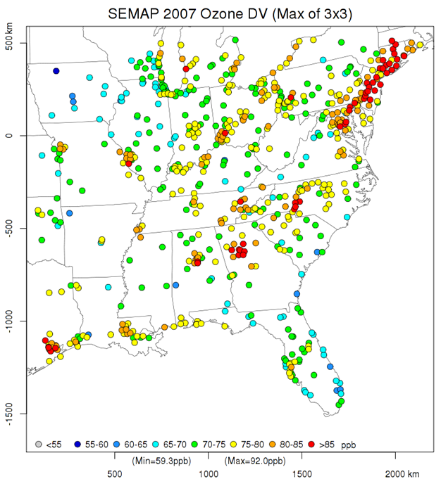

Slide 7
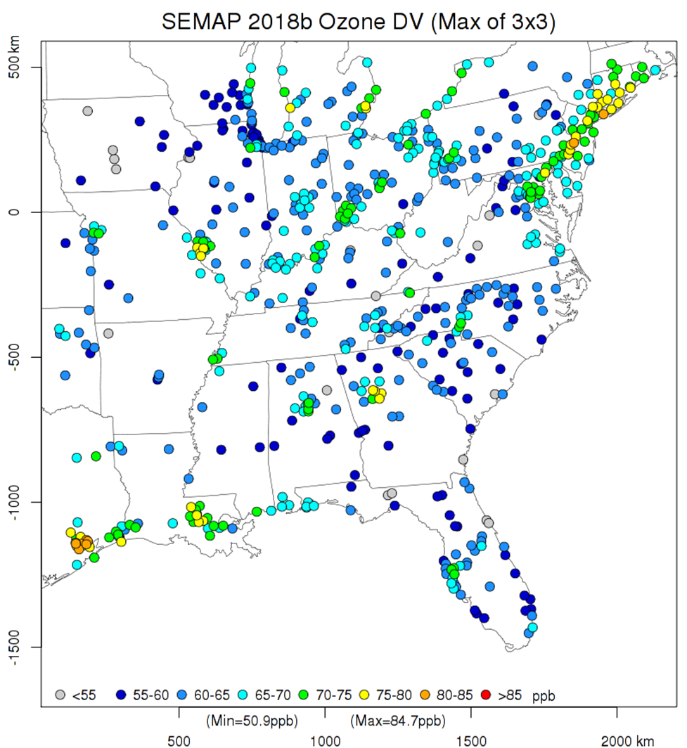
Notes:
2018 O₃ DVFs: 3×3 RRF & 2005-2009 DVC

Slide 8
Ozone Sensitivities
Started with 2018 emissions
2018 results are the baseline.
Performed emission reduction simulations
Ozone season (May-) on 12-km grid
Statewide 30% emission reductions
Separately from each SESARM state
NO_{x} and VOCs individually
Point, area, mobile, nonroad, MAR categories

Slide 9
Absolute and Relative Sensitivities
Absolute Sensitivity:
Difference of daily max. 8-hr O₃ between 2018 sensitivity case and 2018 base case: ΔO₃ = 2018_{sens} − 2018_{base}
Averaged over days with 2018 max. 8-hr O₃ > 70 ppb
Relative Sensitivity:
Run MATS with 2018_{base} as “baseline” and 2018_{sens} as “forecast”: RRF = 2018_{sens} / 2018_{base}
ΔDVF = (DVF*RRF) – DVF = DVF*(RRF−1)
Sites with at least one day with 2018 max. 8-hr O₃ > 70 ppb

Slide 10
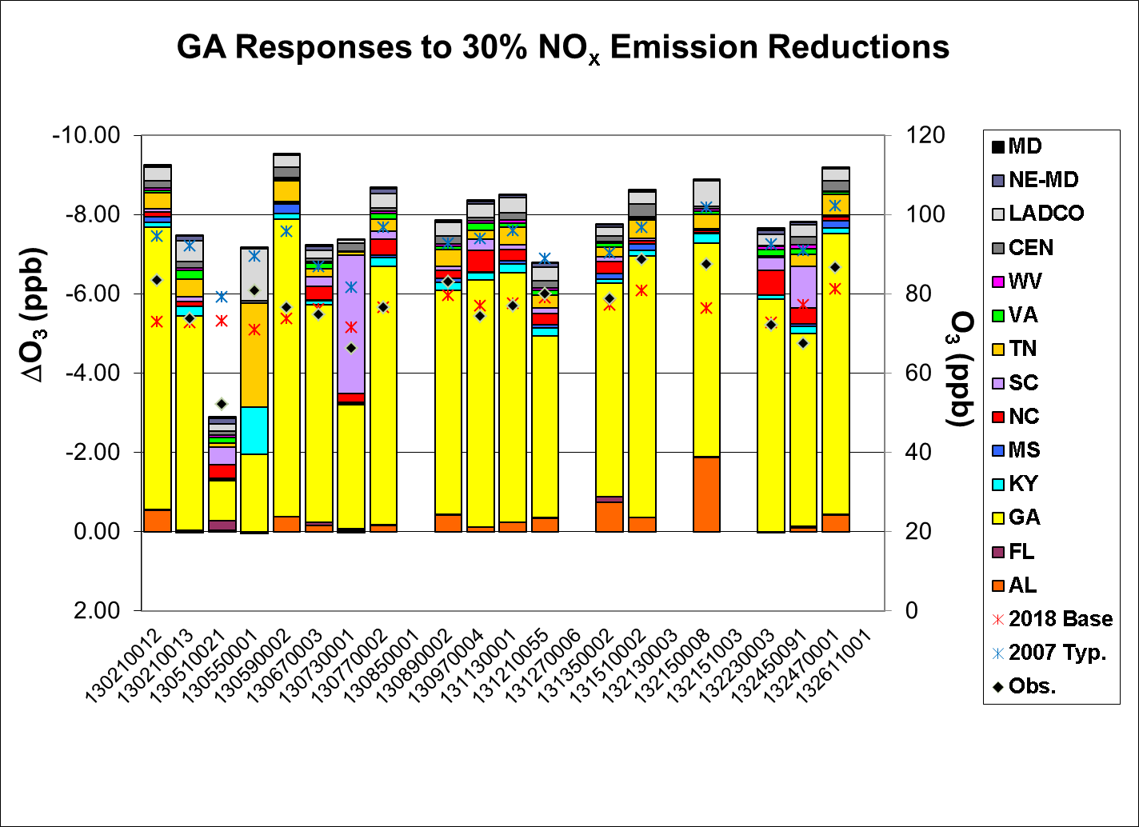
Absolute Sensitivity
Notes:
Absolute

Slide 11
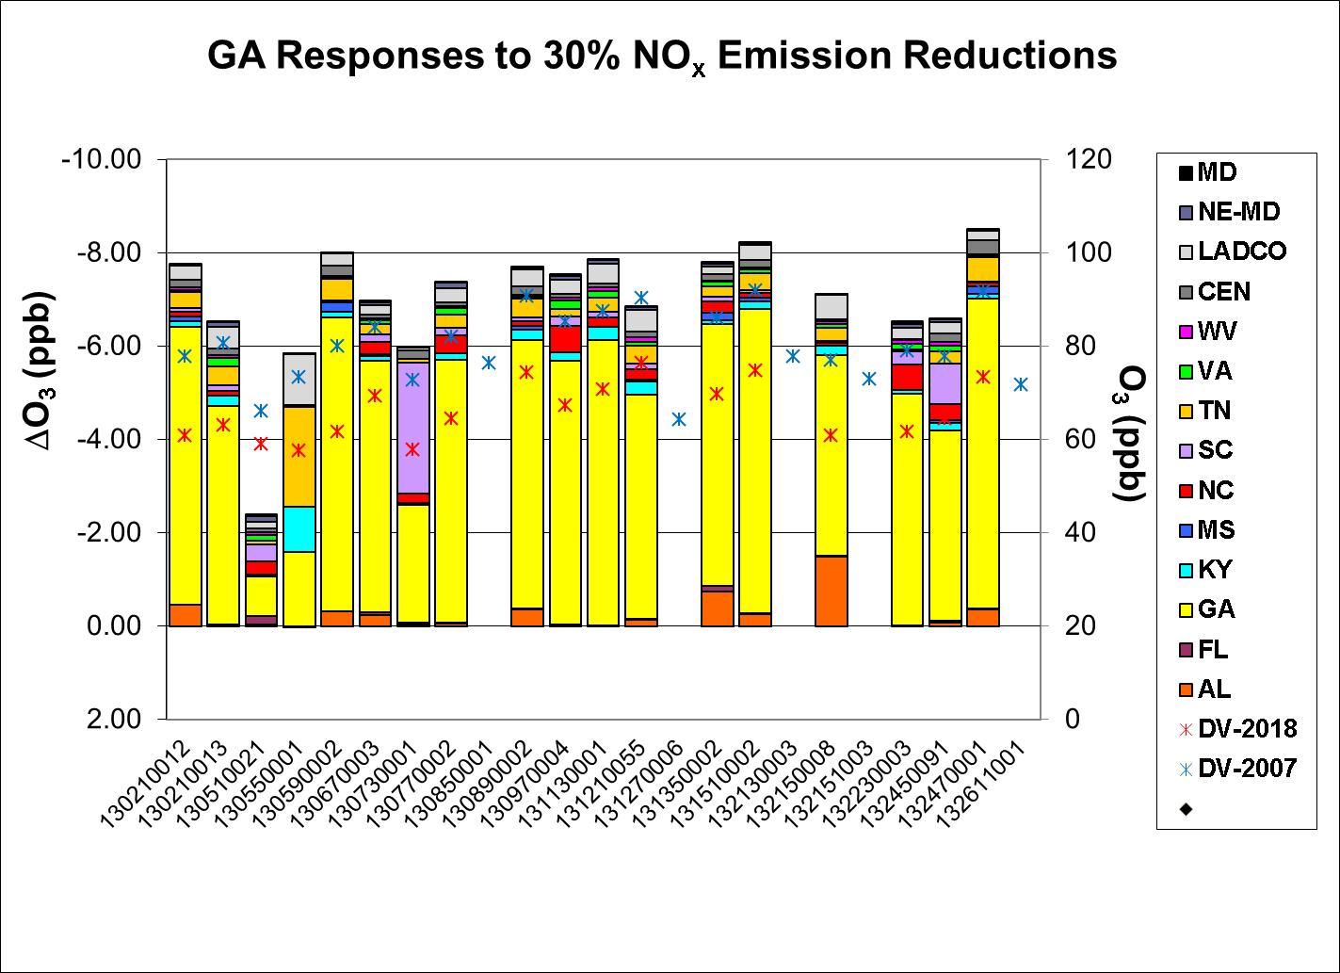
Relative Sensitivity

Slide 12
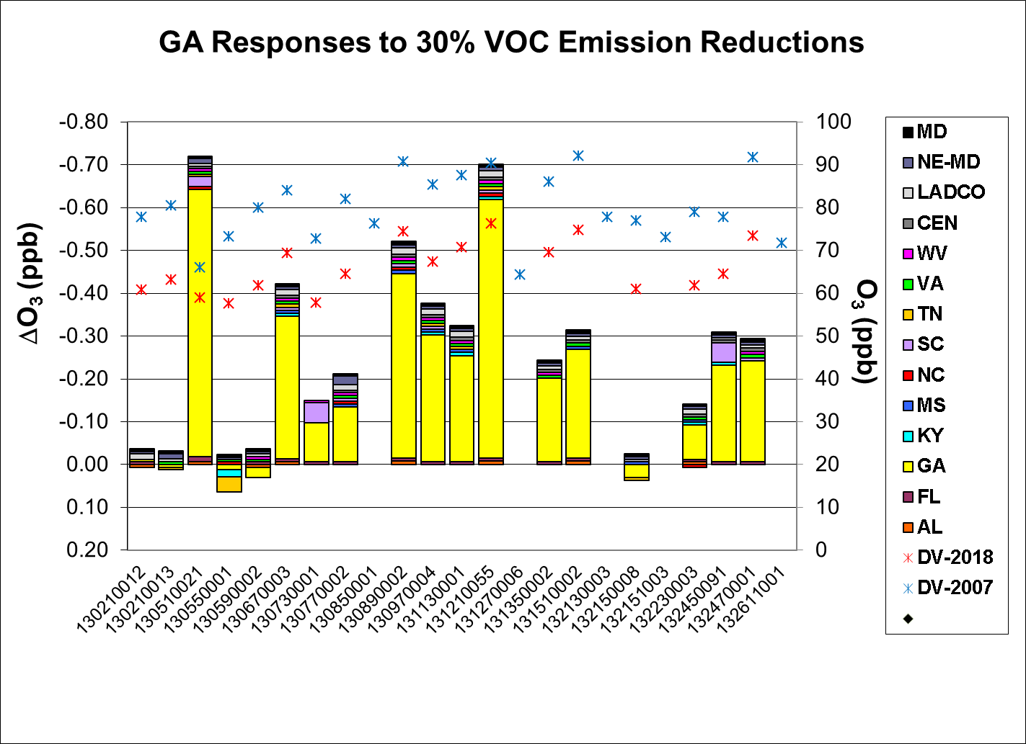
Relative Sensitivity

Slide 13
Normalized Sensitivities
Divided the relative sensitivity for the home state by the annual average daily emissions reduction (ppt/TPD)
(ΔDVF_{NOx} x 1000)/TPD_{NOx}
(ΔDVF_{VOC} x 1000)/TPD_{VOC}

Slide 14
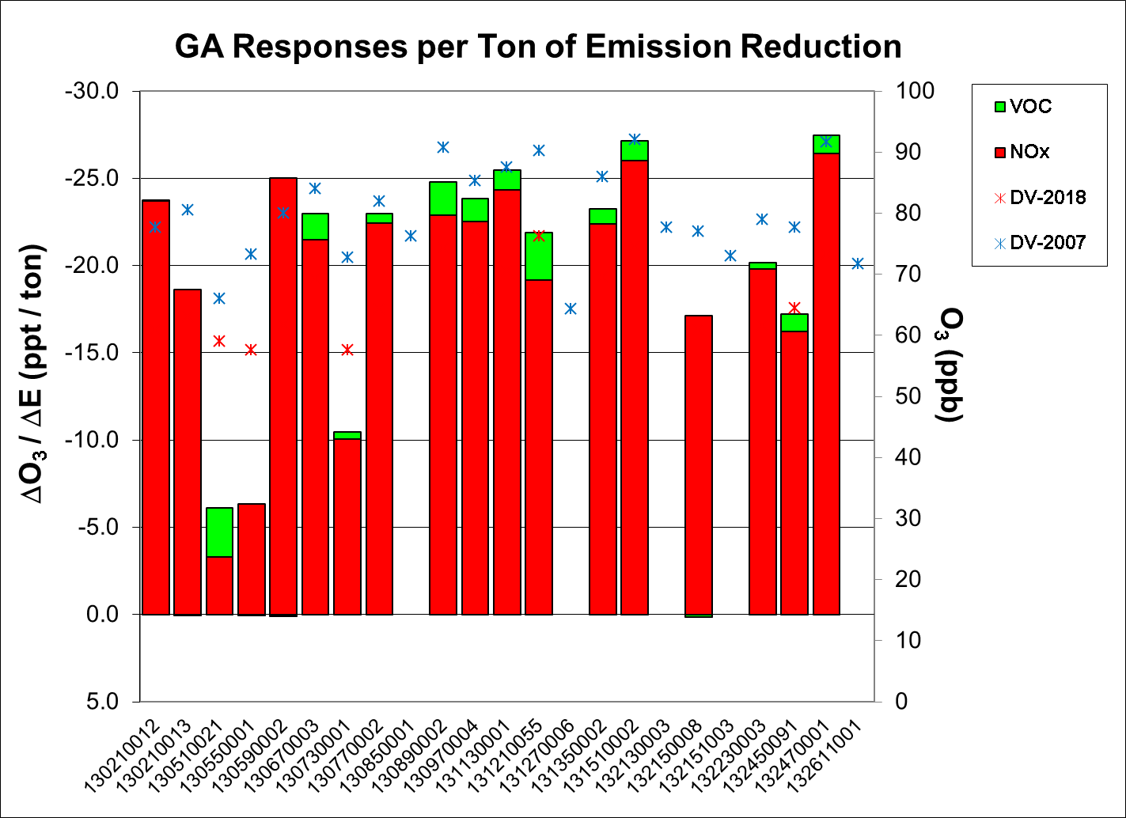
TPD)

Slide 15
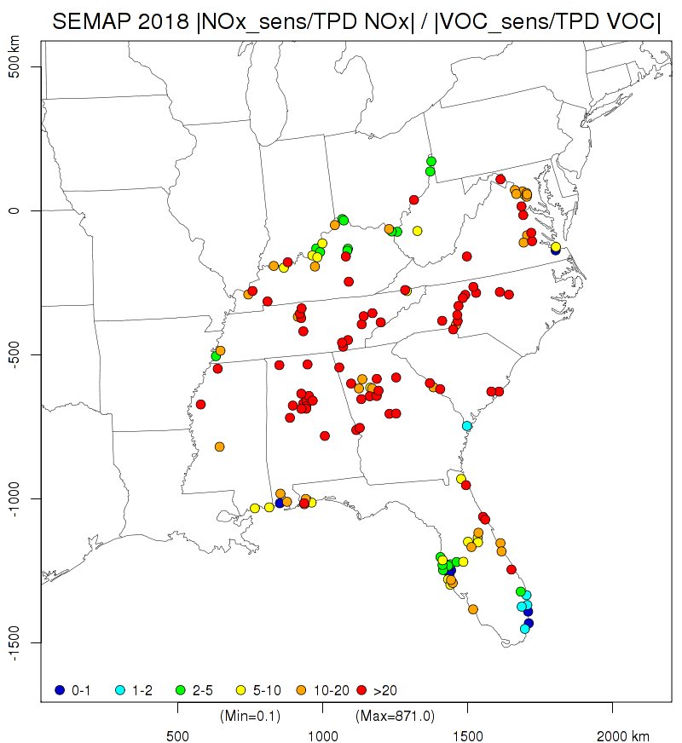

Slide 16
Comparison of two Emission Sensitivity Studies
A First Attempt to Developing Emission Sensitivity Trends

Slide 17
Comparison of the Old & New Sensitivity Analyses
Previous Study* | This Study
CMAQv4.4 with CBIV chemistry | CMAQv5.01 with CB05 chemistry
VISTAS 2009 “on-the-way” | SEMAP 2018
Domain-wide VOC reductions | State-wide VOC reductions
County/state NO_{x} reductions | State-wide NO_{x} reductions
Point and ground NO_{x} reduced separately | Total anthropogenic NO_{x} reductions
June 1- July 10, 2002 episode | 2007 ozone season (5 months)
Average of all days | Average of days with 2007 max. 8-hr O₃ > 75 ppb
* Odman, M. T., Y. T. Hu, A. G. Russell, A. Hanedar, J. W. Boylan and P. F. Brewer (2009). "Quantifying the sources of ozone, fine particulate matter, and regional haze in the Southeastern United States." Journal of Environmental Management 90(10): 3155-3168.

Slide 18
Extent of Ground NO_{x} Reductions in Previous Study

Slide 19
NO_{x} Emission Reductions (Mg/Day)
 | Previous Study* | This Study
Alabama | 140 | 173
Florida | 263 | 343
Georgia | 189 | 228
Kentucky | 119 | 168
Mississippi | 190 | 141
North Carolina | 123 | 173
South Carolina | 105 | 108
Tennessee | 218 | 203
Virginia | 159 | 183
West Virginia | 110 | 100

Slide 20
NO_{x} Emission Sensitivity Trends
VISTAS 2009
SEMAP 2018
Normalized ozone sensitivities to the home state’s NO_{x} emissions per day
Diamonds denote the average of each state’s sites while bars mark the range.
The number of sites is in parenthesis

Slide 21
Conclusions
Atlanta, GA is the only area in the SESARM states with a projected 2018 ozone DVF > 75 ppb.
Anthropogenic NO_{x} emission reductions are much more effective at reducing ozone compared to anthropogenic VOC emission reductions in SESARM states.
Some sites in Florida and some coastal sites in other states (e.g., AL, GA, VA) show comparable benefits from VOC and NO_{x} reductions.

Slide 22
Conclusions (continued)
Ozone is becoming more sensitivities to NO_{x} emissions in Southeastern US, except for Alabama.
In 2018, ozone will decrease more compared to 2009, per ton of NO_{x} reduced.
Alabama’s 2009 sensitivity included only 2 sites (vs. 25 sites in 2018).
This is probably due to CB05 (vs CBIV) chemistry, differences in the numbers of days/sites, and/or decreasing NO_{x} emissions
Average sensitivities of Southeastern States relative to each other remained almost the same.
South Carolina passed Georgia and Alabama in terms of ozone decrease per ton of NO_{x} reduced.

Slide 23
Supplemental Slides

Slide 24
2007 Emission Inventory
SEMAP Emissions Inventory
AMEC/Alpine ➔ Point source (EGU and non-EGU), fire, and on-road mobile (MOVES2010a)
SC&A, Inc. ➔ Area and non-road/MAR
“Actual” Emission Inventory (2007)
Used for model performance evaluations
“Typical” Emission Inventory (2006-2008)
Fires only (not EGUs)
Used for RRF calculations
Non-SEMAP Emissions Inventory
2007 MARAMA, 2007 LADCO, 2008v2 NEI

Slide 25
2018 Emission Inventory
SEMAP Point, Area and MAR
Applied growth & control factors (2017-2025)
SEMAP Non-road Mobile
Reran NONROAD model for 2018
SEMAP On-road Mobile
Scaled hourly SMOKE-MOVES outputs with 2018/2007 ratios based on 2007 and 2018 inventory mode runs
Vary by pollutant, state/county, annual/month, SCC
Does not include Tier 3 controls
SEMAP Fires
Same as 2007 typical
Non-SEMAP Emissions
2017 MARAMA (w/ existing controls)
2007 LADCO and 2008v2 NEI for area sources
EPA 2017 Projections for point and mobile (on-road and non-road)

Slide 26
Relative Sensitivities to NOx Emissions in SESARM States

Slide 27
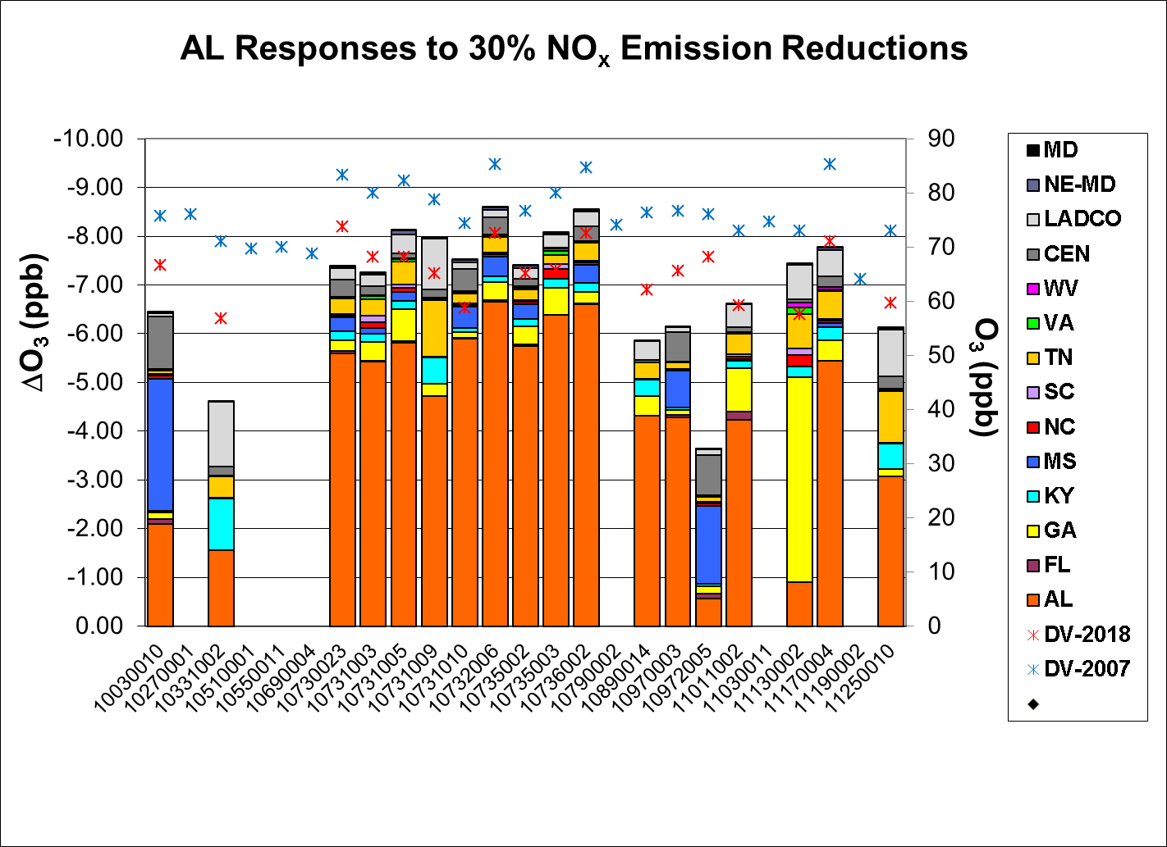

Slide 28
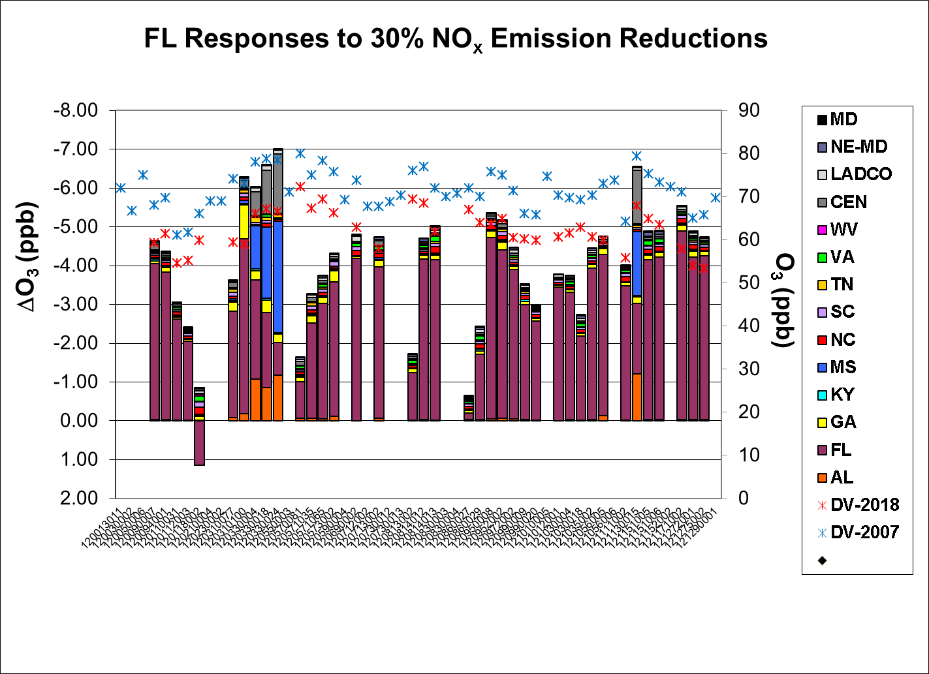

Slide 29
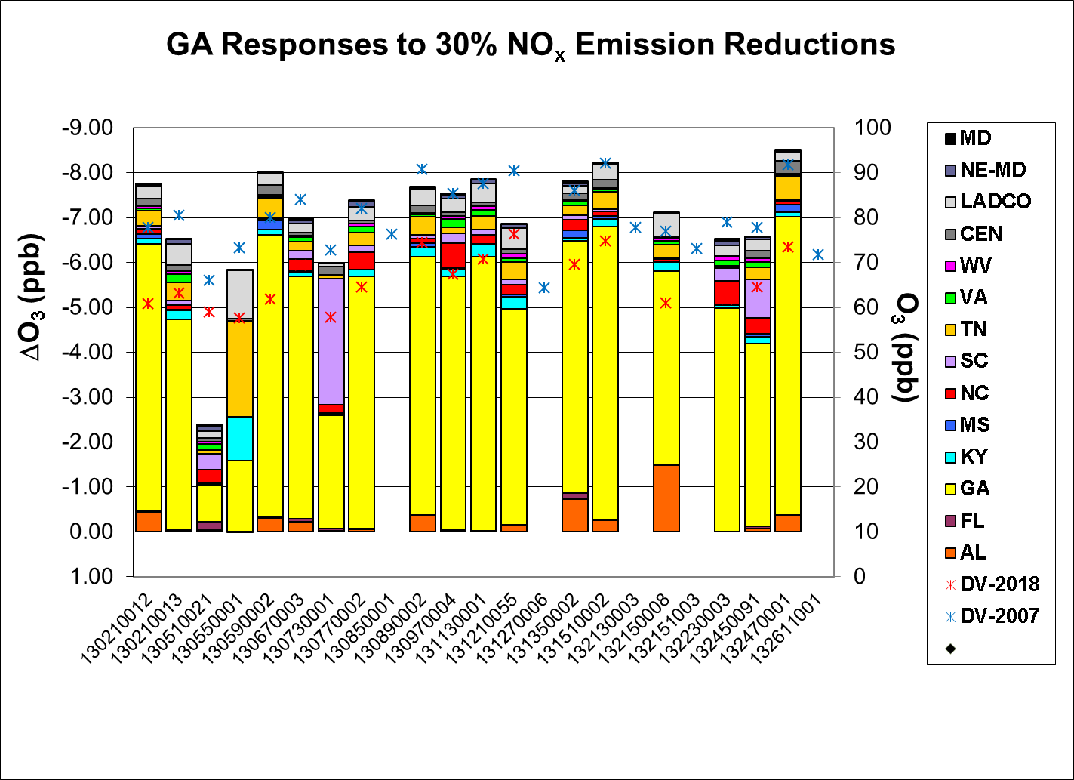

Slide 30
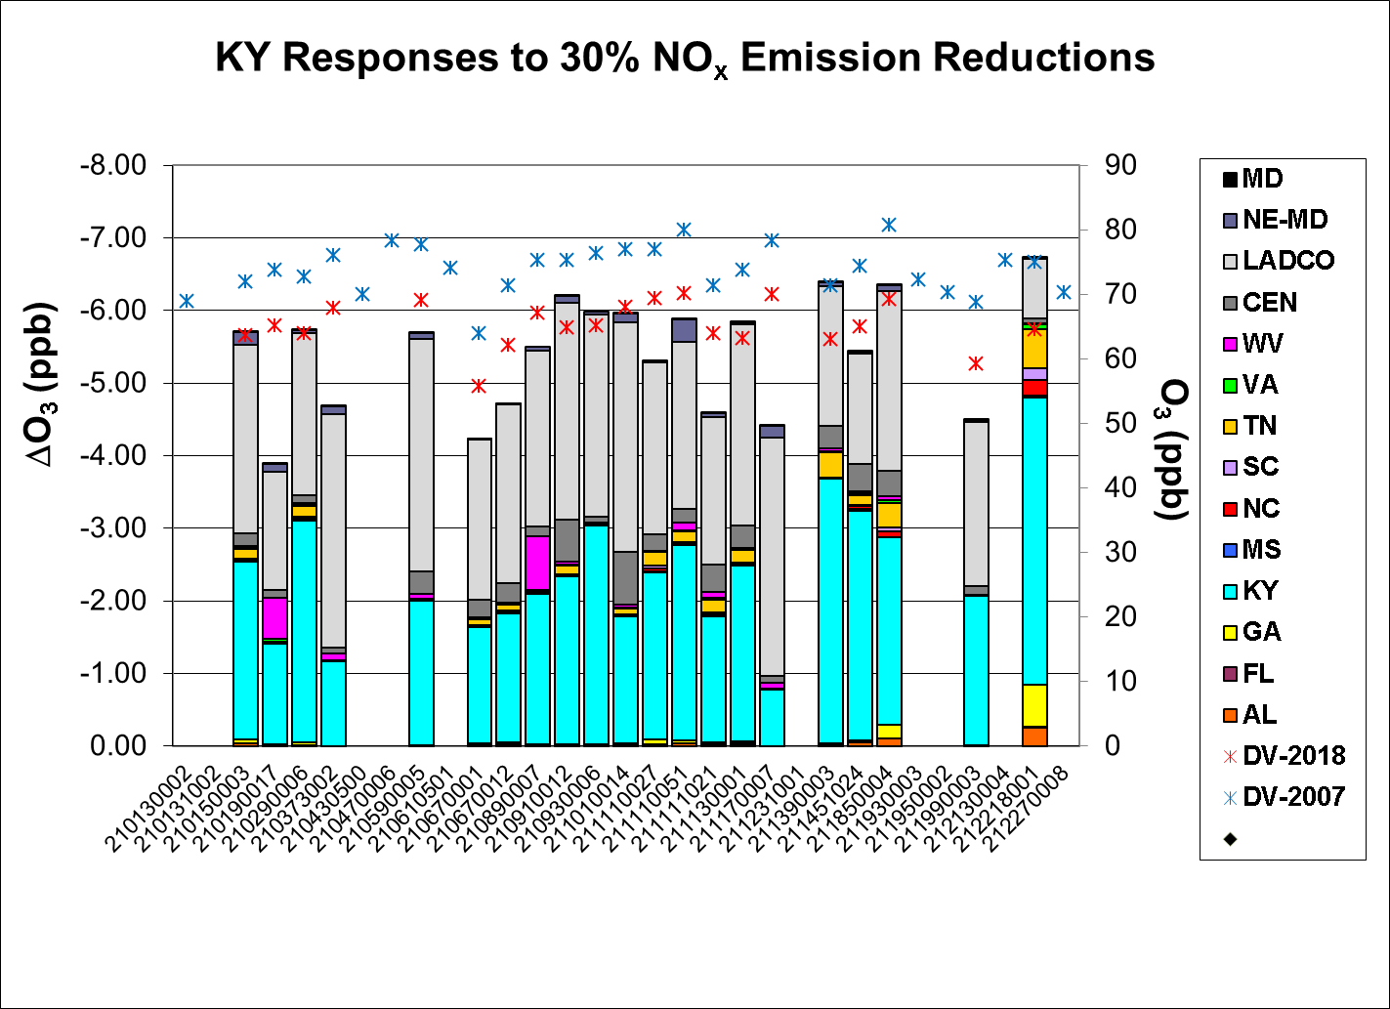

Slide 31
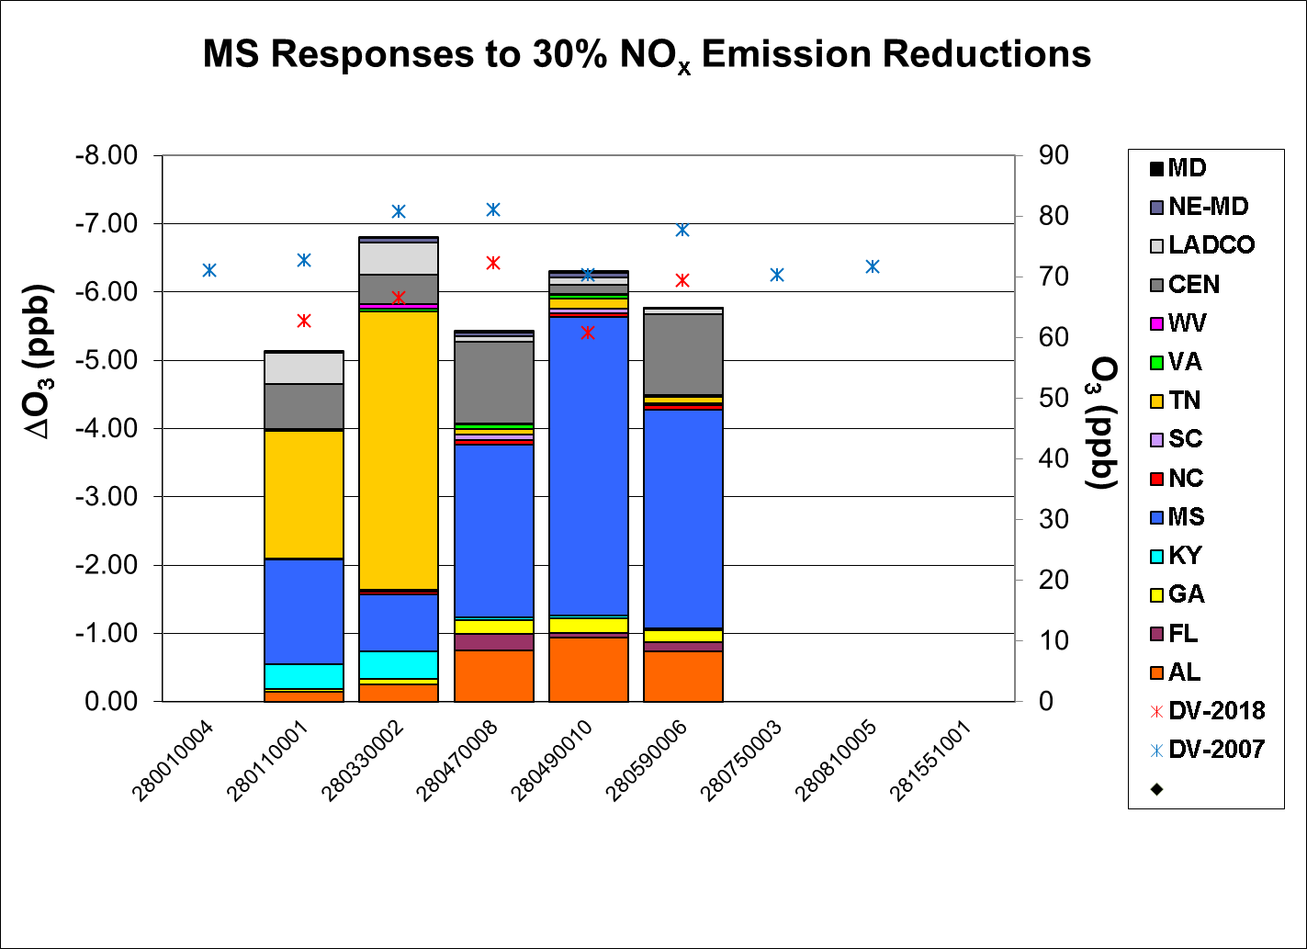

Slide 32
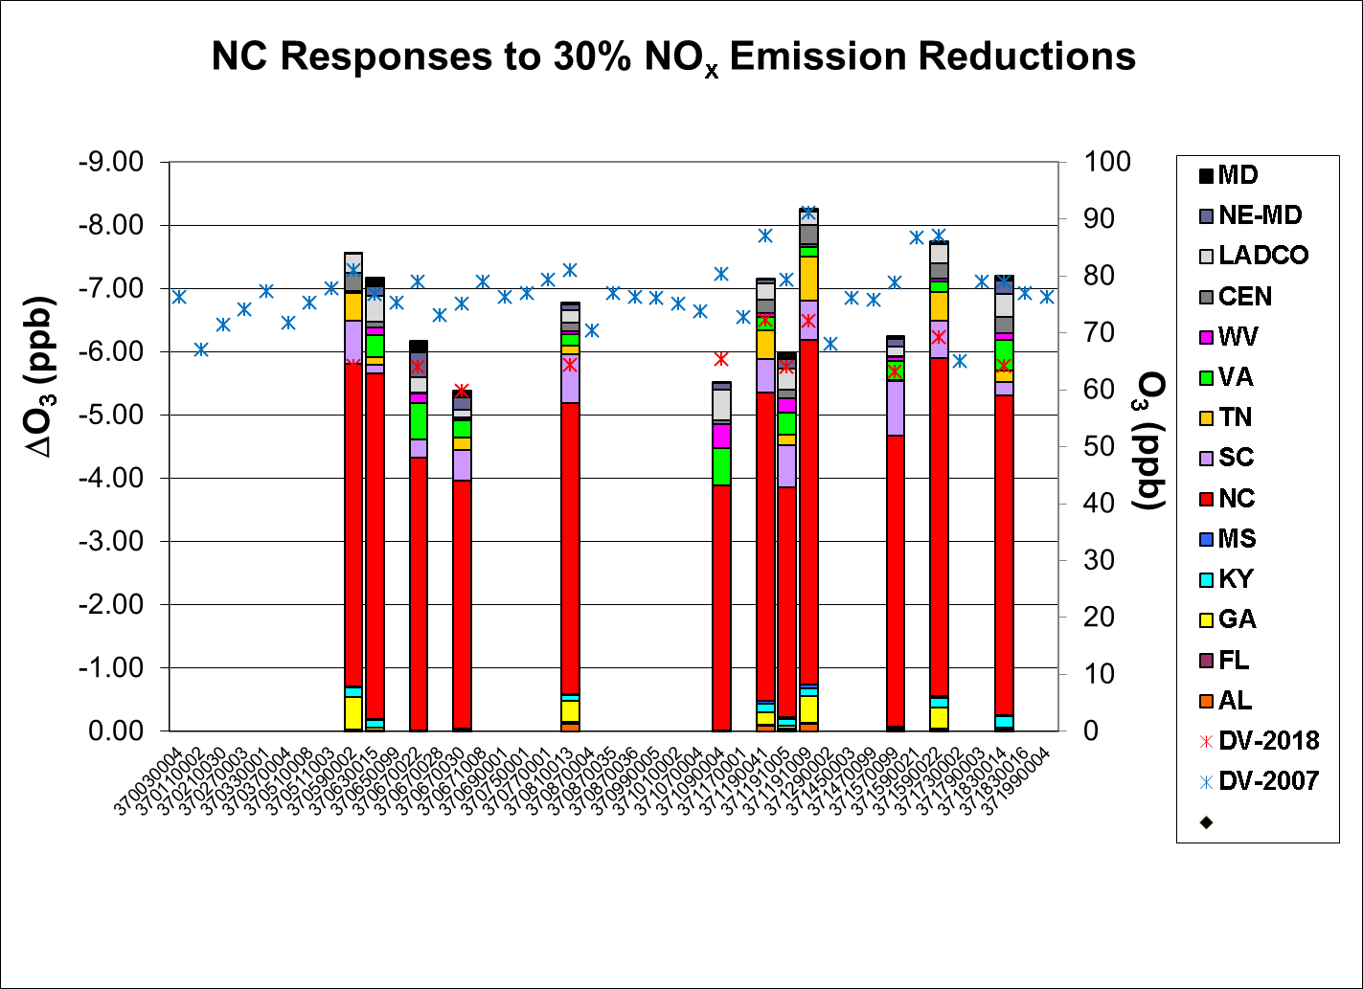

Slide 33
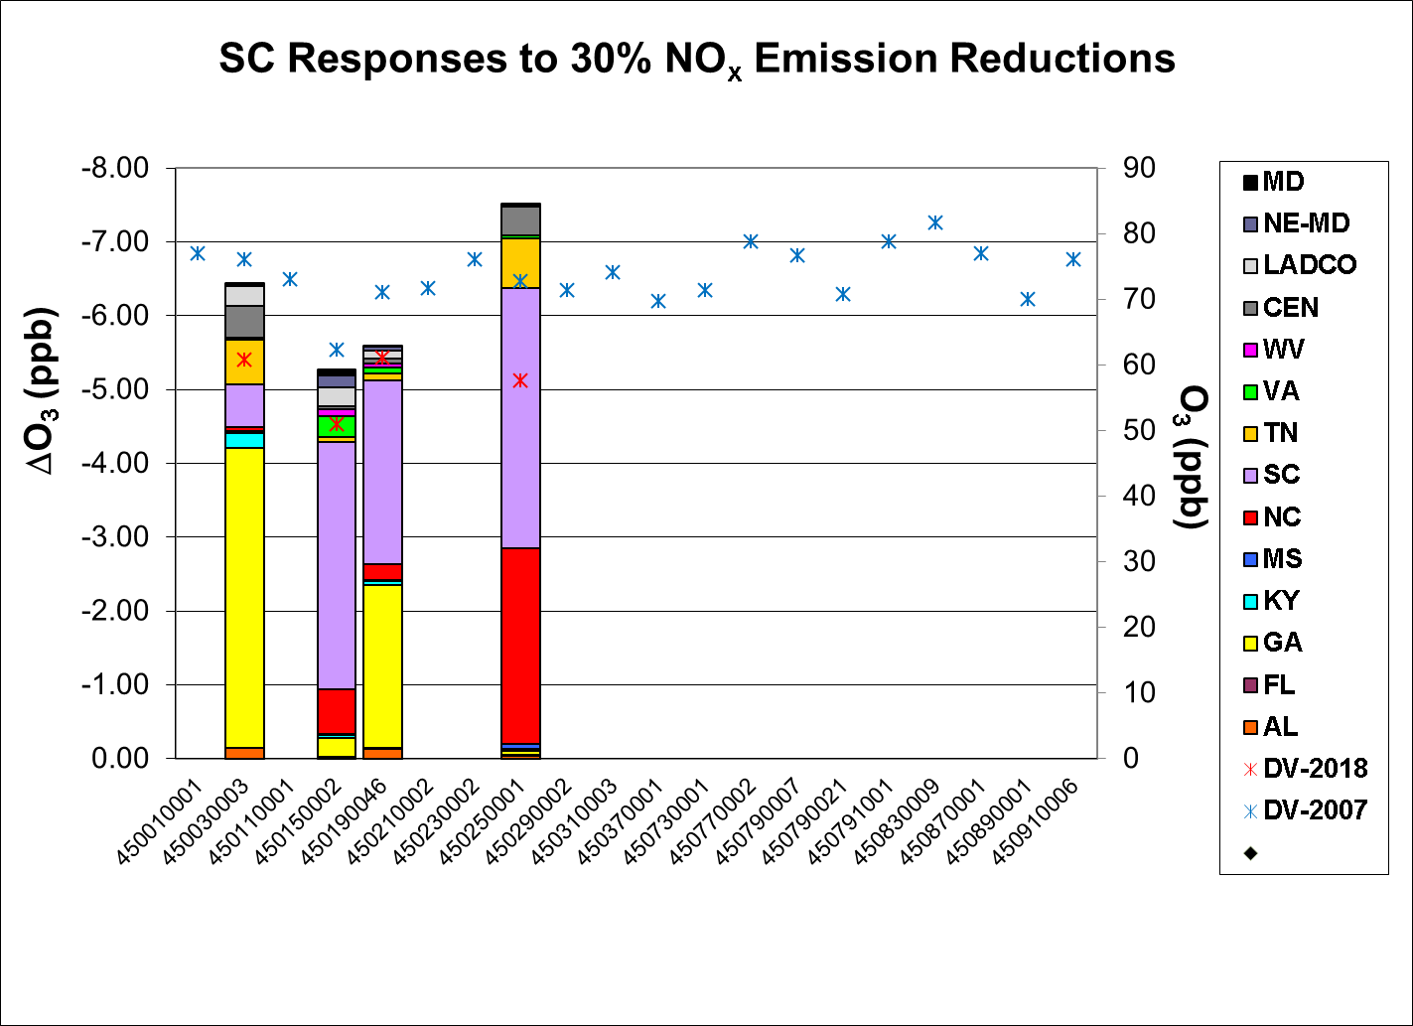

Slide 34
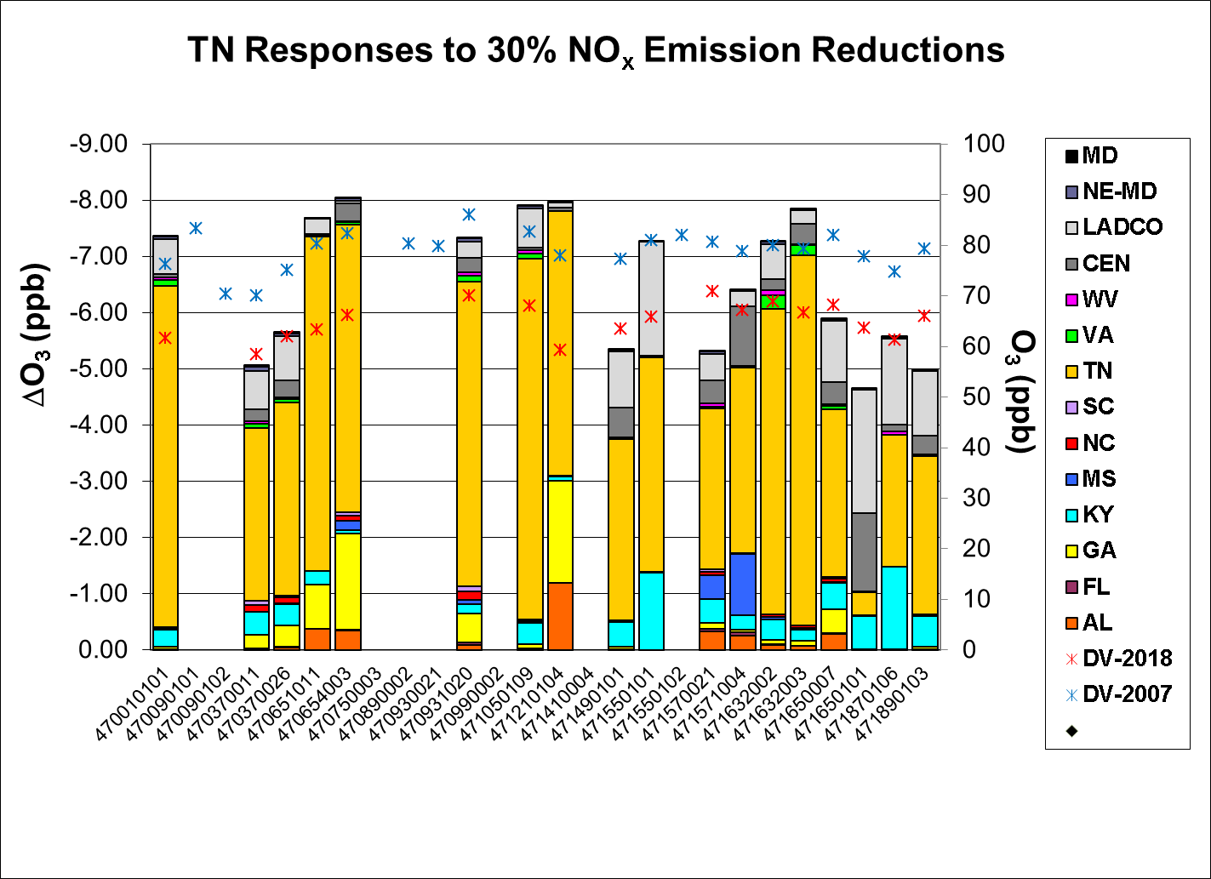

Slide 35
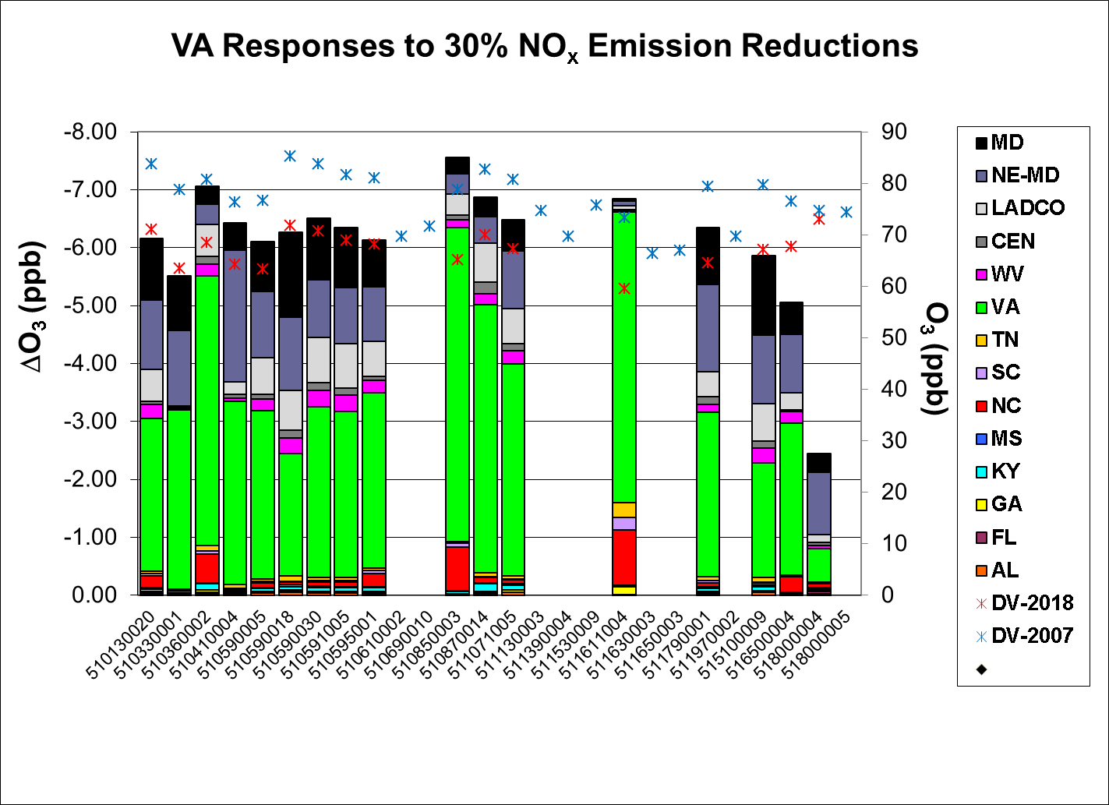

Slide 36
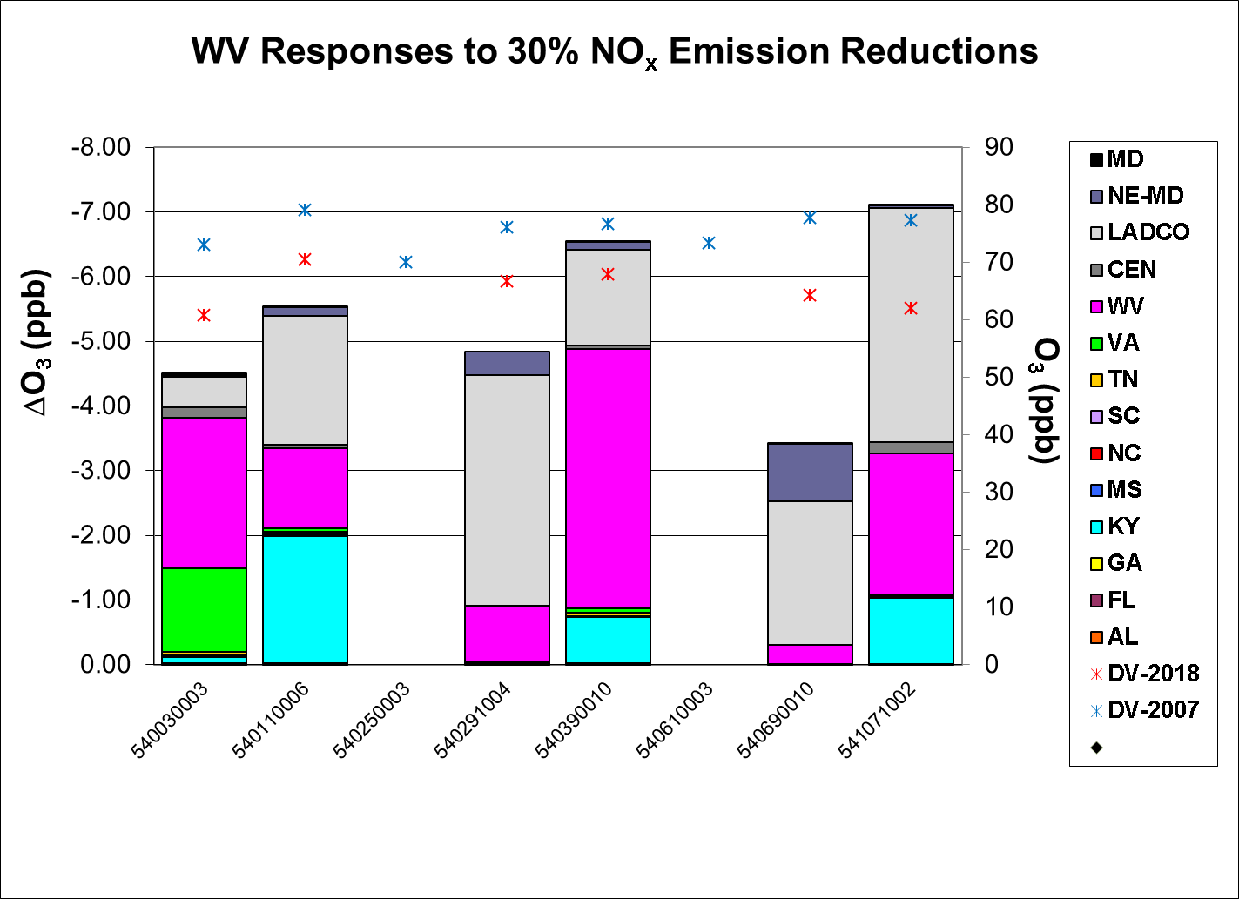

Slide 37
Relative Sensitivities to VOC Emissions in SESARM States

Slide 38
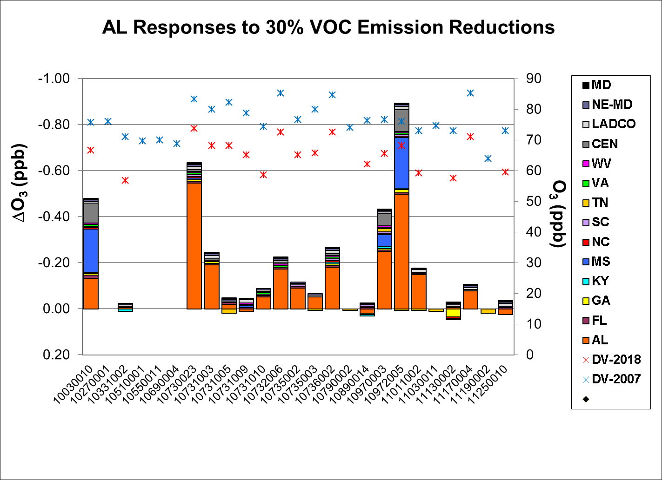

Slide 39
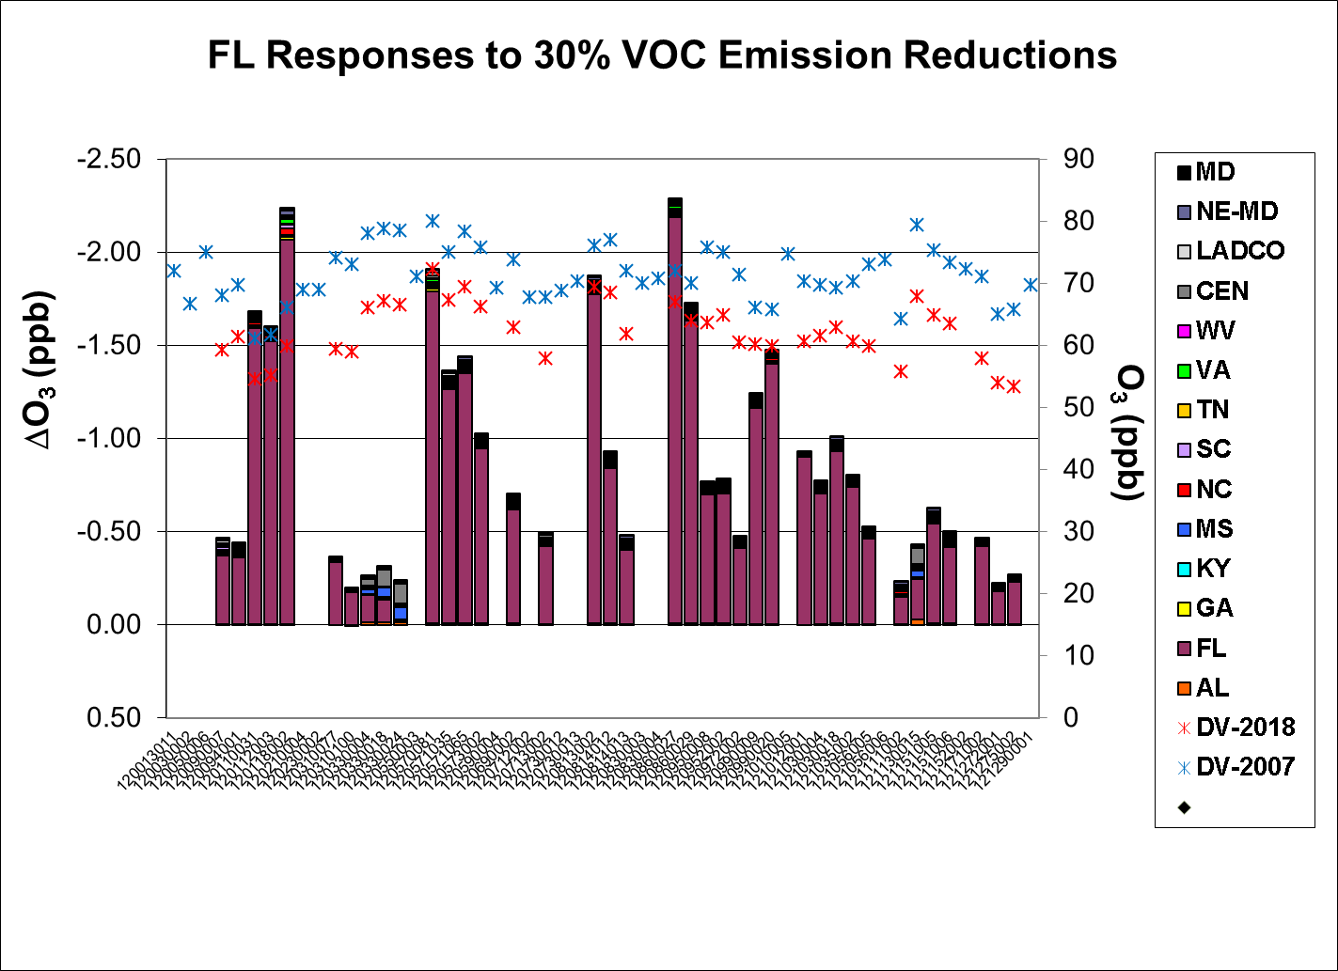

Slide 41
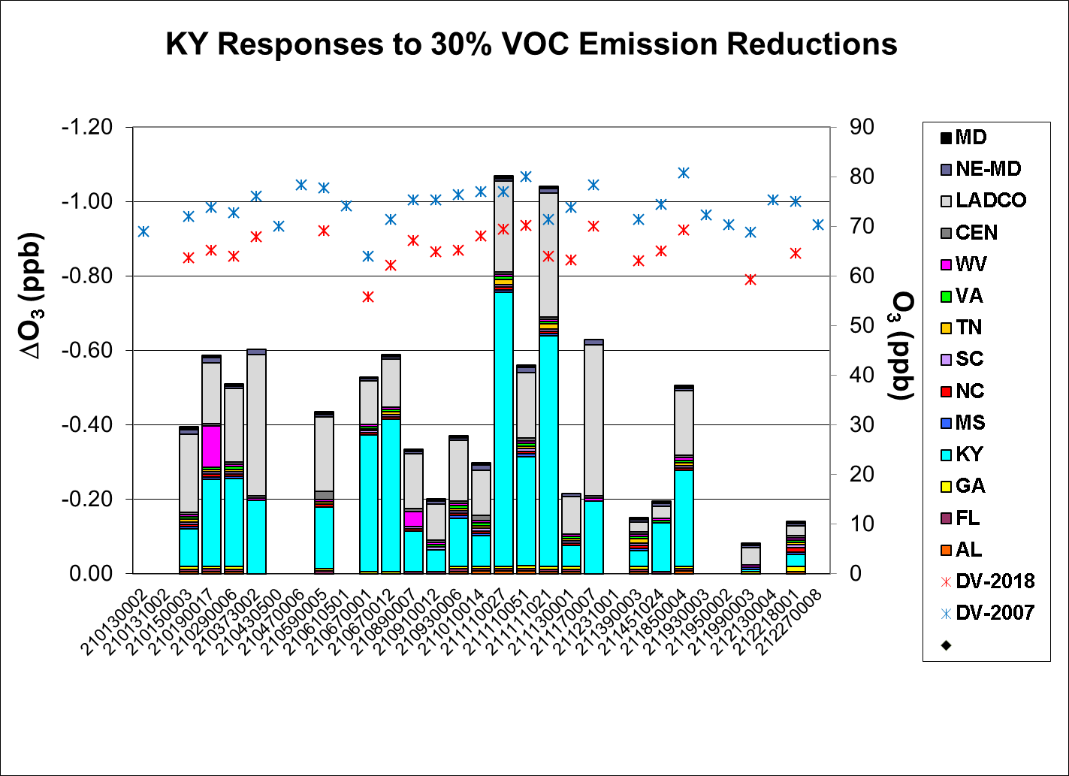

Slide 42
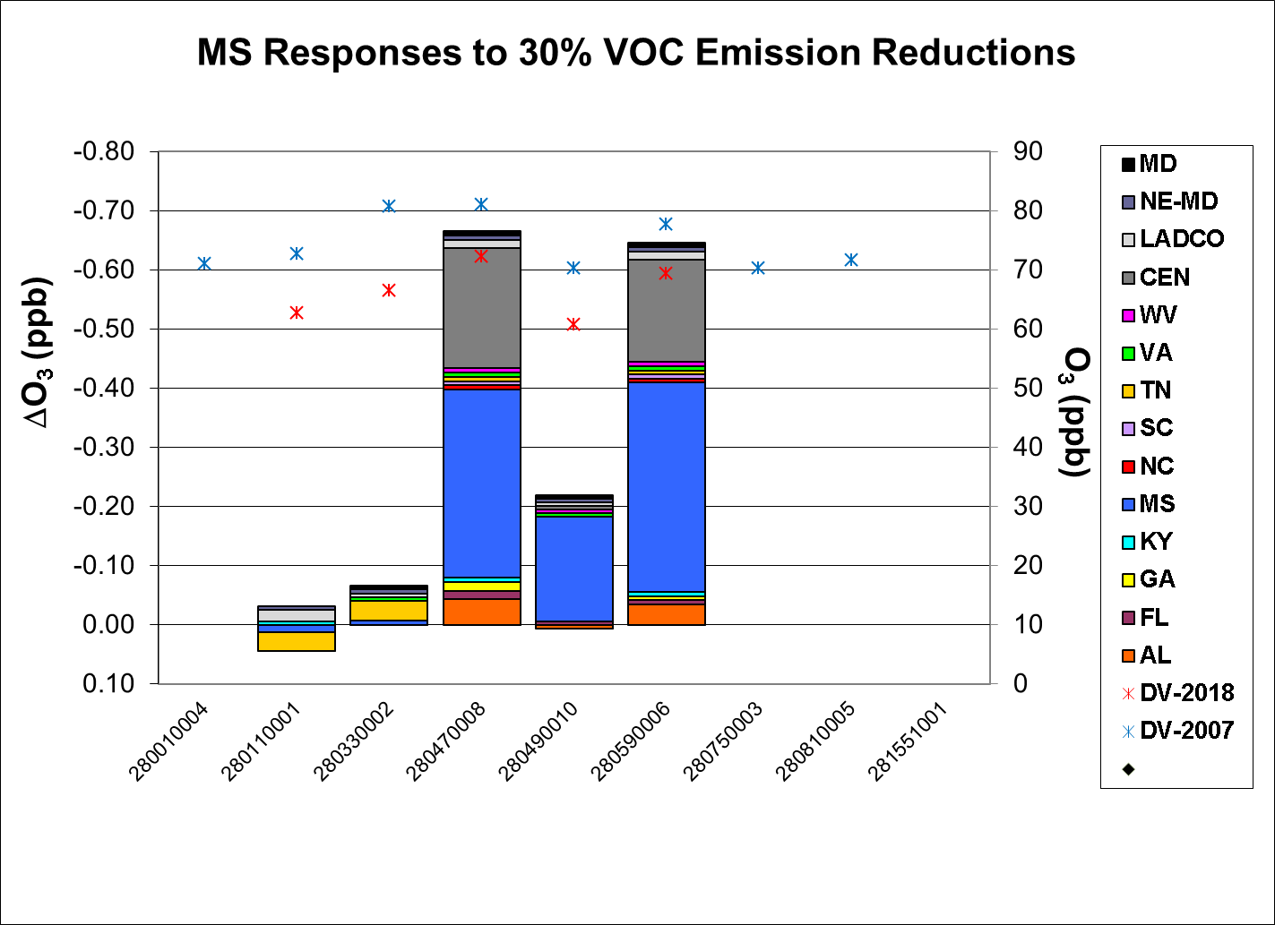

Slide 43
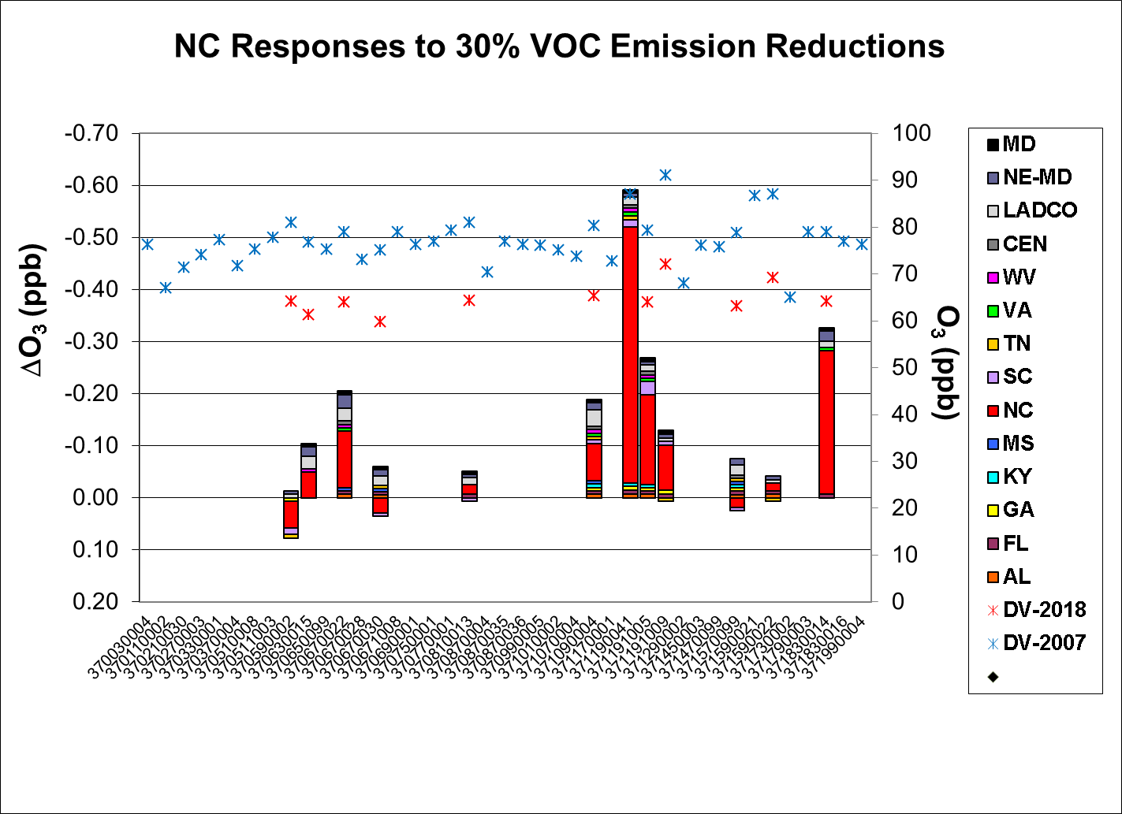

Slide 44
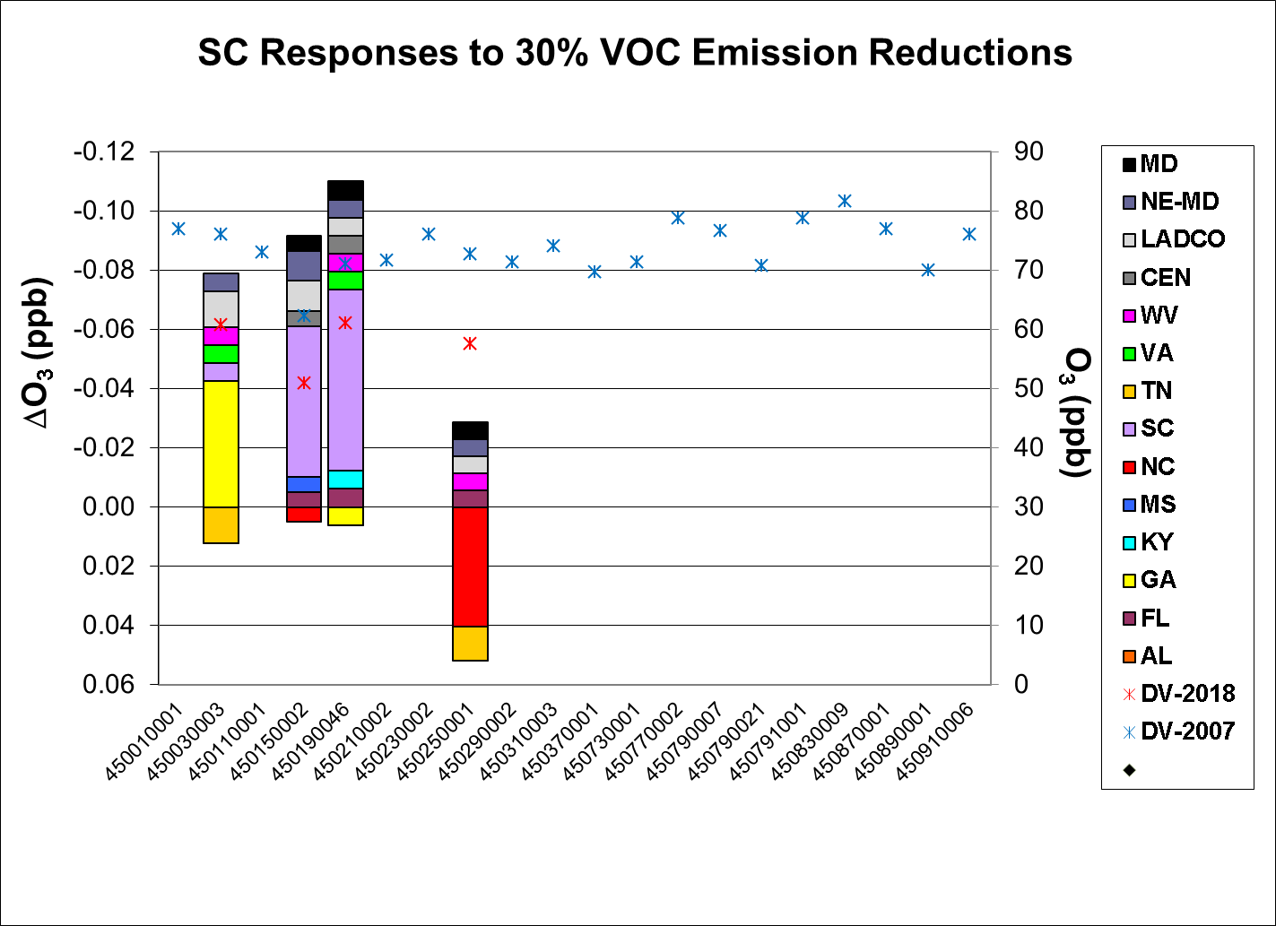

Slide 45
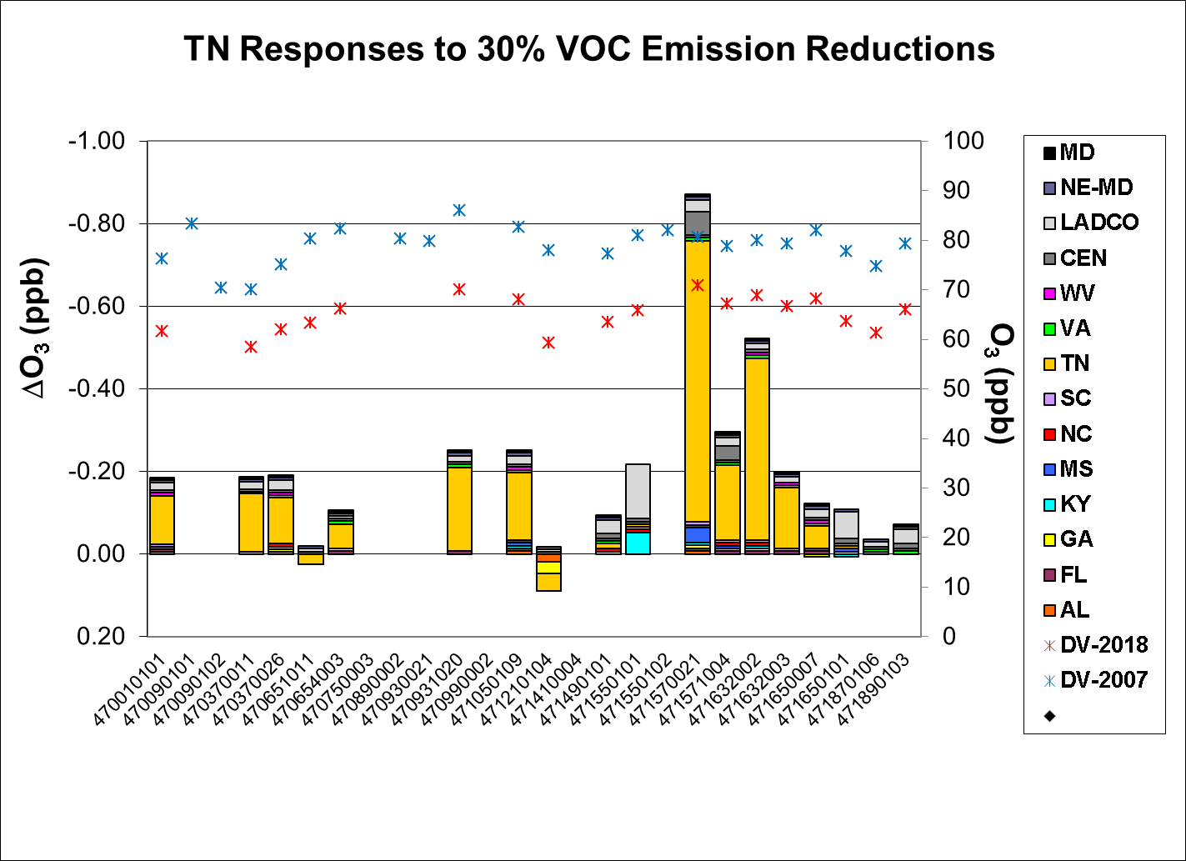

Slide 46
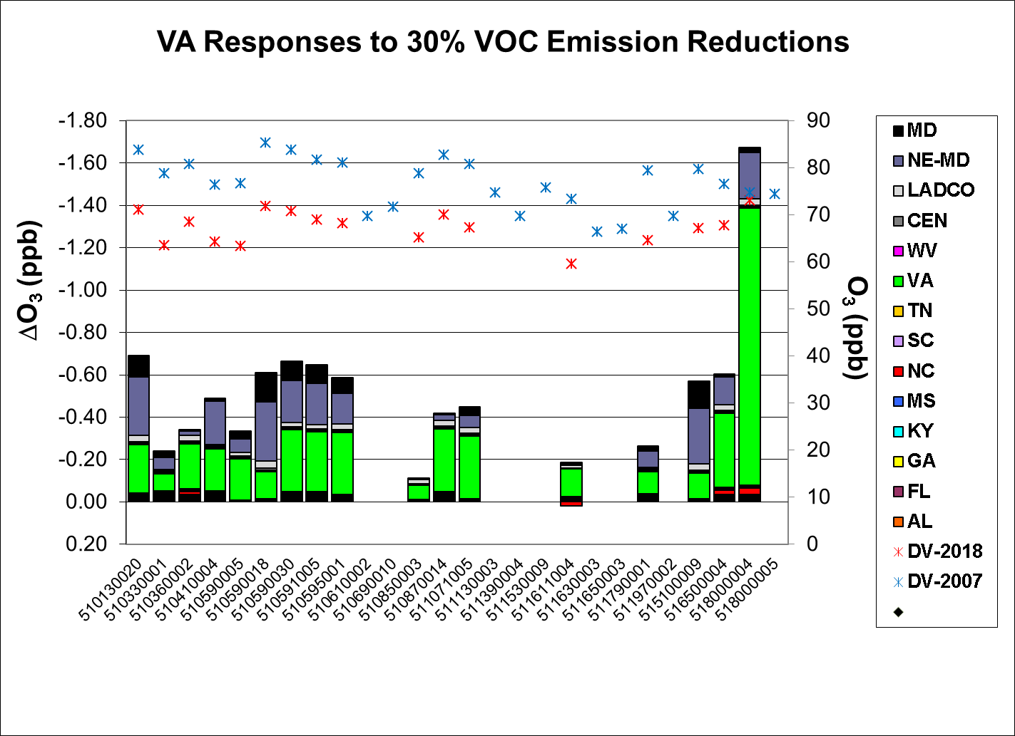

Slide 47
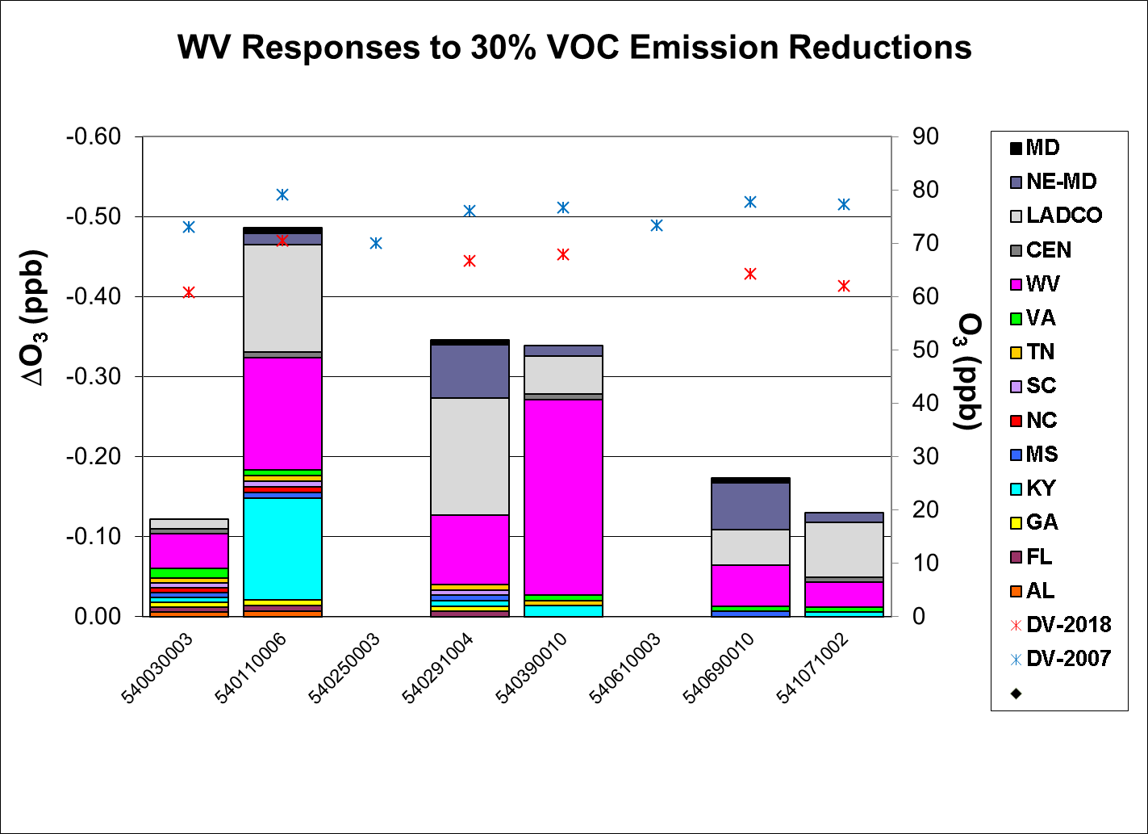

Slide 48
Normalized Sensitivities to NO_{x} & VOC Emissions in SESARM States

Slide 49
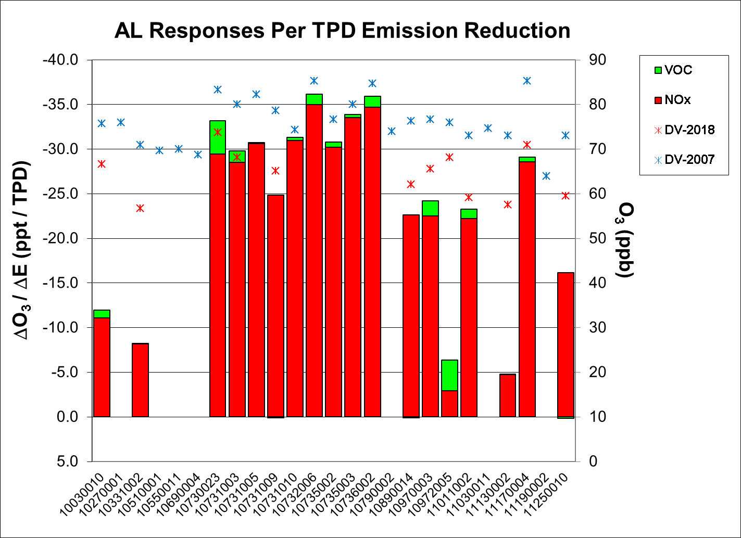

Slide 50
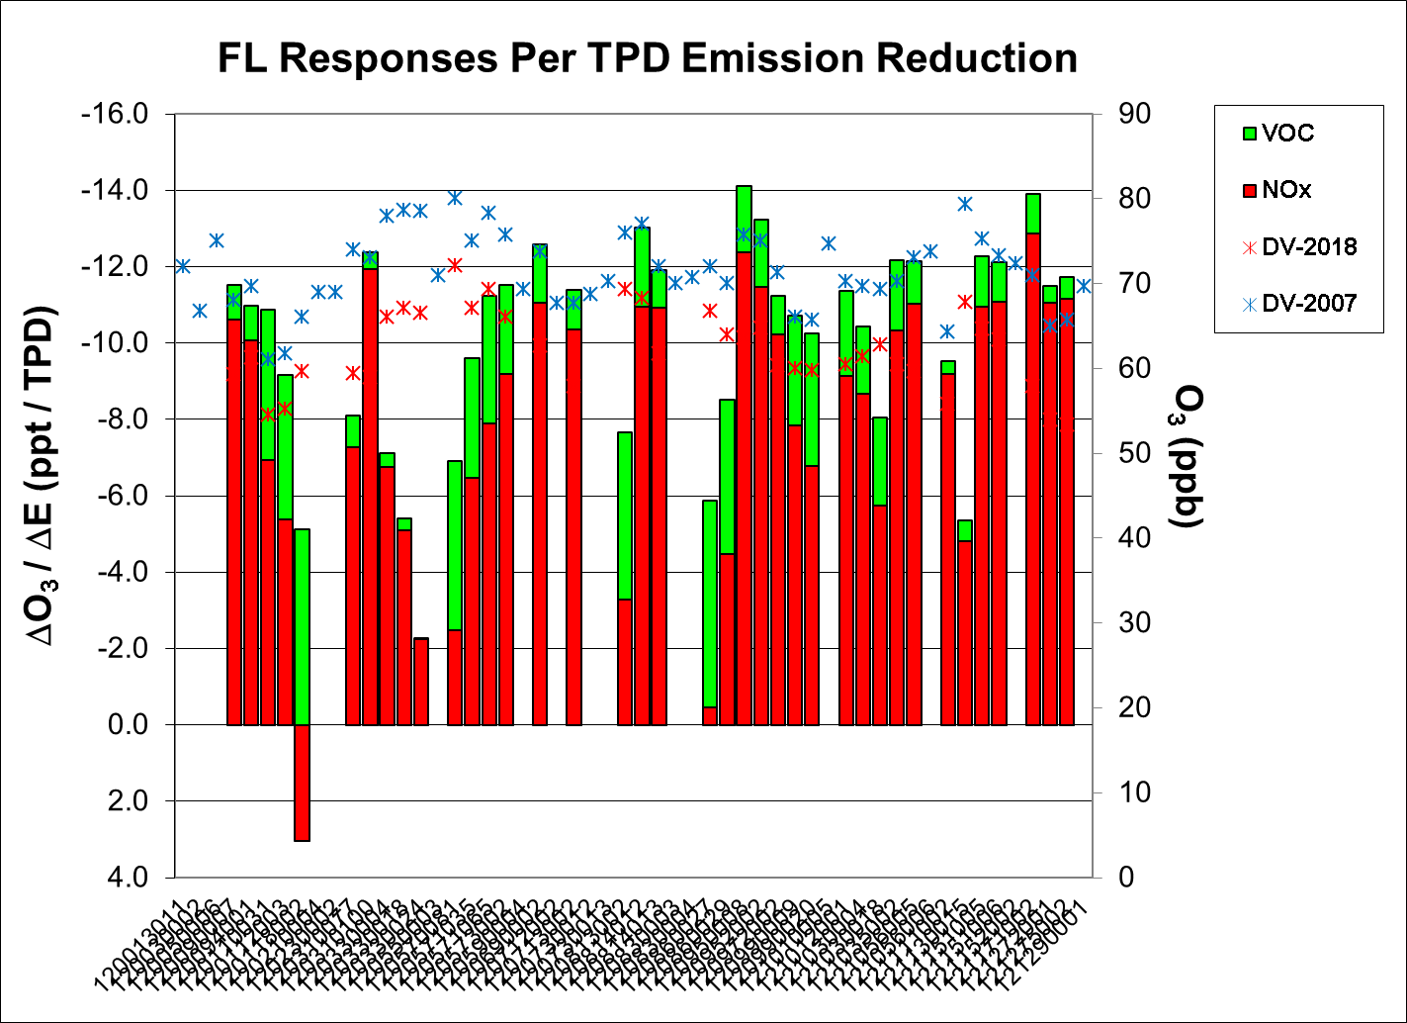

Slide 52
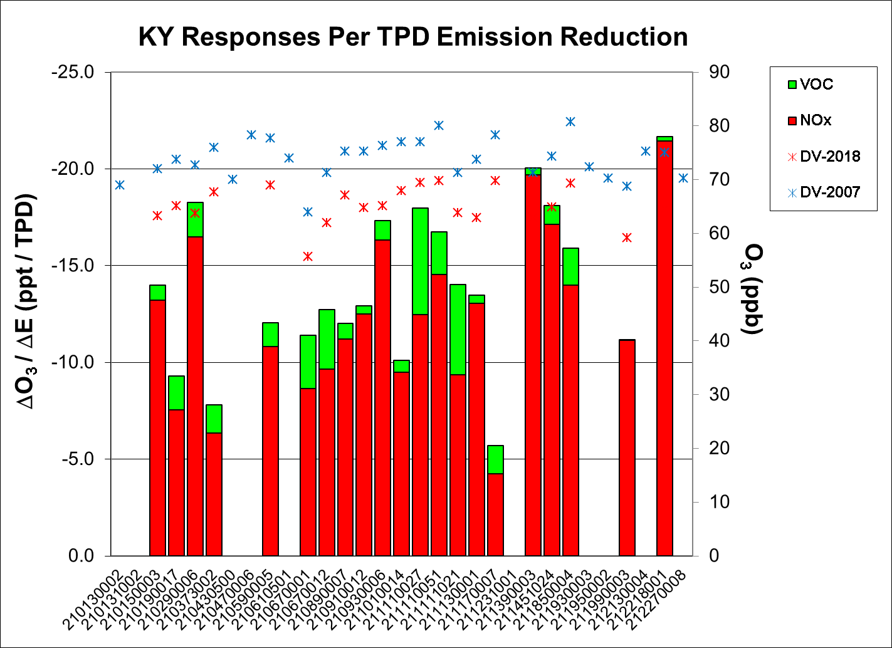

Slide 53
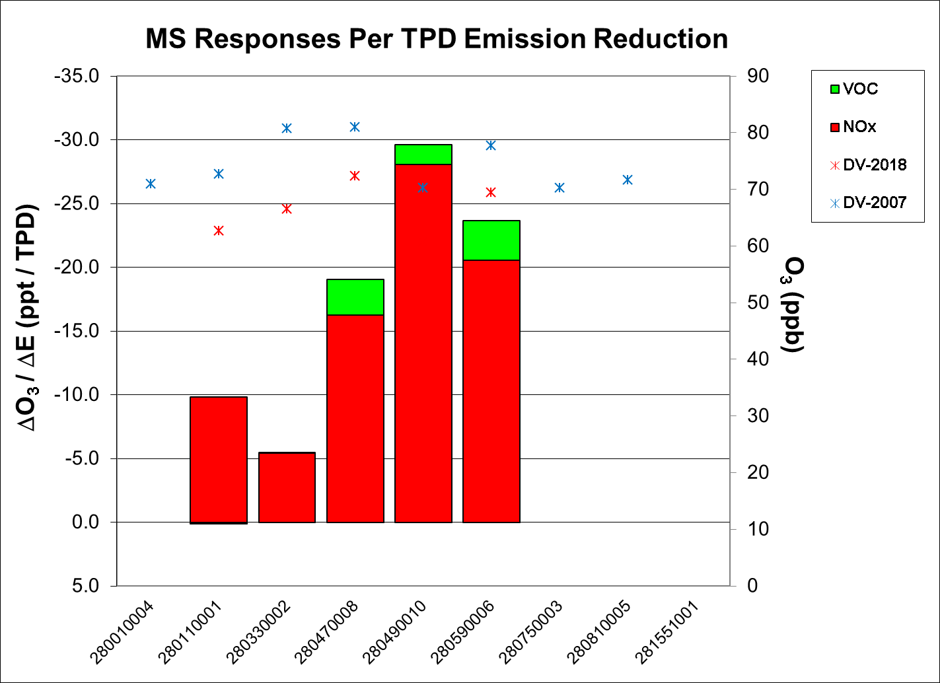

Slide 54
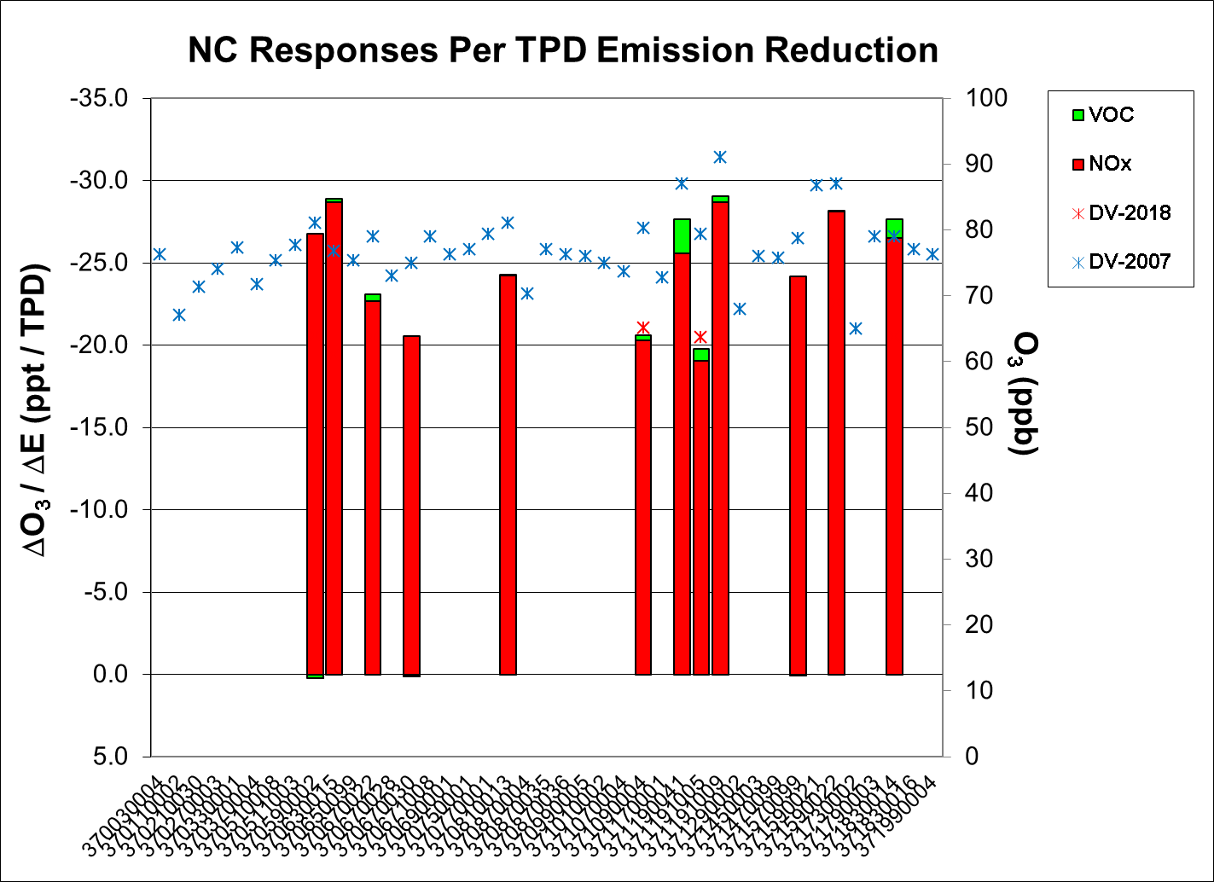

Slide 55
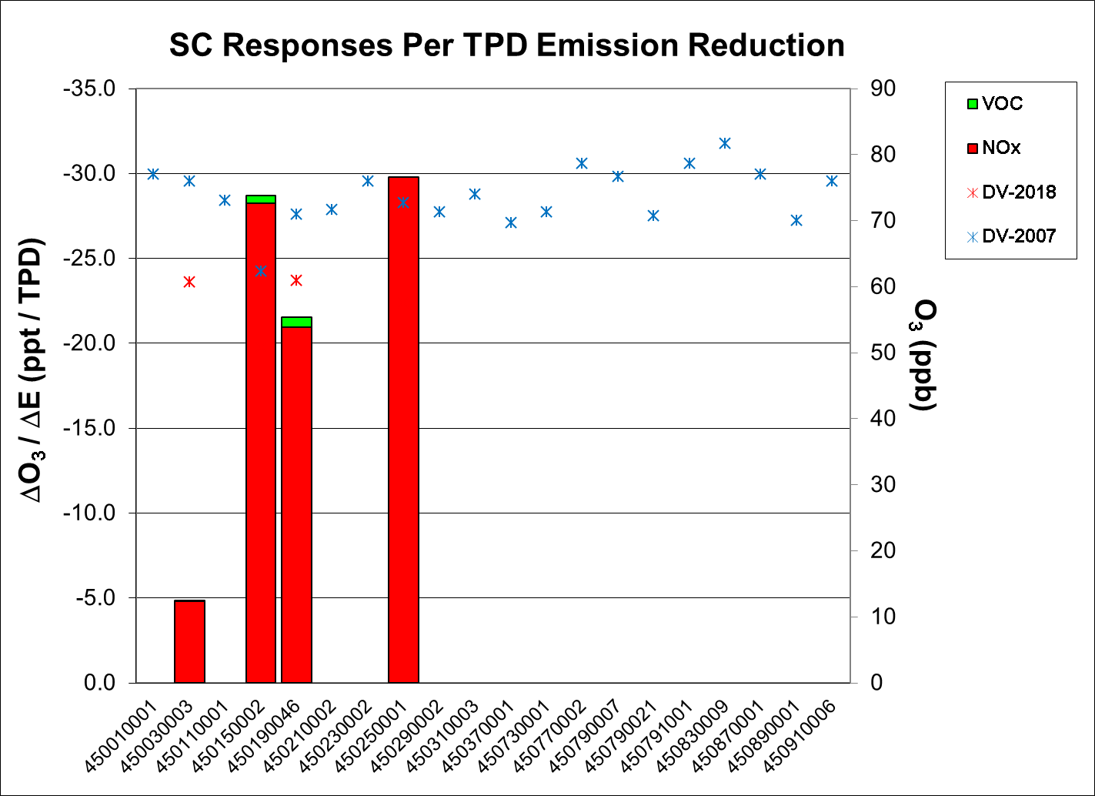

Slide 56
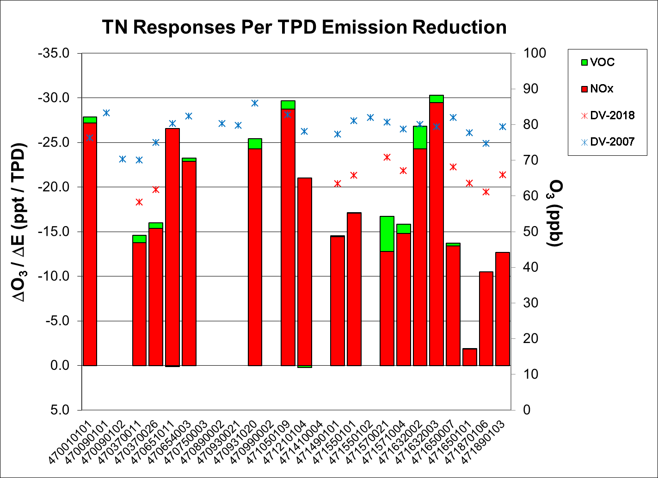

Slide 57
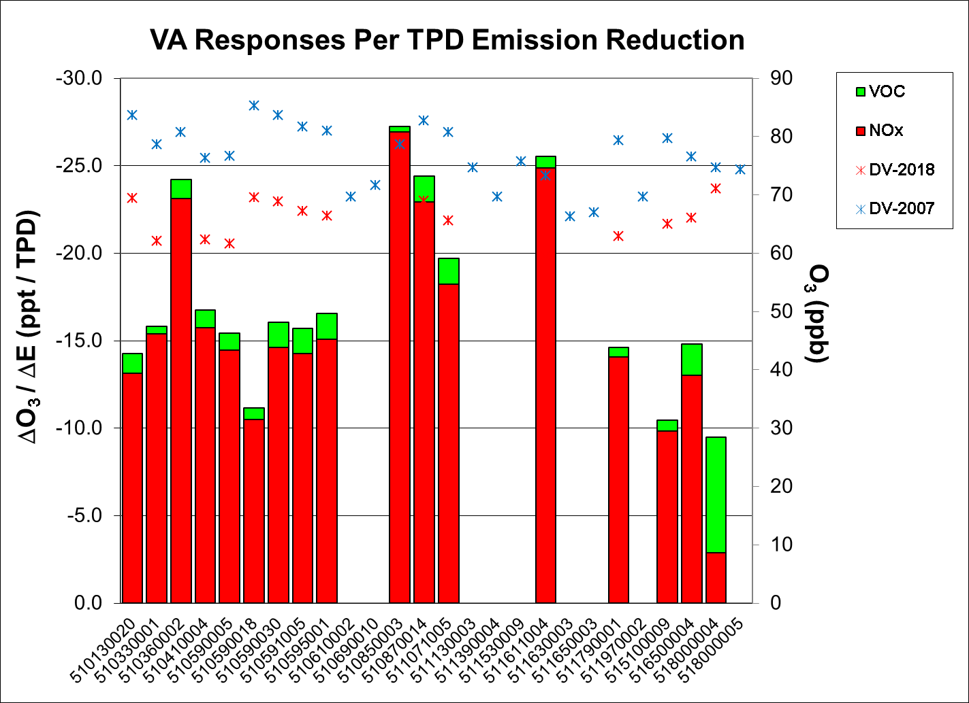

Slide 58
