Slide 1
Modeling the Co-Benefits of Carbon Standards for Existing Power Plants
Charles Driscoll,
Habibollah Fakhraei
Syracuse University
Kathy Fallon Lambert
Harvard Forest, Harvard University
Joel Schwartz,
Jonathan Buonocore
Harvard School of Public Health
Stephen Reid, Ken Craig,
Garnet Erdakos
Sonoma Technology, Inc.
Jonathan Levy
Boston University
Presented at the
13th Annual CMAS Conference
Chapel Hill, NC
October 29, 2014
STI-6102

Slide 2
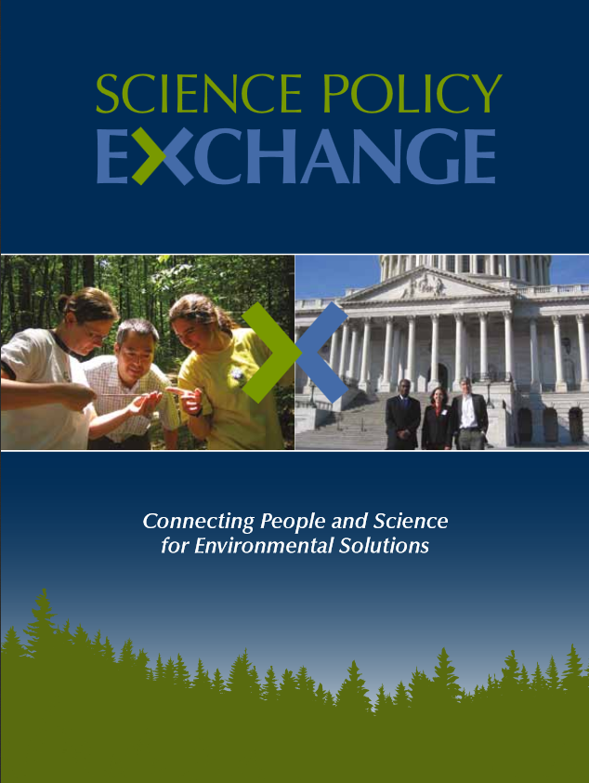
Outline
Background
  EPA Clean Power Plan
  Study objectives
Methods
  Overview
  Emissions scenarios
  CMAQ modeling
  BenMAP modeling
Results
Conclusions

Slide 3
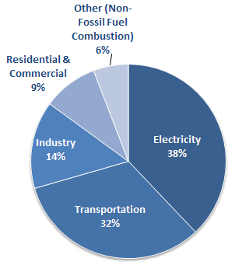
EPA Clean Power Plan
Background
Carbon pollution standards for existing power plants released June 2, 2014.
Projected to reduce carbon emissions from U.S. power plants by 30% from 2005 levels.
In 2012, the electric power sector accounted for 38% of CO₂ emissions and 31% of GHG emissions in the U.S.
From EPA’s Overview of Greenhouse Gases (http://www.epa.gov/climatechange/ghgemissions/gases/co2.html)

Slide 4
Potential Co-Benefits
Background
Power plants are also a significant source of SO₂, NO_{x}, and mercury (Hg).
These pollutants are precursors for PM_{2.5} (SO₂ and NO_{x}) and ozone (NO_{x}), which contribute to human health effects.
Emissions contributions from EPA’s 2011 NEI
For ecosystems, these pollutants contribute to acid rain, vegetation damage, and Hg bio- accumulation in fish.

Slide 5
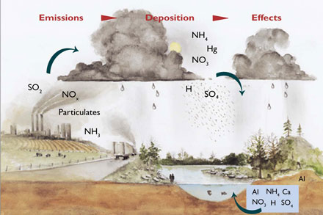
Study Objectives
Background
Inform the federal rulemaking process by
Modeling the potential co-benefits of various carbon standard scenarios.
Integrating human health and ecosystem health impacts to capture the geographic range of benefits.
Estimating the economic value of benefits.
Communicating results to policy makers, with a focus on state agencies.
PM_{2.5}
Ozone (O₃)

Slide 6




Overview of Approach
Methods
Policy scenarios developed by the Bipartisan Policy Center (BPC) and the Natural Resources Defense Council (NRDC), modeled by ICF International.
Notes:
2020 Reference Case and three 2020 policy cases with various levels of stringency and flexibility

Slide 7
Emissions Scenarios (1)
Methods
2020 Reference Case
  Business-as-usual scenario
  Benchmarked to EIA’s Annual Energy Outlook of 2013
  Assumes full implementation of current clean air policies (e.g., EPA’s Mercury and Air Toxics Standard)
Scenario 1
  Low-stringency alternative
  Compliance options limited to “inside the fenceline” changes
  Results in national average emission rates of 907 kg/MWh for coal plants and 454 kg/MWh for gas plants

Slide 8
Emissions Scenarios (2)
Methods
Scenario 2
  Moderate stringency with wide range of compliance options
  Most similar to standards proposed by EPA
  Results in national average emission rates of 680 kg/MWh for coal plants and 454 kg/MWh for gas plants
Scenario 3
  High-stringency alternative
  Mimics the impacts of a national tax on CO₂ emissions
  Results in national average emission rates of 544 kg/MWh for coal plants and 385 kg/MWh for gas plants

Slide 9
Emissions Scenarios (3)
Methods
Changes in CO₂ emissions by scenario

Slide 10
CMAQ Modeling (1)
Methods
CMAQ v4.7.1
Based on EPA’s 2007/2020 Modeling Platform
Year 2007 meteorology from WRF v3.1
CB05 gas chemistry
AE5 aerosol chemistry
Multi-pollutant options engaged for mercury chemistry

Slide 11
CMAQ Modeling (2)
Methods
4 CMAQ Simulations
  2020 reference case
  3 future-year (2020) emissions policy scenarios
Gridded air quality concentrations and deposition rates on a 12-km CONUS domain
CMAQ outputs post-processed for subsequent health, ecosystem analyses
CMAQ Modeling Grid
12-km grid cell resolution
396 x 246 grid cells

Slide 12
BenMAP Modeling
Methods
EPA’s Benefits Mapping and Analysis Program (BenMAP) CE version 1.0.8
Calculates the health benefits of air quality management scenarios
BenMAP run with
  2020 population forecasts
  Incidence and prevalence rates of health outcomes
  Concentration-response functions developed by the project team
Health impacts calculated as additional benefits of carbon standards

Slide 13
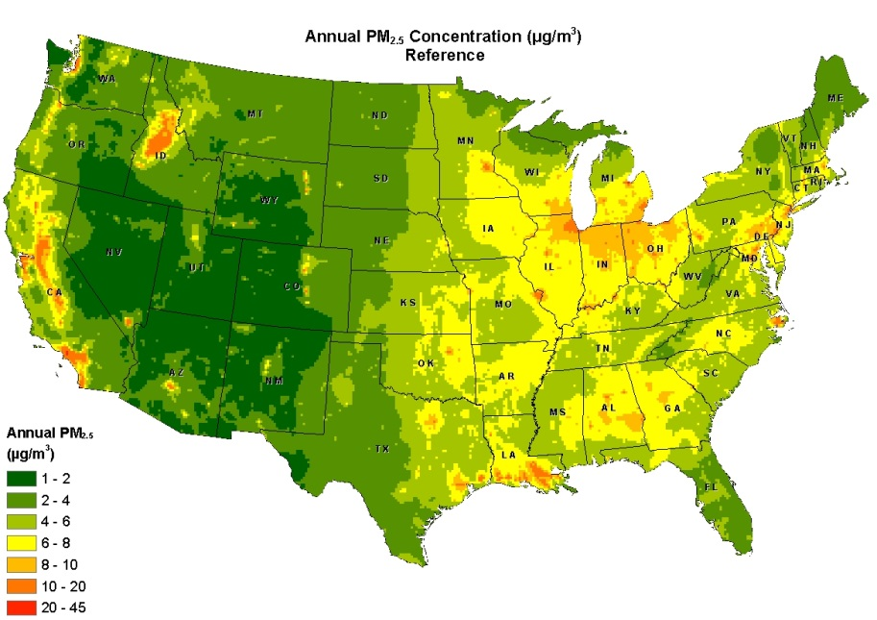
PM_{2.5} Co-Benefits (1)
Results

Slide 14
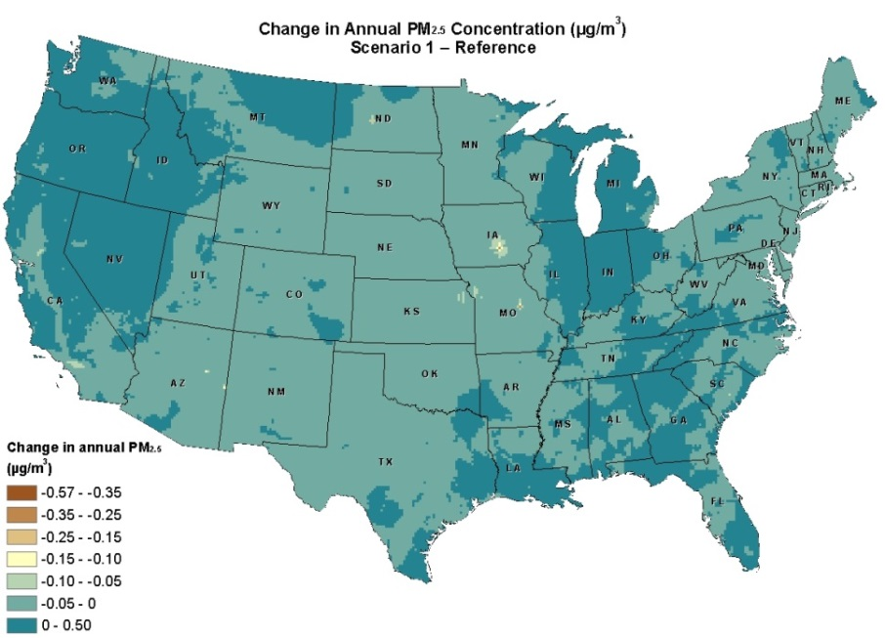
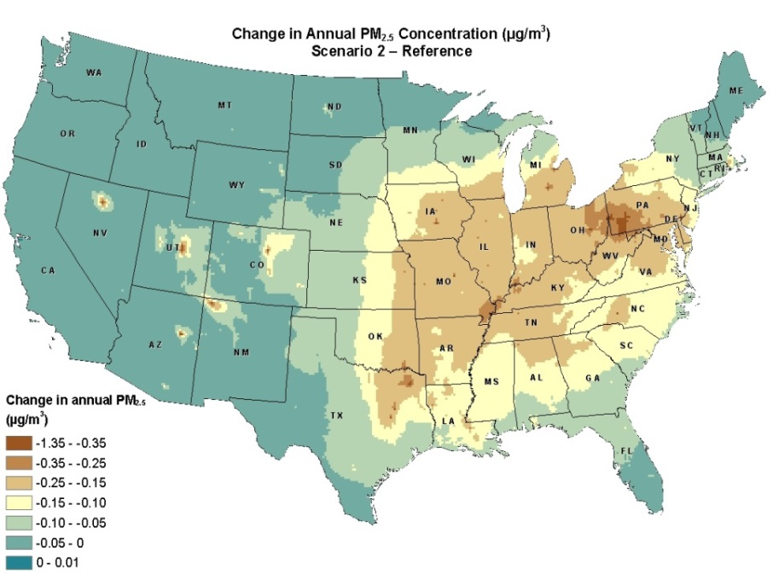
PM_{2.5} Co-Benefits (2)
Results
Generally modest changes for Scenario 1, with PM_{2.5} disbenefits of up to 0.4 µg/m³
For Scenario 2, PM_{2.5} decreases of 0.15 to 1.35 µg/m³ occur across much of the eastern U.S.
Scenario 3 results similar to Scenario 2, but at a much higher cost

Slide 15
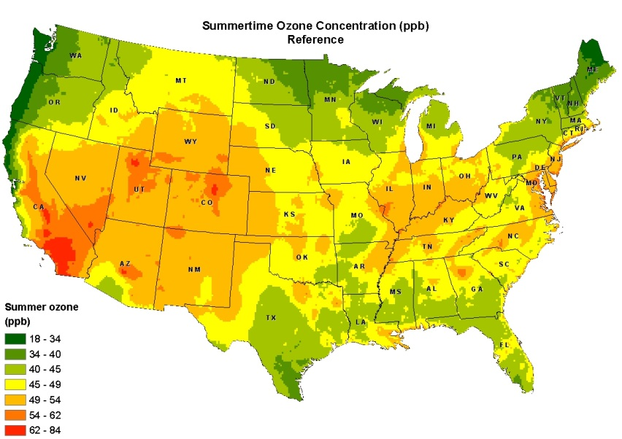
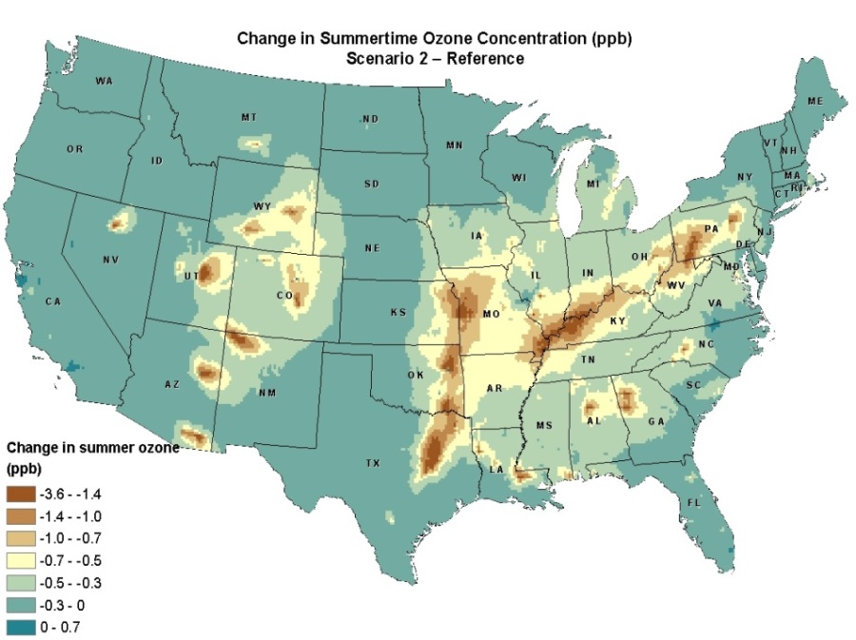
Ozone Co-Benefits
Results
Insignificant ozone co-benefits for Scenario 1
For Scenario 2, peak 8-hr ozone concentration decreases of 0.7 to 3.6 ppb across the Ohio River Valley and Central U.S.

Slide 16
Health Co-Benefits (1)
Results
National-scale health benefits by scenario

Slide 17
Health Co-Benefits (2)
Results

Slide 18
Summary
Conclusions
Stringency level and compliance options for carbon standards impact pollutant co-benefits.
Scenario 1, which focuses on plant retrofits, could increase co-pollutant emissions.
Scenario 2, which is most similar to EPA’s proposal, provides the greatest air quality and human health benefits (3,500 premature deaths avoided in 2020).
Scenario 3 benefits are similar to Scenario 2 but at a higher cost.

Slide 19
Ongoing Work
Conclusions
Part 3 of the project is underway and focuses on ecosystem analyses
W126 analysis of benefits to forests and crops from ozone concentration reductions
Visibility analysis for Class I areas
Evaluation of changes in critical N loadings
Acidification recovery of soils and surface waters

Slide 20
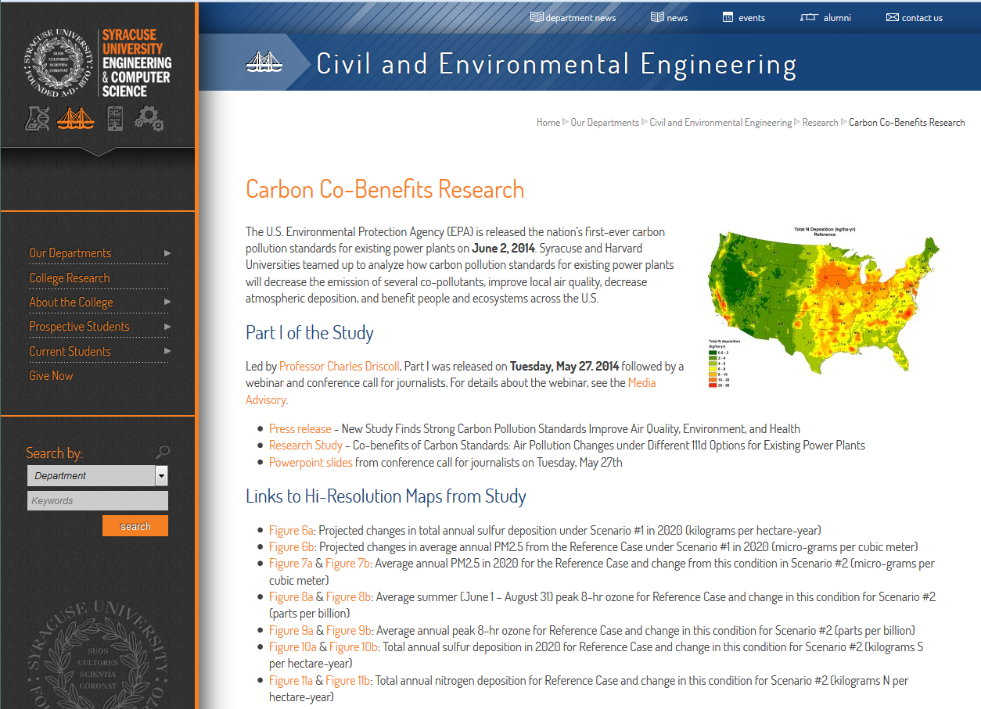
Project Website
Conclusions
For additional information, visit:
http://eng-cs.syr.edu/carboncobenefits

Slide 21

Contacts
Stephen Reid, STI
sreid@sonomatech.com
Kathy Fallon Lambert, Harvard Forest
klambert01@fas.harvard.edu
Dr. Charles Driscoll, Syracuse University
ctdrisco@syr.edu
sonomatech.com @sonoma_tech

