Slide 1

AQMEII Phase 1 and 2: A comparative analysis of off line versus on line models for EU air quality application over two year of simulation
S. Galmarini, I. Kioutsioukis
European Commission, Joint Research Center
AKNLDGMTS to C. Hogrefe (US EPA) and AQMEII p1 and p2 communities

Slide 2
AQMEII
Air Quality Model Evaluation International Initiative
Phase 1 (P1)
RS models
2006
EU and NA
ECMWF BC => GEMS
Focus of this talk: O3, NO2 (JJA), PM10 (DJF) in EU
10-13 models dep on species (for EU)
Phase 2 (P2)
On line coupled RS models
2010
EU and NA
ECMWF BC => MACC
Focus of this talk: O3, NO2 (JJA), PM10 (DJF) in EU
14 models for all species (EU)
  Predominance of wrf-chem versions

Slide 3
Comparison of P1 and P2 on EU only
Analysis of changes in measurements from 2006 2010
Analysis of individual model behavior versus measurement – Operational evaluation
Ensemble analysis – Probabilistic eval
  Reduced ensemble

Slide 4
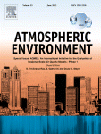
2015: P2 SI
2012: P1 SI

Slide 5
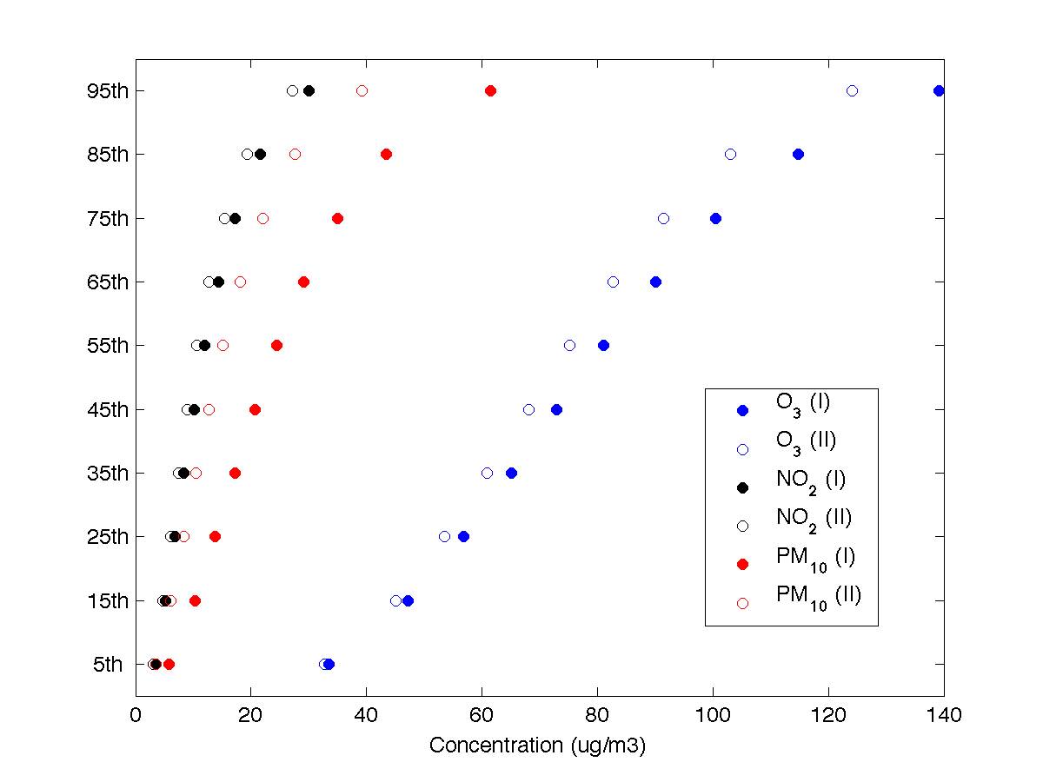
Monitoring data cumulative behavior in 2006 and 2010

Slide 6
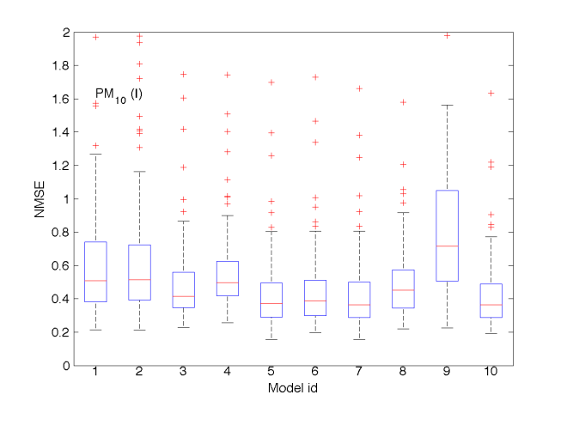
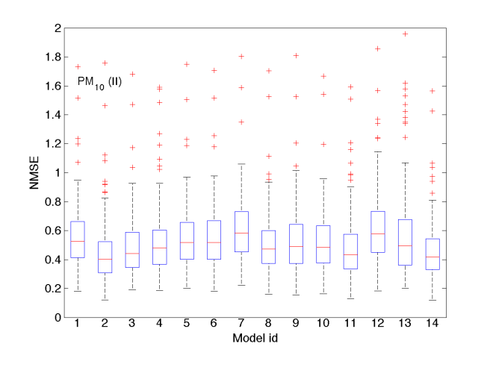
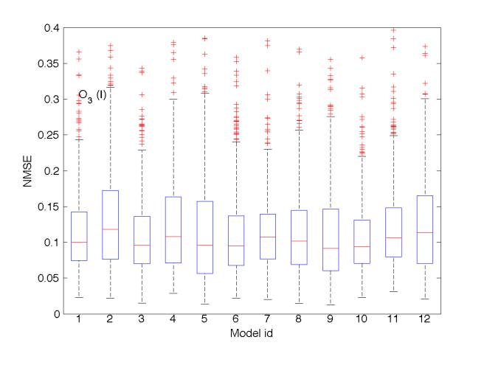
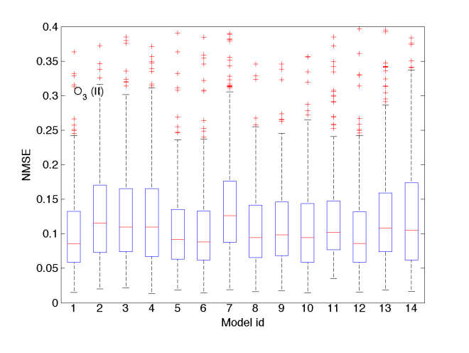
PM10 and O3 models vs monitoring

Slide 7
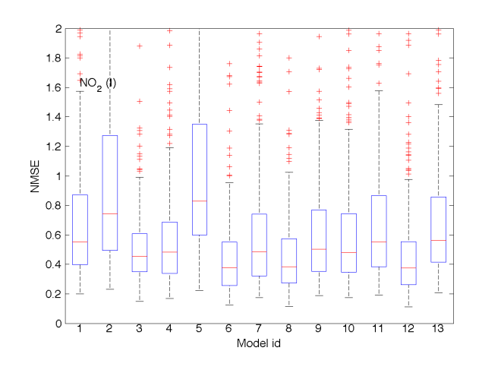
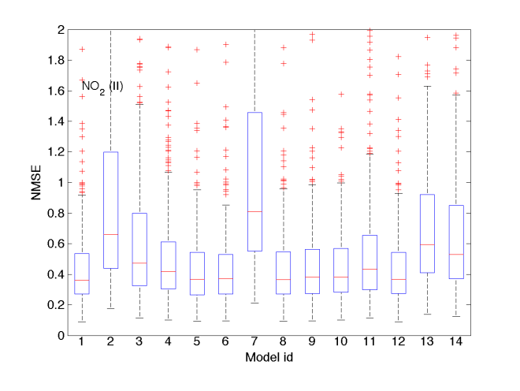
NO2 models vs monitoring

Slide 8
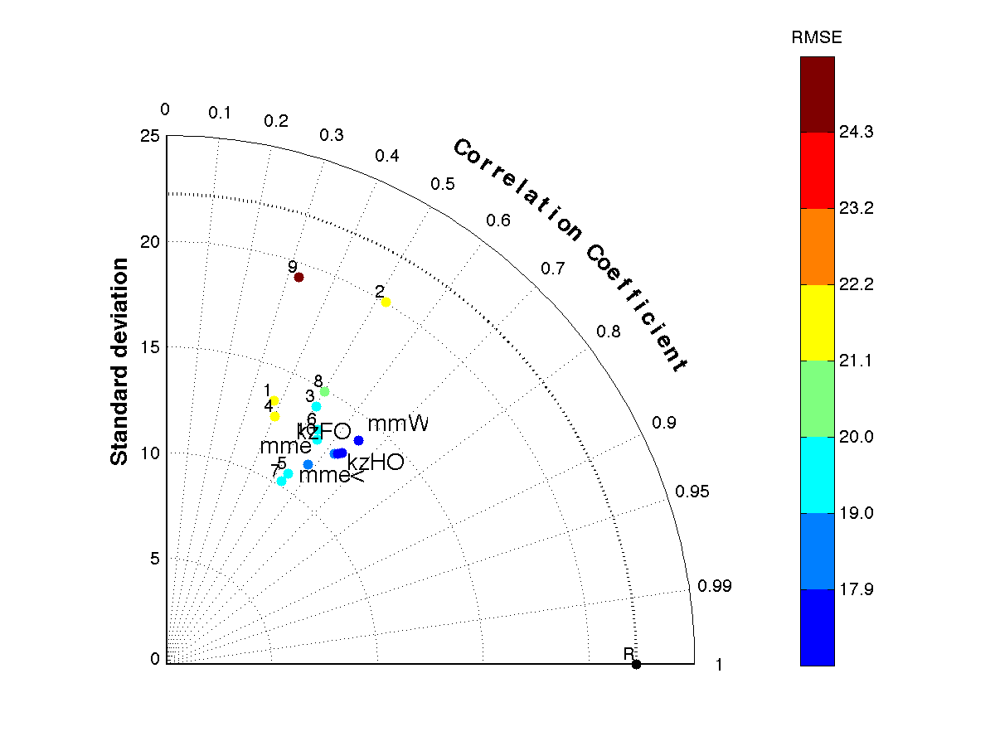
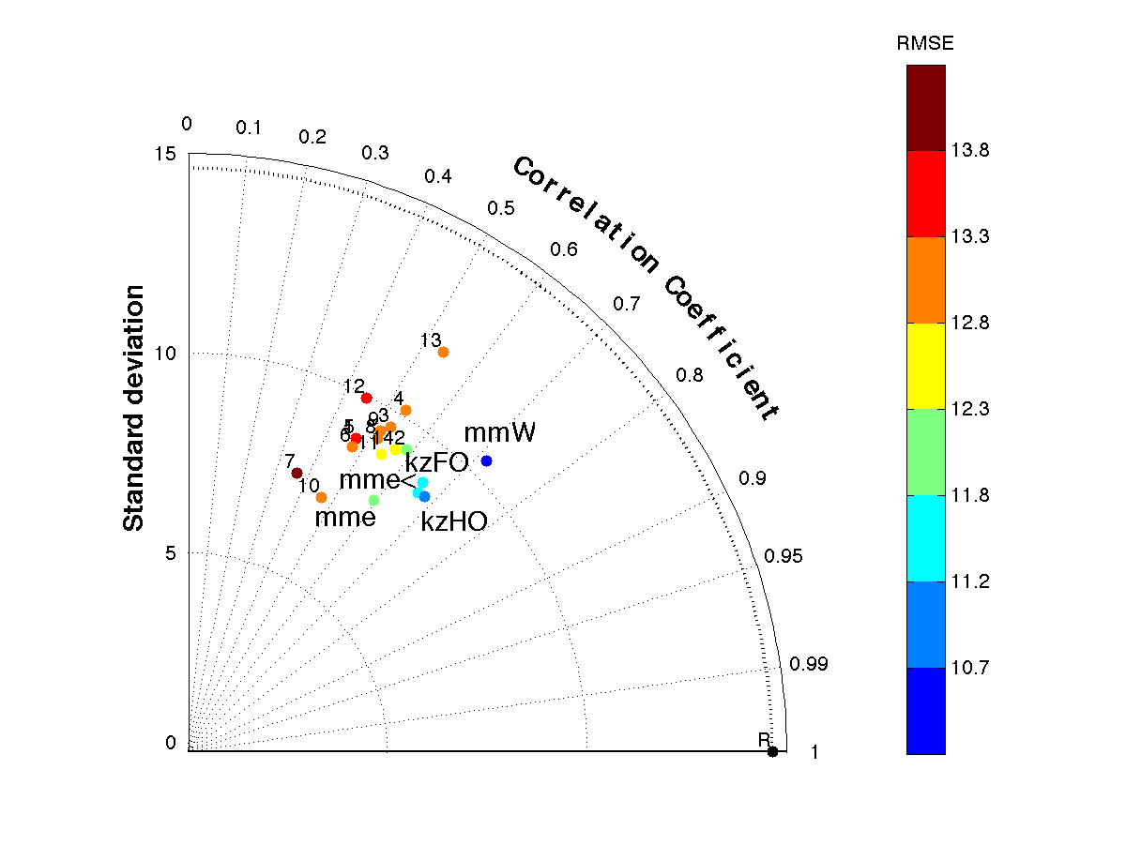
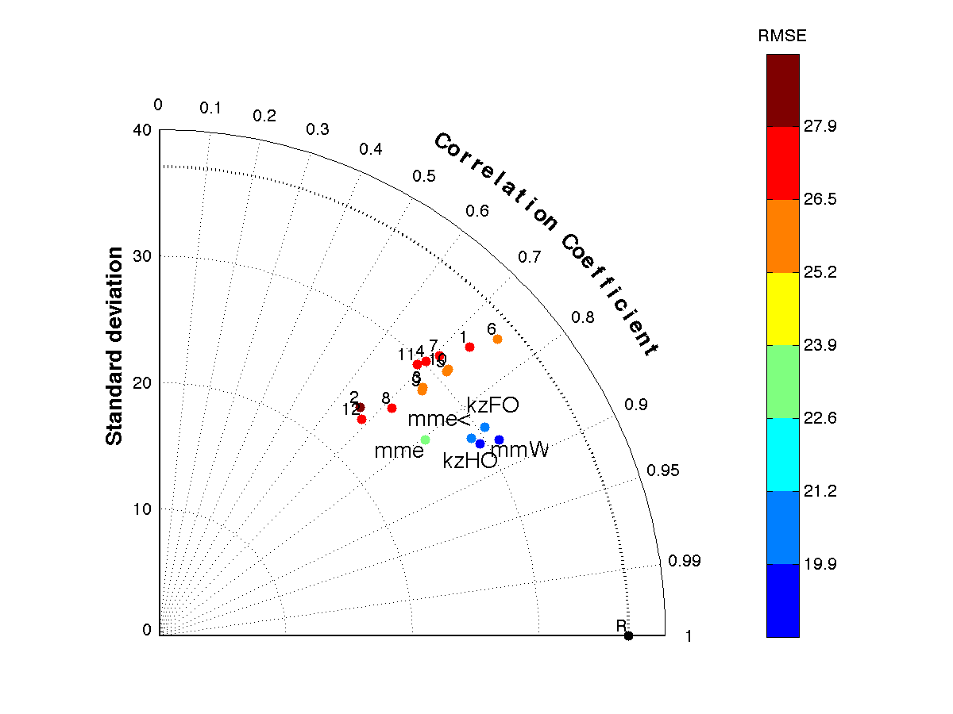
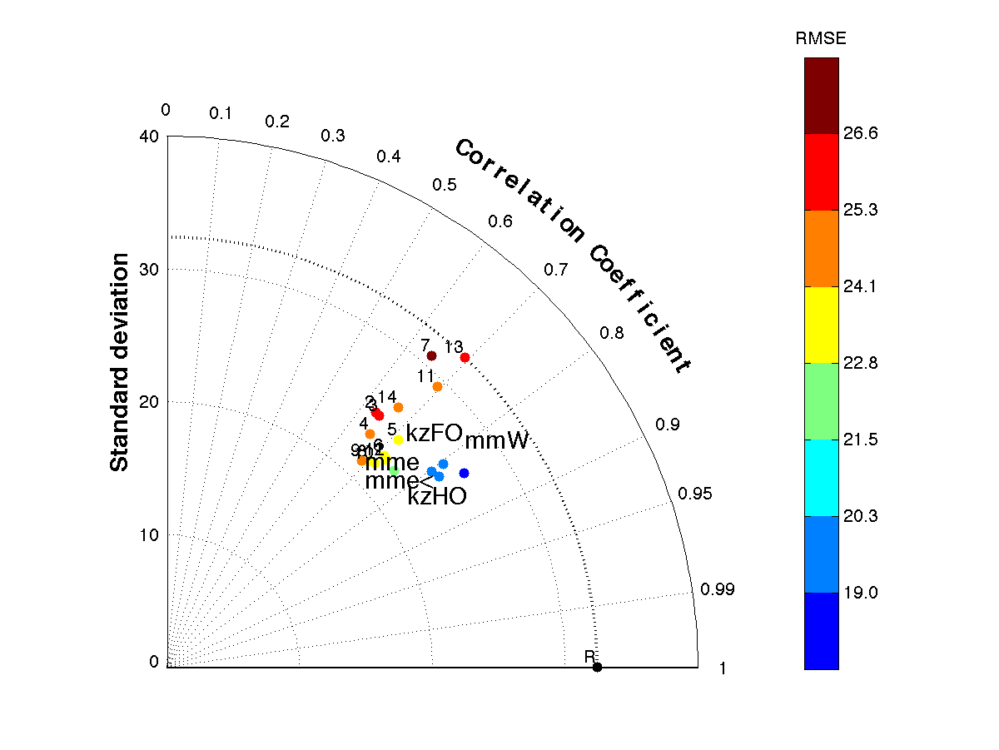
PM (II)
PM (I)
O3 (I)
O3 (II)

Slide 9
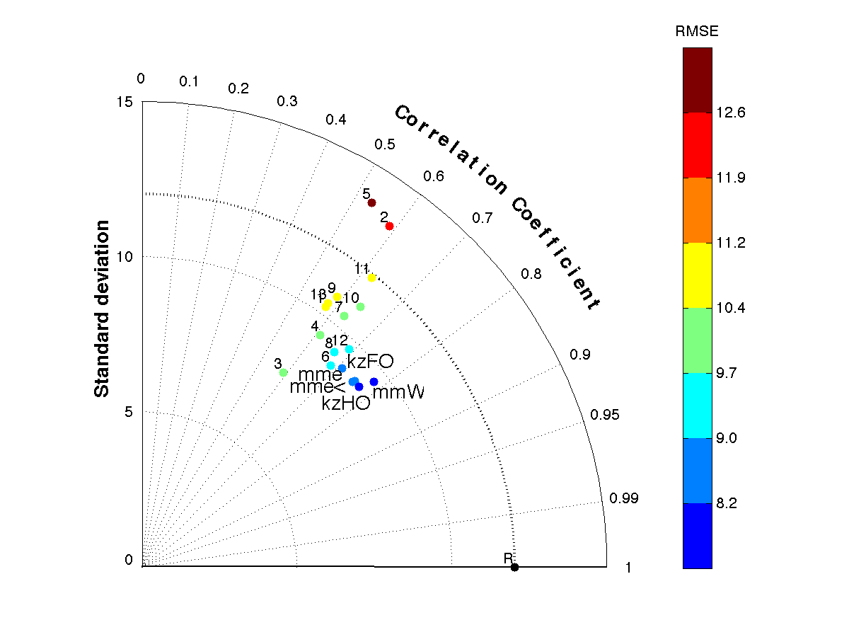
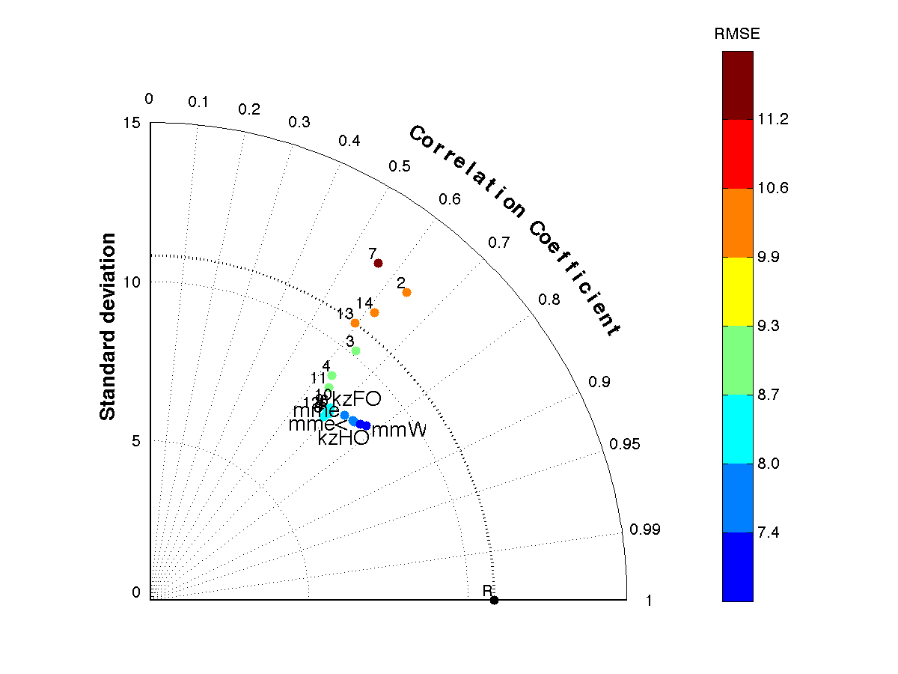
No2 (I)
No2 (II)

Slide 10
Ensemble analysis
Not all models in a multi model ensemble are necessarily contributing to the results
Some can be just “variations on a theme” and potentially produce noise
We have to reduce the ensemble to include only the relevant one
m2
m1

Slide 11
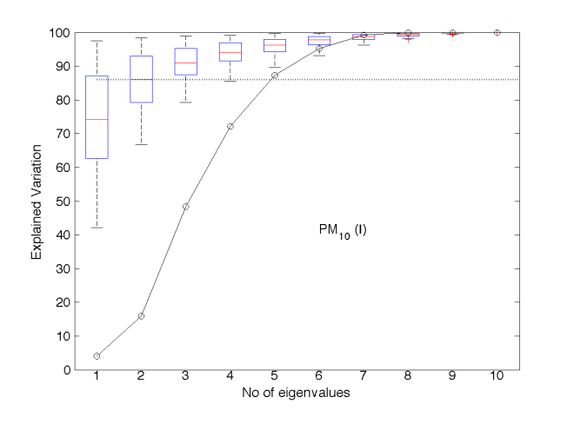
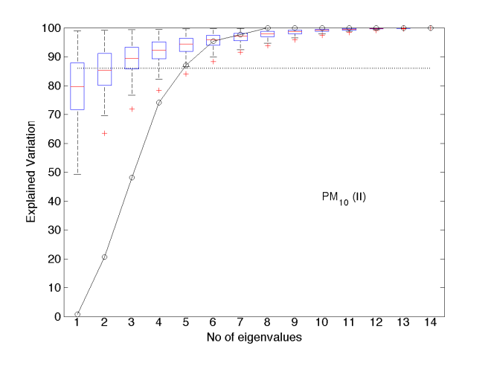
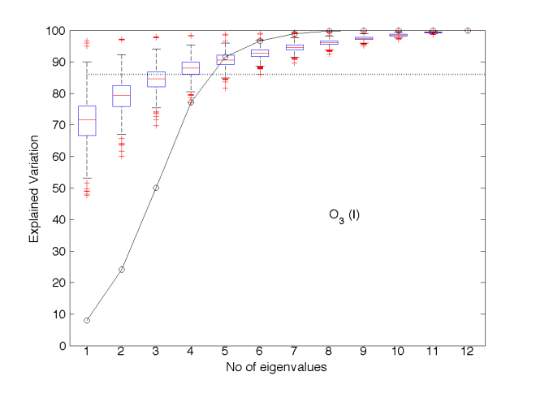
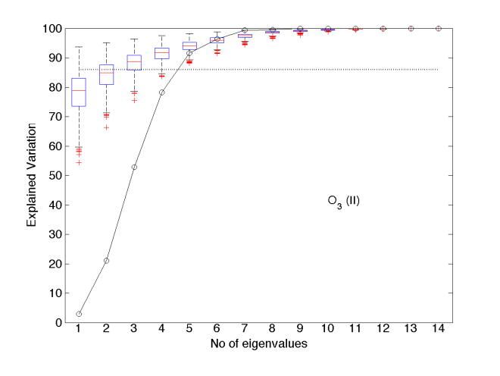
Ensembles redundancy # of effective models: PM and O3

Slide 12
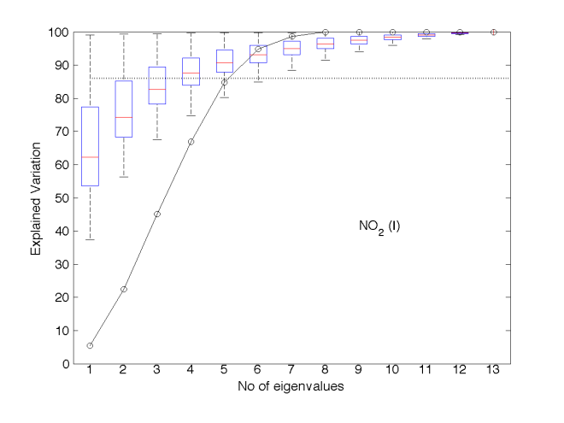
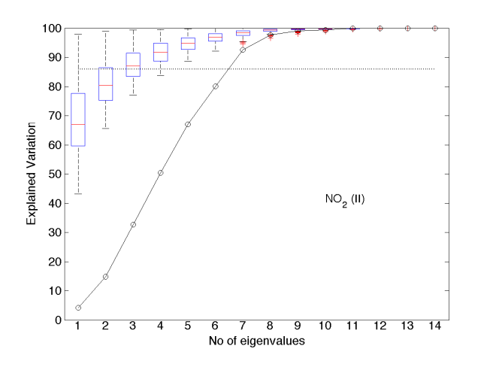
Ensembles redundancy # of effective models:
NO2

Slide 13
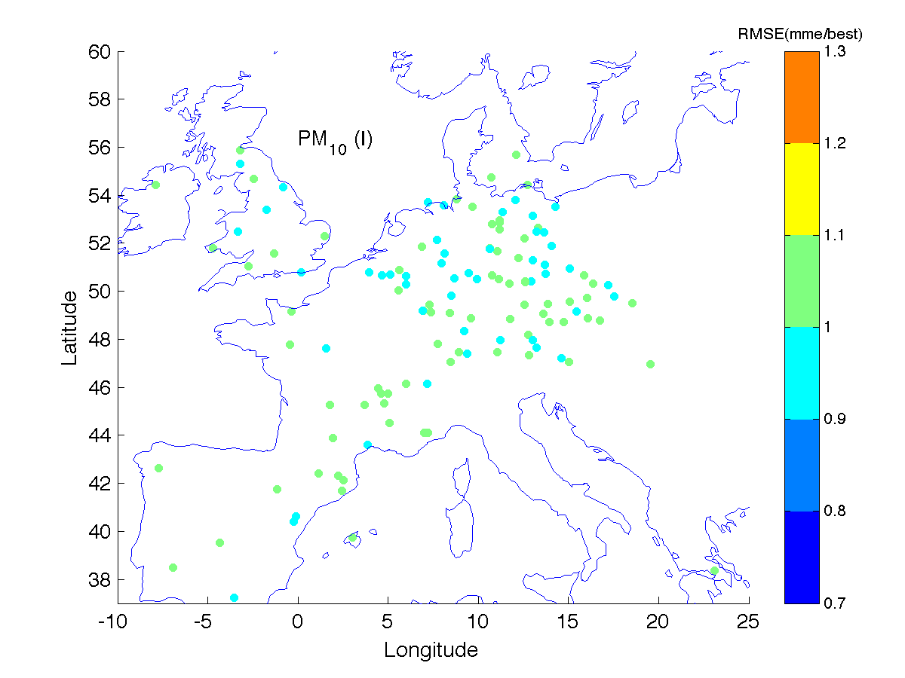
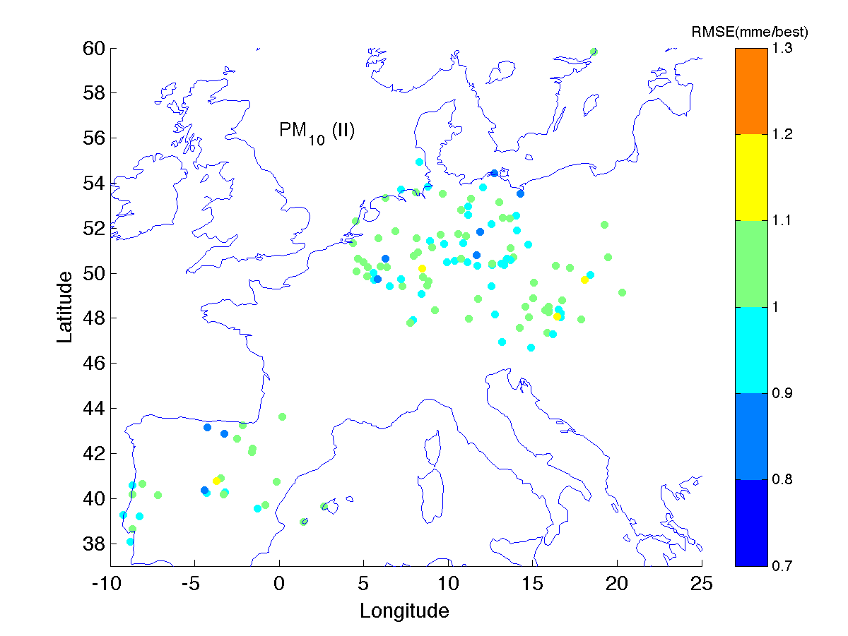
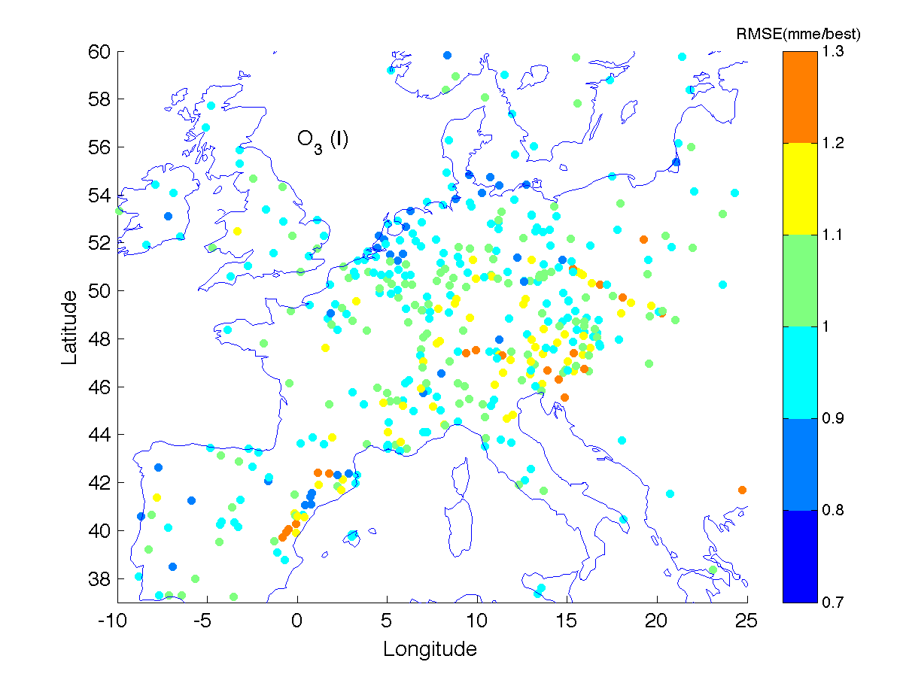
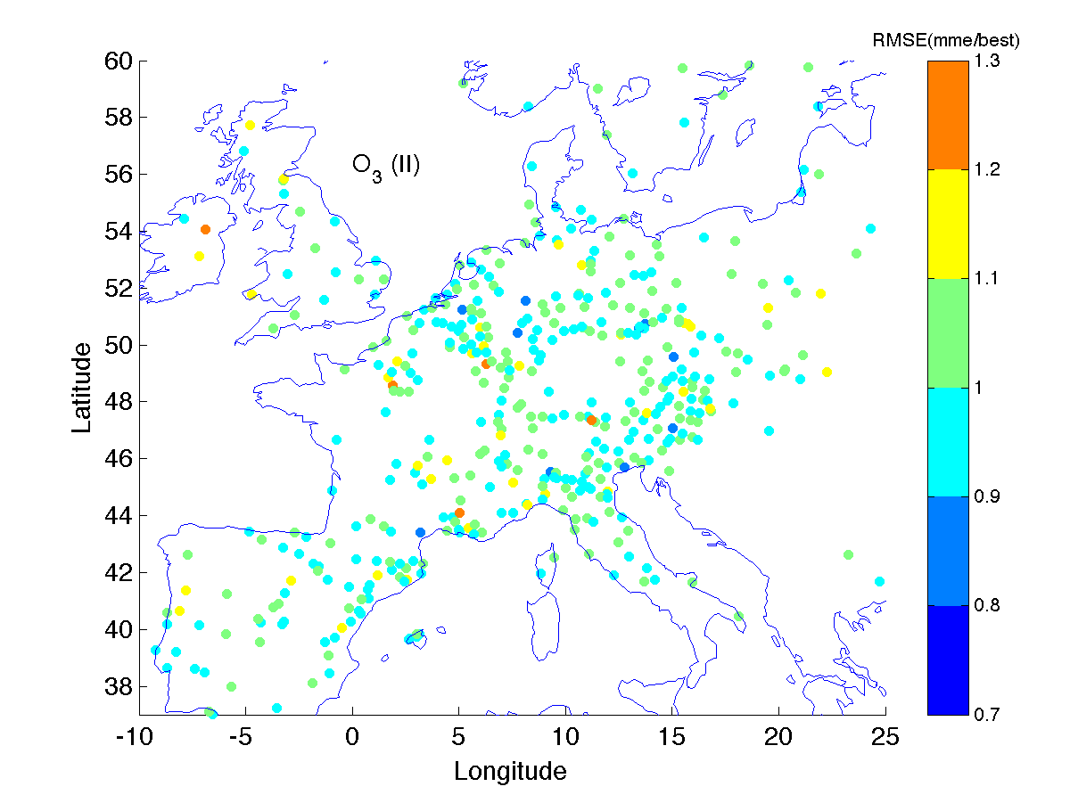

Slide 14
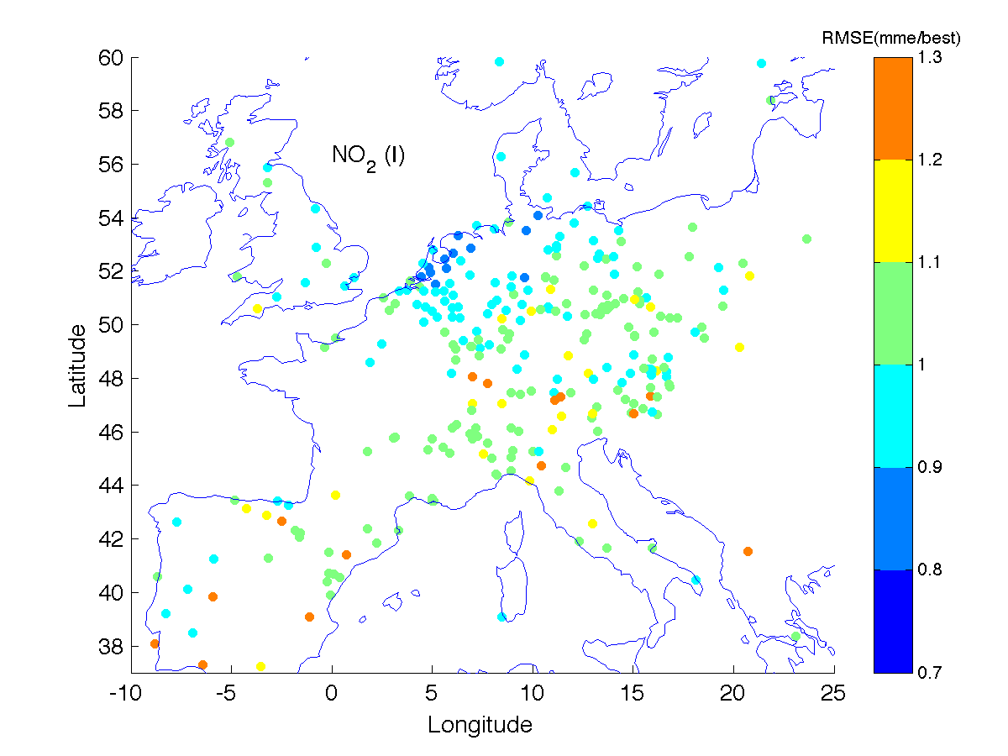
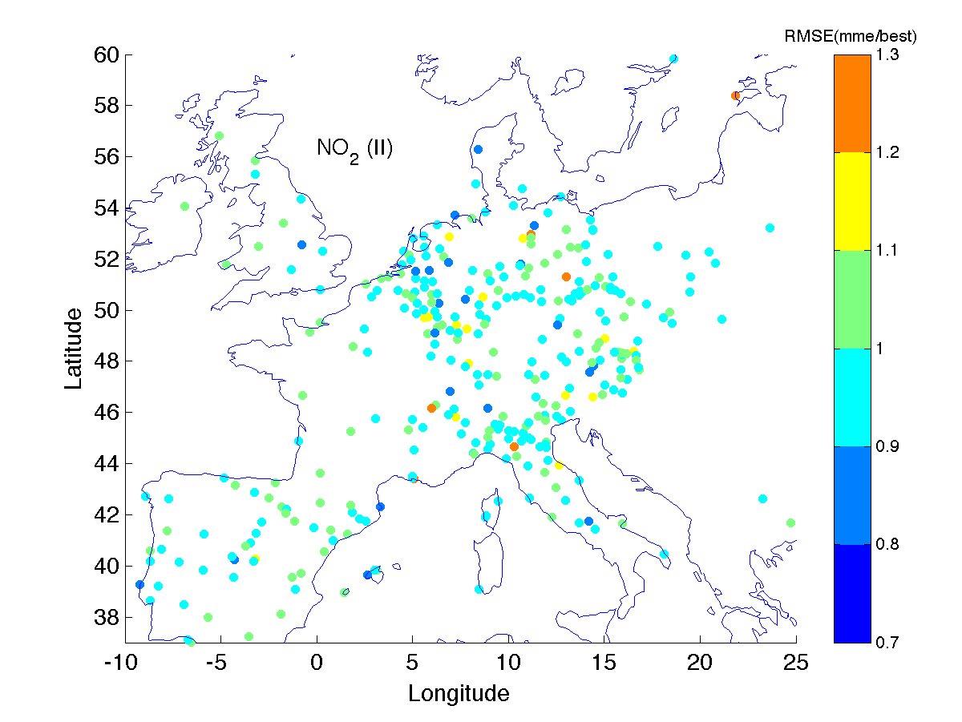
NO2

Slide 15
Conclusions
Average accuracy improved for P2 for NO2, decreased for PM and remained
the same for O3
Same pattern is found for the best deterministic model and in general for most
of P2 models
Diversity is reduced in P2 for O# and PM and therefore redundancy increase due to the presence of several versions of the same model
Diversity increased for NO2 in P2 which will require deeper investigation on the reason
The relative change of accuracy diversity favors the ensemble which is always superior to the best model especially in spatio/temporal performance
The last conclusion raises the issue of multi-model ensemble design as excellent way to balance accuracy and diversity so that the best result can be reached

Slide 16
AQMEII data are available to the community for further investigation and use
Just submit a 1 page description of your application or investigation purposes
and you will be grated access to the ENSEMBLE platform

Slide 17
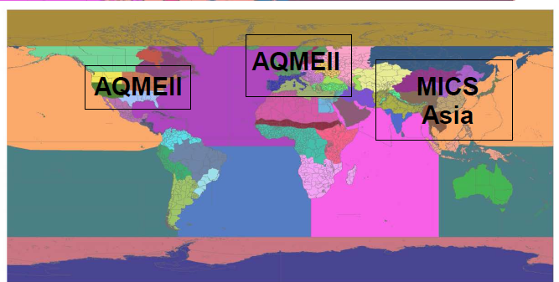
AQMEII P3
Hemispheric Transport of Air Pollution (HTAP)
Assessing impacts on air quality, human health and ecosystems using a multi model approach
Contact
Stefano Galmarini (JRC) and Christian Hogrefe (US-EPA)
Or
aqmeii@jrc.ec.europa.eu

Slide 18
Further readings on ensemble treatments:
De praeceptis ferendis: good practice in multi-model ensembles
I. Kioutsioukis and S. Galmarini
ACP, 2014
Pauci ex tanto numero: reduce redundancy in multi-model ensembles
E. Solazzo, A. Riccio, I. Kioutsioukis, and S. Galmarini
ACP, 2013

