Slide 1
HIGH-RESOLUTION AIR QUALITY MODELING OF NEW YORK CITY TO ASSESS THE EFFECTS OF CHANGES IN FUELS FOR BOILERS AND POWER GENERATION
13th Annual CMAS Conference
Chapel Hill, NC
29 October 2014
Presented by: Sharon Douglas, ICF International

Slide 2
Acknowledgements
Sponsored by:
  New York City Department of Health and Mental Hygiene (DOHMH)
  Mayor’s Office of Long Term Planning and Sustainability (OLTPS)
Co-authors:
  Iyad Kheirbek, New York City DOHMH
  Jay Haney, Tom Myers, Yihua Wei & Belle Hudischewskyj, ICF

Slide 3
Overview & Objectives
Objectives:
  To examine and quantify the air quality effects of changes in heating oil and power-sector fuel use on air quality in New York City (NYC)
  To use the modeling results to estimate the public health benefits attributable to recent changes in fuel use in the heating and power sectors in NYC neighborhoods
Overview of Modeling Components:
  Tools included: WRF, SMOKE, CMAQ, BenMAP (follow-on study by DOHMH)
  Key challenge: To obtain reliable/useable results for 1-km resolution (for use with NYC demographic data)

Slide 4
Modeling Domain
15-, 5- and 1-km grids
Also included a 45-km resolution outermost grid (not shown)

Slide 5
Meteorological Inputs
WRF (version 3.4) was applied for an annual simulation period (2008)
  Suitable physics/moist physics parameters (varied by grid)
  Analysis and “obs” nudging (varied by grid)
  Time steps ranged from 3 minutes (45-km grid) to 4 seconds (1-km grid)
Performance evaluation focused on
  Comparison w/observed data
  Comparison of features and performance between the 15-, 5- and 1-km grids

Slide 6
WRF vs. Observed Wind Speed (April)
5-km grid
Bias = 0
RMSE = 1.4
1-km grid
Bias = -0.3
RMSE = 1.4

Slide 7
WRF vs. Observed Wind Direction (April)
5-km grid
Bias = 1.3
Error = 23.5
1-km grid
Bias = 3.0
Error = 24.6

Slide 8
WRF vs. Observed Temperature (April)
Bias = -1.0
Error = 2.1
5-km grid
1-km grid
Bias = -0.9
Error = 1.9

Slide 9
WRF vs. Observed Humidity (April)
5-km grid
Bias = 0.5
Error = 0.9
1-km grid
Bias = 0.3
Error = 0.8

Slide 10
WRF vs. Obs Wind Direction Frequency
Teterboro Airport
5-km grid
JFK Airport
1-km grid

Slide 11
WRF vs. Obs Wind Direction Frequency
Central Park
1-km grid
Although WRF accounts for increased roughness length and adjusts other land-use parameters over the urban area (applied on a grid-cell by grid-cell basis)
NYC skyline and its effects on the wind patterns are not fully resolved by WRF

Slide 12
Emission Inputs
Emissions were prepared using the 2008 NEI supplemented by local permit data
Permit data provided
  Emissions/locations of all boilers from heating systems in NYC buildings that use residual oil (No. 6 or No. 4) as their primary fuel
  Emissions and locations of all No. 2 oil burning boilers over 350,000 BTUs in NYC subject to permitting
Emissions were estimated using heat throughput of each boiler combined with source- and fuel- specific emissions factors
Model-ready emissions processed using SMOKE

Slide 13
CMAQ Model Performance (Ozone)
5-km grid
1-km grid

Slide 14
CMAQ Model Performance (PM2.5)
5-km grid
1-km grid

Slide 15
CMAQ Scenarios (Heating Oil)
Scenario #1: Partial implementation of the rule on heating oil, reflecting reduction in emissions by the end of the 2012-2013 winter season
Scenario #2: Full implementation of the rule (phase out of No. 4 and No. 6 heating oil)
Both scenarios also include 15 ppm sulfur limit to No. 2 heating oil

Slide 16
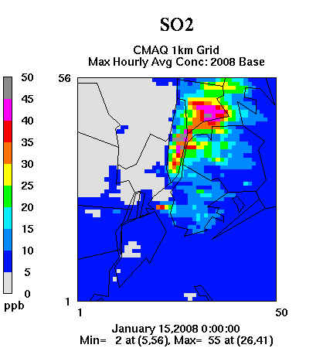
Effects of Heating Oil Changes on SO2
Daily Maximum 1-Hour SO₂ (ppb)
Base
Scenario #1 - Base
Scenario #2 - Base
Partial & full implementation of heating oil rule ⇒ large decreases in SO₂

Slide 17
Effects of Heating Oil Changes on PM2.5
Annual Average PM_{2.5} (µg/m³)
Base
Scenario #1 - Base
Scenario #2 - Base
Full implementation of heating oil rule ⇒ greater & more widespread decreases in PM_{2.5}
As expected, decreases are largest during winter months

Slide 18
CMAQ Scenarios (EGU)
Scenario #3: Adjustment of EGU emissions to reflect changes in fuel use at Title V EGUs outside of the five boroughs of NYC
Scenario #4: Adjustment of EGU emissions to reflect changes in fuel use at EGUs located within the five boroughs

Slide 19
Effects of EGU Fuel Changes on Ozone
Daily Maximum 8-Hour Ozone (ppb)
Base
Scenario #1 - Base
Scenario #2 - Base
NO_{x} reductions lead to simulated increases in ozone concentration throughout the 1-km grid, including over NYC

Slide 20
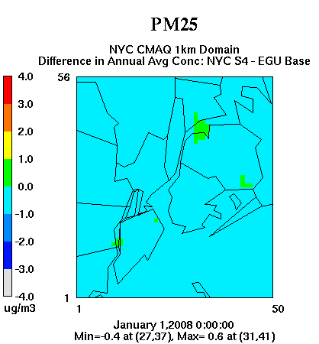
Effects of EGU Fuel Changes on PM2.5
Annual Average PM_{2.5} (µg/m³)
Base
Scenario #1 - Base
Scenario #2 - Base
Reductions outside NYC ⇒ greater & more widespread decreases in PM_{2.5}
As expected, decreases are largest during winter months

Slide 21
Questions Addressed by this Analysis
Can regional modeling tools such as WRF and CMAQ be used to simulate air quality benefits at 1-km resolution for an area as complex as NYC?
  Key challenges (application)
    Input parameter specification (especially for WRF)
    Model evaluation (based on limited data)
  Areas for improvement and future-research
    More detailed emission inventory (other components to the level of detail used for the boilers)
    Improved representation of urban-scale features and characteristics
    Enhanced model performance evaluation (e.g., speciated PM; process-level performance evaluation)

Slide 22
Questions Addressed by this Analysis
What is the impact of changes in heating oil use that have occurred since 2010 on air pollutant concentrations in NYC, including at the neighborhood level?
  Simulated annual average PM_{2.5} concentrations within the 1-km grid are lowered by
    4.3 µg/m³ with partial implementation
    5.5 µg/m³ with full implementation
  These reductions are accompanied by small increases in ozone concentration and large decreases in NO₂ and SO₂

Slide 23
Questions Addressed by this Analysis
What is the impact of changes in fuel use in the electric power generation sector since 2005 on air pollutant concentrations in NYC?
  Simulated annual average PM_{2.5} concentrations over NYC are lowered by
    1-2 µg/m³ with EGU emission changes outside of NYC
    ~ 0.4 µg/m³ with EGU emission changes within NYC
  These reductions are accompanied by increases in ozone concentration but decreases in NO₂ and SO₂

Slide 24
Follow-on Studies
Kheirbek and co-workers at NYC DOHMH used the CMAQ results to examine health benefits associated with the changes in boiler fuels
  Modeled air quality improvements indicate hundreds of avoided deaths, emergency department visits and hospitalizations (respiratory/cardiovascular) each year
  Benefits found to be uneven across NYC, with the greatest benefits indicated for high poverty areas
Modeling platform/databases will be used to examine the effects of motor vehicle emission changes/regulations on air quality within NYC

