Slide 1
Source Attribution and Source Sensitivity Modeling Studies with CMAQ and CAMx
Prakash Karamchandani¹, Jeremiah Johnson¹, Tejas Shah¹, Jaegun Jung¹, Ralph Morris¹, Susan Collet², Toru Kidokoro³, Yukio Kinugasa³
¹ENVIRON International Corporation, Novato, CA
²Toyota Motor Engineering and Manufacturing North America, Inc., Ann Arbor, MI
³Toyota Motor Corporation, Shizuoka, Japan
October 27-29, 2014
13th Annual CMAS Conference, Chapel Hill, NC

Slide 2
Acknowledgement
This study was supported by Toyota Engineering and Manufacturing (TEMA) , North America and Toyota Motor Corporation (TMC), Japan

Slide 3
Study Objectives
Determine source category contributions to future year air quality
  On-road mobile emissions (and sub-categories of on-road emissions)
  Off-road emissions
  Emissions from stationary sources (point, area)
  Natural emissions (biogenic, wild fire)
  Global contributions (boundary conditions)
Compare various approaches to determine source contributions and sensitivities:
  Different models (CMAQ vs CAMx): Brute force method (BFM)
  CAMx source attribution probing tools: OSAT for ozone and PSAT for PM_{2.5}
  CAMx source sensitivity probing tool: HDDM for ozone
Calculate source category impacts on future year design values
Determine future year population exposures in non-attainment areas

Slide 4
Study Components
Model performance evaluation for 2008 base year (CMAQ, CAMx)
Future year (2018, 2030) simulations (CMAQ, CAMx) with zero-out for relevant source categories
Future year CAMx OSAT and PSAT simulations
Future year CAMx-HDDM simulations and CAMx BFM simulations with 20% emission reductions
Analysis of results
Notes:
Analysis of measurements from 2009 Study of Houston Atmospheric Radical Precursor (SHARP) in the Houston area to identify missing HONO formation pathways and recommend parameterizations (UCLA and UH)
Surface model
CAMx surface model originally developed for persistent organic pollutants
Extended in this work to include core model species, such as NO₂, HNO₃, and HONO
Keeps track of accumulated mass deposited to surface
Treats sorption and penetration into soil and vegetation; chemical degradation and transformation; and volatilization back to the air (re-emission)
UNC
CAMx Simulations and evaluation of results
Process analysis
Refinement
Semi-empirical approach
Analysis of evaluation results
Adjust model parameters within range of plausible values

Slide 5
Approach
Phased approach
Initial studies considered limited simulation periods (1 month in winter and 1 month in summer)
Understand differences in results predicted using various modeling tools
Latest study (ongoing) focuses on annual simulations with selected CAMx probing tools

Slide 6
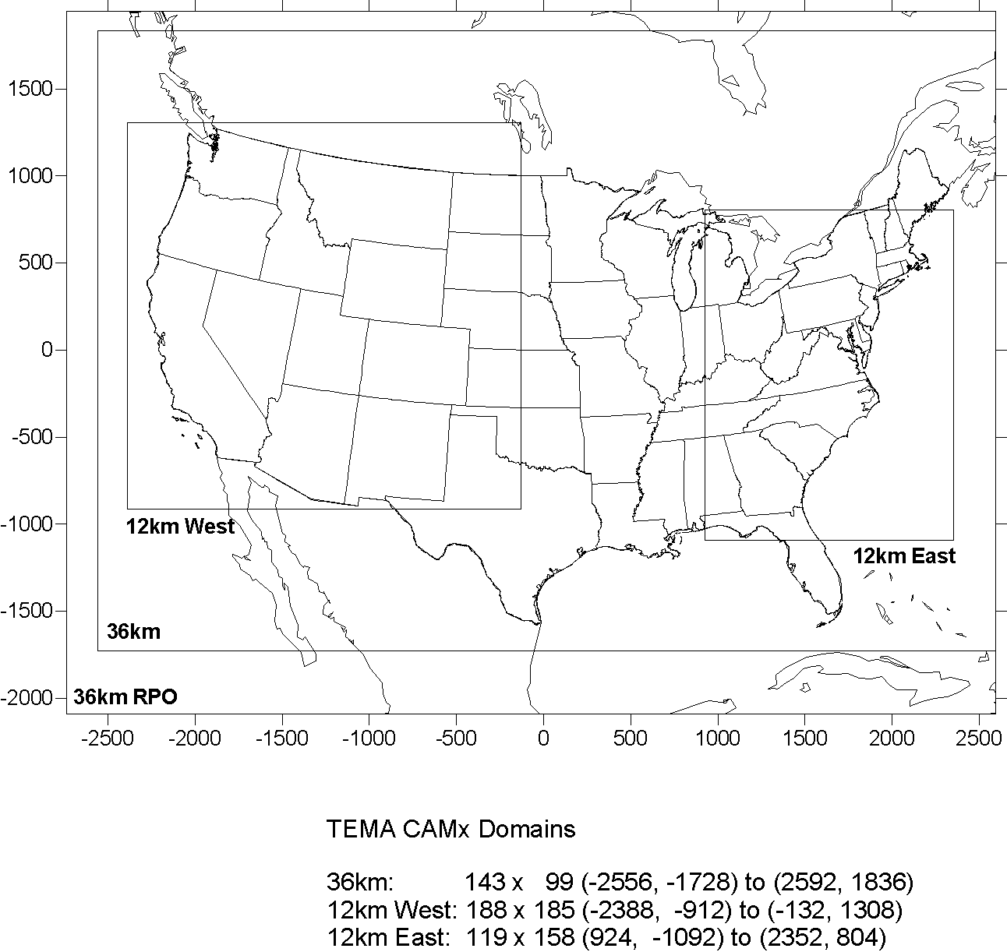
Modeling Domains
Nested Grid
  36 km resolution CONUS
  12 km resolution inner grids
Model Inputs
  Base year (2008) WRF meteorology
  Base and future year (2018 and 2030) emissions
  MOVES and EMFAC2007 used to adjust future year on-road mobile emissions for Tier 3/LEV III impacts
  36 km BCs from MOZART
  MEGAN for biogenic emissions

Slide 7
Summary of 1-Month Simulation Studies
Years: 2008 (Base), 2018 & 2030 (Future), Months: January (PM), July (O₃, PM)
Model | Attribution Determining Method | Species | Emission Sources Tracked
CMAQ | Zero-Out Contributions | O₃, PM | Off-road Mobile (US) Area (US) Point (US) Natural Boundary Conditions On-road Mobile (US) 4 sub-categories: LDGV HDGV LDDV HDDV
CAMx | Source Contributions: a) Zero-Out Contributions b) OSAT/PSAT Attributions | O₃, PM
 | Source Sensitivities (20% Reductions): a) HDDM (First and second-order coefficients) b) BFM: 20% Reduction Applied to Base Emissions | O₃

Slide 8
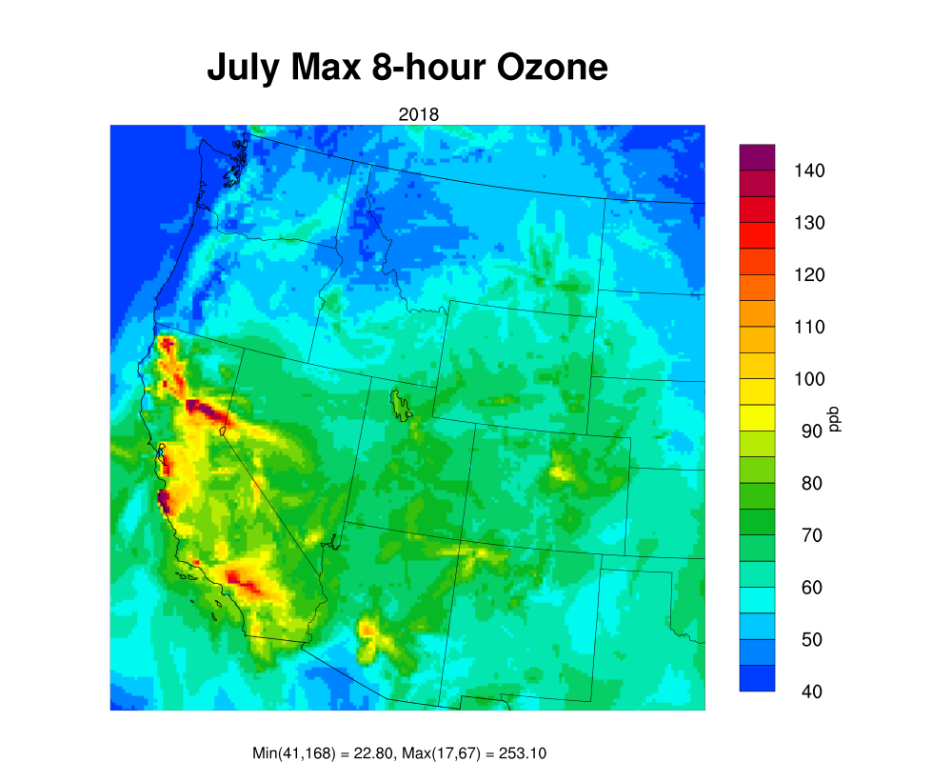
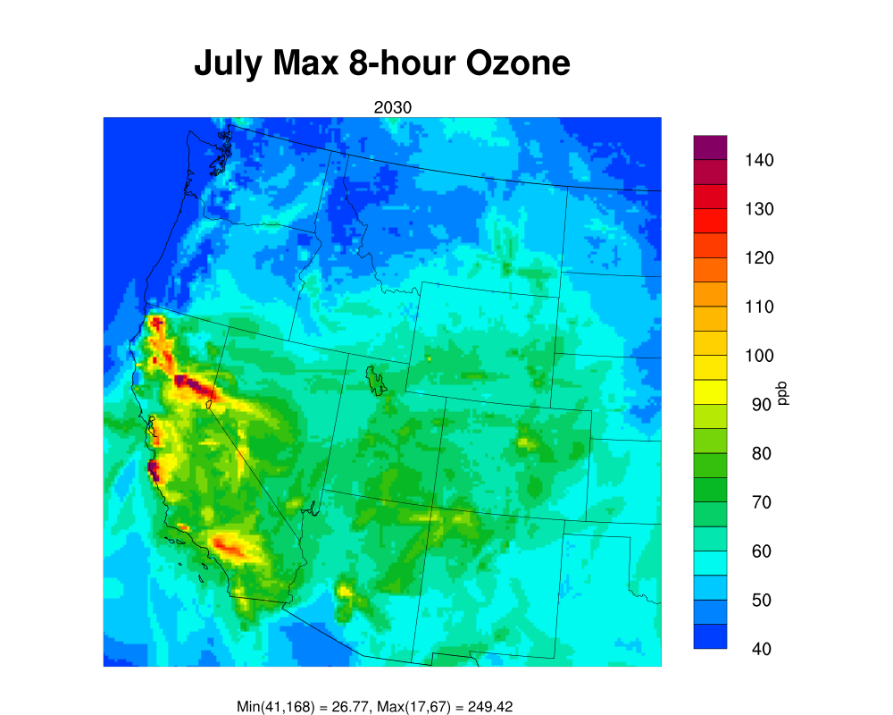
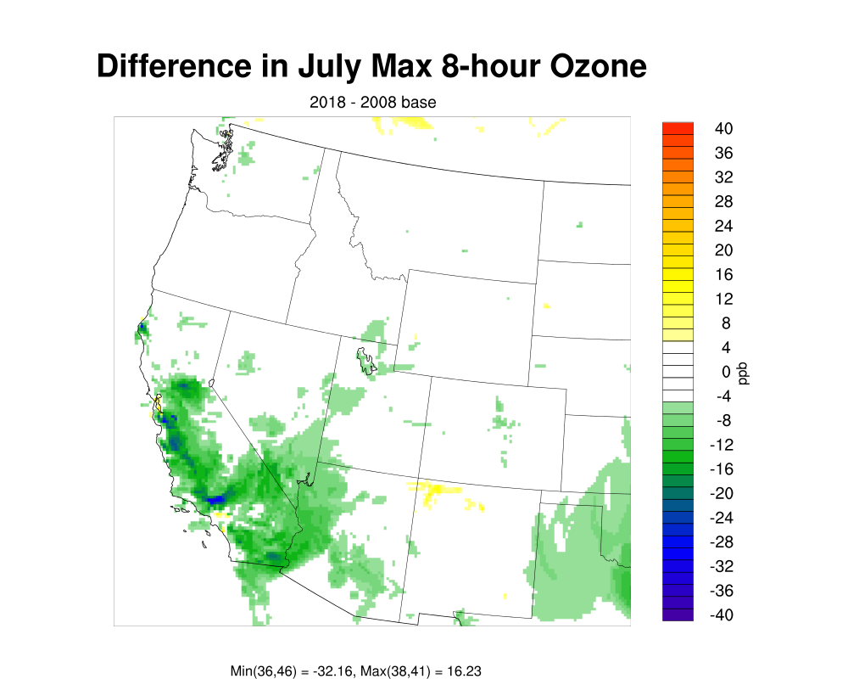
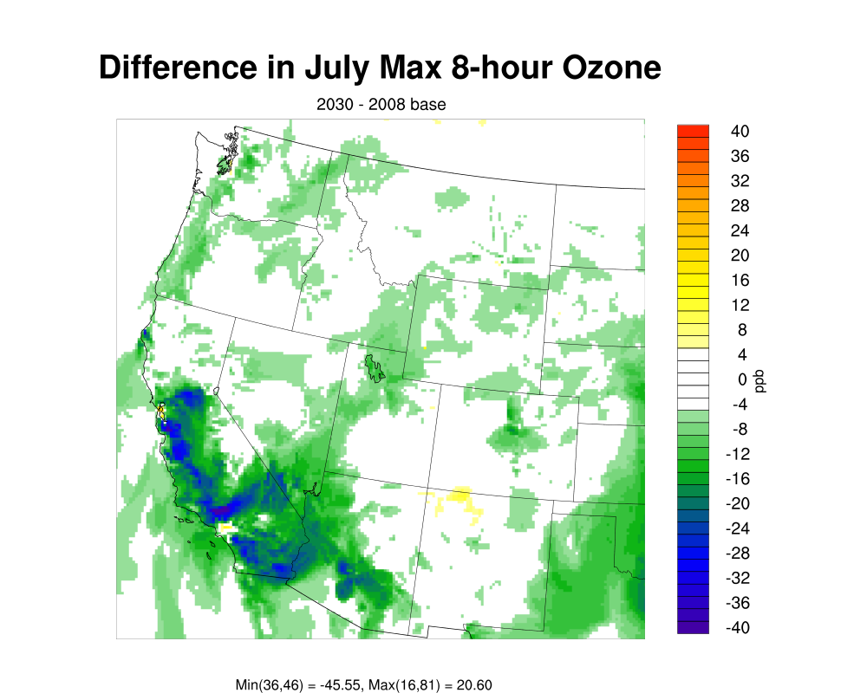
Future Year CMAQ Daily Max 8-hour O₃ and Change in Daily Max
Western US
Notes:
Run A (base run) under-predicts observed HONO substantially
Run B (with direct HONO emissions) better, but still tends to under-predict; moreover predicted HONO:NO₂ ratios are inconsistent with observations
Run H (with CAMx surface model) does a good job for most of the days, but over-predicts during the night on May 19 and 20, with the largest over-predictions on May 20
HONO over-predictions associated with large NO₂ over-predictions at night on May 19 and 20
Focus on HONO:NO₂ ratios as a way to assess model performance at night

Slide 9
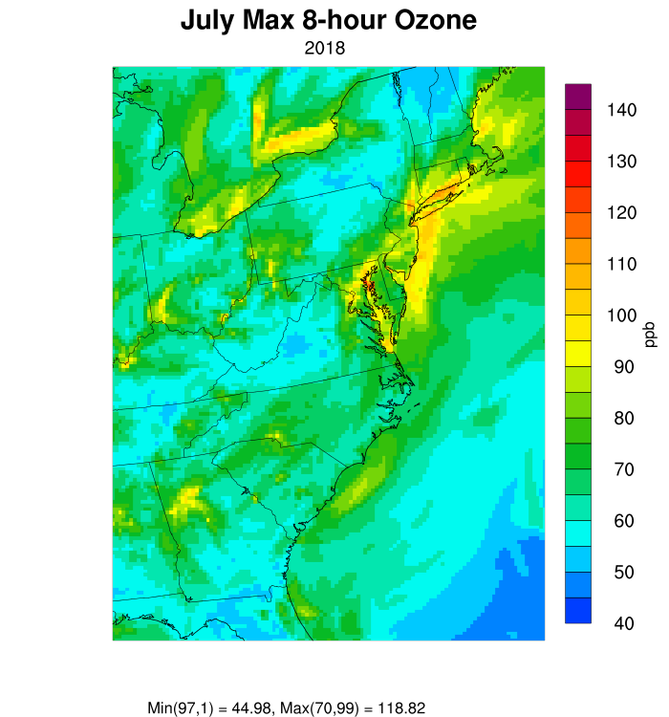
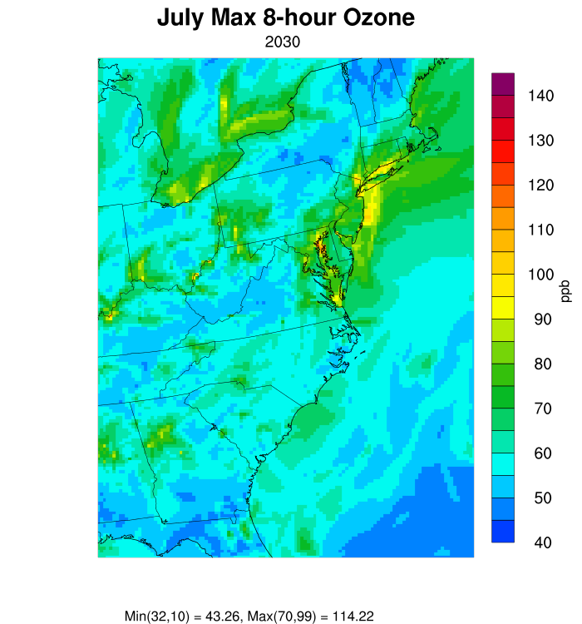
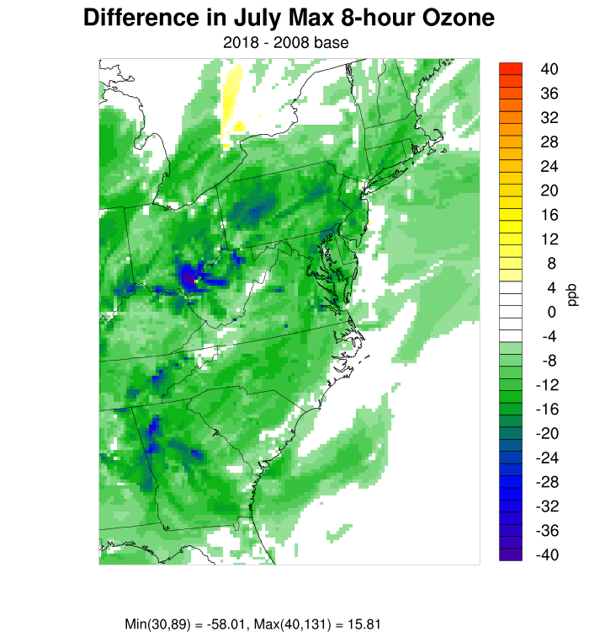
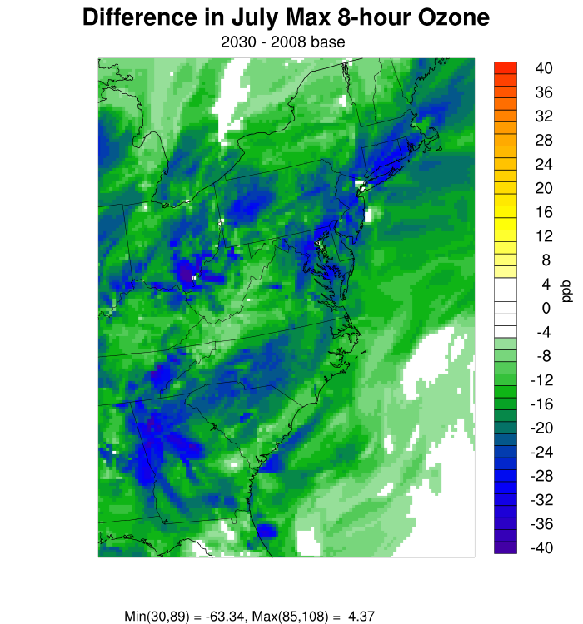
Future Year CMAQ Daily Max 8-hour O₃ and Change in Daily Max
Eastern US
Notes:
Run A (base run) under-predicts observed HONO substantially
Run B (with direct HONO emissions) better, but still tends to under-predict; moreover predicted HONO:NO₂ ratios are inconsistent with observations
Run H (with CAMx surface model) does a good job for most of the days, but over-predicts during the night on May 19 and 20, with the largest over-predictions on May 20
HONO over-predictions associated with large NO₂ over-predictions at night on May 19 and 20
Focus on HONO:NO₂ ratios as a way to assess model performance at night

Slide 10
O₃ 2008 DVCs and Future Year DVFs
- 2030 DVFs < 75 ppb, except for 8 counties in CA
- 2030 DVFs < 70 ppb, except for 15 counties in CA and 1 county each in CO & MD
120
SB, RS CA
2008
DVB
100
LA CA
2018
DVF
CMAQ
2030
DVF
80
75
70
Ozone DV ppb
60
40
20
0
AL
CA
GA
MD
MI
NY
PA
SC
WY
X axis：Alphabetical Order, States => Counties
Notes:
Good agreement for April 21
NO₂ is substantially over-predicted during the night on May 20

Slide 11
O₃ Non-Attainment Area Populations
More areas reach attainment in future years, resulting in lower population exposure
19.7
59.2
2008
20.7
58.9
18.4
20.9
2018
18.8
21.0
11.4
11.5
CMAQ
2030
CAMx
13.3
14.2
0
20
40
60
80
Millions of People
Notes:
Good agreement for April 21
NO₂ is substantially over-predicted during the night on May 20

Slide 12
Comparison of Approaches
Source Attribution: OSAT vs Zero-Out
Approach | Pros | Cons
Zero-Out | Simple to understand Answers “what if” questions | Not a true source apportionment because of nonlinearity Expensive for more than a few source sectors or source regions
OSAT | Source apportionment under current or future conditions “Book-keeping” not affected by nonlinearity Efficient for a large number of source sectors or source regions | Not appropriate for “what if” scenarios with large emission perturbations because of nonlinearity
Source Sensitivity: HDDM vs BFM
Approach | Pros | Cons
BFM | Simple to understand Answers “what if” questions for a particular scenario | Expensive for more than a few emission scenarios
HDDM | More efficient than BFM because it yields sensitivity coefficients that can be applied to a range of scenarios (multiple “what if” questions answered in a single simulation) | Expensive if only a small number of source scenarios required Large computer memory requirements

Slide 13
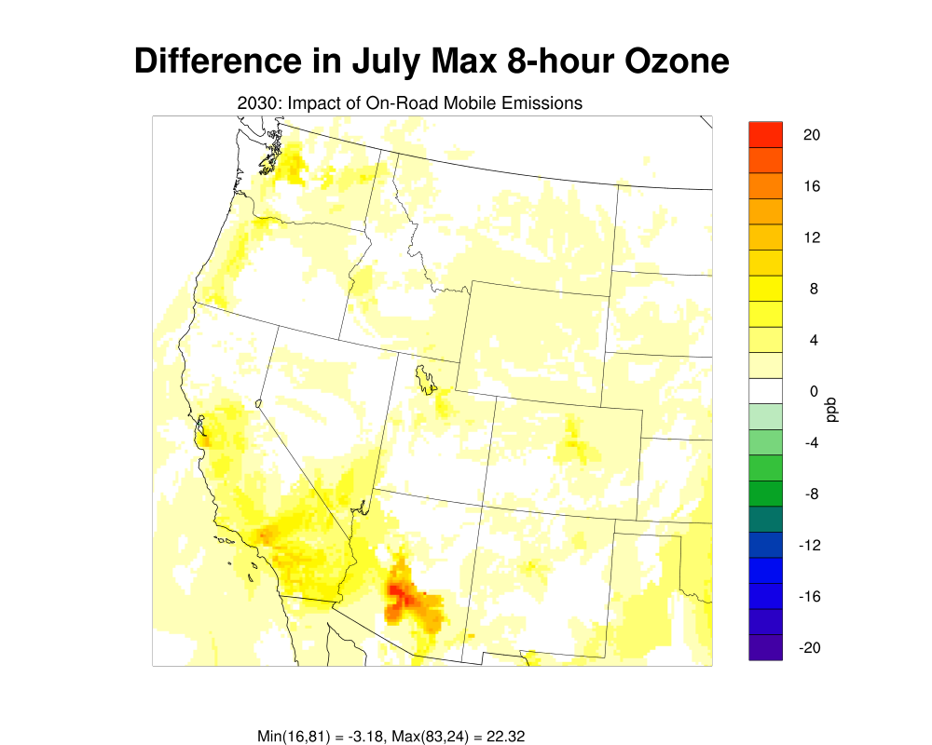
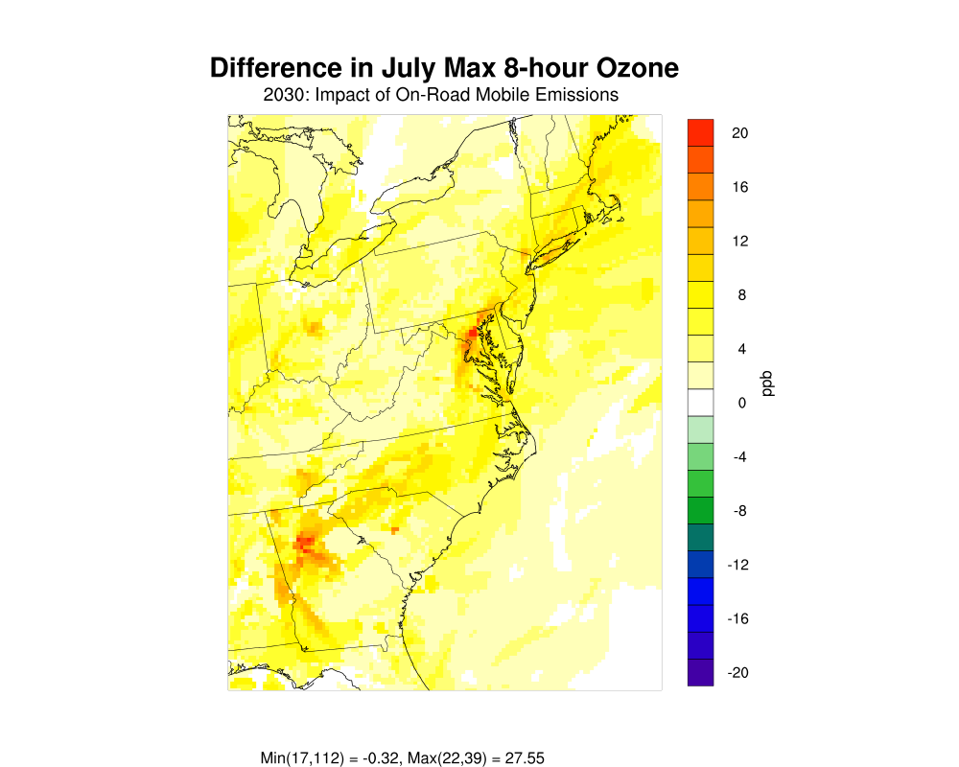
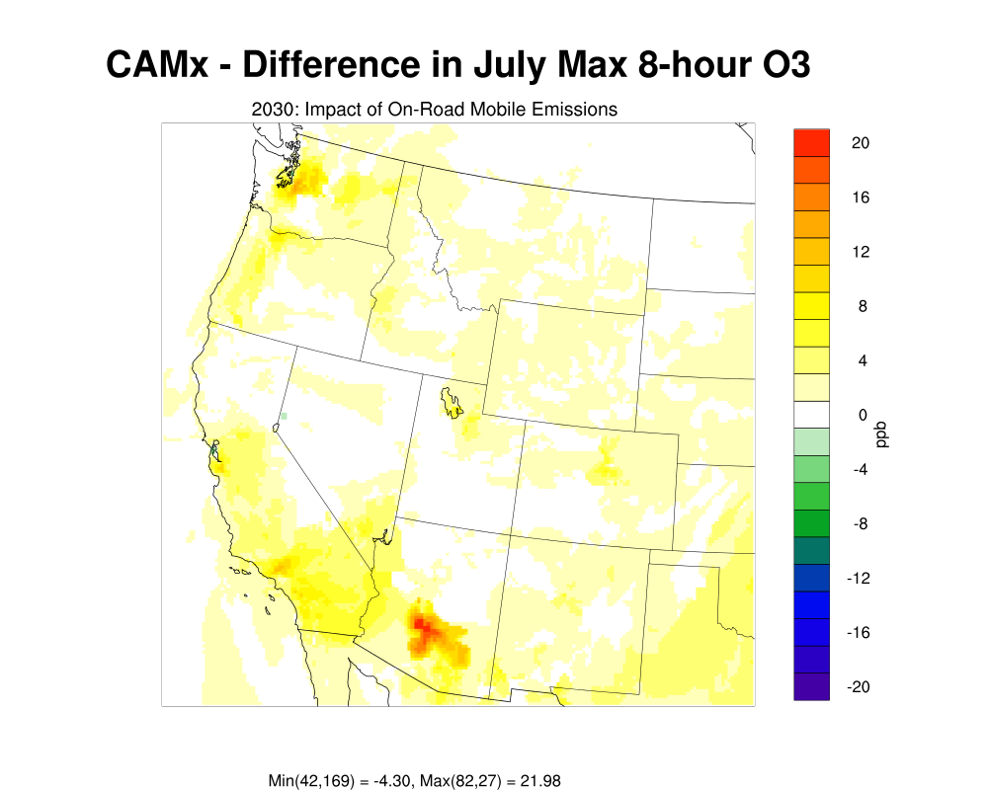
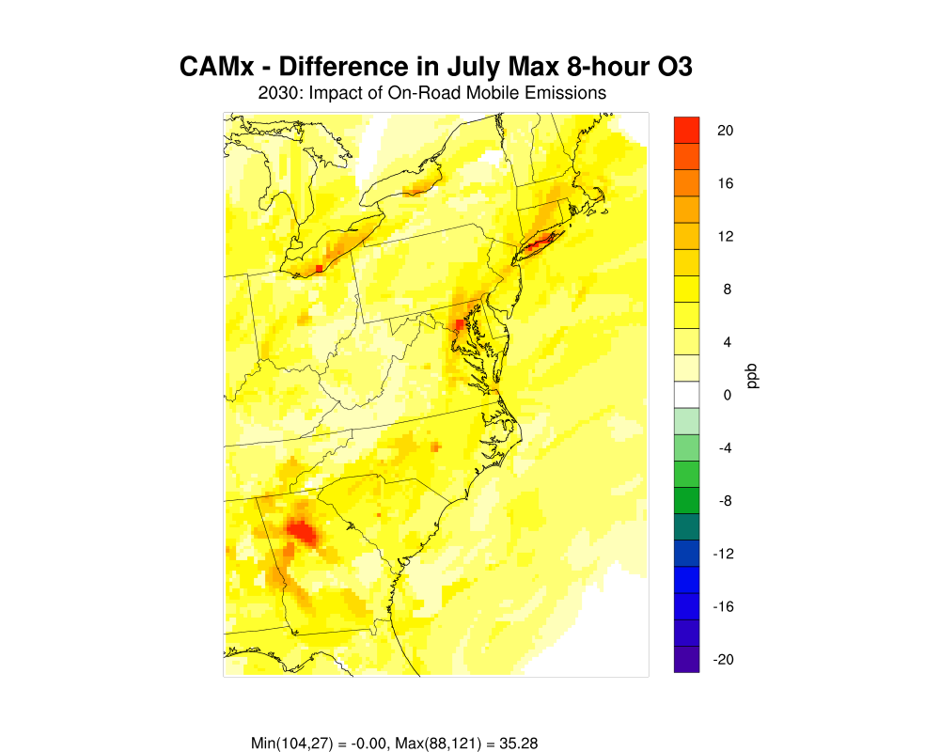
CMAQ vs CAMx Zero-Out: 2030 Max O₃
On-Road Mobile Contributions
Western US
Eastern US
CMAQ
CMAQ
CAMx
CAMx
Notes:
Run A (base run) under-predicts observed HONO substantially
Run B (with direct HONO emissions) better, but still tends to under-predict; moreover predicted HONO:NO₂ ratios are inconsistent with observations
Run H (with CAMx surface model) does a good job for most of the days, but over-predicts during the night on May 19 and 20, with the largest over-predictions on May 20
HONO over-predictions associated with large NO₂ over-predictions at night on May 19 and 20
Focus on HONO:NO₂ ratios as a way to assess model performance at night

Slide 14
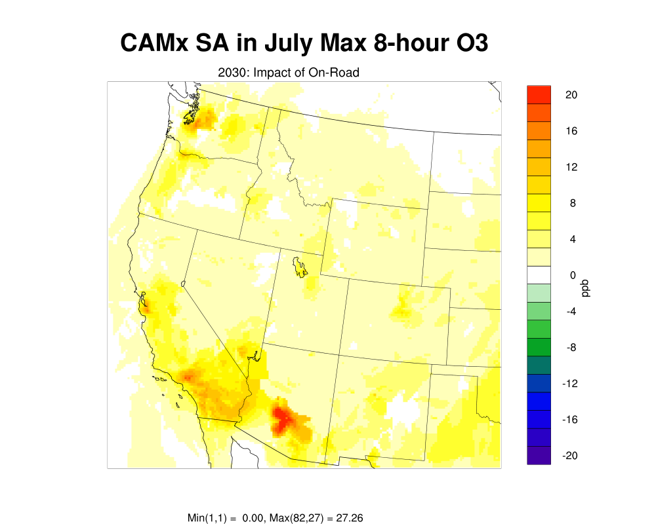
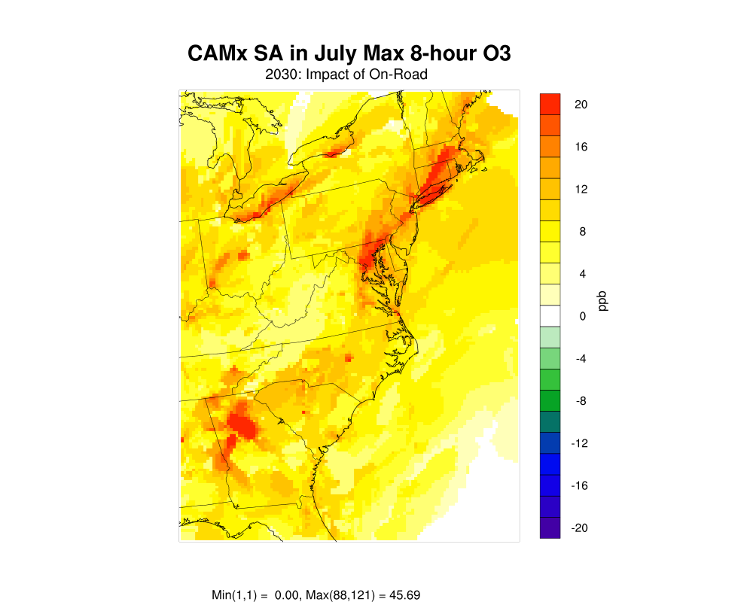
CAMx Zero-Out vs OSAT: 2030 Max O₃
On-Road Mobile Contributions
Western US
Eastern US
CAMx Zero-Out
CAMx OSAT
Notes:
Run A (base run) under-predicts observed HONO substantially
Run B (with direct HONO emissions) better, but still tends to under-predict; moreover predicted HONO:NO₂ ratios are inconsistent with observations
Run H (with CAMx surface model) does a good job for most of the days, but over-predicts during the night on May 19 and 20, with the largest over-predictions on May 20
HONO over-predictions associated with large NO₂ over-predictions at night on May 19 and 20
Focus on HONO:NO₂ ratios as a way to assess model performance at night

Slide 15
Comparison of Source Attribution Approaches
Generally good agreement between CMAQ and CAMx zero-out results
OSAT generally predicts larger contributions of tracked anthropogenic source categories, particularly on-road mobile emissions, due to non-linearities which can be large with BFM
2030 O₃
Calculated Ozone ppb
On-Road
Notes:
Good agreement for April 21
NO₂ is substantially over-predicted during the night on May 20

Slide 16
CAMx O₃ OSAT Apportionment-NOx vs VOC
NOx
VOC
Ozone Contributions %
Point
Source
Global
BCs
Leftover
Emissions
Natural
(Bio+Fires)
On-Road
Off-Road
Other Area
Notes:
Surface model generally captures the observed diurnal variation in HONO:NO₂ ratios
Base run and run with direct HONO emissions do not capture these features

Slide 17
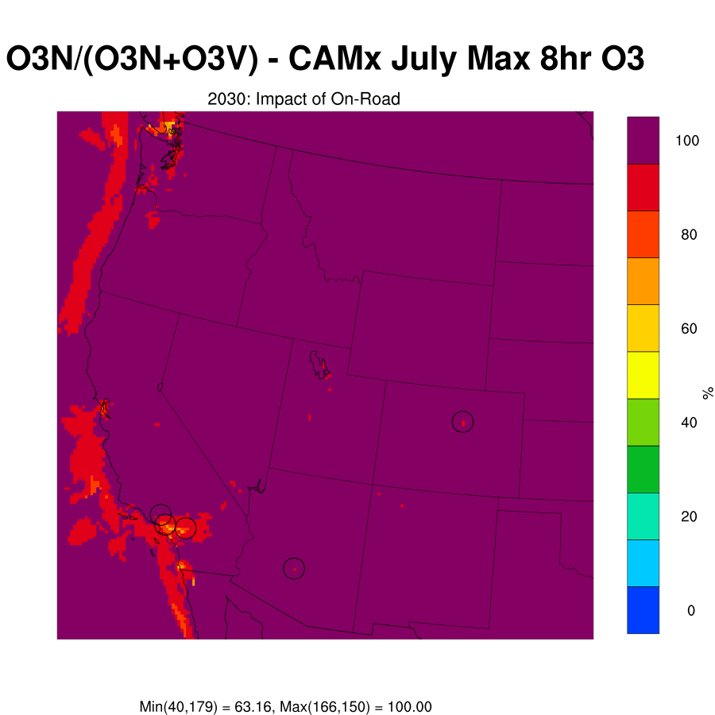
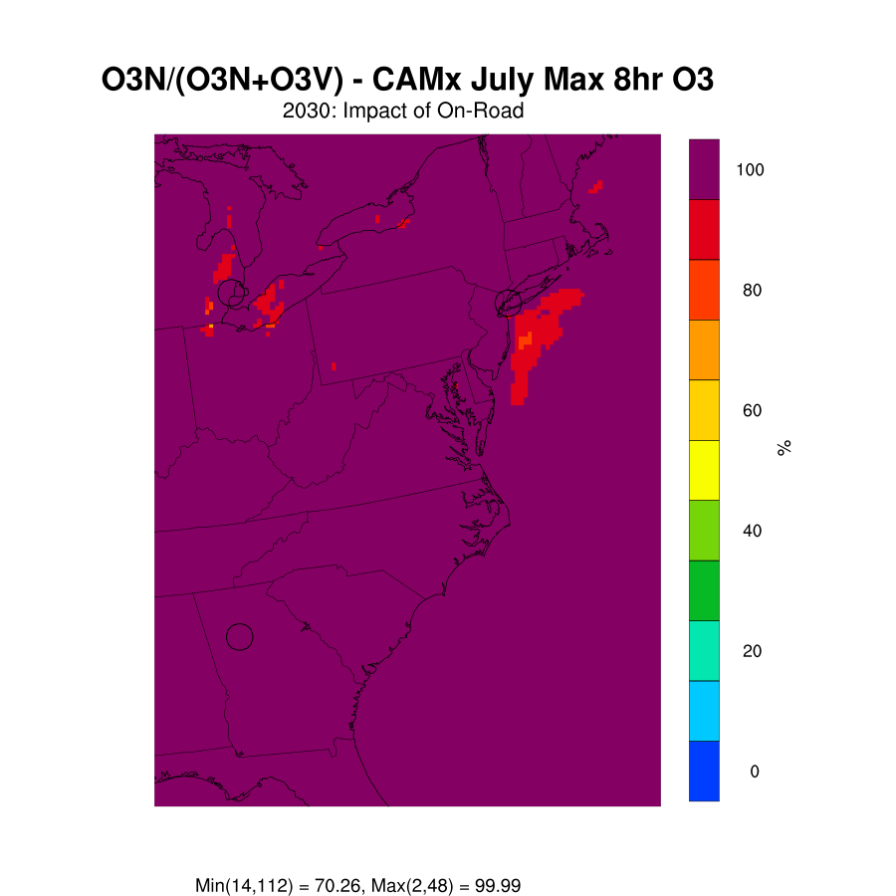
CAMx O₃ OSAT Apportionment-NOx vs VOC
On-Road Mobile Contributions to 2030 O₃
Western US
Eastern US
Notes:
Surface model generally captures the observed diurnal variation in HONO:NO₂ ratios
Base run and run with direct HONO emissions do not capture these features

Slide 18
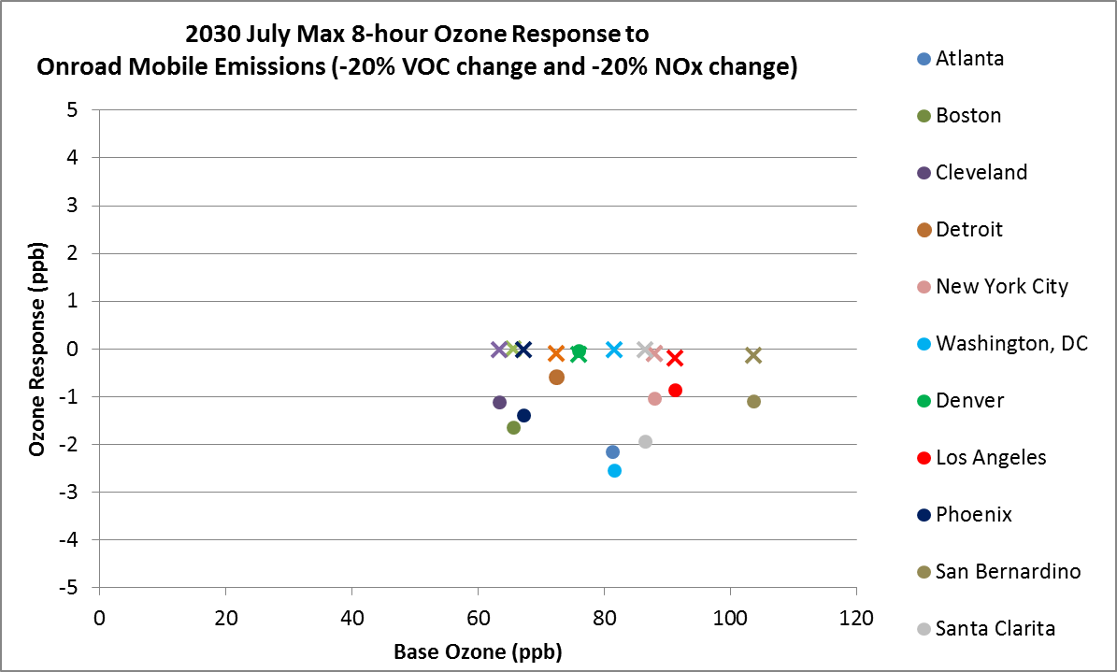

2030 HDDM Results: NOx vs. VOC
Effects of 20% Reductions in On-Road Mobile NOx or VOC Emissions
Notes:
Surface model performs well on April 21, during both day and night
Over-predictions on May 20 are associated with NO₂ over-predictions

Slide 19
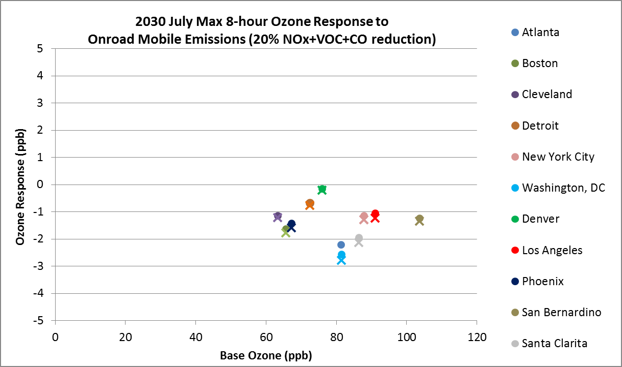

2030 HDDM Results: HDDM vs BFM
Effects of 20% Reductions in On-Road Mobile NOx and VOC Emissions
Notes:
Surface model performs well on April 21, during both day and night
Over-predictions on May 20 are associated with NO₂ over-predictions

Slide 20
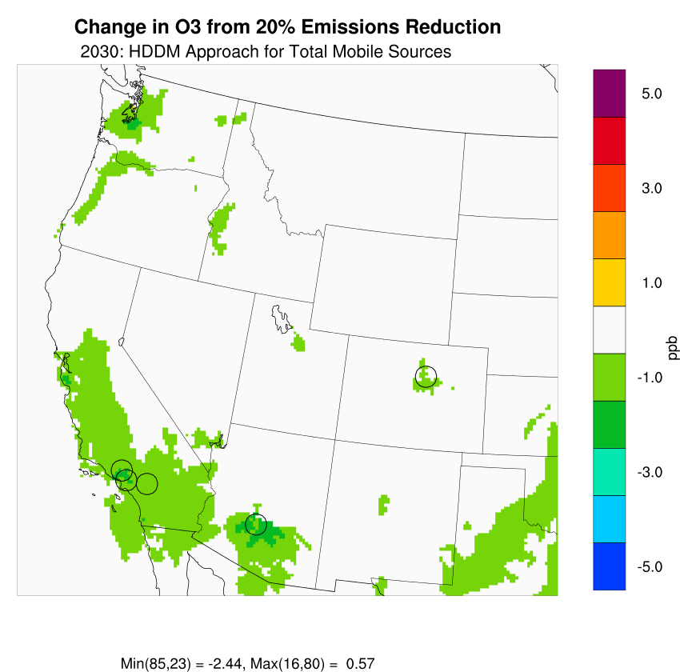
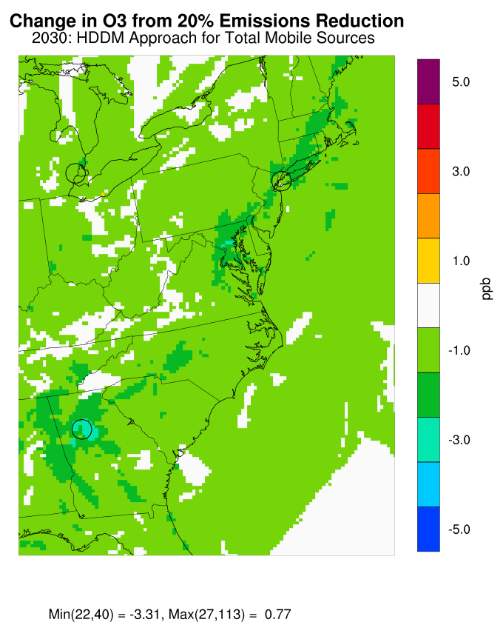

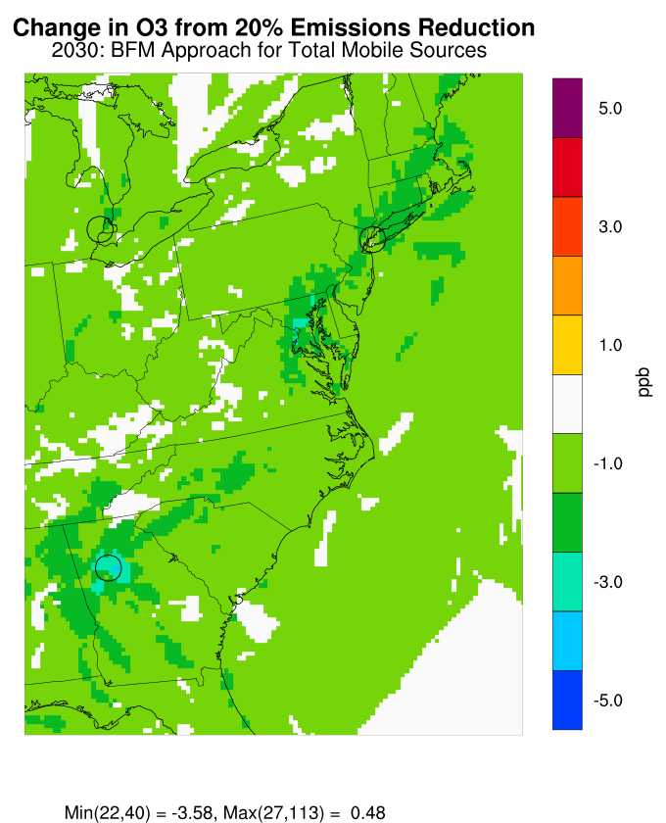
HDDM vs BFM Results
Effects of 20% Reductions in On-Road Mobile NOx and VOC Emissions
Western US
Eastern US
2030
HDDM
2030
BFM
Notes:
Surface model performs well on April 21, during both day and night
Over-predictions on May 20 are associated with NO₂ over-predictions

Slide 21
Conclusions
Results from CMAQ and CAMx zero-out simulations are generally comparable
The sum of the source contributions in the zero-out simulations does not add up to the base value because of the inherent non-linearity in the system, resulting in sometimes large contributions of the so-called “unexplained” category with the brute force method
Because of the non-linearity, the zero-out method predicts generally lower source attributions of anthropogenic source categories than OSAT
Ozone responses to 20% reductions in NOx and VOC emissions calculated from HDDM sensitivity coefficients and BFM results are generally similar
Both apportionment (OSAT) and sensitivity (HDDM) approaches provide valuable information on source culpability at a lower cost than a large number of brute force calculations; the choice of the tool to be used depends on the study objectives
Notes:
Surface model Explicitly simulates HONO formation on ground surfaces by reactions of deposited HNO₃ and NO₂:
Daytime photolysis of HNO₃ and NO₂
Thermal NO₂ reaction during night and day
Daytime levels simulated well on most days
Nighttime levels simulated well except when NO₂ is over-predicted
Observed and predicted HONO:NO₂ ratios are in good agreement

