Slide 1
Real-Time Applications of the GEM-MACH Air Quality Forecast Model
Michael Moran¹, Sylvie Gravel², Radenko Pavlovic³, Paul Makar¹, Craig Stroud¹, Sylvain Ménard³, Paul-André Beaulieu³, Balbir Pabla¹, Junhua Zhang¹, Qiong Zheng¹, Philip Cheung¹, and Samuel Gilbert³
¹Air Quality Research Division, Environment Canada, Toronto, Ontario, Canada
²Air Quality Research Division, Environment Canada, Montreal, Quebec, Canada
³Air Quality Modeling Applications Section, Environment Canada, Montreal, Quebec, Canada
2014 CMAS Conference Chapel Hill, North Carolina 27-29 Oct. 2014

Slide 2
Background
Environment Canada (EC) has run the in-line meteorology/chemistry model GEM-MACH operationally since Nov. 2009 to produce twice-daily, 48-hour, continental-scale air quality forecasts of O₃, NO₂, PM_{2.5}, and Air Quality Health Index.
This past summer EC ran 3 additional configurations of GEM-MACH to produce daily forecasts in real time in support of both operational forecasting and other programs.
This talk describes the goals, configurations, and sample outputs of these multiple forecast runs.

Slide 3
Four Daily Real-time GEM-MACH Forecast
Configurations Run During Summer 2014
Operational North American AQ forecasting with GEM-MACH at 10 km
Experimental North American wildfire forecasting at 10 km
Research forecasting for Alberta Oil Sands region at 2.5 km
Developmental forecasting at 2.5 km in preparation for 2015 Pan & Parapan American Games in Toronto, Ontario

Slide 4
Application 1
Operational North American AQ forecasting with GEM-MACH at 10 km
Motivation: Canada-wide forecasts of O₃,
NO₂, and PM_{2.5} are needed to provide 2-day
guidance on expected AQ conditions

Slide 5
What is GEM-MACH?
modèle Global Environnemental Multi-échelle –Modélisation de la qualité de l'Air et de la CHimie
et / and
Global Environmental Multiscale model – Modelling Air quality and CHemistry
GEM-MACH is a multi-scale chemical weather forecast model composed of dynamics, physics, and in-line chemistry modules that is able to simulate size-resolved PM, photochemical oxidants, and acid deposition

Slide 6
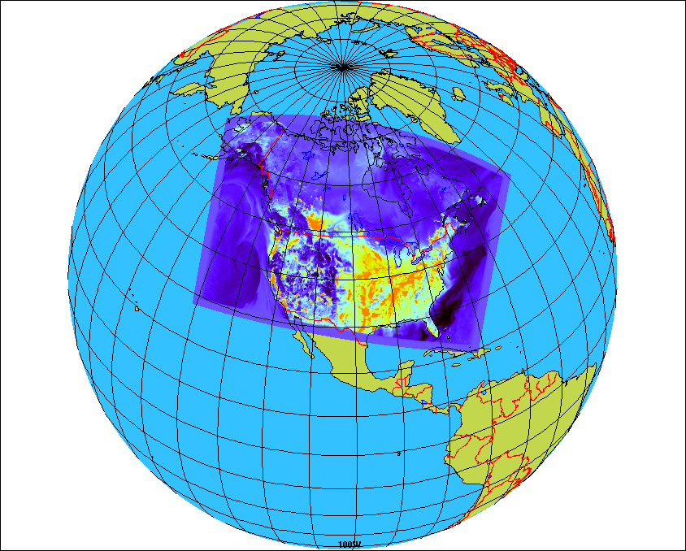
First GEM-MACH v1 Application: In RAQDPS,
EC’s Operational AQ Forecast System
Installed in Regional AQ Deterministic Prediction System in Nov. 2009
Regional system with a domain covering North America
  10 km horizontal grid spacing
  80 vertical levels with lid at 0.1 hPa (~10 levels in 1st km of the atmosphere)
In-line coupled meteorology and chemistry model GEM-MACH
  One-way coupling (meteorology affects chemistry)
  Full process representation of oxidant and aerosol chemistry:
    gas-, aqueous- & heterogeneous chemistry mechanisms
    aerosol dynamics
    dry and wet deposition (including in- and below-cloud scavenging)
  2-bin sectional representation of PM size distribution (i.e., 0-2.5 and 2.5-10 μm) with 8 chemical components
Notes:
6
Regional yet more than 37 million sq km

Slide 7
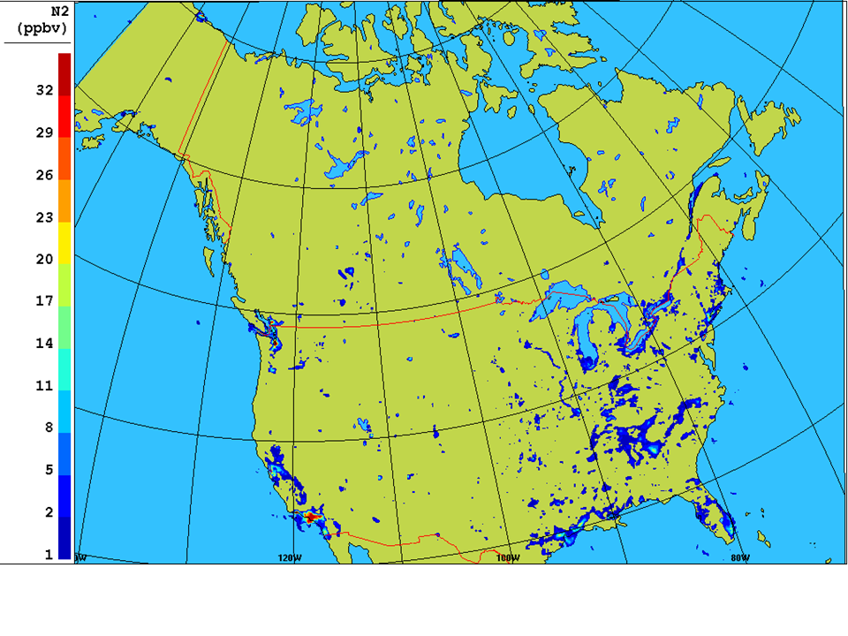
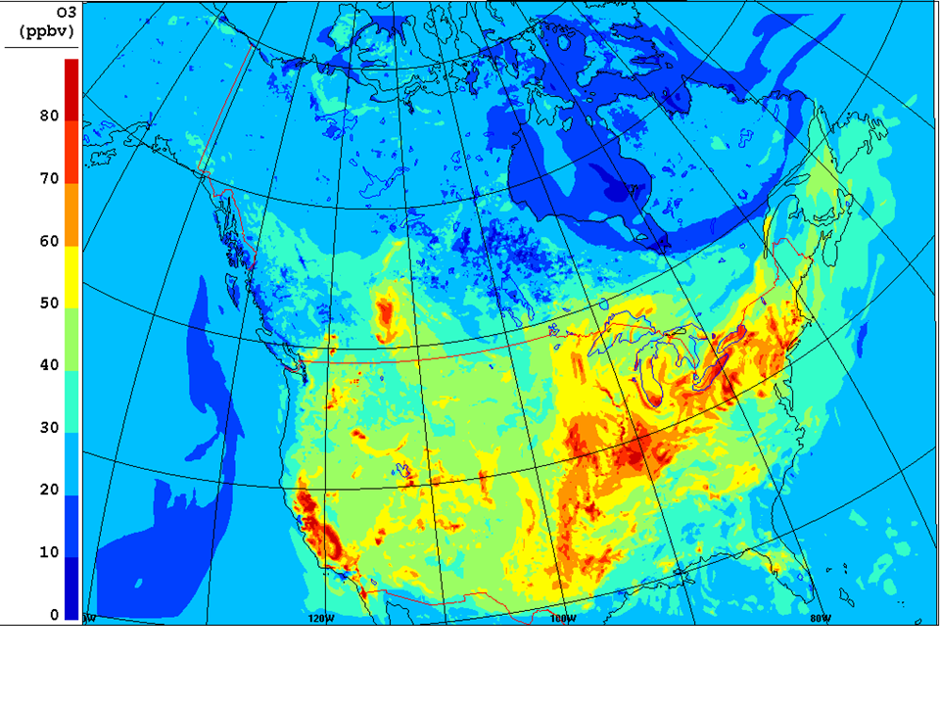
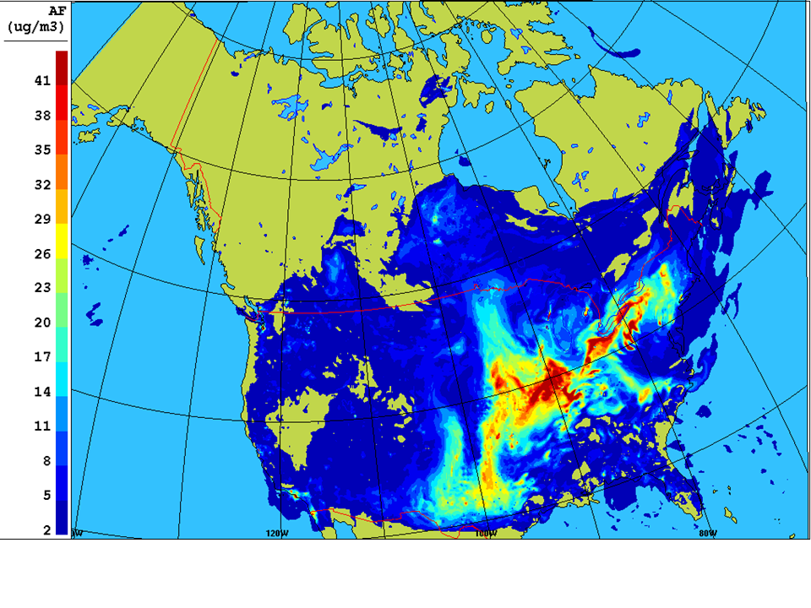
Plots of GEM-MACH10 Surface NO₂, O₃, and PM_{2.5} Concentration Fields, 1500 EST, 12 July 2012 [Units: ppbv, ppbv, μg m⁻³]
NO2
O3
PM2.5

Slide 8
Application 2
Experimental North American wildfire forecasting at 10 km
Motivation: Wildfire emissions can have
large impacts on local and regional
air quality

Slide 9
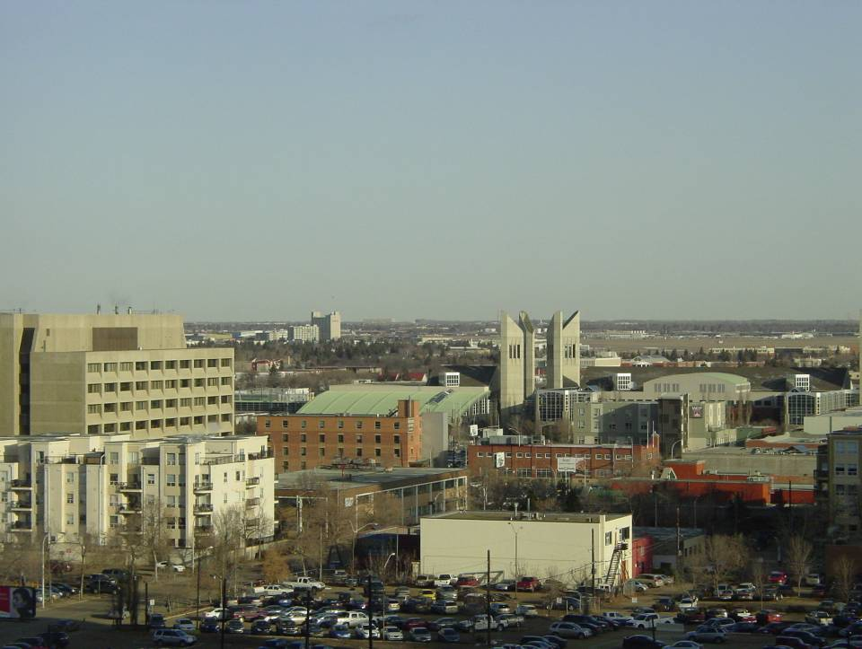
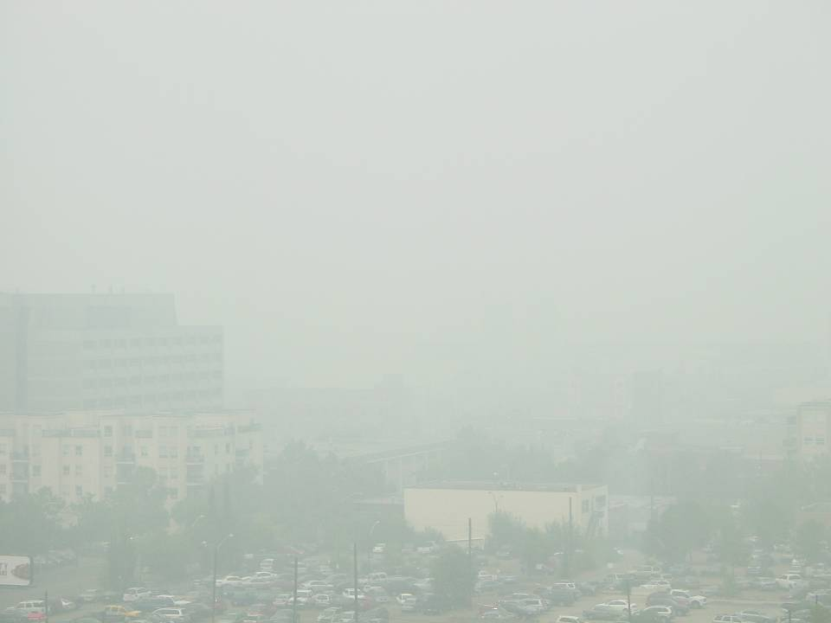
Example for Edmonton, Alberta:
Bad Air Quality Due to Wildfires in British Columbia
(Good AQ Day on Left; Aug. 19, 2010 View on Right)
Grant MacEwan University
Grant MacEwan University
Edmonton without smoke
Observed hourly PM_{2.5} up to 250 μg/m³

Slide 10
Timeline of FireWork Development
2011
  (i) Developed fire emissions method for GEM-MACH; (ii) Processed fire information from Canada and USA for historical cases; and (iii) Established a case study for a 2010 wildfire in British Columbia
2012
  GEM-MACH with near-real-time wildfire emissions was run for the entire summer (May-October) at 15-km grid spacing; the new wildfire version of GEM-MACH is named “FireWork”
2013
  FireWork was run by the development group for the entire summer with operational settings at 10-km grid spacing
2014
  FireWork was run by Canadian Meteorological Centre operations for the entire summer in experimental mode; hourly PM_{2.5} difference plots between FireWork and operational GEM-MACH (without wildfires) were calculated

Slide 11

GEM-MACH Wildfire Project Approach
FireWork framework
Fire Information from AVHRR/MODIS
USA
Canada
CWFIS
(Cdn Wildland
Fire Information
System)
CWFIS
(Cdn Wildland
Fire Information
System)
Weather model output (GEM)
BlueSky FEPS only
Emissions
(SMOKE)
BlueSky FEPS only
GEM-MACH

Slide 12
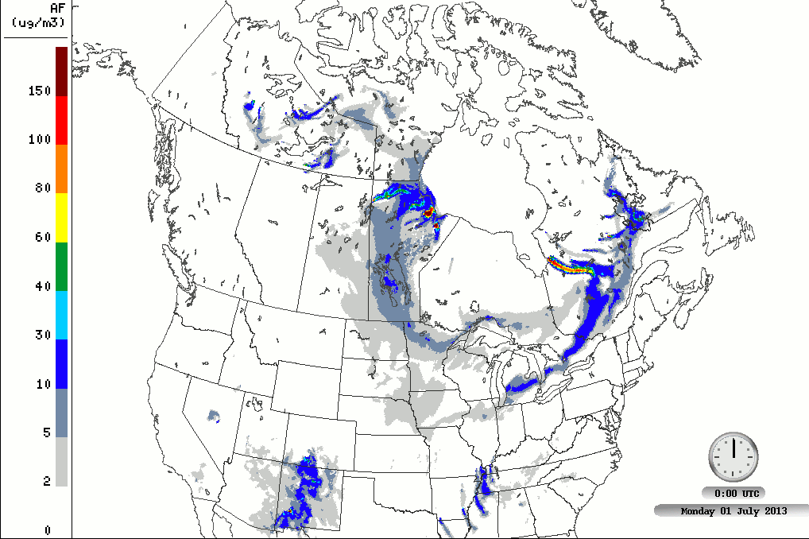
Surface PM_{2.5} Animation: FireWork Operational 10-km Sample Output (2013-07-02 run)

Slide 13
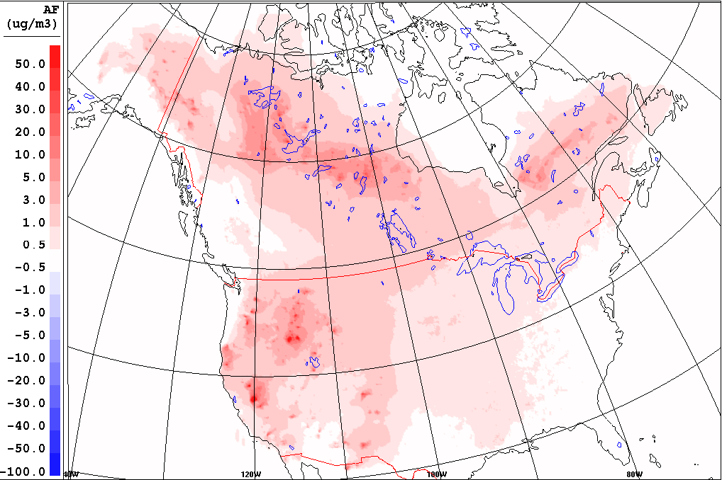
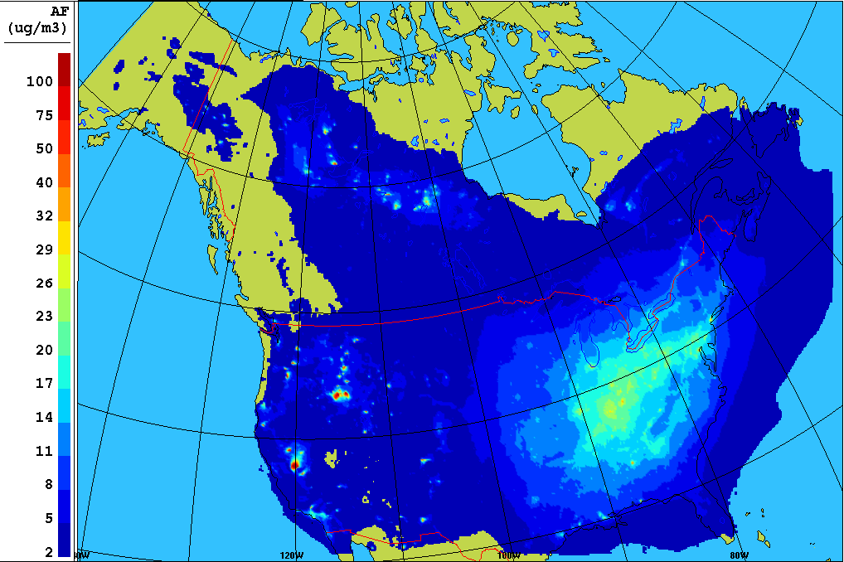
Results for Summer 2013 (June – August)
Average PM_{2.5} Concentrations and Differences
Wildfire emissions contribution to average summertime PM_{2.5} concentrations
Difference: FireWork – GEM-MACH
AVG FireWork forecast
Notes:
5 days with important Wildfires in Quebec are missing.

Slide 14
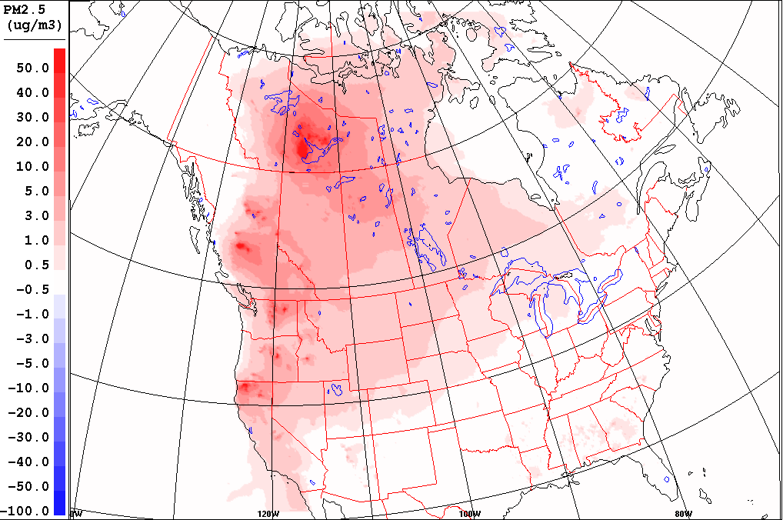
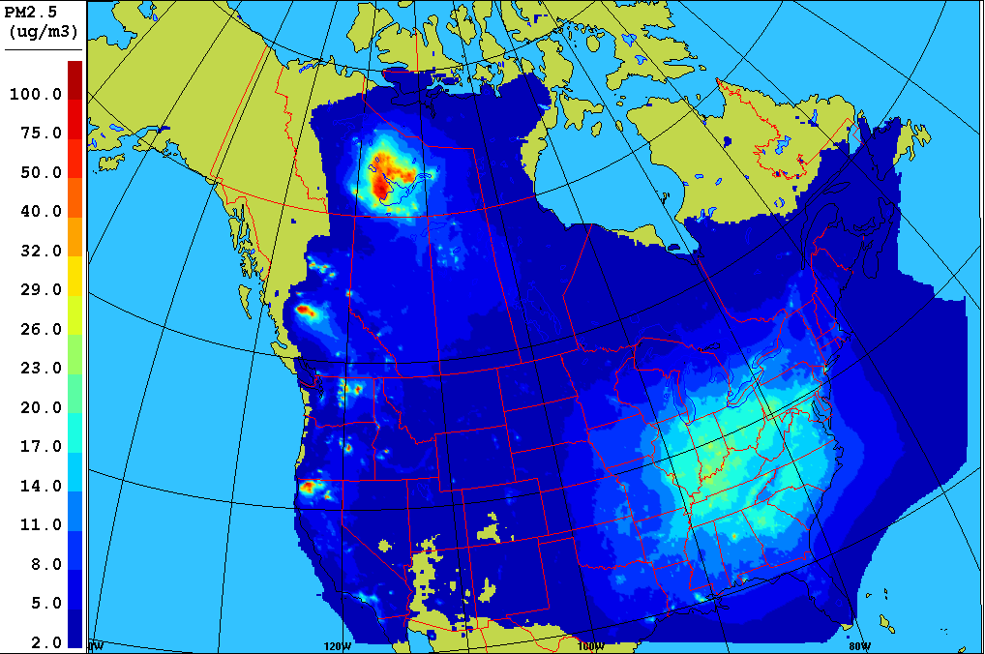
Results for Summer 2014 (June – August)
Average PM_{2.5} Concentrations and Differences
Wildfire emissions contribution to average summertime PM_{2.5} concentrations
Difference: FireWork – GEM-MACH
AVG FireWork forecast

Slide 15
Application 3
Research forecasting for Alberta Oil Sands region at 2.5 km
Motivation: Partnership between the
governments of Canada and the province of
Alberta to build a coherent, high-resolution
picture of the processes underlying air
quality in the Oil Sands region, connecting
emissions to concentrations to deposition

Slide 16
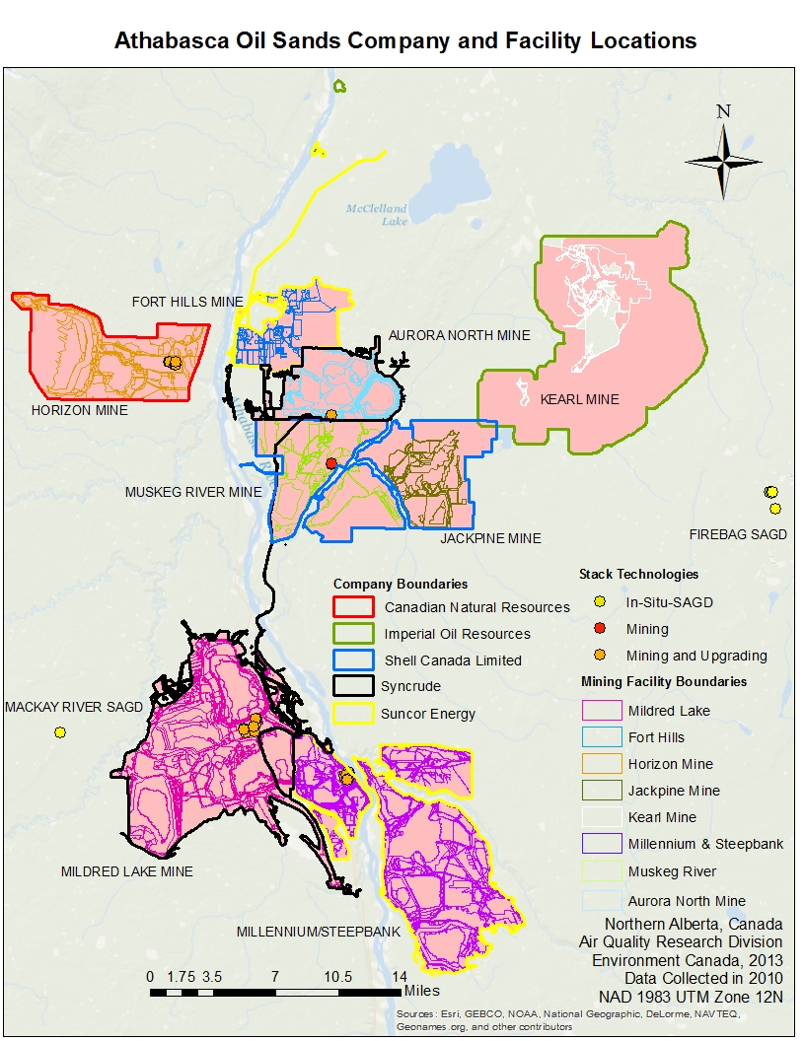
2010 GIS mapping data courtesy Alberta Environment and Sustainable Resource Development
Emission Improvements
Extensive review of available emission inventories
- Update to 2010 Cdn NPRI
Locations of tailing ponds,
surface mines and plant facilities were updated based on AESRD shapefile database.
New temporal allocation factors and chemical speciation profiles applied.
LOT 10A
AMS13

Slide 17
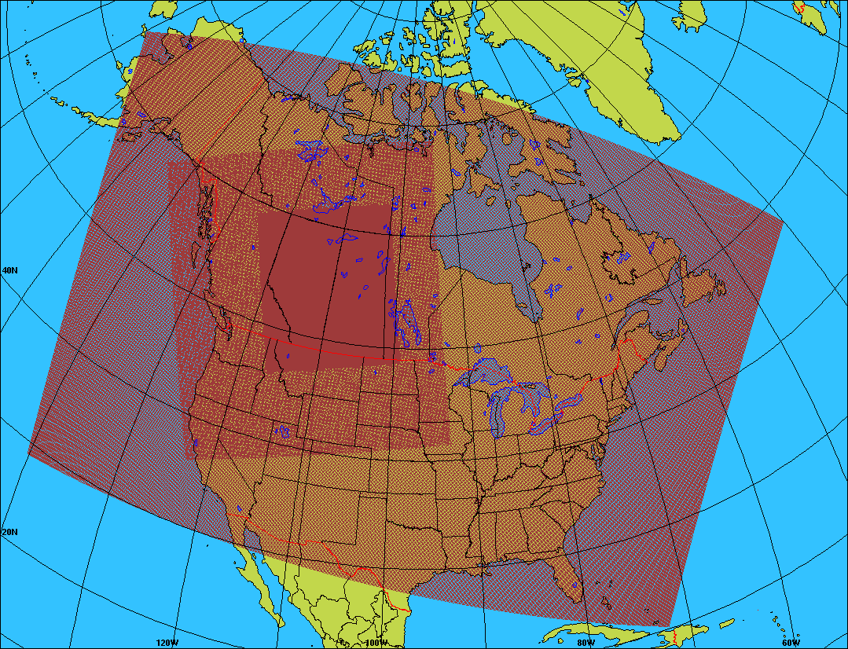
GEM-MACH Oil Sands Modelling Project:
Ongoing Daily Nested Runs Began in Nov. 2012
Operational GEM-MACH North American 10-km continental forecast domain
Experimental GEM-MACH 2.5-km Oil Sands domain
Experimental GEM-MACH 10-km Oil Sands domain

Slide 18
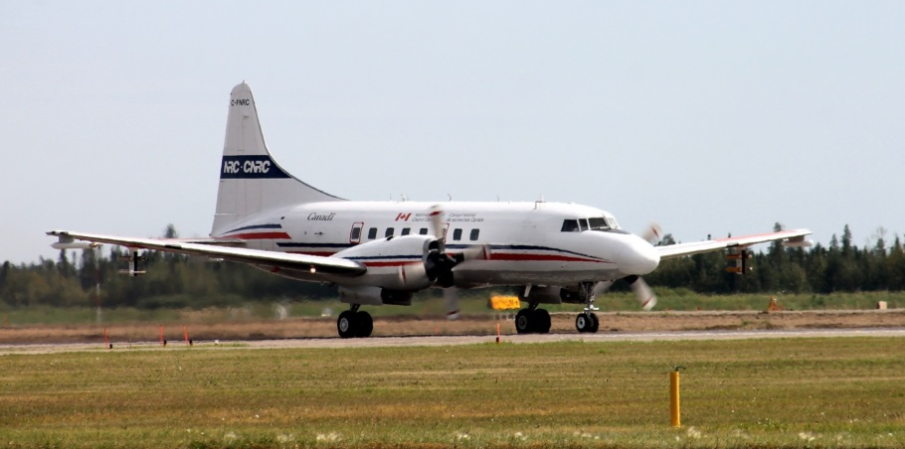
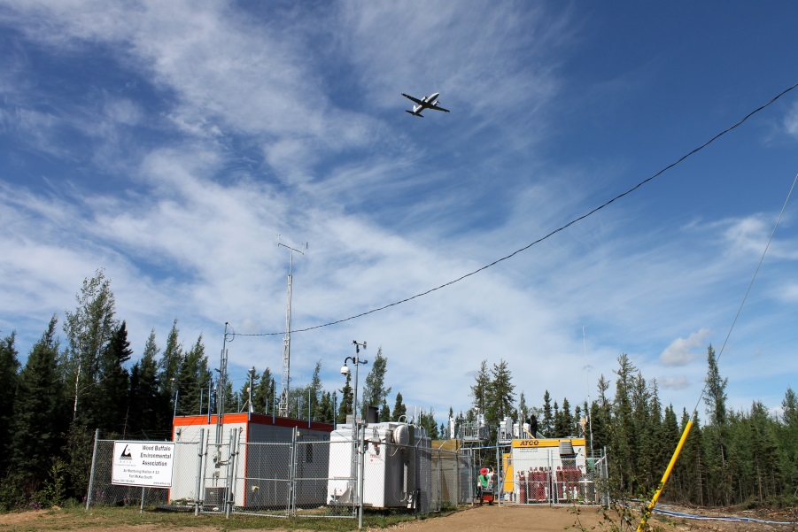
Daily GEM-MACH Forecasts Supported Summer 2013 Measurement Intensive Study in Oil Sands Region: Aircraft + 2 Supersites
National Research Council Convair-580
High time resolution measurements:
  Particle size distributions (6 nm to 20 μm).
  PM₁ mass and chemical speciation
  Black carbon aerosol mass and size dist.
  Meteorology, including 3D winds and turbulence
  Gases: SO₂, NO, NO₂, NO_{y}, CO, CO₂, CH₄, H₂O, NH₃, HCHO
  VOCs, measured using three methods:
    150-hydrocarbon suite (canisters),
    Carboxylic acids, inorganic acids, isocyanic acid, substituted phenols (CIMS)
    Non and substituted VOCs (PTR-MS)

Slide 19
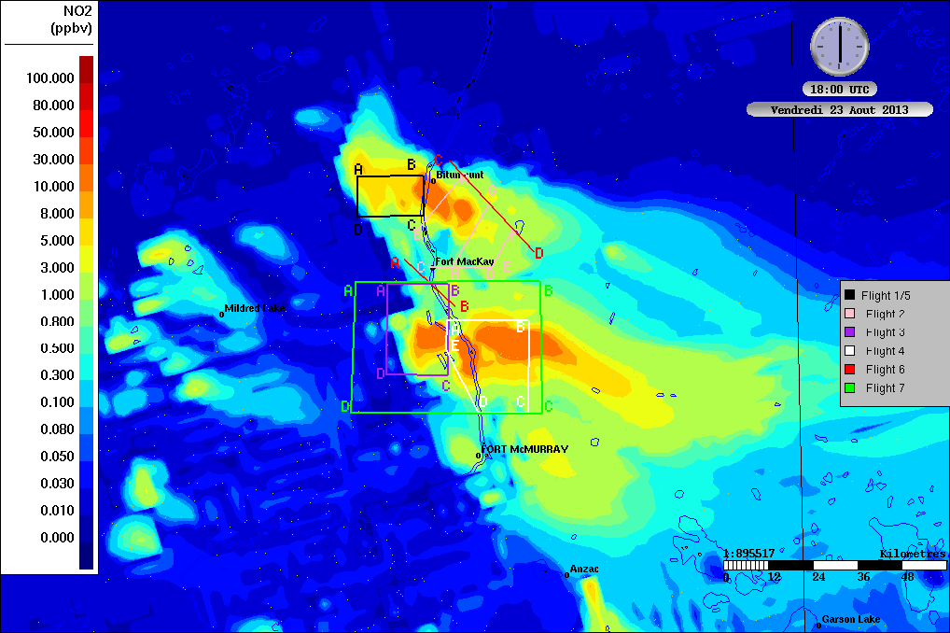
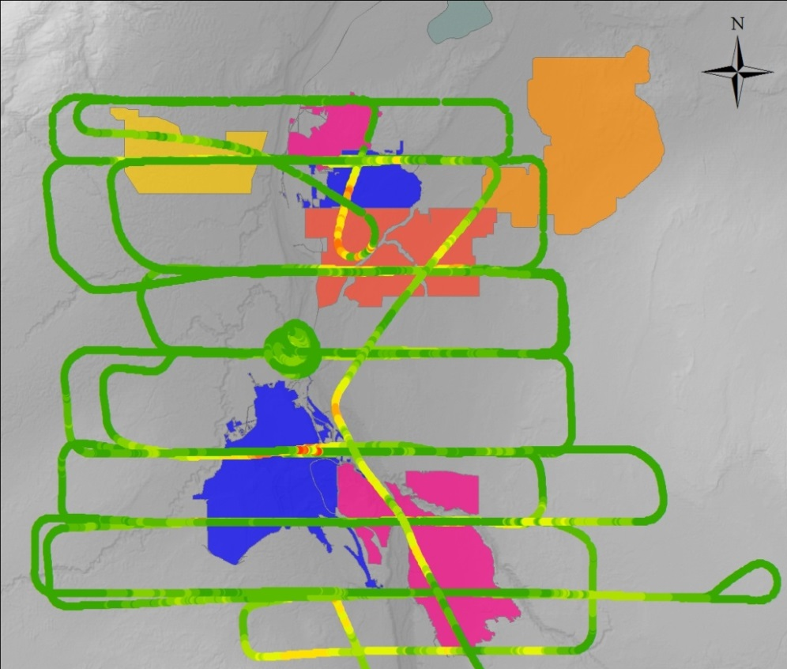

Model Validation Flight
Obs. max NO_{x} > 100 ppbv
(over 4 hour flight)
Model max NO₂ 10 to 30 ppbv (at noon)
(Raw aircraft NO_{x} observations courtesy S.M. Li, K. Hayden, J. Narayan)
Observations will be compared to time-step-resolved (2 minutes) model output in future work.
Notes:
Stars show the locations of Lot10a and AMS13

Slide 20
Application 4
Developmental forecasting at 2.5 km in preparation for 2015 Pan & Parapan American Games in Toronto, Ontario
Motivation: GEM-MACH AQ forecasts will
support Games health-and-safety and
emergency-response functions. Real-time
forecasts were undertaken this past
summer to test the model set up in
preparation for next summer.

Slide 21
PanAm Air Quality Modelling Objectives
Accelerate the development of a higher spatial resolution air quality model (2.5-km grid spacing) for AQHI predictions in urban areas across Canada
Improve representation of pollutant emissions for urban areas (e.g., on-road mobile sources, residential wood combustion, food cooking)
Capture the interactions between chemistry and weather at the mesoscale (flow systems with scales on the order of 5 to 100 km). Examples of mesoscale systems include urban heat islands and lake breezes (under calm and fair weather conditions). These conditions over urban environments are conducive for poor air quality.

Slide 22
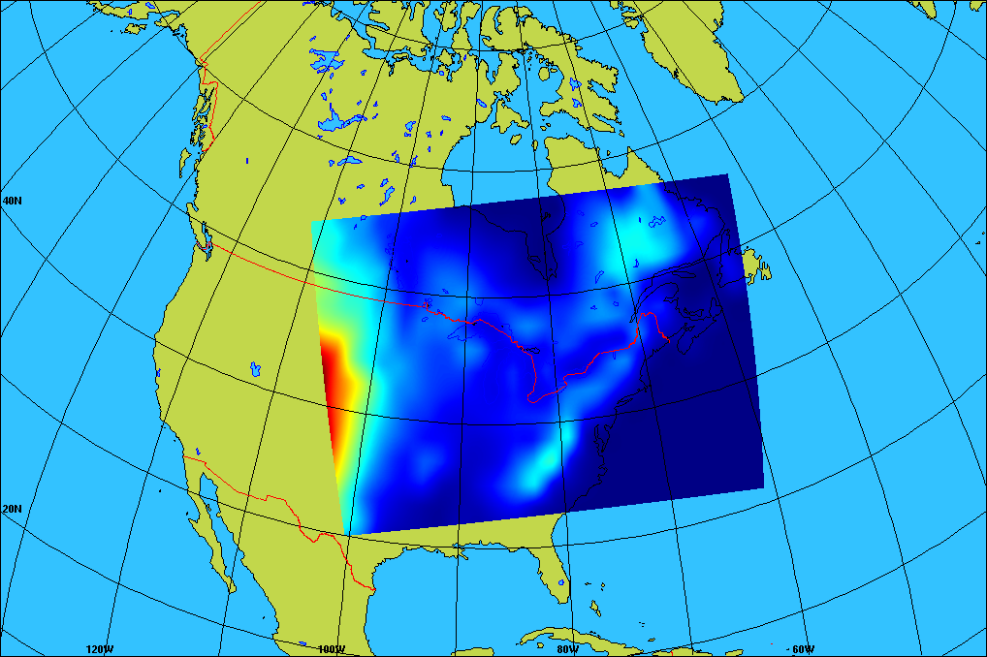
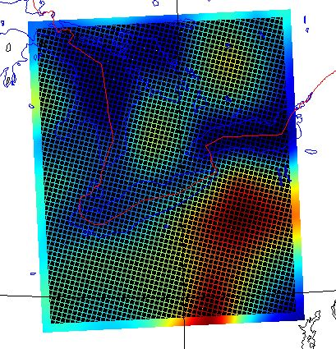
Nested 10-km / 2.5-km Grid Configuration for 2015 Pan & Parapan American Games
High-resolution 2.5-km domain includes Toronto-Hamilton, Detroit-Windsor,
Cleveland, Buffalo, Pittsburgh plus 3 of Great Lakes to capture lake-breeze effects
Regional 10-km GEM-MACH domain
Chemical lateral boundary conditions from MOZART global CTM (month, day of week, hour of day)

Slide 23
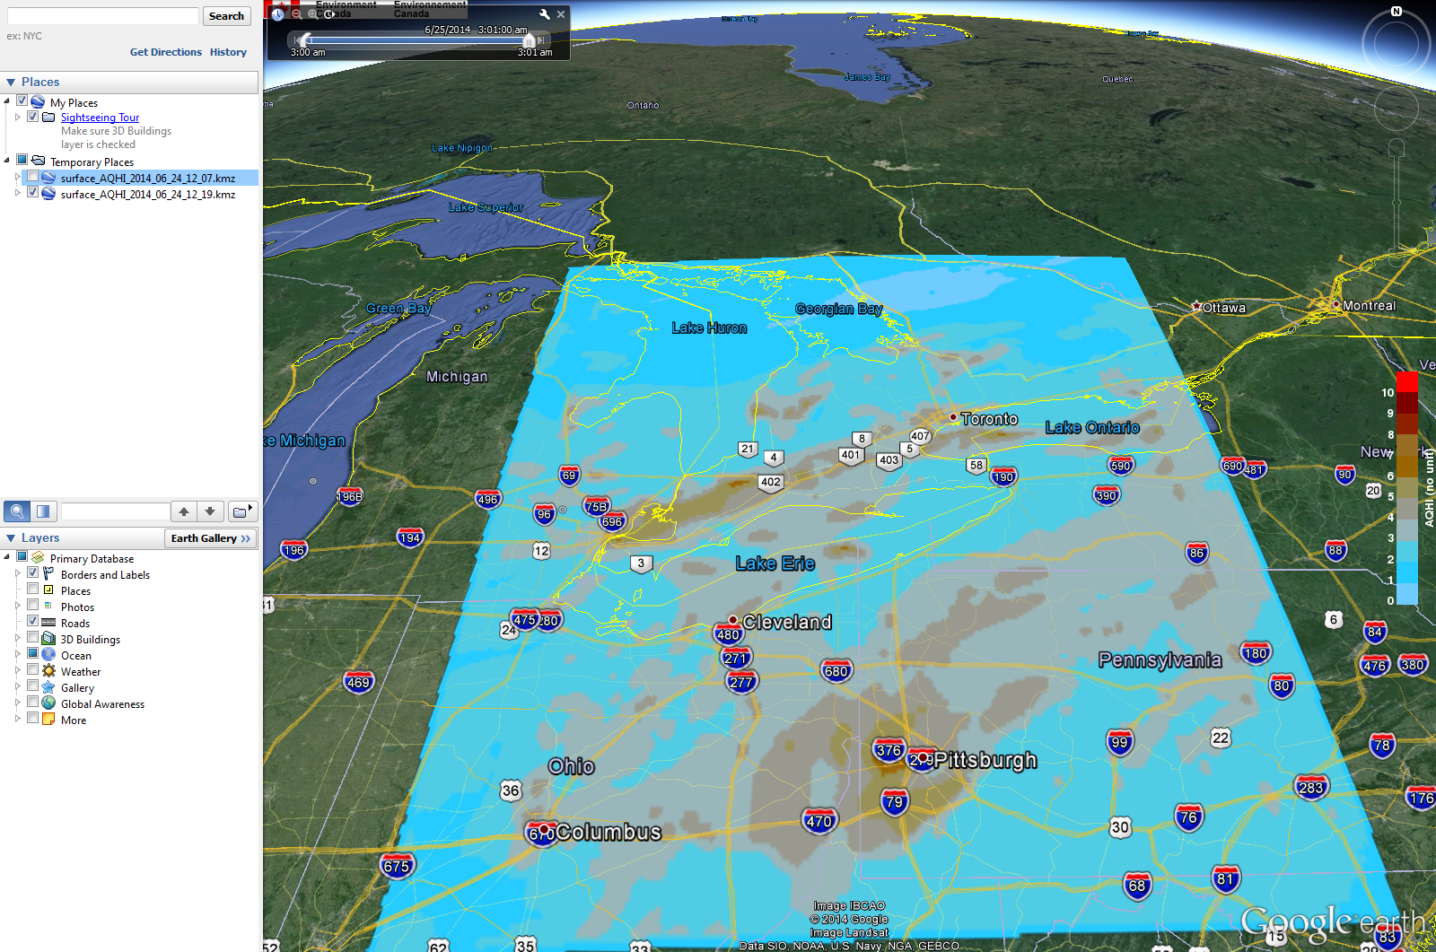
Air Quality Health Index (AQHI) Forecast
for the High-Resolution 2.5-km Domain
Image from
June 24, 2014

Slide 24
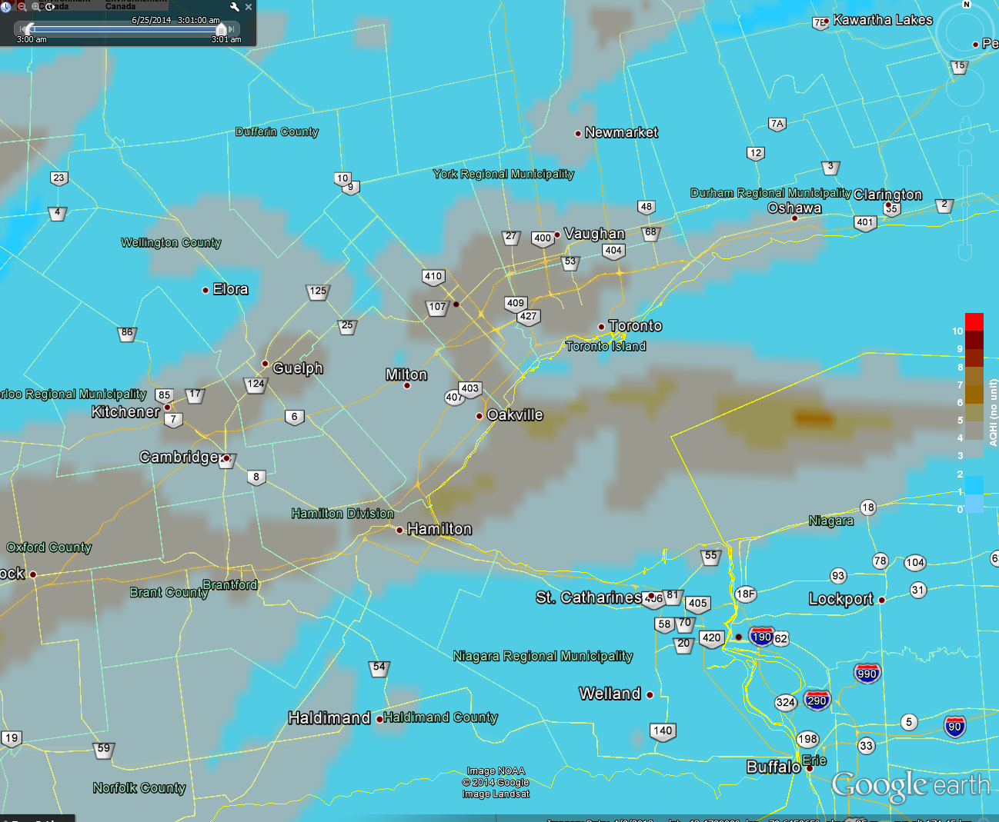
AQHI Forecast for the Greater Toronto Area

Slide 25
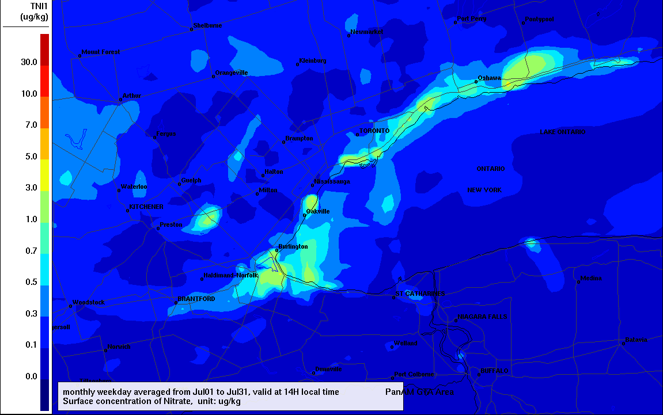
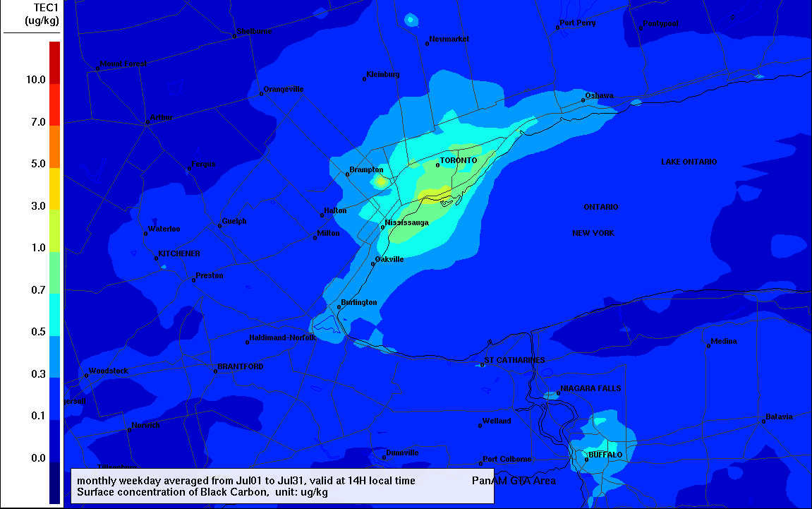
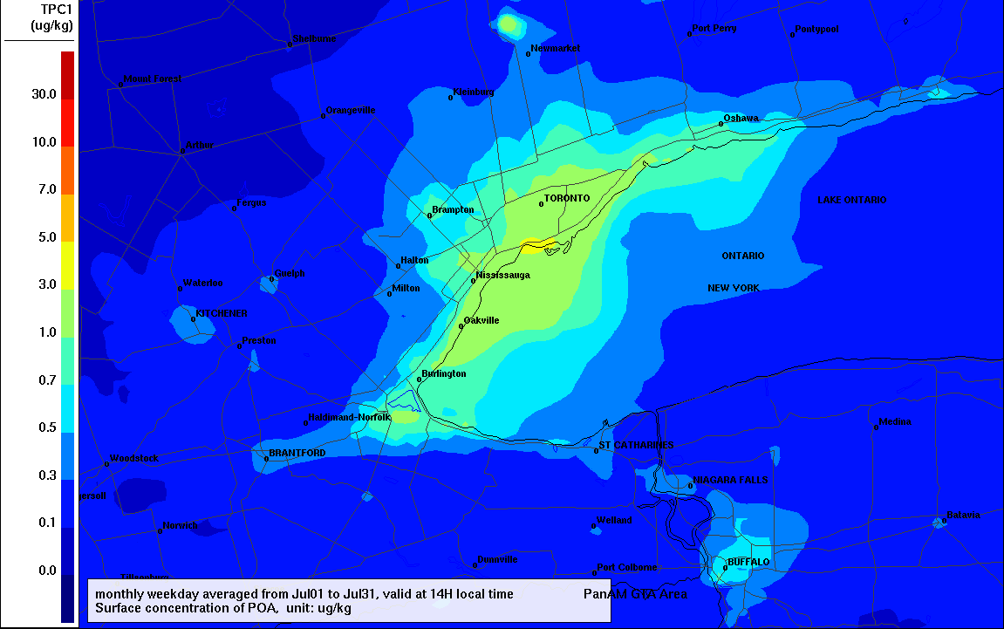
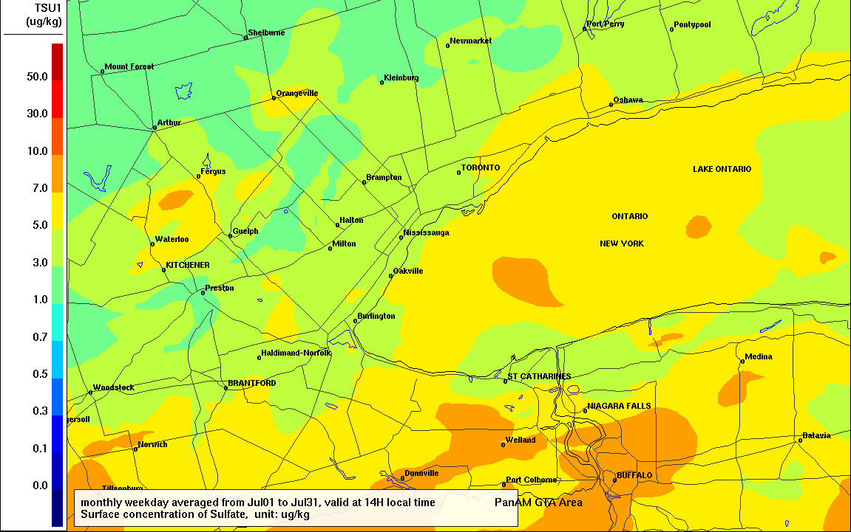
GEM-MACH v2 Aerosol Composition
Average for July 2014 Weekdays
Nitrate
Black Carbon
POA
Sulfate

Slide 26
Thank you for your attention

