Slide 1
Remote Sensing of Atmospheric Ammonia from the Cross-track Infrared Sounder (CrIS): Application to Air Quality Studies in California and the Southeast US
M. J. Alvarado¹, K. E. Cady-Pereira¹, M. W. Shephard²,
J. D. Hegarty¹, C. R. Lonsdale¹, D. K. Henze³,
M. Turner³
¹Atmospheric and Environmental Research
²Environment Canada
³Univerisity of Colorado - Boulder
Copyright 2014, Government sponsorship acknowledged.

Slide 2
NH₃ is an important PM_{2.5} precursor
NH₃ + HNO₃⬅➔NH₄NO₃
2 NH₃ + H₂SO₄➔(NH₄)₂SO₄
Long-range export
Long-range import
SO₂, NO_{X} decreasing
but NH₃ forecast to increase
PM_{2.5}
Nitrogen Deposition
Increase incidence of cardiovascular and respiratory diseases
Increase number of CCN
Harmful algal blooms
Loss of species diversity

Slide 3
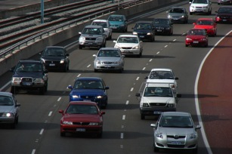
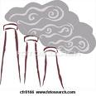


NH₃ sources are not well known
Automobiles (catalytic converters)
Large urban centers
  50% of NH₃ in LA area (Nowak et al., GRL, 2012)
Biomass burning
Bi-directional
Flux
Industry
Fertilizer
Coal Mining
Power generation
AGRICULTURE
Animal waste (temperature dependent)
Fertilizer application

Slide 4
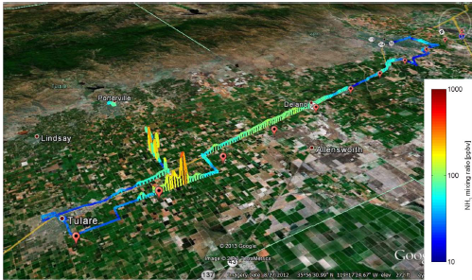
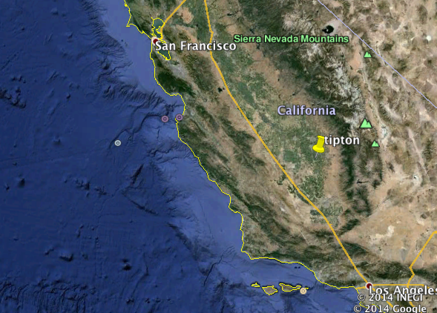
Monitoring NH₃ is difficult
NH₃ from an Open path Quantum Cascade Laser (QCL) on a moving platform in the San Joaquin Valley during DISCOVER-AQ 2013.
NH₃ is highly reactive
➔ highly variable in space and time
Miller et al., AMT 2013

Slide 5
Better emissions with TES NH₃
Largest changes western US and Mexico
Used GEOS-Chem adjoint with TES NH₃ profiles, averaging kernels and error covariances to optimize model
Optimized GC shows better agreement with AMoN network measurements
Zhu et al., 2013, JGR

Slide 6
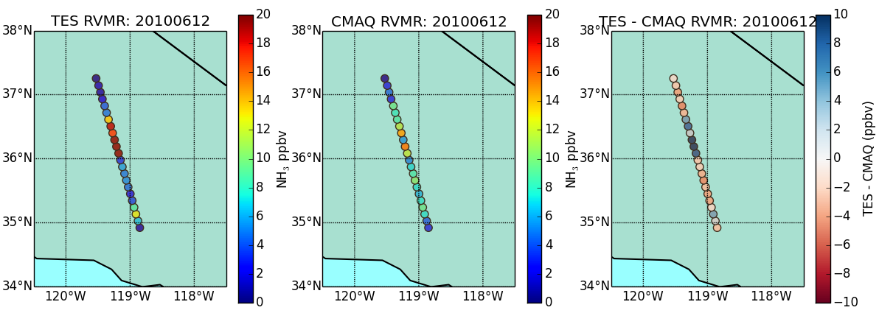
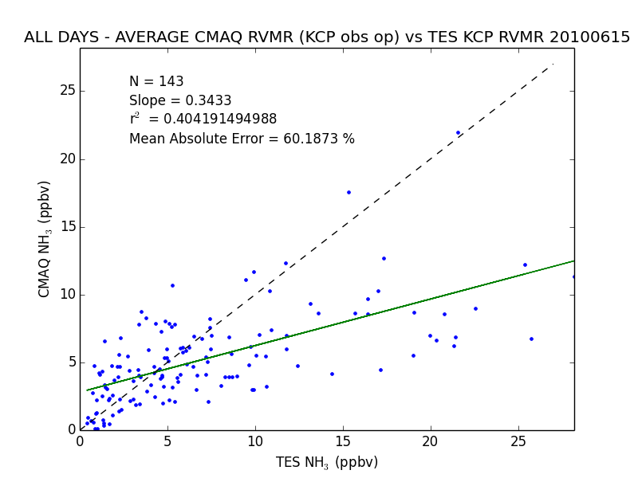
Using TES to constrain NH₃ near Bakersfield during CalNEX
TES shows that CARB emissions underestimate NH₃ during TES overpass (~1:30 PM LT).
Appears to be caused by incorrect diurnal distribution of NH₃ emissions.
See Hegarty et al. CMAS 2014 presentation, “Evaluation of CMAQ Simulations of NH₃ in California using Satellite Observations from TES” from yesterday for details
CMAQ NH₃ (ppb)
TES NH₃ (ppb)
Notes:
Discuss some of the differences in TES versus CMAQ.

Slide 7
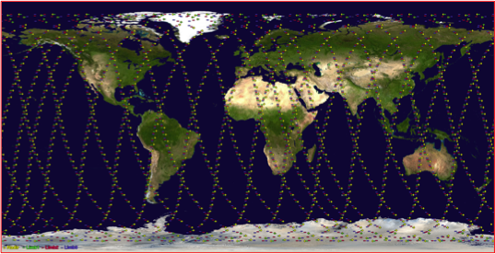
Why switch to CrIS?
TES is past its design lifetime, taking little new data, and has low spatial coverage
CrIS could monitor global NH₃ with high spatial coverage for many more years (>2022)
 | TES | CrIS
Satellite | AURA | NPP
Available Data | July 2004-present | October 2011-present
Resolution | 0.06 cm⁻¹ | 0.625 cm⁻¹
Footprint | 5x8 km rectangle | 14 km diameter circle
Repeat cycle | Once every 16 days | Daily
Equatorial crossing | 1:30 am and 1:30 pm | 1:30 am and 1:30 pm
Noise in NH₃ window | 0.09 – 0.12 K | 0.03 – 0.06 K

Slide 8
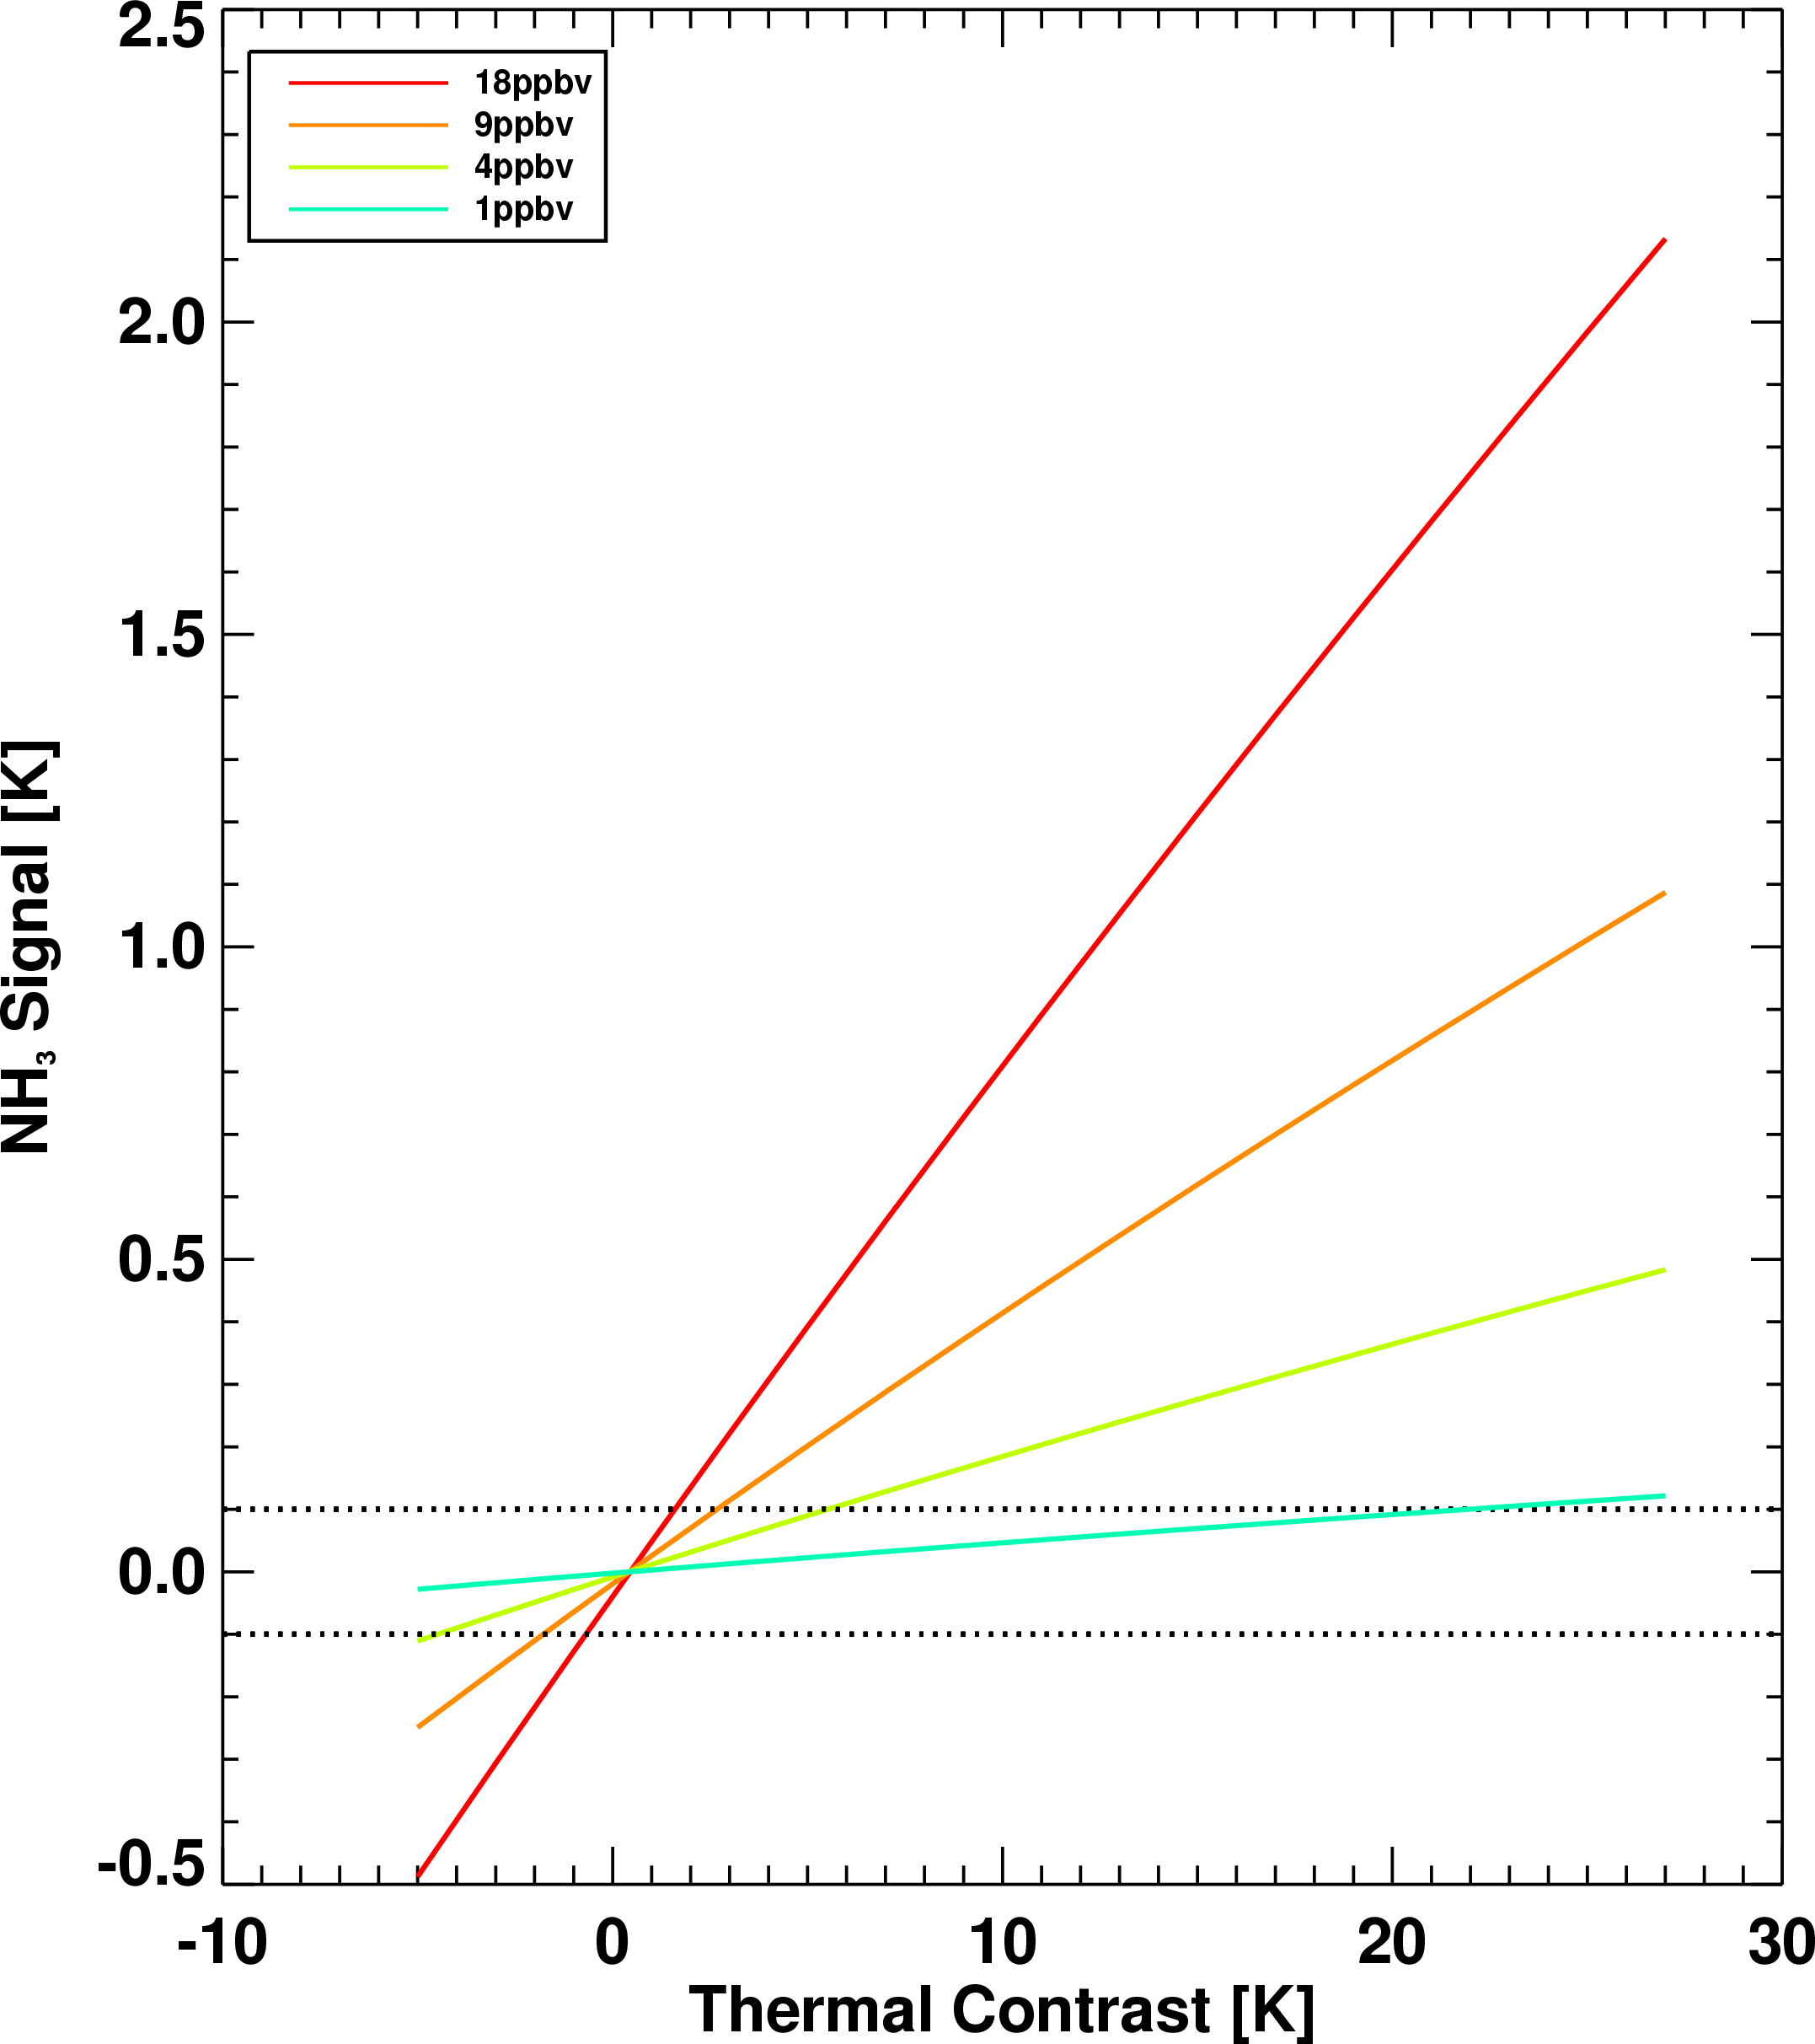
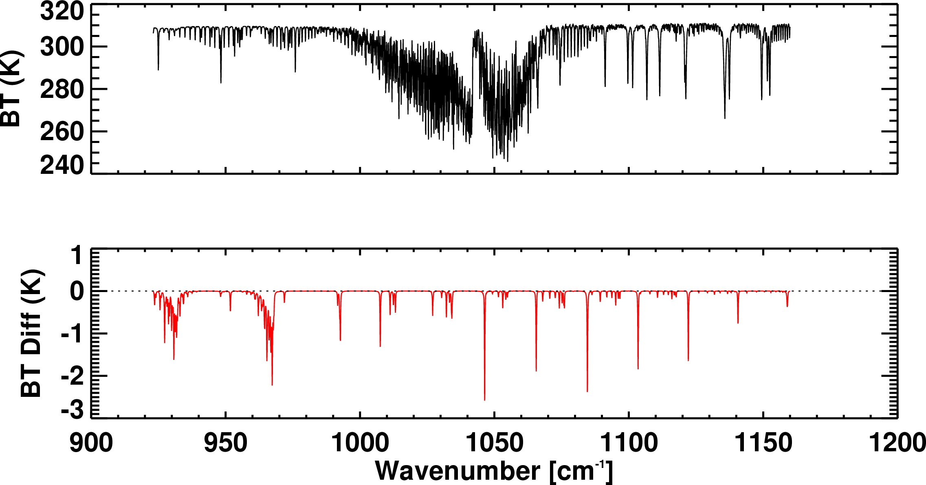
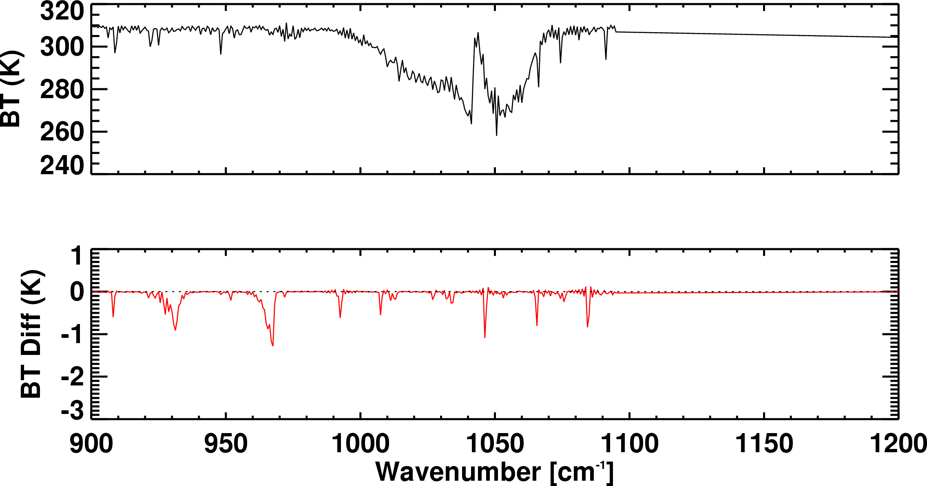
NH₃ signal from TES and CrIS
Simulated spectra and NH₃ signal
18 ppbv at surface
TES
CrIS
Detectability is ~1 ppbv under ideal conditions
But thermal contrast also plays a role

Slide 9
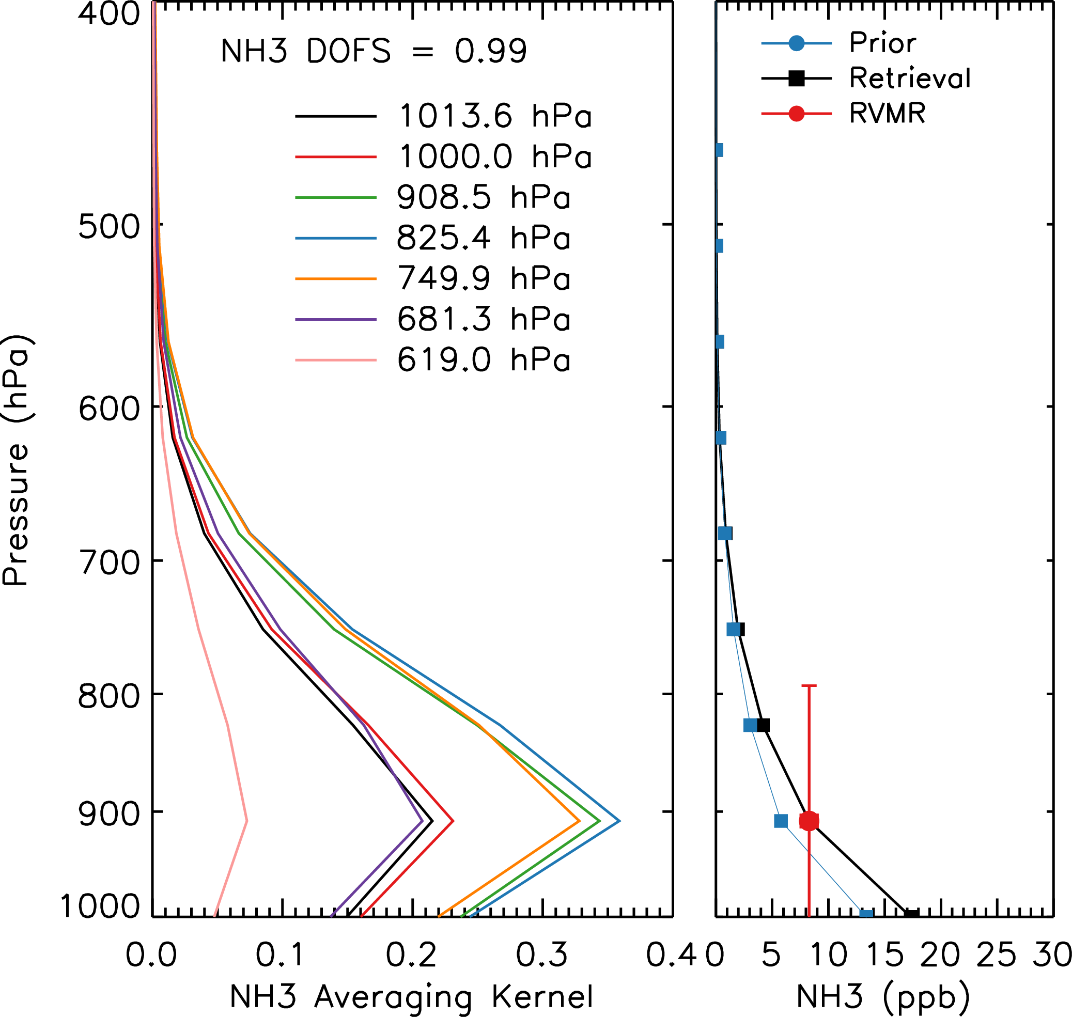
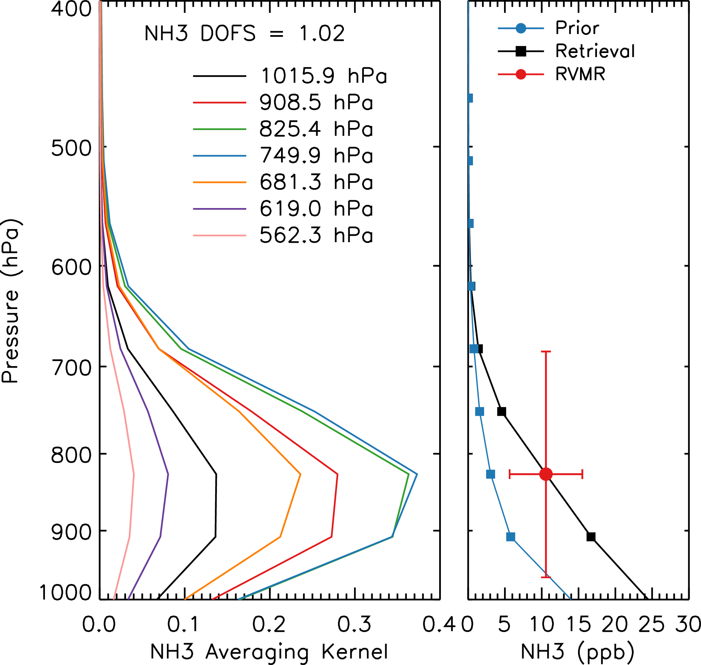
TES and CrIS Sensitivity to NH₃
TES
CrIS
Both instruments most sensitive to NH₃ between 950 and 600 mbar
TES is more sensitive to amounts lower in the atmosphere
1 piece of information or less: DOFS<1.0
Collapse all information to a single point: RVMR
  Easier to compare with in situ measurements, models and other instruments

Slide 10
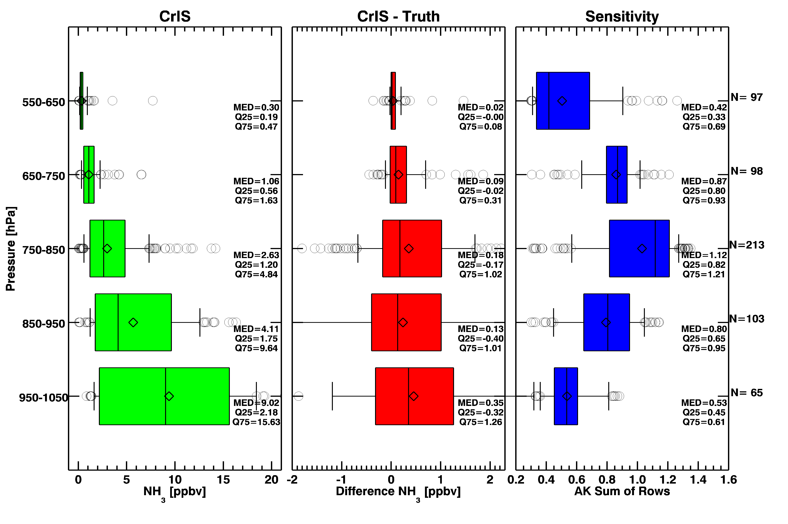
CrIS NH₃ Retrieval: Simulated Spectra
Notes:
Doubled NH₃ emissions in GEOS-Chem to generate “true” profiles
Profiles fed into RT model and CrIS noise added to get simulated spectrum.
Test ability of retrieval to reproduce the “true” profiles

Slide 11
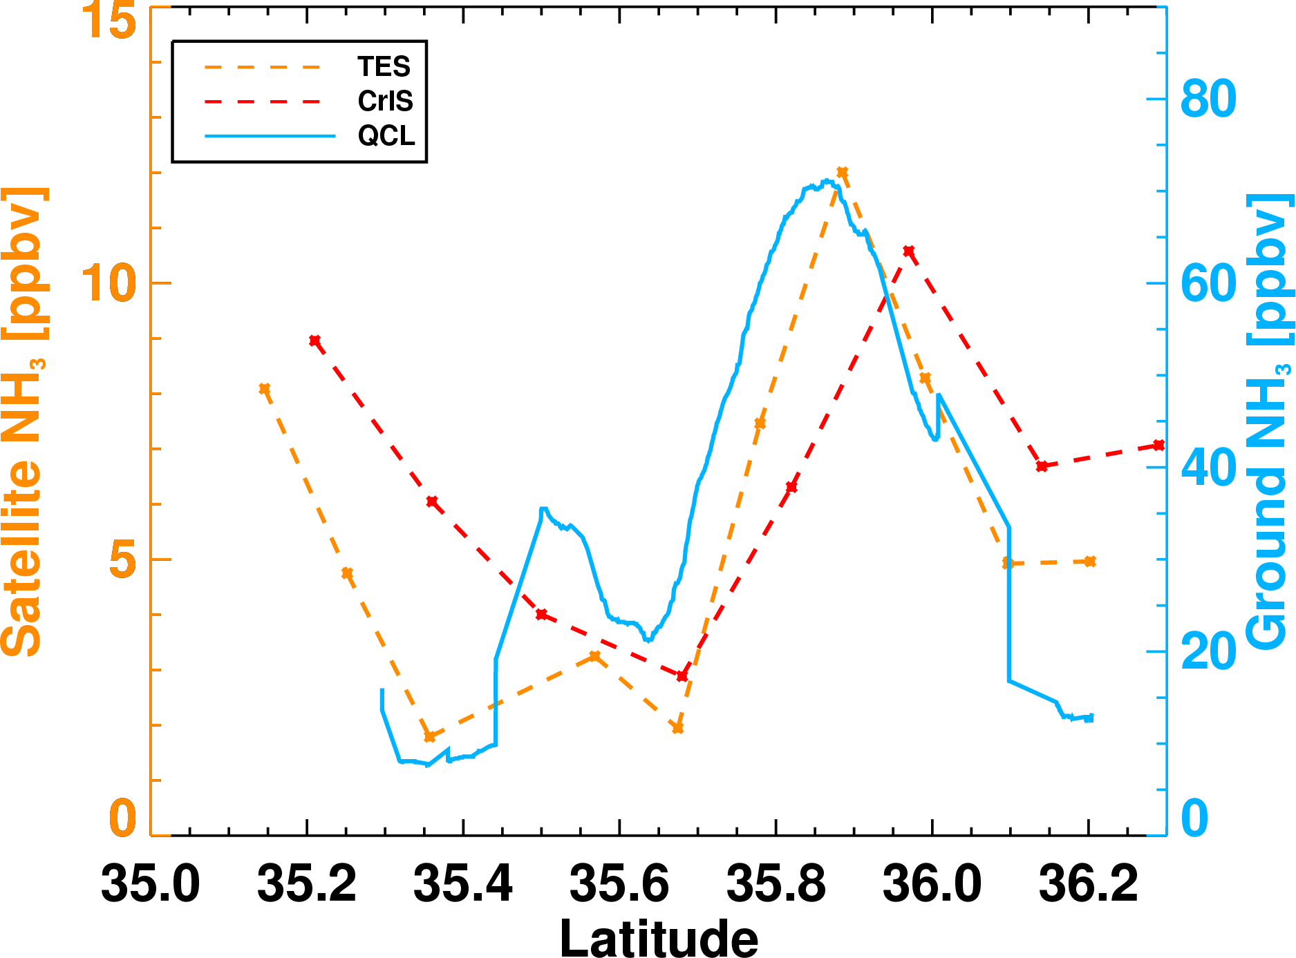
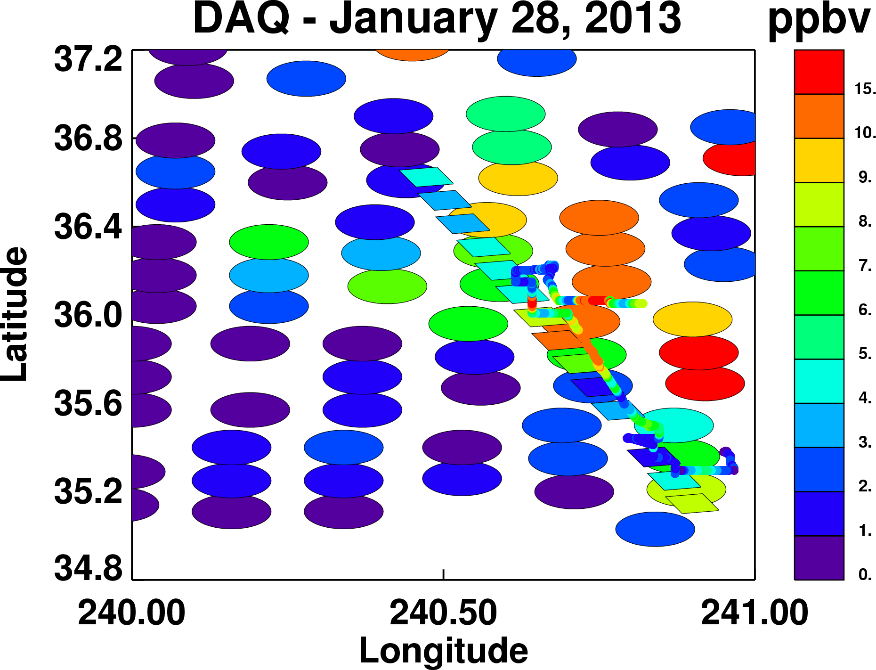
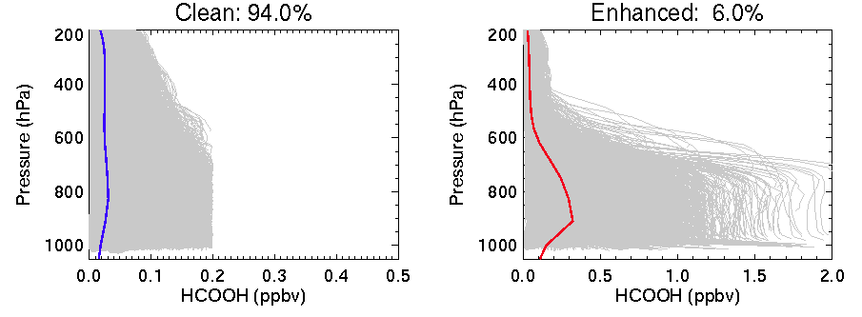
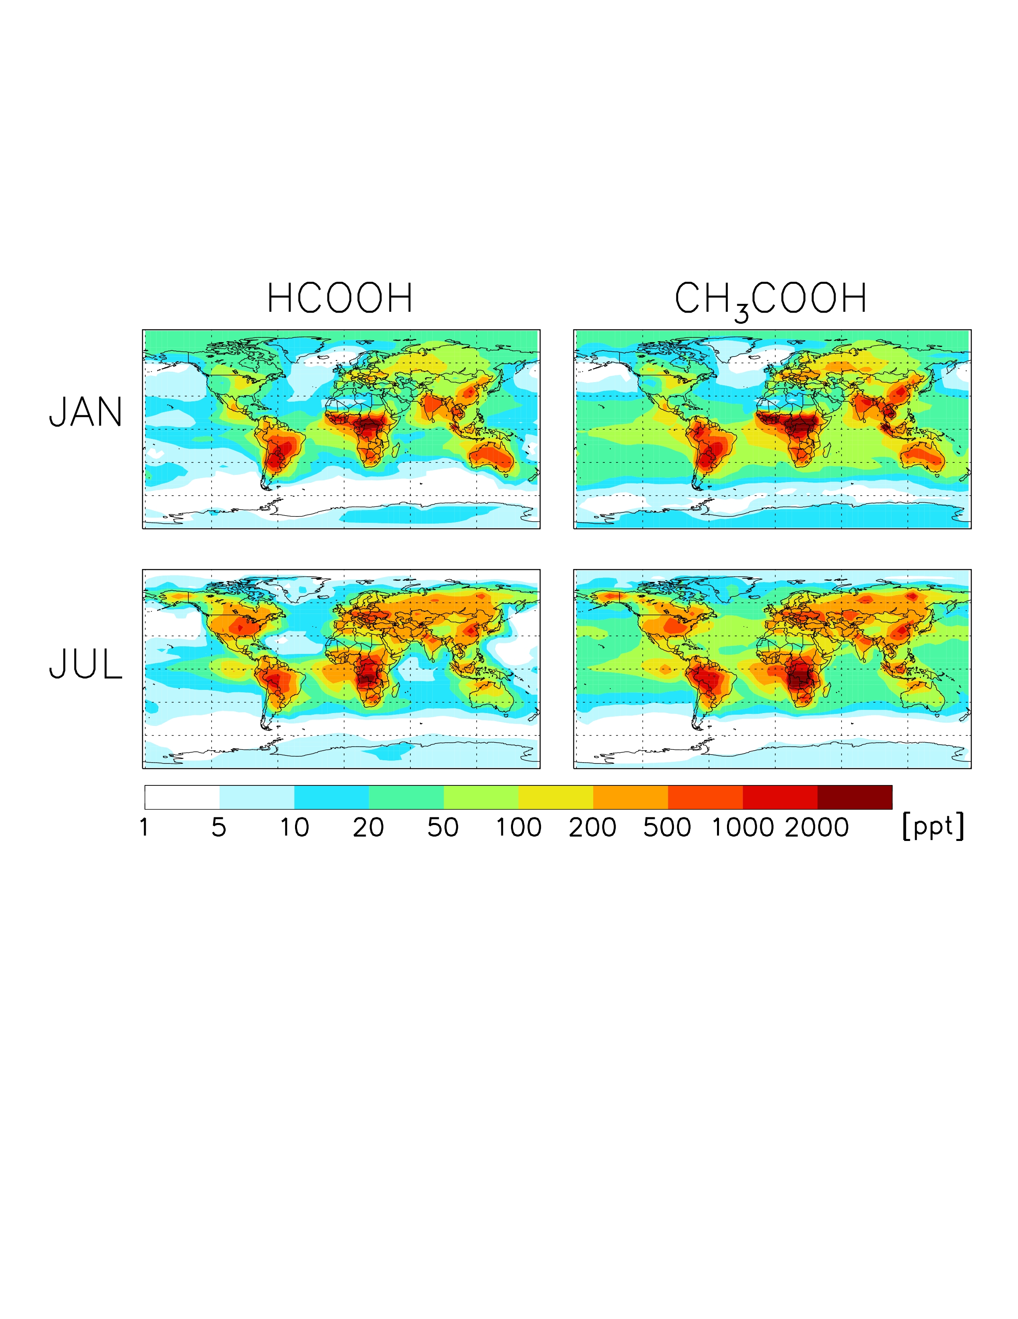
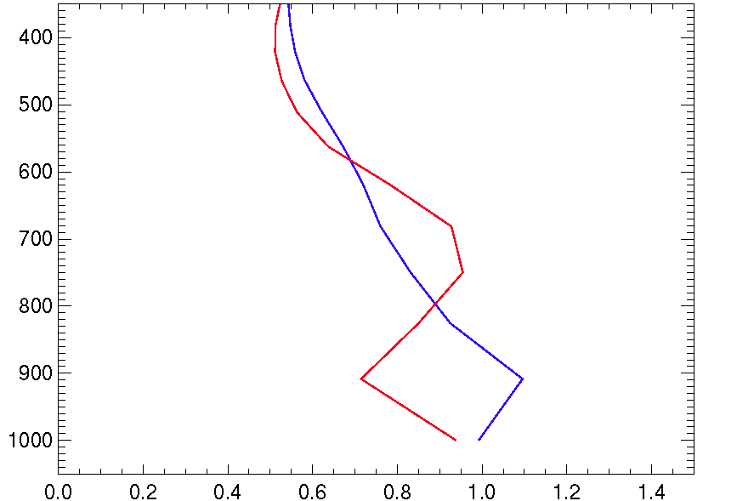
TES and CrIS versus surface NH₃
QCL directly under TES transect in the San Joaquin Valley on January 28, 2013
QCL Surface Data
TES Transect Data
CrIS Swath Data

Slide 12
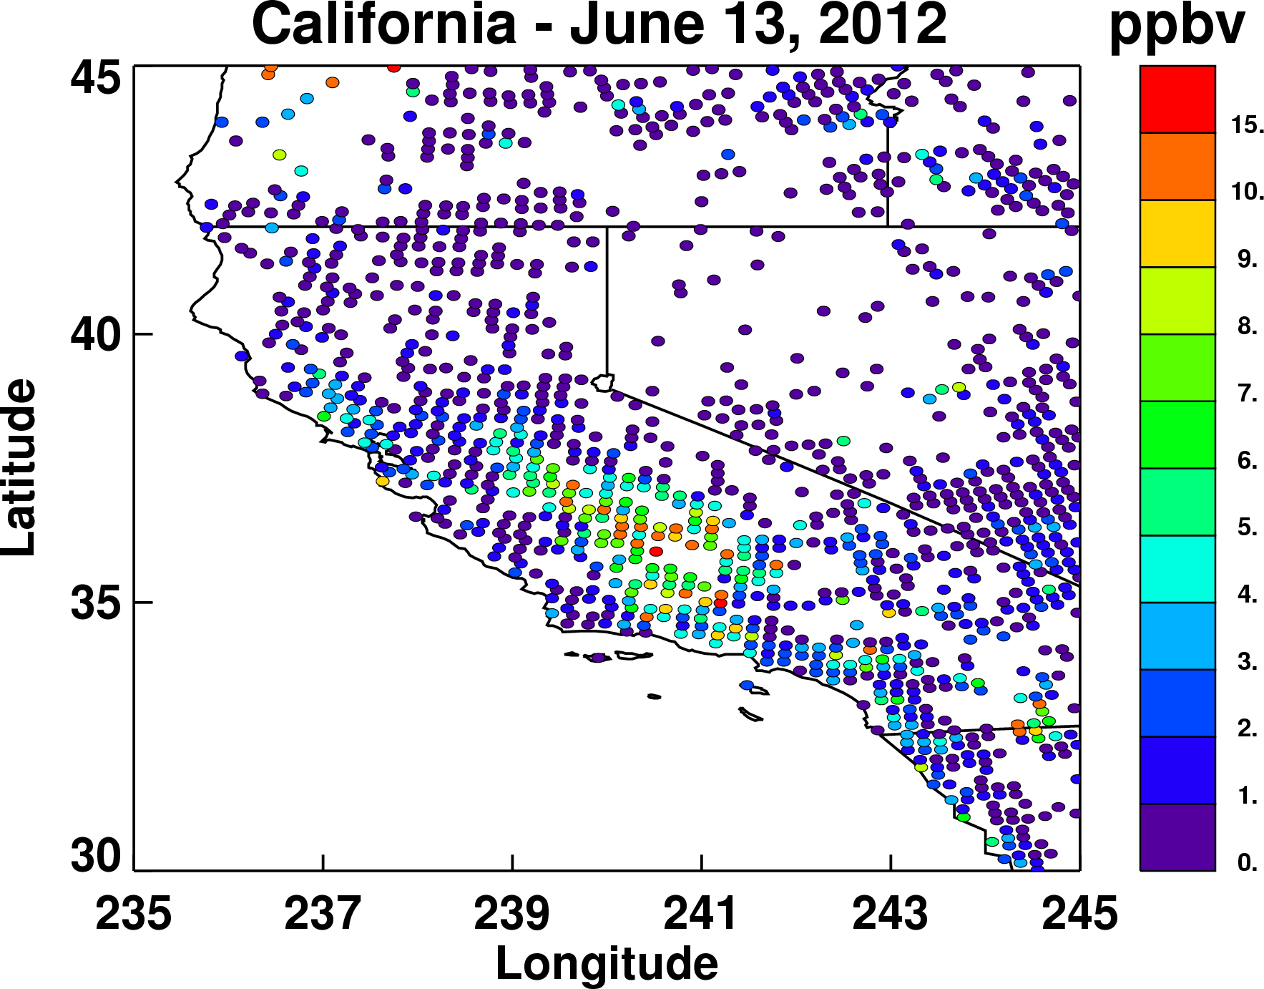
Application of CrIS NH₃ to California

Slide 13
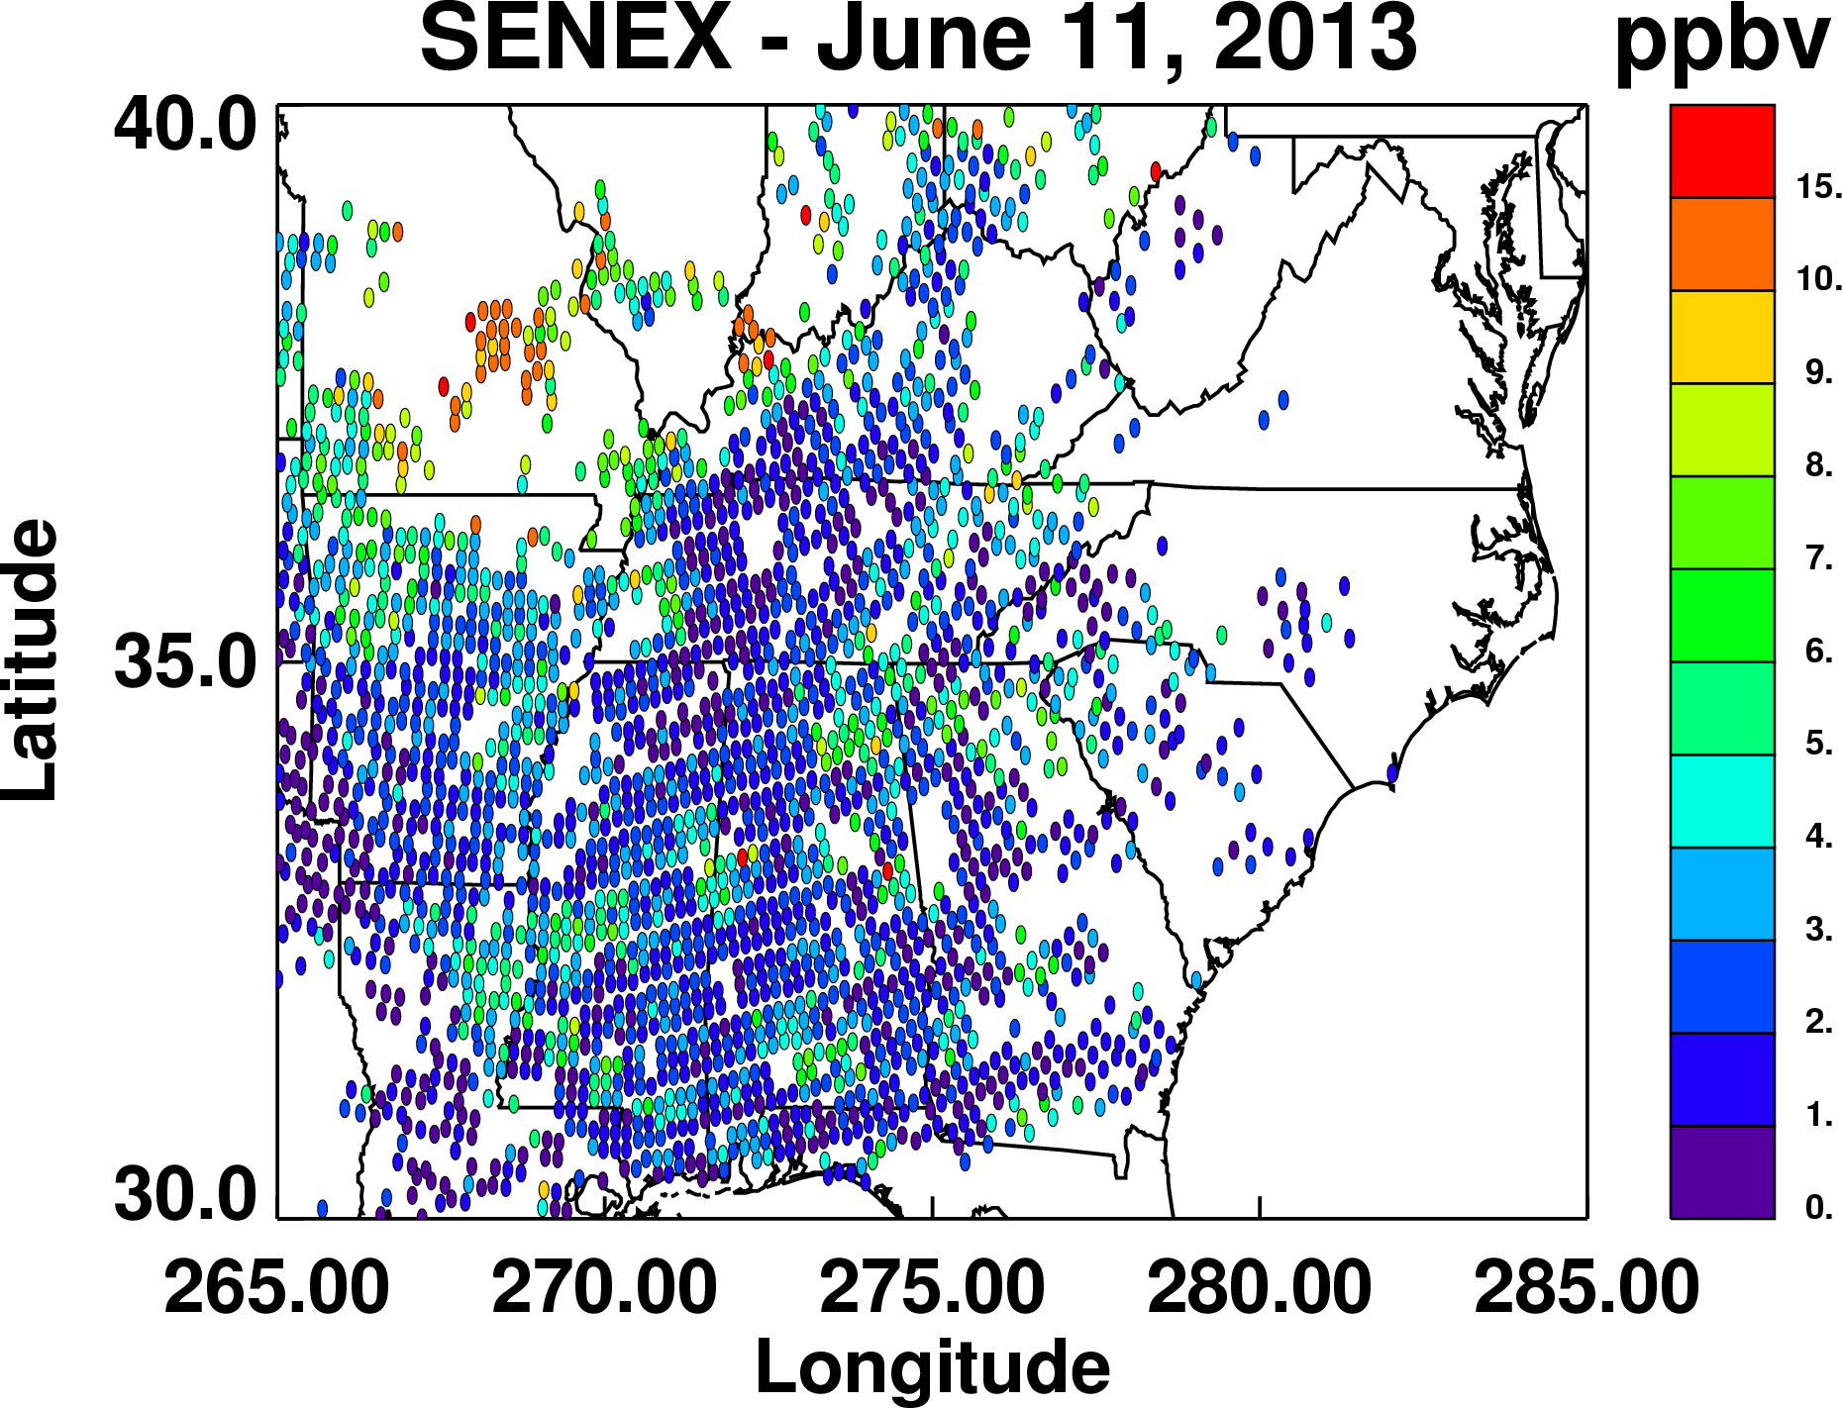
Application of CrIS NH₃ to SENEX

Slide 14
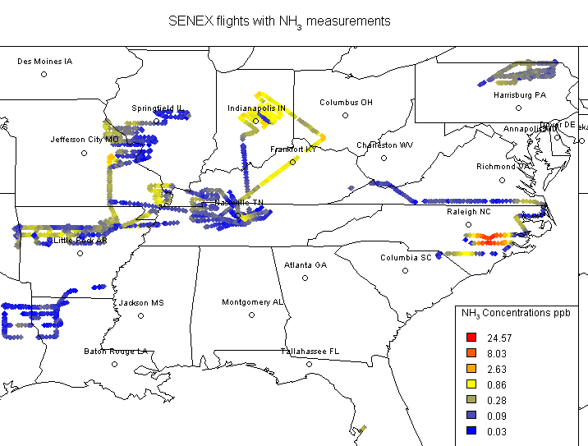
Future Work on CrIS NH₃ Retrieval
  Validate against SENEX, FRAPPE, and other field NH₃ measurements.
  Use CMAQ adjoint to test ability of CrIS to optimize NH₃ emissions.
  Deliver CrIS NH₃ retrieval algorithm to NASA
SENEX Flights with NH₃ Measurements
NH₃ mixing ratios (ppbv) measured by the NOAA WP-3 aircraft during SENEX 2013. (Figure courtesy of Jesse Bash, US EPA NERL.)

Slide 15
Summary
A prototype NH₃ retrieval for CrIS, based on the TES algorithm, has been built and tested
  LOD ~ 1 ppb, DOFS < 1.0, sensitive slightly higher in atmosphere than TES
  Algorithm performs well for simulated spectra
  Qualitatively similar to surface data from DISCOVER-AQ
  Further validation needed (e.g., SENEX and FRAPPE)
CrIS NH₃ retrievals will be used to study NH₃ emissions in California and Southeast US (e.g., SENEX)
Algorithm will be delivered to NASA SIPS for processing

Slide 16
Acknowledgements
Juliet Zhu, Colorado State University
John Walker and Robert Pinder, EPA
Armin Wisthaler, University of Innsbruck
Kang Sun and Mark Zondlo, Princeton
Amy Jo Scarino, NASA Langley
Ming Luo, Jet Propulsion Laboratory, California Institute of Technology
    NOAA CPO AC4 Program Grant Numbers NA13OAR4310060 and NA14OAR4310129
TES Science Team
NASA Suomi-NPP Science Team

Slide 17
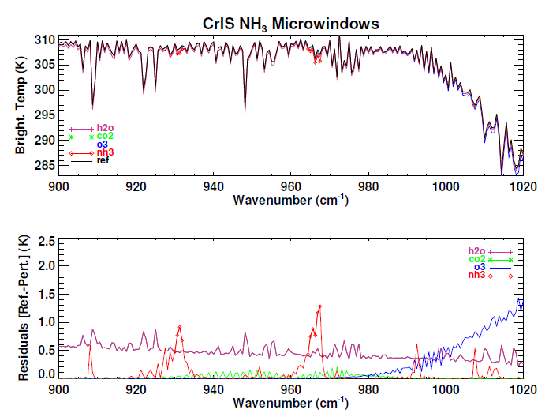
CrIS microwindows and constraints
Lower spectral resolution of CrIS required different microwindows.
A priori and constraints from TES (Shephard et al., 2011)
  Polluted, Moderately polluted, and Unpolluted profiles
A priori selected based on signal to noise ratio (SNR) and thermal contrast

