Slide 1



Estimating Empirical Sensitivities of Air Pollutants to Emissions Using Statistical Modeling
Lucas Henneman, David Lavoué, Heather Holmes, Howard Chang, KJ Liao, Jim Mulholland, Armistead Russell
Georgia Institute of Technology
Atlanta, GA

Slide 2
Acknowledgements
This material is based upon work supported by Health Effects Institute and the National Science Foundation Graduate Research Fellowship under Grant No. DGE-1148903.
Gil Grodzinsky and Jon Morton of the Georgia Environmental Protection Division Air Protection Branch
Southeastern Aerosol Research and Characterization Network (SEARCH)
EPA Air Markets Database
Fellow researchers at Georgia Tech and Emory

Slide 3
Air Pollution Accountability
Health Effects Institute. (2003). Assessing the Health Impact of Air Quality Regulations: Concepts and Methods for Accountability Research
Notes:
----- Meeting Notes (10/6/14 11:30) -----
When we look at trying to connect the first three boxes, which is the goal of our side of the project, a number of challenges arise

Slide 4
Motivation
Develop daily time series of factual and counterfactual concentrations for health effects assessment
Results will estimate number of health outcomes avoided by controls
Potential Approaches
  Statistical models
    Better capture natural variability and estimate uncertainty
    Empirical link to emissions changes
  Chemical transport models (next phase)
    Can directly link emissions to air quality changes
    Tend to smooth out trends and have biases

Slide 5
Challenges
Many regulations implemented simultaneously across different sectors
Compliance timelines and effectiveness are not uniform
Variability in measurements due to meteorological fluctuations
Anticipated future regulations, changing demand, fuel costs, etc. drive actions by emitters
Notes:
take actions such as retrofitting a plant to a new fuel, installing controls, or switching load between different plants for
operators may act for reasons besides current regulations, such as

Slide 6
Approach
Raw Concentrations
Emissions Estimates
Meteorological Detrending
Reduction Estimates
Detrended Concentrations
*
Counterfactual Emissions
Counterfactual Concentrations
Counterfactual Health Outcomes
*S: Sensitivity

Slide 7
Meteorological Detrending
Raw Concentrations
Detrended Concentrations
SIGNAL(t) = LT(t) + S(t) + W(t) + STM(t) + D(t)
Where (period in parentheses):
LT: Long Term (>365 days)
S: Seasonal (365 days)
W: Weekly (7 days)
STM: Short Term Meteorological (1-30 days)
D: Daily (1 day)
Notes:
LT component in species decomposition combines changes in background concentra- tions, climate, and precursor emissions (in secondary emissions) [6, 12].
The weekly signal W is assumed to only be present in the species concentrations since human patterns of activity do not have substantial effect on short-term meteorology.
Pollutant species (espe- cially primary pollutants) show a distinct weekly trend.
The goal of the detrending is to quantify and remove the STM signal so that the remaining daily signal is not affected by meteorological fluctuations.
Two methods: mean

Slide 8
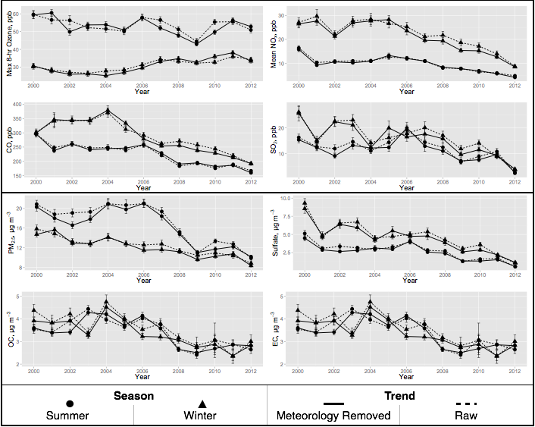
Detrended Ozone
Raw Concentrations
Detrended Concentrations
Highest levels are decreasing while lowest levels are increasing

Slide 9
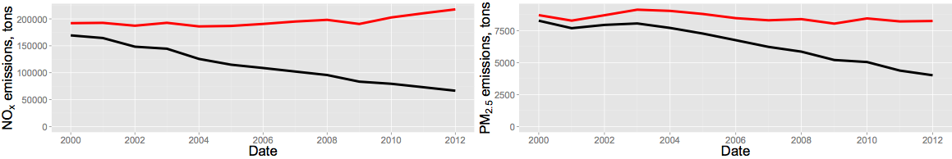
MOVES-Modeled
Mobile Emissions
Emissions Estimates
Counterfactual Emissions
Annual Average Vehicle Miles Traveled (~12% Increase)
NO_{x} Emissions
PM_{2.5} Emissions
Actual Counterfactual

Slide 10
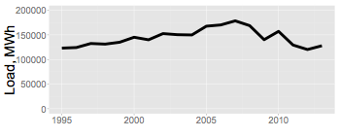
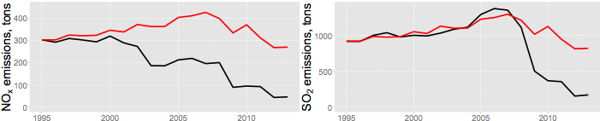
EGU Emissions
Emissions Estimates
Counterfactual Emissions
Load for all plants in Atlanta
NO_{x} Emissions
SO₂ Emissions
Actual Counterfactual

Slide 11
Pollutant Sensitivities
Counterfactual Concentrations
Sensitivities: relationship between observed concentration and emission
∆C: difference between observed and counterfactual
∆C added to original observed to return counterfactual

Slide 12
Calculating Ozone
Sensitivities
Counterfactual Concentrations
V_{t}: auto-regressive model with normal errors

Slide 13
Comparison of Sensitivities to CMAQ DDM Results
Sensitivity to 100% reduction in emissions (ppb)

Slide 14
Ozone sensitivities have decreased
Positive response to NO_{x} controls (ozone goes down)
Range of proposed standard
Negative response to NO_{x} controls (ozone goes up)
Relatively
insensitive

Slide 15
Counterfactual Annual
Ozone Concentrations
Counterfactual Concentrations

Slide 16
Counterfactual Daily
Ozone Concentrations
Counterfactual Concentrations
Notes:
Maintains natural variability

Slide 17
Assumptions/Limitations
Only included on-road and EGU emissions in counterfactuals so far
Counterfactual EGU emissions: account for all factors that affect emission factors (fuel changes, improved efficiency of distribution, etc.)
Individual mobile pollutants (NO_{x}, CO, SO₂, etc.) are too correlated include separately in sensitivity models

Slide 18
Summary
Annual ozone distributions have decreased in width due to emissions controls
Controls have had little effect on median ozone concentrations
Statistical modeling can produce sensitivities that are comparable with CMAQ-DDM
Impact of reducing NO_{x} emissions has decreased as the distribution of ozone has shrunk
Notes:
Difference of 4 ugm3 max in 2012
5 ugm3 difference in median between 2000 and 2012

Slide 19
Thank You

Slide 20
Backup Slides

Slide 21
Detrended Concentrations
Raw Concentrations
Detrended Concentrations

Slide 22
Counterfactual Annual
PM_{2.5} Concentrations
Counterfactual Concentrations

Slide 23
PM_{2.5} Sensitivities to
Mobile and EGU Emissions
Counterfactual Concentrations
Long-term
Seasonal
Daily

Slide 24
Counterfactual Annual
Sulfate Concentrations
Counterfactual Concentrations

Slide 25
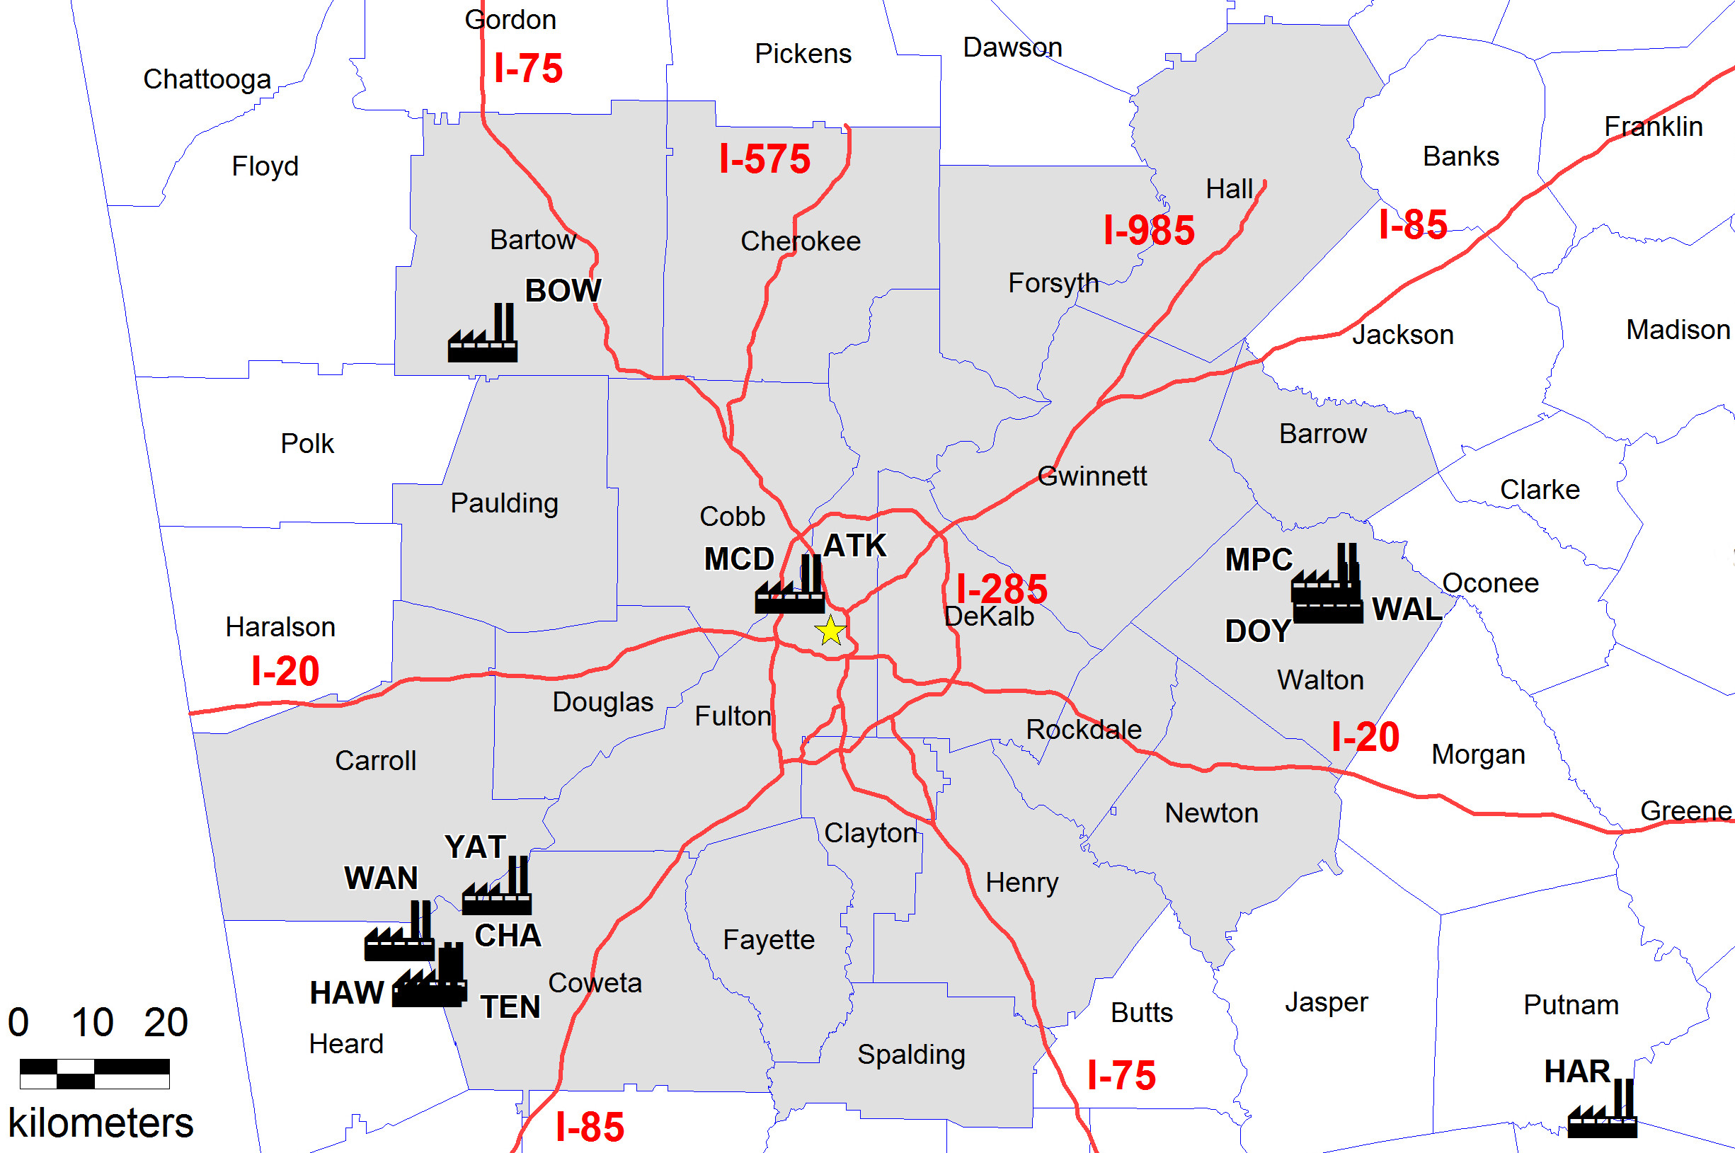
Study Area
JST
Notes:
20 county nonattainment (8hr ozone standard)
Other point sources are likely important, but they likely vary with these (variations are important in statistical modeling)

Slide 26
PM in Atlanta
Historically dominated by sulfate (SO₄²⁻) and organic carbon
Nitrate (NO₃²⁻), ammonia (NH₄⁺), and black carbon (BC) present to lesser extent
Seasonality?

Slide 27
Controls/actions of Interest
Georgia Gasoline
Switching coal to less sulfur
Georgia multipollutant rule
CAIR
Switching to natural gas
Plant operators may install controls/switch fuels for a number of reasons:
  Combinations of regulations
  Projected future regulations
  price

Slide 28
Air Pollution Regulations
Legal basis provided by the Clean Air Act Amendments (1990)
NAAQS: O₃, NO₂, SO₂, PM_{(10 &} _{2.5)}, CO, and Pb
2 paths to lowering emissions:
  Regulatory programs that target specific sources
  National Ambient Air Quality Standards (and associated State Implementation Plan (SIP) Calls)
SIPs require states to develop local regulatory programs
Source-specific regulations target many industrial sources

Slide 29


Mobile Regulations
National Programs – target vehicle and fuel together
  Tier 2 Vehicle and Gasoline Sulfur Program (Phased in 2004-9)
  The Heavy-Duty Highway Rule (2007)
Georgia Programs
  Georgia Gasoline (2000-2004)
  Inspection and Maintenance (1993 and on)
www.gobytrucknews.com
solarenergy-usa.com

Slide 30
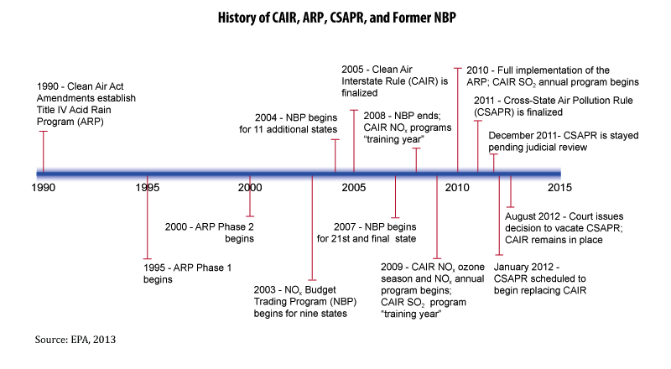
EGU Regulations

Slide 31

EGU Regulations – Georgia SIPs
Ozone season (May-Sept) NO_{x} controls on coal-fired EGUs (2003-2008)
Georgia Multipollutant Control for Electric Utility Steam Generating Units (2008 and on)
  Required specific controls on units
Plant Bowen
wikipedia.org

Slide 32
Detrended PM Species
Individual daily adjustments may be large, but do not necessarily translate into large differences in seasonal averages

Slide 33
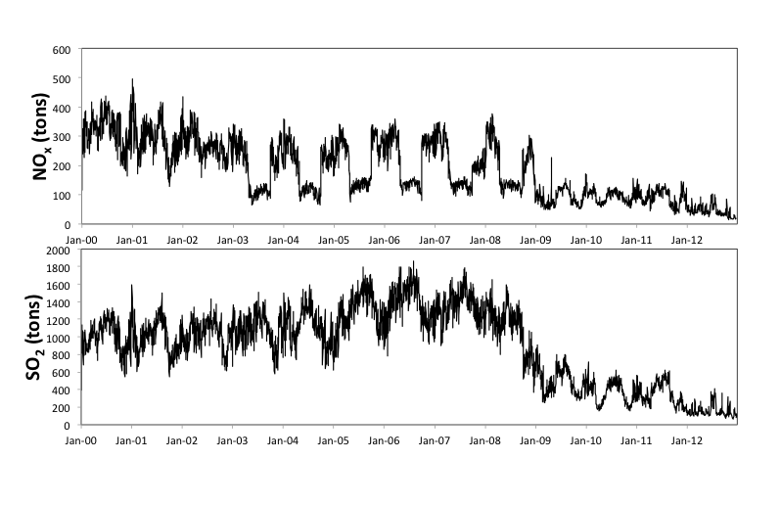
Atlanta-area EGU Emissions
EPA Air Markets Database
Notes:
More difficult to ‘see’ (or model) changes in mobile emissions

Slide 34
Meteorological Detrending
A daily pollutant concentration or meteorology signal can be decomposed (or detrended) into components:
ln[SIGNAL(t)] = LT(t) + S(t) + W(t) + STM(t) + WN(t)
and
SIGNAL(t) = exp[LT(t) + S(t) + W(t) + STM(t) + WN(t)]
Where (period in parentheses):
LT: long-term (>365 days)
S: seasonal (365 days)
W: weekly (7 days)
STM: short-term meteorological (1-30 days)
WN: white-noise (1 day)
A log transform is used before detrending to ensure that the variance of each component is stable across the length of the time series for the regression
Notes:
LT component in species decomposition combines changes in background concentra- tions, climate, and precursor emissions (in secondary emissions) [6, 12].
The weekly signal W is assumed to only be present in the species concentrations since human patterns of activity do not have substantial effect on short-term meteorology.
Pollutant species (espe- cially primary pollutants) show a distinct weekly trend.
The goal of the detrending is to quantify and remove the STM signal so that the remaining daily signal is not affected by meteorological fluctuations.
Two methods: mean

Slide 35
Atlanta-Area
Anthropogenic Sources
NO_{x}
PM_{2.5}
2002 2005 2008 2011
2002 2005 2008 2011
2002 2005 2008 2011
SO₂
VOCs
2002 2005 2008 2011
2002 2005 2008 2011
EPA National Emissions Inventories
Notes:
Major sources of each pollutant
----- Meeting Notes (10/6/14 11:30) -----
My own broad categories

Slide 36
Estimating Counterfactual EGU Emissions
Emissions Ration (ER) calculated for base year (1995) using load (L)
ER₁₉₉₅ multiplied by L to estimate counterfactual emissions
Takes into account all factors that lead to change in emissions, not just controls
Notes:
Will want to discuss potential of using electricity generated.

Slide 37
Kolmogorov-Zurbenko Filter
Kolmogorov-Zurbenko (KZ) filter, a multiple-pass moving average filter with parameters m and p.
m defines the window length, and p the number of passes
Rao and his coworkers have shown that different combinations of m and p yield specific cutoff frequencies
The algorithm in R can handle missing values
Notes:
`It’s a moving average filter, many people in the field use it because it is robust to missing values and has clean cutoff frequencies.

Slide 38
KZ Ensemble Method
LT is captured in both species and meteorological data using a window of 365 days passed over 3 times (denoted KZ_{365,3})
LT is subtracted, and S is captured by applying a KZ_{15,5} filter to the remainder and averaging the result over the 365-day year
LT and S are subtracted from the species and meteorological signals to yield ∆ terms

Slide 39
Calculating STM
Multilinear least squares regression is used to calculate STM – X is the matrix of ∆M and weekday and holiday factors
The best fit of the regression is used to calculate STM:
STM is removed from the original signal to produce a meteorologically-adjusted time series

Slide 40
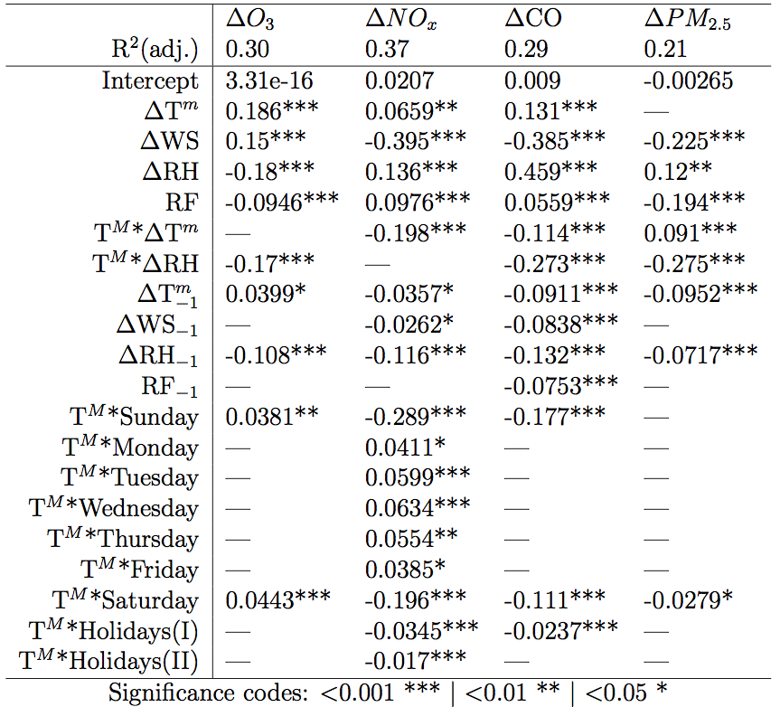
Regression Coefficients (ß)

Slide 41
Correlations (R²) of Total Model Fit
 | KZ Ensemble | Mean Year
Ozone (Max 8-hr) | 0.62 | 0.61
Ozone (Daily Max) | 0.69 | 0.67
Ozone (24-hr Mean) | 0.61 | 0.62
NOx (Daily Mean) | 0.71 | 0.69
NOx (Morning Mean) | 0.62 | 0.60
CO (Daily Mean) | 0.15 | 0.13
CO (Morning Mean) | 0.37 | 0.33
SO2 (Daily Mean) | 0.28 | 0.19
PM2.5 (Daily Mean) | 0.53 | 0.53

Slide 42
PM_{2.5} Sensitivities to Mobile and EGU Emissions
Estimated with a linear regression
Includes auto-regressive model with normal errors:
Notes:
Only capturing mobile and EGU emissions, not biogenic, dust, burning, etc
R2 or 0.46

Slide 43
Sulfate Sensitivities to Mobile and EGU Emissions
Estimated with a linear regression
SO₂* captures Meteorology – SO₂ impact
Notes:
R2 or 0.46

Slide 44
Meteorologically-Detrended Ozone
Raw
Meteorologically Detrended

Slide 45
Southeast Controls
Legal basis provided by The Clean Air Act Amendments (1990)
Controls aim at reducing both exhaust and evaporative emissions
Regulations are both national (written by the EPA) or local (written by Georgia EPD)
Regulations are in three general categories:
  Gasoline and diesel engines (both on- and off-road)
  Electricity generating units (EGU’s)
  Local controls

Slide 46
Approach
Raw Concentrations
Emissions Estimates
Meteorological Detrending
Reduction Estimates
Detrended Concentrations
*
Counterfactual Emissions
Detrended Counterfactual Concentrations
Add meteorology
Counterfactual Concentrations
*S: Sensitivity

Slide 47
Questions for EPD
What is the best way to get mobile emissions estimates for the time period (daily, monthly)?
Are there Miles Driven (per day or per month) estimates?
Electricity demand in Atlanta area?
Which programs are of greatest interest to the EPD?

Slide 48
Empirical Ozone Sensitivities
S is estimating with a nonlinear regression (depends on ozone level and temperature):
ν_{t} is an auto-regressive model of order-1:
Therefore, S is calculated for each day:

Slide 49
Counterfactual annual Sulfate Concentrations (regional emiss)

Slide 50
Counterfactual Annual Sulfate Concentrations

Slide 51
Counterfactual Annual PM_{2.5} Concentrations
Notes:
Difference of about 4ugm3 in later years, up to 7 in 2010

Slide 52
Anthropogenic PM_{2.5} Contributions
S^{TOT} S^{MOB} S^{EGU}
Notes:
Mobile seasonality: based on MOVES’s monthly splits of VMT and fuel formulation, weekday/weekday. Can see when SO2 controls go in

Slide 54
Empirical Ozone Sensitivities
Estimated with a nonlinear regression:
ν_{t} is an auto-regressive model of order-1:
Notes:
R2 of 0.98
w/out detrending, R2 of 0.90

Slide 55
Sulfate Contributions
Total EGU Mobile SO₂*
Notes:
Maybe plot sulfate concentrations on same slide?
In 2000, sulfate conc. up to 30ugm-3, since 2008, very few days over 10 ugm-3.

Slide 56
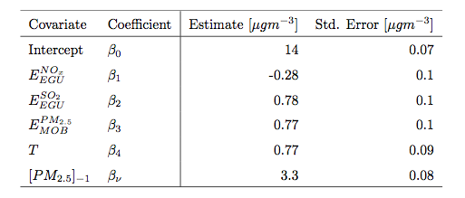
Sulfate contributors (scaled)
Covariate | Estimate [µg m⁻³] | Std. Error [µg m⁻³]
Intercept | 3.6 | 0.03
E_{NOx,EGU} | 0.18 | 0.04
E_{SO2,EGU} | 0.53 | 0.04
E_{NOx,EGU} | 0.86 | 0.04
SO₂* | 2.7 | 0.03
RH | 0.064 | 0.03
T | -0.31 | 0.03
Lag 1 [SO₄²⁻] | 0.56 | 0.03

