Slide 1
Multiscale Kain-Fritsch Scheme:
Formulations and Tests
Kiran Alapaty¹, John S. Kain², Jerold A. Herwehe¹, O. Russell Bullock Jr. ¹, Megan S. Mallard³, Tanya L. Spero ¹, and Christopher G. Nolte¹
¹National Exposure Research Laboratory, U.S. Environmental Protection Agency,
Research Triangle Park, NC
²National Severe Storms Laboratory, National Oceanic Atmospheric Administration,
Norman, Oklahoma
³Institute for Environment, University of North Carolina, Chapel Hill, NC
US EPA

Slide 2
Forewords…
Kain-Fritsch Convection Parameterization is the most widely used scheme in:
Global Models & Regional Models
Europe, Asia, and US
KF scheme is designed for ~25 km grids→ no scale dependency
This research is geared to benefit climate simulations – based on GCM and LES modeling studies
A small step forward to achieve scale independency improving climate simulations
Evaluation results were presented by Jerry Herwehe (Pls see his poster)
Notes:
Any improvements that we make will help a large number of researchers and communities

Slide 3
Our Broad Objective…
Develop credible regional climate projections for use in air quality, ecosystems, and human health research studies at the US EPA.
US EPA

Slide 4
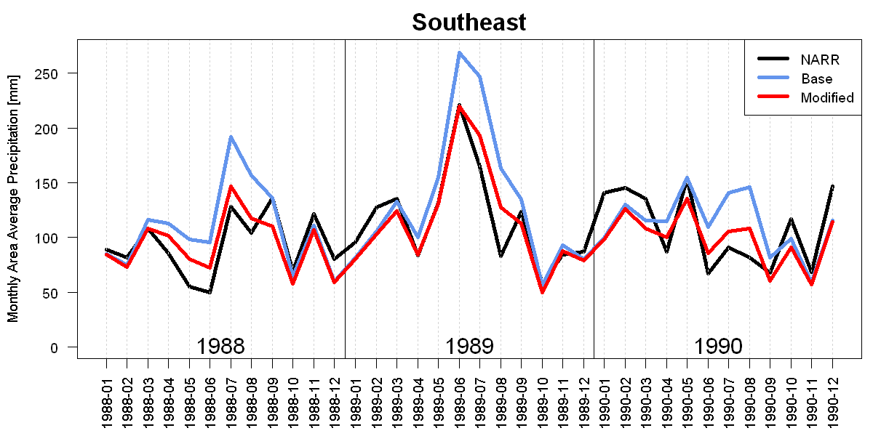
Impacts of introducing KF Cloud-Radiation Interactions
Surface Precipitation for Southeast U.S.A.
at 36 km grids in the WRF model
US EPA
Wet bias from Kain-Fritsch convection scheme is largely eliminated at 36 km grids
Alapaty et al., 2012, GRL; Herwehe et al., 2014, JGR
Notes:
Climate Branch at EPA is developing regional climate data sets for use with ecosystem and human exposure studies. Credibility of regional climate data is very important for our exposure studies and thus improved the WRF regional climate simulations by incorporating cloud-radiation interactions increasing the credibility of climate simulations. With this we can have confidence in our future climate projections using this improved model.

Slide 5
US EPA
Regional Climate Simulations
(12 km grid spacing)
using the WRF model
Notes:
Climate Branch at EPA is developing regional climate data sets for use with ecosystem and human exposure studies. Credibility of regional climate data is very important for our exposure studies and thus improved the WRF regional climate simulations by incorporating cloud-radiation interactions increasing the credibility of climate simulations. With this we can have confidence in our future climate projections using this improved model.

Slide 6
Weather Research & Forecasting (WRF)
Model V3.6.1 for 12 km climate simulations
US EPA
Kain-Fritsch (KF) convective parameterization
RRTMG SW and LW radiation
WSM6 microphysics (plus 2 other)
YSU PBL
Revised Monin-Obukhov surface layer
Noah LSM
Mild analysis nudging of free atmosphere
u-v wind components, temperature : 5.0E-5 s⁻¹
moisture: 5.0E-6 s⁻¹
NCEP-DOE AMIP-II reanalysis (R-2) 1.875° data
DX = 12 km – JJA 2006 simulations
Notes:
12 km grids, 3.5 m simulation, physics, inputs, fdda, mpe, prism, cfsr, etc…

Slide 7
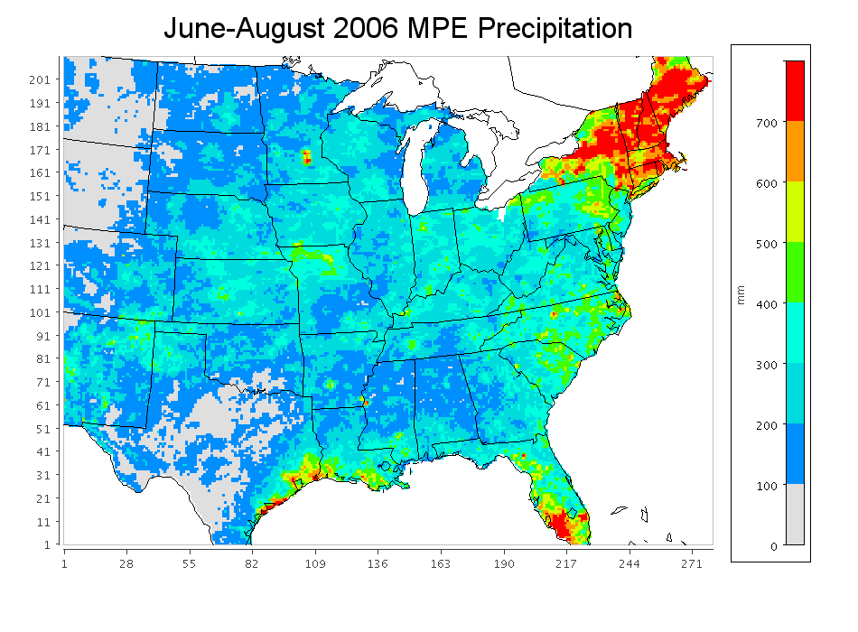
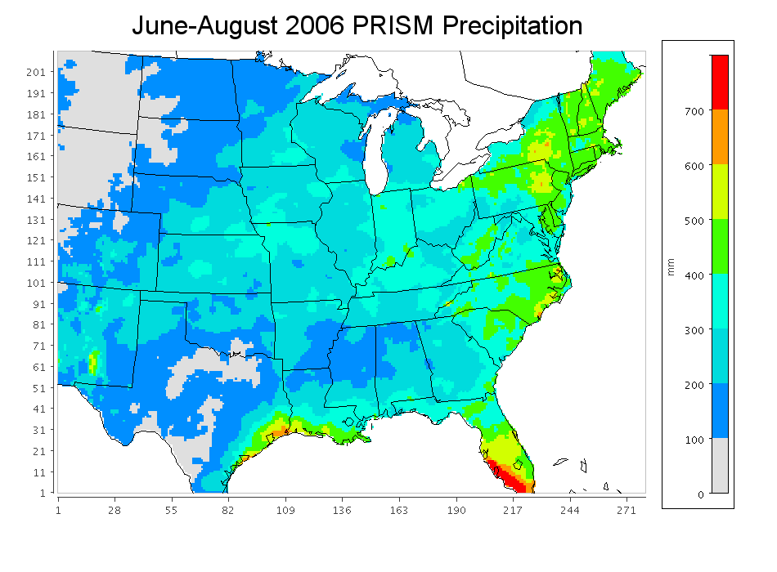
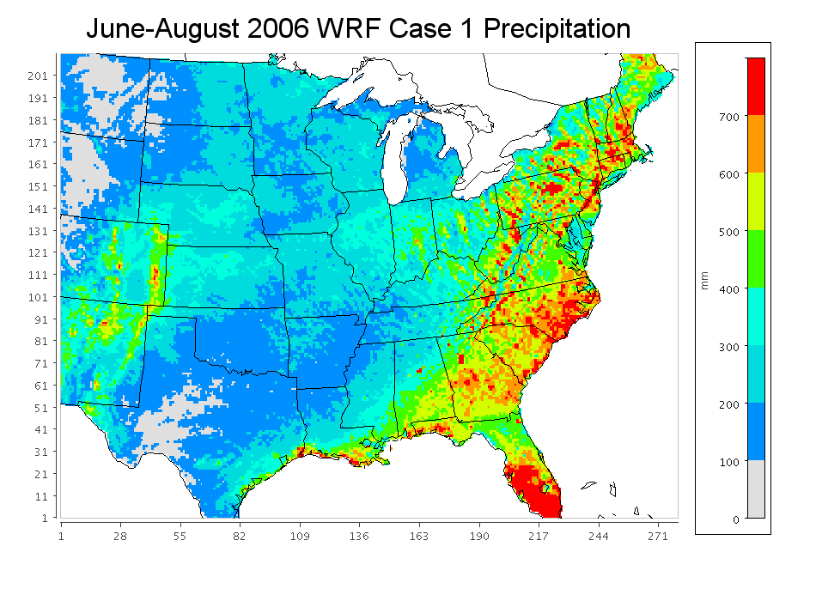
US EPA
Observations for
Precipitation from Two Different Sources
WRF 3.6β over-predicted surface Precipitation even with KF-Radiation Interactions
Wet Bias with the KF scheme

Slide 8
Which moist physics should restore stability to the atmosphere?
US EPA
KF = Kain Fritsch
E = Explicit/Resolved
KF scheme SHOULD
gradually drop out
Warm periods
----------------------------------------------------
KF & E schemes
Warm & Cool periods
E scheme
Grid Resolution
~36 km ………
………. ~1 km
One way to gradually dropout the KF is to control its ability to
stabilize the atmosphere and help to moisten the environment
Notes:
As resolution increases, a CPS should drop out smoothly such that as resolution increases, the influence of a CPS should decrease and almost cease at deep cloud resolving grid resolutions

Slide 9
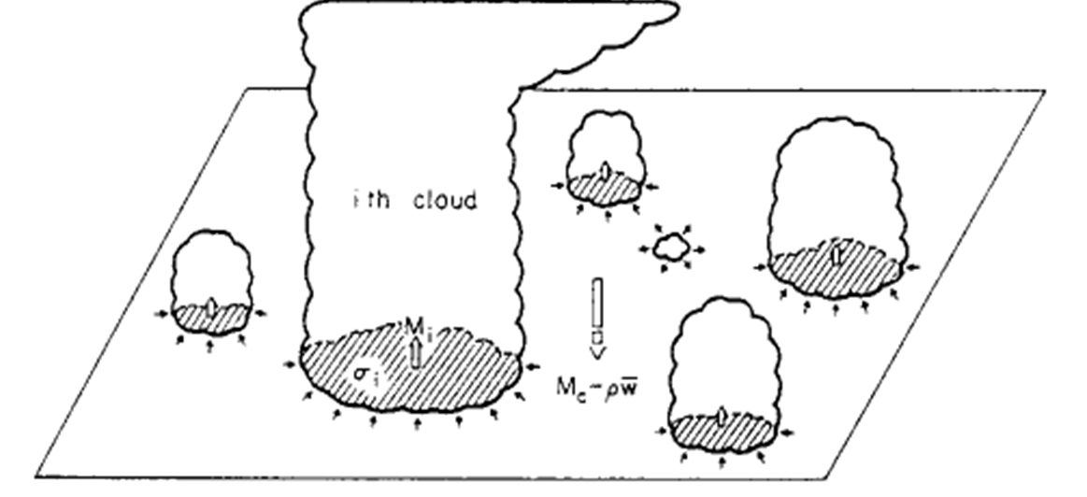
Arakawa & Schubert (1974) → at any grid resolution up to cloud resolving grids
MSKF Scheme β parameter
Alapaty et al. (2013)
Arakawa & Wu (2013)
Dependence of cloud fraction
on “Resolution” using a CRM (warm season)
25 km
Cloud Fraction

Slide 10
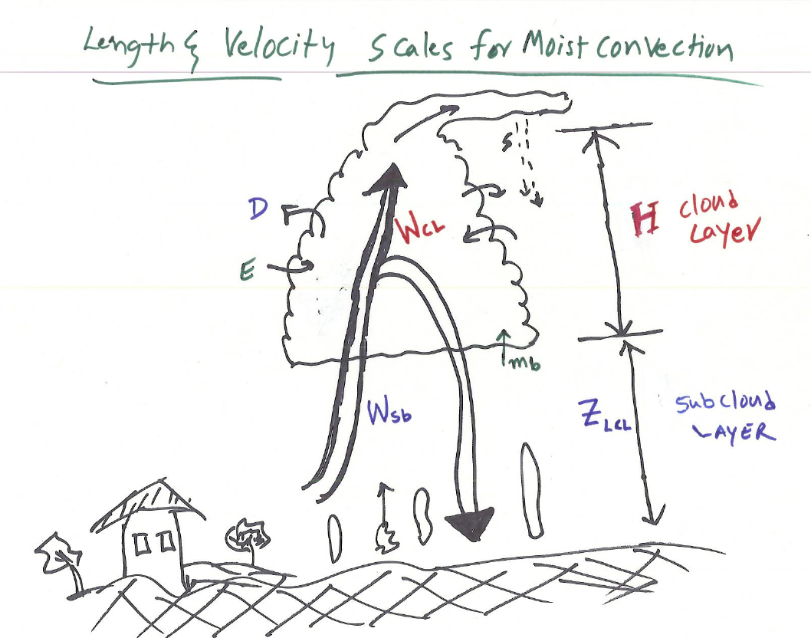
US EPA
Bulk Approach:
1:10 size
Pbl:clouds
Cloud layer length scale = H
Cloud layer velocity scale: W_{CL}
Sub-Cloud layer length scale = Z_{LCL}
Sub-cloud layer velocity scale: W_{Sb}
UNKNOWNS:
W_{CL} AND W_{Sb}
From Kiran’s notes

Slide 11
Developing Multiscale Kain-Fritsch Scheme to Transition Across Grid Spacing
KF parameters that control surface precipitation
(0) KF Cloud-Radiation interactions (NEW)
(1) Adjustment timescale (τ) (NEW)
(2) Minimum Entrainment (relax 2 km radius constraint) (NEW)
(3) Fallout RATE in Autoconversion (UPDATED)
(4) Stabilizing Capacity (UPDATED)
(5) Eliminate “double” counting of precipitation (NEW)
(6) Vertical momentum impacts: Impacts on grid-scale W using KF mass fluxes (NEW)
(7) New Trigger function suitable for high-resolution grids
(under development) (NEW)
Green = scale- dependent parameters
KF scheme is real good at 25 km grid spacing !
Notes:
Probable parameters that influence the estimation of surface precipitation in the KF scheme: these parameters need some scale dependency so that the KF scheme becomes something called a scale-independent (scale-aware) CP scheme

Slide 12
What is the Adjustment Timescale (τ ) for
Cumulus Clouds (both Deep & Shallow)?
It is the time needed to restore stability to
the atmosphere
Why is τ important?
In air pollution modeling it can influence
photolysis rates & sulphate aerosol
produced via oxidation of SO₂ in Clouds
In NWP & climate models it determines
duration of convective heating &
drying, precipitation, and radiative fluxes
In KF scheme
τ =U/dx
(0.5h to 1h)
GCM study of Bechtold et al. (2008)

Slide 13
Estimation of Cloud Velocity Scale, W_{CL} :
for Shallow Cumulus Clouds:
From Grant & Lock (2004) LES studies and BOMEX observations
Now, for Deep Cumulus Clouds…
Bullock et al. MWR revision
From Arakawa & Schubert (1974), Cloud Work Function per unit cloud base mass flux:
e.g, Old Grell scheme
where
When η = 1, then
Using the relation
or
13
13
13
Notes:
BOMEX = Barbados Oceanographic and Meteorological EXperiment

Slide 14
…..
Shallow Cumulus Clouds
Based on LES & Obs
Gran & Lock
2004
Irony:
Reveals gap
Between Shallow
and Deep Cumulus
Cloud modelers
Deep Cumulus Clouds
Based on Cloud Work Function
Bullock et al.
2014 in review
Notes:
Russ Bullock’s formulation

Slide 15
Two formulations for Convective Adjustment Timescale (Bullock et al., Alapaty et al.)
14
Notes:
W* does not exist in SBL but convective clouds do exist; also, over water/oceans W* is at best small +ve number (i.e, small SHF). So, new formulation works for land or water – continental clouds due to heating or large-scale forcing over land/water like in monsoon environments

Slide 16
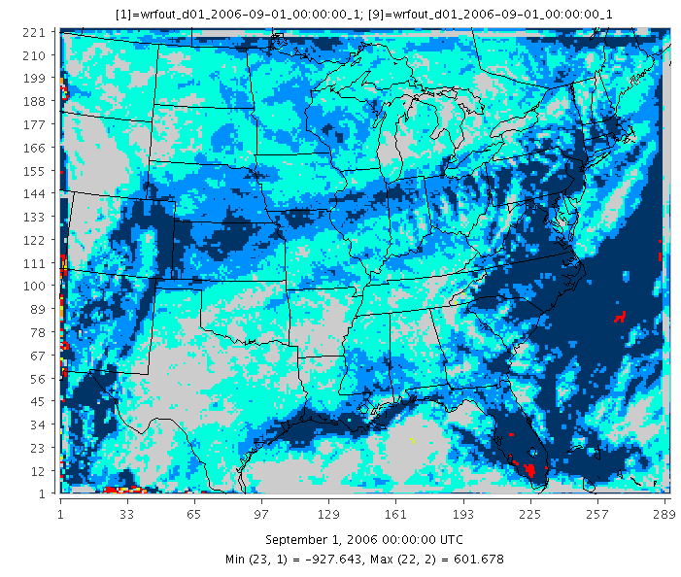
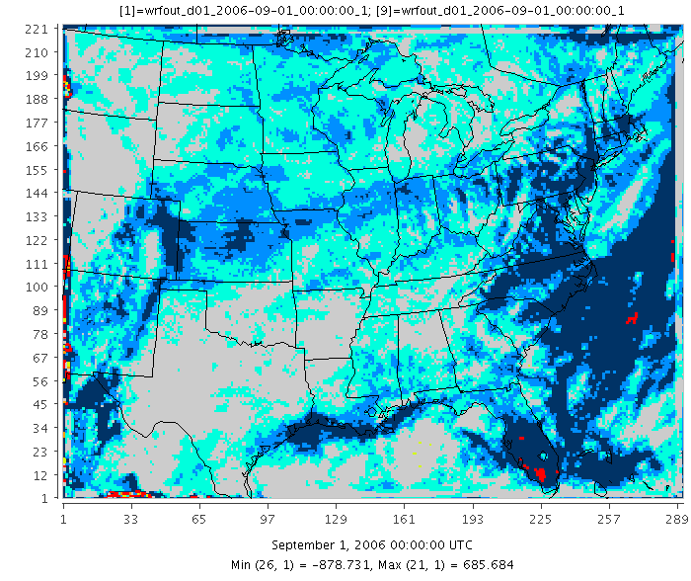
Developing Multiscale KF to Transition Across Grid Spacing: (1) New Adjustment Timescale, τ
OLD
τ =U/dx
(0.5h to 1h)
NEW
Bullock et al.
Alapaty et al.
JJA 2006 KF Precipitation Differences (NEW - OLD)
Notes:
1616

Slide 17
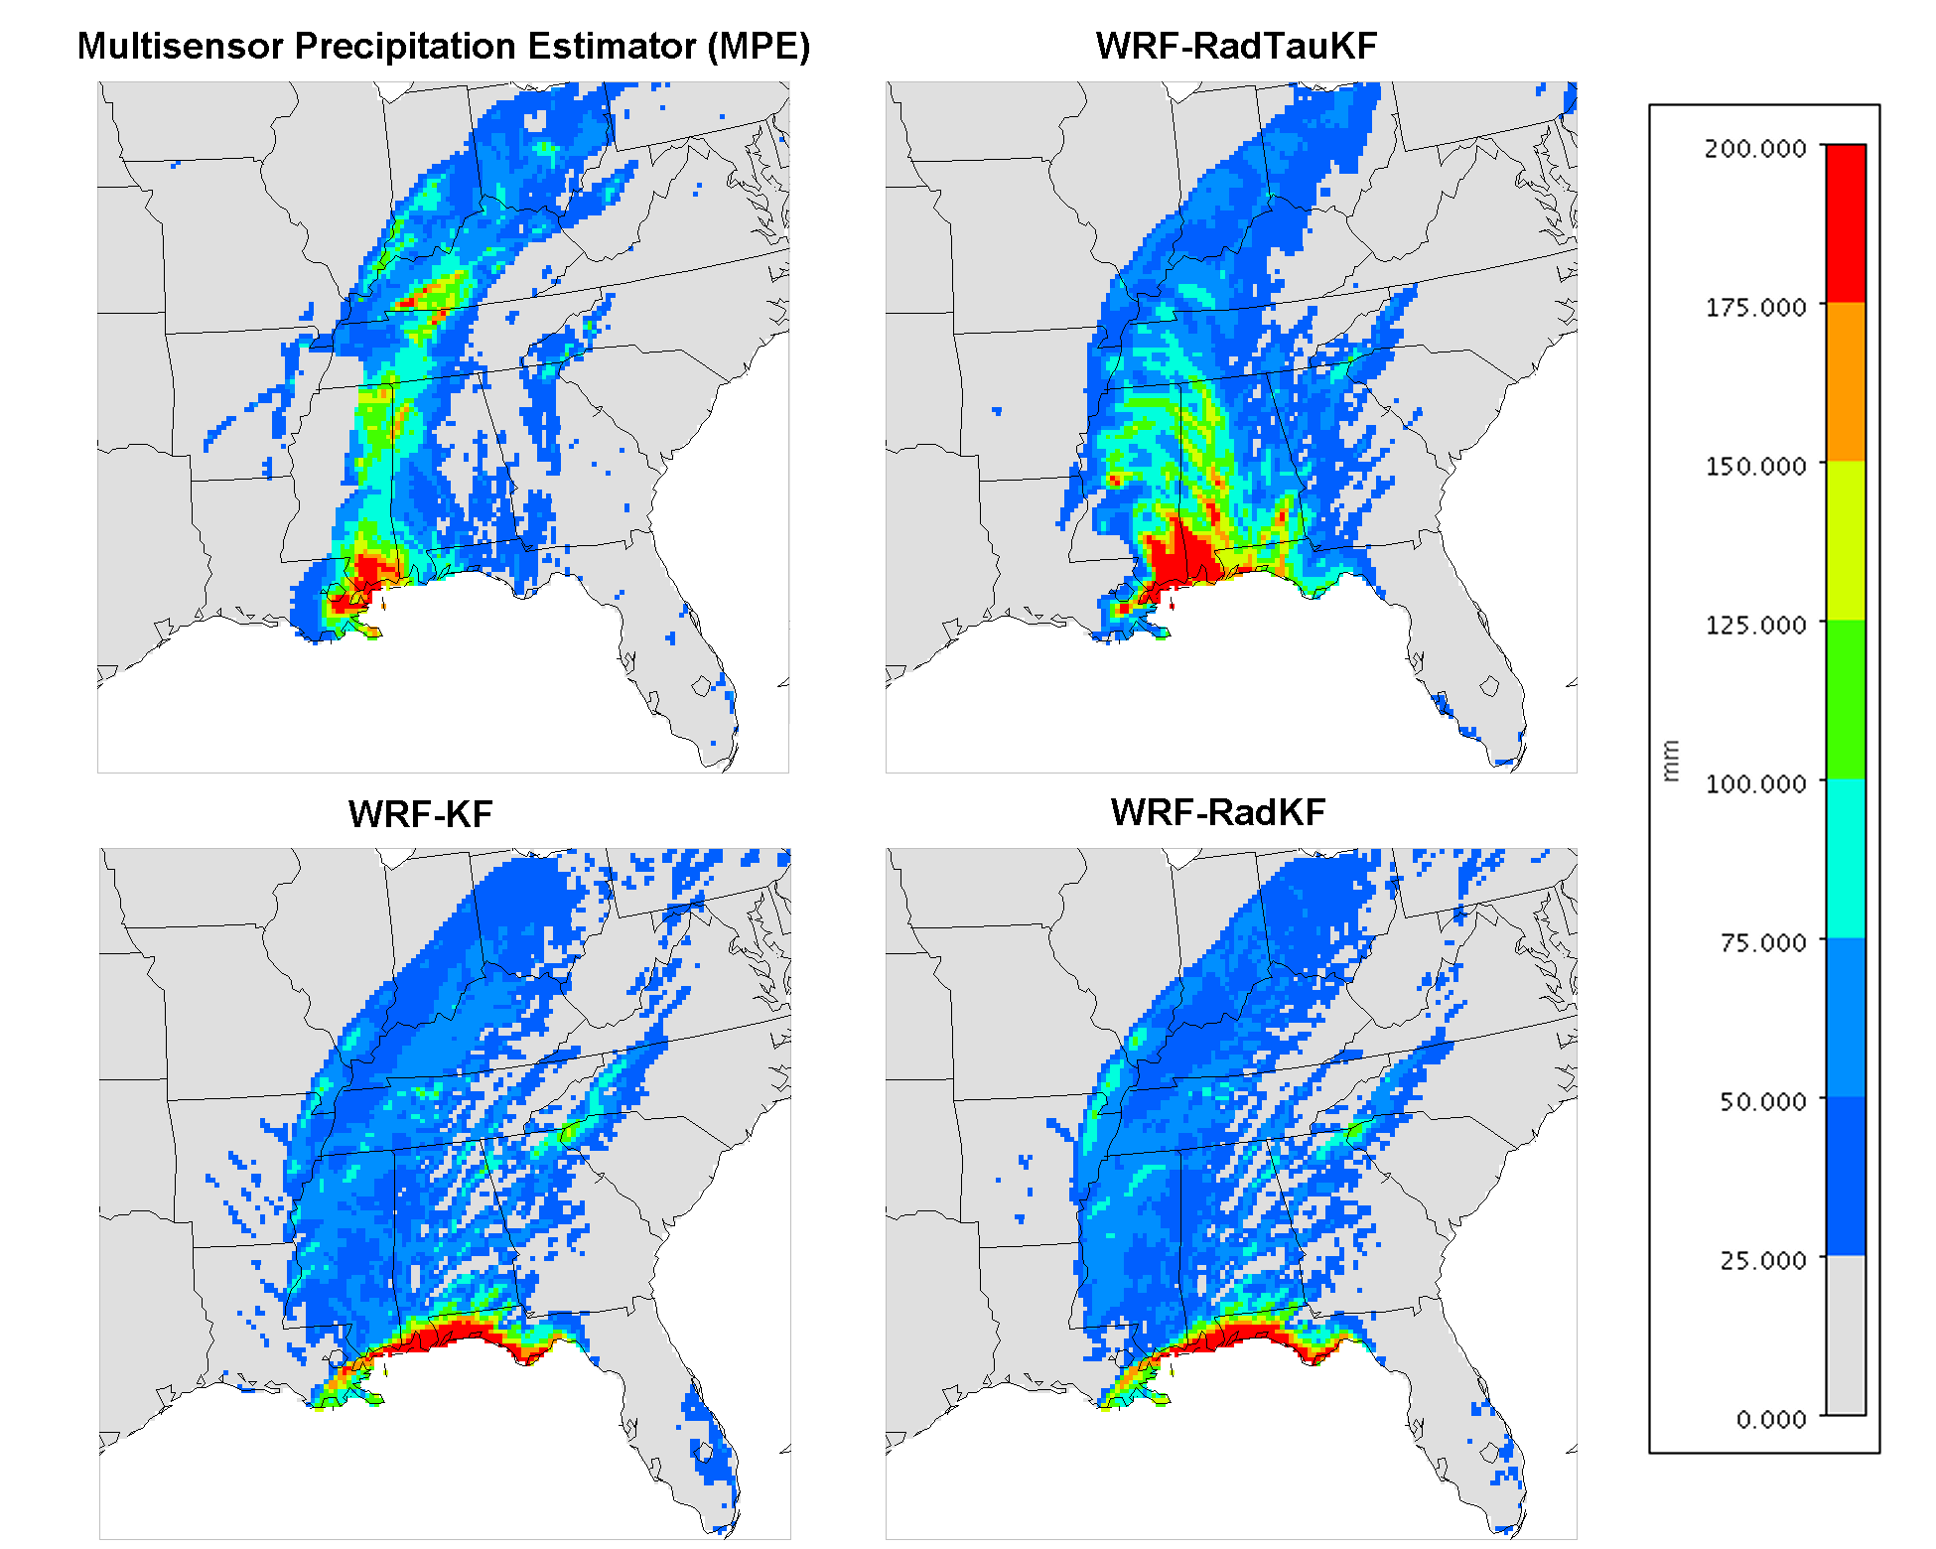
Hurricane Katrina: August 28-31, 2005
RCM added value!
Observations
Dynamic Tau Version
Standard KF Version
Hurricane Katrina inland rainfall totals dramatically improved with US EPA science updates.
(Bullock et al., MWR in review)

Slide 18
Adapting KF to Transition Across Grid Spacing: (2) Entrainment
4 km grids
OLD
NEW
Efficiency (C₁= Tokioka parameter = 0.03)
(actually 0.025, Tokioka 1988)
GCM studies: Kang et al. (2009); Kim et al. (2011):
Max and Min values of Tokioka parameter are based on GCM works
→ Larger C₁ (Tokioka) → Grid-scale Precip KF precip
LES Studies: Stevens and Bretherton (1999): Dependency of entrainment with horizontal grid resolution for Shallow Cumulus
→ Entrainment increases as grid spacing decreases
KF clouds

Slide 19
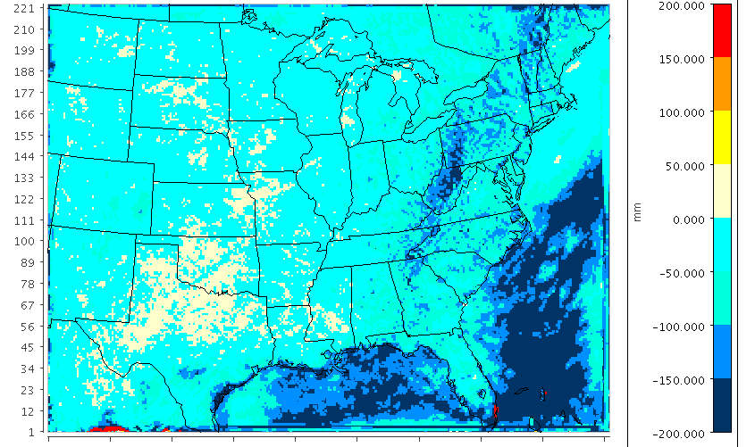
Developing Multiscale KF to Transition Across Grid Spacing: (2) New Entrainment
US EPA
OLD
NEW
JJA 2006 KF Precipitation Differences (NEW - OLD)

Slide 20
Developing Multiscale KF to Transition Across Grid Spacing: (3) New Fallout Efficiency
No microphysics (in most of the CPS)
C_{pe} → Tuning Parameter ( s⁻¹)
GCMs: Kim & Kang (2011) : C_{pe} = 0.02
RCMs: WRF, C_{pe} = 0.03
NRCM, C_{pe} = 0.01
OLD
NEW
On going work: replace this Equation with
a 2-moment microphysics scheme → AMS 2015
(Chris Nolte)
Notes:
NRCM = NCAR Regional Climate Model; Chris Nolte is helping me on aerosols

Slide 21
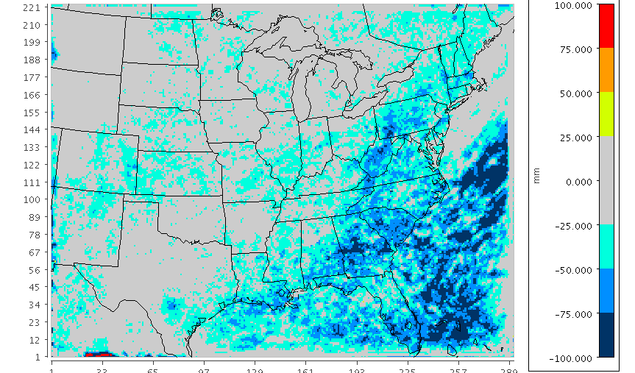
Developing Multiscale KF to Transition Across Grid Spacing: (3) New Fallout Efficiency
JJA 2006 KF Precipitation Differences (NEW - OLD)

Slide 22
Developing Multi-Scale KF to Transition Across Grid Spacing: (4) Stabilizing Capacity
Developing Multi-Scale KF to Transition Across Grid Spacing: (5) “Double” counting
Developing Multi-Scale KF to Transition Across Grid Spacing: (6) Linear Mixing of W_{kf}
Developing Multi-Scale KF to Transition Across Grid Spacing: (7) New Trigger Function for
high resolution under development
More improvements expected

Slide 23
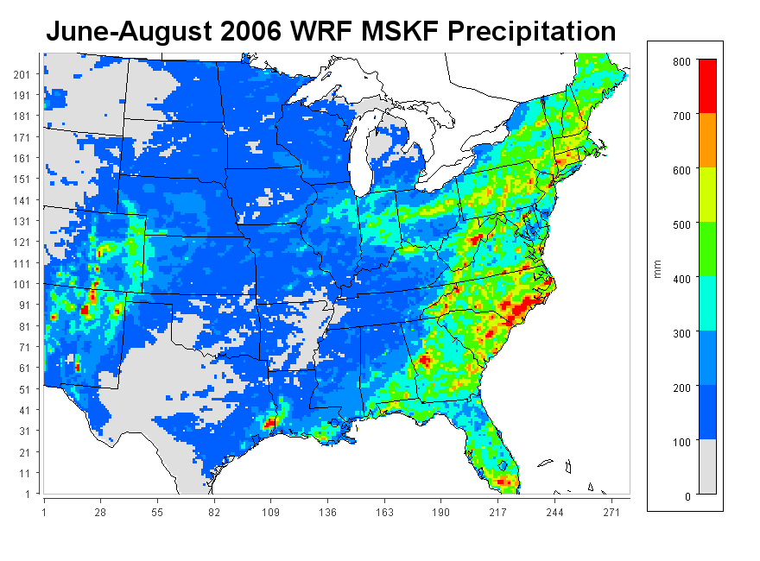
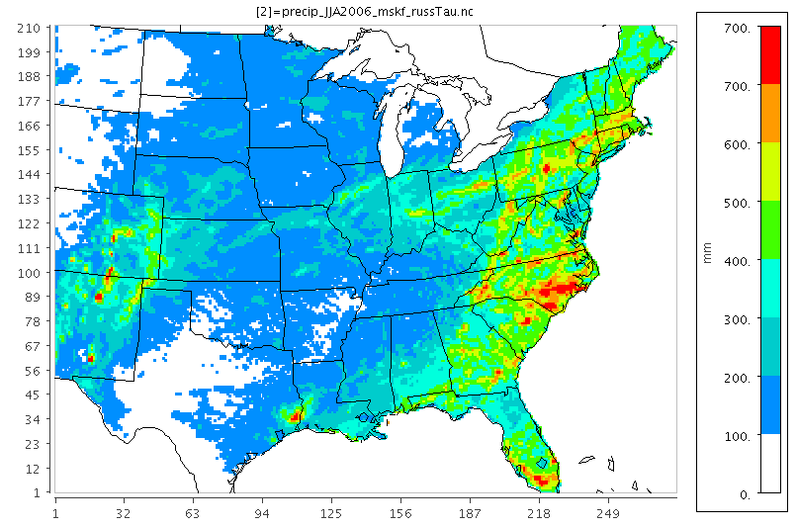
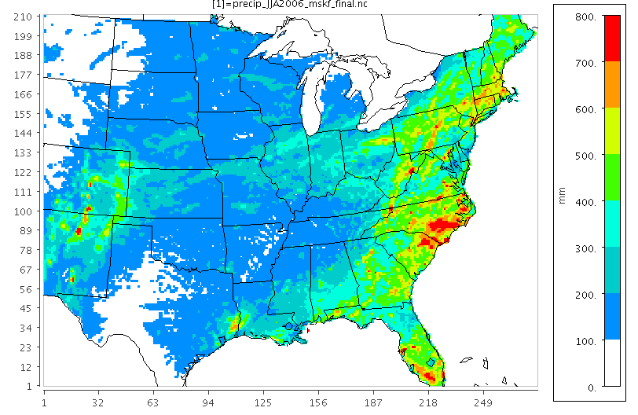
12 km WRF JJA simulations with MSKF
Accumulated Surface Precipitation
Bullock’s dynTau
Generalized dynTau
……………………………………………
……………………………………………

Slide 24
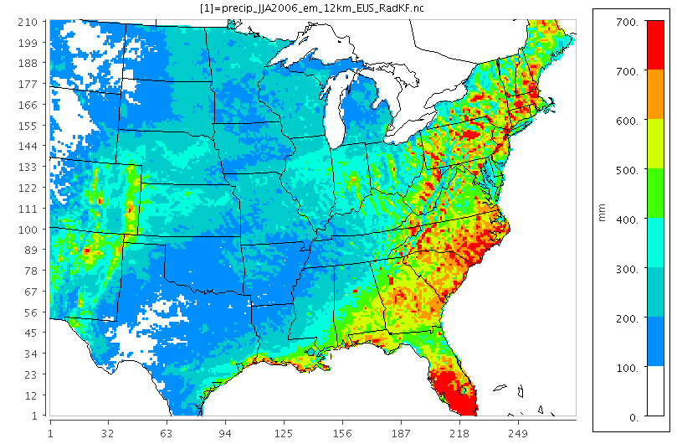
Observation
US EPA
Accumulated JJA 2006 Precipitation
June-August 2006 WRF MSKF Precipitation
KF - RAd
mskf

Slide 25
9 km and 3 km MSKF simulations:
WRF 3.3.1 -- Forecast mode: Yue et al., in review
1800 UTC 29 – 0000 UTC 30 July 2010
9 KM grids
1800 UTC 29 – 0000 UTC 30 July 2010
3 KM grids

Slide 26
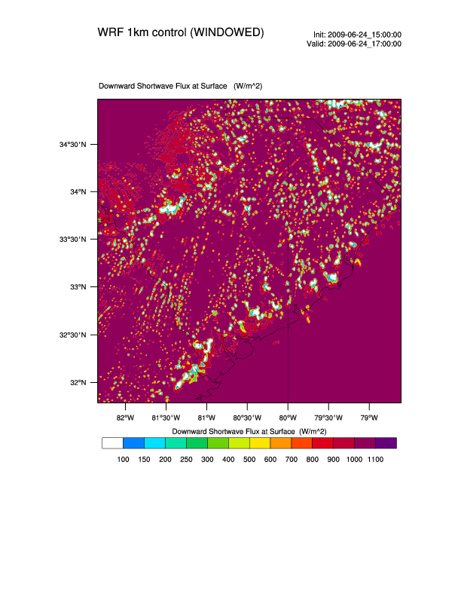
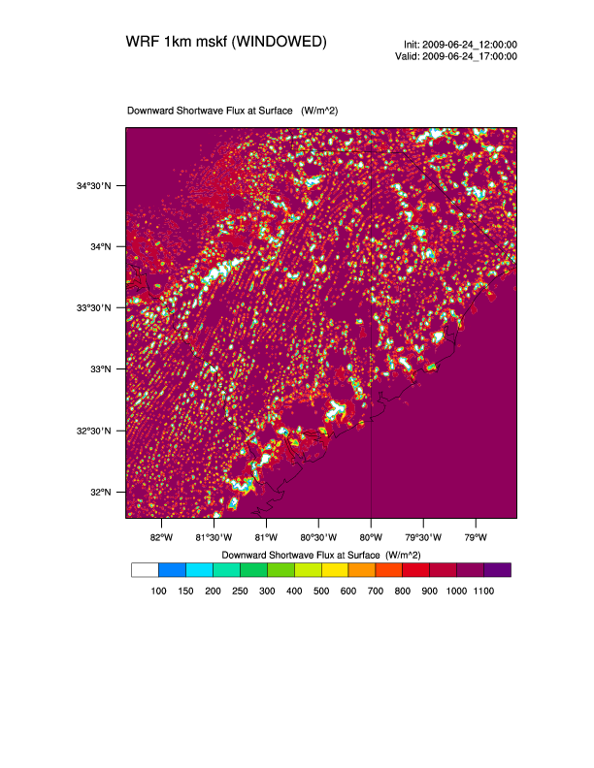
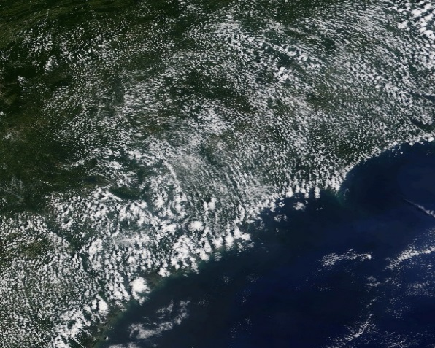
1 km MSKF simulations for Eastern North Carolina
WRF 3.3.1 -- Forecast mode: Sims et al.
Surface shortwave by the WSM6, WSM6+MSKF, and Satellite clouds on June 29, 2012 at 1700 UTC using 1 km grids.
GOES Imagery

Slide 27
SUMMARY
Several New formulations within the Kain-Fritsch (KF) scheme were tested using 12 km, 9 km, 3 and 1 km grids
In general : Results are positive for all these grid spacings
For the eastern US our 12 km 3-month simulations indicate:
Each of the science updates reduces precipitation bias while new adjustment timescale & entrainment formulations are big contributors
Surface stats are encouraging (See Jerry Herwehe’s poster)
Slight dry bias exists in some western regions of the domain.
Last item (new trigger) is being worked out for further improvements

Slide 28
Additional Material

Slide 29
Adapting KF to Transition Across Grid Spacing: (2) Entrainment: EFFICIENCY vs EFFICACY
TWP-ICE Darwin, Australia, DOE ARM – SCAM5 test for 2006 monsoon

Slide 30
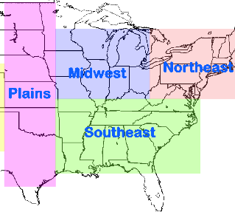
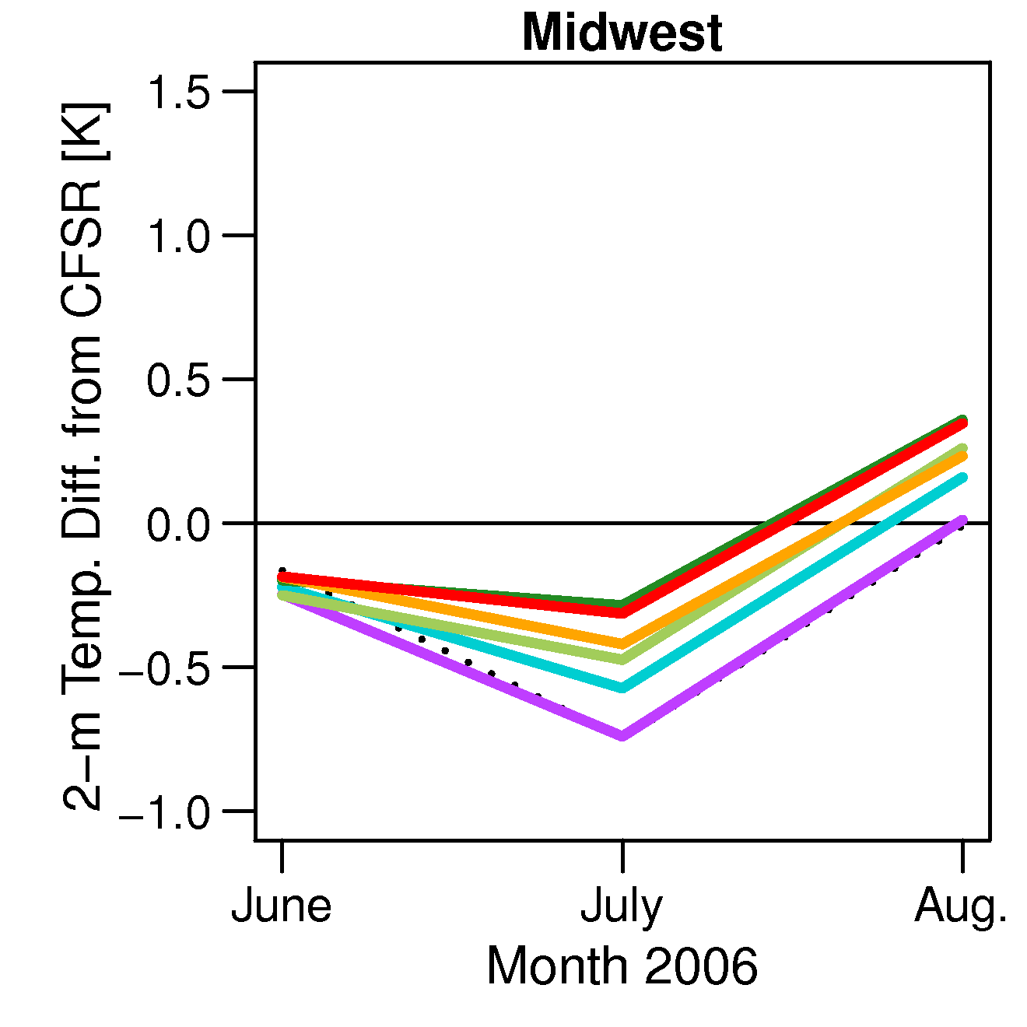
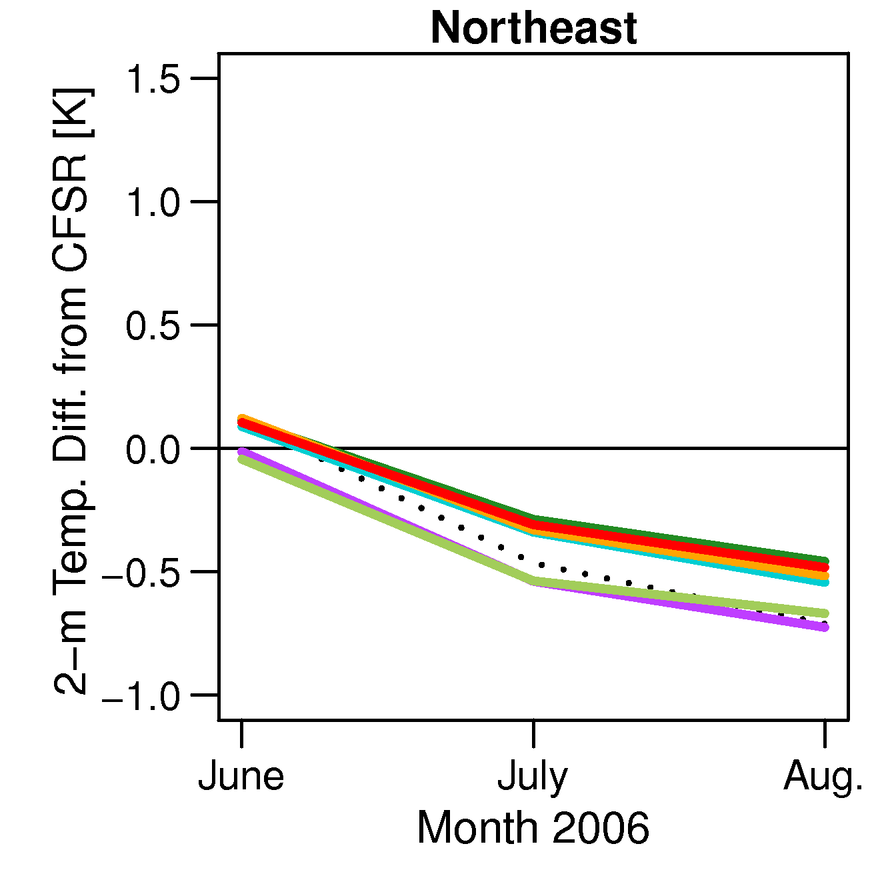
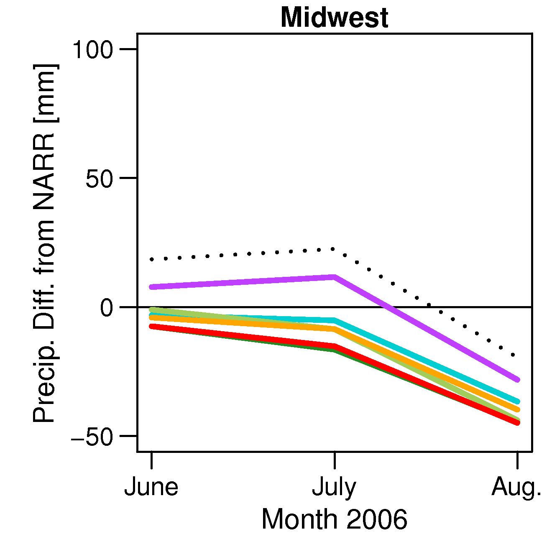
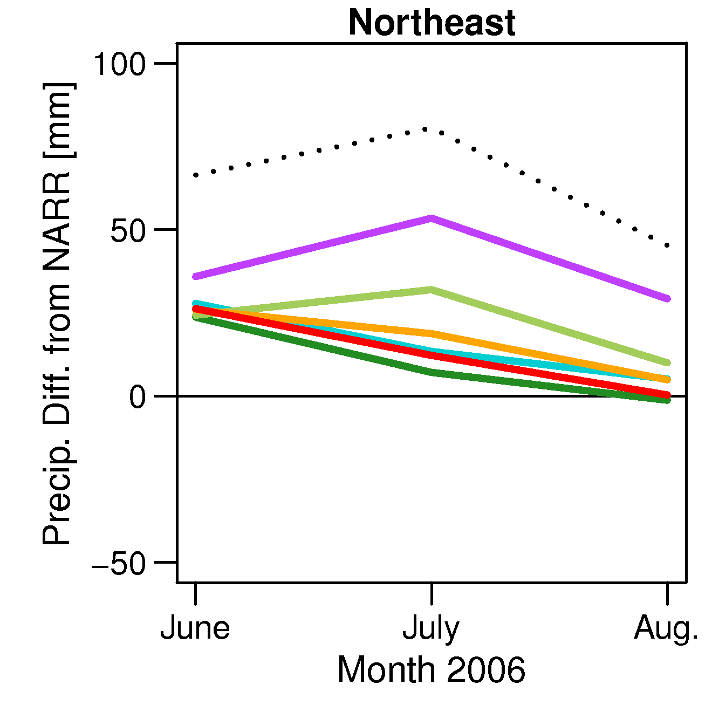
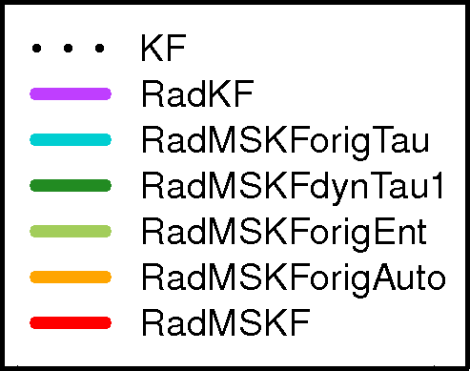
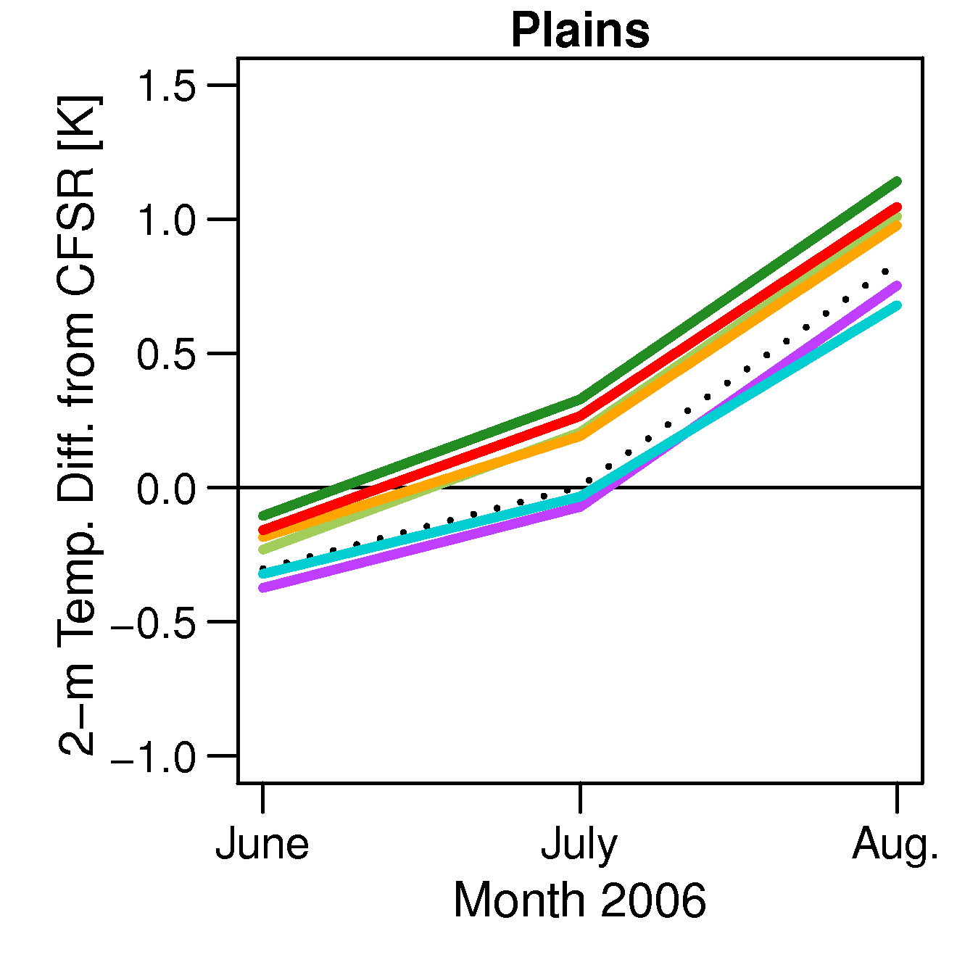
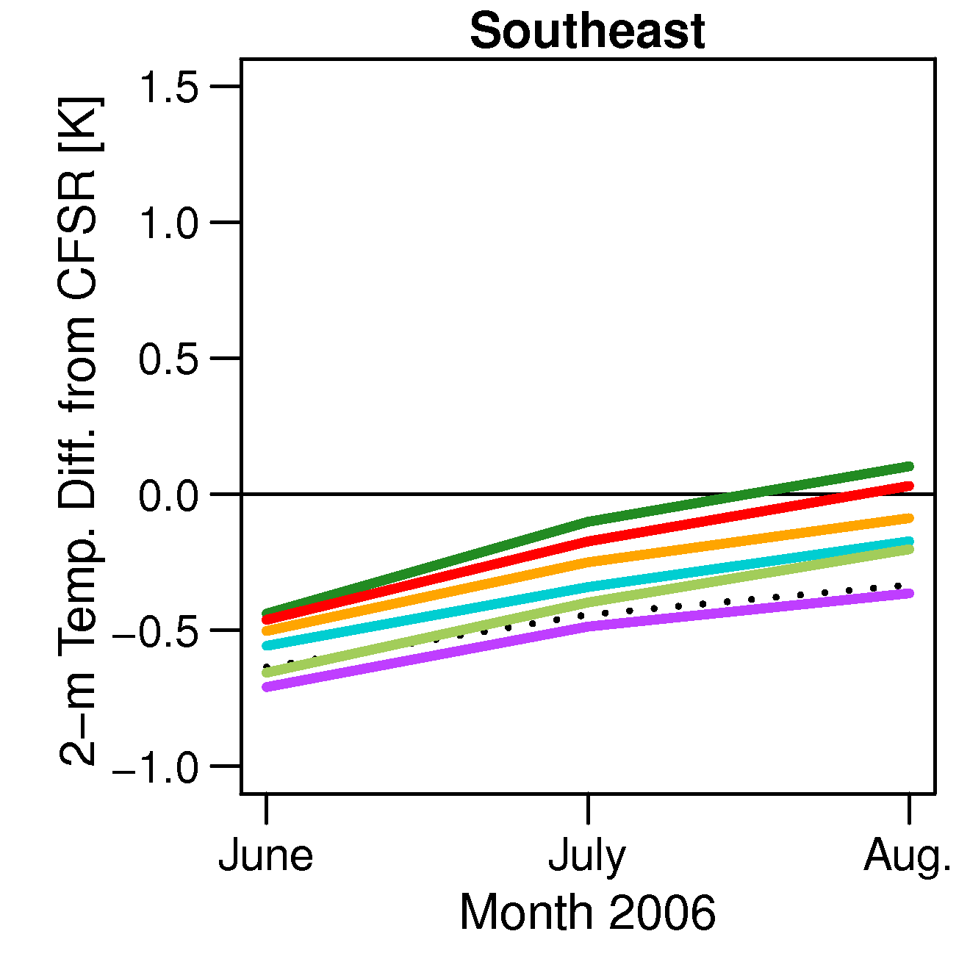
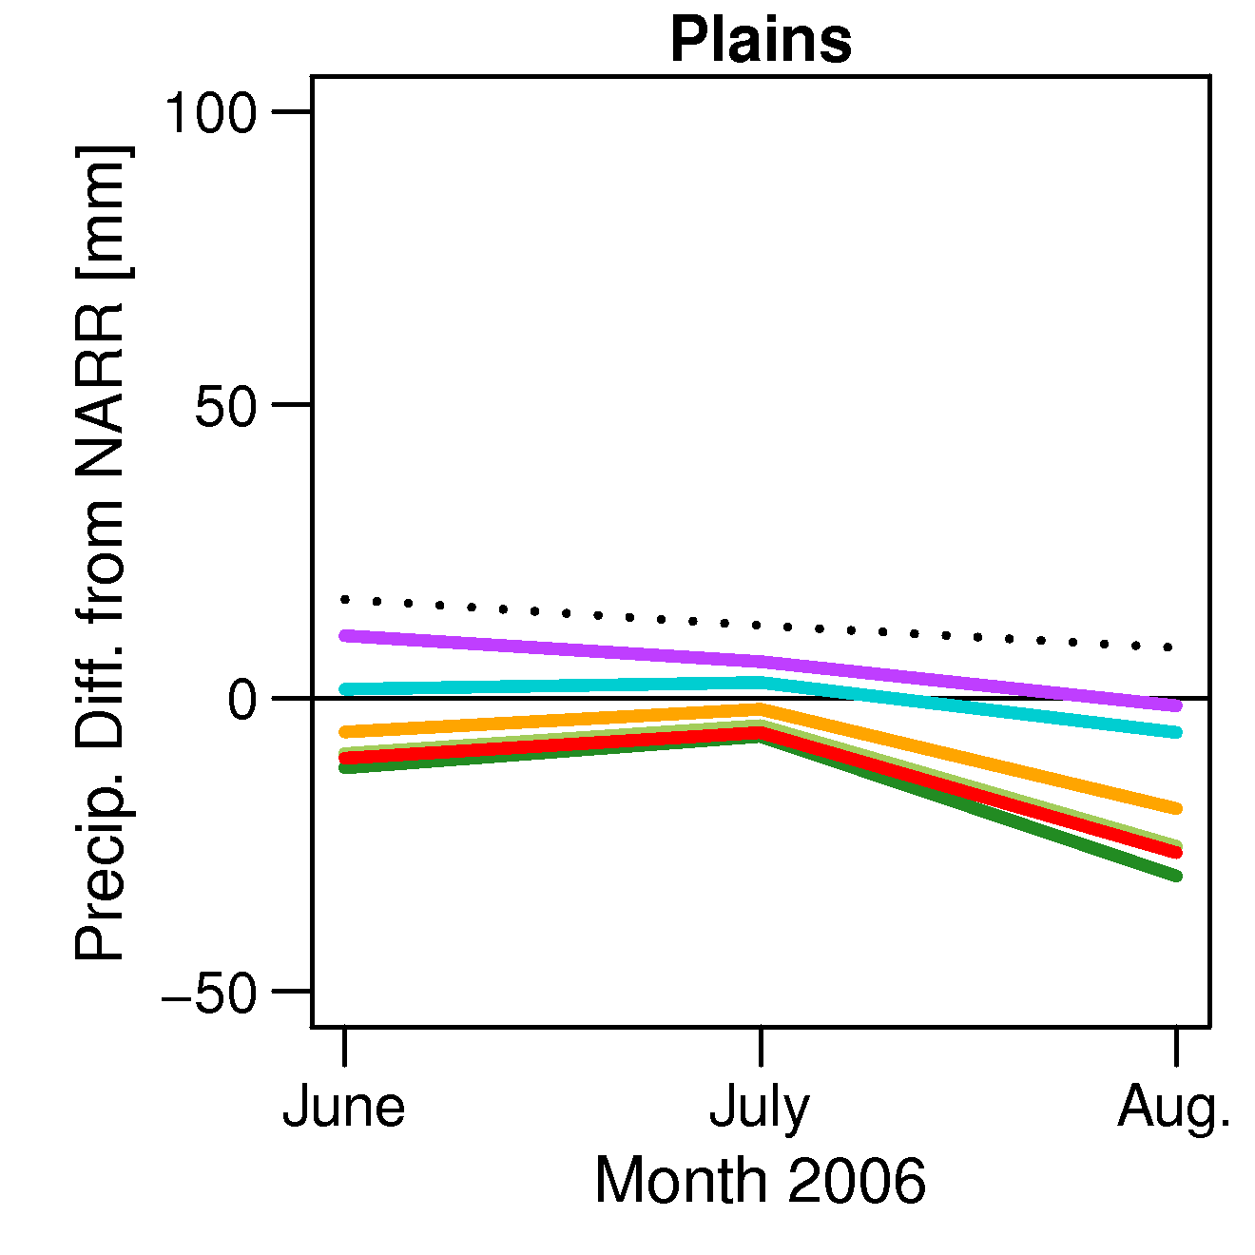
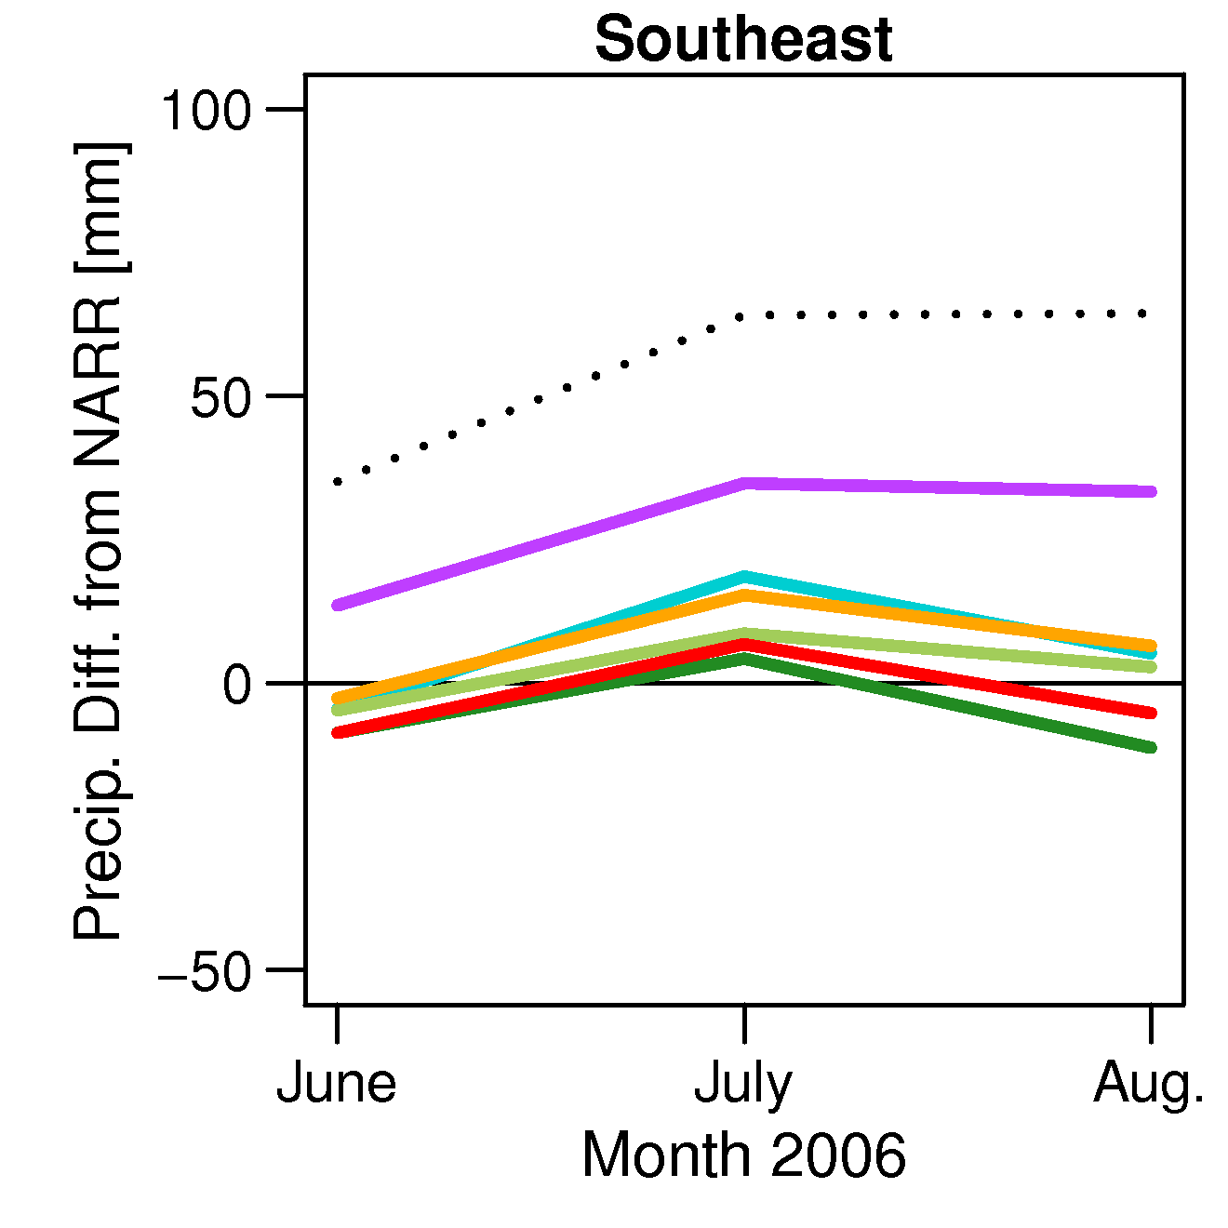
Area Averaged Monthly Variation of
Surface Temperature & Precipitatoin
US EPA
Temperature Bias (Model – CFSR)
Precipitation Bias (Model – NARR)

