Slide 1
Cost estimate and control effective of multi-pollutant abatement from the power sector in the Yangtze River Delta region, China
Jian Sun and Joshua S. Fu*
Civil and Environmental Engineering
Energy Science and Engineering
University of Tennessee, Knoxville, TN
and
Computer Science and Mathematics Division
Oak Ridge National Laboratory
Thanks to Prof Shuxiao Wang, Tsinghua University, China to provide Chinese cost information and emission data
and
Dr. Carey Jang to use the CoST – CE in the ABaCAS framework
13th CMAS Conference, October 28, 2014

Slide 2
Main
Introduction
Methodology
Results & Discussion
Conclusion

Slide 3
1. Introduction
Why do we consider “cost”?
Large amount of pollutants is emitted from different sources and will cause environment pollution and health issues. To avoid it, we need to install new control technology or retrofit the old devices to reduce the emission of pollutants. So associated investment for installation or retrofit is required, which refers to the “cost” here.

Slide 4
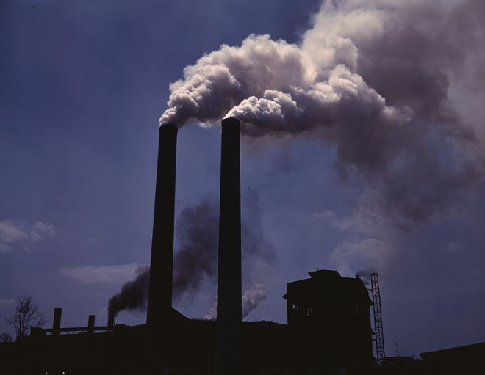
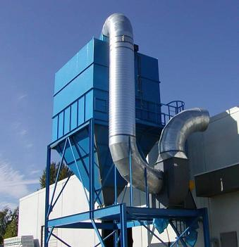
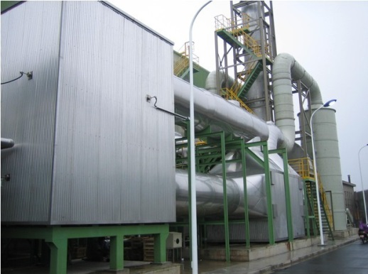
1. Introduction (con’t)
Air Pollution
Control Technology
Cost

Slide 5
1. Introduction (con’t)
History:
US EPA has developed different tools to calculate the cost:
(1) Air Compliance Advisor7.5 (ACA7.5, 2003);
(2) AirControlNET4.1 (ACN4.1, 2006);
(3) Control Strategy Tool (CoST, replacement for ACN, 2008)
Taiwan EPA:
TECAS (Taiwan Emission & Cost Analysis System)

Slide 6
1. Introduction (con’t)
Basic concepts:
Pollutant type (NOx, SO₂, PM_{2.5}, etc)
Pollutant emission sources (power plant, industry, domestic (area), mobile, etc)
Pollu. reduction tech.
Cost for installation & retrofit
NOx: SNCR, SCR, LNB, etc.
SO₂: FGD
PM_{2.5}: CYC, WET, ESP, FF, ESPFF

Slide 7
1. Introduction (con’t)
Goals:
Model the pollutant reduction amount and total retrofit cost associated with the control strategy;
Apply to various types of emission sources;
Example: provide reference for making YRD air pollution control regulations;

Slide 8
1. Introduction (con’t)
CoST-Community Edition model:
Control cost analysis component of ABaCAS (Air Benefit and Cost and Attainment Assessment System);
ABaCAS: An integrated tool to provide assessment of emissions control cost, and their associated air quality attainment and health benefits;

Slide 9
1. Introduction (con’t)
ABaCAS website: http://www.abacas-dss.com
Detailed introduction
Home page
Download packages

Slide 10
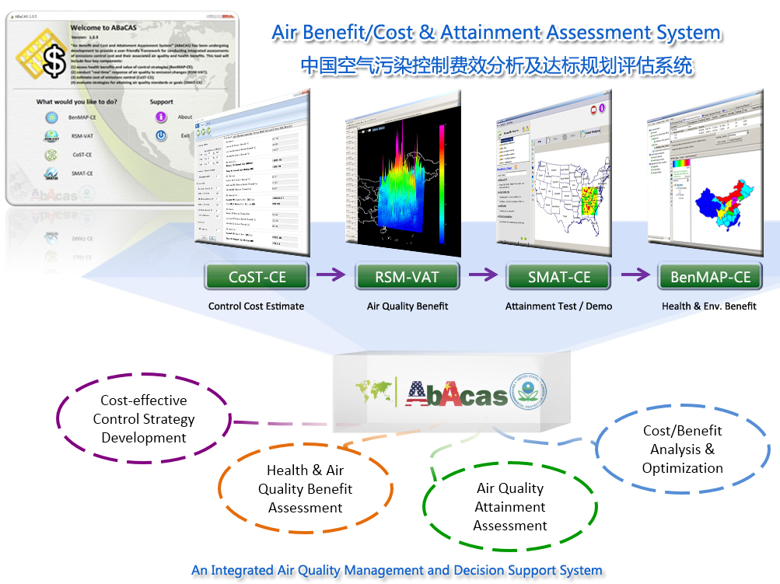
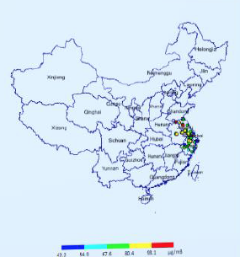
1. Introduction (con’t)
CoST: The first input
Four key components

Slide 11
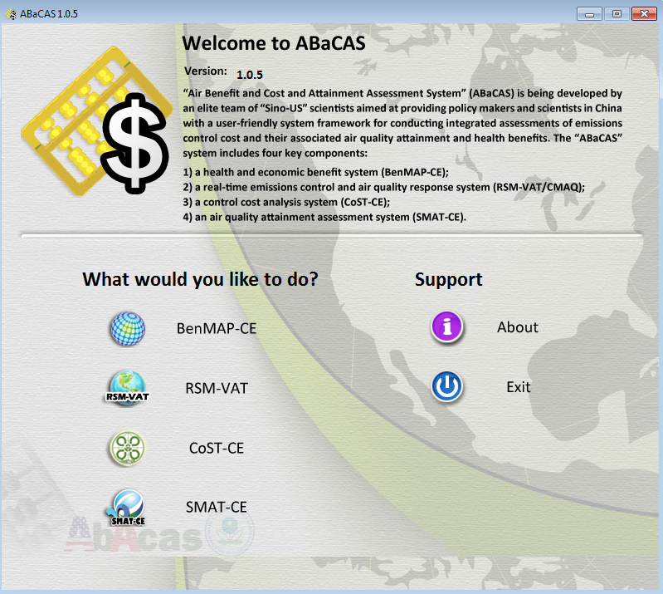
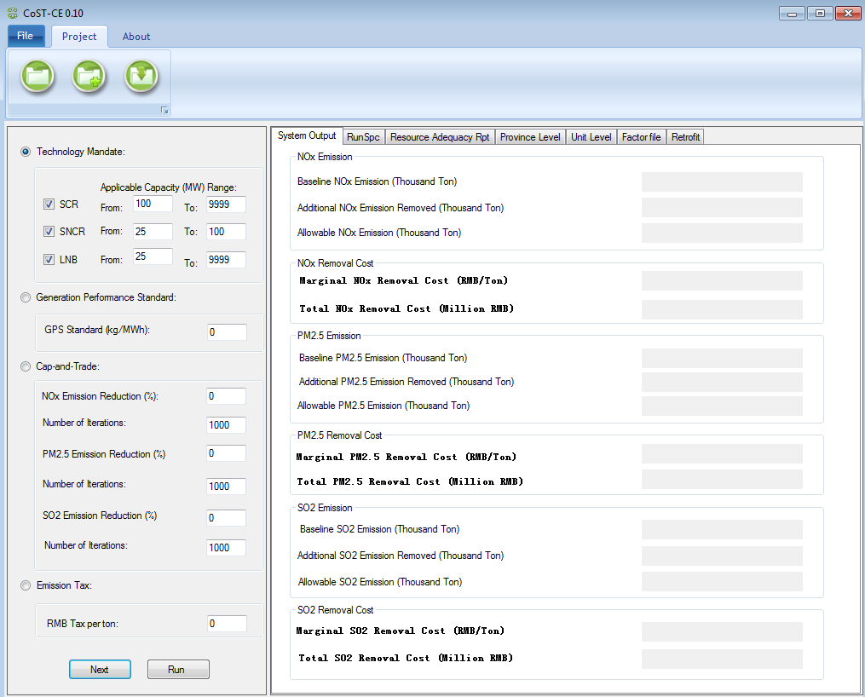
1. Introduction (con’t)
Main interface of ABaCAS
Main interface of CoST-CE

Slide 12
Main
Introduction
Methodology
Results & Discussion
Conclusion

Slide 13
2. Methodology
Below is the equations that will be used in the cost calculation:
A: The reduction amount of pollutant, ton;
E’: The current emission of pollutant, ton;
rp: The target percentage of reduction, %;
R: The remaining amount of pollutant after applying the control technology, ton;
E: The original emission of pollutant, ton;
EFF: The reduction efficiency of control efficiency, %;
M: The additional removed amount of pollutant after retrofitting the
control technology, ton;

Slide 14
2. Methodology (con’t)
The cost to retrofit control technology at one power plant:
TC: The total cost of retrofitting control technology, Million RMB;
CC: The capital cost of control technology, RMB/MW;
FOM: The fix operation & maintenance cost over the life time of device (thirty years here), RMB/MW;
FUEL: The fuel cost over the life time of device (thirty years here), RMB/MW;
P: The unit capacity, MW;

Slide 15
2. Methodology (con’t)
The objective of cost model:

Slide 16
Main
Introduction
Methodology
Results & Discussion
Conclusion

Slide 17
3. Results & Discussion
Calculate the control cost in CoST-CE model
RSM-VAT result using the input factor from CoST-CE model (offline-linkage)

Slide 18
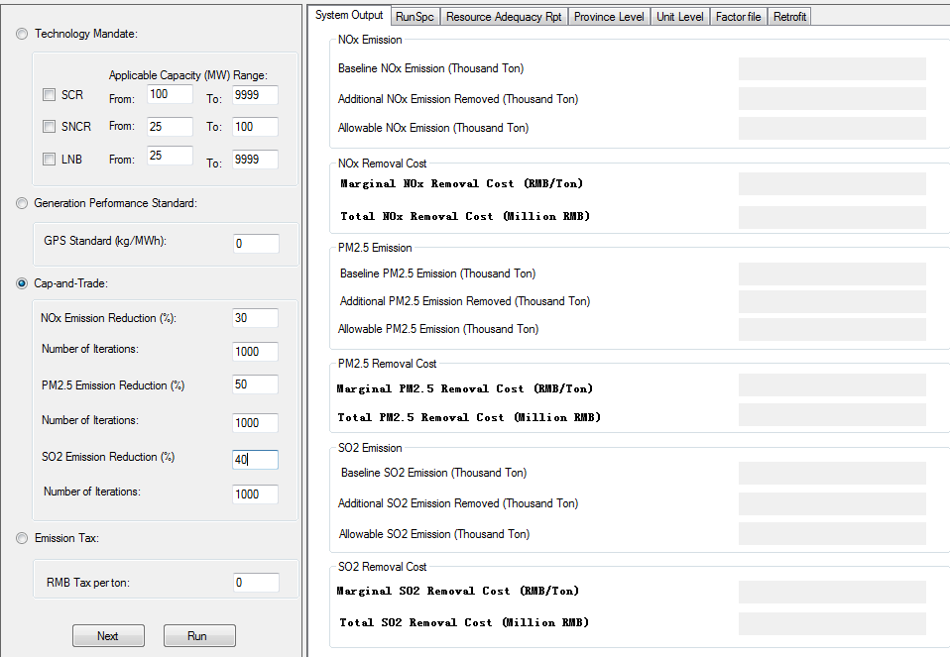
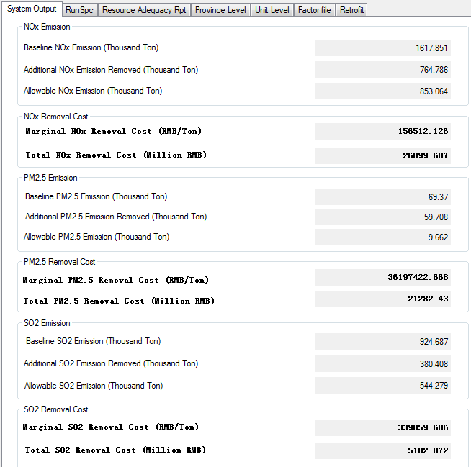
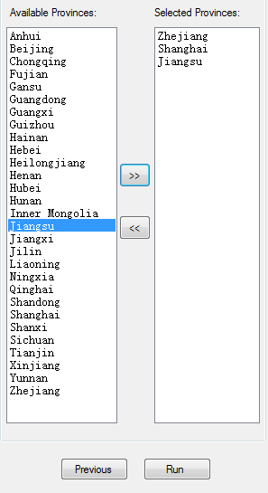
3. Results & Discussion (con’t)
1. Set control percent
2. Choose province
3. Run & Output

Slide 19
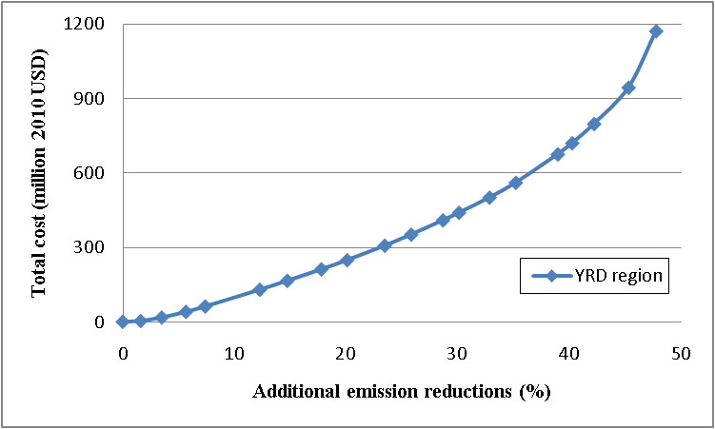
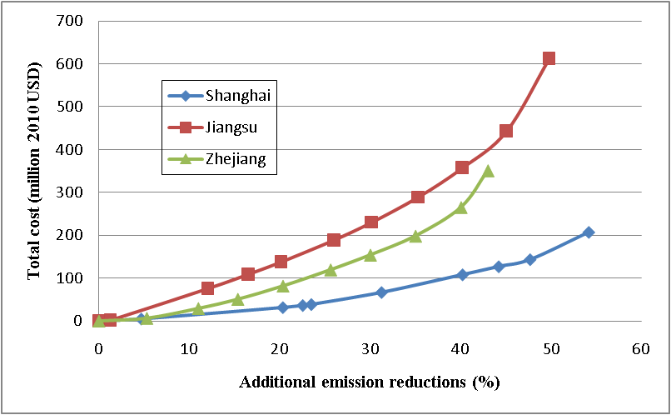
3. Results & Discussion (con’t)
With the CoST-CE output, the control cost curves can be calculated:
a). SO₂
SO₂ emission reductions (%) relative to current emissions vs. total abatement cost (million 2010 US Dollars) for the YRD region
SO₂ emission reductions (%) relative to current emissions vs. total abatement cost (million 2010 US Dollars) for provinces in the YRD region

Slide 20
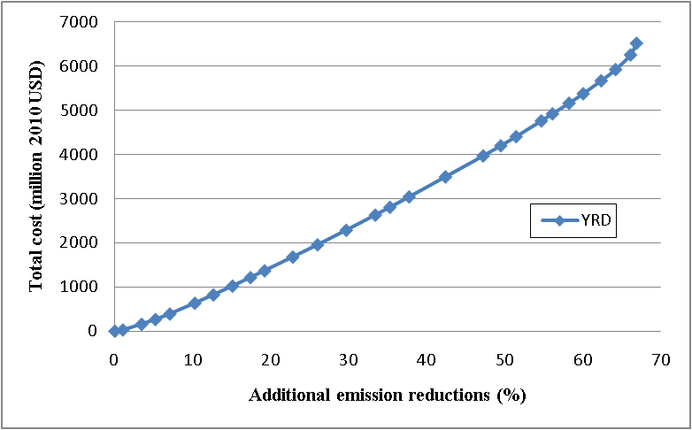
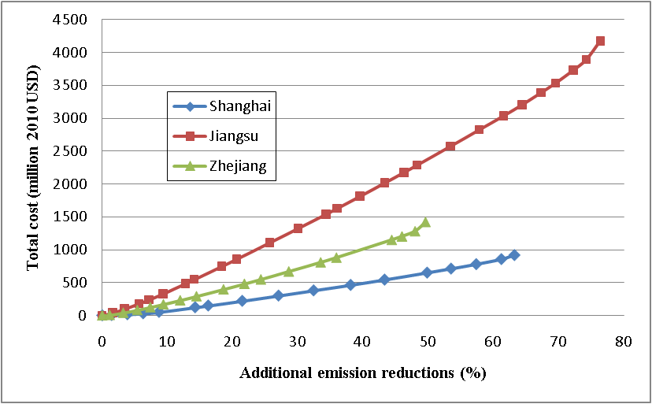
3. Results & Discussion (con’t)
b). NO_{X}
NO_{X} emission reductions (%) relative to current emissions vs. total abatement cost (million 2010 US Dollars) for the YRD region
NO_{X} emission reductions (%) relative to current emissions vs. total abatement cost (million 2010 US Dollars) for provinces in the YRD region

Slide 21
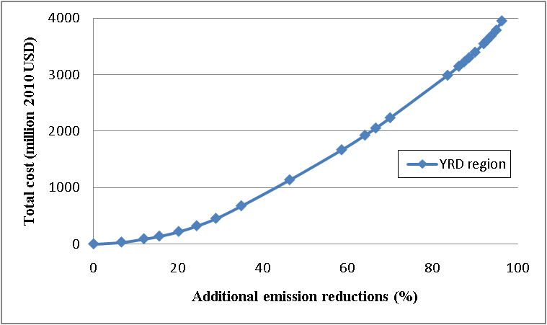
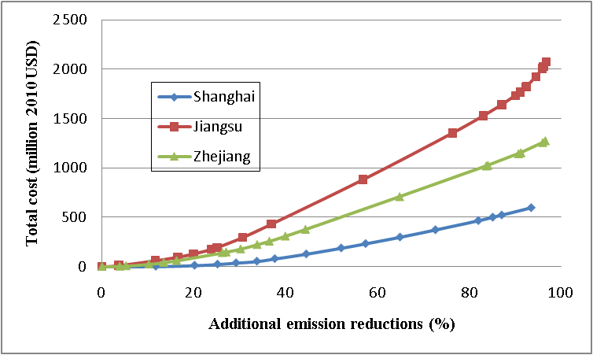
3. Results & Discussion (con’t)
c). PM2.5
PM_{2.5} emission reductions (%) relative to current emissions vs. total abatement cost (million 2010 US Dollars) for the YRD region
PM_{2.5} emission reductions (%) relative to current emissions vs. total abatement cost (million 2010 US Dollars) for provinces in the YRD region

Slide 22
3. Results & Discussion (con’t)
Maximum additional sector-wide emission reduction percentages for each pollutant in each province in the YRD region
Region | SO₂ | NO_{X} | PM_{2.5}
 | % | % | %
Shanghai | 54.24 | 63.15 | 93.41
Jiangsu | 49.82 | 76.36 | 96.74
Zhejiang | 43.09 | 49.61 | 96.60
YRD | 47.77 | 66.88 | 96.21

Slide 23
3. Results & Discussion (con’t)
Total control cost for maximum additional sector-wide emission reduction percentages for each pollutant in each province in the YRD region
Region | SO₂ | NO_{X} | PM_{2.5}
 | Million 2010 USD | Million 2010 USD | Million 2010 USD
Shanghai | 208 | 920 | 596
Jiangsu | 613 | 4174 | 2077
Zhejiang | 351 | 1428 | 1278
YRD | 1172 | 6522 | 3950

Slide 24
3. Results & Discussion (con’t)
Calculate the control cost in CoST-CE model
RSM-VAT (Response Surface Modeling-Visualization and Analysis Tool) results using the input factor from CoST-CE model (interactive linkage)

Slide 25
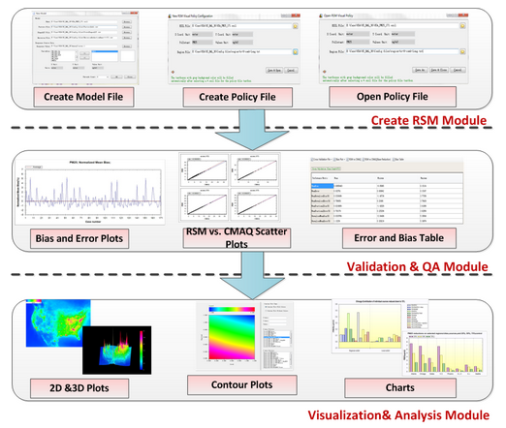
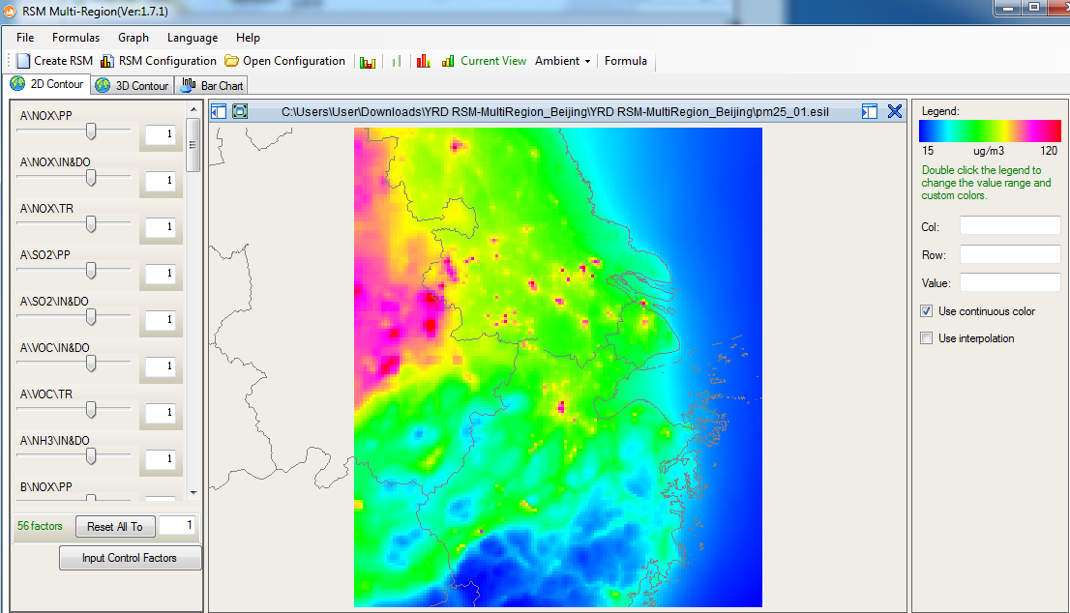
3. Results & Discussion (con’t)
RSM-VAT: Tool to build up a “real-time” response between pollution concentration and emission reduction control using CMAQ modeling data.
Functional design
Main interface

Slide 26
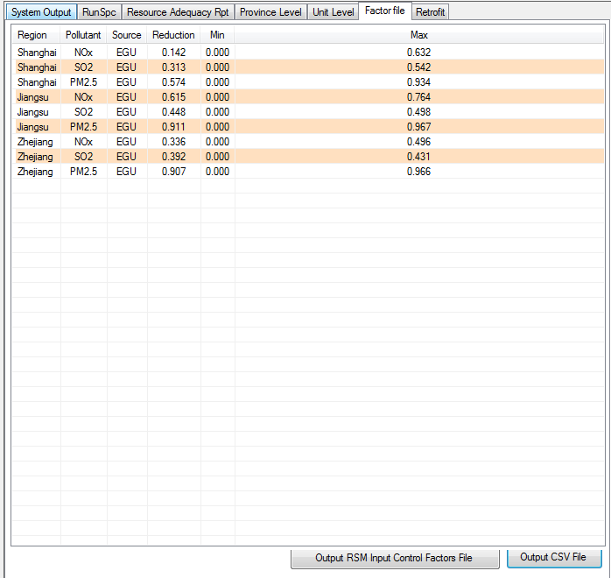
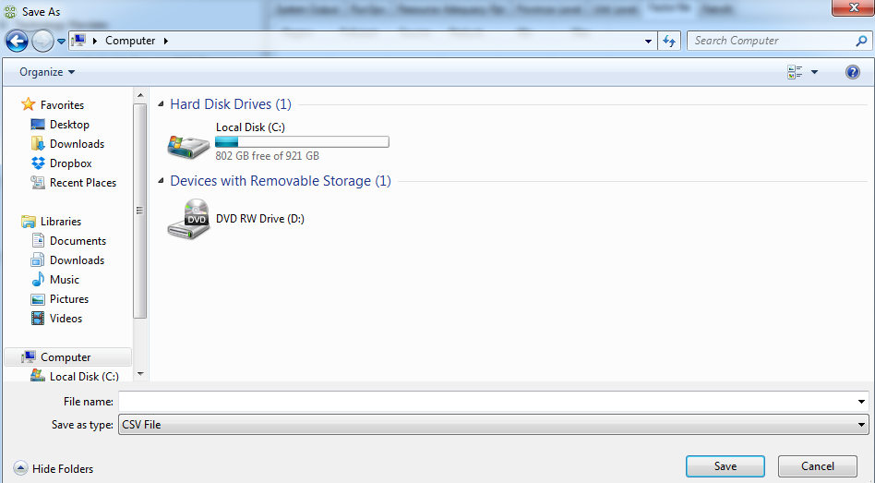
3. Results & Discussion (con’t)
How to link CoST-CE and RSM-VAT?
2. Save as CSV file
1. Create input factor file

Slide 27
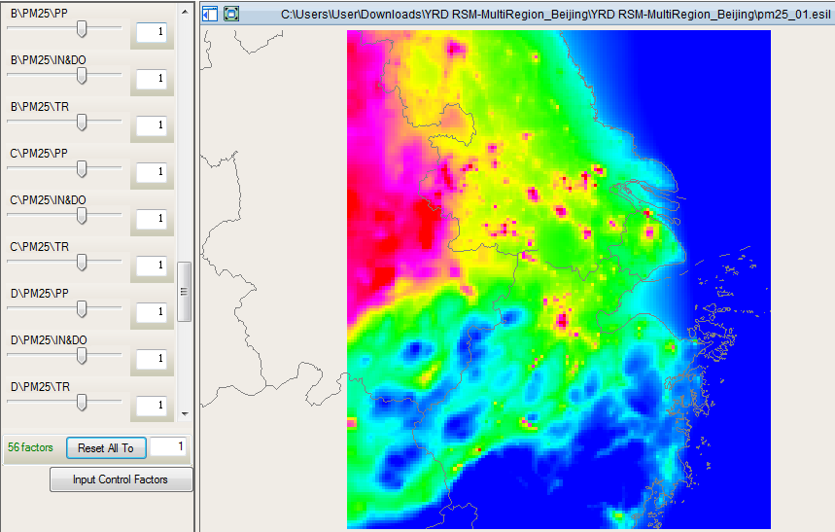
3. Results & Discussion (con’t)
3. Input factor file in RSM
4. Visualize the effect

Slide 28
3. Results & Discussion (con’t)
a) Emission inventory for YRD in 2010
Sector-wide emission inventory of NOx and PM2.5 for each province at YRD region
Region | Power Plant |  | Industry & Domestic |  | Mobile
 | NO_{X} | PM_{2.5} | NO_{X} | PM_{2.5} | NO_{X} | PM_{2.5}
 | 1000 tons/year | 1000 tons/year | 1000 tons/year | 1000 tons/year | 1000 tons/year | 1000 tons/year
Shanghai | 178.48 | 12.59 | 179.99 | 95.41 | 109.54 | 3.97
Jiangsu | 707.69 | 62.49 | 612.39 | 610.77 | 427.5 | 29.44
Zhejiang | 531.74 | 53.73 | 372.3 | 255.47 | 362.7 | 17.91
YRD | 1417.91 | 128.81 | 1164.68 | 961.65 | 899.74 | 51.32

Slide 29
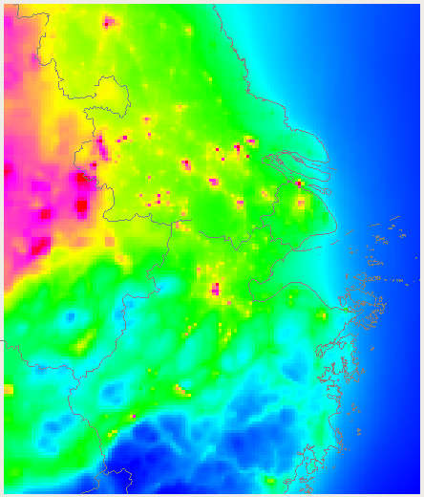
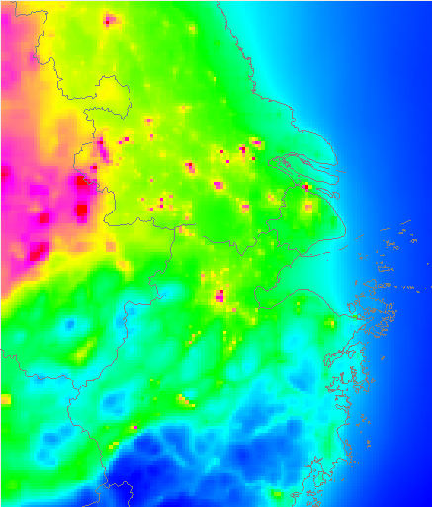
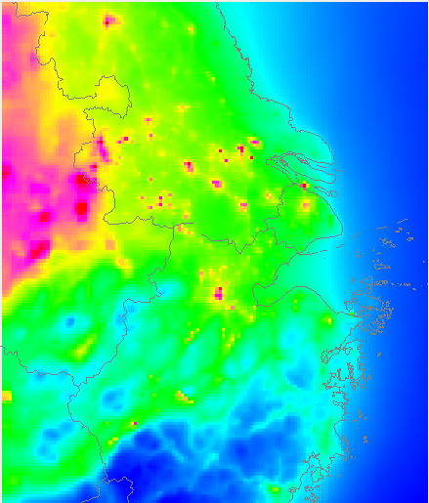
3. Results & Discussion (con’t)
b) PM2.5 control effect on PM2.5 at Jan, 2010
Original
Max. PP Control at YRD
Max: 205 µg/m3
Max. PP control at Zhejiang
Max. PP control at Shanghai
Max. PP control at Jiangsu

Slide 30
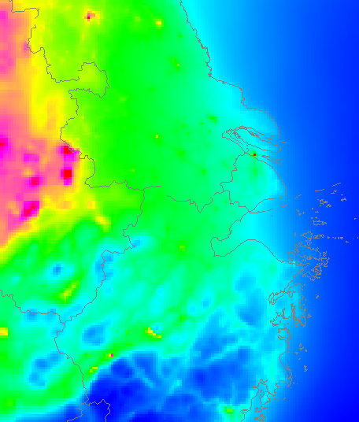
3. Results & Discussion (con’t)
b) PM2.5 control effect on PM2.5 at Jan, 2010
Original
Max. PP Control at YRD
Max: 205 µg/m3
Same Max. Control Percent for YRD Industry/Domestic Emission
Same Max. Control Percent for YRD Mobile Emission

Slide 31
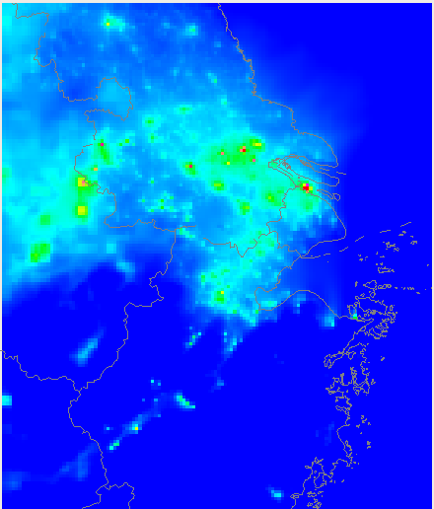
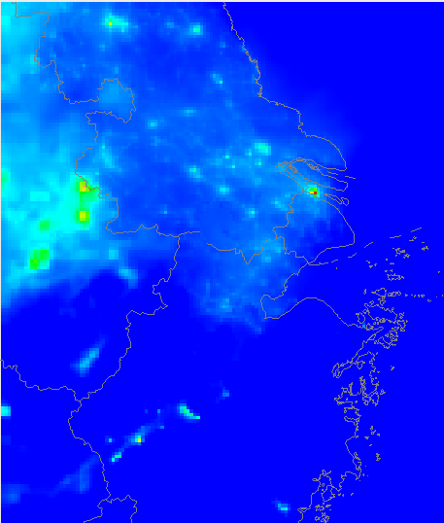
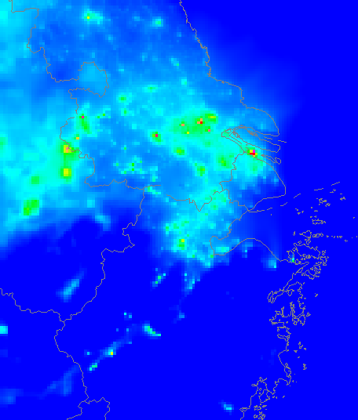
3. Results & Discussion (con’t)
c) PM2.5 control effect on PM2.5 at Aug, 2010
Original
Max. PP Control at YRD
Max: 276 µg/m3
Same Max. Control Percent for YRD Industry/Domestic Emission
Same Max. Control Percent for YRD Mobile Emission

Slide 32
3. Results & Discussion (con’t)
d) Total PM2.5 control cost vs. PM2.5 conc. change for power plant in Jan, 2010 (+: increase; -: decrease)
Region | PM_{2.5} Control Percent | Total Control Cost | PM_{2.5} conc. Change
 | % | Million 2010 US Dollars | µg/m3
Shanghai | 25.13 | 24 | -0.066
 | 52.05 | 187 | -0.132
 | 72.57 | 372 | -0.184
 | 93.41 | 596 | -0.241
Jiangsu | 23.87 | 176 | -0.122
 | 56.85 | 880 | -0.292
 | 76.38 | 1353 | -0.392
 | 96.74 | 2077 | -0.49
Zhejiang | 26.21 | 140 | -0.06
 | 39.93 | 308 | -0.09
 | 64.84 | 710 | -0.144
 | 96.6 | 1278 | -0.216
Control Cost
Control Effect

Slide 33
3. Results & Discussion (con’t)
e) Total PM2.5 control cost vs. PM2.5 conc. change for power plant in Aug, 2010 (+: increase; -: decrease)
Region | PM_{2.5} Control Percent | Total Control Cost | PM_{2.5} conc. Change
 | % | Million 2010 US Dollars | µg/m3
Shanghai | 25.13 | 24 | -0.064
 | 52.05 | 187 | -0.133
 | 72.57 | 372 | -0.185
 | 93.41 | 596 | -0.238
Jiangsu | 23.87 | 176 | -0.117
 | 56.85 | 880 | -0.278
 | 76.38 | 1353 | -0.373
 | 96.74 | 2077 | -0.473
Zhejiang | 26.21 | 140 | -0.052
 | 39.93 | 308 | -0.079
 | 64.84 | 710 | -0.128
 | 96.6 | 1278 | -0.191
Control Cost
Control Effect

Slide 34
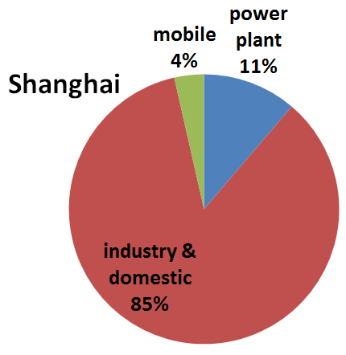
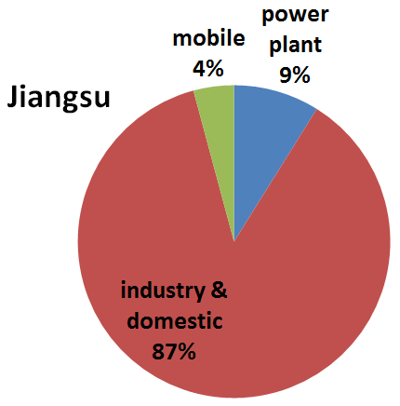
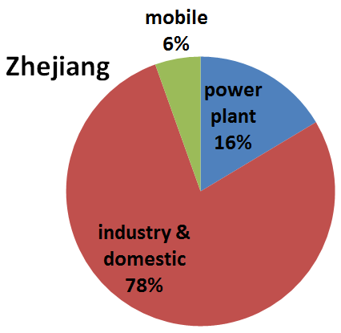
3. Results & Discussion
e) Total PM2.5 control cost vs. PM2.5 conc. change for power plant in Aug, 2010 (+: increase; -: decrease)
Region | PM_{2.5} Control Percent | Total Control Cost | PM_{2.5} conc. Change
 | % | Million 2010 US Dollars | µg/m3
Shanghai | 25.13 | 24 | -0.064
 | 52.05 | 187 | -0.133
 | 72.57 | 372 | -0.185
 | 93.41 | 596 | -0.238
Jiangsu | 23.87 | 176 | -0.117
 | 56.85 | 880 | -0.278
 | 76.38 | 1353 | -0.373
 | 96.74 | 2077 | -0.473
Zhejiang | 26.21 | 140 | -0.052
 | 39.93 | 308 | -0.079
 | 64.84 | 710 | -0.128
 | 96.6 | 1278 | -0.191
Control Cost
Control Effect

Slide 35
4. Conclusion
Shanghai has the largest maximum additional emission reduction percent for SO2 in the YRD region;
Jiangsu Province has the largest maximum additional emission reduction percent for NOx and PM2.5 in the YRD region
The maximum total control cost for Jiangsu Province is higher than that for Zhejiang Province and Shanghai, considering the total capacity of power plants and current installation status of control technology;
Reducing PM2.5 emission at power plant requires high total control cost, but has little effect on the ambient PM2.5 concentration.
Industry/Domestic PM2.5 emission dominates the PM2.5 concentration at YRD region based on the emission inventory;
Policy decision should be made by balancing the total control cost and its actual air quality benefit.

Slide 36
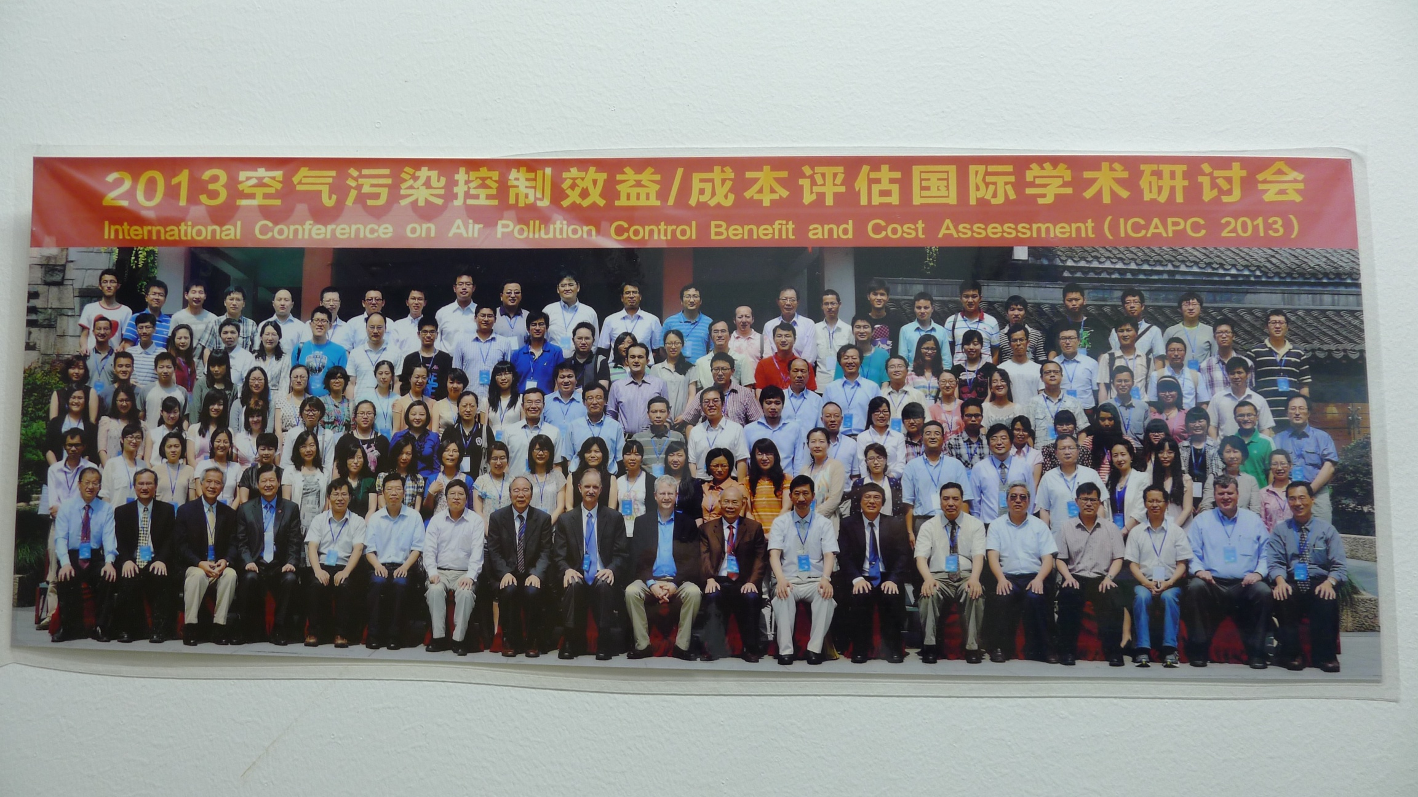
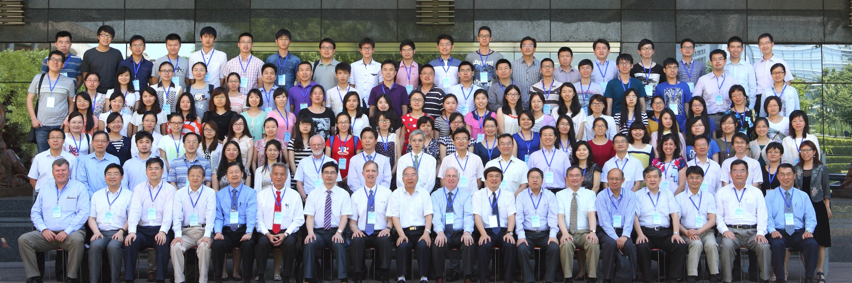
2013 ABaCAS Conference/Training Workshop (Hangzhou, 6/05-07)
2014 ABaCAS Conference/Training Workshop (Beijing, 5/28-30)

Slide 37
The 3rd ABaCAS Training Workshop/Conference
Guangzhou (China) –
Summer (Mid of June) 2015
Joshua S. Fu
University of Tennessee, Knoxville, TN, USA
Shuxiao Wang
Tsinghua University, Beijing, China
Yun Zhu
South China University of Technology, Guangzhou, China

Slide 38
Acknowledgement
Thanks for the funding support
USEPA
Energy Foundation
Institute for Security and Sustainable Environment, University of Tennessee

Slide 39
Thank you for you Attention
QUESTION?

