Slide 1
The Community Multiscale Air Quality (CMAQ) Model: Updates and Future Development
Jonathan Pleim
and
EPA CMAQ Development Team
Atmospheric Modeling and Analysis Division
UK-US Atmospheric Modeling & Analysis Meeting
20-24 October, 2014

Slide 2
New CMAQ releases
The latest publically available model is CMAQv5.0.2
  Released early 2014, included:
    Updates to base model
    Instrumented models
    Community contributions
    Updates to 2-way WRF-CMAQ model
Next model is CMAQv5.1
  To be released in October 2015, includes:
    Science updates
    Revised code structure for faster execution
    Improved physics and data assimilation in WRF
    Improved 2-way coupled WRF-CMAQ
Plans for Next Generation AQ model (user forum)

Slide 3
Recent developments (v5.0.2)
NH3 Bidirectional Flux from fertilizer
  Soil NH3 and pH from fertilizer computed by Environmental Policy Integrated Climate (EPIC) model (Γ = NH4+ / H+ )
  FEST-C1.1 available from CMAS website
  New 2-level bi-directional flux algorithm in CMAQ
Instrumented models:
  Direct Decoupled Method 3D (DDM-3D)
  Integrated Source Apportionment Method (ISAM)
  Sulfur Tracking
Community Contributions
  VBS – Volatility Basis Set (see Matt Woody talk tomorrow)
    Alternative approach for modeling organic aerosols

Slide 4
2015 Model Release – CMAQv5.1
Model Structure Efficiency improvements
    Parallel I/O
    More efficient PBL solver for ACM2
    Aerosol Microphysics (Fahey Poster)
  Improve treatment of aerosol size distributions
    Update nucleation parameterization
      Correction of current binary nucleation scheme (Vehkamaki et al., 2002)
      Researching new nucleation scheme involving amines and NH₃ and the growth due to organics (Binkowski)
    Revisions to size distribution of PM emissions
    Gravitational settling through all layers
    Evaluate size distributions against measurements (Appel poster)

Slide 5
Gas Chem Mechanisms
CB05e51 – runs faster
  Minor error updates and updates for better SOA from isoprene
  Further speciate organic nitrates
    Implications for both N-deposition as well as reactive N (and oxidant) chemistry (see Schwede talk and Luecken poster today)
SAPRC07T – for the research studies
  Minor updates to correct OH+NO2, photolysis rates
  Research version with isoprene as Xie et al (2013)
RACM2
  New mechanism in CMAQ (5.0.2), different representation of peroxy radical reactions (Sarwar et al 2013, ACP)
Halogen chemistry (lowers marine Ozone) (Sarwar poster today)
  Simple parameterized chemistry in release
  Detailed Iodine and Bromine chemistry in research version

Slide 6
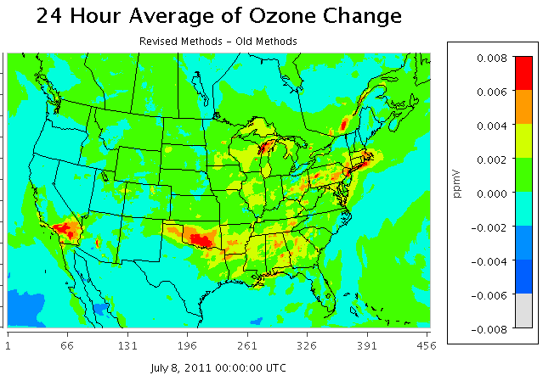
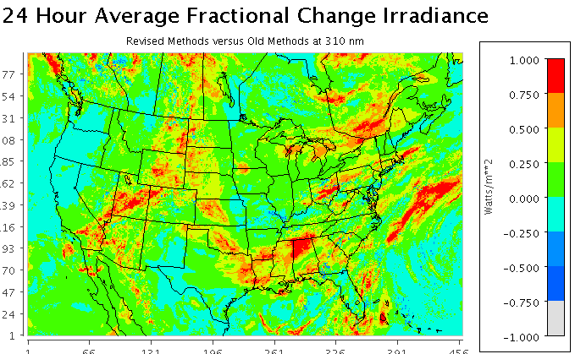
In-Line Calculation of Photolysis Rates
Code Restructuring and Optimization
Cloud Effects based on hydrometer concentrations predicted by WRF resolved and CMAQ convective cloud models
Absorption by aerosol elemental carbon based on Bond and Bergstrom (2006)
Run-time options for Full Mie Calculation and Core-Shell Mixing Model to determine aerosol effects
In comparison to old methods:
  revised methods generally increase cloud transmissivity
  increased ozone in some cloudy areas
Courtesy of Bill Hutzell

Slide 7
SOA Updates
SV_PAH1 SV_PAH2
PAHs
APAH1 APAH2
SV_ALK1 SV_ALK2
AALK1 AALK2
long
alkanes
APAH3
cloud water
SOA from isoprene updated
  SOA from ISOPRENE + NO₃ added
  Acid catalyzed isoprene SOA (AISO3J) updated
SOA from PAHs (naphthalene) added
SOA from alkanes added (CB05) or updated (SAPRC)
SV_TOL1 SV_TOL2
ATOL1 ATOL2
AORGC
O
high-yield aromatics
AOLGA
H
AXYL1 AXYL2
ATOL3
SV_XYL1 SV_XYL2
GLY MGLY
low-yield aromatics
AXYL3
NCOM
ABNZ1 ABNZ2
SV_BNZ1 SV_BNZ2
ABNZ3
POC
VOCs
benzene
ATRP1 ATRP2
AOLGB
SV_TRP1 SV_TRP2
ANTHROPOGENIC EMISSIONS
monoterpenes
AISO3
ASQT
sesquiterpenes
SV_SQT
AISO1 AISO2
BIOGENIC EMISSIONS
EMISSIONS
EMISSIONS
SV_ISO1 SV_ISO2
EMISSIONS
isoprene
IEPOX
Aqueous aerosol

Slide 8
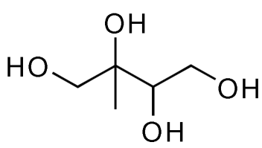
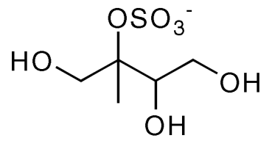
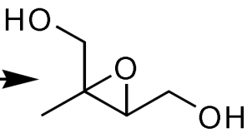
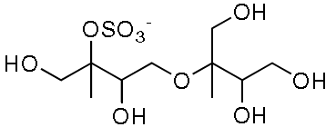
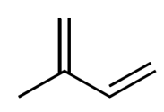
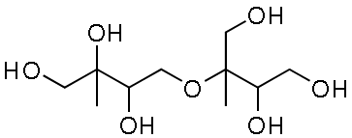
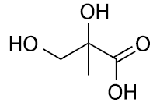
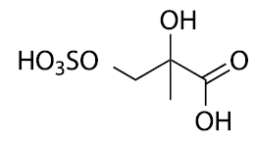
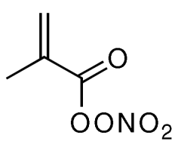
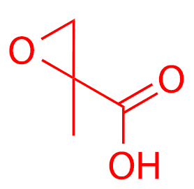
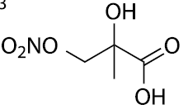
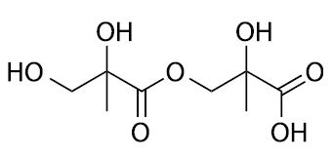
Updated Acid-Catalyzed Isoprene SOA
+H₂O
Based on later generation isoprene epoxides (IEPOX and MAE)
Implemented as heterogeneous reaction that is a function of aerosol-phase composition (aerosol sulfate, water, pH, etc)
+SO₄⁻²
+NO₃⁻
acid
+HO₂
IEPOX
+OH,O₂
RO₂
isoprene
+H₂O
+NO
+SO₄⁻²
+OH
acid
+NO₃⁻
MPAN
MAE
(MAE Chemistry not in CB05)
Updates to low-NOx chemistry (Xie et al. 2013 ACP), high-NOx chemistry (Lin et al. 2013 PNAS), and aerosol (Pye et al. 2013 ES&T)

Slide 9

Heterogeneous Chemistry
Current model: Uptake of N₂O₅ on aerosols
When particle contain Cl, uptake of N₂O₅ can also produce ClNO₂
Average change in winter-time predictions due to ClNO₂ Chemistry
TNO3 O₃ SO₄²⁻
Alters partitioning of reactive nitrogen, impacts oxidant chemistry, and thus
impacts production of secondary pollutants (Sarwar et al., GRL, 2014)

Slide 10
Dynamic Aqueous Chemistry with Rosenbrock Solver
A KPP-generated RODAS3 solver for aqueous phase chemistry based on the CMAQv5.0 aqueous chemistry mechanism has been developed
Simultaneously treats phase transfer, chemistry, ionization, and deposition
Benefits:
  Easily expandable for new chemistry or processes (e.g. IEPOX/MPAN SOA)
  More robust
  Reduced potential for coding error
  Treatment of mass transfer limitations and increased dependence of aqueous chemistry on cloud microphysical parameters
Disbenefits
  Increased computational requirements
Courtesy of Kathleen Fahey
Notes:
kmt = mass transfer coefficient, wL = liquid water content fraction, Cg and Caq = gas and aq concentrations, H = henry’s law coefficient, Qi = Aq diffusion limitation, Raq = chemical production, Ascav = Aitken scavenging, Wdep = wet deposition, Xion = dissociation/association; KPP= kinetic preprocessor

Slide 11
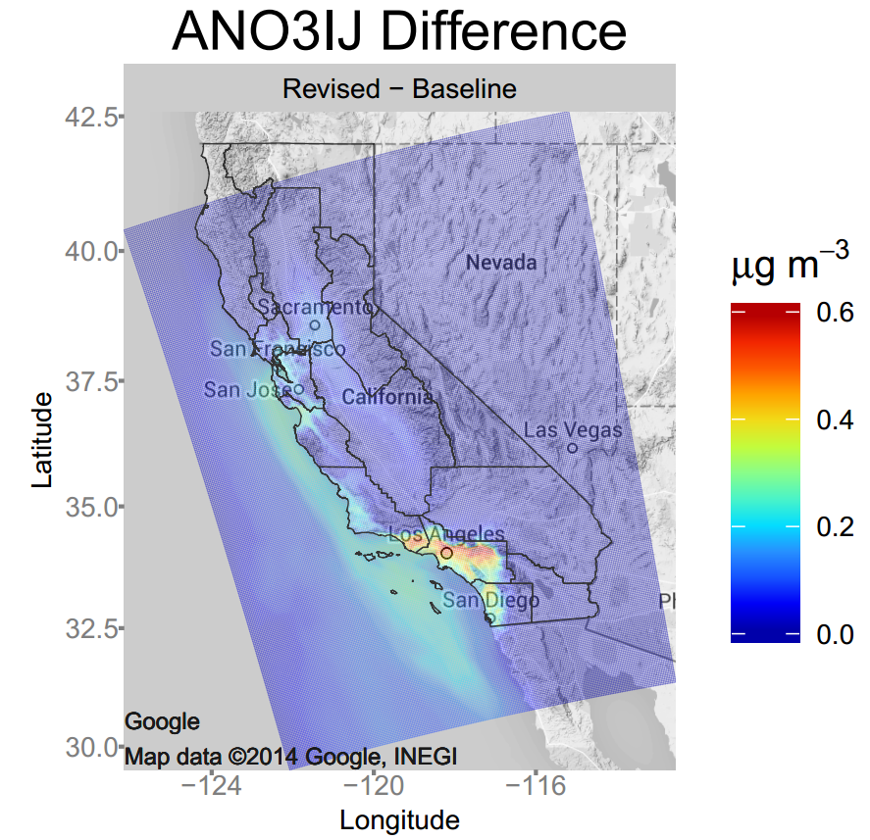
Emissions/land surface
Integrate soil NO emissions and bidirectional exchange algorithms
Sea-salt Emissions
  Added dependency on sea surface temperature
    Better reflects recent measurements and findings
  Reduced the size of the surf zone emissions
  Effects:
    Increase SS emissions
    Increase Nitrate aerosol
Updates to biogenic emissions (BEIS)
  Two layer model with leaf temperature parameterization
  BELD data: Updated to 2001-2011 NLCD, MODIS, and Forest Inventory Analysis (FIA) data
    Finer spatial allocation of tree species
  Isoprene compared to AQS: ~30% reduction in NMB and 15% reduction in NME
  Reduction bias and error of PM2.5 and O₃ ~1%-5%
Gantt et al in prep

Slide 12
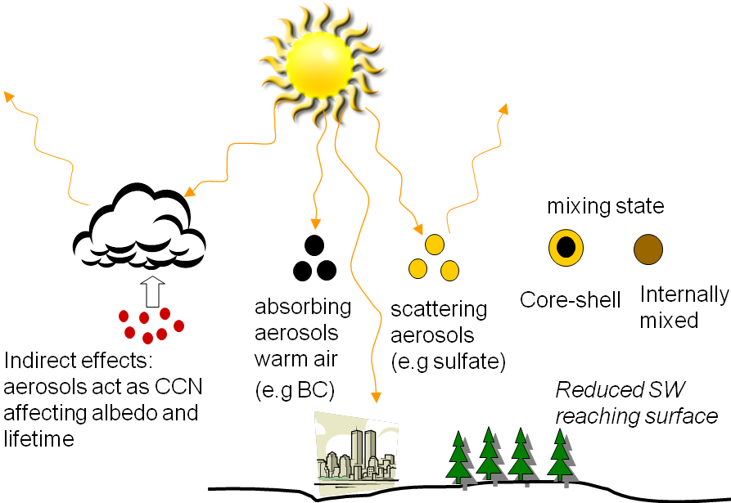
2-way WRF-CMAQ
Updated to CMAQv5.1
Updated to WRFv3.6.1
Direct aerosol radiative effects now use core-shell algorithm for coated EC/BC
Investigating trends in aerosol direct radiative effect over 20 years
  Northern Hemisphere – 108 km resolution
  North America - 36 km and 12 km resolution
  Chuen Meei Gan talk and Jia Xing Poster tomorrow
Indirect aerosol radiative effect based on Abdul-Razzak and Ghan (2002, 2000) for CCN activation and Liu et al. (2007) for IN activation

Slide 13
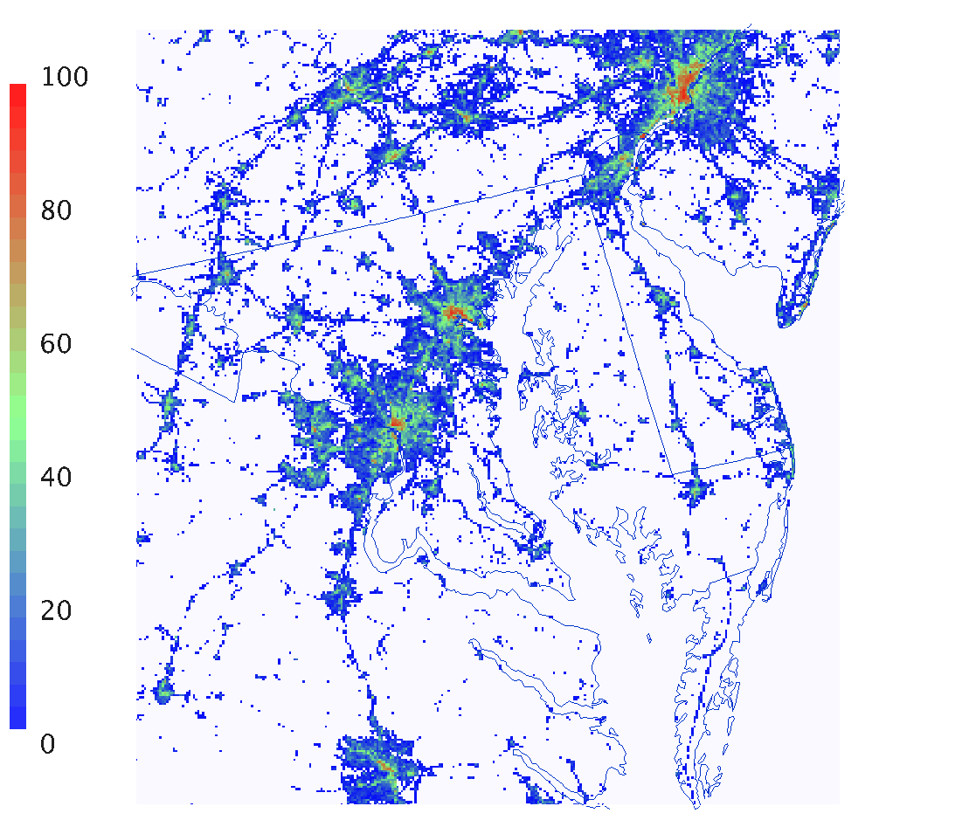
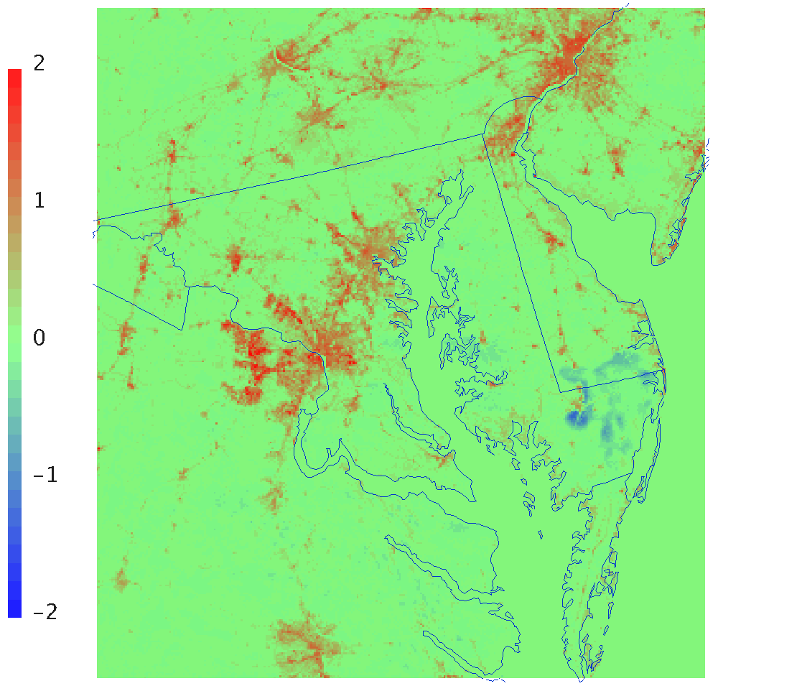
Meteorology
To be included in WRF3.7 – March 2015
A Simple Bulk Urban Approach for PX LSM
  Utilize NLCD-based Impervious surface data directly in land-surface model to scale surface heat capacity
  Use NLCD tree canopy coverage data in ET model
  Increase surface roughness and albedo for urban LU classes to better represent developed areas
New iterative analysis scheme for high resolution modeling for indirect soil moisture and temperature nudging
Ensemble FDDA study – estimate the uncertainty in CMAQ output that results from variability of the meteorology fields (Gilliam et al in prep)
Updates to PX-LSM and ACM2 PBL models
  Improve SBL and evening transition

Slide 14
CMAQv5.1 Time table
October/November 2014: Initial code freeze
November 2014-January 2015: Initial testing, debugging, and evaluation
January 2015: freeze β-version of the code
  β-version of the code will be made available upon request to facilitate the integration of community contributions
February-August, 2015: additional testing/evaluation/documentation
May/June 2015: Peer review
September 2015: CMAQv5.1 release

Slide 15
Extra

Slide 16
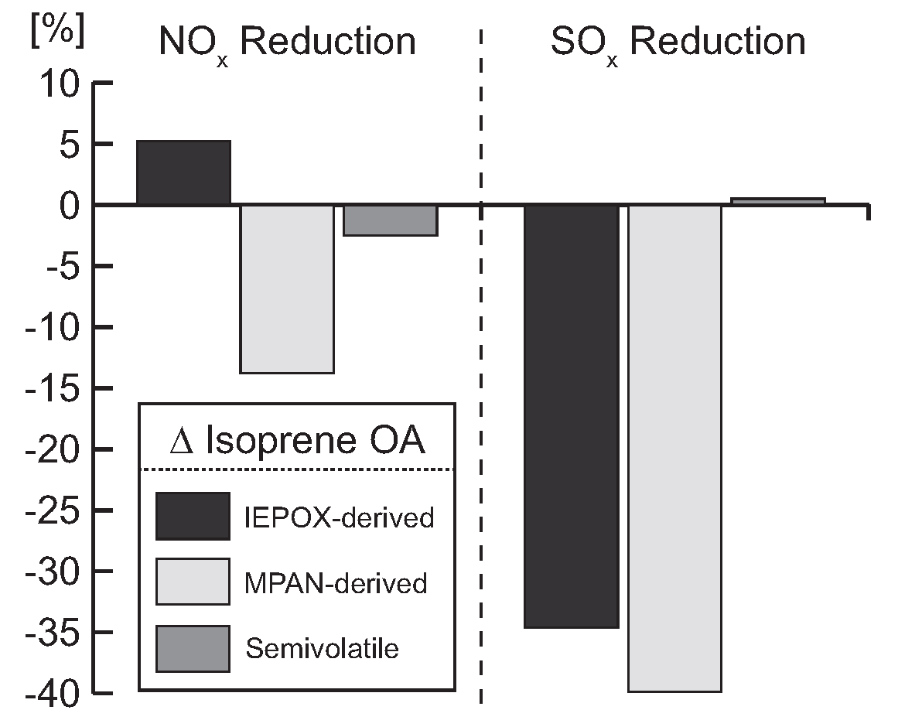
Response to emision controls
Effect of 25% emission reduction on isoprene SOA
  SO_{x} reduction has larger impact than NO_{x} reduction
  Change in epoxide OA in opposite direction of change in semivolatile OA
[Pye et al. 2013 ES&T]

