Slide 1


Organic nitrates and ozone over eastern US
Jingqiu Mao (Princeton/NOAA GFDL), Larry Horowitz, Peter M. Edwards, Kyung-Eun Min, Steve Brown, Ilana B. Pollack, Thomas B. Ryerson, Martin Graus, Carsten Warneke, Jessica B. Gilman, Brian M. Lerner, Andy Neuman, John B. Nowak, Patrick R. Veres, James M. Roberts, Felipe Lope-Hilker, Ben H. Lee, Joel A. Thornton, Jennifer B. Kaiser, Frank N. Keutsch, Glenn M. Wolfe, Thomas F. Hanisco, Joost A. De Gouw, Kenneth C. Aikin, Kelley C. Wells, Dylan B. Millet, Vaishali Naik, Fabien Paulot, Meiyun Lin, Daniel J. Jacob
Funding from NOAA CPO

Slide 2
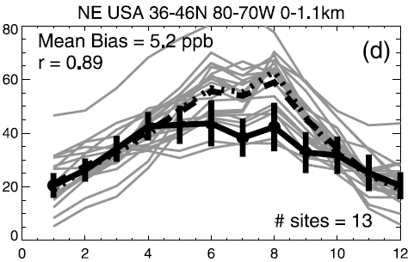
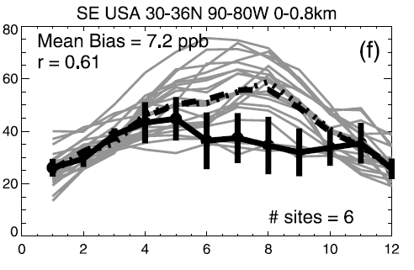
Summertime ozone over eastern US is a long-standing problem for most global models
Northeast US
Multimodel mean
Obs from CASTNET surface sites
Southeast US
Multimodel mean
Obs from CASTNET surface sites
This bias is attributed to the treatment of isoprene chemistry in the model.
(Fiore et al., 2009, JGR)
Notes:
Fiore: Model and obs are for 2001
Naik: AM3 is 1980-2000, CASTNET is 1988-2009

Slide 3
A new isoprene chemistry for global models
ISOPO2 + NO is based on Paulot et al. (2009, ACP).
ISOPO2 + HO2 is based on Paulot et al. (2009, Science).
Isomerization of ISOPO2 is based on
Peeters et al. (2009, PCCP) and Crounse et al. (2011, PCCP) .
(Mao et al., JGR, 2013)

Slide 4
First generation of isoprene nitrates degraded to second generation nitrates!
First generation isoprene nitrates (C5)
Overall NO_{x} recycling efficiency is around 55%!
Second generation isoprene nitrates (C3-C4)
(Paulot et al., 2009, ACP)

Slide 5
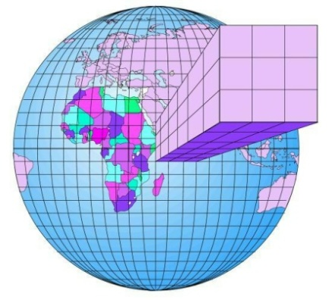
The International Consortium on Atmospheric Transport and Transformation (ICARTT) aircraft study: July-August 2004
Chemical transport model (GEOS-Chem) at 2x2.5 degree
Extensive measurements on isoprene oxidation products, including total alkyl nitrates (∑ANs)

Slide 6
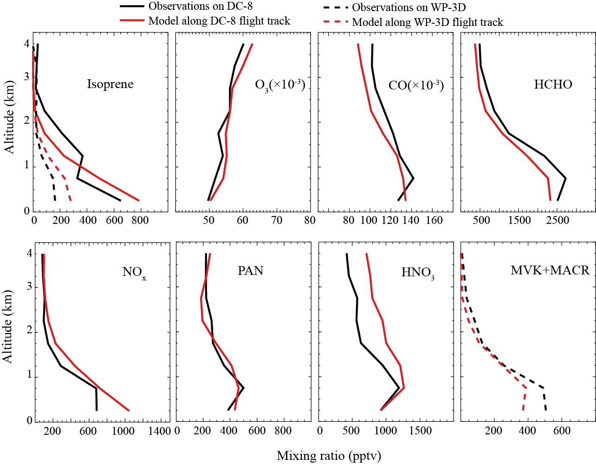
Mean vertical profiles during ICARTT
Observations
GEOS-Chem
O₃ has no bias in boundary layer and free troposphere.
HCHO provides good constraint on isoprene emissions.
(Mao et al., JGR, 2013)

Slide 7
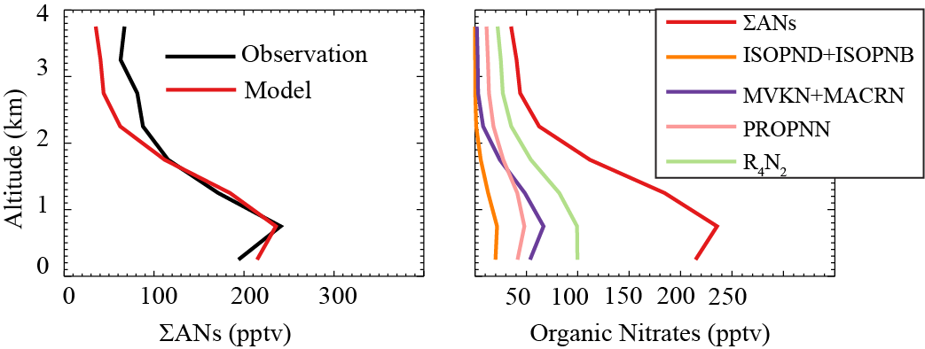
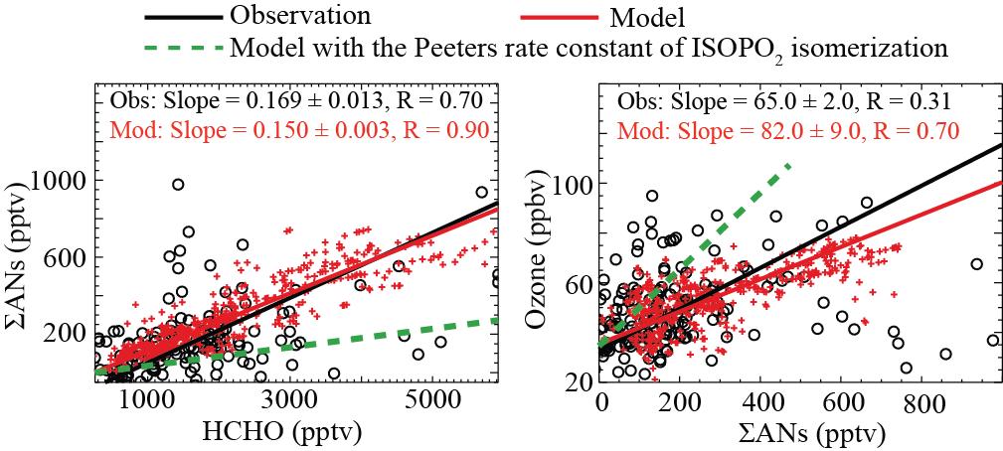
Total organic nitrates excluding peroxyacylnitrates (∑ANs)
Vertical profiles
Speciation of ∑ANs
Model well reproduced ∑ANs.
∑ ANs is dominated by secondary organic nitrates.
∑ANs vs. HCHO
∑ANs vs. O₃
Model well reproduced ∑ANs vs. HCHO and ∑ANs vs. O₃ correlations.
These correlations cannot be reproduced by a fast isomerization channel of ISOPO₂.
(Mao et al., JGR, 2013)

Slide 8
NO_{y} budget in eastern U.S. boundary layer for July 2004
Species | Emission | Chemical (P-L) | Dry Deposition | Wet Deposition | Net Export
NO_{x} | 386 | -337 | 44 | ------ | 5
PANs |  | 24 | 13 | ------ | 11
∑ANs
ANs |  | 18 | 7.4 | 3.6 | 7
R₄N₂ |  | 10 | 0.5 | ------- | 10
HNO₃ |  | 277 | 180 | 110 | -3
(Unit Gg N)
Export of ∑ANs > Export of PANs
(Mao et al., JGR, 2013)

Slide 9
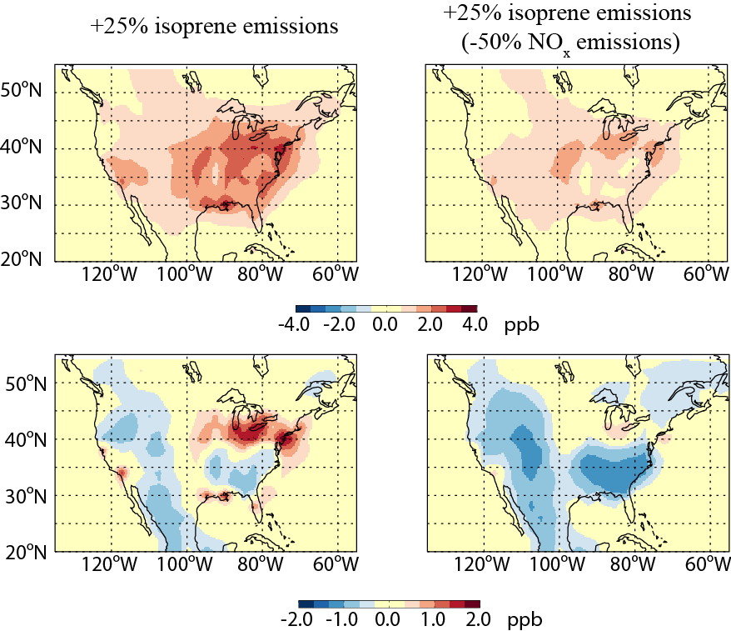
Surface ozone response to isoprene emissions
NO_{x} emissions↓
Sensitivity of ozone to isoprene emissions ↓
New chemistry
Previous studies without NO_{x} recycling
Isoprene↑
NO_{x} ↓
OH ↓
O₃ ↓
Current anthro NO_{x} emissions (2004)
Reduce current anthro NO_{x} emissions by 50%
(Mao et al., 2013, JGR)

Slide 10


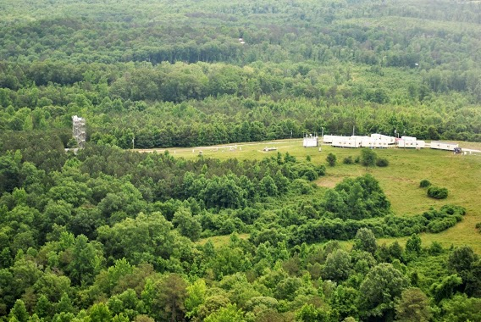
Field studies over Southeast US in the summer of 2013
SENEX (NOAA)
Two aircrafts based at Smyrna, TN and a tower located at Centerville, Alabama.
Measurements include VOC, NO_{x}, ozone, aerosols, CCN etc.
GFDL provided C180 nudge simulations to SENEX data archive.
A modeling workshop to be held in GFDL this summer.
NOMADSS (NCAR)
SOAS (NSF & EPA)

Slide 11
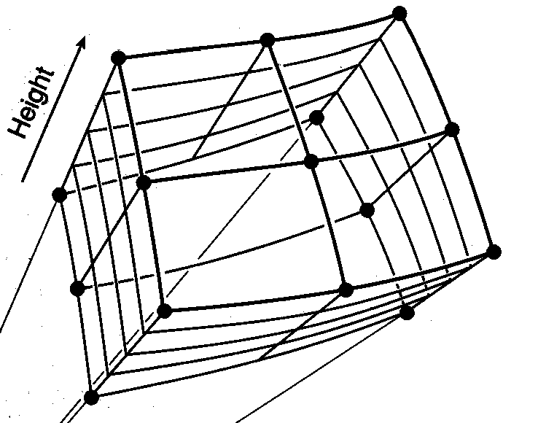
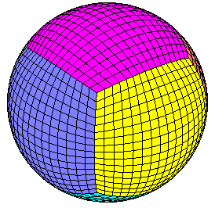
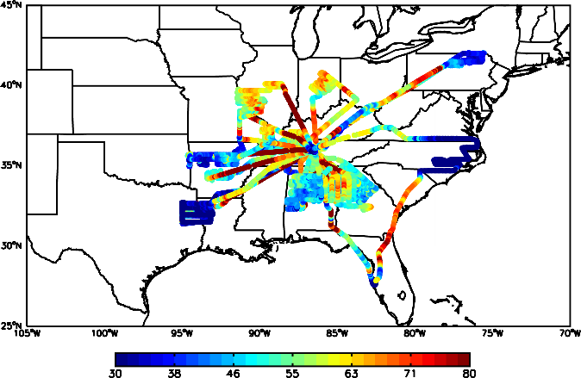
GFDL AM3 model
SENEX 2013 (NOAA)
June 3rd to July 10th
SENEX (Southeast) flight track
Fully coupled chemistry-climate model
Nudging wind with GFS meteorological field
Global high resolution (50 x 50 km)
MEGAN biogenic emissions (process-based emission)
New isoprene chemistry (Mao et al., 2013 JGR)
Colored by ozone

Slide 12
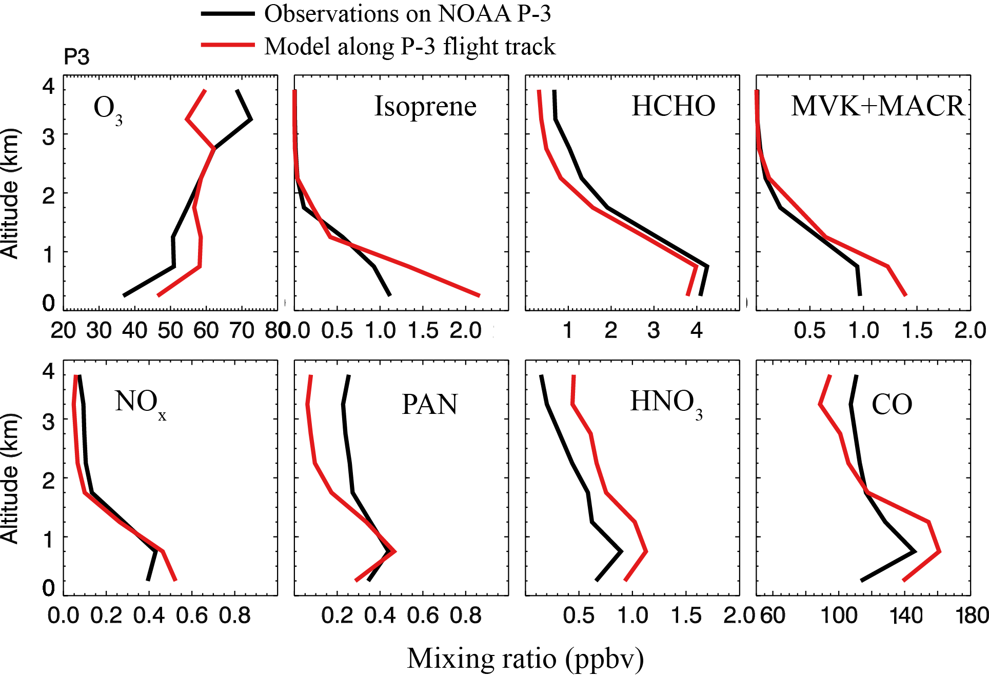
Mean vertical profiles during SENEX
Plumes have been filtered by NO_{x}/NO_{y}<0.4, NO_{x}<4 ppbv, CH₃CN<225 pptv.
Model tends to overestimate ozone by 5-10 ppb.
By including a high yield of daytime terpene nitrates (27%), ozone can be reduced by <1 ppb in boundary layer.
By including a high yield of nitrate from terpene + NO₃, ozone can be reduced by < 1ppb in boundary layer.

Slide 13
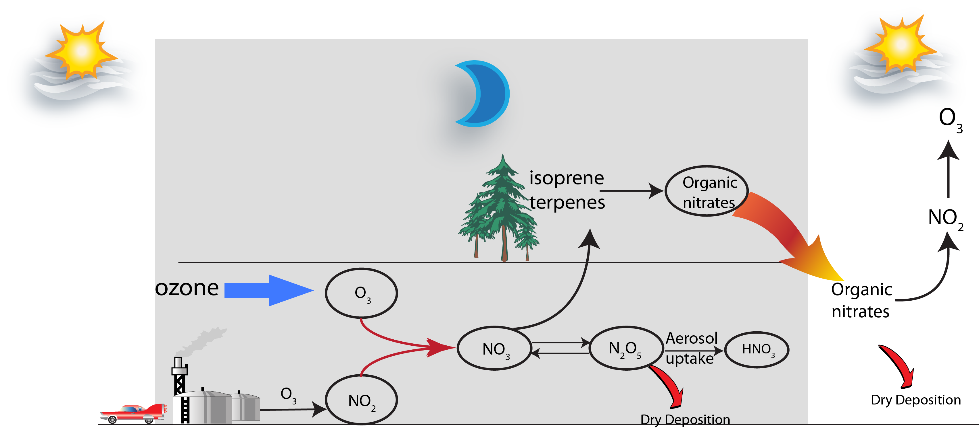
Influence of nighttime NOx chemistry on daytime ozone
The limiting step is NO₂ + O₃ reaction.
With 40 ppb of O₃, nighttime NO_{x} lifetime is about 8 hours.
The production of NO₃ can be mainly considered as a sink for NO_{x}.
Organic nitrate yield of isoprene + NO₃ is ~70%>> daytime yield (11.7%)
Organic nitrate yield of terpenes + NO₃ is 40-50% (Fry et al., 2009,2011, ACP)

Slide 14
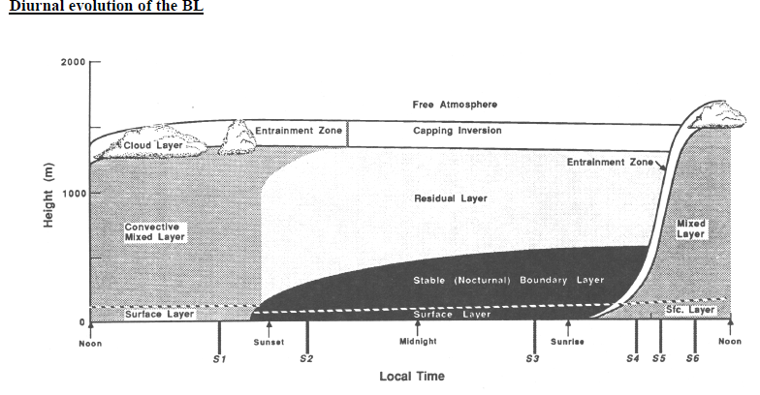
Sunset
Sunrise
10am
(Stull, 1988)
After sunset, many VOCs and OVOCs are frozen in the residual layer.

Slide 15
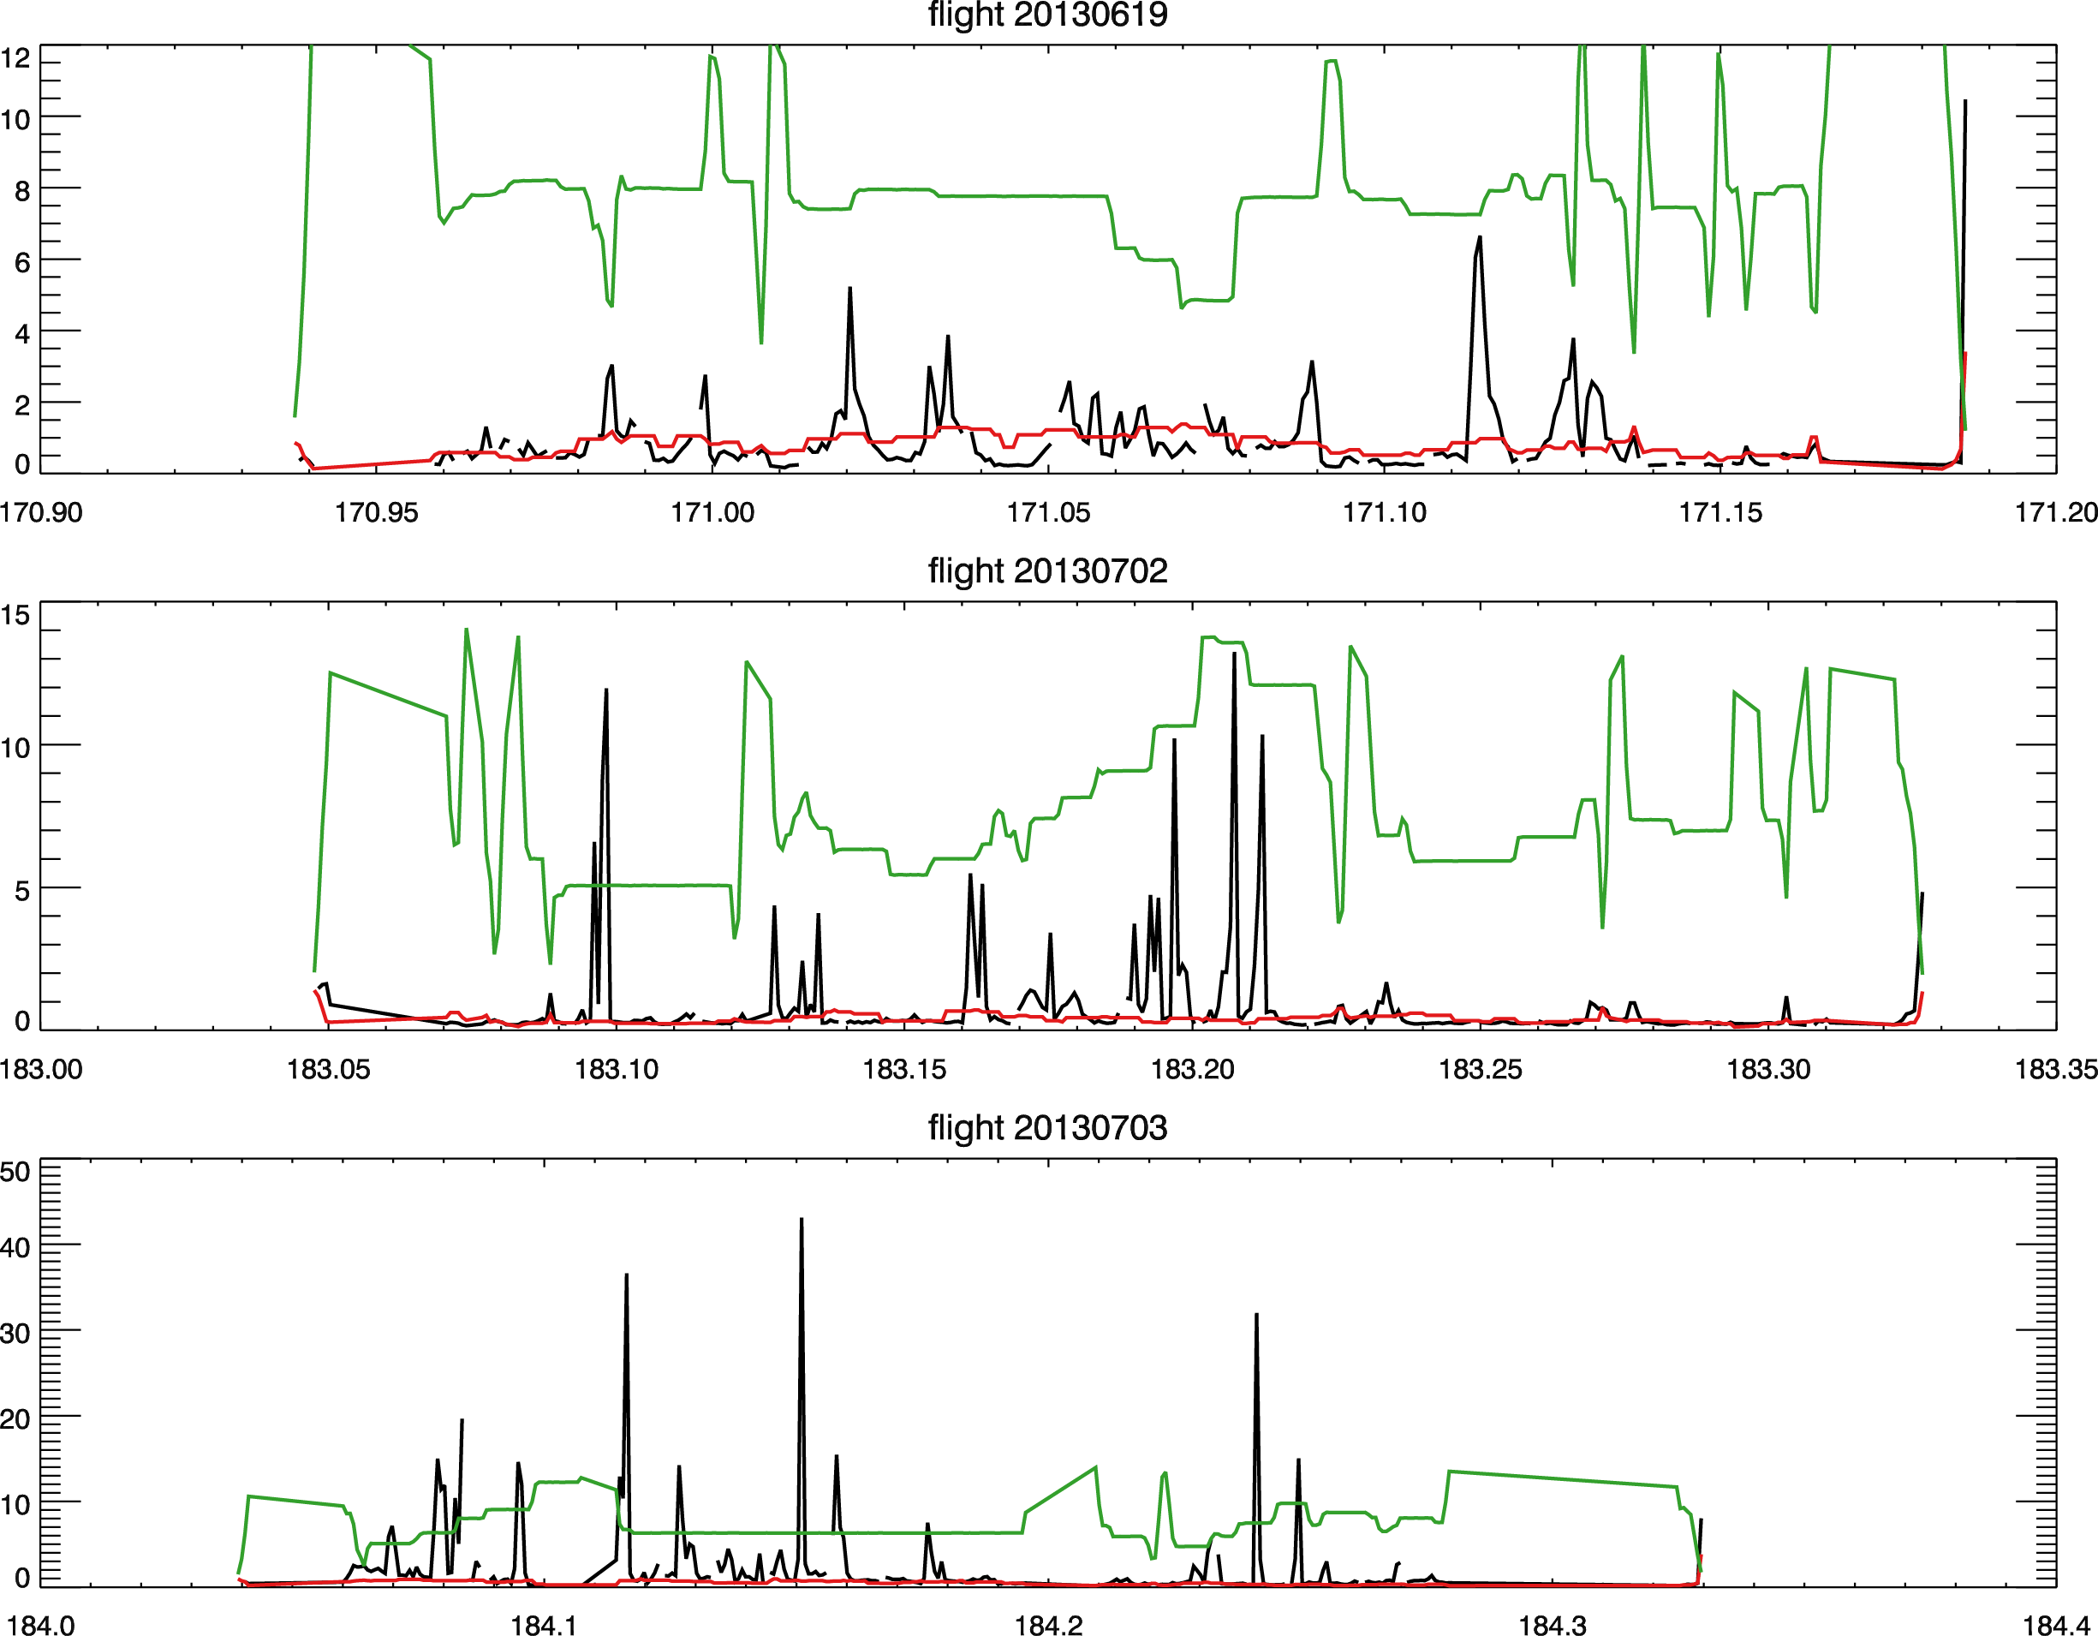
Three night flights during SENEX
Altitude (m)/100
Measured NO₂ (ppb)
Modeled NO₂ (ppb)
Atlanta
Power plants
Power plants
Most plumes are emitted at 500 – 1000 m ( in residual layer).
NO₂ in plume is 10-30 ppbv, not high enough to titrate ozone.

Slide 16
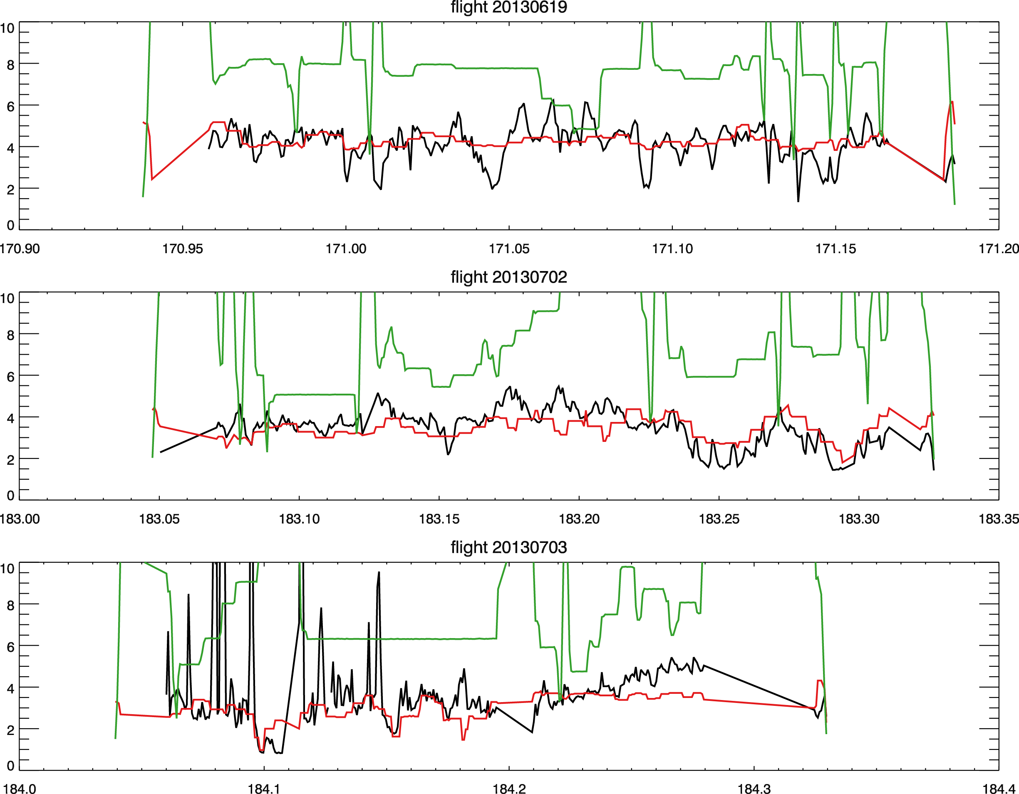
Remarkable feature : Large amount of VOCs remain in residual layer!
Altitude (m)/100
Measured HCHO (ppb)
Modeled HCHO (ppb)
Well mixed HCHO in residual layer.
HCHO is around 4 ppb at different heights, indicating a well mixed residual layer from the last day.
Acetaldehyde is around 1 ppb throughout the night (PAN precursor)
Isoprene (not shown) is about 1-2 ppb in residual layer.

Slide 17

A potential problem in global models for nighttime chemistry
Real world
Model world
130 m
70 m
60 m
Model assumed well-mixed lowest layer.

Slide 18


Emitted in residual layer
Consistent with Paul Shepson’s measurements during SOAS.
Maybe some PAN is being formed at night?
Residual layer
Advection and mixing in free trop
NO_{x}
OVOCs
PAN
NO₃
Organic nitrates
Stable boundary layer
Emitted in surface layer
Residual layer
Surface ozone
Organic nitrates
NO₃
NO_{x}
NO_{x}
NO_{x} emitted into the residual layer will:
be oxidized faster through NO₂ + O₃ (more ozone),
A lot more isoprene in residual layer to react than surface layer (bigger volume),
(3) contribute less to surface ozone.

Slide 19
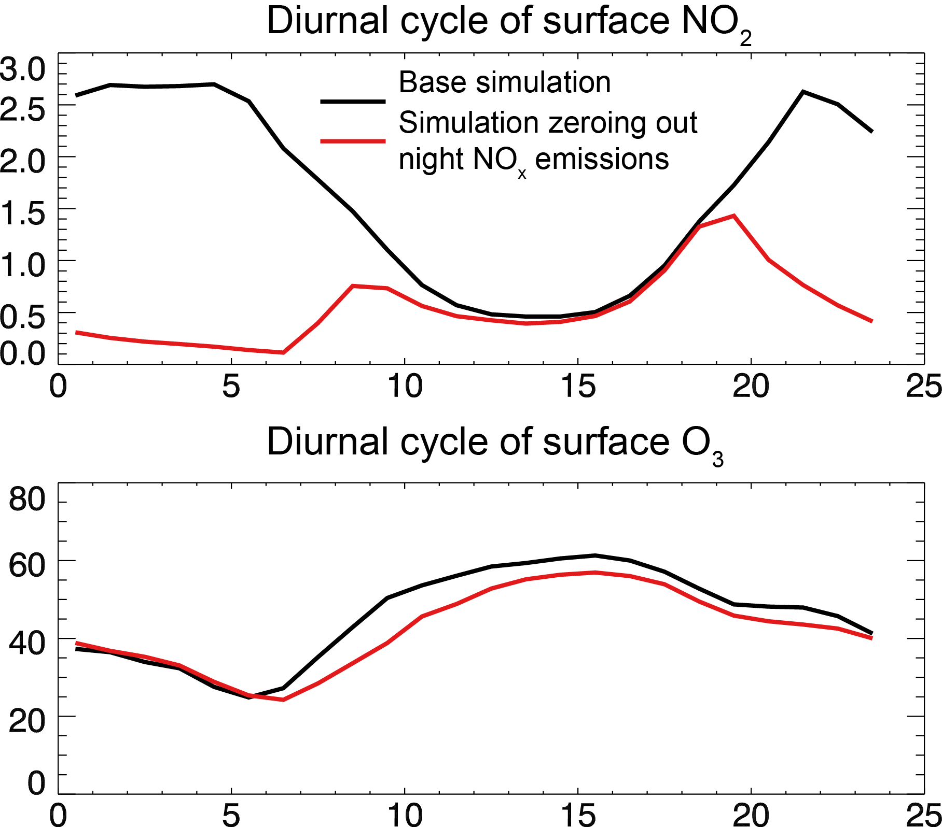
We now calculate the upper limit of the effect of vertically resolved nighttime NO_{x} emissions (assuming all emissions into the residual layer are removed instantly).
Not much difference on afternoon NO_{x}, where we do most aircraft sampling.
But you can see difference on ozone, 5-10 ppb.

Slide 20
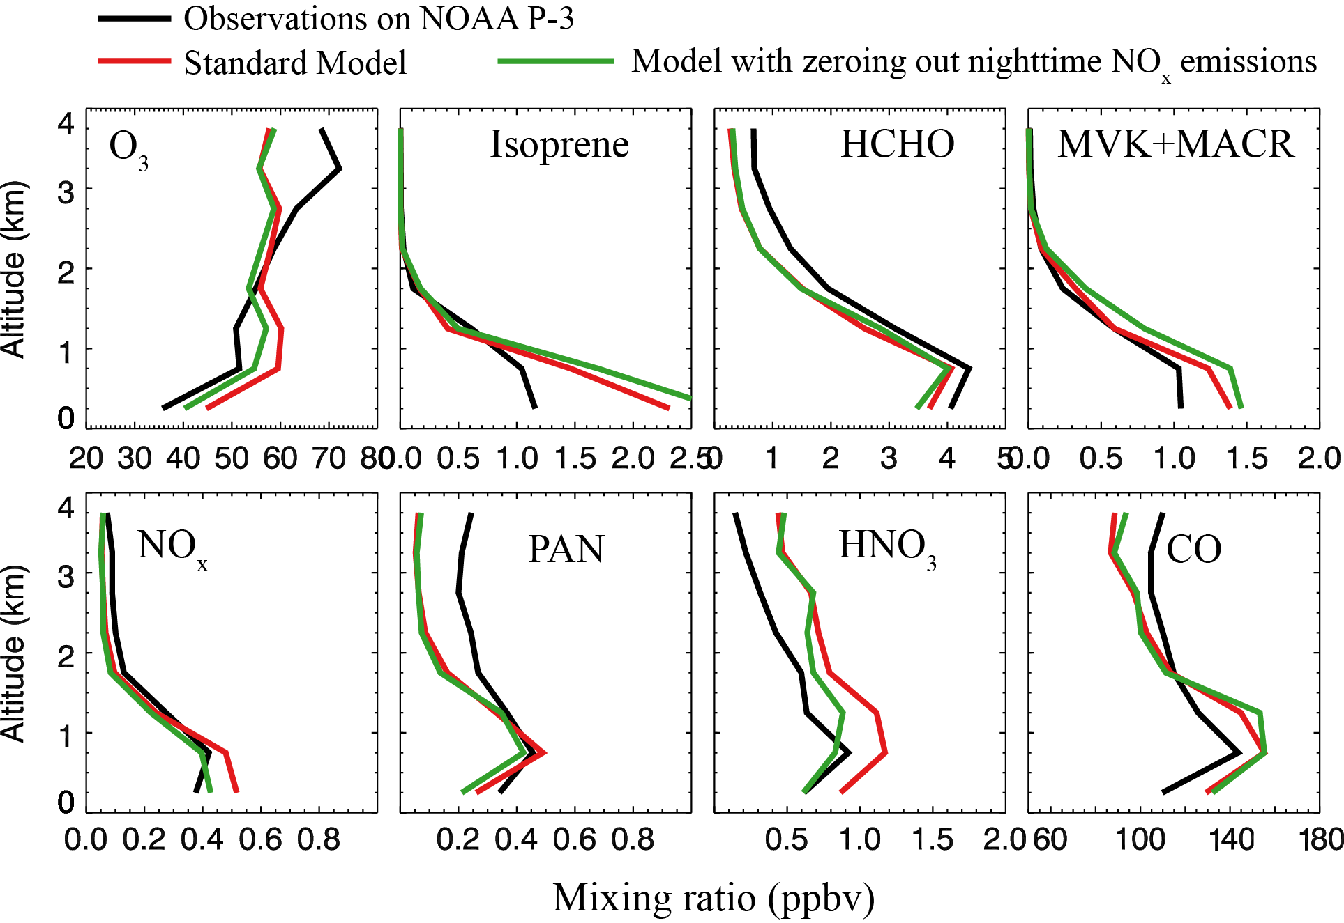
Zeroing out nighttime NO_{x} emission in the model (30% of total anthropogenic NO_{x} emissions)
This improves afternoon ozone by 5 ppb in the model.
If we assume those nighttime NO_{x} can be converted to PAN, this may also improve PAN simulation.

Slide 21
Summary
Current best estimate of daytime isoprene nitrate yield is ~12%, with ~50% recycling efficiency of NO_{x}.
-- This results in a positive dependence of surface ozone on isoprene emissions throughout the U.S.
-- Good agreement between observed and modeled total alkyl nitrates provides additional constraints on isoprene chemistry.
Nighttime BVOCs oxidation is a sink for NO_{x}
-- Sink can be more efficient for NO_{x} emitted in residual layer (high O₃, VOCs).
-- This may help to reduce surface ozone bias in global models.
-- Important for nitrogen export, as more PANs and alkyl nitrates may be produced in residual layer

