Slide 1
Evaluation of CMAQ Simulations of NH₃ in California using Satellite Observations from TES
Jennifer Hegarty¹, Chantelle Lonsdale¹,
Karen Cady-Pereira¹, Matthew Alvarado¹,
John Nowak², Jennifer Murphy³, Milo Markovic^{3,4} and
Trevor VandenBoer^{3,5}
1. Atmospheric and Environmental Research (AER)
Aerodyne Research, Inc.
University of Toronto
NOAA ESRL and CIRES
Memorial University of Newfoundland

Slide 2
Background
Ammonia (NH₃) contributes to the formation of ammonium nitrate (NH₄NO₃) and ammonium sulfate ((NH₄)₂SO₄) aerosols which degrade air quality.
Emission estimates of NH₃ uncertain.
can be off by a factor of 2 (Nowak et al., 2013)
diurnal cycle may not be well represented (work on feed lot emissions in North Carolina by Jesse Bash)
Improved estimates may be obtained from a top-down approach utilizing models such as the CMAQ-Adjoint.
requires observations with good temporal and spatial coverage
in situ observations of NH₃ are limited
Satellite observations may be able to provide the needed coverage.

Slide 3
Approach /Objectives
Perform CMAQ simulations of NH₃ in California during the CALNEX measurement campaign using estimates of emissions from the California Air Resources Board (CARB)
Evaluate CMAQ simulations with satellite observations from the Tropospheric Emission Spectrometer (TES) and aircraft and surface observations from CALNEX.
Special Observation TES transects were performed to coincide with CALNEX
Identify major simulation errors and isolate those due to emission uncertainties from other sources (e.g. meteorological modeling).
Run CMAQ-Adjoint to refine emissions estimates.

Slide 4
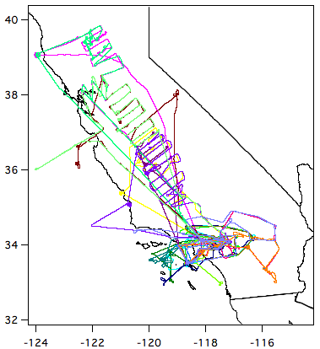
CALNEX
NOAA WP-3D Flight Tracks
Flight Dates
Combined aircraft and ground-based measurement campaign focused on the California Central Valley and Los Angeles Basin during May – June 2010.
Provides rich data set for studying NH₃ emissions.
Bakersfield surface measurement site
Los Angeles surface measurement site

Slide 5
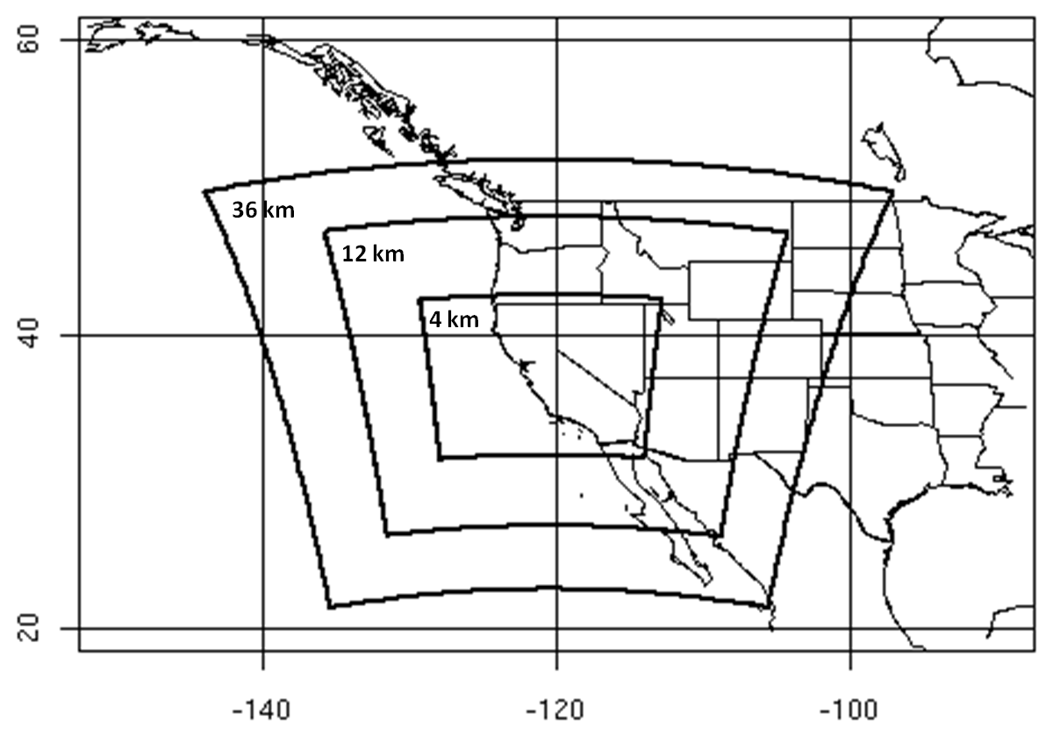
WRF-CMAQ Modeling
WRF Domains
WRF ARW Version 3.5 with 3 nest levels of 36, 12 and 4 km
41 levels, 1st layer ~50m deep
YSU PBL
IC and BC from North American Regional Reanalysis (NARR)
Daily restarts and grid nudging above PBL
CMAQv5.0.1 run on inner 4 km domain only.
cb05tucl chemistry
ae6_aq aerosols
CMAQ boundary conditions provided by GEOS-Chem on a 2.0⁰ x 2.5⁰ latitude–longitude grid.
Emissions provided by California Air Resources Board (CARB)

Slide 6
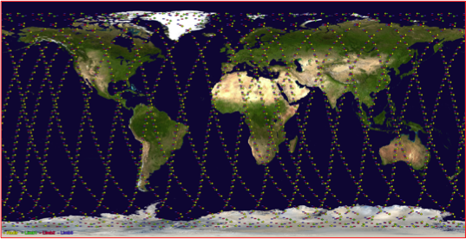
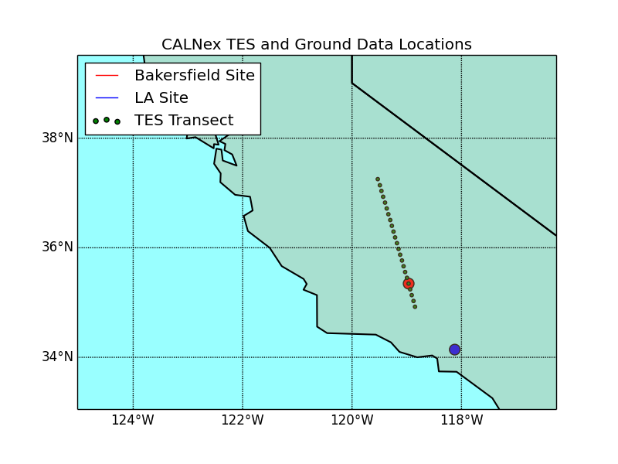
Tropospheric Emission Spectrometer
 | TES
Satellite | AURA
Launch | July 2004
Spectral Coverage | 650 – 3050 cm⁻¹
Equatorial crossing | 1:30 am and 1:30 pm
Spectral Resolution | 0.06 cm⁻¹
Footprint | 5x8 km rectangle
Repeat cycle | Once every 16 days
Orbital Track for a TES Global Survey
Special Observation Transect for CALNEX
Two TES observation modes:
Global Surveys: entire globe in ~ 1 day
Special Observations: higher sampling density over shorter tracks
Special Observations were made over the California Central Valley during CALNEX
The observations were made during the afternoon overpass.

Slide 7
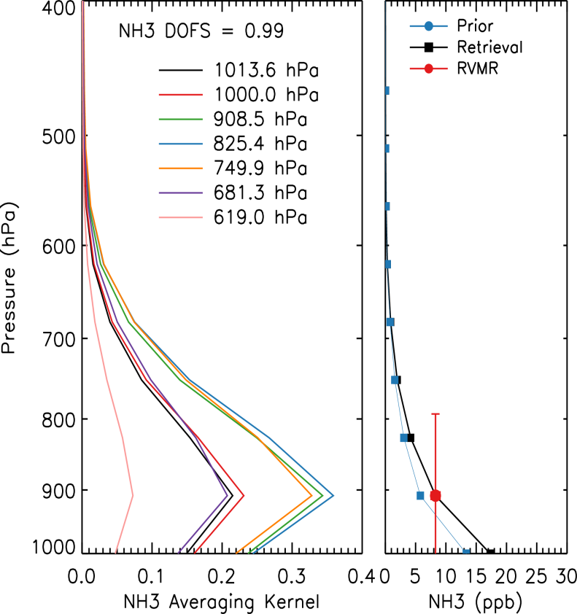
TES NH₃ Measurements
TES NH₃ detectability is ~ 1 ppbv under ideal conditions.
large ground-atmosphere thermal contrast
TES is most sensitive to NH₃ between 950 and 600 hPa.
1 piece of information or less: DOFS<1.0
To make comparisons with models easier collapse retrieved profile to a single value called the Representative Volume Mixing Ratio (RVMR).
RVMR calculated by applying the TES averaging kernel to the retrieved profile.
A corresponding CMAQ RVMR is calculated by applying the TES averaging kernel to the co-located CMAQ NH₃ profiles.

Slide 8
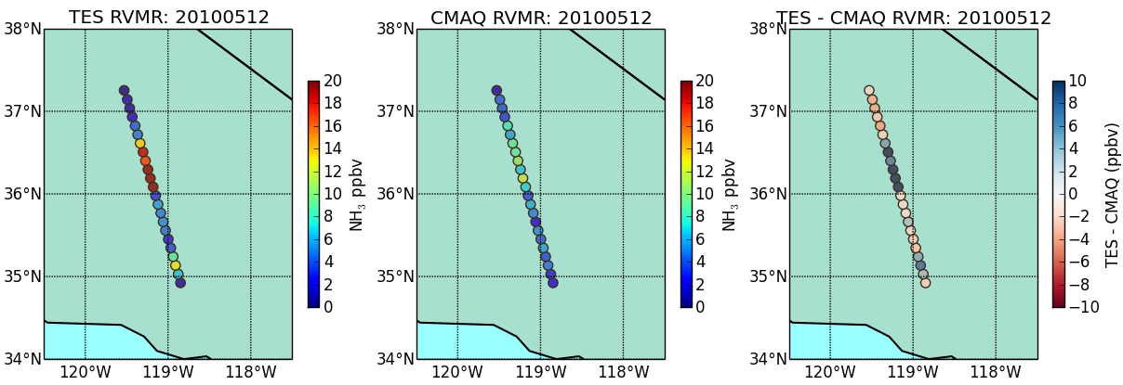
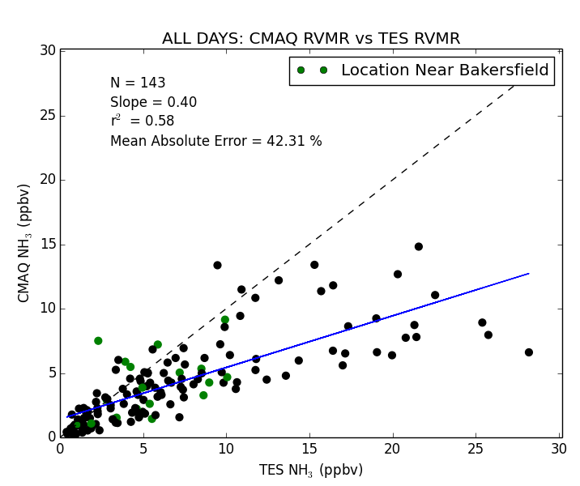
CMAQ -TES Comparison
CMAQ and TES generally agree on the locations of the high and low NH₃.
CMAQ seems to be biased low compared to TES for the highest NH₃ RVMRs.

Slide 9
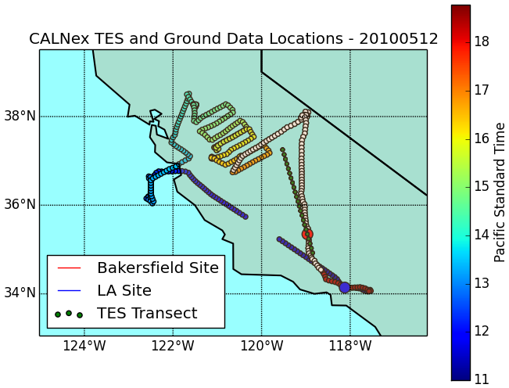
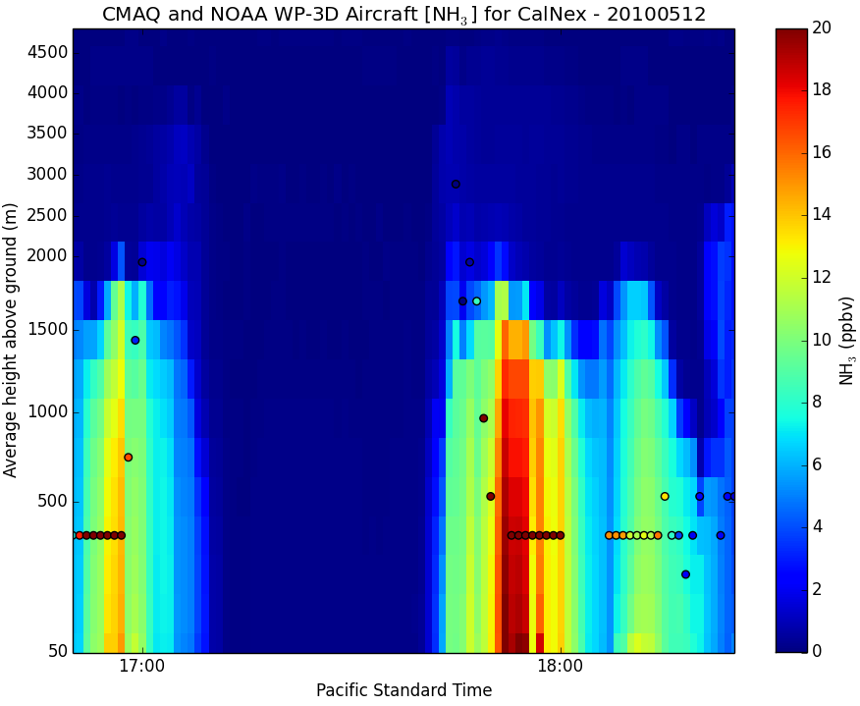
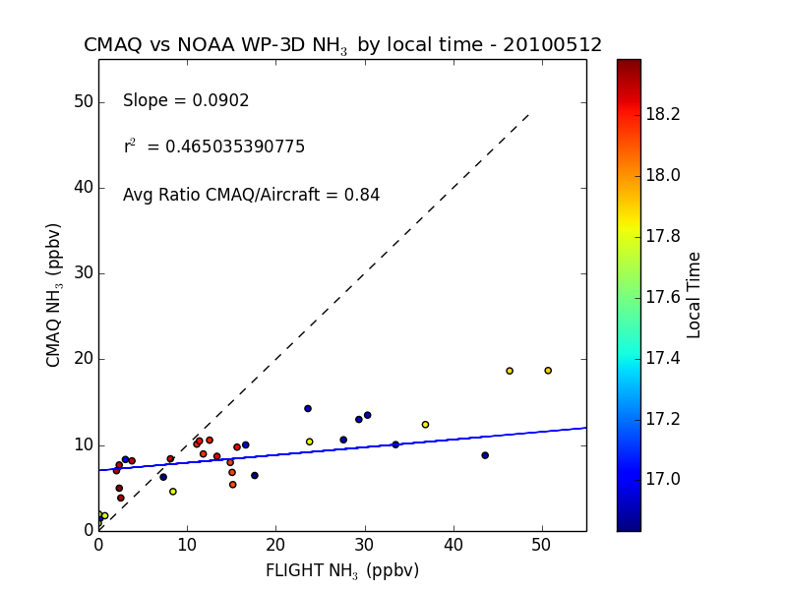
CMAQ –Aircraft Comparison
Aircraft, TES, and Ground Locations, 20100512
CMAQ generally captures the NH₃ plumes observed by aircraft.
CMAQ seems to be biased low compared to aircraft for the highest NH₃ mixing ratios.

Slide 10
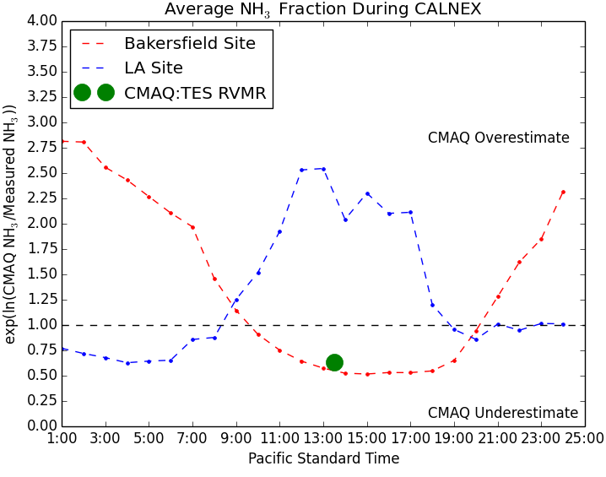
CMAQ and Observed Diurnal Cycles at Surface Sites
At Bakersfield CMAQ is biased high during the night and low during the day.
CMAQ exhibits the opposite characteristics at Los Angeles.

Slide 11
Possible Explanations for Diurnal Errors
Gas / Particle Partitioning
NH₃ not representative of total NH_{x}
Transport
diurnal change in transport pattern
WRF PBL Height
too much or too little vertical dilution
Emissions
diurnal cycle incorrectly specified

Slide 12
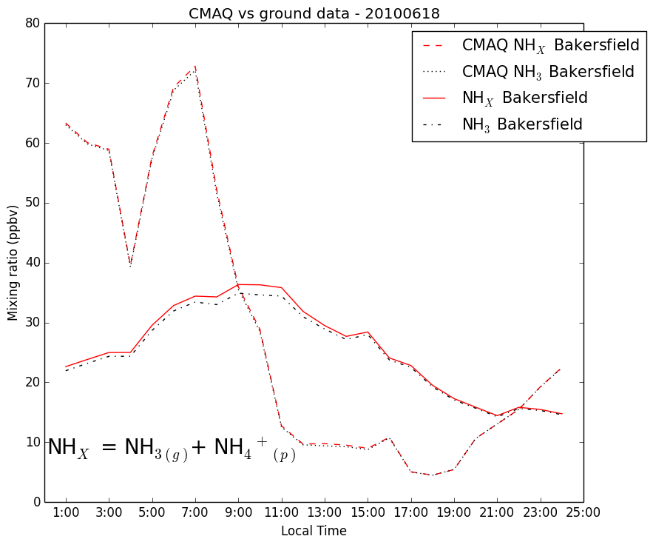
Bakersfield, CA NH₃ June 18, 2010
Modeled
Observed

Slide 13
Transport to Bakersfield June 18, 2010
WRF ARW, 4km
EDAS 40 km
HYSPLIT back trajectories using 4 km WRF ARW meteorology show consistent transport pathway throughout day.
Afternoon EDAS 40 km back trajectories show flow over coastal ranges, which if accurate, would suggest lower observed NH3 mixing ratios
Transport errors do not explain diurnal error pattern.

Slide 14
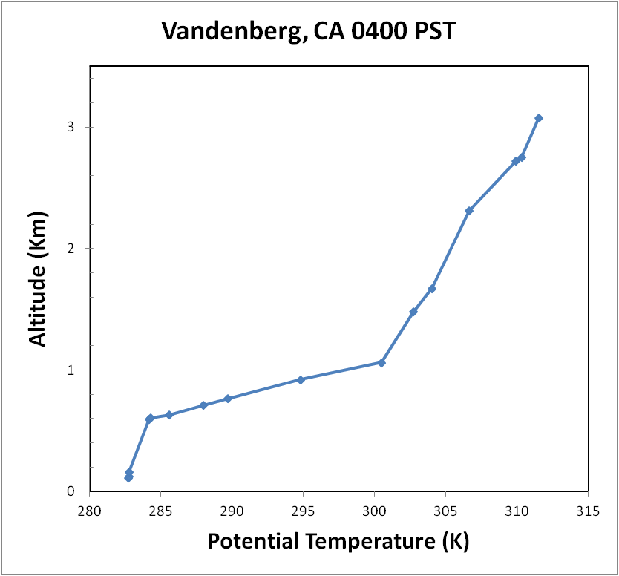
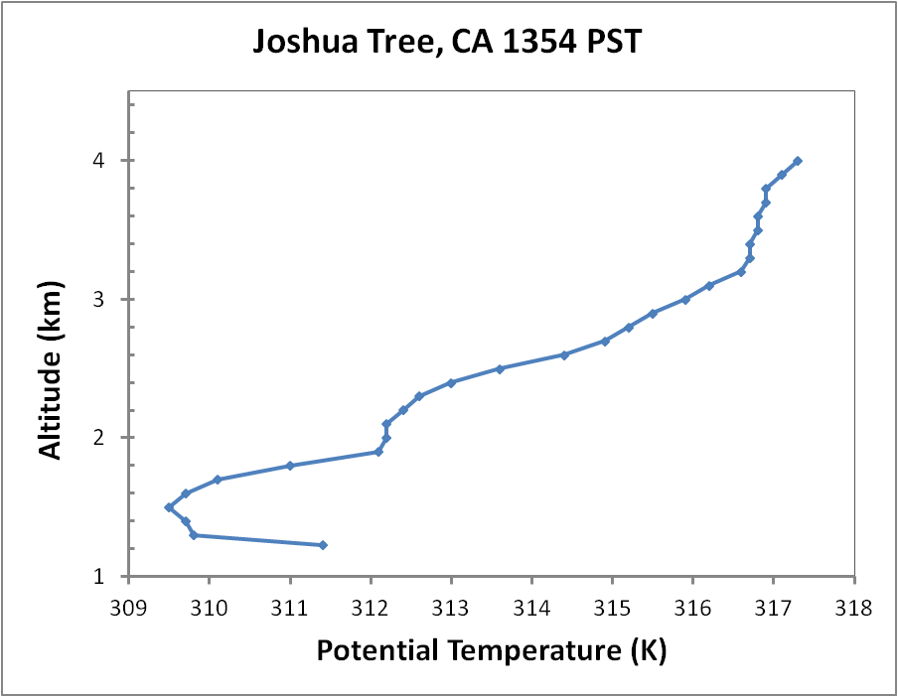
WRF and Observed PBL Heights June 18, 2010
WRF PBL
PBL Top
PBL Top
WRF PBL
Nighttime WRF PBL ~50% of observed depth.
Afternoon WRF PBL ~20% greater than observed.
WRF PBL errors are of the correct sign to explain a portion of the diurnal errors in the NH₃ simulation.
Bakersfield
VB
JT

Slide 15
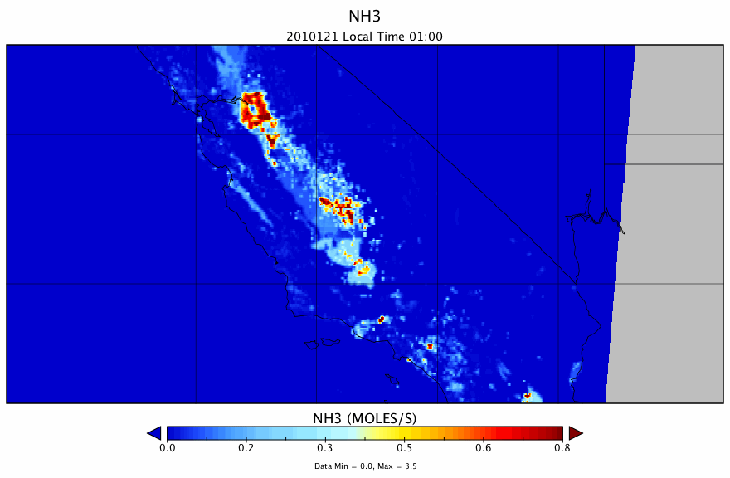
CARB NH₃ Emissions Loop

Slide 16
Summary and Ongoing Work
CMAQ simulations of NH₃ are qualitatively / spatially consistent with TES satellite observations and aircraft.
Surface observations at Bakersfield and Los Angles indicate errors in CMAQ simulation of the diurnal NH₃ cycle.
Constant NH₃ emissions in California Central Valley may misrepresent the emission cycle and are the probable source of CMAQ under simulation of daytime NH₃.
Dramatic step-up of emissions near Los Angeles are another potential error leading to an over simulation of daytime NH₃.
PBL height errors could also play a role particularly at nighttime.
Current work focusing on identifying sources of emission errors in CARB files.
Future: CMAQ-Adjoint will be run to quantify emission uncertainties.

Slide 17
The End

Slide 18
Additional Slides

Slide 19
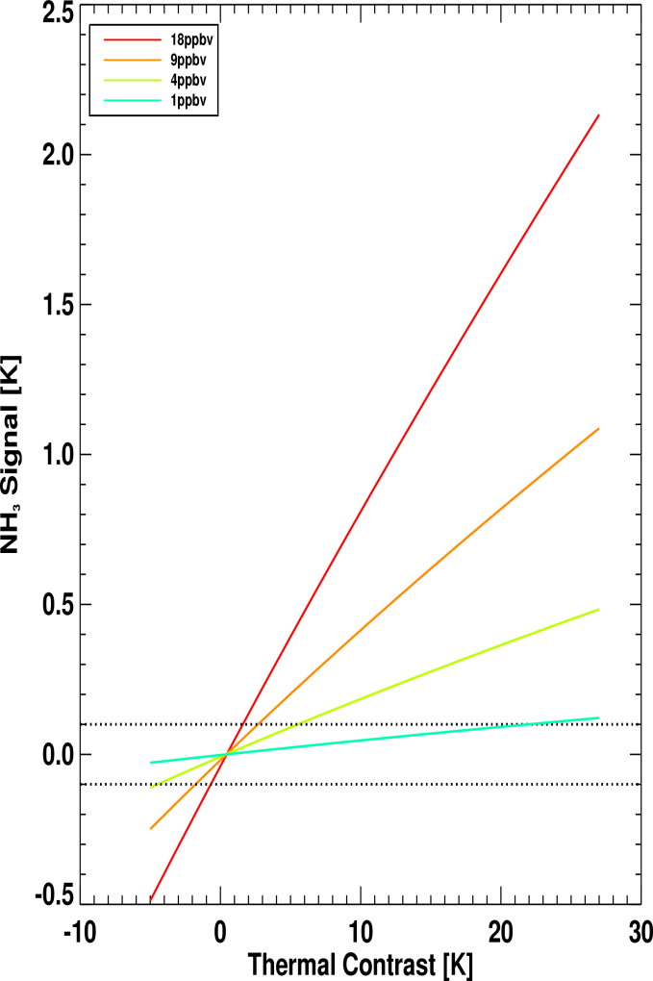
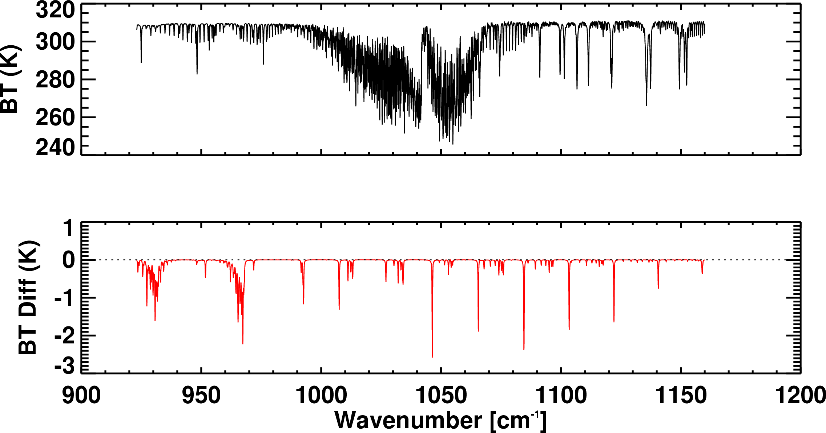
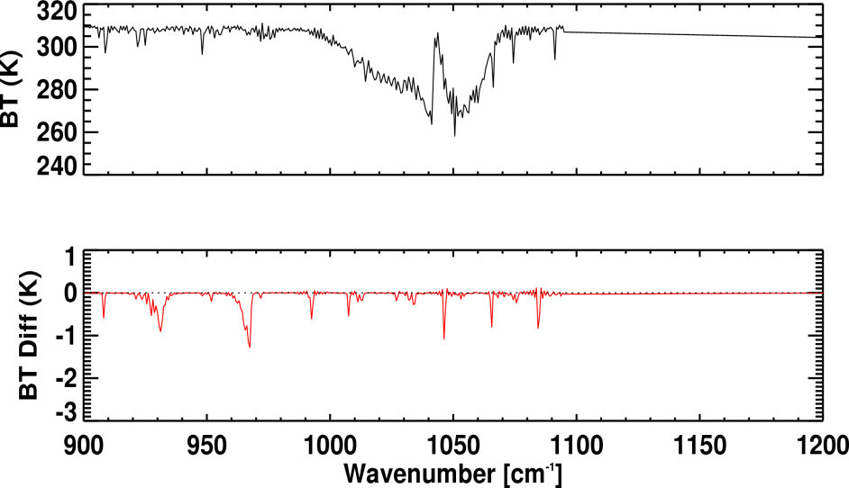
NH₃ signal from TES and CrIS
Simulated spectra and NH₃ signal
18 ppbv at surface
TES
CrIS
Detectability is ~ 1 ppbv under ideal conditions
But thermal contrast also plays a role

Slide 20
Transport to Bakersfield June 18, 2010
7 PST, Early Morning
10 PST, Late Morning
16 PST, Late Afternoon
HYSPLIT back trajectories at 7, 10 and 16 PST using 4 km WRF ARW meteorology show consistent transport pathway throughout day.

Slide 21
Transport Evaluation
Notes:
Some estimated PBL heights:
Big Sur 22 UTC, 36.30 N, 121.89 W, NW of Bakersfield, 12 m elevation and right on coast ~ 800 m altitude (also an elevated inversion between 800m and 1300 m altitude)
Joshua Tree, 22 UTC, 34.08, 116 .30, SE of Bakersfield, 1226 m elevation, ~ 1700 m altitude
San Diego (Mirimar), 12 UTC, SSW of Bakersfield, 128 m elevation, 305 m altitude
San Diego (Mirimar), 00 UTC, June 19, 2010, SSW of Bakersfield, 128 m elevation, 640 m altitude
WRF ARW at Bakersfield, 35.350N, 118.970 W, 135.4 m elevation:
12 UTC 148.425 agl (283 m altitude ~ 22m lower than indicated by San Diego sounding).
13 UTC 27.180 agl
15 UTC 359.527 agl
18 UTC 1114.798 agl
21 UTC 1677.955 agl
22 UTC 1866.281 agl (2001.681 altitude) about 368 m greater than Joshua Tree
23 UTC 2009.700 agl
00 UTC 19th 2265.64 agl
01 UTC 19th 2365 agl
Errors in PBL height may be 15 – 20 % but cannot account for all of the differences we see between CMAQ and ground observations throughout diurnal cycle.

Slide 22
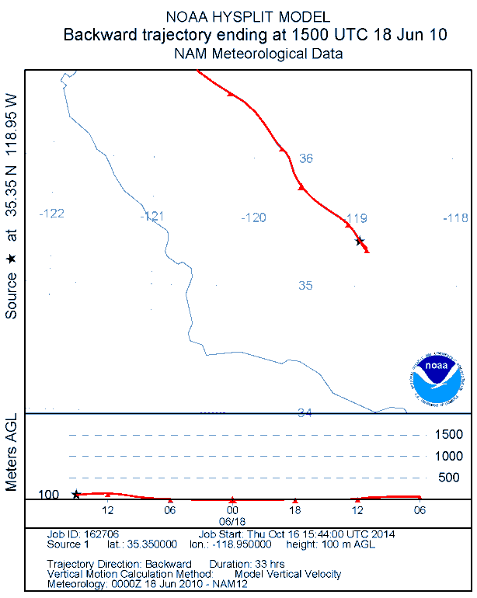
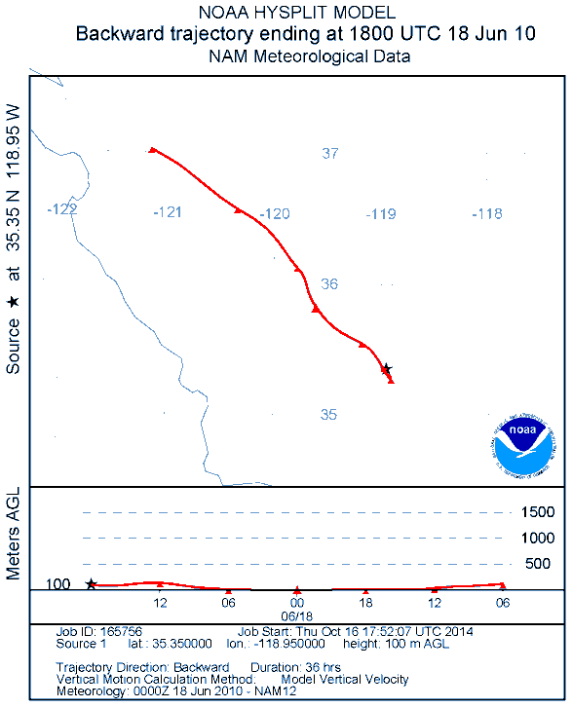
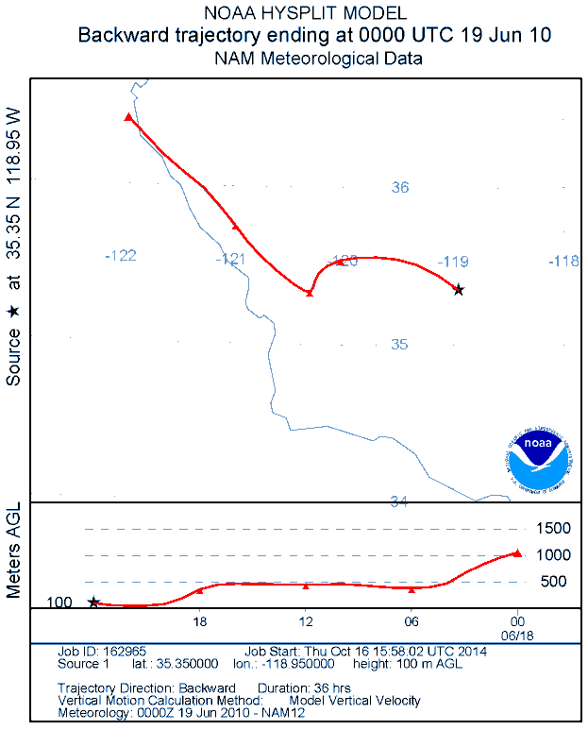
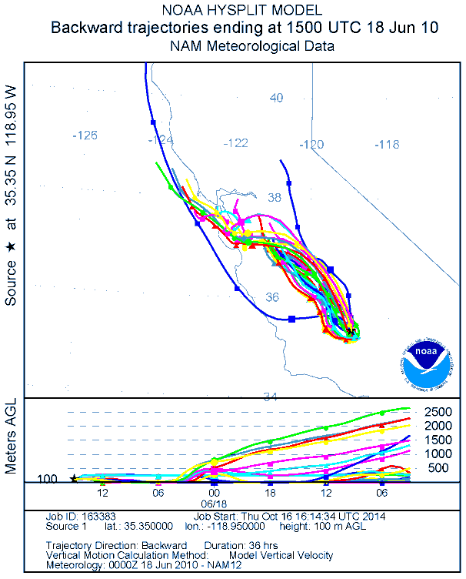
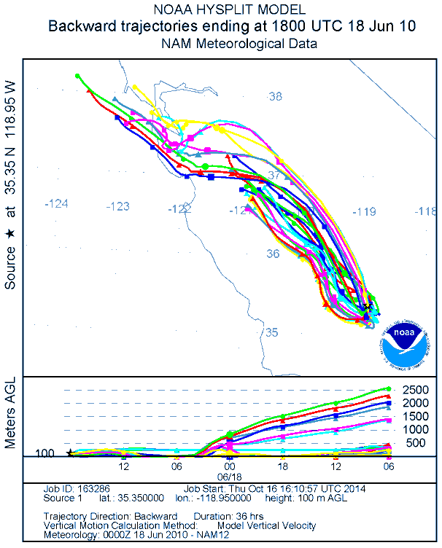
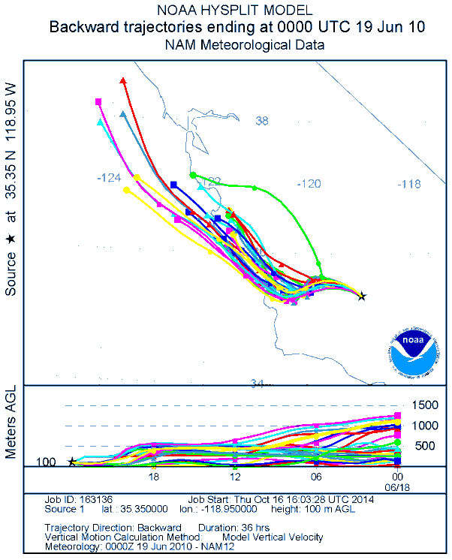
NAM 12

Slide 23
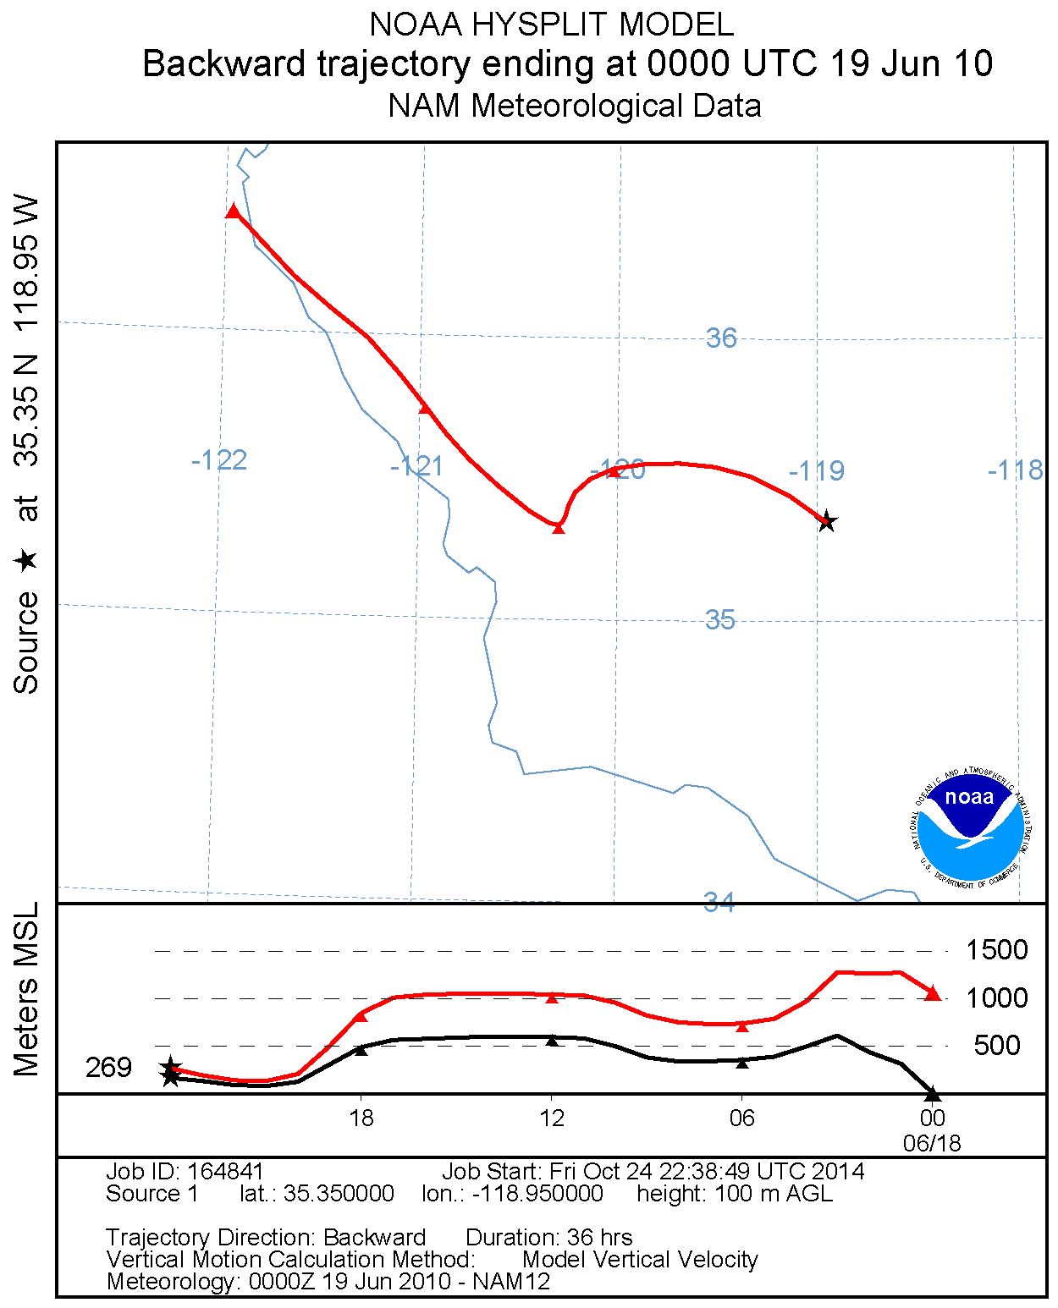
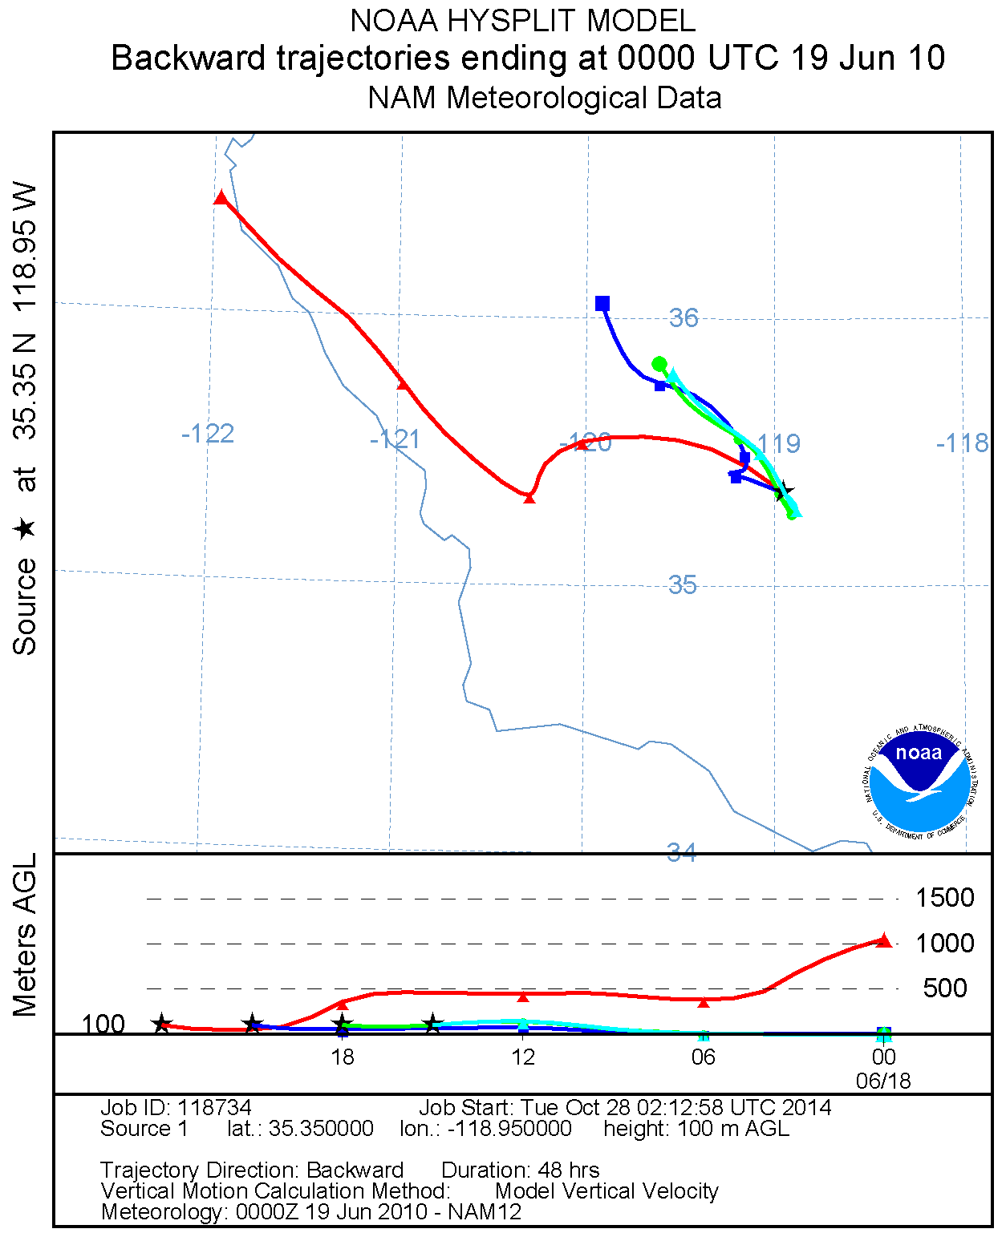
HYSPLIT NAM12

