Slide 1
Update to and Demonstration of NWS/NCEP Meteorological Models and their Utility for Air Quality
Jeff McQueen, Pius Lee, Jianping Huang,
Ho-Chun Huang, Perry Shafran, Jerry Gorline,
Eric Rogers, Geoff DiMego & Ivanka Stajner
October 28, 2014

Slide 2
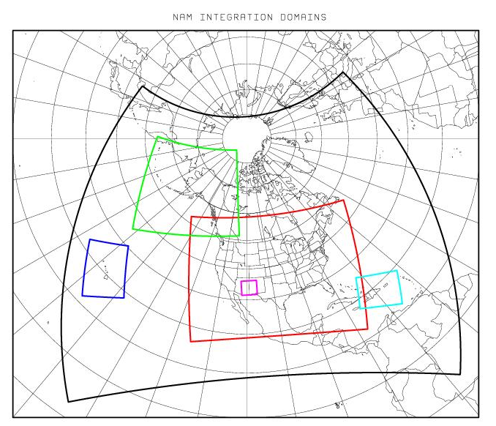
NAM V3.1 Model Changes
Replace legacy GFDL radiation with RRTM
Allows aerosol interactions as for NEMS Global Aerosol Capability (NGAC)
Modified Gravity Wave Drag/Mountain Blocking
More responsive to subgrid-scale terrain variability
Target : Improve synoptic performance without adversely impacting 10-m wind forecasts
New version of Betts-Miller-Janjic convection
Moister convective profiles, convection triggers less
Target : Improve QPF bias from 12-km parent, esp. in warm season
Ferrier-Aligo microphysics
Improved Structure of Convection
Modified treatment of snow cover/depth
Use forecast rime factor in land-surface physics
Target : Reduce snow depth in marginal winter
conditions w/complex precipitation type
Reduce roughness length for 5 vegetation
types
Target : Improved 10-m wind in eastern CONUS
NAM 12 km parent, nests and 1.3 km fire weather domains
Notes:
Radiative transfer model with radiation fluxes at each model layer
In Global, connected to an aerosol model
Advect 5 cloud parameters snow/rain/graupel/ice/vapor

Slide 3
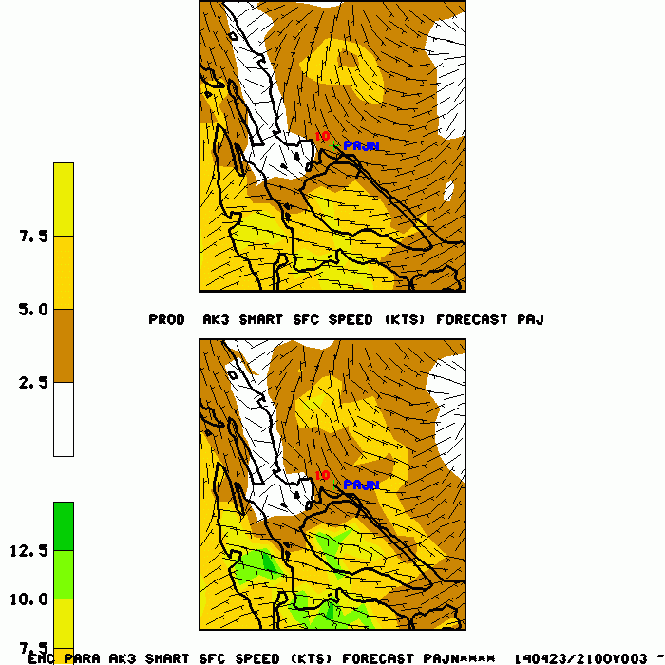
Changes to Downscaled Grids
2.5 km and 3 km DNG used as first guess for Real Time Mesoscale Analysis (RTMA)
5 km CONUS / 6 km Alaska DNG grids extended to 192-h via DGEX
Addition of Haines Index for Fire weather
Improved 10-m wind treatment
Use mass-consistent wind field model
Based on velocity potential, incorporating local terrain gradients
Ops downscaled NAM AKNEST
(3 km)
Parallel downscaled NAM AKNEST (3 km)
Improved representation of the effects of local terrain on winds

Slide 4
CMAQ V4.6.3 CB05/AERO-4
V4.6.2 : April 28, 2014
Inclusion of latest EPA Carbon Bond 5 (CB05) chemical mechanism.
Inclusion of AERO-4 aerosol chemistry.
Updated anthropogenic emissions with 2014 Dept. Energy projections.
V4.6.3: June 13, 2014
Modulate fugitive dust emission: suppress over ice/snow.
Incorporate NESIDS HMS wild fire smoke: CONUS
Incorporate real-time surface dust emissions (wind dependent): CONUS
NTR, organic nitrate, photolyzed and removed quicker.
Layer specific time step was added to speed up code.
V4.6.3v2: June 27, 2014
Correction to overestimates of dust emissions
repartition percent going to PM2.5, mix beyond first level
V4.6.3v3: July 16, 2014 With NAM Parallel
Turned off gas emissions from fires.
Ozone predictions will not be impacted by inclusion of smoke emissions.
Notes:
Daniel Tong modulate emissiosn, fugitive dust
Li Pan

Slide 5
Inclusions of real-time smoke emissions
NESDIS Hazard Mapping System (HMS) provides fire points
USFS BlueSky system run within HYSPLIT dispersion model provides fire emissions (organic carbon, black carbon…)

Slide 6
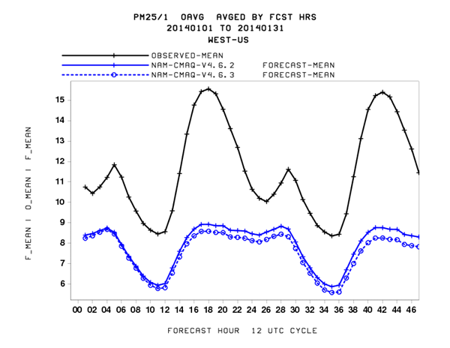
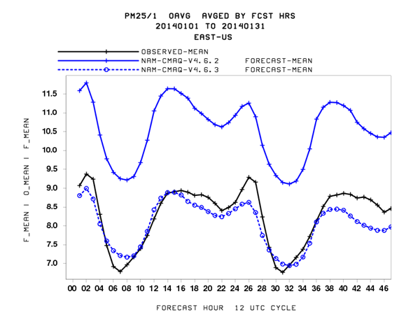
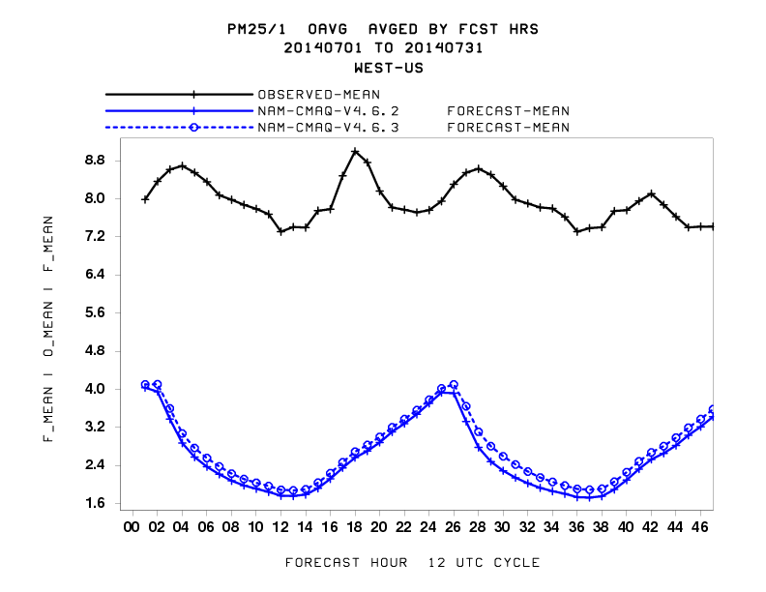
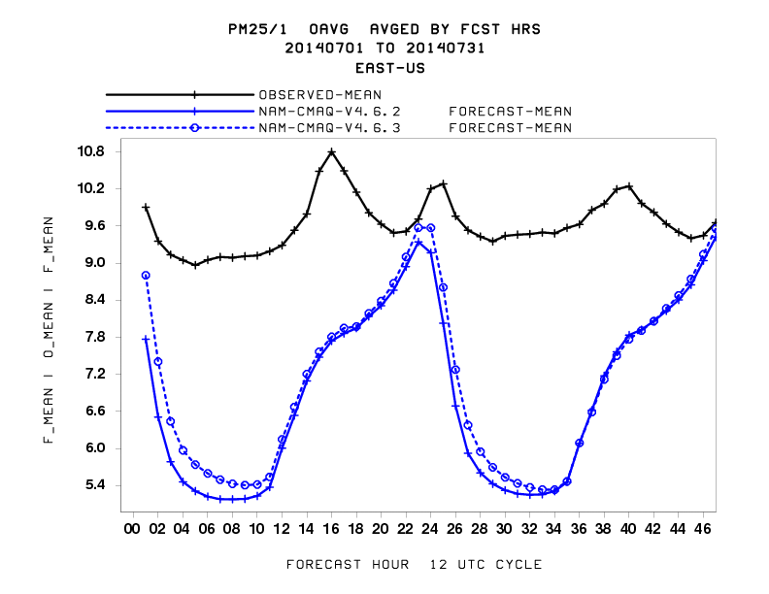
1 hr avg PM2.5 performance Obs vs V4.6.2, V4.6.3
Western U.S.
Eastern U.S.
Jan 2014
July 2014
Significant improvement in Eastern U.S.:
- Met, PM treatment over snow
Notes:
Black line is obs
Blue dashed line is v4.6.3…markedimprovement over Eastern U.S in Winter
Underpreiction in summer and out west….speculation too much mixing, SOA missing

Slide 7
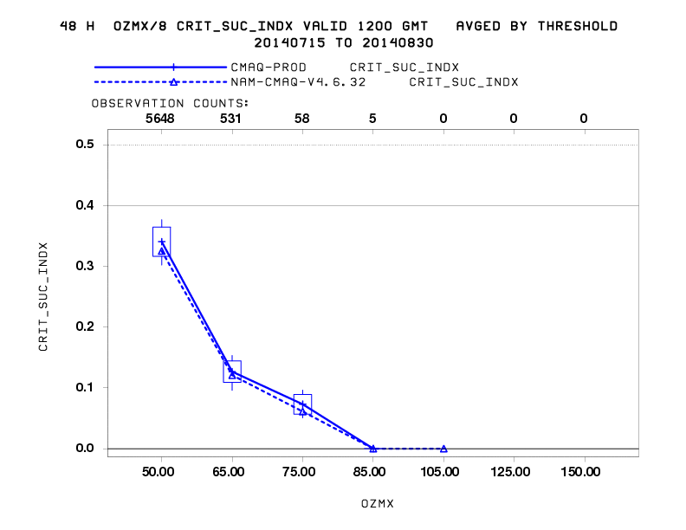
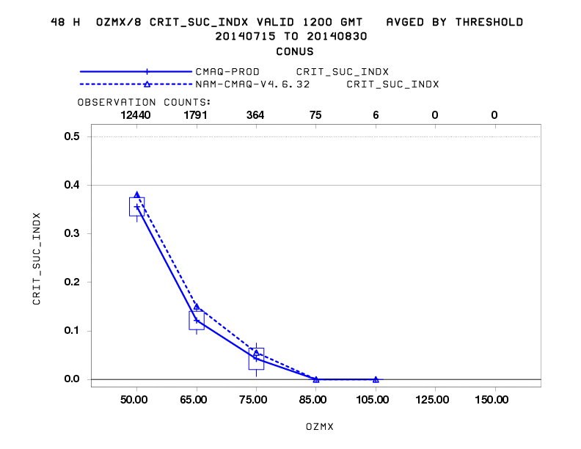
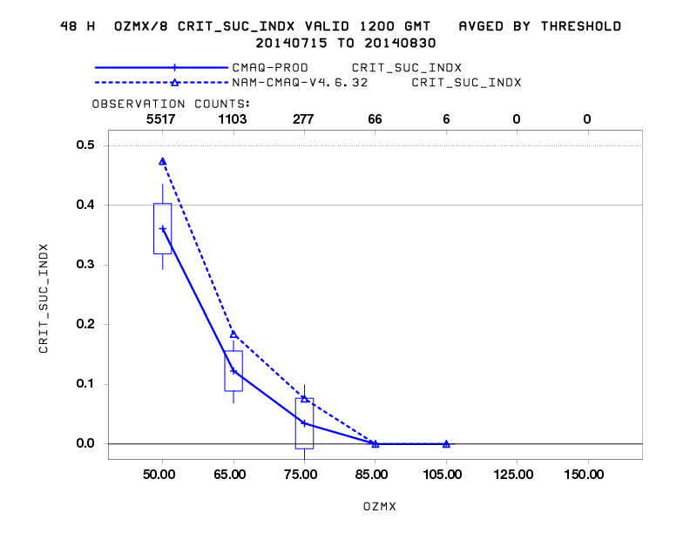
8 hour Avg Daily Max Ozone Performance Skill Score: Prod, V4.6.3
Eastern U.S.
CONUS
Western U.S.
Significant improvement in Western U.S
for most thresholds

Slide 8
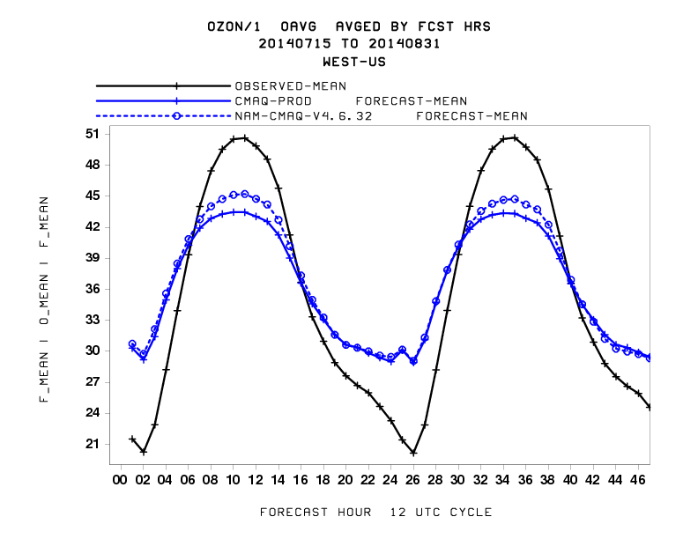
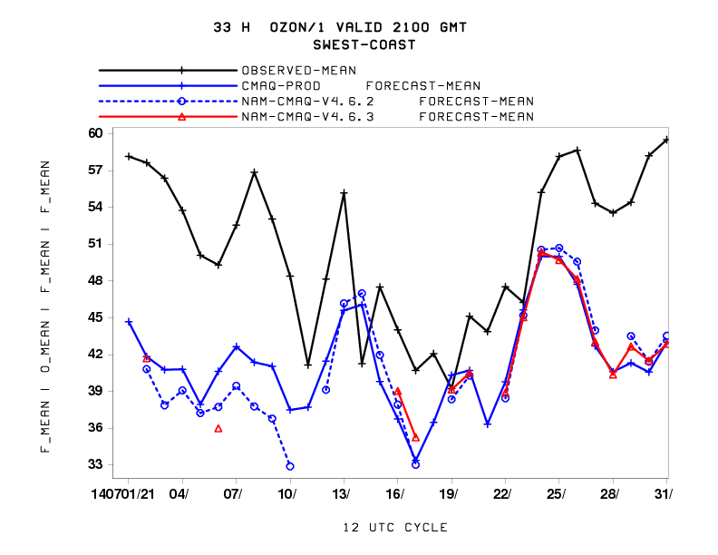
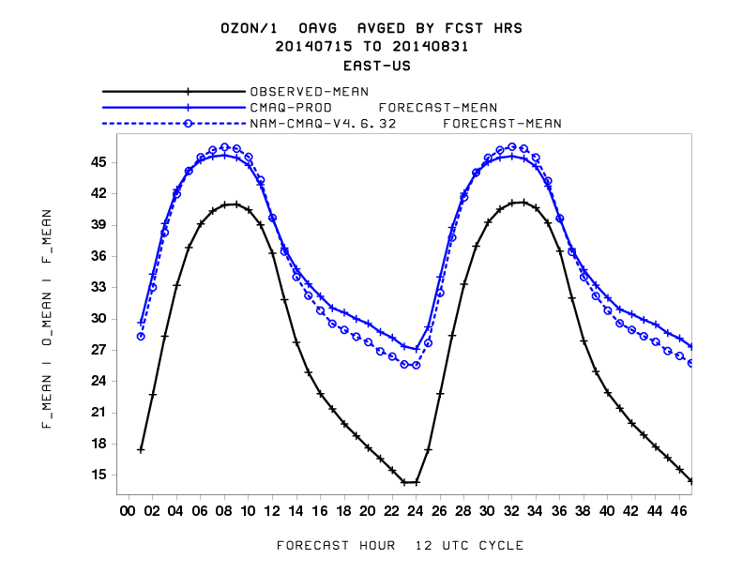
1 hour Avg Daily Max Ozone Performance vs observations : Prod vs V4.6.3
Diurnal forecast for West
Parallel
33 hour forecast 1 h avg O3 for SW Coast
- Underprediction worse for high ozone
episodes
Diurnal forecast for East

Slide 9
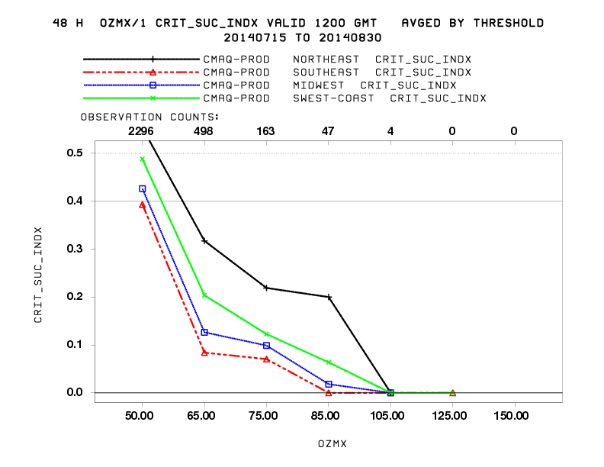
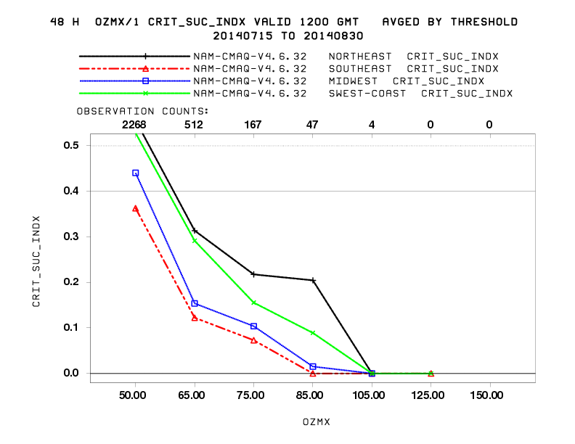
1 hour Avg Daily Max Ozone Performance Regional Skill Score: Prod vs V4.6.3
Production
Parallel
Improvement over:
SW US >65 – 85 PPB
SE US 65 PPB

Slide 10
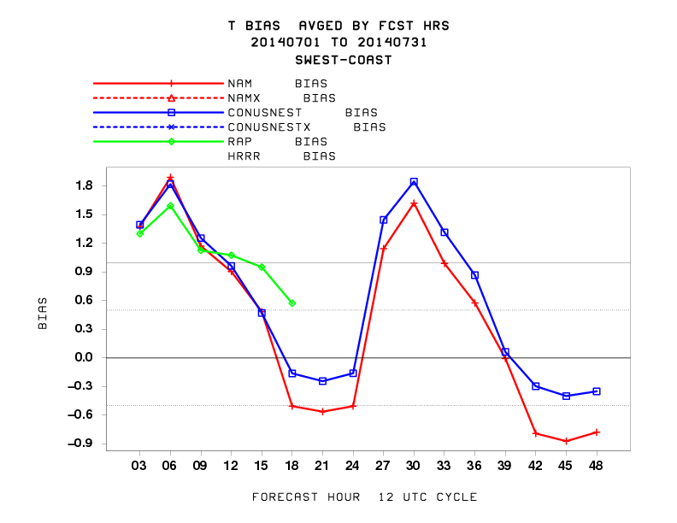
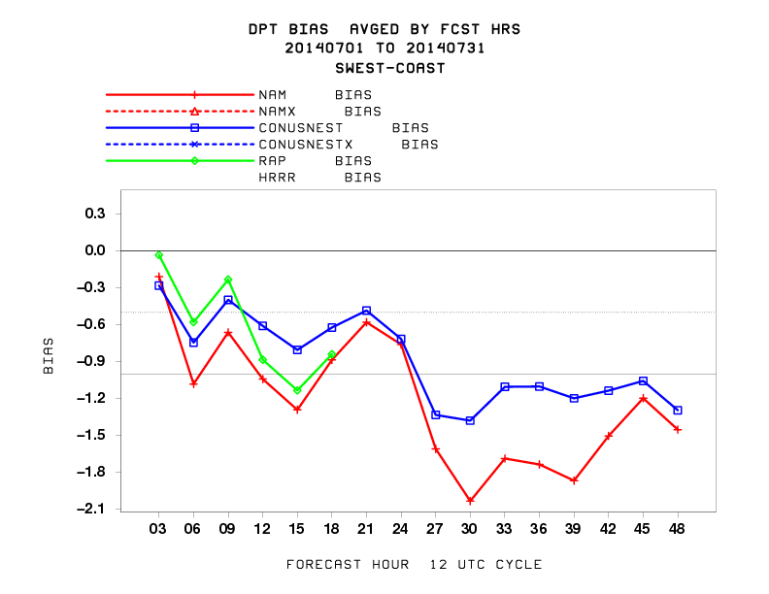
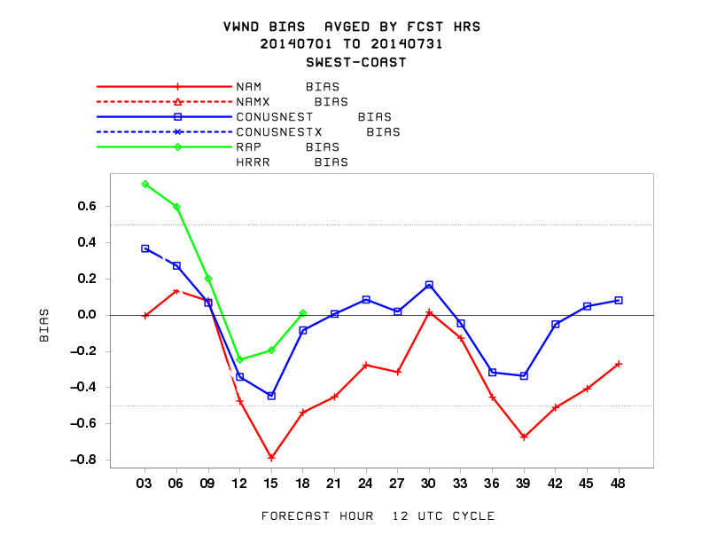
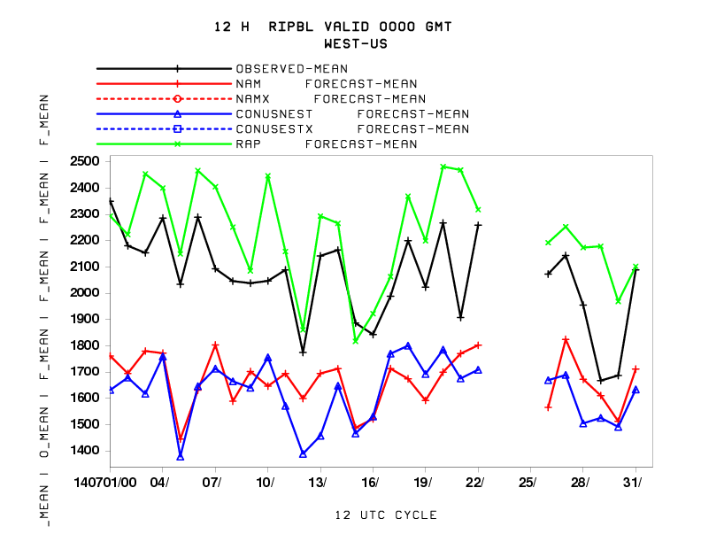
Met BIAS NAM, NAM Nest, RAP South West Coast (July 2014)
2 m Temperature
2 m Dew point T
10 m wind
Daily PBL Height
(WEST U.S.)
Warm, Dry bias with lower PBL than observed
Conus Nest improved DPT and Winds

Slide 11
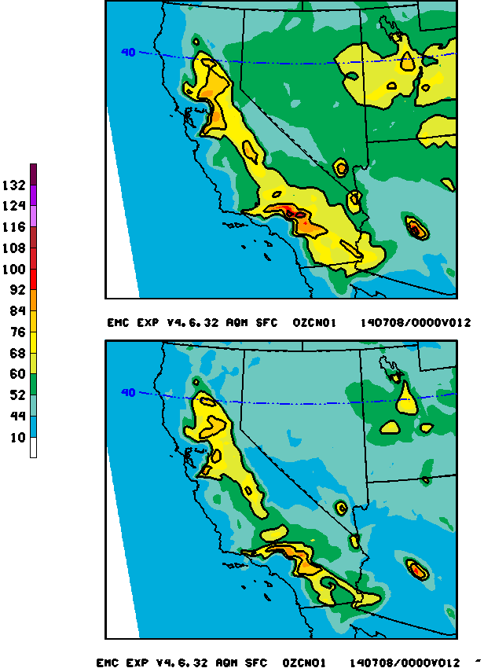
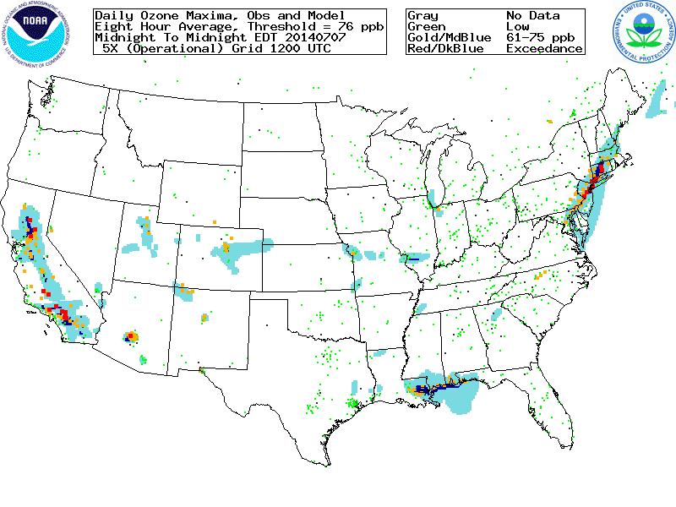
NAM-CMAQ Ozone Predictions July 07 , 2014 Case
8h Ozone Daily Maximum
Experimental: V4.6.3
Experimental run better captures Code Orange
event in Southern California
Production : V4.5

Slide 12
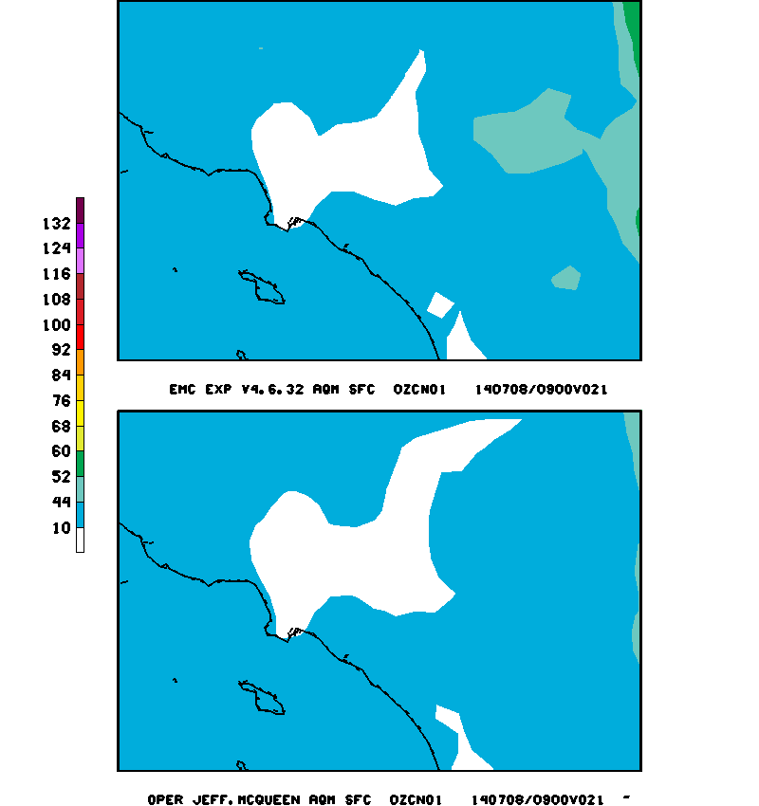
1 hour average Ozone Predictions July 08 , 2014 Case
EXP
Experimental : V4.6.3 Ozone Daily max vs obs
Operational

Slide 13
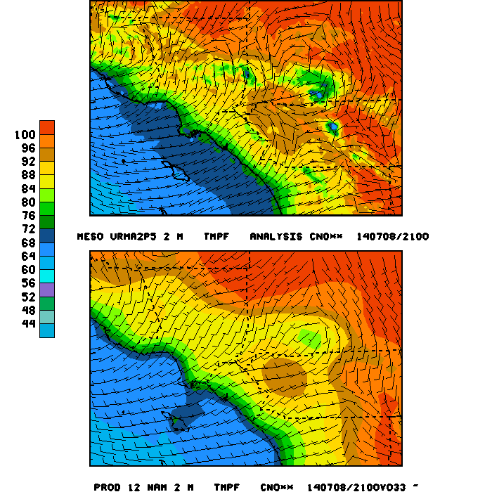
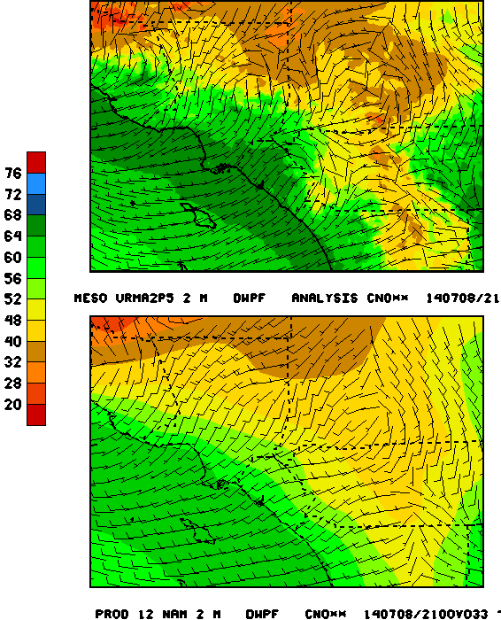
NAM Parent, Nest, DNG vs URMA Temperatures July 8, 2014 21 UTC (33 H forecast)
2 m Temperature
Dew Point Temperature
URMA 2.5 km
NAM 12 km
Temperatures cooler than observed near San Bernadino
Dewpoints drier than observed near coast
Notes:
Unrestricted Mesoscale Analysis
Brings in mesonets,
12 km NAM does not see the mountain blocking so strong flow will serve to dilute the forecast

Slide 14
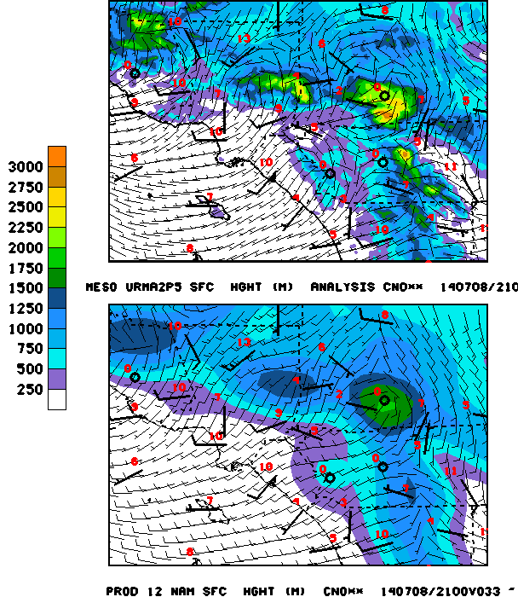
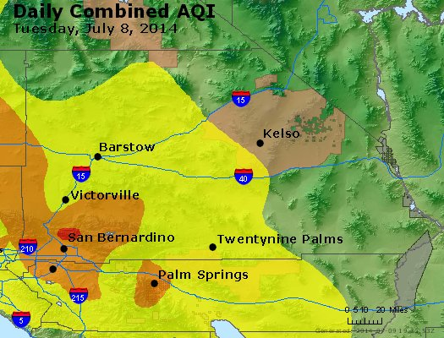
NAM Parent, Nest vs URMA Wind Vectors July 8, 2014 21 UTC (33 h forecast)
URMA 2.5 km
Nest 4 km
NAM 12 km
Ozone AQI
- Complex flow fields delineated by URMA
- Turning and slowing of winds around high terrain near San Bernadino not captured by NAM 12

Slide 15
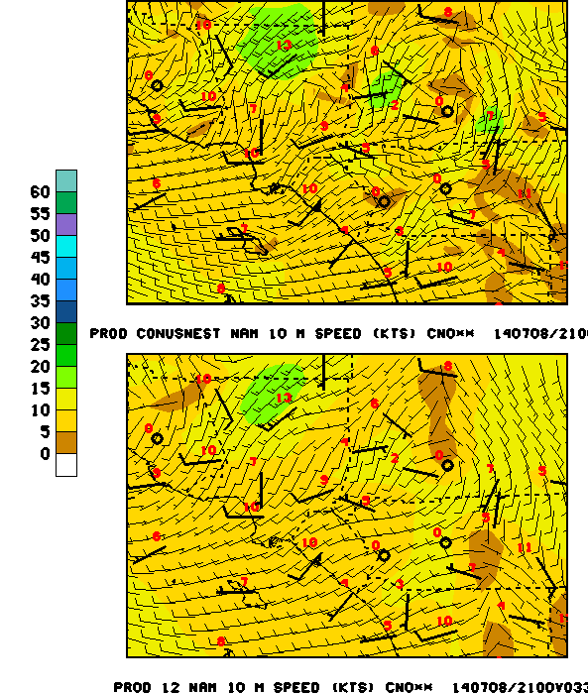
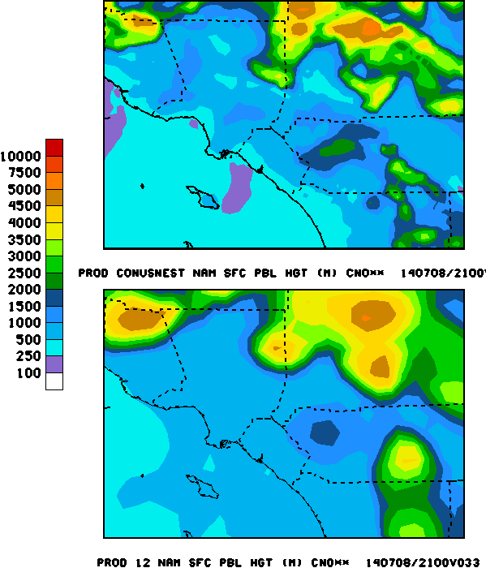
NAM Parent vs NEST Wind, PBL July 8, 2014 21 UTC (33 h forecast)
Wind Speed
PBL Hght
Nest 4 km
NAM 12 km
Nest:
Wind speeds lower around S. Bernadino valley
PBLH lower near coast/marine layer
Inland seabreeze extent lessened
Notes:
Allows hot temps, low winds to develop in valleys…NAM 12 misses and overruns topography

Slide 16
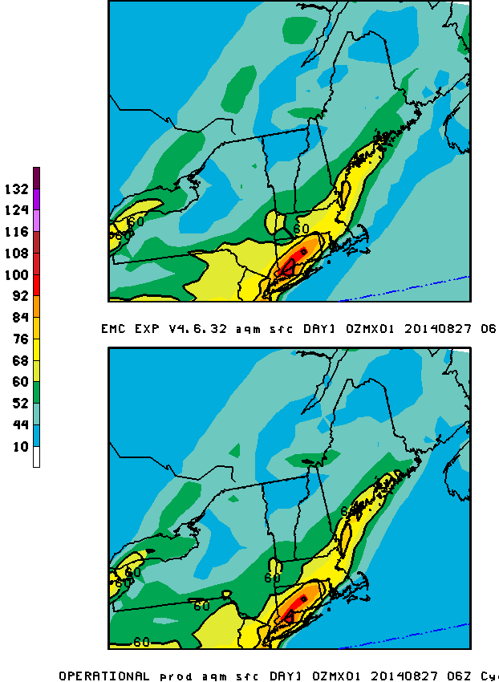
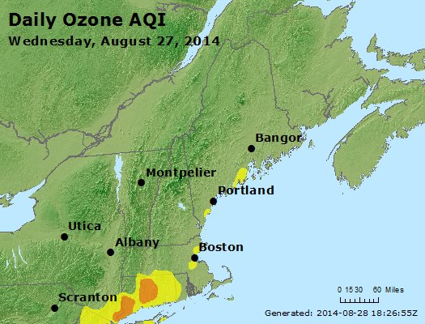
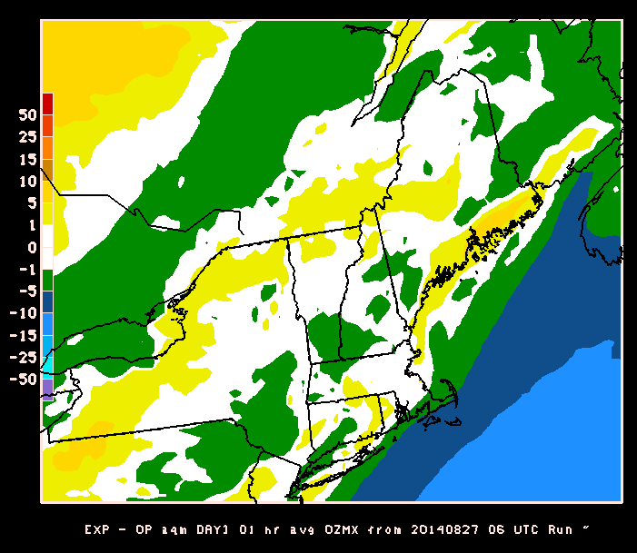
August 27, 2014 NE US Case
Daily 1 hour Ozone Max
AIRNOW Observed Ozone AQI
Daily 1 hour Ozone Max Difference
EXP - Operational
Notes:
Reduced NYC plume from NYC
But likely too high

Slide 17
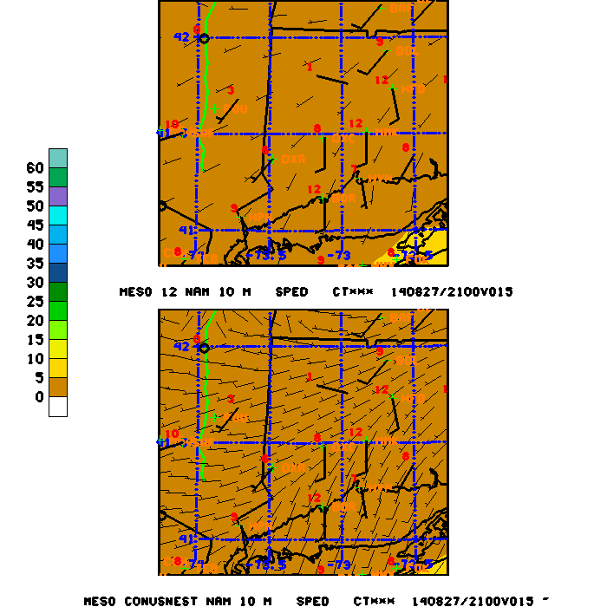
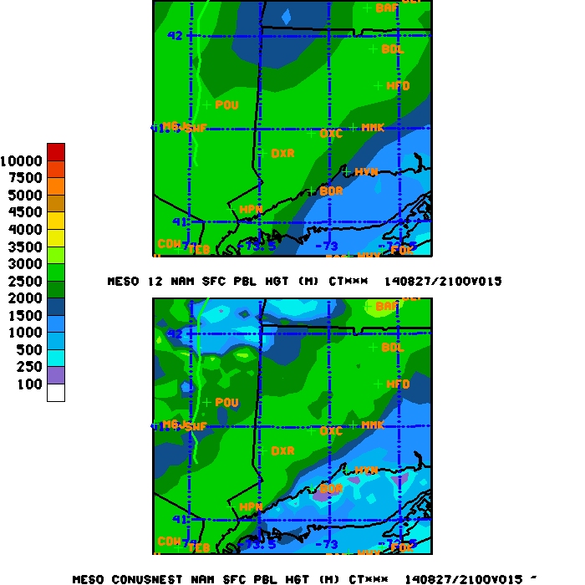
NAM Parent vs Nest August 27, 2014 21 UTC
Marine layer moves further inland with NAM Nest
But winds are weaker than observed
Notes:
Weaker winds may contribute to higher ozone/less dispersion

Slide 18
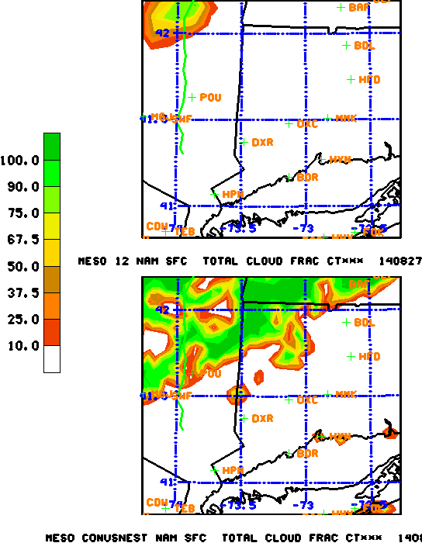
NAM Parent vs 4 km Nest August 27, 2014 21 UTC
Cloud cover
Soill moisture
Frontal clouds better delineated with Nest
Can contribute to weaker ozone plume

Slide 19
Summary
Smoke, dust, ozone, anthropogenic PM : unified system using CMAQ V4.6.3 supported by CMAS.
Ozone predictions improved with latest changes to V4.6.3
Although strong under-prediction in California still evident
PBL under-predicted with NAM upgrade:
may contribute to Eastern U.S ozone over-predictions
NWS Un-Restricted Mesoscale Analysis (2.5 km) proved useful for evaluating
NAM 12 and 4 km predictions
4 km Nest useful for identifying processes not resolved with 12 km runs
- 4 km nest captured blocking flow in San Bernadino Valley, California
Met performance should be carefully evaluated while proceeding to address other system errors
- Concern that we are making changes to chem/emissions that mask 1st order met errors
Notes:
Smoke and dust, ozone, anthropogenic PM now in one unified system with CMAQ Unified
Now using a version of CMAQ supported by EPA CMAS community Supported
First time in 7 years we’ve seen consistent improvement in ozone predictions Updated
Inclusion of PM in operational model provides refliable PM product for all of U.S. Reliable

Slide 20
Future plans
Short term (1-2 years)
Include NGAC real-time aerosol boundary conditions
Improve smoke emissions
Update USFS BlueSky emissions
(forest load, consumption, spread emissions)
Evaluate NGAC Fire Radiative Power smoke emissions approach
Evaluate plume rise (additional met constraints)
Improve dust emissions
NAM gust vs speed
DNG winds
Soil moisture impact
Include ESRL bias correction
At stations
spreading technique to grid
Short-range High Resolution smoke/dust
modeling
HYSPLIT smoke driven with NAM 4 km
July 19, 2014

