Slide 1
Synoptic perspectives of pollutant transport patterns observed from satellites over East Asia
Hyun Cheol Kim ^{1,2}, Pius Lee¹, Soontae Kim³, Changhan Bae³, Byeong-Uk Kim⁴, and Eunhye Kim³
¹ NOAA/Air Resources Laboratory, College Park, MD
² UMD/Cooperative Institute for Climate and Satellites, College Park, MD
³ Ajou University, Dept. of Environmental Engineering, Suwon, Korea
⁴ Georgia Environmental Protection Division, Atlanta, GA

Slide 2
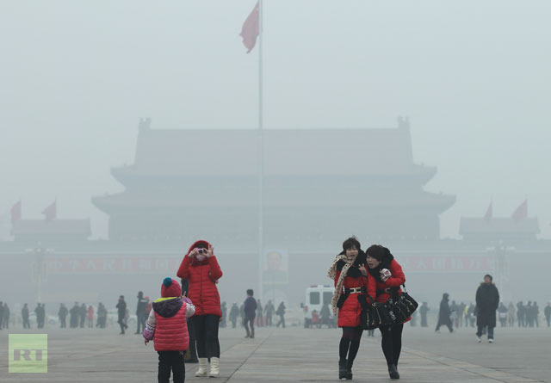
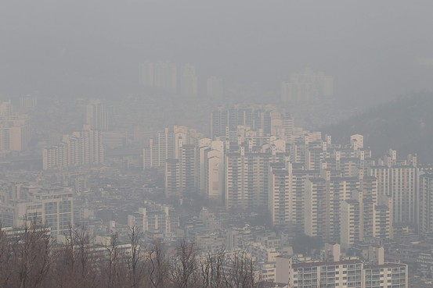
Motivation
In recent years, wintertime high pollutant episodes are serious concerns in East Asia
Reasons for recent increase is not clear: increase of anthropogenic? Meteorological impact?
What is the role of regional-scale or long-range transport in air pollution in East Asia?
What is the best way to monitor near real-time transport of pollutants? Can satellite monitor them?
(Beijing, Jan. 29,2013, Reuters/China Daily)
(Jan. 17, 2014, Seoul, Korea)

Slide 3
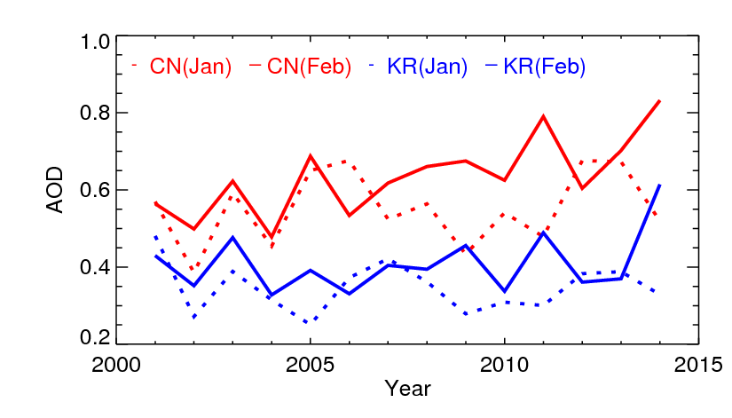
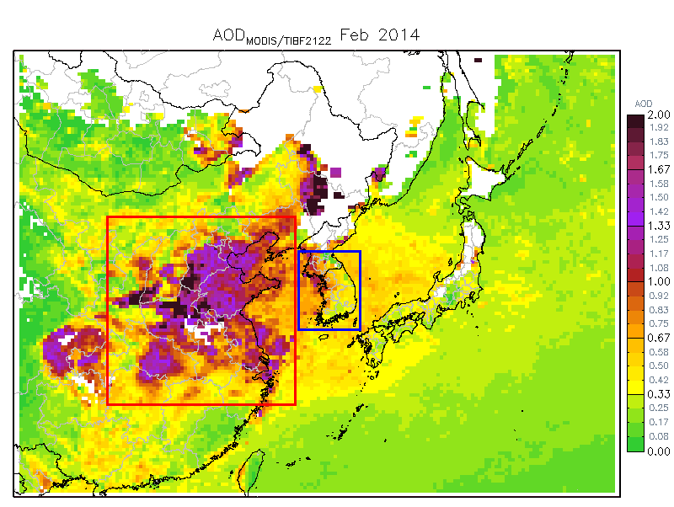
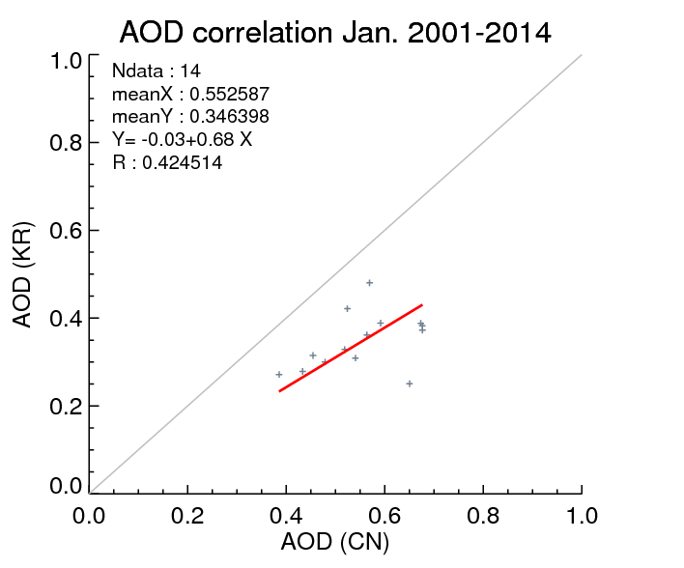
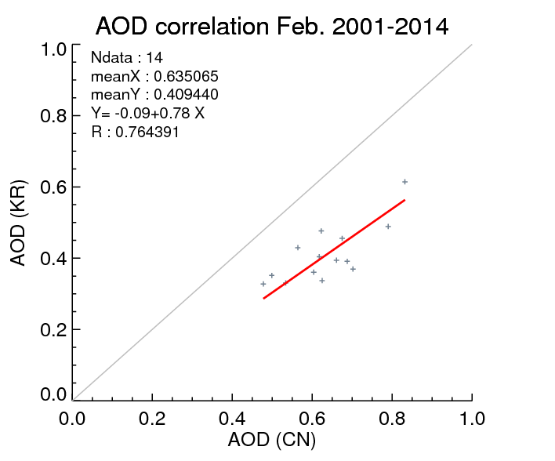
Wintertime AOD time series
Inter-annual variations of wintertime AOD over China and Korea are well correlated

Slide 4
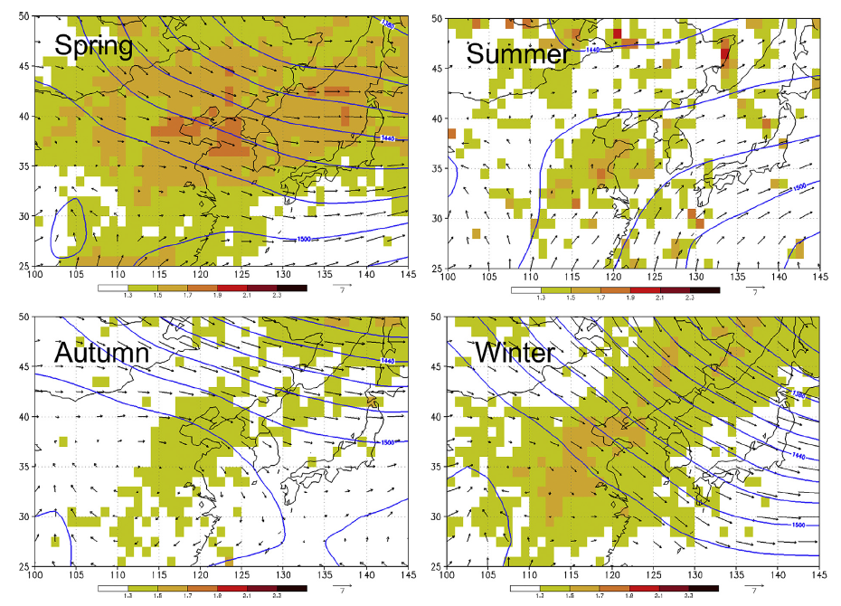
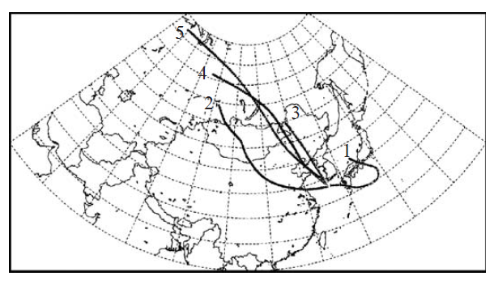
Seasonal transport patterns in East Asia (from literatures)
Type 3-5: Dominant northerly wind (>70%)
Type 2: Usual pathway for springtime Yellow Sand transport
March – May, 2001
ACE-Asia campaign
(Kim et al., 2005)
During cool season (Fall-Spring) Northwesterly wind is dominant.
(Kim et al., 2014)

Slide 5
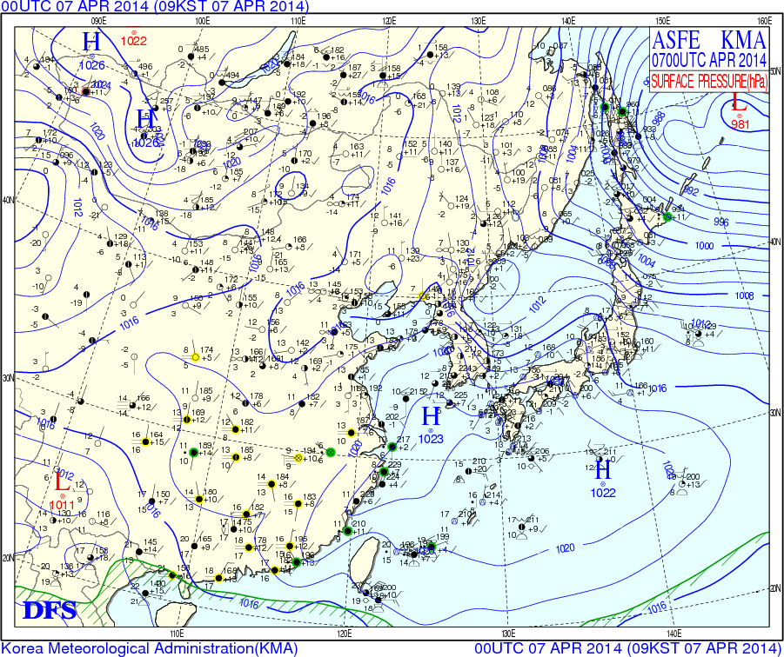
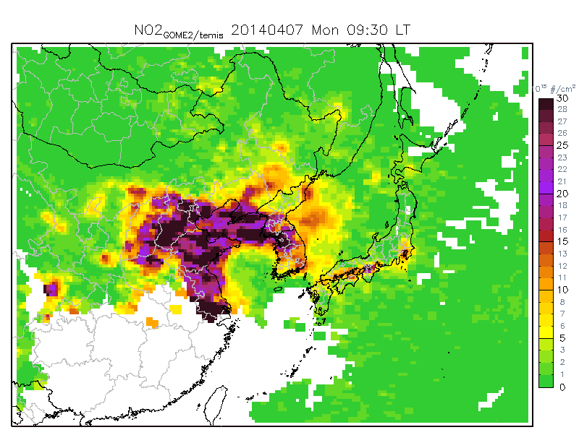
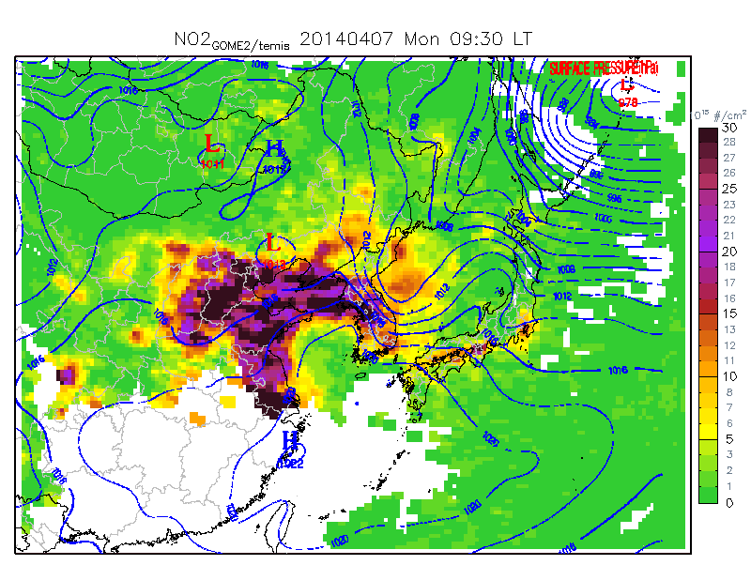
Data & method
MODIS AOD (NASA)
Composite image from regular MODIS AOD and Deep Blue algorithm
Indicator for aerosol
OMI/GOME-2 NO2 column (NASA & ESA)
Indicator for (fresh) anthropogenic emission
KNMI retrievals. GOME-2 uses both satellite products (MetOp-A & MetOp-B)
WRF/CMAQ AQF system (Ajou Uiversity)
Weather map (KMA)
Overlaid to NO2 VCD using IGDP tool (GIS georeferencing technique)

Slide 6
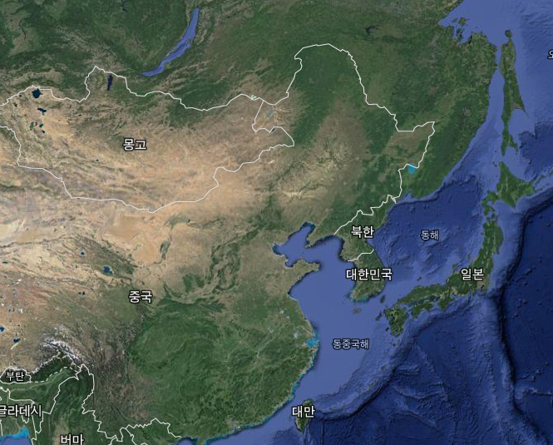
Wintertime East Asia synoptic flow patterns
Siberian
High
L
Midlatitude
Cyclogenesis
China
H
Korea
Japan
Extension of
Siberian High
“Cold surges”

Slide 7
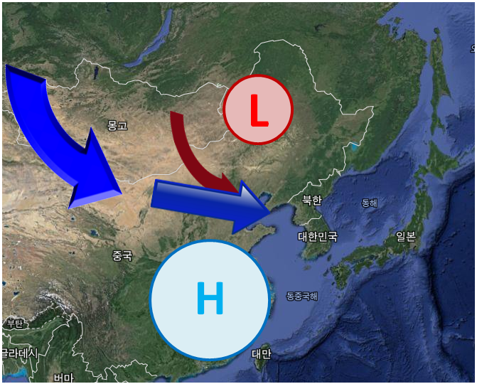
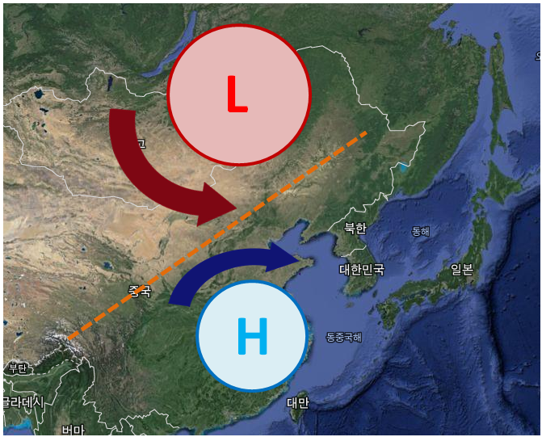
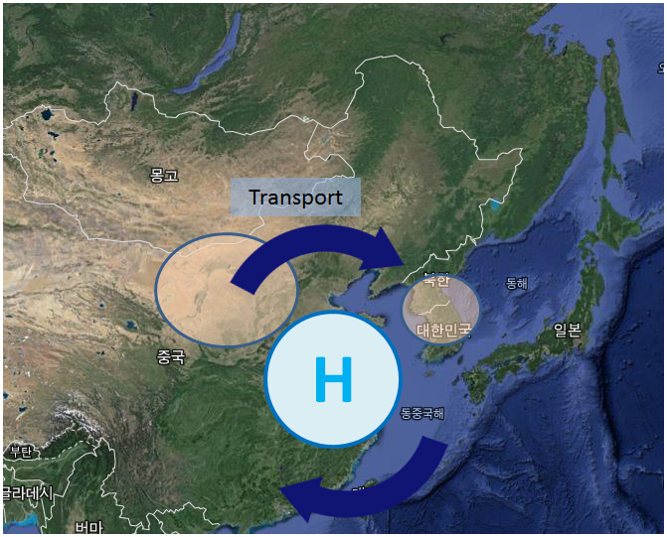
3 important flow patterns
High pressure system (initiated from Siberian High) is a crucial common component in high pollutant events in East Asia
Type 1: Dominant high pressure system over China
Type 2: High pressure system first, then pushed by low pressure system (& cold front)
Type 3: Stationary high pressure system over China or Yellow Sea

Slide 8
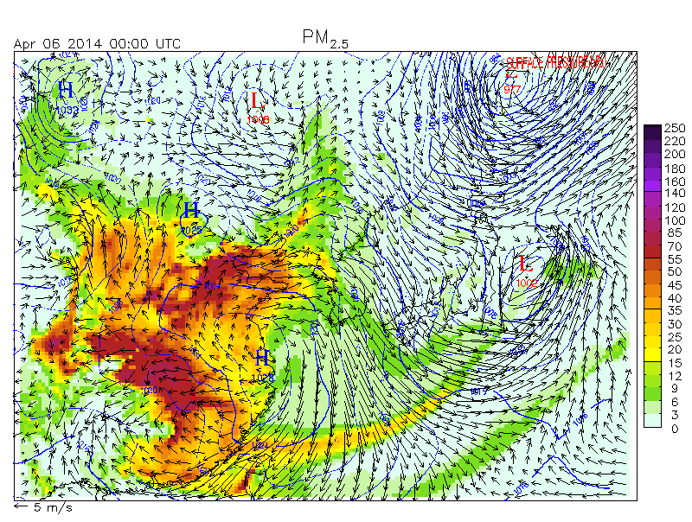
Type 1 : Dominant high pressure system
High pressure extends from Siberian High, and reaches to Chinese east coast.
(Northern) weak low pressure system often exists, and just balances westerly flow.

Slide 9
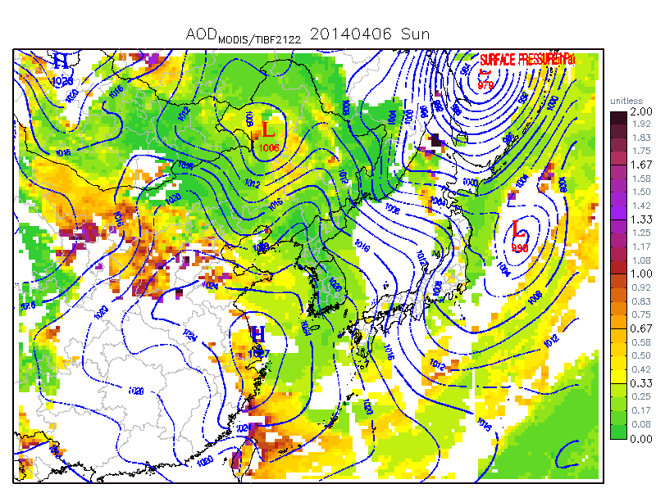
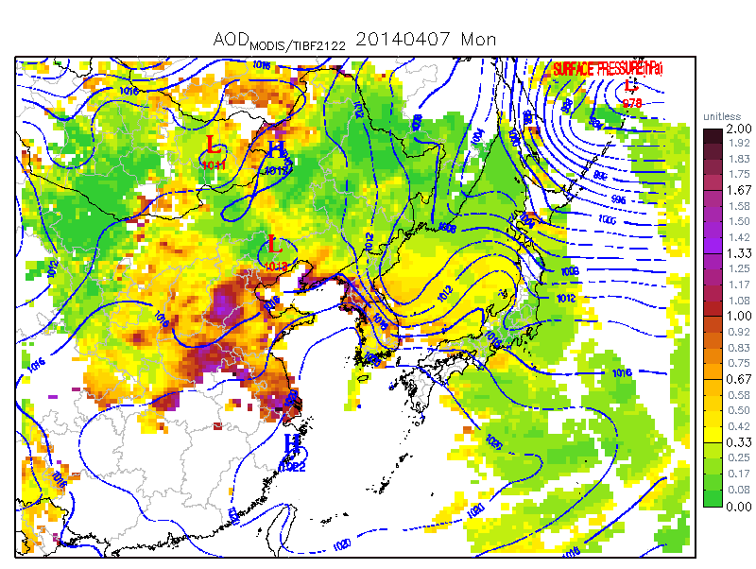
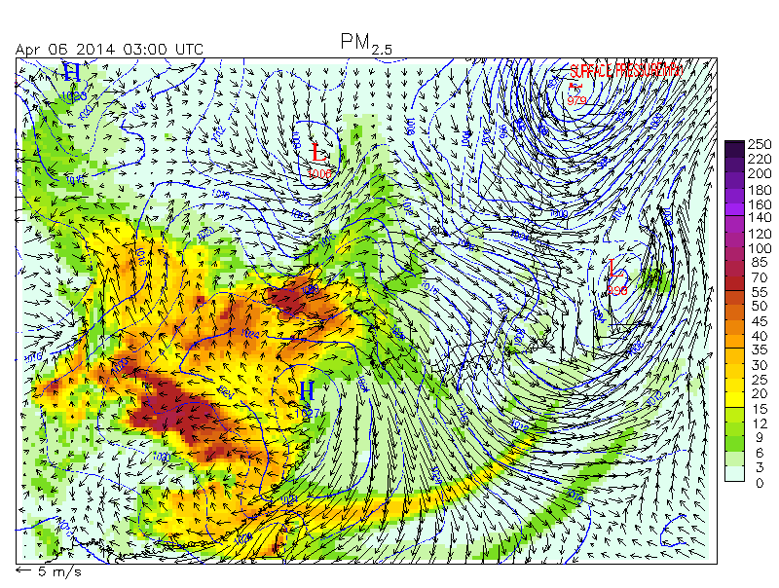
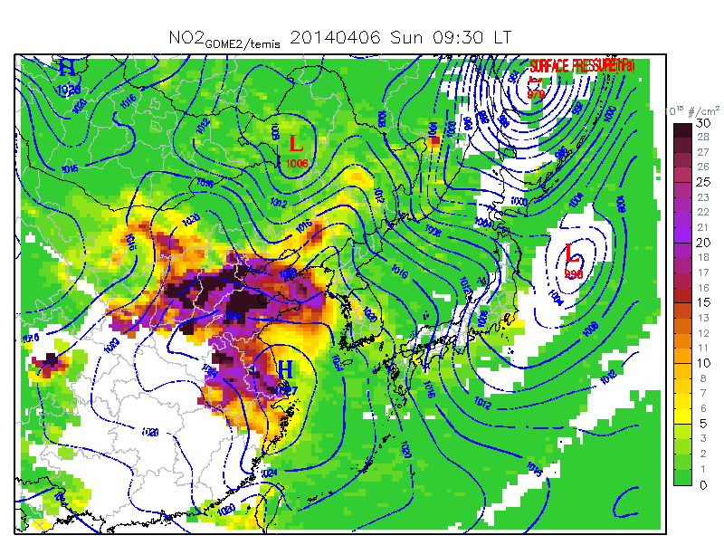
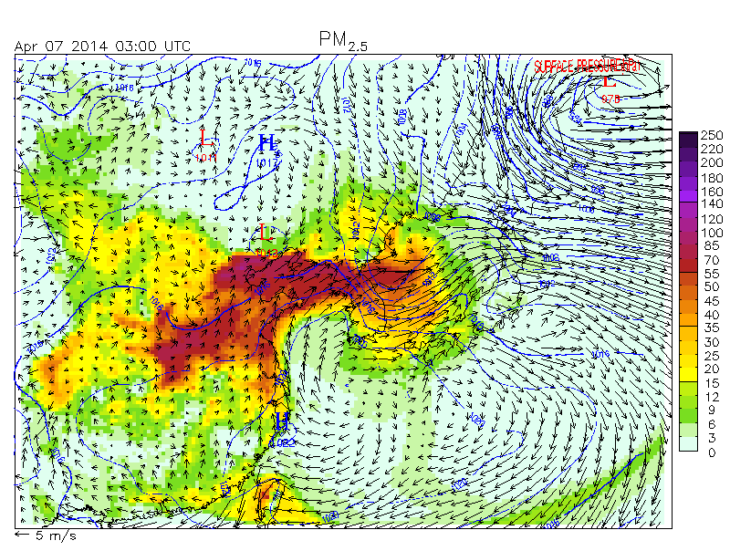
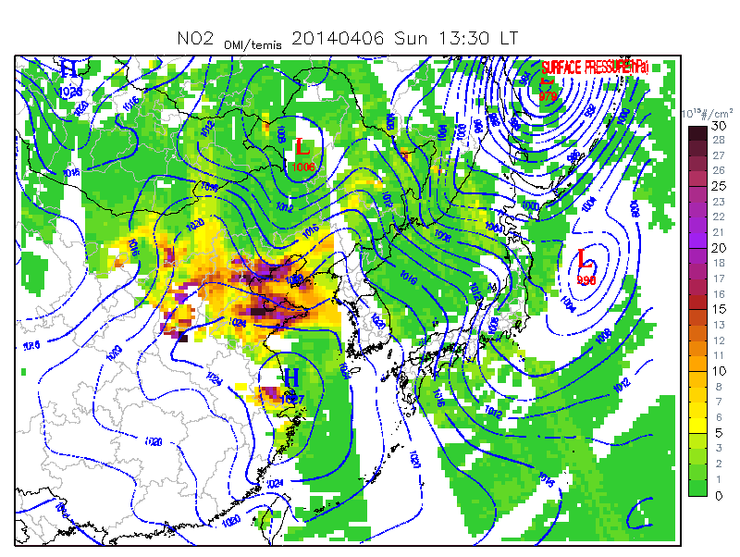
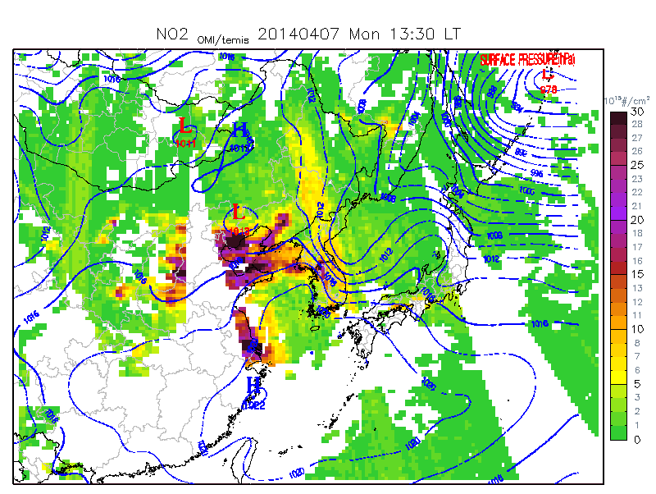
MODIS AOD
Apr. 6
Apr. 7
Apr. 6
GOME-2 NO2
Apr. 6
Apr. 7
Apr. 7
OMI NO2
Surface PM2.5
(Ajou U. AQF)
Simulated PM distributions are well detectable from MODIS AOD, GOME-2 NO₂ VCD, and OMI NO₂ VCD
Apr. 6
Apr. 7

Slide 10
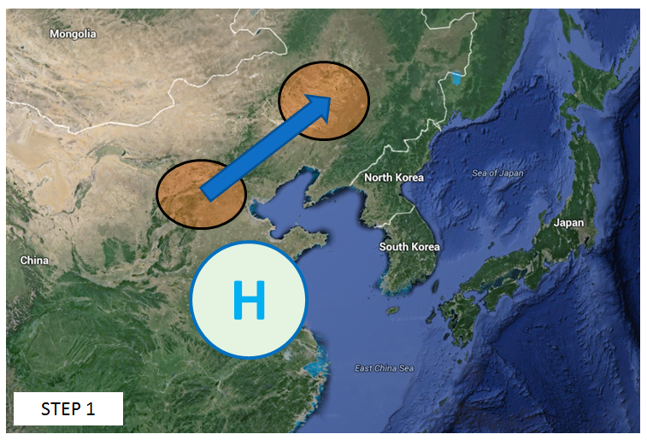
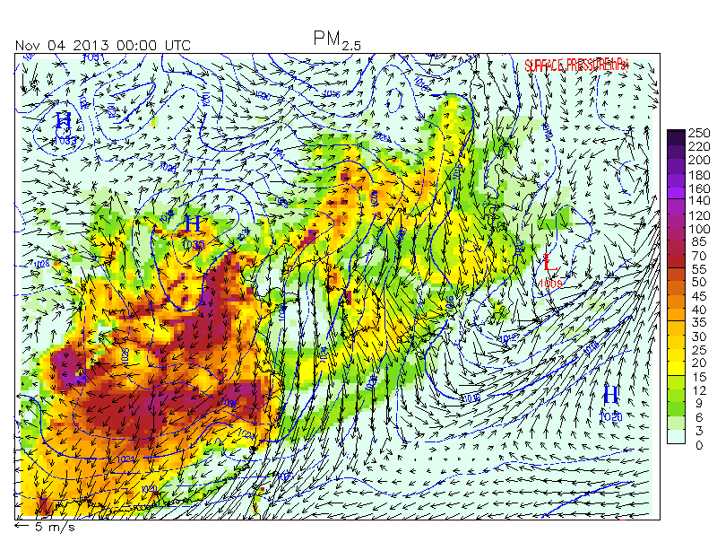
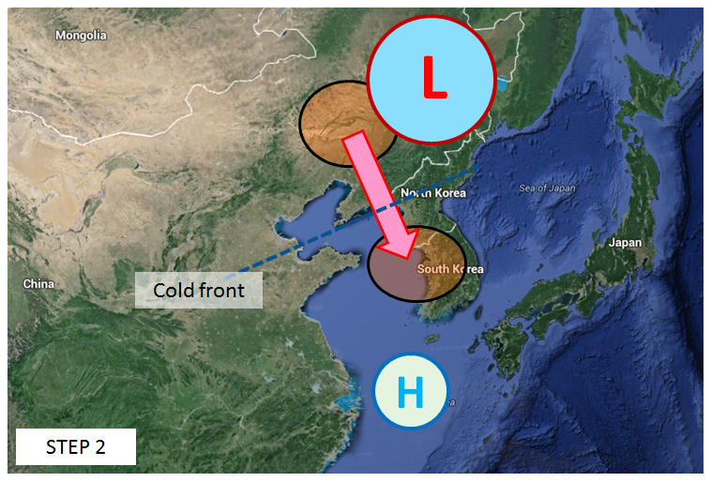
Type 2: Pollutants pushed by cold front
STEP 1: High pressure system builds up pollutants and moves them to Manchurian region
STEP 2: Cold frontal activity associated with low pressure system pushes down pollutants

Slide 11
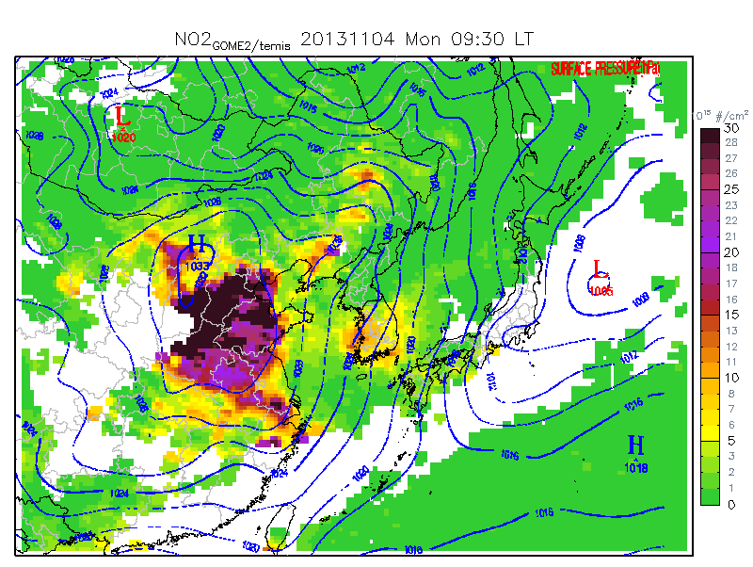
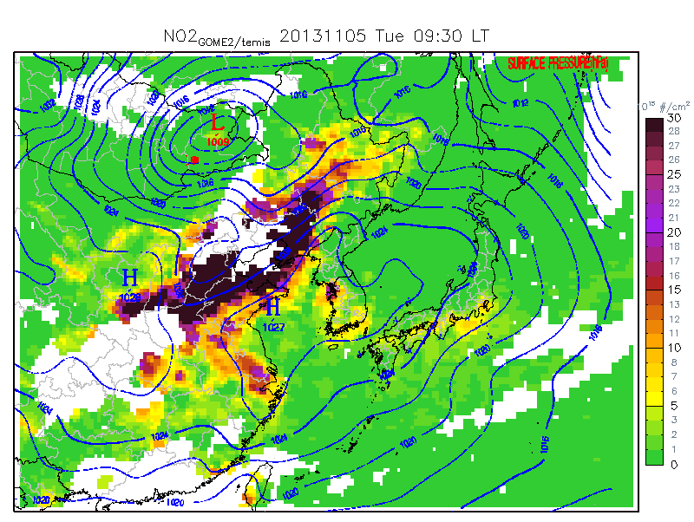
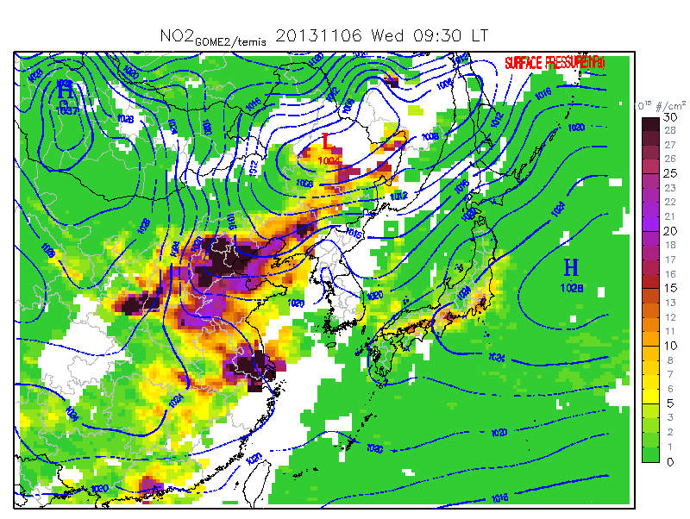
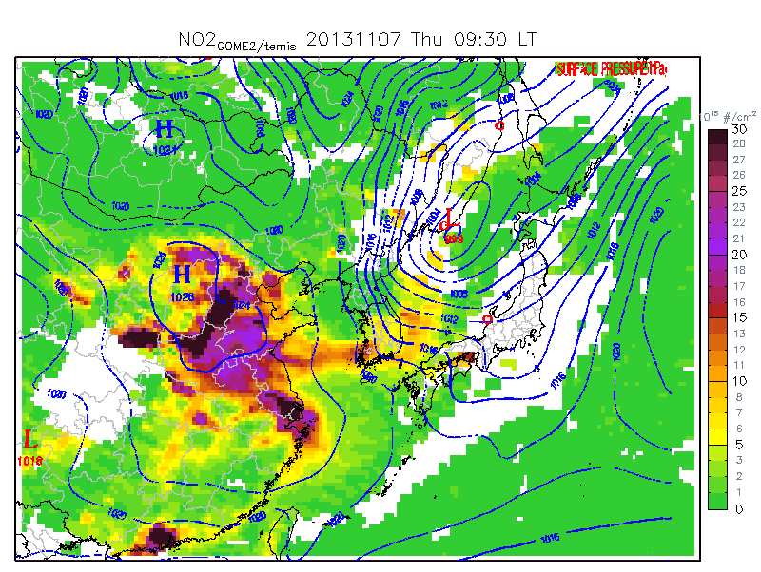
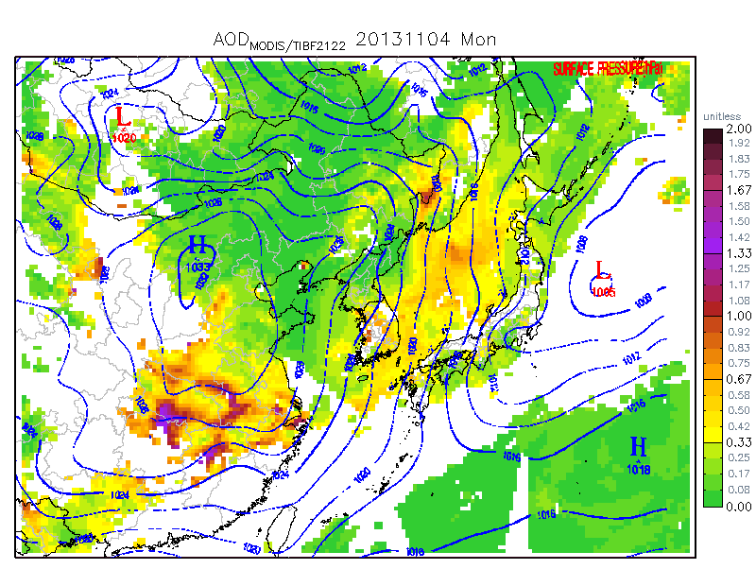
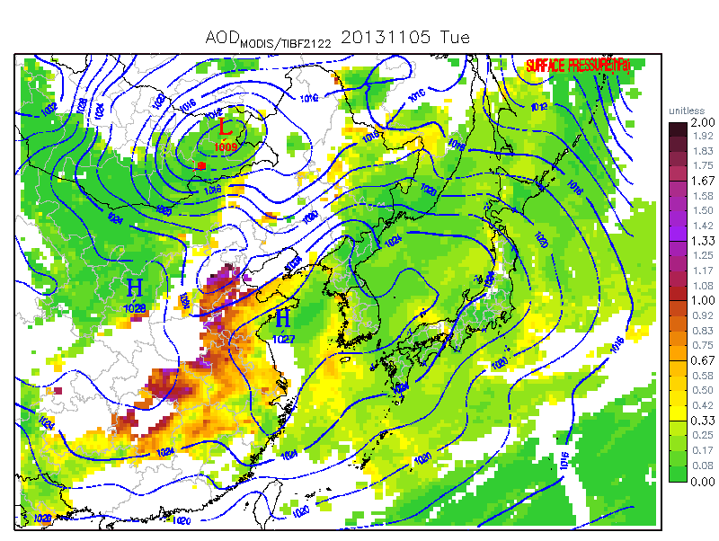
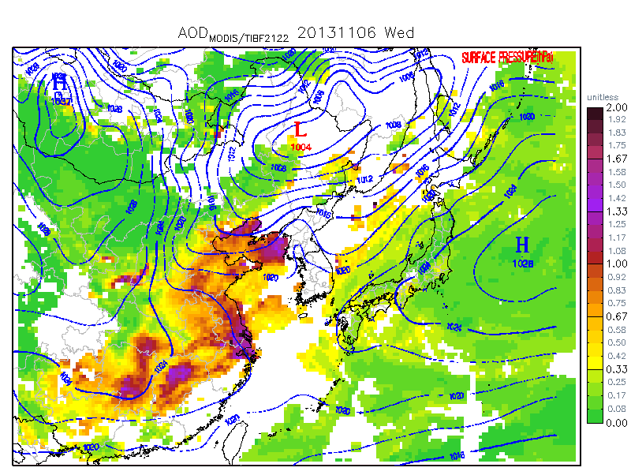
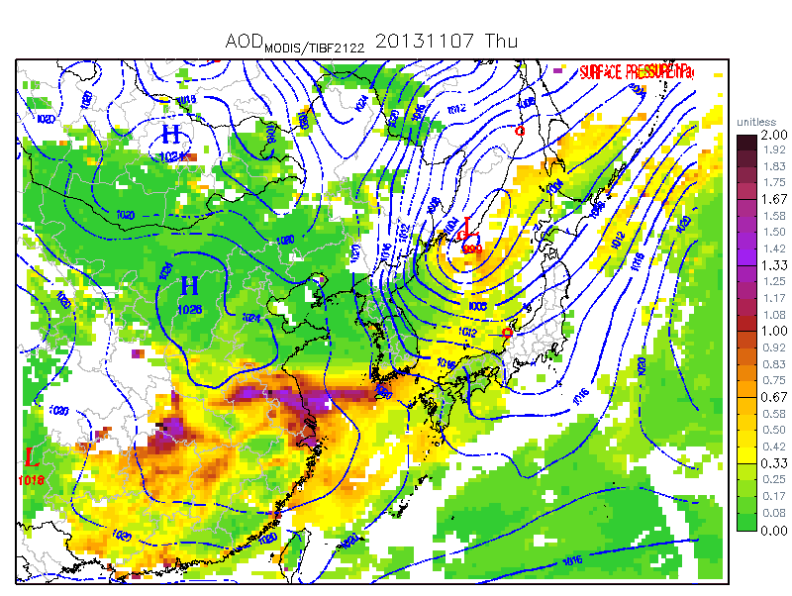
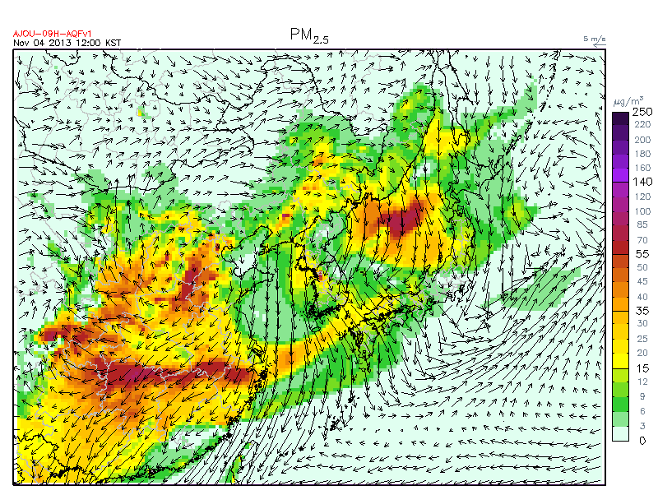
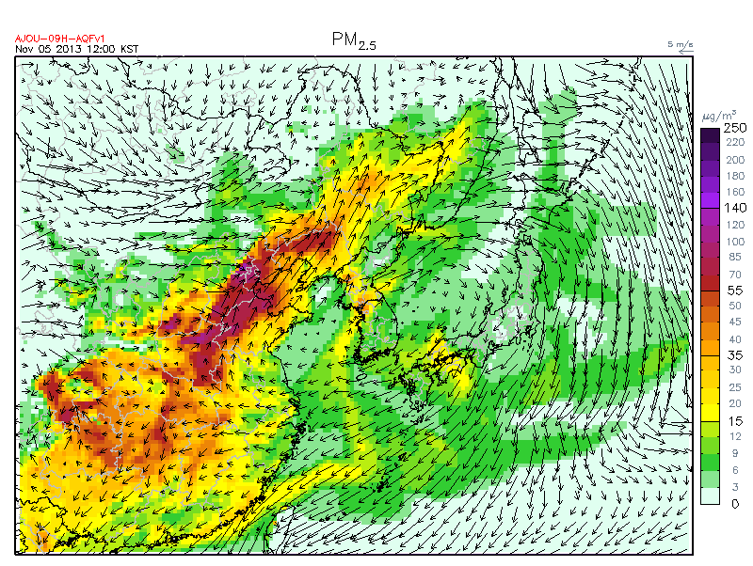
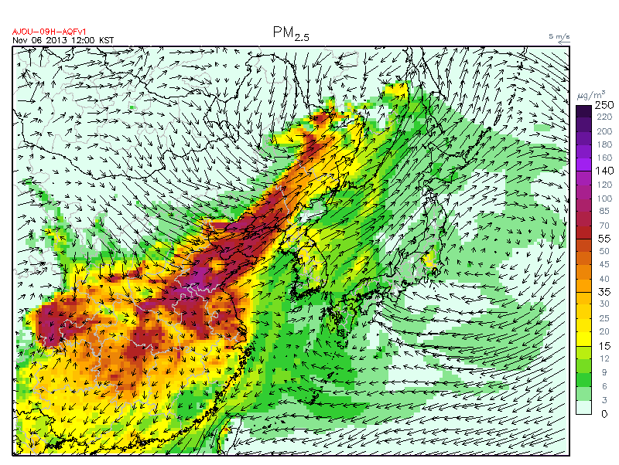
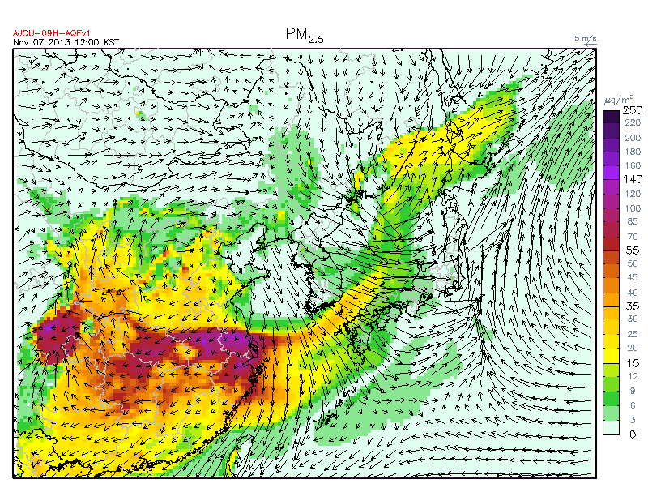
Type 2: Day by day development
Nov. 4, 2013
Nov. 5, 2013
Nov. 6, 2013
Nov. 7, 2013
NO2
AOD
PM2.5

Slide 12
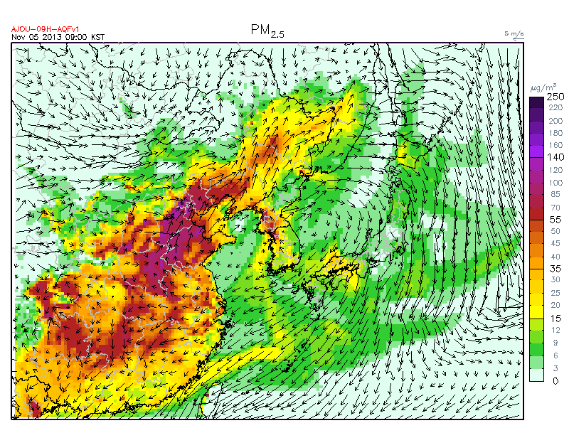
CMAQ PM_{2.5} (Animation)
MODIS AOD
CMAQ PM_{2.5} (Snapshot)
GOME-2 NO2

Slide 13
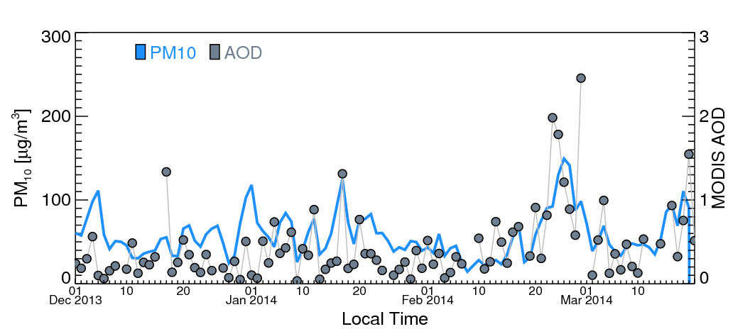
Type 3: Stationary high pressure system
Time series at Seoul Metropolitan Area (SMA)
Stationary high pressure over East China or Yellow Sea caused a very strong pollutant event (Feb. 26)

Slide 14
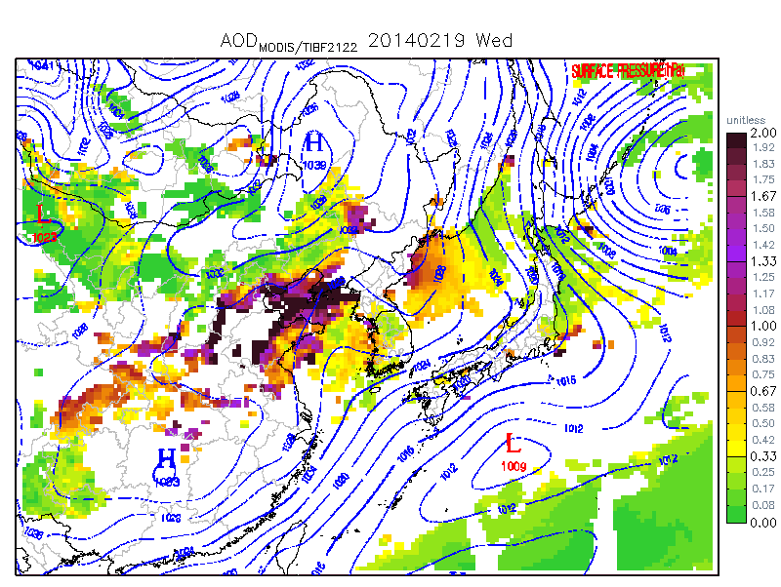
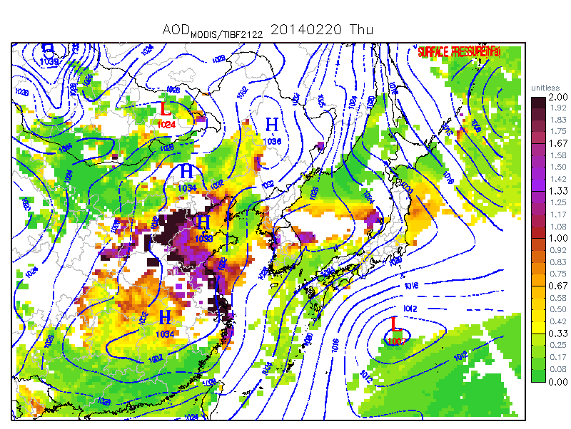
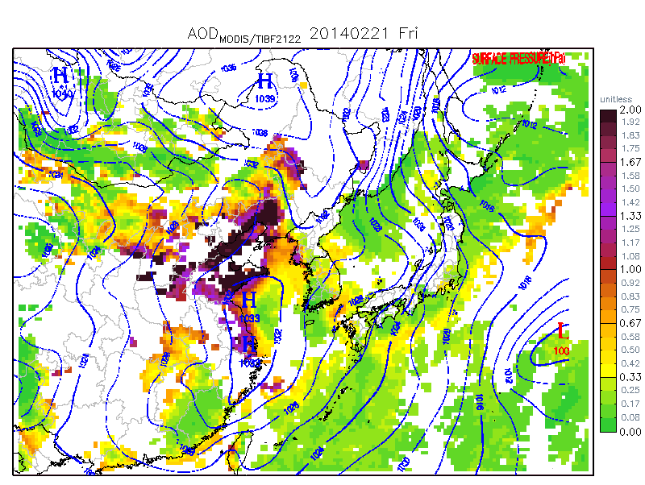
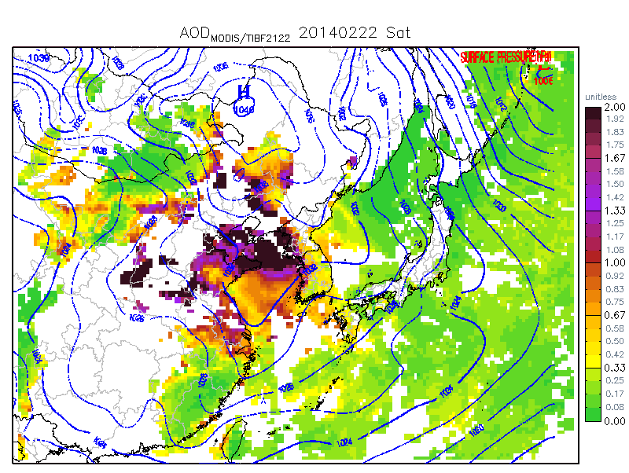
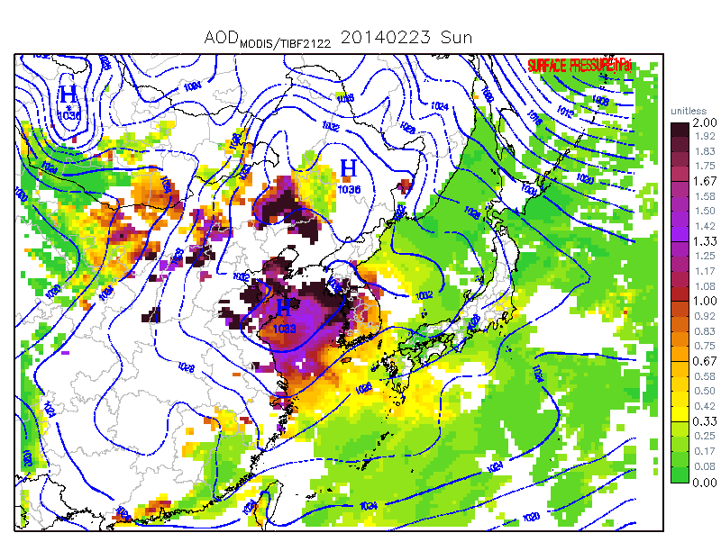
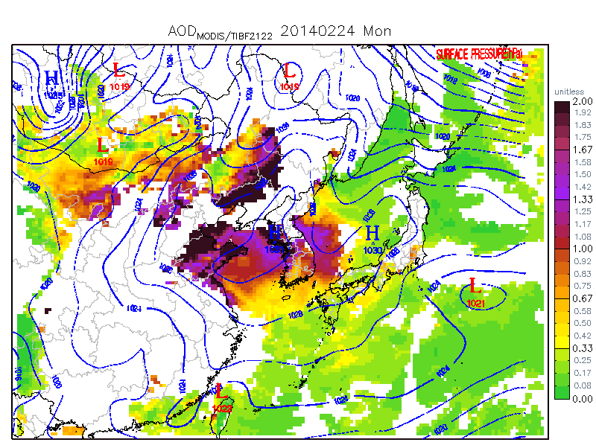
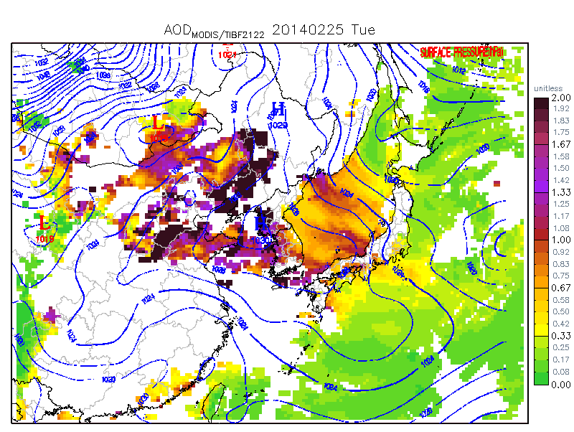
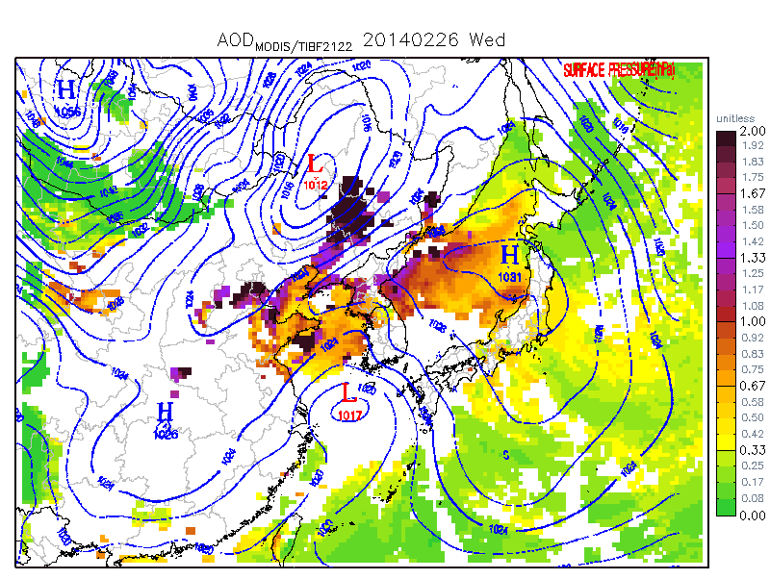
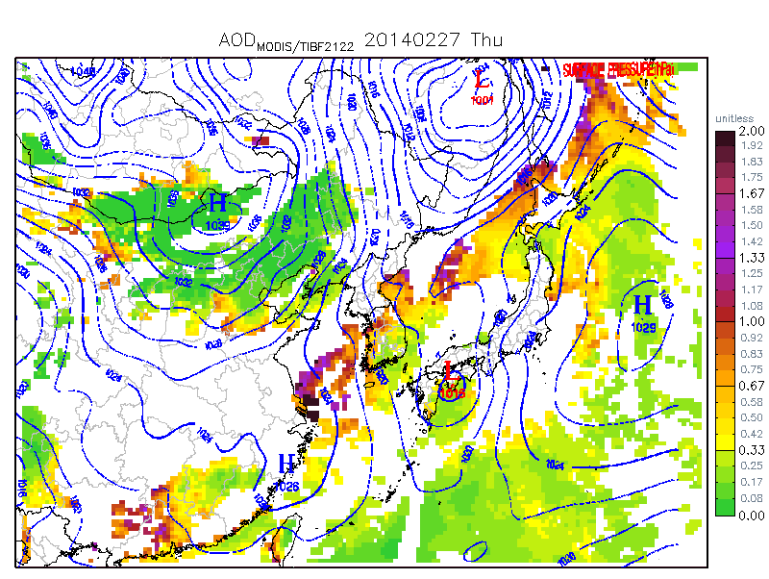
Feb. 19
Feb. 20
Feb. 21
Feb. 22
Feb. 23
Feb. 24
Feb. 25
Feb. 26
Feb. 27
Several days of significant stagnant High pressure system caused a serious high PM event in China and Korea

Slide 15
Conclusion
Synoptic patterns in East Asia are important in producing and transporting this region’s pollutants. We used satellite observations, combined with synoptic weather maps, to demonstrate their impacts.
High pressure systems provide favorable conditions for pollution development, with cloudless and subsiding atmosphere. It also provide eastward transport in the north side (e.g. Manchuria).
Low pressure system forces pollutants eastward. When balanced with high pressure system, it keeps pumping Chinese pollutants to Korea and Japan. When the low pressure system is strong, it pushes out pollutants, developed under high pressures, to Pacific Ocean. Unique shallow band-shaped plumes were identifiable form multiple satellite observations. Cold frontal activity is also important in lifting of pollutants.
Stagnant high pressure system at the Yellow Sea caused a significant high PM episodes in China and Korea (Feb. 25, 2014).
Accurate predicting of synoptic systems are crucial in forecasting and understanding pollutant transports in East Asia.

