Slide 1
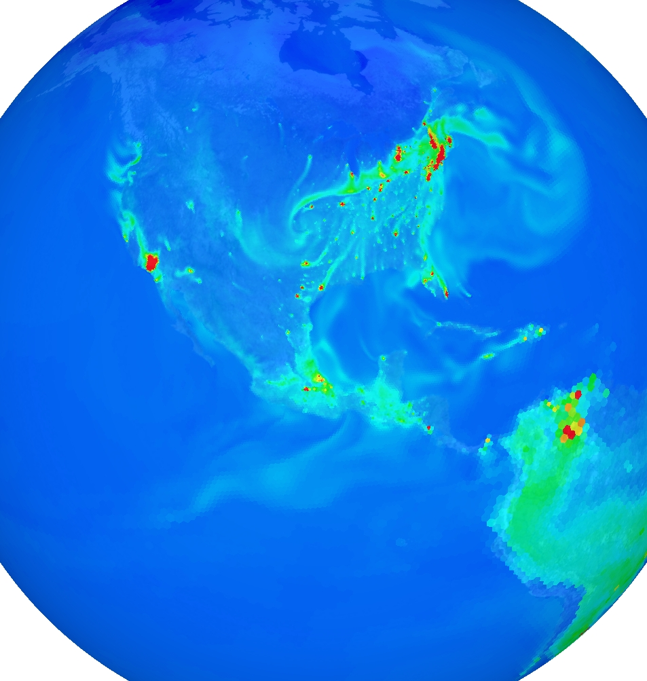
Next Gen AQ model
Need AQ modeling at Global to Continental to Regional to Urban scales
  Current systems using cascading nests is cumbersome
  Duplicative modeling in overlap regions
  Interpolation errors at boundaries
  Seamless multi-scale grid refinement (e.g OLAM, MPAS)
    Minimize interpolation errors in transition from coarse to fine resolution
Tighter AQ standards require global modeling:
  Inter-continental transport (Ozone and PM)
  Stratospheric ozone
  Marine chemistry
Earth system Linkages
  Greenhouse gases
  Nitrogen, carbon cycling
  AQ – Climate interactions
  Eco, hydro linkages
NO₂
Courtesy of Martin Otte
OLAM-Chem

Slide 2
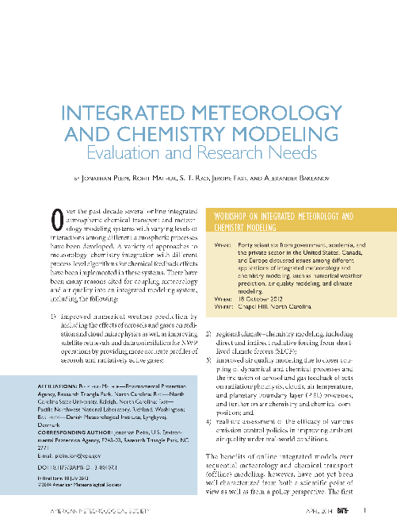
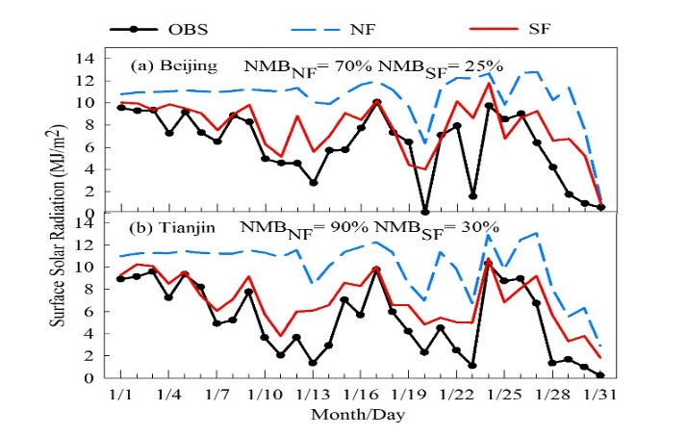
Need for online Met-Chem model
Growing trend toward integrated Met-Chem modeling
  Improve NWP – radiative feedbacks and satellite data assimilation
  Regional climate-chemistry modeling including SLCF
  Improve AQ modeling
Chem affects Met which affects AQ
  Aerosol direct effects
    Reduced SW ground → reduces PBL → greater concentrations
  Aerosol indirect effects
    Effects cloud cover, COD, radiative forcing, precipitation
    Effects propagate through AQ
  Gaseous direct effects on LW
    Ozone, methane, N₂O, etc
  AQ effects on land surface
    Ozone damages stomatal function which affects:
      Transpiration, CO₂ uptake, dry deposition
    CO₂ changes, including regulatory controls, affect stomatal conductance
BAMS 2014
Jiandong Wang et al., 2014, ERL

Slide 3
Vision
Extend to global scales
  Single global mesh with seamless refinement to local scales
  Integrated chemistry, dynamics, physics
Three configurations of flexible systems:
  On-line global variable grid (e.g. MPAS, OLAM)
  Online regional (WRF-AQ)
  Offline regional (redesigned CMAQ)
Interoperability of as much model code as possible
  Gas, aerosol, aqueous in modular box
  Modules for biogenic emissions, dry dep/bidi, wind-blown dust, photolysis, etc
Transport in met models for online systems (adv, diffusion)
  Ensure mass conservation
  Consistency with met parameters
  Minimize numerical diffusion and dispersion
MPAS

Slide 4
Community development
Initial discussions among EPA, NCAR, NOAA, DOE
  Leverage diverse expertise across community
Multiple purposes:
  Air quality policy development and regulation
  Air quality forecasting
  Atmospheric chemistry research
  Climate modeling with short-lived climate forcers
  Earth system applications: coupled system for air, hydro, eco, ag, energy, etc…
Standardize model engineering for coupling chemical components to different dynamics models
Initial steps: add chemistry to existing global models
  For example: MPAS-Chem, OLAM-Chem
Involve grant programs to foster development
  EPA STAR grants
  DOE Model development grants

Slide 5
Integrated Met-Chem modeling
High temporal coupling (data exchange frequency > once per hour)
  Better resolve high-frequency meteorological dynamics
    WS, WD changes, PBL height variations, cloud formation, rainfall
  Affects chemical transport, transformation, and removal at high spatial resolution
More consistent dynamical, physical, and numerical modeling
  More constant cloud convective transport of chemistry and met
  Closer integration of cloud microphysics and aqueous chemistry
  More consistent advection and diffusion
On-line chemistry necessary for global models with non-uniform, refining grid meshes (e.g. OLAM, MPAS)
  Advection and horizontal diffusion must be integrated in dynamics solver
Domain config | WRF-CMAQ | WRFadv-CMAQ | Data transfer (min) | Increased time
CA 12 km, 16 cores | 1:44:20 | 2:09:07 | 2.6 | 24% (3 run avg)
CA 4 km, 64 cores | 9:37:21 | 15:05:05 | 46 | 57% (4 run avg)

