Slide 1
ESP v2.0: Improved method for projecting U.S. greenhouse gas and air pollutant emissions through 2055
Dan Loughlin¹, Limei Ran², Dongmei Yang²,
Zac Adelman², B.H. Baek² and Chris Nolte¹
¹U.S. EPA Office of Research and Development, Research Triangle Park, NC
²Center for Environmental Modeling for Policy Development, UNC Chapel Hill, Chapel Hill, NC
Presented at the 2014 CMAS Conference, Oct. 27th-29th, 2014
UNC Chapel Hill, Chapel Hill, NC

Slide 2
Purpose of presentation
Present a revised method for developing multi-decadal greenhouse gas and air pollution emission projections suitable for supporting research activities
Apply the method to produce a 2050 gridded air pollutant emission inventory
Discuss potential applications and future research directions

Slide 3
Outline
Background and objective
Methodology
Illustrative application
Conclusions and next steps
References

Slide 4
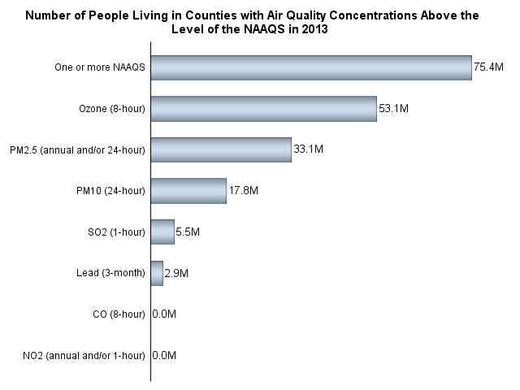
Background and objective
Millions of U.S. residents live in areas that exceed air quality standards

Slide 5
Background and objective
Impact on emissions
Factors influencing future-year emissions
Population growth and migration
Economic growth and transformation
Technology change
Land use change
Climate change
Current and future policies
Environmental
Energy
Climate
Land use
Air
GHG
?
?
?
?
?
?
?
?
?
?
?
?
?
?
Overall?

Slide 6
Background and objective
Impact on emissions
Factors influencing future-year emissions
Population growth and migration
Economic growth and transformation
Technology change
Land use change
Climate change
Current and future policies
Environmental
Energy
Climate
Land use
Air
GHG
A scenario is an internally consistent storyline about how these factors “play out” over the next several decades.
The objective of the Emission Scenario Projection (ESP) method is to translate such scenarios into air pollutant and GHG emissions suitable for air quality and climate studies.
?
?

Slide 7
Methodology
ESP overview
Focuses on energy-related emissions (e.g., extraction of fuel resources and the combustion of fossil fuels) as these are the primary sources of CO2 and many traditional air pollutants
Projects U.S. energy-related emissions to any future year from 2005 to 2055
Greenhouse gases (GHG) coverage:
Carbon dioxide (CO2), methane (CH4)
Traditional air pollutants coverage:
Nitrogen oxides (NOx), sulfur dioxide (SO2), carbon monoxide (CO), volatile organic compounds (VOCs), direct particulate matter (PM)
Produces a gridded, future-year inventory that is suitable for use in detailed air quality models, such as the Community Multiscale Air Quality (CMAQ) model (Byun and Schere, 2006)

Slide 8
Methodology
Primary ESP components
MARKet ALlocation energy system model (MARKAL)
Energy system optimization model that selects the least cost set of technologies and fuels to meet projected energy demands over a modeling horizon.
Reference: Loulou et al. (2004)
U.S. EPA MARKAL 9-region database
Database developed by the U.S. EPA and used in applying MARKAL to examine U.S. energy system scenarios and resulting emissions.
Reference: U.S. EPA (2013)
Integrated Climate and Land Use Scenarios model (ICLUS)
Land use change model that characterizes U.S. future population and land use patterns at up to a 50m resolution over a wide range of assumptions.
References: U.S. EPA (2009), Bierwagen et al. (2010)
Sparse Matrix Operator Kernel Emission (SMOKE) processor
Emission processing system that translates an emissions inventory into a gridded emissions file for use in the CMAQ air quality model.
Reference: Houyoux et al. (2000)

Slide 9
Methodology
ESP v1.0 (Loughlin et al., Geoscientific Model Development, 2011)
Base year
emission inventory
Scenario assumptions
MARKAL
energy system model
Multiplicative regional, source category and pollutant-specific emission growth and control factors
SMOKE emission model
Future-year
gridded emission inventory
Limitation:
Multiplicative growth factors increase or
decrease emissions in place. This does not
account for spatial redistribution from
population growth and migration and
from land use change.
Air quality model
Future-year
gridded
air quality
estimate

Slide 10
Methodology
ESP v2.0 (Ran et al., forthcoming)
Base year
emission inventory
Scenario assumptions
MARKAL
energy system model
Multiplicative regional, source category and pollutant-specific emission growth and control factors
SMOKE emission model
Regional population
projections
Updated grid cell-level population and land use spatial surrogates
Future-year
gridded emission inventory
ICLUS population and land use model
Air quality model
Future-year
gridded
air quality
estimate
New in ESP v2.0

Slide 11
Illustrative application
Develop a 2050 emission inventory using the EPAUS9r_12 MARKAL “base case” and ICLUS “census” projections

Slide 12
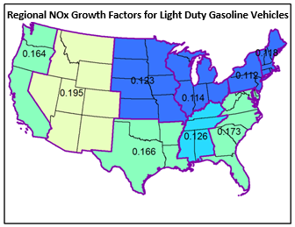
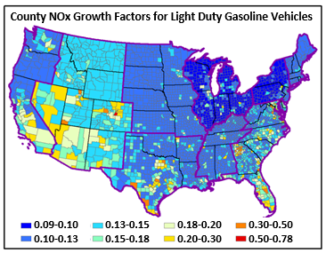
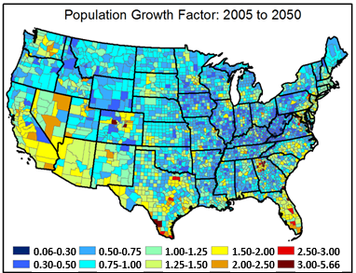
Illustrative application
Translating regional- to county-level emission growth factors
Regional emission growth factors from MARKAL
County population growth factors from ICLUS

Slide 13
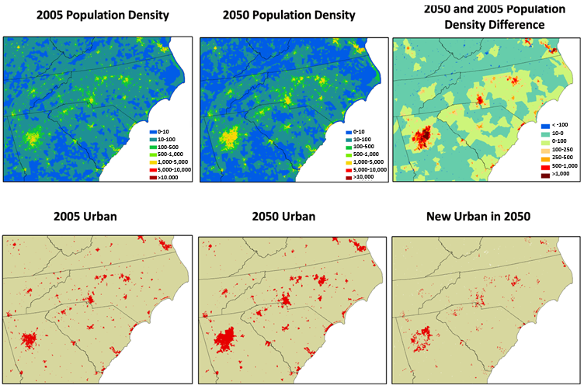
Illustrative application
High resolution ICLUS population and land use outputs

Slide 14
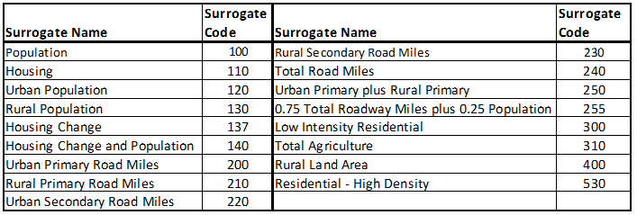
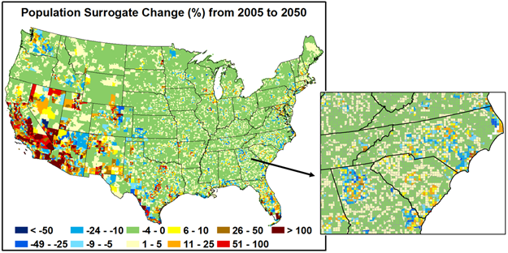
Illustrative application
Spatial surrogates that are
modified with ICLUS results:
Example of change in the
population-based spatial
surrogate for the 12 km
modeling grid:

Slide 15
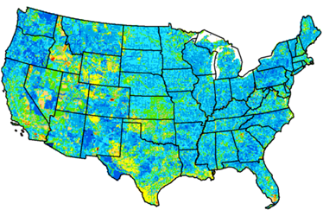
Illustrative application
Changes in anthropogenic NOx emissions, 2005 to 2050
Fractional differences at the 12 km grid cell level
Fractional Difference (FD) =
Where:
e₂₀₅₀(i) is the quantity of NOx emissions in grid cell i in 2050
e₂₀₀₅(i) is the quantity of NOx emissions in grid cell i in 2005
FD ranges from -200 to 200
An FD of zero means that e₂₀₅₀(i) and e₂₀₀₅(i) are equal in value.
A value of 67 implies that e₂₀₅₀(i) is twice the value of e₂₀₀₅(i).

Slide 16
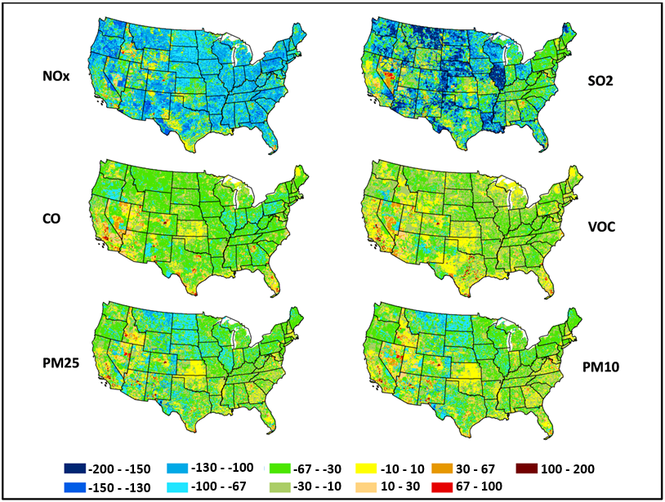
Illustrative application
Changes in anthropogenic emissions, 2005 to 2050
Fractional differences at the 12 km grid cell level

Slide 17
Conclusions
We demonstrate the development of a future-year inventory that accounts for population, land use and technology change.
The addition of spatial allocation to the ESP method is important, as region-to-county growth factor disaggregation and county-to-grid allocation result in a different spatial pattern of emissions.
For NOx, accounting for population and land use change generally leads to:
greater reductions in emissions in rural areas
fewer reductions (and even growth) in expanding urban areas
Other pollutants show similar trends.
Compared to a grow-in-place approach, spatial reallocation:
decreases emissions in the urban core, but increases emissions in the surrounding areas
By capturing these dynamics, ESP v2.0 will allow examination of the air quality impacts of alternative scenarios, thus potentially providing valuable insights regarding future challenges and opportunities for air quality management.

Slide 18
Next steps
We are continuing to update the ESP methodology. Updates being explored include:
Adoption of a more recent version of the U.S. EPA MARKAL database
Development of temporal allocation factors for SMOKE that account for MARKAL’s technology and fuel use projections
E.g., the increasing use of natural gas in the electric sector to meet baseload energy demands
Consideration of commercial and industrial land use types
More detailed consideration of alternative economic growth and transformation assumptions
Integration of alternative climate change scenarios

Slide 19
References
Bierwagen, B. G., Theobald, D. M., Pyke, C. R., Choate, A., Groth, P., Thomas, J. V., and Morefield, P.: National housing and impervious surface scenarios for integrated climate impact assessments, Proceedings of the National Academy of Sciences, 107(49), 20887-20892, 2010.
Byun, D., Schere, K.: Review of the governing equations, computational algorithms, and other components of the Models-3 Community Multiscale Air Quality (CMAQ) modeling system, Applied Mechanics Reviews, 59(2), 2006.
Houyoux, M. R., Vukovich, J. M., Coats, C. J., Wheeler, N. J., and Kasibhatla, P. S.: Emission inventory development and processing for the Seasonal Model for Regional Air Quality (SMRAQ) project, Journal of Geophysical Research: Atmospheres (1984–2012), 105(D7), 9079-9090, 2000.
Loughlin, D. H., Benjey, W. G., and Nolte, C. G.: ESP v1.0: methodology for exploring emission impacts of future scenarios in the United States, Geoscientific Model Development, 4(2), 287-297, 2011.
Loulou, R., Goldstein, G., and Noble, K.: Documentation for the MARKAL family of models, available at: http://www.etsap.org (last access: March 2011), 389 pp., 2004.
US EPA: Land-Use Scenarios: National-Scale Housing-Density Scenarios Consistent with Climate Change Storylines, An interim report of the US EPA Global Change Research Program, National Center for Environmental Assessment, EPA/600/R-08/076F, Washington, DC. Available at: http://cfpub.epa.gov/ncea/global/recordisplay.cfm?deid=203458 (last access: August 2013), 2009.
U.S. Environmental Protection Agency (2013). EPA U.S. nine-region MARKAL database: Database documentation. Office of Research and Development, Risk Management Research Laboratory, Air Pollution Prevention and Control Division. EPA600/B-13/203.

