Slide 1
Modeling the Health Impacts of Changes in Ozone Due to Climate Change
Chris Nolte, Tanya Spero, Neal Fann, Pat Dolwick, Sharon Phillips, and Susan Anenberg
U.S. Environmental Protection Agency, Research Triangle Park, North Carolina
13th Annual CMAS Users’ Conference
28 October 2014

Slide 2
Acknowledgments
Kiran Alapaty
Jared Bowden
Russ Bullock
Jerry Herwehe
Megan Mallard
Lara Reynolds
Kathy Brehme
Nancy Hwang
Daiwen Kang

Slide 3
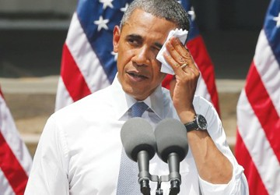
Introduction
In response to President’s Climate Action Plan, US Global Change Research Program is writing a special report Impacts of Climate Change on Human Health in the United States: A Scientific Assessment.
Draft for public comment March 2015 Final report March 2016
Chapters on: Thermal Extremes; Air Quality; Vectorborne and Zoonotic Disease; Waterborne and Foodborne Disease; Food Safety, Nutrition, and Access; Extreme Weather and Climate Events; Mental Health and Stress-Related Disorders; Risk Factors and Populations of Concern
Air Quality chapter will include sections on Ambient Air Quality, Indoor Air Quality, and Aeroallergens
Notes:
Need to explain that report, including AQ chapter, also draws on existing body of scientific literature.

Slide 4
Methods Overview
Use WRF to downscale IPCC AR5 global climate model (GCM) scenarios over North America
Use downscaled meteorology to drive CMAQ to project changes in air quality over continental U.S. attributable to climate change
Use change in O₃ as input to BenMAP to estimate effects on O₃ mortality and various measures of morbidity, as well as economic cost of these effects

Slide 5
Modeling Configuration – Global and Regional Climate
NASA Goddard Institute for Space Studies (GISS) ModelE2
NCAR/DOE Community Earth System Model (CESM)
Downscaled two 11-year time slices from 5th Coupled Model Intercomparison Project (CMIP5) simulations from each model:
1995-2005 from the “historical” run
2025-2035 from RCP 6.0 (ModelE2) or RCP 8.5 (CESM)
36 × 36 km grid cells over most of North America

Slide 6
Air Quality Modeling
CMAQ 5.02
Meteorology downscaled from GCMs.
EPA OTAQ 2030 emissions incorporating existing regulations used for both historical and future CMAQ simulations
Emissions of NO_{x} and SO₂ have declined dramatically in recent years and are projected to continue to decline
Focus of this effort is on the effect of climate change on AQ at 2030
Where results project changes, these are not relative to present day but rather are relative to what conditions would be if climate did not change
CMAQ simulations using CESM-WRF meteorology
1995-2005 and RCP 8.5 2025-2035
CMAQ simulations using ModelE2-WRF meteorology
Leveraged previous CMAQ simulations using 2006 emissions to select low/middle/high years from each 11-year period

Slide 7
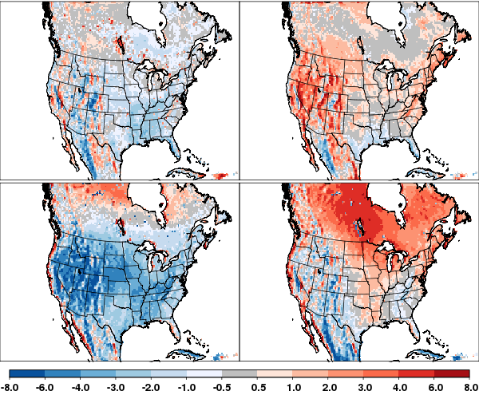
Representations of Current Climate – Temperature Biases relative to Climate Forecast System Reanalysis (CFSR)
ModelE2 RCP 6.0
CESM RCP 8.5
Differences in May-Sep averages for 1995-2005
May-Sep daily min
May-Sep daily max
K

Slide 8
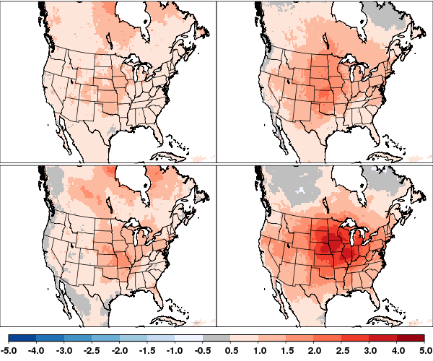
Projected Changes in Daily Min/Max Temperatures from 2000 to 2030
ModelE2 RCP 6.0
CESM RCP 8.5
Differences in 11-year averages (future – historical)
May-Sep daily min
May-Sep daily max
K

Slide 9
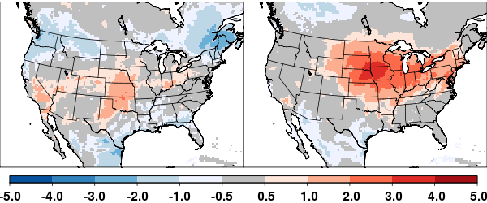
Change in May-September mean MDA8 O₃
All health impacts in this study based on differences in May-September means of daily maximum 8-h O3 (MDA8)
ModelE2 RCP 6.0
CESM RCP 8.5
ppb
Changes in PM not considered for this assessment
Climate effects on PM less certain
Not modeling changes in wildfires or windblown dust

Slide 10
EPA Benefits Mapping and Analysis Program (BenMAP)
Used to assess health impacts and economic benefits of possible emissions control strategies
$$∆I=P Y0 (e^{β∆x}−1)$$
I is incidence
P is exposed population
Y₀ is baseline incidence rate
β is concentration-response factor from epidemiological studies
$∆x$ is change in pollutant concentration (here MDA8 O₃)

Slide 11
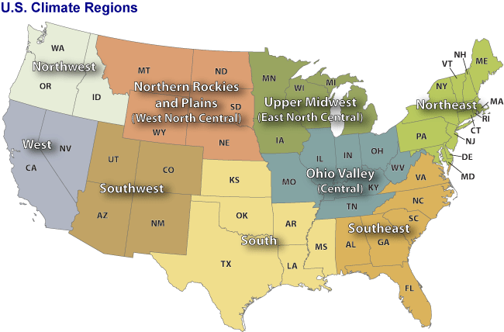
Regional analysis based on NCDC Climate Regions

Slide 12
Ozone-Related Premature Deaths in 2030: ModelE2 RCP 6.0
Region | Avoided (incurred) premature deaths¹
Northwest | 22
Rockies | (1)
West | (25)
Southwest | (10)
Upper Midwest | (9)
Ohio Valley | (34)
South | (15)
Northeast | 16
Southeast | 20
Total | (37)
¹ Estimates rounded to two significant figures. Confidence intervals omitted. Impacts estimated using the Bell et al. 2004 mortality risk coefficient and the ICLUS A1 scenario projected population

Slide 13
Ozone-Related Premature Deaths in 2030: CESM RCP 8.5
Region | Avoided (incurred) premature deaths¹
Northwest | (1)
Rockies | (8)
West | (10)
Southwest | (11)
Upper Midwest | (62)
Ohio Valley | (130)
South | (25)
Northeast | (160)
Southeast | (26)
Total | (440)
¹ Estimates rounded to two significant figures. Confidence intervals omitted. Impacts estimated using the Bell et al. 2004 mortality risk coefficient and the ICLUS A1 scenario projected population

Slide 14
Avoided (Incurred) Premature Ozone Deaths by Projected Population: RCP6.0
Avoided (incurred) premature deaths estimated from the average of recent-year (1995-2002) and projected
 | ICLUS A1 2030 | ICLUS B2 2030 | Woods & Poole 2030 | ICLUS A1 2050 | ICLUS B2 2050
Average of 3 years (2025-2035) | (37) | (39) | (29) | 52 | 54
Least conducive (2035) | 220 | 200 | 180 | 290 | 242.1
Moderately conducive (2027) | 5.7 | 8.4 | 11 | (6.5) | (0.8)
Highly conducive (2025) | (340) | (320) | (280) | (440) | (400)

Slide 15
Avoided (Incurred) Premature Ozone Deaths by Climate Region &Year: RCP8.5
 | Climate Region
 | NW | Rockies | West | SW | Upper Midwest | Ohio Valley | South | NE | SE | Total
Average | (1) | (8) | (10) | (11) | (62) | (130) | (25) | (160) | (26) | (440)
2025 | (18) | (7) | 74 | 20 | (77) | (150) | 60 | (210) | 5 | (300)
2026 | (17) | (8) | (35) | (16) | (50) | (51) | (24) | (220) | 69 | (350)
2027 | 22 | (10) | 50 | (23 | (71) | (77) | (8) | (110) | (110) | (440)
2028 | (9) | (6) | 58 | 65 | (34) | (27) | 33 | (75) | 49 | 55
2029 | (6) | (4) | 81 | 23 | (28) | (110) | 47 | (110) | (91) | (200)
2030 | 17 | (10) | (45) | (35) | (72) | (130) | (6) | (140) | 7 | (410)
2031 | 27 | (11) | (77) | (48) | (75) | (170) | (84) | (51) | (36) | (520)
2032 | (14) | (11) | (3 | (13) | (150) | (250) | (16) | (390) | 40 | (810)
2033 | (13) | (9) | (32) | (12) | (10) | (77) | (82) | 4 | (110) | (340)
2034 | (2) | (4) | (110) | (59) | 0 | (97) | (110) | (130) | (39) | (560)
2035 | (2) | (11) | (68) | (25) | (120) | (220) | (77) | (340) | (66) | (920)

Slide 16
Summary
Warming at 2030 of 0.8 – 1.0 K projected by ModelE2 RCP 6.0 and 1.2 – 3.3 K projected by CESM RCP 8.5
May-September mean MDA8 O3 increases due to climate change 0.5 – 4.5 ppb
Emissions are projected to decline; this will lead to larger decreases in MDA8 O3 than climate-driven increases modeled here.
Modeled health impacts range from 37 – 440 additional deaths per year in the U.S. attributable to increases in O₃.
Substantial interannual variability
Fann N, Nolte CG, Dolwick P, Spero TL, Curry-Brown A, Phillips S, Anenberg S, The geographic distribution and economic value of climate change-related ozone health impacts in the United States in 2030, J. Air Waste Manage. Assoc., in review.

Slide 17
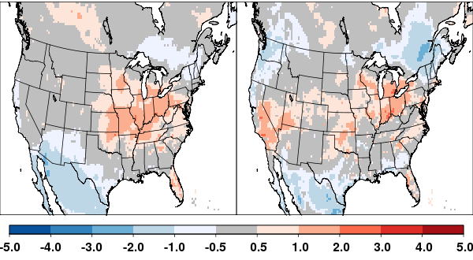
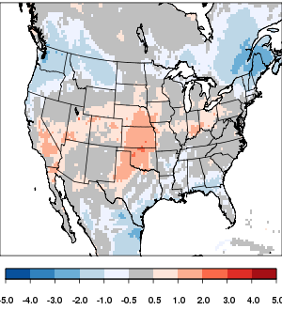
MDA8 O₃ Interannual Variability and Emissions Sensitivity
Difference in 11-year avg using 2006 emissions
Difference in 3-year avg using 2006 emissions
Difference in 3-year avg using 2030 emissions

