Slide 1
Improving Sources of Stratospheric Ozone and NOy and Evaluating Upper Level Transport in CAMx
Chris Emery, Sue Kemball-Cook, Jaegun Jung, Jeremiah Johnson, Greg Yarwood
and
Bright Dornblaser, TCEQ
13th Annual CMAS Conference
October 28, 2014

Slide 2
Acknowledgements
This project was funded by the Texas Commission on Environmental Quality
The authors gratefully acknowledge the NOAA Air Resources Laboratory (ARL) for the provision of the HYSPLIT model and use of the READY website (http://www.ready.noaa.gov).

Slide 3
Background
As the NAAQS become more stringent, understanding transport is increasingly important
O₃ and some NOy are long-lived in the upper troposphere (UT) and lower stratosphere (LS)
  Can be transported for long distances
  Can mix downward and influence surface O₃
Models used for O₃ planning must accurately simulate O₃ and NOy in the UT/LS
  Simulate impact of stratospheric air on background
  Comparison with column-integrated satellite data

Slide 4
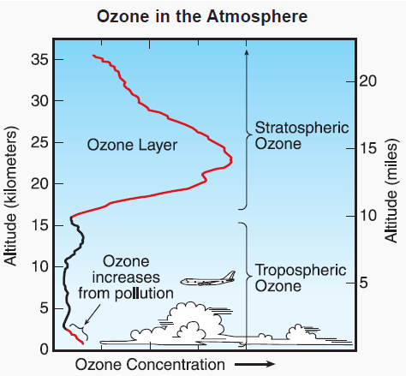

CAMx Vertical Grid
Model top 15 km
Downward motion brings LS air into modeling domain
Top BC is “Zero gradient” mixing ratio assumption
TCEQ
Vertical
Grid
Figure: http://esrl.noaa.gov/csd/assessments/ozone/2006/chapters/Q1.pdf

Slide 5
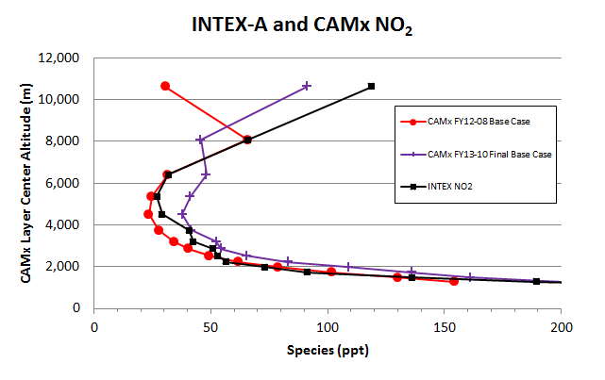
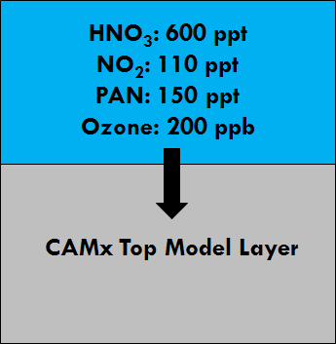
Modeling with the Standard CAMx Top BC
Comparison of OMI vs. CAMx NO₂ columns prompted deeper evaluation of CAMx in UT/LS
CAMx (red) underestimated UT/LS NO₂ relative to INTEX-A aircraft profiles (black)
  Ad hoc top BCs for O₃ and NOy improved comparison (purple)

Slide 6
Layer Collapsing
WRF
CAMx
CAMx is typically run with fewer layers than WRF for efficiency
Effect on surface ozone generally minimal
Test effect on UT/LS O₃ and NOy
Layer
Collapsing
in UT
No Layer
Collapsing
Surface

Slide 7
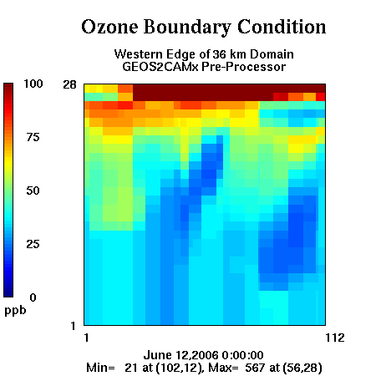
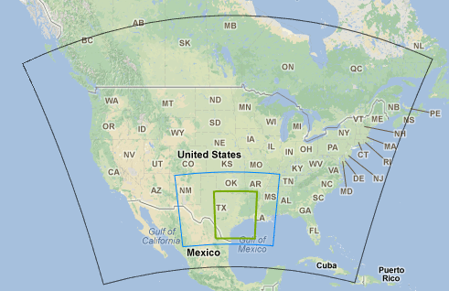
GEOS-Chem Global Model
A common source for lateral BCs
  Spatially interpolate to CAMx grid
  Map species to CAMx list
Add new top BCs

Slide 8
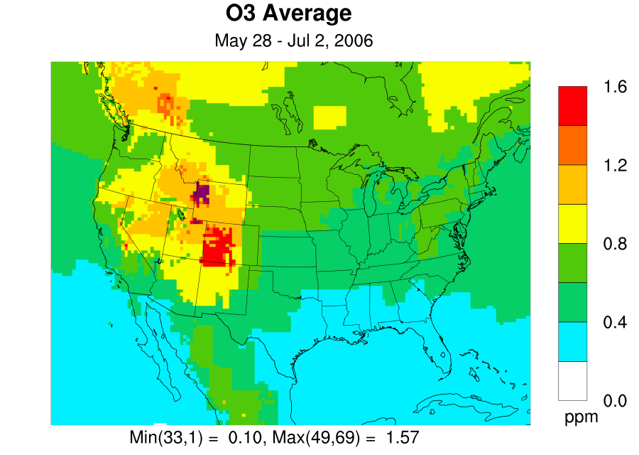
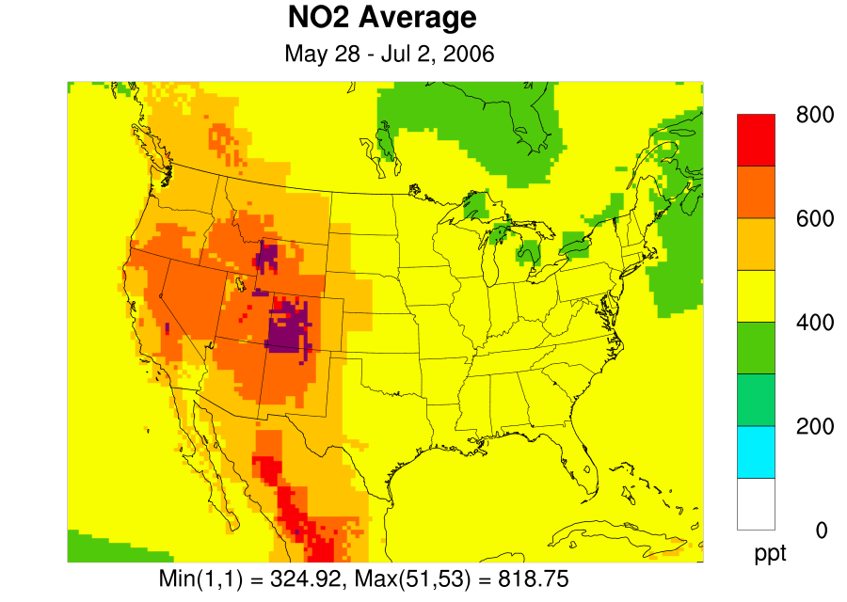
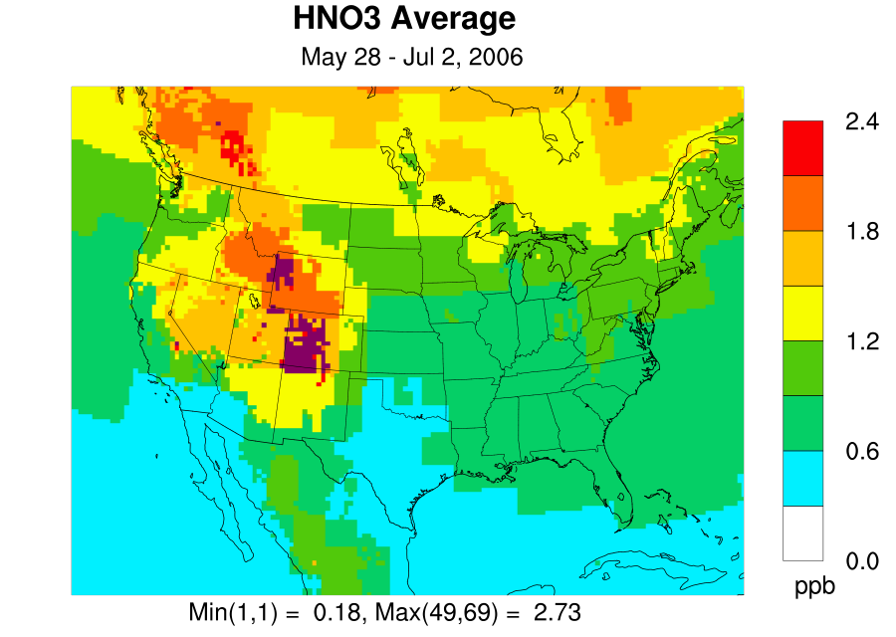
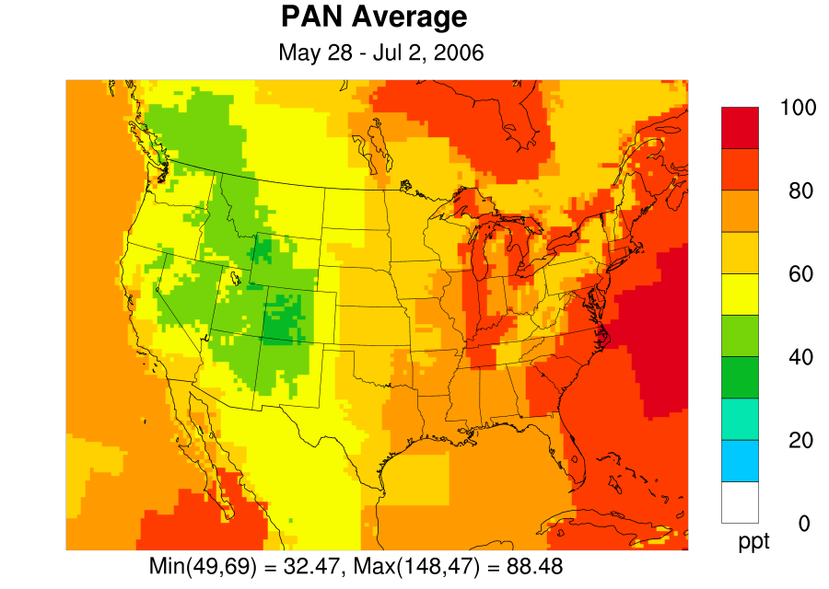
Example of New Top BC Extraction

Slide 9
CAMx Model Performance Evaluation
3 CAMx runs
  Standard Zero Gradient Top BC, 28 layers
  GEOS-Chem Top BC, 28 layers
  GEOS-Chem Top BC, 38 layers (no layer collapsing)
Rider 8 modeling platform, June 2006 episode
  Lightning NOx emissions
  TCEQ AEM3 aircraft emission inventory
  CB6r2 chemical mechanism

Slide 10
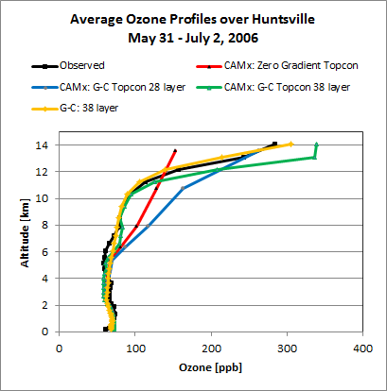
Ozonesonde at Huntsville, AL
Good agreement < 6 km
  No clear benefit from top BC or extra layers
GEOS-Chem matches observed profile well
  Though not at all US sites
Zero gradient run
  Diffusive, poor > 6 km
38 layer top BC run better than 28 layer top BC run > 6 km

Slide 11
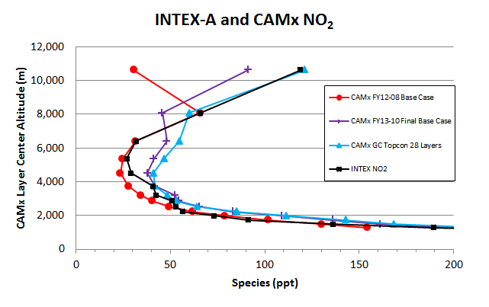
NO₂ Profile with new Top BCs
Top BC improves UT/LS NO₂ profile

Slide 12
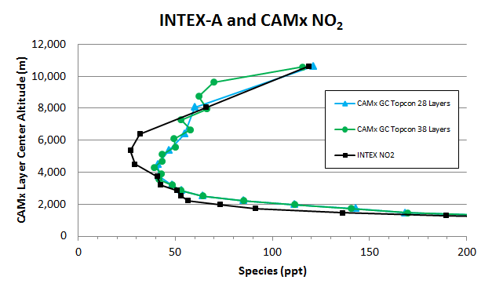
Effect of Layer Collapsing
Layer collapsing affects NO₂ profile less than ozone

Slide 13
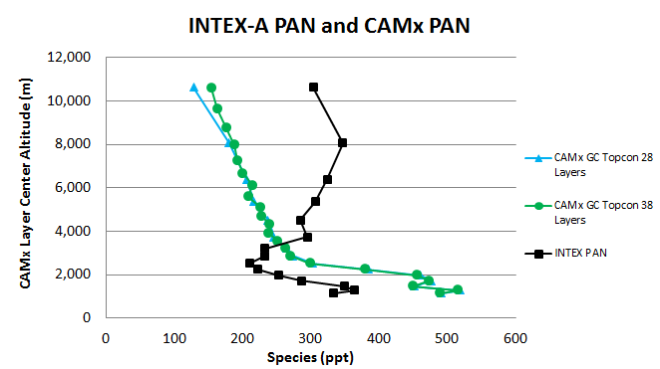
Effect of Layer Collapsing on PAN Profile
CAMx has a low bias in middle and upper troposphere
PAN driven by BCs (GOES-Chem too low by >100 ppt)

Slide 14
HYSPLIT Trajectory Analysis
Forward/backward trajectories from UT/LS vertical intrusion events
Prepared using 4 sets of inputs:
  WRF three-dimensional wind field
  WRF two-dimensional wind field
    HYSPLIT calculates vertical component using default divergence method
  CAMx three-dimensional wind field
    Vertical component calculated using CAMx algorithm
  EDAS three-dimensional wind field

Slide 15
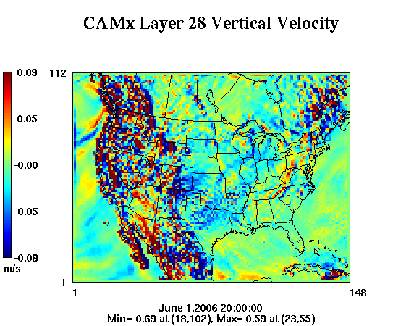
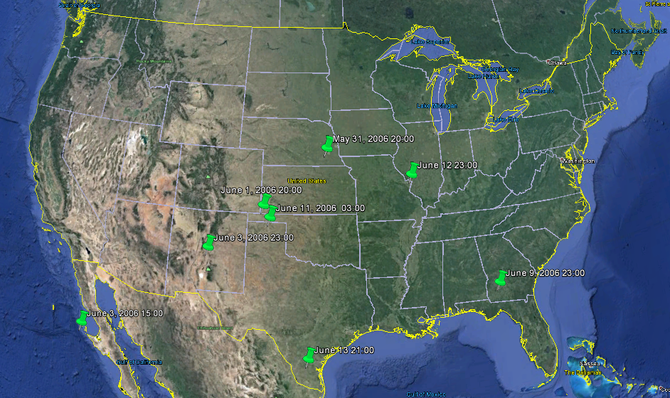
Diagnosing UT/LS Intrusion Events

Slide 16
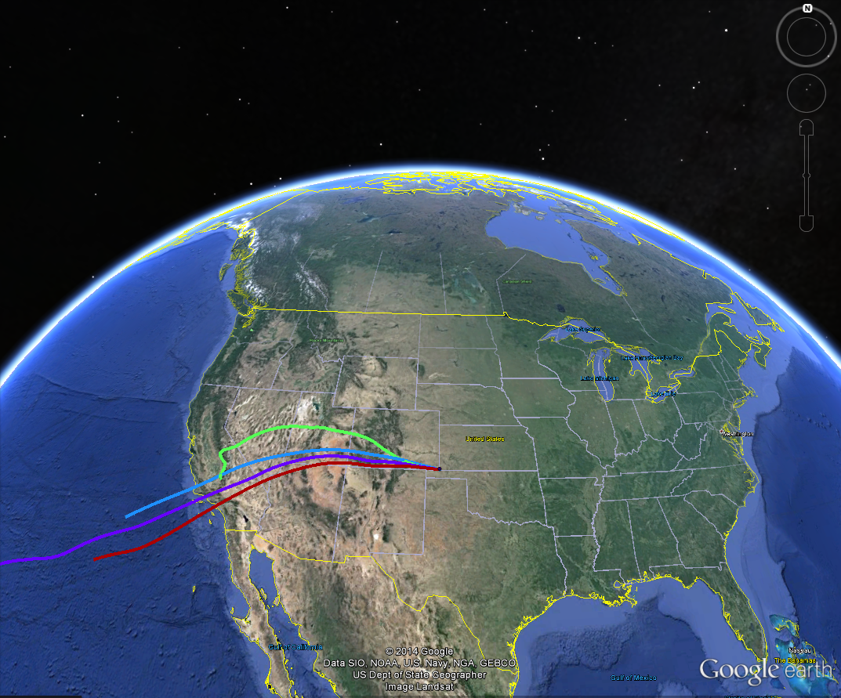

June 2, 2006

Slide 17
Summary
New top BC improves performance in UT/LS
  Allows for column-integrated satellite comparisons
UT/LS O₃ for 38 layer run was better than 28 layer run
  High vertical resolution needed for UT/LS transport
  Effects at surface intermittent and generally small
    28 layers sufficient for surface O₃ in Texas summertime
    Larger effects expected in Intermountain West springtime
GEOS-Chem performance in UT/LS was variable
  Sometimes contributes to biases in CAMx
CAMx transport in UT/LS consistent with other models

Slide 18
Thank You
Questions?

Slide 19
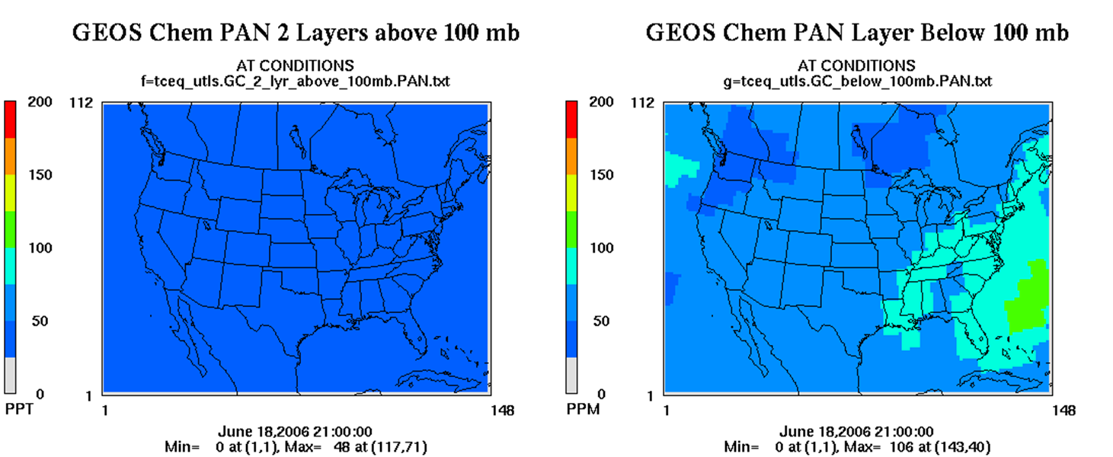
GEOS-Chem PAN
GEOS-Chem PAN (<100 ppt) lower than INTEX-A observations (300 ppt) near the tropopause

Slide 20
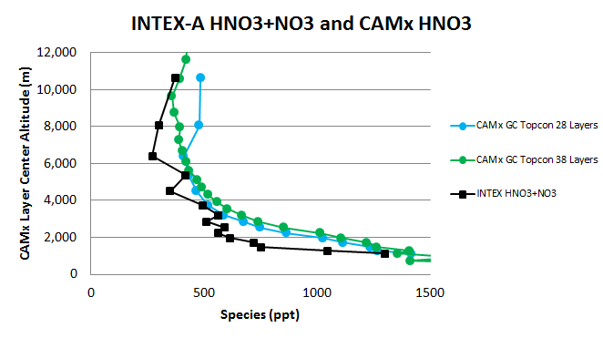
Effect of Layer Collapsing on HNO₃ Profile
Good (slightly high) simulation of HNO₃ profile

